Slide 1
R(17-1) Simulation-based projection of divertor heat-flux footprint for NSTX-U
C.S. Chang, J-W Ahn, A. Diallo,
Travis Gray, Gustavo Canal, S. Ku

Slide 2
FY17: simulation-based projection of divertor heat flux footprint for NSTX-U
Understanding the underlying physical mechanisms that contribute to the scrape-off layer (SOL) power flux width, λ_{q}, is of utmost importance for future tokamaks such as ITER and FNSF. The 2016 Theory Joint Research Milestone (JTM) carried out extensive modeling to predict λ_{q} under attached divertor conditions. XGC modeling reproduced the observed trends in present day tokamaks where λ_{q} is found to be proportional to the midplane poloidal field, B_{pol}^{-1.19}. The XGC SOL widths were influenced by both the magnetic drift of warm ions across the separatrix and by the cross-field ExB heat-flux width from the edge turbulence. However, only a limited NSTX dataset was included in the 2016 JTM. Here we will complete simulation of the plasma current scan of NSTX to evaluate the SOL width and edge turbulence under a wider range of conditions, to evaluate the magnitudes of the turbulent ExB and ion drift effects in XGC. Finally, we will carry out simulations to predict λ_{q} for a 2 MA NSTX-U discharge, using a set of assumptions to project the expected midplane profiles.

Slide 3
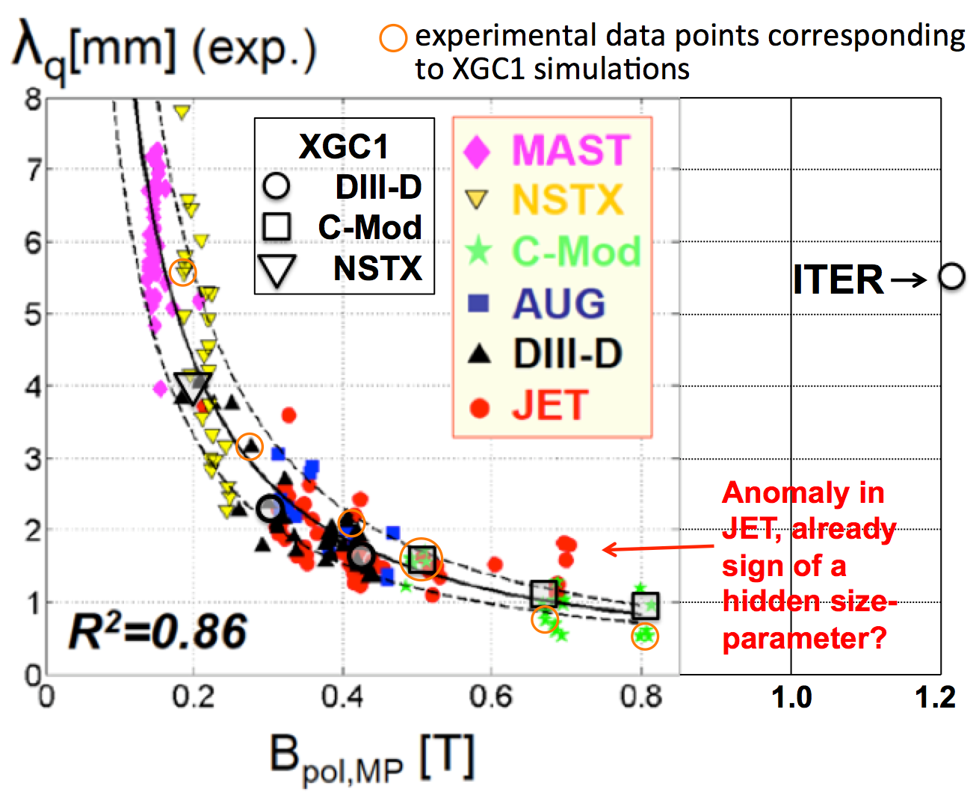
Add some more NSTX and (projected) NSTX-U points to the scaling figure

Slide 4
Plan and (timeline)
Identify a baseline NSTX discharge (done)
  NSTX 139047, 665ms
  1MA
Generate necessary eqdsk data for the baseline NSTX discharge (done)
  Create input file for XGC1 (done)
Execute the baseline simulation on Cori and analyze the data (April 15)
Project the baseline NSTX discharge to NSTX-U (B_{T}=1T), approximately
  NSTX-U case #1 (May 15)
  Keep the above q profile →B_{θ0}(r) determined → j(r) & I_{p} determined (~1.5MA)
  Assmue n_{o} = 0.7n_{G} (=I_{p}/πa²)
  Set β_{N} = β(aB_{T}/I_{p}) to be 15% less, on axis → T_{o} is determined, assume T_{eo}=T_{io}
  Keep the same R/L_{p}=R dlog p/dr for p=(n,Te,Ti) → n, Te, Ti profiles determined
  This assumption may matter for the core transport, but not for edge
  Estimate the pedestal width from the β_{θ}^{ped} scaling, use modified-Tanh
  Rμ₀j = μ₀R² dp/dΨ + FdF/dΨ → FF’ determined
  NSTX-U case #2 (June 15)
  Increase I_{p} to 2MA → q₉₅ will be somewhat lower

Slide 5
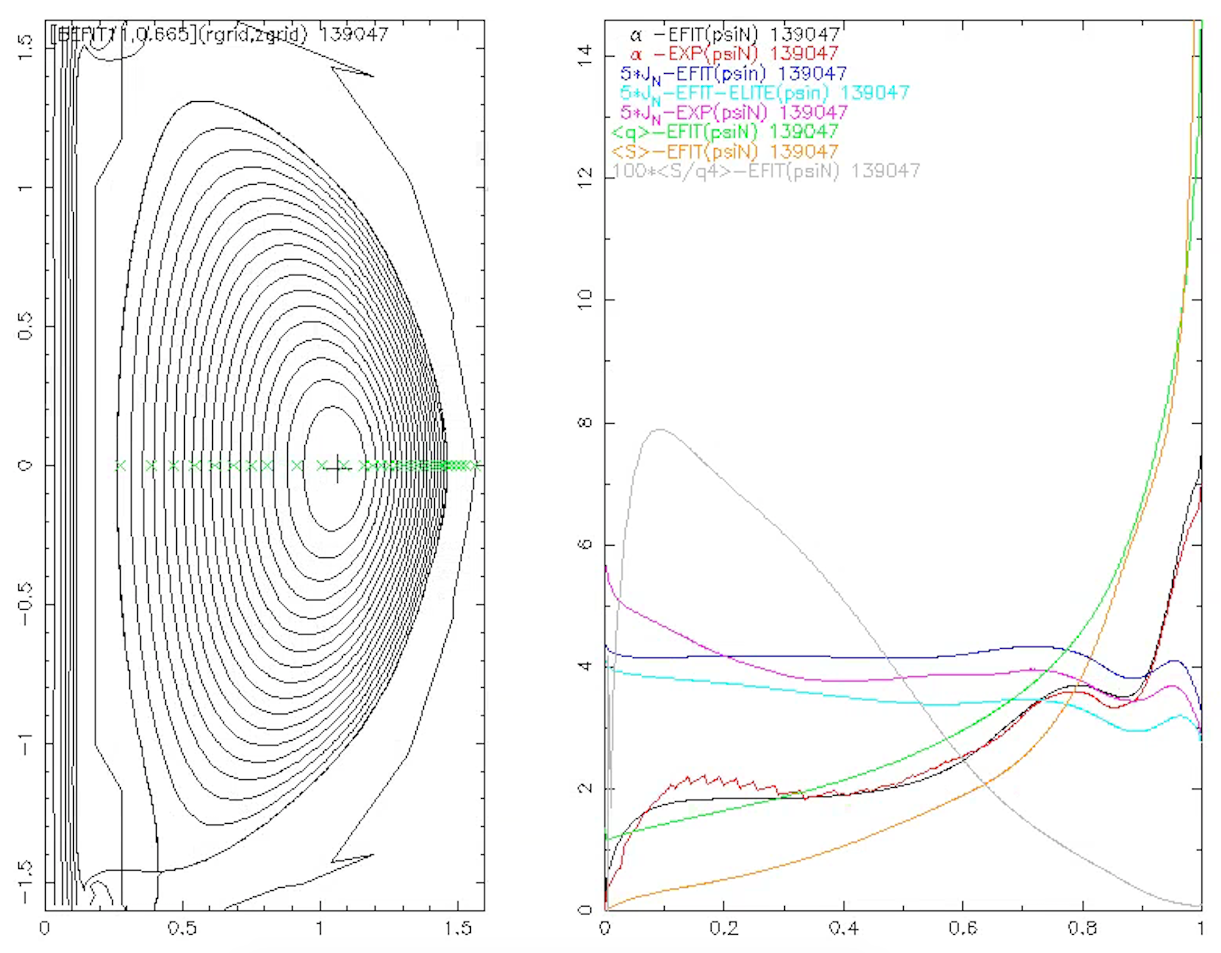
NSTX baseline discharge
q

Slide 6
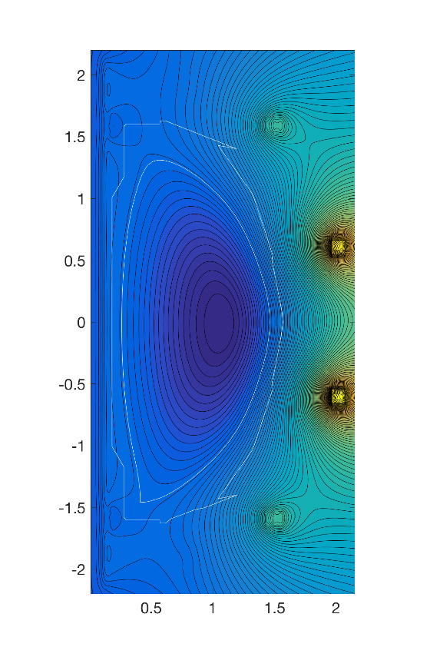
XGC input
Separatrix - midplane
  Bp = 0.2508 T
  Bt = 0.2868 T
Axis
  Bt = 0.4875 T

Slide 7
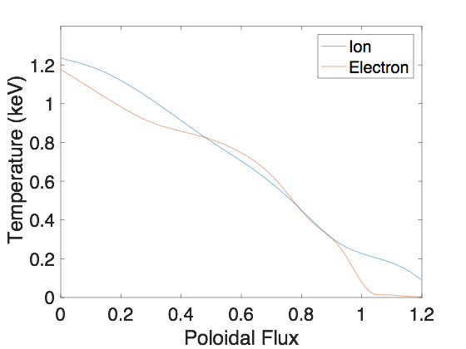
Temperature

Slide 8
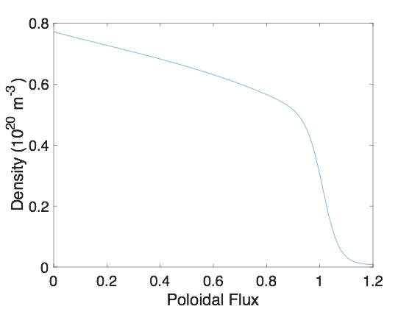
Density

Slide 9
And, in connection with PFC, we may try to
come up with a ST heat-flux width scaling with Ip,
create a predictive curve for the i/o divertor heat-flux ratio and width (validation against existing data?)
study the S parameter for Eich scaling.

