Slide 1




NSTX-U
Supported by
Overview of the NSTX-U 5 Year Plan
Research Program for 2014-2018
Coll of Wm & Mary
Columbia U
CompX
General Atomics
FIU
INL
Johns Hopkins U
LANL
LLNL
Lodestar
MIT
Lehigh U
Nova Photonics
Old Dominion
ORNL
PPPL
Princeton U
Purdue U
SNL
Think Tank, Inc.
UC Davis
UC Irvine
UCLA
UCSD
U Colorado
U Illinois
U Maryland
U Rochester
U Tennessee
U Tulsa
U Washington
U Wisconsin
X Science LLC
J. Menard
For the NSTX-U Research Team
Culham Sci Ctr
York U
Chubu U
Fukui U
Hiroshima U
Hyogo U
Kyoto U
Kyushu U
Kyushu Tokai U
NIFS
Niigata U
U Tokyo
JAEA
Inst for Nucl Res, Kiev
Ioffe Inst
TRINITI
Chonbuk Natl U
NFRI
KAIST
POSTECH
Seoul Natl U
ASIPP
CIEMAT
FOM Inst DIFFER
ENEA, Frascati
CEA, Cadarache
IPP, Jülich
IPP, Garching
ASCR, Czech Rep
NSTX-U PAC-33 Meeting
PPPL – B318
February 19-21, 2013

Slide 2
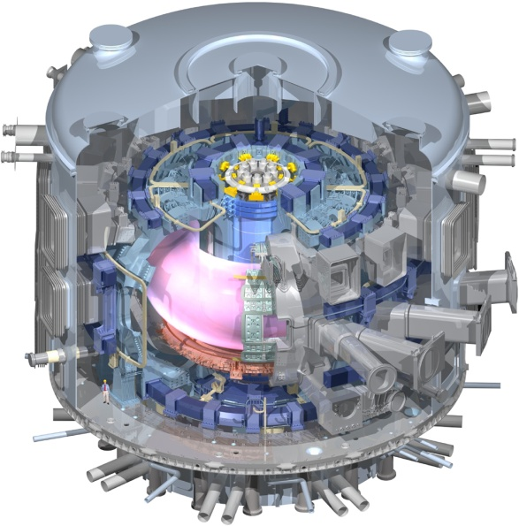
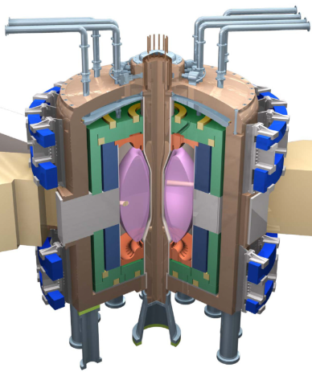
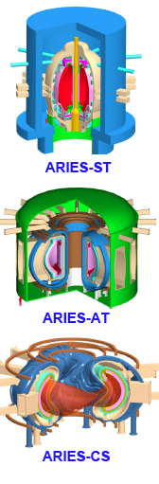
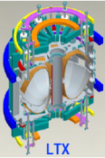
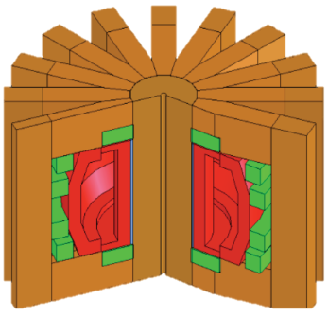
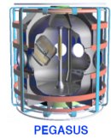
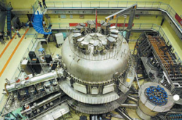
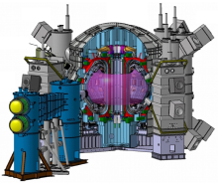
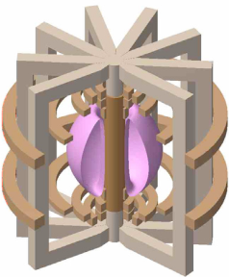
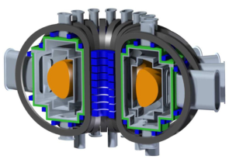
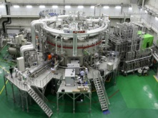
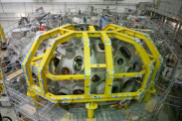
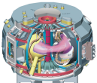
STs and planned NSTX-U program support and accelerate wide range of development paths toward fusion energy
Extend Predictive Capability
  Non-linear fast-ion dynamics
  Transport from electron gyro-scale turbulence at low ν*
  High beta, rotation, shaping, toroidicity for MHD, transport
Burning Plasma Physics - ITER
Fusion Nuclear Science Facility
Pilot Plant or DEMO
FNSF-ST
LTX
ARIES-ST
PEGASUS
NSTX-U
STs Narrow Gaps to Pilot/DEMO:
Steady-State, Plasma-Material Interface R&D
100% non-inductive + high β
Plasma-Material Interface
  Strong heating + smaller R →
  access high P/R, P/S
  Novel PMI solutions: snowflake, liquid metals, Super-X (MAST-U)
FNSF-AT
ARIES-AT
EAST
JT-60SA
NHTX
VULCAN
Fusion Nuclear Science
  High neutron wall loading
  Potentially smaller size, cost
  Smaller T consumption
  Accessible / maintainable
ARIES-CS
KSTAR
W7-X, LHD
QUASAR

Slide 3
Outline
Review of PAC-33 charge
Performance requirements for next-steps
NSTX-U long-range research goals
Highest-priority facility enhancements
Overview of 5 year plan research thrusts
Contributions to ITER, predictive capability
Summary

Slide 4
NSTX-U PAC-33 Charge Background
The NSTX-U research team is presently engaged in writing a 5 year plan for 2014-18
  Plan utilizes the new capabilities associated with the NSTX Upgrade project (new centerstack and 2nd neutral beam injector)
  plus proposed additional high-leverage facility enhancements
The written plan is due to the Office of Fusion Energy Sciences (FES) in early April 2013,
  Full plan will be presented to an FES-appointed external review panel in May/June of 2013
The NSTX-U research team would very much value a critical assessment of the draft 5 year plan by the PAC to assist the team in preparing for the plan review
Charge questions are similar to those expected during 5 year plan review based on FES guidance, previous reviews

Slide 5
NSTX-U PAC-33 Charge Questions
Assess the NSTX-U 5 year plan with respect to how well it addresses the key physics issues needed to evaluate the potential of the ST to provide high-performance plasmas for use in a future fusion research facility
  Example future fusion research facilities include a toroidal
  plasma-material-interface facility, a fusion nuclear science
  facility, or a Pilot Plant/DEMO
Assess the plans to investigate key tokamak physics issues for ITER
Assess plans to contribute to model validation and the development of predictive capability
In addressing charges 1-3 above, please comment in particular on the strength of planned NSTX-U contributions to boundary physics and plasma-material-interaction research.
Comment on possible improvements to the NSTX-U 5 year plan presentations including logic and format
All presentations
Dedicated Kaye presentation
All presentations
Maingi, Soukhanovskii,
Jaworski, Canik presentations

Slide 6
Outline
Review of PAC-33 charge
Performance requirements for next-steps
NSTX-U long-range research goals
Highest-priority facility enhancements
Overview of 5 year plan research thrusts
Contributions to ITER, predictive capability
Summary

Slide 7
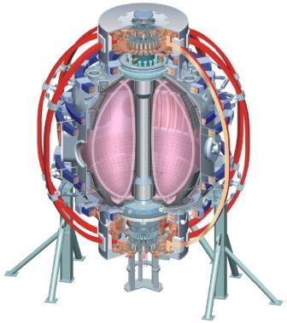
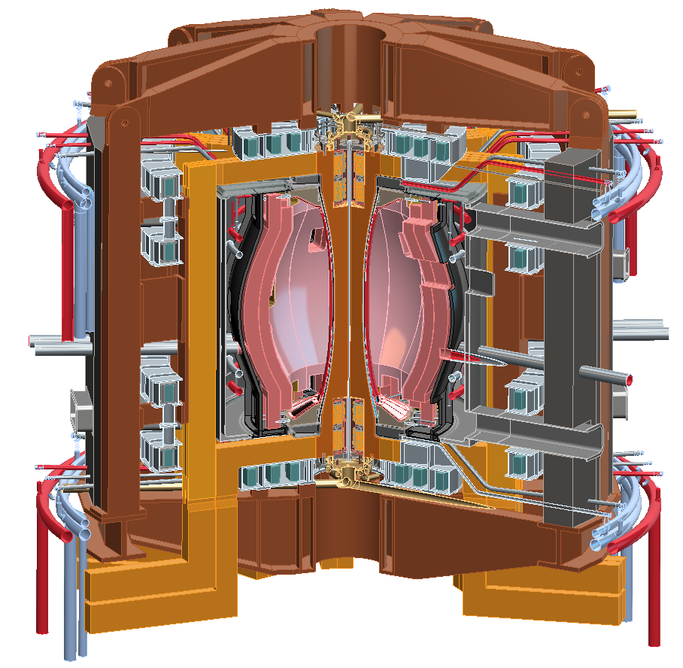
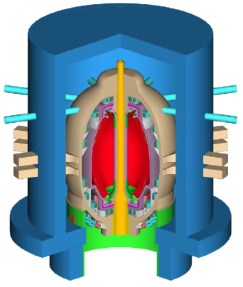
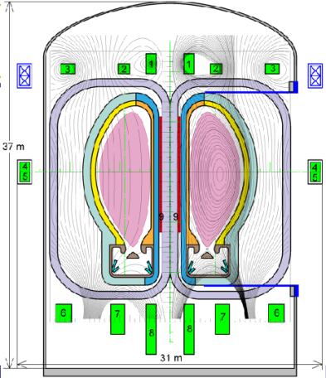
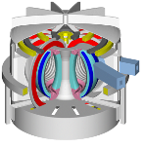
NSTX Upgrade will access next factor of two increase in performance to bridge gaps to next-step STs
Low-A
Power Plants
Parameter | NSTX | NSTX Upgrade | Plasma Material Interface Facility | Fusion Nuclear Science Facility | Pilot Plant
Major Radius R₀ [m] | 0.86 | 0.94 | 1.0 | 1.3 | 1.6 – 2.2
Aspect Ratio R₀ / a | ≥ 1.3 | ≥ 1.5 | ≥ 1.8 | ≥ 1.5 | ≥ 1.7
Plasma Current [MA] | 1 | 2 | 3 – 4 | 4 – 10 | 11 – 18
Toroidal Field [T] | 0.5 | 1 | 2 | 2 – 3 | 2.4 – 3
Auxiliary Power [MW] | ≤ 8 | ≤ 19* | 30 – 50 | 22 – 45 | 50 – 85
P/R [MW/m] | 10 | 20 | 30 – 50 | 30 – 60 | 70 – 90
P/S [MW/m²] | 0.2 | 0.4-0.6 | 0.7 – 1.2 | 0.6 – 1.2 | 0.7 – 0.9
Fusion Gain Q |  |  |  | 1 – 2 | 2 – 10
ARIES-ST (A=1.6)
JUST (A=1.8)
VECTOR (A=2.3)
* Includes 4MW of high-harmonic fast-wave (HHFW) heating power
Non-inductive start-up, ramp-up, sustainment
Confinement scaling (esp. electron transport)
Stability and steady-state control
Divertor solutions for mitigating high heat flux
Key issues to resolve for next-step STs

Slide 8
5 year plan addresses key physics + operational questions facing high-performance next-steps, ITER
Requirements for tokamak / ST next-steps:
Key questions to resolve:
Full non-inductive (NI) current drive for steady-state operation
  ST requires NI start-up/ramp-up
High confinement to minimize auxiliary heating, device size
Sustained high β to minimize magnet size, forces, power
Divertor/first-wall survival with intense power/particle fluxes
Are non-inductive plasma J(ρ), p(ρ) profiles consistent with high β, τ_{E}?
Can J(ρ) profile be controlled, and strong Alfvenic instabilities avoided?
How does confinement depend on parameters, gradients?: q, ν*, β, Ω_{φ}
How can plasma confinement be controlled and increased?
What is maximum sustainable β with passive and active mode control?
Can plasma disruptions be predicted, avoided, mitigated?
Can fluxes be reduced below engin. limits at high power & NICD fractions?
Do PFCs/scenarios exist w/ low net erosion, tolerant of off-normal events?

Slide 9
5 year plan goal: access performance levels of next-steps, approach Pilot-Plant regimes
Requirements for tokamak / ST next-steps:
1.0
Bootstrap fraction
0.9
ST-Pilot
Full non-inductive (NI) current drive for steady-state operation
  ST requires NI start-up/ramp-up
High confinement to minimize auxiliary heating, device size
Sustained high β to minimize magnet size, forces, power
Divertor/first-wall survival with intense power/particle fluxes
f_{BS}
0.8
ST-PMI
ST-FNSF
0.7
NSTX-U
0.6
0.5
2.0
Normalized Confinement
1.8
ST-Pilot
H_{98y2}
1.6
1.4
ST-FNSF
NSTX-U
ST-PMI
1.2
1.0
8.0
Normalized Beta
β_{N}
7.0
ST-Pilot
6.0
NSTX-U
5.0
ST-PMI
ST-FNSF
4.0
3.0
1.0
ST-PMI
ST-FNSF
ST-Pilot
P/S
0.8
0.6
NSTX-U
[MW/m²]
0.4
0.2
0.0
Power exhaust challenge

Slide 10
Outline
Review of PAC-33 charge
Performance requirements for next-steps
NSTX-U long-range research goals
Highest-priority facility enhancements
Overview of 5 year plan research thrusts
Contributions to ITER, predictive capability
Summary

Slide 11
High-level goals for NSTX-U 5 year plan
Demonstrate stationary 100% non-inductive at performance that extrapolates to ≥ 1MW/m² neutron wall loading in FNSF
  Note: Non-inductive goal also supports ST-based PMI facility application
Access reduced ν* and high-β combined with ability to vary q & rotation to dramatically extend ST plasma understanding
3. Develop and understand non-inductive start-up/ramp-up
to project to ST-FNSF operation with small or no solenoid
  Note: ST-based PMI facility could have solenoid for start-up/ramp-up
4. Develop and utilize high-flux-expansion “snowflake” divertor
and radiative detachment for mitigating very high heat fluxes
5. Begin to assess high-Z PFCs + liquid lithium to develop high-duty-factor integrated PMI solution for SS-PMI, FNSF, beyond

Slide 12
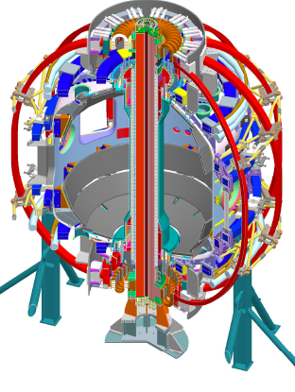
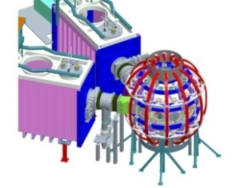
NSTX-U goal staging: first establish ST physics + scenarios, transition to long-pulse + PMI integration (5YP incremental)
2014 | 2015 | 2016 | 2017 | 2018 | 2019 | 2020 | 2021 | 2022 | 2023
Upgrade Outage
Establish ST physics, scenarios
Integrate long-pulse + PMI solutions
Start-up and Ramp-up
Increase CHI closed-flux current
Achieve NI start-up/ramp-up
New
center-stack
Assess plasma gun start-up at increased device size
Increase/extend ramp-up heating and off-axis current-drive for advanced scenarios
Develop/understand ECH/EBW H&CD for ST
Boundary Physics
Establish main-ion density and ν* control
Understand snowflake divertor performance
Understand high-Z first-wall erosion, migration, particle sources & sinks
Inform U.S.
next-step conceptual design including aspect ratio and divertor optimization
Materials and PFCs
Assess baseline graphite PFC performance
Assess high-Z tile/divertor impact and performance
Assess high-Z divertor and/or first-wall
Assess impact of high-temperature first-wall
Liquid
metals / lithium
Establish low impurities / Z_{eff} , assess increased Li coverage, replenishment
Test flowing liquid metal for heat-flux mitigation, surface replenishment
Assess flowing LM PFC with full toroidal coverage
MHD
Understand kinetic MHD, extend mode and disruption detection, develop mitigation
Enhance non-axisymmetric field spectrum and capabilities with off-midplane coils for control of: RWM, EF, RMP, rotation, NTM, EP
Transport & Turbulence
Understand ES and EM turbulence at high β, low ν*, emphasizing e-transport
Extend wave-number coverage of turbulence measurements
Waves and Energetic Particles
Characterize AE stability, fast-ion transport, NBI-CD, support plasma start-up, assess effectiveness of fast-wave in NBI H-modes
Prototype driving edge-harmonic oscillations (EHOs) and/or *AE
2nd NBI
Scenarios and Control
Demonstrate full non-inductive, high I_{P} & P_{AUX} operation Control: boundary, β, divertor heat flux, Ω & q profiles
Assess integrated control of long-pulse / high-performance

Slide 13
Outline
Review of PAC-33 charge
Performance requirements for next-steps
NSTX-U long-range research goals
Highest-priority facility enhancements
Overview of 5 year plan research thrusts
Contributions to ITER, predictive capability
Summary

Slide 14
Prioritization of major facility enhancements
Extensive diagnostic/facility idea input gathered 2011-2012
Options ranked according to program impact, cross-links, cost
Programmatic impact includes:
  Importance to next-step ST viability
  Physics or operational contributions to ITER
  Uniqueness for ST or in world program
Highest priority major facility enhancements: (5YP base funding)
  Cryo-pump: n_{e} , collisionality control important to all science areas and scenarios, enables comparison between cryo and Li-coatings
  ECH/EBW (1MW, 28GHz): ECH/EBW critical for heating helicity injection/start-up plasma, EBW potentially very efficient for off-axis CD
  Off-midplane non-axisymmetric control coils (NCC): greatly expanded control of poloidal, toroidal spectrum for EF, RWM, ELM, rotation control
5YP incremental funding priorities (not in priority order):
  Divertor Thomson, accelerate high-Z/Li, intermediate-k δn, full NCC, 2MW EC, EHO/EP

Slide 15
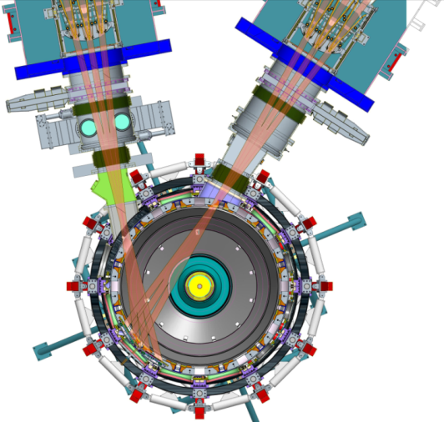
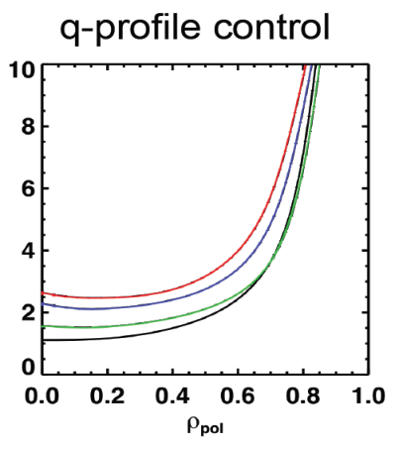
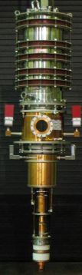
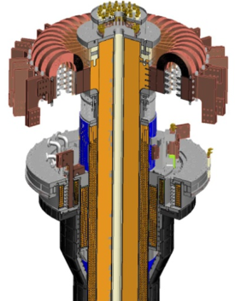
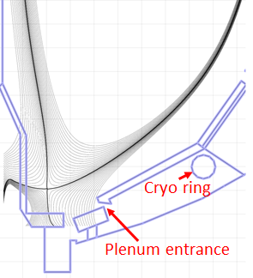
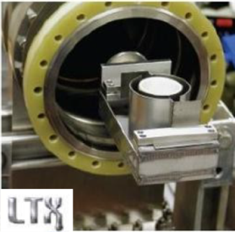
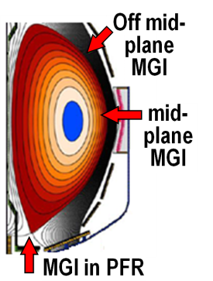
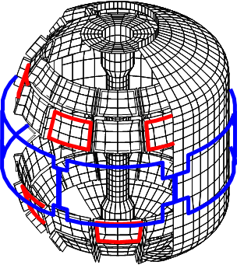

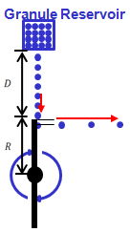
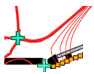
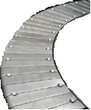
NSTX-U plan will address key issues using cross-cutting set of existing/early tools + additional facility enhancements
Key issues to resolve:
Present NBI
q profile control
28 GHz, 1-2MW
Gyrotron
Non-inductive current profile consistency and control, avoidance of Alfvenic modes
ECH / EBW for start-up
(Longer-term: EBW H&CD)
New 2nd NBI → 2×P_{NBI}
Vary PFC Li coverage to vary recycling, p(ρ), τ_{E}
Cryo-pump for D, n_{e}, ν* control w/o Li coatings
Confinement dependence on: ν*, q, β, Ω_{φ}, means to control, increase
New CS: 2×B_{T}, I_{P} 5×longer pulse
Midplane + off-midplane non-axis. control coils (NCC) for EFC, RWM, ELM-RMP, NTV
Sustainable β w/ passive and active control, disruption prediction, avoidance, mitigation
Extended low-f MHD sensor set
Reduced power/particle fluxes, low net erosion, resilience to off-normal events/disruptions
Snowflake divertors + partial detachment
Erosion & shielding of high-Z tiles + Li
Li granule injector (LGI) for ELM pacing

Slide 16
Outline
Review of PAC-33 charge
Performance requirements for next-steps
NSTX-U long-range research goals
Highest-priority facility enhancements
Overview of 5 year plan research thrusts
Contributions to ITER, predictive capability
Summary

Slide 17
Plan Organization and Research Thrusts
NSTX-U topical science groups (TSGs) are responsible for program plan definition and 5 year plan presentations + chapters
  TSG structure: experimental leader/deputy + theory co-leader for strong theory-experiment linkages
Each chapter contains 2-4 research “thrusts” which define actions that will be taken to achieve the high-level goals
The remainder of this presentation will summarize the TSG research thrusts of the NSTX-U 5 year plan

Slide 18
Overview of NSTX-U 5 year plan research thrusts
Macroscopic Stability (MS)
Transport and Turbulence (TT)
Boundary Physics (BP)
Materials and Plasma Facing Components (MP)
Energetic Particles (EP)
Wave Heating and Current Drive (RF)
Plasma Start-up and Ramp-up (PSR)
Advanced Scenarios and Control (ASC)

Slide 19
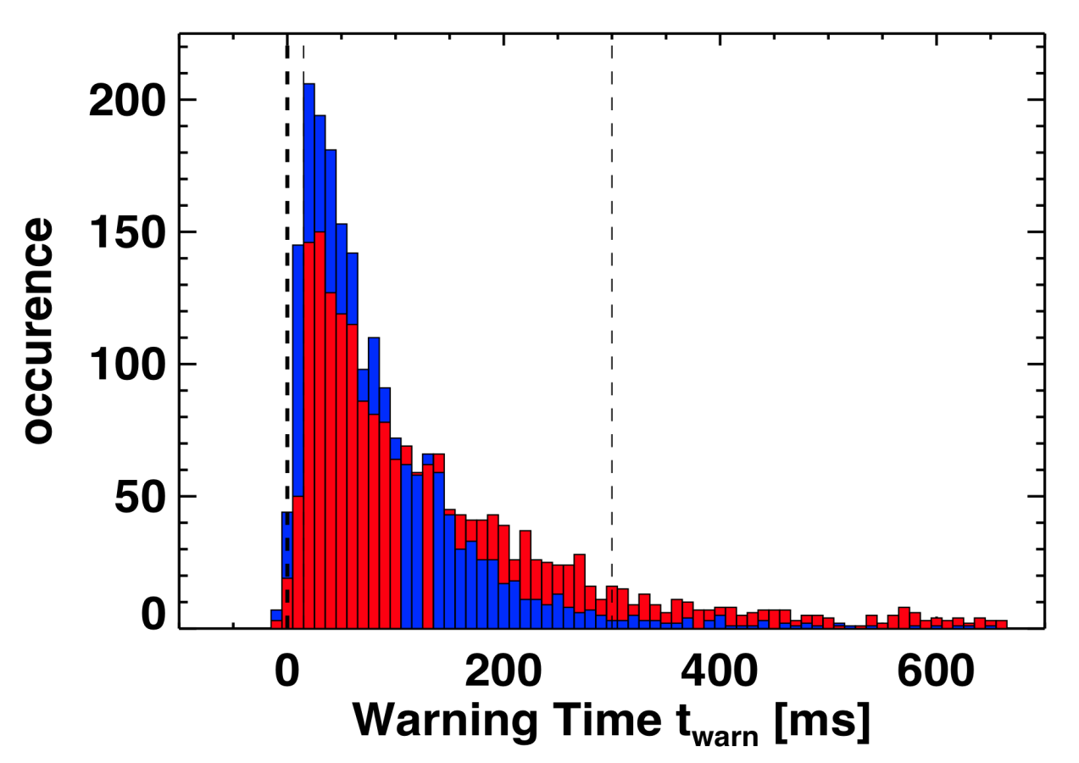
Stability control improvements significantly reduce unstable RWMs; developed advanced disruption warning
Disruption warning algorithm shows high probability of success
  Uses combinations of single threshold tests
Lower warning threshold
Higher warning threshold
~2100 Discharges
False Positive:
Warning > 300 ms before I_{P} quench
Late Warning:
Warning < 10 ms before I_{P} quench
Unstable RWM
Stable / controlled RWM
Disruption probability reduced by a factor of 3 in controlled experiments
  Reached 2× computed n=1 no-wall limit β_{N} / l_{i} = 6.7
Lower probability of unstable RWMs at high β_{N} / l_{i}
Minimize late warnings:
<1% late warning, ~15% false positive
Minimize late warn + false positives:
~2% late warning, ~4% false positive

Slide 20
Macroscopic Stability (MS) 5 Year Goal:
Establish the physics and control capabilities needed for sustained stability of high performance ST plasmas
Thrust MS-1: Understand and advance passive and active feedback control to sustain macroscopic stability
  Study effects of reduced ν*, also q and rotation on LM, RWM, NTM
  Advance RWM state-space control for EF, RWM for ITER, next-steps
MS-2: Understand 3D field effects to provide basis for optimizing stability through rotation profile control by 3D fields
  Study EF penetration, rotation damping, ELM triggering & suppression
    Utilize varied torque deposition from 2nd NBI, existing/off-midplane NCC
MS-3: Understand disruption dynamics, develop disruption prediction/detection, avoidance, and mitigation
  rt-ID of global stability limit: low-f, n=1 resonant field amplification (RFA)
  Enhance measurement, quantification of disruption heat loads, halos
  Develop/test novel particle delivery techniques for disruption mitigation:
    MGI in private-flux-region (PFR), electromagnetic particle injector (rail gun)

Slide 21
NSTX results and NSTX-U 5 year plan research thrusts
Macroscopic Stability (MS)
Transport and Turbulence (TT)
Boundary Physics (BP)
Materials and Plasma Facing Components (MP)
Energetic Particles (EP)
Wave Heating and Current Drive (RF)
Plasma Start-up and Ramp-up (PSR)
Advanced Scenarios and Control (ASC)

Slide 22
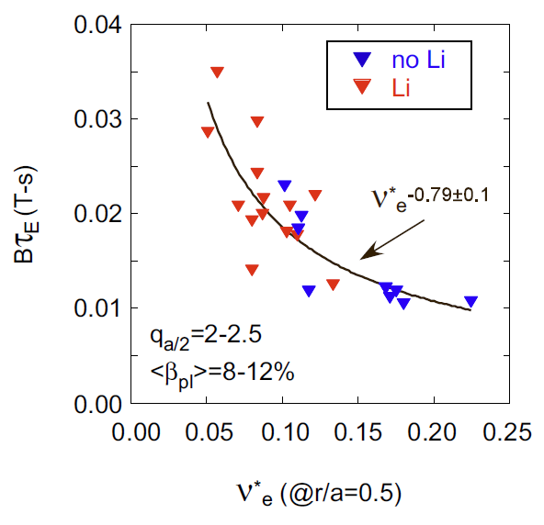
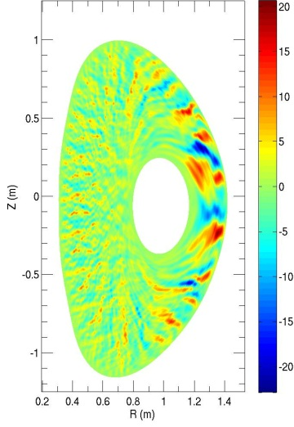
τ_{E} scalings unified by collisionality; nonlinear microtearing simulations find reduced electron heat transport at lower ν
Experiment
Theory
δB_{r} (Gauss)
experiment
B_{t}τ_{E} (T-s)
χ_{e}^{sim} ~ ν_{e}^{1.1}
120968
W. Guttenfelder, et al., PRL 106 (2011) 155004
ν∗_{e} (at r/a = 0.5)
Quantitatively predicted χ_{e}, scaling ~ ν_{e}^{1.1} consistent w/experiment (Ωτ_{E} ~ B_{t}τ_{E} ~ ν*_{e}^{-0.8})
Transport dominated by magnetic “flutter”
  Significant δB_{r}/B ~ 0.1%
Increase in τ_{E} as ν∗_{e} decreases
Trend continues when lithium used
NSTX-U computed to extend studies down to < 1/4 of present ν*

Slide 23
Transport and Turbulence (TT) 5 Year Goal:
Establish predictive capability for transport in next-step devices focusing on the ST high-β + low-collisionality regime
Thrust TT-1: Characterize H-mode global energy confinement scaling in the lower collisionality regime of NSTX-U
  Extend τ_{E} scaling to low ν* by increasing B_{T}, I_{P}, P_{NBI}, lowering n_{e}, Z_{eff}
TT-2: Identify instabilities responsible for anomalous electron thermal, momentum, particle/impurity transport
  ID isolated regimes for μ-instabilities using theory, 1st principle models
    Example: microtearing χ_{e} is linear in ν, while ETG χ_{e} is independent of ν
  Relate measured turbulence to prediction:
    High-k_{θ} (μ-wave), low-k (BES), EM/δB (polarimetry)
TT-3: Establish and validate reduced transport models
  Predict/compare T_{e,i} profiles using neoclassical + drift-wave models, develop semi-empirical/analytic models directly from GK simulations
  Develop model for GAE/CAE-driven electron transport
  Assess predicted confinement for ST-based next-steps such as FNSF

Slide 24
NSTX results and NSTX-U 5 year plan research thrusts
Macroscopic Stability (MS)
Transport and Turbulence (TT)
Boundary Physics (BP)
Materials and Plasma Facing Components (MP)
Energetic Particles (EP)
Wave Heating and Current Drive (RF)
Plasma Start-up and Ramp-up (PSR)
Advanced Scenarios and Control (ASC)

Slide 25
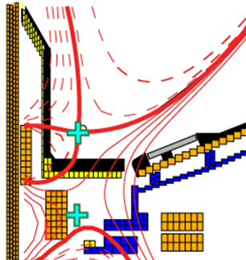
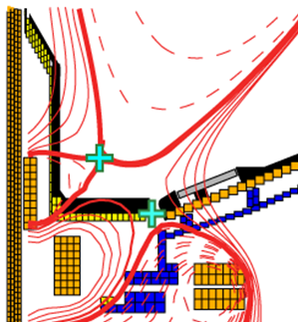

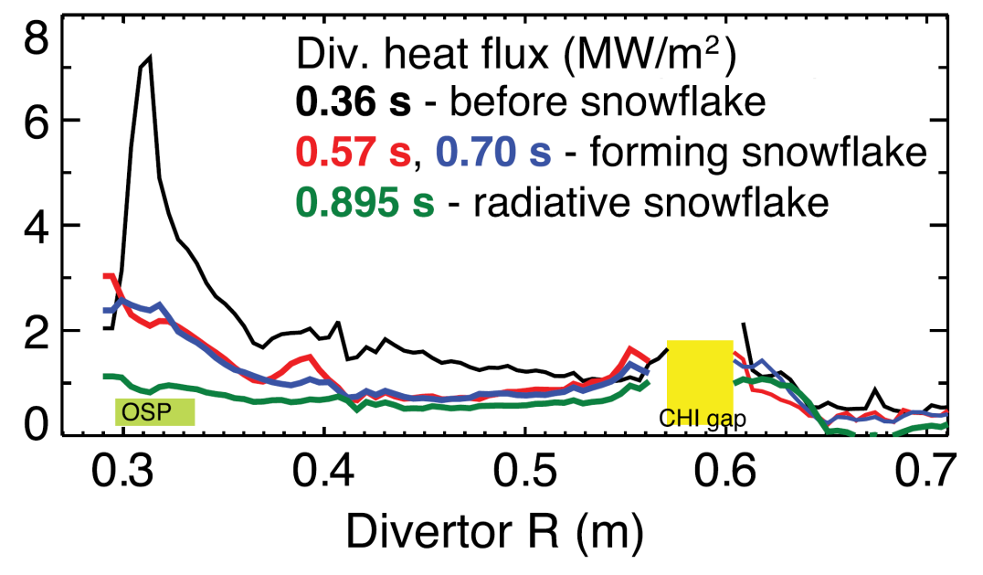
Pedestal width scaling differs from conventional A;
“snowflake” divertor effective for heat flux mitigation
Pedestal width scaling
NSTX: can reduce heat flux by 2-4× via partial detachment at sufficiently high f_{rad}
0.16
0.4 (β_{θ}^{ped})
^{1.05}
NSTX
0.12
Standard Divertor
Snowflake Divertor
Pedestal width (ψ_{N})
C-Mod
0.08
DIII-D
0.04
^{0.5}
~ 0.08 (β_{θ}^{ped})
Snowflake→ high flux expansion = 40-60 lowers incident q⊥, promotes detachment
0.00
0.1
0.3
0.5
0.7
0.9
Pedestal width scaling β_{θ}^{α} applies to multiple machines
In NSTX, observed ped. width is larger
  Data indicates stronger scaling: β_{θ} vs. β_{θ}^{0.5}
  Measured low-k turbulence correlation lengths consistent with XGC1 predictions

Slide 26
Boundary Physics (BP) 5 Year Goal:
Develop and understand integrated plasma exhaust solutions compatible with high core performance for FNSF and ITER
Thrust BP-1: Assess, optimize, and control pedestal structure, edge transport and stability
  Characterize L-H thresholds, pedestal height/structure vs. B_{T}, I_{P}, shape
  Develop improved control of pedestal transport and stability - tools:
    Li coverage, fueling, cryo-pumping, ELM triggering/suppression (LGI, NCC)
BP-2: Assess and control divertor heat and particle fluxes
  Extend/establish heat flux width scalings at lower ν, higher B_{T}, I_{P}, P_{SOL}
    Compare data to multi-fluid turbulence and gyro-kinetic models
  Assess, control, optimize snowflake divertor
  Develop highly-radiating boundary solutions with feedback control
  Validate cryo-pump physics assumptions, characterize n_{e} control
  Assess impact of high-Z tile row(s) on power exhaust, core impurities

Slide 27
NSTX results and NSTX-U 5 year plan research thrusts
Macroscopic Stability (MS)
Transport and Turbulence (TT)
Boundary Physics (BP)
Materials and Plasma Facing Components (MP)
Energetic Particles (EP)
Wave Heating and Current Drive (RF)
Plasma Start-up and Ramp-up (PSR)
Advanced Scenarios and Control (ASC)

Slide 28
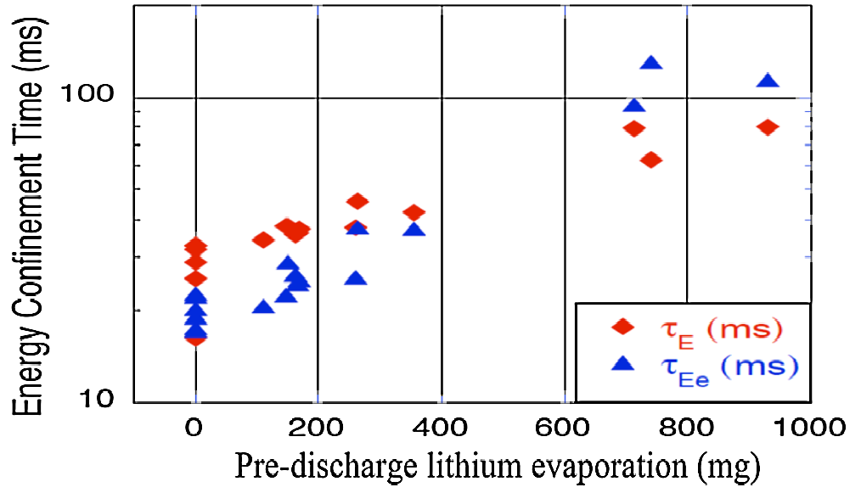
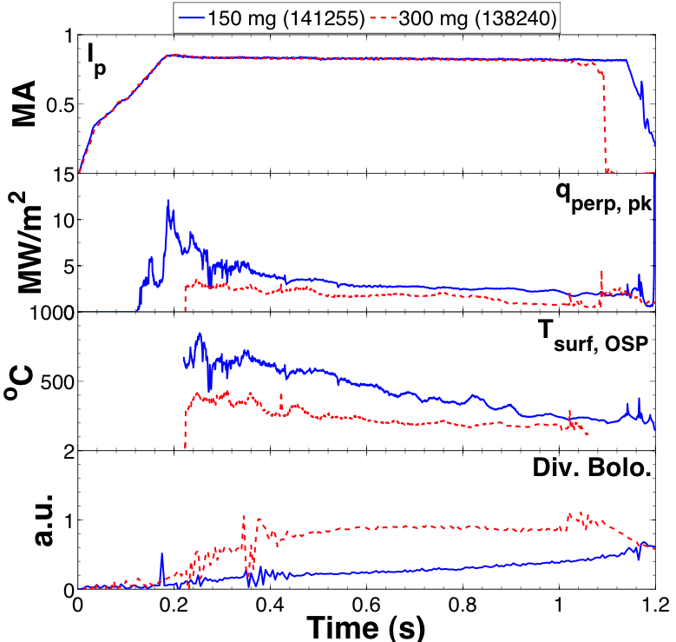
Plasma confinement increases ~continuously with increasing Li evaporation; Li may also be means of heat flux mitigation
150 mg
300 mg
ELM-free discharges
I_{P} = 0 .8 MA, P_{NBI} ~ 4 MW
High δ, f_{exp} ~20
Energy Confinement Time (ms)
Pre-discharge lithium evaporation (mg)
R. Maingi, et al., PRL 107 (2011) 145004
Global parameters improve
  H98(y,2) increases from ~0.9 → 1.3-1.4
  No core Li accumulation
ELM frequency declines to zero
Edge transport declines
High τ_{E} critical for FNSF, next-steps
Increased Li deposition may be advantageous for power handling
  Lower peak divertor heat flux and T_{surface}
  Increased divertor radiation
May require threshold Li level
Motivates “vapor-shielding” research
What is τ_{E} upper bound?

Slide 29
Materials and PFCs (MP) 5 Year Goal:
Initiate comparative assessment of high-Z and liquid metal PFCs for long-pulse high-power-density next-step devices
Thrust MP-1: Understand lithium surface-science during extended PFC operation
  Assess increased coverage of PFCs by Li, compare to B-zation, B+Li
  Utilize Materials Analysis Particle Probe (MAPP) to identify in-situ between-shot chemical compositions of the coatings
MP-2: Unravel the physics of tokamak-induced material migration and evolution
  Measure shot-to-shot erosion and redeposition (QCMs, marker-tiles)
  Utilize MAPP + QCM for shot-to-shot analysis of migration+composition
  Determine magnitude of wall-erosion for NSTX-U conditions
MP-3: Establish the science of continuous vapor-shielding
  Study vapor-shielding in long-pulse linear plasma device Magnum-PSI
  Extend Magnum results to NSTX-U with Li-coated high-Z substrates

Slide 30
NSTX results and NSTX-U 5 year plan research thrusts
Macroscopic Stability (MS)
Transport and Turbulence (TT)
Boundary Physics (BP)
Materials and Plasma Facing Components (MP)
Energetic Particles (EP)
Wave Heating and Current Drive (RF)
Plasma Start-up and Ramp-up (PSR)
Advanced Scenarios and Control (ASC)

Slide 31
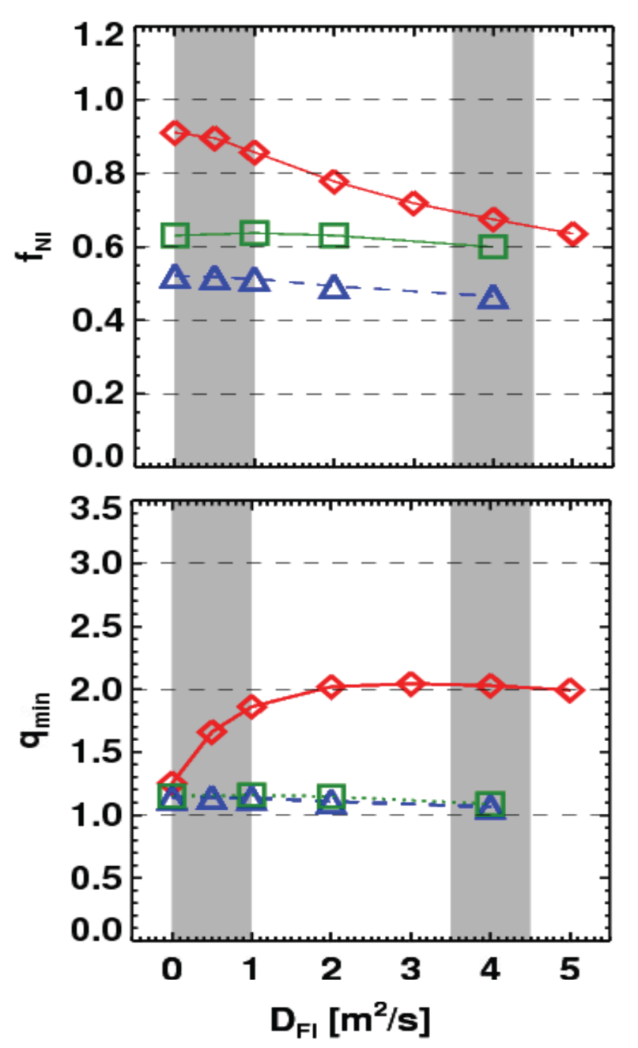
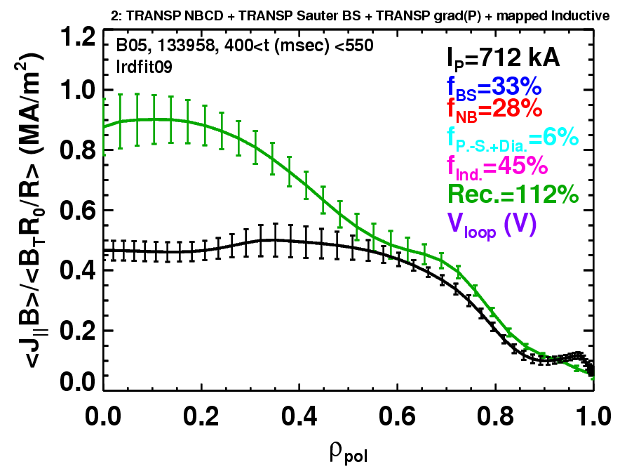
Rapid TAE avalanches could impact NBI current-drive in advanced scenarios for NSTX-U, FNSF, ITER AT
NSTX-U TRANSP simulations
NSTX: rapid avalanches can lead to
redistribution/loss of NBI current drive
Discrepancy between reconstruction and total assuming
classical J_{NBCD}
1 MA, 1T, H₉₈=1, near non-inductive
1.6 MA, 1T, partial inductive
1.2 MA, 0.55T, high β_{T}
All: f_{GW}=0.7, H₉₈=1
Minor radius
700kA high-β_{P} plasma with rapid
TAE avalanches has time-average D_{FI} = 2-4m²/s

Slide 32
Energetic Particle (EP) 5 Year Goal:
Develop predictive capability for fast-ion transport caused by Alfven Eigenmodes (AEs), explore control of AE modes
Thrust EP-1: Develop predictive tools for projections of *AE-induced fast ion transport in FNSF and ITER
  Vary fast-ion instability drive (NBI, q, rotation, 3D fields) and measure *AE mode structure (high-f magnetics, BES, reflectometry)
  Characterize fast ion transport associated with specific classes of *AEs
  Compare results to simulation, develop reduced models
    ORBIT, NOVA-K, M3D-K, HYM to understand mode-induced transport
EP-2: Assess requirements for fast-ion phase-space engineering techniques
  Perform active spectroscopy to measure linear TAE damping rates
    Extend/benchmark EP stability codes at low aspect ratio, high β, rotation
  Extend bandwidth of *AE antennae to study high-f modes (increm.):
    Higher-f + cyclotron resonances → means to modify distribution function?

Slide 33
NSTX results and NSTX-U 5 year plan research thrusts
Macroscopic Stability (MS)
Transport and Turbulence (TT)
Boundary Physics (BP)
Materials and Plasma Facing Components (MP)
Energetic Particles (EP)
Wave Heating and Current Drive (RF)
Plasma Start-up and Ramp-up (PSR)
Advanced Scenarios and Control (ASC)

Slide 34
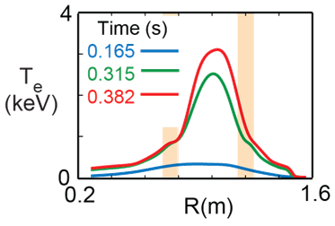
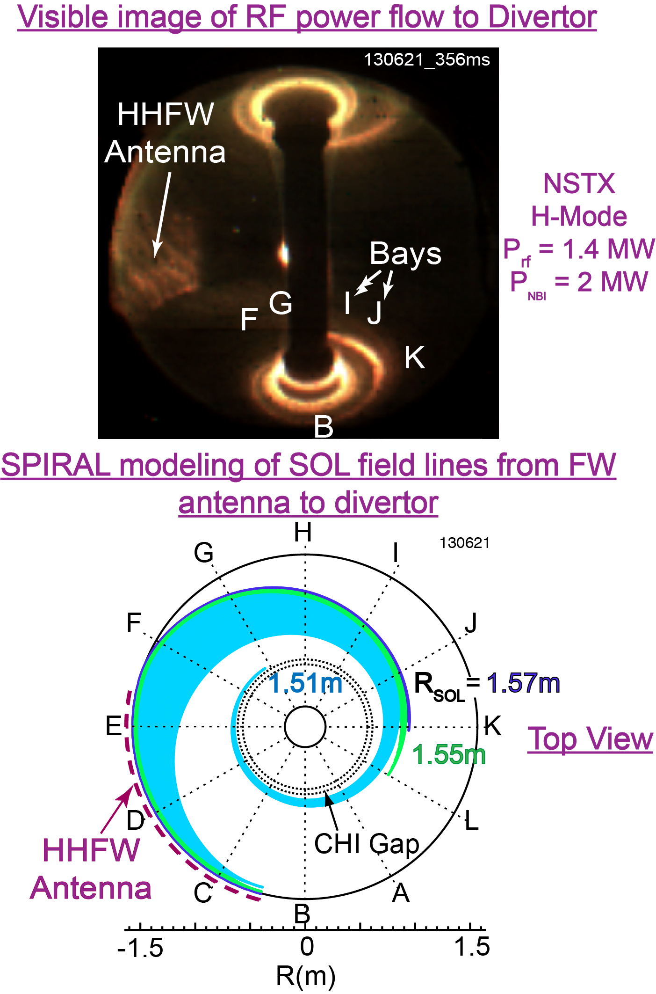
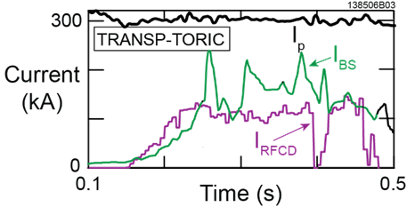
HHFW can efficiently heat low I_{P} targets for plasma start-up, but can lose power to divertor in SOL in front of antenna
T_{e}(0)=3keV RF-heated H-mode at I_{P} = 300kA with only P_{RF} = 1.4MW
Non-inductive fraction ≥ 70%
  f_{BS} ~50%, f_{RFCD} ~ 20-35%

Slide 35
Radio-frequency Heating and Current Drive (RF) 5 Year Goal:
Provide and understand heating and current-drive for full non-inductive (NI) start-up and ramp-up in support of FNSF
Thrust RF-1: Develop fast wave and EC heating/current-drive for fully non-inductive plasma current start-up and ramp-up
  Extend HHFW to higher power (3-4MW)
  Demonstrate HHFW-driven 100% non-inductive ramp-up to ≥ 300kA
    Goal: generate sufficient target current for confining 2nd NBI fast-ions
  Use HHFW, ECH (~1MW, 28GHz) to increase T_{e} of CHI plasmas
  High-power EBW to generate start-up current - builds on MAST results
RF-2: Validate advanced RF codes for NSTX-U and predict RF performance in ITER and future burning plasma devices
  Fast-wave SOL power flows: AORSA, TORIC, SPIRAL
  RF/fast-ion interactions: “Hybrid” finite orbit width CQL3D FP code
  ECH absorption, EBW heating and current drive: GENRAY

Slide 36
NSTX results and NSTX-U 5 year plan research thrusts
Macroscopic Stability (MS)
Transport and Turbulence (TT)
Boundary Physics (BP)
Materials and Plasma Facing Components (MP)
Energetic Particles (EP)
Wave Heating and Current Drive (RF)
Plasma Start-up and Ramp-up (PSR)
Advanced Scenarios and Control (ASC)

Slide 37
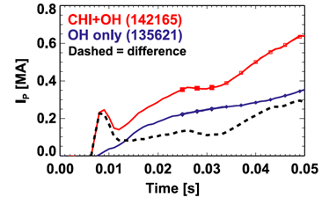
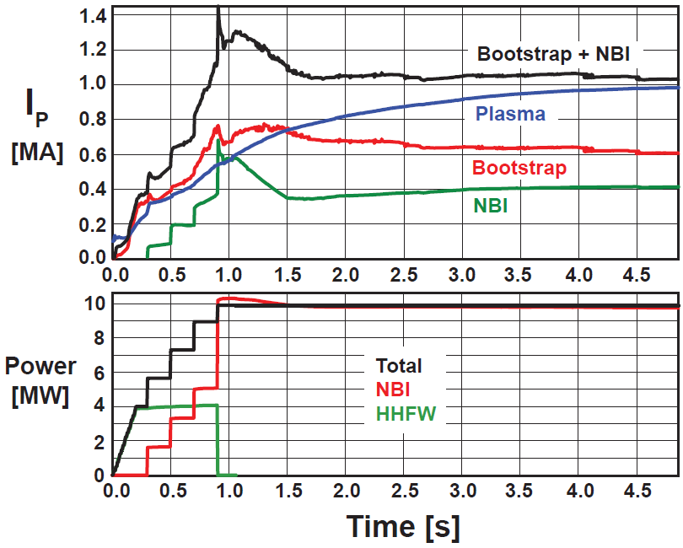

Coaxial Helicity Injection (CHI) has generated ~200kA (closed flux), TSC simulations → start-up/ramp-up to ~1MA possible
More tangential injection provides 3-4x higher CD at low I_{P}:
  1.5-2x higher current drive efficiency
  2x higher absorption (40→80%) at low I_{P} = 0.4MA
TSC simulation of non-inductive ramp-up from initial I_{P} = 0.1MA, T_{e}=0.5keV target
TSC simulation of CHI startup
1.0 ms
1.6 ms
2.7 ms
2
1
Z (m)
0
-1
-2
0
1
2
0
1
2
0
1
2
R (m)
R (m)
R (m)

Slide 38
Plasma Start-up and Ramp-up (PSR) 5 Year Goal:
Develop and understand non-inductive start-up/ramp-up to project to ST-FNSF operation with small or no solenoid
Thrust PSR-1: Establish and extend solenoid-free plasma start-up and test NBI ramp-up
  Re-establish CHI discharges, increase generated currents → 400kA
  Assess NBI H&CD in 300-400kA OH targets, compare to TSC/TRANSP
  Attempt NBI ramp-up of I_{P} = 0.3-0.6MA (inductive target) to 0.8-1MA
PSR-2: Ramp-up CHI Plasma discharges using NBI and HHFW and Test Plasma Gun Start-up
  Maximize levels of CHI-produced plasma current (ECH, 2.5-3kV CHI)
  Use ECH/HHFW to extend duration of high-current CHI target
    Test effectiveness of NBI coupling to CHI-target
  Test full non-solenoidal start-up: CHI+ECH/HHFW→HHFW+NBI→1MA
    Validate ramp-up current drive results with 2D TSC/3D NIMROD simulations
  If technically ready, commission and test plasma guns on NSTX-U

Slide 39
NSTX results and NSTX-U 5 year plan research thrusts
Macroscopic Stability (MS)
Transport and Turbulence (TT)
Boundary Physics (BP)
Materials and Plasma Facing Components (MP)
Energetic Particles (EP)
Wave Heating and Current Drive (RF)
Plasma Start-up and Ramp-up (PSR)
Advanced Scenarios and Control (ASC)

Slide 40
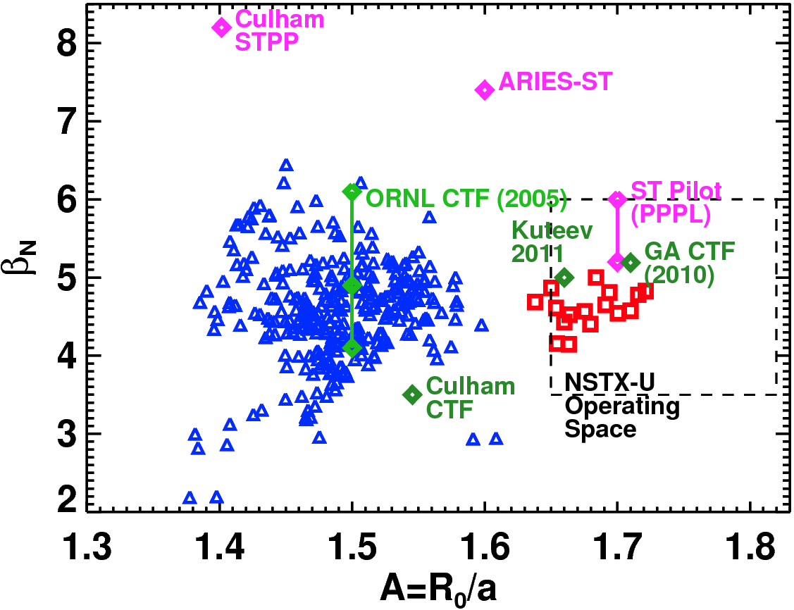
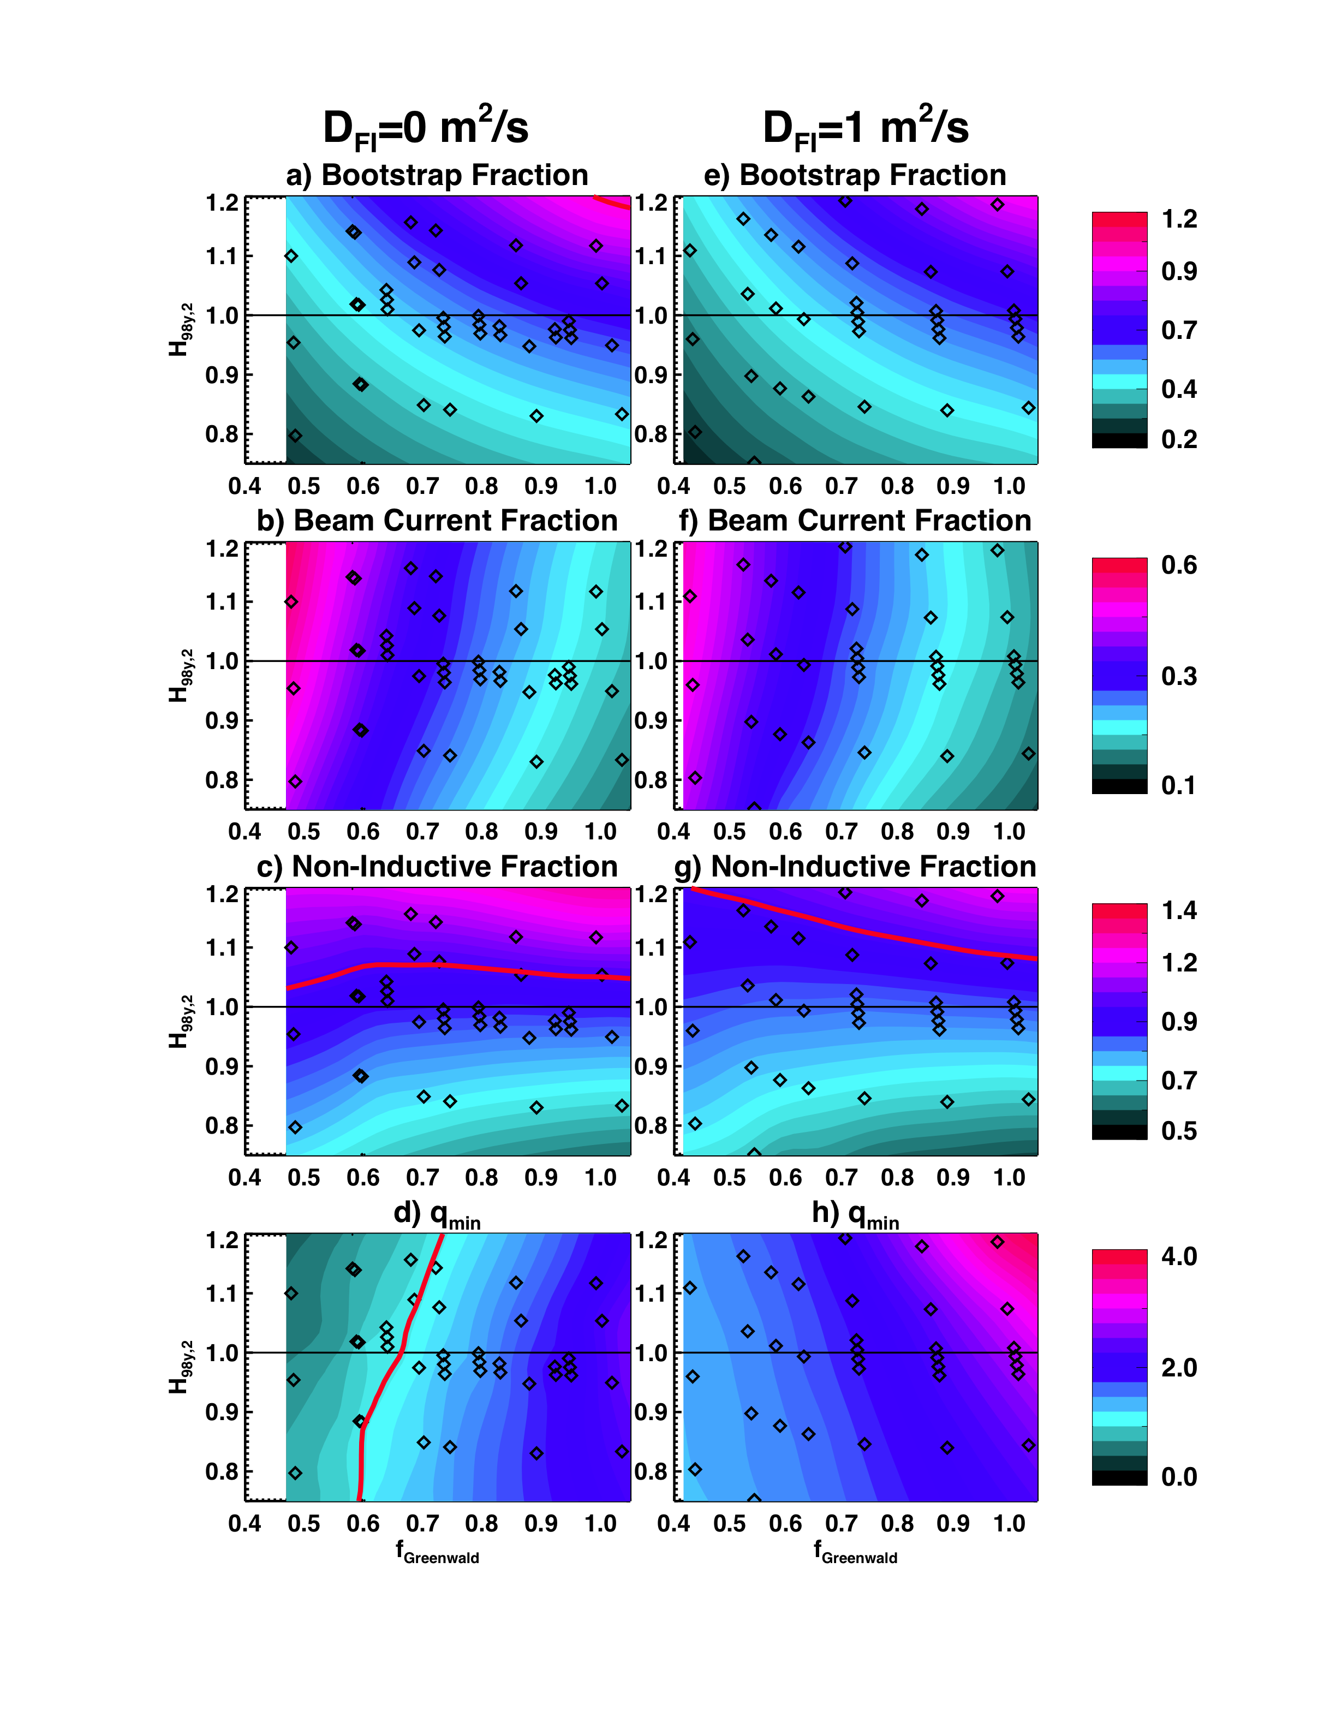
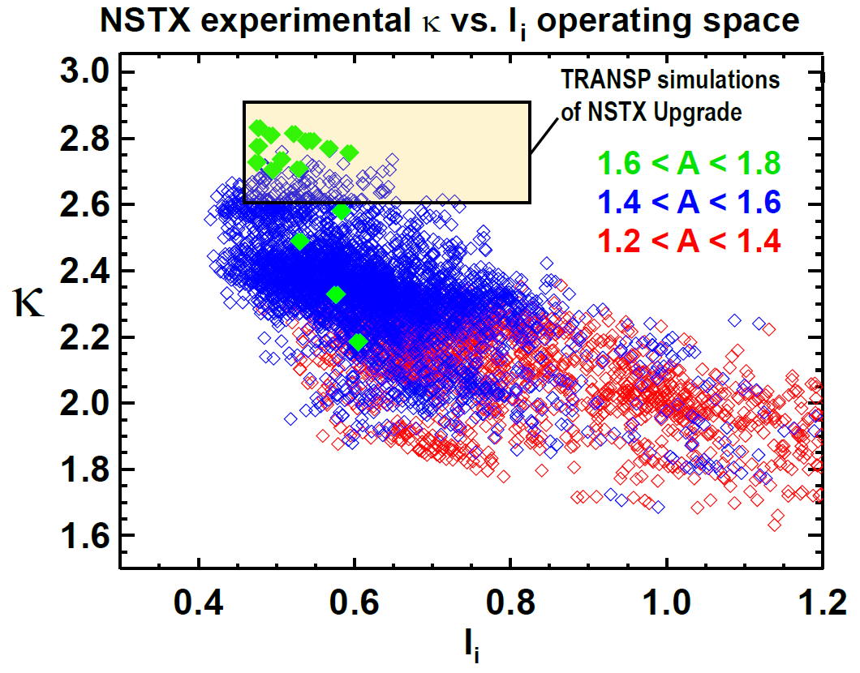
NSTX has already accessed the A, β_{N}, κ values needed for an ST-based FNSF – next step is to access 100% non-inductive
NSTX-U TRANSP predictions:
B_{T}=1.0 T, I_{P}=1 MA, P_{inj}=12.6 MW
Contours of Non-Inductive Fraction
Contours of q_{min}

Slide 41
Advanced Scenarios and Control (ASC) 5 Year Goal:
Develop basis for steady-state operation/control for next-step STs, help resolve key scenario and control issues for ITER
Thrust ASC-1: Scenario Physics
  Develop and assess 100% non-inductive operation
  Extend the high-current, partial-inductive scenarios to long-pulse
ASC-2: Axisymmetric Control Development
  Develop methods to control: heat flux for high-power scenarios, rotation and current profile control, improved shape and vertical position control
ASC-3: Disruption Avoidance By Controlled Plasma Shutdown
  Detect impending disruptions
  Develop techniques for automated termination
ASC-4: Scenario Physics for Next Step Devices
  Determine the optimal, simultaneous q- and rotation profiles
  Study the conditions for classical beam current drive
  Explore and validate integrated models for projections to FNSF

Slide 42
Thrusts strongly support all 5 high-level goals,
MS, TT, BP, ASC thrusts contribute most broadly
Demonstrate stationary 100% non-inductive at performance that extrapolates to ≥ 1MW/m² neutron wall loading in FNSF
Access reduced ν* and high-β combined with ability to vary q and rotation to dramatically extend ST plasma understanding
Develop and understand non-inductive start-up/ramp-up
to project to ST-FNSF operation with small or no solenoid
4. Develop and utilize high-flux-expansion “snowflake” divertor
and radiative detachment for mitigating very high heat fluxes
5. Begin to assess high-Z PFCs + liquid lithium to develop high-duty-factor integrated PMI solution for SS-PMI, FNSF, beyond
MS1 | MS2 | MS3 | TT1 | TT2 | TT3 | BP1 | BP2 | MP1 | MP2 | MP3 | EP1 | EP2 | RF1 | RF2 | PSR1 | PSR2 | ASC1 | ASC2 | ASC3 | ASC4
MS1 | MS2 | MS3 | TT1 | TT2 | TT3 | BP1 | BP2 | MP1 | MP2 | MP3 | EP1 | EP2 | RF1 | RF2 | PSR1 | PSR2 | ASC1 | ASC2 | ASC3 | ASC4
MS1 | MS2 | MS3 | TT1 | TT2 | TT3 | BP1 | BP2 | MP1 | MP2 | MP3 | EP1 | EP2 | RF1 | RF2 | PSR1 | PSR2 | ASC1 | ASC2 | ASC3 | ASC4
MS1 | MS2 | MS3 | TT1 | TT2 | TT3 | BP1 | BP2 | MP1 | MP2 | MP3 | EP1 | EP2 | RF1 | RF2 | PSR1 | PSR2 | ASC1 | ASC2 | ASC3 | ASC4
MS1 | MS2 | MS3 | TT1 | TT2 | TT3 | BP1 | BP2 | MP1 | MP2 | MP3 | EP1 | EP2 | RF1 | RF2 | PSR1 | PSR2 | ASC1 | ASC2 | ASC3 | ASC4

Slide 43
Outline
Review of PAC-33 charge
Performance requirements for next-steps
NSTX-U long-range research goals
Highest-priority facility enhancements
Overview of 5 year plan research thrusts
Contributions to ITER, predictive capability
Summary

Slide 44
NSTX has made, and NSTX-U will continue to make substantial contributions to ITER
MS: Plasma response effects in error field correction, kinetic effects on RWM, mode control and NTV, physics-based disruption warning system, novel disruption mitigation tests
TT/BP: ELM pacing with 3D fields (future: possible suppression or triggering w/ 3D fields or granules), impurity transport, SOL heat-flux-width scaling, divertor detachment physics
EP: Non-linear *AE avalanche dynamics and fast-ion transport + transport by 3D fields – highly relevant to burning plasmas
RF: Power coupling, edge power loss, interactions w/ fast-ions
ASC: Advanced integrated plasma control, contributions to disruption prediction-avoidance-mitigation framework
See talk by Stan Kaye for more details

Slide 45
Unique physics regimes + advanced diagnostics strongly support predictive capability development
MS: Kinetic MHD for RWM stability, plasma response and momentum transport from 3D fields (MISK, IPEC, POCA, VALEN, …)
TT: High-β/electromagnetic effects on electron transport from micro-tearing and Alfvenic instabilities (GYRO, GTS, …, HYM, ORBIT)
BP/MP: Edge kinetic neoclassical & turbulent transport (GENE, GS2, XGC0-1), SOL turbulence (SOLT), snowflake/detachment: neutrals, impurities (UEDGE, SOLPS, BOUT++, EIRENE, DEGAS2, DIVIMP)
EP: Gyro-center and full orbit following (ORBIT, SPIRAL), linear and non-linear Alfven instability,fast-ion transport (NOVA-K, M3D-K, HYM)
RF: heating, edge power loss (AORSA, TORIC, SPIRAL), RF/fast-ion interactions (hybrid FOW CQL3D), ECH/EBW heating & CD (GENRAY)
PSR/ASC: 2D/3D helicity injection physics (TSC, NIMROD), time-dependent ramp-up/sustainment modeling (TSC/TRANSP/NUBEAM)

Slide 46
Summary: NSTX-U 5 year plan makes leading contributions to fusion science, next-step applications
Provides ST (and assists AT) basis for next-steps and for ITER
  Implement actuators/controls for 100% non-inductive at high confinement, β
  Develop non-inductive formation and ramp-up - needed for ST, benefits AT
  Advance disruption warning/detection, explore novel disruption mitigation
Develop novel plasma-material-interface solutions for next-steps
  Lead in development of “snowflake”, combine with radiation, detachment
  Lead in use of liquid metals for recycling/erosion control, vapor-shielding
Uniquely contribute to toroidal confinement predictive capability
  Access non-linear AE instabilities relevant to ITER burning plasmas/DEMO
  High β + low ν EM effects on transport, potentially relevant to ITER pedestal

Slide 47
Agenda for remainder of PAC-33
M. Ono presentation on Upgrade Project and NSTX-U facility and diagnostics will describe tools and budget supporting the planned research program
S. Kaye presentation will provide overview of NSTX-U five year plan contributions to ITER
Topical Science Group (TSG) presentations will describe planned research thrusts supporting next-steps, ITER, and the development of predictive capability

Slide 48
Backup

Slide 49
Possible Charge Assessment Criteria
PAC could consider using the following criteria for evaluating the 5 year plan:
Assess the scientific and technical merit of the ongoing and planned research
  How well does it maintain a U.S. leadership position in key areas of fusion research? (consider both merit and originality)
  Does the research effectively address important issues in plasma and fusion energy science and technology at the forefront of the field?
  Is the research plan adequately developed and likely to lead to new or fundamental advances in fusion science and technology?
  Does the proposed research employ innovative concepts or methods, and are potential problems identified along with appropriate mitigation strategies?
B. Assess the importance and relevance of the proposed 5-year research program
  What is the likelihood of accomplishing the objectives stated in the proposal?
  What is the quality of integration of NSTX-U research with other national and international fusion research activities?

Slide 50
NSTX-U 5 Year Plan Well Aligned with FES 10 Year Vision
FES 10 Year Vision
NSTX-U 5 Year Plan
ITER Research
  U.S. has a strong research team hitting the ground on a completed ITER project in Cadarache. Team is capable of asserting world leadership in burning plasma science
Fusion materials science
  The U.S. has made strides in fusion materials science and passed critical metrics in tokamak and ST operations with national research teams. It is prepared to move beyond conceptual design of a fusion nuclear science facility
Extend the reach of plasma control science and plasma-wall interactions
  U.S. fusion research has successfully levered international research opportunities in long pulse plasma control science, plasma-wall interactions, and 3-D physics
Validated predictive capability
  The U.S. is a world leader in integrated computation, validated by experiments at universities and labs. Such computation should be transformational, as it must reduce the risks associated with fusion development steps
(E.J. Synakowski, APS-DPP 2012)
Non-linear AE* dynamics, fast-ion transport
Disruption warning, planned mitigation tests
Leading models of 3D δB, MHD stability/control
Developing future leaders for ITER/FNSF era
5 year plan goal is to establish physics and operational basis for ST-based FNSF
Establish J/Ω_{φ} profile + exhaust control, low-f MHD control enabled by advanced 3D coil set
Snowflake divertors, detachment, Li-based PFCs, SOL widths at very high power density
Collaboration with KSTAR, EAST, LHD
Provide data from unique parameter regime of high-β + low ν* for kinetic/3D MHD, core/edge turbulence, fast-ion transport by non-linear *AE

Slide 51
FES budget guidance for NSTX-U 5 year plan
Use FY2012 level as the base
  Regard FY2013 as an anomaly
For FY2014 and beyond, escalate the FY2012 budget in each successive year using ~2.5% inflation rate (“base funding”)
Include an over-target case that is ~10% higher than the baseline in each year (“incremental”)
Costs of facility upgrades in subsequent timelines are guesstimates
Substantial engineering analysis is needed to better define costs
However, the guesstimates do fit within the guidance budget profiles

Slide 52
Base FY13-15 research milestones emphasize analysis and simulation for NSTX-U, FNSF, ITER, + initial NSTX-U ops
FY2013
FY2014
FY2015
Expt. Run Weeks:
0
0
15
Macroscopic Stability
Assess access to reduced density
and ν* in high-performance scenarios (with ASC, BP TSGs)
Transport and Turbulence
Perform integrated physics+optical design of new high-k_{θ} FIR system
Assess H-mode τ_{E}, pedestal, SOL characteristics at higher B_{T}, I_{P}, P_{NBI} (with BP, M&P, ASC, WEP TSGs)
Boundary
Physics
Materials & PFCs
Assess relationship between lithium-conditioned surface composition and plasma behavior
Waves+Energetic Particles
Perform physics design of ECH & EBW system for plasma start-up & current drive in advanced scenarios
Assess reduced models for *AE mode-induced fast-ion transport
Assess effects of NBI injection on fast-ion f(v) and NBI-CD profile (with SFSU, MS, ASC TSGs)
Solenoid-free Start-up/ramp-up
Adv. Scenarios and Control
Assess advanced control techniques for sustained high performance (with MS, BP TSGs)
Develop physics+operational tools for high-performance discharges (with CC, ASC, MS, BP, M&P TSGs)
ITER Needs + Cross-cutting
Identify disruption precursors and disruption mitigation & avoidance techniques for NSTX-U and ITER
Joint Research Target (3 facility)
Stationary regimes w/o large ELMs, improve understanding of increased edge particle transport
Quantify plasma response to non-axisymmetric (3D) magnetic fields in tokamaks
TBD

Slide 53
in FY2014-15 would enhance NSTX-U facility utilization, accelerate start-up/ramp-up + snowflake
Incremental funding
FY2013
FY2014
FY2015
Expt. Run Weeks:
0
0
14
20
Macroscopic Stability
Assess access to reduced density
and ν* in high-performance scenarios (with ASC, BP TSGs)
Transport and Turbulence
Perform integrated physics+optical design of new high-k_{θ} FIR system
Assess H-mode τ_{E}, pedestal, SOL characteristics at higher B_{T}, I_{P}, P_{NBI} (with BP, M&P, ASC, WEP TSGs)
Boundary
Physics
Develop snowflake configuration, study edge and divertor properties
(with ASC, TT, MP)
Materials & PFCs
Assess relationship between lithium-conditioned surface composition and plasma behavior
Waves+Energetic Particles
Perform physics design of ECH & EBW system for plasma start-up & current drive in advanced scenarios
Assess reduced models for *AE mode-induced fast-ion transport
Assess effects of NBI injection on fast-ion f(v) and NBI-CD profile (with SFSU, MS, ASC TSGs)
Solenoid-free Start-up/ramp-up
Assess CHI + HHFW start-up at higher field + NBI current ramp-up (with WEP, ASC TSGs)
Adv. Scenarios and Control
Assess advanced control techniques for sustained high performance (with MS, BP TSGs)
Develop physics+operational tools for high-performance discharges (with CC, ASC, MS, BP, M&P TSGs)
ITER Needs + Cross-cutting
Identify disruption precursors and disruption mitigation & avoidance techniques for NSTX-U and ITER
Joint Research Target (3 facility)
Stationary regimes w/o large ELMs, improve understanding of increased edge particle transport
Quantify plasma response to non-axisymmetric (3D) magnetic fields in tokamaks
TBD

Slide 54
10 year plan tools with 5YP incremental funding
1.1 × (FY2012 + 2.5% inflation)
2014 | 2015 | 2016 | 2017 | 2018 | 2019 | 2020 | 2021 | 2022 | 2023
Upgrade Outage
1.5 → 2 MA, 1s → 5s
Metallic PFCs, 5s → 10-20s
Start-up and Ramp-up
Upgraded CHI for ~0.5MA
0.5-1 MA CHI
New
center-stack
Extend NBI duration to 10-20s and/or implement 2-4 MW off-axis EBW H&CD
up to 1 MA plasma gun
ECH/EBW
1MW
2 MW
Boundary Physics
Lower divertor cryo-pump
Diagnostics for high-Z wall studies
Inform U.S.
next-step conceptual design including aspect ratio and divertor optimization
Divertor Thomson
Materials and PFCs
High-Z tile row on lower OBD
Lower high-Z divertor
U + L high-Z divertors
All high-Z PFCs
Hot high-Z FW PFCs using bake-out system
Liquid
metals / lithium
Upward
LiTER
LLD using bakeable cryo-baffle
Flowing Li divertor
or limiter module
Full toroidal flowing Li divertor
Li granule injector
MGI disruption mitigation
Partial NCC
Full NCC
NCC SPA upgrade
MHD
Enhanced MHD sensors
Transport & Turbulence
δB polarimetry
DBS, PCI, or other intermediate-k
High k_{θ}
Waves and Energetic Particles
HHFW limiter upgrade
HHFW straps to excite EHO
High-power AE antenna
2nd NBI
1 coil AE antenna
4 coil AE antenna
Neutron-collimator, fusion source profile array
Scenarios and Control
Establish control of:
Control integration, optimization
Control integration, optimization with long-pulse and full metal wall
n_{e}
q_{min}
Divertor P_{rad}
Snowflake
Rotation

Slide 55
5 year plan tools with 5YP base funding
(FY2012 + 2.5% inflation)
2014 | 2015 | 2016 | 2017 | 2018
Upgrade Outage
1.5 → 2 MA, 1s → 5s
Upgraded CHI for ~0.5MA
Cryo-pump, high-Z tile row on cryo-baffle, and partial NCC would be installed in-vessel during ~1 year outage between FY2016 and FY2017
  NSTX-U would operate 1st half of FY2016 and 2nd half of FY2017
Start-up and Ramp-up
New
center-stack
Up to 0.5 MA plasma gun
ECH/EBW
1MW
Boundary Physics
Lower divertor cryo-pump
Materials and PFCs
High-Z tile row on lower OBD
High-Z tile row on cryo-baffle
Lower high-Z divertor
Liquid
metals / lithium
Upward
LiTER
LLD using bakeable cryo-baffle
Li granule injector
MHD
MGI disruption mitigation
Partial NCC
Enhanced MHD sensors
Tool technical detail provided in M. Ono’s presentation (next)
Transport & Turbulence
δB polarimetry
High k_{θ}
Waves and Energetic Particles
HHFW limiter upgrade
2nd NBI
1 coil AE antenna
4 coil AE antenna
Scenarios and Control
Establish control of:
n_{e}
q_{min}
Snowflake
Rotation
Divertor P_{rad}

Slide 56
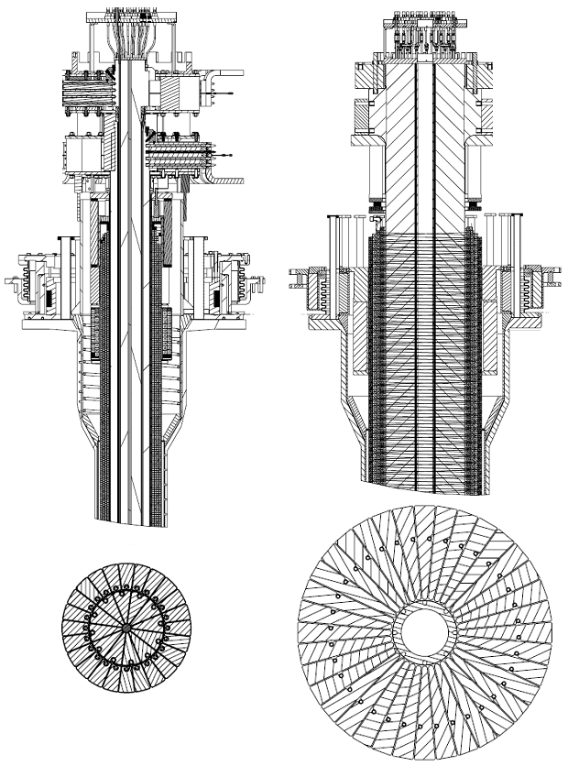


NSTX Upgrade will address critical plasma confinement and sustainment questions by exploiting 2 new capabilities
Previous
center-stack
New
center-stack
ST-FNSF
constant q, β, ρ∗
2x higher B_{T} and I_{P} increases T, reduces ν* toward ST-FNSF to better understand confinement
  Provides 5x longer pulses for profile equilibration, NBI ramp-up
NSTX Upgrade
?
ITER-like scaling
TF OD = 20cm
TF OD = 40cm
Normalized e-collisionality ν_{e}* ∝ n_{e} / T_{e}²
I_{P}=0.95MA, H_{98y2}=1.2, β_{N}=5, β_{T} = 10%
B_{T} = 1T, P_{NBI} = 10MW, P_{RF} = 4MW
  2x higher CD efficiency from larger tangency radius R_{TAN}
100% non-inductive CD with q(r) profile controllable by:
  tangency radius, density, position
n
e
/
n
Greenwald
0.95
0.72
R_{TAN} [cm]
__________________
50, 60, 70, 130
60, 70,120,130
70,110,120,130
Present NBI
New 2nd NBI
J. Menard, et al., Nucl. Fusion 52 (2012) 083015

