Slide 1




NSTX-U
Supported by
NSTX-U 5 Year Plan for Non-axisymmetric Control Coil (NCC) Applications
J.-K. Park,
J. W. Berkery, A. H. Boozer,
J. M. Bialek, S. A. Sabbagh, T. E. Evans,
S. P. Gerhardt, J. E. Menard
for the NSTX Research Team
Coll of Wm & Mary
Columbia U
CompX
General Atomics
FIU
INL
Johns Hopkins U
LANL
LLNL
Lodestar
MIT
Lehigh U
Nova Photonics
ORNL
PPPL
Princeton U
Purdue U
SNL
Think Tank, Inc.
UC Davis
UC Irvine
UCLA
UCSD
U Colorado
U Illinois
U Maryland
U Rochester
U Tennessee
U Tulsa
U Washington
U Wisconsin
X Science LLC
Culham Sci Ctr
York U
Chubu U
Fukui U
Hiroshima U
Hyogo U
Kyoto U
Kyushu U
Kyushu Tokai U
NIFS
Niigata U
U Tokyo
JAEA
Inst for Nucl Res, Kiev
Ioffe Inst
TRINITI
Chonbuk Natl U
NFRI
KAIST
POSTECH
Seoul Natl U
ASIPP
CIEMAT
FOM Inst DIFFER
ENEA, Frascati
CEA, Cadarache
IPP, Jülich
IPP, Garching
ASCR, Czech Rep
NSTX-U PAC-33
B318, PPPL
February 19-21, 2013

Slide 2
Motivation
The use of 3D fields to control error fields, RWMs, momentum (rotation), and particle/heat transport is essential to meet NSTX-U programmatic/TSG goals and support ITER
  Access reduced ν* and high-β combined with ability to vary q, rotation
  Error fields: To control LMs and TMs at low collsionality
  Rotation: To improve micro-to-macro stability
  Particle/heat: To modify pedestal, edge stability, divertor flux
  RWMs: To achieve high-β advanced operation with active control
Proposed non-axisymmetric control coils (NCC), if combined with present RWM/EFC, will be a unique and powerful 3D tool for future STs as well as tokamaks

Slide 3
Outline
Proposed NCC geometry for NSTX-U
  Partial and full choices for NCC
Comparison of partial/full NCCs using Figures-Of-Merit
  Error field control
  Rotation control
  RMP for ELM control
  RWM active control
Summary
  Coil performance comparison table
Future plan for analysis

Slide 4
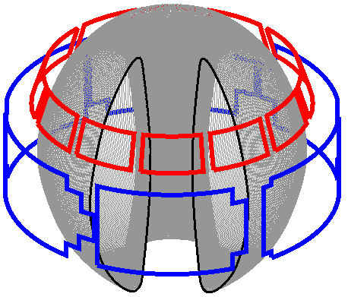
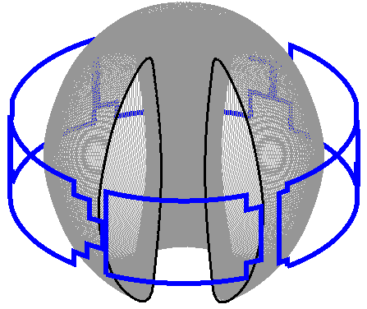
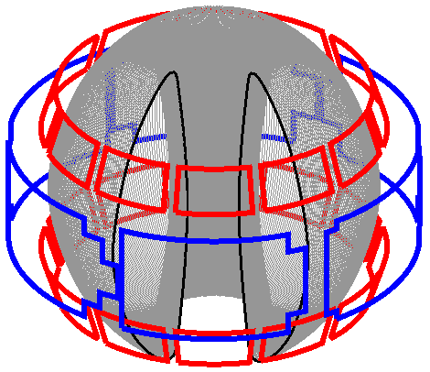
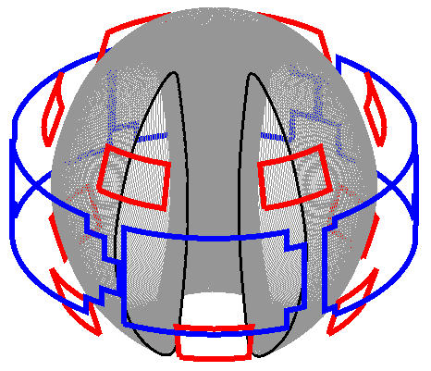
A range of off-midplane NCC coil configurations is being assessed for potential physics capabilities
NCC proposal: Use two off-midplane rows of 12 coils toroidally
  To produce rich poloidal spectra for n=1 – 6
  To rotate n=1 – 4
  Poloidal positions of 2x12 coils have been selected based on initial studies
Partial NCCs are also under active investigation
  Anticipate possible staged installation to the full 2x12
  3 best options are presented here and compared with existing midplane coils
12U
Midplane
2x12
2x6-Odd

Slide 5
Figures-Of-Merit for EF/NTV/RMP/RWM have been analyzed with partial/full NCCs for NSTX-U
Various combinations of targets and coils have been investigated
  NSTX-U target plasmas: TRANSP
  Stability analysis: DCON
  3D equilibrium analysis: VAC3D and IPEC
  NTV analysis: Combined NTV
  RWM analysis: VALEN3D
Figures-Of-Merit defined for each physics element
  Error field control: NTV per resonant field
  Quantifies selectivity of non-resonant vs. resonant field
  Rotation control: Core NTV per Total NTV
  Quantifies controllability of rotation by NTV braking
  RMP for ELM control: NTV per Chirikov
  Quantifies edge particle/heat control without affecting core
  RWM active control: β Gain
  Quantifies high-β advanced operation

Slide 6
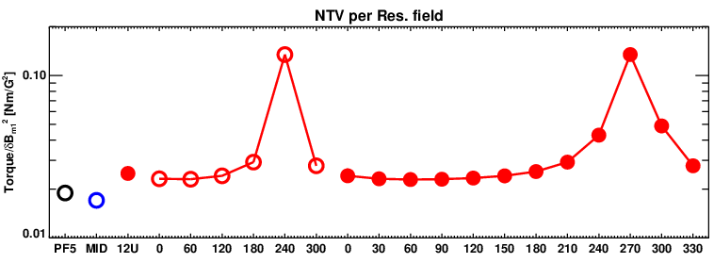
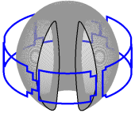
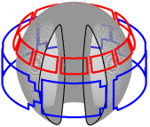
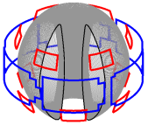
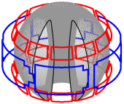
Selectivity of n=1 non-resonant field vs. resonant field can be greatly enhanced with partial NCCs
Figure of Merit for error field control: NTV per resonant field
  High FOM is good for the field application without locking or
  tearing excitation
  Variability of FOM can be advantageous for error field physics study
FOM can be largely enhanced with 2x6-Odd, comparable to 2x12
PF5-error
MID
12U
2x6-Odd
2x12
Phase difference for 2x6-Odd
Phase difference for 2x12
* Combinations of EFC to NCC are not shown here

Slide 7
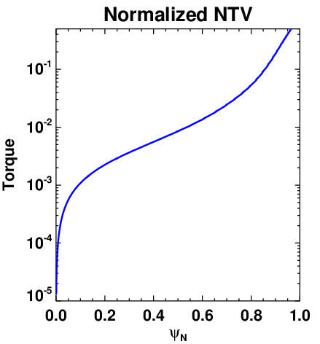
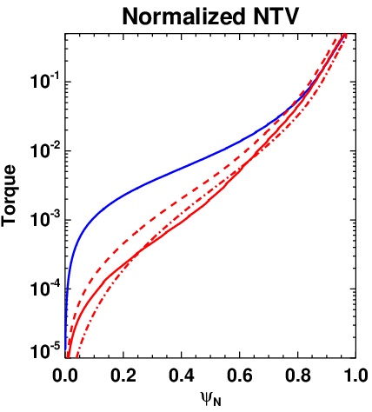
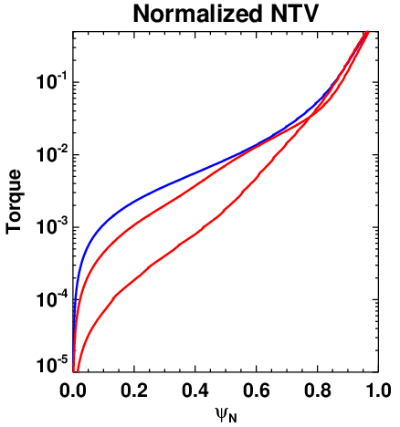
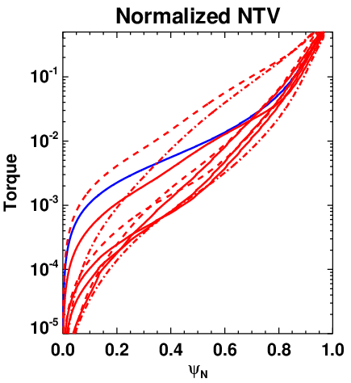
Controllability of rotation by NTV braking can be enhanced slightly by 2x6, and largely by 2x12
Figure of Merit for rotation control: Core to total NTV
  Variability of FOM is good for rotation profile and
  rotation shear control
Variability of core NTV braking can be slightly enhanced by 2x6-Odd, but will be greatly increased by 2x12
MID
12U
2x6-Odd
2x12
EFC n=3
12U n=3
12U n=4
12U n=6
EFC n=3
2x12 n=3
2x12 n=4
2x12 n=6
EFC n=3
2x6-Odd n=3
EFC n=3
* Same line types are used when only phases between upper and lower coils are different
* Combinations of EFC to NCC are not shown here

Slide 8
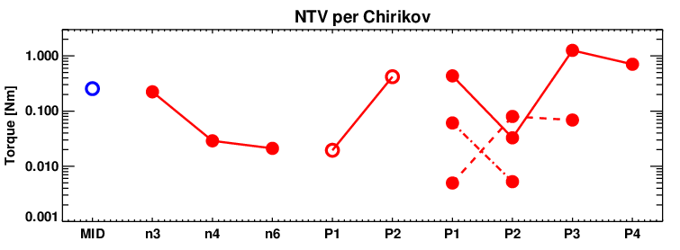
RMP characteristics can be improved by 1x12 or 2x6, and even more refined by 2x12
Figure of Merit for RMP: NTV when Chirikov=1 is achieved
  Low FOM is good since it is important to access Chirikov=1
  without driving 3D neoclassical transport
  Variability of FOM can be advantageous for RMP physics study
NTV can be reduced by 1x12 or 2x6, and can be even be decreased by up to an order of magnitude by n=4 and n=6 in 2x12
n=3
n=3
n=3
n=4
MID
12U
2x6-Odd
n=6
2x12
12U
Phase difference 2x6-Odd
Phase difference 2x12
* Combinations of EFC to NCC are not shown here

Slide 9
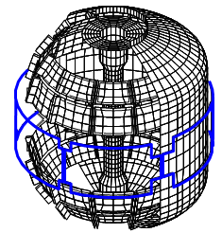
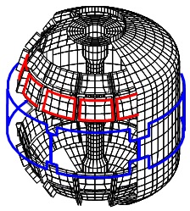
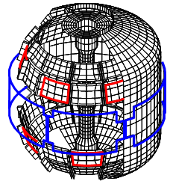
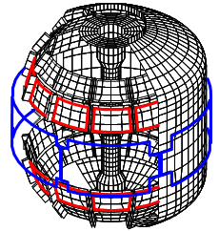
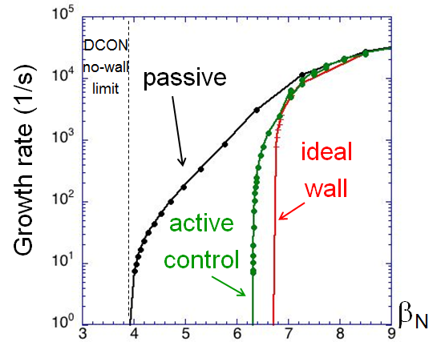
RWM control capability increases and physics studies are expanded as NCC coils are added
Figure of Merit for RWM control: β gain over marginal stability
  High FOM is good for sustained high-β operation
RWM control performance increases as NCC coils are added
  Full 2x12 option: very close to the ideal-wall limit
Midplane
12U
2x6-Odd
2x12
β_{N} = 4.9 ; F_{β} = 1.25
β_{N} = 6.1 ; F_{β} = 1.54
β_{N} = 6.3 ; F_{β} = 1.61
β_{N} = 6.6 ; F_{β} = 1.70

Slide 10
Summary of analysis
Figures-Of-Merit analyses indicate 2x6-Odd is more favorable than 12U for error field, rotation control, RMP, RWM control
  12U can provide high-n rotating capability, but poloidal spectrum is too limited to give good FOM
Figures of Merit | Favorable values | MID | 12U | 2x6-Odd | 2x12
EF (n=1) | High F_{N-R} | 0.017 | 0.025 | 0.13 | 0.13
 | Wide ΔF_{N-R} | 1.00 | 1.00 | 5.65 | 5.65
NTV (n≥3) | Wide ΔF_{N-N} | 1.00 | 2.00 | 3.97 | 19.6
RMP (n≥3) | Small F_{N-C} | 0.25 | 0.021 | 0.019 | 0.005
 | Wide ΔF_{N-C} | 1.00 | 10.5 | 22.1 | 252
RWM (n=1) | High F_{β} | 1.25 | 1.54 | 1.61 | 1.70

Slide 11
Future analysis plans
Additional configurations will be investigated
  Combined coil configurations between NCCs and EFC, including different Ampere-turn ratios, and with constraint of only 6 independent power supplies
  Target plasmas with different q_{min} and q-shear
  VALEN3D calculations of conceptual design of optimized sensors for RMP control
Important coil configurations will be identified based on FOM and coupled with varied collisionality and rotation
  Present IPEC-NTV calculations will be performed
  NTVTOK, MISK, MARS-K calculations will be added
Advanced computations will be performed for selected coil configurations, target plasmas, kinetic profiles
  POCA will be used for selected cases
  FORTEC3D or XGC0 can be tested for a few limited cases

Slide 12
Back up

Slide 13
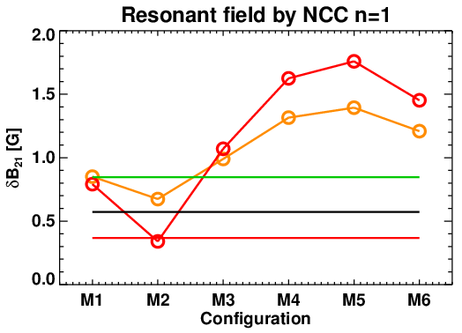
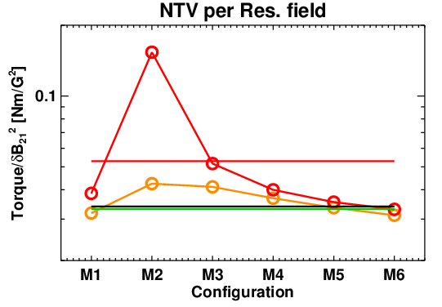
1x6 array can provide large selectivity of non-resonant to resonant field
1x6 PPU array produces comparable resonant field per currents with very different non-resonant field contents
“Non-resonant field selectivity”, defined by NTV torque per (dB₂₁)², can be varied by an order of magnitude if PPU and EFC currents are optimized
  This capability is essential to understand “non-resonant error field” effects on locking and tearing in tokamaks including ITER
MS
ITPA WG9
2xPPU+EFC
Highly non-resonant
PPU+EFC
EFC
PF5
PPU
Resonant
Phase difference between PPU and EFC n=1
Phase difference between PPU and EFC n=1
*PPU currents per EFC (1kAt is the base) should be further optimized (Likely more than 2)

Slide 14
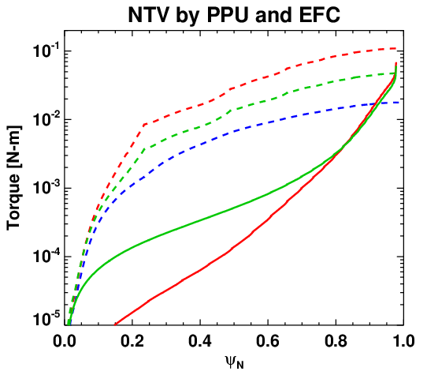
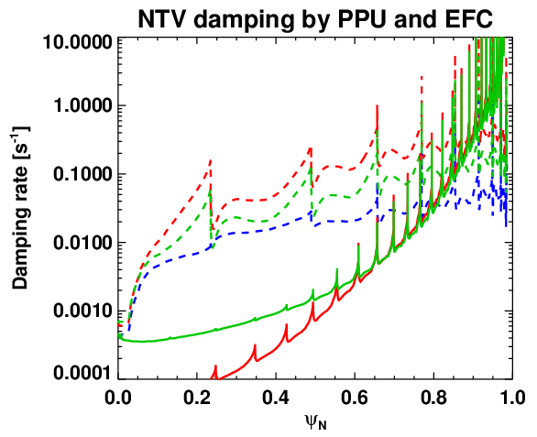
Local rotation control will be possible to large extents if n=1 and n=3 PPU+EFC are utilized
1x6 PPU, when combined with EFC, can produce spatially very different NTV braking profiles
Local control of rotation and rotation shear will be possible to large extents if combined with off-axis NBI beams
  This capability is essential to achieve advance control of macroscopic to microscope instabilities
MS, TT, EP
n=1 2xPPU+EFC (M5)
n=1 EFC
n=1 2xPPU+EFC (M2)
n=3 EFC
n=3 PPU
*Note torque profile is the integrated torque from the core
*Note damping profiles assume NTV alone, but should be combined with NBI and momentum diffusion model

Slide 15
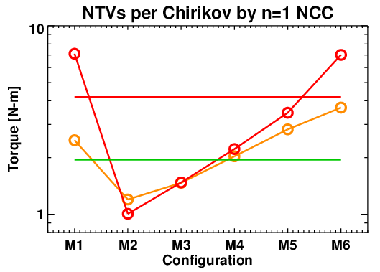
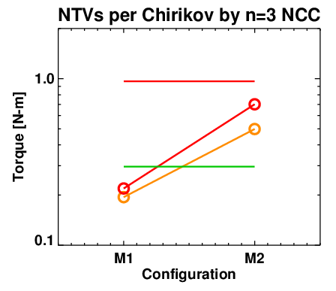
PPU can increase figure of merits for RMP, which can be tested against ELM triggering capability
1x6 PPU, when combined with EFC, can meet Chirikov overlap criteria with various NTV braking characteristics
  Figure of merit can be defined by NTV when Chirikov overlap parameter = 1
Wide range of figure of merit can be produced when PPU is optimized with EFC, and can be tested for ELM modification
  n=1 can give 1~10, and n=3 can give 0.1~1.0 Nm per Chirikov
  ELM triggering vs. suppression threshold can be studied
BP
2xPPU+EFC
PPU
EFC
PPU+EFC
Phase difference between PPU and EFC n=1
Phase difference between PPU and EFC n=3

Slide 16
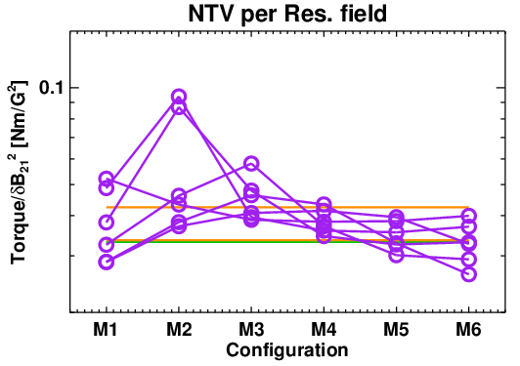
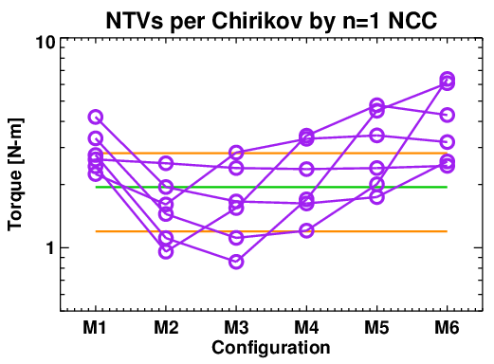
Another 6-array can largely extend n=1 and n=3 field selectivity, rotation controllability, FOMs
Another 6-array can largely extend “non-resonant” and “resonant field selectivity” by changing alignment between fields to resonant helical pitch
RMP figure of merit can be also further increased or decreased
  Particularly 2x6 is essential to decrease torque/dB₂₁², and thus increase “resonant field selectivity”, and also to decrease torque per Chirikov
Optimized currents are expected to greatly improve n=1 capability
MS, BP
B+EFC
Different phase between PPU and PPL
B+EFC
PPU+EFC
EFC
PPU+EFC
Highly resonant for core
Highly resonant for edge
Phase difference between PPU and EFC n=1
Phase difference between PPU and EFC n=1
*All coils are in the same currents (1kAt is the base) and ratio is not optimized

Slide 17
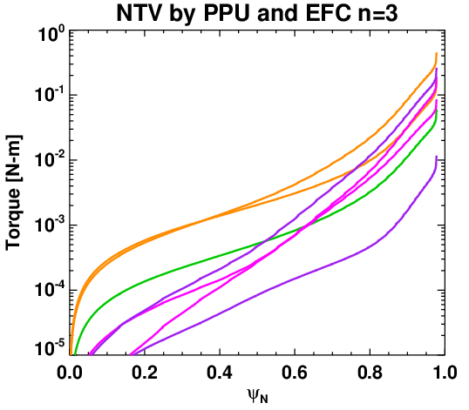
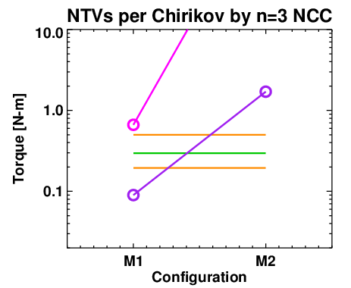
2x6 array, if optimized (B#), NTV braking controllability and RMP FOM variability can be largely enhanced
2x6 array can increase NTV braking controllability when option B# is used and EFC is nulled or optimized
Option B is also effective to produce good RMP, by decreasing NTV per Chirikov
MS, TT, EP
BP
PPU+EFC
A+EFC
B+EFC
EFC
Phase difference between PPU and PPL n=3
Highly resonant with edge
*Note torque density profile for n≥3 is always peaked in the edge for these examples, which means that rotation profile will be primarily scaled down by momentum diffusion, but other q-profile equilibrium can be different

Slide 18
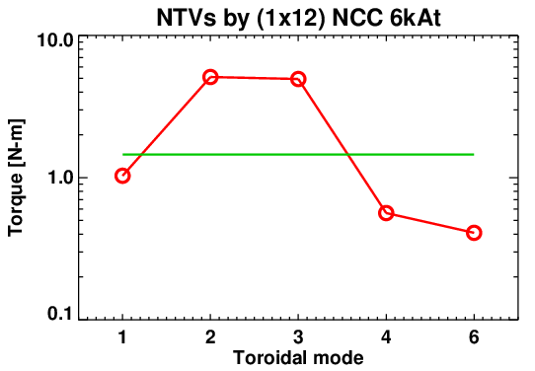
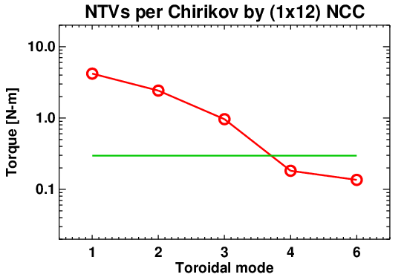
1x12 array NCC will be important to explore n≥3 spectral variations and rotation capability
1x12 upper array alone can enhance rotation controllability and RMP characteristics using natural attenuation of high toroidal harmonics
ITER aims n≥3, and 12 toroidal array will allow detailed n≥3 physics studies with 3D diagnostics by field rotation
Preliminary studies for full NCC with 2x12 (without combined with EFC) showed an-order-of-magnitude variation in rotation and RMP FOM can be easily produced
MS, TT, EP, BP
EFC
EFC
Naturally becomes edge resonant

Slide 19
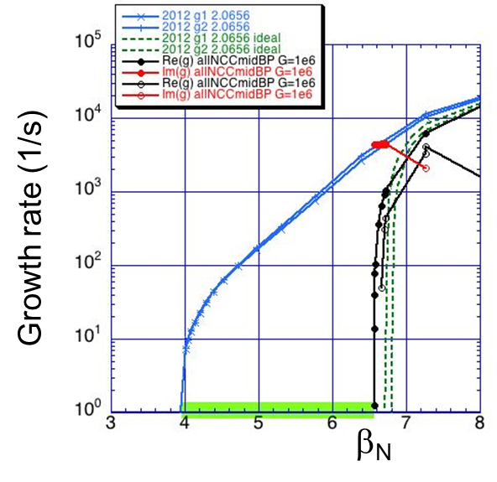
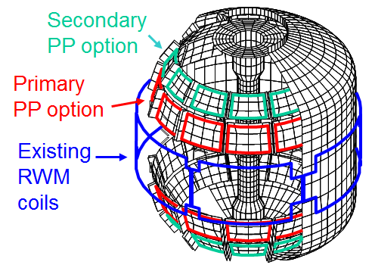
Full NCC can provide high-β advanced operation near ideal-wall limit by active RWM control
Full NCC, if combined with idealized sensors, will allow high-β advanced operation even near ideal-wall limit by active RWM control
  Idealized sensors: RWM control up to β/ β_{no-wall} = 1.70 ~ ideal wall limit
  Present sensors: lower performance, but can be optimized with state-space controller
MS, ASC
J. Bialek, S. Sabbagh
RWM by NCC
Ideal wall limit

