Slide 1




NSTX-U
Supported by
NSTX-U 5 Year Plan for Transport and Turbulence
Coll of Wm & Mary
Columbia U
CompX
General Atomics
FIU
INL
Johns Hopkins U
LANL
LLNL
Lodestar
MIT
Lehigh U
Nova Photonics
Old Dominion
ORNL
PPPL
Princeton U
Purdue U
SNL
Think Tank, Inc.
UC Davis
UC Irvine
UCLA
UCSD
U Colorado
U Illinois
U Maryland
U Rochester
U Tennessee
U Tulsa
U Washington
U Wisconsin
X Science LLC
Yang Ren
Walter Guttenfelder
Gregory W. Hammett
for the NSTX-U Research Team
Culham Sci Ctr
York U
Chubu U
Fukui U
Hiroshima U
Hyogo U
Kyoto U
Kyushu U
Kyushu Tokai U
NIFS
Niigata U
U Tokyo
JAEA
Inst for Nucl Res, Kiev
Ioffe Inst
TRINITI
Chonbuk Natl U
NFRI
KAIST
POSTECH
Seoul Natl U
ASIPP
CIEMAT
FOM Inst DIFFER
ENEA, Frascati
CEA, Cadarache
IPP, Jülich
IPP, Garching
ASCR, Czech Rep
NSTX-U PAC-33 Meeting
PPPL – B318
February 19-21, 2013

Slide 2
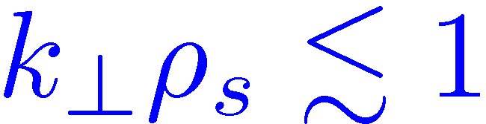
NSTX-U T&T 5 Year Plan will Address Crucial Transport Needs of FNSF and ITER
The goal of NSTX-U T&T research aims to establish predictive capability for the performance of FNSF and future devices
  NSTX-U is unique in achieving high β and low collisionality regime
Thrust 1: Characterize H-mode global energy confinement scaling in the lower collisionality regime of NSTX-U
Thrust 2: Identify regime of validity for instabilities responsible for anomalous electron thermal, momentum, and particle/impurity transport in NSTX-U
  Low-k modes ( ): ITG/TEM/KBM, microtearing
  High-k mode: ETG
  Alfven eigenmodes: CAE/GAE
Thrust 3: Establish and validate reduced transport models

Slide 3
Outline
A summary of acronyms used in presentation
Plans for NSTX-U T&T TSG activities in FY14
FY15-18 operational plans for thrusts 1-3
Summary

Slide 4
A Summary of Acronyms (SoA)
Instabilities
  ITG – ion temperature gradient, electrostatic
  TEM – trapped electron mode, electrostatic
  KBM – kinetic ballooning mode, electromagnetic
  MT – microtearing, electromagnetic
  ETG – electron temperature gradient, electrostatic
  CAE – compressional Alfven eigenmode, electromagnetic
  GAE – global Alfven eigenmode, electromagnetic
Codes
  GYRO – an eulerian gyrokinetic code
  GTS – global particle-in-cell Gyrokinetic Tokamak Simulation (GTS) code
  GENE – Gyrokinetic Electromagnetic Numerical Experiment (GENE) code
  XGC1 –full-f global particle-in-cell gyrokinetic code
  TGLF – an gyro-Landau-fluid code
  MMM08 – multi-mode anomalous transport model
  NCLASS – a local neoclassical transport code
  NEO – a local eulerian neoclassical transport code
  GTC-NEO –a global particle-in-cell neoclassical transport code
  HYM – nonlinear 3-D HYbrid and MHD simulation code (HYM)
  TRANSP – a time dependent tokamak transport and data analysis code with free boundary and multi-zone predictive capability
  TGYRO – a transport solver
  MIST – Multi-Ionic Species Transport (MIST) code
  STRAHL – an impurity transport code
  DEGAS2– a neutral transport code
Diagnostics
  BES – beam emission spectroscopy (BES)
  CHERS – charge exchange recombination spectroscopy (CHERS)
  ME-SXR –multi-energy soft X-ray (ME-SXR)

Slide 5
NSTX-U T&T TSG Activities in FY14 will Focus on Preparation for NSTX-U Operation
Continue analyzing existing data, coupled with GK simulations
  BES, k_{r} backscattering, High-k scattering, reflectometry, ME-SXR
  Identifying experiments for NSTX-U and preparing data analysis tools (BES, high-k scattering, neural network for fast T_{e} profile analysis using ME-SXR data)
Continue simulation and modeling for NSTX and NSTX-U
  Testing of transport models (TGLF, MMM08, etc...) in transport solvers (TRANSP, TGYRO) for T_{e} and T_{i} predictions in a variety of NSTX scenarios
    Validating model growth rates and fluxes with linear and nonlinear gyrokinetics
  First attempt in predicting core electron thermal transport in NSTX-U by coupling ORBIT code with HYM CAE/GAE mode calculations
  Further gyrokinetic simulations for NSTX-U, e.g. GTS with kinetic electrons
Prepare turbulence and transport diagnostics
  Integrated bench testing of high-k scattering system
  BES system with additional channels
  One channel ¹-wave polarimetry system (NSTX/DIII-D, back to NSTX-U)
  ME-SXR diagnostic design optimization for NSTX-U
  Collaboration with EAST on ME-SXR and FTU on high-Z impurity transport

Slide 6
T&T Plans for FY15-18 will Exploit the Enhanced Capabilities of NSTX-U to Substantially Advance Physics Basis for Future Devices
Expanded operational capabilities of NSTX-U
  Double B_{T}, I_{p} and NBI heating power and cryopump (lower collisionality)
  More tangential 2nd NBI and partial NCC (q and flow profile modification)
  Fully relaxed plasmas and fully non-inductive scenario
Turbulence diagnostics covering ion and electron gyro-scale
  BES with a total of 48 detecting channels for low-k and AE measurement
  One channel polarimeter aiming to measure magnetic fluctuations
  16-channel reflectometer measuring density fluctuations
  A FIR high-k scattering system measuring k_{µ} spectrum
Couple with a variety of data analysis and modeling tools
  Power balance analysis/Transport solver: TRANSP, TGYRO
  Gyrokinetic (GK) codes: GENE, GS2, GTS, GYRO, XGC1
  Neoclassical and reduced models: GTC-NEO, NCLASS, NEO, TGLF
  Impurity transport codes: MIST, STRAHL
  Neutral transport code: DEGAS2

Slide 7
Thrust 1: Characterize H-mode global energy confinement scaling in the lower collisionality regime of NSTX-U

Slide 8
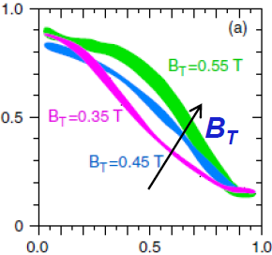
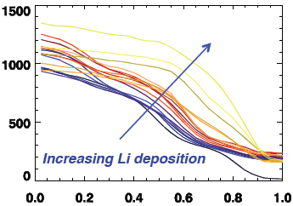
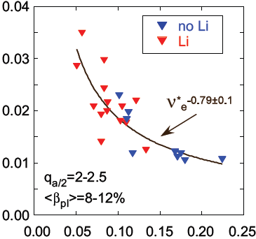
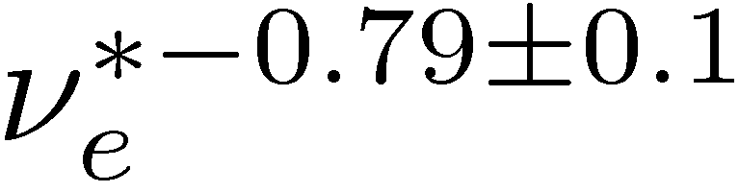
Inverse ν_{e}* Confinement Scaling is Found to Unify NSTX Boronized and Lithiated H-mode Confinement Results
T_{e} broadening is an important element for ν_{e}* reduction
  Correlated with B_{T} without Li
  Correlated with Lithium deposition
Observed ν_{e}* scaling reconciles NSTX boronized and lithiated H-mode plasma dimensional scalings
  ~B_{T}^{0.85} and ~I_{p}^{0.38} without Li
  ~B_{T}^{-0.09} and ~I_{p}^{0.94} with Li
NSTX-U will investigate if this scaling extends to even lower ν_{e}*, i.e. a factor of 3-6 reduction
  Lower ν_{e}* stabilizing for microtearing,
  ETG not sensitive to ν_{e}*
T_{e} (keV)
T_{e} (eV)
r/a
ν_{e}* (@ r/a=0.5)
destabilizing to TEM/KBM

Slide 9
NSTX-U will Address ST Confinement Scaling in the Regime more Relevant to Future STs (Thrust 1)
Near-term plan for FY15-16
  Re-establish and extend confinement scaling to lower ν_{e}* with higher B_{T}, I_{P} and NBI power
    B_{T}/I_{P} ≤ 0.8 T/1.6 MA in FY15 and 1.0 T/2 MA in FY16
  Compare I_{p} and B_{T} scaling to the different scalings found on NSTX
  Characterize confinement scaling with different PFC materials
    Carbon vs high-Z
  Project 0D performance for future STs with expanded empirical confinement scaling
NSTX-U FY15 milestone (R15-2):
  Assess H-mode energy confinement, pedestal and scrape off layer characteristics with higher B_{T}, I_{P} and NBI heating power
Long-term plan for FY17-18
  Characterize confinement scaling for
    Fully relaxed plasmas
    Advanced scenarios, e.g. fully non-inductive discharges, as they are developed
  Decouple ν_{e}* and ½* dependence of global confinement with density control from cryopump

Slide 10
Thrust 2: Identify regime of validity for instabilities responsible for anomalous electron thermal, momentum, and particle/impurity transport in NSTX-U

Slide 11
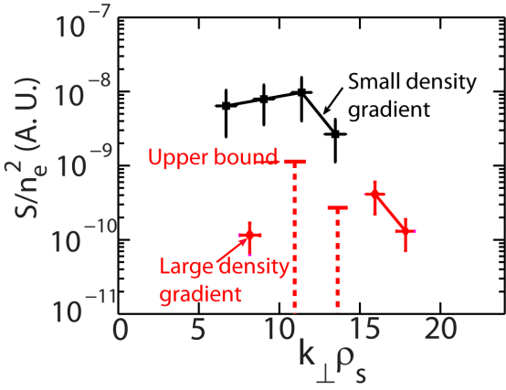
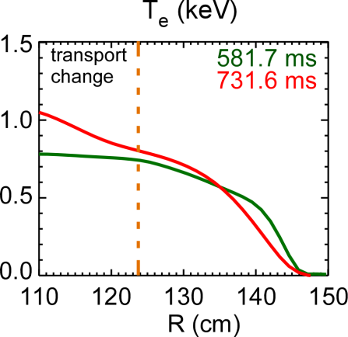
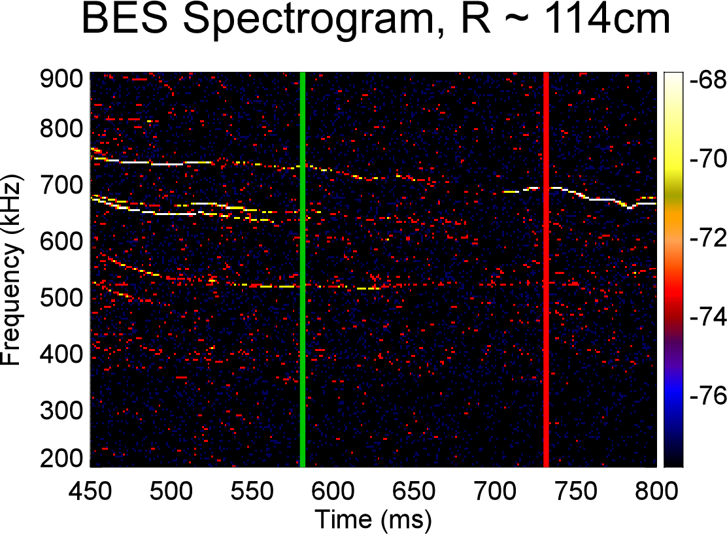
T&T Research on NSTX has Gained Insight into Underlying Mechanisms behind Thermal Transport
Ion thermal transport is close to neoclassical in NSTX H-mode plasmas
  Anomalous in L-mode plasmas
Electron channel dominates the thermal transport in most regimes
  Predicted dominant electron heating in NSTX-U/FNSF/ITER
Evidence of ITG, KBM, microtearing, ETG and CAE/GAE modes on NSTX
  ITG and ETG in L-mode
  KBM/microtearing/ETG/CAE/ GAE in H-mode
ETG
Microtearing
CAE/GAE mode

Slide 12
NSTX-U T&T Plan will Address Important Issues in Electron and Ion Thermal Transport (Near-term FY15-16)
Identify dominate modes in the lower ν_{e}* H-mode plasmas of NSTX-U and determine Â_{i}/Â_{i,neo} vs ν_{e}* (coordinated with thrust 1)
  Characterize low/high-k turbulence along as global confinement is varied
Characterize low/high-k turbulence and thermal transport in isolated regimes of micro-instabilities guided by GK simulations
  MT/ETG (high/low β and ν_{e}* H-mode); ITG/TEM (NBI and RF-heated L-mode)
BES/reflectometry/polarimetry for CAE/GAE measurements with a range of B_{T}, I_{p}, ν_{e}* and P_{NBI}, coupled with ORBIT code
Profile stiffness study from cold pulse propagation with a laser blow-off system and ME-SXR
Couple with turbulence diagnostics, GK simulations and experimental tools
  k_{µ} spectrum (high-k scattering); B fluctuations (polarimeter); zonal flow (BES)
  Global/local transport trend and turbulence characteristics with GK simulations
  Profile variations (q and flow) for turbulence and neoclassical transport modification

Slide 13
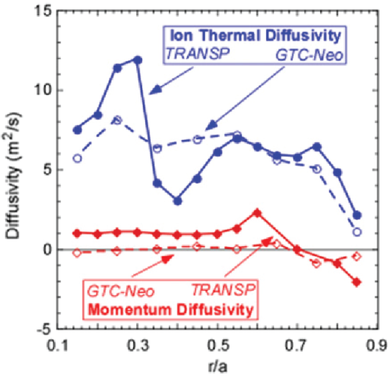
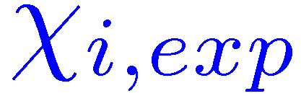
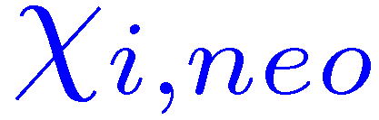

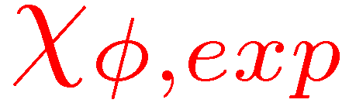
NSTX Results for Momentum Transport and Intrinsic Torque/Rotation Stimulate Research Plan for NSTX-U
Effective Â_{Á} from transport analysis found to be anomalous in NSTX H-mode plasmas
Momentum pinch consistent with some theoretical models involving low-k turbulence
  Measured by magnetic braking and NBI pulses
  Not comparison with nonlinear GK simulation yet
Edge intrinsic torque/rotation showing correlation with pressure/T_{i} gradient
2nd NBI pulses to be used in perturbative experiments for pinch and intrinsic torque measurements
Need to couple with low-k turbulence measurements and GK simulations

Slide 14

Momentum Transport and Intrinsic Torque/Rotation Studies will have Increased Emphasis in NSTX-U T&T Plan (Near-term FY15-16)
Characterize Â_{Á} as a function of ν_{e}*, B_{T} and I_{P}
  Compare with trends in Â_{i}/Â_{i,neo} and low-k turbulence
NBI and existing external coils pulses for momentum diffusivity, pinch and intrinsic torque measurements in a variety of regimes
  Microtearing/ETG regimes, e.g. high/low β and ν_{e}* H-mode
  ITG/TEM regimes, e.g. NBI-heated L-mode
Vary q and flow profiles ( , ExB shear) to explore the parametric dependence of Â_{Á}, pinch and intrinsic torque and the correlation with low-k turbulence
  Use 2nd NBI and existing external coils
Intrinsic rotation study with passive CHERS in scenarios with negligible external momentum input (RF-heated and ohmic)
Compare momentum measurements and low-k turbulence with GK simulation predictions

Slide 15
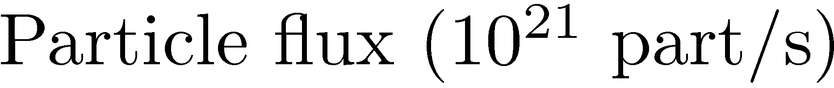
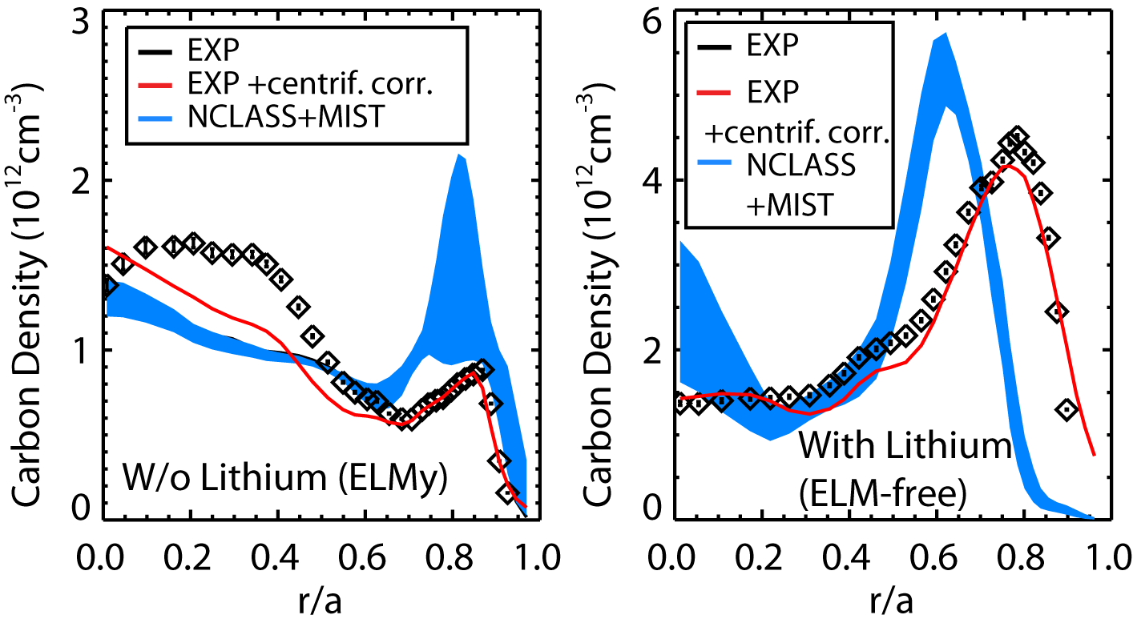
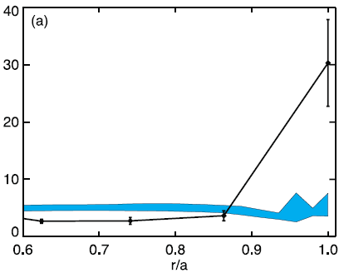
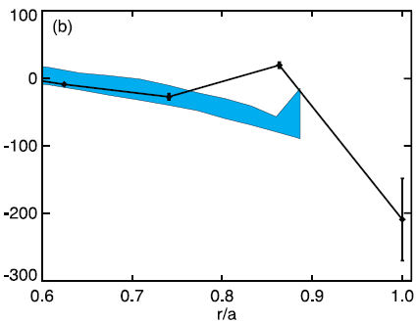
Particle/Impurity Transport is often Consistent with Neoclassical Transport in Core, more Uncertain at Edge
Main ion transport studied in L-mode with particle balance analysis using TRANSP
  Where NBI fueling dominant (½<0.6)
  Particle transport close to neoclassical, but ion thermal is anomalous
  Will we still see this in NSTX-U?
NSTX NBI-heated L-mode
Experiment
Neoclassical
NBI fueling dominant
½
Without Li
With Li
Core C⁶⁺ profile shape consistent with local neoclassical calculation (NCLASS and NEO)
  Larger departure from neoclassical at edge with Li than w/o Li
  Global neoclassical in future (GTC-neo)
Neon transport close to neoclassical calculations in core
  Deviate from neoclassical diffusion in the edge possibly due to turbulence (w/ BP TSG)
NSTX NBI-heated H-mode
D (m²/s)
Experiment
Using perturbative neon puff
Neoclassical
V (m/s)

Slide 16
Particle/Impurity Transport Studies will be Explored in the Lower Neoclassical Transport Regime of NSTX-U (Near-term FY15-16)
Compare particle/impurity transport with neoclassical transport as NSTX-U reaches lower ν_{e}* with increased B_{T}, I_{P} and P_{NBI}
  Trace-impurity V and D with perturbative neon puff
  Carbon/lithium with CHERS measurements
  High-Z impurity with the laser blow-off system and metal PFC
  Coupled with impurity transport codes
  Main ion transport studies through steady-state analysis, coupled with modeling (DEGAS2) and measurements of edge neutral source
Similar experiments in isolated regimes of micro-instabilities
Vary q, and ExB shear to alter neoclassical transport and low-k turbulence and to explore parametric dependence of particle/impurity transport
Compare anomalous particle/impurity transport with GK calculations and correlate it with low-k turbulence measurements

Slide 17
Long-term (FY17-18) NSTX-U T&T Plan to Address Thrust 2
Identify operational regimes of ETG, microtearing, CAE/GAE and ITG/TEM/KBM modes for thermal transport
Identify low-k turbulence responsible for momentum transport/ intrinsic torque and particle/impurity transport and its operational regimes
Facilitated by further NSTX-U facility enhancements
  More high-Z tiles for impurity transport
  Decouple ν_{e}* and ½* dependence with density control from cryopump
  Better inter-machine experiments for R/a scaling from B_{T} enhancement
  Partial NCC modification of flow profile and flow shear
Expanding turbulence and transport parametric dependence
  β, ½* (density control from cryopump), T_{i}/T_{e} (RF heating) and Z_{eff} (impurity control techniques), using full engineering capability of NSTX-U
Emphasize transport and turbulence in long pulse fully relaxed and fully non-inductive scenarios
Move towards an integrated and self-consistent understanding of all transport channels simultaneously

Slide 18
Thrust 3: Establish and Validate Reduced Transport Models

Slide 19
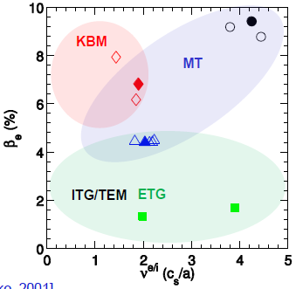
NSTX-U T&T 5 Year Plan Aims to Deliver Reduced
Transport Models
Reduced transport models are required deliverables to meet the goal of achieving predictive capability for performance of next generation STs and ITER
r/a~0.6-0.7
NSTX-U will allow validation of transport models over a broad range of parameters, e.g. R/a, β, ν
  Wide range of theoretical mechanisms to consider
  More comprehensive validation of physics models being used for conventional aspect ratio tokamaks and ITER
Emphasis throughout 5 years will be on predictive transport simulations using TRANSP and TGYRO coupled with core transport models:
  Neoclassical (NC) (Chang-Hinton model, NCLASS, NEO)
  Drift wave (DW) (TGLF, MMM08, …)
  Energetic particle (EP) driven χ_{e} (stochastic ORBIT model)
Additional emphasis on validating NC, DW & EP models with first principles simulations (GTC-neo, gyrokinetics & HYM, respectively)

Slide 20
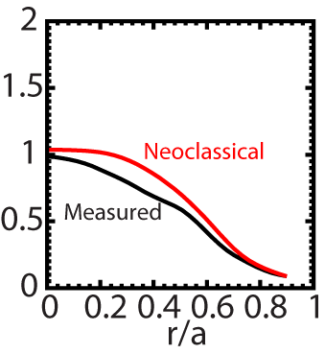
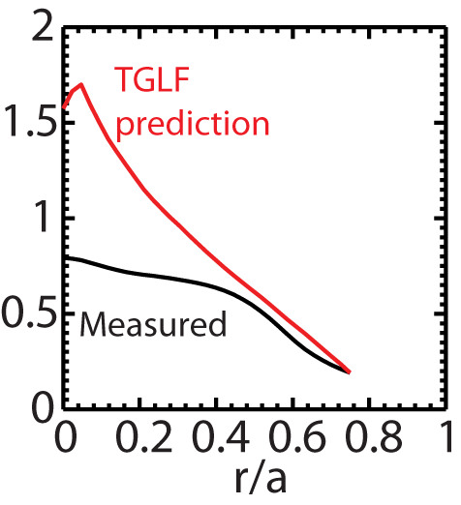
FY15-16 Modeling will Focus on Ion and Electron Thermal Transport at Expanded I_{p}, B_{T} and P_{NBI}
Predict T_{e} & T_{i} profiles using neoclassical and drift wave models and compare with NSTX-U profiles
T_{i} (keV)
T_{e} (keV)
  Clarify the regime of validity of neoclassical model for ion thermal and impurity transport
  Validate drift-wave-based models and identify their deficiencies for predicting core T_{e}
Validate drift wave models with linear and nonlinear GK, focusing on:
  Linear instability regimes, e.g. TEM/MT/KBM, scaling and thresholds
  Nonlinear electron & ion heat flux scaling for the different mechanisms
Consider developing semi-empirical or analytic models based directly on GK simulations
    Depending on quantitative success of available DW models
Develop model χ_{e,EP} based on ORBIT simulations using measured CAE/GAE mode structures (w/ EP TSG)

Slide 21
FY17-18 Long Term Plans will Focus on Complete T_{e} Profile Prediction for Low Collisionality & Advanced Scenarios
Validate predictions at lowest collisionality accessible with cryopump and advanced scenario development
  Integrate analytic χ_{e,EP} model into TRANSP predictions for core T_{e} profile
  Non-linear HYM simulations for first principles GAE/CAE spectra for ORBIT χ_{e,EP} modeling
Depending on success of T_{e}, T_{i} predictions:
  T_{e}, T_{i}, τ_{E} predictions for future device, e.g. ST-FNSF, Pilot
  Integrated scenario predictions (consistent equilibrium & q profile evolution) for fully relaxed and fully non-inductive scenarios
  Predict density and rotation profile (n, Ω)
Investigate non-local core effects using global gyrokinetics
  Relatively large ρ* in NSTX-U, possible turbulence spreading into near-axis region
  Pursue heuristic model to incorporate non-local effects
When feasible move to core/pedestal full-F simulations, e.g. XGC1 to investigate possible non-local influence from pedestal to core region (w/ BP TSG)

Slide 22
Summary: NSTX-U T&T Research will Provide Physics Basis Leading to Predictive Capability for Transport in Future ST/AT Devices
Stimulated by the results from NSTX, the proposed T&T research thrusts for NSTX-U aim to address
  H-mode global energy confinement
  Transport mechanisms and their operational regimes
  Establishment and validation of reduced transport models
A set of turbulence diagnostics coupled with a comprehensive set of data analysis and simulation/modeling tools will greatly facilitate achieving the research goals
  BES, reflectometry, polarimetry and high-k_{µ} scattering system
  TRANSP, GYRO, GTS, XGC1, NEO, GTC-NEO etc.
FY15 NSTX milestone well suited for providing an initial assessment of confinement performance in expanded regime of NSTX-U

Slide 23
Backup Slides

Slide 24
NSTX-U Plans Towards PAC31 T&T Recommendations
PAC31-34 | In the framework of gyrokinetic modeling of turbulence, it is suggested to move towards increasingly realistic simulations, including the impact of rotational shear on micro- tearing, the impact of an additional C impurity species in conditions of experimentally measured large effective charges, and consider the impact of these effects on the collisionality scaling, particularly in the case that correlations between parameters are present in the experiments | NSTX-U T&T TSG gyrokinetic modeling activities have already taken initiatives in the “increasingly realistic simulations” suggested by the PAC, e.g. recent nonlinear simulations of microtearing modes in NSTX H-mode plasmas on the collisionality scaling and ITG modes in NSTX NBI-heated L-mode plasmas on ExB shear effect. Experiment and simulation comparison is an essential element of the NSTX-U T&T 5 year plan. Using realistic experimental profiles and including essential physics in gyrokinetic simulations are crucial for the comparison. This is facilitated by the continuously increasing computational power and improvement in gyrokinetic codes.
PAC31-35 | Comparison between conditions in which neoclassical transport is expected to produce a significant amount of ion heat transport with conditions in which this is estimated to be smaller with respect to power balance transport levels (e.g. comparisons among L-modes and H-modes) is potentially helpful in this direction. | We have observed anomalous ion thermal transport in NSTX NBI-heated L-mode plasmas and found that ITG modes may be responsible using linear and nonlinear gyrokinetic simulations. This is in contrast to H-mode plasmas where strong ExB shear usually suppresses low-k turbulence. NSTX-U T&T research has explicit plans to study ion thermal transport in comparison with neoclassical transport in both L and H mode plasmas and the effect of ExB shear will be studied using flow profile modification capability from the 2nd NBI.
PAC31-36 | Strongly connected to these research activities, it is suggested to progress towards increasingly accurate calculations of neoclassical transport, establishing the domain of applicability of conventional theory (e.g. the NCLASS and the NEOART codes), in particular with respect to the magnitude of the poloidal Larmor radius and of the impurity rotation velocity, and performing comparisons within a hierarchy of neoclassical models, including, in addition to NCLASS or NEOART, also codes like NEO and XGC0. The application of such a hierarchy of models/codes to observations of ion heat and impurity transport is of extreme interest (size of ion heat conductivity, of impurity diffusivity, and size of impurity convection to diffusion ratio). | Local neoclassical codes, NCLASS and NEO, are being extensively compared in the context of impurity transport in NSTX. It is found that NCLASS and NEO calculations for impurity transport generally agree except in the situations with strong toroidal flow where centrifugal effect has to be taken into account. Comparison with global neoclassical code, GTC-NEO, will be carried out for NSTX plasmas. In NSTX-U T&T plans, NCLASS, NEO and GTC-NEO will be used to calculate neoclassical transport in a variety of regimes and with different plasma parameters, and their regimes of validity will be assessed.
PAC31-37 | It is suggested to consider the development of a model for *AE induced electron heat transport already during the outage phase (in collaboration with the TSG on Energetic Particles) to be tested against past NSTX results and to be applied then to NSTX-U. | There is a plan in FY14 to make the first attempt to predict core electron thermal transport in NSTX-U by coupling ORBIT code with HYM CAE/GAE mode calculations.
PAC31-38 | Finally, in order to be ready for the exploitation of NSTX-U, the preparation of diagnostics for turbulence and transport analyses plays an important role. These diagnostics require good profile measurements, including also current density/safety factor profile (e.g. MSE-LIF) and impurity transport (e.g. ME-SXR) and multi-scale multi-field fluctuation measurements (FIR high-k? scattering, BES, polarimetry, reflectometry). When this is deemed necessary, it is suggested to verify that these diagnostics will have the appropriate radial coverage and spectral range for fluctuation measurements in the expected NSTX-U scenarios. | One important aspect of NSTX-U T&T 5 year plan for FY14 is to prepare turbulence and transport diagnostics for NSTX-U operation, e.g. a FIR high-k scattering system, BES, polarimetry, reflectometry and ME-SXR (MSE-LIF diagnostic was installed on NSTX [tested in neutral gas] and will be tested in plasma once NSTX-U is in operation.) Some modeling has been done to calculate diagnostic spatial and/or spectral coverage in NSTX-U scenarios, e.g. for the FIR high-k scattering system. Additional modeling will be carried out for the preparation of the diagnostics.
PAC31-39 | During NSTX-U operation, the PAC suggests that high priority be given to establishing the impact of low collisionality, high beta, and rotation on confinement and to related modeling/validation of theory based transport models and turbulence simulations | The priority is set as the PAC suggested. The thrust 1 of NSTX –U T&T 5 year plan is specifically to characterize H-mode global energy confinement scaling in the lower collisionality regime of NSTX-U. The 2nd NBI will allow us to vary flow profile and achieve high beta and their effects on confinement will assessed. Reduced transport modeling and gyrokinetic simulations will be carried out and compared with experiments.

Slide 25
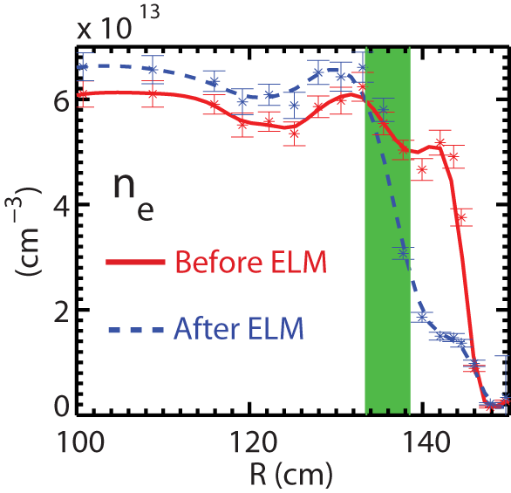
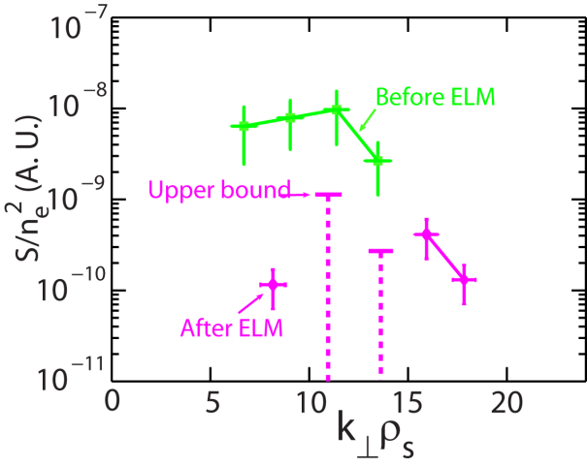
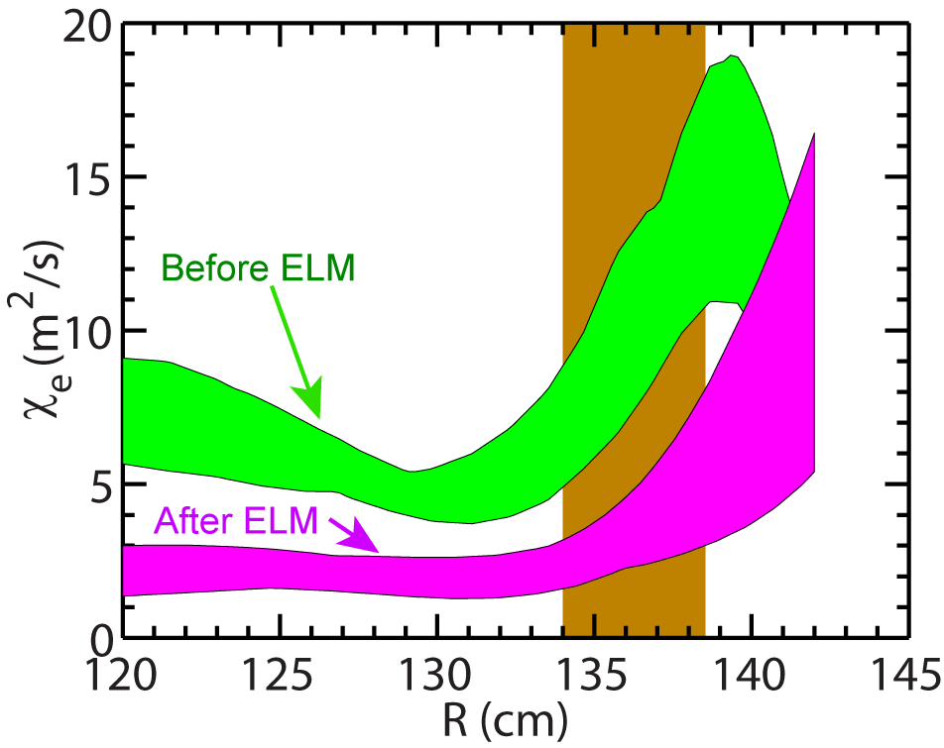
Density Gradient Stabilization of High-k Turbulence was Identified
Provided the first experimental evidence of density gradient stabilization of high-k turbulence
Correlated with a factor of about two decrease in electron thermal diffusivity
Consistent with theoretically predicted increase in critical electron temperature gradient for ETG modes due to density gradient
A possible way to stabilize/mitigate ETG turbulence by density profile control
Ren et al., PRL, 2011 and PoP, 2012

Slide 26
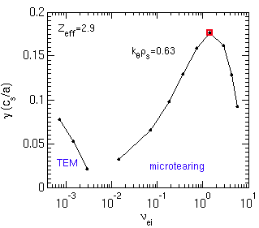
Microtearing Instability Exhibits Thresholds in Electron Temperature Gradient, Collisionality and Beta
(1) Apparent threshold in ∇T_{e}, (a/L_{Te})_{crit} ≈1.3-1.5 (a/L_{Te,exp}=2.7)
(2) Growth rates decrease with ν_{e} < ν_{e,exp} (consistent with experimental ν* scan)
(3) Lowering beta stabilizes microtearing
Linear growth rates (γ⋅a/c_{s}) for NSTX 120968 t=0.56 s r/a=0.6
(1)
(2)
(3)
Exp. value
Exp. value

Slide 27
Nonlinear Microtearing Transport Comparable to Experimental Transport*
With no E×B shear predicted transport (1.2 ρ_{s}²c_{s}/a) comparable to experimental transport (1.0-1.6 ρ_{s}²c_{s}/a)
Transport reduced when increasing γ_{E} to local experimental value
What are the other important dependencies?
χ_{e} vs. E×B shear
χ_{e} exp
ρ_{s}²c_{s}/a=5 m²/s
*Guttenfelder et al., submitted to PRL (2010)

Slide 28
Predicted Non-linear Collisionality Dependence Consistent with Experimental Scaling
χ_{e} vs. ν_{e}
χ_{e} vs. a/L_{Te}
χ_{e} exp
χ_{e,sim} ~ ν_{e}^{1.1}
χ_{e} exp
Transport very sensitive to ∇T_{e} - may be more important to characterize scaling of effective threshold gradient, (a/L_{Te})_{crit,microtearing}
Might help distinguish from expected ETG scaling, (a/L_{Te})_{crit,ETG} – work in progress

Slide 29
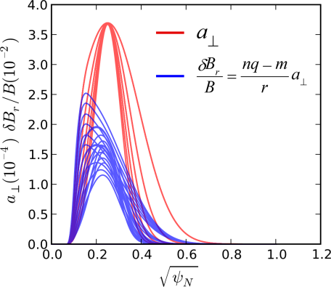
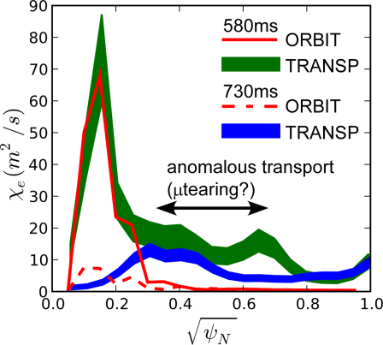
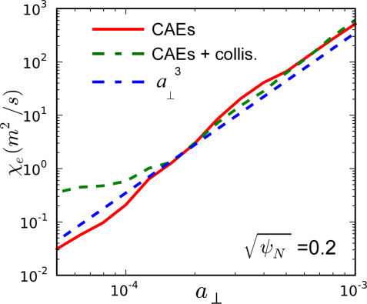
ORBIT Guiding Center Code Used to Simulate CAE/GAE Effects on Electron Thermal Transport
Scalar vector potential
A Gaussian radial structure for the CAE modes is chosen to match the experimentally measured mode peak location and width
Frequencies and toroidal and poloidal mode numbers are determined using measurements and theoretical dispersion equations
ORBIT simulations predict a strong scaling of transport with mode amplitude (~ a³⁻⁴)
CAE & GAE modes combined can produce high levels of electron transport (~70 m²/s) for r/a < 0.2 at t=580 ms
Predicted transport is much lower at t=730 ms as the number of CAE modes appears to decrease

Slide 30
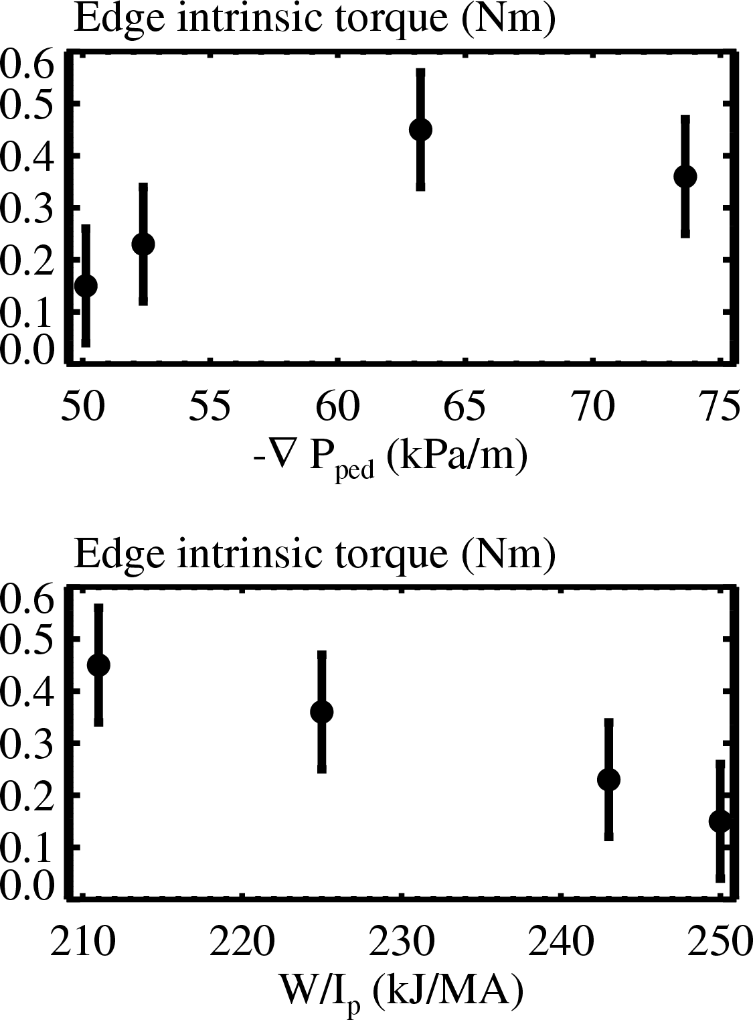
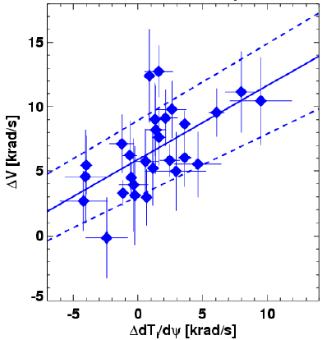
NSTX Edge Intrinsic Torque and Rotation Show Dependence on Pressure Gradient and T_{i} Gradient, Respectively
Edge intrinsic torque shows some correlation with pressure gradient
  Measured with NBI torque steps
  Qualitatively similar dependence on pedestal gradients as DIII-D
Edge intrinsic rotation shows better correlation with T_{i} gradient (TC-9)
  Measured on pedestal top through Ohmic L-H transition with passive CHERS
  Zero input torque, small NTV torque and transport effect
  No correlation found with T_{e} and n_{e} gradients
Rotation vs. Ion temperature gradient

Slide 31
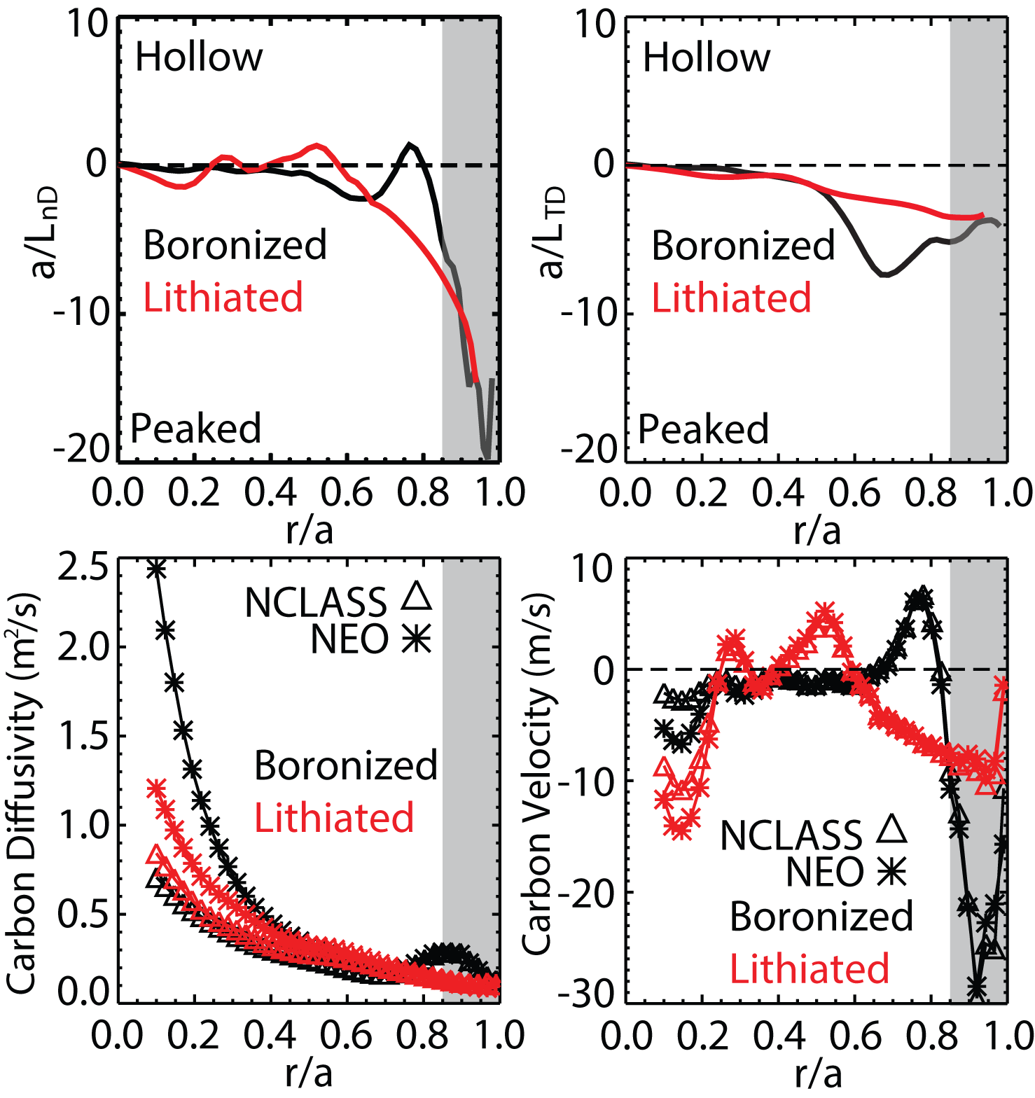
Changes in Main Ion Profiles with Lithium Conditioning Lead to Changes in Carbon Neoclassical Transport
With lithium conditioning:
Change in n_{D} and T_{D} profiles
- Wider edge inward convection, 0.6 < r/a < 1.0
- Increased core inward convection
- Reduction in edge diffusivity
Consistent results obtained using NCLASS and NEO:
  - Differences observed only in regions with large toroidal rotation
  Comparable impurity peaking factors
31
Notes:
31
31
31
31

Slide 32
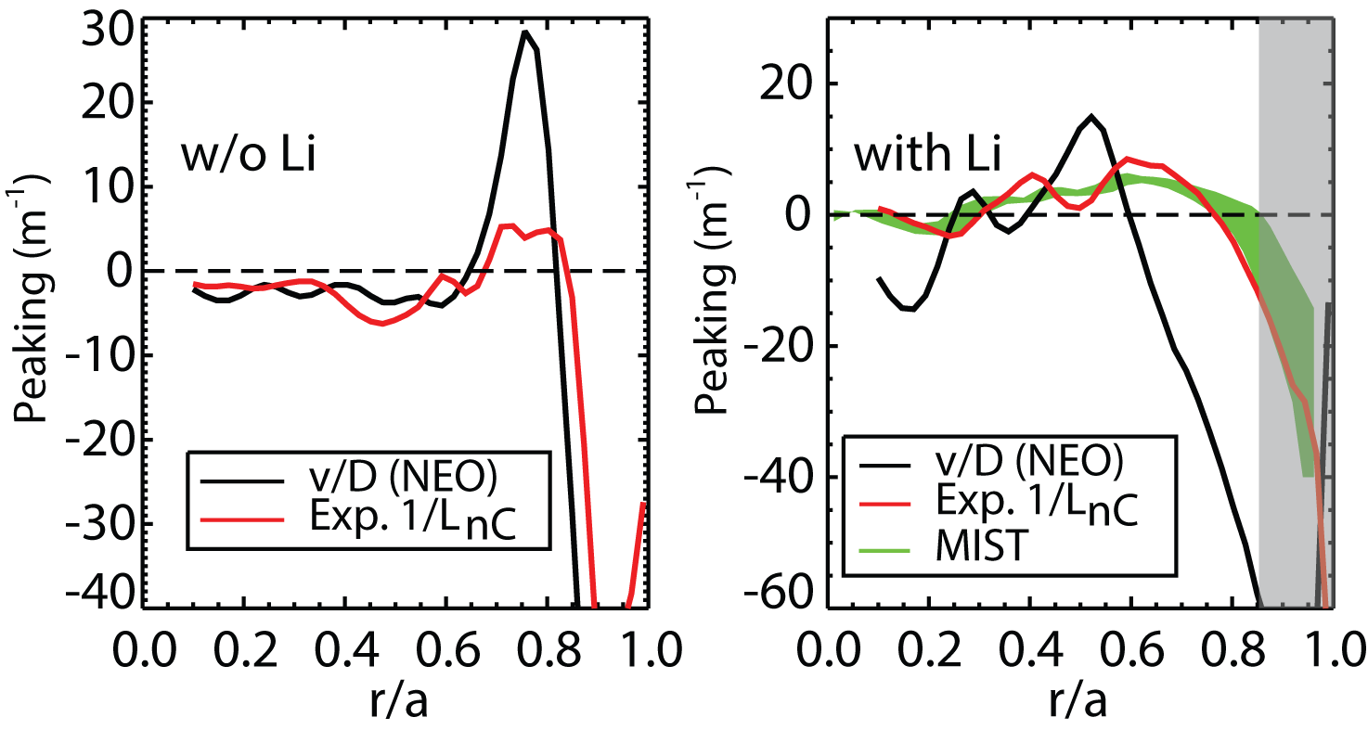
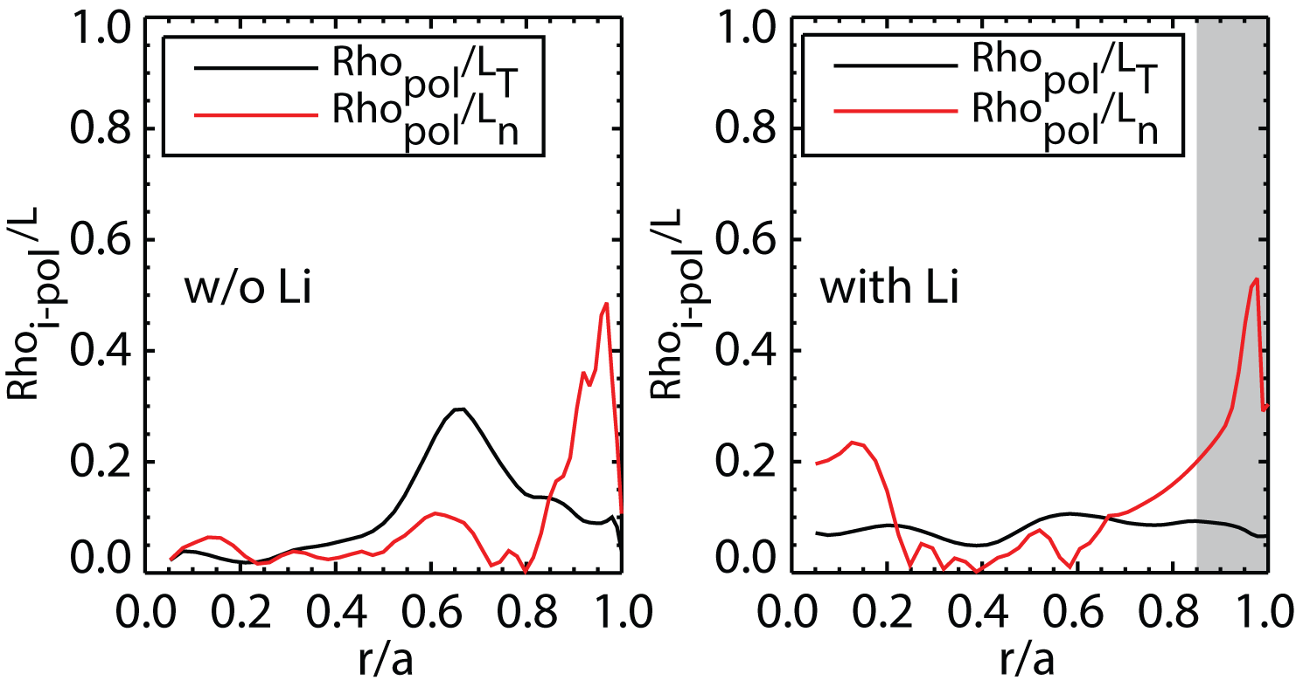
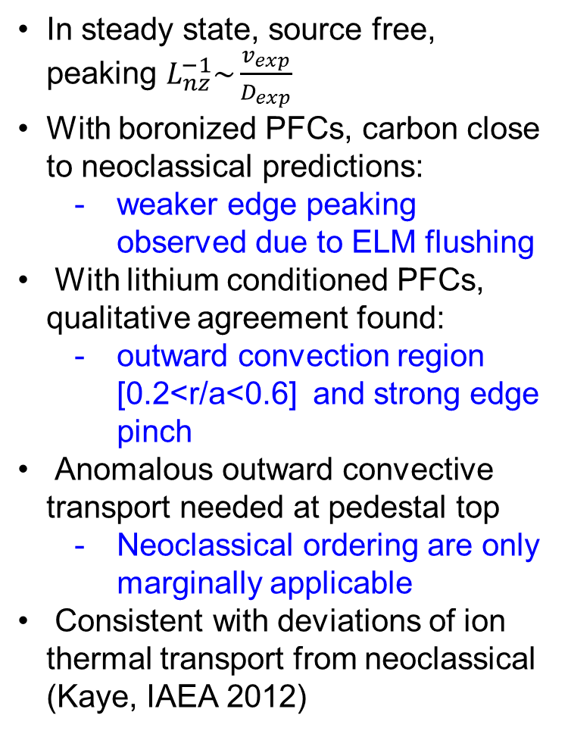
In lithium Conditioned Discharges Residual Anomalous Transport is Needed to Explain Carbon Profiles
In steady state, source free, peaking $L_{nz}^{−1}\sim \frac{v_{exp}}{D_{exp}}$
With boronized PFCs, carbon close to neoclassical predictions:
  weaker edge peaking observed due to ELM flushing
With lithium conditioned PFCs, qualitative agreement found:
  outward convection region [0.2<r/a<0.6] and strong edge pinch
Anomalous outward convective transport needed at pedestal top
  Neoclassical ordering are only marginally applicable
Consistent with deviations of ion thermal transport from neoclassical (Kaye, IAEA 2012)
32
Notes:
32
32
32
32

Slide 33
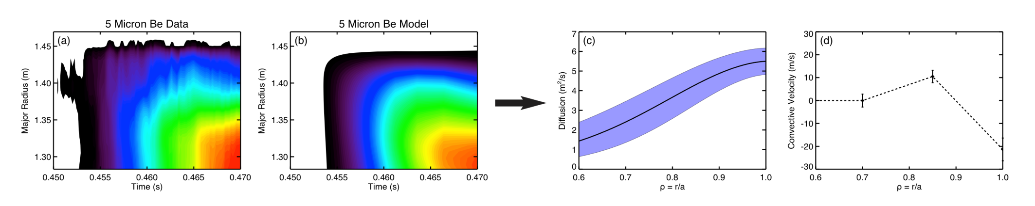
Multi-Energy SXR Technique is Used to Determine Impurity Transport Profiles in the NSTX Plasma Edge
Perturbative impurity transport measurements were performed using neon gas puffs in the plasma edge (non-perturbative to bulk plasma)
ME-SXR arrays measure emission from many charge states of neon with high space and time resolution, coarse spectral resolution
  Five 20-channel photodiode arrays with different filters (one with no filter for bolometry) provide tangential SXR emissivity measurements in five energy bands
  1 cm radial resolution (r/a ~ 0.6–1.0) and 10–100 kHz time resolution
  Filtered ME-SXR arrays measure emission from highly-charged neon
  Bolometer measures emission from lower charge states, thus providing the source term for higher charge states via ionization
Impurity transport simulations (STRAHL) are coupled with a synthetic ME-SXR diagnostic and fit to data to obtain diffusion, convection profiles
5 μm Be Data 5 μm Be Simulation Radial Diffusion Radial Convection

