Slide 1




NSTX-U
Supported by
NSTX-U 5-Year Plan for Materials and Plasma Facing Components
Coll of Wm & Mary
Columbia U
CompX
General Atomics
FIU
INL
Johns Hopkins U
LANL
LLNL
Lodestar
MIT
Lehigh U
Nova Photonics
Old Dominion
ORNL
PPPL
Princeton U
Purdue U
SNL
Think Tank, Inc.
UC Davis
UC Irvine
UCLA
UCSD
U Colorado
U Illinois
U Maryland
U Rochester
U Tennessee
U Tulsa
U Washington
U Wisconsin
X Science LLC
M.A Jaworski, C.H. Skinner, R. Kaita
and D.P. Stotler
Culham Sci Ctr
York U
Chubu U
Fukui U
Hiroshima U
Hyogo U
Kyoto U
Kyushu U
Kyushu Tokai U
NIFS
Niigata U
U Tokyo
JAEA
Inst for Nucl Res, Kiev
Ioffe Inst
TRINITI
Chonbuk Natl U
NFRI
KAIST
POSTECH
Seoul Natl U
ASIPP
CIEMAT
FOM Inst DIFFER
ENEA, Frascati
CEA, Cadarache
IPP, Jülich
IPP, Garching
ASCR, Czech Rep
NSTX-U PAC-33 Meeting
PPPL – B318
February 19-21, 2013
Notes:
11

Slide 2
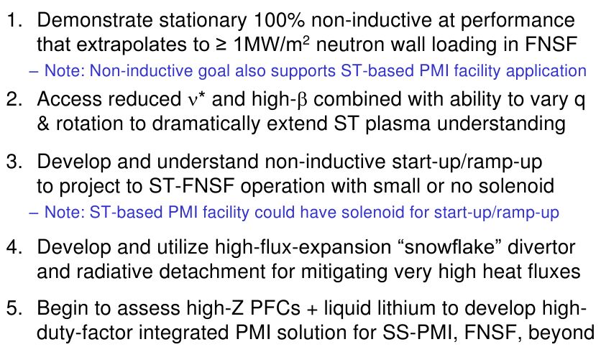
High-level goals for NSTX-U 5 year plan
(see Program Overview Talk)

Slide 3
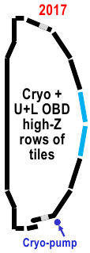
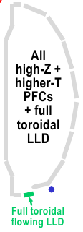


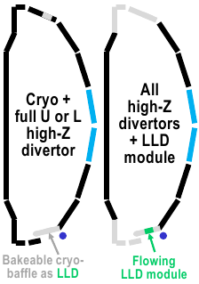
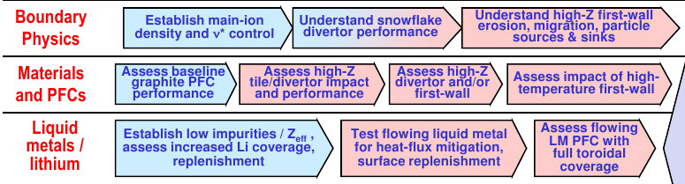
NSTX-U long-term objective is to perform comparative assessment of high-Z and liquid metal PFCs (see Maingi talk)
Conversion to all-metal PFCs provides opportunity to to examine role of PFCs (including liquids) on integrated scenarios with good core, pedestal, div.
NSTX-U has two emphases for addressing power exhaust and PMI issues for next step devices
  Magnetic topology and divertor configuration
  Self-healing/replenishable materials (e.g. liquids)
2019-2023

Slide 4
M&P research will develop understanding of material migration and heat-flux handling of high-Z and liquid Li PFCs
Understand lithium surface-science for long-pulse PFCs
  Assess impact of more complete Li coverage
  Use the new Material Analysis and Particle Probe (MAPP) and laboratory studies to link tokamak performance to PFC surface composition
Unravel the physics of tokamak-induced material migration and evolution
  Confirm erosion scalings and evaluate extrapolations
  Determine migration patterns to optimize technical solution
Establish the science of continuous vapor-shielding
  Determine the existence and viability of stable, vapor-shielded divertor configurations
  Determine core compatibility and extrapolations for extended durations and next-step devices

Slide 5
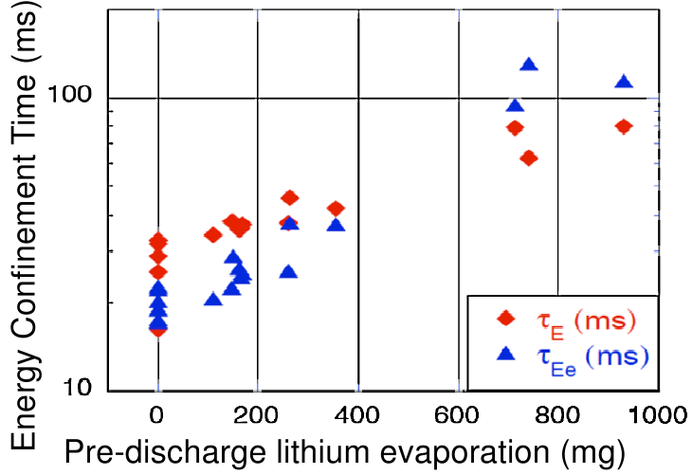
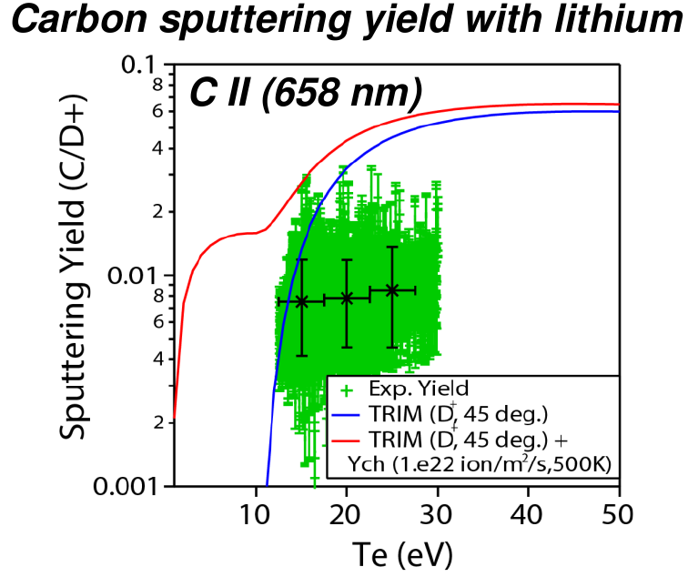
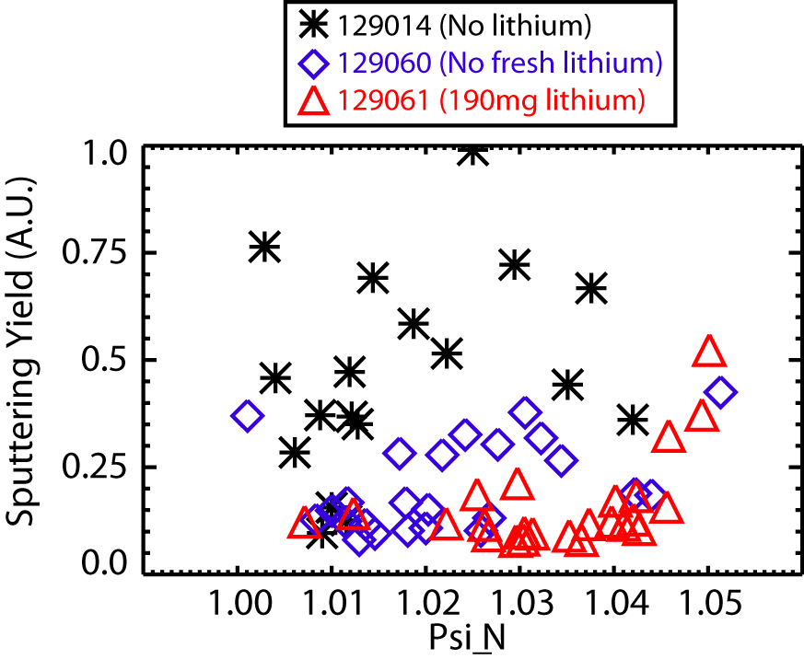
Li wall conditioning results in confinement improvements and reduction in divertor carbon source
Confinement increases continually with pre-discharge lithium application
  Deuterium inventory stationary (see J. Canik talk)
  ELM elimination results in core carbon accumulation (see J. Canik talk)
Carbon influx in divertor reduced after application of lithium conditioning
Maingi PRL 2011; NF 2012.
c.f. Sugai, JNM 1995.
Plasma spectroscopy and target Langmuir probes provide gross yield
F. Scotti

Slide 6
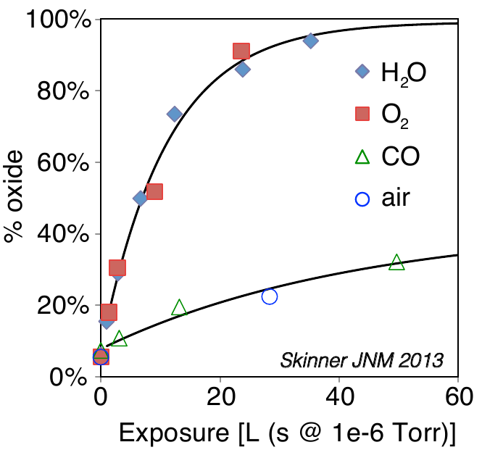
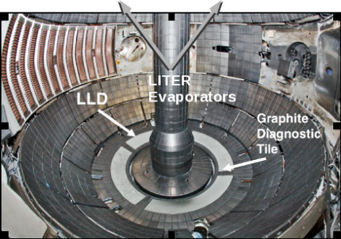
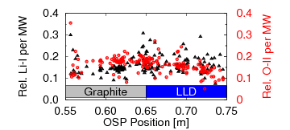
Oxygen recently identified as important to lithium chemistry and sputtering
Oxygen uptake by lithium films quantified in laboratory experiments
  Oxide layer formation in ~200s in NSTX (~600s inter-shot time)
  Consistent with Liquid Lithium Divertor (LLD) results showing little change in impurity emission
Influence of oxygen contaminants being investigated in laboratory
  Molecular dynamics simulations of Li-C-O show increased D uptake (Krstic, PRL 2013)
  Non-zero oxygen sputter yield from contaminated surfaces
  No indications of O degrading plasma performance (so far)
  Motivates flowing system to control impurity accumulation
Oxygen uptake by Li coating on Mo
Laboratory-based
PU collaboration
LLD
NSTX whole-divertor impurity emission
Jaworski, IAEA 2012

Slide 7
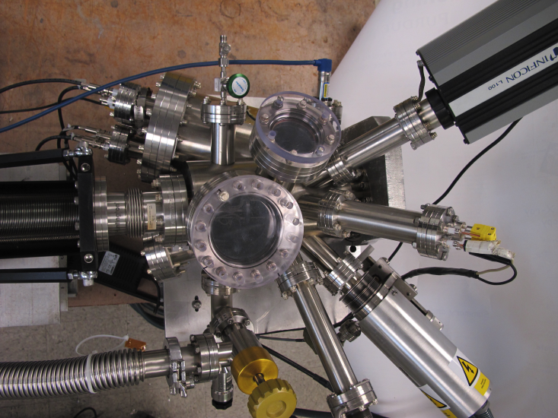
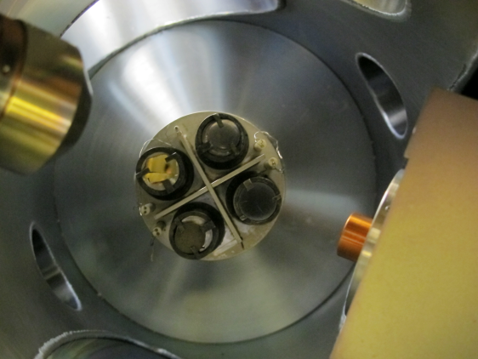
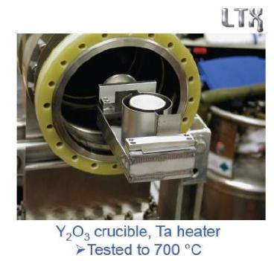
MAPP will be a key diagnostic for bridging the gap between discharge performance and lab-based surface science
Determine material composition and surface chemistry inside tokamak
  Exploit MAPP capabilities to link with surface science labs at PPPL, Purdue, U-Illinois
  Identify role of contaminants in Li PMI
  Being prepped for use in LTX this year
Optimize areal coverage of wall conditioning techniques
  Diffusive evaporations and upward-facing evaporators
  Examine energy confinement, impurity production, particle control...
Purdue
MAPP capabilities
TDS
XPS
LEISS
DRS
Up to 4 samples exposed
Upward evaporator under development for NSTX-U

Slide 8
Thrust 1 research plan makes use of multiple tools to unravel lithium surface-science during transition to high-Z PFCs
FY14 – Surface science laboratory and LTX experiments
  Utilization of MAPP to examine high-Z substrates in LTX
  Measurements of deuterium retention in lithium on high-Z substrates in laboratory experiments (PU collaboration)
FY15 – Comparison of boronization with more complete PFC coverage by Li, establish baseline performance data sets
  Diffusive evaporation and MAPP to identify surface chemistry changes during transition to lithium wall conditioning
  Prepare high- and low-triangularity discharges to prep for high-Z tiles
FY16 – High-Z tile installation, upward evaporation
  Examine role of evaporation rate on Li efficacy
  Determine how high-Z substrate affects coating performance
FY17-18 – High-Z tiles and vapor shielding
  Determine high-temperature (T>500C via plasma heating), coated PFC performance and role of impurities in lithium PMI throughout machine

Slide 9
M&P research will develop understanding of material migration and heat-flux handling of high-Z and liquid Li PFCs
Understand lithium surface-science for long-pulse PFCs
  Assess impact of more complete Li coverage
  Use the new Material Analysis and Particle Probe (MAPP) and laboratory studies to link tokamak performance to PFC surface composition
Unravel the physics of tokamak-induced material migration and evolution
  Confirm erosion scalings and evaluate extrapolations
  Determine migration patterns to optimize technical solution
Establish the science of continuous vapor-shielding
  Determine the existence and viability of stable, vapor-shielded divertor configurations
  Determine core compatibility and extrapolations for extended durations and next-step devices

Slide 10
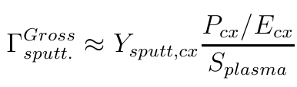

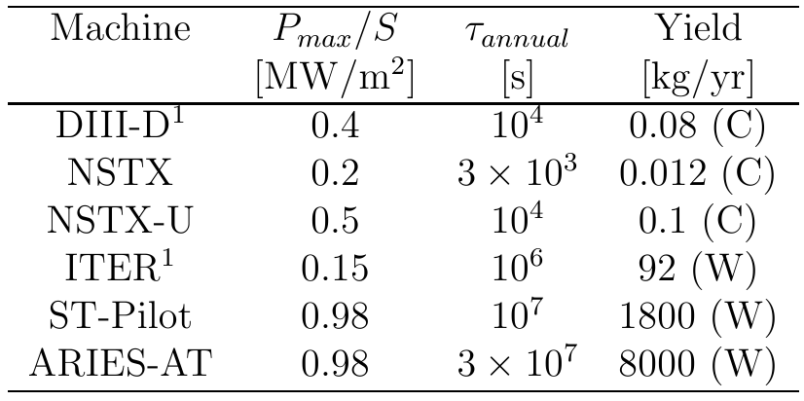
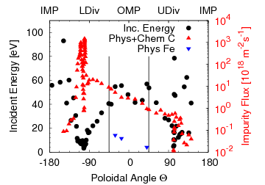
NSTX discharges already indicate significant first-wall erosion and NSTX-U will extend this erosion by factor of 10
Simplified estimates indicate large amounts of wall erosion in next-step devices
  Estimates based on charge-exchange neutrals at the edge
  Several simplifications (e.g no neutral pressure dep., poloidal uniformity)
Plasma + neutral transport codes enable modeling of these processes
  Fluid codes: UEDGE, SOLPS, OEDGE; Neutral codes: EIRENE, DEGAS2; impurity codes: DIVIMP
  Mean neutral energies in NSTX discharge 40-90eV
  Flux to walls poloidally non-uniform (peaked near outboard LSN)
  ~20% of carbon flux from first wall
¹P.C. Stangeby, JNM 2011.
OEDGE

Slide 11
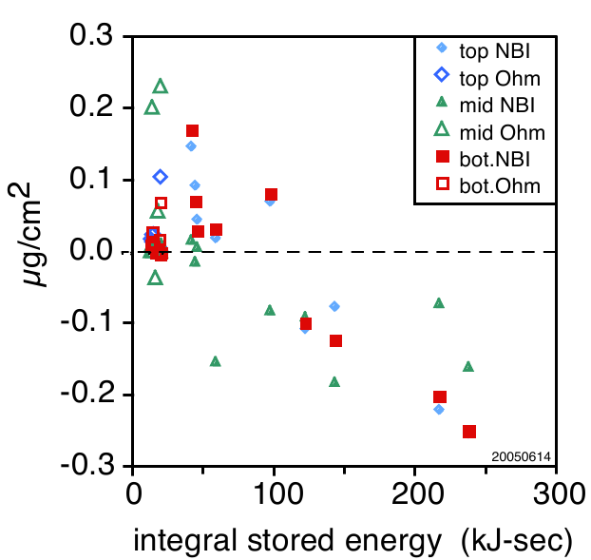
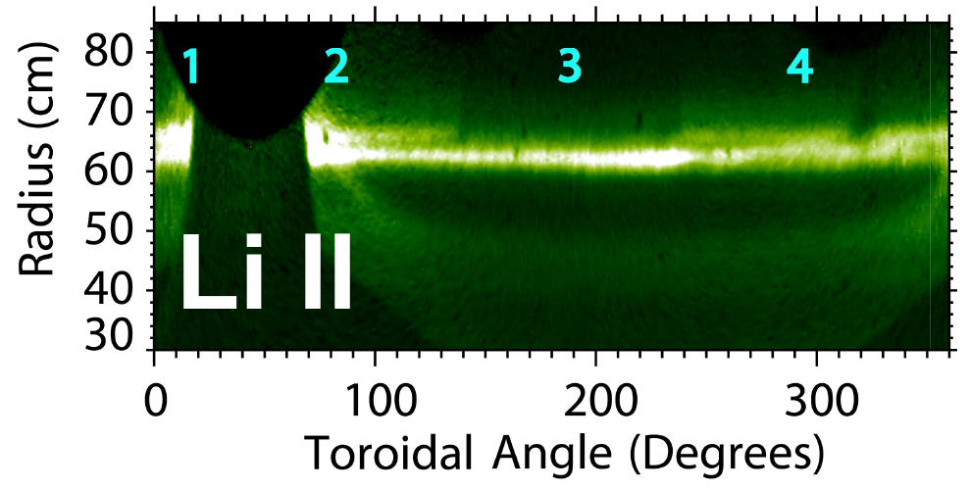
Complementary erosion diagnostics will enable identification of erosion/redeposition patterns
NSTX-U will expand coverage of erosion diagnostics
  QCMs and witness samples at multiple first-wall locations (4x poloidal locations, 20 witness plates in NSTX)
  Marker tiles will be used in high-heat flux regions
  MAPP to be upgraded with QCM allowing simultaneous mass/composition measurements
  Net erosion diagnosed with mixture of inter-shot and campaign-integrated diagnostics
Expanded suite of plasma diagnostics to constrain plasma models
  Langmuir probes for local n_{e}, T_{e}, potential (Div. Thomson incremental)
  Gross erosion via plasma spectroscopy
Mass-loss measured on QCMs
Full-toroidal camera coverage
Skinner, JNM 2007
Scotti, RSI 2012

Slide 12
Thrust 2 research will quantify material erosion/migration on first-wall and in divertor for both high-Z and low-Z surfaces
FY14 – Data analysis and test-stand experiments to prepare for tokamak experiments
  Continue analysis of NSTX discharges to optimize diagnostics
  Magnum-PSI experiments to measure gross and net erosion at high Temp.
FY15 – Make initial assessment of material erosion and migration in NSTX-U discharges, compare B vs. Li discharge conditions
  Utilize MAPP to measure composition of films, compare to Magnum-PSI material evolution data and models; measure gross and net erosion
  Prepare for high-Z tile upgrade with low- and high-triangularity data sets
FY16 – Establish first-wall erosion scalings, protection of high-Z substrate and compatibility with high-performance discharges (e,g. high-Z impurity accum.)
  Examine dependence on edge neutral pressure, input power, pulse length
  Determine impact of synergistic operations on material migration (e.g. impurity seeded divertors, snowflake configuration)
FY17-18 – Determine impact of upper divertor high-Z tiles and the impact of vapor-shielded regime on material migration

Slide 13
M&P research will develop understanding of material migration and heat-flux handling of high-Z and liquid Li PFCs
Understand lithium surface-science for long-pulse PFCs
  Assess impact of more complete Li coverage
  Use the new Material Analysis and Particle Probe (MAPP) and laboratory studies to link tokamak performance to PFC surface composition
Unravel the physics of tokamak-induced material migration and evolution
  Confirm erosion scalings and evaluate extrapolations
  Determine migration patterns to optimize technical solution
Establish the science of continuous vapor-shielding
  Determine the existence and viability of stable, vapor-shielded divertor configurations
  Determine core compatibility and extrapolations for extended durations and next-step devices

Slide 14
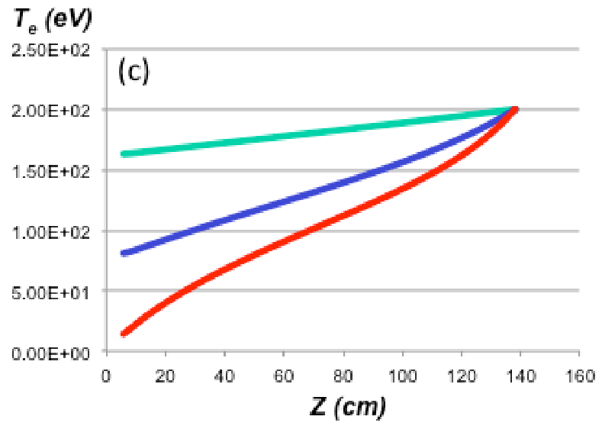
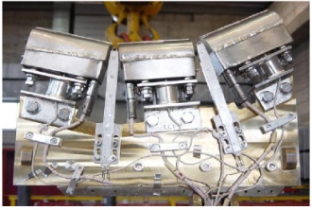


High temperature lithium surface may be able to provide a self-healing surface and intrinsic low-Z impurity radiation source
Lithium vapor cloud can potentially provide effective power and pressure loss at divertor target
  Non-coronal Li radiation
  Li vapor pressure vs. plasma press.
Capillary-Porous System targets have dissipated large incident heat fluxes - tested to 25MW/m² limited by Li inventory (Evtikhin JNM 2002)
Diagnosis in NSTX-U via complementary diagnostics
  Langmuir probes for target pressure, n_{e}, T_{e}
  Optical, VUV emission and bolometry for P_{rad}
  DBIR thermography and TCs for heat flux and energy deposited
Lithium radiative power dissipation
Increasing Lithium
M. Ono, IAEA FEC 2012.
FTU CPS

Slide 15
Thrust 3 will establish the existence of vapor-shielded regime and assess compatibility with high-performance discharges
FY14-15 – Assess the high Li influx regime (w/ Thrust 2)
  Complete high-Z tile design for installation in year 3
  Conduct high temperature experiments on Magnum-PSI
  Validate plasma transport and atomic physics data bases for high-density, high-Li fraction plasmas
FY16 – Validate high-Z substrate design and reference performance
  Boron vs. Lithium experiments diverted directly onto high-Z tiles
  Assess power and pressure balance in the NSTX-U SOL
FY17 – Extend operational space of vapor-shielded regime
  Determine core compatibility with vapor-shielded divertor plasmas
  Determine vapor-shield performance with varying SOL pressures, input powers, connection length
  Assess transient loading response (ELM loads)
FY18 – Determine flowing-system replenishment needs due to net erosion to extend vapor-shielding regime beyond 1s tests

Slide 16
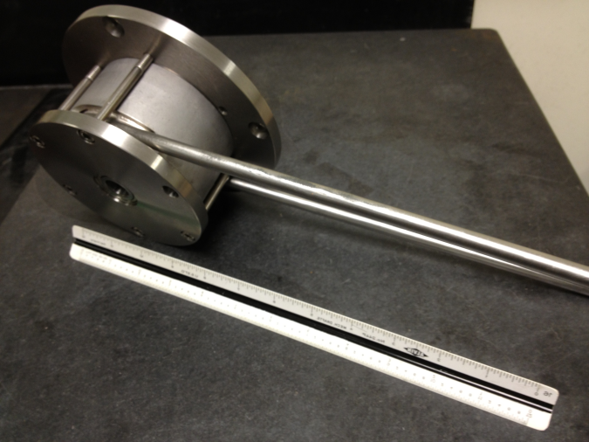
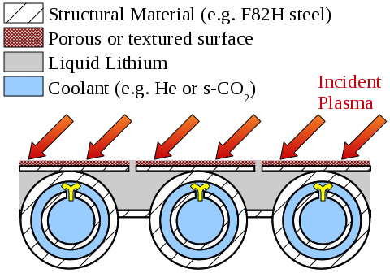
Parallel plasma-facing component research and development to support high-Z tile upgrade and vapor-shielding studies
Recrystallization limits
High-Z PFC assessment
  Lamellae used on other machines (e.g. JET-ILW, CMOD) to reduce stress
  Both compatible with Li
Flowing liquid lithium PFC development underway
  Conceptual design and initial engineering assessment of long-pulse, LM-PFCs underway
  Basic liquid-metal loop technologies being assembled for testing
Const.
Surface q₀
10MW/m²
for 5s
PPPL Liquid lithium pump
Actively-supplied, capillary-restrained, gas-cooled LM-PFC

Slide 17
NSTX-U Five-year plan will begin assessment of a high-Z PFC and liquid lithium integrated PMI solutions for next steps
M&P research will contribute to the understanding of material migration and evolution to prepare for next-step devices
  Study mixed material issues with Li, C, O and high-Z studies
  Examine whole machine material erosion, migration, re-deposition
  Begin assessment of high-Z PFCs with low-Z coatings
M&P research will advance liquid metal PFCs as an innovative solution to handling fusion exhaust power and particle loads
  Establish the science of continuous vapor shielding with high-temperature, liquid lithium PFCs and determine the compatibility with high-performance discharges
  Perform side-by-side comparison of a high-Z PFC vs. a liquid metal PFC to inform next-step devices

Slide 18
Backup

Slide 19
PAC-31 response slide 1
Diagnostic priorities for M&P research plan (divertor)
  Top priority: divertor Langmuir probe array, divertor spectroscopy (cameras+spectrometers), DBIR thermography, MAPP, QCMs, marker tiles, witness samples, divertor bolometry
  Highly desirable: SOL flow measurements (e.g. Mach probes), remote material analysis (e.g. LIBS), spectrally and spatially resolved VUV spectroscopy, hydrogen sensors, time-resolved pressure gauges

Slide 20
PAC-31 Response slide 2
PAC 31-8: The PAC suggests that a much clearer plan is needed to better clarify the evolution from carbon to all-metal walls. Effects of the high-Z wall on the PWI and plasma performance should be determined without influence of Li layers, i.e., prior to Li studies on the metal walls...
  This is explicitly included in the 5-yr plan which makes use of multiple years examining the transition from boronized wall conditions to lithiated conditions. The timing of a bare-wall run campaign is still being debated and will depend on run-time allocation for such an endeavour.

Slide 21
PAC 31 response slide 3
PAC 31-13: ...The NSTX-U team needs to address the engineering issues of high-Z tile edge design and configuration, especially leading edges that intercept parallel plasma flow along the magnetic field, B. This is an important issue to reduce erosion and melting, in particular, for the snowflake divertor...
  The plan for high-Z tile implementation, at present, is to limit the installed tiles to the outer divertor to mitigate risk. In these locations, the angle of incidence is higher which alleviates leading edge effects, but still carries large incident power fluxes when diverted in this region of the device. Examining erosion of the high-Z tiles is a central element of the M&P program and will be used to inform design decisions for high-Z PFCs to be implemented in the inner divertor.

Slide 22
PAC 31 response slide 4
PAC 31-19: The reduction of peak heat flux with Li deposition was documented, as well as the narrowing of the heat-flux radial profile for the same power as no-Li discharges. Just where the remaining power went is not well understood, though likely it is distributed via impurity radiation...
  Examining the usage of lithium impurities as a radiator is the focus of Thrust 3 in M&P TSG. Analysis of the discharges in question is ongoing, but made difficult by diagnostic coverage present in NSTX (e.g. sparse probe and bolometer coverage). Diagnostic coverage in NSTX-U will be improved to better understand the physics involved.

Slide 23
PAC 31 response slide 5
PAC 31-21: Hydrogenic and impurity particle recycling & transport in the inboard divertor and wall can contribute to the overall sources of these particles, and it is thus important to understand such processes in this region when designing PFCs appropriate for ST tokamaks. Simulation and experiment studies such as local Li coating and divertor pumping from the private region will help evaluate their influence on divertor and core plasmas. It is also important to measure influx profiles of intrinsic D and Li, and seeded impurities.
  A broader analysis of NSTX discharges is planned in the years leading up to NSTX-U operations. Improved diagnostic coverage will improve confidence in the accuracy of plasma reconstructions and fluid models as an aid to interpreting the experimental measurements.

Slide 24
PAC 31 response slide 6
PAC 31-28: Compatibility of impurity seeding with Li layers (impurity retention and Li erosion) and the feedback system should be investigated at this stage
  Noble gas elements are chemically compatible with lithium and the measurement of erosion rates is a central thrust of this TSG. The existence of boronization campaigns and end-of-run experiments may permit the use of chemically reacting impurities such as nitrogen and will be considered.

Slide 25
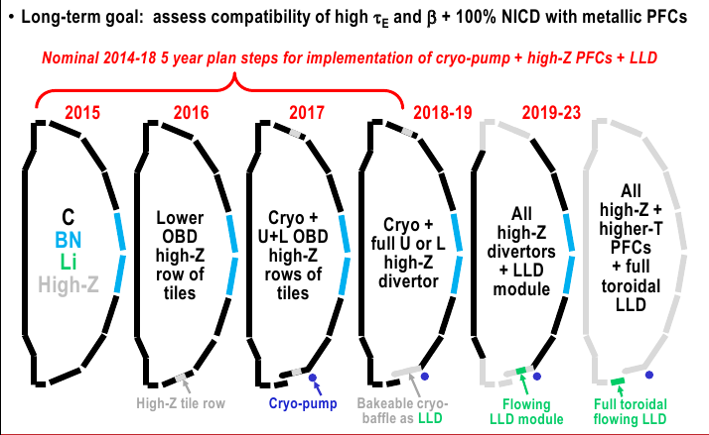
NSTX-U 5YP PMI goal: implement cryo-pumping and begin transition to metallic PFCs to support PMI/FNSF next-steps

Slide 26
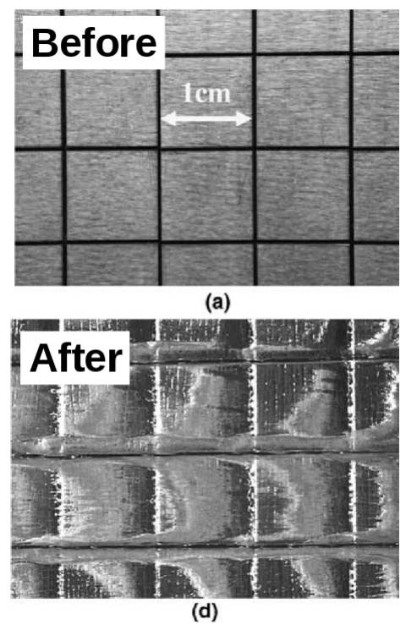
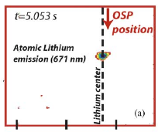
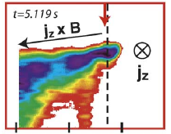
Taming the plasma-material interface is a grand-challenge for magnetic fusion energy
Creation of economical fusion energy depends on component lifetime
Significant uncertainty in how existing PFC candidates will extrapolate
  Solids look promising but...
  Liquids look promising but...
PMI challenge must be met to enable a high-power-density, long-pulse facility such as FNSF
Tungsten melting under ELM-like bombardment (Federici, JNM 2005)
Lithium ejection in DIII-D (Whyte, FED 2004)

Slide 27
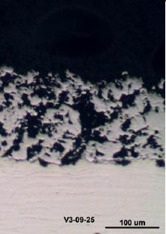
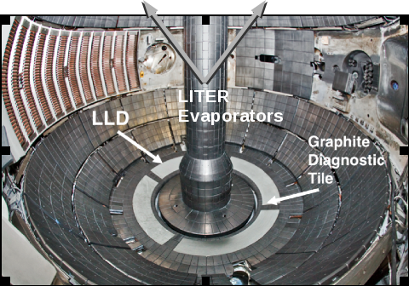
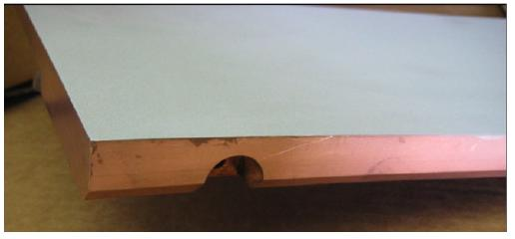
NSTX performed liquid-metal PFC experiments with the Liquid Lithium Divertor (LLD)...
Liquid lithium divertor installed for FY2010 run campaign
2.2cm copper substrate, 250um SS 316, ~150um flame-sprayed molybdenum porous layer; LITER loaded
37g estimated capacity, 60g loaded by end of run

Slide 28
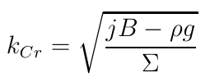
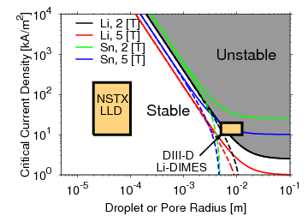
...and demonstrated stable liquid metal PFC operation in a diverted tokamak
Large transient currents measured with Langmuir probes, LLD porous geometry limits wavelength
Raleigh-Taylor analysis provides marginal stability curves; NSTX LLD stable
CPS tests also reduced droplet ejection with smaller pore sizes*
100 μm
For the fastest growing modes
Li cup
size
Pore
size
Jaworski JNM 2011, Jaworski IAEA FEC 2012, Whyte FED 2004, *Evtikhin JNM 2002

Slide 29
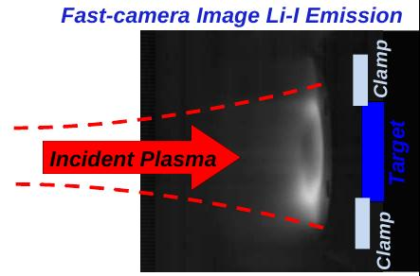
Local erosion and redeposition already being studied in linear device and will be extended to NSTX-U divertor
Magnum-PSI linear test-stand provides divertor-relevant plasmas (FOM-DIFFER/PPPL collab.)
  1.4T (upgrade to 2.5T)
  >10 MW/m² inc. heat flux
  Tilting target for obl. inc.
  Extensive diagnostics
Initial experiments already indicate large redeposition fraction of lithium
  In-situ deposition of lithium films w/ evaporator
  Evolution of surface impurities observed and may provide means of discharge cleaning Li
Parameter | Value
Discharge time | 8x 5s (40s total)
Typical T_{e}, N_{e} | 1eV, 1.4e20 m⁻³
Gross Li yield (TRIM est.) | 0.52 mg m⁻²
Total deposited (max Net) | 0.05 mg m⁻²
Redeposition (if max Net) | 0.9

Slide 30
Thin coatings can provide protection of high-Z substrates
Ion penetration depth of ~10nm means plasma will only interact with coating material
Lithium erosion rate is large and highly temperature dependent
  Erosive fluxes could quickly remove protective layers
  No experimental data of erosion yield above ~500C, at these fluxes^{1,2}
Coating lifetime is extended by redeposition fraction
  Motivates flowing systems to replenish coating
  No temperature dependence in boron sputter yield³, τ~2s at R=0
0.6g/s ~ 1.2 cc/s at 600C
¹Doerner, JNM 2001. ²Allain, JNM 2003. ³Hechtl, JNM 1992

Slide 31
Vapor shielding regime should be identifiable through target plasma parameters, surface temperature and bolometry
Large lithium erosion rates should provide several indicators of vapor shielding
  Target plasma pressure loss due to Li vapor pressure
  Target electron temperature reduction by plasma radiation
  Optical emission, total radiation from near target
  Reduced PFC temperature rise measured via DBIR thermography, PFC calorimetry
Transient testing length will be determined by lithium lifetime
  Assessed in Thrust 2 plan
  Motivates long-pulse flowing PFC
Unmitigated temperature rise
q = 10 MW/m²

Slide 32
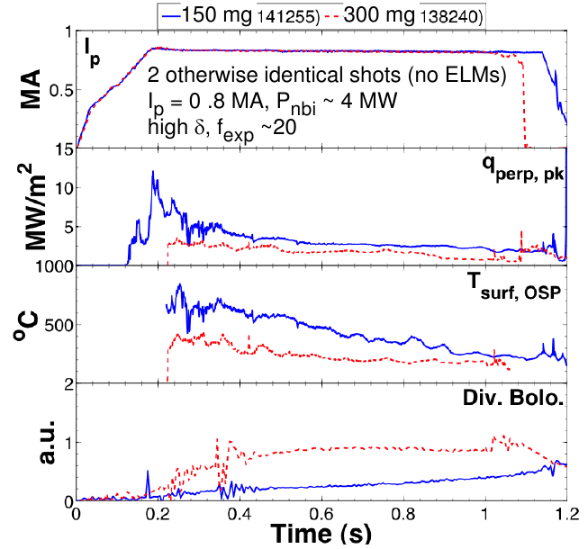
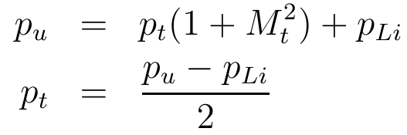
High temperature lithium surface may be able to provide a self-healing surface and intrinsic low-Z impurity radiation source
NSTX indicates reduced surface heat flux with elevated lithium deposition
Capillary-Porous System targets have dissipated large incident heat fluxes at high temperatures
  E-beam tested to 25MW/m² for 5-10 min
  QSPA plasma disruption tested up to 60 MJ/m²
Diagnosis in NSTX-U via complementary diagnostics
  Langmuir probes for target pressure, n_{e}, T_{e}
  Optical, VUV emission and bolometry for P_{rad}
  DBIR thermography and TCs for heat flux an energy deposited
T.K. Gray,
IAEA FEC 2012.

Slide 33
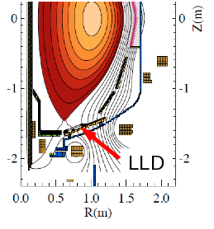
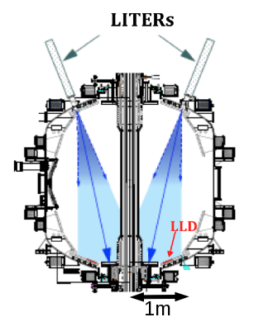
Overview of experiments
Experiments diverting onto the LLD occurred throughout run campaign
Either diverted onto LLD or just inboard on ATJ graphite
LITER only available filling method for the LLD
  7% filling efficiency estimated
  Always coating entire lower divertor in addition to LLD
Database of shots taken throughout run year
No boronization campaign prior to lithium introduction
Database already starts with 60g inventory in vessel

Slide 34
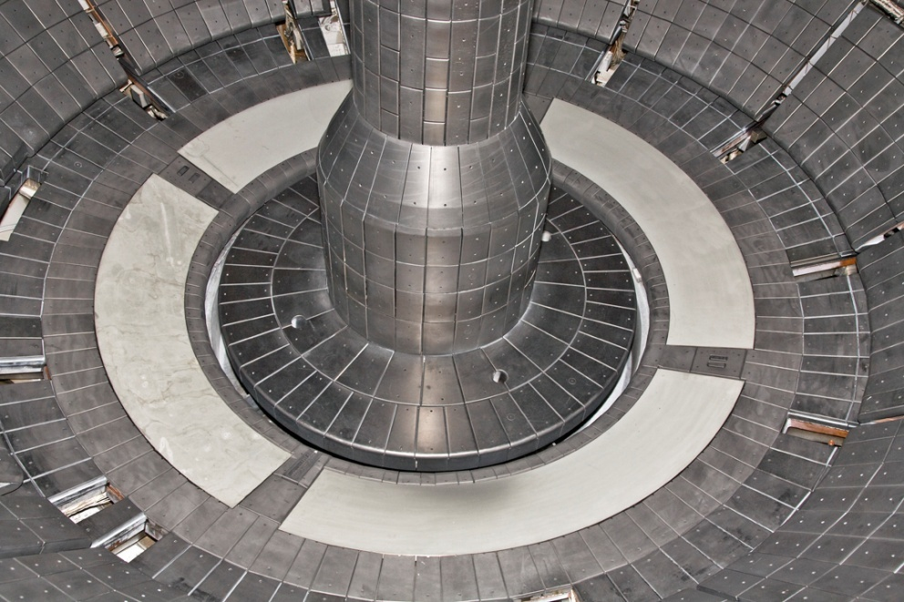
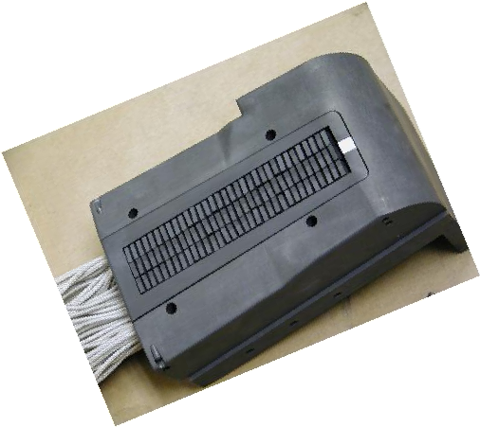
High-density Langmuir probe array installed for divertor plasma characterization
Liquid Lithium Divertor (LLD) installed to study lithium plasma-material interactions
Probe array characterizes local plasma properties in a range of experiments
Provides high spatial density of measurements
Oblique incidence yields smaller effective probe size
Diagnostic tile
2x7mm
electrode
J Kallman, RSI 2010
MA Jaworski, RSI 2010

Slide 35
Consistency between diagnostics demonstrated with empirical plasma reconstruction framework
Utilizes measured data points as starting point in constraining plasma models to fill the gaps between diagnostics
Solution improves as more and more data constrains background
OEDGE code suite used here: Onion-Skin Method (OSM2)+EIRENE+DIVIMP
  OSM2 solves plasma fluid equations
  EIRENE performs Monte Carlo neutral hydrogen transport, iteratively coupled to OSM2
  DIVIMP performs Monte Carlo impurity transport
Utilized here to compare probe interpretation methods against other diagnostics

Slide 36
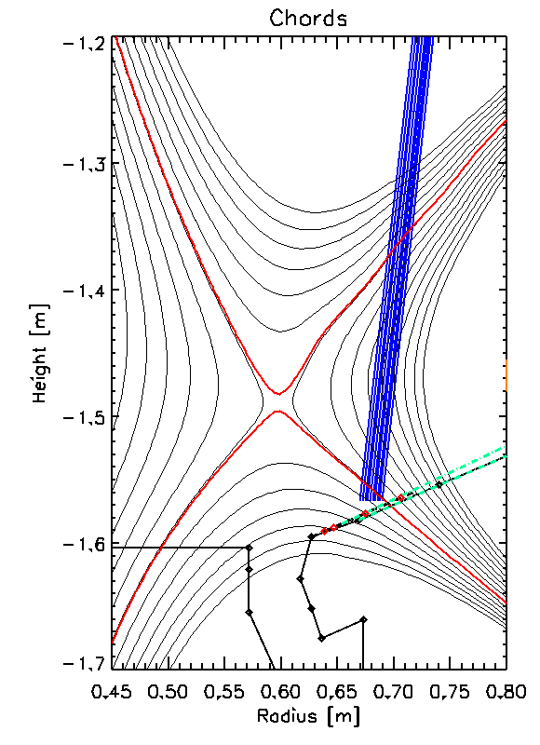
Density measurement from spectroscopy confirm kinetic probe interpretation
Divertor spectrometer viewing strike-point region during discharge
Deuterium Balmer lines shown in spectra
Pressure broadening analysis indicates dneisty of 3.6e20 m⁻³
  Existence of high-n Balmer lines indicates low temperature
Divertor spectrometer
view
F. Scotti

Slide 37
Broadening measurement and modeling of hydrogen spectrum consistent with kinetic probe interpretation
Pressure broadening yields density
OEDGE plasma+neutral solution provides local parameters
Collisional-radiative model by D. Stotler calculates excited state populations
Brightness ratios normalized to B6-2 consistent with 3<T_{e}<5eV
Balmer-Series Brightness Ratios
B6-2 norm
Jaworski, et al., 20th PSI, Aachen, Germany, June 2012.

Slide 38

Distribution function analysis indicates some local changes in plasma conditions on plasma-heated LLD
Discharge sequence repeatedly heated and plasma-conditioned the LLD surface
Local plasma temperatures elevated with hotter LLD surface temperature (T_{LLD} > T_{melt,Li})
Increase in plasma temperatures correlated with increase in V_{p}-V_{f} potential difference¹
Local changes raise the question whether large-scale global changes are also observed...
Comparisons made on
identical ψ_{N} locations
T_{melt,Li} = 181C
¹Jaworski et al., Fusion Eng. Des. 87 (2012) 1711.

Slide 39
Significant power onto LLD measured
Embedded thermocouples provide measure of temperature changes from before and after discharge
Each plate is 43kg of copper
  ΔE = mc_{p}ΔT per plate
  P_{LLD} ~ 4ΔE / τ_{pulse}
  P_{LCFS} = P_{NBI}+P_{OHM}-P_{RAD}-dW/dt
LLD absorbing about 25% of exhaust power (P_{LCFS})
  ~1MW in some cases
No molybdenum observed in the plasma after melted (Soukhanovskii, RSI, 2010)
Graphite
LLD
Jaworski, et al., IAEA FEC 2012

Slide 40
Surface contamination indicates this was not a “fair” test of a liquid lithium PFC
Divertor filterscopes provide indicator of impurities
  Relative fraction of impurity should be reflected in sputter yield
  Particle flux proportional to power
Normalization against flux indicates no difference diverted onto the LLD
Plasma cleaning in PISCES-B did show oxygen reduction*
  400s, T>600K
  LLD transiently exceeded these temperatures, but not steady
τ_{intershot} ~ τ_{oxidize} indicates oxidation likely (see GO6.008, A. Capece)
Emission ϵ
Coverage θ
Divertor Power P
Jaworski IAEA FEC 2012, *Baldwin NF 2002.

Slide 41
Performance should be independent of lithium quantity if surface contamination is key variable
FY2010 LLD experimental set
  Experiments span 60g to nearly 1kg of deposited lithium
  Includes 75hr deposition at mid-year
  Calculate ITER 97L H-factor average from 400-600ms for each discharge
Discharges look about the same between start and end of run
  Consistent with surface contamination hypothesis
Fully-flowing PFC can provide a means of sweeping away gettered material and creating “stationary” surface conditions.
Jaworski, et al., IAEA FEC 2012

Slide 43
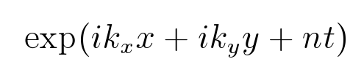
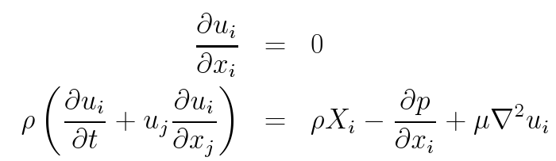
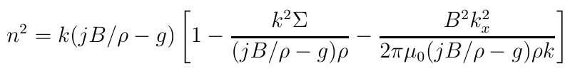
Vertical body forces can destabilize free surface
Net result of radial currents is to produce vertical forces
  Currents in SOL that close in the PFC
  Disruption eddy currents
Net body force upward has the potential to create Raleigh-Taylor instability
  Must overcome gravity and surface tension
  Must overcome magnetic tension (depending on orientation)
Jaworski JNM 2011

Slide 44
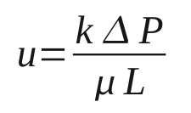
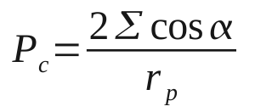
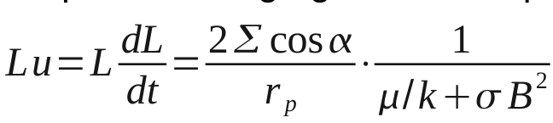
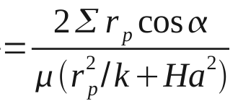
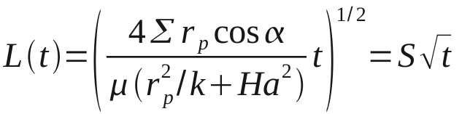
Porous-MHD effects alter liquid-metal wicking
Wicking into porous material described with Darcy Eqn.
  Pressure head provided by capillary pressure
Addition of MHD pressure losses and rearrangement creates porous-MHD version of the Lucas-Washburn eqn.
Solution yields “sorptivity”, S, of porous material including MHD effects

Slide 45
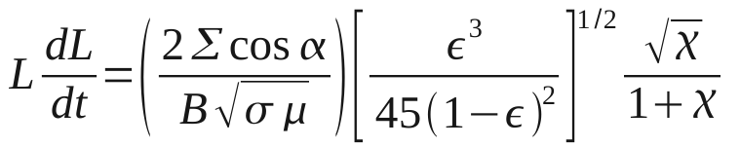
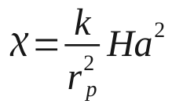

Wicking into material can be optimized with pore size
Re-arrangement provides permeability-enhanced Hartmann parameter
  Permeability of packed-bed used for illustration¹
  Liquid lithium material properties in 1T field yield 130μm pore
Sorptivity no longer isotropic as in many hydrodynamic systems
  S²/2 = 8, 19 cm²/s (perp, para) Li, r_{p,opt}=130μm
  S²/2 = 6, 20 cm²/s (perp, para) Sn, r_{p,opt}=290μm
¹Scheidegger, A.E. The physics of flow through porous media, University of Toronto Press, Toronto, Canada, 3rd ed. 1974.

Slide 46


Conduction dominated thermal transport makes conventional cooling relevant
Control-volume analysis illustrates relevant thermal transport regime¹
Thin, slowly-moving liquid metal can be considered a solid in thermal anaysis
Conventional gas cooling techniques applicable to these types of LM-PFCs
LIMIT²
ASCRS
¹Jaworski, et al., JNM 2009, ²Ruzic, et al., NF 2011.

Slide 48


Reduced sizes can benefit power extraction
At constant stress, radius reduction can reduce pipe-wall thickness
  Rely on liquid metal protection of substrate
  Manufacturing challenges...
Yield stress and creep deformation provide design points
ODS-RAFM should avoid rupture for >2yrs
  T_{max,steel}~610C
  Highest stress at lowest temperatures (500-550C)
  Further optimization to be done in 3D to address margins of safety, etc.
>300 MPa
270 MPa
200 MPa
100 MPa
2 MPa
Zinkle, et al., Fusion Materials Report, June 1998, p.135.

Slide 49



Liquid lithium demonstrated to protect fragile substrate
Red Star Capillary-Porous-System (CPS) long-since shown to substrate damage under ELM-like disruptions (5MJ/m², 0.5ms in QSPA)
Able to withstand 25MW/m² heat fluxes via strong evaporation and vapor shield
In principle, all PFCs in fully-flowing system will return to an equilibrium position (i.e. self-healing)
Pre-exposure
Post-exposure
No Lithium
Evtikhin, et al., J. Nucl. Mater. 271-272 (1999) 396.

Slide 50

Supercritical CO2 is a more effective coolant than helium
Replacement of He with s-CO2 in base T-tube design reduces pumping power by 30%
  Identical front-face temperatures
  2x pressure drop, 1/3 required flow
Better thermal efficiency at lower temperatures than He Brayton cycle¹
  S-CO2 w/ 550C turbine inlet has 45% thermal efficiency
  He w/ 700C turb. inlet had 43% (ARIES-CS)²
s-CO2
T_{inlet} = 600 C
T_{outlet} = 647 K
V_{inlet} = 8 m/s
ΔP = 108 kPa
Helium
T_{inlet} = 600 C
T_{outlet} = 677 K
V_{inlet} = 24 m/s
ΔP = 50 kPa
^{I} Dostal, et al., Tech. Report MIT-ANP-TR-100, MIT, March, 2004.
²Raffray, et al., FST 2008.

Slide 51
Material compatibility determines substrate
Liquid surface absorbs incident plasma, substrate material absorbs neutrons
Liquid lithium compatible with steel, vanadium alloys, refractory metals¹
Liquid tin compatible with refractories, not compatible with steel above 400C (unknown compatibility with vanadium alloys)¹
Porous structure can be produced by various methods (e.g. laser texturing², flame-spraying³, foam CVD⁴)
¹ Zinkle and Ghoniem, FED 2000. ² Lin, et al., JNM 2013. 3 Kugel, et al., FED 2011, ⁴ Jaworski, et al., JNM 2008.

Slide 52
More advanced options could exist
T-tube first example considered with well documented design for extension and modification
  Still requires significant absolute pressure and wall thicknesses
  Continued size reduction becomes difficult to manufacture
  ~10 MW/m² may be the limit with steel structures
  Integrated PFC-power cycle analysis is on-going work...
Liquid metal heat-pipes another option being pursued
  Reduces pressure at the target front-face allowing thinner structures and lower stress levels (may not need ODS)
  Can effectively spread heat-flux over larger area reducing requirements on gaseous cooling
  Porous-MHD issues already under study with free-surface work

Slide 53
Other open issues
Tritium processing and closing the liquid lithium loop
  Requires confinement device experiments to demonstrate re-capture of migrating materials
  Could prove to be lithium “Achilles heel” due to on-site inventory¹
Liquid metal protection of substrate material requires demonstration
  Thin walls for better heat transfer rely on sacrificial liquid layer
  Runaway electron beams? Other disruption events?
Integrated core performance with high-temperature, liquid-metal PFCs
  High-temperature, high evaporation/erosion lithium not demonstrated in divertor (encouraging results with limiter on FTU²)
  High-temperature liquid tin PFCs never tested to date
Plasma modeling...
¹M. Nishikawa, “Tritium in a fusion reactor (effect of Li system on tritium)” Presentation at PPPL ST tokamak discussion, March 27, 2012.
²M.L. Apicella, et al., Plasma Phys. Control. Fusion 54 (2012) 035001.

Slide 54
DEMO challenges considerable but progress is being made to determine if a technically feasible LM-PFC option exists
For 10MW/m² peak divertor heat loads incident on target in “Pilot-plant” ST- and AT-DEMOs
  Actively-supplied, capillary-restrained system prevents ejection
  Liquid lithium on ODS-RAFM structure with s-CO2 cooling looks encouraging (eliminates net-reshaping of PFC)
  Some additional optimization to be done with full 3D design
  Need data with high temperature lithium surface in divertor-like plasma
Experimental demonstration and additional analysis will address open issues over coming years
  @PPPL – internal lab funding, NSTX-U base program, other sources pending
  Collaboration underway with Magnum-PSI, NSTX-U, and EAST
Still several open issues forcing talk titles with the word “possible” but progress is being made; your input is welcome!

Slide 55

Liquid metal-structural compatibility
Li, Sn, Ga
Li, Sn, Ga
Li, Sn, Ga?
Li, Sn, Ga?
Li, Sn?, Ga?
Li, Sn, Ga
Li, Sn, Ga
Li, Sn, Ga
Li, Sn, Ga
Li?, Sn, Ga
Zinkle and Ghoniem, FED 2000. (Sn and Sn-Li used interchangeably)
“The Liquid Metal Handbook” Liquid-metals handbook”, United States Office of Naval Research. U.S. Govt. Print. Off. 1950. (Gallium estimates)

Slide 56
Evaporative self-cooling by Lithium

Slide 57

Supercritical CO2 power cycle provides higher thermal efficiency at lower temperatures than He Brayton
Real gas properties of CO2 reduce power required at compression
Dostal, et al. found that above 550C, s-CO2 recompression cycle better than He Brayton cycle (2 inter. no reheat)¹
  45% thermal efficiency w/ 550C turbine inlet
  49.5% thermal efficiency w/ 650C turbine inlet
  c.f. 43% helium cycle w/ 700C turbine inlet in ARIES-CS²
Turbo-machinery size comparison¹
^{I} Dostal, et al., Tech. Report MIT-ANP-TR-100, MIT, March, 2004.
²Raffray, et al., FST 2008.

Slide 58


Why liquids? Because solids may not extrapolate
Two major failure modes for solids that are known:
  Melting (transient heat loads)
  Net-reshaping (erosion, migration, redeposition)
Some speculative failure modes:
  Neutron-PMI synergistic effects (aside from bulk material changes)
  Steady-state, self-regulating walls?
B. Lipschultz, et al., “Tungsten melt effects on C-MOD operation & material characteristics”, 20-PSI, Aachen, Germany, May, 2012.
Coenen, et al., “Evolution of surface melt damage, its influence on plasma performance and prospects of recoverhy”, 20-PSI, Aachen, Germany, May, 2012.
Klimov, et al., JNM 390-391 (2009) 721.

Slide 59

Wall erosion/redeposition not mitigated by divertor configuration
P.C. Stangeby, et al., JNM 415 (2011) S278.
Charge-exchange processes create steady wall-flux
Low density plasma at first wall reduces local redeposition
1000s of kgs of eroded material migrating around tokamak vessel
Likely to redeposit in locations where cooler plasmas exist or behind baffled areas of machine
Do PFCs remain functional with large amounts of redeposited material?
  Need very high duty-factor to even study the problem!

Slide 60
Magnum-PSI plasmas similar to NSTX divertor conditions
Parameter | Magnum-PSI | NSTX discharges with heavy lithium (Liquid Lithium Divertor)
Power [kW] | 60 | 4 MW NBI (15MW NSTX-U)
Pressure source [Pa] | 10⁴ | N/A
Pressure target [Pa] | <3 | ~0.1-1 (OEDGE modeling)
Ti target [eV] | 0.1-10 | 1-50?
Te target [eV] | 0.1-10 | 1-15 (non-Maxwellian)
Ni target [m⁻³] | 10²⁰-10²¹ | 5x10²⁰ at SP
Ion flux target [m⁻²s⁻¹] | 10²⁴-10²⁵ | 2x10²³ at SP
Power flux [MW m⁻²] | 10 | 2-5 at ~5 deg. Incl. (25 unmit.)
B [T] | 1.9 | 0.6 (1T NSTX-U)
Beam diameter [cm] | 10-1.5 | ~4cm FWHM
Pulse length [s] | 12-110 | 1s (5s-10s)
Target size [cm] | 3cm – 60x12 | Order~10cm
Bias [V] | -100 < V_{target} < 0 | -20 < V_{floating} < 20

Slide 61
Simple transport models under development to understand local material transport
Quasi-2D transport model developed
  1D mass continuity in x
  1D profile variation in r
Emission simulated using ADAS rate coefficients
Next-steps: include ion fluid and recombination emission
Simulated Diagnostic View
Sightline

Slide 62

Experiment construction underway to provide testbed for PFCs and demonstration of necessary technologies
Liquid Lithium Test Stand Loop Diagram
Liquid lithium loop for demonstration of:
  Safe operation of loop
  Robust operation and maintainability
  Develop control systems, handling procedures
  And expertise for integration with tokamak systems
PFC proof-of-principle tests
  Couple to vacuum system
  Demonstrate LM concepts in relevant vacuum environment

Slide 63


EM pump designed, hardware currently being fabricated
Lithium Reservoirs
Magnetic field simulation
Predicted Pump Performance

Slide 64


Slide 65


Slide 66


