Slide 1




NSTX-U
Supported by
NSTX-U 5 Year Plan for Particle Control and Analysis for ST-FNSF
Coll of Wm & Mary
Columbia U
CompX
General Atomics
FIU
INL
Johns Hopkins U
LANL
LLNL
Lodestar
MIT
Lehigh U
Nova Photonics
Old Dominion
ORNL
PPPL
Princeton U
Purdue U
SNL
Think Tank, Inc.
UC Davis
UC Irvine
UCLA
UCSD
U Colorado
U Illinois
U Maryland
U Rochester
U Tennessee
U Tulsa
U Washington
U Wisconsin
X Science LLC
J.M. Canik
S.P. Gerhardt, M.A. Jaworski, R. Maingi, E. Meier, J.E. Menard, M. Ono, V.A Soukhanovskii, D. Stotler
For the NSTX Research Team
Culham Sci Ctr
York U
Chubu U
Fukui U
Hiroshima U
Hyogo U
Kyoto U
Kyushu U
Kyushu Tokai U
NIFS
Niigata U
U Tokyo
JAEA
Inst for Nucl Res, Kiev
Ioffe Inst
TRINITI
Chonbuk Natl U
NFRI
KAIST
POSTECH
Seoul Natl U
ASIPP
CIEMAT
FOM Inst DIFFER
ENEA, Frascati
CEA, Cadarache
IPP, Jülich
IPP, Garching
ASCR, Czech Rep
NSTX-U PAC-33 Meeting
PPPL – B318
February 19-21, 2013

Slide 2
Motivation and overview of talk
Particle control needs for NSTX-U:
  Need to avoid density limit, radiative collapse during long-pulse shots
    Greenwald fraction f_{G}~0.7-1.0 sufficient for non-inductive studies
  Lower density to access reduced collisionality physics
    f_{G}~0.3-0.5 desired
  Develop FNSF-relevant pumping scenarios
Plans for Years 1-2 of NSTX-U operation: lithium and ELMs
  Lithium provides deuterium control, without saturation in ~1 s in NSTX
  Impurities can be flushed using ELM triggering to control radiation
  Lithium granule injector is main upgrade to NSTX-U
Plans for Years 3-4 of NSTX-U operation: cryo-pumping
  Physics design of pumping system
  Preliminary analysis of FNSF pumping geometry
Goal for end of 5-year plan: stationary n_{e}, f_{G}~0.5, low Z_{eff}~2-2.5

Slide 3
Particle control in NSTX-U will be accomplished with variety of fueling and exhaust techniques
NSTX-U will compare novel and conventional exhaust techniques
  Lithium for deuterium pumping+ELM-triggering for impurity expulsion
  Cryo-pumping of ELMy H-modes
Conventional and advanced fueling techniques will be used
  Supersonic gas injector (fast time response, ~1ms)
  Conventional gas injectors (located at HFS, LFS, shoulder)
Ultimately these will combined for active control over density
  Will require efforts of ASC and BP TSGs
  This talk will focus on exhaust (most challenging aspect in NSTX)

Slide 4
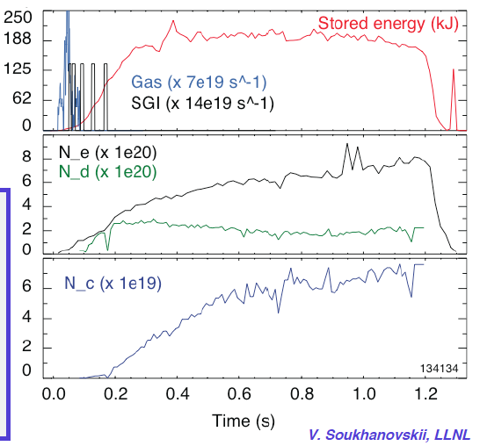
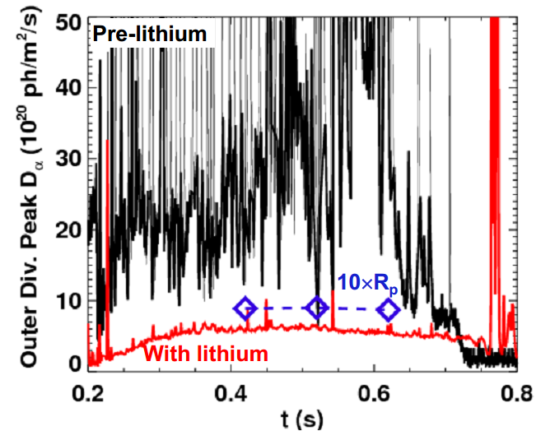
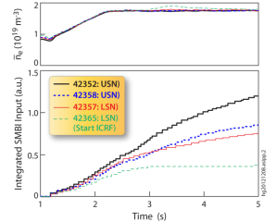
Lithium is sufficient for controlling deuterium, with no evidence of saturation of lithium pumping in ~1 s discharges
Plasma following strong lithium conditioning show stationary, low deuterium content
Recycling remains reduced throughout ~1 s discharges (Boyle, PSI ‘12)
  No increase near end as expected if lithium pumping is saturated
EAST collaboration supports use of pumping by lithium coatings for NSTX-U pulse lengths (Guo, IAEA ‘12)
  L-mode, I_{p}=0.4 MA, P_{RF}=1MW, LSN shots
  Fueling required to maintain constant n_{e} compared for shots following Li deposition
  Effective e-folding time for lithium pumping is ~18 shots or 180 s
    Pumping persistence in higher-power H-mode plasmas to be assessed in future experiments
EAST

Slide 5
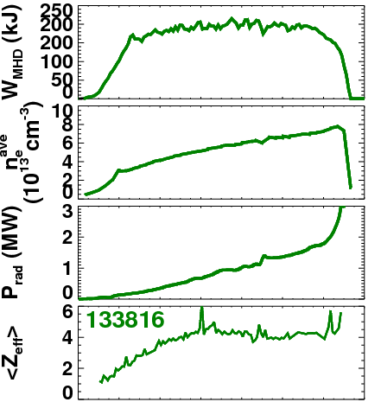
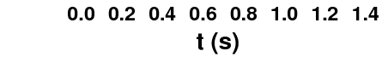
ELM-free lithium operation exhibits impurity accumulation
Without impurity flushing from ELMs, P_{rad} ramps, Z_{eff} is high (~4)
  Radiation from high-Z, Z_{eff} from Carbon
  Fairly typical for ELM-free H-mode
ELM-triggering with 3D fields helps to expel impurities
  P_{rad} can be kept below ~1 MW fairly easily
  Modest reduction in n_{e} ramp, Z_{eff}
  Large ELMs reduce rotation, trigger core MHD modes at high frequency
Initial NSTX-U operation will use lithium+ELMs for particle control
  Can also combine with other methods for reducing impurities (e.g., divertor gas puff, snowflake)
  Likely limited to high f_{G}
  Should allow pulse lengths past ~1.5 s, how far past is TBD

Slide 6
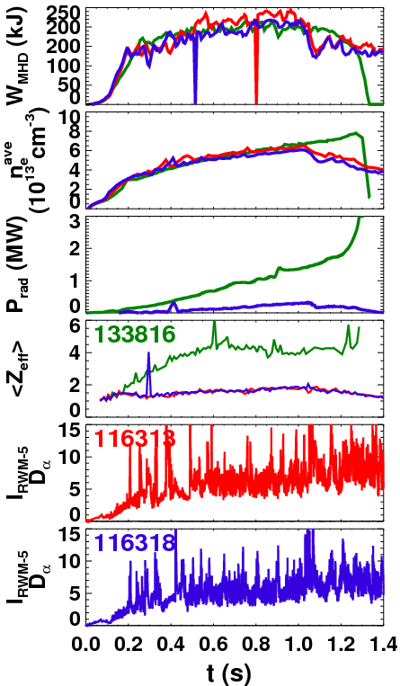
ELMy H-modes with boronized carbon PFCs will be developed in years 1-2 of NSTX-U operation
ELMy discharges without lithium showed low impurity content
Density still ramps throughout shot (until core MHD)
Low-Z_{eff} plasmas with boronized PFCs discharges will be further developed
  Optimize fuelling and discharge formation to minimize gas input
  Utilize between-shot He glow to provide a conditioned wall
  Deuterium inventory likely to rise throughout the discharge
  Will serve as basis for cryo-pumped scenarios when cryo is installed

Slide 7
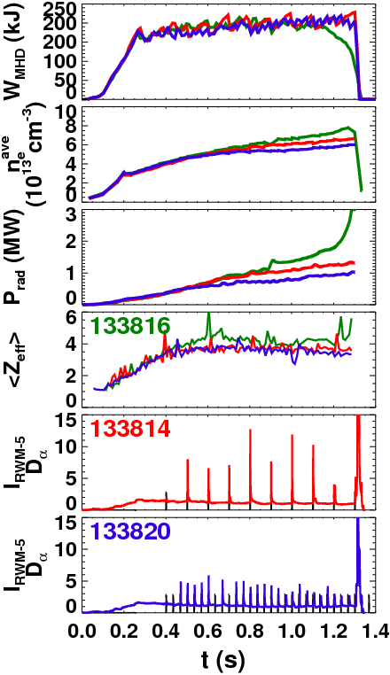
Years 1-2 of NSTX-U operation will test lithium for deuterium control, with ELMs to mitigate impurity accumulation
ELM-triggering with 3D fields helps to expel impurities (Canik NF ‘12)
  P_{rad} can be kept below ~1 MW fairly easily
  Modest reduction in n_{e} ramp, Z_{eff}
Initial NSTX-U operation will test the use of lithium+ELMs for particle control
  Likely limited to high f_{G}(~0.8-1.0) and high Z_{eff} (3-3.5)
  Should allow pulse lengths past ~1.5 s, how far past is TBD
FY15 goals will be to re-establish, and extend ELM-paced scenarios
  Combine with other methods for reducing impurities (e.g., divertor gas puff, snowflake)
  Improve ELM triggering (vertical jogs, Li optimization to avoid ELM suppression)

Slide 8
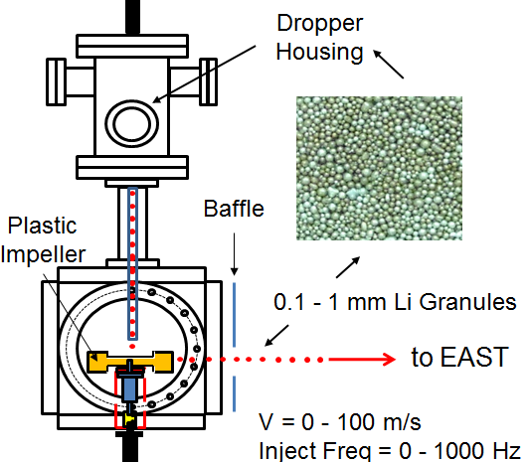
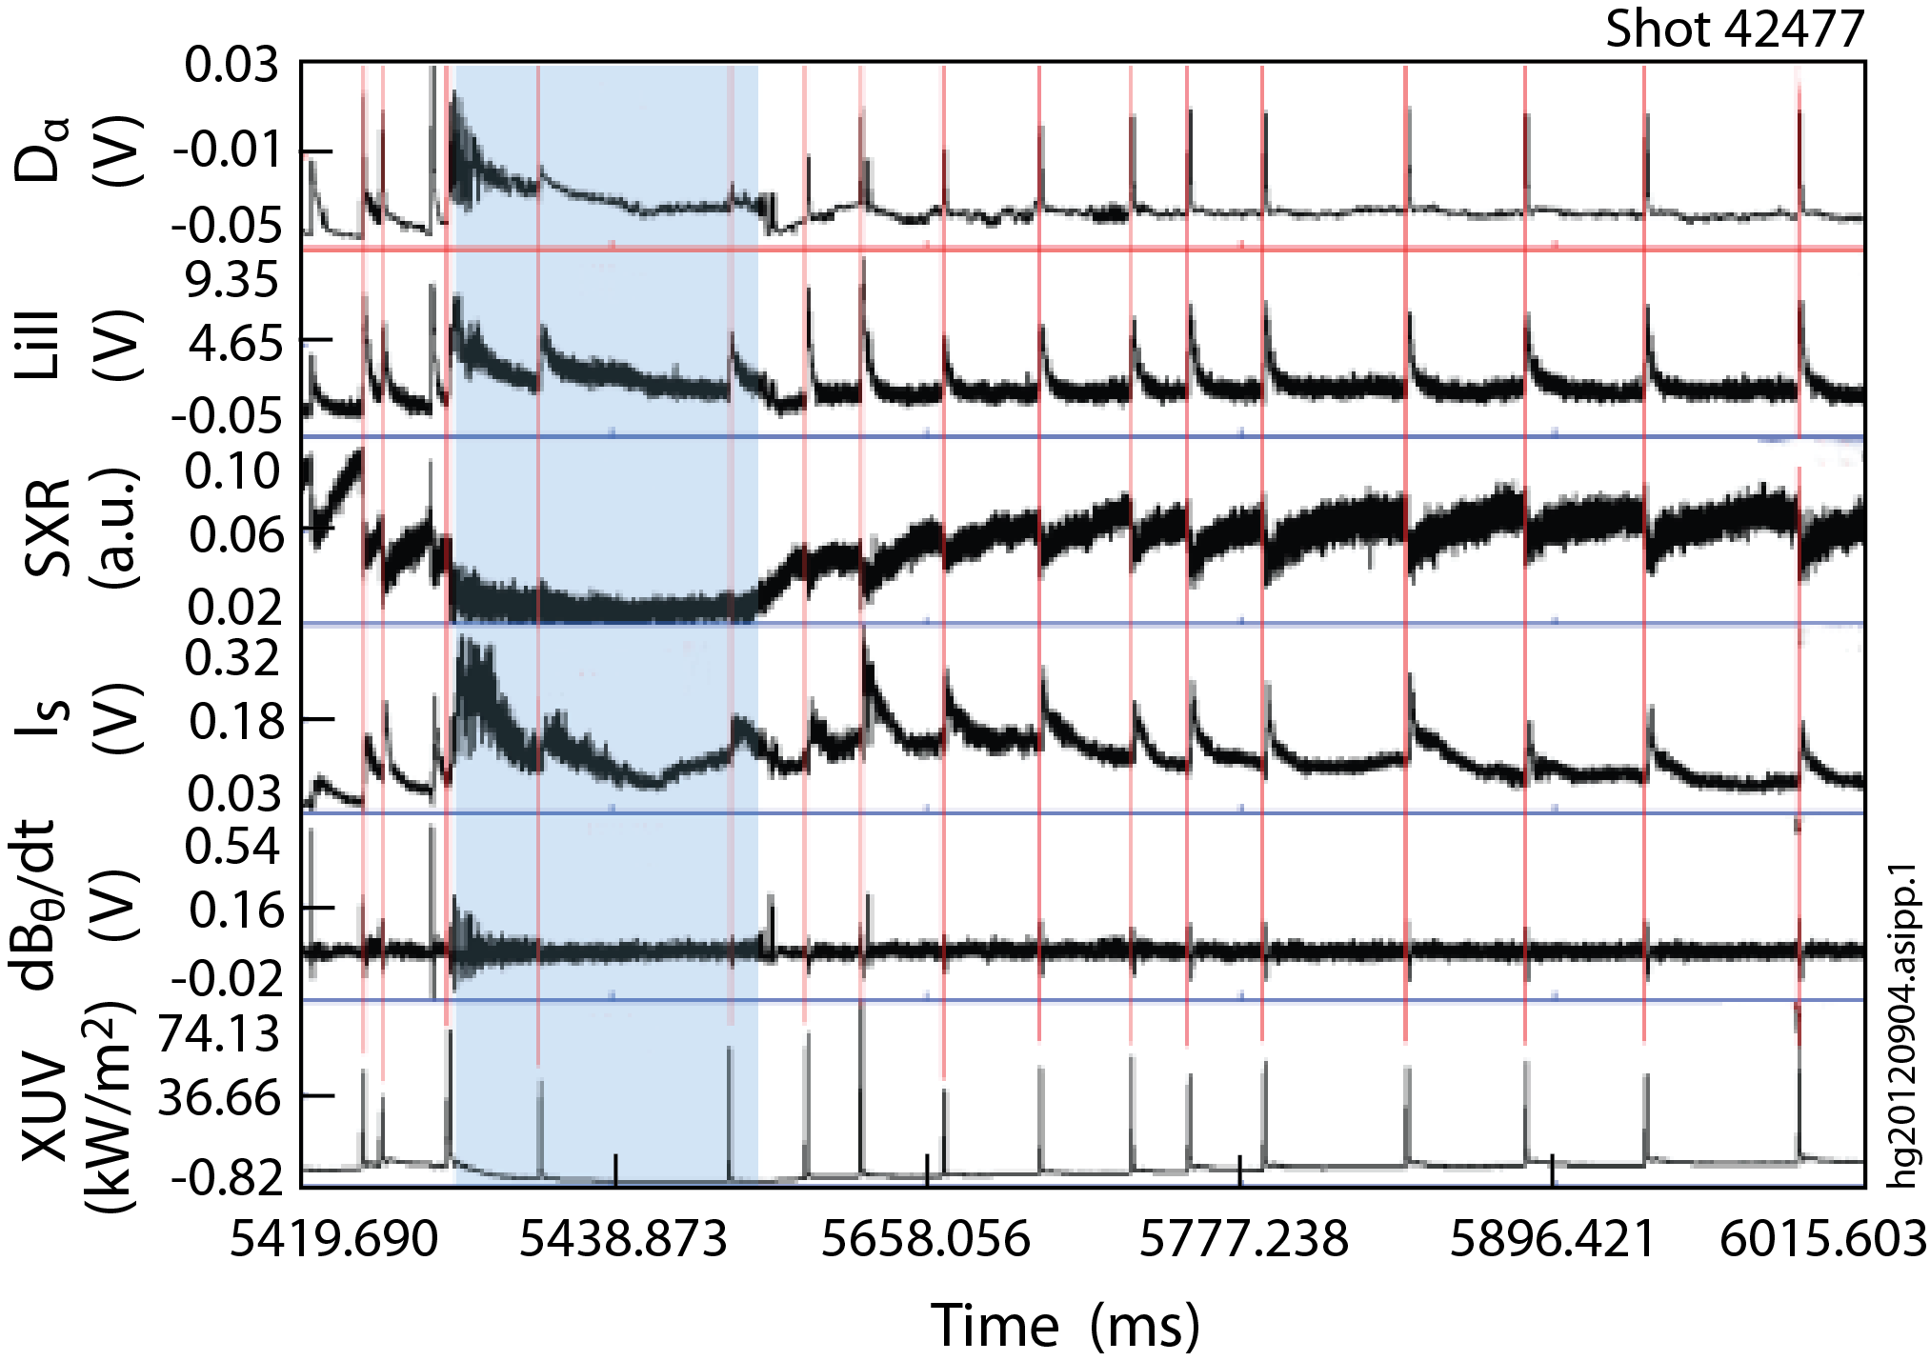
Late FY15/early FY16 lithium+ELMs scenarios will be enhanced by Lithium Granule Injector
LGI will be tested for high-frequency ELM pacing for impurity control
  Pellet ELM pacing established method for reducing ELM size, controlling impurity content (Baylor APS/IAEA ‘12)
  Potential for more benign, high frequency ELM triggering
  Injection of lithium pellets could potentially replenish coatings on PFCs
  Scheduled to be installed at end of FY15
  Goal: reduce Z_{eff} to ~2-2.5
EAST collaboration has shown LGI ELM-pacing potential
  Demonstrated ELM-pacing at 25 Hz with nearly 100% triggering reliability
  Capable of up to 1 kHz injection
Mansfield, IAEA ‘12

Slide 9
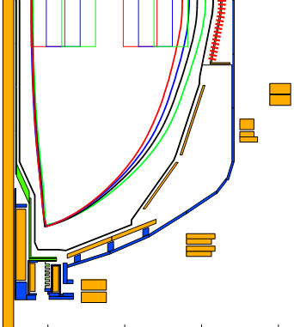
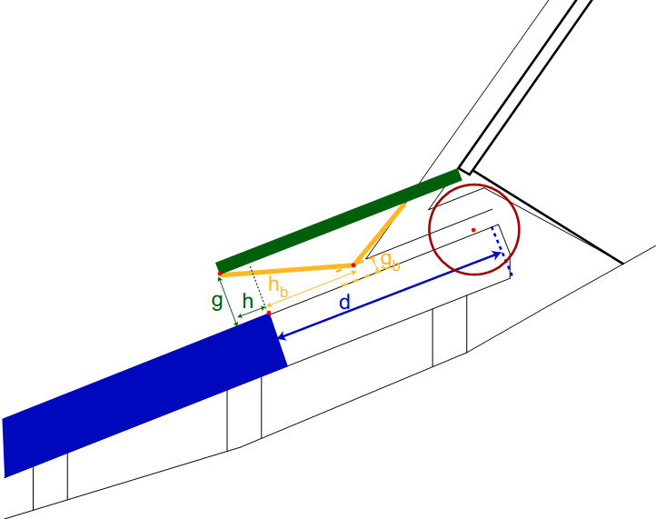
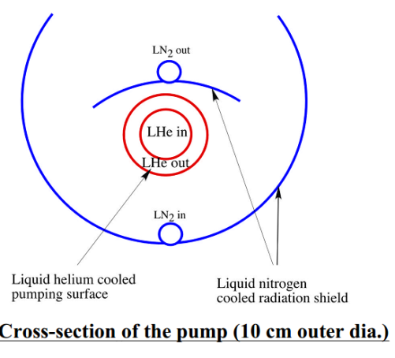
NSTX-U Years 3-4 will utilize cryo-pumping for particle control
Cryo-pump is proven technology for plasma density control
  More conventional pumped ELMy H-mode scenario
NSTX-U design is similar to DIII-D outer lower pump
  Plenum located under new baffling structure near secondary passive plates
  Pumping capacity of a toroidal liquid He cooled loop
    S=24,000 l/s @ R=1.2m (Menon, NSTX Ideas Forum 2002)
  Need plenum pressure of 0.6 mTorr to pump beam input (TRANSP)
g = throat height
h = throat length
Baffle
h
Cryo
g

Slide 10
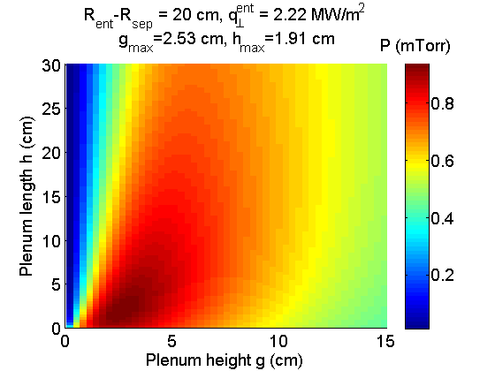
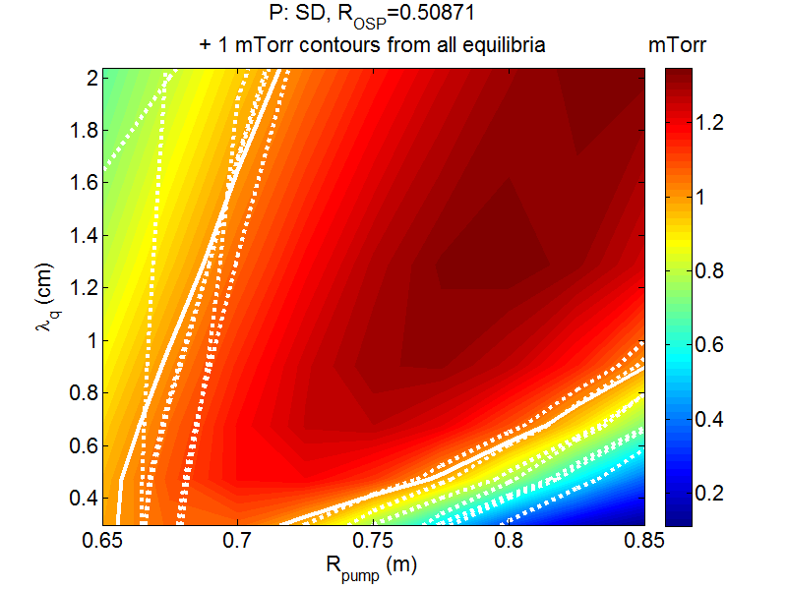
Semi-analytic pumping model used to optimize plenum geometry
Model developed for DIII-D pumping studies (Maingi, NF ‘99)
  Predicts plenum pressure, validated with DIII-D data
  Projected NSTX-U heat flux (I_{p} scaling) and divertor T_{e} (~15 eV) used as input
  Uses first-flight neutral model (insufficient for detached divertor)
Pressure is maximum for duct height g~2.5 cm, length h~2 cm
  But is only weakly reduced if these are increased together
With pump entrance at R=0.72m, pressures >1 mTorr can be reached over wide range of plasma shapes and SOL widths
  Comparable to pressures in DIII-D plenum
  Well above that needed to pump NBI particle input
+

Slide 11
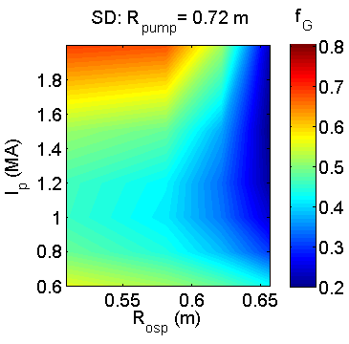
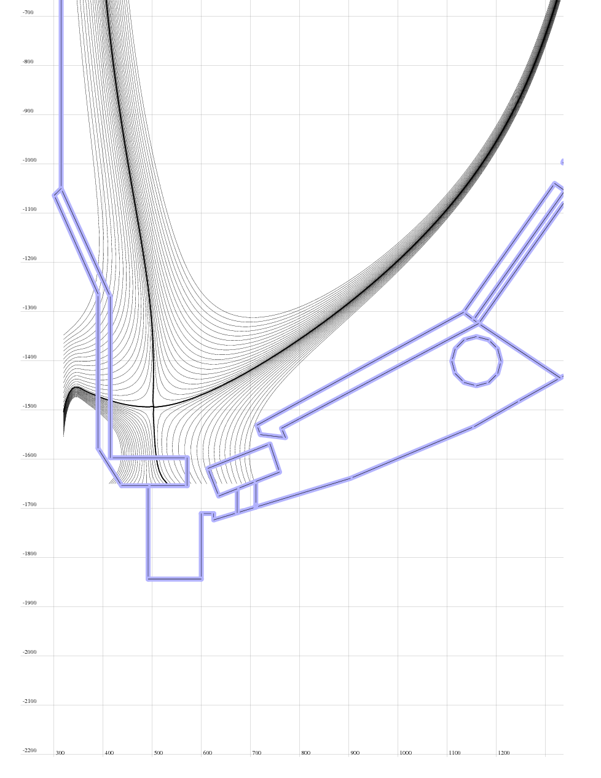
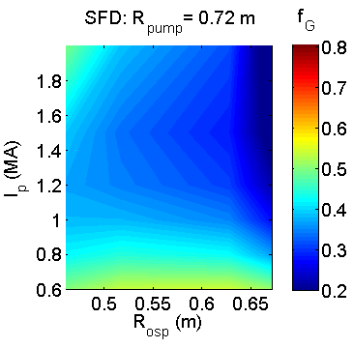
Optimized plenum geometry can pump to low density for conventional and snowflake divertors over a range of R_{OSP}, I_{p}
R_{OSP}: outer strike point radius
R_{pump}: plenum entrance radius
SD: standard divertor
SFD: snowflake divertor
f_{G}: n_{e}/n_{G}
Core density estimated assuming pumped flux=NBI input
  2-pt model used to estimate upstream density
  Assume n_{e}/n_{e}^{sep}~3
Can pump to f_{G}<0.5
  f_{G}~0.7 desirable for all scenarios, lower provides more flexibility
  Moving R_{OSP} closer to pump allows lower n_{e}, but limited by power handling
High flux expansion in SFD gives better pumping with SOL-side configuration
  More plasma in far SOL near pump
  More room to increase R_{OSP} at high I_{p}
q_{pk} > 10 MW/m²
-1.8 -1.6 -1.4 -1.2 -1.0 -0.8
Z (m)
0.4 0.6 0.8 1.0 1.2
R (m)

Slide 12
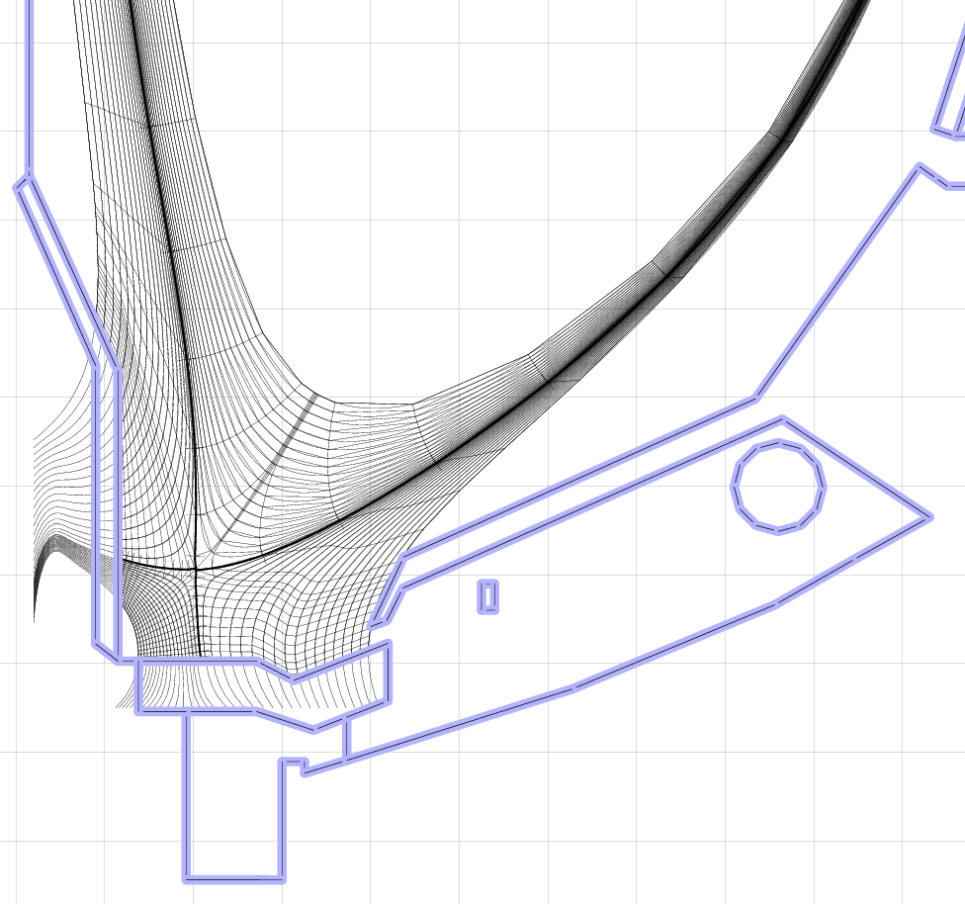
SOLPS calculations confirm optimization approach based on analytic model
SOLPS: 2D fluid plasma/neutral transport
  Plasma transport classical parallel to B (+kinetic corrections), ad-hoc cross-field transport coefficients
  Kinetic neutral transport using MC code EIRENE
    More comprehensive treatment of neutral transport (beyond first-flight)
    Can treat radiative/detached divertor
Range of divertor conditions have been produced using standard and snowflake equilibria
SOLPS-calculated plenum pressure agrees with analytic model for T_{e}^{div}>2 eV, factor of ~3 higher in detached regimes
-1.8 -1.6 -1.4 -1.2 -1.0
Z (m)
0.4 0.6 0.8 1.0 1.2
R (m)
Optimization of design presented here is conservative
  Pumping likely to be stronger for realistic conditions

Slide 13
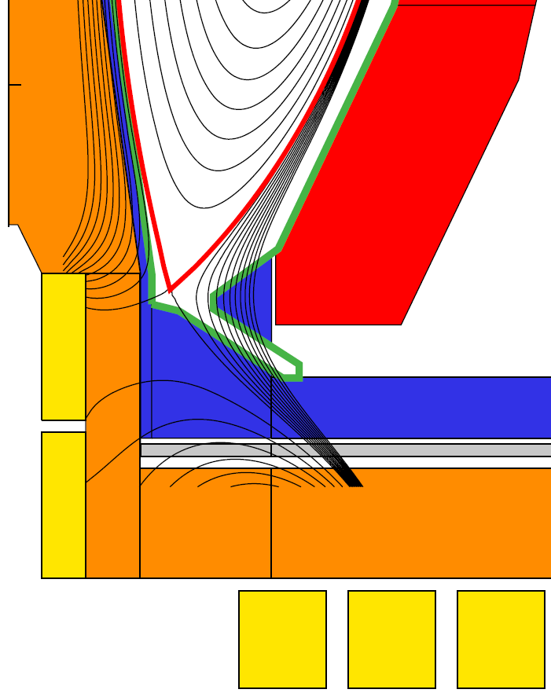
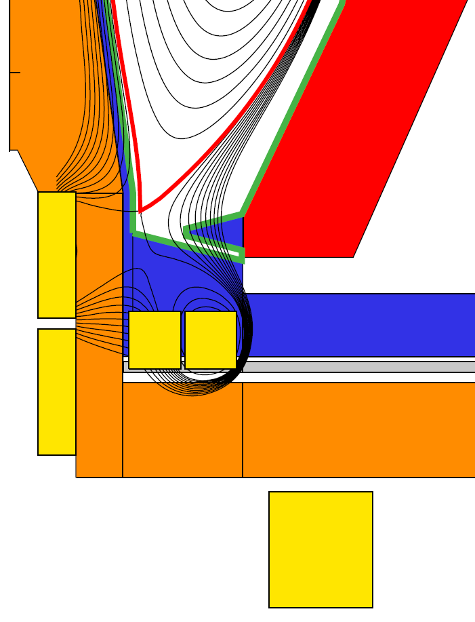
NSTX-U cryo experiments will support FNSF
Field-line angle
of incidence at
strike-point = 1˚
Conventional
Snowflake
Flux expansion = 15-25, δ_{x} ~ 0.55
1/sin(θ_{plate}) = 2-3
Flux expansion = 40-60, δ_{x} ~ 0.62
1/sin(θ_{plate}) = 1-1.5
SOL-side pumping could enable FNSF
  Compact FNSF designs leave little room for vertical target+dome for ITER-like PFR pumping

Slide 14
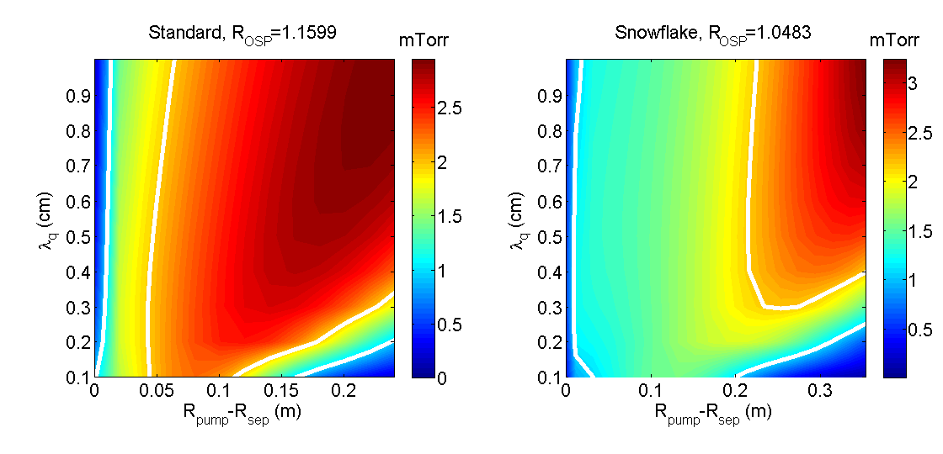
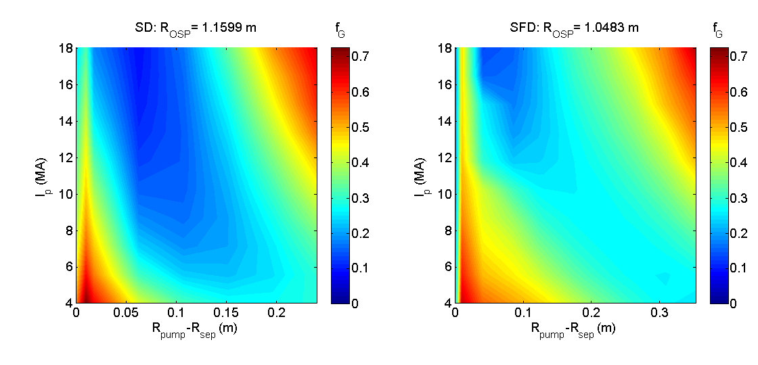
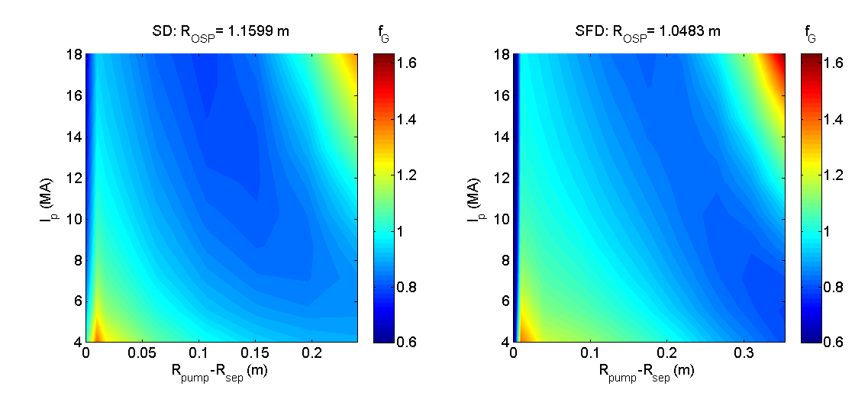
FNSF pumping trends are similar to those in NSTX-U design, projections will be improved by NSTX-U measurements
Analytic model used to optimize geometry, with assumed T_{e}(=5 eV) and λ_{q}
High pressures (>2.5 mTorr) are achievable with SOL-side pumping
  With NSTX-U-like pumping speed, need to reach 0.5 (NNBI) to 2 (PNBI) mTorr
  SD and SFD results are similar, since PFC geometry is altered to keep the plasma-wetted area the same
Achievable densities are promising
  NNBI leads to f_{G}<0.2 (compatible with Peng, FS&T ‘11 FNSF designs)
  For PNBI, f_{G}~0.8 (sufficient for Menard, NF ‘11 ST-FNSF designs)
NSTX-U will provide first results on density that can be achieved with an FNSF-like pumping system
  Needed to benchmark and improve models for projecting the density and SOL width
NNBI: 0.5 mTorr
PNBI: 2.0 mTorr

Slide 15
NSTX-U particle control plans will develop and compare complementary approaches to particle exhaust
FY14: remainder of NSTX-U outage
  Begin engineering design of cryo, update physics as needed
  Use EAST collaboration on lithium pumping, comparison with cryo
  EAST collaboration on ELM-triggering with lithium granules
FY15: initial NSTX-U operation with lithium
  Re-establish lithium scenarios with triggered ELMs, extend to longer pulse
  Get first divertor data in NSTX-U, confirm/finalize cryo design
FY16: optimize lithium+ELM operation
  Test pacing with lithium granule injector
  Evaluate combinations of impurity reduction techniques
FY17: test newly-installed cryo-pump
  Characterize pressure, pumping, impact on density, compare to models
  Develop strongly pumped scenarios
FY18: routine use of cryo-pump in physics studies
  Incorporate cryo into closed-loop density feedback control
  Use pumping to control density in physics expts, e.g. for low ν* studies

Slide 16
Summary: NSTX-U will test complementary methods for achieving particle control
Lithium+ELM scenarios
  Primary control technique in early NSTX-U operation
  May benefit from LGI for improved ELM pacing
Cryo-pumped ELMy H-mode
  ELMy discharges with boronized PFCs to be developed in FY15/16
  Cryo to be installed in outage prior to FY17 operations
Goal for end of 5-year plan
  f_{G} ~ 0.5
  Z_{eff} ~ 2-2.5
  Stationary density
  Up to an order of magnitude reduction in ν* compared to NSTX

Slide 17
BACKUP SLIDES TO BE ADDED
Previous PAC slides/APS talk on cryo details
EAST lithium slides
EAST dropper slides
FNSF details

Slide 18
General layout similar to DIII-D lower outer cryo-pump system is taken as starting point for design analysis
Plenum location studied: under new baffling structure
near secondary passive plates, possibly replacing
some outer divertor plates and tiles
Pumping capacity of a toroidal liquid He cooled loop
(Menon, NSTX Ideas Forum 2002)
  S=24,000 l/s @ R=1.2m
  Need plenum pressure of 0.83 mtorr
  to pump beam input (10MW~20 torr-l/s)
Pumping rate:
  P_{pl} = plenum pressure
  I₀ = neutral flux into plenum
  C = throat conductance
To optimize, need C(g,h), I₀(g,h)
g = throat height
h = throat length
Baffle
h
Cryo
g

Slide 19
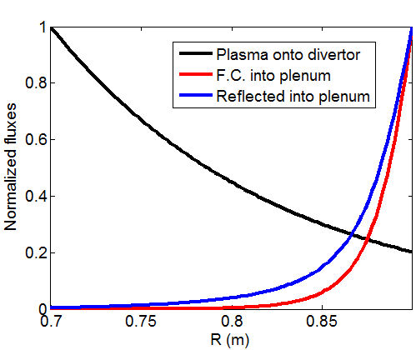
Semi-analytic pumping model* used to optimize pumping chamber
Uses first-flight model for neutral flux into pump plenum
Requires knowledge of divertor plasma profiles
Validated against DIII-D experiments
Plenum pressure corrected for penetration of neutrals
through long duct (verified using EIRENE)
Neutral current into plenum
Solid angle of plenum entrance
Transmission of neutrals through plasma
Origin of neutrals making it into plenum tends to be
localized to near-entrance region
Dominantly due to solid angle factor
*R. Maingi, Nucl. Fus. 39 (1999) 1187

Slide 20
Model upgraded to include conductance correction in a long channel
I_{D0} = I_{D0}(x) = current of “fast” atomic
deuterium entering from plasma
If fast atoms are turned into thermal
molecules on collision will the wall, then:
  I_{D0}(x) = I_{D0}(0)*F(x)/F(0), where F is the
  solid angle factor evaluated along x
I_{D2} = current of thermal molecules leaving
I_{D2} = volume integral of sources (I_{D0}), sinks (P_{pl}S)
⇒ I_{D2}(x) = I_{D0}(x) – P_{pl}S
Pressure is
So plenum pressure is
P_{pl}
S
x=length along
duct
I_{D0}
I_{D2}

Slide 21
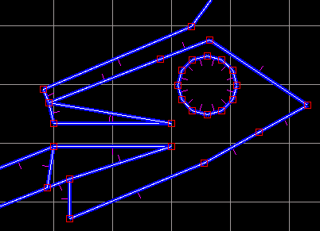
Expressions for conductance, pressure have been checked with Monte Carlo neutral code EIRENE
Set of ducts constructed in EIRENE, varying length and height
Three calculations made for each:
  No pumping, gas source inside plenum
    Gives the actual conductance of duct/aperture
    C = I_{pl}/P_{pl}
    (I_{pl}=source in plenum, P_{pl}=plenum pressure)
  No pumping, gas source outside plenum (mimic neutrals coming from plasma)
    Gives effective conductance, accounts for how far neutrals make it down duct before hitting the walls
    C_{eff} = I_{ent}/P_{pl}
    (I_{ent}=current of neutrals crossing duct entrance)
  Pumping on (S=24 ,m³/s), gas source outside plenum
    Check pressure against analytic expression:
    P = (C/C_{eff})*I_{ent}/(S+C)

Slide 22
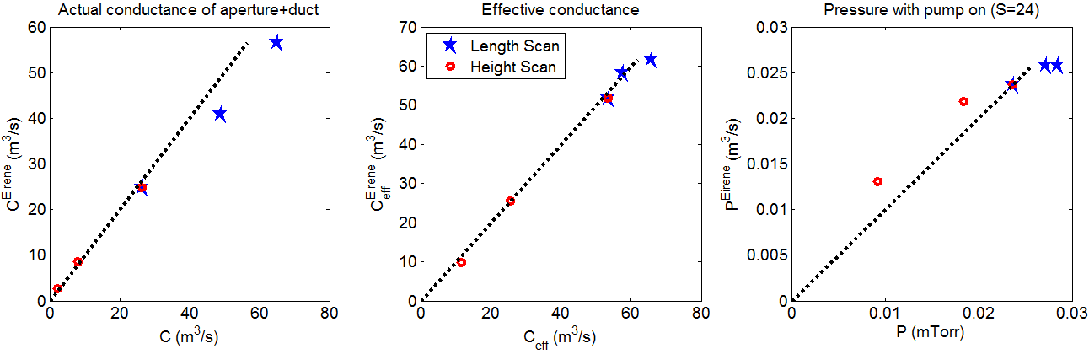
EIRENE confirms pressure variations with plenum entrance geometry
X-axis: analytic expressions, Y-axis: values calculated with EIRENE
Conductances are ok, but duct expression is somewhat off (based on length scan on left)
Pressure variations from EIRENE largely agree with analytic expressions
  Difference is largely due to the conductances: if the EIRENE-calculated conductances are used, pressures lie on the line
  Just using P=I/(S+C) gives numbers higher by ~x2-3, trends off

Slide 23
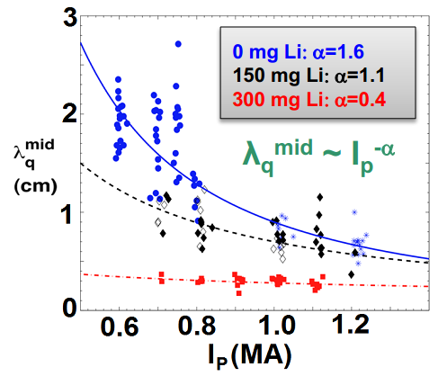
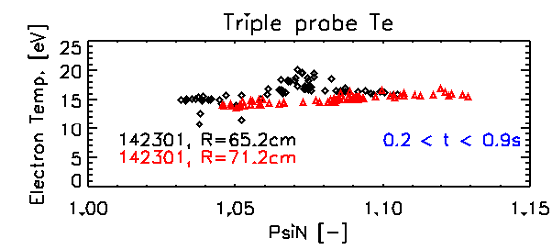
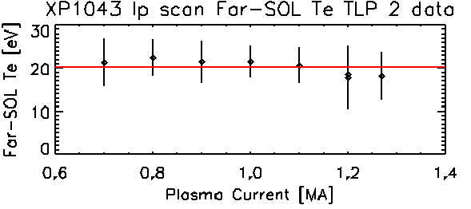
Projected divertor parameters combined with semi-analytic pumping model are used to calculate pumping rates
Analytic model requires divertor n, T, Γ profiles
Heat flux, angle of B wrt PFC surface (α), and plasma temperature are sufficient to calculate n, Γ:
  Recent experiments yield scaling of SOL heat flux width
    No-lithium scaling used here, but all trend towards λ_{q}~3mm at I_{p}=2MA
    P_{div} = 5 MW assumed (1/2 of 10 MW input)
  Langmuir probes show T_{e}~15-20 eV in far SOL, with lithium radial, I_{p} dependence
    T_{e}~15 eV assumed (NSTX-U-like discharges)
NSTX shots with A=1.7 of NSTX-U
NSTX divertor scaling experiments

Slide 24
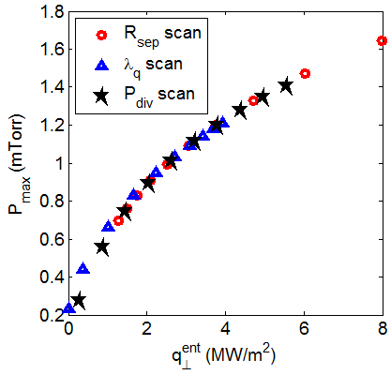
Pressure projections are used to optimize plenum geometry parameters
  Exponentially decaying heat flux footprint imposed, with T_{e}=15 eV
Plenum entrance height, length are varied to maximize pressure
Pressure in optimized plenum depends primarily on heat flux at pump entrance
  Varied through R_{OSP}, flux expansion or P_{tot} ⇒ profile effects not important
  Reaching P~0.8 mTorr (to pump 10 MW NBI) requires q⊥^{ent}~2 MW/m²
Optimal plenum entrance for P=0.8mTorr: height g~2.5 cm, length h~2 cm
+

Slide 25
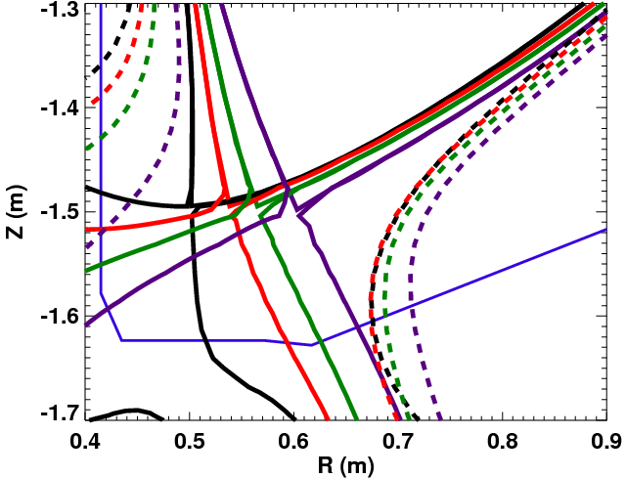
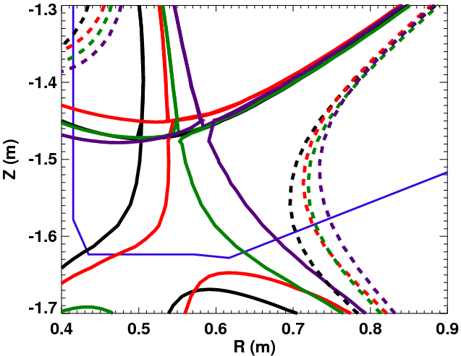
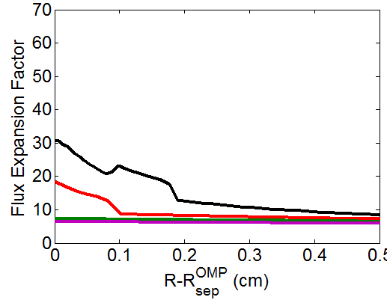
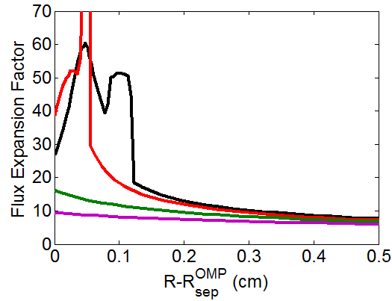
Equilibria with variety of R_{OSP}, flux expansion are used to map heat flux profiles, assess candidate pump entrance locations
Standard and snowflake divertors considered
  Four R_{OSP} each
  ψ_{N}=1.0,1.03 shown
  Movement of ψ_{N}=1.03 strike line is much less than that of R_{OSP}
Flux expansion, flux surface geometry used to convert midplane heat flux profile (from scaling) to divertor heat flux
  As R_{OSP} is increased, flux expansion is decreased
Standard
Snowflake

Slide 26
Realistic equilibria, heat flux scaling, and empirical T_{e}^{SOL} are used to project plenum pressure for candidate location R_{pump}
Analytic model for plenum pressure with optimized entrance parameters
Pressure is non-monotonic with R_{pump} due to field geometry
  At low R_{pump}, α is lower, so n/Γ⊥ is increased
  ⇒more neutrals ionized before reaching pump
Optimizing position for narrowest SOL gives R_{pump}~0.7
  Narrow SOL gives least flexibility in moving R_{OSP} to improve pumping
  R_{pump}=0.72 gives high P for wide range of SOL width
STANDARD DIVERTOR P₀

Slide 27
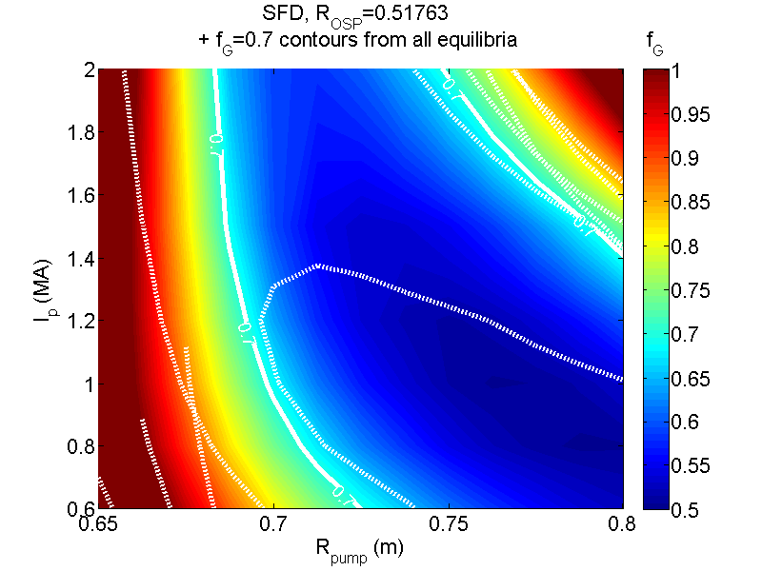
R_{pump}=0.72 gives n_{e} control for range of I_{p}, equilibria
Modified 2-pt model used to estimate n_{e}^{sep}
  q||^{sep} from I_{p} scaling, T_{e}^{div} varied
  Final n_{e}^{sep}: pumping=NBI input
n_{e}/n_{e}^{sep} ~ 3 used to estimate f_{G}=n/n_{G}
  Consistent with NSTX data
SNOWFLAKE DIVERTOR n/n_{G}

Slide 28
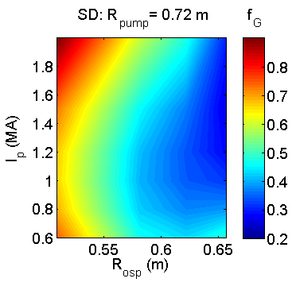
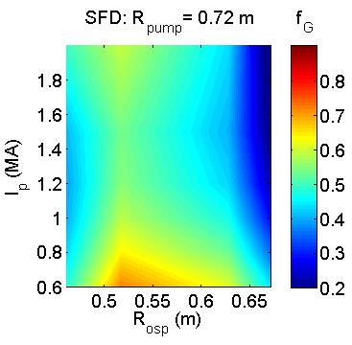
Optimized plenum geometry capable of pumping to low density for a range of R_{OSP}, I_{p}
Equilibrium f_{G} down to < 0.5
  Moving R_{OSP} closer to pump allows lower n_{e}, but limited by power handling
High flux expansion in SFD gives better pumping with SOL-side configuration
  More plasma in far SOL near pump
  More room to increase R_{OSP} at high I_{p}
q_{pk} > 10 MW/m²
-1.8 -1.6 -1.4 -1.2 -1.0 -0.8
Z (m)
0.4 0.6 0.8 1.0 1.2
R (m)

Slide 29
SOLPS is used to analyze pumping including near-detached conditions
SOLPS: 2D fluid plasma/neutral transport
  Plasma transport classical parallel to B (+kinetic corrections), ad-hoc cross-field transport coefficients
  Kinetic neutral transport using MC code EIRENE
    More comprehensive treatment of neutral transport (beyond first-flight)
    Can treat radiative/detached divertor
Both standard and snowflake divertor with R_{OSP}~0.5m studied
  Note that grid can’t extend past pump, so only small SOL region modeled
Constant D=0.5, χ_{e,i}=2.0 m²/s
  Gives λ_{q}^{mid} ~ 3mm
  No attempt to match expt
Simulations both without and with carbon included have been performed
-1.8 -1.6 -1.4 -1.2 -1.0
Z (m)
0.4 0.6 0.8 1.0 1.2
R (m)

Slide 30
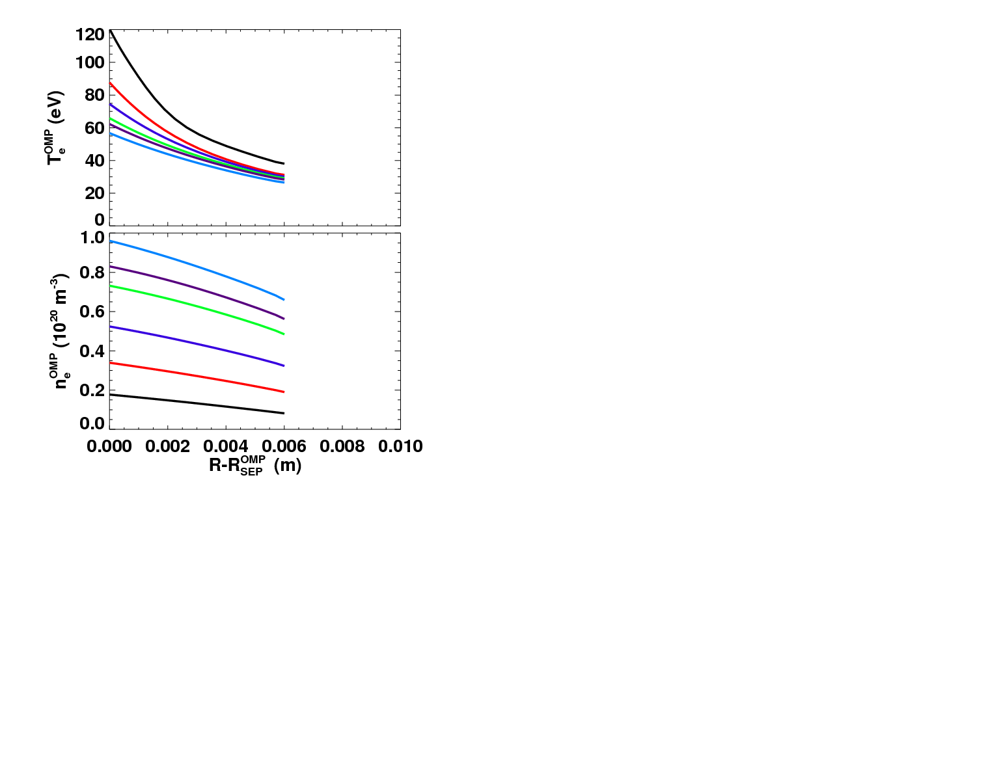
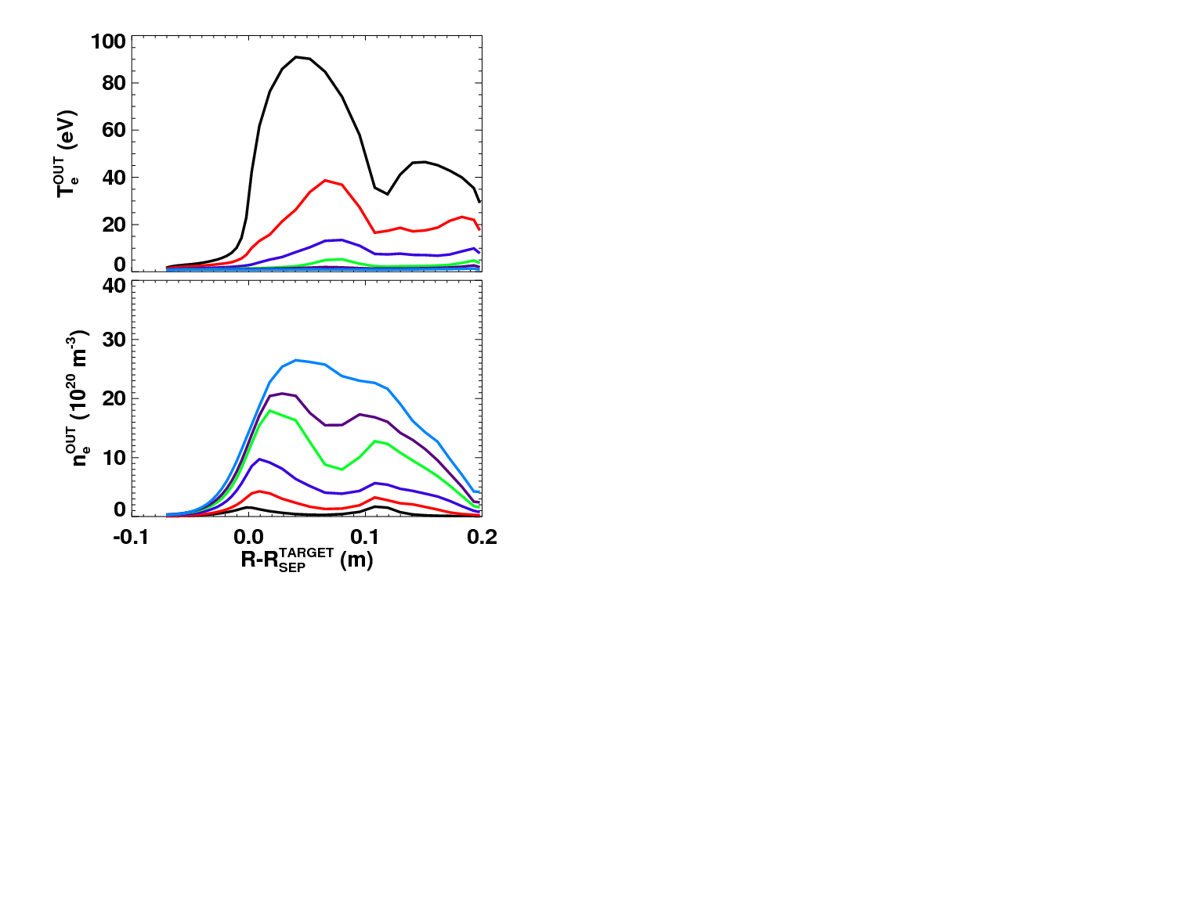
A wide range of divertor plasma parameters have been modeled
Input power P=10MW in all cases
n_{e} at core grid edge set as boundary condition
  Scanned to vary divertor conditions
Resulting divertor parameters vary from strongly attached to nearly detached (T_{e}~1eV)
Midplane
Divertor

Slide 31
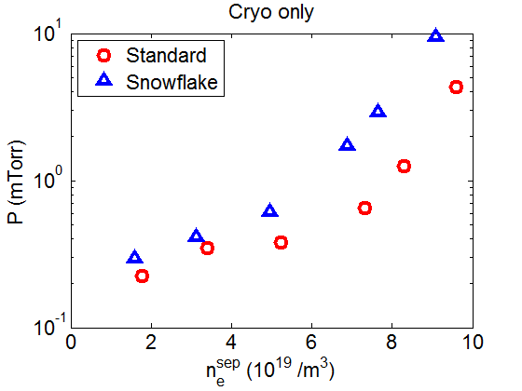
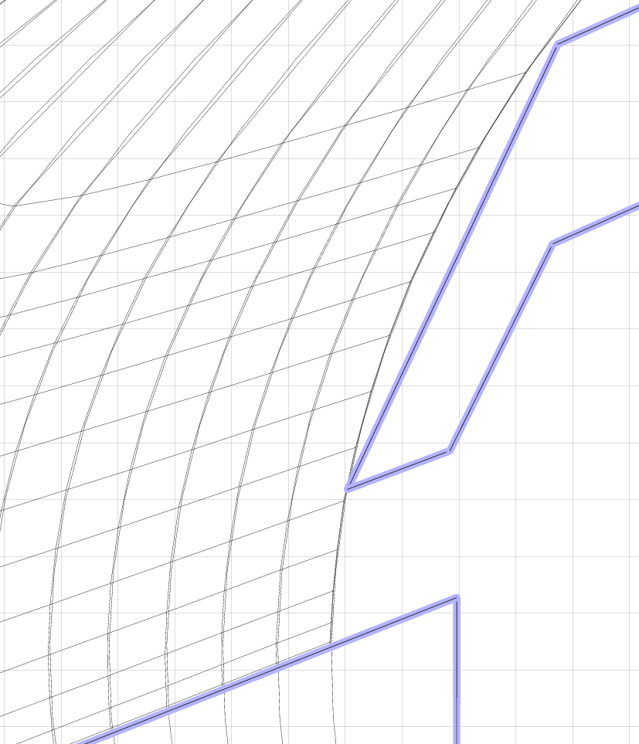
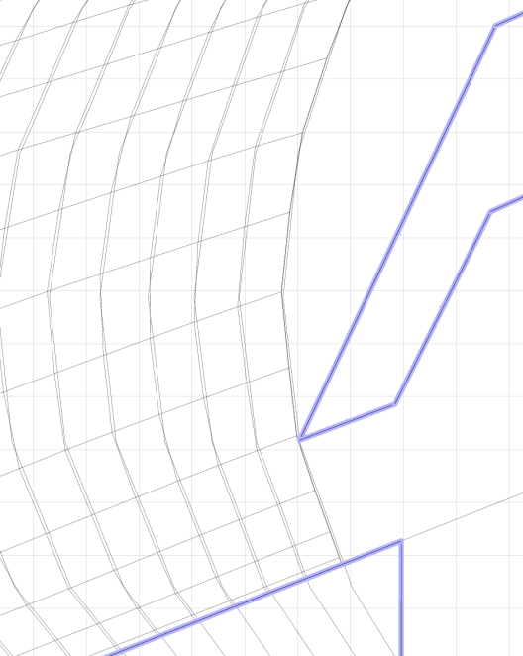
Snowflake shows higher plenum pressures that standard divertor for similar conditions
At same separatrix density, pressure is ~2x higher with Snowflake divertor configuration
Partially due to geometry of field lines at pump entrance (plasma flux reaches nearer entrance; not accounted for in earlier projections)
Pressures above 1 mTorr can be reached at high n_{e} in both cases
Standard
Snowflake

Slide 32

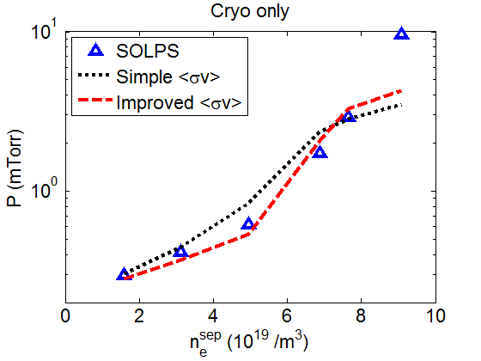
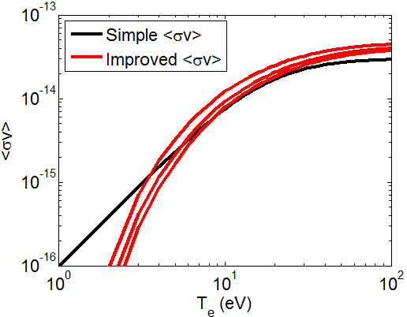
Plenum pressure from SOLPS shows good agreement with semi-analytic expressions when divertor is attached
Divertor n_{e}, T_{e}, Γ⊥ from SOLPS used in semi-analytic model
Model reproduces pressure within factor of ~2 (except high n_{e})
Agreement is improved using more accurate ionization rate
  Simple rate coefficients used in original model:
  Interpolating tables of ⟨σv⟩(n_{e},T_{e}) as in EIRENE improves comparison
n_{e}=1,3,10x10¹⁹ m⁻³

Slide 33
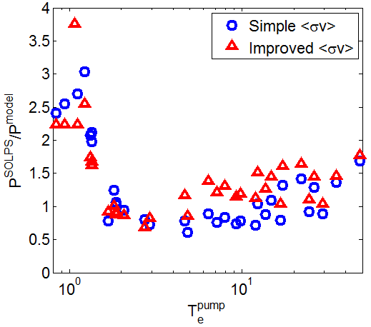
Semi-analytic model underestimates pressure under detached conditions
Model pressure close to SOLPS calculation for T_{e}>2 eV
  Often underestimates by ~50%
  Model does not give large overestimate in any cases
For T_{e}<2 eV SOLPS-calculated pressure is up to ~3x higher than model
  First-flight neutral model expected to break down
  Consistent with DIII-D pumping observations
Optimization of design presented here is conservative
  Pumping likely to be stronger for realistic conditions

Slide 34
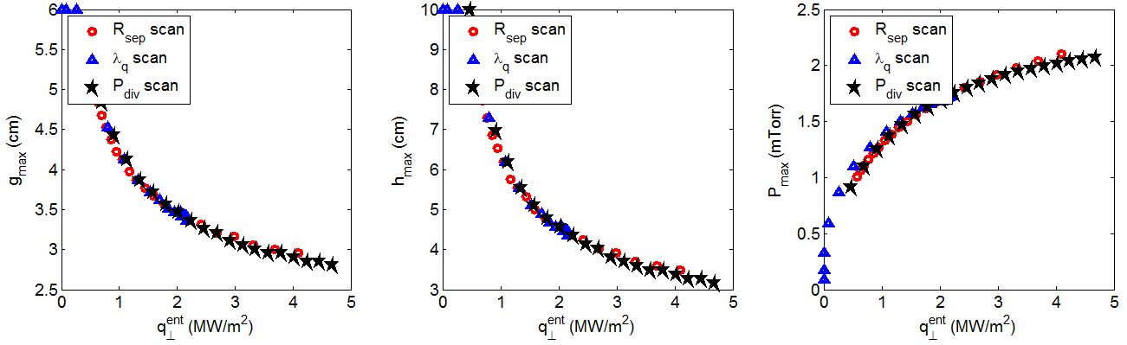
Duct optimization for R_{pump}=1.3 m
Exponentially decaying heat flux assumed, based loosely on parameters from the Menard/Brown DEMO talk
  Assuming T_{e}=5 eV, due to erosion requirements
It’s actually pretty easy to get to P=0.5 mTorr
Aiming for 1 mTorr gives a duct with g~4.5, h~7 cm
  Need ~1MW/m² at pump entrance
Can already see that if PNBI is used this will be harder
  Need ~5 MW/m² at pump entrance to get to 2 mTorr
  Would probably need to increase pumping speed in that case (or maybe play more with divertor geometry—still want to try vertical target)

Slide 35
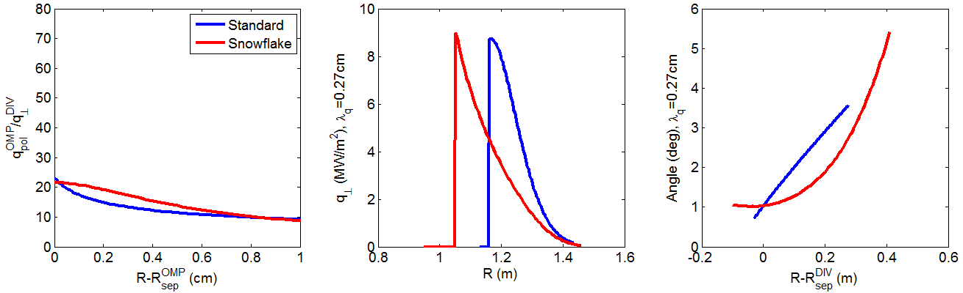
Standard and Snowflake equilibria used to map fluxes onto divertor
Flux surface shapes can be found in Menard/Brown DEMO talk
Both divertors have ~the same geometric heat flux reduction
  Snowflake gets it through flux expansion, standard through poloidal inclination of target
  Note that target geometry is different in the two cases
  Total field angle of incidence is similar at OSP (~1 deg)

Slide 36
Looks like reasonable pumping can be achieved
Assuming Te=5 eV
Projected pressure shows usual maximum in pump position that varies with SOL width
  Even though heat flux is higher near OSP, the angle is lower too, so that plasma density is high and ionizes more neutrals
For λ_{q}~2.7mm, a pump at R~1.3 looks like its close to optimal for both divertor configurations
Reaching 0.5 mTorr is easy, and it looks like even 2 mTorr is within reach (one of the white contours, not sure why there are two…)

Slide 37
Achievable Greenwald fraction assuming we only have to pump 500 keV beam input
Eich scaling for SOL width used during I_{p} scan
Note that 2-pt model used here doesn’t account for radiation
  E.g., assumes that the full 80% radiated power is in the core
Can easily reach very low f_{G}, consistent with pressure plots
Might be better to move pump inwards a bit, maybe to ~1.25 or even 1.2 to be able to pump high current shots

Slide 38
Achievable Greenwald fraction assuming we only have to pump 150 keV beam input
Assuming that you need ~4 times the pressure with low energy PNBI
Can still pump down to reasonable densities (~0.8 GW)
Contours are pushed out to the right a little bit compared to previous slide, so the R=1.3 pump looks good in this case

Slide 39


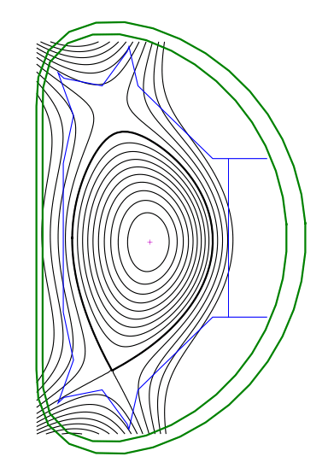
Configuration of EAST shot 42477
LSN during Li granule injection
EAST
EAST
Ti(0) ~ Te(0) ~ 1 keV
88 mm
Impeller
2.0 m
7

Slide 40
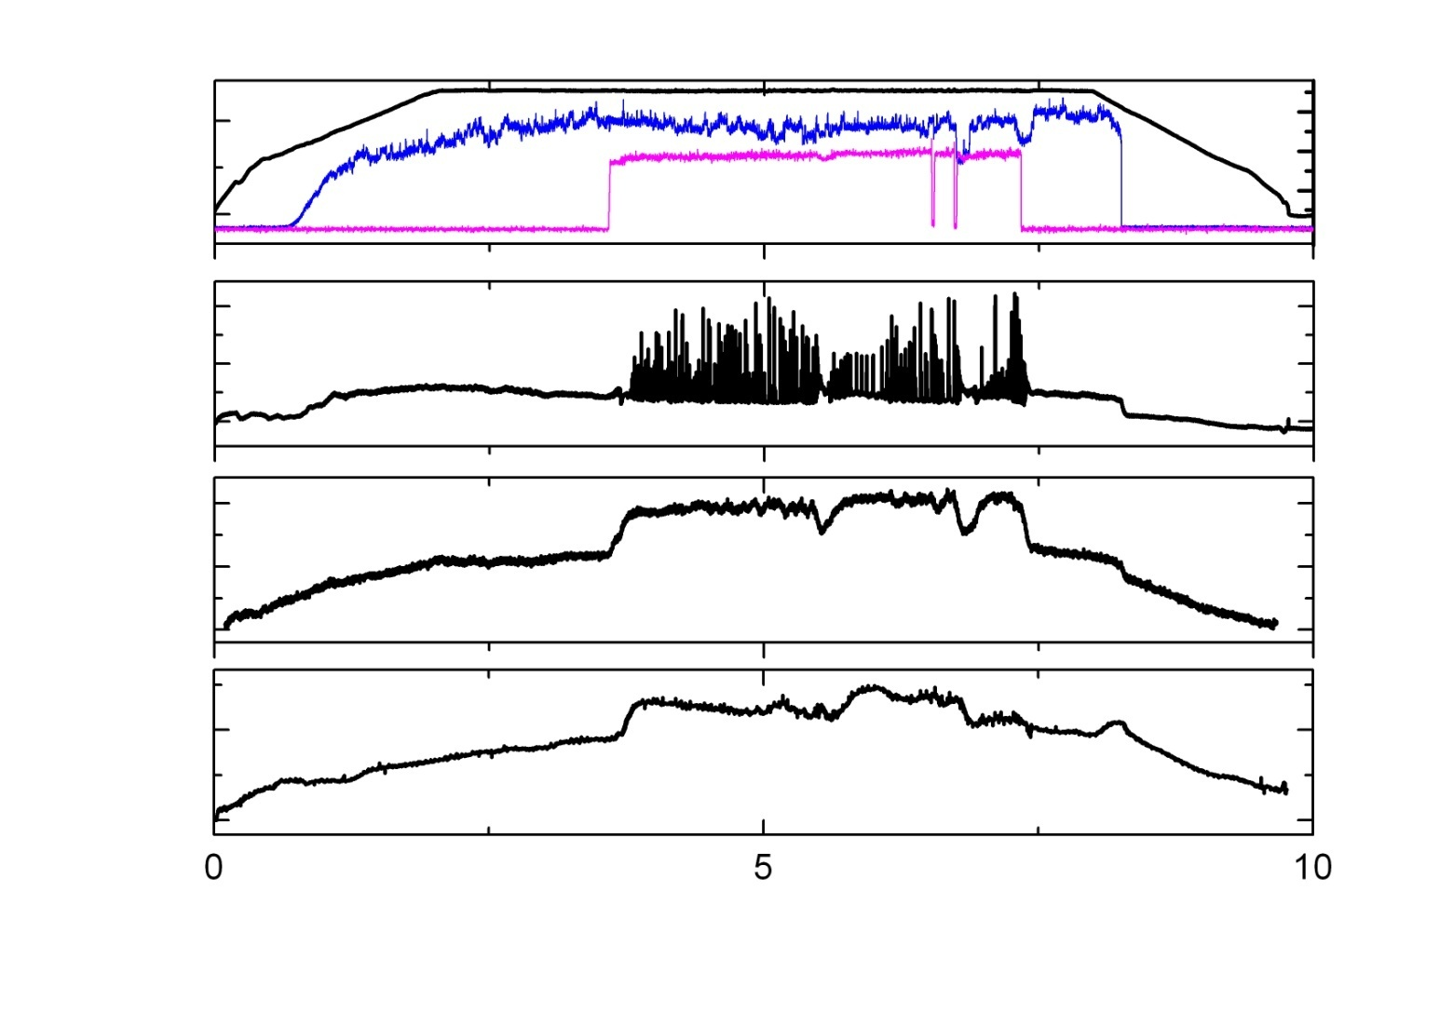
One sec injection @ 25 Hz of 0.7 mm
Li granules at 52 m/s - shot 42477
EAST
EAST
400
Ip
2
kA
MW
LHCD
ICRF
0
0
1
Da
A.U.
0
100
Stored U
kJ
0
6
neL
10¹³m⁻²
0
Time (s)
8

Slide 41
Examples of Triggered ELMs
Shot 42477
EAST
EAST
9

Slide 42
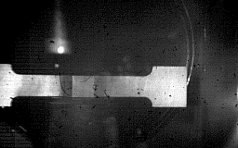





Video Images of Li granule Injection
and ablation processes – shot 42477
EAST
EAST
Video camera image
Same image filtered
Granule impeller contact
Guide tube
Lighting
reflection
52 m/s
3 m/s
Li granule
Impeller
a) Granule exits tube
b) Granule exits tube
c) Impeller hits granule
38.06 ms after image c
First frame with ablation
Maximum ablation
Last frame with ablation
d) Rectangular “flash”
e) Max “flash” intensity
f) Ablation “flash”ends
Images (d – f) ablation duration Δt = 469 µs
11

Slide 43
Video timing of Li granule injections
with respect to 1st Granule
EAST
EAST
Granule
#
20
1071
19
1045
18
879
17
732
16
546
15
487
14
442
13
397
12
342
11
313
10
293
9
258
8
222
7
189
6
163
5
141
4
68.7
3
32.7
2
6.5
Δt (ms)
12

Slide 44

Li granule injection timing on video
versus edge XUV signal
EAST
EAST
1071
1045
879
732
546
487
442
397
342
313
XUV (a.u.)
293
258
222
189
163
141
68.7
32.7
6.5
0
Time (ms)
1000
13

