Slide 1




NSTX-U
Supported by
FY14-18 Five Year Plan
Energetic Particle (EP) Physics
Coll of Wm & Mary
Columbia U
CompX
General Atomics
FIU
INL
Johns Hopkins U
LANL
LLNL
Lodestar
MIT
Lehigh U
Nova Photonics
Old Dominion
ORNL
PPPL
Princeton U
Purdue U
SNL
Think Tank, Inc.
UC Davis
UC Irvine
UCLA
UCSD
U Colorado
U Illinois
U Maryland
U Rochester
U Tennessee
U Tulsa
U Washington
U Wisconsin
X Science LLC
M. Podestà
G. Taylor, N. N. Gorelenkov
for the NSTX-U Research Team
Culham Sci Ctr
York U
Chubu U
Fukui U
Hiroshima U
Hyogo U
Kyoto U
Kyushu U
Kyushu Tokai U
NIFS
Niigata U
U Tokyo
JAEA
Inst for Nucl Res, Kiev
Ioffe Inst
TRINITI
Chonbuk Natl U
NFRI
KAIST
POSTECH
Seoul Natl U
ASIPP
CIEMAT
FOM Inst DIFFER
ENEA, Frascati
CEA, Cadarache
IPP, Jülich
IPP, Garching
ASCR, Czech Rep
NSTX-U PAC-33 Meeting
PPPL – B318
February 19-21, 2013

Slide 2
Goal: enable predictions of fast ion behavior and associated instabilities in high-β, super-Alfvénic regimes (ITER/FNSF)
Need to understand/predict fast ion distribution behavior
  Fast ions affect power balance, MHD stability
  Provide current drive, torque
Sources
NB, fusion
F_{nb}
space, velocity, time
Sinks
Thermalization,
transport

Slide 3
Goal: enable predictions of fast ion behavior and associated instabilities in high-β, super-Alfvénic regimes (ITER/FNSF)
Need to understand/predict fast ion distribution behavior
    ...especially when it deviates from “classical”
    > Non-linear physics dominates
Sources
NB, fusion
Ext. fields
ripple, 3D fields
F_{nb}
space, velocity, time
Sinks
Thermalization,
transport
Instabilities
*AEs, kinks, RWM

Slide 4
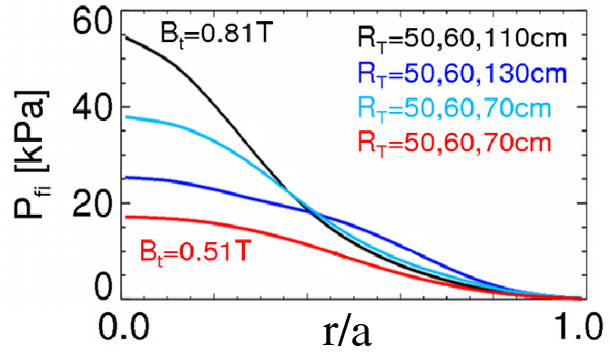
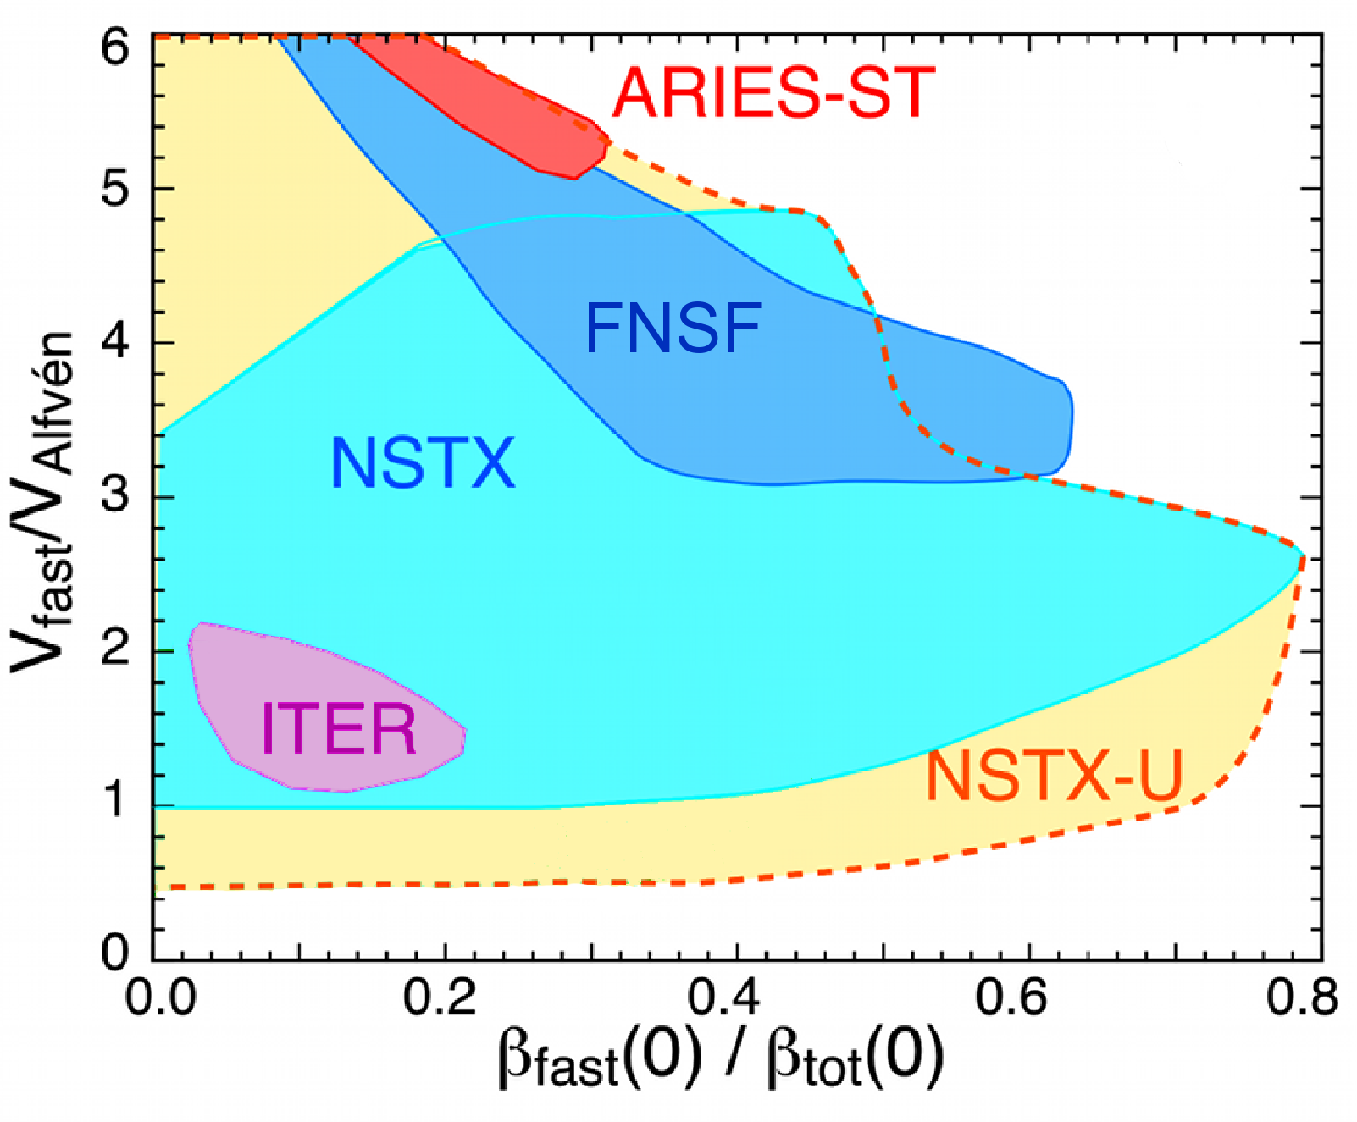
Goal: enable predictions of fast ion behavior and associated instabilities in high-β, super-Alfvénic regimes (ITER/FNSF)
Need to understand/predict fast ion distribution behavior
    ...especially when it deviates from “classical”
    > Non-linear physics dominates
    NSTX-U features unique capabilities for EP studies towards ITER, FNSF, next-steps
3 additional NB sources, 3D fields, q-profile/density control
  Improved flexibility to manipulate fast ion distribution F_{nb}, NB-CD
Higher B_{t}, current, longer pulses with super-Alfvénic ions and high β
  Expand regimes for EP physics
  towards ITER, FNSF

Slide 5
Outline
EP Thrusts and Milestones for FY14-18
5 year Research plans and goals
  FY14 : preparing for beginning of NSTX-U operations
  FY15-18 : EP research in support of 2 main EP Thrusts
Theory, diagnostics in support of EP research
Summary
10% incremental budget:
Incr.
Backup Slides:
B#Z

Slide 6
Outline
EP Thrusts and Milestones for FY14-18
5 year Research plans and goals
  FY14 : preparing for beginning of NSTX-U operations
  FY15-18 : EP research in support of 2 main EP Thrusts
Theory, diagnostics in support of EP research
Summary
10% incremental budget:
Incr.
Backup Slides:
B#Z

Slide 7
EP Thrusts & Milestones: assess predictive capability, tools & techniques for F_{nb} and mode control
  Thrust EP-1: Develop predictive tools for *AE-induced fast ion transport
  Reproduce fast ion transport for broad range of modes’ properties (frequency, spectrum, structure)
  Verification&Validation vs. NSTX-U data to assess predictive capability
Thrust EP-2: Assess requirements for fast ion phase space engineering
  Assess techniques to affect F_{nb}, modes’ properties through NB, rf, 3D fields, external antennae
B#25
B#26

Slide 8
EP Thrusts & Milestones: assess predictive capability, tools & techniques for F_{nb} and mode control
  Thrust EP-1: Develop predictive tools for *AE-induced fast ion transport
  Reproduce fast ion transport for broad range of modes’ properties (frequency, spectrum, structure)
  Verification&Validation vs. NSTX-U data to assess predictive capability
Thrust EP-2: Assess requirements for fast ion phase space engineering
  Assess techniques to affect F_{nb}, modes’ properties through NB, rf, 3D fields, external antennae
  FY14 Milestone: Assess reduced models for *AE-induced fast ion transport.
  FY15 Milestone*: Assess the effects of NB injection parameters on fast ion distribution function, NB driven current profile.
  *(w/ WH&CD, ASC, MS, SFSU Topical Science Groups)
B#25
B#26
B#27
B#28

Slide 9
Outline
EP Thrusts and Milestones for FY14-18
5 year Research plans and goals
  FY14 : preparing for beginning of NSTX-U operations
  FY15-18 : EP research in support of 2 main EP Thrusts
Theory, diagnostics in support of EP research
Summary
10% incremental budget:
Incr.
Backup Slides:
B#Z

Slide 10
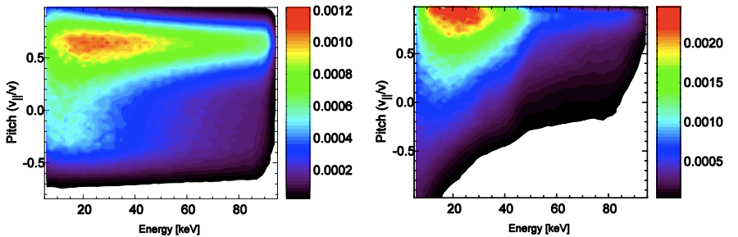
EP research in FY14: develop new analysis tools, prepare for FY15 operations
FY14 Milestone: assess reduced models for *AE-induced fast ion transport
  Model for Quasi-Linear relaxation of fast ion profile for given *AEs
  Model for resonant fast ion transport (NUBEAM/TRANSP) to complement existing “diffusive/convective” models
Planned improvements of numerical tools
  3D ‘halo’ model in TRANSP (analysis/simulation of CX data)
  Improved F_{nb}, rotation description (M3D-K, NOVA-K, HYM)
B#27
B#29
Analytic
(single slowing-down)
NUBEAM
(1 NB, 3 energy comp.)

Slide 11
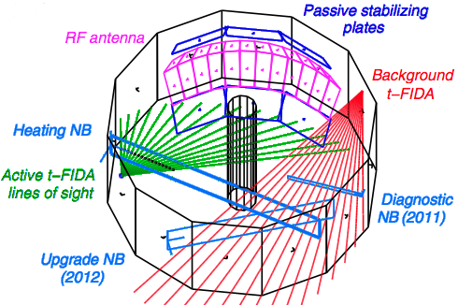
EP research in FY14: develop new analysis tools, prepare for FY15 operations
FY14 Milestone: assess reduced models for *AE-induced fast ion transport
  Model for Quasi-Linear relaxation of fast ion profile for given *AEs
  Model for resonant fast ion transport (NUBEAM/TRANSP) to complement existing “diffusive/convective” models
Planned improvements of numerical tools
  3D ‘halo’ model in TRANSP (analysis/simulation of CX data)
  Improved F_{nb}, rotation description (M3D-K, NOVA-K, HYM)
B#27
B#30
B#31
B#29
Prepare for NSTX-U operations
  Diagnostics being upgraded, reinstalled, calibrated (e.g. FIDA, NPAs, sFLIP, reflectometer, BES)
  Add Charged Fusion Product array, collimated neutron detectors
  Start planning experiments, with focus on FY15 Milestone
Incr.

Slide 12
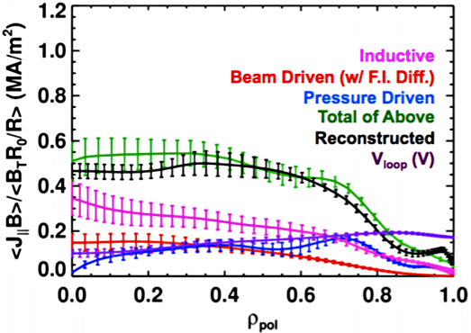
Thrust EP-1 Plans & Goals: focus on *AE dynamics, stability and induced fast ion transport
Compare (classical) NUBEAM predictions for 1st+2nd NBI to experiments
  Use MHD-quiescent discharges, improved diagnostics (FIDAs, ssNPA, sFLIP, neutrons) to address FY15 Milestone
  Compare measured current profile (MSE) w/ NUBEAM/TRANSP
  Map NB parameters space, establish baseline for future fast ion/*AEs studies
Characterize beam ion driven *AE activity
  Compare *AE properties (wavenumber/frequency spectra, structure) measurements to predictions from NOVA-K, M3D-K
  Extend simulations to full 1T, 2MA NSTX-U scenarios
B#28
FY15
FY16
TRANSP reconstruction of current profile.
Anomalous D_{fi}:
1m²/s (baseline)
50m²/s (impulses)

Slide 13
Thrust EP-1 Plans & Goals: focus on *AE dynamics, stability and induced fast ion transport
Compare (classical) NUBEAM predictions for 1st+2nd NBI to experiments
  Use MHD-quiescent discharges, improved diagnostics (FIDAs, ssNPA, sFLIP, neutrons) to address FY15 Milestone
  Compare measured current profile (MSE) w/ NUBEAM/TRANSP
  Map NB parameters space, establish baseline for future fast ion/*AEs studies
Characterize beam ion driven *AE activity
  Compare *AE properties (wavenumber/frequency spectra, structure) measurements to predictions from NOVA-K, M3D-K
  Extend simulations to full 1T, 2MA NSTX-U scenarios
Study effects of high-frequency GAE/CAEs on thermal electron transport (w/ T&T TSG)
Extend *AE studies to non-linear, multi-mode physics
  Compare fast ion transport measurements to simulations
  Improved codes for stability, dynamics, induced transport (NOVA-K, ORBIT, SPIRAL, M3D-K, HYM)
Extend simulations/predictions of fast ion transport to FNSF/Pilot (stationary phase)
B#28
FY15
FY16
FY17
FY18
B#29
(Y4) Extend *AEs projections to FNSF/Pilot ramp-up phase
Incr.

Slide 14
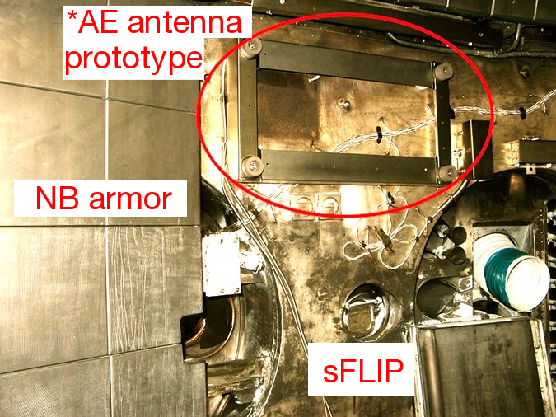
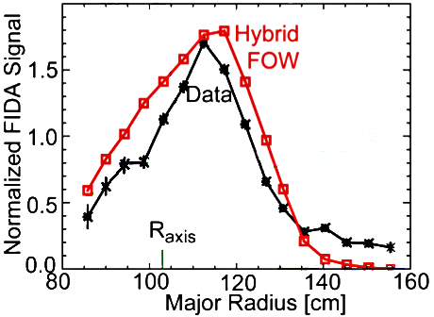
Thrust EP-2 Plans & Goals: assess development of F_{nb}, mode control tools/techniques
B#26
Test *AE antenna system
  Up to 4 coils, target “physics operations” @ low power (<5kW) for FY16
Compare measured *AE damping rates to theory, simulations
  Challenge *AE damping models
  Expand previous work (C-Mod, JET, MAST) to unique ST regimes
FY15
FY16
Characterize scenarios with combined NBI + rf heating
Ex.: Measured vs simulated (CQL3D) F_{nb}(r) for NBI + HHFW scenarios on NSTX
See WH&CD presentation (next)

Slide 15
Thrust EP-2 Plans & Goals: assess development of F_{nb}, mode control tools/techniques
B#26
Test *AE antenna system
  Up to 4 coils, target “physics operations” @ low power (<5kW) for FY16
Compare measured *AE damping rates to theory, simulations
  Challenge *AE damping models
  Expand previous work (C-Mod, JET, MAST) to unique ST regimes
FY15
FY16
5 year plan period
Characterize scenarios with combined NBI + rf heating
Study rotation, 3D fields effects on *AEs (RWM, upgraded SPAs for improved rotation control, NCC after FY16)
Extend stability measurements to high-frequency *AEs
  Test/validate theories on high-f *AEs drive, damping
Assess capability of & requirements for selective mode excitation using NB, rf, 3D fields, possibly ( ) antennae
FY17
B#23
FY18
Incr.
(Y3-4) Implement and test high-power (>10kW) *AE excitation system
Incr.

Slide 16
Outline
EP Thrusts and Milestones for FY14-18
5 year Research plans and goals
  FY14 : preparing for beginning of NSTX-U operations
  FY15-18 : EP research in support of 2 main EP Thrusts
Theory, diagnostics in support of EP research
Summary
10% incremental budget:
Incr.
Backup Slides:
B#Z

Slide 17
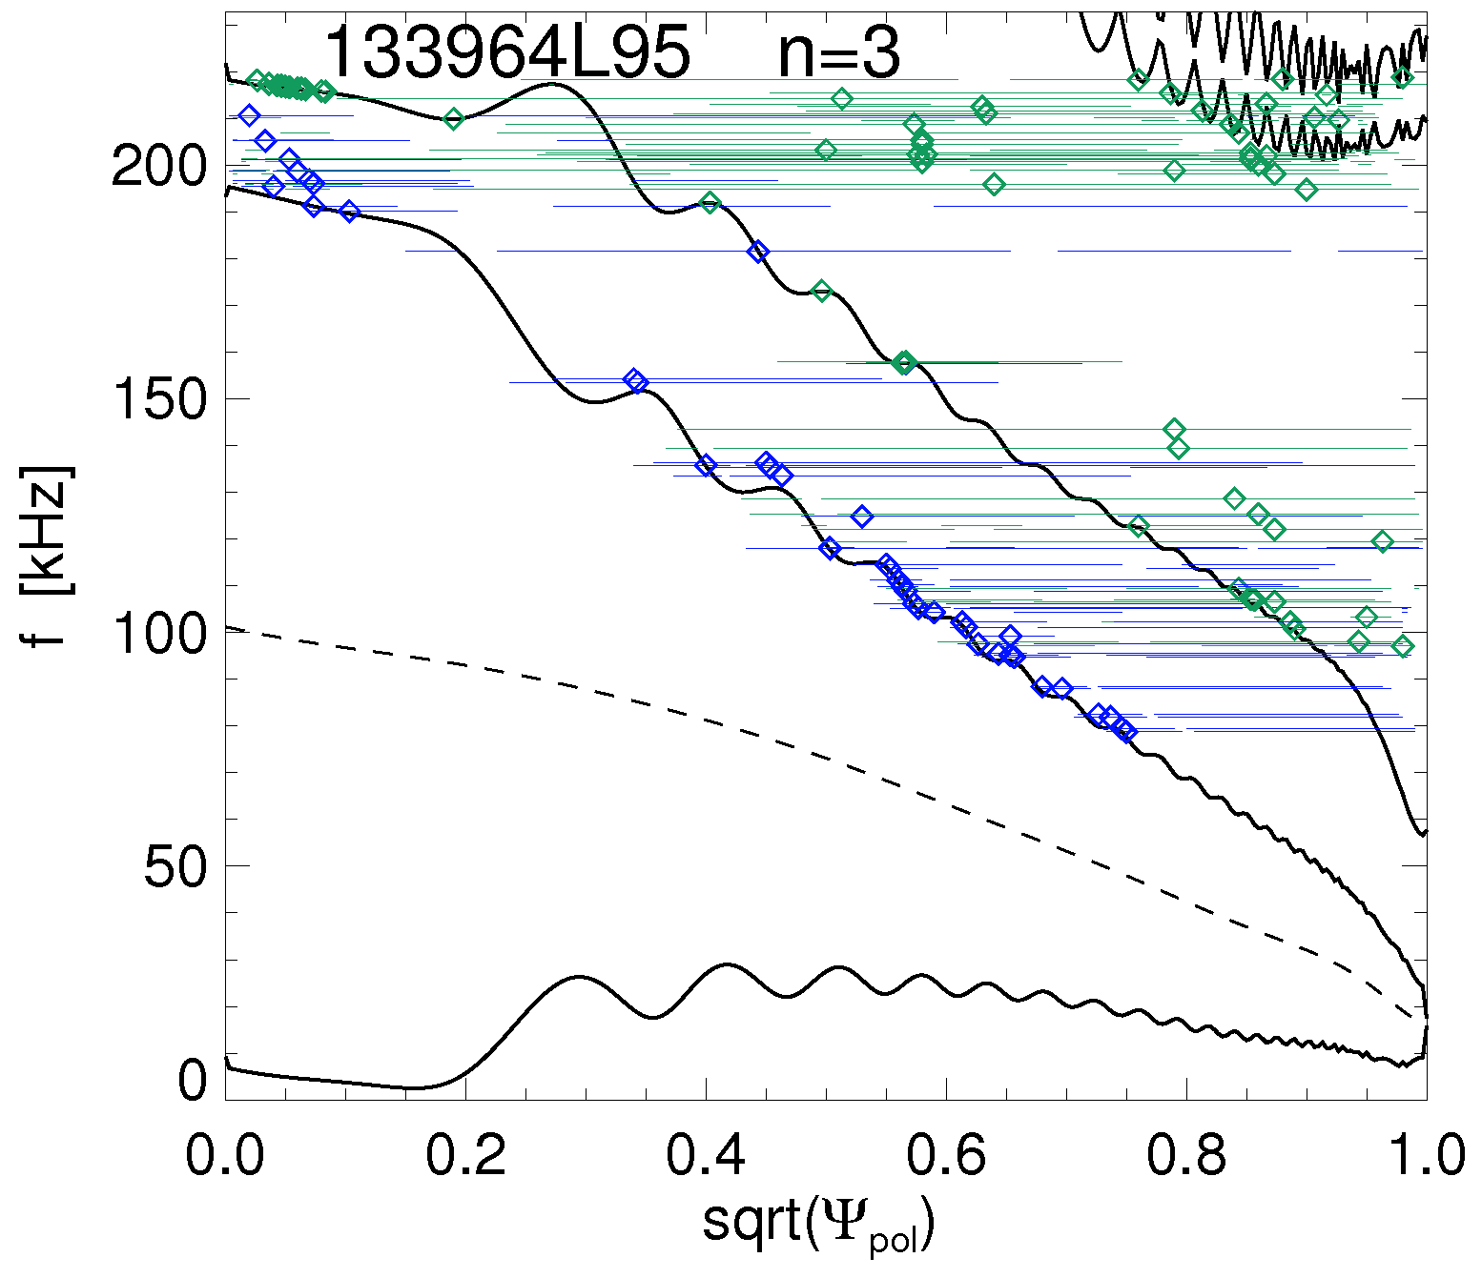
Theory & code developments complement EP Research, enable detailed theory/experiment comparison for V&V
FY13
FY14
FY15
FY16
FY17
FY18
5 year plan period
Upgrade Outage
5 year plan period
Improved rotation, F_{nb} description in NOVA-K, M3D-K and HYM
ORBIT, SPIRAL for fast ion response to *AE modes
Extend simulations to full 1T, 2MA NSTX-U scenarios
Theory
Develop/apply reduced fast ion transport models
Extend to FNSF/Pilot
Extend to current ramp up in FNSF/Pilot
3D ‘Halo’ model
in TRANSP
Incr.
TAEs
EAEs
EAEs/TAEs
Ex.: NOVA-K stability of n=3, f~154kHz TAE mode for NSTX-U scenario:
> Rotation MUST be taken into account!
 | w/o rot. | w/ rot
γ_{damping}/ω [%] | -60 | -5.2
γ_{drive}/ω [%] | 4.8 | 4.6
f_{Doppler}
“cntr”-TAEs

Slide 18
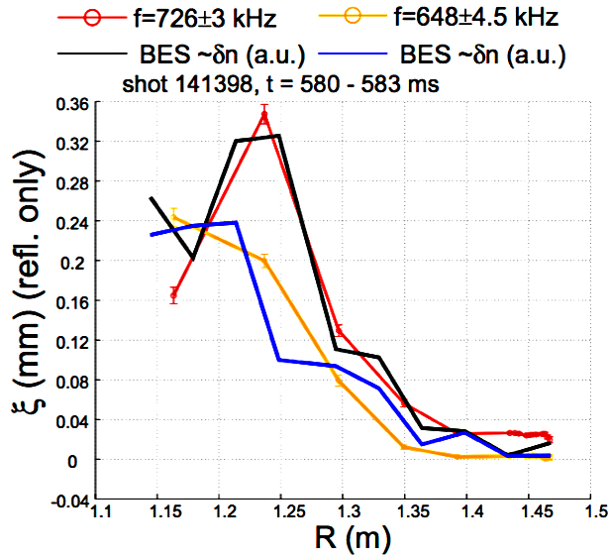
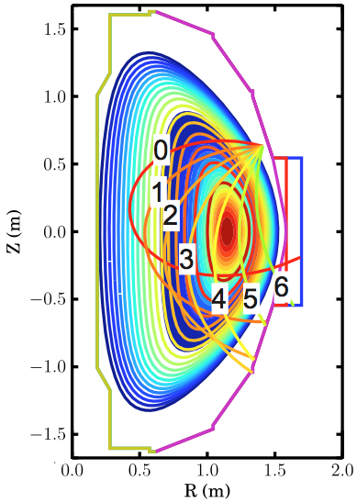
Diagnostics well suited for *AEs and F_{nb} characterization; incr. budget required for better measurements at high-n_{e}
FY13
FY14
FY15
FY16
FY17
FY18
5 year plan period
Upgrade Outage
5 year plan period
Fast ion distribution measurements: Vert.+Tang. FIDA; upgraded ssNPA
Incr.
fusion source profile array
Diagnostics
Incr.
neutron collimator for high n_{e}
Mode structure measurements: BES, reflectometers
Optimize *AE antenna for more
efficient coupling to *AEs (broad f range)
*AE antenna for damping rate measurements
Incr.
Charged Fusion Products array
Reflectometers, BES provide detailed mode structure measurements.
High n_{e}: data quality reduced, need different approach(es) for F_{nb} measurements.

Slide 19
Outline
EP Thrusts and Milestones for FY14-18
5 year Research plans and goals
  FY14 : preparing for beginning of NSTX-U operations
  FY15-18 : EP research in support of 2 main EP Thrusts
Theory, diagnostics in support of EP research
Summary
10% incremental budget:
Incr.
Backup Slides:
B#Z

Slide 20
Summary of EP Research goals and plans for FY14-18 Five Year Plan
FY14-18 EP Research will improve understanding, prediction capabilities for *AE instabilities, fast ion dynamics
  Leverage unique NSTX-U flexibility (NBI, B_{t}, I_{p}, 3D fields)
  Excellent synergy with Theory group, code developers
Focus on *AE stability, dependence on fast ion distribution
  Benefits from active MHD spectroscopy, including high-f *AEs
  Target non-linear, multi-mode physics toward *AE mode control
Expect unique contributions to EP physics for STs and next-step, burning plasma devices
  High-β, high v_{fast}/v_{Alfvén} has significant overlap with expected EP parameter regime in ITER, FNSF, ST-based Pilot

Slide 21
Backup slides

Slide 22

FY14-18 Energetic Particle Research timeline
Baseline & ~10-15% incremental funding ( )
FY13
FY14
FY15
FY16
FY17
FY18
5 year plan period
5 year goal
Upgrade Outage
5 year plan period
Characterize F_{nb} w/ 2nd NB line; compare to TRANSP
Extend fast ion studies to full 1T, 2MA scenarios
1. Develop predictive tools for projections of *AE-induced transport to FNSF/ITER
Physics
Investigate *AE dynamics and fast ion transport mechanisms
Compare with linear/nonlinear predictions
Develop ramp-up scenarios with
reduced/optimized *AE activity
Incr.
Assess reduced models for *AE-induced fast ion transport
Characterize NBI+HHFW scenarios
2. Assess requirements for fast ion phase space engineering through selective excitation/suppression of *AE modes
NB, HHFW as actuators for *AE activity
Tools
Fast ion distribution measurements: Vert.+Tang. FIDA; upgraded ssNPA
fusion source profile array
Incr.
Diagnostics
Mode structure measurements: BES, reflectometers
neutron collimator for high n_{e} scenarios
Incr.
*AE antenna for damping rate measurements
Optimize *AE antenna for
more efficient coupling
to *AEs (high power)
Incr.
Theory
Improved rotation, F_{nb} description in NOVA-K, M3D-K and HYM
ORBIT, SPIRAL for fast ion response to *AE modes
Extend simulations to full 1T, 2MA NSTX-U scenarios
Develop/apply reduced fast ion transport models
Extend to FNSF/Pilot
3D ‘Halo’ model in TRANSP
Extend to current ramp up in FNSF/Pilot
Incr.
NCC coils (full)
Facility
2nd (more tangential) NB line
Incr.
NCC coils (partial)
Assess *AE antenna for mode excitation
Incr.
Plasma Control
q-profile, rotation control
with 2nd NBI

Slide 23
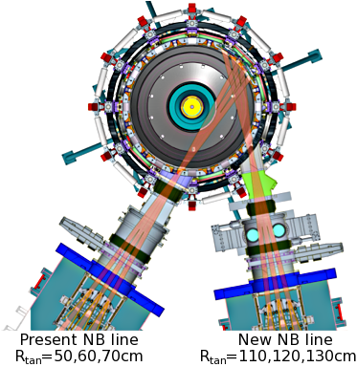
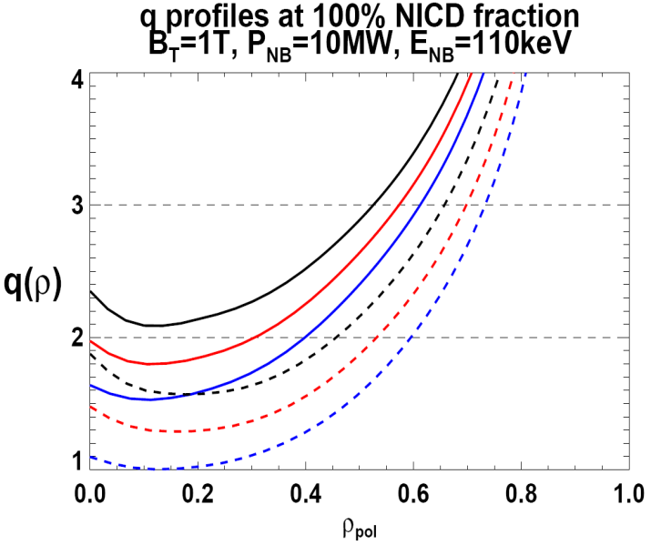
Facility & Control developments give access to new physics, enable projections to next-step
FY13
FY14
FY15
FY16
FY17
FY18
5 year plan period
Upgrade Outage
5 year plan period
NCC coils (partial)
Incr.
2nd (more tangential) NB line
NCC coils (full)
Facility
Assess *AE antenna for mode excitation
Incr.
Plasma Control
q-profile, rotation control
with 2nd NBI; density control
Flexible NBI parameters + NCC coils:
control q-profile, rotation; add 3D fields
affect mode stability, dynamics
n
e
/
n
Greenwald
0.95
0.72
R_{TAN} [cm]
__________________
50, 60, 70, 130
60, 70,120,130
70,110,120,130

Slide 24
Collaborations of EP group, FY13-14
EP group participates to experiments on MAST in FY13:
  Study of TAE “avalanches” and associated fast ion transport
  Participate to experiments exploiting active MHD spectroscopy
  Test Charged Fusion Product array (developed by FIU/PPPL), compare measurements with MAST Neutron Camera
EP group is involved with experiments on DIII-D in FY13
  Characterization of regimes with bursting/chirping *AE instabilities, comparison with NSTX results
  Study of non-linear *AE behavior
NSTX-U collaborators developing diagnostics, analysis tools supporting EP research (see Chapter 12 of 5-year Plan for details)
  FIU: developing Charged Fusion Product array
  UC Davis: fluctuation diagnostics (interferometers)
  UC Irvine: fast ion diagnostics (FIDA, ssNPA), analysis tools (FIDASIM)
  UC Los Angeles: mode structure measurements (reflectometers), fluctuation diagnostics (polarimeter, Doppler Back-Scattering), analysis tools
  UW: fluctuation diagnostics (Beam Emission Spectroscopy)

Slide 25
Thrust EP-1: Develop predictive tools for projections of *AE-induced fast ion transport in FNSF and ITER
Vary fast-ion instability drive by varying:
  NBI source to vary n_{fast}(r), fast-ion anisotropy, q, rotation
  3D fields to vary rotation, fast-ion transport
  B_{T}, I_{P}, P_{NBI}, and density to vary q, v_{fast} / v_{A}, β_{fast} / β_{tot}
Measure *AE mode properties including radial structure, frequency and wavenumber spectrum, and stability
  Utilize high-f magnetics, BES, reflectometry
Characterize fast ion transport associated with specific classes of *AEs
  Utilize fast-ion D-alpha diagnostics, SSNPA, neutron rate
Utilize linear and non-linear numerical and theoretical tools (ORBIT, NOVA-K, M3D-K, HYM) to understand mode-induced fast-ion transport in NSTX-U, ITER, FNSF

Slide 26
Thrust EP-2: Assess requirements for fast-ion phase-space engineering techniques
Perform active spectroscopy to measure linear *AE damping rates to benchmark stability codes at low aspect ratio
  Utilize linear stability validation in NSTX-U to improve fundamental understanding of mode drive and stability mechanisms in ITER burning plasmas and for FNSF, ST-based Pilot
With incremental funding, upgrade driving amplifier to higher power, extend bandwidth of *AE antenna system to study high frequency modes
  Higher-f + possible cyclotron resonances may provide means to controllably modify the non-thermal ion distribution function and possibly lower the overall fast ion pressure

Slide 27
FY14 Milestone R14-2:
Develop models for *AE mode-induced fast-ion transport
Good confinement of fast ions from neutral beam injection and fusion reactions is essential for the successful operation of ST-CTF, ITER, and future reactors. Significant progress has been made in characterizing the Alfvénic modes (AEs) driven unstable by fast ions and the associated fast ion transport. However, models that can consistently reproduce fast ion transport for actual experiments, or provide predictions for new scenarios and devices, have not yet been validated against a sufficiently broad range of experiments.
In order to develop a physics-based parametric fast ion transport model that can be integrated in general simulation codes such as TRANSP, results obtained from NSTX and during collaborations with other facilities (MAST, DIII-D) will be analyzed. Information on the mode properties (amplitude, frequency, radial structure) and on the fast ion response to AEs will be deduced from Beam Emission Spectroscopy, Reflectometers, Fast-Ion D-alpha (FIDA) systems, Neutral Particle Analyzers, Fast Ion Loss Probes and neutron rate measurements.
The fast ion transport mechanisms and their parametric dependence on the mode properties will be assessed through comparison of experimental results with theory using both linear (e.g., NOVA-K) and non-linear (e.g., M3D-K, HYM) codes, complemented by gyro-orbit (ORBIT) and full-orbit (SPIRAL) particle-following codes.
Based on the general parametric model, the implementation of reduced models in TRANSP will then be assessed. For instance, the existing Anomalous Fast Ion Diffusion (AFID) and radial fast ion convection models in TRANSP could be improved by implementing methods to calculate those transport coefficients consistently with the measured (or simulated) mode properties. Further improvements will also be considered to include a stochastic transport term or quasi-linear models.

Slide 28
FY15 Milestone R15-2:
Assess the effects of neutral beam injection parameters on the fast ion distribution function and neutral beam driven current profile.
Accurate knowledge of neutral beam (NB) ion properties is of paramount importance for many areas of tokamak physics. NB ions modify the power balance, provide torque to drive plasma rotation and affect the behavior of MHD instabilities. Moreover, they determine the non-inductive NB driven current, which is crucial for future devices such as ITER, FNSF and STs with no central solenoid. On NSTX-U, three more tangentially-aimed NB sources have been added to the existing, more perpendicular ones. With this addition, NSTX-U is uniquely equipped to characterize a broad parameter space of fast ion distribution, F_{nb}, and NB-driven current properties, with significant overlap with conventional aspect ratio tokamaks.
The two main goals of the proposed Research Milestone on NSTX-U are (i) to characterize the NB ion behavior and compare it with classical predictions, and (ii) to document the operating space of NB-driven current profile. F_{nb} will be characterized through the upgraded set of NSTX-U fast ion diagnostics (e.g. FIDA, ssNPA, sFLIP, neutron counters) as a function of NB injection parameters (tangency radius, beam voltage) and magnetic field. Well controlled, single-source scenarios at low NB power will be initially used to compare fast ion behavior with classical models (e.g. the NUBEAM module of TRANSP) in the absence of fast ion driven instabilities. Diagnostics data will be interpreted through the “beam blip” analysis technique and other dedicated codes such as FIDASIM. Then, the NB-driven current profile will be documented for the attainable NB parameter space by comparing NUBEAM/TRANSP predictions to measurements from Motional Stark Effect, complemented by the vertical/tangential FIDA systems and ssNPA to assess modifications of the classically expected F_{nb}.
As operational experience builds up in the first year of NSTX-U experiments, additions to the initial F_{nb} assessment will be considered for scenarios where deviations of F_{nb} from classical predictions can be expected. The latter may include scenarios with MHD instabilities, externally imposed non-axisymmetric 3D fields and additional Fast Wave heating.
(w/ WH&CD, ASC, MS and SFSU TSGs)

Slide 29
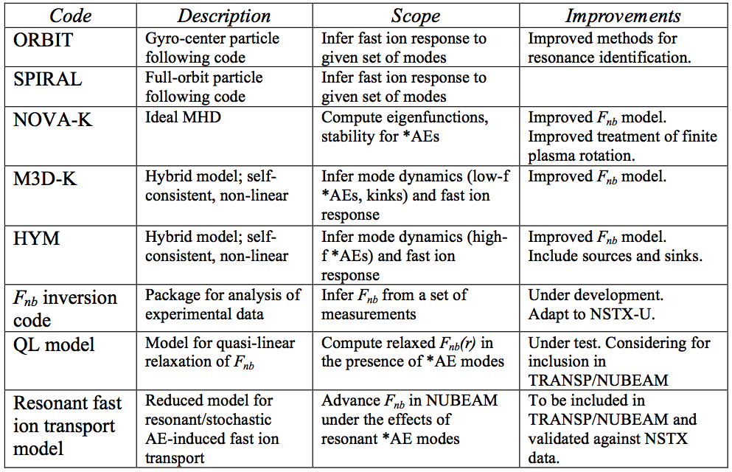
Summary of theory and simulation capabilities
for EP research

Slide 30
Quasi-Linear model computes critical fast ion profile in the presence of unstable TAEs
Evolution of fast ion distribution, modes:
Self-consistent QL relaxation
where
initial profile
relaxed profile
where
TAE modes
At marginal stability:
QL model uses analytic expressions for growth, damping rates vs. β_{fast} :
Compute critical conditions on dβ_{fast}/dr at each radial position :
mode number(s), n
relative mode widths to particle orbit
Plasma parameters
Isotropy
with
[K. Ghantous, PoP (2012)]
[H. Berk, IAEA (2012)]
[N. Gorelenkov, APS (2012)]
[K. Ghantous PPPL #4850 (2013)]
Model being tested for DIII-D, ITER, ARIES; NSTX next
Notes:
The idea. Growth. Mode grows. Damping exists. Particle diffuse due to particle mode interacion. Gradient diminishes. Finally drive stops.
Great! Unless it reaches edge. And particles are lost.

Slide 31
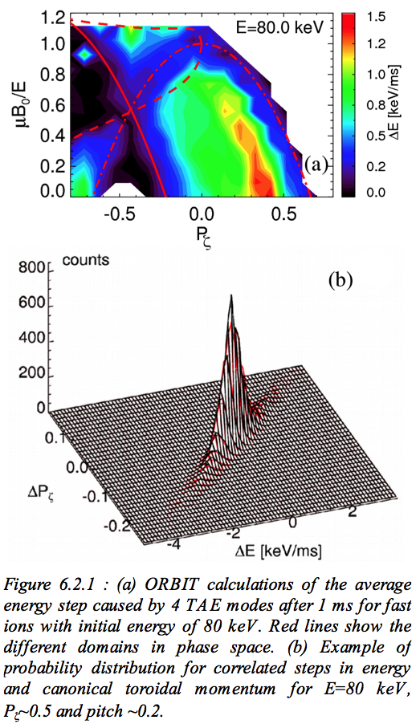
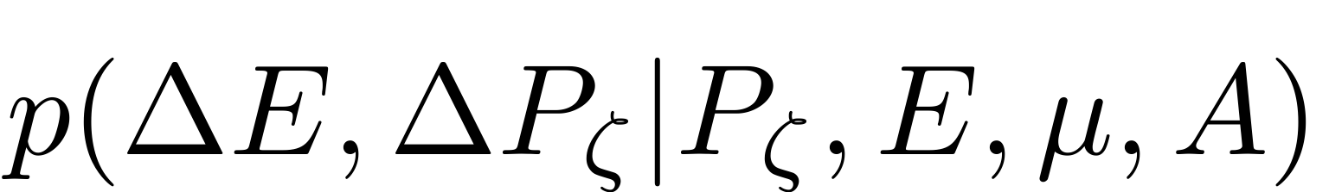
Resonant fast ion transport model is being implemented in NUBEAM to mimic F_{nb} modifications by resonant *AEs
Resonant/stochastic fast ion transport may not be well described by diffusive processes, Γ~dn/dr not accurate enough
  Resonances introduce selectivity in phase space (energy, pitch, magnetic moment)
Fast ion transport models presently implemented in NUBEAM do not include basic physics of wave-particle resonant interaction
Introduce a probability distribution function for particle transport:
  For each bin in (E,P_{ζ},μ), steps in ΔE,ΔP_{ζ} can be described by
  Include mode amplitude variations A_{modes}=A_{modes}(t)
Different ways possible (e.g. ORBIT, SPIRAL, theory) to compute p(ΔE,ΔP_{ζ})

Slide 32
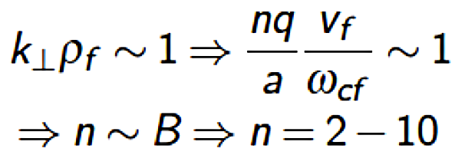
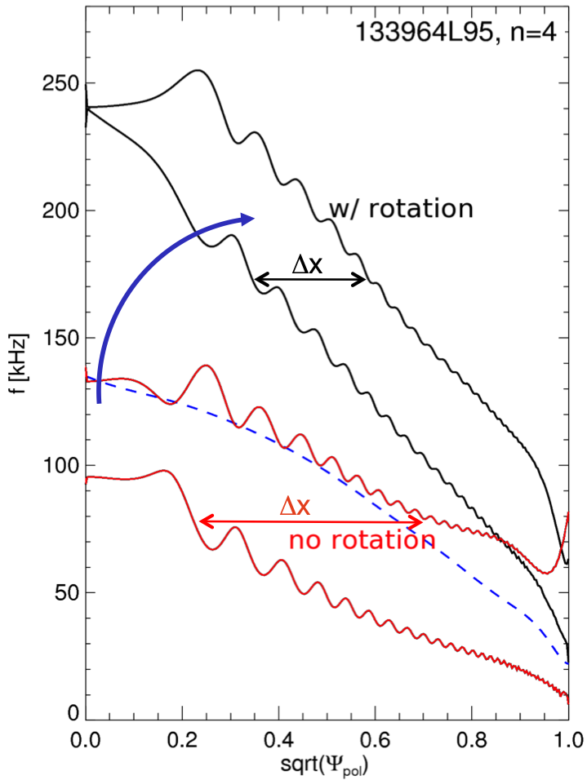
Initial predictions for TAE behavior on NSTX-U
M. Podestà, APS (2012), TTF (2013)
Expect up-shift of mode number with higher B_{t}
  Broad spectrum possible because of large v_{f}/v_{Alfvén}
TAE gap is broader for NSTX-U scenarios, consistent
with 0th-order scaling for gap frequency & width
On average, Doppler shift alters the radial gap width
  Radial width of TAEs decreases for higher n’s
  But modes can tunnel through continuum
    Mixed TAE+EAE modes
    Antenna could excited edge harmonics
Consistent treatment of rotation is crucial for correct computation of both damping and drive terms: improving NOVA-K
TAE modes might be even more unstable in NSTX-U than in NSTX (including H-mode plasmas)
  Higher β_{fast}; more tangential injection favors resonance w/ passing ions
[N. Gorelenkov, PRL (2005)]
Δf
TAE EAE
f_{gap,0}
Δx
f_{gap,0}~v_{A}/4πqR~B/n^{1/2}R
continuum
Δf_{gap,0}/f_{gap,0}~a/R
Δx_{gap,0} : radial “width”

Slide 33
Reference to Responses to PAC-31 Recommendations /1
Recommendation Number | PAC Recommendations | NSTX-U Response | Ref. slide(s)
PAC31-2 | We suggest that milestones that leverage NSTX contributions to ITER physics and operations be moved earlier if possible, e.g., research on fast ion transport and disruption avoidance. | Collaboration with MAST and DIII-D on fast-ion physics will be carried out in FY13, and there are two research milestones for energetic particles - 1 in FY14 and 1 in FY15. | 27,28
PAC31-40 | Appreciable progress has been made on NSTX in this field despite the short run period. This also prevented the exploitation of the newly installed prototype TAE antenna, which now has to be deferred to NSTX-U. The PAC recommends that this capability be retained and active collaboration be pursued to allow rapid exploitation in NSTX-U. | Agree - the AE antenna will be retained and expanded, and collaboration on MAST pursued in this research area | 14,18
PAC31-41 | Of particular interest is that the modeled fast ion redistribution in energy and space during TAE avalanches and a low-frequency kink-like mode does not lead to significant fast ion losses. This needs to be reconciled with transport calculations that seem to indicate an appreciable fast particle loss. | Agree | 13
PAC31-42 | Impressive is the modeling of the electron transport due to GAEs that seems to be consistent with TRANSP calculations. The PAC recommends maintaining a strong crosscutting effort between the Transport & Confinement and the Wave & Energetic Particle topical groups, even strengthening it even further. The PAC strongly endorses plans to develop simplified models to be implemented into predictive transport models. This should be a high priority item reflected in the research milestones for the near term program. | Agree - however progress will likely be slower than desired in this research area due to lack of personnel to work on AE-induced electron thermal transport reduced models in addition to all the standard turbulence modelling and fast-ion transport modelling | 13,10 30,31

Slide 34
Reference to Responses to PAC-31 Recommendations /2
Recommendation Number | PAC Recommendations | NSTX-U Response | Ref. slide(s)
PAC31-43 | The funding of these "new" diagnostics in the financially challenging budget situation remains a cause for concern. Therefore, the PAC encourages a physics driven priority list to be developed. | Agree | 18
PAC31-44 | The analysis of NSTX-U scenarios with respect to the expected fast ion physics is important due to the importance of the contribution of the ST in this area with respect to ITER/DEMO physics. The modeling should be used to guide the NSTX-U research plan as well as the diagnostic strategy. | Agree | 32
PAC31-45 | The PAC is concerned that the proposed time line is not aggressive enough with only one research milestone in FY 2014, not reflecting the importance of the field with respect to NSTX-U and other future tokamaks. The PAC recommends to accelerate the time line in particular with respect to developing simplified models of the *AE induced fast ion transport. | Agree this area could use more emphasis, so an FY15 milestone is also now included in the 5YP to systematically explore the performance of the 2nd NBI (and 1st NBI) w.r.t. AE excitation and fast-ion transport. | 27,28 11
PAC31-46 | The collaborations indicated with DIII-D and MAST seem to be appropriate and more concrete plans should be developed well in advance, in particular with respect to diagnostics and TAE antenna exploitation | Agree - more concrete plans have been developed | 24

Slide 35
Reference to Responses to PAC-31 Recommendations /3
Recommendation Number | PAC Recommendations | NSTX-U Response | Reference Slide(s)
PAC31-47 | An important aspect for future devices is the avoidance of detrimental fast particle driven MHD. Here, a further understanding of such operating regimes should be established within the NSTX database. The assumptions for a deeper understanding and the access to these regimes could be tested on other devices with the appropriate actuators and diagnostics (e.g. ASDEX-Upgrade, DIII-D and MAST). This should be done together with the Advanced Scenarios topical group. | Agree | 24,28
PAC31-49 | The plans presented for the early exploitation of NSTX-U include the most important issues and reflect the capabilities well. In view of developing a strong research plan a clearer understanding of the ITER/DEMO needs compared to the needs for the FNSF with respect to energetic particle physics may help to focus the research activities. The PAC recommends formulating high priority research goals leading to high impact publications to further aid the development of the NSTX-U research plan | Agree - however developing a predictive capability for fast-ion instability onset and associated transport is high priority, and is applicable and supportive of FNSF and ITER | 22 [ITER Needs]
PAC31-62 | In addition to these activities, the PAC also recommends that a focused activity be included in the plans for this time frame to validate that the off-axis NBI is working as expected in terms of heating, torque, current drive, and energetic particles. | Agree - there is now an FY15 energetic particle research milestone to perform such validation | 28

