Slide 1




NSTX-U
Supported by
Overview of NSTX-U Research Program Plans
Coll of Wm & Mary
Columbia U
CompX
General Atomics
FIU
INL
Johns Hopkins U
LANL
LLNL
Lodestar
MIT
Lehigh U
Nova Photonics
Old Dominion
ORNL
PPPL
Princeton U
Purdue U
SNL
Think Tank, Inc.
UC Davis
UC Irvine
UCLA
UCSD
U Colorado
U Illinois
U Maryland
U Rochester
U Tennessee
U Tulsa
U Washington
U Wisconsin
X Science LLC
J. Menard (PPPL)
NSTX-U Program Director
For the NSTX-U Research Team
Culham Sci Ctr
York U
Chubu U
Fukui U
Hiroshima U
Hyogo U
Kyoto U
Kyushu U
Kyushu Tokai U
NIFS
Niigata U
U Tokyo
JAEA
Inst for Nucl Res, Kiev
Ioffe Inst
TRINITI
Chonbuk Natl U
NFRI
KAIST
POSTECH
Seoul Natl U
ASIPP
CIEMAT
FOM Inst DIFFER
ENEA, Frascati
CEA, Cadarache
IPP, Jülich
IPP, Garching
ASCR, Czech Rep
NSTX-U PAC-35 Meeting
PPPL – B318
June 11-13, 2013

Slide 2
Outline
PAC Charges
NSTX-U mission, priorities, assessments
FY14-16 overview and milestones
FY14-16 research plan highlights
ITPA and ITER contributions
ST-FNSF mission and configuration study
Ideas to enhance NSTX-U attractiveness
Summary

Slide 3
PAC-35 Charge Questions
Assess the operational preparation and research priorities and preliminary plans for the first two run-years of NSTX-U with emphasis on the first run year
Please comment on and/or expand the preliminary set of ideas to make NSTX-U more attractive/available to university scientists – including early career researchers and students
  Background: NSTX has been asked by Fusion Energy Sciences to develop/implement ideas to “Expand engagement with university scientists to enhance the NSTX-U program”.
Comment on progress and plans for establishing and expanding the partnership between the NSTX-U program and the PPPL Theory department
Responses to PAC-33 comments are listed in the XL file on PAC-35 website
Many PAC recommendations were incorporated into the 5 year plan - thank you!
In response to PAC-33 specific requests for presentations / information:
Stan Kaye will present report on status of improved NSTX-U / PPPL Theory partnership
Francesca Poli will present modelling of non-inductive start-up, ramp-up, sustainment

Slide 4
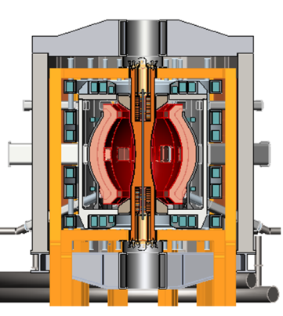
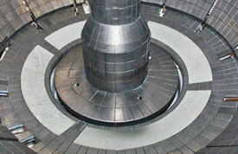
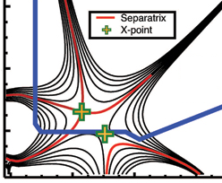
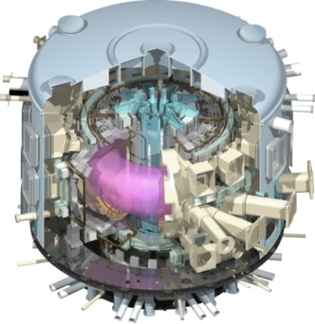
NSTX Upgrade mission elements
Advance ST as candidate for Fusion Nuclear Science Facility (FNSF)
Develop solutions for the plasma-material interface challenge
Explore unique ST parameter regimes to advance predictive capability - for ITER and beyond
Develop ST as fusion energy system
ST-FNSF
Liquid metals/Li
“Snowflake”
ITER

Slide 5
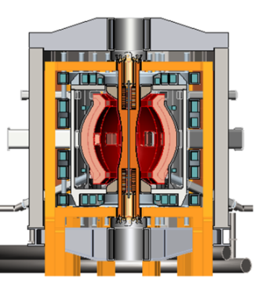
5 highest priority goals of NSTX-U 5 year plan:
Advance ST for Fusion Nuclear Science Facility (FNSF)
  Demonstrate 100% non-inductive sustainment at performance that extrapolates to ≥ 1MW/m² neutron wall loading in FNSF
  Develop and understand non-inductive start-up and ramp-up
  (overdrive) to project to ST-FNSF with small/no solenoid
Develop solutions for plasma-material interface challenge
  Develop and utilize high-flux-expansion “snowflake” divertor and radiative detachment for mitigating very high heat fluxes
  Begin to assess high-Z PFCs + liquid lithium to develop high-duty-factor integrated PMI solutions for next-steps
Explore unique ST parameter regimes to advance predictive capability - for ITER and beyond
  Access reduced ν* and high-β combined with ability to vary q and rotation to dramatically extend ST physics understanding

Slide 6
5 year goal is to develop ST understanding and integrated scenarios necessary for assessing ST viability as FNSF
2015 | 2016 | 2017 | 2018 | 2019 | 2020
Max B_{T} [T], I_{P} [MA]
0.8, 1.6
1, 2
Structural force
and coil heating
limit fractions
0.5, 0.5
1.0, 0.75
1.0, 1.0
Nominal τ_{pulse} [s]
1 – 2
2 – 4
4 – 5
Sustained β_{N}
3 – 5
4 – 6
NCC
5 – 6
ν* / ν* (NSTX)
0.6
0.4
Cryo
0.3 – 0.2
0.2 – 0.1
Inform choice
of FNSF
aspect ratio
and divertor
Non-inductive
fraction (Δt ≥ τ_{CR})
70 – 90%
80 – 110%
90 – 120%
100 – 140%
NBI+BS I_{P} ramp-up: initial → final [MA]
0.6 → 0.8
0.5 → 0.9
0.4 → 1.0
ECH / EBW
CHI closed-flux
current [MA]
0.15 – 0.2
0.2 – 0.3
0.3 – 0.5
0.4 – 0.6
P_{heat} [MW] with
q_{peak} < 10MW/m²
8
10
15
20
Divertor heat-flux control
Snowflake and radiative divertor exhaust location
Lower
Lower or Upper
Lower + Upper
Cryo: access lowest ν*, compare to Li
ECH / EBW: bridge T_{e} gap from start-up to ramp-up
Off-midplane non-axisymmetric control coils (NCC): rotation profile control (NTV), sustain high β_{N}

Slide 7
10 year goal: integrate 100% non-inductive + high β & τ_{E} with advanced divertor solution + high-Z solid / liquid metal walls
2015 | 2016 | 2017 | 2018 | 2019 | 2020 | 2021 | 2022 | 2023
Establish ST physics, scenarios
Integrate long-pulse + PMI
Maximum
B_{T} [T] and I_{P} [MA]
0.8, 1.6
1, 2
Structural force
and coil heating
limit fractions
0.5, 0.5
1.0, 0.75
1.0, 1.0
Extend NBI, plasma from 5s to 10-20s
Nominal τ_{pulse} [s]
1 – 2
2 – 4
4 – 5
Sustained β_{N}
3 – 5
4 – 6
NCC
5 – 6
ν* / ν* (NSTX)
0.6
0.4
Cryo
0.3 – 0.2
0.2 – 0.1
Inform choice
of FNSF
aspect ratio
and divertor
Inform choice
of FNSF / DEMO plasma facing components and divertor
Non-inductive
fraction (Δt ≥ τ_{CR})
70 – 90%
80 – 110%
90 – 120%
100 – 140%
NBI+BS I_{P} ramp-up: initial → final [MA]
0.6 → 0.8
0.5 → 0.9
0.4 → 1.0
CHI closed-flux
current [MA]
0.15 – 0.2
0.2 – 0.3
ECH
0.3 – 0.5
0.4 – 0.6
P_{heat} [MW] with
q_{peak} < 10MW/m²
8
10
15
20
Snowflake and radiative divertor exhaust location
Divertor heat-flux control
Lower
Lower or Upper
Lower + Upper
High-Z and
lithium PFCs
High-Z tile row
High-Z tile rows
High-Z outboard div
High-Z first-wall
All high-Z
Increased Li coverage
Liquid Li on high-Z div tiles
Flowing Li module
Flowing Li divertor

Slide 8
2013: External review of NSTX-U was favorable
5 year plan programmatic comments (debrief report):
  “quality of proposed research is excellent, employing state-of-the-art diagnostics to obtain data that will be compared to theory using wide variety of numerical models.”
  “Proposed research is essential for advancing ST to a nuclear science mission.”
5 year plan facility enhancement comments (written report):
  “…addition of cryo-pump will be an excellent addition to their program.”
  “NCC will greatly enhance physics studies and control”
  “Given the essential need for non-inductive startup for FNSF-ST, acquisition of a 28 GHz gyrotron to provide capability for heating CHI plasmas to allow better absorption of HHFW, is important to the long-term program”
  “The proposed additions of the flowing liquid Lithium divertor and divertor Thomson scattering diagnostic are desirable.”
FESAC Prioritization of Proposed Scientific User Facilities:
  Grade: A - “absolutely central” for enabling world leading science: energetic particle physics for ITER, high power density & flux expansion + liquid metals, FNSF viability
8

Slide 9
NSTX-U Team Remaining Scientifically Productive
Active in Scientific Conferences, Publications, and Collaborations
Strong APS meeting (7 invited talks, 52 additional presentations) participation in the fall 2013. Three NSTX APS-DPP press releases available on the web.
All of the FY2013 milestones were completed on schedule
Significant collaboration research contributions are being made in diverse science areas by the NSTX-U research team (for more details see: next slide, this talk, all other PAC presentations)
7 IAEA orals by NSTX-U researchers (~50/50 NSTX/collaboration)
61 refereed publications for CY 2013 with 4 PRLs
Two NSTX researchers received APS Fellowship (Gates, Skinner)
NSTX-U (S. Gerhardt) led 3 facility joint research target (JRT)
9

Slide 10
Overview of FY2014 NSTX-U research activities
Collaborations supporting NSTX-U, ITER, FNSF
  DIII-D: Snowflake/detachment, pedestal/Li, QH, RWM, operations
  C-Mod: Pedestal structure, high-Z PFC studies, RF
  KSTAR: NTV physics, MHD stability and control
  MAST: Momentum and particle transport, EBW plasma start-up
  York: Synthetic aperture μ-wave imaging (DBS, BXO)
  EAST: Joint analysis of NSTX/EAST Li/boundary physics data
  MAGNUM-PSI: study and develop high-Z + Li PFCs
Prepare for NSTX-U operation
  Finish data analysis, publications from NSTX, collaborations
  Transition off-site collaboration/researchers back to NSTX-U
  Finalize physics design of long-term facility enhancements
    Row of high-Z tiles on outboard divertor, divertor cryo-pump
    ECH/EBW for start-up/ramp-up, off-midplane 3D coils
  Prepare diagnostics, control system, analysis for NSTX-U ops

Slide 11
Overview of FY2015-16 NSTX-U research activities
Resume operation, explore new regimes:
    High β + lower ν*, higher non-inductive w/ higher B_{T}, I_{P}, 2nd NBI
FY2015
  Complete CD-4 for NSTX Upgrade Project near end of CY14
  Obtain first data at 60% higher field/current, 2-3× longer pulse:
    Re-establish sustained low l_{i} / high-κ operation above no-wall limit
    Study thermal confinement, pedestal structure, SOL widths
    Assess current-drive, fast-ion instabilities from new 2nd NBI
FY2016
  Extend NSTX-U performance to full field, current (1T, 2MA)
    Assess divertor heat flux mitigation, confinement at full parameters
  Access full non-inductive, test small current over-drive

Slide 12
Near-term upcoming NSTX-U Program events
Input to FESAC sub-panel on 10 year strategic plan for FES
  Articulate coordinated strategy for U.S. spherical tokamak facilities
  Address critical issues in support of FNSF and ITER
    Start-up / ramp-up / sustainment, disruptions, energetic particles, …
  Plans for long-term increased emphasis on PMI / PFC / liquid metals
Research Forum to solicit experimental proposals for FY2015 run campaign tentatively planned for December 2014
  Waiting for successful VPI of OH coil before finalizing Forum dates
  Each topical science group (TSG) will nominally follow year-by-year priorities/detailed plans developed for recent 5 year plan
  The research forum specifically requests abbreviated eXperimental Proposals (XPs) be presented at the forum
    Motivation, goal, shot plan, # of run days, diagnostics, analysis…
  XP prioritization will be strongly driven by annual research milestones

Slide 13
NSTX-U research milestones target exploitation of new Upgrade capabilities, exploration of new regimes in FY15-16
FY2014
FY2015
FY2016
Expt. Run Weeks:
0
18
20
16
20
Macroscopic Stability
R14-1
Assess access to reduced density
and ν* in high-performance scenarios (with ASC, BP TSGs)
IR16-1
Transport and Turbulence
Assess τ_{E} and local transport and turbulence at low ν* with full range of B_{T}, I_{P}, and NBI power
R15-1
Assess H-mode τ_{E}, pedestal, SOL characteristics at higher B_{T}, I_{P}, P_{NBI} (with BP, M&P, ASC, WEP TSGs)
R16-1
Boundary
Physics
Assess scaling, mitigation of steady-state, transient heat-fluxes w/ advanced divertor operation at high power density
Develop snowflake configuration, study edge and divertor properties
(with ASC, TT, MP)
R16-2
Materials & PFCs
IR15-1
Assess high-Z divertor PFC performance and impact on operating scenarios
R14-2
R15-2
Waves+Energetic Particles
Assess reduced models for *AE mode-induced fast-ion transport
Assess effects of NBI injection on fast-ion f(v) and NBI-CD profile (with SFSU, MS, ASC TSGs)
R16-3
Assess fast-wave SOL losses and core thermal and fast ion interactions at increased B_{T}, I_{P}
Solenoid-free Start-up/ramp-up
R16-4
R14-3
Develop high-non-inductive fraction NBI H-modes for ramp-up & sustainment (Joint ASC+SFSU)
Adv. Scenarios and Control
Assess advanced control techniques for sustained high performance (with MS, BP TSGs)
R15-3
Develop physics+operational tools for high-performance discharges (with CC, ASC, MS, BP, M&P TSGs)
ITER Needs + Cross-cutting
Joint Research Target
Quantify plasma response to non-axisymmetric (3D) magnetic fields in tokamaks
Quantify impact of broadened current and pressure profiles on tokamak confinement and stability
Assess disruption mitigation and warning / prediction techniques
(+ additional theory contribution)

Slide 14
NSTX-U Topical Science Groups (TSGs) play lead role in carrying out research program
Topical Science Groups
TSG Responsibilities:
Macroscopic Stability
J. Berkery**, J.-K. Park
Theory: A. Boozer**
Determine and address highest priority scientific issues through discussion and consensus at open meetings
Draft scientific milestones with Program/Project directors
Define facility/theory resources needed to achieve goals
Organize NSTX-U Research Forum sessions
Propose and execute experiments to achieve milestones and address research priorities
Present TSG results and plans at annual PAC meetings
Lead brainstorming, organization, writing of 5 year plan
Aid results dissemination with Physics Analysis Division
  Publications, talks, seminars, colloquia, conferences, ITPA, BPO
Provide summaries of scientific progress at NSTX-U team meetings and other venues to promote discussion
Assist and report to NSTX-U Program/Project directors
Transport and Turbulence
Y. Ren, W. Guttenfelder
Theory: G. Hammett
Boundary Physics
V. Soukhanovskii##, A. Diallo
Theory: C.-S. Chang
Materials and PFC Research
M. Jaworski, C. Skinner
Theory: D. Stotler
Waves and Energetic Particles
M. Podestá, R. Perkins
Theory: N. Gorelenkov, N. Bertelli
Solenoid-free start-up & ramp-up
R. Raman#, D. Mueller
Theory: S. Jardin
Advanced Scenarios & Control
S. Gerhardt, E. Kolemen
Scenario modelling: F. Poli
Cross-Cutting / ITER needs
J. Menard, S. Kaye, R. Maingi
Theory/Modeling: J. Canik*
**Columbia University, ## LLNL
#University of Washington, *ORNL

Slide 15
Planned FY2014-16 research supports
5 highest priority goals of NSTX-U 5 year plan:
Advance ST for Fusion Nuclear Science Facility (FNSF)
  Demonstrate 100% non-inductive sustainment at performance that extrapolates to ≥ 1MW/m² neutron wall loading in FNSF
  Develop and understand non-inductive start-up and ramp-up
  (overdrive) to project to ST-FNSF with small/no solenoid
Develop solutions for plasma-material interface challenge
  Develop and utilize high-flux-expansion “snowflake” divertor and radiative detachment for mitigating very high heat fluxes
  Begin to assess high-Z PFCs + liquid lithium to develop high-duty-factor integrated PMI solutions for next-steps
Explore unique ST parameter regimes to advance predictive capability - for ITER and beyond
  Access reduced ν* and high-β combined with ability to vary q and rotation to dramatically extend ST physics understanding

Slide 16
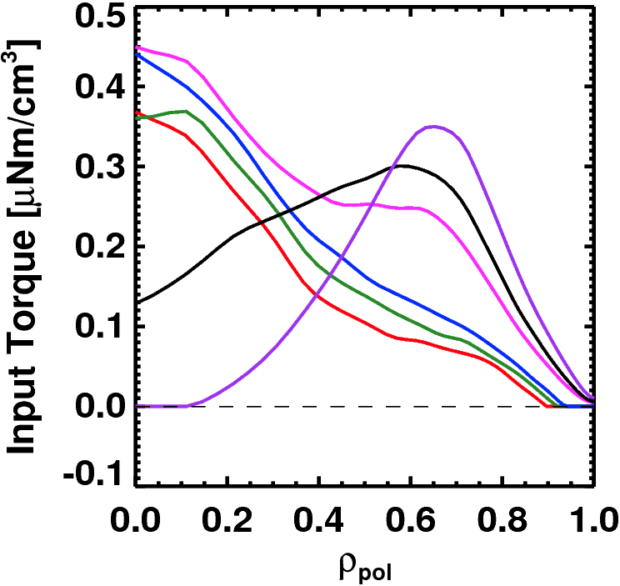
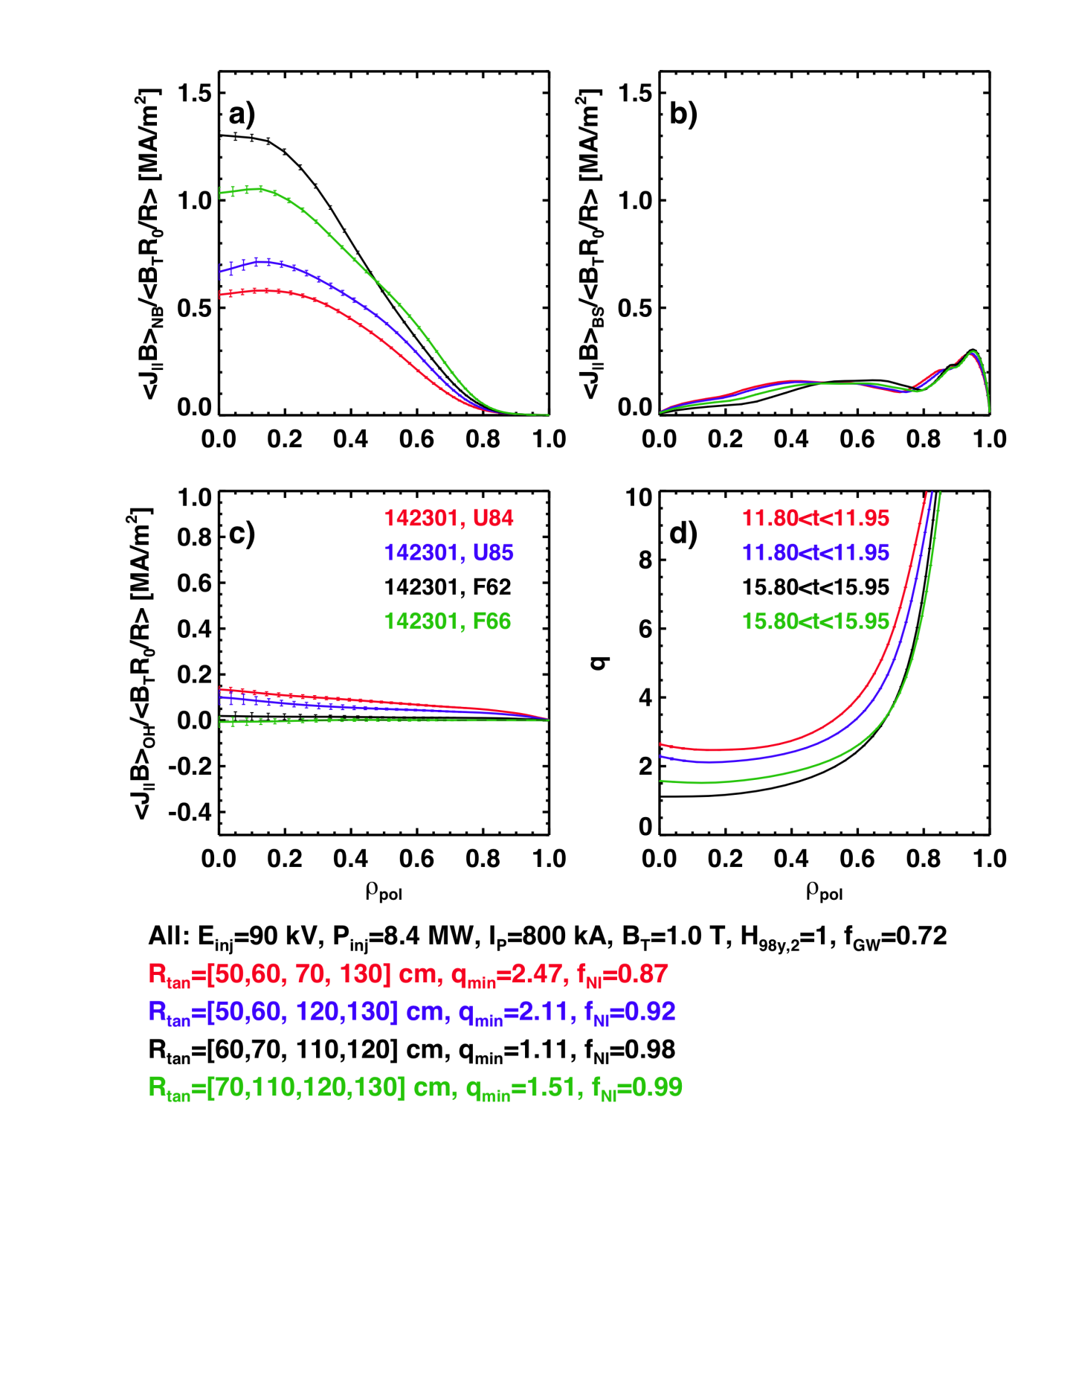
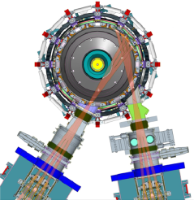
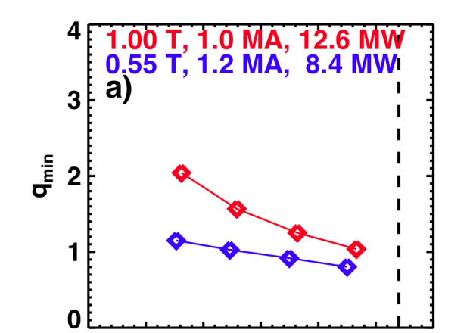
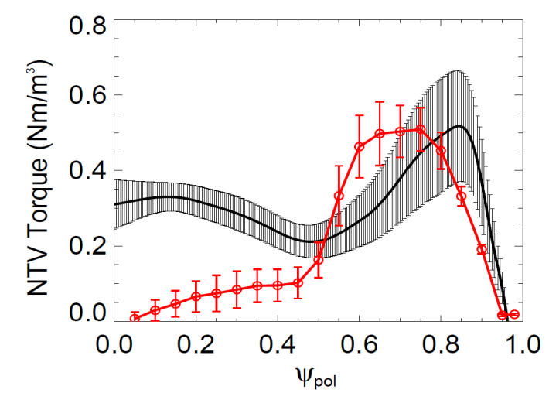

NSTX-U is developing a range of profile control actuators for detailed physics studies, scenario optimization for FNSF
q-Profile Actuators
Rotation Profile Actuators
Variations in Beam Sources
800 kA Partial Inductive, 87% < f_{NI} < 100%
Torque Profiles From 6 Different NB Sources
Largest R_{tan}
800 kA and 1 T
[50,60,70,130] cm
[50,60,120,130] cm
[60,70,110,120] cm
[70,110,120,130] cm
Neutral
Beams
(TRANSP)
Smallest R_{tan}
Variations in Outer Gap
Measured and Calculated Torque Profiles from 3D Fields
n=3 Experiment
n=3 POCA
27 22 17 12 7 2
Outer Gap
For more info see presentations by Gerhardt and Poli
K. Kim, J.-K. Park

Slide 17
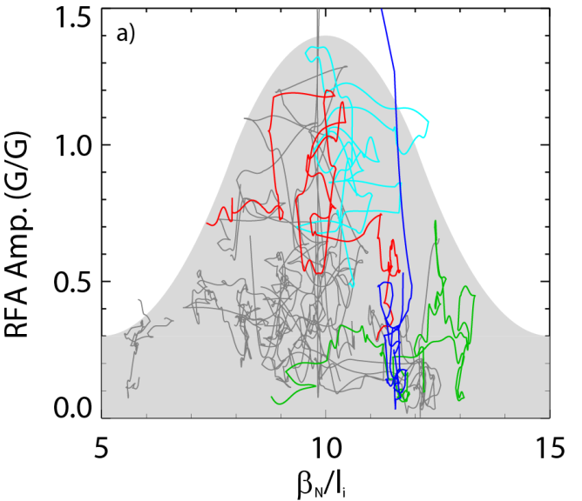

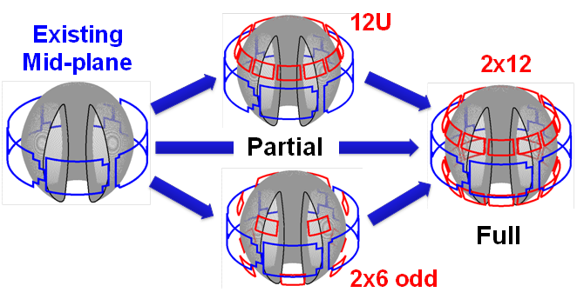
Rotation profile control will be an important tool for accessing and sustaining high β
n=1 MHD spectroscopy: high β_{N} can be more stable → important for advanced scenarios
Resonant Field
Amplification (G/G)
For these plasmas, high β_{N} was correlated with rotation that maximizes RWM damping
  Stabilization from ion precession drift resonance
  Strong motivation for rotation profile control
Berkery - APS Invited 2013
β_{N} / l_{i}
5YP: Off-midplane 3D coils enable control of resonant vs. non-resonant torques, v_{φ} profile
1
Resonant Field
Amplification (G/G)
0
S. Sabbagh, J. Berkery (Columbia)
J-K Park (PPPL), J. Canik (ORNL)
E×B rotation frequency

Slide 18
Advanced Scenarios and Control Research Plans for FY2014-16:
Implement advanced controls, explore high non-inductive & I_{P} scenarios
FY14: Develop and implement advanced control algorithms in preparation for NSTX-U operation
  Snowflake control on DIII-D (PPPL+LLNL+GA)
  J profile control using on/off-axis 2nd NBI
    ORISE post-doc: J profile control algorithms w/ TRANSP as plasma simulator
    Implement rt-MSE (Nova Photonics) in rt-EFIT for q-profile reconstruction
  Rotation control: 2nd NBI deposition flexibility + 3D fields/NTV
FY14: DIII-D/National Campaign: test 100% NI at lower B_{T}
FY14-15: Re-establish NSTX-U control and plasma scenarios
FY15: Assess new 2nd NBI current-drive vs. R_{TAN}, n_{e}, outer gap
  Push toward 100% non-inductive at higher B_{T}, P_{NBI}
FY15: Explore scenarios (τ_{E}, l_{i}, MHD) at up to 60% higher I_{P}, B_{T}
FY16: Explore scenarios at full I_{P} and B_{T} capability of NSTX-U
  Goal: Access 100% non-inductive, test small I_{P} overdrive

Slide 19
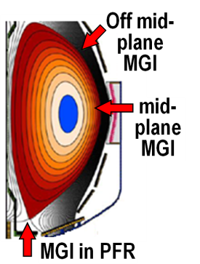
Macroscopic Stability Research Plans for FY2014-16:
Complete 3D coil physics design, re-establish high-β ops, test MGI
FY14: JRT - analysis for plasma response to 3D fields (J-K Park)
  Also, complete physics design of new Non-axisymmetric Control Coils (NCC) for mode, error field, and v_{φ} control
FY14: Understand/model low-density/ramp-up disruptions in NSTX in prep for low ν* operation in NSTX-U scenarios
  Hybrid fast-ion + ∇Ω_{φ} + ∇p-driven kink is a leading candidate early mode
FY15: Re-establish n=1-3 error-field correction, RWM control, minimize EF rotation damping, sustain operation above no-wall limit
FY15: Test poloidal dependence of Massive Gas Injection (outboard vs. private flux region)
FY16: Contribute unique MGI data (low-A, injector location) for mitigation + warning, prediction
  Assess mitigation triggering via real-time warning in NSTX-U

Slide 20
Planned FY2014-16 research supports
5 highest priority goals of NSTX-U 5 year plan:
Advance ST for Fusion Nuclear Science Facility (FNSF)
  Demonstrate 100% non-inductive sustainment at performance that extrapolates to ≥ 1MW/m² neutron wall loading in FNSF
  Develop and understand non-inductive start-up and ramp-up
  (overdrive) to project to ST-FNSF with small/no solenoid
Develop solutions for plasma-material interface challenge
  Develop and utilize high-flux-expansion “snowflake” divertor and radiative detachment for mitigating very high heat fluxes
  Begin to assess high-Z PFCs + liquid lithium to develop high-duty-factor integrated PMI solutions for next-steps
Explore unique ST parameter regimes to advance predictive capability - for ITER and beyond
  Access reduced ν* and high-β combined with ability to vary q and rotation to dramatically extend ST physics understanding

Slide 21
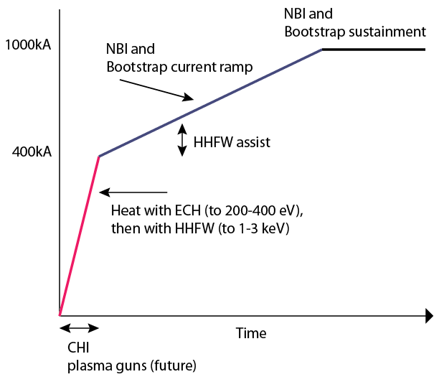
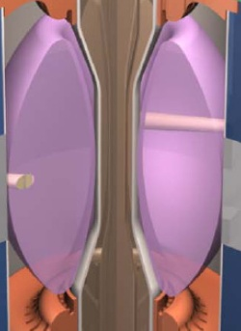
Plasma initiation with small or no transformer is unique challenge for ST-based Fusion Nuclear Science Facility
NSTX-U Non-Inductive Strategy:
ST-FNSF has no/small central solenoid
Poli and Gerhardt presentations
Perkins presentation
Raman presentation
NSTX-U 5 year plan goal:
  Generate ~0.4MA closed-flux start-up current with helicity injection
  Heat CHI with ECH and/or fast wave, ramp 0.4MA to 0.8-1MA with NBI

Slide 22
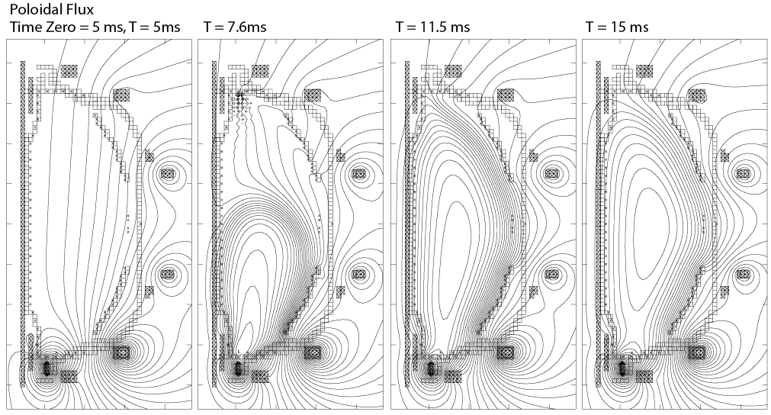
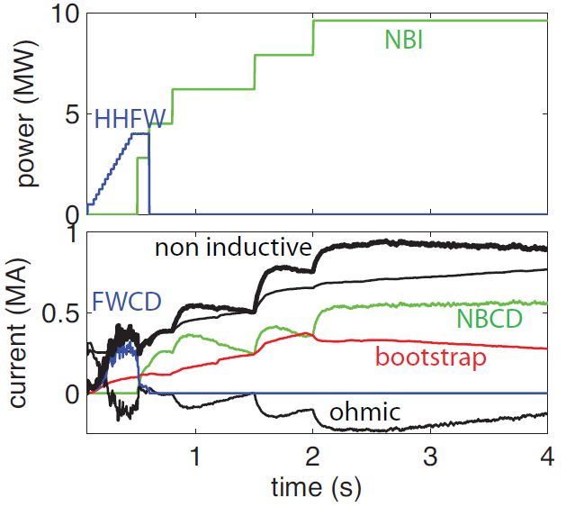
Simulations support non-inductive start-up/ramp-up strategy
TSC code successfully simulates CHI I_{P} ~200kA achieved in NSTX
TRANSP: NSTX-U more tangential NBI → 3-4x higher CD at low I_{P} (0.4MA)
  1.5-2x higher CD efficiency, 3x lower prompt loss
New TRANSP simulations of ramp-up: 0.3MA→0.9MA with FW+BS→NBI+BS
  1st self-consistent NBI-CD calcs during NI ramp-up
FY14: Implemented NSTX-U geometry in TSC
F. Poli
TSC + tools included in 5 year plan support CHI I_{P} → 400kA in NSTX-U
  2.5 x higher injector flux (scales with I_{P})
  Higher B_{T} = 1T (increases current multiplication)
  > 2kV CHI voltage (increases flux injection)
  1MW 28GHz ECH (increases T_{e})
V_{surface} = 0 constraint → need to add induction from PF coil swing (future)
R. Raman (U-Wash)

Slide 23
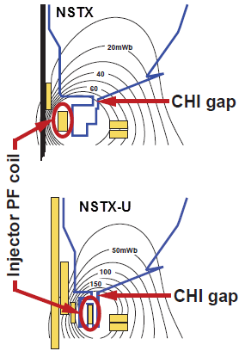
Solenoid-Free Start-up and Ramp-up Research Plans for FY2014-16:
Prepare CHI for NSTX-U, assess CHI/NBI start-up/ramp-up
FY14: Complete design of upgraded capacitor bank and diagnostics for NSTX-U, implement CHI gap tiles
  Also finish CHI design study for QUEST, possibly implement CHI
FY14: DIII-D/National Campaign: test small current overdrive using NBI+BS
FY15: Establish NSTX-U CHI, assess impact of new injector, gap, higher B_{T}
FY15-16: Initial tests of small NBI+BS overdrive ramp-up using new 2nd NBI and higher B_{T}

Slide 24
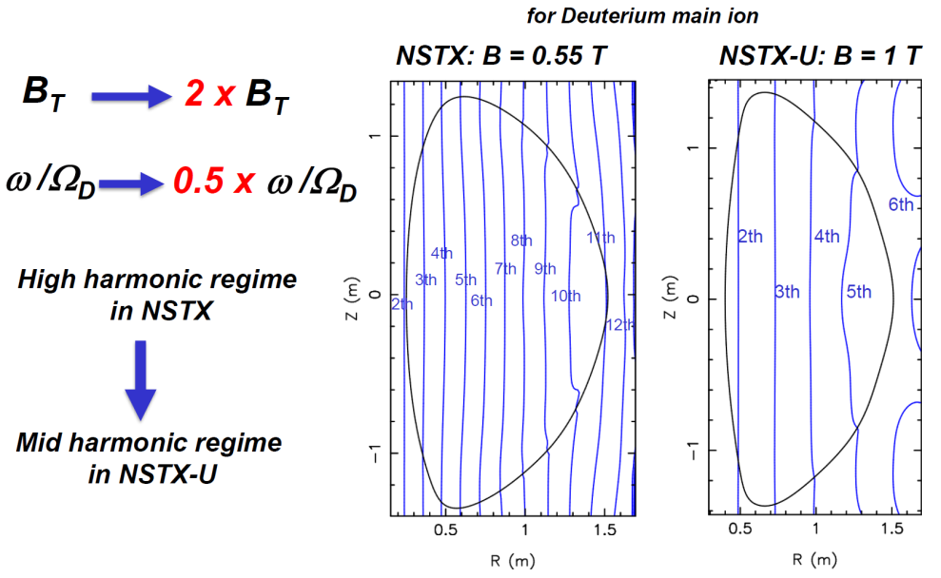
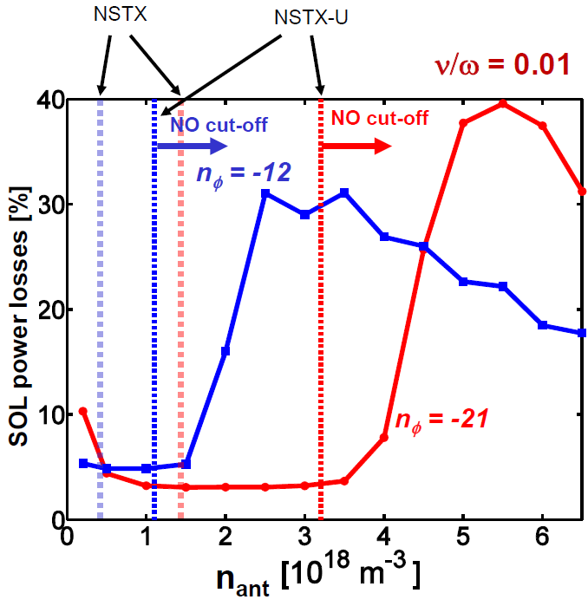
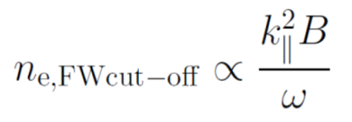
Wave Physics Research Plans for FY2014-16:
Finalize ECH/EBW design, simulate & develop reliable FW H-mode
FY14-15: Guide 1MW/28GHz ECH/EBW engineering design
  ECH to heat CHI, form target for HHFW/NBI
  EBW H&CD for start-up, sustainment
FY16: Assess fast-wave SOL losses and core thermal and fast ion interactions at increased B_{T}, I_{P}
AORSA modeling:
higher B → lower SOL losses
N. Bertelli

Slide 25
Planned FY2014-16 research supports
5 highest priority goals of NSTX-U 5 year plan:
Advance ST for Fusion Nuclear Science Facility (FNSF)
  Demonstrate 100% non-inductive sustainment at performance that extrapolates to ≥ 1MW/m² neutron wall loading in FNSF
  Develop and understand non-inductive start-up and ramp-up
  (overdrive) to project to ST-FNSF with small/no solenoid
Develop solutions for plasma-material interface challenge
  Develop and utilize high-flux-expansion “snowflake” divertor and radiative detachment for mitigating very high heat fluxes
  Begin to assess high-Z PFCs + liquid lithium to develop high-duty-factor integrated PMI solutions for next-steps
Explore unique ST parameter regimes to advance predictive capability - for ITER and beyond
  Access reduced ν* and high-β combined with ability to vary q and rotation to dramatically extend ST physics understanding

Slide 26
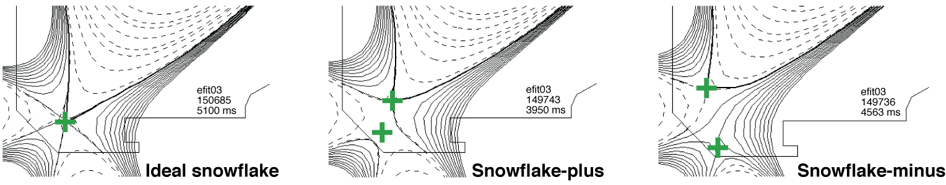
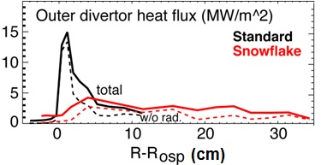
Snowflake divertor results + simulations project to favorable particle and power exhaust control in NSTX-U, next-steps
Snowflake on DIII-D (GA+LLNL+PPPL collaboration) extended 2-3x reduction in q_{peak} to 3s duration
  Compatible with cryo-pumping (n_{e}/n_{G}= 0.4-0.75)
NSTX-U divertor cryo projections: f_{G} ≤ 0.5 for wide range of I_{P} (λ_{SOL})
  Standard/snowflake/X: 0.6/0.7 to 1.5/2MA
  Maintain q_{peak} ≤ 10MW/m²
Multi-fluid edge transport model (UEDGE) predicts factor of ~5 reduction in NSTX-U peak heat flux
  Geometry + impurity radiation (4% C)
  UEDGE also being applied to ST-FNSF advanced divertor options
E. Meier, V. Soukhanovskii (LLNL)

Slide 27
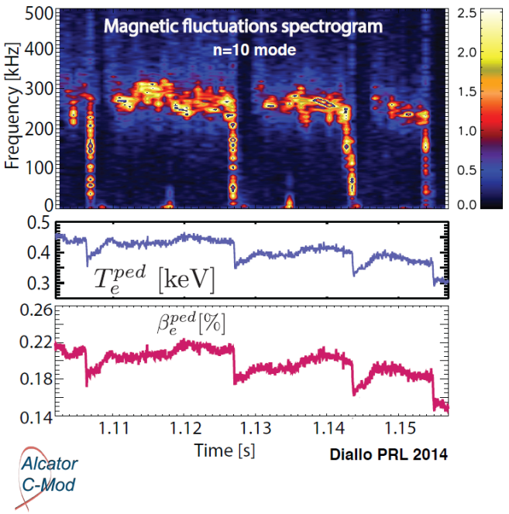
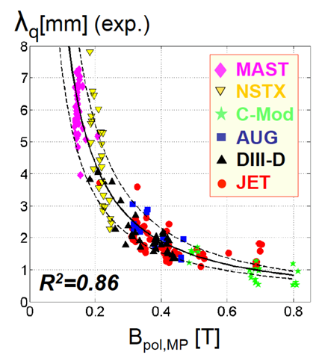
Boundary Physics Research Plans for FY2014-16:
Advance heat flux, cryo, pedestal, SOL studies, extend to higher B_{T}, I_{P}
FY14: Complete divertor-cryo physics design
FY14: Pedestal/SOL collaborations
  C-Mod: Measured field-aligned EM mode that clamps pedestal ∇T_{e} – consistent with kinetic ballooning mode (KBM) and EPED/ELITE
  NSTX-U/DIII-D: Analysis of enhanced pedestal (EPH) / very-high confinement (VH) H-modes
    Both obtain H_{98y,2} >> 1, likely from increased E×B shear
    New: Li dropper in DIII-D: 2-3× higher p_{ped}, 1.5× higher H₉₈
FY15: Measure pedestal structure, SOL width, ELM types, snowflake/X performance at up to 60% higher I_{P}, B_{T}, 2× higher P_{NBI}
FY16: I_{P} → 2MA → test snowflake/X, detachment, PFCs with q|| up to 4-5× higher than NSTX

Slide 28
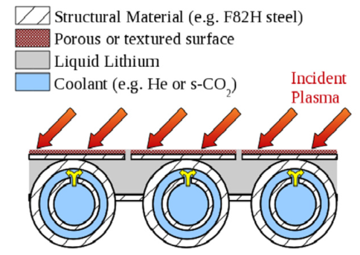
Materials and Plasma Facing Components Plans for FY2014-16:
Advance Li understanding/technology, support NSTX-U wall conditioning
FY14: Develop Li-coating tools for upper PFCs of NSTX-U to increase Li coverage of C, D pumping, thermal confinement
FY14: EAST: assess particle/impurity control w/ triggered ELMs, cryo-pumping, lithiumization, high-Z PFCs
FY15: Test lithium granule injector (LGI) for ELM triggering and impurity control, Li coating performance in NSTX-U
FY16: Begin to assess high-Z (+Li coated) PFC performance with 1 row of W or TZM tiles on outboard divertor (at large R)
FY14-15: Lab-based R&D for advanced Li PFCs
  Study Li on metal substrates, response to plasma power and particle fluxes (MAGNUM-PSI)
  High-heat-flux high-Z PFC design (TZM or W lamellae)
  Flowing Li loop tests
  Develop capillary-restrained gas-cooled Li PFC

Slide 29
Planned FY2014-16 research supports
5 highest priority goals of NSTX-U 5 year plan:
Advance ST for Fusion Nuclear Science Facility (FNSF)
  Demonstrate 100% non-inductive sustainment at performance that extrapolates to ≥ 1MW/m² neutron wall loading in FNSF
  Develop and understand non-inductive start-up and ramp-up
  (overdrive) to project to ST-FNSF with small/no solenoid
Develop solutions for plasma-material interface challenge
  Develop and utilize high-flux-expansion “snowflake” divertor and radiative detachment for mitigating very high heat fluxes
  Begin to assess high-Z PFCs + liquid lithium to develop high-duty-factor integrated PMI solutions for next-steps
Explore unique ST parameter regimes to advance predictive capability - for ITER and beyond
  Access reduced ν* and high-β combined with ability to vary q and rotation to dramatically extend ST physics understanding

Slide 30
Testing predictability of T_{e} profiles using reduced χ_{e} models in regimes where single micro-instability is dominant
Linear gyrokinetic simulations find microtearing unstable in mid-radius region of high-collisionality H-modes
Microtearing
  Other micro-instabilities subdominant at this location for this class of discharge
ExB
Reduced model for microtearing χ_{e} (Rebut-Lallia-Watkins (RLW) - 1988) shows reasonable agreement between predicted & measured T_{e} for r/a > 0.3
  χ_{e} much larger than RLW must be used in core to match central T_{e}
  Enhanced core electron thermal transport may be due energy transfer from core GAE/CAE → mid-radius KAW → electrons
    See presentations by Kaye, Podestá, Guttenfelder
r/a
ν
H
*
i
g
h
H
-
0
M
o
d
e
.
8
1
2
0
9
6
7
0
.
5
1
s
)
V
M
e
a
s
u
r
e
e
d
k
(
P
r
e
d
i
c
t
0
e
d
.
e
4
T
A
d
χ
-
h
o
c
e
2
0
2
-
3
0
m
/
(
s
C
A
E
p
r
o
x
y
)
χ
R
L
W
0
e
(
)
.
0
0
.
0
0
.
2
0
.
4
0
.
6
0
.
8
1
.
0
E. Belova – HYM code (Theory/NSTX-U partnership)
S. Kaye
r/a
30

Slide 31
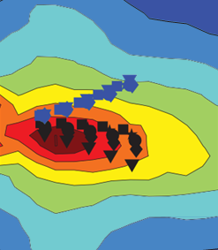
Transport and Turbulence Research Plans for FY2014-16:
First τ_{E} data at higher B_{T}, I_{P} + turbulence, develop reduced χ_{e} models
FY14-16: Develop model χ_{e, AE} using measured CAE/GAE mode structures and HYM/ORBIT simulations (w/ EP group)
FY14-16: Develop and validate reduced transport models using ST data + linear and non-linear gyro-kinetic simulations
FY15: Extend ST confinement scalings and understanding with up to 60% increase in B_{T} and I_{P}
  Measure low-k δn (BES w/ increased edge channel count), 1st polarimetry data
FY16: Extend confinement studies to full B_{T}, I_{P} → 2-3× lower ν*
FY16: Initial utilization of new high-k FIR scattering system for ETG turbulence
  Measure k_{r} & k_{θ} to study turbulence anisotropy
Bay G Launching
(dB)
−70
30
R
−80
20
k_{θ} ρ_{s}
−90
FY16 (incremental): Study turbulence vs. ν*, rotation, q with high-k + BES + polarimetry
10
−100
0
-20
-10
0
10
20
−110
k_{r} ρ_{s}

Slide 32
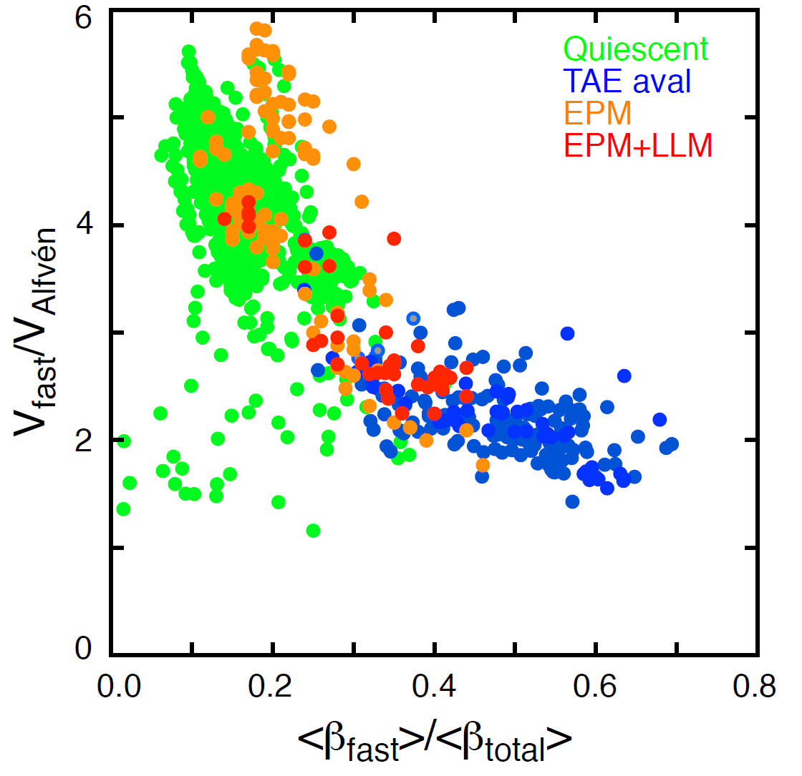
FY13-14: Assessed parametric dependence of TAE avalanches and energetic particle modes (EPMs) in NSTX
Identified regimes w/ small fast-ion loss: important for NSTX-U, FNSF, ITER
Modes lead to neutron rate decrements up to 30%
TAE avalanches only occur for β_{fast} > 0.3 β_{total}
Conversely, quiescent plasmas were only seen where β_{fast} < 0.3 β_{total}
Two types of EPM:
  Higher q_{min}~2-3 (earlier in shot), more continuous → long-lasting mode (LLM)
  Lower q_{min} → 1 (later in shot), more bursty and fishbone-like, n=1-3
High density
Low density
NSTX quiescent operating range
(NSTX-U will access up to 2× lower v_{f}/v_{A})
E. Fredrickson

Slide 33
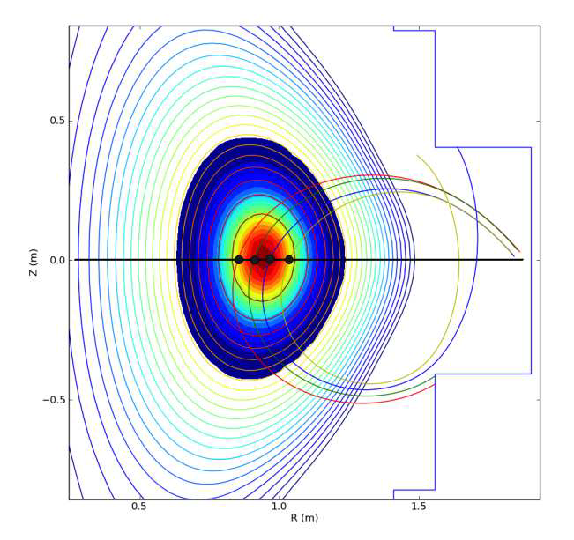
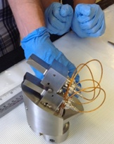
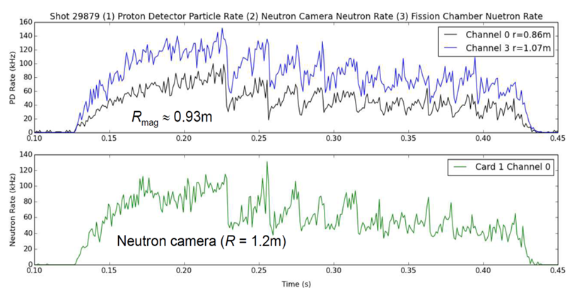
Developed new DD fusion product detector through collaboration with MAST
Detector measures radial profile of DD fusion reactivity
  3 MeV protons and 1 MeV tritons
Profiles obtained for range of plasma conditions:
  Quiescent, sawtoothing, fishbones
DD detector and neutron camera show similar time-dependence – profile comparisons ongoing
Results encouraging for development of higher channel count system for NSTX-U
  Smaller, cheaper than neutron-camera
D. Darrow (PPPL), W. Boeglin and R. Perez (Florida International University)

Slide 34
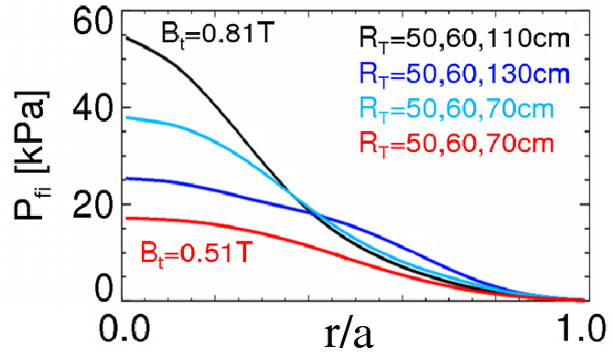
Energetic Particle Physics Research Plans for FY2013-15:
Develop full + reduced fast-ion transport models, characterize new 2nd NBI
FY14: Collaborate with DIII-D/National Campaign studying AE thresholds & fast-ion transport vs. q_{min} and on/off-axis NBI
FY14: Finalize design/implementation of prototype AE antenna and of upgraded ssNPA diagnostic
FY14-15: Develop reduced model for AE-induced fast ion losses – needed for NBICD in STs/ATs/ITER
FY14-15: Contribute to development of reduced model of electron thermal transport from CAE/GAE
FY15-16: Measure fast-ion (FI) density profiles, confinement, current drive, AE stability
  Exploit new 2nd NBI and higher B_{T}, access to reduced v_{fast} / v_{A}

Slide 35
Outline
PAC Charges
NSTX-U mission, priorities, assessments
FY14-16 overview and milestones
FY14-16 research plan highlights
ITPA and ITER contributions
ST-FNSF mission and configuration study
Ideas to enhance NSTX-U attractiveness
Summary

Slide 36
Supporting ITER through ITPA participation
Representatives in every Task Group, leadership in several:
  R. Maingi: chair of Pedestal and Edge Physics TG
  S. Sabbagh: Leads WG on RWM code benchmarking, RWM stability & control
Active in 25 JEX/JACs with many contributors from NSTX-U
Pedestal, Scrape-Off Layer, Divertor
PEP-26 | Critical edge parameters for achieving L-H transitions | PEP-36 | ELM energy losses and their dimensionless scaling in the context of operational parameters
PEP-27 | Pedestal profile evolution following L-H/H-L transitions | DSOL-24 | Disruption heat loads
PEP-29 | Vertical jolts/kicks for ELM triggering and control | DSOL-28 | Narrow heat flux widths and divertor power dissipation
Energetic Particles
EP-2 | Fast ion losses and redistribution from localized AEs | EP-6 | Fast ion losses and associated heat loads from edge perturbations (ELMs and RMPs)
EP-4 | Effect of dynamical friction (drag) at resonance on non-linear AE evolution
Integrated Operating Scenarios
IOS-3.2 | Define access conditions to get to a steady-state scenario | IOS-4.3 | Collisionality of confinement in advanced inductive plasmas
IOS-4.1 | Access conditions for advanced inductive scenarios with ITER-relevant conditions | IOS-5.2 | Maintaining ICRH coupling in expected ITER regime
Macroscopic Stability and Control
MDC-2 | Joint experiments on resistive wall mode physics | MDC-17 | Active disruption avoidance
MDC-14 | Rotation effects on neoclassical tearing modes | MDC-18 | Evaluation of axisymmetric control aspects
MDC-15 | Disruption database development | MDC-21 | Global mode stabilization physics and control
Transport and Turbulence
TC-9 | Scaling of intrinsic plasma rotation with no external momentum input | TC-17 | ρ* scaling of intrinsic torque
TC-10 | Experimental identification of ITG, TEM and ETG turbulence and comparison with codes | TC-24 | Impact of resonant magnetic perturbations on transport and confinement
TC-15 | Dependence of momentum and particle pinch on collisionality
Maingi (chair), Ahn, Canik, Chang, Diallo, Goldston, Jaworski
Fredrickson, Fu, Gorelenkov, Heidbrink, Kramer, Podestá
Gerhardt, Kessel, Poli, Gates
Sabbagh, Berkery, Jardin, Park, Zakharov, Gerhardt, Menard
Kaye (previous chair), Ren, Guttenfelder, McKee/Smith
36

Slide 37
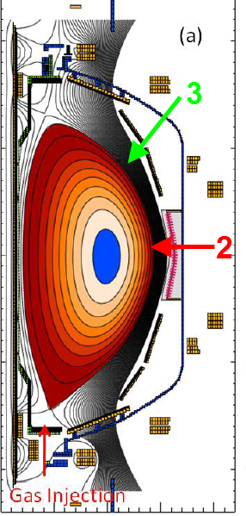
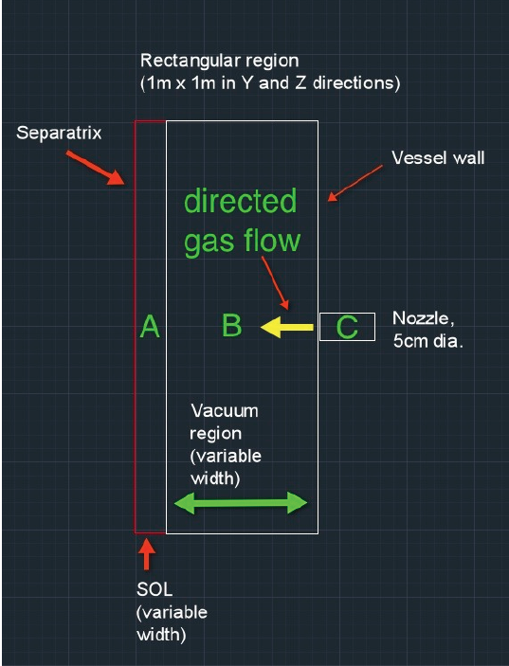
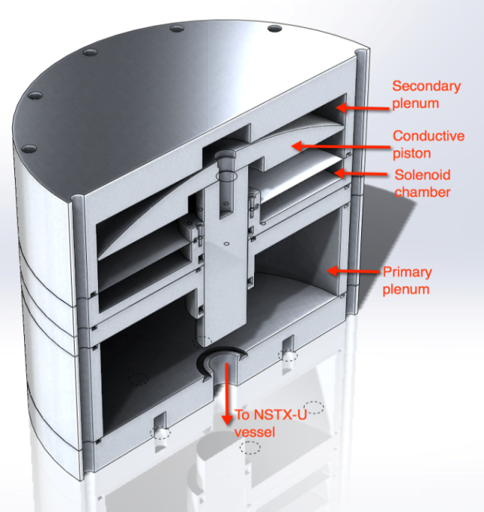
Supporting ITER through massive gas injection (MGI) research for disruption mitigation
MGI research will assess gas penetration efficiency at different poloidal locations
NSTX-U researchers successfully tested, will utilize pulsed-induction MGI valves
Same design as is being developed for ITER
Builds on designs used on JET and TEXTOR
Eliminates magnetic material in valve that can saturate in external magnetic field
Sub-ms opening time → well suited for MGI
Can operate at very high pressure (5-10kTorr)
Discharging small capacitor through a pancake coil (in solenoid chamber) induces image currents on conducting (non-magnetic) piston, which causes it open on a sub ms time scale
Predictive capability: Modeling using DEGAS-2 is quantifying the gas penetration past the SOL for NSTX-U
1
NSTX-U can offer new insight by:
  Reducing the amount of gas
  Injecting gas into the private flux and lower x-point regions of divertor to determine if these are more desirable locations for MGI
R. Raman (University of Washington)
37

Slide 38
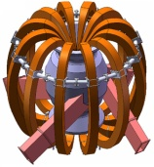
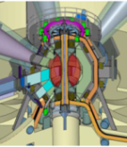
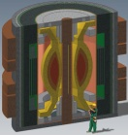
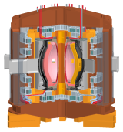
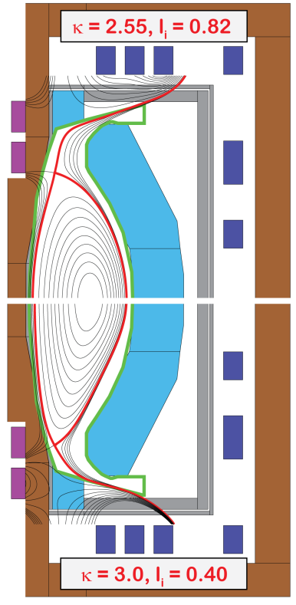
NSTX/ST researchers contributing to LDRD-funded study of Mission and Configuration of an ST-FNSF
Overarching goal of study:
  Determine optimal mission, performance, size
Goals of study:
  Review existing designs, ID advantageous features, improve configuration
  Develop self-consistent assessment + configuration for use by community
  Assess T self-sufficiency, maintainability, flexibility
Russia
Culham
UT Austin
ORNL
PPPL
FY2013-14 results/progress:
  Tritium breeding ratio (TBR) ~ 1 likely requires breeding blanket near top+bottom of centerstack (CS)
  Identified coil configuration compatible with:
    Breeding in CS end region + vertical maintenance
    Ex-vessel PF coils on outboard, can be S/C, support range of l_{i} and β_{N}
    Divertor power exhaust: q_{peak} ~ 3-5MW/m², partially detached
  Now carrying out free-boundary TRANSP simulations for NNBI+BS current drive, fusion performance, neutronics
  Exploring methods / locations to incorporate CHI electrodes
Blanket regions

Slide 39
NSTX-U collaborators offered many good ideas on how to enhance research program attractiveness
NSTX-U Program has 2014 FES “Notable Outcome”:
  “Expand engagement with university scientists to enhance NSTX-U program”
  Note to FES: expect collaborators to request / need ~2-3 run-days / year on-average (based on 2010 run statistics)
NSTX-U Program coordinated 3 meetings with 22 FES-funded NSTX-U collaboration grantees
  Asked for brainstorming on “Ideas to enhance participation in NSTX-U research and/or program by U.S. Universities, early-career researchers, students”
  Two main categories of ideas: (1) FES, (2) NSTX-U / PPPL
NSTX-U/PPPL is in preliminary stages of deciding what ideas to implement - we welcome your input

Slide 40
Suggestions / ideas for FES (1)
Stabilize funding to prevent loss of personnel and to enable engaging graduate students in research
  Fluctuations in funding harmful – especially for smaller groups with little funding margin
FES-related DOE solicitations should explicitly encourage student research
  2013 NSTX-U Collaboration Solicitation does not explicitly encourage student research
    In contrast, NSF-DOE Basic Plasma Science solicitations do explicitly encourage support for education – important criterion in proposal review
  Suggest/encourage additional funding for students

Slide 41
Suggestions / ideas for FES (2)
Expand Early Career Research (ECR) awards to University Scientists and/or Research Professors
  Early Career Awards have proven very effective for initiating long term collaboration with major facilities
  Current DoE solicitations for early career researchers only cover tenure track faculty (up to $150k/yr)
    Many university researchers are encouraged to be PIs on collaboration proposals, but cannot apply for these awards
  Extending ECR to research faculty positions could:
    Foster new strong collaborations with universities
    Perhaps lead to formation of new tenure-track positions
Note: FES has previously inquired about such expansion within the Office of Science, but there is/was reluctance to expand to non-tenure-track

Slide 42
Suggestions / Ideas for NSTX-U/PPPL (1)
Identify graduate and undergraduate ‘independent research’ projects to be done for academic credit
  Coordinate / ID topics across major research facilities
  Solicit interested students from range of Universities
  Scope: senior thesis / similar – 6 – 12 month project
    Would be more in-depth / extensive than SULI/NUF summer project
Host student visits to national facilities during operations
  Advertise the NSTX-U research environment
  Provide a context for students with their peers
Set aside run-time explicitly for exploratory ideas
  Target students, early career, groups outside main-line fusion
Have a “fellow/scholar” program for mid-career research collaborators to aid in promotions at home institution
  Small seed funding for travel can help support students in projects affiliated with NSTX-U from their home institutions

Slide 43
Suggestions / Ideas for NSTX-U/PPPL (2)
Actively encourage proposals from University Researchers to DoE, NSF, etc. that directly benefit NSTX-U – such encouragement could also target other activities at PPPL
Direct PPPL funding of small, targeted 1-year NSTX-U subcontracts with University Researchers
  Benefits researchers by raising their stature, both within and outside of the University, while also providing exposure to increased opportunities
    Such contracts could act as a stepping stone to full DoE Grants
Develop/utilize remote experimental collaboration IT/software capabilities to enhance participation of off-site researchers
Allocate space for a “diagnostic test laboratory” (this will be included as part of PPPL “campus plan”)

Slide 44
Leading candidate ideas to promote NSTX-U program attractiveness
Support consideration of all 3 ideas for FES
  Stabilize funding (in progress), encourage student participation in collaboration solicitations, non-tenure-track ECR (difficult)
Several NSTX-U/PPPL ideas could be high impact
  Students: senior projects, visits/travel, targeted run-time
  Universities: joint proposals, short-term direct grants, enhanced collaboration tools (remote control room)
Idea: NSTX-U Innovative Research Award (NIRA)
  Target innovative / breakthrough R&D – fund primarily universities
    High-impact science and/or address critical NSTX-U / ITER / FNSF needs
  Encourage early-career and student participation / leadership
  Fund from (supplemented) NSTX-U science budget: $0.5-1M / year
  Typical award level: up to ~100-200k / year for up to 3 years
    Awards granted twice per year, annual progress review and funding renewal
  Review: NSTX-U management + small committee + FES concurrence

Slide 45
Summary
Research team productive during Upgrade outage
  Publications, conferences, JRT and ITPA leadership
5 year plan and near-term research goals in place for research campaign starting spring 2015
  Research forum / CD-4 to be held near end of this CY
  Goals/milestones emphasize high-priority research for FNSF and ITER
Developed ideas to enhance NSTX-U attractiveness
  Will finalize ideas with FES, implement as resources permit
45

Slide 46
Backup Slides

Slide 47
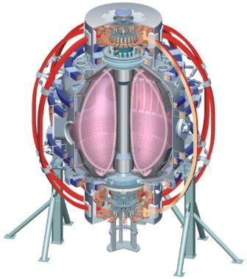
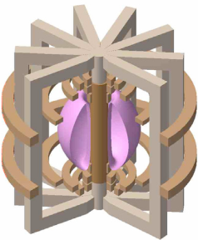
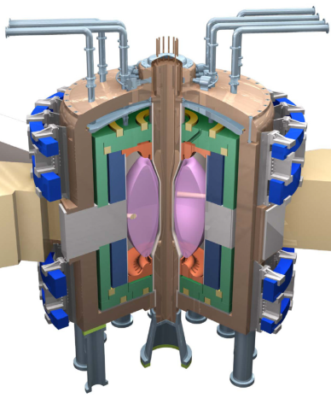
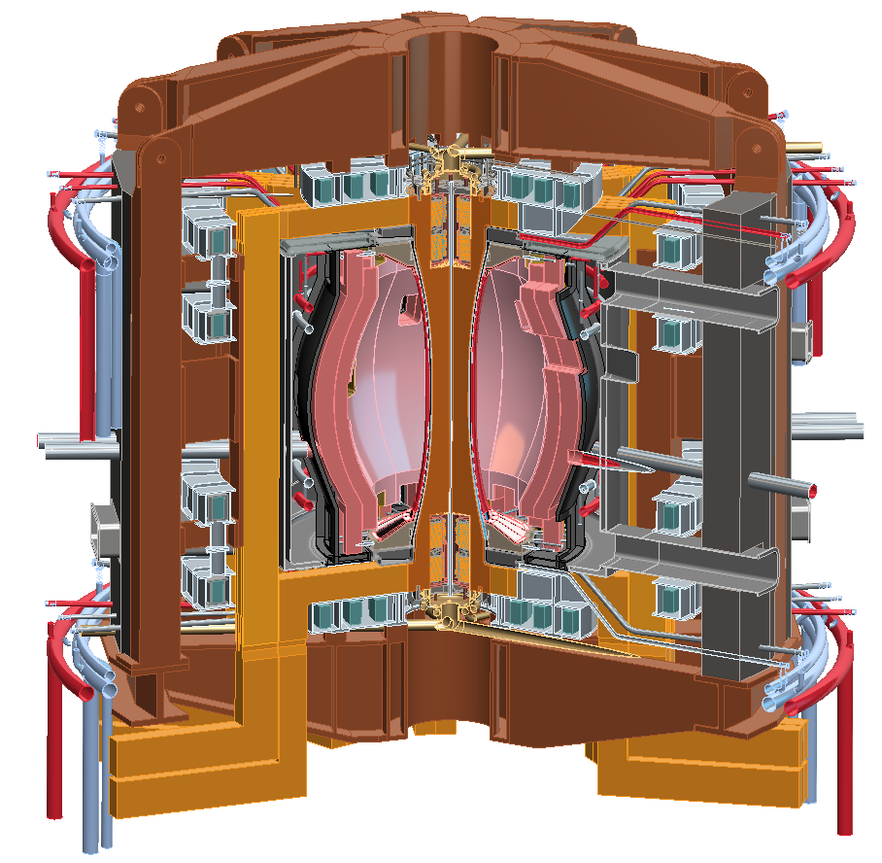
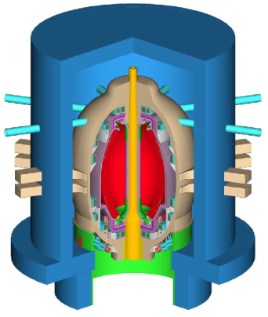
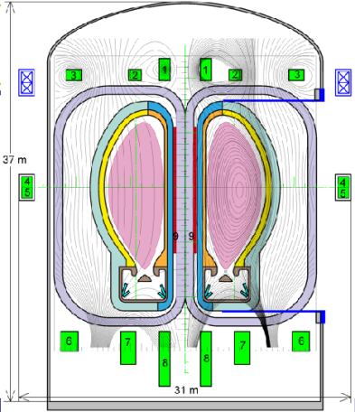
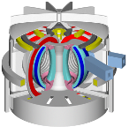
NSTX Upgrade will access next factor of two increase in performance to bridge gaps to next-step STs
Low-A
Power Plants
Parameter | NSTX | NSTX Upgrade | Plasma Material Interface Facility | Fusion Nuclear Science Facility | Pilot Plant
Major Radius R₀ [m] | 0.86 | 0.94 | 1.0 | 1.3 | 1.6 – 2.2
Aspect Ratio R₀ / a | ≥ 1.3 | ≥ 1.5 | ≥ 1.8 | ≥ 1.5 | ≥ 1.7
Plasma Current [MA] | 1 | 2 | 3 – 4 | 4 – 10 | 11 – 18
Toroidal Field [T] | 0.5 | 1 | 2 | 2 – 3 | 2.4 – 3
Auxiliary Power [MW] | ≤ 8 | ≤ 19* | 30 – 50 | 22 – 45 | 50 – 85
P/R [MW/m] | 10 | 20 | 30 – 50 | 30 – 60 | 70 – 90
P/S [MW/m²] | 0.2 | 0.4-0.6 | 0.7 – 1.2 | 0.6 – 1.2 | 0.7 – 0.9
Fusion Gain Q |  |  |  | 1 – 2 | 2 – 10
ARIES-ST (A=1.6)
JUST (A=1.8)
VECTOR (A=2.3)
* Includes 4MW of high-harmonic fast-wave (HHFW) heating power
Non-inductive start-up, ramp-up, sustainment
Confinement scaling (esp. electron transport)
Stability and steady-state control
Divertor solutions for mitigating high heat flux
Key issues to resolve for next-step STs

Slide 48
5 year plan goal: access performance levels of next-steps, approach Pilot-Plant regimes
Requirements for tokamak / ST next-steps:
1.0
Bootstrap fraction
0.9
ST-Pilot
Full non-inductive (NI) current drive for steady-state operation
  ST requires NI start-up/ramp-up
High confinement to minimize auxiliary heating, device size
Sustained high β to minimize magnet size, forces, power
Divertor/first-wall survival with intense power/particle fluxes
f_{BS}
0.8
ST-PMI
ST-FNSF
0.7
NSTX-U
0.6
0.5
2.0
Normalized Confinement
1.8
ST-Pilot
H_{98y2}
1.6
1.4
ST-FNSF
NSTX-U
ST-PMI
1.2
1.0
8.0
Normalized Beta
β_{N}
7.0
ST-Pilot
6.0
NSTX-U
5.0
ST-PMI
ST-FNSF
4.0
3.0
1.0
ST-PMI
ST-FNSF
ST-Pilot
P/S
0.8
0.6
NSTX-U
[MW/m²]
0.4
0.2
0.0
Power exhaust challenge

Slide 49
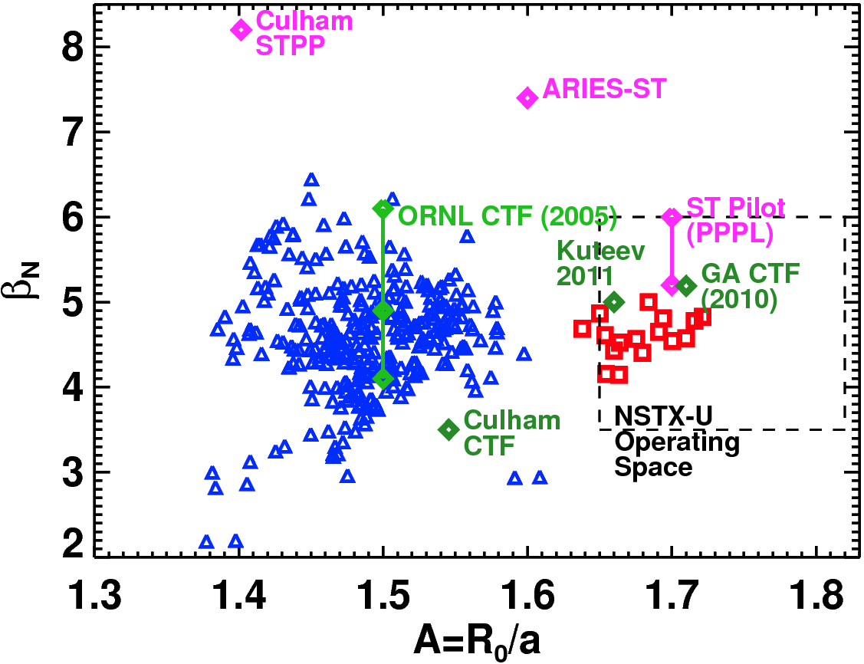
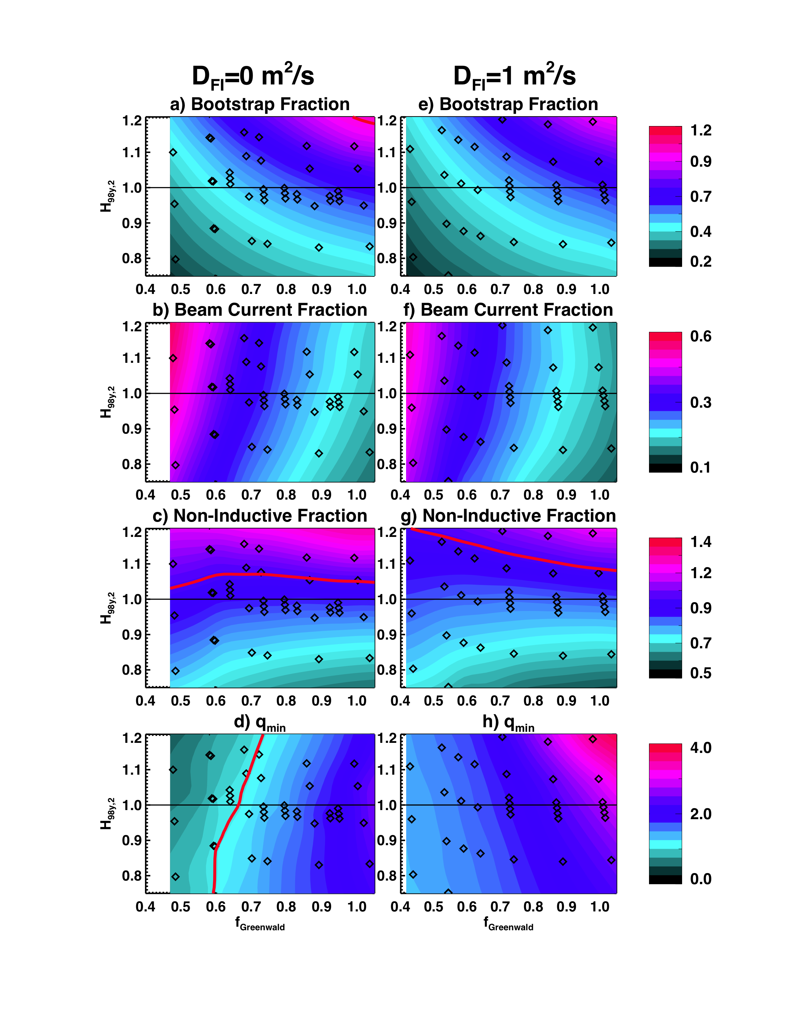
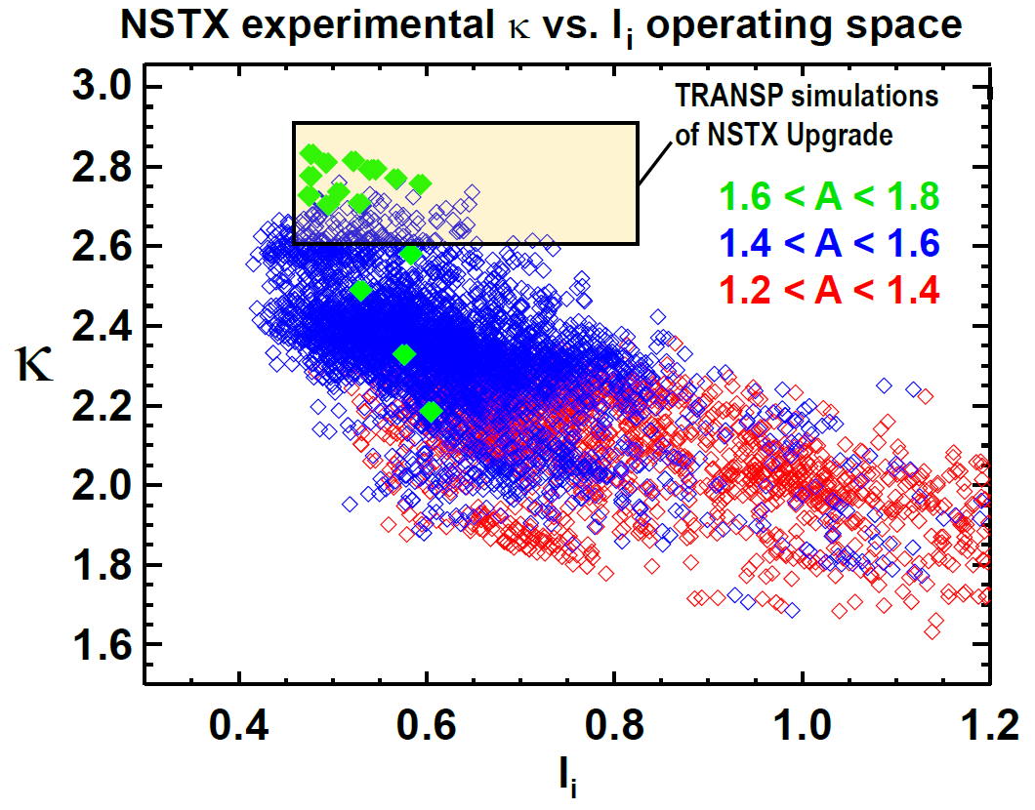
NSTX has already accessed A, β_{N}, κ needed for ST-based FNSF – next step is to access & control 100% non-inductive
NSTX-U TRANSP predictions:
B_{T}=1.0 T, I_{P}=1 MA, P_{inj}=12.6 MW
Contours of Non-Inductive Fraction
Contours of q_{min}

Slide 50

Non-inductive ramp-up from ~0.4MA to ~1MA projected to be possible with new CS + more tangential 2nd NBI
More tangential NBI provides 3-4x higher CD at low I_{P}:
  2x higher absorption (40→80%) at low I_{P} = 0.4MA
    Now modeling coupling to 0.2-0.3MA (TRANSP)
  1.5-2x higher current drive efficiency
TSC simulation of non-inductive ramp-up from initial CHI target
  - Simulations now being improved to use TRANSP/NUBEAM loop within TSC
  Experimental challenges:
    Maximum NBI power in low l_{i} CHI plasma
Present NBI
More tangential 2nd NBI
R. Raman, F. Poli, C.E. Kessel, S.C. Jardin
50

Slide 51


NSTX-U (S. Gerhardt) led 3 facility joint research target (JRT)
2013 JRT: “Explore enhanced confinement regimes without large edge instabilities, but with acceptable edge particle transport and a strong thermal transport barrier, and extrapolate … to ITER.”
NSTX contributed data from Enhanced Pedestal H-mode (EPH)
EPH is attractive regime of nearly stationary high confinement, β:
  H₉₈ ≤ 1.6 with β_{N} = 6-6.5 and high non-inductive fraction = 60-70%
51

Slide 52



Participated in MAST 28 GHz EBW start-up
campaign that achieved record plasma current
  Grooved reflecting polarizer machined into center column in MAST
28 GHz O-mode weakly absorbed (< 2%) below n_{e} ~ 1 x 10¹⁹ m⁻³ cut off
Polarizer on center column converts to X-Mode that then 100% converts to EBWs
Previously achieved I_{p}~33 kA but arcs in waveguide limited RF power [Sept 2009]
During EBW start-up campaigns in 2013 coupled 70-100 kW for 300-400 ms achieving I_{p} = 50-75 kA → η_{eff} ~ 0.5-1 A/W
ORNL-led + G. Taylor (PPPL)
52

