Slide 1




NSTX-U
Supported by
NSTX Upgrade Project Status, Facility/Diagnostic Progress and Plans
Coll of Wm & Mary
Columbia U
CompX
General Atomics
FIU
INL
Johns Hopkins U
LANL
LLNL
Lodestar
MIT
Lehigh U
Nova Photonics
ORNL
PPPL
Princeton U
Purdue U
SNL
Think Tank, Inc.
UC Davis
UC Irvine
UCLA
UCSD
U Colorado
U Illinois
U Maryland
U Rochester
U Tennessee
U Tulsa
U Washington
U Wisconsin
X Science LLC
Culham Sci Ctr
York U
Chubu U
Fukui U
Hiroshima U
Hyogo U
Kyoto U
Kyushu U
Kyushu Tokai U
NIFS
Niigata U
Tsukuba U
U Tokyo
JAEA
Inst for Nucl Res, Kiev
Ioffe Inst
TRINITI
Chonbuk Natl U
NFRI
KAIST
POSTECH
Seoul Natl U
ASIPP
CIEMAT
FOM Inst DIFFER
ENEA, Frascati
CEA, Cadarache
IPP, Jülich
IPP, Garching
ASCR, Czech Rep
Masa Ono
for the NSTX-U Team
NSTX-U PAC 35
June 11-13, 2014

Slide 2
Talk Outline
NSTX Upgrade Project Update
NSTX-U Facility-Diagnostic Status and Plan
FY2014-16 Facility-Diagnostic Plan
Summary

Slide 3
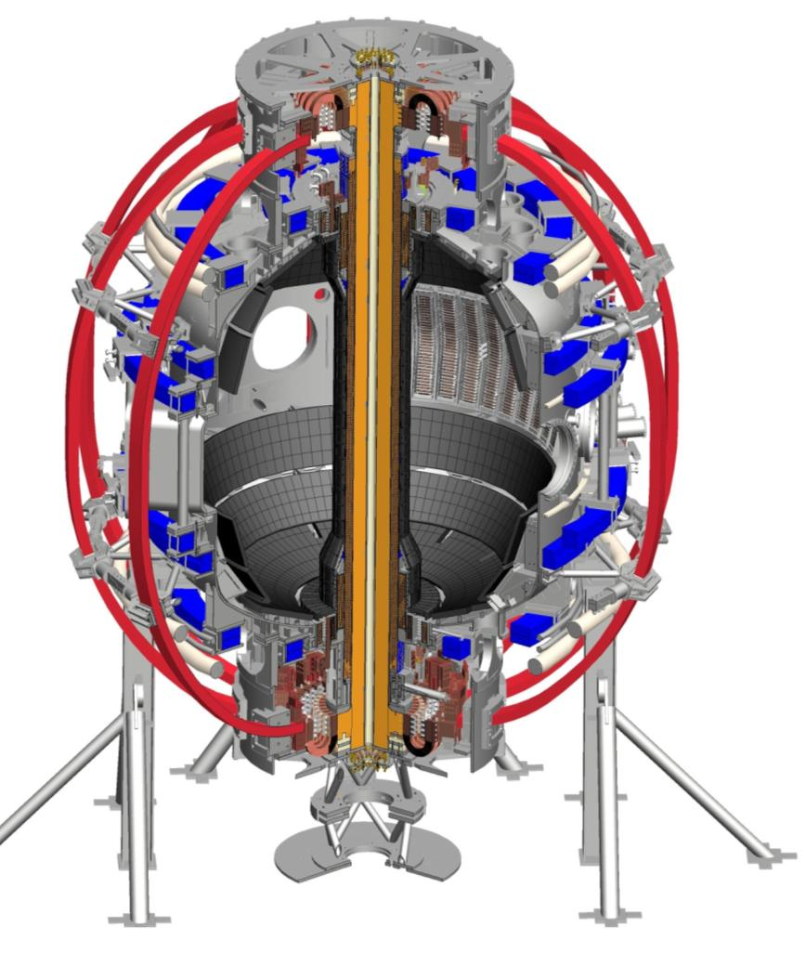
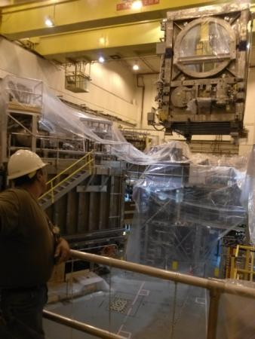
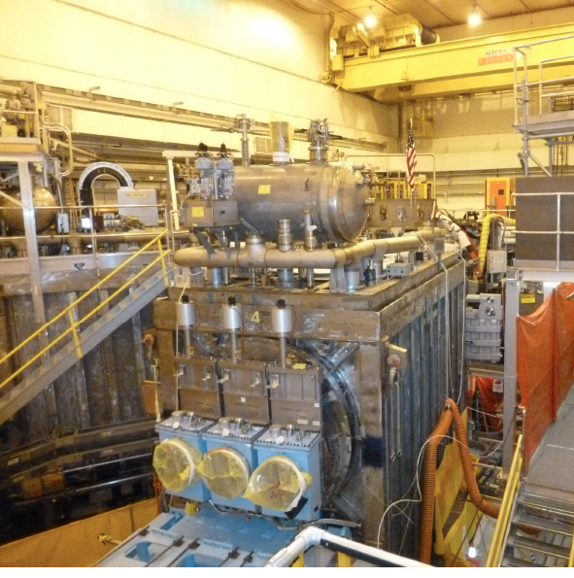

NSTX Upgrade Project Progress Overview
R. Strykowsky, E. Perry, T. Stevenson, L. Dudek, S. Langish, T. Egebo, M. Williams and the NSTX-U Team
New Center Stack Project Scope
2nd NBI Project Scope
Decontaminate TFTR beamline
Refurbish for reuse
Relocate pump duct, 22 racks and numerous diagnostics to make room in the NSTX Test Cell
Install new port on vacuum vessel to accommodate NB2
Move NB2 to the NSTX Test Cell
Install power, water, cryo and controls
Inner TF bundle
TF Flex bus
OH coil
Inner PF coils
Enhance outer TF supports
Enhance PF supports
Reinforce umbrella structure
New umbrella lids
Power systems
I&C, Services, Coil protection
Center stack
Structure
Ancillary Sys
Umbrella Structure
Center-Stack
TF Flex-Bus
Outer TF
PF #4-U
PF #5-U
PF #3-L
PF #2-L
Center-stack Pedestal
3

Slide 4
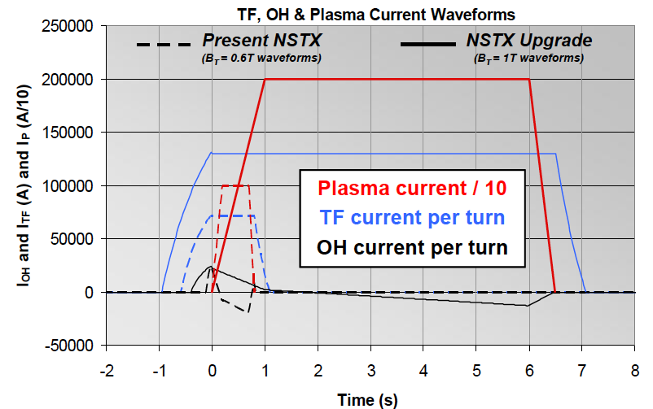
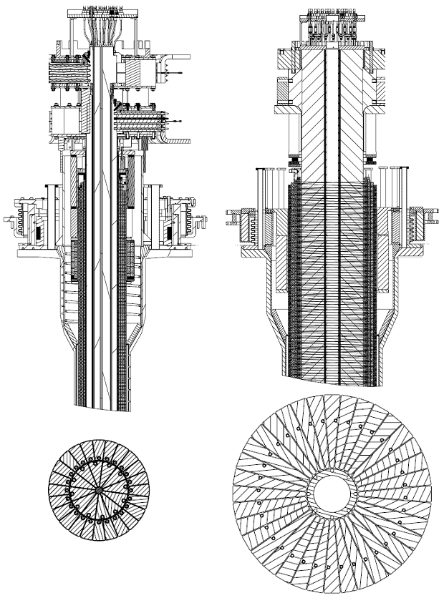
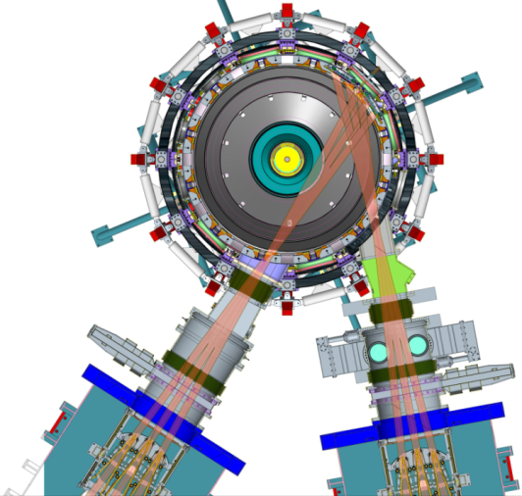
Substantial Increase in NSTX-U Device / Plasma Performance
To provide data base to support ST-FNSF designs and ITER operations
Previous
center-stack
New
center-stack
TF OD = 20cm
TF OD = 40cm
NSTX
 | R₀ (m) | A_{min} | I_{p}(MA) | B_{T} (T) | T_{TF}(s) | R_{CS} (m) | R_{OB} (m) | OH flux (Wb)
NSTX | 0.854 | 1.28 | 1 | 0.55 | 1 | 0.185 | 1.574 | 0.75
NSTX-U | 0.934 | 1.5 | 2 | 1 | 6.5 | 0.315 | 1.574 | 2.1
~ X 5-10 increase in nτT from NSTX
NSTX-U average plasma pressure ∝ B_{T0}² β_{T} (T²%) ~ tokamaks
Present NBI
New 2nd NBI

Slide 5
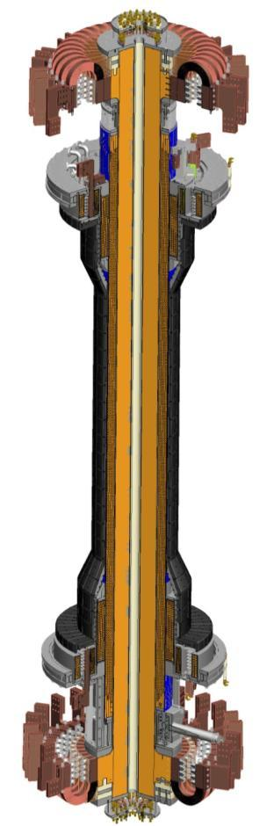
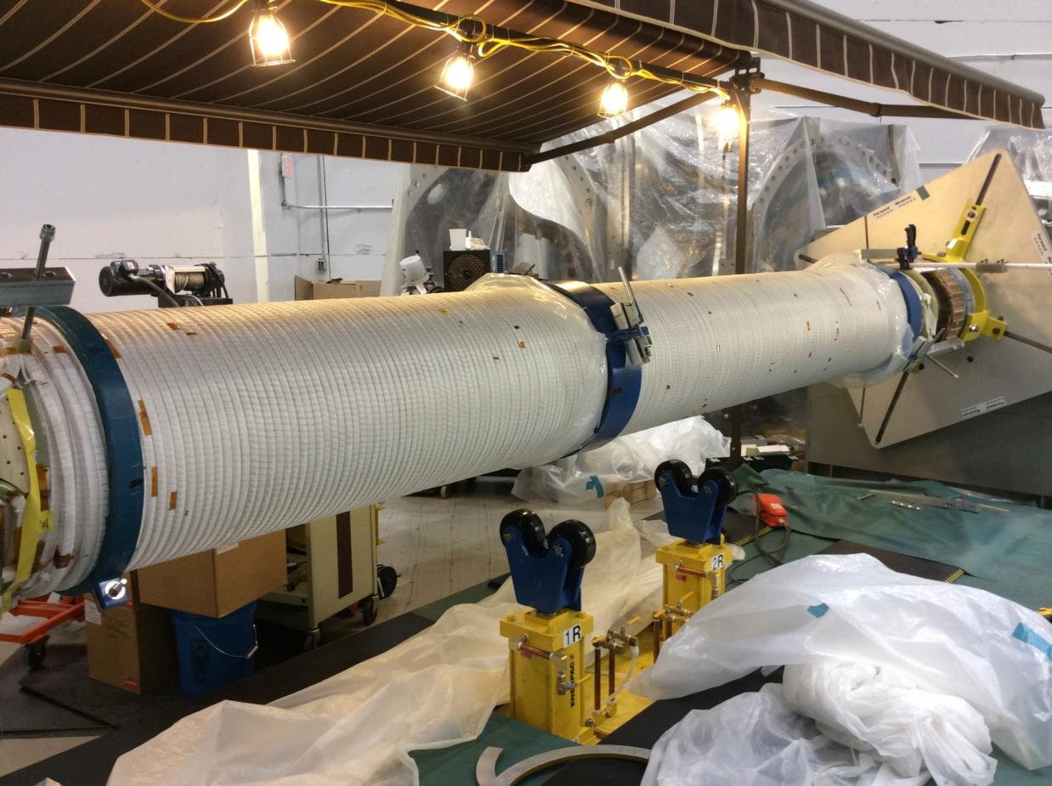
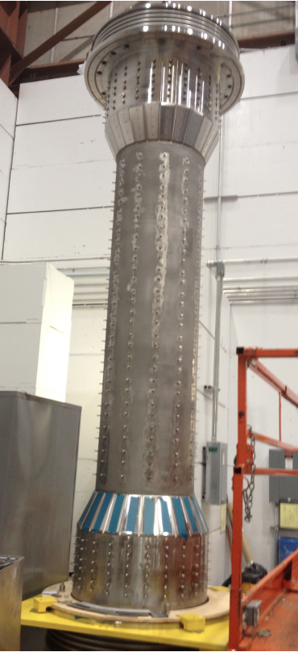
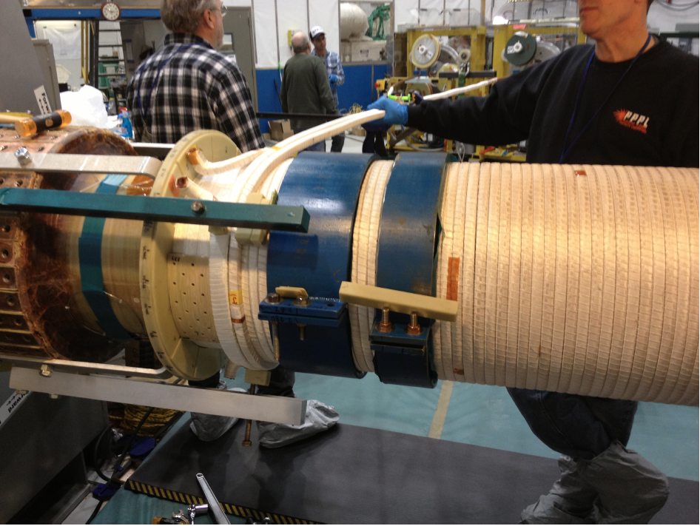
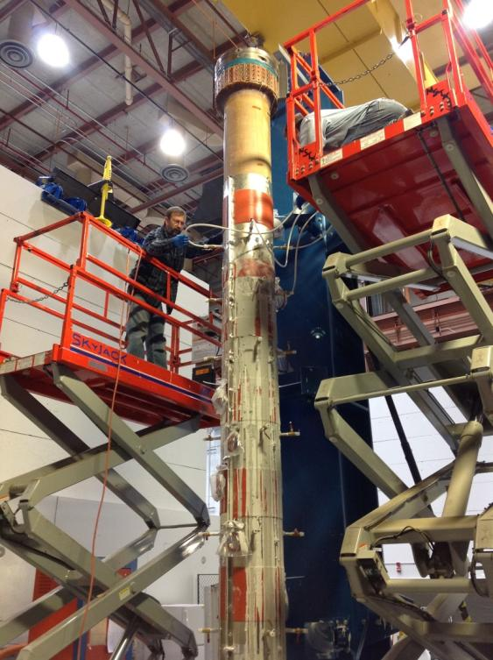
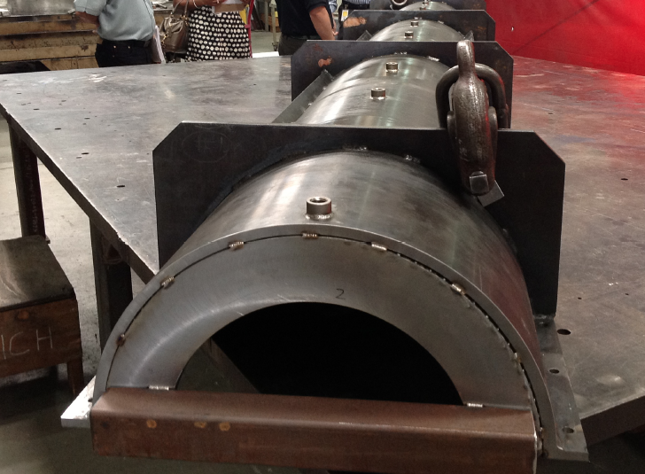
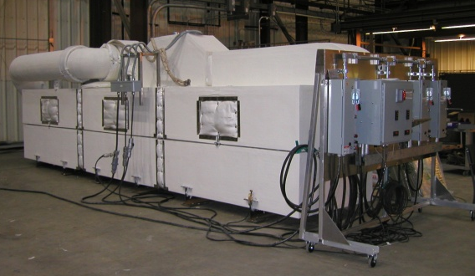
OH Coil Winding Complete
OH Coil VPI being readied
Center-stack
CS Casing
Inner TF bundle
OH
Solenoid
Aquapour application
OH VPI Mold
VPI Oven

Slide 6
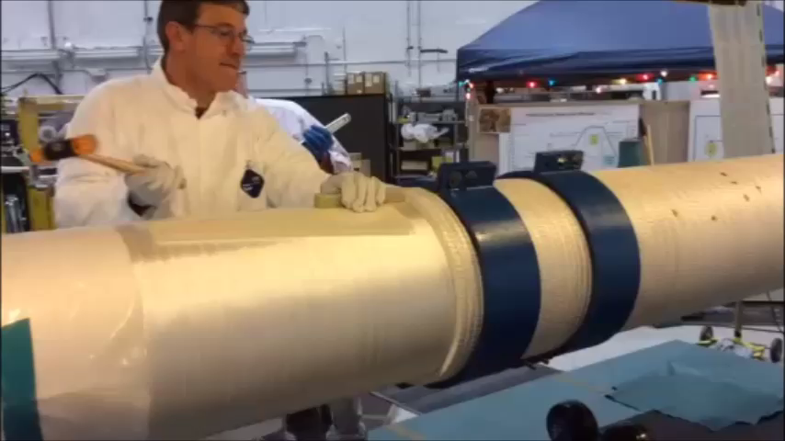
A movie of OH coil winding..

Slide 7
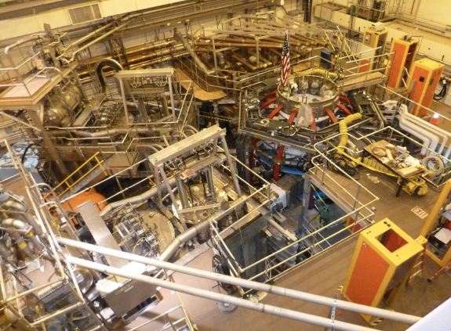
NSTX-U Test Cell Aerial View (May, 2014)
2nd NBI and Structural Enhancement Nearly Complete
Excellent safety record
On schedule and cost
HHFW
System
1st NBI
NSTX-U
2nd NBI

Slide 8
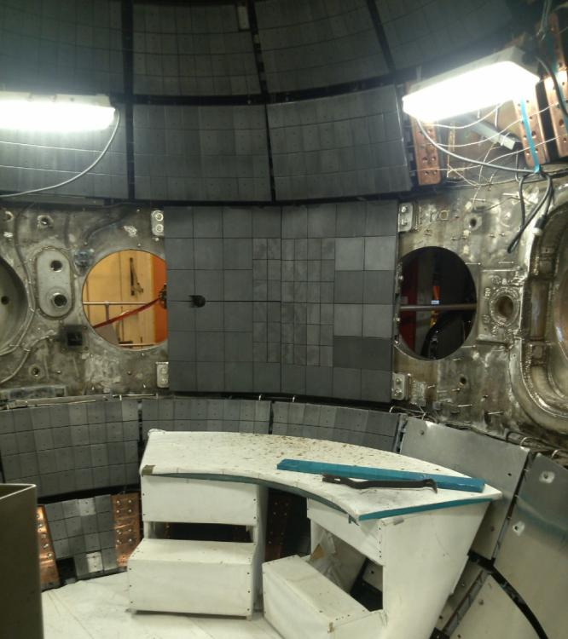
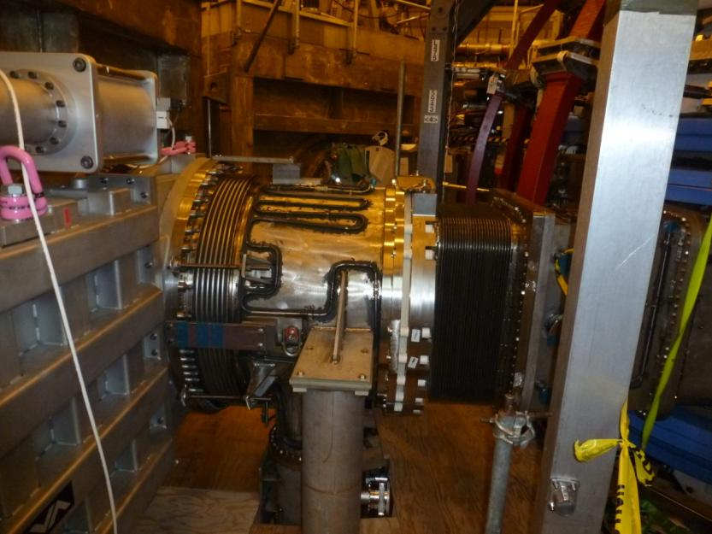
Final 2nd NBI Components being Installed
2nd NBI duct with pumping section and NBI armor installed
Neutral Beam & TIV valve
Vacuum Vessel Bay J/K port
Neutral Beam Armor Installed
Source installation planned for June

Slide 9
Upgrade Project Scope ~ 86% complete
with 27% contingency on work remaining
Centerstack Is on the Critical Path
Components & Hardware
Inner TF Bundle
OH Solenoid
  OH solenoid winding
  VPI OH – June 2014
Centerstack Assembly-
  Delivery to NSTX TC - August 2014
Install Centerstack - September 2014
Readiness review - September 2014
Pumpdown - November 2014
ISTP - December 2014
CD-4 - January 2015

Slide 10
NSTX-U diagnostics to be installed during first 2 years
Diagnostics presently being installed prior to the center-stack installation
MHD/Magnetics/Reconstruction
  Magnetics for equilibrium reconstruction
  Halo current detectors
  High-n and high-frequency Mirnov arrays
  Locked-mode detectors
  RWM sensors
Profile Diagnostics
  MPTS (42 ch, 60 Hz)
  T-CHERS: T_{i}(R), V_{φ}(r), n_{C}(R), n_{Li}(R), (51 ch)
  P-CHERS: V_{θ}(r) (71 ch)
  MSE-CIF (18 ch)
  MSE-LIF (20 ch)
  ME-SXR (40 ch)
  Midplane tangential bolometer array (16 ch)
Turbulence/Modes Diagnostics
  Poloidal Microwave high-k scattering
  Beam Emission Spectroscopy (48 ch)
  Microwave Reflectometer,
  Microwave Polarimeter
  Ultra-soft x-ray arrays – multi-color
Energetic Particle Diagnostics
  Fast Ion D_{α} profile measurement (perp + tang)
  Solid-State neutral particle analyzer
  Fast lost-ion probe (energy/pitch angle resolving)
  Neutron measurements
Edge Divertor Physics
  Gas-puff Imaging (500kHz)
  Langmuir probe array
  Edge Rotation Diagnostics (T_{i}, V_{φ}, V_{pol})
  1-D CCD H_{α} cameras (divertor, midplane)
  2-D divertor fast visible camera
  Metal foil divertor bolometer
  AXUV-based Divertor Bolometer
  IR cameras (30Hz) (3)
  Fast IR camera (two color)
  Tile temperature thermocouple array
  Divertor fast eroding thermocouple
  Dust detector
  Edge Deposition Monitors
  Scrape-off layer reflectometer
  Edge neutral pressure gauges
  Material Analysis and Particle Probe
  Divertor VUV Spectrometer
Plasma Monitoring
  FIReTIP interferometer
  Fast visible cameras
  Visible bremsstrahlung radiometer
  Visible and UV survey spectrometers
  VUV transmission grating spectrometer
  Visible filterscopes (hydrogen & impurity lines)
  Wall coupon analysis
New capability, Enhanced capability

Slide 11
Aiming for Extended Research Operation in FY15
Research operation preparation on going in parallel with Upgrade Project
Run Plan for FY 2015
Nov. 2014
Dec. 2014
Jan. 2015
Feb. 2015
Mar. 2015
Apr. 2015
May 2015
May 2015
Jun. 2015
Jul. 2015
Aug 2015
Sep. 2015
Bakeout
ISTP/Comm
Research Plasma Operation
18 Run Weeks
2 Run Weeks
CD4
CD-4 in January should allow scheduling of the research campaign up to 20 run weeks (Base – 18 run weeks and Incremental – 2 run weeks).
The run assumes three weeks operation and one maintenance weeks. Some extended run weeks for the latter part of operation.
~ 3 month period is allocated between CD-4 and the research plasma operation. More details in S. Gerhardt’s talk.
The Upgrade team is exploring ways to bring the CD-4 schedule earlier by increasing the resources available.

Slide 12
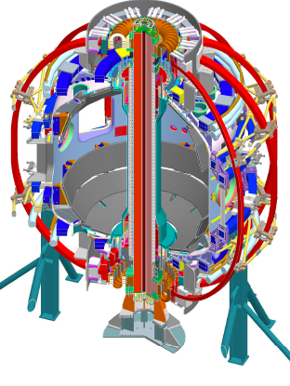
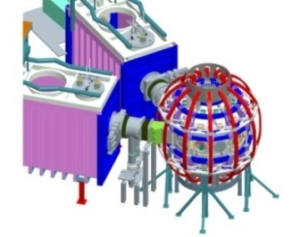
10 Year Facility Plan Targets Research Goals
1.1 × (FY2012 + 2.5% inflation)
2014 | 2015 | 2016 | 2017 | 2018 | 2019 | 2020 | 2021 | 2022 | 2023
Upgrade Outage
1.5 → 2 MA, 1s → 5s
Metallic PFCs, 5s → 10-20s
Run Weeks:
20
16
16
20
22
6
18
22
22
New
center-stack
Start-up and Ramp-up
Upgraded CHI for ~0.4MA
0.4-1 MA CHI
up to 1 MA plasma gun
Extend NBI duration to 10-20s and/or implement 2-4 MW off-axis EBW H&CD
1 MW ECH/EBW
2 MW
Boundary Physics
Lower divertor cryo-pump
Divertor Thomson
Upper divertor cryo-pump
Inform choice of FNSF: aspect ratio, divertor, and PFCs
Materials and PFCs
High-Z tile row on lower OBD
High-Z first-wall + lower OBD tiles
High-Z PFC diagnostics
All high-Z PFCs
Hot high-Z FW PFCs using bake-out system
Liquid
metals / lithium
Upward
LiTER
LLD using bakeable cryo-baffle
Flowing Li divertor
or limiter module
Full toroidal flowing Li lower OBD
Li granule injector
MGI disruption mitigation
Partial NCC
NCC SPA upgrade
Full NCC
MHD
Enhanced MHD sensors
Transport & Turbulence
δB polarimetry
DBS, PCI, or other intermediate-k
High k_{θ}
Waves and Energetic Particles
HHFW limiter upgrade
HHFW straps to excite EHO
High-power AE antenna
2nd NBI
1 coil AE antenna
4 coil AE antenna
Charged fusion product, neutron-collimator
Scenarios and Control
Establish control of:
Control integration, optimization
Control integration, optimization with long-pulse and full metal wall
n_{e}
q_{min}
Divertor P_{rad}
Snowflake
Rotation

Slide 13
Significant Near Term Upgrade Scopes Are Highlighted
ECH, Cryo-Pump and NCC system require resources starting in 2015
2014 | 2015 | 2016 | 2017 | 2018 | 2019 | 2020 | 2021 | 2022 | 2023
Upgrade Outage
1.5 → 2 MA, 1s → 5s
Metallic PFCs, 5s → 10-20s
Run Weeks:
20
16
16
20
22
6
18
22
22
New
center-stack
Start-up and Ramp-up
Upgraded CHI for ~0.4MA
0.4-1 MA CHI
up to 1 MA plasma gun
Extend NBI duration to 10-20s and/or implement 2-4 MW off-axis EBW H&CD
1 MW ECH/EBW
2 MW
Boundary Physics
Lower divertor cryo-pump
Divertor Thomson
Upper divertor cryo-pump
Inform choice of FNSF: aspect ratio, divertor, and PFCs
Materials and PFCs
High-Z tile row on lower OBD
High-Z first-wall + lower OBD tiles
High-Z PFC diagnostics
All high-Z PFCs
Hot high-Z FW PFCs using bake-out system
Liquid
metals / lithium
Upward
LiTER
LLD using bakeable cryo-baffle
Flowing Li divertor
or limiter module
Full toroidal flowing Li lower OBD
Li granule injector
MGI disruption mitigation
Partial NCC
NCC SPA upgrade
Full NCC
MHD
Enhanced MHD sensors
Transport & Turbulence
δB polarimetry
DBS, PCI, or other intermediate-k
High k_{θ}
Waves and Energetic Particles
HHFW limiter upgrade
HHFW straps to excite EHO
High-power AE antenna
2nd NBI
1 coil AE antenna
4 coil AE antenna
Charged fusion product, neutron-collimator
Scenarios and Control
Establish control of:
Control integration, optimization
Control integration, optimization with long-pulse and full metal wall
n_{e}
q_{min}
Divertor P_{rad}
Snowflake
Rotation

Slide 14
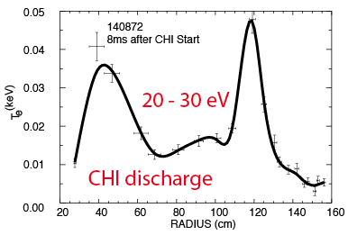
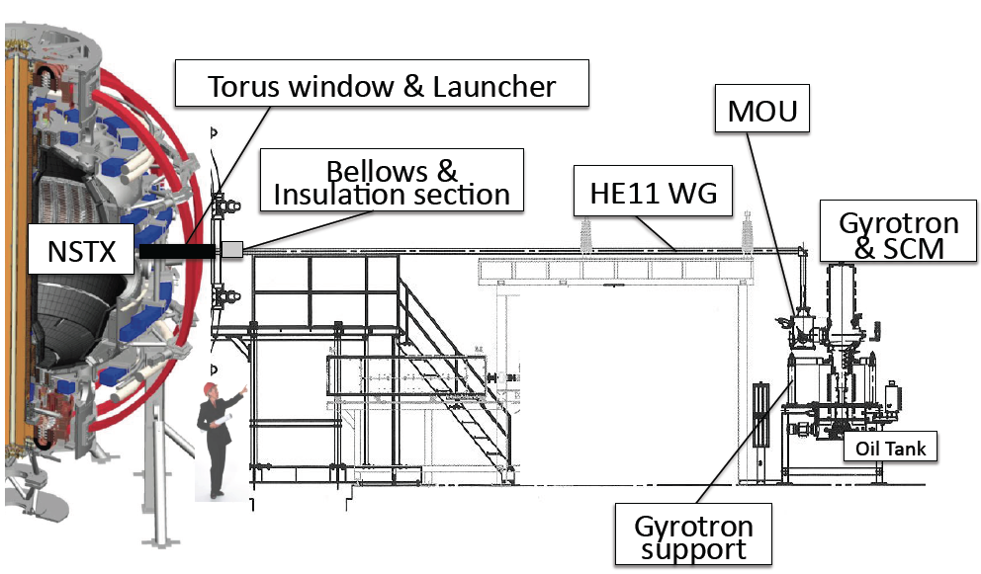
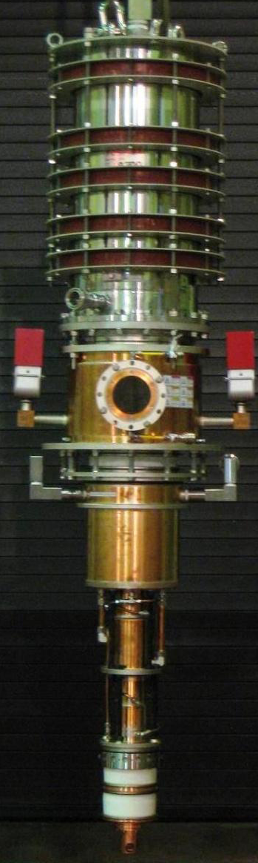
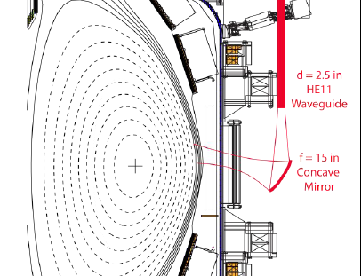
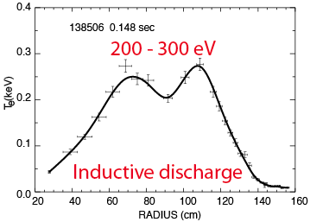
1 MW ECH system: Required to bridge T_{e} Gap Between CHI Start-up and HHFW + NBI Current Ramp
28 GHz, 1.5 MW Tsukuba Gyrotron
1MW
ECH
28 GHz ECH/EBWH waveguide and mirror concept
Tsukuba U
MIT
ORNL
FY 2016 Perform MW-class ECH/EBW system engineering design for non-inductive operations. Incremental funding will enable start of engineering design and procurement in FY 2015.

Slide 15
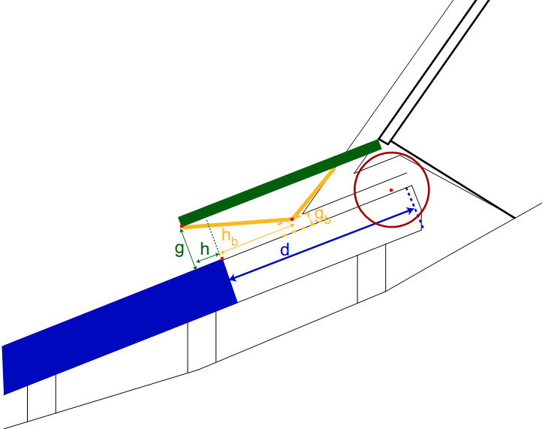
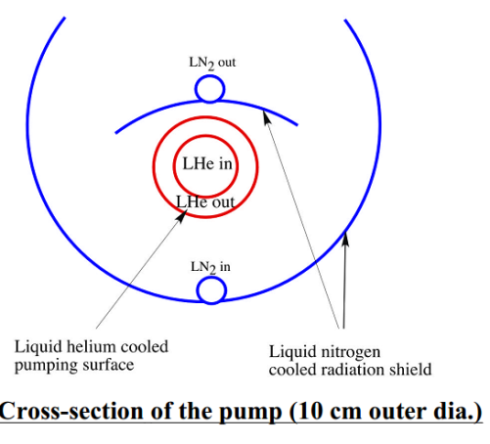
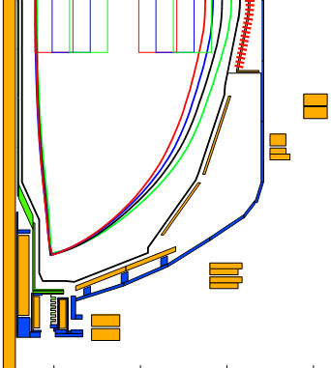
Divertor Cryo-pumping will be used for Particle Control in Long-pulse ELMy H-mode
Cryo-pump is proven technology for plasma density control
  More conventional pumped stationary ELMy H-mode scenario
  Enables comparison with lithium based pumping
NSTX-U design will leverage DIII-D experience
  Plenum located under new baffling structure near secondary passive plates
  Pumping capacity of a toroidal liquid He cooled loop
    S=24,000 l/s @ R=1.2m
  Need plenum pressure of 0.6 mTorr to pump beam input
g = throat height
h = throat length
Baffle
g
h
Cryo
ORNL
Base - Perform cryo-system engineering design for particle control in FY 2016. Incremental funding will enable start of engineering design in FY 2015 and procurement in FY 2016.

Slide 16
NCC will greatly enhance MHD physics studies and control
Range of off-midplane NCC coil configurations is assessed
Full toroidal NCC array (2 x 12)
Partial toroidal NCC array (2 x 6)
Partial NCC
Full NCC
Existing
RWM
coils
Columbia U
General Atomics
• NCC (non-symmetric control coils) can provide various NTV, RMP, and EF selectivity with flexibility of field spectrum (n ≤ 6 for full and n≤ 3 for partial).
• 6-channel Switching Power Amplifier (SPA) powers independent currents in existing EFC/RWM and NCC coils.
Base – No work on NCC until 2017. Incremental funding will enable start of engineering design in FY 2015 and procurement in FY 2016.
16

Slide 17
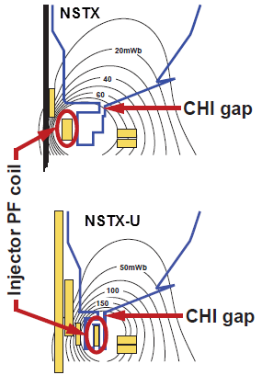
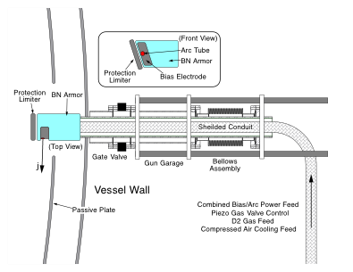
Solenoid-free Start-up
High priority goal for NSTX-U in support of FNSF
CHI Start-Up Base Plan
Point source under developed in PEGASUS
• Inj. Flux in NSTX-U is about 2.5 times higher than in NSTX
• NSTX-U coil insulation greatly enhanced for higher voltage ~ 3 kV operation
PEGASUS Plasma Gun
U. Washington
U. Wisconsin
FY 2014-15 Non-Inductive Start-up Systems Design for Post-Upgrade Operations
• CHI will start with the present 2 kV capability then enhanced to ~ 3 kV higher voltage as needed.
• PEGASUS gun start-up producing exciting results Ip ~ 160 kA. The PEGASUS gun concept is technically flexible to implement on NSTX once fully developed. High voltage gun for the NSTX-U will be developed utilizing the PEGASUS facility in collaboration with University of Wisconsin.

Slide 18
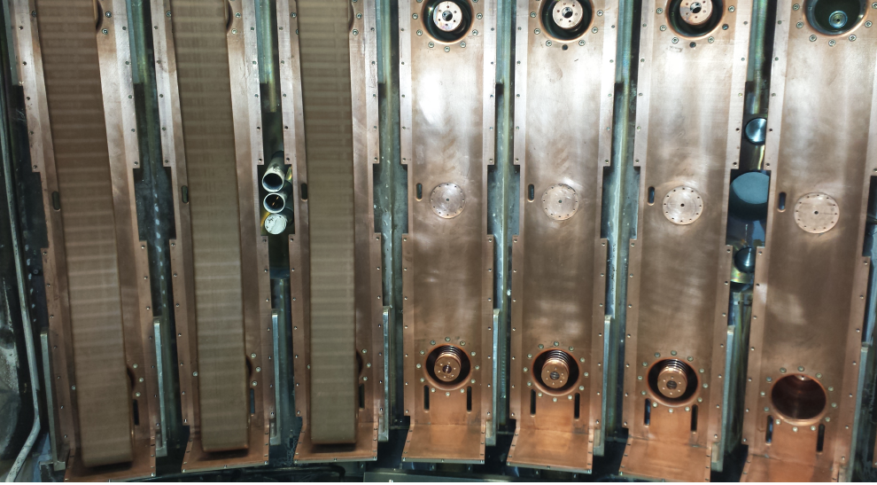
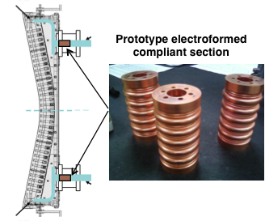
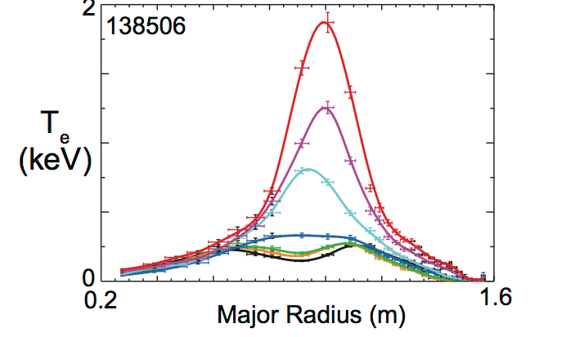
HHFW System for Electron Heating and Current Ramp-up
Antennas were improved for NSTX-U
New Compliant Antenna Feeds
Will allow HHFW antenna feedthroughs to tolerate 2 MA disruptions
1-2 MW
HHFW
Additional ground installed
Prototype compliant feeds tested to 46 kV in the RF test-stand. Benefit of back-plate grounding for arc prevention found.
Antennas were re-installed with the new feeds and back-plate grounding
G. Taylor , et al.,

Slide 19
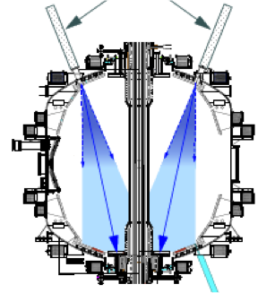
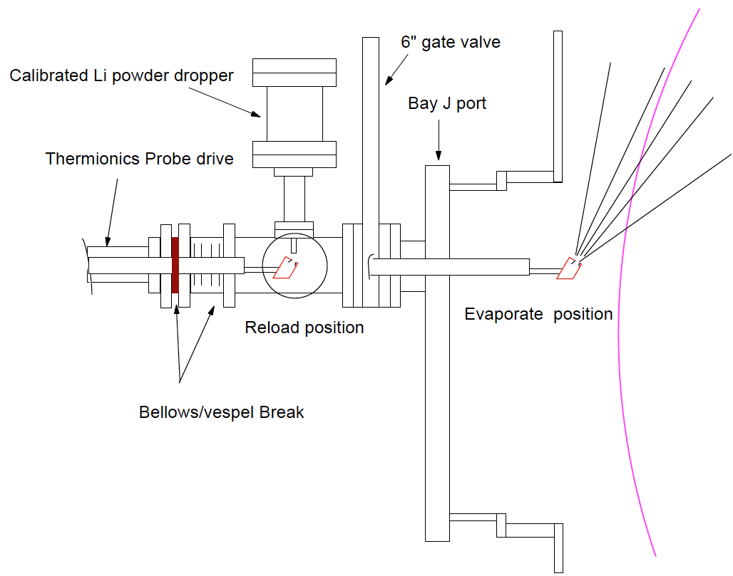
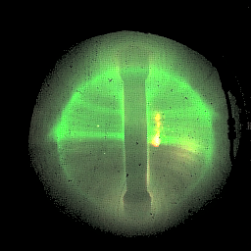
NSTX-U Li Capability During Initial Two Years
Boronization, Li Evaporators and Granular Injector
Existing LITERS
New Upward Evaporating LITER
NSTX-U Day 1: Boronization planned for the initial operation to establish a base plasma performance prior to turning on lithium.
• Upward Evaporating LITER to increase Li coverage for increased plasma performance
NSTX-U li granular injector
for ELM pacing
• High frequency ELM pacing with a relatively simple tool.
• ELM pacing successfully demonstrated on EAST (D. Mansfield, IAEA 2012)
Granule Reservoir
NSTX-U li dropper used for collaborations
• Helped EAST achieve long H-mode
• In DIII-D, H-mode pedestal modified with improved confinement.

Slide 20
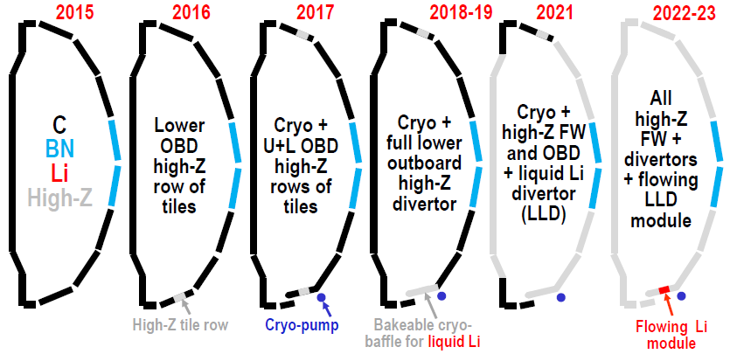
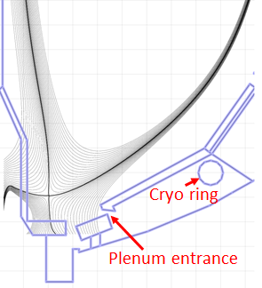
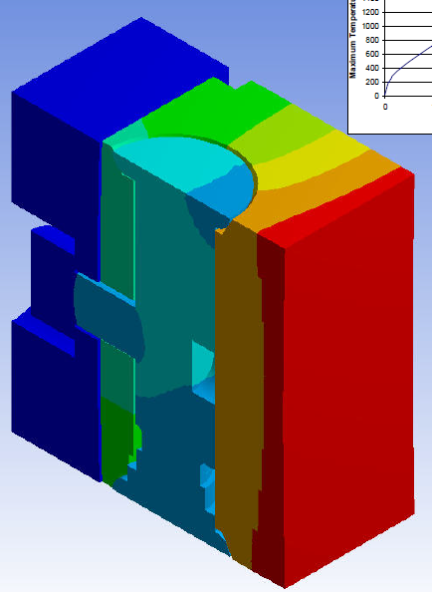
Boundary Facility Capability Evolution
NSTX-U will have very high divertor heat flux capability of ~ 40 MW/m²
High heat flux regions (strike-point regions)
  TZM or W lamellae
Intermediate heat flux regions (cryo-baffles, CS midplane)
  TZM tiles or TZM/W lamellae
Low heat flux regions (passive plates, CS off-midplane)
  W-coated graphite (e.g. ASDEX-U)
C-Mod W lamellae design, 5s @ 12MW/m², 2000C max Temp
NSTX Moly Tiles
Incident
heat flux
ORNL

Slide 21
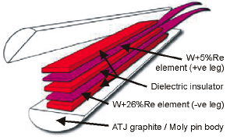
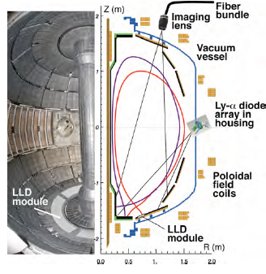
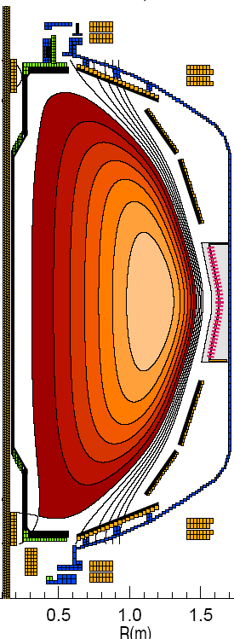
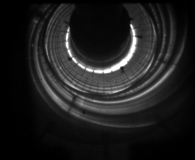
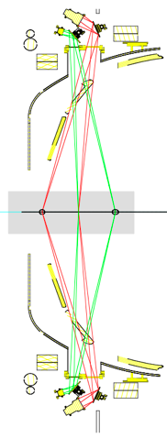
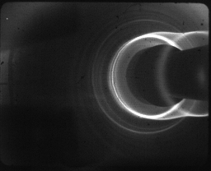
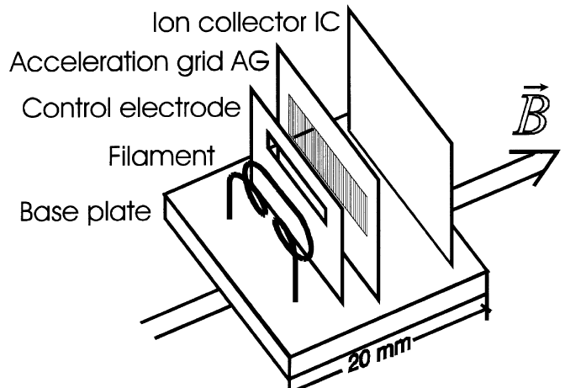
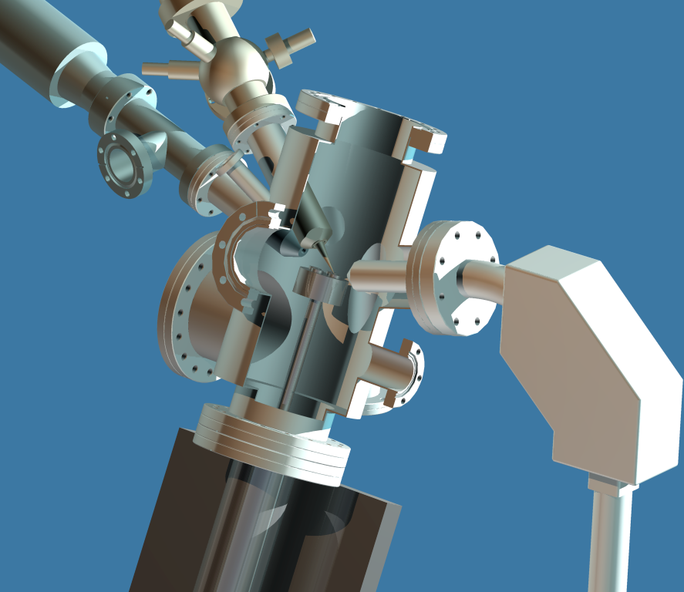
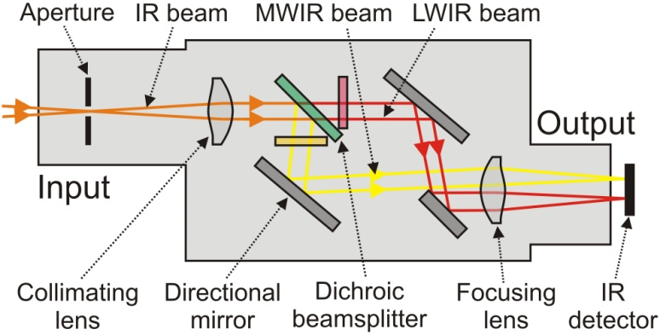
Enhanced Capability for PMI Research
Multi-Institutional Contributions
Divertor fast eroding thermocouples
Two fast 2D visible and IR cameras with full divertor coverage
Divertor Imaging
Spectrometer
ORNL
LLNL, ORNL, UT-K
LLNL
Li I
  Lithium CHERS
ORNL
C II
Divertor fast pressure gauges
MAPP probe for between-shots surface analysis – Tested in LTX
Dual-band fast IR Camera
U. of Illinois

Slide 22
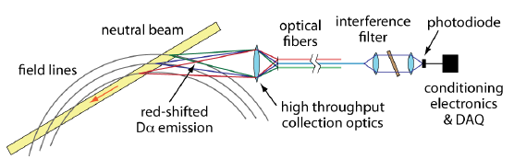
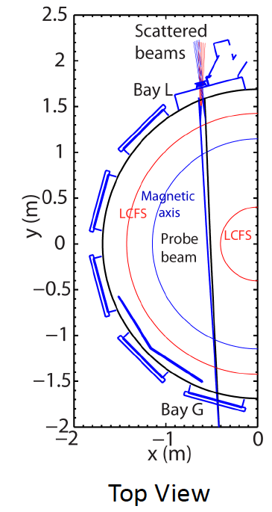
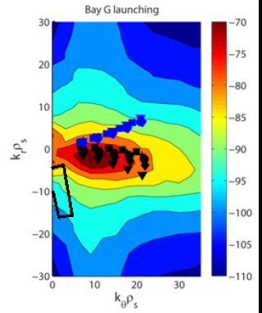


Transport and Turbulence: BES and high-k scattering provide comprehensive k-spectrum coverage of microturbulence
Modes
0.1
1
k⊥(cm⁻¹)
10
100
μTEARING
ITG/TEM
ETG
BES, pol
BES
BES, Polarimeter
μwave Scattering
48 ch BES available for NSTX-U
(24 ch BES available in 2011)
New high-k scattering system for allowing
2-D k spectrum
Optical fibers
UCD
Neutral Beam
field lines
red-shited
Dα emission
High throughput collection optics
U. Wisconsin
A 288 GHz polarimetry system for magnetic fluctuation measurements is being tested on DIII-D.
UCLA

Slide 23

Energetic Particle Research Capabilities: Will have the capability to assess NBI fast ion transport and current drive physics
Fast Ion D-Alpha Diagnostics
A vertical FIDA system measures trapped or barely passing (co-going) fast ions.
A new tangential FIDA system measures co-passing fast ions.
FIDA Views
Vertical
Tangential
UCI
FY 2014 - 15 Energetic Particle Conceptual Design and Diagnostic Upgrade
  SS-NPA enhancement due to removal of scanning NPA
  Active TAE antennas and sFLIP
UCI
2 x 2 5-turn radial active TAE antennas installed

Slide 24


Advanced Scenario and Plasma Control Tools for NSTX-U
Real time rotation control and disruption mitigation
RTV fitting vs off-line CHERS data
  Massive gas injector system at multi-poloidal location
U. Washington
FY 2014-15:
• A Real-Time Velocity (RTV) diagnostic will be incorporated into the plasma control system for feedback control of the plasma rotation profile.
• Multi-poloidal location massive gas injector system for disruption mitigation will be implemented to test the efficiency vs location.

Slide 25
Base NSTX-U Facility/Diagnostic Milestones
Crucial to complete ECH/EBW and Cryo-pump Engineering Designs in FY 2015

Slide 26
NSTX-U Optimized Facility Plan Has Been Developed
Exciting Opportunities and Challenges Ahead
• NSTX upgrade outage activities are going well
  The Upgrade Project progressing on cost and on schedule. CD-4 completion in January 2015 and the research operation starting in April 2015 for 18 run weeks.
  Researchers are preparing for NSTX-U operation while working productively on data analysis, collaboration, and carrying out five year plan.
  NSTX-U operations plan has been developed (see next talk)
• Facility / diagnostic plans developed and being implemented to support exciting 5 Year NSTX-U research plan
  ECH/EBW, Divertor Cryo-pump, and NCC coils are the high priority major enhancements requiring engineering design in 2015 to be ready in 2017
• FY 2014-15 budget guidance will enable the timely NSTX-U research operations start while completing the Upgrade Project.
  The base budget restores the budget to the FY 2012 level (inflation adjusted) and enables timely start of the NSTX-U research operations.
  Incremental budget will enable full facility utilization and a timely implementation of the Five Year Plan enhancements including ECH, Cryo-pump and partial NCC.

Slide 27
Backup Slides

Slide 28

NSTX Upgrade Project Key Milestones On-Track

Slide 29

Remaining Assembly Steps for the Centerstack

Slide 30

Remaining Construction Work in NSTX-U Test Cell

Slide 31
Engineering / Research Operations Preparation
Ramping up for the NSTX-U Operations in Dec. 2014
Upgrading the Plasma Control System (PCS) for NSTX-U.
Upgrading HHFW antenna feedthroughs for higher disruption forces.
Boundary Physics Operations
  Improving the PFC geometry at the CHI gap to protect the vessel and coils.
  Upgrading gas injection system including the massive gas injection disruption mitigation system.
  Boronization system will be readied to support initial research operations.
  Preparing lithium systems (LITERs, granule injector for ELM trigger, upward LITER).
Diagnostic Enhancements
  MPTS re-alignment and laser dump relocation.
  Fabricated new port covers to support high-priority diagnostics. The last large port being installed.
  Installing additional, redundant magnetic sensors.
  Upgrading diagnostics: Bolometry (PPPL), ssNPAs, spectroscopy (collaborators)
Physics & Engineering Operations
  Firing generators for 68 Transrex rectifiers replaced. Testing starting.
  Repair of the Motor Generator radial arm weld cracks to complete in July.
  Upgrading the poloidal field coil supplies to support up-down symmetric snowflake divertors on-going.

Slide 32

Repair of the Motor Generator
(MG#1)
In 2004, Magnetic Particle Inspections identified cracking in the weld fillet of multiple joints between the radial arms of MG#1. Cracks were in primary load paths, taking that set out of service. MG#2 is in limited operations (run and monitor at reduced parameters) with cracks in “stiffener” welds intended to limit elastic deformation (not in primary load paths).
  Over 250” of welds in 19 rotor spider joints will be ground out and replaced to restore MG#1 to its original design configuration.
  A jacking system has been engineered to relieve all loads on the rotor assembly during the repair.
  PPPL and GE engineering collaborated on the detailed repair procedure (D/NSTX-RP-MG-07).
Status: Target completion date is July 2014
A Statement of Work to perform the scope described in the repair procedure and a draft Project Management Plan has been developed.
The repair work has started in early June.

Slide 33

Incremental NSTX-U Facility/Diagnostic Milestones
Accelerates ECH/EBW, Cryo-pump, NCC enhancements by one year

