Slide 1




NSTX-U
Supported by
Progress and plans for Li/Liquid metal and high-Z PFC development
Coll of Wm & Mary
Columbia U
CompX
General Atomics
FIU
INL
Johns Hopkins U
LANL
LLNL
Lodestar
MIT
Lehigh U
Nova Photonics
Old Dominion
ORNL
PPPL
Princeton U
Purdue U
SNL
Think Tank, Inc.
UC Davis
UC Irvine
UCLA
UCSD
U Colorado
U Illinois
U Maryland
U Rochester
U Tennessee
U Tulsa
U Washington
U Wisconsin
X Science LLC
M.A. Jaworski , R. Kaita, C. Skinner, D. Stotler
Culham Sci Ctr
York U
Chubu U
Fukui U
Hiroshima U
Hyogo U
Kyoto U
Kyushu U
Kyushu Tokai U
NIFS
Niigata U
U Tokyo
JAEA
Inst for Nucl Res, Kiev
Ioffe Inst
TRINITI
Chonbuk Natl U
NFRI
KAIST
POSTECH
Seoul Natl U
ASIPP
CIEMAT
FOM Inst DIFFER
ENEA, Frascati
CEA, Cadarache
IPP, Jülich
IPP, Garching
ASCR, Czech Rep
NSTX-U PAC-35 Meeting
PPPL – B318
June 11-13, 2013

Slide 2
Outline
Introduction to the Materials and Plasma-Facing Components (M&P) topical science group mission
Research thrusts for Materials and PFCs from the NSTX-U 5-year plan
Progress and plans on each thrust area
  MP-1: Surface science for long-pulse
  MP-2: Material migration and evolution
  MP-3: Continuous vapor shielding
Summary

Slide 3
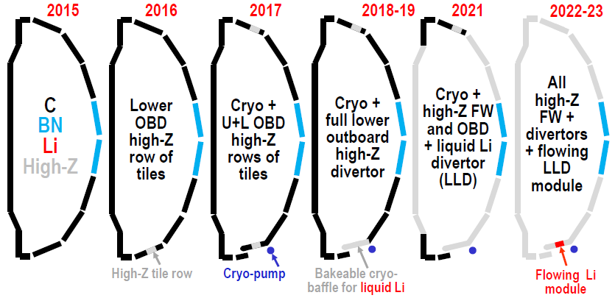
NSTX-U long-term objective is to perform comparative assessment of high-Z and liquid metal PFCs
Conversion to all-metal PFCs enables examination of the role of PFCs on integrated scenarios with good core, pedestal, and divertor operation
NSTX-U has two emphases for addressing power exhaust and PMI issues for next-step devices
  Magnetic topology, radiative divertors (Soukhanovskii talk next)
  Self-healing/replenishable materials (e.g. liquids)
Significant uncertainties in both solid- and liquid-PFCs motivates parallel research
5-year plan base funding
Full-funding could accelerate by ~2 years

Slide 4
M&P research will develop understanding of material migration and heat-flux handling of high-Z and liquid Li PFCs
5-Year Plan Research Thrusts
MP-1: Understand lithium surface-science for long-pulse
  Assess impact of more complete Li coverage
  Use the Material Analysis and Particle Probe (MAPP) and laboratory studies to link tokamak performance to PFC surface composition
MP-2: Unravel the physics of tokamak-induced material migration and evolution
  Confirm erosion scalings and evaluate extrapolations
  Determine migration patterns to optimize technical solutions
MP-3: Establish the science of continuous vapor-shielding
  Determine the existence and viability of stable, vapor-shielded divertor configurations
  Determine core compatibility and extrapolations for extended durations and next-step device parameters

Slide 5
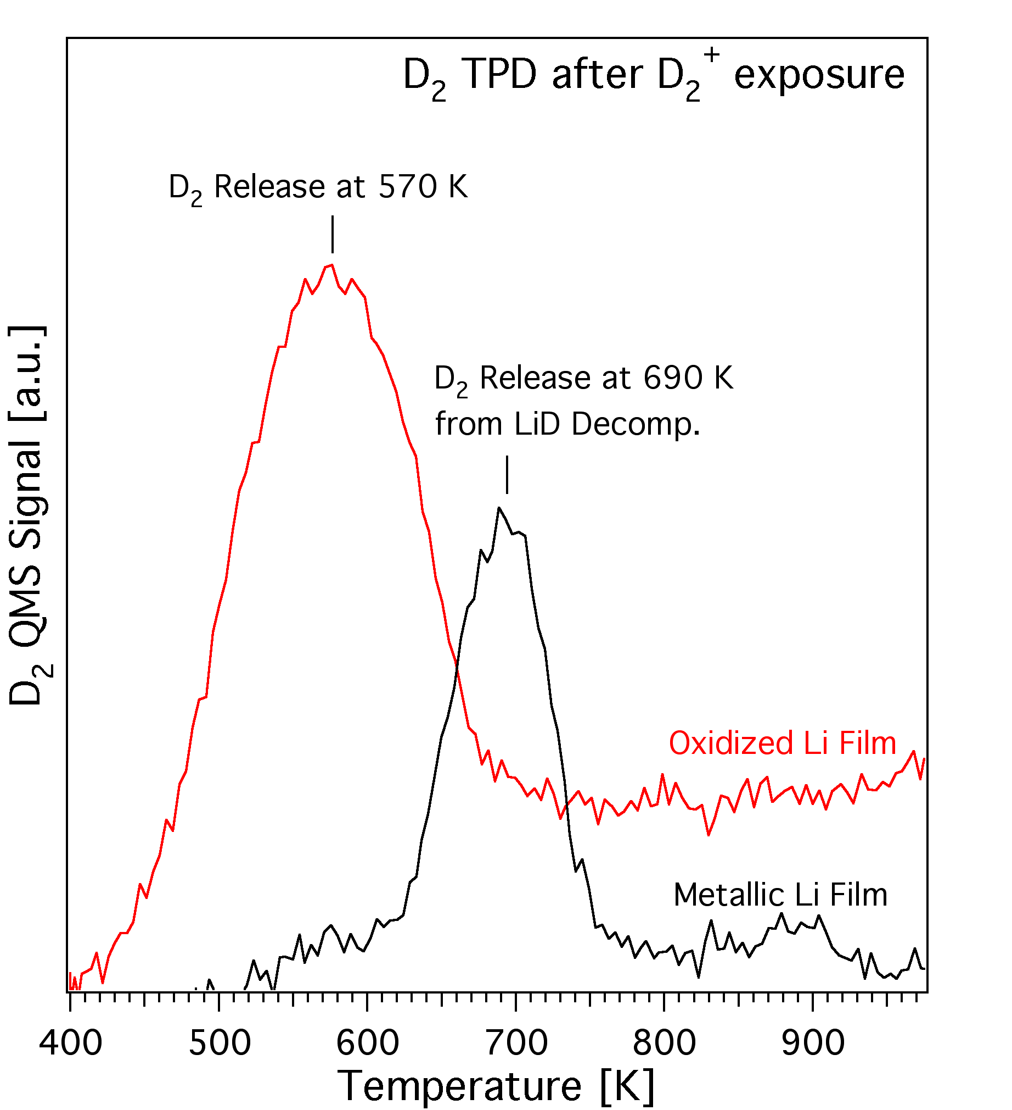
Surface-science laboratory studies probing effects of temperature and impurities on Li and LiD
Fundamental data on Li coatings on high-Z materials extending graphite work
Thin films (few monolayers) of Li deposited on Mo
  D₂ evolved below 750K with or without C and O impurities
  Oxidation of Li film destabilizes LiD
Implication for a reactor: high-temperature thin-films will not retain T

Slide 6
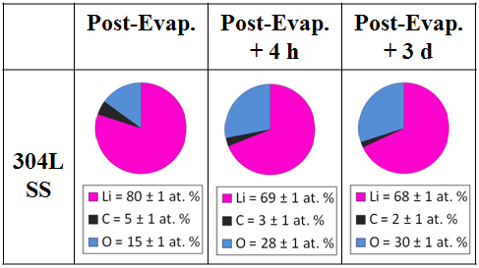
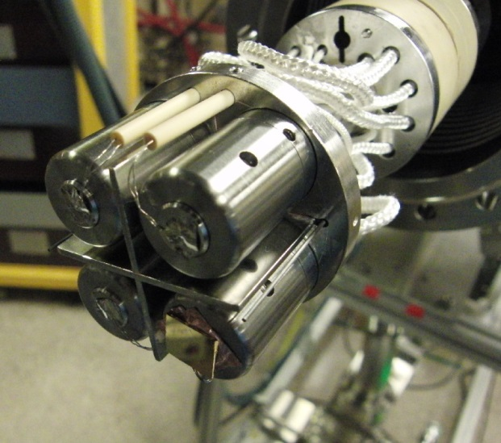
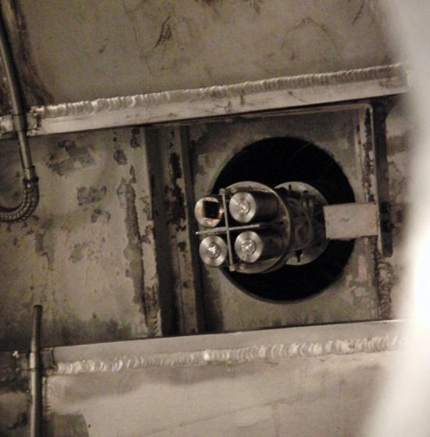
Material Analysis and Particle Probe (MAPP) in-situ diagnostic examining PFC surface composition of Li in prep for NSTX-U
MAPP in regular use on LTX characterizing surface composition
XPS of samples indicate rapid transition to oxidized state
Link to plasma-performance being examined in LTX
Consistent with Li₂O
Probe end inserted into LTX vacuum chamber
Probe end with four sample holders that can be heated independently

Slide 7
FY14-16 research will continue to elucidate atomistic and material characteristics of the NSTX-U PFCs
FY 14: research will continue in surface-science laboratories and in LTX
  Wetting studies, deuterium uptake, surface energies
  Role of impurities on the above
FY 15: research will determine the surface composition during NSTX-U operations alongside material migration
  MAPP, post-mortem witness plates and QCMs determine quantity and composition of PFC surfaces
  Granule injection system will provide new method of depositing lithium into NSTX-U for comparison to boronization, and Li evaporations
FY 16: Li wetting and removal of material will be examined
  Surface composition of high-Z samples will be assessed to inform on expected composition of high-Z target PFCs
  Wetting studies of Li on high-Z with and without contamination will aid in determination of critical parameters for protection of the high-Z substrate

Slide 8
M&P research will develop understanding of material migration and heat-flux handling of high-Z and liquid Li PFCs
MP-1: Understand lithium surface-science for long-pulse PFCs
  Assess impact of more complete Li coverage
  Use the Material Analysis and Particle Probe (MAPP) and laboratory studies to link tokamak performance to PFC surface composition
MP-2: Unravel the physics of tokamak-induced material migration and evolution
  Confirm erosion scalings and evaluate extrapolations
  Determine migration patterns to optimize technical solutions
MP-3: Establish the science of continuous vapor-shielding
  Determine the existence and viability of stable, vapor-shielded divertor configurations
  Determine core compatibility and extrapolations for extended durations and next-step device parameters

Slide 9
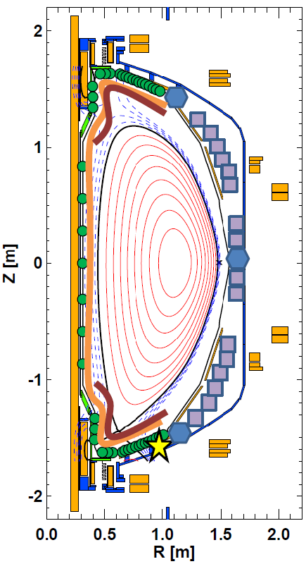
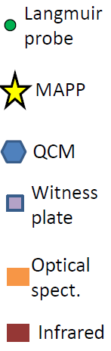
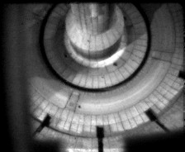
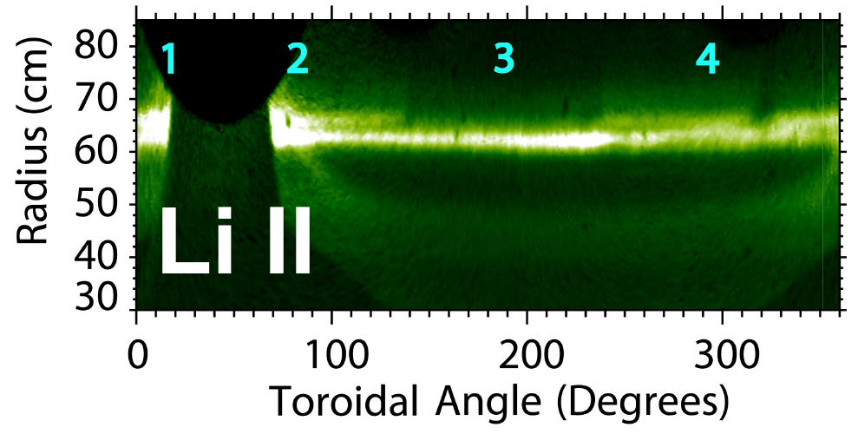
Diagnostics will be key to making strongest possible progress on material migration
Nearly complete PFC coverage available for gross-erosion measurements
  Strong collaborator participation (LLNL, ORNL, UTK)
  Whole-machine and high resolution camera optical systems available
  More extensive probe coverage to aid interpretation with more plasma shapes
QCMs, witness plates and MAPP provide complementary single-shot and campaign integrated data sets
Wide-angle infrared diagnostics characterize PFC surface temp. and heat flux (ORNL)
Full divertor camera coverage
Scotti, RSI 2012

Slide 10
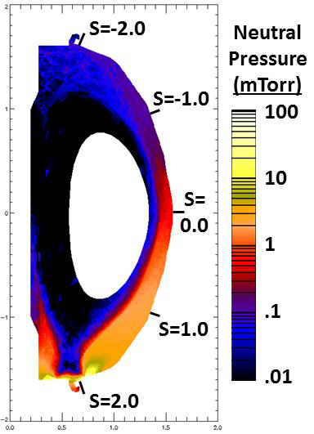
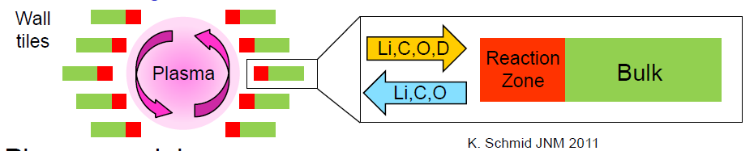
Interpretive modeling key tool to produce picture of whole-machine material migration including localized sources
OEDGE simulations underway for planning FY15 experiments
WallDYN being obtained for use on NSTX-U (PhD thesis)
Experimental data sets will provide constraints on plasma-backgrounds
Both can leverage plasma modeling from UEDGE, SOLPS or other codes

Slide 11
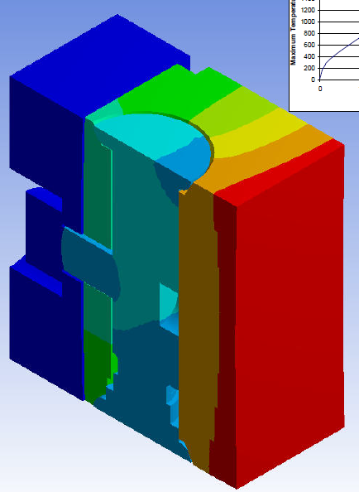
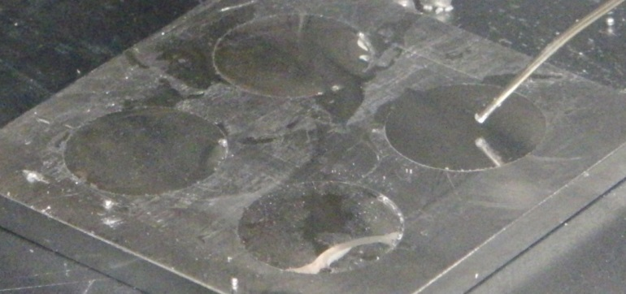
C-Mod and JET high-Z PFCs designs inform design choices for NSTX-U
Target will be located in outboard divertor to minimize risk (LLD logic)
CMOD reference design provides compact example (Willard 2006)
  30mm total height minimizes profile changes on divertor floor
  Will adapt to interface with NSTX-U mounting structures
JET-ILW shallow melt experiments provide example of leading-edge experiments (Coenen PSI 2014)
Pre-filled liquid lithium targets developed for Magnum-PSI experiments will be considered as targets on MAPP probe drive (Eindhoven Univ. student project)
Lamellae
C-Mod W lamellae design, 5s @ 12MW/m², 2000C max Temp
Shoulder
screw
Incident
heat flux
Base plate
Prefilled liquid lithium targets
developed for Magnum-PSI
experiments
Mirror-like liquid lithium

Slide 12
FY 14-16 research plans for material migration will characterize transport of low and high-Z materials
FY 14: Diagnostic check-out and modeling will guide development of XPs for FY15-16
  Deployment of diagnostics to prepare for run (new array of Langmuir probes, existing and new spectroscopic systems)
  WallDYN code will be obtained and first runs made to prepare for migration modeling for FY15
FY 15: First experiments will provide data to validate integrated modeling
  WallDYN will be compared to QCM, MAPP and witness plate measurements of shot-by-shot and campaign-integrated material migration
  Reference discharges will be developed targeting the outboard high-Z tile location for comparison to FY16 data
FY 16: Milestone R16-2 to assess high-Z divertor PFCs will be completed
  Erosion from high-Z tiles will be assessed with and without low-Z coatings
  WallDYN predictions of erosion/transport from high-Z tiles will be compared to measurements with QCM, MAPP, witness plates
  Enhanced impurity production and impact on operation of distributed shallow-melts will be measured

Slide 13
M&P research will develop understanding of material migration and heat-flux handling of high-Z and liquid Li PFCs
MP-1: Understand lithium surface-science for long-pulse PFCs
  Assess impact of more complete Li coverage
  Use the Material Analysis and Particle Probe (MAPP) and laboratory studies to link tokamak performance to PFC surface composition
MP-2: Unravel the physics of tokamak-induced material migration and evolution
  Confirm erosion scalings and evaluate extrapolations
  Determine migration patterns to optimize technical solutions
MP-3: Establish the science of continuous vapor-shielding
  Determine the existence and viability of stable, vapor-shielded divertor configurations
  Determine core compatibility and extrapolations for extended durations and next-step device parameters

Slide 14
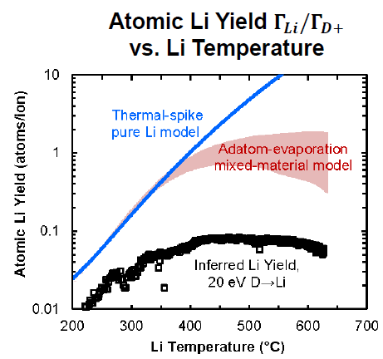
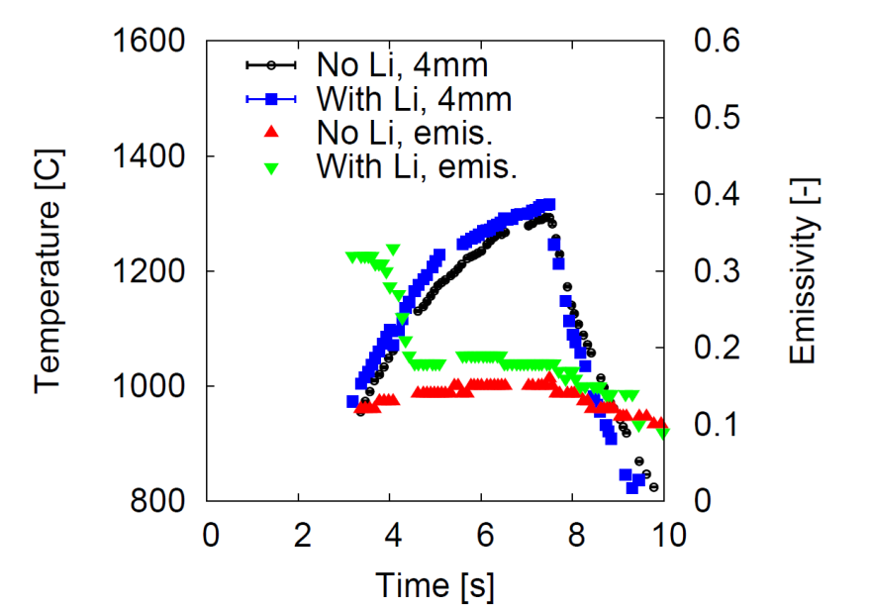
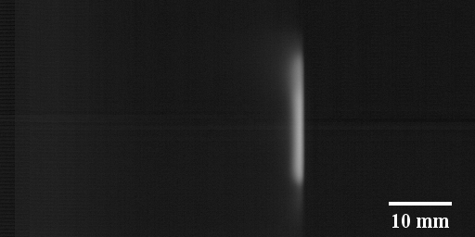
Magnum-PSI experiments on high-temperature Li show strongly reduced erosion and stable cloud production
Gross erosion measured spectroscopically in divertor-like plasma
  Neon plasma reproduces Langmuir Law
  Deuterium suppresses erosion
Reduced gross erosion and strong redeposition result 10x longer lifetime of 1 micron coating
  Consistent with Li trapping in pre-sheath
  Pre-sheath scale length consistent with neutral Li emission region (~3mm)
Abrams, PSI 2014
Neutral Li emission, t=2.5s
Incident Plasma
Target
Jaworski, PSI 2014

Slide 15
Implications of lithium experiments on Magnum-PSI for NSTX-U and next-step devices
Vapor shielding experiments with thin-coatings will be feasible in NSTX-U with the high-Z targets in FY16
  Coatings of ~1 micron persisted up to 1000C, ~4s
  Pre-filled targets under investigation to study effects of larger reservoir
Previous lithium temperature limits being re-evaluated with momentum-conservation criterion accounting for suppressed erosion and strong trapping at the target
Concepts based on pure evaporative cooling (e.g. CPS) or flat-plate targets need refinement to offset:
  Strong trapping at target reduces mass flux, reduces energy transport
  100 micron thick layers observed to thin out from center of the sample

Slide 16
Continuous vapor shielding research plans for FY 15-16
FY 15: Perform preliminary shot development for examining vapor-shielding with the high-Z upgrade in FY16
  Examine lithium radiation in NSTX-U plasmas and compare to collisional radiative models (FOM-DIFFER student participation)
  Develop discharges with high heat-fluxes at high-Z target location and range of scrape-off layer widths
  Develop pre-filled liquid metal targets for possible inclusion as target on MAPP probe drive
FY 16: Perform initial assessment of vapor-shielded regime on high-Z PFC row in NSTX-U
  Determine whether the vapor-shielded regime can be produced in the present NSTX-U configuration
  Determine if carbon/oxygen are strong impediments or can be overcome with suitable evaporations and/or pre-filled targets

Slide 17
Summary
Materials and PFC topical science group developing tools and methods for examining key issues facing NSTX-U and future devices
  Expanded diagnostic coverage backed up with interpretive modeling
  Strong links to surface-science laboratories at PPPL/PU and U-Illinois
High-Z and low-Z targets both face material migration challenges in NSTX-U and next-step devices
  NSTX-U research will make inroads in addressing the behavior of mixed materials in an ST using state-of-the-art analysis tools
  Material migration studies will determine the technological requirements of future solid and liquid PFCs
Experiments on Magnum-PSI indicate liquid lithium PFCs need not be as temperature constrained as previously expected

Slide 18
Backup

Slide 19
Materials and PFC research is developing science and technologies for NSTX-U and DEMO-relevant machines
High-Z, metal PFCs are expected for future power-reactors
  Need to assess impact of high-Z components on core performance
  Survival of the PFCs w.r.t. extreme heat fluxes (ITER-relevance)
Will assess role of lithium as a wall-conditioning and bulk-PFC material (i.e. liquid)
  Protection of the high-Z substrate
  Protection of the plasma from the high-Z substrate
High-power, high-performance discharges will be impacted by PFC performance
  Integrated scenario demonstrations will be required for both liquid lithium and high-Z substrates to determine usefulness of either in FNSF and beyond

Slide 20
Assessment of high-Z row will provide first look on issues facing a future full-metal upgrade (Milestone R16-2)
Requirements on power exhaust mitigation determined by PFC thermal limits
  Develop experiments to determine true limit of the high-Z design
  Intentional leading edges can locally increase heat fluxes, validate design
  Focused visible camera can diagnose melt-layers during and between discharges
Criticality of avoiding PFC damage and subsequent impurity influx will determine margin of error in heat-flux mitigation
  Assess impurity influx under local-melt conditions with a significant, distributed source (e.g. 12 toroidally separated locations)
  Penetration factors from divertor target to main plasma should be measured as well as impact of material influx on local plasma parameters (e.g. via radiative cooling)
Lithium as a protective material and potentially pumping surface can be re-evaluated with post-LLD experience
  Surface science laboratory providing new insight into wetting and deuterium uptake of thin and macroscopic films
  Heating and biasing of targets will be considered as means of removing impurities from lithium layers
  Pre-filled liquid lithium targets will be considered as a means of providing significant reservoir of material to avoid fast saturation

Slide 21
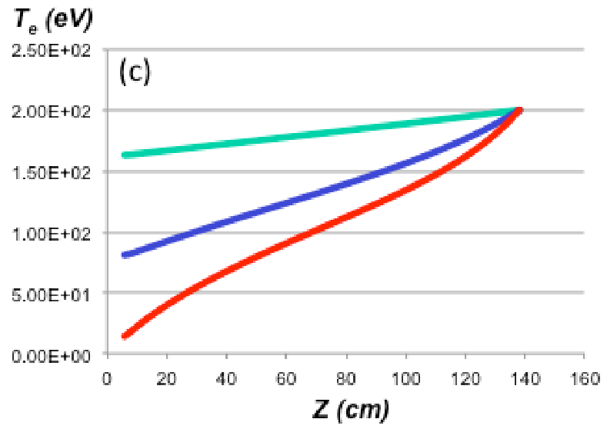


High temperature lithium surfaces may be able to provide a self-healing surface and intrinsic low-Z impurity radiation
Lithium radiative power dissipation
Lithium vapor cloud can potentially provide effective power and pressure loss at divertor target
  Non-coronal Li radiation
  Li vapor pressure vs. plasma press.
Capillary-porous system targets have dissipated large incident heat fluxes – tested to 25MW/m² (Evtikhin JNM 2002)
Diagnosis in NSTX-U via complementary diagnostics
  Langmuir probes for target pressure, n_{e}, T_{e}
  Optical, VUV emission and bolometry for P_{rad}
  DBIR thermography and TCs for heat flux and energy deposited
Increasing Lithium
M. Ono, NF 2013.
M. Jaworski, PPCF 2013

Slide 22
Implications of lithium experiments on Magnum-PSI for NSTX-U and next-step devices
Vapor shielding experiments with thin-coatings will be feasible in NSTX-U in FY16 with the high-Z targets
  Coatings of ~1 micron persisted up to 1000C, ~4s
  Pre-filled targets under investigation to study effects of larger reservoir
Previous lithium temperature limits being re-evaluated with momentum-conservation criterion accounting for suppressed erosion and strong trapping at the target
  Suppressed erosion under high-flux D bombardment and strong-trapping at the target indicates little would escape upstream (parallel indications in NSTX that divertor exhibits strong retention)
  Particle balance criteria previously utilized should be updated with momentum conservation criteria
  An integrated power-cycle analysis will be presented at the IAEA FEC 2014
Concepts based on pure evaporative cooling (e.g. CPS) or flat-plate targets need refinement
  Strong trapping at target reduces mass flux, reduces energy transport
  100 micron thick layers observed to thin out from center of the sample

Slide 23
M&P program providing support for students and collaborators
Two Princeton PhD students examining high-temperature erosion and material migration
Senior and junior PU undergraduate thesis students in 2013-14 participating in diagnostic and liquid loop development
Two international graduate students going to participate in liquid-metal PFC design and Li radiation measurements in coming year (Eindhoven U. and FOM-DIFFER)
Several undergraduates (3) via National Undergraduate Fellowship (NUF), Science Undergraduate Laboratory Internship (SULI), and Princeton Energy Institute (PEI) fellowship students participating in experiments this summer
Strong collaborator-led diagnostic systems enabling pioneering and comprehensive measurements of in-vessel PFCs and tokamak modified surfaces

