Slide 1




NSTX-U
Supported by
Plans for Scrape-off Layer and Divertor Research on NSTX-U
Coll of Wm & Mary
Columbia U
CompX
General Atomics
FIU
INL
Johns Hopkins U
LANL
LLNL
Lodestar
MIT
Lehigh U
Nova Photonics
Old Dominion
ORNL
PPPL
Princeton U
Purdue U
SNL
Think Tank, Inc.
UC Davis
UC Irvine
UCLA
UCSD
U Colorado
U Illinois
U Maryland
U Rochester
U Tennessee
U Tulsa
U Washington
U Wisconsin
X Science LLC
V. A. Soukhanovskii (LLNL)
for the NSTX-U Research Team
Culham Sci Ctr
York U
Chubu U
Fukui U
Hiroshima U
Hyogo U
Kyoto U
Kyushu U
Kyushu Tokai U
NIFS
Niigata U
U Tokyo
JAEA
Inst for Nucl Res, Kiev
Ioffe Inst
TRINITI
Chonbuk Natl U
NFRI
KAIST
POSTECH
Seoul Natl U
ASIPP
CIEMAT
FOM Inst DIFFER
ENEA, Frascati
CEA, Cadarache
IPP, Jülich
IPP, Garching
ASCR, Czech Rep
NSTX-U PAC-35 Meeting
PPPL – B318
June 11-13, 2013

Slide 2
Outline
Research Thrusts from Boundary TSG 5 Year Plan
  BP-1: Assess and control pedestal structure, edge transport and stability
    A. Diallo’s talk, next
  BP-2: Assess and control divertor heat and particle fluxes
    Divertor heat flux mitigation with impurity seeding and divertor geometry
    SOL transport and turbulence, impurity transport
  BP-3: Establish and compare long-pulse particle control methods
    Validate cryo-pump physics design, assess density control and recycling
    Compare cryo to lithium coatings for particle (collisionality) control
Research highlights – collaborations, NSTX
Research plans for FY2015-2016
Summary

Slide 3
Boundary Physics TSG is involved in several research milestones
FY2014
  JRT on plasma response to 3D magnetic fields
  R(14-1): Assess access to reduced density and collisionality in high-performance scenarios
  R(14-3): Develop advanced axisymmetric control in sustained high performance plasmas
FY2015
  R(15-1): Assess H-mode energy confinement, pedestal, and scrape off layer characteristics with higher B_{T}, I_{P} and NBI heating power
  R(15-3): Develop the physics and operational tools for obtaining high-performance discharges
  IR(15-1): Develop and assess the snowflake divertor configuration and edge properties
FY2016
  R(16-1): Assess scaling and mitigation of steady-state and transient heat-fluxes with advanced divertor operation at high power density
  R(16-2): Assess high-Z divertor PFC performance and impact on operating scenarios

Slide 4
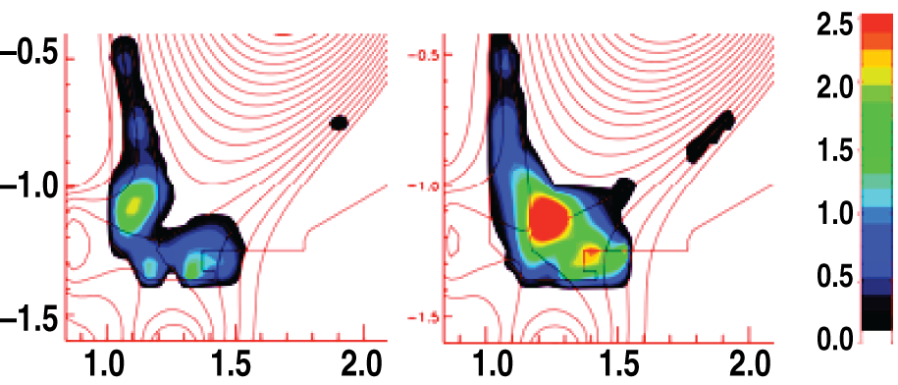
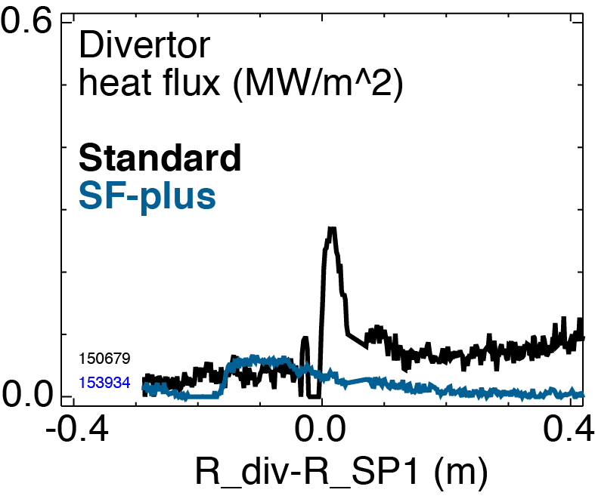
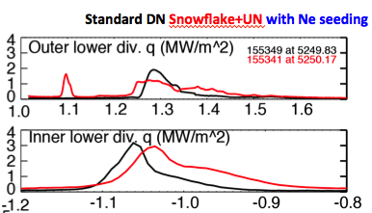
Studying critical radiative and snowflake divertor physics in
DIII-D National Campaign in preparation for NSTX-U
Impact of 3D fields (n=3) on detachment
  In NSTX, re-attachment of outer strike point
  In DIII-D, no effect on divertor heat flux profiles
Inter-ELM and ELM heat transport in radiative snowflake divertor
  Magnetic feedback control development
    Enabled exact and snowflake-plus configurations
  Radiation distributed more uniformly in radiative SF
  ELM energy and peak heat flux reduced in radiative snowflake divertor (cf. NSTX)
  Combined with AT scenario (H98(y,2)~1.4, β_{N}~3)
    P_{in}=11 MW exhausted into upper and lower divertors
    Neon-seeded snowflake effective
  Used DTS to measure high β_{p} in the null region
Radiative divertor control
  Closed loop D₂ seeding with constant core density
  DTS T_{e}, P_{rad} as control signals

Slide 5
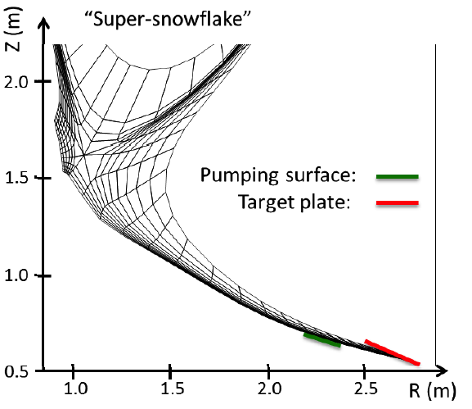
Modeling of radiative snowflake being performed in preparation for NSTX-U operation and for design of ST-FNSF
ELM heat deposition from fast thermography
  A_{wet} decreases during Type-I and III ELMs
  A_{wet} decrease leads to q_{peak} increase with increase of ELM energy loss – mitigation needed (e.g., with rad. snowflake)
UEDGE modeling of ST-FNSF divertor
  Nitrogen-seeded tilted-plate and long-legged snowflake divertor provided x4 reduction in heat flux from ≤ 25 MW/m²
    NSTX-like transport χ_{i,e}= 2-4 m²/s
    P_{SOL}=30 MW, 4% nitrogen, R=1 (saturated metal plate)
    Both compatible with particle control via cryopumping

Slide 6
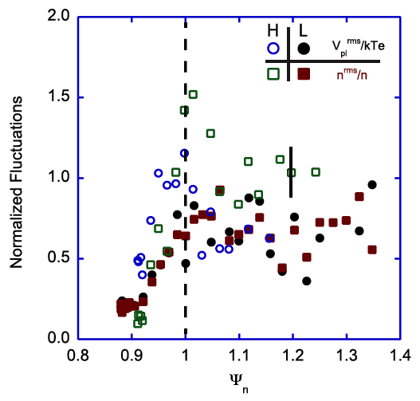
Analysis of NSTX edge data supports planning of SOL research and diagnostics for NSTX-U
Normalized potential and density fluctuation levels high in L- and H-mode SOL (reciprocating probe)
  10 % inside SOL and up to 150 % in outer SOL
  Strong SOL intermittency
Comparison of GPI and BES measurements of edge fluctuations commenced
  Measured poloidal corr. lengths and decorrelation time show reasonable agreement, fluctuation statistics differ
  Dominant fluctuation band of 4-30 kHz
    exhibits short-lived, intermittent time-frequency behavior
Edge neutral density from DEGAS 2 based inversion of edge D_{β} camera light
  Useful for TRANSP, edge passive CHERS
  Assume uniform D₂ flux at wall, MPTS profiles

Slide 7
Near-future (FY2015) SOL and divertor studies will focus on heat flux mitigation and model validation
Establish SOL width and divertor database vs. engineering and physics parameters
  IRTV, bolometers, Langmuir probes, filtered cameras, spectrometers
Re-establish edge turbulence measurements
  GPI, BES, fast cameras, probes
Initial radiative divertor experiments with seeding and lithium
  Re-establish operating space of radiative divertor with D₂, CD₄, Ne seeding
Develop snowflake divertor magnetic control and initiate experiments
  Assess pedestal stability, divertor power balance, turbulence, impact of 3D fields as functions of engineering parameters
Validate cryopump physics design
  Verify divertor neutral pressure, T_{e}, n_{e} as functions of engineering parameters and compare with SOLPS model
Comparison with multi-fluid and gyro-kinetic models
  UEDGE and SOLPS models awaiting benchmarking with NSTX-U edge data
  XGC SOL width modeling, application to snowflake geometry
Finalize conceptual design of divertor Thomson scattering diagnostic
  Present design based on the polychromator-based upgraded DIII-D DTS

Slide 8
Research in FY2016 to focus on divertor heat flux scaling and mitigation using radiative divertor and geometry
R(16-1): Assess scaling and mitigation of steady-state and transient heat-fluxes with advanced divertor operation at high power density
  SOL cross-field transport scalings at twice the I_{P}, B_{t}, and heating power
  Divertor inter-ELM and ELM heat flux mitigation, impurity production, impact on pedestal using various techniques
    magnetic balance (i.e. double-null operation)
    radiative divertor operation, feedback control testing
    snowflake divertors with feedback control
    ELM pacing with 3D fields and granules
  Compare with gyro-kinetic and fluid transport and turbulence codes UEDGE, SOLPS, SOLT, XGC
  Aid in the validation of divertor power and particle exhaust models for ITER and FNSF

Slide 9
Research in FY2016 also to focus on PFC performance and edge impurity transport
R(16-2): Assess high-Z divertor PFC performance and impact on operating scenarios
  Erosion and SOL transport of low-Z coatings and high-Z PFCs
    Initiate modeling with multi-fluid codes (UEDGE, SOLPS) and erosion codes (e.g., ERO)
    Use laser-blow-off system to study edge transport of low-Z and high-Z impurities and benchmark fluid turbulence codes
  Core and pedestal evolution
    Connect edge source (divertor sources and SOL transport) with pedestal and core transport models (TRANSP, MIST/STRAHL, UEDGE)
    Assess penetration factors of high-Z impurities
  Compatibility with heat-flux mitigation schemes
    Assess impact of CD₄, N₂, Ne seeding on high-Z target erosion and edge transport

Slide 10
Summary: Research in FY2015-2016 focuses on power and particle mitigation studies with new NSTX-U capabilities
Power and particle handling: obtain standard divertor baseline, further develop snowflake and radiative divertors
  Assess heat flux and SOL width scalings
  Test key predictions of snowflake configuration, and evaluate synergy with radiative divertors, graphite and high-Z plasma facing components
  Prepare for particle control studies with cryopumping
  Planned research aims at providing SOL and divertor physics basis for ST-FNSF

Slide 11
Backup

Slide 12
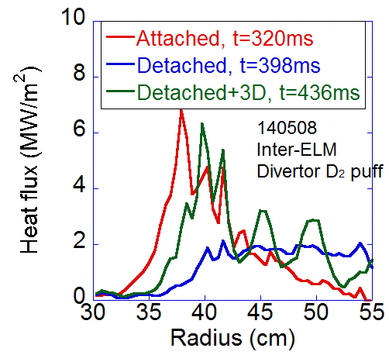
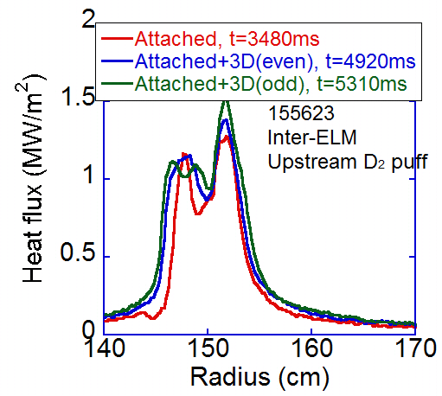
Applied 3D fields yielded different effects on divertor detachment at NSTX and DIII-D
NSTX
Striations by 3D fields
DIII-D
NSTX showed re-attachment of detached plasma due to applied 3D fields
3D fields did not produce striations, leading to no effect on divertor plasma at DIII-D
  Work in progress for the role of plasma response fields (amplitude and phase) in the generation of strike point splitting

Slide 13
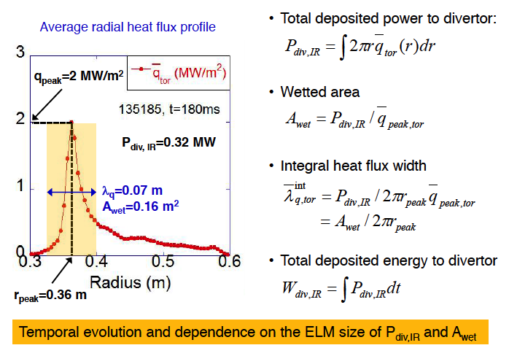
Peak heat flux and heat flux width are determined by total power and wetted area

Slide 14
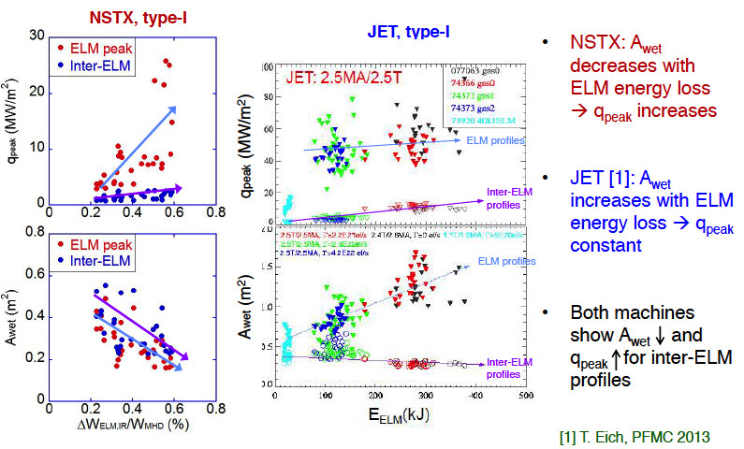
A_{wet} decrease leads to q_{peak} increase with increasing ELM energy loss for type-I ELMs in NSTX

Slide 15
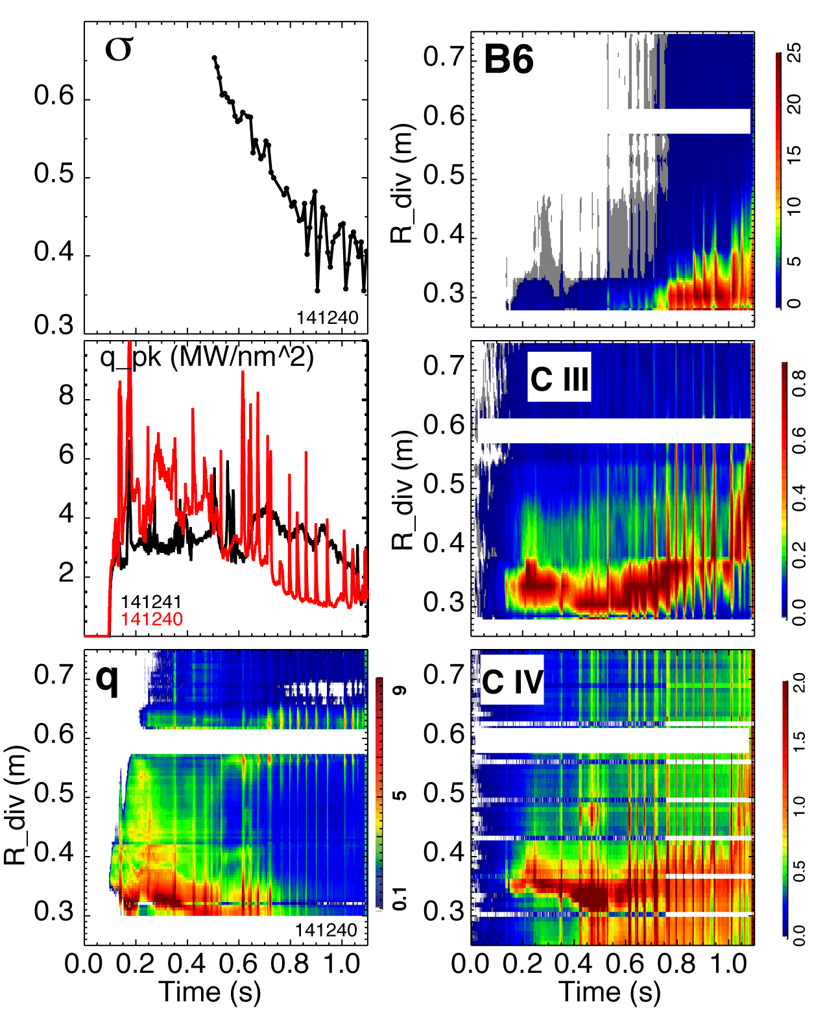
Radiative detachment with strong recombination and high radiated power observed in snowflake divertor
Attached standard divertor - snowflake transition - snowflake + detachment
P_{SOL} ~ 3 MW (P_{NBI} = 4 MW)
Q_{div} ~ 2 MW -> Q_{div} ~ 1.2 MW -> Q_{div} ~ 0.5-0.7 MW

Slide 16
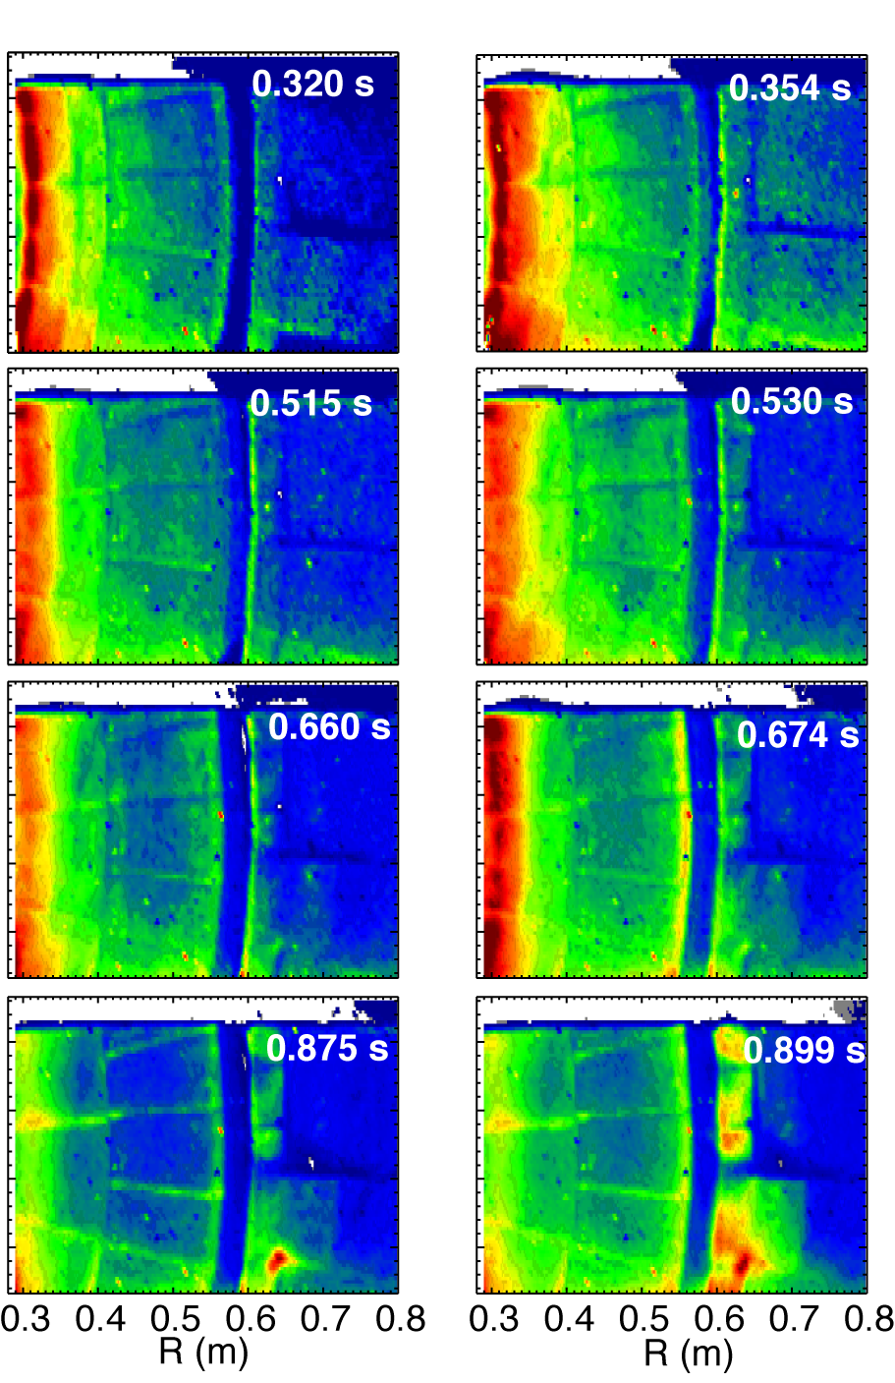
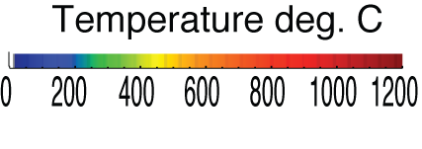
Impulsive heat loads due to Type I ELMs are mitigated in snowflake divertor
Steady-state At ELM peak

Slide 17
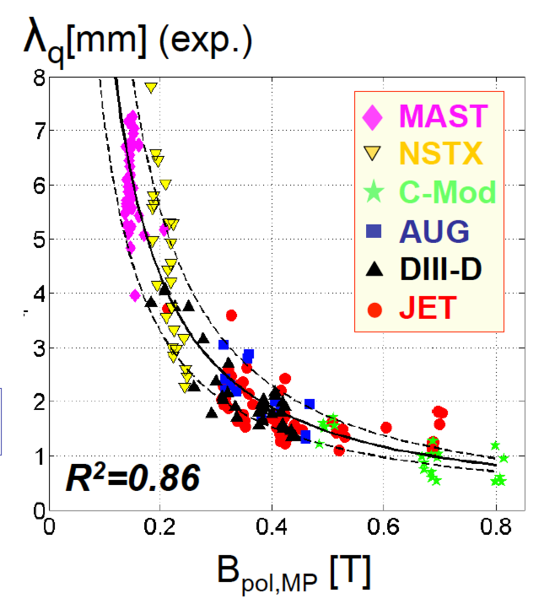
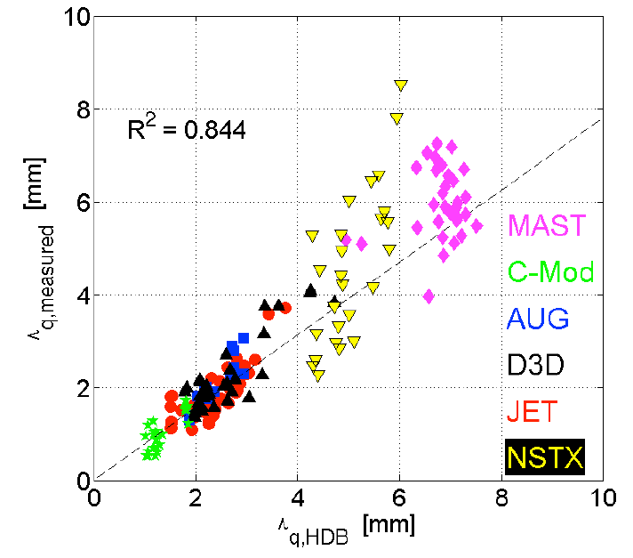
NSTX-U data will help reduce SOL width scaling uncertainties and assess relative importance of turbulent and drift-based transport
SOL width scaling
  In NSTX: λ_{q}^{mid} ~ I_{p}^{-1.6}, independent of P_{SOL} and B_{t}
    For NSTX-U (2 MA): λ_{q}^{mid} = 3±0.5 mm
  Multi-machine database (Eich IAEA FEC 2012):
  λ_{q}^{mid} (mm) = (0.63+/-0.08)x B_{pol,MP}^{-1.19}
    For NSTX-U (B_{p}~0.55 T): λ_{q}^{mid} ~ 1.3 mm
Comparison of λ_{SOL} with SOL models
  Parallel transport: conductive/convective, cross-field : collisional / turbulent / drift
  Goldston drift-based model
    λ_{SOL} ~ (2a/R) ρ_{θ,} for NSTX-U: λ_{q}^{mid} ~ 6 mm
  Exploring mechanisms setting steep pressure gradient region and connection to SOL width
  XGC0 (drift-kinetic): λ_{q}^{mid} ~ I_{p}^{-1.0}
  XGC1 (collisionless, no neutrals): λ_{q}^{mid} ~ I_{p}^{-0.8} (neoclas.)
  SOLT (fluid turbulence): I_{p} scaling is weaker than observed
Diagnostics: MPTS, GPI – multiple views, BES, reflectometry, Langmuir probes

Slide 18
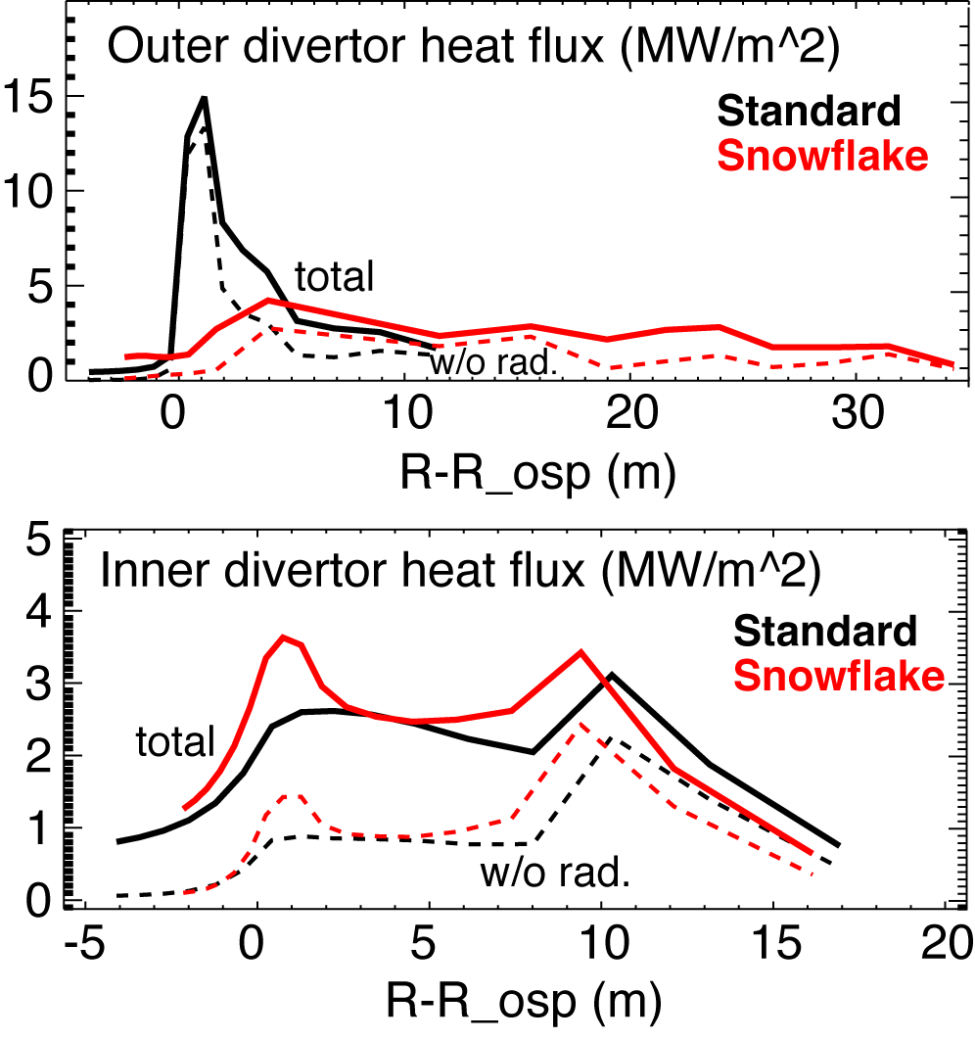
Snowflake and impurity-seeded radiative divertor with feedback control are planned for NSTX-U
Divertor peak heat flux scaling
    q_{peak}~ P_{SOL} and q_{peak} ~ I_{p}
    For NSTX-U q_{peak} ~ 20-30 MW/m²
Snowflake divertor development
  Implementation of control algorithms
  Initial assessment and model validation
Radiative divertor development
  In NSTX, heat flux reduction in radiative divertor compatible with H-mode confinement
  Seeded impurity choice dictated by Z_{imp} and PFC
  Li/C PFCs compatible with D₂, CD₄, Ne, Ar seeding
  UEDGE simulations show Ar most effective
  Feedback control of divertor radiation via impurity particle balance control
Diagnostics: IR thermography, MPTS, Spectroscopy, Langmuir probes

Slide 19
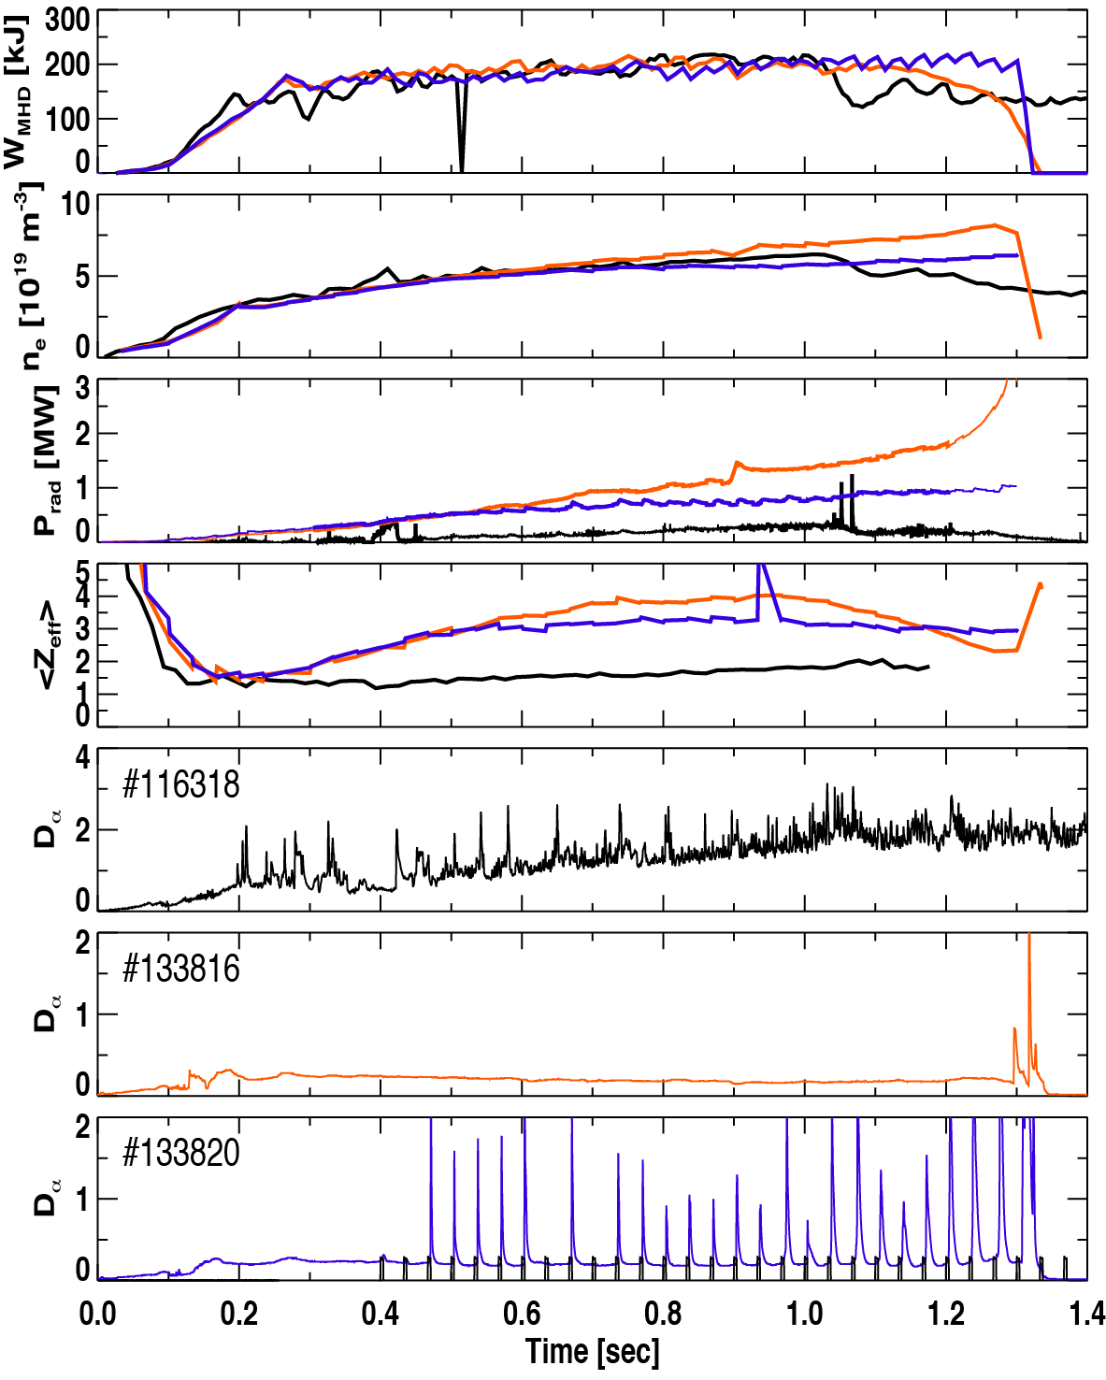
Particle control in NSTX-U will be accomplished with variety of fueling and exhaust techniques
Density control goals for NSTX-U:
  Lower density to access reduced collisionality
    As low as f_{G}~0.3-0.5 desired
  Need to avoid density limit in long-pulse shots
    Greenwald fraction f_{G}~0.7-1.0 sufficient for non-inductive studies
  Develop FNSF-relevant pumping scenarios
Novel and conventional pumping and fueling techniques for density control
  Lithium coatings for deuterium pumping
  Cryopumping
  Conventional and supersonic gas injectors
Impurity control goal Z_{eff} ~ 2-2.5
  ELMy H-modes with boronized carbon PFCs
  ELM-triggering with 3D fields and lithium granules to expel impurities in H-modes with lithium

Slide 20
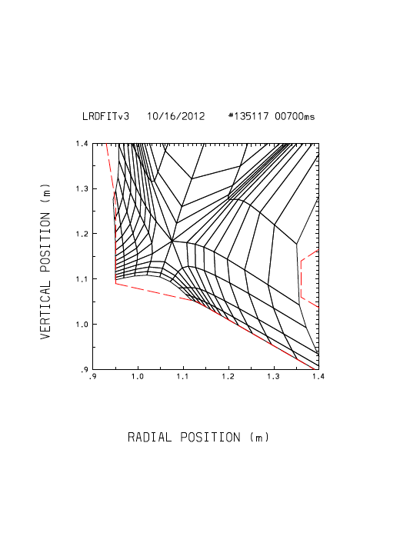
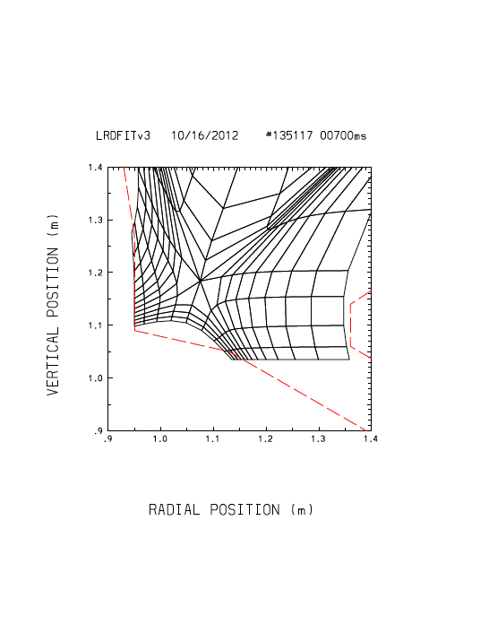
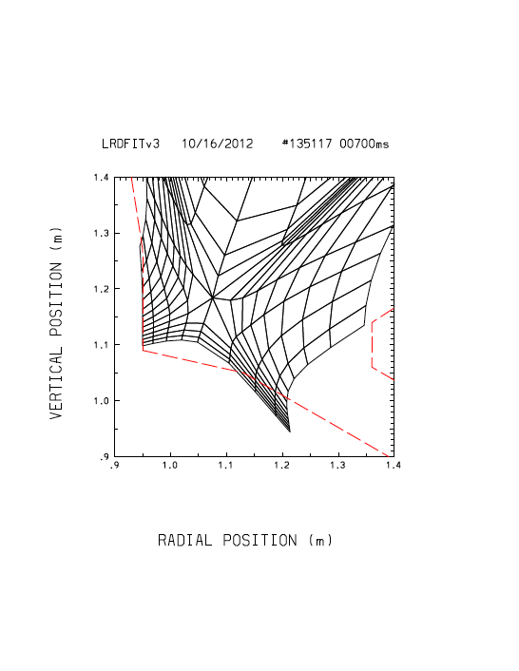
Standard (STD) grids used in ST-FNSF divertor study with UEDGE code
Neutral pumping surface
indicated by .
“STD 30”
~30º
0º
“STD 0”
~-270º
“STD -270”

Slide 21
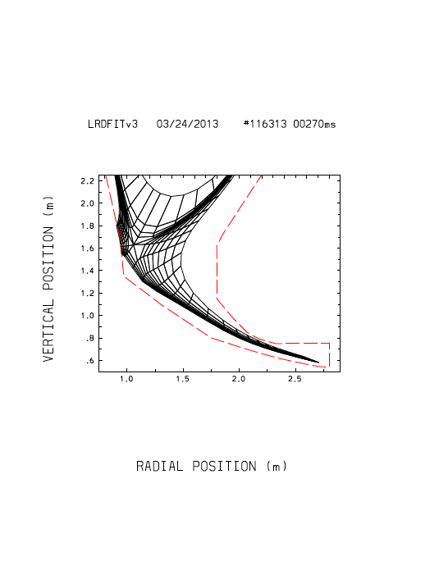
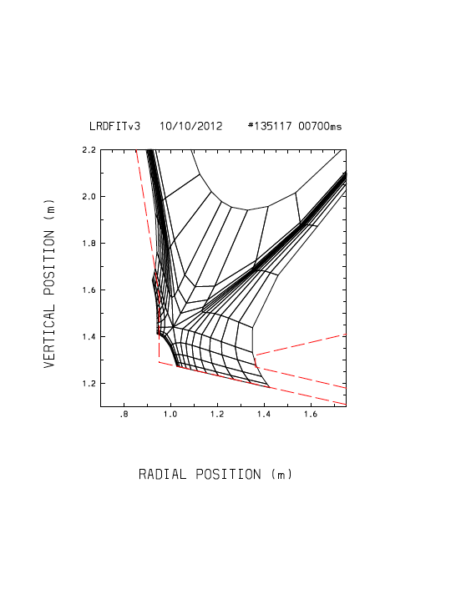
Snowflake (SFD) grids used in ST-FNSF divertor study with UEDGE code
Neutral pumping surface
indicated by .
“Super-SF”
22º
“SFD”

Slide 22
Outer divertor profiles

Slide 23
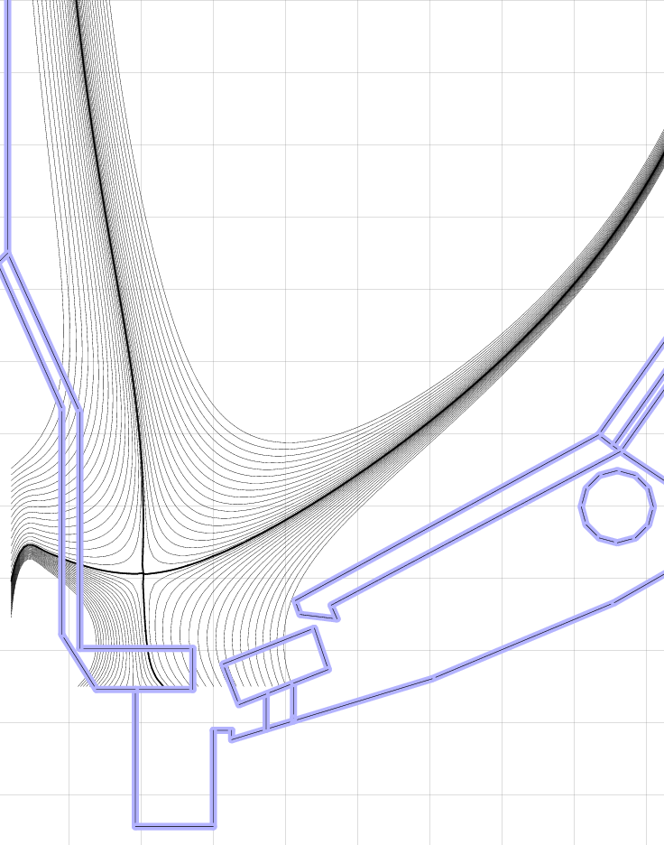
Cryo-pump will be key for density and collisionality control in Years 4-5
BP-3
Cryo-pump is proven technology for plasma density control
  NSTX-U design is similar to DIII-D
  Need plenum pressure of 0.6 mTorr to pump NBI input
Greenwald
fraction
Standard:
Cryo-pump
Pressures >1 mTorr can be reached over wide range of plasma shapes and SOL widths
  Semi-analytic pumping model used to optimize plenum geometry
Optimized plenum geometry can pump conventional and snowflake divertors over a range of R_{OSP}, I_{p}
  Cannot sustain f_{G} < 1 at 2 MA with standard divertor
  High snowflake flux expansion results in better pumping
Snowflake:

