Slide 1




NSTX-U
Supported by
Progress and Plans for Transport and Turbulence
Coll of Wm & Mary
Columbia U
CompX
General Atomics
FIU
INL
Johns Hopkins U
LANL
LLNL
Lodestar
MIT
Lehigh U
Nova Photonics
Old Dominion
ORNL
PPPL
Princeton U
Purdue U
SNL
Think Tank, Inc.
UC Davis
UC Irvine
UCLA
UCSD
U Colorado
U Illinois
U Maryland
U Rochester
U Tennessee
U Tulsa
U Washington
U Wisconsin
X Science LLC
Walter Guttenfelder
Yang Ren, Greg Hammett
and the NSTX-U Research Team
Culham Sci Ctr
York U
Chubu U
Fukui U
Hiroshima U
Hyogo U
Kyoto U
Kyushu U
Kyushu Tokai U
NIFS
Niigata U
U Tokyo
JAEA
Inst for Nucl Res, Kiev
Ioffe Inst
TRINITI
Chonbuk Natl U
NFRI
KAIST
POSTECH
Seoul Natl U
ASIPP
CIEMAT
FOM Inst DIFFER
ENEA, Frascati
CEA, Cadarache
IPP, Jülich
IPP, Garching
ASCR, Czech Rep
NSTX-U PAC-35
PPPL B-318
June 11-13, 2014

Slide 2
NSTX-U Transport and Turbulence (T&T) research aims to establish predictive capability for performance of FNSF & ITER
Challenging and exciting as:
  NSTX-U accesses a variety of drift wave transport mechanisms
All potentially relevant for ITER & other tokamaks
r/a~0.6-0.7
KBM
MT
ITG, TEM, ETG
Notes:
Low beta we find typical microscale ballooning modes, ITG, TEM, ETG. For high performance, high beta discharges we predict fundamentally EM modes like microtearing and KBM. All modes are potentially relevant in other tokamaks & ITER. With flexibility of NSTX-U we can try to isolate and study various mechanisms.

Slide 3
NSTX-U Transport and Turbulence (T&T) research aims to establish predictive capability for performance of FNSF & ITER
Challenging and exciting as:
  NSTX-U accesses a variety of drift wave transport mechanisms
  NSTX-U is unique in achieving high β and low collisionality regime
Will τ_{E}~1/ν* remain valid?
Will microtearing be suppressed?
Will χ_{i}≈χ_{i,NC} & D_{imp}≈D_{imp,NC} hold?
r/a~0.6-0.7
KBM
MT
NSTX-U
ITG, TEM, ETG

Slide 4
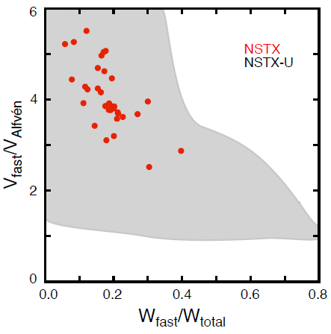
NSTX-U Transport and Turbulence (T&T) research aims to establish predictive capability for performance of FNSF & ITER
Challenging and exciting as:
  NSTX-U accesses a variety of drift wave transport mechanisms
  NSTX-U is unique in achieving high β and low collisionality regime
  Electron thermal transport can also be driven by Global & Compressional Alfvén eigenmodes (GAE/CAEs)
What is role of GAE/CAE setting T_{e,0}?
How will GAE/CAE respond for higher field, 2nd NBI?
r/a~0.6-0.7
GAE/CAE activity
KBM
NSTX
MT
NSTX-U
ITG, TEM, ETG
NSTX-U
Notes:
NSTX-U will allow us to push close to V_fast/V_Alfven~1.
Investigate response to change in fast ion distribution.

Slide 5
NSTX-U Transport and Turbulence (T&T) research aims to establish predictive capability for performance of FNSF & ITER
Challenging and exciting as:
  NSTX-U accesses a variety of drift wave transport mechanisms
  NSTX-U is unique in achieving high β and low collisionality regime
  Electron thermal transport can also be driven by Global & Compressional Alfvén eigenmodes (GAE/CAEs)
Thrust 1: Characterize H-mode global energy confinement scaling in the lower collisionality regime of NSTX-U
Thrust 2: Identify regime of validity for instabilities responsible for anomalous electron thermal, momentum, and particle/impurity transport in NSTX-U
  Low-k modes (k⊥ρ_{s}≤1): ITG/TEM/KBM, MT
  High-k mode: ETG
  CAE/GAE
Thrust 3: Establish and validate reduced transport models
}
drift waves
}
Alfvén eigenmodes
Notes:
Thrust 2 provides physics basis for Thrust 3.

Slide 6
FY15-16 milestones address thrusts of T&T research
(R15-1) Assess H-mode τ_{E}, pedestal and SOL characteristics at high B_{T}, I_{p}, P_{NBI}
  Assess confinement scaling at reduced ν*
(R15-2) Assess the effects of neutral beam injection parameters on the fast ion distribution function and neutral beam driven current profile
  Investigate sensitivity of GAE/CAE induced χ_{e} to fast ion phase space
(Joint Research Target 2015) Quantify impact of broadened current and pressure profiles on confinement and stability
  Study transport and turbulence response with q, s, p₀/⟨p⟩ using expanded NBI flexibility
(IR16-1) Assess τ_{E} and local transport and turbulence at low ν* with full confinement and diagnostic capabilities
  New results from high-k_{θ} scattering (UC-Davis), polarimeter (UCLA), enhanced BES (UW)
Notes:
(R15-1) Joint TSG milestone, (R15-2) EP, ASC milestone, (JRT 15) Multi-machine joint research target, (IR16-1) TT milestone following on from R15-1

Slide 7
OUTLINE
Recent research highlights
Research goals and plans for FY15-16
Summary

Slide 8
OUTLINE
Recent research highlights
  Turbulence measurements
  Thermal transport, measurement and modeling
  Momentum & impurity transport
Research goals and plans for FY15-16
Summary
Notes:
No new analysis on confinement scaling. Recent highlights generally fall under Thrust 2 & 3.

Slide 9
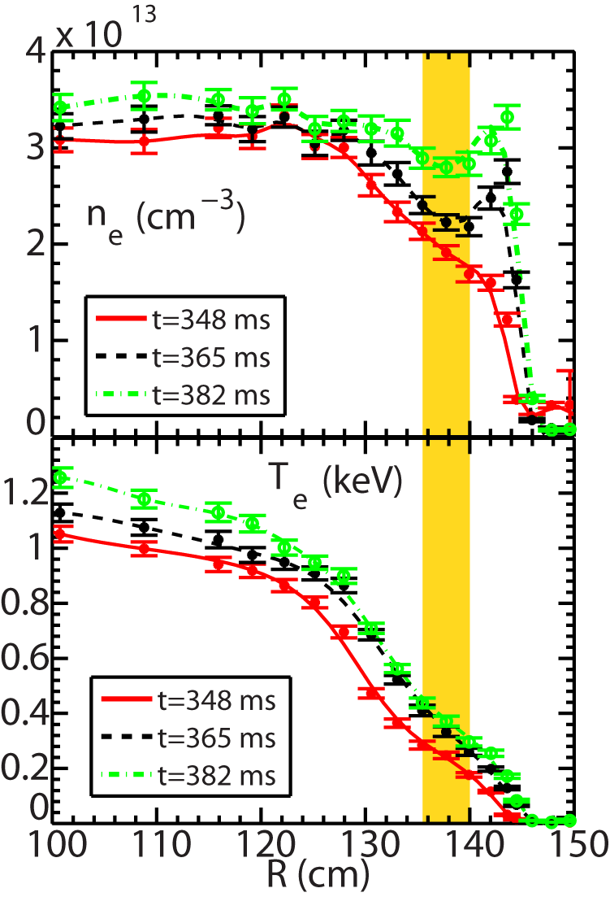
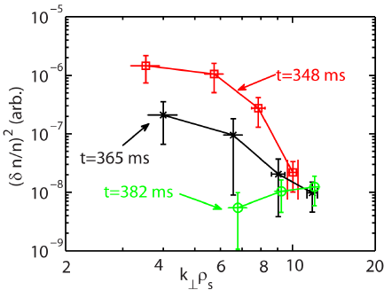
Investigating high-k turbulence and thermal transport across L-H transition early in discharge
Turbulence drop across L-H from core to pedestal (135-145 cm) seen in high-k (also BES & GPI), correlated with pedestal growth & confinement improvement
Thomson scattering profiles
High-k intensity spectra
L-H transition at 350 ms
High-k measurement region
Ren (2014)

Slide 10
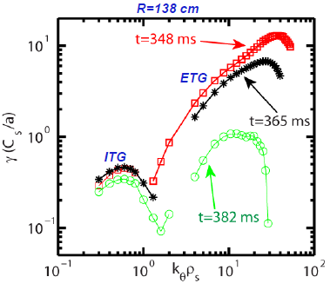
Investigating high-k turbulence and thermal transport across L-H transition early in discharge
Turbulence drop across L-H from core to pedestal (135-145 cm) seen in high-k (also BES & GPI), correlated with pedestal growth & confinement improvement
High-k reduction consistent with reduction in ETG growth rates
  E×B shearing rate also increases in pedestal and core region
Linear growth rates
High-k intensity spectra
L-H transition at 350 ms
ITG/TEM
Ren (2014)
Nonlinear ITG/TEM, ETG simulations to be run in FY14-15 to determine importance of high-k

Slide 11
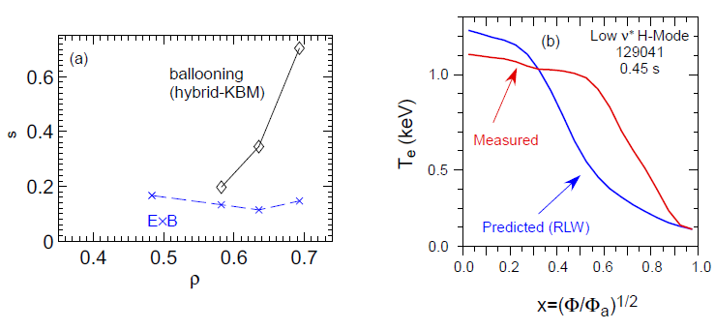
Testing reduced χ_{e} models for microtearing turbulence
Microtearing (MT) instability dominant in high-collisionality H-modes
T_{e} predictions using Rebut-Lallia-Watkins (1988) microtearing model show agreement
  Poor agreement for lower ν* discharges
Beginning to investigate global EM effects (ρ*=ρ_{s}/a~1/120)
high-ν* H-mode
low-ν* H-mode
Microtearing
KBM
ExB
ρ
ρ
Will test physics-based TGLF transport model in FY14-15 (w/ GA, G. Staebler)
0
.
8
)
Measured
V
e
k
Predicted
(
0
.
e
4
T
Collaboration with UC-Boulder, GEM (Chowdhury)
EM in XGC1 (Lang, Ku) & GTS (Startsev, Wang) in FY14-15 (PPPL-Theory)
0
.
0
0
.
0
0
.
2
0
.
4
0
.
6
0
.
8
1
.
0
ρ
Kaye (2014)
ρ
Notes:
Dedicated, systematic tests of TGLF

Slide 12
Testing reduced χ_{e} models for microtearing turbulence
Microtearing (MT) instability dominant in high-collisionality H-modes
T_{e} predictions using Rebut-Lallia-Watkins (1988) microtearing model show agreement
  Poor agreement for lower ν* discharges
Beginning to investigate global EM effects (ρ*=ρ_{s}/a~1/120)
high-ν* H-mode
low-ν* H-mode
Microtearing
KBM
ExB
ρ
ρ
Will test physics-based TGLF transport model in FY14-15 (w/ GA, G. Staebler)
0
.
8
)
Measured
V
e
k
Predicted
(
0
.
e
4
T
Collaboration with UC-Boulder, GEM (Chowdhury),
EM in XGC1 (Lang, Ku) & GTS (Startsev, Wang) in FY14-15 (PPPL-Theory)
Ad-hoc χ_{e}
20-30 m²/s
(GAE proxy)
χ_{e} (RLW)
0
.
0
0
.
0
0
.
2
0
.
4
0
.
6
0
.
8
1
.
0
ρ
Kaye (2014)
ρ
No drift wave instability predicted near axis – influence of GAE/CAE?

Slide 13
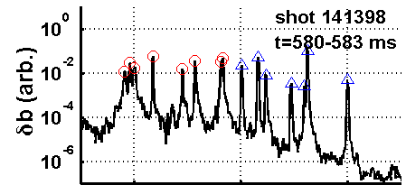
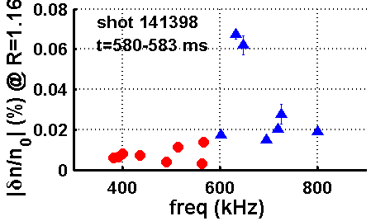
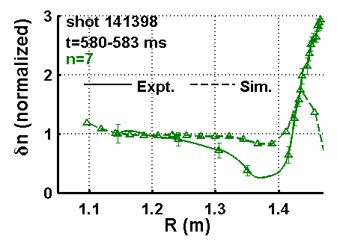
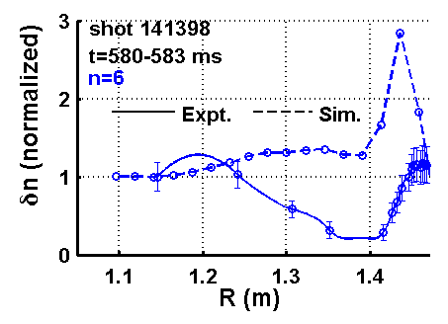
Improving model estimates of energy transport due to Alfvén eigenmodes
Assumed GAE, CAE mode structures, amplitude, polarity used previously to model χ_{e,EP} from ORBIT modeling (Gorelenkov, 2010; Tritz, 2012)
Measured n, ω, δn + dispersion allow distinction of GAE, CAE
HYM simulations predict both GAE and CAE
  E.g, counter propagating GAE frequencies consistent, mode structure shows some discrepancies
  Measured displacements used to estimate CAE→KAW power channeling, P_{CAE→KAW}~γ(δB)², δB~ξ
Crocker, NF (2013)
Will use measured mode structures, amplitude, polarity in ORBIT simulations to model χ_{e,EP} in FY14-16 (Crocker, UCLA)
GAEs
CAEs
n=7
f_{exp} = 520 kHz
f_{sim} = 510 kHz
n=6
f_{exp} = 560 kHz
f_{sim} = 590 kHz
Will test additional physics in HYM simulations in FY14-16
(E. Belova, PPPL Theory)
FY17+ goal of fully nonlinear, self-consistent HYM predictions of χ_{e,EP} and P_{CAE→KAW}
Crocker, IAEA (2014)

Slide 14
Momentum transport predictions being used to help constrain theory
#1
#2
#3
#4
#5
high β H-modes (r/a~0.7)
Coriolis pinch (#2) for ITG generally describes conventional aspect ratio results
  Microtearing (MT) & kinetic ballooning modes (KBM) predicted in NSTX H-modes, calculated pinch is inconsistent
Simulation challenges at high β motivated analysis in low β L-modes
  Nonlinear simulations with E×B shear (#4) predict weak pinch, even for low β ITG
  Led perturbative L-mode experiments at MAST using 3D δB fields (2013) – analysis ongoing
Investigating finite-ρ* effects for momentum transport in low-β L-mode
  Global GTS, GYRO & XGC1 (δf) simulations predict inward directed residual stress (#5) in absence of flow (u=u′=γ_{E}=0)
Kaye (2009)
RV_{ϕ}/χ_{ϕ} (experiment)
KBM
k_{θ}ρ_{s}<0.4
Investigating centrifugal effects (#3) in FY14, collaboration with U-Bayreuth, GKW (Buccholz)
RV_{ϕ}/χ_{ϕ} (QL simulations)
ITG in low β NSTX L-mode
Collaboration with CCFE
Inward directed residual stress
Ongoing global benchmark in FY14-15
Notes:
If residual stress important, will need to revisit experimental analysis

Slide 15
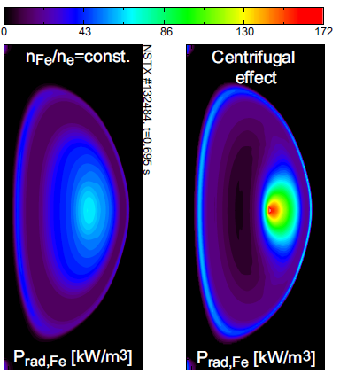

NSTX-U will study low- and high-Z impurity transport prior to significant high-Z PFC coverage in FY17+
Impurity transport studies will be accomplished using gas-puff (Ne, Ar), laser blow off (Ca, Mo, W – FY16, LLNL/JHU) and many diagnostic enhancements:
  Survey x-ray spectrometers (LLNL)
  XCIS: V_{ϕ,Z}, T_{Z}, n_{Z} (Ca, Ar, Mo, W) (PPPL)
  1D tangential mid-plane + 2D poloidal bolometers (PPPL)
Collaboration between LLNL, JHU, PPPL
Will investigate whether high-Z transport follows neoclassical
  Including toroidal rotation + centrifugal effects on poloidal asymmetry
  Using 2nd NBI + NTV to vary rotation
Plan to investigate particle transport using edge neutral measurement (D_{α} from MSE, BES; D_{β} camera) + DEGAS2 calculations
  Assess perturbative capability using TS, ME-SXR
  Perturbative particle transport measurements led on MAST in 2013 (Ren) – analysis ongoing
f₀=28 kHz
(M_{D,0}=0.56)
Collaboration with CCFE
Delgado-Aparicio, HTPD (2014)

Slide 16
OUTLINE
Recent research highlights
Research goals and plans for FY15-16
  Thrust 1: Characterize H-mode energy confinement at low ν*
  Thrust 2: Identify regime of validity for mechanisms responsible for χ_{e}, χ_{i}, χ_{ϕ}, D_{imp}
  Thrust 3: Establish and validate reduced transport models
Summary

Slide 17
FY15 research plans
Characterize H-mode confinement scaling at increased B_{T}/I_{p} = 0.8 T/1.6 MA
  Push to lowest collisionality possible (is τ_{E}~1/ν* still valid?)
  Characterize changes in multi-channel transport χ_{e}, χ_{i}, χ_{ϕ}, D_{imp} (e.g., does χ_{i}≈χ_{i,NC} & D_{i}≈D_{i,NC} remain at lower ν*)
  Compare with theory (e.g., is microtearing suppressed at reduced ν*?)
Explore parametric transport and turbulence dependencies with q and flow profiles using expanded NBI flexibility, 3D coils
  Characterize changes in low-k turbulence (BES, reflectometry), compare with gyrokinetic simulations
Measure CAE/GAE mode frequencies and structure (BES, reflectometry)
  Characterize effect of GAE/CAE on experimental χ_{e}, sensitivity to NBI tangency radii/pitch angle
  Compare with theory, HYM simulations
Develop & test χ_{e,EP} model using ORBIT + measurement/HYM predictions
  Test sensitivity of GAE/CAE measurements, predictions to fast ion phase space
Thrust 1
R15-1
JRT 15
Thrust 2
w/ EP
R15-2
Thrust 3

Slide 18
FY15-16 research plans
Investigate momentum transport using NBI modulation from additional beam sources, longer duration discharges
  Characterize Pr, RV_{ϕ}/χ_{ϕ} in low- and high-β discharges, compare with theory
  Study intrinsic rotation in Ohmic & RF discharges using passive CHERS, MSE-LIF (FY16)
Measure high-Z impurity transport prior to significant high-Z PFC coverage (FY17+); Assess effect of HHFW
  Perturbative experiments (D, V) for impurity and electron thermal transport using trace Ne, Ar (puff) and high-Z (LBO), coupled with ME-SXR, XCIS
Continue turbulence simulations with increasing realism
  Finite-ρ*, toroidal flow effects for high-β electromagnetic turbulence
Develop, test reduced drift wave transport models (e.g. TGLF)
  Test fidelity of models with gyrokinetic simulations for broad parameter space
  Predict T_{e}, T_{i} profiles to validate models with experiments
Thrust 2
Thrust 3

Slide 19
FY16 research plans
Extend H-mode confinement scaling up to full B_{T}/I_{p} = 1.0 T/2.0 MA, P_{NBI}=15 MW
  Access lowest collisionality (dual LiTER, ELM pacing; cryo after FY17)
  Characterize changes with addition of high-Z divertor tiles
Obtain first data from new turbulence diagnostics
  High-k FIR scattering: investigate ETG turbulence, k_{θ}-k_{r} isotropy; probe high field side δn for evidence of KAW resonance
  288 GHz polarimeter: investigate magnetic fluctuations associated with microtearing, GAE/CAE
Assess confinement, local transport and turbulence at low ν* with full confinement and diagnostic capabilities (resources permitting)
  Comprehensive low-k, high-k, and magnetic turbulence coverage (BES, high-k, polarimeter, reflectometer), compare with simulations & reduced models
  Study in isolated regimes of microinstabilities (MT vs. ETG vs. ITG/TEM/KBM)
Thrust 1
Thrust 2
IR16-1

Slide 20
Summary: NSTX-U T&T research in FY15-16 will advance physics basis for predictive capability
Characterize confinement scaling for high beta, lowest collisionality plasmas
  Evaluate 0D performance for ST-FNSF designs
Analyze multi-channel transport (χ_{i}, χ_{e}, χ_{ϕ}, V_{ϕ}, D_{imp}, V_{imp}), turbulence measurements (low-k, high-k, magnetic), effects of GAE/CAE-KAW to discriminate most important transport mechanisms
  Motivate new theory, models and/or diagnostics (PCI, DBS, CPS)
Continue assessment of predictive capability of reduced transport models → improve prediction of confinement (τ_{E}) and temperature (T_{e}, T_{i}) profiles
Notes:
Refine extrapolation for 0D performance for ST-FNSF designs

Slide 21
BACKUP SLIDES

Slide 22
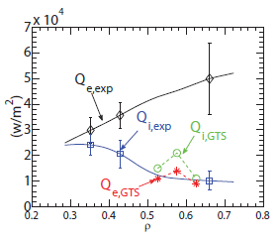
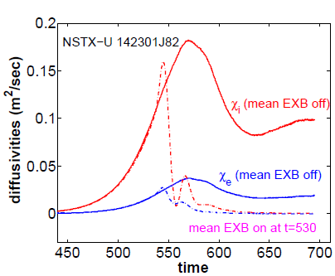
Global simulations used increasingly to investigate electrostatic ion scale turbulence
Investigating TEM turbulence in low-β NSTX H-mode where ETG has been reduced by large ∇n (Ren, PRL 2011, PoP 2012)
  TEM predicts substantial ion and momentum flux, electron flux below experiment
  Suggests need for multiscale TEM-ETG simulations
Global electrostatic GTS sims with kinetic electrons for NSTX-U scenario predict little transport, even without E×B shear
  Suggests ion transport may remain neoclassical in NSTX-U
TEM in low β NSTX H-mode
W. Wang – GTS code
(PPPL Theory)
Implementing EM effects in GTS in FY14-15 (Startsev, Wang – PPPL Theory)

Slide 23
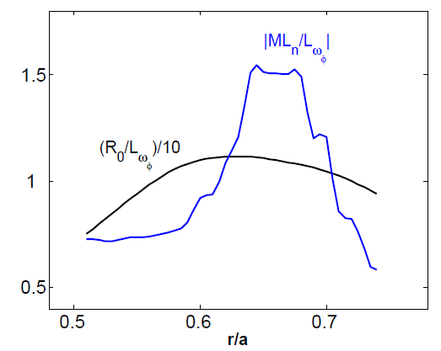
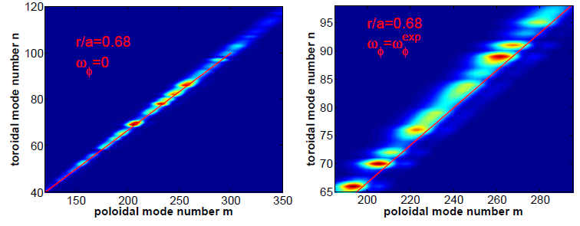

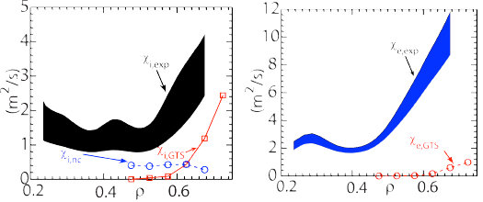
Strong flow shear can destabilize Kelvin-Helmholtz (K-H) instability in NSTX (Wang, TTF 2014)
K-H instability expected for |ML_{n}/L_{ω}|>1 from linear analytic theory (Catto, 1973; Garbet, 1999)
K-H identified in global electrostatic ITG simulations for NSTX low β L-mode (Ren, 2013)
  Mostly unstable K-H modes have finite k|| (shifted away from nq=m)
K-H/ITG + neoclassical close to experiment χ_{i}
  χ_{e} underpredicted
  ETG possibly important
GTS code
nq=m
Nonlinear ETG simulations to be run in FY14 to investigate contribution in NSTX L-modes

Slide 24
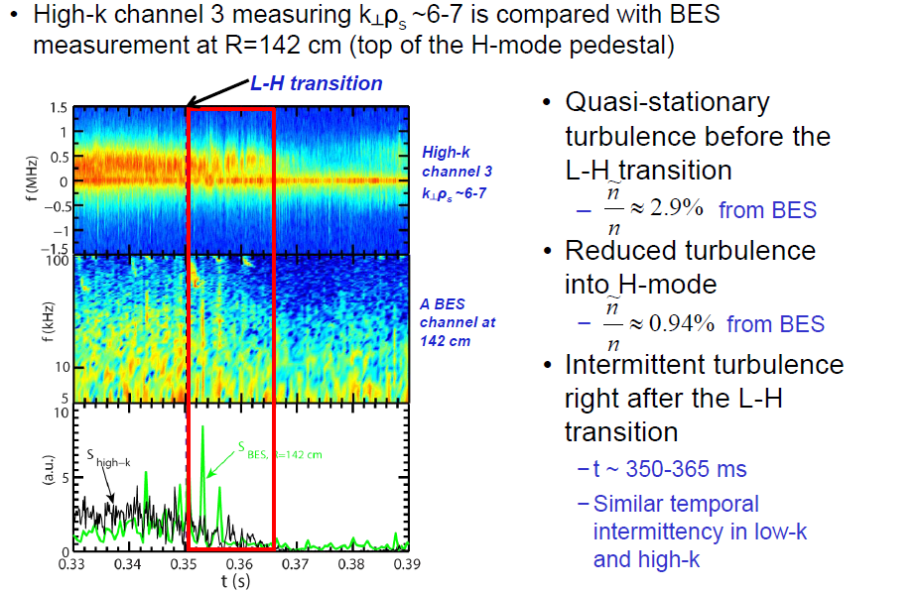
Across L-H transition, low-k turbulence measured by BES shows similar temporal behavior as high-k turbulence
Ren (2014)

Slide 25
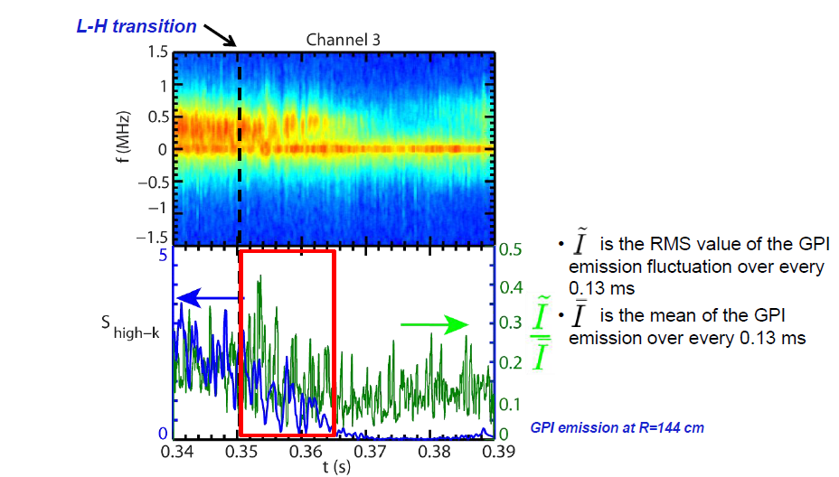
Across L-H transition, GPI measurements are more intermittent than high-k turbulence
Ren (2014)

Slide 26
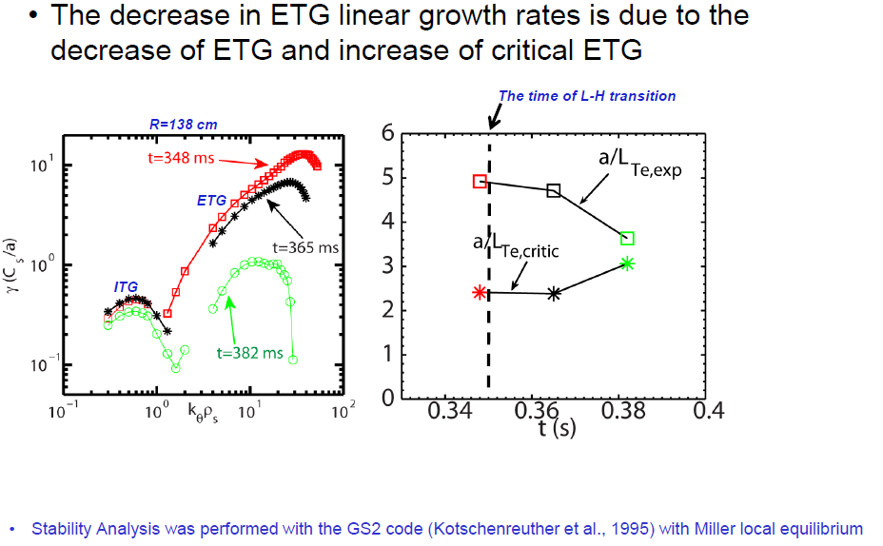
Electron temperature gradient moves closer to ETG threshold after L-H transition
Ren (2014)

Slide 27
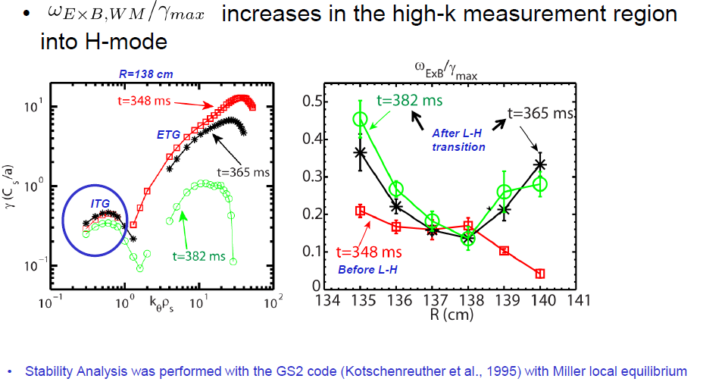
Low-k modes expected to be more suppressed after L-H transition
Ren (2014)

Slide 28
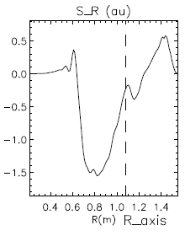
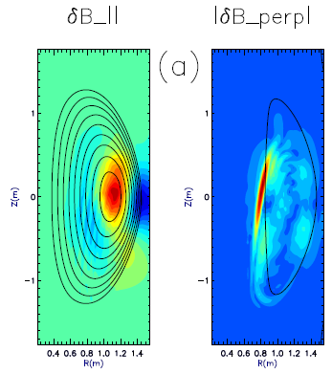
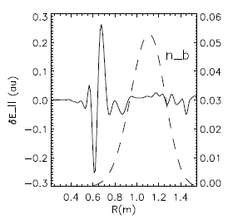
Investigating coupling of CAEs to kinetic Alfvén waves (KAW) as additional energy “loss” mechanism
GAE/CAEs cause large χ_{e} through stochastic orbits [Gorelenkov, NF 2010]
CAEs also couple to KAW - Poynting flux redistributes fast ion energy near mid-radius, E|| resistively dissipates energy to thermal electrons
  P_{CAE→KAW}~0.4 MW from QL estimate + experimental mode amplitudes (Belova,IAEA 2014)
  P_{e,NBI}~1.7 MW for ρ<0.3, NBI power deposited on core electrons
Radial Poynting flux
⟨E×B⟩_{R}
E. Belova – HYM code
(PPPL Theory)
CAE
(n=8)
KAW
~ρ_{beam}
ω_{A}(R,Z)=ω_{CAE}

Slide 29
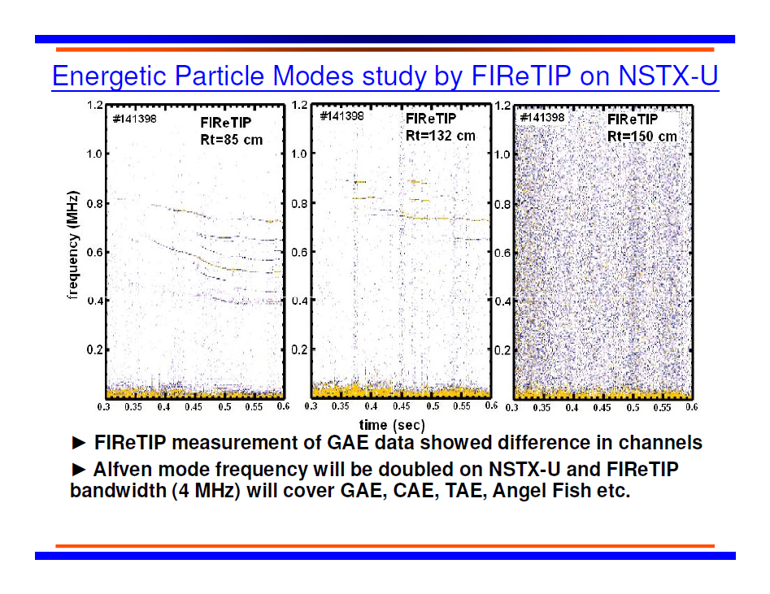
Will assess ability of available measurements (FIReTIP, high-k scattering, polarimeter) to measure KAW
K.C. Lee, APS (2010)

Slide 30
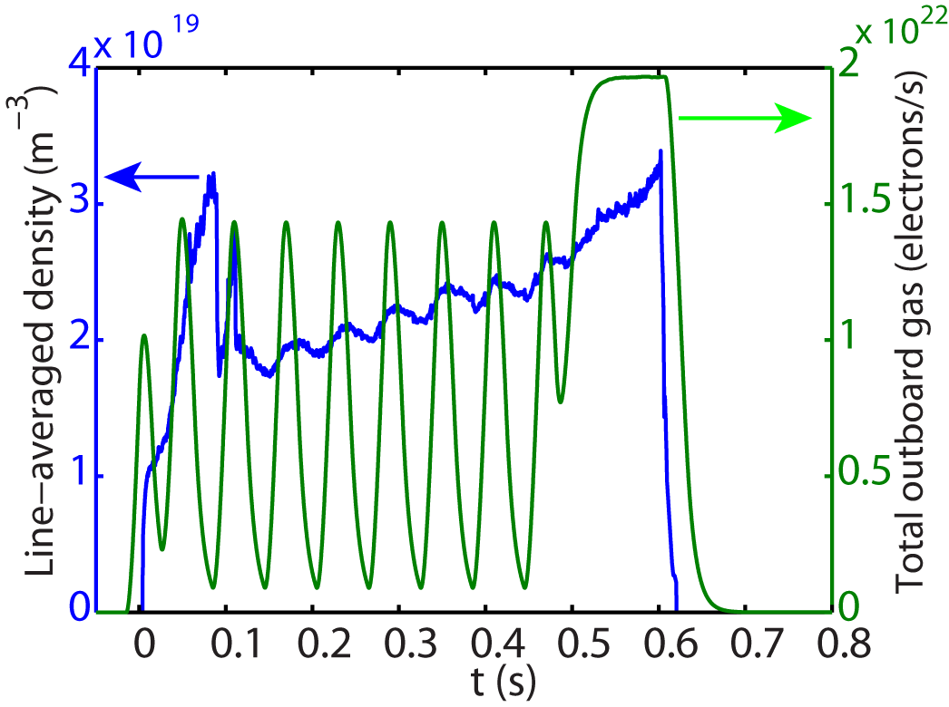
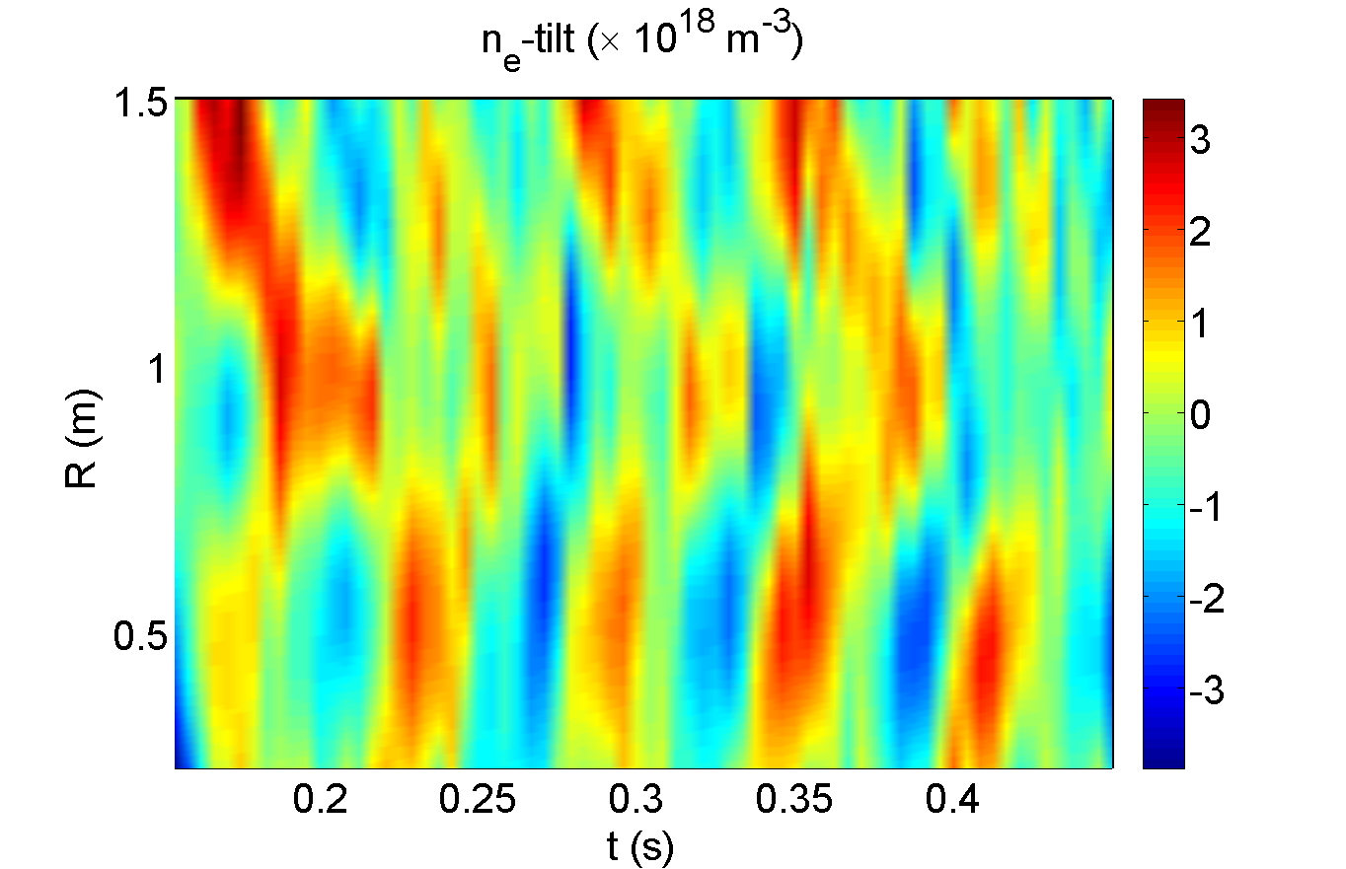
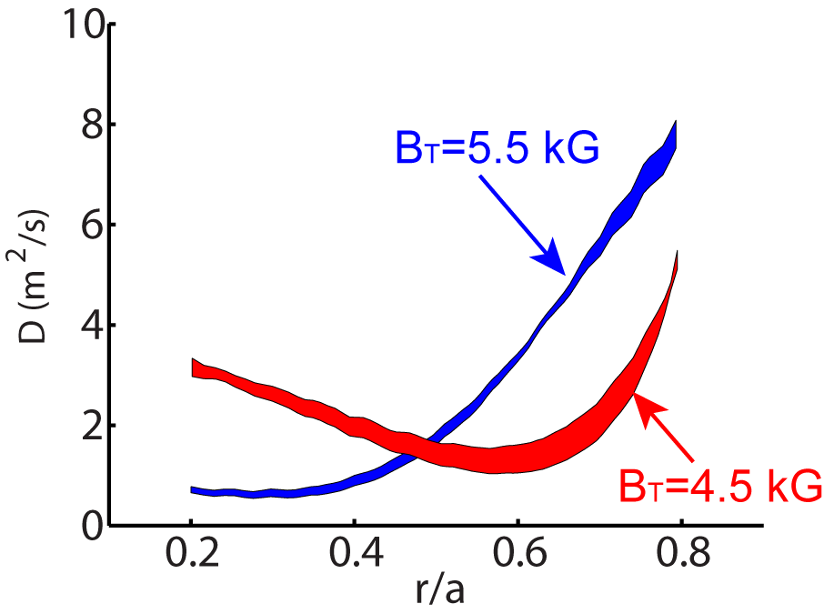
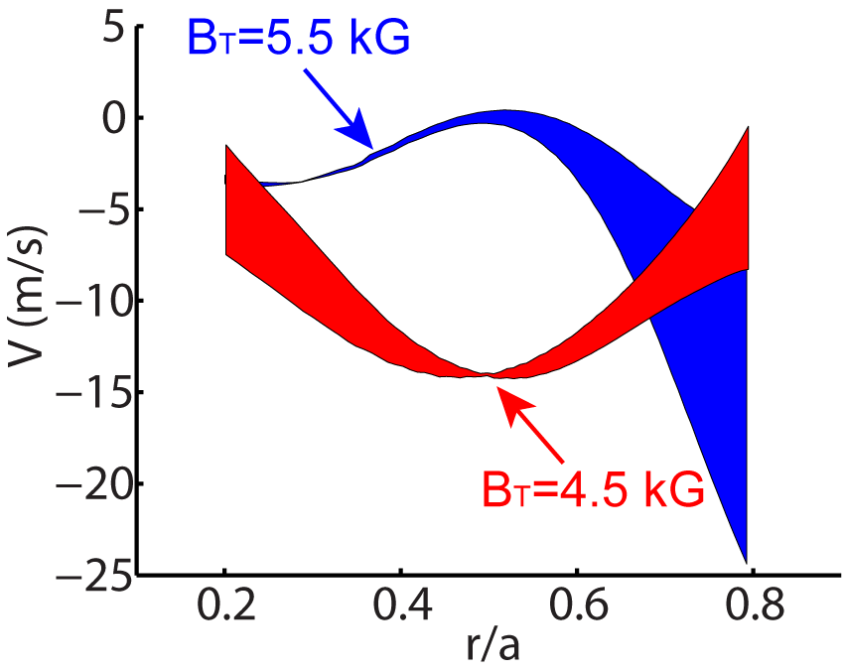
Perturbative Particle Transport Experiment was Carried out on MAST L-mode Plasmas
Modulated gas puff is used to introduce density perturbation
  Clear density modulation seen in line-averaged density
  Experiment carried out with different density, current and toroidal field
Shot 29811 , B_{T}= 5.5 kG, I_{P}=400 kA
Clear inward propagation of density perturbation
Particle diffusivity, D, and pinch, V, evaluated with Fourier analysis
  D and V change as toroidal magnetic field is varied
Inward propagation of perturbation
Magnetic axis

Slide 31
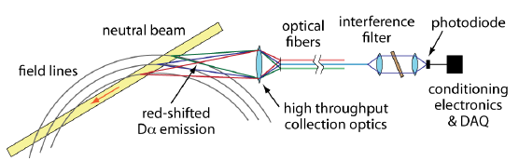
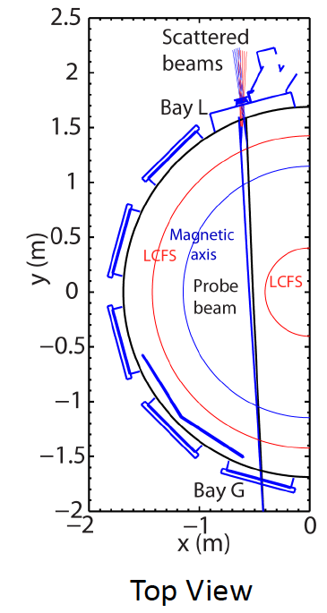
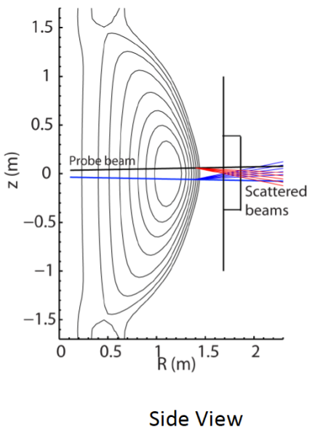
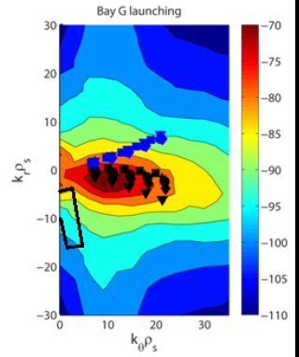
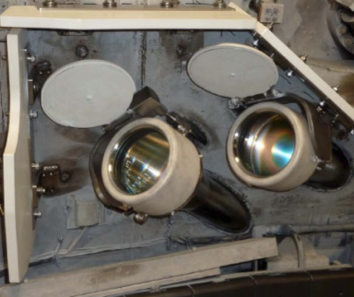
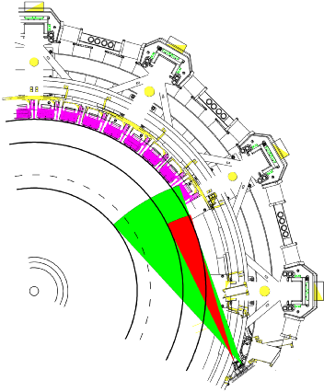
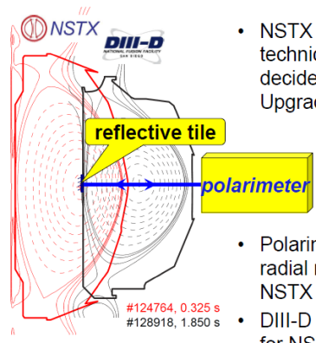
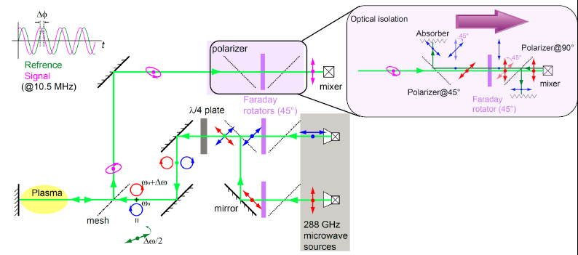
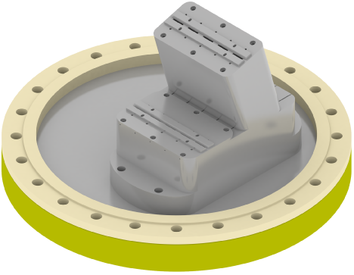
Additional new and upgraded diagnostics critical for T&T research
48 ch. BES
New high-k scattering system for 2-D k spectrum
Neutral Beam
Optical fibers
PPPL/UCD
(FY16)
field lines
red-shited
Dα emission
High throughput collection optics
U. Wisconsin
(FY15)
288 GHz polarimetry system for internal magnetic fluctuation measurements (tested on DIII-D in 2012)
200 ch., 10 kHz ME-SXR for fast T_{e}, impurity measurements
UCLA
(FY16)
JHU
(FY15)

Slide 32
Additional new and upgraded diagnostics critical for T&T research
48 ch. BES
48 ch. BES
New high-k scattering system for 2-D k spectrum
Neutral Beam
Optical fibers
PPPL/UCD
(FY16)
field lines
red-shited
Dα emission
High throughput collection optics
U. Wisconsin
(FY15)
288 GHz polarimetry system for internal magnetic fluctuation measurements (tested on DIII-D in 2012)
200 ch., 10 kHz ME-SXR for fast T_{e}, impurity measurements
UCLA
(FY16)
JHU
(FY15)
Similar system installed & successfully tested on EAST for FY14 operation (prior to NSTX-U operations)
Ongoing FY14 collaboration with C-Mod and DIII-D to investigate electromagnetic effects and interpretation of line-integrated polarimetry (C-Mod) and cross-polarization scattering (DIII-D) measurements

Slide 33
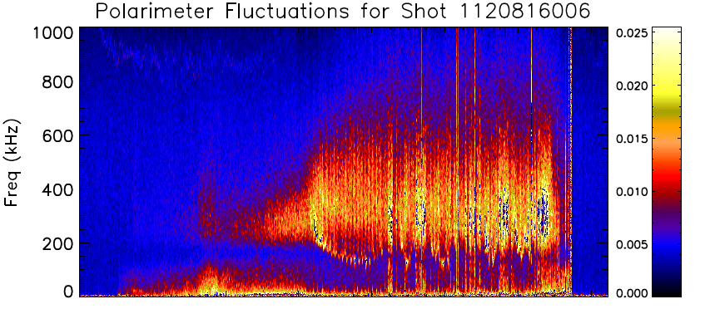
Collaborating with C-Mod to investigate electromagnetic effects & diagnostics related to NSTX-U
Broadband fluctuations observed in C-Mod line-integrated polarimeter (~n_{e}⋅B), not seen in PCI (~n_{e} only) (Bergerson, RSI 2012)
Collaborating on gyrokinetic analysis and measurement interpretation in anticipation of related NSTX-U research
  Experimental run time allocated for FY14 to investigate β_{N}~2 ITER-like scenarios, hopefully with new polarimeter data
Ch. 2

Slide 34
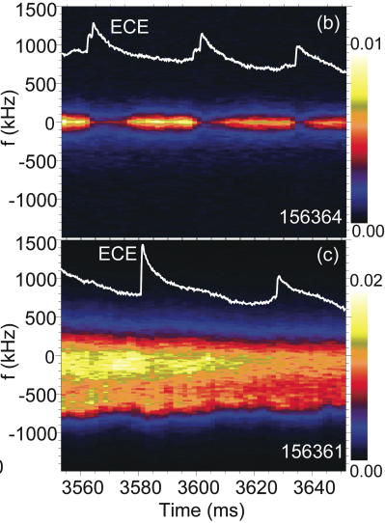
Collaborating with DIII-D to investigate electromagnetic effects & diagnostics related to NSTX-U
Ion thermal & momentum transport found to be neoclassical in DIII-D high density QH-mode (Holland, TTF 2013) – similar to NSTX H-modes
  Gradients nearest to microtearing threshold
Rhodes, HTPD (2014)
UCLA implementing cross-polarization scattering (CPS) to measure internal magnetic fluctuations
  Collaborating on gyrokinetic analysis and interpretation to evaluate possible implementation and utility on NSTX-U
CPS
DBS

Slide 35
A Summary of Acronyms (SoA)
Instabilities
  ITG – ion temperature gradient, electrostatic
  TEM – trapped electron mode, electrostatic
  KBM – kinetic ballooning mode, electromagnetic
  MT – microtearing, electromagnetic
  ETG – electron temperature gradient, electrostatic
  CAE – compressional Alfven eigenmode, electromagnetic
  GAE – global Alfven eigenmode, electromagnetic
Codes
  GYRO – an eulerian gyrokinetic code
  GS2 – an eulerian gyrokinetic code
  GTS – global particle-in-cell Gyrokinetic Tokamak Simulation (GTS) code
  GENE – Gyrokinetic Electromagnetic Numerical Experiment (GENE) code
  XGC0/XGC1 –full-f global particle-in-cell gyrokinetic code
  TGLF – an gyro-Landau-fluid code
  MMM08 – multi-mode anomalous transport model
  NCLASS – a local neoclassical transport code
  NEO – a local eulerian neoclassical transport code
  GTC-NEO –a global particle-in-cell neoclassical transport code
  HYM – nonlinear 3-D HYbrid and MHD simulation code (HYM)
  TRANSP – a time dependent tokamak transport and data analysis code with free boundary and multi-zone predictive capability
  TGYRO – a transport solver
  MIST – Multi-Ionic Species Transport (MIST) code
  STRAHL – an impurity transport code
  DEGAS2– a neutral transport code
  ORBIT – A guiding center test particle code for tokamak geometry
Diagnostics
  BES – beam emission spectroscopy (BES)
  CHERS – charge exchange recombination spectroscopy (CHERS)
  ME-SXR – multi-energy soft X-ray (ME-SXR)
  TGIS – Transmission Grating Imaging Spectrometer (TGIS)
  LBO – Laser Blow-off system (LBO)

Slide 36
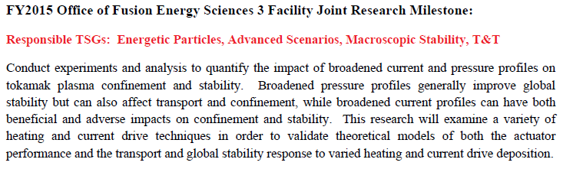
Joint Research Target 2015

Slide 37
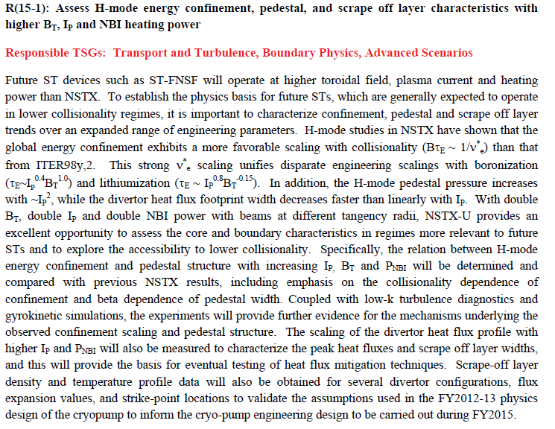
Milestone R(15-1)

Slide 38
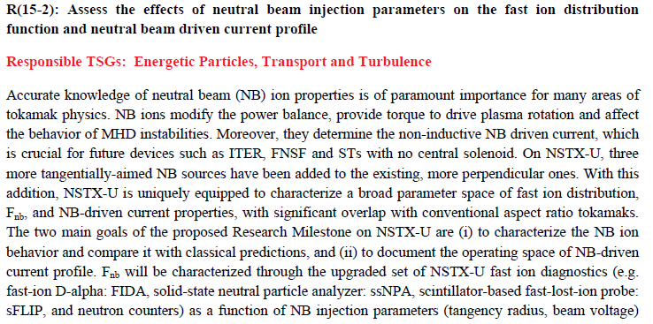
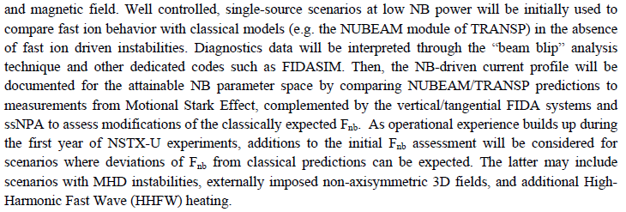
Mileston R(15-2)

Slide 39
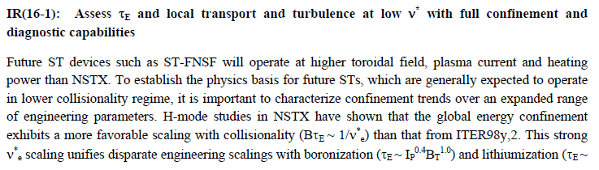
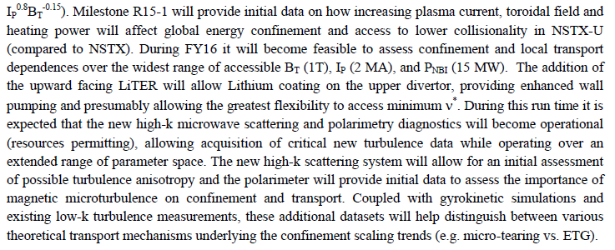
Milestone IR(16-1)

