Slide 1




NSTX-U
Supported by
Progress and Plans for Fast Wave and Electron Cyclotron Heating Research
Rory Perkins
Gary Taylor, Nicola Bertelli, Mario Podestà,
Nikolai Gorelenkov
for the NSTX-U Research Team
Coll of Wm & Mary
Columbia U
CompX
General Atomics
FIU
INL
Johns Hopkins U
LANL
LLNL
Lodestar
MIT
Lehigh U
Nova Photonics
ORNL
PPPL
Princeton U
Purdue U
SNL
Think Tank, Inc.
UC Davis
UC Irvine
UCLA
UCSD
U Colorado
U Illinois
U Maryland
U Rochester
U Tennessee
U Tulsa
U Washington
U Wisconsin
X Science LLC
Culham Sci Ctr
York U
Chubu U
Fukui U
Hiroshima U
Hyogo U
Kyoto U
Kyushu U
Kyushu Tokai U
NIFS
Niigata U
U Tokyo
JAEA
Inst for Nucl Res, Kiev
Ioffe Inst
TRINITI
Chonbuk Natl U
NFRI
KAIST
POSTECH
Seoul Natl U
ASIPP
CIEMAT
FOM Inst DIFFER
ENEA, Frascati
CEA, Cadarache
IPP, Jülich
IPP, Garching
ASCR, Czech Rep
NSTX-U PAC-35 Meeting
PPPL – B318
June 11-13, 2014

Slide 2
Outline
Motivation for Fast Wave (FW) & (future) Electron Cyclotron (EC) and Electron Bernstein Wave (EBW) research
Progress during the past year
Research goals and plans for FY 2015 & 2016
Summary
2

Slide 3
Outline
Motivation for Fast Wave (FW) & (future) Electron Cyclotron (EC) and Electron Bernstein Wave (EBW) research
Progress during the past year
Research goals and plans for FY 2015 & 2016
Summary
3

Slide 4
RF research in Five-Year Plan supports non-inductive (NI) operation
30 MHz FW and 28 GHz EC/EBW heating research support two high-level NSTX-U goals:
  Developing and understanding NI plasma current start-up and
  ramp-up in order to project to a ST-FNSF
  Demonstration of 100% NI operation at performance levels extrapolating to ≥ 1 MW/m² neutron wall loading in a FNSF
FW, EC and electron Bernstein wave (EBW) heating can facilitate start-up, ramp-up, and sustainment:
  EC heating can increase T_{e}(0) in CHI and gun-initiated plasmas to allow NBI and FW heating
  FW-driven NI I_{p} ramp-up to a level that can confine fast-ions from
  neutral beams
  EBW heating can potentially provide CD in NBI H-mode plasmas
4

Slide 5
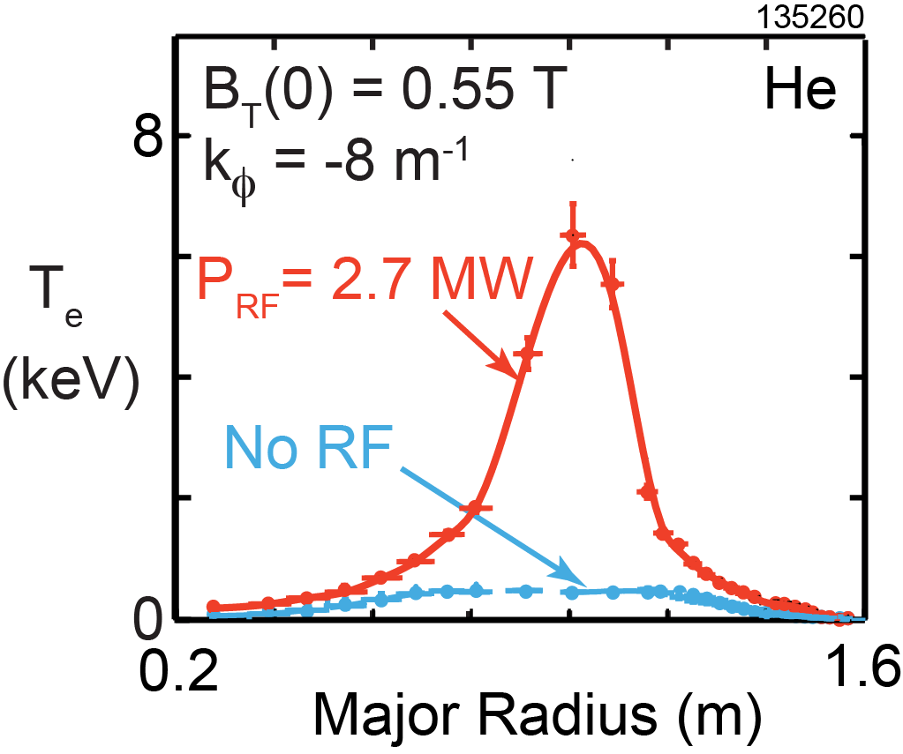
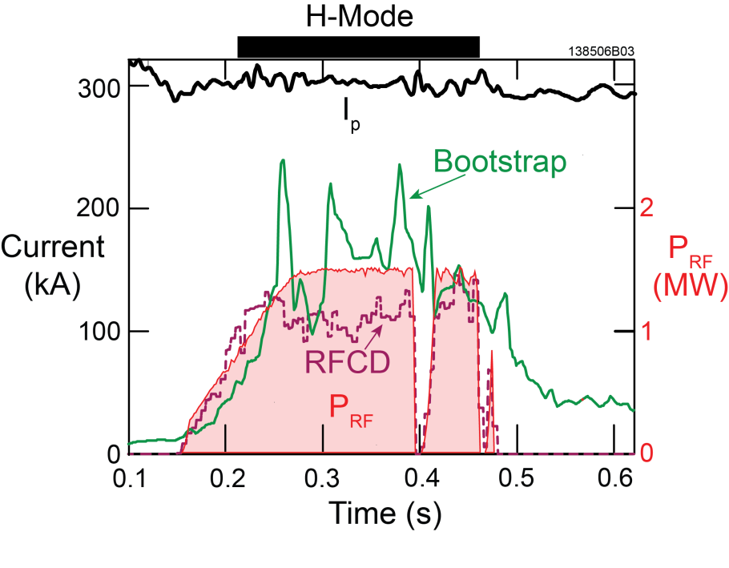
FW heating led to record high electron temperatures and support a largely NI 300 kA H-mode plasma on NSTX
Record Te ~ 6.3 keV attained with 2.7 MW of FW power
    L-mode Ohmic target plasmas
    Can potentially be used for physics studies
Sustained >70% NI I_{p} ~ 300 kA H-mode plasma
  Mostly bootstrap current
  P_{FW} ~ 1.4 MW; limited by antenna arcing (Li flakes or density drops)
[G. Taylor et al., Phys. Plasmas 19 (2012) 042501]
5

Slide 6
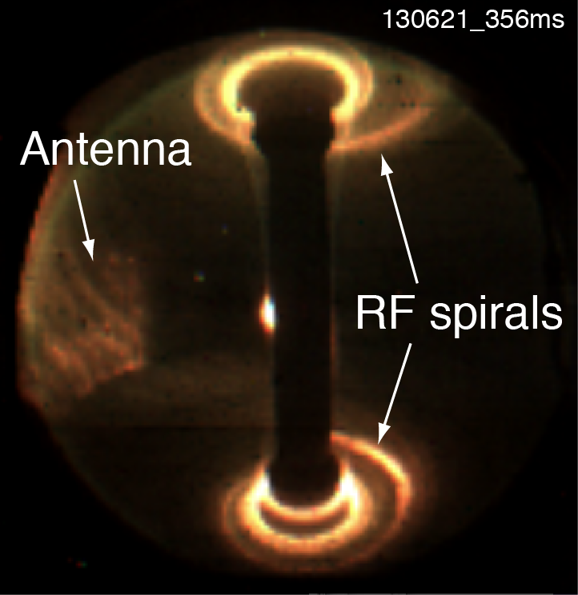
Optimized FW heating requires understanding
FW interactions with SOL and with ions
FY16 milestone [R16-3]
Field-aligned FW losses in SOL produced bright hot spiral on NSTX divertors
    Up to 30% of applied FW power might be lost to the SOL in this fashion
    Mechanisms responsible for this power loss have yet to be definitively identified
Assess FW absorption on NB and thermal ions in NSTX-U:
    Fast ions accelerated by FW power to loss orbits could significantly reduce heating efficiency
    Can influence/suppress Alfvén eigenmodes [M. Podestà’s talk]
6

Slide 7
Continue to develop and validate RF codes for ST parameters to predict future performance
AORSA: full-wave code, all-orders in k_{perp}ρ
  Compare computations of RF fields in SOL against measurements of RF fields in divertor over a range of SOL and antenna parameters
  Validate partition of FW power absorption between fast ions, thermal ions, and electrons
TORIC: full-wave code (reduced model) with TRANSP interface
  Benchmark ion absorption of FW against AORSA and GENRAY
  Study non-Maxwellian (fast ion) effects on FW propagation
GENRAY (ray-tracing) & CQL3D (Fokker-Planck code)
  Hybrid full-orbit, finite orbit width has potential to accurately describe beam-ion interaction with FW (collaboration with R. Harvey, CompX)
7

Slide 8
Outline
Motivation for Fast Wave (FW) & (future) Electron Cyclotron (EC) and Electron Bernstein Wave (EBW) research
Progress during the past year
Research goals and plans for FY 2015 & 2016
Summary
8

Slide 9
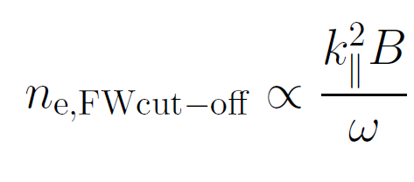
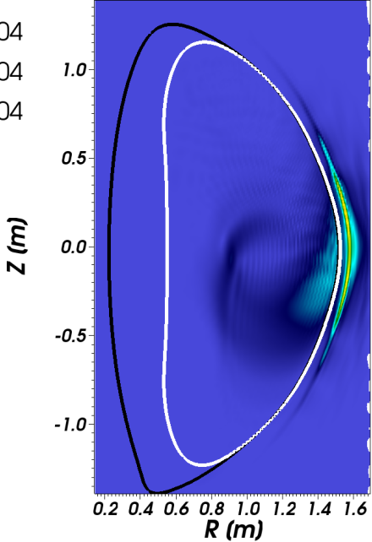
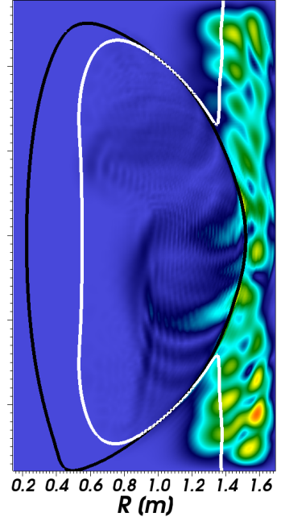
AORSA simulations show low FW losses in SOL depending on location of righthand cutoff
Field-amplitude depends on location of righthand cutoff
  Large amplitude when region in front of antenna is propagative
  Low amplitude when region in front of antenna is cutoff
  Transition is sharp
Lower SOL density (n_{ant} = 1x10¹² cm⁻³)
Higher SOL density (n_{ant} = 2x10¹² cm⁻³)
Cutoff layer
NSTX-U at B_{T}(0) = 1.0 T will have wider evanescent region:
  AORSA predicts reduced SOL losses
  Previous experiments showed improved heating in going from 0.45 T to 0.55 T
k_{φ} = 13 m⁻¹
Heating phasing
Antenna
Location
[N. Bertelli et al., Nucl. Fusion 54 (2014) 083004]
  [J. Hosea et al., Phys. Plasma 15 (2008) 056104]
9

Slide 10


Probe analysis suggests RF rectification is an important contributor to FW losses in SOL
Heat flux to Langmuir probes is doubled underneath spiral relative to probe away from spiral (shot 141899)
  q_{RF} = 0.209 MW/m² q_{noRF} = 0.103 MW/m²
RF fields produces negative shift in probe floating potential
  V_{fl-RF} and V_{fl-noRF} floating potentials relative to tile with and without RF
  RF voltage (V_{RF}) under spiral related to shift in floating potential:
exp[(V_{fl-noRF}-V_{fl-RF})/T_{e}) = I₀(V_{RF}/T_{e})
[A. Boschi and F. Magistrelli, Il Nuovo Cimento 29 (1963) 487]
Sheath transmission factor with RF obtained by adding V_{RF}sin(ωt) to potential drop and averaging γ over RF cycle
q_{surface} = γ×j⁺_{sat}×T_{e}
Enhancement of heat flux probably larger at more intense portion of spiral
Coaxial Langmuir probes on NSTX-U will permit direct measurement of V_{RF}

Slide 11
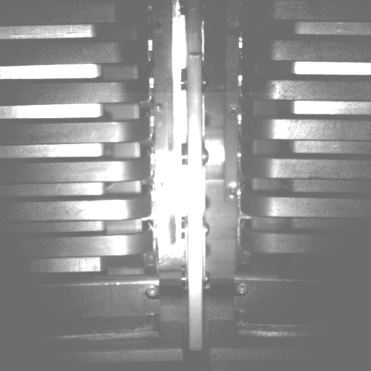
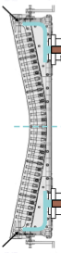
Using upgrade outage period to identify and implement improvements to FW antenna for NSTX-U
Utilizing RF test-stand previously used for TFTR
Arcing observed between straps near low-voltage point
  Resolved with additional grounding to vessel wall
  Being implemented on NSTX-U
Good agreement between measured and predicted antenna heating (see backup)
Face-on View of Two Antenna Straps
Poloidal Cut of Antenna Strap
Additional grounding implemented
Location of arc
11

Slide 12
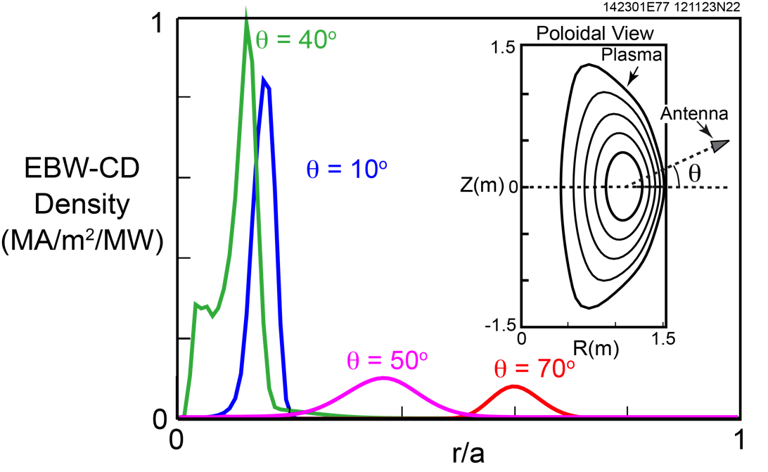
Modeling for EC/EBW heating and current drive performed for long-term NSTX-U goals
ECH simulations suggest favorable performance in start-up
  B_{T}(0) = 1 T CHI start-up plasma (F. Poli’s presentation)
  First-pass EC absorption rising to ~ 50% from initial < 5 %
  T_{e}(0) increasing from 10 eV to ~ 1 keV in < 30 ms
  73 kA NI CD with 80 kW of EBW power during MAST EBW startup experiment last year (V. Shevchenko, G. Taylor in collaboration)
EBWCD profiles
EBW modeling for NBI H-modes predicts CD efficiencies ≤ 40 kA/MW:
  100% NI plasmas
  Peak EBWCD density around 1 MA/m²/MW
[G. Taylor, et al., Proc. 18th Joint Workshop on ECE and ECRH, Nara, Japan (2014)]
12

Slide 13
Outline
Motivation for Fast Wave (FW) & (future) Electron Cyclotron (EC) and Electron Bernstein Wave (EBW) research
Progress during the past year
Research goals and plans for FY 2015 & 2016
Summary
13

Slide 14
FY2015 Goal: Assess antenna performance and characterize field-aligned FW losses in SOL
Assess performance of FW antenna in NBI H-mode B_{T}(0) ≤ 0.8 T discharges:
    Assess double-feed performance in both boronized and lithiated conditions
    Assess interactions of beam-ions with antenna limiters
      New dedicated IR camera will monitor antenna heat loads
Optimize FW heating by varying the position of the righthand cutoff for B_{T}(0) ≤ 0.8 T:
  Vary the toroidal field strength (expect higher heating efficiency)
  Modify edge density (gas puffing and Li conditioning)
  Vary antenna phasing
  Monitor SOL losses with wide-angle IR camera, dedicated Langmuir probe array, and poloidal bolometric array for SOL
14

Slide 15
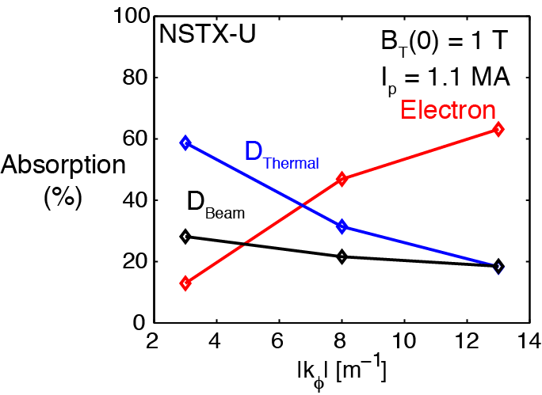
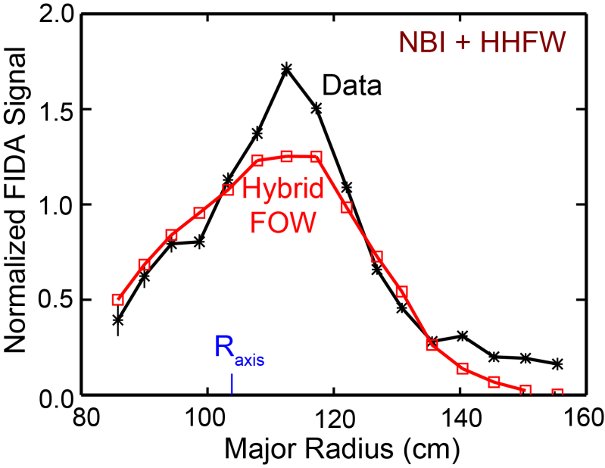
FY2015 Goal: Assess FW heating and current drive with NBI fast-ions in B_{T}(0) ≤ 0.8 T discharges
AORSA simulations predict greater deuterium heating when T_{i} > T_{e}
  Ion heating increases and electron heating decreases as k_{φ} decreases
  Results sensitive to T_{i}/T_{e} (= 2.5 in figure)
  Current drive is mostly bootstrap
Will vary the beam tangency radius, beam injection voltage, k_{φ} and T_{i}/T_{e} (varying density & heating source timing) in experiments
  Continue validation of CQL3D with fast ion diagnostic (FIDA) data
Current Drive
Phasing
  [N. Bertelli, AIP Conf. Proc. 1580, 310 (2014)]
[Collaboration with R. Harvey & CompX]
15

Slide 16
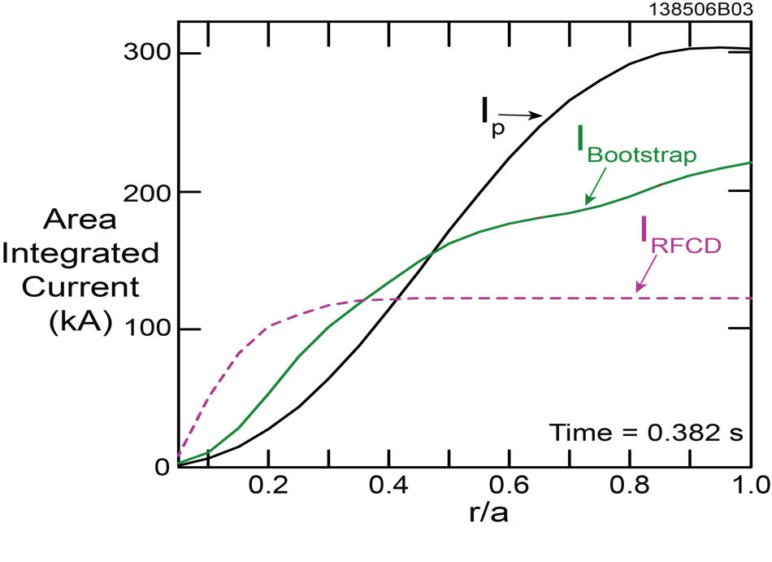
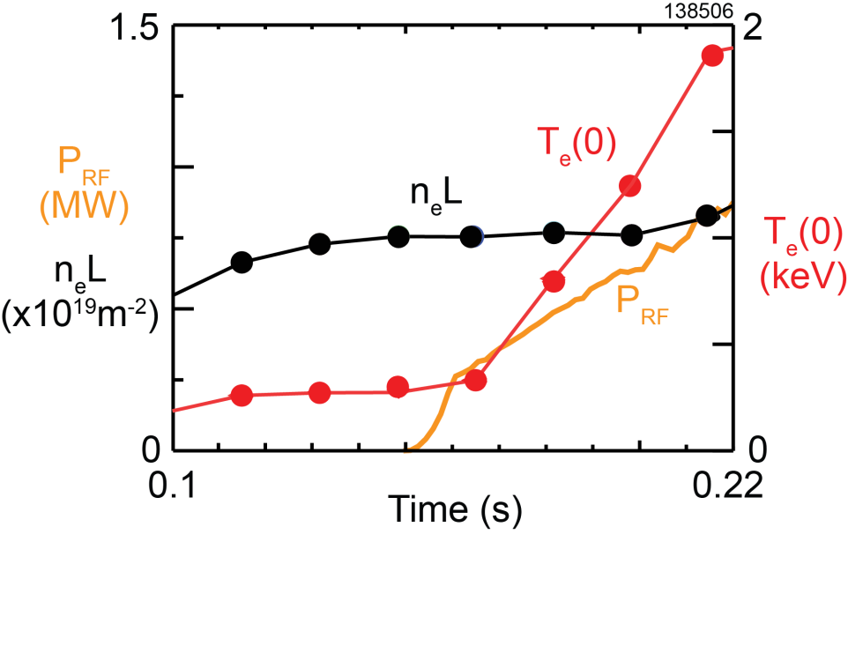
FY2015 Goal: Sustain fully NI I_{p} ~ 300 kA H-mode plasmas with only FW power
Previously generated >70% NI I_{p} = 300 kA H-mode
  Rapidly heated plasma to T_{e} ~ 3 keV
  P_{RF} ~ 1.4 MW; previously limited by antenna arcing
This goal will be aided by:
  Improved Li conditioning & high-voltage standoff of antenna
  Improved FW coupling (increased B_{T})
  new MSE-LIF q(r) diagnostic
    does not require heating beam
    available end of FY2015
[G. Taylor et al., Phys. Plasmas 19 (2012) 042501]
16

Slide 17
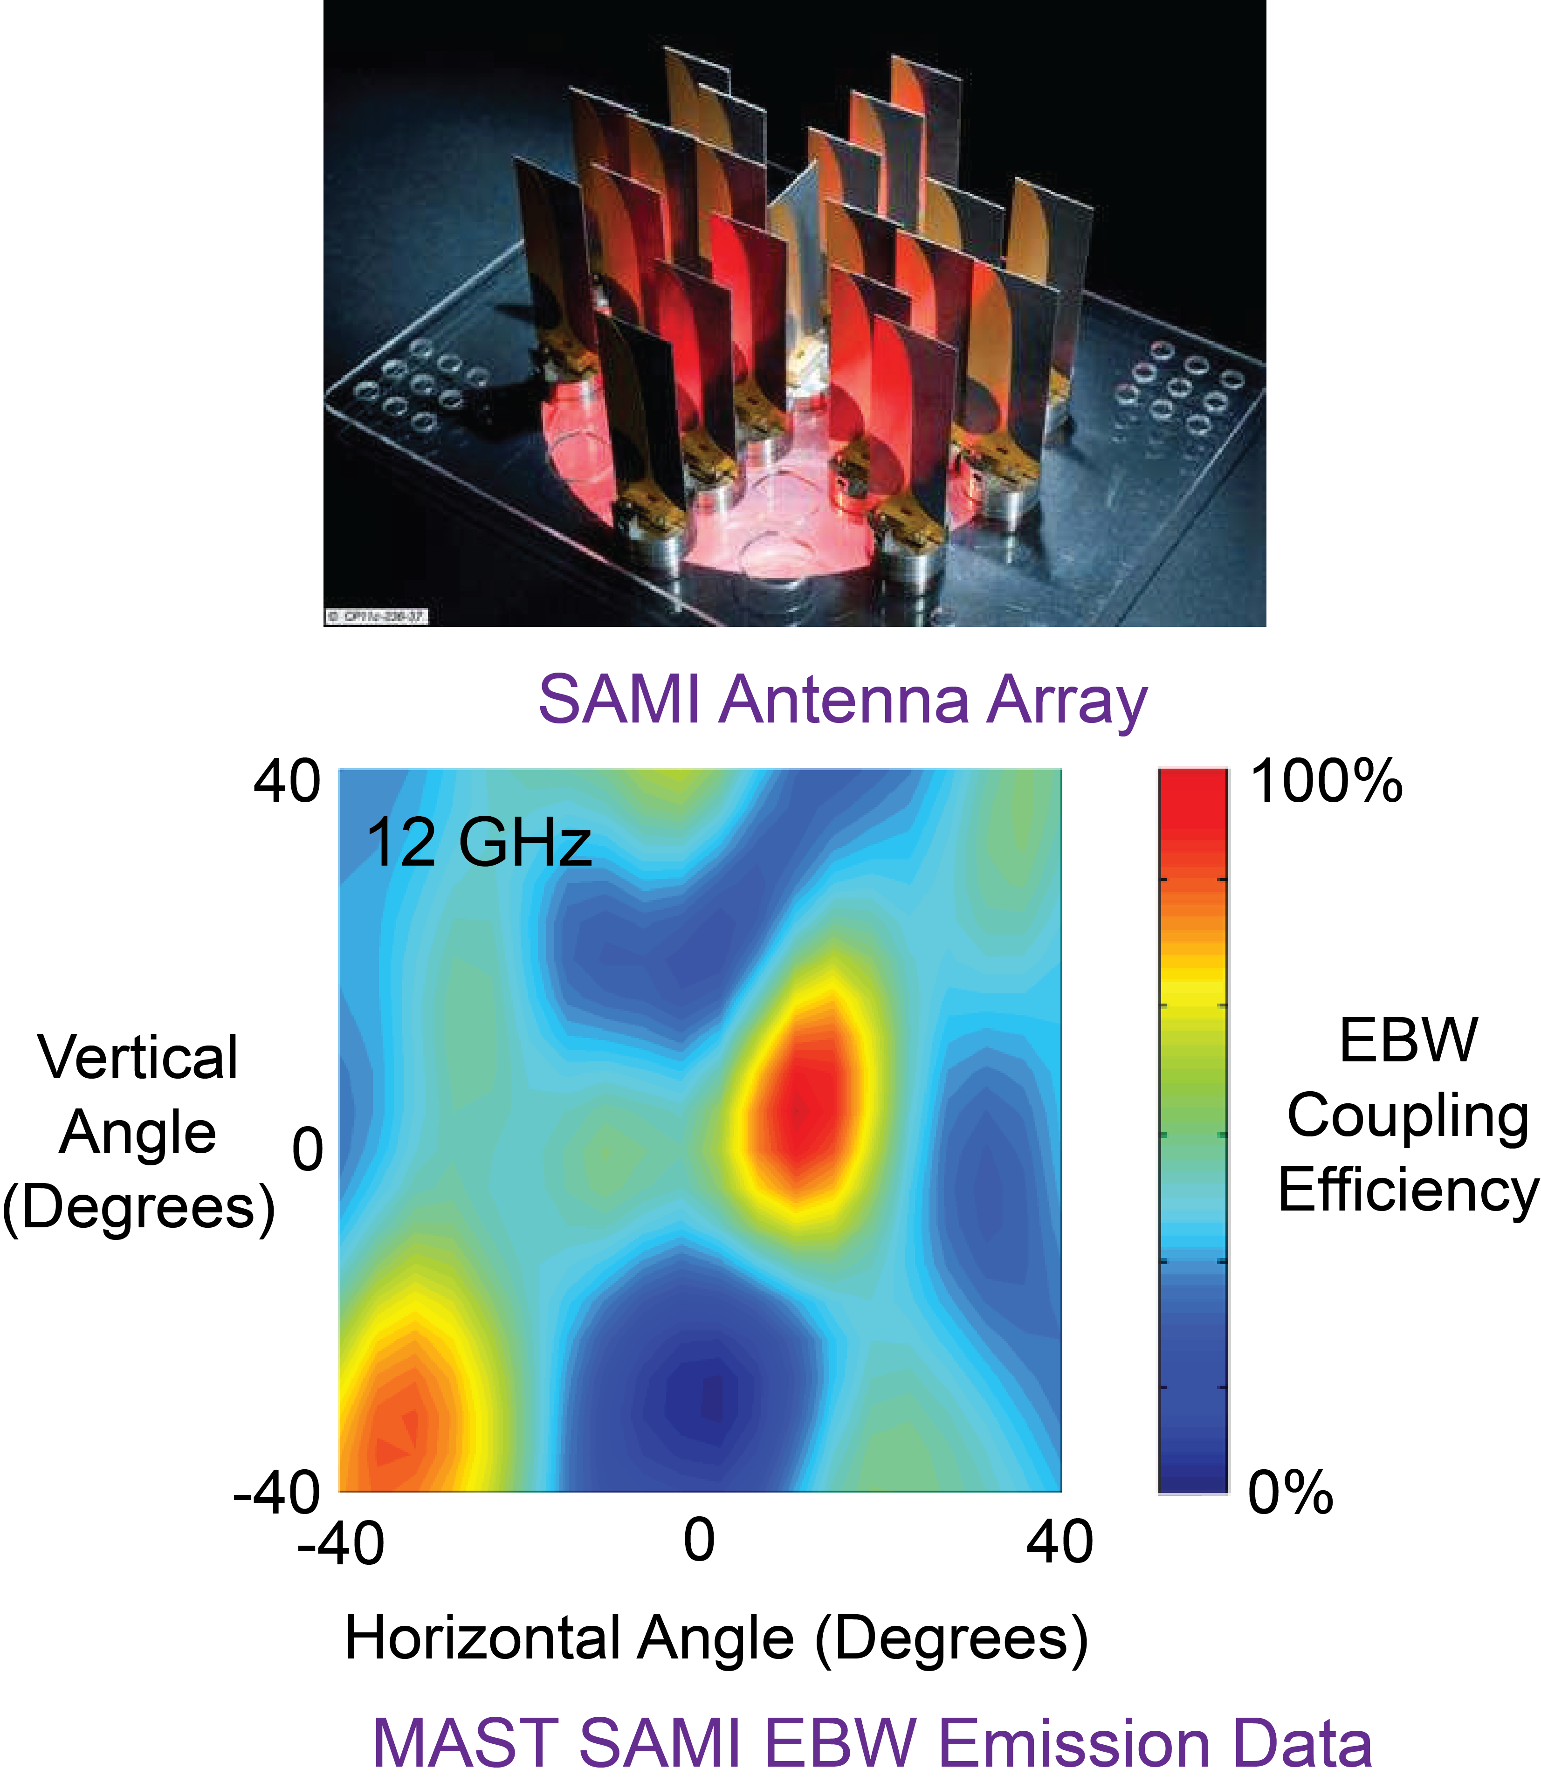
FY2015 Goal: Synthetic aperture microwave imaging (SAMI) diagnostic to image EBW emission
  Assess O-X-B coupling efficiency versus poloidal and toroidal angle
    Important for EBW heating design (mirror aiming)
    [Collaboration with University of York and CCFE]
  Image Doppler reflectometry to measure edge plasma flows
  Can observe density fluctuation on millisecond timescale
  Will measure magnetic pitch near edge region
17

Slide 18
Research goals and plans for FY2016
Optimize FW heating at highest field values B_{T}(0) ≤ 1.0 T
    Field-aligned SOL losses expected to diminish with increased field
    Study FW interaction with fast-ions at higher fields
Assess need for FW limiter upgrade that is compatible with higher P_{nbi} available on NSTX-U:
    If necessary, upgrade FW limiter during FY16-17 vacuum opening
Test impact of FW on NBI I_{p} ramp-up from 400 kA to ~ 1 MA
Demonstrate NI ramp-up of an FW-only H-mode to higher currents (~ 400 - 500 kA)
18

Slide 19
Summary: NSTX-U FW and EC/EBW research supports non-inductive start-up / ramp-up necessary for ST-based FNSF
Aim to deliver efficient and reliable coupling of 4 MW of FW power into low-current H-mode plasmas
    Establish whether combining FW and NBI is operationally viable
    Establish if upgraded FW limiter is needed to be compatible with NBI
Demonstrate that FW heating and CD can (with future ECH assist) bridge the gap between CHI start-up and NBI ramp-up
Establish physics design basis for 28 GHz heating system
and complete engineering design:
  Measure O-X-B coupling efficiency for a wide range of plasma scenarios to determine viability of EBW heating and CD
19

Slide 20
Backup Slides
20

Slide 21
Develop FW and EC heating for fully
NI discharges
Non-Inductive Strategy
I_{P} Target [kA]
~750
~500
~300
H-mode
Time
EC/EBW heating
(to 400 eV)
FW
(to 1 keV)
NBI and FW
Bootstrap current ramp-up
NBI and Bootstrap current sustainment
CHI
Plasma guns
Experiments in NSTX-U will initially develop NI start-up, ramp-up and plasma sustainment separately
Reduced RF edge losses and fast-ion interactions with the FW antenna
may yield improved RF coupling and heating efficiency
21

Slide 22
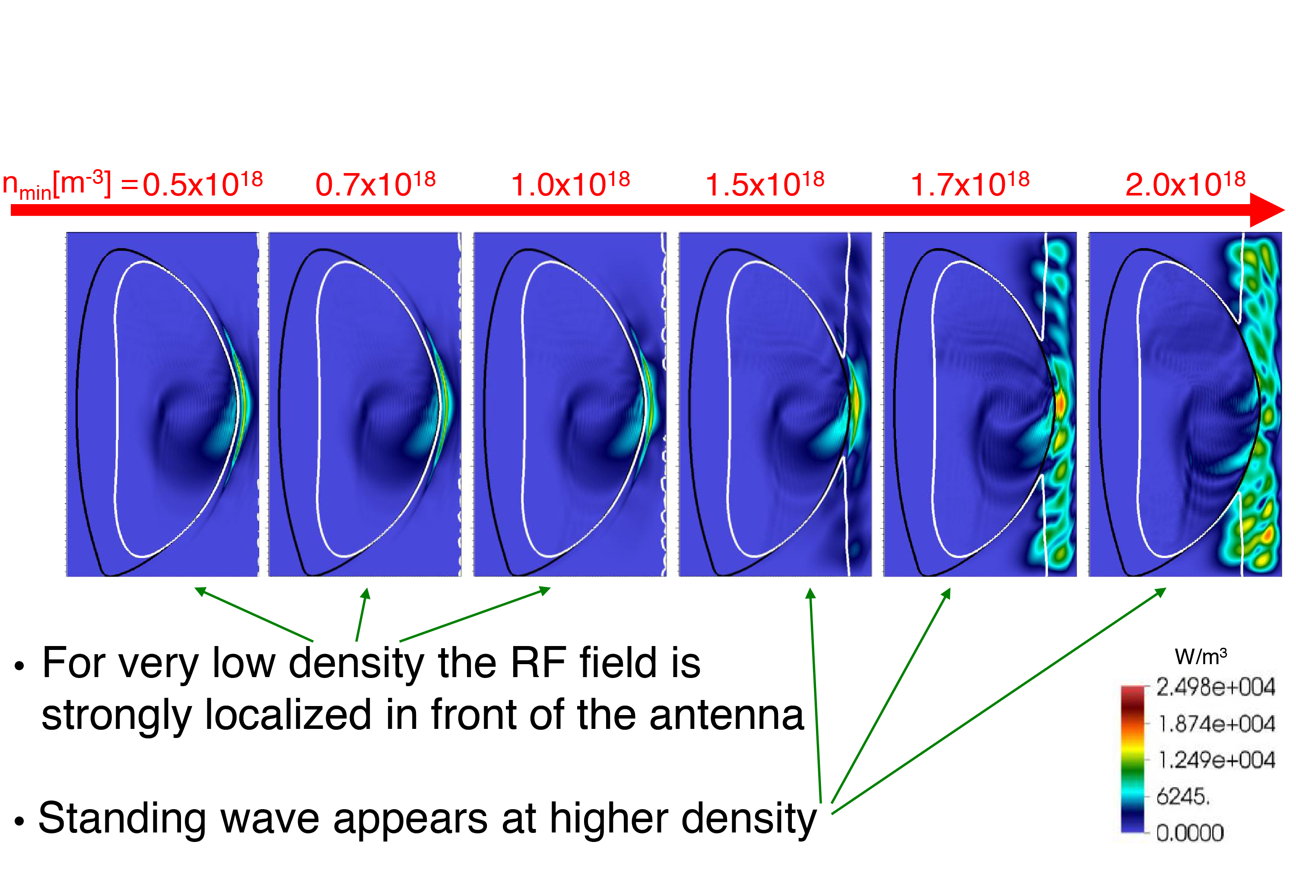
AORSA predicts RF field amplitude in SOL increases when FW cut-off is “open” in front of antenna
E_{tot} for n_{φ} = -21, Δφ = -150º (for NSTX Shot# 130608)
[N. Bertelli, et al., accepted for publication in Nuclear Fusion (June 2014)]
22

Slide 23
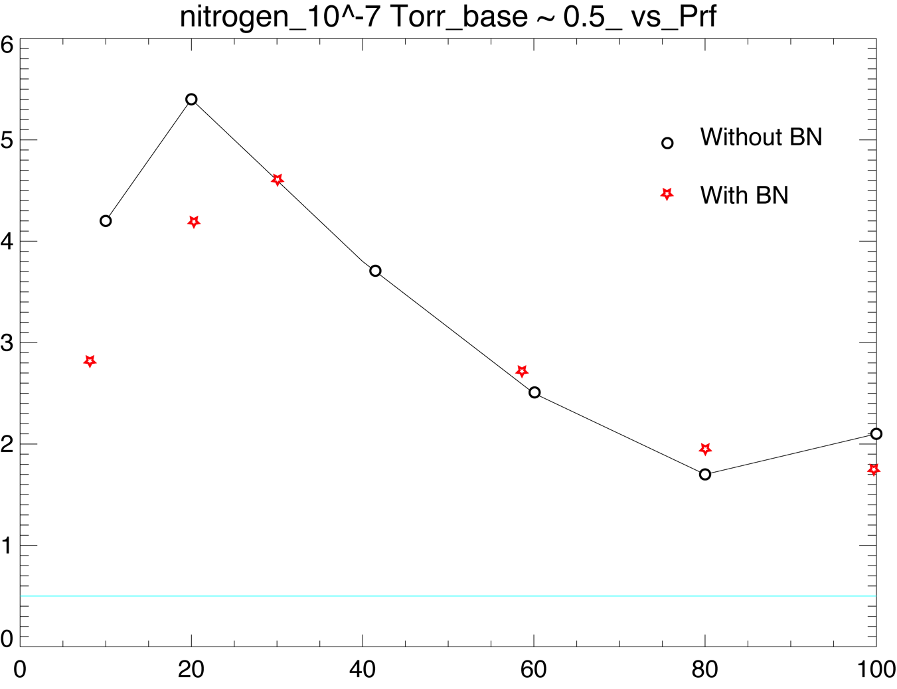
Total pressure rise in test stand as a function of applied RF power
Rise and fall in pressure with increased RF power suggests multipacting
BN stands of the boron nitride septum pieces, which could be removed from test stand
  Rise and fall is present both with and without boron nitride

Slide 24
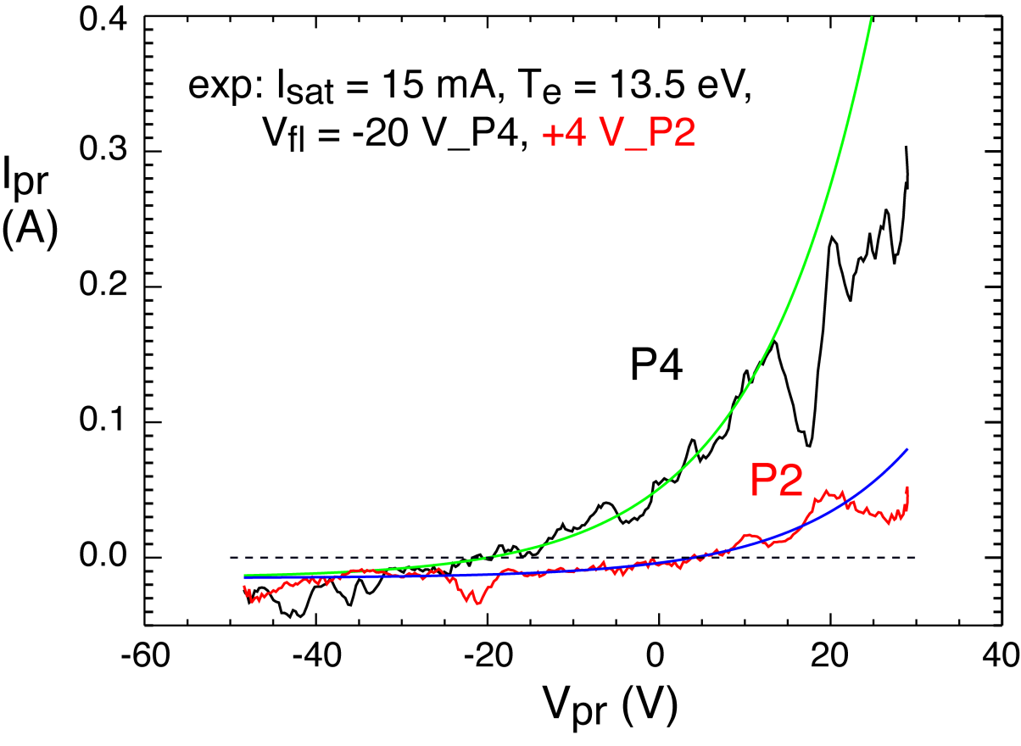
Probe analysis suggests RF rectification is an important contributor to FW losses in SOL
Heat flux to Langmuir probes is double for Probe 4 (under spiral) relative to Probe 2 (away from spiral)
  q_{P4} = 0.209 MW/m²
  q_{P2} = 0.103 MW/m²
Results obtained by:
  Negative shift in floating potential V_{f} for P4 to P2
  Gives RF voltage via the equation:
exp(ΔV_{f}/T_{e}) = I₀(V_{RF}/T_{e})
[A. Boschi and F. Magistrelli, Il Nuovo Cimento 29 (1963) 487.]
  Average γ over an RF cycle of amplitude V_{RF}
  Assumes same T_{e} and I_{sat} for both probes
= q_{surface}/(j⁺_{sat} *T_{e})
141899 - t = 0.451 sec
V_{RF} = 43.7 V
For T_{i} = T_{e}
γ_{P4} = 14.43
γ_{P2} = 7.12
Enhancement of heat flux probably larger at more intense portion of spiral
Coaxial Langmuir probes on NSTX-U will permit direct measurement of V_{RF}

Slide 25
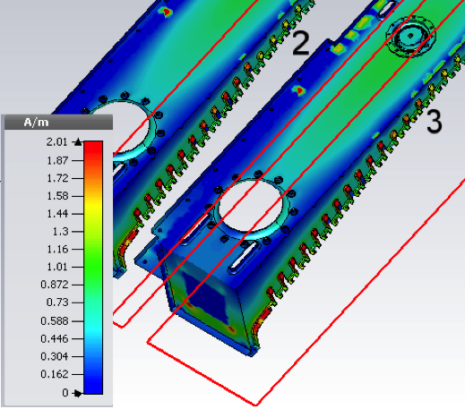
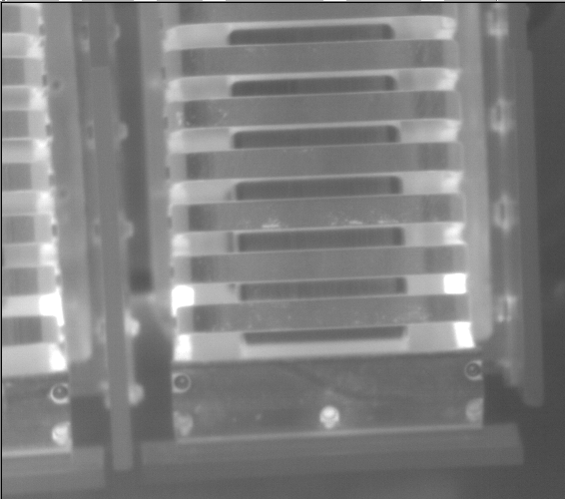
Return RF currents in antenna visualized with infrared camera and show agreement with simulations
Microwave Studio calculations of RF currents
IR camera image after RF pulse

Slide 26
RF research will also benefit from upgraded fast-ion, current profile and edge density diagnostics
Several diagnostics will provide information on fast-ion interactions with FW power in NSTX-U:
  Vertical and tangential FIDA systems will provide time (Δt ~ 10 ms), space (Δr ~ 5 cm) and energy (ΔE ~ 10 keV) measurements of the fast-ion distribution
  FIDA data will be complemented by an upgraded solid-state Neutral Particle Analyzer with 5 radial channels and ~ 1 MHz data rate
  Also there will be a new charged fusion product profile diagnostic and a scintillator-based lost fast-ion probe
New MSE diagnostic using laser-induced fluorescence will measure CD profile without needing high-power NBI blip:
  Important for CD measurements in FW-only H-modes
Upgraded 10-40 GHz refectometer and additional laser Thomson scattering channels will provide improved SOL density data
26

Slide 27
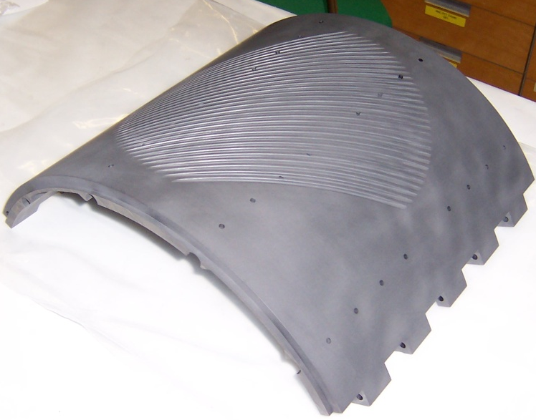
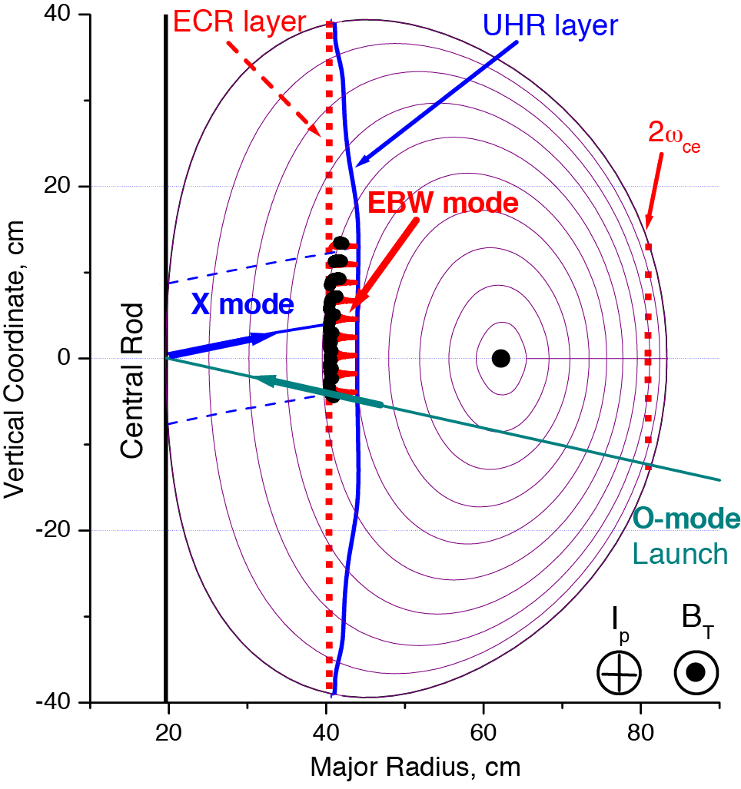
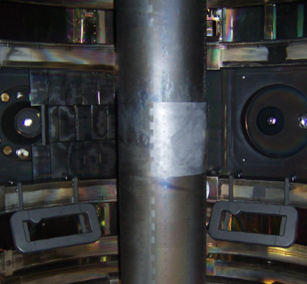
28 GHz EBW heating will be used for plasma start-up using a technique used successfully in MAST*
Grooved reflecting polarizer machined into center column in MAST
O-mode EC waves launched from low field side are weakly absorbed (< 2%) below the cut off electron density of ~ 1 x 10¹⁹ m⁻³
Grooved reflecting polarizer on the center column converts O-mode to X-Mode that then ~ 100% converts to EBWs
* V. F. Shevchenko et al. Nucl. Fusion 50 (2010) 022004
27

Slide 28
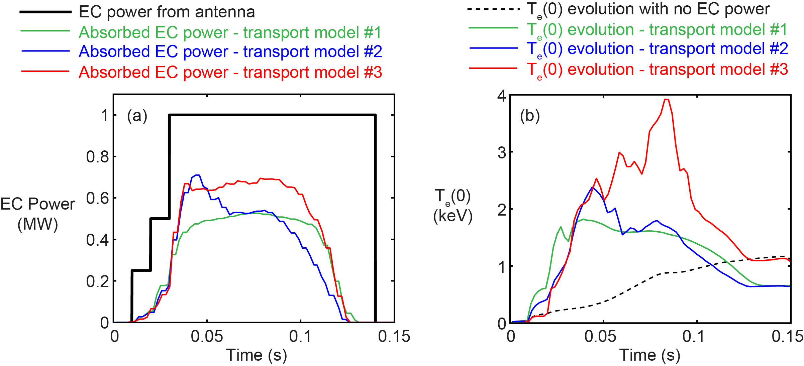
Simulations of EC heated NSTX-U start-up plasma predict rapid core electron heating
TRANSP-TORAY simulations of 28 GHz O-mode were recently run for a B_{T}(0) = 1 T start-up plasma :
  Various transport models were used resulting in variations in time evolution of the EC absorption and T_{e}(0)
  All cases had first-pass EC absorption reaching ~ 50% and T_{e}(0) increasing from 10 eV to > 1 keV within 30 ms
[G. Taylor, et al., Proc. 18th Joint Workshop on ECE and ECRH, Nara, Japan (2014)]
TRANSP-TORAY Simulation Results
    Model #1: Analytic n_{e}(r) that reproduce NSTX L-mode profiles.
    Model #2: n_{e}(r) from NSTX CHI discharge (shot #142140)
    Model #1 and #2: Analytic I_{p} waveform starting at 100 kA and ramping to 300 kA in 50 ms.
    Model #3: n_{e}(r) and I_{p} evolution from
    shot #142140
Plasma
Overdense
F. Poli
28

Slide 29
NSTX-U scenario used for computing FW power absorbed by ions and electrons
H-mode scenario planned for NSTX-U, obtained by TRANSP
simulations [S. P. Gerhardt, Nucl. Fusion 52, 083020 (2012)]
B(R₀) = 1 T, I_{p}= 1.1 MA, and P_{NBI} = 6.3 MW
n_{e}(0) = 1.1 x 10²⁰ m⁻³, T_{e}(0) = 1.22 keV, and T_{D}(0) = 2.86 keV
Density, temperature profiles used in the simulations:

Slide 30
Large ion absorption of FW power decreases as when T_{e} >= T_{i}
T_{e}(0) = 1.22 keV and T_{i}(0)/2 = 1.43 keV
2T_{e}(0) = 2.44 keV and T_{i}(0)/2 = 1.43 keV
Electron and ion absorption is
strongly sensitive to the ratio
T_{e}/T_{i}
Electron absorption increases
when T_{e}/T_{i} increases
Stronger effect for |k_{f}| ≥ 8 m⁻¹
|k_{φ}| ≥ 8 m⁻¹ favorable for
heating electrons
Thermal D and beam ions absorption decreases for T_{e} much larger than T_{i}
T_{e} > T_{i} in ramp-up phase

Slide 31
FY16 Milestone R16-3: Assess fast-wave SOL losses and core thermal and fast ion interactions at increased field and current
Use of high-harmonic fast wave (HHFW) injection for heating and current drive in NSTX-U is important to develop non-inductive start-up/ramp-up schemes, to achieve higher plasma performance, and to validate RF codes in support of the ITER FW program. The successful exploitation of HHFW depends on how much power can be coupled to the core plasma through the scrape-off layer (SOL) and how the coupled power is partitioned between different species in the core. For NSTX-U H-mode plasmas, the latter typically include thermal electrons/ions and fast ions from Neutral Beam (NB) injection. Mechanisms responsible for RF power losses in the SOL will first be addressed to optimize FW coupling to the core as a function of excited wave spectrum, toroidal field and plasma current (B_{T} and I_{P}). For instance, full-wave simulations with the AORSA code suggest a local enhancement of RF fields for propagating (rather than evanescent) fast waves in the SOL, which results in increased losses through damping. Losses are predicted to decrease at lower SOL density and/or at higher B_{T}. AORSA predictions will be tested against improved measurements of RF fields through dedicated probe arrays. The amount of lost power will be quantified through infrared cameras. The improved understanding of SOL loss mechanisms will provide more accurate estimations of the fraction of injected HHFW power reaching the core. The synergy between NB and FW injection in H-mode plasmas will be evaluated for the higher B_{T} and I_{P} of NSTX-U. In particular, the efficiency of thermal ions heating at higher B_{T}, predicted to increase by full-wave simulations, will be investigated. Similarly, modifications of the fast ion distribution, previously observed on NSTX, will be assessed with the enhanced fast ion diagnostics set of NSTX-U as a function of plasma parameters, FW spectrum and NB injection geometry, including the new (more tangential) NB lines. The characterization of scenarios with combined NB and FW injection will provide a valuable dataset to benchmark RF codes (e.g. AORSA, TORIC and CQL3D-FOW), which have been considerably improved in the past years. NSTX-U will provide the required data for extensive validation before their use for scenario predictions in future devices such as ITER and FNSF.
31

Slide 32
FY14-18 Wave heating and current drive research timeline
(assuming baseline funding)
FY13
14
15
16
17
18
Upgrade Outage
5 year plan period
5 year goal
5 year plan period
Physics
Assess performance of
12-strap double-feed FW antenna and compatibility with NBI H-modes at higher B_{T}
Complete simulation of FW heating during I_{p} ramp-up and flat top
Assess effect of cryo-pumping and 3-D fields on FW antenna performance
Simulate/mockup reduced- strap FW antenna performance
Supporting HHFW Research for Thrusts
Measure and mitigate RF power flows in the SOL and to the divertors in the H-mode regime
Study FW interaction with NBI fast-ions
Generate 100% NI
I_{p} ~ 500 kA FW
H-mode using inductively generated target
Assess FW electron heating during NBI NI current ramp-up
28 GHz EBW
start-up
Complete simulation of 28GHz EC/EBW heating during I_{p} ramp-up and flat top
Develop plasma scenarios with fully non-inductive ramp-up and H-mode sustainment that utilize RF heating and current drive, and determine the validity of advanced RF codes.
Thrust 1
28 GHz EC heated CHI start-up
300 kA to 500 kA
NI ramp-up with FW
Test O-X-B heating with "fixed" horn
Measure B-X-O coupling
Upgrade advanced RF codes to include SOL, realistic antenna, and accurate fast-ion modeling
Validate advanced RF codes that include SOL, realistic antenna geometry, accurate modeling of fast-ion interaction and effect of edge fluctuations by comparing to NSTX-U data
Use advanced RF codes to predict RF performance in FNSF and ITER
Thrust 2

Slide 33
FY14-18 upgrades that support wave heating and current drive research (assuming baseline funding)
FY13
14
15
16
17
18
Upgrade Outage
5 year plan period
5 year plan period
Tools
Diagnostics for measuring HHFW and EBW power deposition and current drive (eg. Upgraded MPTS, ME-SXR, MSE-LIF, MSE-CIF)
Fast IR for RF power SOL power losses
10-40 GHz edge reflectometer for SOL measurements in front of antenna
Diagnostics
RF magnetic and Langmuir probes to measure RF power flow to divertor
Tangential FIDA and upgraded ssNPA for measuring RF acceleration of NBI ions
SAMI - microwave imaging diagnostic
AORSA 3D high-resolution SOL
Add high-fidelity realistic antenna geometry to AORSA-3D
GENRAY with SOL edge fluctuations and wave scattering for RF coupling
Theory
Full finite-orbit-width CQL3D and AORSA/ORBIT-RF for simulation of RF acceleration of NBI ions
TORIC with SOL and SPIRAL modeling of RF power loss to divertor
Include RF operator in NUBEAM
Use RF operator in NUBEAM to accurately model fast-ion absorption
Facility
Compliant HHFW feedthroughs
1 MW 28 GHz EC/EBW heating system with fixed horn antenna
Test FW straps to excite EHO

