Slide 1




NSTX-U
Supported by
Progress and Plans for
Solenoid-free Plasma Start-up and Ramp-up
Coll of Wm & Mary
Columbia U
CompX
General Atomics
FIU
INL
Johns Hopkins U
LANL
LLNL
Lodestar
MIT
Lehigh U
Nova Photonics
Old Dominion
ORNL
PPPL
Princeton U
Purdue U
SNL
Think Tank, Inc.
UC Davis
UC Irvine
UCLA
UCSD
U Colorado
U Illinois
U Maryland
U Rochester
U Tennessee
U Tulsa
U Washington
U Wisconsin
X Science LLC
R. Raman
D. Mueller, S.C. Jardin
and the NSTX-U Research Team
Culham Sci Ctr
York U
Chubu U
Fukui U
Hiroshima U
Hyogo U
Kyoto U
Kyushu U
Kyushu Tokai U
NIFS
Niigata U
U Tokyo
JAEA
Inst for Nucl Res, Kiev
Ioffe Inst
TRINITI
Chonbuk Natl U
NFRI
KAIST
POSTECH
Seoul Natl U
ASIPP
CIEMAT
FOM Inst DIFFER
ENEA, Frascati
CEA, Cadarache
IPP, Jülich
IPP, Garching
ASCR, Czech Rep
NSTX-U PAC-35 Meeting
PPPL – B318
June 11-13, 2014

Slide 2
Outline
Introduction
Progress in the last year – in preparation for upcoming run
  NIMROD & TSC Simulations
  Progress with CHI on QUEST
Solenoid-free Start-up & Ramp-up (SFSU) research goals and plans for FY15 & 16
Key results expected by the end of the FY16 run
  Impact on further NSTX-U operation and future devices

Slide 3
Goal: Develop and understand non-inductive start-up/ramp-up to project to ST-FNSF operation with small or no solenoid
Aligned with FES program vision for FNSF requirements
  Enabling access to low aspect ratio for nuclear applications
  Simplify the tokamak concept to reduce cost
High level NSTX-U goals:
  Demonstrate and understand solenoid-free current start-up
  Ramp-up the solenoid-less seed current non-inductively using RF and NBI
Solenoid-free Start-up & Ramp-up 5YR objectives:
  FY15-16: Establish high current CHI target that is suitable for non-inductive current ramp-up
  FY15-16: Test Ramp-up of a 300-600kA inductively generated plasma using RF and NBI
  FY17-18: Integrate non-inductive start-up to ramp-up. Test Ramp-up of ECH-heated CHI generated plasma with RF and NBI

Slide 4
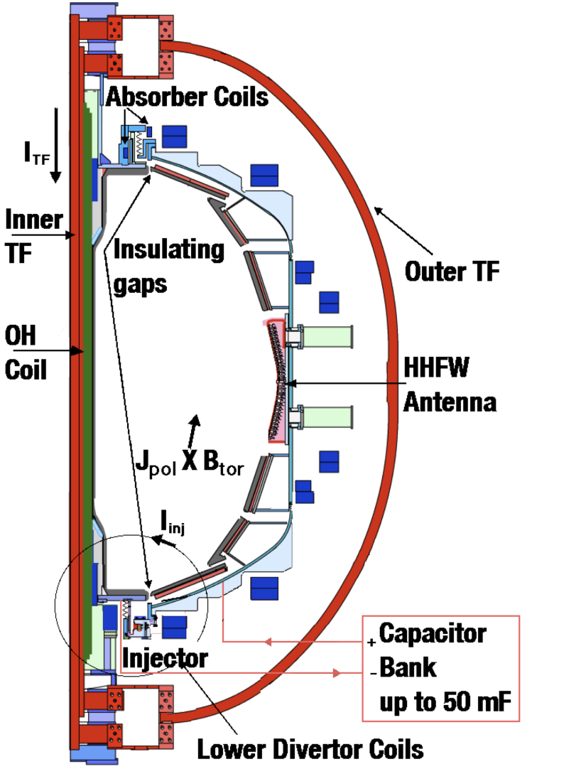

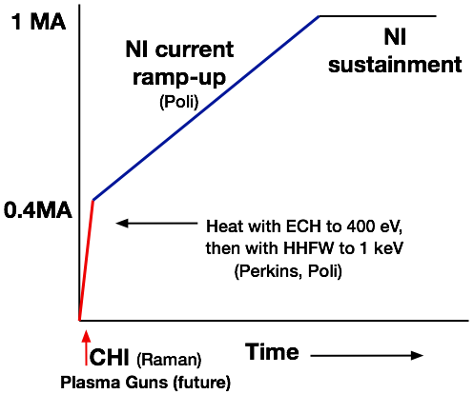
CHI is planned to be used as initial current seed for subsequent non-inductive current ramp-up in NSTX-U
CHI in NSTX/NSTX-U
NSTX-U Start-up and
Ramp-up strategy
Off-axis non-inductive current drive to be studied on DIII-D as part of DIII-D 2014 National Campaign (Mueller, Menard, Holcomb, et al.,)

Slide 5
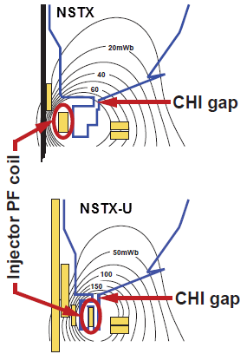
CHI start-up to ~0.4MA is projected for NSTX-U, and projects to ~20% start-up current in next-step STs
Parameters | NSTX | NSTX-U | ST-FNSF
Major radius [m] | 0.86 | 0.93 | 1.2
Minor radius [m] | 0.66 | 0.62 | 0.80
B_{T} [T] | 0.55 | 1.0 | 2.2
Toroidal flux [Wb] | 2.5 | 3.9 | 15.8
Sustained I_{p} [MA] | 1 | 2 | 10
Injector flux (Wb) | 0.047 | 0.1 | 0.66
Projected Start-up I_{p} (MA) | 0.2 | 0.4 | 2.0
New Tools for CHI
  > 2.5 x Injector Flux (proportional to I_{p} )
  TF = 1 T (increases current multiplication)
  ECH (increases T_{e})
  > 2kV CHI voltage (increases flux injection)
  Full Li coverage (reduces low-Z imp.)
  Metal divertor, Cryo pump (increases T_{e})
Injector flux in NSTX-U is ~ 2.5 times higher than in NSTX → supports increased CHI current

Slide 6
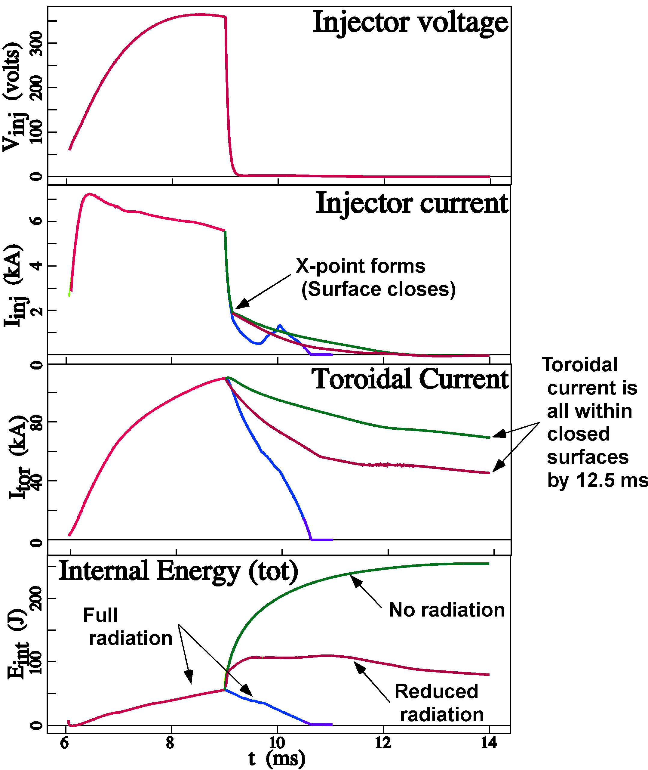
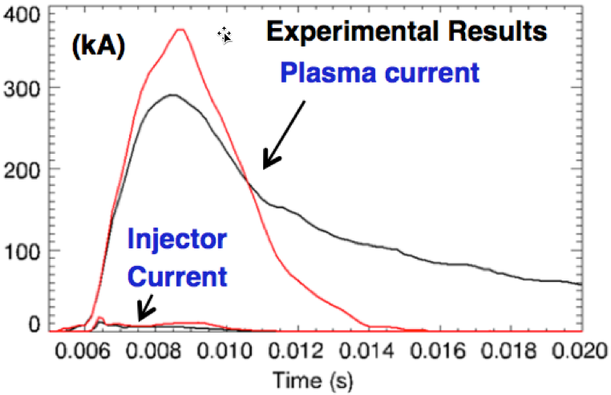
Pursuing direct simulation of experiment and basic physics understanding of CHI trends using NIMROD (3 Publications)
Recent Modeling – Plasma injection with Impurity radiation
Helicity and plasma injection at the bottom slot into a low-density background generates flux bubble
An X-point forms near the bottom of NSTX as the injection voltage drops → forming closed magnetic surfaces
Impurity radiation –– required to match experimental temperatures → fast current decay after injection ends
–– Rapid removal of impurities following injection improves target-plasma quality and duration.
–– Note plasma heating in “No radiation” and “Reduced radiation” models
Simulations by B. Hooper (LLNL) with support from C. Sovinec (U-Wisconsin)
E.B. Hooper et al., PoP (2013)

Slide 7
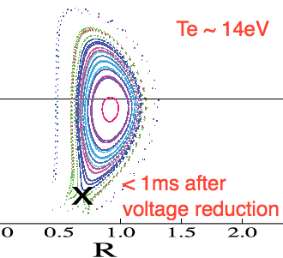
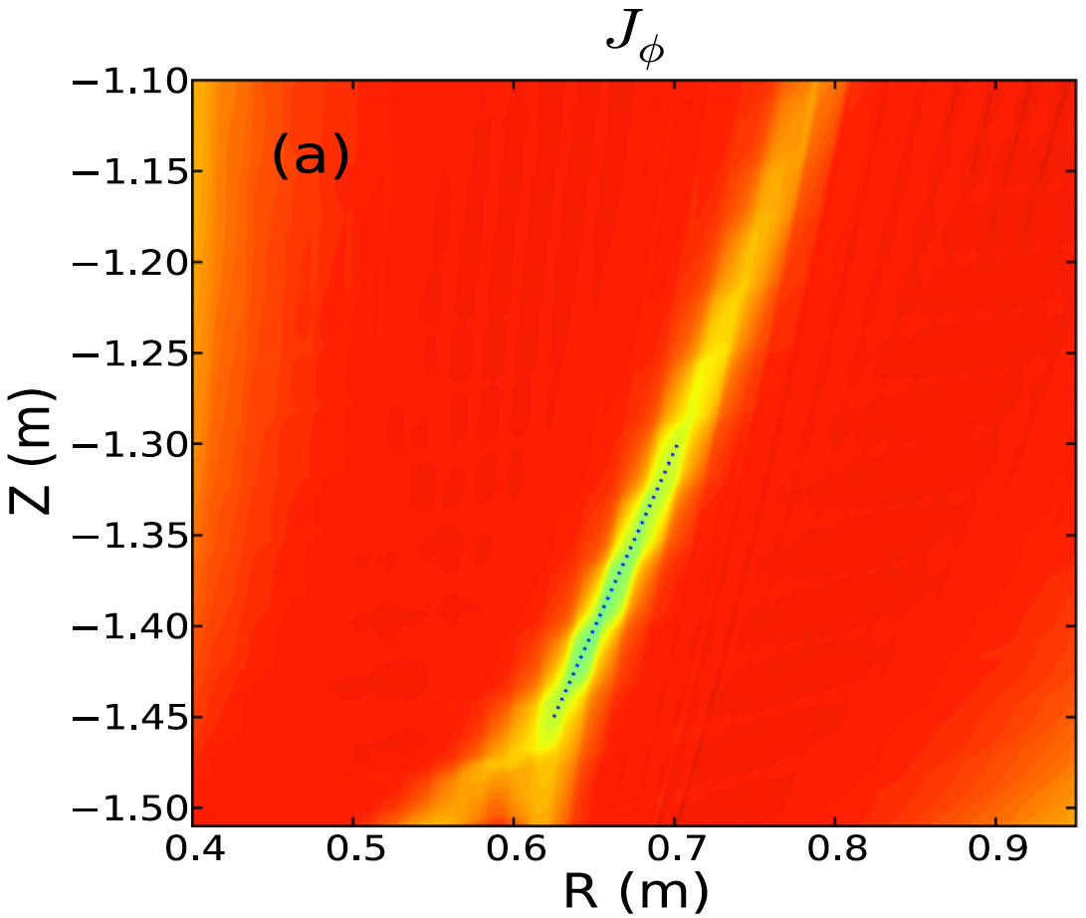
NIMROD simulations suggest Transient CHI has resemblance to 2D Sweet Parker-type reconnection
With reduction of injector voltage & current a toroidal E-field is generated in the injector region
  E_{toroidal} X B_{poloidal} drift brings oppositely directed field lines closer and cause reconnection generating closed flux
Direction of plasma flows
In Injector Region only
Elongated Sweet-Parker-type current sheet forms in injector region
Higher-n modes/MHD not impacting 2D reconnection
Current
sheet
F. Ebrahimi, et al., PoP (2013)
F. Ebrahimi, et al., PoP (2014)

Slide 8
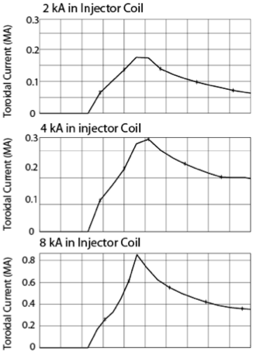
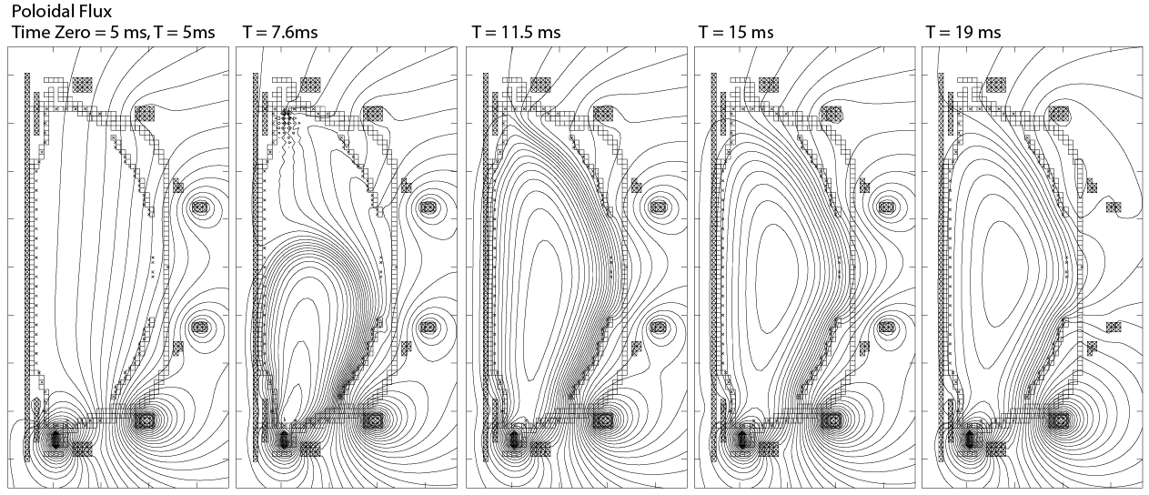

TSC simulations being used to guide choice of NSTX-U coil currents for initial CHI operation
Initial Transient CHI discharges will start with increasing levels of current in the PF1C injector coil
CHI discharge will be grown into magnetic well that is suitable for the final equilibrium
PF1CU (absorber coil) coil current will be pre-programmed to provide a buffer flux
PF1AL and PF2L, PF3L coil currents may be adjusted in time, as needed, to reduce injector current requirements
CHI generated toroidal current increases approximately linearly with injector flux as expected
NSTX-U Vessel Geometry, 100 eV

Slide 9
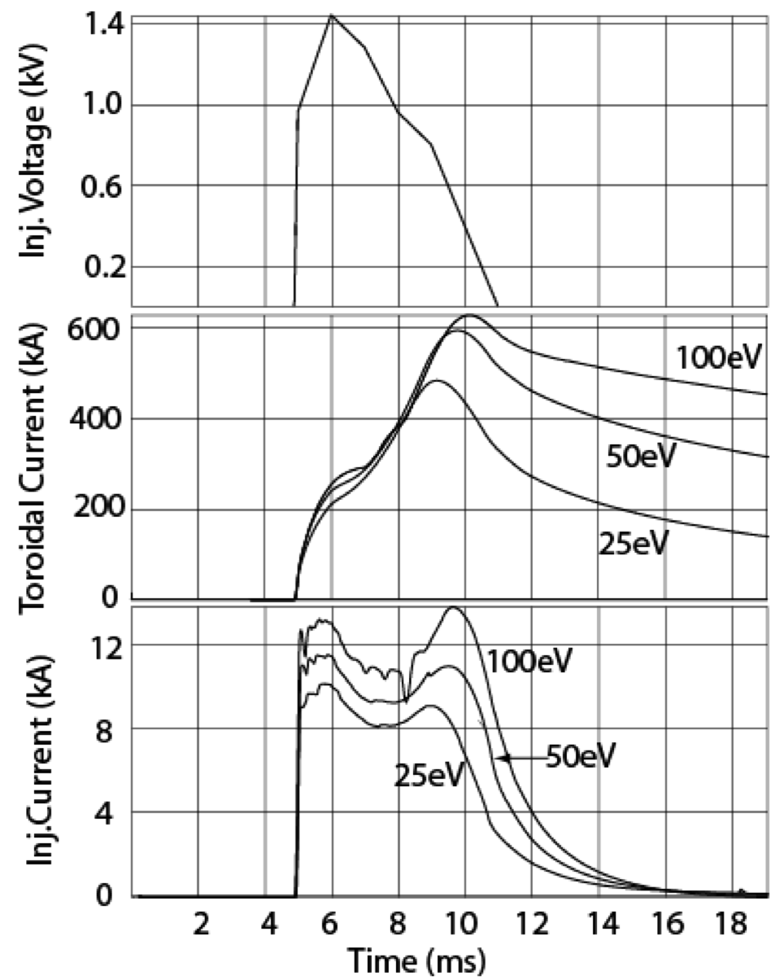
Helicity injected plasmas (CHI & Gun Start-up) can significantly benefit from ECH heating
Increased T_{e} predicted to significantly reduce current decay rate due to resistive dissipation
  ECH heated plasma can be further heated with HHFW
  Maximum HHFW power < 4MW, higher B_{T} in NSTX-U would improve coupling
  HHFW has demonstrated heating a 300 kA / 300 eV plasma to > 1 keV in 20ms
TSC simulations

Slide 10
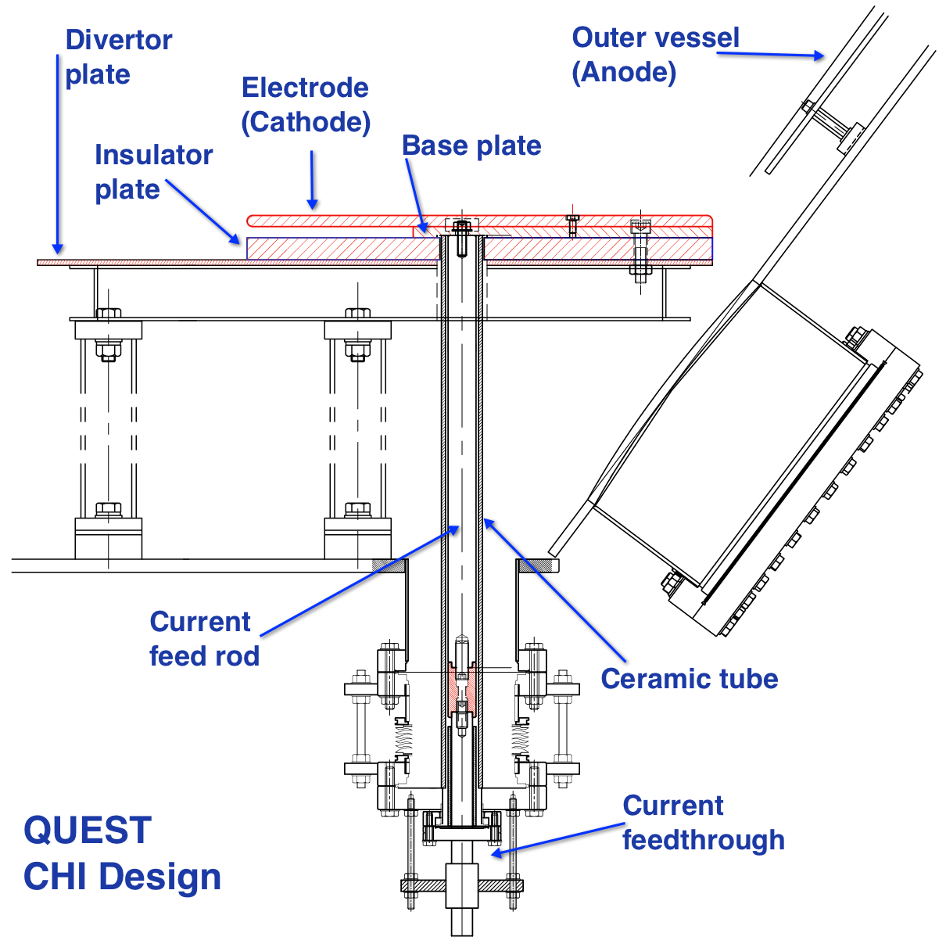
New CHI Electrode Design to be Tested on QUEST
(Collaboration with Japan)
Provides early test of ECH heating of CHI plasma for NSTX-U/FNSF
CHI design completed (March 2014)
  CHI installation later during 2014
Electrode mounted on top of divertor plate
Electrode-based CHI may be applicable to FNSF
US Contribution to project
  Primary insulators
  Capacitor bank power supplies
  Gas injection systems

Slide 11
SFSU Research Plans for FY2015
Transient CHI Start-up
  Using PF1C as the primary coil, establish current targets approaching 200kA and compare scaling with NSTX results
  Study improvements to CHI plasma T_{e} in discharges with higher poloidal flux with more complete Li coatings
Assess inductive flux savings and compare to NSTX results
Assess NBI coupling + current drive efficiency in 300-400kA flat-top current inductive plasmas (supports TRANSP validation activities – Poli)

Slide 12
SFSU Research Plans for FY2016
Transient CHI Start-up
  Study improvements to CHI plasma T_{e} in discharges with higher poloidal flux with Li coating of the upper divertor
  Develop targets approaching 400kA for FY17 and FY18 ramp-up experiments (will need ECH + higher CHI voltage during FY17)
Generate discharges with partial solenoid pre-charge
  Ramp-up CHI discharge while reducing solenoid current to zero
Test NB coupling to CHI targets with small inductive drive
  Understand importance of current profile on NB coupling
Obtain full non-inductive current drive in flat-top phase with ohmic seeding, then clamp OH coil current to constant value progressively earlier in time (in support of TRANSP validation)

Slide 13
SFSU expected results by end of FY2016 run
Understand Transient CHI current generation potential in NSTX-U
  T_{e} dependence on injected poloidal flux
  Effect of more complete Li coatings on radiation and achievable T_{e}
  CHI Voltage limits and requirements in preparation for FY17 and FY18
  Improved modeling with 3D NIMROD and 2D TSC of NSTX-U CHI discharges
  Understand performance of CHI in new configuration on QUEST in support of ST-FNSF
Understand coupling of NBI to low current inductively generated targets
  In plasmas with varying parameters (T_{e} and n_{e} and profiles)
  Determine NI current ramp-up rates that do not lead to MHD
  Lowest plasma current below which NB CD & Bootstrap current overdrive is not possible (may not cover all possibilities due to Run Time limitations)

Slide 14
Summary: FY15-16 Start-up & Ramp-up Research will Develop Capabilities for Eventual Full NI Ops. On NSTX-U
Transient Coaxial Helicity Injection will develop capabilities for solenoid-free plasma start-up for the ST
  Initial goal is to develop targets approaching 400kA targets in support of FY17-18 goals
  Numerical simulations will/are supporting experiments
  New CHI electrode design in support of ST-FNSF to be tested on QUEST
  Localized Helicity Injection to be tested on NSTX-U, when technically ready (FY17 or later)
NB Coupling in low current inductively generated discharges will be studied to apply this capability to CHI targets during FY17-18

Slide 15
Back-up Slides

Slide 16
CHI Research plans in preparation for NSTX-U operations in FY2015
Initial NSTX-U Hardware Configuration for Transient CHI Start-up identified
  Developed initial start-up scenarios for NSTX-U for FY15 Expts.
MOV rating will be increased from 1.65kV to 2kV
  NSTX-U Engineering will implement this capability in the near future
Starting work on energizing CHI cap bank for tests into dummy load
  FY2015 and 2016 experiments will use existing capacitor bank

Slide 17
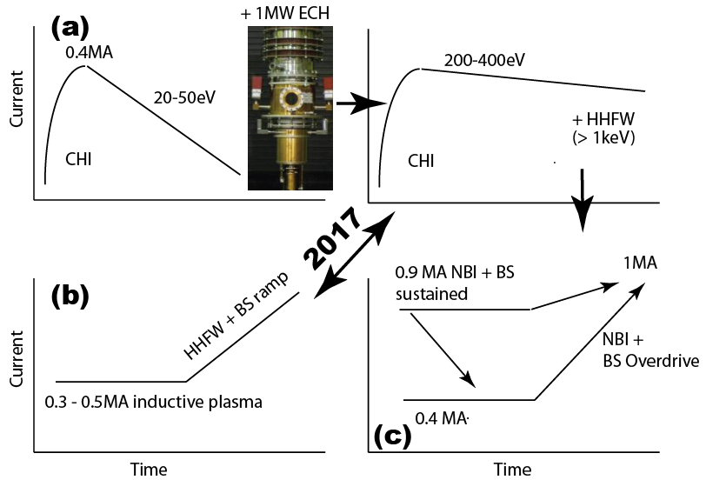
Start-up and Ramp-up Research Involves Three Parallel Paths that Will be Linked as Technical Capabilities Permit
(a) Generate and increase current produced by CHI
  Heat with ECH (to 200-400eV)
  Then heat with HHFW (to > 1keV)
  Then ramp-up current using NBI and BS current overdrive
(b) Current ramp-up of intermediate I_{p} plasmas (Wave particle TSG)
  Progressively increase initial current (from 0.3 to 0.5MA) and ramp-up using HHFW and BS current overdrive
  Assist extension of NBI CD to lower I_{p}
(c) Current ramp-up at near full I_{p} with NBI and bootstrap current overdrive
  Progressively reduce initial current from 0.9 to 0.4MA and non-inductively ramp-up current to 1MA using NBI and BS current overdrive

Slide 18
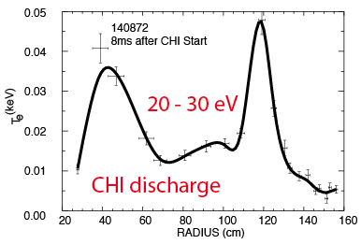
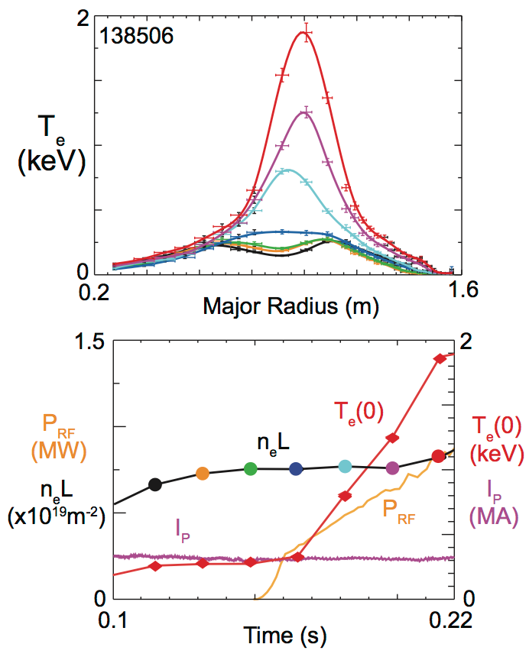
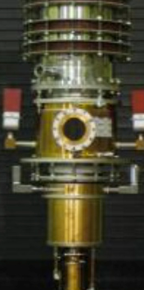
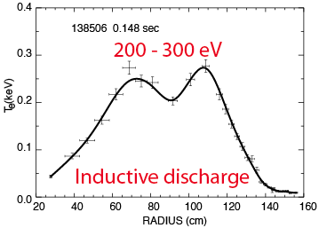
Bridge Electron Temperature Gap Between CHI Start-up and Current Ramp-up Requirements with ECH Heating
1MW
ECH
1-2 MW
HHFW
T_{e} = 1 keV
300eV
20ms
G. Taylor, et al.,
Phys. Plasmas 19 (2012) 022004

Slide 19
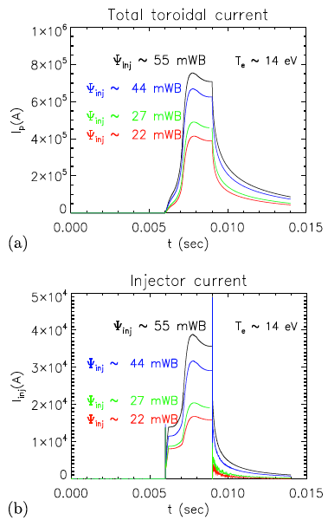
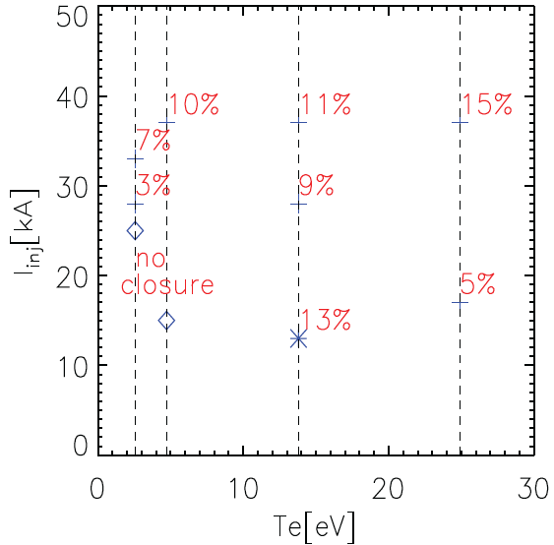
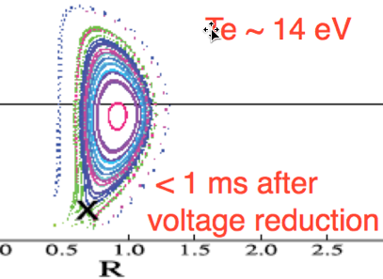
NIMROD simulations show approximate consistency with scaling relations used for CHI design on NSTX and NSTX-U
CHI produced current increases with Injector Flux
Injector current increases with injector flux
Closed flux fraction increases with narrowness of flux foot print width
Closed flux fraction increase with faster reduction of injector current to zero
Lower limit on Te below which closed flux does not for
  - Closed flux fraction increases with Te
NSTX vessel geometry
F. Ebrahimi, et al., PoP (2014)

