Slide 1
Questions from PAC-35 – Day 1
What is "administrative limit" for total energy input into NSTX-U?
Please provide a chart versus time showing the tasks and required device/diagnostic capabilities for the first year, including requirements for the conditioning strategy. (Alternative: please describe the process required to develop such a chart.)
Please briefly summarize the university collaborations that are currently underway on the NSTX-U project, including a short descriptor of the nature of the research and the people involved, i.e., number of PhD-track students, postdocs, research staff.
Please briefly summarize the areas of theoretical research that are *not* included in the NSTX-Theory Partnership, especially those areas that might have been terminated as a result of the Partnership

Slide 2
Response to Question 1 - Executive Summary
(What is "administrative limit" for total energy input into NSTX-U?)
Beams have energy limits. For six sources:
  80 kV -> 5 sec, 1.7 MW/source, 6 sources -> 51 MJ
  95 kV -> 2 sec, 2.5 MW/source, 6 sources -> 30 MJ
  Limits handled by numerous timing systems at the source control consoles
Vessel is ultimately qualified for 70 MJ total (14 MW x 5 seconds).
  Assumes cooling water flowing on both inner and outer vessel, and that the inner horizontal target is limited to 5 MW/m².
Cooling H₂0 on casing behind inner horizontal target implemented from Day 0.
Beam armor has dual interlocks on the plasma current.
  Armor designed to take full power without failing
    Designed for [10.3 MW, 5 sec] or [15 MW, 1 sec]
    CFCs, ATJ, Poco
NSTX achieved: 600 second cycle with 8 MJ, no active vessel cooling
NSTX-U will run on 15-20 minute cycle initially
  Administrative limit on the pulse length in the commissioning phase will easily keep us in the envelope demonstrated on NSTX.
  Monitor IR camera data and TCs post-shot.
We do not have plans to interlock the discharge against TC or IR TV measurements during the first campaign.
We have active plans, in many TSGs, to address peak heat flux mitigation.
See backup for more details

Slide 3
Response to Question #2 - Highest Level Schedule
2014
2015
Aug.
Sept
Oct
Nov
Dec.
Jan.
Feb.
Mar.
Apr.
May
June
July
Aug
Sept.
Upgrade Construction
CD-4
Bake
Comm.
Research Operations

Slide 4
Implementation Schedule for Diagnostics
2014
2015
Aug.
Sept
Oct
Nov
Dec.
Jan.
Feb.
Mar.
Apr.
May
June
July
Aug
Sept.
Upgrade Construction
CD-4
Bake
Comm.
Research Operations
Most Basic Magnetics
Plasma TV
General In-Vessel Diagnostic Work
MPTS Rayleigh/Raman Scattering
Neutron Calibrations
Envelope of Experiments Grows as Diagnostic Systems Become Available
Complete magnetics for equilibrium reconstruction (…and EFIT!)
Fast Mirnovs & mode spectrograms
MPTS
Neturon Detectors
Filter scopes
This will allow a good TRANSP run!
We can do important experiments!
New
Modified
Unchanged
IR TV
RWM sensors (locked modes…)
Visible, EUV, SXR spectroscopy
Toroidal CHERS
MSE-CIF
Bolometry
Many other diagnostics will be commissioned during this phase as well…
MPTS = Multi-Pulse Thomson Scattering

Slide 5
Implementation Schedule for Conditioning/Fuelling Techniques
2014
2015
Aug.
Sept
Oct
Nov
Dec.
Jan.
Feb.
Mar.
Apr.
May
June
July
Aug
Sept.
Upgrade Construction
CD-4
Bake
Comm.
Research Operations
Glow Discharge System
Resistive Bake of the CS
Hot Helium Bake of the Outer Vessel and C PFCs (+ resistive bake of the CS)
Granule Injector for Dedicated XPs
FIReTIP realtime interferometry
ELM Pacing with 3D fields
Boronization (and are starting to work on it now.)
Lithium Evaporators for Research + General Conditioning
Timing determined by:
Physics goals
  Have we got a good baseline on boronized conditions?
  can we diagnose/optimize the B->Li transition?
Confidence that no vents will be necessary.
Technician and engineer resources.
Desire to limit the total Li inventory.
Timing of Li introduction ultimately determined by discussions between run coordinator, TSG leaders, engineering, NSTX-U program management.
Supersonic gas injection (SGI) commissioning
New
Modified
Unchanged
Stretch Goals
Density Feedback
Upward Evaporators (more likely FY16 run)

Slide 6
Implementation Schedule for Control Code/Hardware
2014
2015
Aug.
Sept
Oct
Nov
Dec.
Jan.
Feb.
Mar.
Apr.
May
June
July
Aug
Sept.
Upgrade Construction
CD-4
Bake
Comm.
Research Operations
Rectifier Testing
DCPS
Basic Power Supply Control
Basic gas delivery
Physics Algorithms (not priority order)
β_{N}+l_{i} control
Multiple X-point tracking & SFD control
Automated rampdowns
Realtime toroidal rotation and MSE
Divertor gas injection and MGI
I_{P} control
Flux-projection shape control
Vertical position control
HFS and LFS gas delivery
rtEFIT
Vertical Position control upgrades
RWM control & DEFC
ISOFLUX shape control
Supersonic Gas Injection
CHI and HHFW commissioning
New
Modified
Unchanged

Slide 7
Implementation Schedule for Control Code/Hardware
2014
2015
Aug.
Sept
Oct
Nov
Dec.
Jan.
Feb.
Mar.
Apr.
May
June
July
Aug
Sept.
Upgrade Construction
CD-4
Bake
Comm.
Research Operations
Rectifier Testing
DCPS
Basic Power Supply Control
Basic gas delivery
Physics Algorithms (not priority order)
β_{N}+l_{i} control
Multiple X-point tracking & SFD control
Automated rampdowns
Realtime toroidal rotation and MSE
Divertor gas injection and MGI
Note on baseline fueling plan:
NSTX system had 1/8” OD long fueling tube on the HFS
(~600 ms decay time, ½ of discharge)
NSTX-U system uses ¼” OD tubes
(faster pump-out, fuelling over shorter fraction of discharge).
Also have large diameter tubes near the “shoulders”.
HFS improvement + SGI + new Boronization will be explored in early FY-15 research
I_{P} control
Flux-projection shape control
Vertical position control
HFS and LFS gas delivery
rtEFIT
Vertical Position control upgrades
RWM control & DEFC
ISOFLUX shape control
Supersonic Gas Injection
CHI and HHFW commissioning
New
Modified
Unchanged

Slide 8
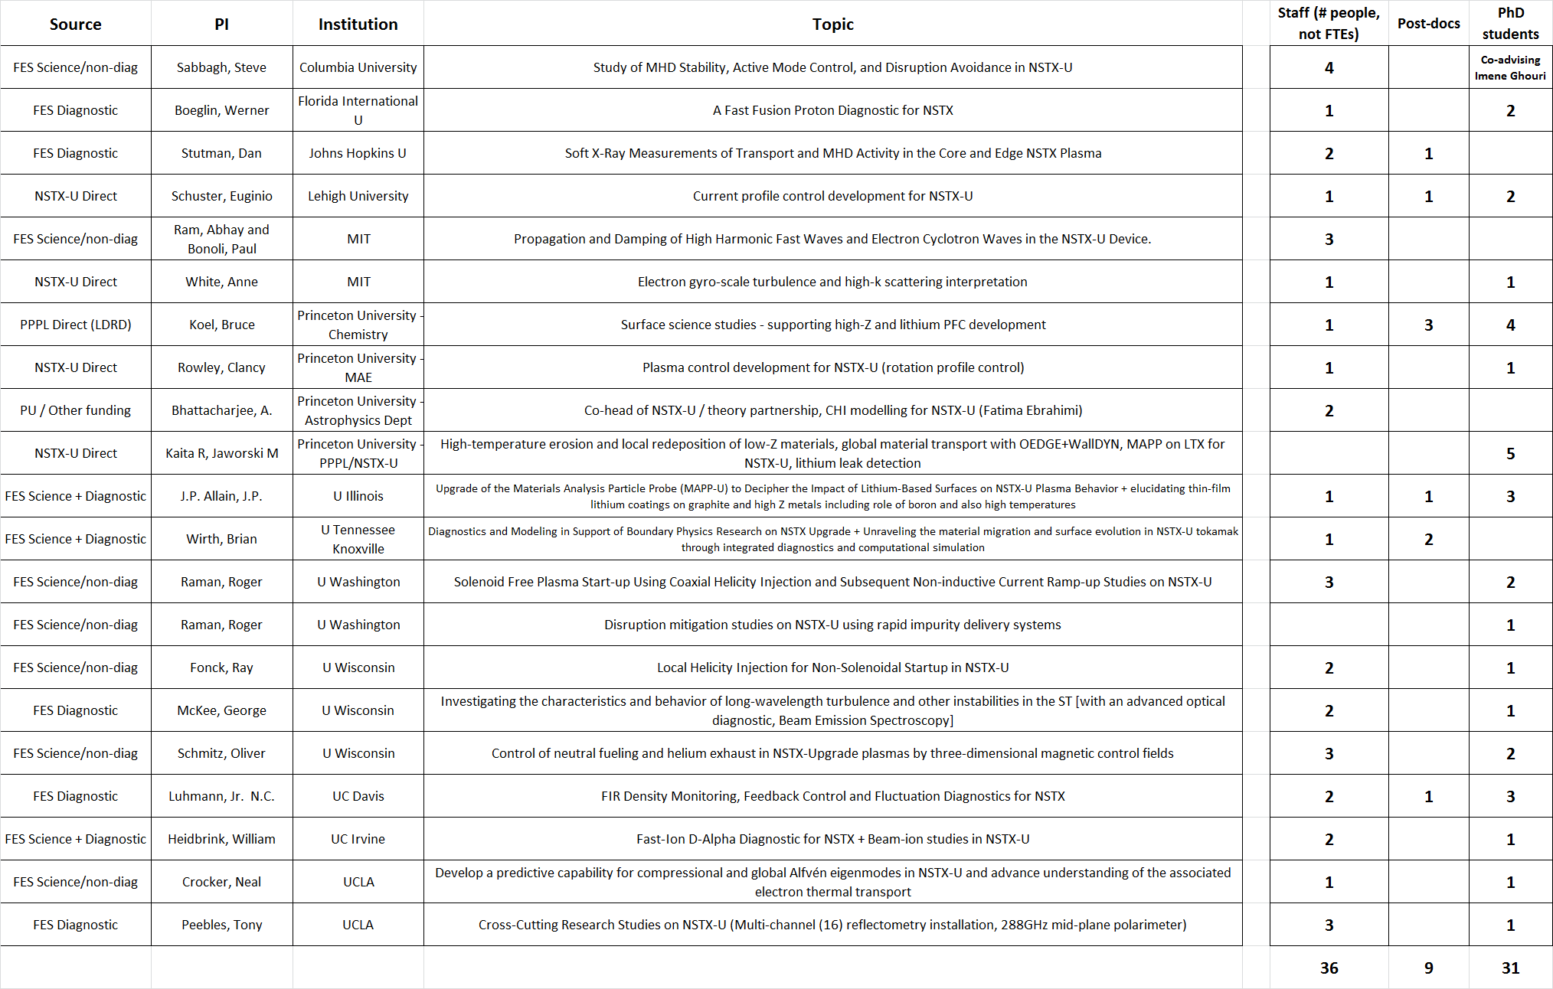
Response to Question 3

Slide 9
Question 4a: Briefly summarize the areas of theoretical research that might have been terminated as a result of the Partnership
Assumption: Enough funds to support the additional 2.5 Theory + 1.0 CPPG
Steve Jardin (M3D-C¹): less work on
  Sawtooth studies on DIIID, CMOD, and ASDEX-U
  M3D-C1 code modifications to include kinetic effects
C.S. Chang et al. (XGC0, XGC1): less work on
  Gyrokinetic impurity transport in SOL and pedestal (development)
  Gyrokinetic study of L-H transition
Elena Belova (CAE/KAW): less work for Tri Alpha (FRC)
Edward Startsev (implementing e-m effects in GTS): less work on HEDP
Weixing Wang (GTS core transport studies): less work DIII-D core transport
Josh Breslau (VDE simulations): stopped working on innovative stellarator coil design
Roscoe White (energetic ion transport by *AE modes): less work on density limit disruptions
Amitava Bhattacharjee (helped establish Partnership): delayed greatly finishing review paper on sawtooth physics with Ian Chapman and Hyeon Park
AB: “working with the NSTX team often produces synergisms in which the whole becomes larger than the sum of the parts.”

Slide 10
Question 4b: What NSTX-related Theory work is being done outside the NSTX-U/Theory Partnership?
NTV Physics (NTVTOK, IPECs/POCA): Columbia U., NSTX-U
Kinetic stabilization of IWM, RWM: NSTX-U, Columbia Univ.
Development of reduced model for fast ion transport: NSTX-U
Transport model validation (RLW, TGLF, MMM): NSTX-U, GA, Lehigh U.
Core gyrokinetic studies, including momentum transport (GYRO, GTS, GS2, GEM, GKW): NSTX-U, U. Colorado, U. Bayreuth
Impurity transport (MIST/STRAHL): Johns Hopkins U.
SOL transport physics, including blobs (UEDGE, SOLPS, SOLT): LLNL, Lodestar
Pedestal physics (XGC0,1, ELITE, GS2/GYRO, gyrokinetic edge model development): NSTX-U, GA, ORNL, PPPL Theory
Materials modeling: U. Tenn, U. Illinois
FW & EBW physics (AORSA, TORIC, GENRAY, CQL3D): ORNL, NSTX-U, MIT, CompX
CHI/reconnection modeling (NIMROD): LLNL, U. Wisc.

Slide 11
Backup for Question 1

Slide 12
Heating System Limitations from the GRD
Beam duration is limited by low cycle fatigue on the primary energy ion dump.
  5 seconds: 6*1.7 MW =10.2 MW total power from 6 sources
  Note: Upgrades to hypervapotrons, as envisioned for TPX, would eliminate this issue.
  Limits enforced by source operators (administratively) and numerous timing systems.
The HHFW system is assumed to create 4 MW of power for 5 seconds

Slide 13
Vessel is Qualified for 70 MJ on a 20 Minute Cycle
Vessel power balance assumed 14 MW for 5 s.
  is 70 MJ
  NSTXU-CALC-11-01-00
Assumed that
  DN plasma
  ~40% of the power ends up on the horizontal targets
    For an assumed power loading of 5 MW/m² on average.
  1200 s rep rate = 20 min
  The CS and outer vessel are actively cooled between shots
    Capability is new on the CS to buffer the coils from the plasma thermal loads
    We have had this capability on the outer vessel for bake-out.
Under these assumptions, the tile surfaces go toward ~1000 C at the end of the pulse, but
  the vessel/casing are maintained without boiling the water in any location.
  The vessel system is qualified for 70 MJ

Slide 14
However, the Peak Heat Flux May Prove Problematic…
Limit #1: Thermal stresses in target tiles can exceed ATJ graphite limits.
  Inner horizontal target tiles qualified for 5 sec operation at Q_{ave}=5 MW/m², Q_{Pk}=8.0 MW/m²
Limit #2: Desire to avoid tile surface temperatures exceeding T_{max}~1200 C.
  Due to enhanced sublimation.
Conservative assumption:
Primary solutions:
Discharge Parameters |  |  | Worst-Case Standard DN Divertor f_{exp}=15 & f_{div}=0.4 |  | f_{exp}=60 & f_{div}=0.4 or f_{exp}=15 & f_{div}=0.1
I_{P} [MA] | P_{inj} [MW] | Heating Duration [s] | Q_{Pk} [MW/m²] | Time to T_{max} [s] | Q_{Pk} [MW/m²] | Time to T_{max} [s]
0.75 | 10.2 | 5.0 | 6 | 12.6
1.5 | 10.2 | 5.0 | 18 | 1.4
2.0 | 10.2 | 5.0 | 28 | 0.5
1.5 | 15.6 | 1.5 | 27 | 0.6
2.0 | 15.6 | 1.5 | 43 | 0.25
100% NI
Long Pulse
Highest Power
BP TSG

Slide 15
However, the Peak Heat Flux May Prove Problematic…
Unless it is Mitigated
Limit #1: Thermal stresses in target tiles can exceed ATJ graphite limits.
  Inner horizontal target tiles qualified for 5 sec operation at Q_{ave}=5 MW/m², Q_{Pk}=8.0 MW/m²
Limit #2: Desire to avoid tile surface temperatures exceeding T_{max}~1200 C.
  Due to enhanced sublimation.
Conservative assumption:
Primary solutions:
Broadening the heat channel (f_{exp}) via the snowflake divertor
Increasing the fraction of radiated power (decreasing f_{div})
Discharge Parameters |  |  | Worst-Case Standard DN Divertor f_{exp}=15 & f_{div}=0.4 |  | f_{exp}=60 & f_{div}=0.4 or f_{exp}=15 & f_{div}=0.1
I_{P} [MA] | P_{inj} [MW] | Heating Duration [s] | Q_{Pk} [MW/m²] | Time to T_{max} [s] | Q_{Pk} [MW/m²] | Time to T_{max} [s]
0.75 | 10.2 | 5.0 | 6 | 12.6 | 1.5 | 200
1.5 | 10.2 | 5.0 | 18 | 1.4 | 4.5 | 22
2.0 | 10.2 | 5.0 | 28 | 0.5 | 7 | 8.7
1.5 | 15.6 | 1.5 | 27 | 0.6 | 7 | 9.3
2.0 | 15.6 | 1.5 | 43 | 0.25 | 11 | 4.0
100% NI
Long Pulse
Highest Power
BP TSG

Slide 16
These Observations Motivate the Strong Desire to Mitigate the Peak Heat Flux
Collaborations…
  LLNL and PPPL members of the NSTX-U team collaborating on snowflake divertor research on DIII-D.
    Physics, control,…
  PPPL members of the NSTX-U team active in radiative divertor control at DIII-D.
Engineering Analysis…
  Mike Jaworski and I have been working with analysis division to assess the impact of more realistic heat flux profiles on tile thermal stresses.
Infrastructure…
  NSTX-U has more divertor coils in order to optimize the divertor geometry.
  Installing high-throughput divertor gas systems to control the director radiation.
  Comprehensive system if IR cameras to asses surface temperatures
    ORNL collaboration.
Plans…
  Heat flux mitigation figures prominently in the plans/goals for ASC, Boundary Physics, and Materials/PFC TSGs.

Slide 17
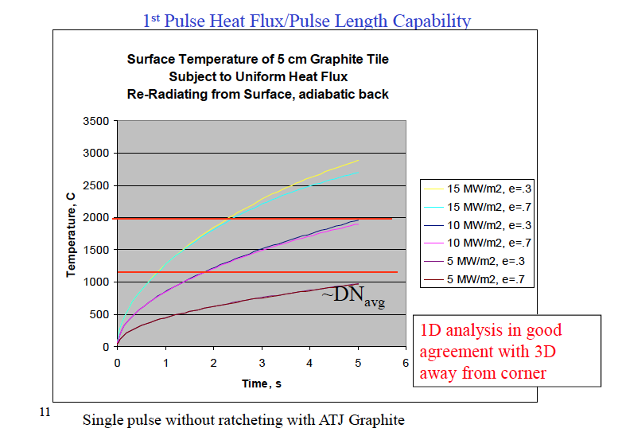
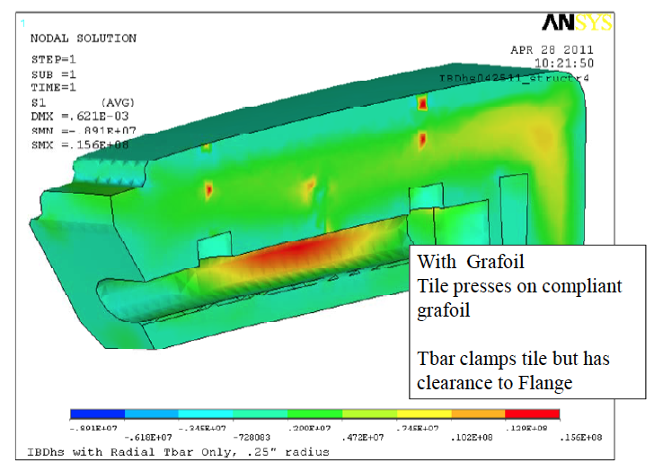
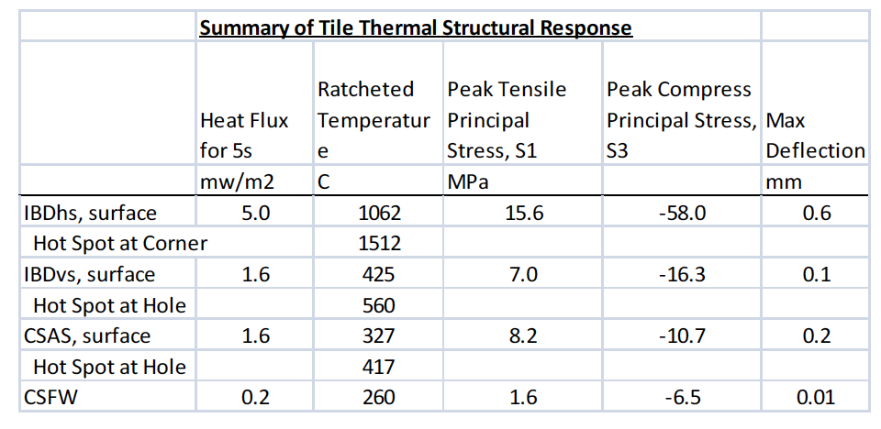
Criterion For Heat Flux Limits
Calibrate expression for tile surface temperature against engineering models:
  T_{surf}=CQ_{ave}t1^{/2}
  Use T_{surf}=1000 C, t=5 s, Q_{avg}=5 MW/m².
    Derive C~90 Cm²/MWs^{1/2}
Derive heat flux Q from simple scalings:

