Slide 1

Overview of NSTX-U Research Program Progress and Plans
J. Menard, PPPL
For the NSTX-U Research Team
NSTX-U PAC 37
PPPL B318
January 26-28, 2016

Slide 2
Outline
Events since PAC-35
Charge Questions
Mission and Capabilities of NSTX-U
Research Goals and Milestones
Key Scientific Issues NSTX-U Will Address
Organizational Structure
Run Coordination
Support for FESAC / FES Strategic Goals
Summary

Slide 3

NSTX-U Research Team Has Been Scientifically Productive
Very Active in Scientific Conferences, Publications, and Collaborations
Strong APS meeting participation
  2014: 1 ST review talk, 5 NSTX invited talks, 44 posters
  2015: 3 NSTX invited talks (+4 by team-members), 54 posters
L. Delgado-Aparicio: DOE Early Career Award for research on impurity transport and control
Multitude of technical NSTX-U / next-step presentations at 2015 SOFE, Li Symposium, IAEA-TM on divertors
International ST Workshop: 78 talks+posters, 50% international
45 refereed publications for FY2015
34 IAEA FEC 2016 synopses on NSTX-U + ST-FNSF

Slide 4
NSTX-U Research Team Has Been Scientifically Productive
Very Active in Scientific Conferences, Publications, and Collaborations
Collaborative research contributions made in range of topics directly relevant to NSTX-U program
  DIII-D: Pedestal transport, fast-ions instabilities, RWM / RFA, QH-mode TEM particle transport, Li dropper, granule injector, snowflake/X divertors
  EAST: Lithium coating / wall physics, flowing liquid Li limiter
  KSTAR: NTV rotation damping, error fields, RMP
  C-Mod: ELM cycle / pedestal structure, high-Z spectroscopy
  MAST / York: Momentum transport studies / SAMI diagnostic
  QUEST: CHI + ECH start-up research, EBW-CD start-up modelling (new)
  ITPA halo current data / studies: DIII-D, AUG, C-Mod (+ NSTX / NSTX-U)

Slide 5
Reminder: Project / Program events since PAC-35
Successful vessel pump-down (December 2014)
Team-wide Research Forum (February 2015)
Commissioning for 1st plasma, OH arc fault (April)
PAC-36 - program letter, arc fault discussion (June)
Arc recovery, corrective actions (May)
First test plasma: 110→140kA, 0.5T (August)
Bake, facility / diagnostic commissioning (Fall)
Plasma commissioning: 800kA, 0.6T (late December)
Diverted NBI H-mode achieved (January 2016)
Just begun operating! PAC input very timely, valuable

Slide 6
Presentations / agenda organized to aid you / PAC-37 in addressing charge questions
Please assess the research planned to be carried out for the NSTX-U FY2016 experimental campaign
  Are there any major missing elements, or new opportunities?
Please assess the alignment between the NSTX-U research plans and goals and the FESAC / FES initiatives, research opportunities, and ITER urgent research needs.
Please comment on the progress and plans for the NSTX-U / PPPL theory partnership, and how well this partnership and the broader NSTX-U research activities support “integrated predictive capability”.
Please comment on the present team prioritization of planned facility enhancements including:
  Divertor cryo-pump, non-axisymmetric control coils (NCC), 28GHz gyrotron, conversion to high-Z PFCs + liquid metals research
Key Presentations:
Menard, Ono, Maingi, Kaye, Gerhardt
All (except Ono)
Bhattacharjee, Boyer, Poli
Menard, Ono, Maingi, Kaye, Gerhardt, Jaworski, Sabbagh

Slide 7
Outline
Events since PAC-35
Charge Questions
Mission and Capabilities of NSTX-U
Research Goals and Milestones
Key Scientific Issues NSTX-U Will Address
Organizational Structure
Run Coordination
Support for FESAC / FES Strategic Goals
Summary

Slide 8
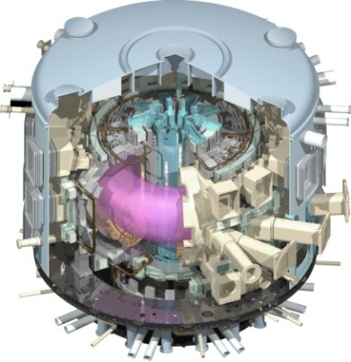
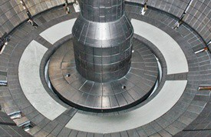
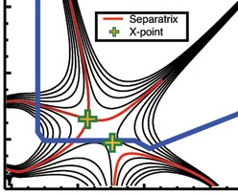
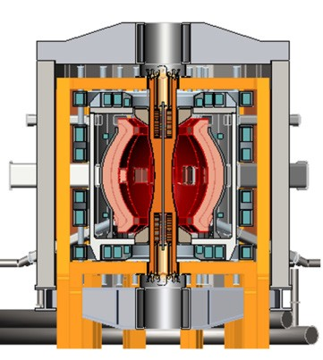
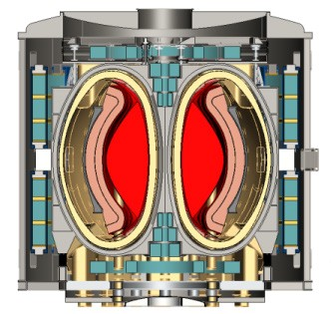
NSTX-U Mission Elements:
Explore unique ST parameter regimes to advance predictive capability - for ITER and beyond
ITER
Develop solutions for plasma- material interface (PMI)
Liquid metals / Lithium
Snowflake/X
ST-FNSF /
Pilot-Plant
Advance ST as Fusion Nuclear Science Facility and Pilot Plant

Slide 9
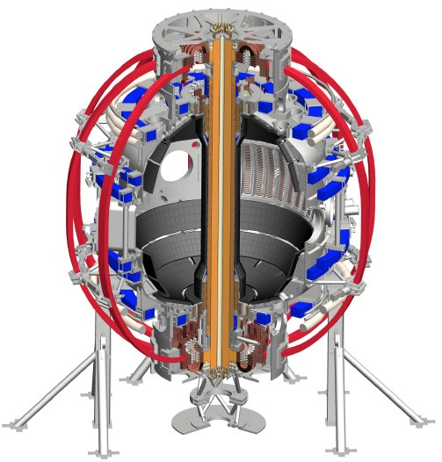
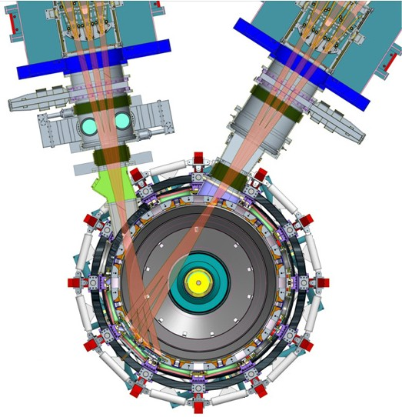
NSTX-U will access new physics with 2 major new tools:
1. New Central Magnet
2. Tangential 2nd Neutral Beam
Higher T, low ν* from low to high β
→ Unique regime, study new transport and stability physics
Full non-inductive current drive
→ Not demonstrated in ST at high-β_{T}
Essential for any future steady-state ST

Slide 10
NSTX-U will have major boost in performance
1. New Central Magnet
2. Tangential 2nd Neutral Beam
➢2× heating power (5 → 10MW)
Tangential NBI → 2× current drive efficiency
➢4× divertor heat flux (→ ITER levels)
➢Up to 10× higher nTτ_{E} (~MJ plasmas)
➢2× toroidal field (0.5 → 1T)
➢2× plasma current (1 → 2MA)
➢5× longer pulse (1 → 5s)

Slide 11
Outline
Events since PAC-35
Charge Questions
Mission and Capabilities of NSTX-U
Research Goals and Milestones
Key Scientific Issues NSTX-U Will Address
Organizational Structure
Run Coordination
Support for FESAC / FES Strategic Goals
Summary

Slide 12
5 year goal: Establish core physics/scenarios for ST
10 year goal: Integrate high-performance core + metal walls
First 5 years
Second 5 years
Establish ST physics / scenarios:
High-performance + metal walls
Confinement vs. β , collisionality
Sustain high β with advanced control
Non-inductive start-up, ramp-up
Mitigate high heat fluxes
Test high-Z divertor, Li vapor shielding
Convert all PFCs from C to high-Z
Static → flowing Li divertor module(s), full toroidal flowing Li divertor, high T_{wall}
5s → 10-20s for PFC/LM equilibration
Assess ST with high-Z, high-Z + Li
Inform choice of
FNSF configuration:
Inform choice of FNSF / DEMO
plasma facing materials:
Lower A or higher A?
Standard, snowflake, Super-X (MAST-U)?
High-Z consequences? need high-Z + Li?
Assess for both divertor and first-wall

Slide 13
Summary of FY2016-18 NSTX-U Research Milestones
FY2016
  Obtain 1st data at 60% higher field/current, 2-3× longer pulse:
    Re-establish sustained low l_{i} / high-κ operation above no-wall limit
    Study thermal confinement, pedestal structure, SOL widths
    Assess current-drive, fast-ion instabilities from new 2nd NBI
FY2017
  Extend NSTX-U performance to full field, current (1T, 2MA)
    Assess divertor heat flux mitigation, confinement at full parameters
  Access full non-inductive, small current over-drive
  First 2D high-k scattering, test prototype high-Z tiles, HHFW
FY2018
  Study low-Z and high-Z impurity transport
  Assess causes of core electron thermal transport
  Test advanced q profile and rotation profile control
  Assess CHI plasma current start-up performance
  Divertor power and momentum balance (vapor shielding)
Milestone #
R16-3
R16-1
R16-2
R17-1,3
R17-4
R17-2
IR17-1
R18-1
IR18-2
R18-2
R18-3
IR18-1

Slide 14
NSTX-U Milestone Schedule for FY2016-18
FY2016
FY2017
FY2018
Run Weeks:
Incremental
18
16
18
12
16
R16-1
R17-1
R18-1
Boundary Science
+ Particle Control
Assess H-mode confinement, pedestal, SOL characteristics at higher B_{T}, I_{P}, P_{NBI}
Assess scaling, mitigation of steady-state, transient heat-fluxes w/ advanced divertor operation at high power density
Assess impurity sources and edge and core impurity transport
R17-2
IR18-1
Assess high-Z divertor PFC performance and impact on operating scenarios
Investigation of power and momentum balance for high density and impurity fraction divertor operation
R16-2
R17-3
IR18-2
Assess effects of NBI injection on fast-ion f(v) and NBI-CD profile
Assess τ_{E} and local transport and turbulence at low ν* with full confinement and diagnostic capabilities
Assess role of fast-ion driven instabilities versus micro-turbulence in plasma thermal energy transport
Core Science
Begin ~1 year outage for
major facility enhancement(s) sometime during FY2018
IR17-1
R18-2
R16-3
Assess fast-wave SOL losses, core thermal and fast ion interactions at increased field and current
Control of current and rotation profiles to improve global stability limits and extend high performance operation
Integrated Scenarios
Develop physics + operational tools for high-performance: κ, δ, β, EF/RWM
R17-4
R18-3
Develop high-non-inductive fraction NBI H-modes for sustainment and ramp-up
Assess transient CHI current start-up potential in NSTX-U
FES 3 Facility Joint Research Target (JRT)
C-Mod leads JRT
DIII-D leads JRT
NSTX-U leads JRT
Assess disruption mitigation, initial
tests of real-time warning, prediction
Examine effect of configuration on operating space for dissipative divertors
TBD

Slide 15
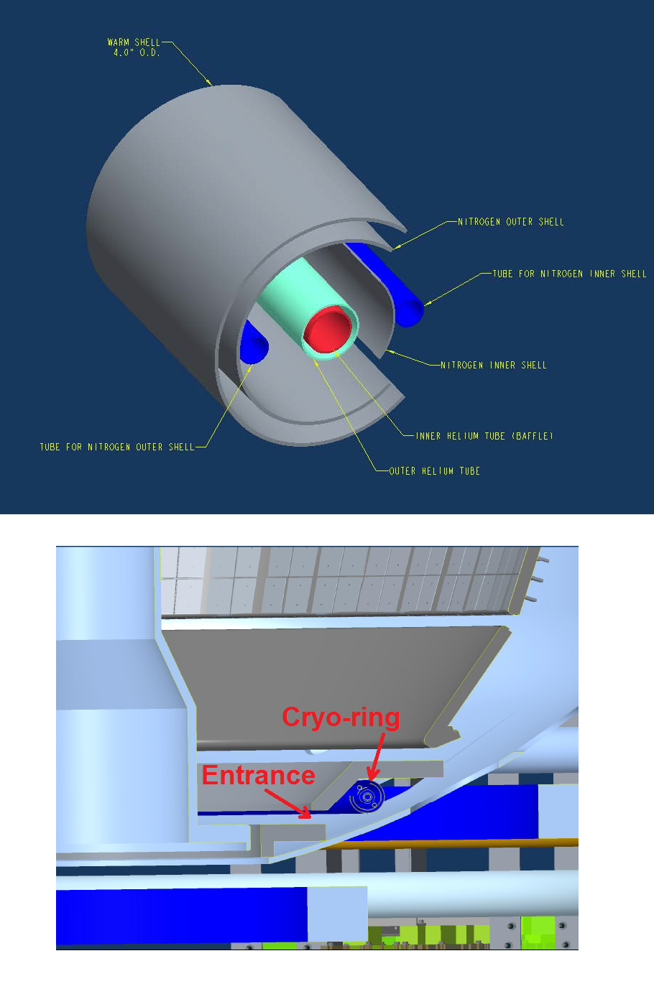
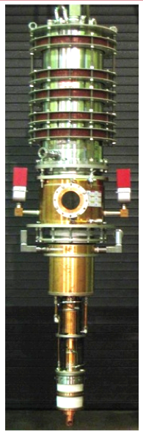
Motivations for next major facility enhancements
One (maybe 2) enhancement(s) feasible / affordable for FY18-19 outage
1. Divertor cryo-pump with high-Z baffle
  Control density and ν* without Li, compare to Li
  Accelerate transition to high-Z PFCs, support liquid metal tests with bakeable baffle
2. Non-axisymmetric control coils (NCC)
  Resonant, non-resonant NTV rotation control
  RMP ELM suppression (not yet achieved in ST)
  Enhanced RWM/EF control
Full toroidal NCC array (2 x 12)
NCC
3. 28GHz / 1MW gyrotron (Tsukuba)
  Heat CHI target w/ ECH for HHFW
  EC/EBW-only CD for start-up
  Longer-term: EBW CD for sustainment
Existing
RWM
coils

Slide 16
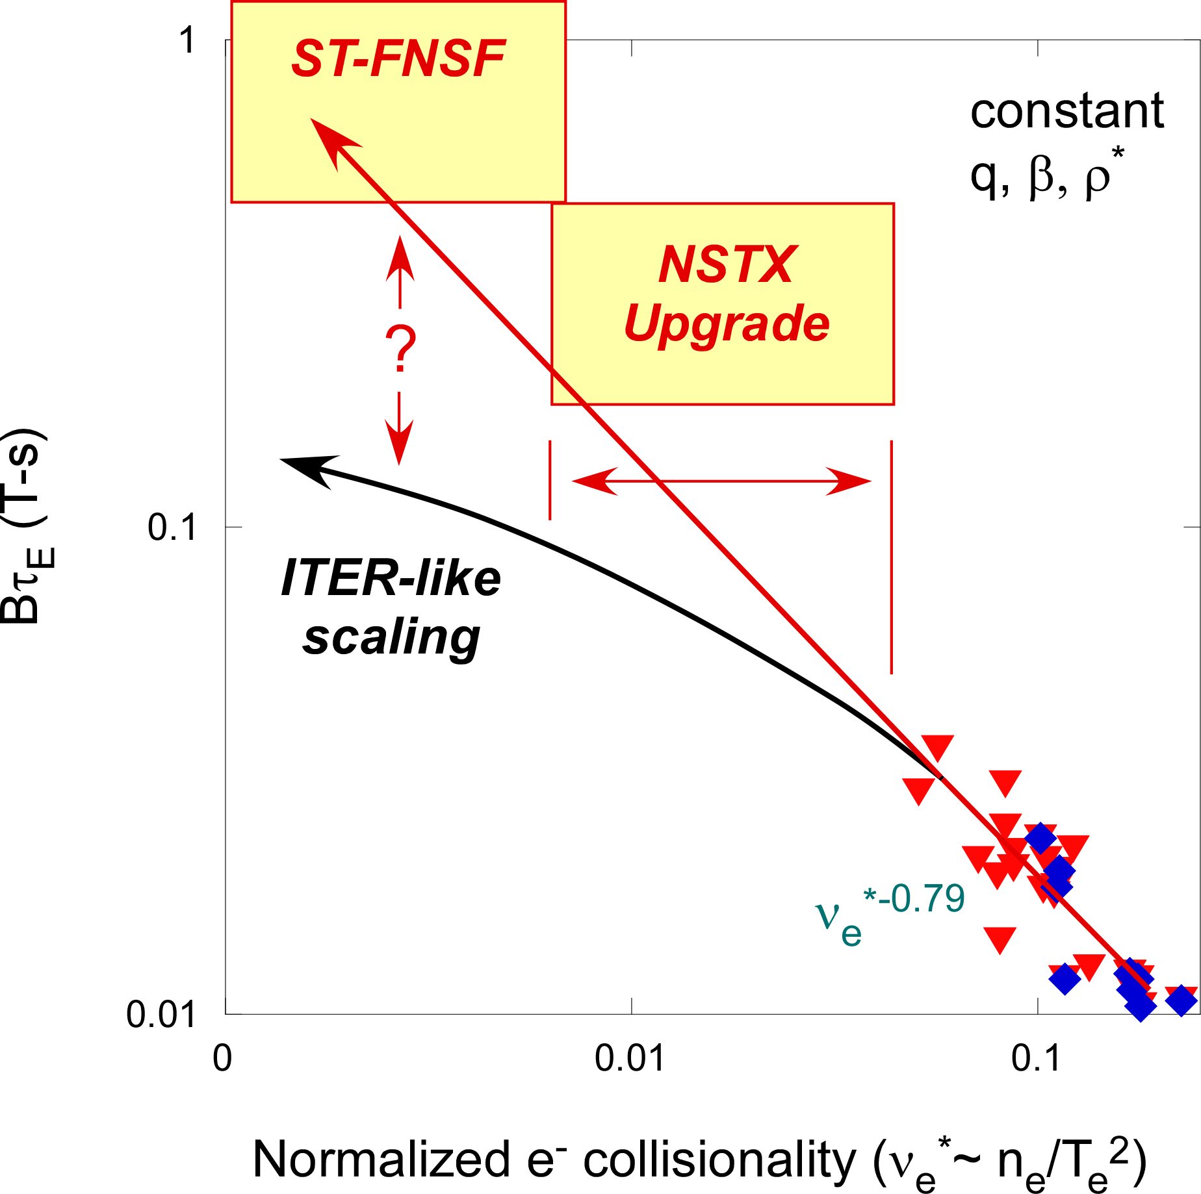
Favorable confinement trend with collisionality and β found in ST experiments
ST scaling observed in NSTX and MAST: τ_{E, th} ∝ ν_{*e}^{-0.8} β^{-0.0}
Tokamak empirical scaling (ITER 98y,2): τ_{E, th} ∝ ν_{*e}^{-0.1} β^{-0.9}
See Bhattacharjee and Kaye talks for more details
Role of enhancements:
Vary ν* ↔ cryo, β, Ω_{φ} ↔ NCC
Promising scaling to ST-FNSF / Pilot, will trend continue on NSTX-U / MAST-U?

Slide 17
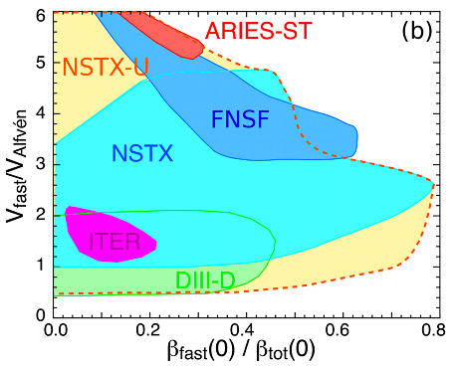
NBI-heated STs excellent testbed for α-particle physics
α-particles couple to Alfvénic modes when V_{α} > V_{Alfvén}~ β^{-0.5} C_{sound}
V_{fast} > V_{A} condition easily satisfied in high-β ST with NBI heating
NSTX-U: large fast-ion dynamic range spanning ST and conventional A
  Toroidal field 2× NSTX → V_{fast} < V_{A} → stabilize modes
  Tangential 2nd NBI → very flexible fast-ion distribution
    Vary pitch angle, pressure profile
Role of enhancements:
Vary β_{fast} / β_{tot} ↔ cryo, Ω_{φ} ↔ NCC
Can we find TAE-quiescent, high-performance regimes in NSTX-U?

Slide 18
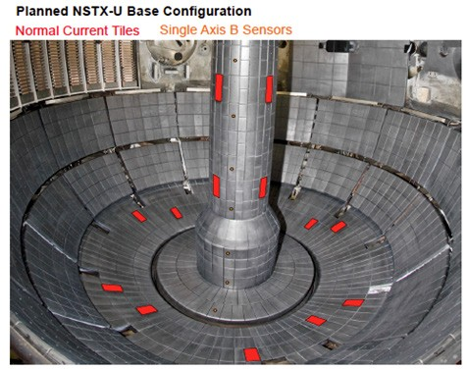
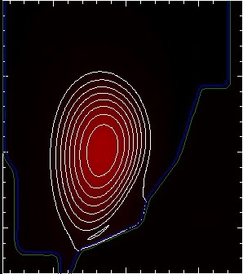
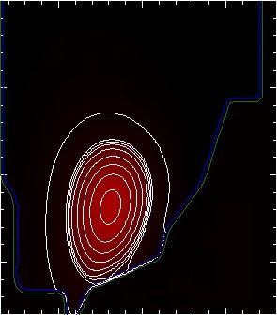
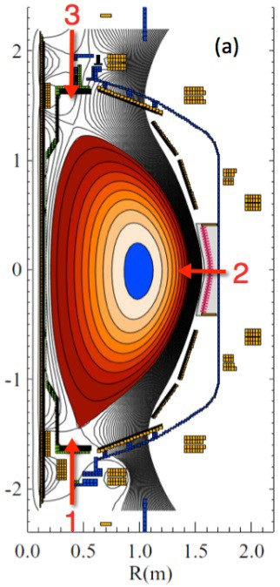
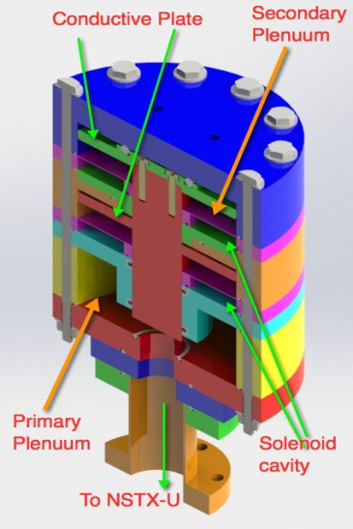
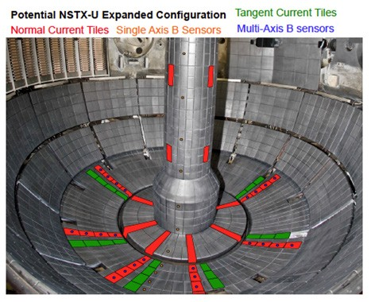
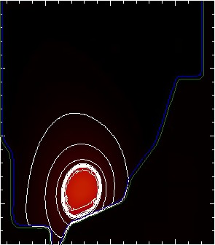
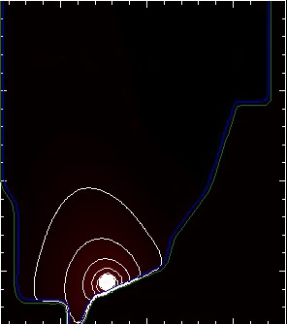
NSTX-U aims to play leading role in disruption prediction, avoidance, and mitigation (DPAM) for ITER and FNSF
Advanced non-linear MHD modelling of vertical displacement events (VDE) + halo currents with M3D-C¹
Enhance measurements of halo-current dynamics
Test ITER-like Massive Gas Injection (MGI) valves
  Test poloidal dependence of density assimilation
  First data expected FY16
RB_{T} t = 2850
RB_{T} t = 2875
FY16
RB_{T} t = 2900
RB_{T} t = 2918
NSTX-U / PPPL
Theory Partnership
University of Washington
NSTX Discharge 132859
FY17-18
Role of enhancements:
Control ν* ↔ cryo, β, Ω_{φ} ↔ NCC
See Bhattacharjee and Sabbagh talks for more details

Slide 19
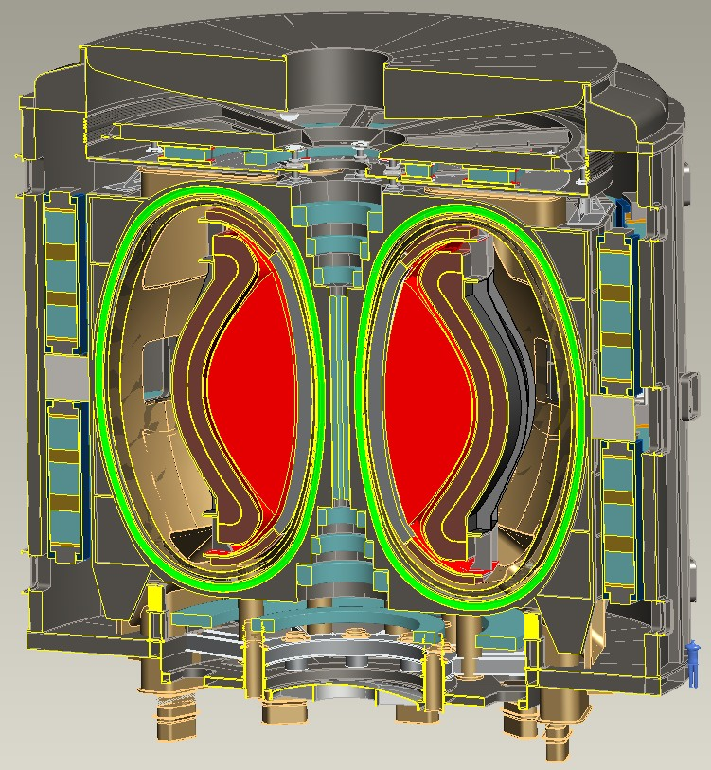
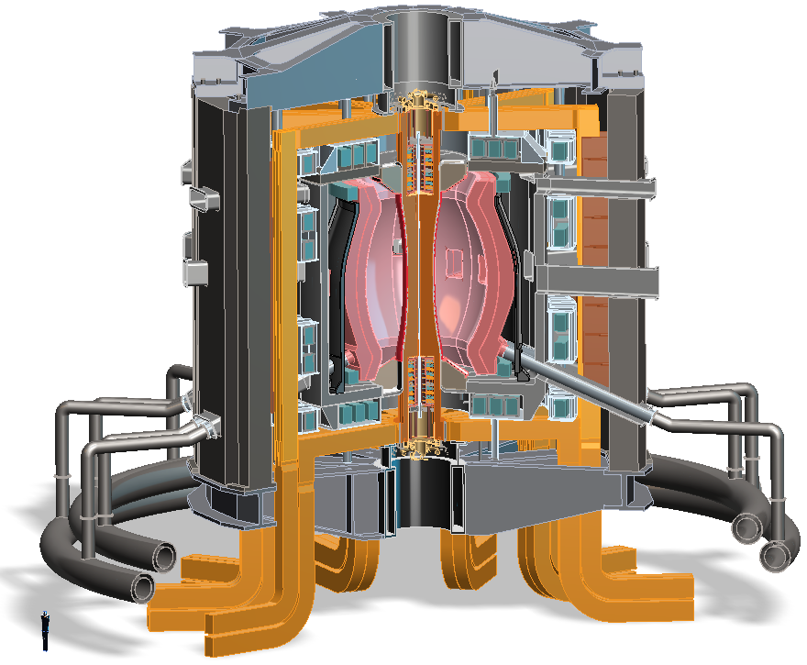
Design studies show ST potentially attractive as
Fusion Nuclear Science Facility (FNSF) or Pilot Plant
FNSF: Provide neutron fluence for material/component R&D (+ T self-sufficiency?)
Pilot Plant: Electrical self-sufficiency: Q_{eng} = P_{elec} / P_{consumed} ≥ 1 (+ FNSF mission?)
FNSF with copper TF coils
A=1.7, R₀ = 1.7m, κ_{x} = 2.7
Fluence = 6MWy/m², TBR ~ 1
FNSF / Pilot Plant with HTS TF coils
A=2, R₀ = 3m, κ_{x} = 2.5
6MWy/m², TBR ~ 1, Q_{eng} ~ 1

Slide 20
Steady-state operation required for ST/AT FNSF or Pilot Plant
NSTX achieved 70% “transformer-less” current drive
NSTX-U designed to achieve 100% (TRANSP):
H_{98y2}
ITER H-mode confinement scaling multiplier
See Boyer and Gerhardt talks for more details
Role of enhancements:
Control n_{e} / n_{gw} ↔ cryo, β, Ω_{φ} ↔ NCC
I_{P}=1 MA, B_{T}=1.0 T, P_{NBI}=12.6 MW
Will NSTX-U achieve 100% as predicted by simulations?

Slide 21
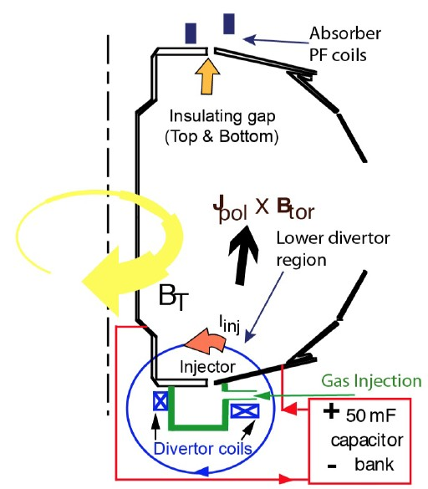
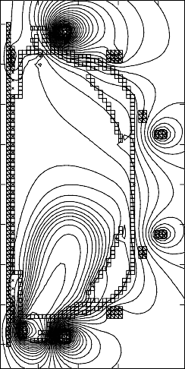
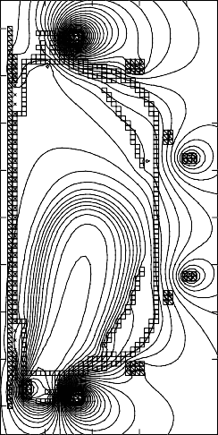
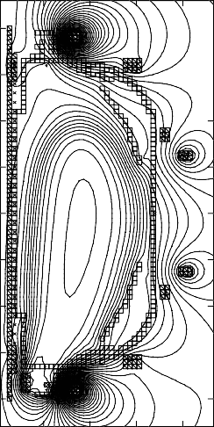
ST-FNSF may need solenoidless current start-up method
Coaxial Helicity Injection (CHI) effective for current initiation
CHI developed on HIT, HIT-II
Transferred to NSTX / NSTX-U
NSTX: 150-200kA closed flux current
NSTX-U: CHI projects to 300-400kA
TSC axisymmetric simulation of CHI startup
1.0 ms 1.6 ms 2.7 ms
2
Z (m)
0
-2
2
0
2
0
R (m)
R (m)
0
R (m)
2
Role of enhancements:
High-Z divertor tiles ↔ reduce low-Z P_{rad}
R. Raman et al., PRL 2006

Slide 22
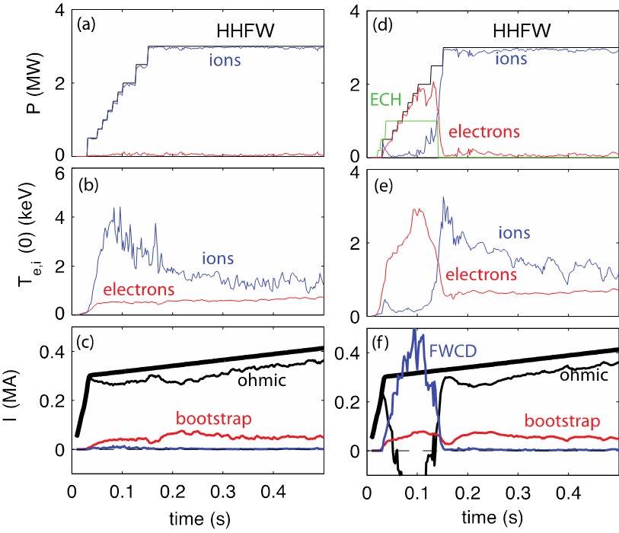
1MW 28GHz ECH / EBW gyrotron is game-changer for solenoid-free start-up
HHFW phasing: k|| = 3m⁻¹ (CD)
CHI can form I_{P}=300-400kA, but:
  T_{e} too low for HHFW absorption
  Density too low and I_{P} decay too fast for NBI absorption in CHI plasma
Good ECH first pass absorption predicted → “bridge the T_{e} gap”
Strong ECH + High-Harmonic Fast-Wave (HHFW) synergy found in TRANSP simulations of non-inductive start-up
  Sustain I_{P} enough for NBI to couple (not shown)
EBW-only start-up also promising
  High η_{CD} ~1 A/W in MAST, QUEST
No ECH
With ECH
Role of enhancements:
Gyrotron, also n_{e} control ↔ cryo
See Poli and Gerhardt talks for more details

Slide 23
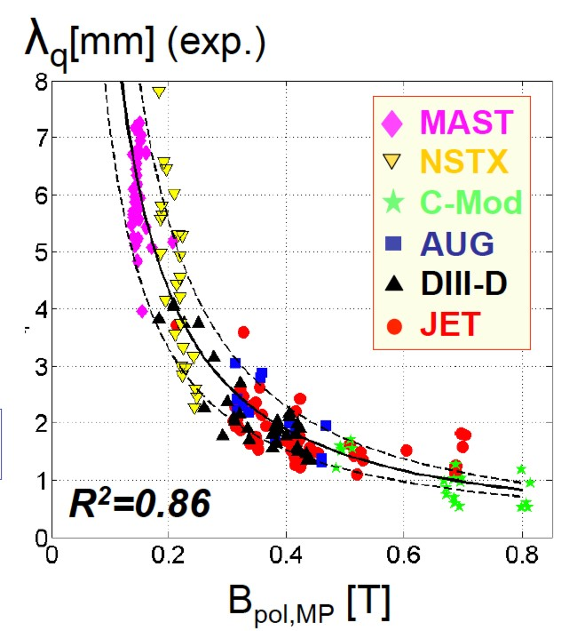
Dedicated tokamak + ST experiments found power exhaust width varies as 1 / B_{poloidal}
ST data breaks aspect ratio degeneracy of data set
Role of enhancements:
Control n_{e} and detachment ↔ cryo
3D/RMP effects in divertor ↔ NCC
Will 1/B_{poloidal} variation continue at higher I_{P}? What about detached conditions?

Slide 24




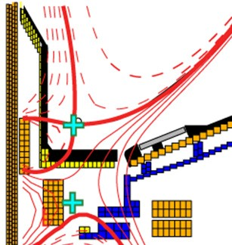
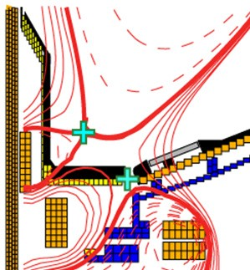
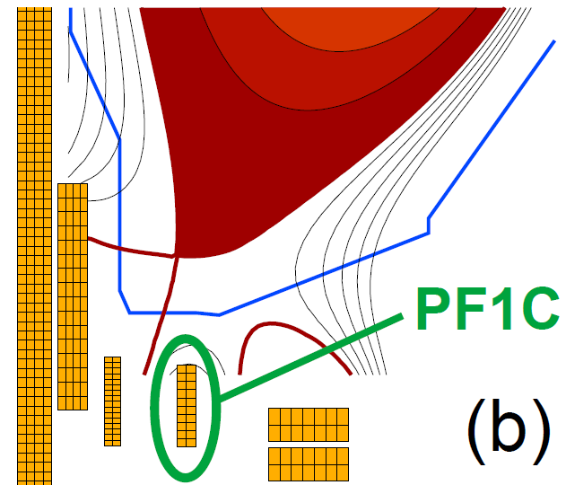
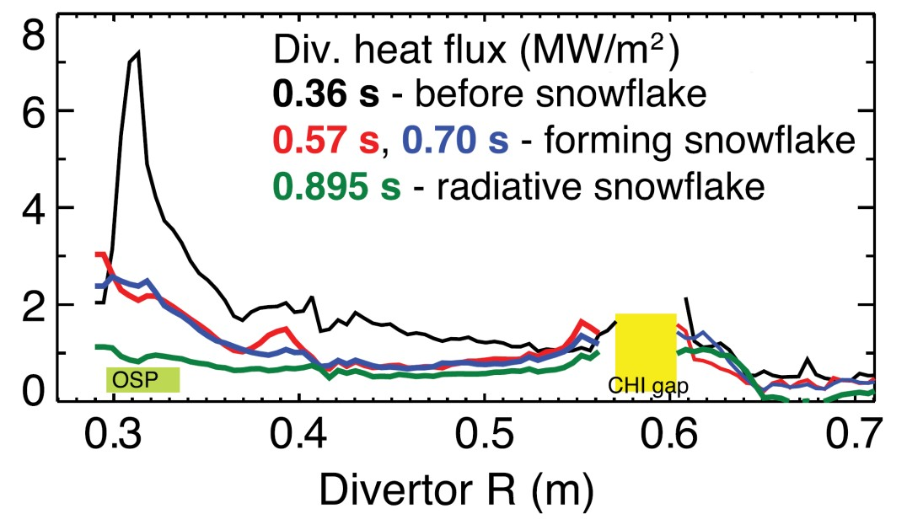
NSTX-U will test ability of radiation and advanced divertors to mitigate very high heat-fluxes
NSTX: reduced heat flux 2-4×via radiation (partial detachment)
Additional null-point in divertor expands field, reduces heat flux
Standard Divertor
Snowflake/X Divertor
NSTX-U peak heat fluxes will be up to 4-8× higher than in NSTX
NSTX-U has additional coils for up-down symmetric snowflake/X, improved control
SFD: V. Soukhanovskii (LLNL)
XD: M. Kotschenreuther (UT)

Slide 25
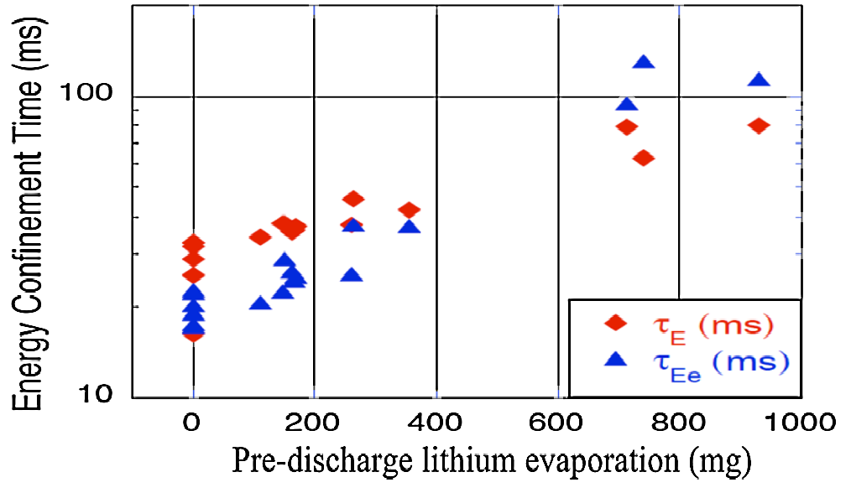
Plasma confinement increased continuously with increasing Li coatings in NSTX – what is limit?
Global parameters improve
  H_{98y2} increases ~0.9 → 1.4
  No core Li accumulation
High H critical for compact FNSF / Pilot Plants
Energy Confinement Time (ms)
Pre-discharge lithium evaporation (mg)
R. Maingi, et al., PRL 107 (2011) 145004
NSTX-U will double Li-wall coverage with upward evaporators
Will further assess contributors to confinement improvement:
  Lower-recycling / reduced neutral source / higher T_{e}
  Edge profile / turbulence changes
  Influence of (low-Z) impurities in pedestal region
Role of enhancements:
Compare Li-wall pumping to conventional pumping ↔ cryo

Slide 26
NSTX-U boundary / PFC plan: add divertor cryo-pump, transition to high-Z wall, study flowing liquid metal PFCs
5yr goal: Integrate high τ_{E} and β_{T} with 100% non-inductive
10yr goal: Assess compatibility with high-Z & liquid lithium PFCs
2016
2017-18
2018-19
2020-21
2022-23
High-Z tile row
All high-Z FW +
divertors
+ flowing LLD
module
Cryo + full lower outboard high-Z divertor
Cryo + high-Z FW
B+C BN
Li High-Z
Lower OBD
high-Z row of tiles
and OBD
+ liquid Li divertor (LLD)
Downward Li evaporator +
Li granule injector
High-Z tile row
Up + downward Li evaporator, possible pre-filled Li tiles (FY18)
Heatable high-Z PFCs for liquid Li (including pre-filled)
Cryo-pump
or
Flowing Li module (Concept, location, size TBD)
See Maingi, Jaworski talks for more details

Slide 27
Outline
Events since PAC-35
Charge Questions
Mission and Capabilities of NSTX-U
Research Goals and Milestones
Key Scientific Issues NSTX-U Will Address
Organizational Structure
Run Coordination
Support for FESAC / FES Strategic Goals
Summary

Slide 28
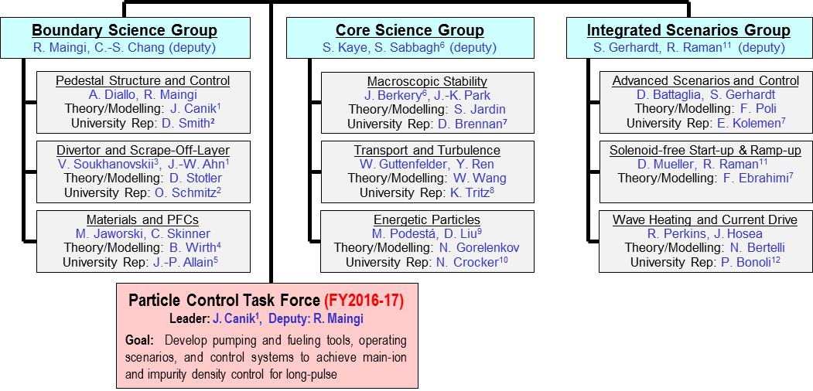
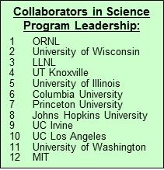
New NSTX-U Science organizational structure for 2015-16:
3 Science Groups, 9 Topical Science Groups, 1 Task Force
Science Group (SG)
Task Force (TF)
Topical Science Group (TSG)
Each TSG has a leader, deputy, theory rep, and at least 1 university rep to enhance university participation
Task Force focuses resources on particle control – important for NSTX-U research goals, addresses PAC recommendations
12 collaborating institutions engaged in NSTX-U science program leadership

Slide 29
Motivations for restructuring science program
TSGs provide expertise in broad range of topics, but program would benefit from better coordination between TSGs
  SG leader responsibility: Coordinate TSG physics research plans, experimental/shot plans, diagnostic coverage & usage
Efficient shot usage especially important during first run year (many systems need to be re-commissioned)
  Experiments that engage multiple TSGs receive more run-time
Incorporate much wider set University researchers/PIs in planning + coordination of research program (FES/PPPL goal)
New - Task Force for long-pulse particle control
New - Working Groups: Disruption PAM (Sabbagh, Raman), NCC performance spec (Park, Canik), data frameworks (Tritz, Yuh, Smith)
  Task Forces have dedicated run-time, Working Groups do not, but recommend Program/SG/TSG actions

Slide 30
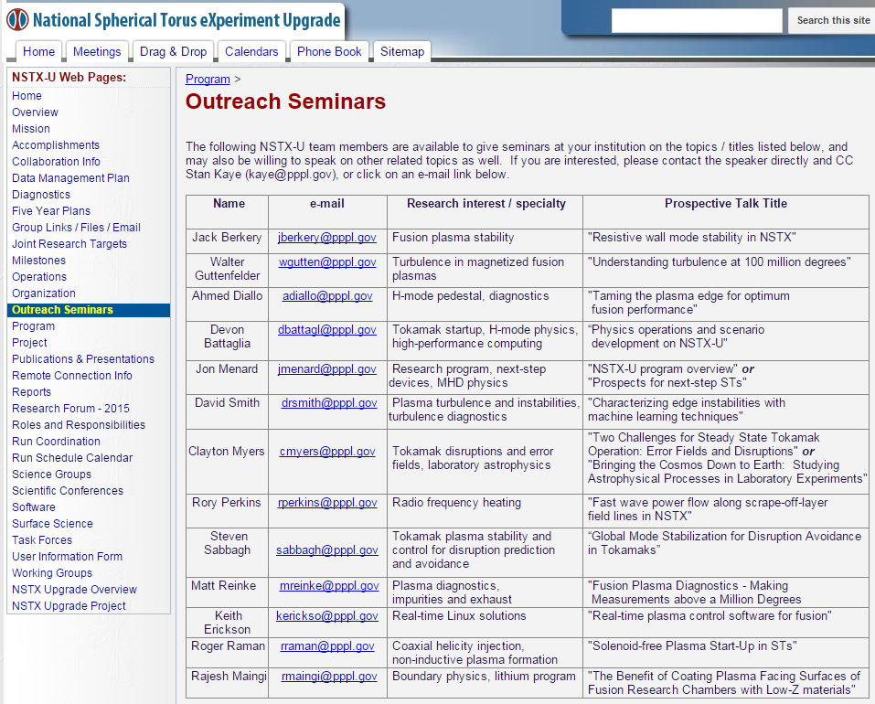
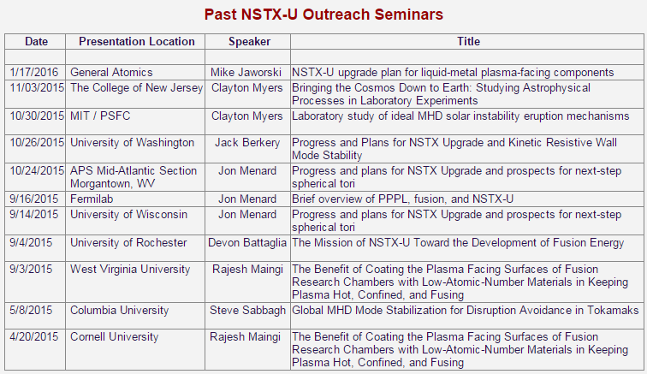
NSTX-U university collaborators spearheaded new outreach seminar effort –11 talks given so far
J. Berkery (CU), D. Smith (UW)

Slide 31
Research Forum held February 2015
Experimental proposals prioritized using several criteria:
Viability of proposal given available NSTX-U capabilities
OFES Joint Research Targets / Milestones
NSTX-U Research Milestones, Facility Enhancement design
ITER: Direct IO requests, ITPA: NSTX-U is leader / prominent
Experiments leading to high-profile publications/presentations:
  PRL, Science, Nature Invited talks: IAEA, APS, EPS, Sherwood, …
Career development: PhD thesis, post-doctoral research
Any good idea generated during run – potential “break-thru” ?
Maximize institutional / researcher breadth of XP leadership

Slide 32
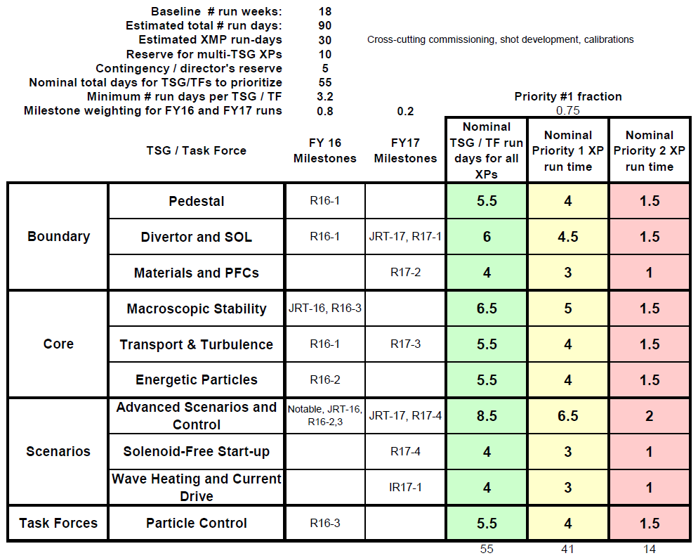
Very strong interest in NSTX-U research
Requested research time exceeds available time by factor of 4
Forum guidance / plan (Feb 2015): 16 run weeks
Recently incremented to 18 run weeks = 90 total run days
Requested / Available Run Time:
  Total: 273 / 90 = ~3×
  Research: 243 / 60 = ~4×
84 unique lead author names
TSG / TF run-time guidance for FY16:
~85% of requested time

Slide 33
Experimental proposal preparation and execution well underway
29 eXperimental Machine Proposals (XMP) for commissioning / calibration identified and/or written
  11 of the 29 already being executed (see Battaglia listing)
  Expect ~5-6 run weeks of XMP
27 eXperimental Proposals (XPs) written, reviewed for highest priority (P1a) experiments ~6 run weeks
►~1/2-2/3 of FY16 run-time has XMP/XP ready
Additional allocations:
  High priority experiments - P1b,c ~3.5-4 run weeks
  Priority P2a,b ~ 1.5-2 run weeks
  Reserve ~1 run week
For more info see: Master Spreadsheet of XMPs and XPs

Slide 34
Research Operations Goals for first 2 run-months
(still consistent with Forum guidance / assumptions)
Machine Commissioning – ~1 month (run weeks 1-4)
  Develop basic breakdown, current ramp, shape/position control, diverted plasmas, H-mode access, basic fuelling optimizations.
  Diagnostic commissioning
  Boronized PFCs
  Mostly XMPs
  Goal: 1 MA, 0.5 T, NBI-heated H-mode (i.e. ~NSTX fiducial levels)
1st Month of Science Campaign (run weeks 5-8)
  Boronized PFCs, possibly begin Li coatings (end of period)
  Operations and basic profile diagnostics, neutron rate,…
  HHFW available for commissioning
  6 beam sources up to 90 kV
  Operation up to 1.4 MA and 0.65 T, 2 seconds
We are here at
~2.5 run weeks
M. Ono talk will cover operational readiness

Slide 35
Outline
Events since PAC-35
Charge Questions
Mission and Capabilities of NSTX-U
Research Goals and Milestones
Key Scientific Issues NSTX-U Will Address
Organizational Structure
Run Coordination
Support for FESAC / FES Strategic Goals
Summary

Slide 36
Substantial leadership and participation in FES workshops by NSTX-U, collaborators, PPPL
Transients: 36% of 67 whitepapers: 13 for disruptions, 11 for ELMs
  Co-chair: R. Nazikian
  Disruptions: D. Brennan (co-lead), S. Sabbagh, D. Gates
  ELMs: R. Nazikian (lead), J. Canik (co-lead), O. Schmitz, W. Solomon
PMI: 29% of 56 whitepapers - evenly split among topical areas
  Chair: R. Maingi ← hosted by PPPL
  SOL / Div: R. Goldston, J. Myra, V. Soukhanovskii
  PMI / Div. Simulators: J.P. Allain (leader), M. Jaworski, B. Wirth
  Engineering Innovation: C. Kessel (leader), R. Ellis, R. Majeski
  Core-edge Integration: J. Canik, M. Kotschenreuther, R. Majeski, R. Wilson
  Cross-cutting: R. Maingi, J. Menard, H. Neilson
Integrated Modeling: 24% of 119 whitepapers – Disruptions, WDM
  Disruptions: D. Brennan (co-lead), S. Gerhardt, S. Jardin
  Boundary: J. Canik, C-S Chang, G. Hammett
  Whole Device Modelling: C. Kessel (co-lead), B. Grierson, S. Kaye, F. Poli
  Multi-Physics, multi-scale: G. Fu, G. Hammett
  Data Management / Software Integration: S. Kaye / F. Poli

Slide 37
NSTX-U research program well aligned with FESAC / FES strategic priorities
Advancing predictive capability, model validation
  See NSTX-U / Theory Partnership and Science Group talks
Supporting integrated modeling, exascale computing
  See TRANSP + Integrated Scenarios talks, XGC applications
Mitigating / avoiding transients (disruptions, ELMs)
  See Boundary and Core Science Group talks, DPAM talk
Taming the PMI (Divertor, SOL, first wall, PFCs)
  See Boundary Science and high-Z / liquid metal plan talk
Establishing physics basis for FNSF / next-steps
  Contributions from all talks
Supporting discovery science, basic plasma physics
  Reconnection / plasmoids in Partnership, Integrated Scenarios talks

Slide 38
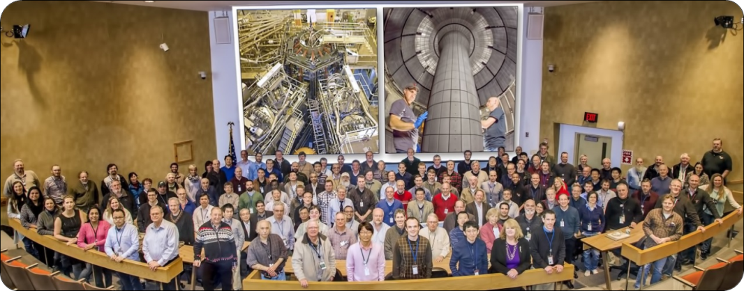
Summary: NSTX-U will make fundamental and world-leading contributions to toroidal fusion science
Investigate unique high-β, low collisionality regime for understanding transport and stability
Explore advanced divertors, high-Z and Li walls
Inform optimal configuration for next-steps
FY2016 run campaign is now underway!
  Thank you for your attention!

Slide 39
Backup

Slide 40
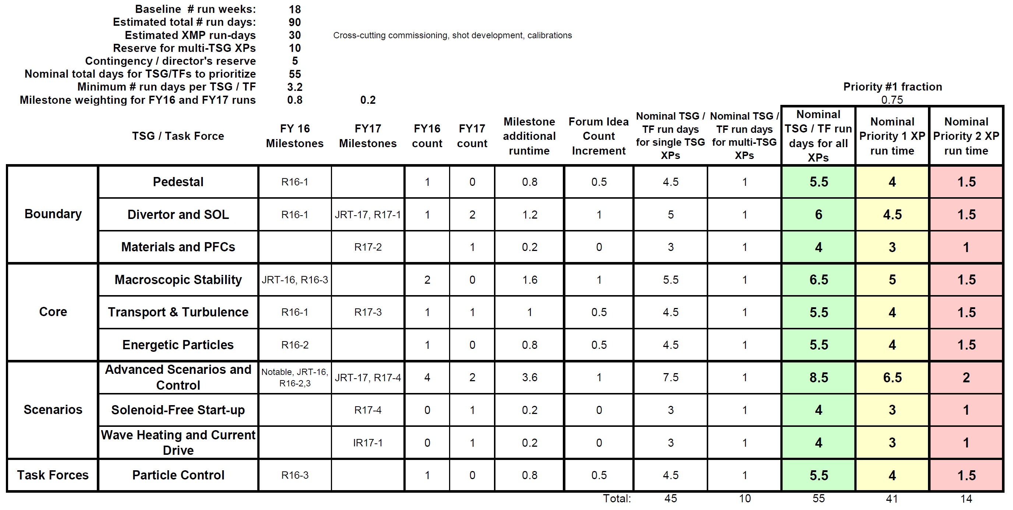
Run Time Guidance for XP Prioritization (January 2016)
Similar to Research Forum, but +1 week for XMP, +1 week for XP

Slide 41
NSTX-U 5 year plan: Develop physics/scenario understanding needed to assess ST viability as FNSF/DEMO, support ITER
2016 | 2017 | 2018 | 2019 | 2020 | 2021
Max B_{T} [T], I_{P} [MA]
0.8, 1.6
1, 2
Structural force
and coil heating
limit fractions
0.5, 0.5
1.0, 0.75
1.0, 1.0
Nominal τ_{pulse} [s]
1 – 2
2 – 4
4 – 5
Sustained β_{N}
3 – 5
4 – 6
NCC
5 – 6
ν* / ν* (NSTX)
0.6
0.4
Cryo
0.3 – 0.2
0.2 – 0.1
Inform choice
of FNSF/DEMO
aspect ratio
and divertor
Non-inductive
fraction (Δt ≥ τ_{CR})
70 – 90%
80 – 110%
90 – 120%
100 – 140%
NBI+BS I_{P} ramp-up: initial → final [MA]
0.6 → 0.8
0.5 → 0.9
0.4 → 1.0
ECH / EBW
CHI closed-flux
current [MA]
0.15 – 0.2
0.2 – 0.3
0.3 – 0.5
0.4 – 0.6
P_{heat} [MW] with
q_{peak} < 10MW/m²
8
10
15
20
Divertor heat-flux control
Snowflake and radiative divertor exhaust location
Lower
Lower or Upper
Lower + Upper
Cryo: access lowest ν*, compare to Li
ECH / EBW: bridge T_{e} gap from start-up to ramp-up
Off-midplane non-axisymmetric control coils (NCC): rotation profile control (NTV), sustain high β_{N}

Slide 42
NSTX-U engaged in 31 ITPA joint experiments / activities
 | Advanced Scenarios and Control
IOS-1.2 | Divertor heat flux reduction in ITER baseline scenario (considering)
IOS-1.3 | Operation near P_{LH} (considering)
IOS-2.1 | Compare helium H-modes in different devices (considering)
IOS-3.3 | Core confinement for q(0)=2 (considering)
IOS-5.2 | Maintaining ICRH coupling in expected ITER regime
 | Boundary Physics
PEP-26 | Critical edge parameters for achieving L-H transition
PEP-28 | Physics of H-mode access with different X-point height (considering)
PEP-29 | Vertical jolts/kicks for ELM triggering and control
PEP-30 | ELM control by pellet pacing in ITER-like conditions and consequences for plasma confinement
PEP-31 | Pedestal structure and edge relaxation mechanisms in I-mode (considering)
PEP-37 | Effect of low-Z impurity on pedestal and global confinement
DSOL-31 | Leading edge power loading and monoblock shaping
DSOL-34 | Far-SOL fluxes and link to detachment (considering)
DSOL-35 | In-out divertor ELM energy density asymmetries (consdiering)
 | Macroscopic Stability
MDC-1 | Disruption mitigation by massive gas jets
MDC-8 | Current drive prevention/stabilization of NTMs (considering)
MDC-15 | Disruption database development
MDC-17 | Active disruption avoidance
MDC-18 | Evaluation of axisymmetric control aspects
MDC-19 | Error field control at low plasma rotation
MDC-21 | Global mode stabilization physics and control
MDC-22 | Disruption prediction for ITER
 | Transport and Turbulence
TC-9 | Scaling of intrinsic plasma rotation with no external momentum input (considering)
TC-10 | Experimental identification of ITG, TEM and ETG turbulence and comparison with codes
TC-11 | He and impurity profiles and transport coefficients
TC-14 | RF rotation drive (considering)
TC-15 | Dependence of momentum and particle pinch on collisionality
TC-17 | ρ* scaling of intrinsic torque (considering)
TC-19 | Characteristics of I-mode plasmas (considering)
TC-24 | Impact of resonant magnetic perturbations on transport and confinement (considering)
 | Energetic Particles
EP-6 | Fast ion losses and associated heat loads from edge perturbations (ELMs and RMPs)

Slide 43
Roles / Responsibilities for Task Forces
Long-pulse particle control
Address specific operational and/or scientific goal that cuts across or impacts multiple SGs / TSGs
Goal must be very high priority within research program
Receives dedicated run-time, and has dedicated session at Research Forum
  Similar to a TSG, but may not necessarily have theory/modelling or university representatives – depends on duration or scope
Organizes experimental proposals to achieve goal
Finite duration - nominally 1-2 years, renewable if necessary
TF leadership should nominally have a leader and a deputy, and should include at least 1 collaborator if possible
Reports directly to Program / Project

Slide 44
Roles / Responsibilities for Working Groups
DPAM: Prep for JRT-16, understand then avoid causes of disruptions in NSTX-U
Respond to specific programmatic or technical charge from NSTX-U Program or Project
Addresses issues that cross-cut more than one SG or TSG
Nominal lifetime = 1-2 years, can be extended/renewed
Provides points of contact between NSTX-U and other groups as necessary (e.g. PPPL theory, FESAC, ITPA, ITER)
Does not have dedicated NSTX-U run time, but provides recommendations on XP prioritization, other resource needs
WG leadership should nominally have a leader and a deputy, and should include at least 1 collaborator if possible
Multi-facility and multi-institutional effort

Slide 45
NSTX-U = National Spherical Torus eXperiment - Upgrade
Highly collaborative research program
Domestic (33)
International (22)
402 team members
290 scientists
(~70% non-PPPL)
55 institutions
22 US Universities

