Slide 1

Overview of NSTX-U Facility and Diagnostic Status and Plans
Masa Ono
NSTX-U PAC 37
January 26 - 28, 2016

Slide 2
Presentation Outline
Completion of NSTX Upgrade Project
NSTX-U Facility Commissioning
Facility Operations Status and Plan
Facility Enhancement Status and Plan

Slide 3
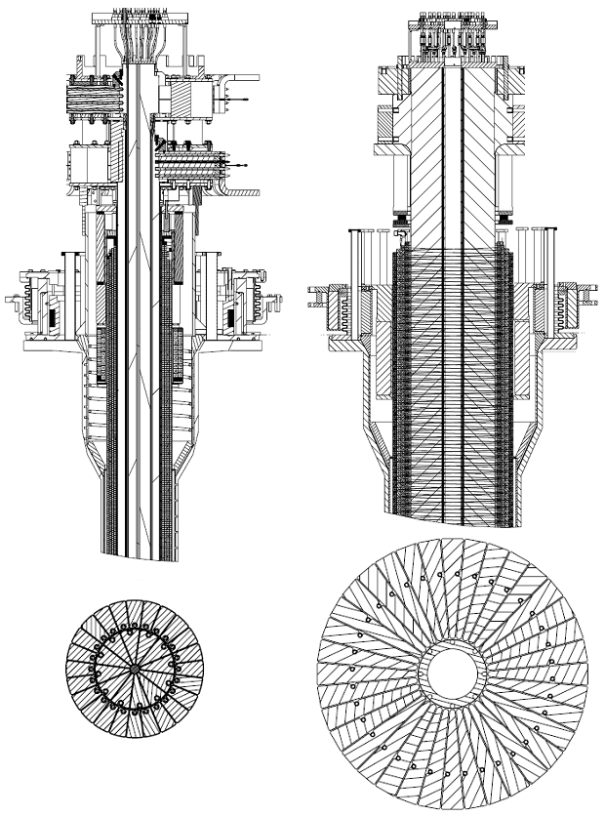
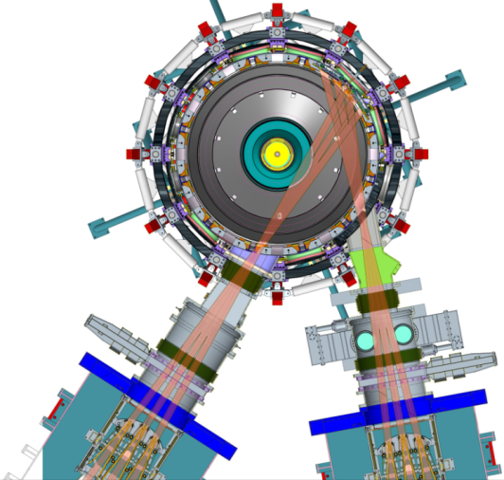
New CS and 2nd NBI are two main upgrade elements
to provide data base to support ST-FNSF designs and ITER operations
Previous
center-stack
New
center-stack
New CS provides higher x2 B_{TF} (improves stability), 3-5s needed for J(r) equilibration
  CS Fabrication: 1T, 5s TF and 2 V-S OH
  Structural enhancement due to x 4 E&M forces
  Ancillary systems – power systems & I & C
More tangential injection provides 3-4x higher CD at low I_{P} for full non-inductive operation
  Relocate 2nd NBI from refurbished TFTR NBI system
  Tangential port installation
  Port relocation and test cell rearrangement
TF OD = 20cm
TF OD = 40cm
Upgrade Project completed on budget and on schedule in September 2015.
Present NBI
New 2nd NBI

Slide 4
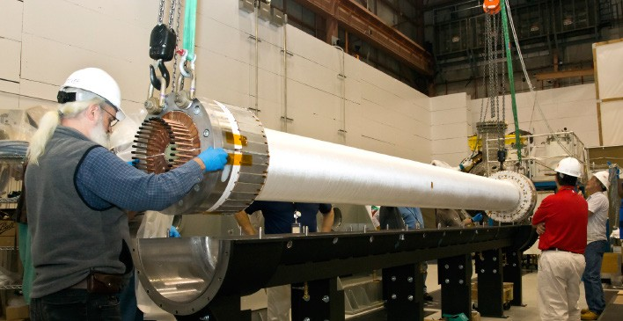
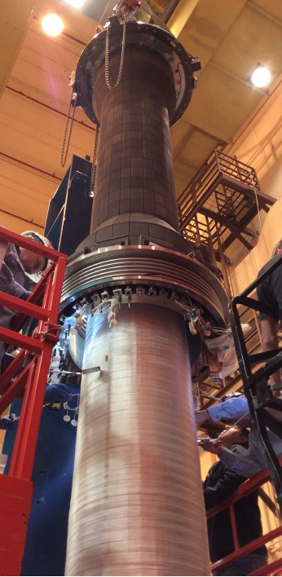
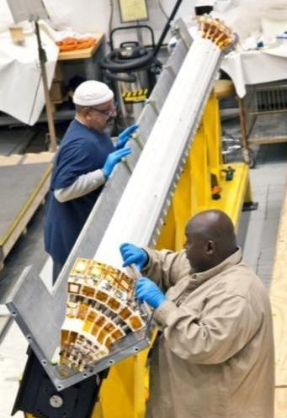
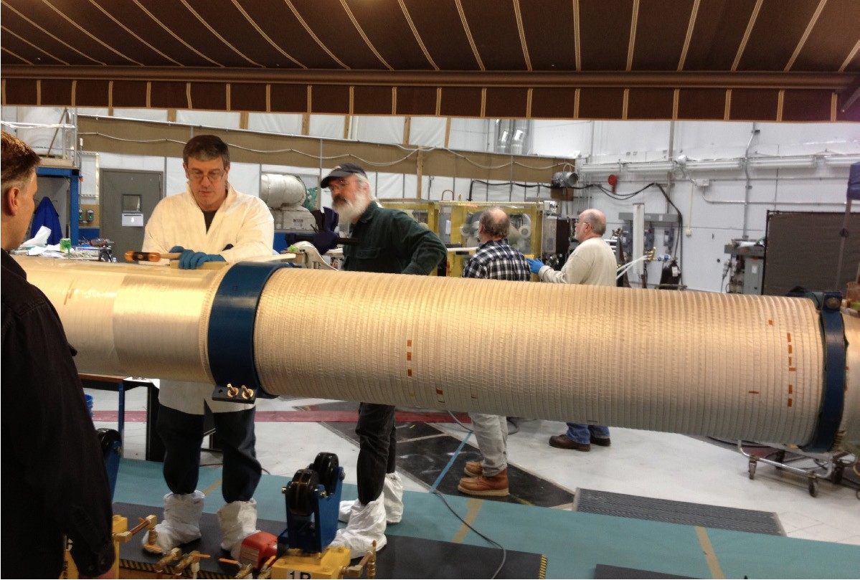
Central magnet construction was complex, multi-stage, multi-year effort
Built 4 toroidal field (TF) quadrants
Install vacuum- tight casing over TF + OH bundle
Combine quadrants (5th VPI)
Wind ohmic heating (OH) coil over TF, then final 6th VPI
4 vacuum pressure impregnations (VPI)
4

Slide 5

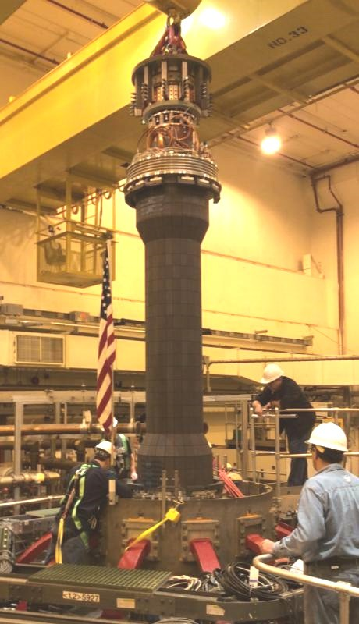


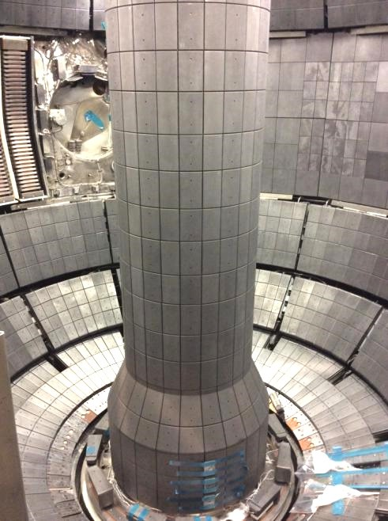
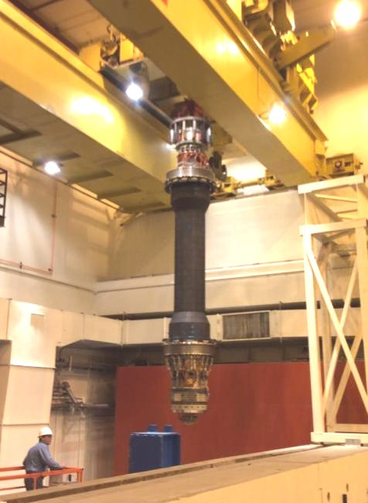
Fabrication and installation of central magnet ultimately successful
Over the machine
Over shield wall
Inside NSTX-U!
5

Slide 6
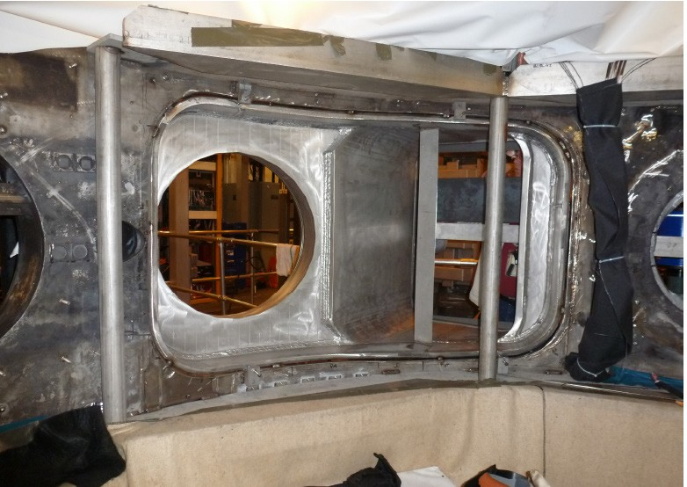
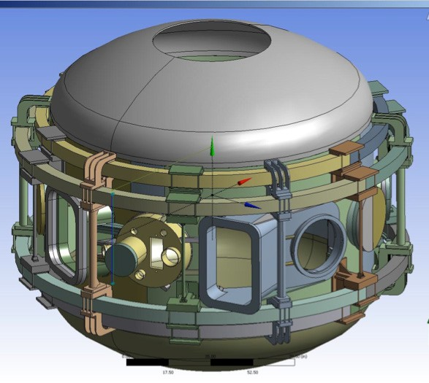

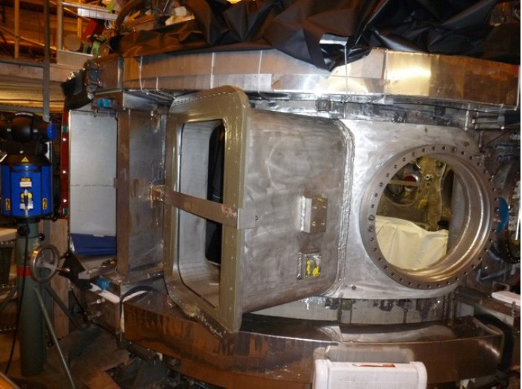

Tangential neutral beam required major vacuum vessel modifications
Interior View of Bay J-K
Exterior View of Bay J-K
2nd NBI “Bay Window”
6

Slide 7
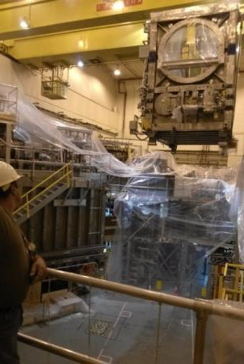
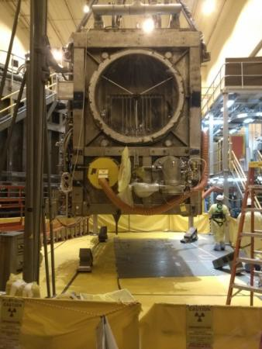
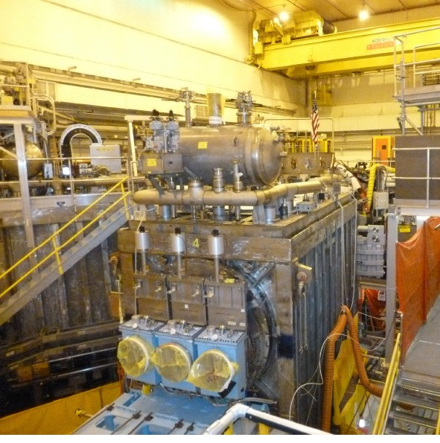
2nd beam (from TFTR DT campaign) required
T-decontamination, NSTX test-cell re-arrangement
Beam Box being lifted over NSTX
Beam Box placed in its final location and aligned
Beam Box being populated with components
7

Slide 8
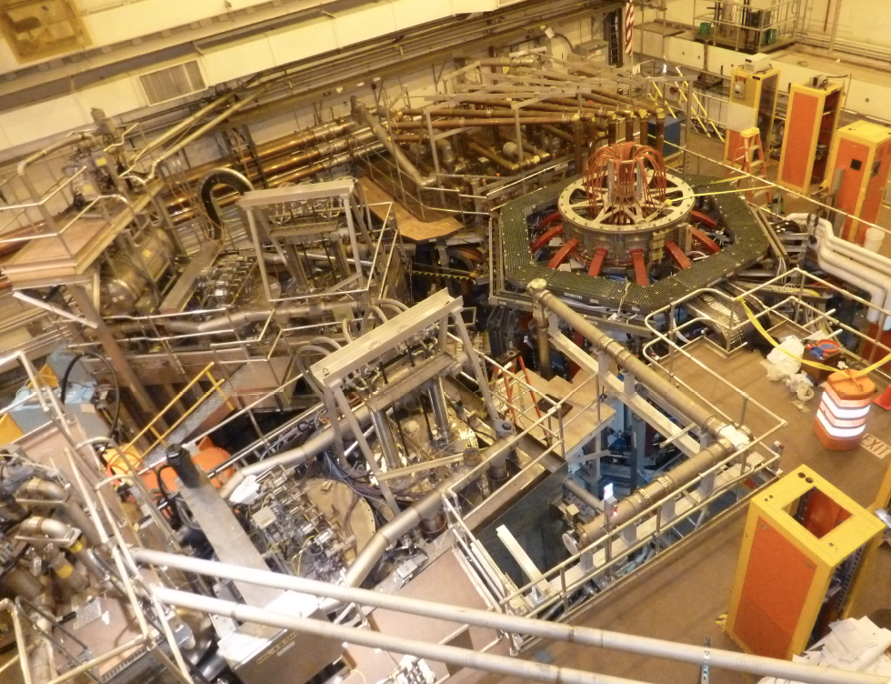
NSTX-U Facility Is Now Operational
Achieved First Plasma on August 10, 2015
HHFW System
NSTX-U
1st NBI
2nd NBI
MPTS Exit Flight Tube

Slide 9
Presentation Outline
Completion of NSTX Upgrade Project
NSTX-U Facility Commissioning
Facility Operations Status and Plan
Facility Enhancement Status and Plan

Slide 10
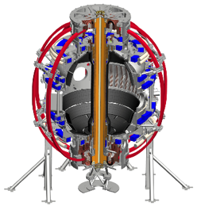
Digital System Provides Electromechanical Coil Protection
DCPS supporting the research operation very nicely
Protects the NSTX-U coils and mechanical structure against electromagnetic loads
Computes forces and stresses in realtime based on reduced models of the full mechanical structure
Redundant systems
Full commissioning of the system went very well; DCPS is now routinely supporting operations.
Power Supply Suppress and Bypass
Coil and Plasma Current Measurements
Realtime Acquisition #1
Realtime Acquisition #2
Stand Alone Digital Coil Protection Computer
Digital Coil Protection & Plasma Control Computer
Level-1 Fault Interface
Rectifier Hardware Controls
Discussions on going with ITER for collaboration
Notes:
A bunch of sensors give conditioned current inputs
Output is Go/NoGo… Fault/No Fault

Slide 11
Excellent Progress on Magnetic Diagnostics
Plasma current, loop voltage, poloidal flux and field measurements in good shape supporting EFIT.
  All integrators recalibrated
  Rogowski coils fully calibrated, and pickup compensations established
  All Mirnov sensors and flux loops have had their position determinations refined based on calibration shots.
New diamagnetic loop system is now operational also supporting EFIT.
  Based on using the Rogowski return loop as a diamagnetic loop.
  Successfully implemented and eliminated the old TF-coil diamagnetic system.
High-n and high-f array is taking data.
  Used for detecting rotating Kink/Tearing modes, *AE modes.
RWM sensors are writing mode fit data to the tree.
  Realtime RWM sensor codes have also been upgraded, now in testing.
11

Slide 12
Significant Progress in Plasma Control System
Now supporting the research operations
PCS has been supporting plasma operations.
  Pre-programmed PF control & simple radial and vertical position control, I_{P} control.
  Gas injection and pre-fill control
  Real-time magnetic sensor calibrations
  Beam control from PCS
  Automatic discharge shutdown following disruption detection.
  rtEFIT running in the background on the control machines
  RWM/EF coil current control from PCS has been restored.
Some older less-reliable real-time digitizers have been replaced, and a new every-shot latency measurement system has been implemented.
Near term PCS steps
  Finish testing rtEFIT and begin to use ISOFLUX shape control
  Finish the recommissioning of the RWM/EF control algorithms
  Then move on to profile control and snowflake divertor control.
12

Slide 13
NSTX-U diagnostics to be installed during first year
More than half are led by collaborators
Ready now/commissioning
  Magnetics for equilibrium reconstruction
  Halo current detectors
  High-n and high-frequency Mirnov arrays
  RWM / Locked-mode sensors
  MPTS (42 ch, 60 Hz)
  T-CHERS: T_{i}(R), V_{φ}(r), n_{C}(R), n_{Li}(R), (51 ch)
  P-CHERS: V_{θ}(r) (71 ch)
  Edge Rotation Diagnostics (T_{i}, V_{φ}, V_{pol})
  Midplane ME-SXR (200 ch)
  Midplane tangential AXUV bolometer array (40 ch)
  Ultra-soft x-ray arrays – multi-color
  Fast Ion D_{α} profile measurement (perp + tang)
  Solid-State neutral particle analyzer
  Neutron measurements
  Charged Fusion Product
  Fast IR camera (two color)
  Material Analysis and Particle Probe
  AXUV-based Divertor Bolometer
  Tile temperature thermocouple array
  Fast visible cameras
  Visible bremsstrahlung radiometer
  Visible and UV survey spectrometers
  VUV transmission grating spectrometer
  Visible filterscopes (hydrogen & impurity lines)
  Wall coupon analysis
  1-D CCD H_{α} cameras (divertor, midplane)
  2-D divertor fast visible cameras (4)
  Two-color intensified 2D cameras TWICE (2)
  Edge neutral density diagnostic ENDD
  IR cameras (30Hz) (3)
  Dust detector
  Edge Deposition Monitors
  Scrape-off layer reflectometer
  Edge neutral pressure gauges
Ready by mid-run
  Fast lost-ion probe (energy/pitch angle resolving)
  Microwave Reflectometer
  Beam Emission Spectroscopy (48 ch)
  MSE-CIF (18 ch)
  MSE-LIF (20 ch)
  SAMI edge field pitch diagnoistc
  Divertor VUV Spectrometer (SPRED)
  Gas-puff Imaging (500kHz)
  Langmuir probe array
  Divertor fast eroding thermocouple
Ready by end of run
  FIReTIP interferometer
Ready next run year
  Poloidal FIR high-k scattering
  Midplane metal foil bolometer
  Metal foil divertor bolometer
New capability,
Enhanced capability
13

Slide 14
Presentation Outline
Completion of NSTX Upgrade Project
NSTX-U Facility Commissioning
Facility Operations Status and Plan
Facility Enhancement Status and Plan

Slide 15
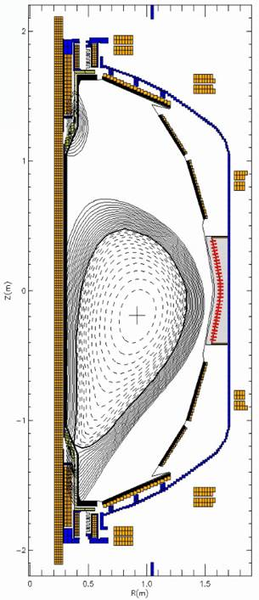
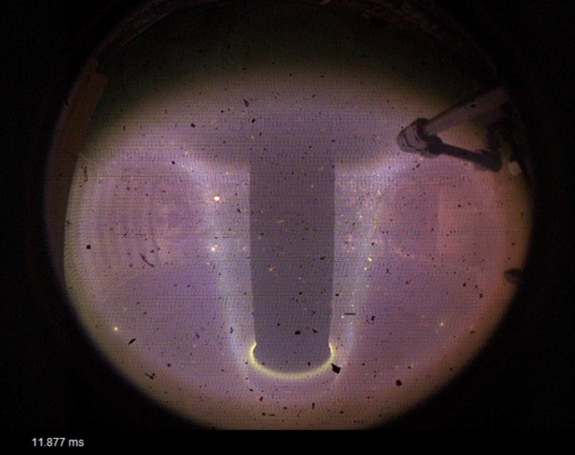
CD-4 KPP #1 Plasma achieved on August 10, 2015
Upgrade Project successfully closed on budget and on schedule
Shot 201085
Time: 28ms
I_{p} = 117 kA
B_{T0} = - 0.482 T
R₀ = 0.8 m
Z₀ = - 0.2 m
I_{wall} ~ 0.4 MA
EFIT I_{p}
CD-4 KPP Target
Calibrated and compensated magnetics, EFITs plasma movie all showed consistent pictures
15

Slide 16
FY 2016 plasma operations started
Expecting to run 18 run weeks in FY 2016
November 2015
December 2015
January 2016
February
Post bake
ISTP
Holiday
Plasma Operation
Maintenance
ISTW 2015
APS
Plasma Operations started on Dec. 18.
Boronizations
PAC 37
H-Mode!
• After CD-4, we vented briefly to install various items before the bake.
• Bakeout was completed with good vacuum pressure in October
• During ISTP, MGs experienced control problem during ISTP. The problem resolved and MG#1 is supporting the operations.
• Plasma operation started on Dec. 18 and ran for 2.5 days before the holiday.
• The first boronization performed on Jan. 4, 2016 and performed three times.
• NBI injection started and H-mode access achieved quickly.
Plasma Operations progressed rapidly as reported by D. Battaglia
16

Slide 17
NBI Heating System Status
Plan to start all sources after this maintenance period
Neutral Beam #2:
  N2A and N2B Sources have experienced fault at 60 kV. The problem traced to the transmission lines between the source and the high voltage enclosure (HVE). (See the back up slide for the transmission line arc repair.) The repair should be complete during this maintenance period.
  N2C Source is at 75 kV – being injected into the plasma
Neutral Beam #1
  All three NB#1 ion sources have completed arc conditioning, and are being High Voltage conditioning.
  N1A Source is at ~ 80 kV – has been injecting into the plasma
  N1B Source is at 60 kV - has been injecting into the plasma
  N1C Source is at 87 kV – has been injecting into the plasma
  Over 4 MW level injection achieved, routine H-mode operations
17

Slide 18
Latest run plan schedule for 2016
Goal is to operate 18 run weeks
FY16 budgets are favorable enough to support 18 weeks
Want as much data as possible for IAEA synopses/meeting, APS-2016
December: 0.5 run weeks (XMP)
January: ~ 2 run weeks (XMP, XP), PAC-37
Two week maintenance: Ar-PS, LITER, LGI, Diagnostics
• February: ~ 3 run weeks
March ~ 3 run weeks
  Mid-run assessment in March/April
April – June 9.5 run weeks, complete FY16 run
July: Start outage: install high-k, high-Z tiles, …
Resume operations winter 2017 for FY17: ~16 run weeks
18

Slide 19
NSTX-U device performance progression
1st year: Limit forces to ½ way between NSTX and NSTX-U, and ½ of the design-point heating of any coil
  Presently operating at B_{T} ~ 0.65T
  Increase to B_{T} ~ 0.8T after completing engineering analysis
2nd year goal: Full field and current, coil heating to ¾ of limit
3rd year goal: Full capability
Parameter | NSTX (Max.) | Year 1 NSTX-U Operations | Year 2 NSTX-U Operations | Year 3 NSTX-U Operations | NSTX-U Ultimate Goal
I_{P} [MA] | 1.2 | ~1.6 | 2.0 | 2.0 | 2.0
B_{T} [T] | 0.55 | ~0.8 (0.65) | 1.0 | 1.0 | 1.0
Allowed TF I²t [MA²s] | 7.3 | 80 | 120 | 160 | 160
I_{P} Flat-Top at max. allowed I²t, I_{P}, and B_{T} [s] | ~0.4 | ~3.5 | ~3 | 5 | 5
19

Slide 20
Presentation Outline
Completion of NSTX Upgrade Project
NSTX-U Facility Commissioning
Facility Operations Status and Plan
Facility Enhancement Status and Plan

Slide 21
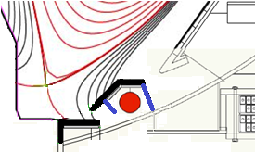
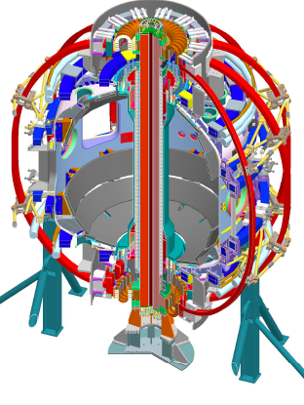
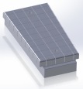
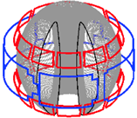
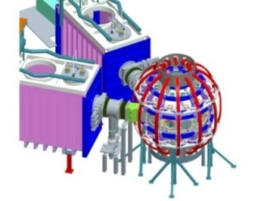
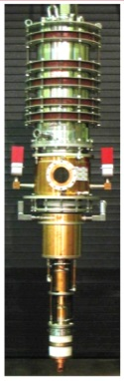
Five Year Facility Enhancement Plan (green – ongoing)
2015: Engineering design for high-Z tiles, Cryo-Pump, NCC, ECH
Fiscal Year:
2015 | 2016 | 2017 | 2018 | 2019
Major enhancements:
Base funding
+15% incremental
Upgrade Outage
1.5 → 2 MA, 1s → 5s
Run Weeks:
18
16
12-16
10-12
New
center-stack
Pulse-burst MPTS
Lower divertor cryo-pump
Boundary Science
+ Particle Control
Boronization
High-Z tile row on lower OBD
High-Z PFC diagnostics
Li granule injector
LiTER
Upward
LiTER
LLD using bakeable cryo-baffle
MAPP
MGI disruption mitigation
Upgraded halo sensors
Off-midplane 3D coils (NCC)
Core Science
δB diag. - incremental
Enhanced MHD sensors
Laser blow-off
42 ch MPTS
DBS, PCI, or other intermediate-k
48 ch BES
High k_{θ}
MSE/LIF
Charged fusion product
Neutron collimator
4 coil AE antenna
Establish control of:
Rotation
q_{min}
HHFW limiter upgrade
Snowflake
Integrated Scenarios
FIReTIP
n_{e}
Divertor P_{rad}
2nd NBI
1 MW ECH/EBW
Upgraded CHI for ~0.5MA
0.5-1 MA CHI
up to 1 MA plasma gun
21

Slide 22
Five Year Facility Enhancement Plan (green – ongoing)
2015: Engineering design for high-Z tiles, Cryo-Pump, NCC, ECH
Fiscal Year:
2015 | 2016 | 2017 | 2018 | 2019
Major enhancements:
Base funding
+15% incremental
Upgrade Outage
1.5 → 2 MA, 1s → 5s
Run Weeks:
18
16
12-16
10-12
New
center-stack
Pulse-burst MPTS
Lower divertor cryo-pump
Boundary Science
+ Particle Control
Boronization
High-Z tile row on lower OBD
High-Z PFC diagnostics
Li granule injector
LiTER
Upward
LiTER
LLD using bakeable cryo-baffle
MAPP
MGI disruption mitigation
Upgraded halo sensors
Off-midplane 3D coils (NCC)
Core Science
δB diag. - incremental
Enhanced MHD sensors
Laser blow-off
42 ch MPTS
DBS, PCI, or other intermediate-k
48 ch BES
High k_{θ}
MSE/LIF
Charged fusion product
Neutron collimator
4 coil AE antenna
Establish control of:
Rotation
q_{min}
HHFW limiter upgrade
Snowflake
Integrated Scenarios
FIReTIP
n_{e}
Divertor P_{rad}
2nd NBI
1 MW ECH/EBW
Upgraded CHI for ~0.5MA
0.5-1 MA CHI
up to 1 MA plasma gun
22

Slide 23
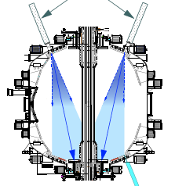
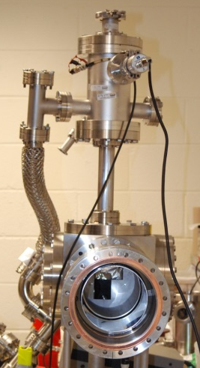
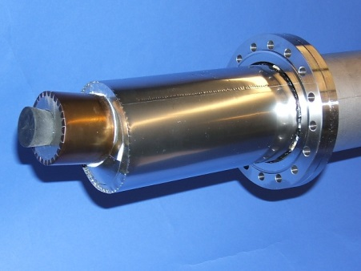
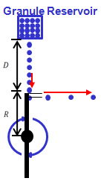
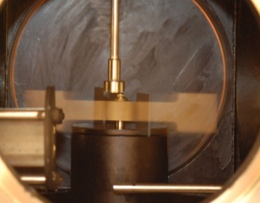
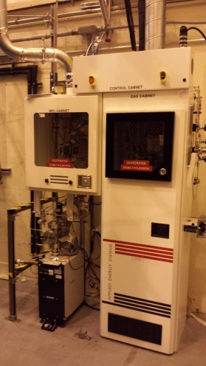
First Year Boundary Physics Tools
Boronization, Lithium Evaporators, Granule Injector
Lithium Evaporator (LITERs)
LITERs
Granule injector (GI) for ELM pacing
Successfully tested
on EAST and DIII-D
Granules: Li, B₄C, C
f ~ up to 500 Hz
Granular Reservoir
• LITERs filing set up in high bay south of NSTX-U Test Cell
• Argon purge system being implemented for safety
Rotating Impeller
• Remote control undergoing tests
• Stand complete
• Vacuum interlock requirements identified and implementation plan specified
Boronization System
dTMB Gas Cabinet
for safety
• Multiple injection and glow made more uniform boronization.
• System is working very well. Third boronization complete. Also being used for He glow discharges.
23

Slide 24
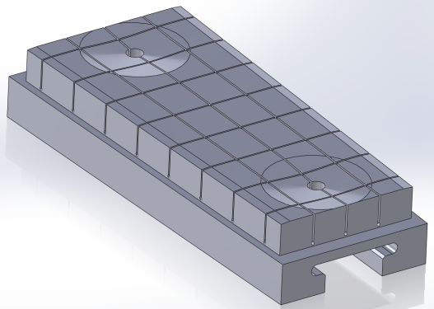
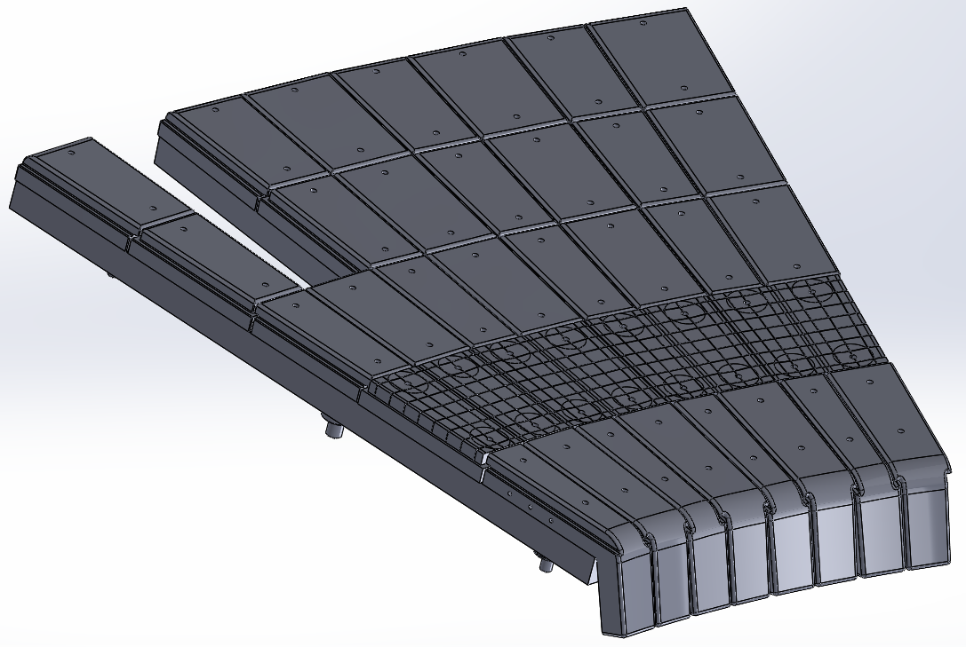
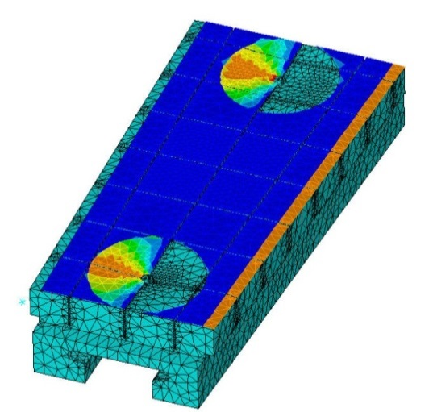
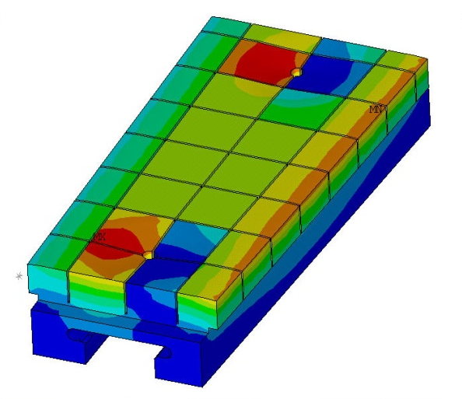
High-Z Tile Design Nearly Complete
(See M. Jaworski’s PAC talk for more detail - plan to be ready by the 2016 outage)
Successful PDR held in
December
  Final drawings and installation issues
  nearly complete (FDR mid-Feb.)
  82% of raw materials on-site
Final design rated to 10 MW/m² for 1s heat flux for 1000s of cycles
  Installation flexibility introduced to accommodate “as built” vessel tolerances
  Edge and access-way chamfers introduced to reduce heat-flux peaking
Design “lesson’s learned” already informing cryo-pump PFC design
  Geometric flexibility emphasized to avoid stress-limited design
  Tight tolerancing in sub-structure emphasized to avoid time-intensive installation tasks
Surface heat flux
Temperature
24

Slide 25
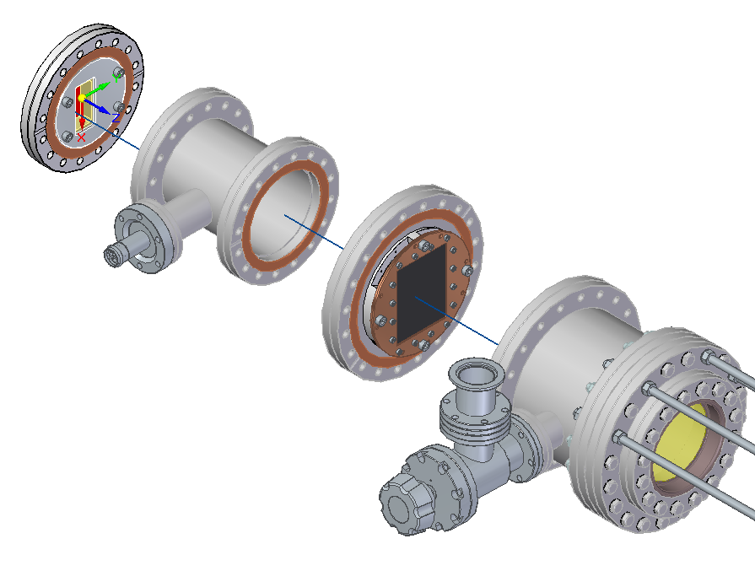
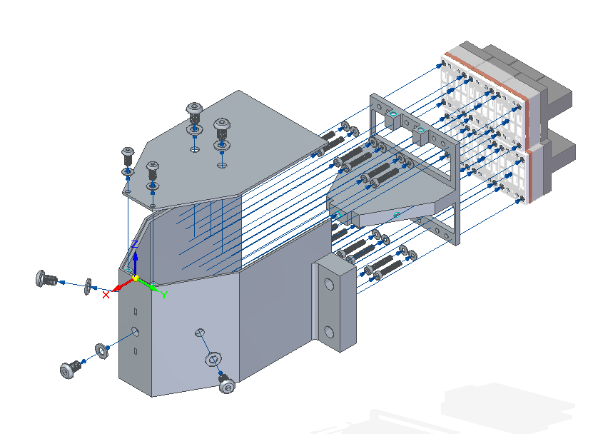
NSTX-U Developing Tools for Measuring
Core and Boundary Radiation
Prototype IR video bolometer (IRVB) with NIFS and DIFFER
Redesign and expand bolometer diagnostics to support FY17 operations
  16 ch of lower divertor viewing for boundary radation
  24 ch tangential midplane core radiation
plasma
thin Pt foil, heated by radiation, imaged by IR camera
testing 32-ch system for viewing lower x-pt late in FY16 campaign
Midplane Bolometer
CDR Nov. 2015
M. Reinke, ORNL
25

Slide 26
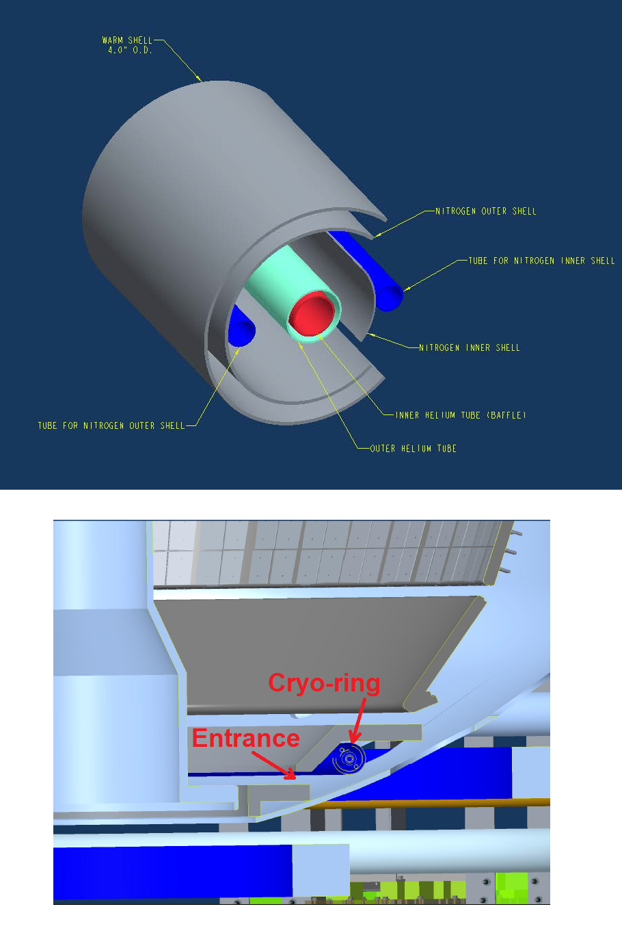

Divertor Cryo-pump Design Activities Started
Physics Design Described at PAC 33 by J. Canik, ORNL
Initial in-vessel geometry has been laid out. MIT will design cryo-ring.
  Pump radius, throat dimensions taken from the modeling.
  Is a significant perturbation, requiring a rebuild of basically the entire lower outer divertor.
  High-Z tile research will contribute to the choice of PFCs (see M. Jaworski’s talk)
Specification in progress for the Liquid He refrigerator.
  Likely suitable model found
  Location in room adjacent to NSTX-U has been identified.
Ex-vessel liquid He plumping and transfer Dewar is under design.
Cryo-ring
Transfer line layout
26

Slide 27
Five Year Facility Enhancement Plan (green – ongoing)
2015: Engineering design for high-Z tiles, Cryo-Pump, NCC, ECH
Fiscal Year:
2015 | 2016 | 2017 | 2018 | 2019
Major enhancements:
Base funding
+15% incremental
Upgrade Outage
1.5 → 2 MA, 1s → 5s
Run Weeks:
18
16
12-16
10-12
New
center-stack
Pulse-burst MPTS
Lower divertor cryo-pump
Boundary Science
+ Particle Control
Boronization
High-Z tile row on lower OBD
High-Z PFC diagnostics
Li granule injector
LiTER
Upward
LiTER
LLD using bakeable cryo-baffle
MAPP
MGI disruption mitigation
Upgraded halo sensors
Off-midplane 3D coils (NCC)
Core Science
δB diag. - incremental
Enhanced MHD sensors
Laser blow-off
42 ch MPTS
DBS, PCI, or other intermediate-k
48 ch BES
High k_{θ}
MSE/LIF
Charged fusion product
Neutron collimator
4 coil AE antenna
Establish control of:
Rotation
q_{min}
HHFW limiter upgrade
Snowflake
Integrated Scenarios
FIReTIP
n_{e}
Divertor P_{rad}
2nd NBI
1 MW ECH/EBW
Upgraded CHI for ~0.5MA
0.5-1 MA CHI
up to 1 MA plasma gun
27

Slide 28
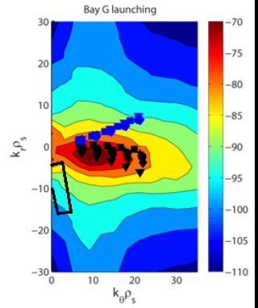
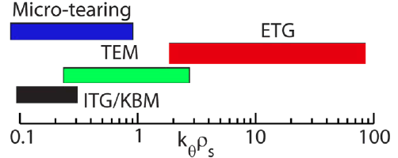
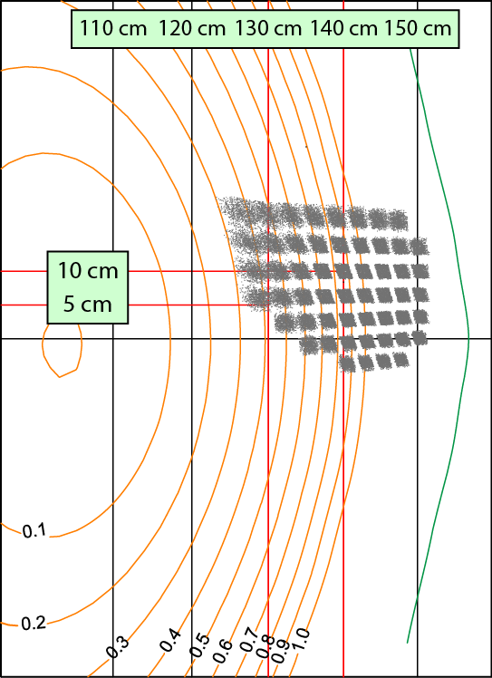
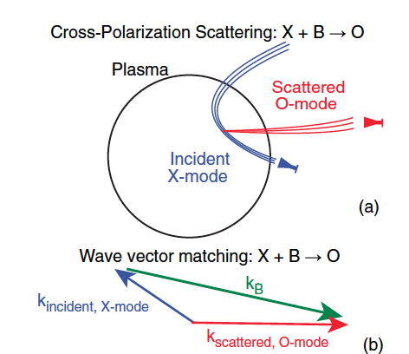
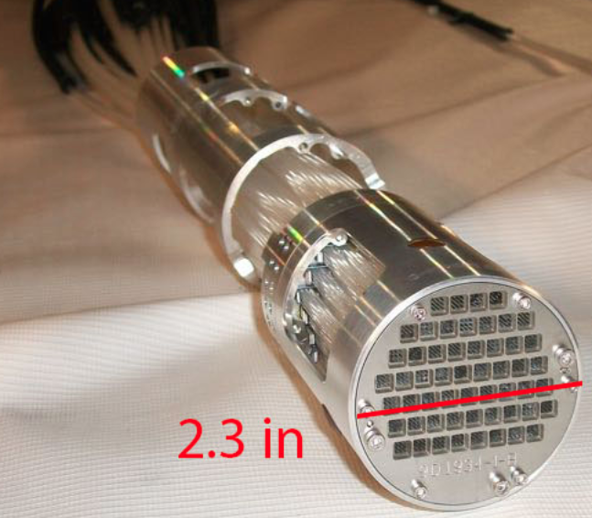
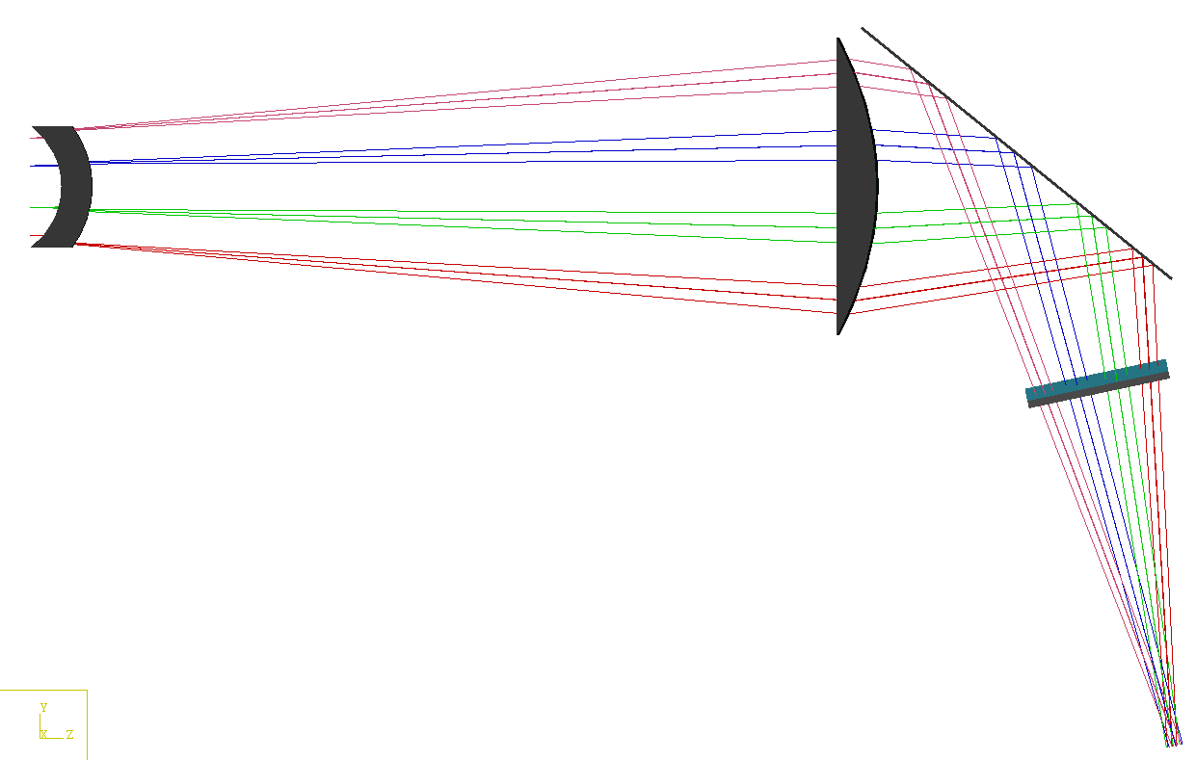
Microturbulence Diagnostics Being Enhanced
To measure ion to electron gyro-scale, magnetic fluctuations
Beam Emission Spectroscopy
for low k turbulence
48 chs being readied
Low k
High-k scattering for ETG
High k
Cross-Polarization Scattering for magnetic fluctuations being developed in collaboration with DIII-D and MAST
UC Davis
BES-2D-Fiber
Assembly
Collection optics (Bay L)
4x1 subharmonic mixer array
U Wisconsin
UCLA
Available for FY 17

Slide 29
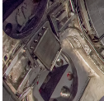
Enhanced FIDA will measure NBI distribution function
For NBI fast ion transport and current drive physics
Fast Ion D-Alpha Diagnostics
FIDA Views
• Both vertical (perpendicular) and new tangential (parallel) FIDA systems are ready.
• Both FIDA systems have 10 ms, 5 cm, ≈ 10 keV resolutions.
CHI Gap
Vertical
Center-Stack
Tangential
HHFW
Antennas
FY 2016 - 2017 Energetic Particle Conceptual Design and Diagnostic Upgrade
  SS-NPA installed but investigating pick-up problem.
  sFLIP is installed for lost ion measurements
  Active 2 X 2 TAE antennas installed. Initially passive spectroscopy then active excitation at few kW level.
  Proto-type charged fusion product (CFP) profile diagnostic to be installed this year.
  8+8 reflectometry array available for AEs.
TAE antennas
UCI
sFLIP
FIU
UCLA

Slide 30
Flexible Mid-Plane Feedback Coils for MHD Studoes
NCC will greatly enhance MHD physics studies and control
Full toroidal NCC array (2 x 12)
Partial toroidal NCC array (2 x 6)
Partial NCC
Full NCC
Existing
RWM
coils
Columbia U
General Atomics
• 6-channel Switching Power Amplifier (SPA) powers independent currents in existing EFC/RWM Coils.
• NCC (a facility enhancement) can provide various NTV, RMP, RWM, and EF selectivity with flexibility of field spectrum (n ≤ 6 for full and n≤ 3 for partial)
Base – Engineering design work on NCC to be performed in 2016 – 2017 to develop reliable cost and schedule.
30

Slide 31
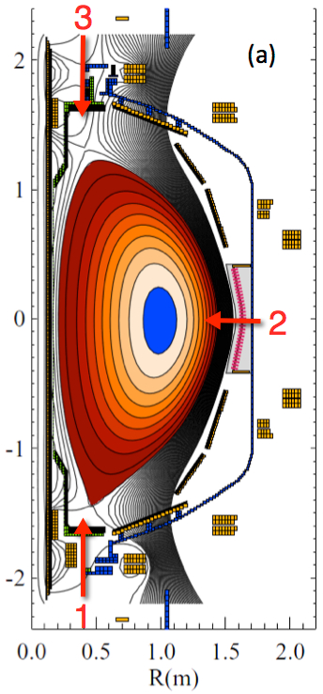
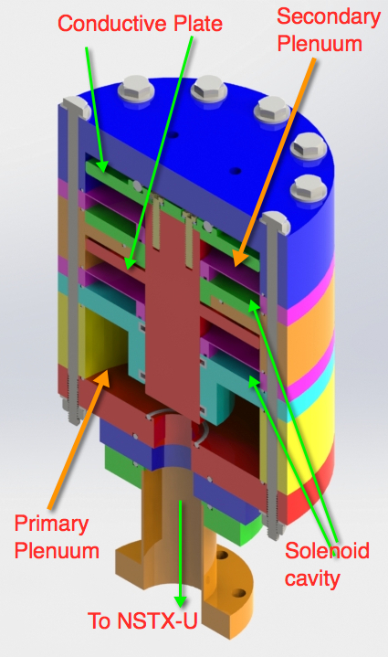
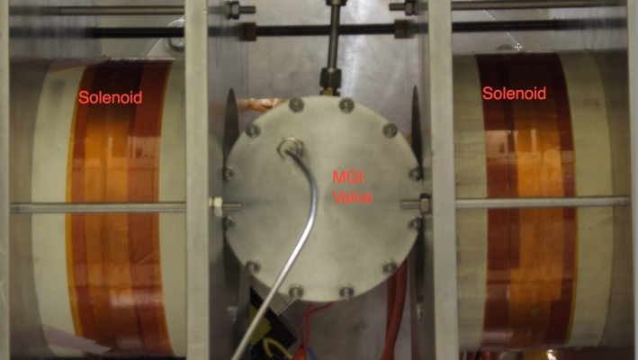
Disruption Mitigation System for NSTX-U
Massive gas injection system at multiple poloidal positions
NSTX-U MGI Valve
  - Massive gas injector system at multi
  poloidal location with identical injection set-up
  - Compact power supply proto-type tested at UW
  - A new double solenoid MGI design (zero net J x B
  torque) based on the ORNL ITER MGI design
  MGI also tested on the U. Washington test stand with magnetic field
Magnets
Magnets
MGI
Valve
U. Washington
• Conceptual Design Review of MGI system was held on October 16. Recommended changes were incorporated into the power system hardware.
• All the MGI components including MGI valves were delivered to PPPL from U. Washington.
• Preparation are being made to commission the MGI system on NSTX-U this year.

Slide 32
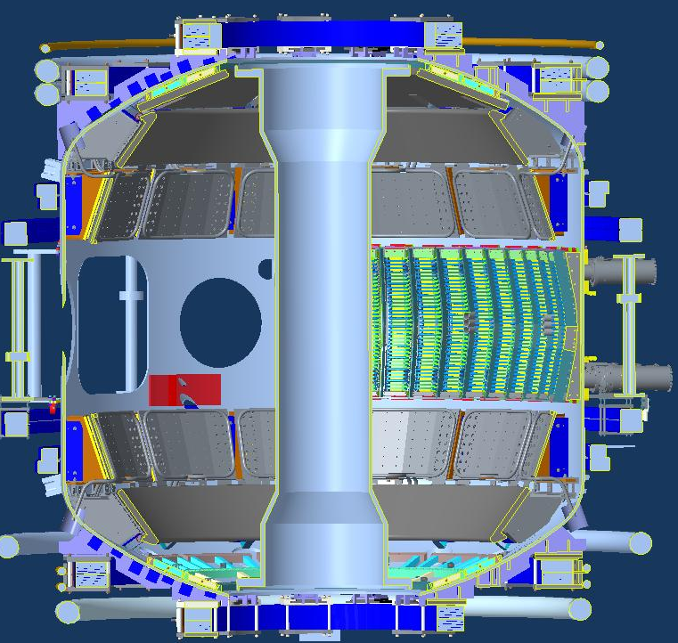
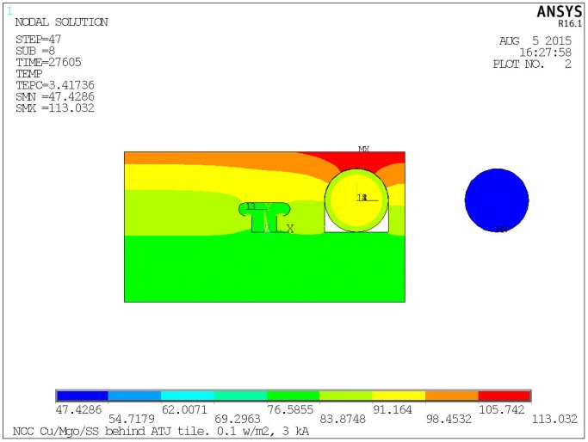


NCC Lorentz and Thermal
Stress Analysis
NCC Coils Design Activity Made Significant Progress
NCC Physics Design Presented by J-K Park at PAC 33
NCC = Non-axisymmetric Control Coil
2 x 12
Coil
Thermal Analysis
Tile
End of Last Pulse Temp (8 hours)
PP
Lead
3 kA,0.1 MW/m2 Plasma Heating,5s pulse,1200 s reprate
• Selected candidate conductors and test sample received for R&D.
• The R&D selection criteria include thermal capability, manufacturability, impact on interfacing objects, fabrication lead time and cost.
• Helium cooling system or no direct cooling options will be quantified.
• Cost and schedule will be prepared as part of the CDR which is targeted for May, 2016.
With Lead Clamp, 50 C Heat-up, 3kA+ Background Field
32

Slide 33
Five Year Facility Enhancement Plan (green – ongoing)
2015: Engineering design for high-Z tiles, Cryo-Pump, NCC, ECH
Fiscal Year:
2015 | 2016 | 2017 | 2018 | 2019
Major enhancements:
Base funding
+15% incremental
Upgrade Outage
1.5 → 2 MA, 1s → 5s
Run Weeks:
18
16
12-16
10-12
New
center-stack
Pulse-burst MPTS
Lower divertor cryo-pump
Boundary Science
+ Particle Control
Boronization
High-Z tile row on lower OBD
High-Z PFC diagnostics
Li granule injector
LiTER
Upward
LiTER
LLD using bakeable cryo-baffle
MAPP
MGI disruption mitigation
Upgraded halo sensors
Off-midplane 3D coils (NCC)
Core Science
δB diag. - incremental
Enhanced MHD sensors
Laser blow-off
42 ch MPTS
DBS, PCI, or other intermediate-k
48 ch BES
High k_{θ}
MSE/LIF
Charged fusion product
Neutron collimator
4 coil AE antenna
Establish control of:
Rotation
q_{min}
HHFW limiter upgrade
Snowflake
Integrated Scenarios
FIReTIP
n_{e}
Divertor P_{rad}
2nd NBI
1 MW ECH/EBW
Upgraded CHI for ~0.5MA
0.5-1 MA CHI
up to 1 MA plasma gun
33

Slide 34


Solenoid-free start-up in support of ST-FNSF
NSTX-U CHI configuration permits ~ 400 kA level start-up
CHI Start-Up in NSTX-U
QUEST CHI Experiment to test high-Z electrode operation
• Inj. Flux in NSTX-U is about 2.5 times higher than in NSTX
• NSTX-U coil insulation greatly enhanced for higher voltage ~ 3 kV operation
U. Washington
• CHI will start with the present 2 kV capability then enhanced to higher voltage as needed.
• Control system updates for the CHI cap bank have been completed, and the system is ready for remote testing.
• The CHI control room procedure has been updated.
An ST-FNSF like CHI configuration will undergo plasma tests on QUEST after FY 2016 NSTX-U operation
CHI electrodes installed in QUEST, CHI power supply and gas injection system fabricated at U-Washington

Slide 35



HHFW system will be ready for operation in March
All sources are ready to start antenna conditioning
New Compliant Antenna Feeds
Allow HHFW antenna feedthroughs to tolerate 2 MA disruptions
Antennas were re-installed with the new feeds and back-plate grounding
Transmission lines installed & tuned.
Additional ground installed
- Prototype compliant feeds tested to 46 kV in the RF test-stand. Benefit of back-plate grounding for arc prevention found.
- RF diagnostics also installed.
• All sources will be ready to support HHFW operation in March.

Slide 36



28 GHz ECH System Design Progressing Well
Develop engineering design and cost/schedule this year
CHI can form a 200-400 kA seed plasma, but it is too cold for HHFW absorption.
Use of ECH can “bridge the T_{e} gap” to where HHFW and then NB current drive can support the ramp and sustain the current – crucial for OH solenoid-free compact STs - Talk by F. Poli at this PAC.
  Good first pass absorption predicted.
Goal of first ECH power in 2019 run with 15% incremental funding.
28 GHz 1 MW Tube by Tsukuba
28 GHz Gyrotron Room
NSTX-U
Test Cell
28 GHz Gyrotron Development
• 2nd generation 1.5 MW 28/35 GHz gyroton being developed at Tsukuba University. (See back-up slide)
• The gyrotron is being constructed. Will be tested this summer.
Gyroton room
Power Supply Room
Gyrotron will be located in the TFTR basement. Stray magnetic fields was measured to be negligible
36

Slide 37
Summary of Facility and Diagnostics
Research operations successfully started
• CD-4 KPP#1 Plasma successfully achieved on August 10, 2015. The upgrade project was closed in September 2015.
• Bake-out has concluded on October 20, 2015.
• Research preparation progressing well. Team is vigorously preparing diagnostics and research tools for the first year of plasma operations.
• Research operation started on December 18, 2015.
• Very good progress on the plasma control system.
• Routine H-mode obtained shortly after the second boronization.
• Engineering design work continuing for the major facility enhancements: high-Z tiles, divertor cryo-pump, ECH, and NCC.

Slide 38
Back-Up slides

Slide 39




NBI 2 Transmission Line Breakdown Repair
Arc occurred at a steep bend causing inner accel to touch outer return
Inside of the NBI transmission line. Arc has occurred between the accel wire (blue) and the return wire. A strong bend caused them to touch, causing an arc damage at 60 kV.

Slide 40
OH Arc Recovery Activity Completed on July 31
ISTP restarted on Aug. 5 & CD-4 Plasma Achieved on Aug. 10
April 2015
May 2015
June 2015
July 2015
August 2015
ISTP
OH Recovery
ISTP
OH Repair complete
ACC Approval
MPTS Calibration
PAC 36 Call
OH Arc
(Apr. 24, 2015)
Internal reviews
External Review
(May 28, 2015)
CD4 First Plasma
(Aug. 10, 2015)
OH Arc Related Reviews
• On causes: technical, procedural, process (April 30 – May 13)
R. Ellis (chair, ME), J. Delooper (best practices), J. Hosea (phys.), C. Neumeyer (EE), M. Bell (phys.)
• On extent of condition (May 13 – May 22)
J. Hosea (chair, phys), R. Ellis (ME), N. Greenough (EE),D. Mueller (phys)
• Root cause analysis (May 4 – July)
I. Zatz (chair, ME), J. Lacenere (EE), J. Malsbury (QA), M. Mardenfeld (ME)
• External Review (May 28)
A. Kellman (Chair, GA), J. Irby (MIT), B. Merrill (INL), G. Ganetis (BNL)
• PPPL Activity Certification Committee (August 3)
C. Gentile (Chair) et al.,
40

Slide 41


Upper OH Coil Arrangement
Inner TF Conductors
Water Connections (8)
J x B force
OH Coil Ground Plane Paint
41

Slide 42

OH Arc Recovery Status Summary
No significant damages and improvements implemented
The overall health of the NSTX-U machine appears good.
  The damage was contained to external to OH coil (and other coils)
  Electrical continuity/insulation and hydrostatic testing of the OH coil (and other coils nearby) indicate the coils are fine.
  Magnetic diagnostics check out fine.
  Bottom umbrella removed and inspected. Bottom area including support bracket improved.
June 22, 2015
  OH coil grounding loop eliminated and hose clamp improved.
  OH cooling water support bracket electrical insulation improved.
  Insulation tapes / bus supports generally improved.
42

Slide 43








Enhanced Capability for PMI Research
Multi-Institutional Contributions
Divertor fast eroding thermocouples
Multiple fast 2D visible and IR cameras with full divertor coverage
Divertor Imaging
Spectrometer
ORNL
LLNL, ORNL, UT-K
LLNL
Li I
ORNL
C II
Dual-band fast IR Camera
MAPP probe for between-shots surface analysis – Now taking data
U. of Illinois, PPPL

Slide 44





Tsukuba University is developing Prototype 28 / 35 GHz Gyrotron for NSTX-U & G-10/PDX
→ New design of cathode, cavity and mode converter for 1.5 – 2 MW
3
●Design Parameters of New Tube
Power (MW)
28 GHz
0
0
80
Beam Current (A)
3
2986 mm
Power (MW)
34.77 GHz
0
0
80
Beam Current (A)
TE_{8,5} (28 GHz) & TE_{10,6} (35 GHz) by the selection rule
• 2 MW calculated outputs at both 28 & 35 GHz are obtained.
• We (Tsukuba) started its fabrication and it will be tested this summer.

