Slide 1



Overview of the Disruption Prediction, Avoidance, and Mitigation Working Group and Initial Results
S.A. Sabbagh¹, R. Raman²
For the NSTX-U DPAM Working Group
¹Columbia University, New York, NY
²University of Washington, Seattle, WA
NSTX-U PAC 37 Meeting
PPPL, Princeton, NJ
January 27th, 2016
V1.6

Slide 2
Overview of the NSTX-U Disruption Prediction, Avoidance, and Mitigation (DPAM) Working Group - OUTLINE
Motivation and connection to DOE FES priorities
Mission statement and Scope
Disruption Prediction: Characterization and forecasting approach, implementation, and development
Disruption Avoidance: Mode stabilization and control
Disruption Mitigation: Preparation of NSTX-U MGI system
Connection to JRT-16 Joint Research Target Milestones

Slide 3
Disruption avoidance is a critical need for future tokamaks; NSTX-U is focusing stability research on this
The new “grand challenge” in tokamak stability research
  Can be done! (JET: < 4% disruptions w/C wall, < 10% w/ITER-like wall)
    ITER disruption rate: < 1 - 2% (energy load, halo current); << 1% (runaways)
Strategic plan: utilize/expand stability/control research success
  Synergize and build upon disruption prediction and avoidance successes attained in present tokamaks (don’t just repeat them!)
FESAC 2014 Strategic Planning report defined “Control of Deleterious Transient Events” highest priority (Tier 1) initiative
  Working group members had significant leadership roles in the 2015 DOE Workshops on solving issues of “Transient Events in Tokamaks”
NSTX-U will produce focused research on disruption avoidance with quantitative measures of progress
  Long-term goal: many sequential shots (~3 shot-mins) without disruption

Slide 4
DPAM Working Group - Mission Statement and Scope
Mission statement
  Satisfy gaps in understanding prediction, avoidance, and mitigation of disruptions in tokamaks, applying this knowledge to move toward acceptable levels of disruption frequency/severity using quantified metrics
Scope
  Location: Initiate and base the study at NSTX-U, expand to a national program and international collaboration (multi-tokamak data)
  Timescale: Multi-year effort, planning/executing experiments of various approaches (leveraging the 5 NSTX-U Year Plan) to reduce plasma disruptivity/severity at high performance
  Breadth: High-level focus on quantified mission goal, with detailed physics areas expected to expand/evolve within the group, soliciting research input/efforts from new collaborations as needed
More than 50 members presently on email list; 3 meetings held to date

Slide 5
Disruption Prediction

Slide 6
Disruption event chain characterization capability started for NSTX-U as next step in disruption avoidance plan
Disruption prediction/avoidance framework (from upcoming DOE “Transient Events” report)
Approach to disruption prevention
  Identify disruption event chains and elements
  Predict events in disruption chains
  Cues disruption avoidance systems to break event chains
    Attack events at several places with active control
  Synergizes and builds upon both physics and control successes of NSTX
t
  New Disruption Event Characterization and Forecasting (DECAF) code created

Slide 7
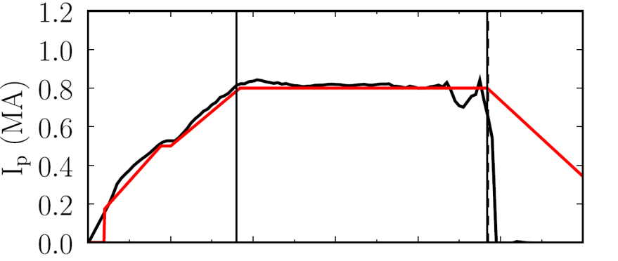
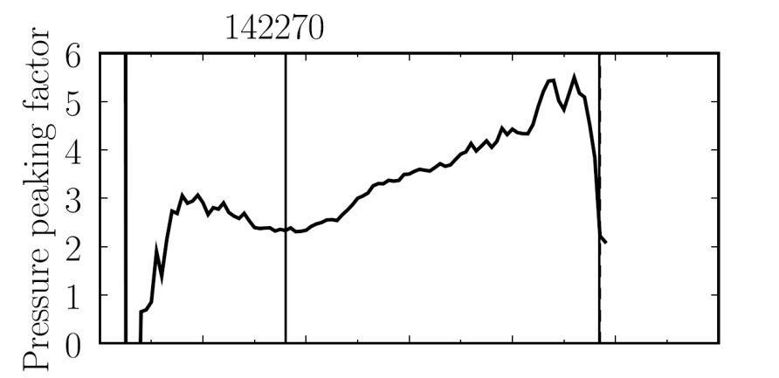

Disruption Event Characterization And Forecasting Code (DECAF) yielding initial results (pressure peaking example)
10 physical events presently defined in code with quantitative warning points
  Builds on manual analysis of de Vries
  Builds on warning algorithm of Gerhardt
  New code written (in Python), easily expandable, portable to other tokamaks (recent capability to process DIII-D data)
Example: Pressure peaking (PRP) disruption event chain identified by code before disruption
  (PRP) Pressure peaking warnings identified first
  (VDE) VDE condition subsequently found 19 ms after last PRP warning
  (IPR) Plasma current request not met
  (SCL) Shape control warning issued
NSTX
142270
P.C. de Vries et al., Nucl. Fusion 51 (2011) 053018
Disruption
S.P. Gerhardt et al., Nucl. Fusion 53 (2013) 063021
PRP warnings
Event chain
PRP
VDE
IPR
SCL
Detected at: 0.4194s
0.4380s
0.4522s
0.4732s
J.W. Berkery, S.A. Sabbagh, Y.S. Park (Columbia U.)
and the NSTX-U Disruption PAM Working Group

Slide 8
DECAF is structured to ease parallel development of disruption characterization, event criteria, and forecasting
Physical event modules encapsulate disruption chain events
  Development focused on improving these modules
  Structure eases development
    E.g. separate code by C. Myers that improved disruption timing definition was quickly imported
Physical events are objects in physics modules
  e.g. VDE, LOQ, RWM are objects in “Stability”
  Carry metadata, event forecasting criteria, event linkages, etc.
Physical event modules
Code control workbooks
Density Limits
Confinement
Main data structure
Stability
Tokamak dynamics
Output processing
Power/current handling
Technical issues

Slide 9
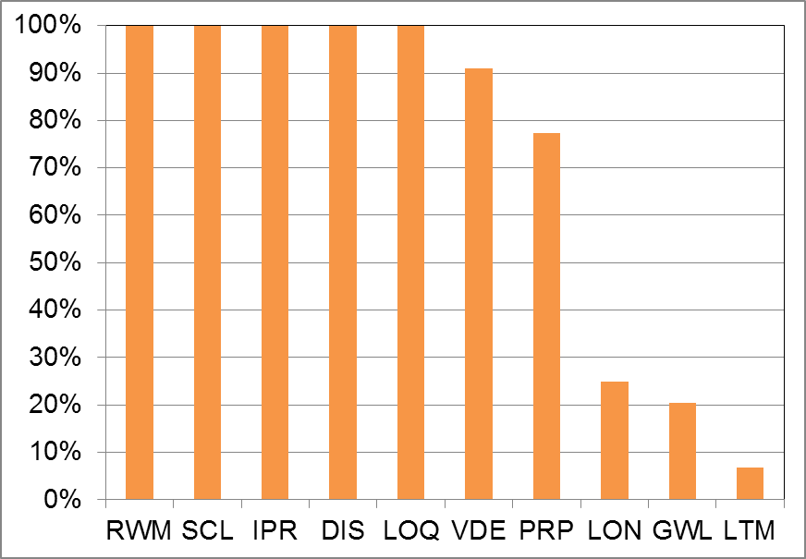
Initial DECAF results detect disruption chain events when applied to dedicated 44 shot NSTX RWM disruption database
Several events detected for all shots
  RWM: RWM event warning
  SCL: Loss of shape control
  IPR: Plasma current request not met
  DIS: Disruption occurred
  LOQ: Low edge q warning
  VDE: VDE warning (40 shots)
Others:
  PRP: Pressure peaking warning
  GWL: Greenwald limit
  LON: Low density warning
  LTM: Locked tearing mode
Occur with or after RWM

Slide 10
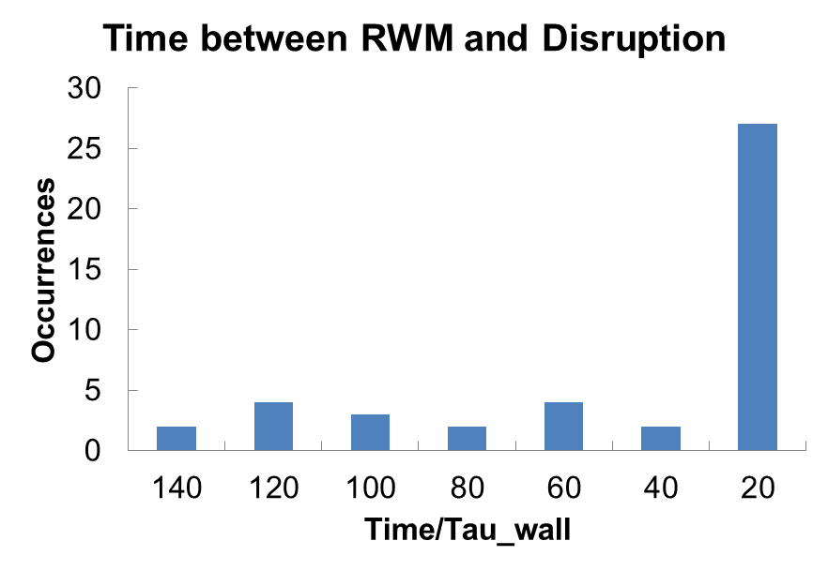
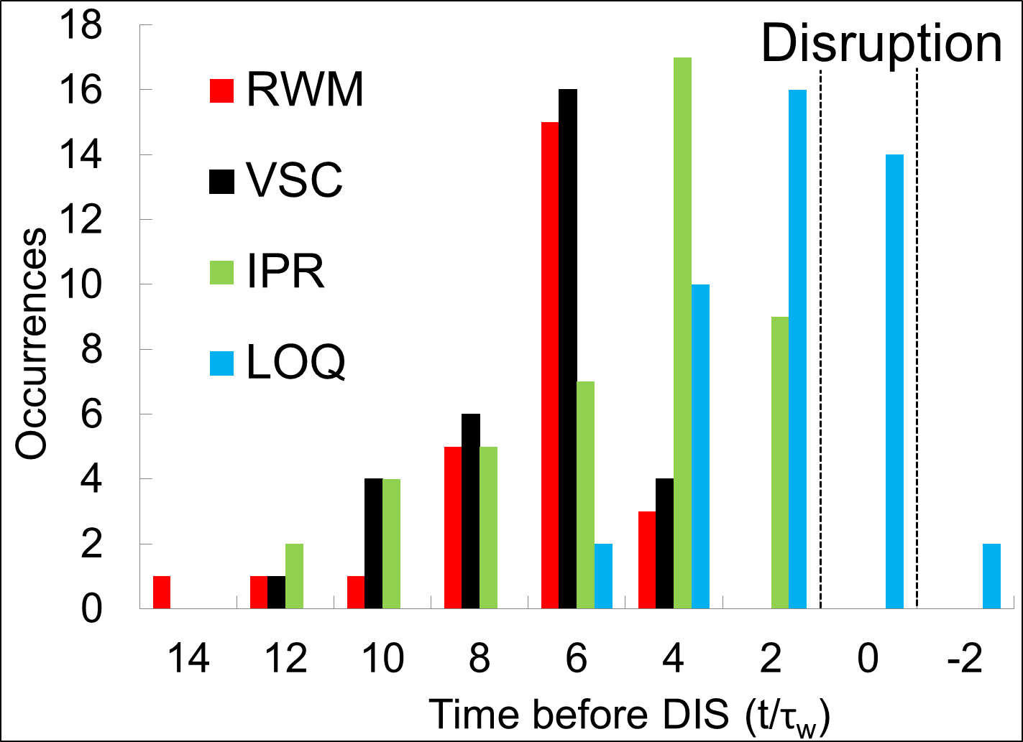
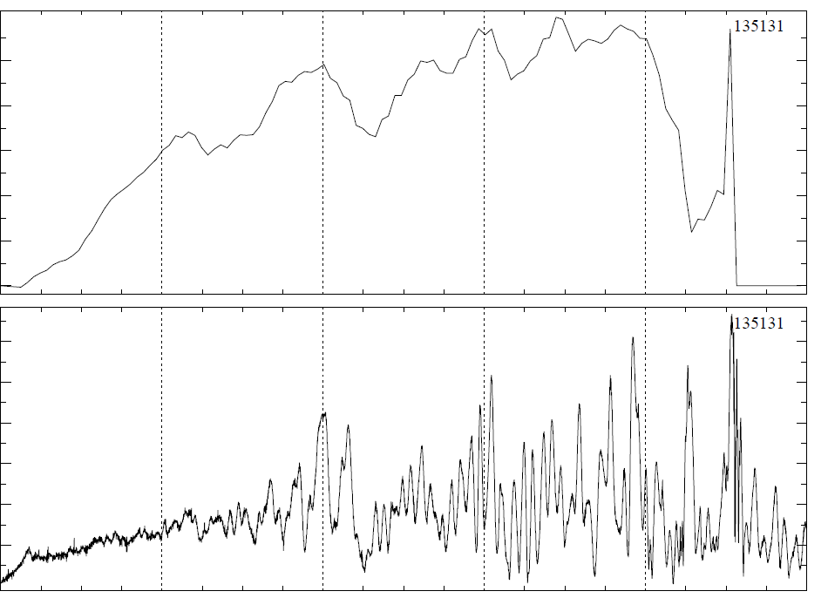
Initial DECAF results detects disruption chain events when applied to dedicated 44 shot NSTX RWM disruption database
VDE
6
Most RWM near major disruption
  61% of RWM occur within 20 τ_{w} of disruption time (τ_{w} = 5 ms)
  Earlier RWM events NOT false positives – cause large decreases in β_{N} with recovery (minor disruptions)
β_{N}
4
2
0
60
40
B_{PL}^{n=1} (G)
20
0
t(s)
0.0
0.2
0.4
0.6
0.8
1.0

Slide 11
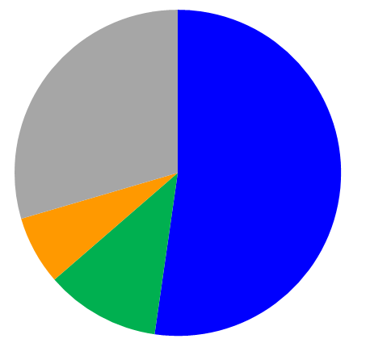
Initial DECAF analysis already finding common disruption event chains (44 shot NSTX disruption database)
Common disruption event chains (52.3%)
  Related chains
    RWM ➔ SCL ➔ VDE ➔ IPR ➔ DIS
    VDE ➔ RWM ➔ SCL ➔ IPR ➔ DIS
    VDE ➔ RWM ➔ IPR ➔ DIS ➔ SCL
    RWM ➔ SCL ➔ VDE ➔ GWL ➔ IPR ➔ DIS
Disruption event chains w/o VDE (11.4%)
New insights being gained
  Chains starting with GWL are found that show rotation and β_{N} rollover before RWM (6.8%)
  Related chains
    GWL ➔ VDE ➔ RWM ➔ SCL ➔ IPR ➔ DIS
    GWL ➔ SCL ➔ RWM ➔ IPR ➔ DIS
RWM
VDE
SCL
IPR
DIS
Disruption event chains with RWM
Other
(29.5%)
Event chains with RWM and VDE
(52.3%)
GWL start
(6.8%)
No
VDE
(11.4%)

Slide 12
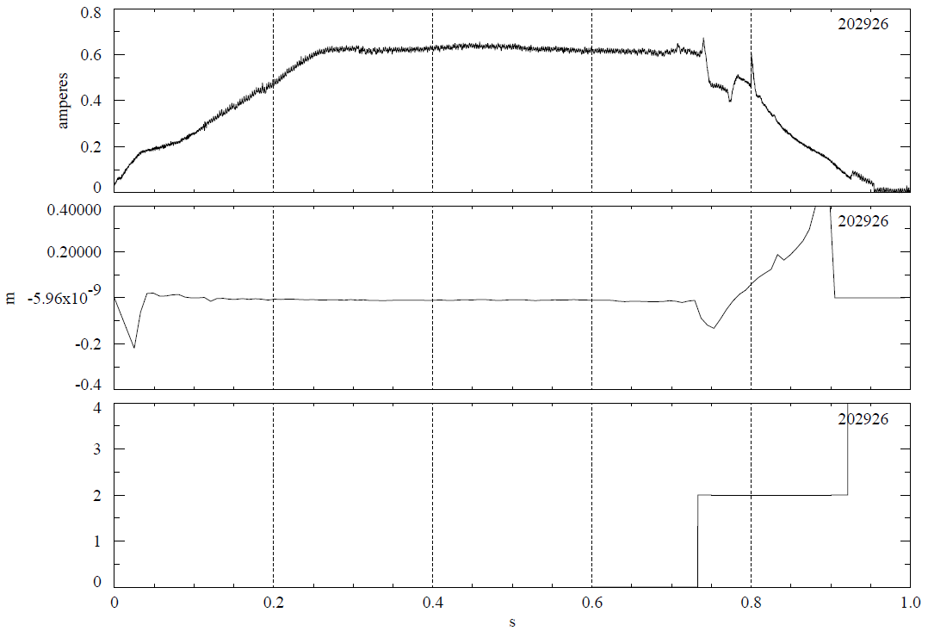
First DECAF results for NSTX-U replicate the triggers found in new real-time state machine shutdown capability
0.8
DECAF
Important capability of DECAF to compare analysis using offline vs. real-time data
  Simple, initial test
PCS Shut-down conditions are analogous to DECAF events
  PCS loss of vertical control ➔ DECAF
DECAF comparison:VDE event
  Matches PCS when r/t signal used (1 criterion)
  VDE event 13 ms earlier using offline EFIT signals (3 criteria)
I_{p} (MA)
0.4
VDE
Using r/t data (t = 0.733s) Using EFIT (t = 0.720s)
0
0.4
EFIT offline reconstruction
of Z position
Z_{axis} (m)
0
VDE
-0.4
4
PCS trigger
For VDE
(t = 0.733s)
2
PCS trigger
0
0.0
0.2
0.4
0.6
0.8
1.0
t(s)
See talk by S. Gerhardt (next) for detail of new NSTX-U automated shutdown capability

Slide 13
Disruption Avoidance

Slide 14
NSTX-U is building on past strength, creating an arsenal of capabilities for disruption avoidance
Predictor/Sensor (CY available) | Control/Actuator (CY available) | Modes | REFER TO
Rotating and low freq. MHD (n=1,2,3) 2003 | Dual-component RWM sensor control (closed loop 2008) | NTM RWM | - Menard NF 2001 - Sabbagh NF 2013; + backup slides
Low freq. MHD spectroscopy (open loop 2005); Kinetic RWM modeling (2008) | Control of β_{N} (closed loop 2007) | Kink/ball RWM | - Sontag NF 2007 - Berkery (2009–15) - Gerhardt FST 2012
r/t RWM state-space controller observer (2010) | Physics model-based RWM state-space control (2010) | NTM, RWM Kink/ball, VDE | - THIS TALK - Sabbagh NF 2013; + backup slides
Real-time V_{φ} measurement (2016) | Plasma V_{φ} control (NTV 2004) (NTV + NBI rotation control closed loop ~ 2017) | NTM Kink/ball RWM | - Podesta RSI 2012 - Zhu PRL 06 +backup - THIS TALK
Kinetic RWM stabilization real-time model (2016-17) | Safety factor, l_{i} control (closed loop ~ 2016-17) | NTM, RWM Kink/ball, VDE | - Berkery, NF 2015 - D. Boyer’s TALK
MHD spectroscopy (real-time) (in 5 Year Plan) | Upgraded 3D coils (NCC): improved V_{φ} and mode control (in 5 Year Plan) | NTM, RWM Kink/ball, VDE | - NSTX-U 5 Year Plan - THIS TALK

Slide 15
Joint NSTX / DIII-D experiments and analysis gives unified kinetic RWM physics understanding for disruption avoidance
RWM Dynamics
  RWM rotation and mode growth observed
  No strong NTM activity
  Some weak bursting MHD in DIII-D plasma
    Alters RWM phase
  No bursting MHD in NSTX plasma
DIII-D (β_{N} = 3.5)
NSTX (β_{N} = 4.4)
rotation
growth
rotation
growth
ΔB_{p}^{n=1}(G)
amplitude
amplitude
phase
phase
φ_{Bp}^{n=1}(deg)
toroidal magnetics
toroidal magnetics
Frequency (kHz)
D_{α}
D_{α}
(arb)
t (s)
t (s)
S. Sabbagh et al., APS Invited talk 2014

Slide 16
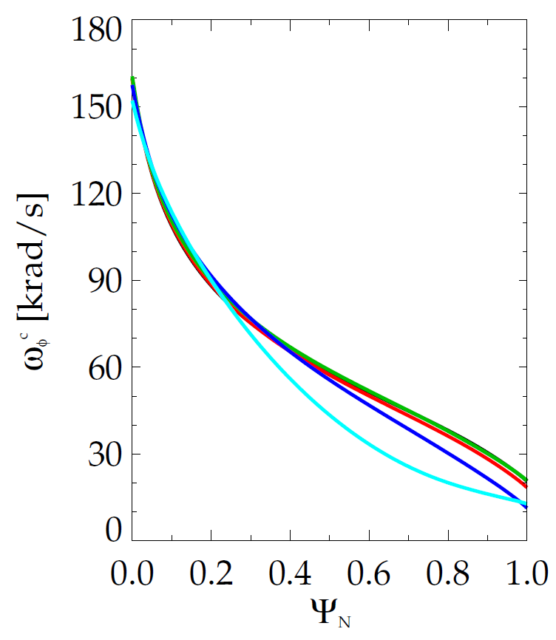
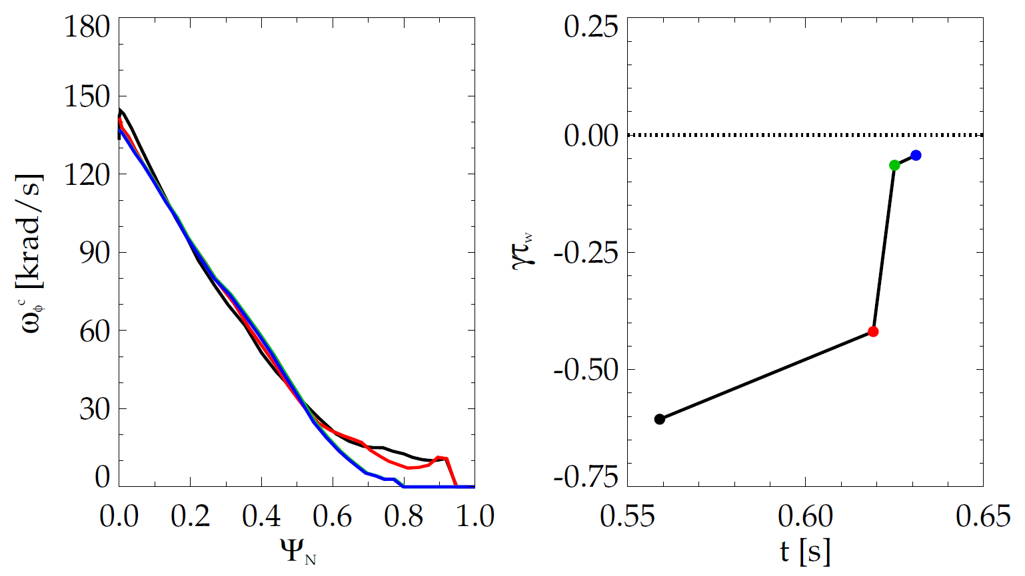
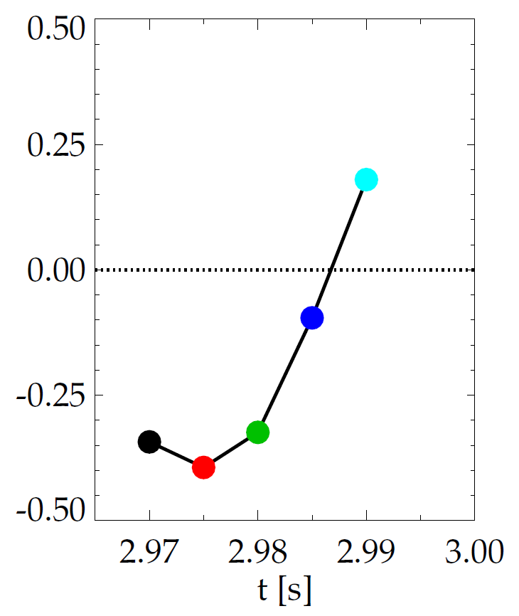
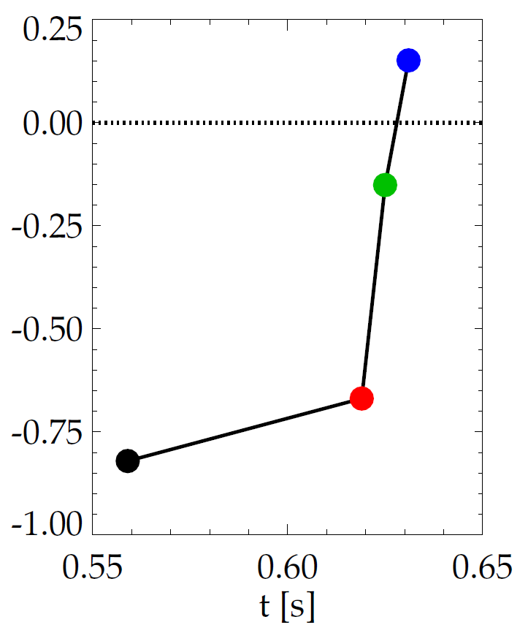
Evolution of plasma rotation profile leads to kinetic RWM instability as disruption is approached
DIII-D (minor disruption)
NSTX (major disruption)
unstable
stable
γτ_{wall}
unstable
γτ_{wall}
stable
MISK
MISK
increasing time
increasing time
Kinetic RWM stabilization occurs from broad resonances between plasma rotation and particle precession drift, bounce/circulating, and collision frequencies
S. Sabbagh et al., APS Invited talk 2014

Slide 17
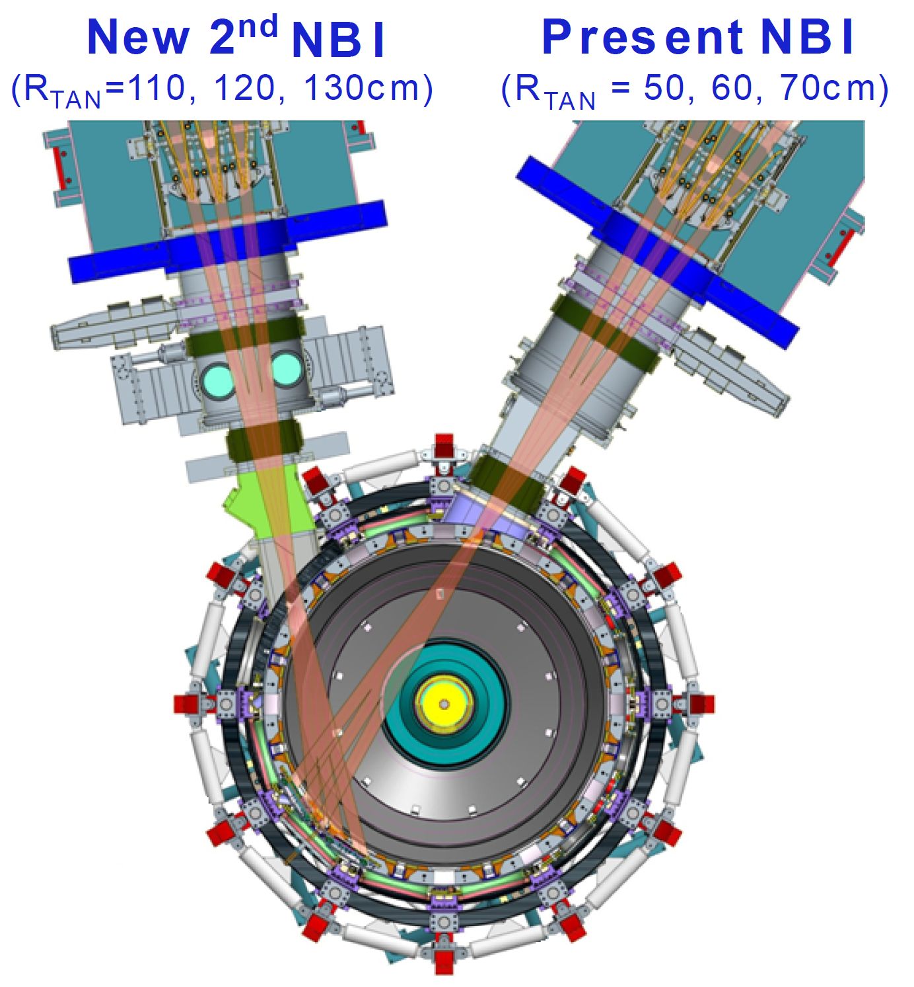
State space rotation controller designed for NSTX-U using non-resonant NTV and NBI to maintain stable profiles
Momentum force balance – ω_{φ} decomposed into Bessel function states
NTV torque:
I. Goumiri, et al., submitted to NF (2016)
Momentum Actuators
NBI and NTV torque profiles for NSTX-U
1.5
New NBI
(broaden rotation)
3D Field Coil
(shape ω_{φ} profile)
1.0
-NTV
Torque
NBI, -NTV torque density (N/m²)
0.5
NBI
Torque
(NSTX)
0.0
0.0
0.2
0.4
ψ_{N}
0.6
0.8
1.0

Slide 18
State space rotation controller designed for NSTX-U using non-resonant NTV and NBI to maintain stable profiles
Momentum force balance – ω_{φ} decomposed into Bessel function states
NTV torque:
I. Goumiri, et al., submitted to NF (2016)
Momentum Actuators
NBI and NTV torque profiles for NSTX-U
1.5
New NBI
(broaden rotation)
3D Field Coil
(shape ω_{φ} profile)
NBI Torque
(NSTX-U)
1.0
-NTV
Torque
NBI, -NTV torque density (N/m²)
0.5
NBI
Torque
(NSTX)
0.0
0.0
0.2
0.4
ψ_{N}
0.6
0.8
1.0

Slide 19
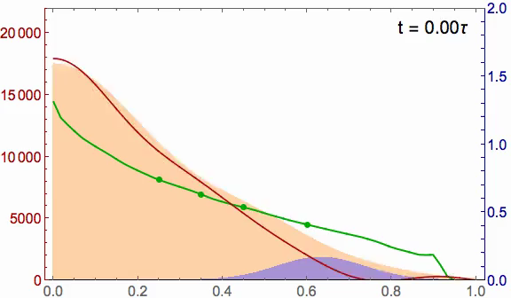
State space rotation controller designed for NSTX-U can evolve plasma rotation profile toward global mode stability
Recall:
NSTX (major disruption)
NSTX-U (6 NBI sources and n = 3 NTV)
2.0
20
Marginally stable profile
unstable
stable
γτ_{wall}
Steady-state reached in ~ 3τ_{m}
1.5
15
MISK
1.0
NBI, -NTV torque density (N/m²)
Plasma rotation (kHz)
Broader stable
profile
Plasma rotation (krad/s)
10
5
NTV
0.5
stable
NBI
marginally
stable
0
0.0
0.0
0.2
0.4
ψ_{N}
0.6
0.8
1.0
I. Goumiri (Princeton student), S.A. Sabbagh (Columbia U.), C. Rowley (P.U.), D.A. Gates, S.P. Gerhardt (PPPL)

Slide 20
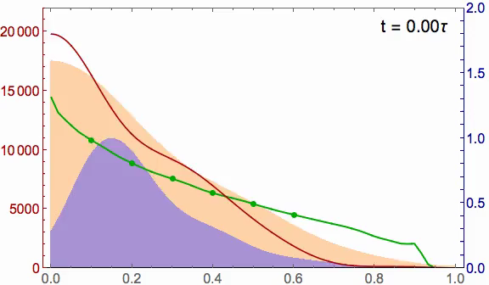
With planned NCC coil upgrade, rotation controller can reach desired rotation profile faster, with greater fidelity
NSTX-U ω_{φ} control with
  6 NBI sources
  Greater core NTV from planned NCC upgrade
Better performance
  Faster to target t ~ 0.5τ_{m}
  Matches target ω_{φ} better
2.0
20
Marginally stable profile
1.5
15
NBI
1.0
Plasma rotation (kHz)
NBI, -NTV torque density (N/m²)
10
Broader stable
profile
Planned NCC upgrade
5
0.5
NTV
0
0.0
0.0
0.2
0.4
ψ_{N}
0.6
0.8
1.0
I. Goumiri (Princeton student), S.A. Sabbagh (Columbia U.), C. Rowley (P.U.), D.A. Gates, S.P. Gerhardt (PPPL)

Slide 21
Active RWM control design study for proposed NSTX-U 3D coil upgrade (NCC coils) shows superior capability
NCC 2x6 odd parity, with favorable sensors
NCC 2x12 with favorable sensors, optimal gain
NCC (plasma facing side)
Full NCC coil set allows control close to ideal wall limit
  NCC 2x6 odd parity coils: active control to β_{N}/β_{N}^{no-wall} = 1.58
  NCC 2x12 coils, optimal sensors: active control to β_{N}/β_{N}^{no-wall} = 1.67

Slide 22
NSTX RWM state space controller sustains high β_{N}, low l_{i} plasma – available for NSTX-U with independent coil control
RWM state space feedback (12 states)
NSTX Experiments
(from 2010)
I_{p} (MA)
n = 1 applied field suppression
  Suppressed disruption due to n = 1 field
Feedback phase scan
  Best feedback phase produced long pulse, β_{N} = 6.4, β_{N}/l_{i} = 13
(A)
Run time has been allocated for continued experiments on NSTX-U in 2016
S. Sabbagh et al., Nucl. Fusion 53 (2013) 104007

Slide 23
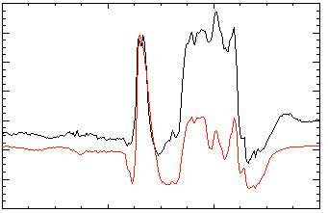
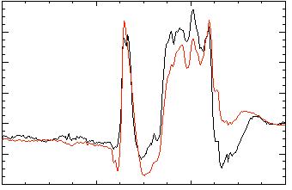
In addition to active mode control, the NSTX-U RWM state space controller can be used for real-time disruption warning
Effect of 3D Model Used
The controller “observer” produces a physics model-based calculation of the expected sensor data – a synthetic diagnostic
If the real-time synthetic diagnostic doesn’t match the measured sensor data, a r/t disruption warning signal can be triggered
  Technique will be assessed using the DECAF code
No NBI Port
80
δB_{p}⁹⁰
Sensor
data
RWM Sensor Differences (G)
40
RWM
0
Controller
(observer)
-40
137722
0.56
0.58
0.60
0.62
t (s)
With NBI Port
80
δB_{p}⁹⁰
40
RWM Sensor Differences (G)
0
-40
137722
0.56
0.58
0.60
0.62
t (s)

Slide 24
Disruption Mitigation

Slide 25
NSTX-U Disruption Mitigation Research Aims to Develop MGI and EPI Technologies in Support ITER and FNSF
Massive Gas Injection (MGI): (starting 2016)
  ITER-type MGI valve will be used on NSTX-U in a configuration to do nearly exact comparison experiments
  Experimental results to be studied using M3D-C¹ (A. Fil, S. Jardin, et al.)
    Develop understanding of gas assimilation fraction by the plasma
    Use to project to ITER plasmas
  Similar plasma poloidal size, shape of DIII-D and NSTX-U allows multi-machine comparison studies
Electromagnetic Particle Injector (EPI): (in 5 Year Plan)
  Motivation: Handle fast disruptions
    For warning times < 10 ms, MGI may not be a viable option
  Rapid delivery of impurities deeper into plasma with fast time-response
    Under 5ms from trigger to delivery at 7m from plasma
    Efficiency of system improves in a magnetic field environment

Slide 26
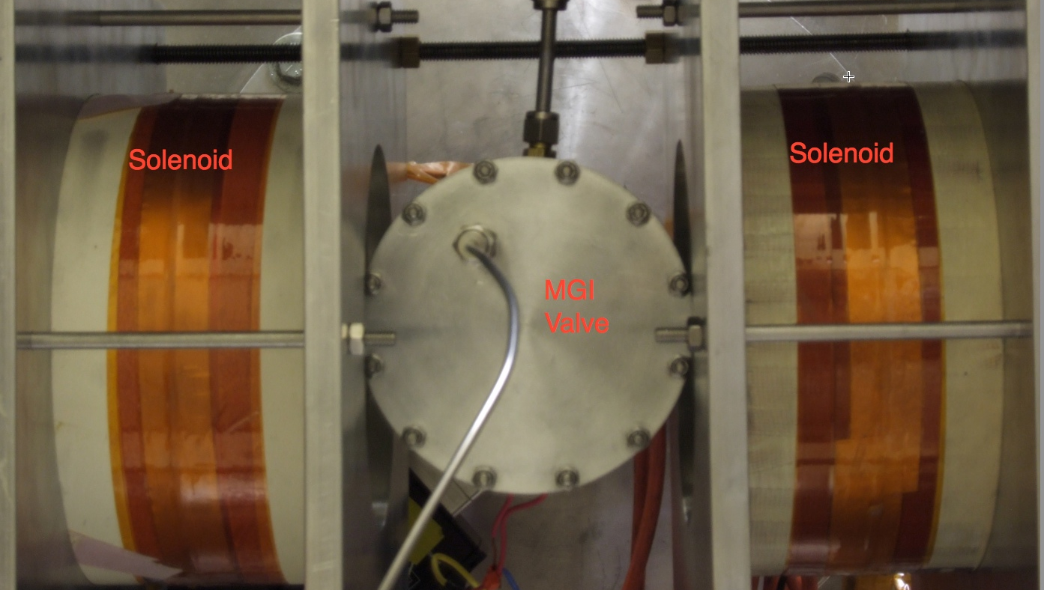
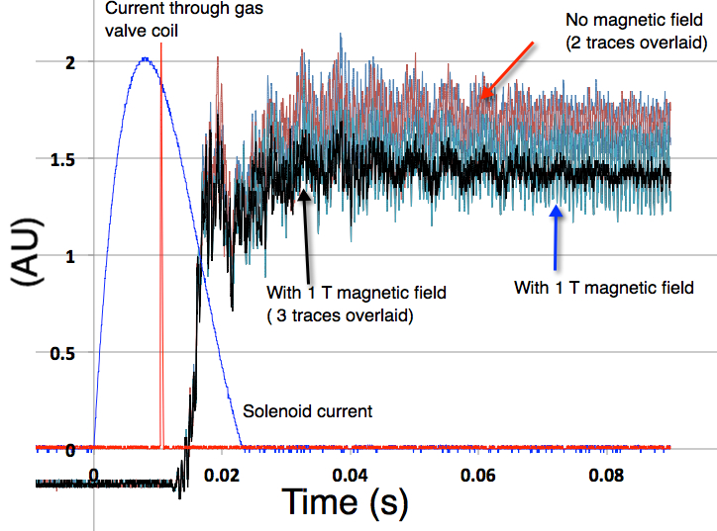
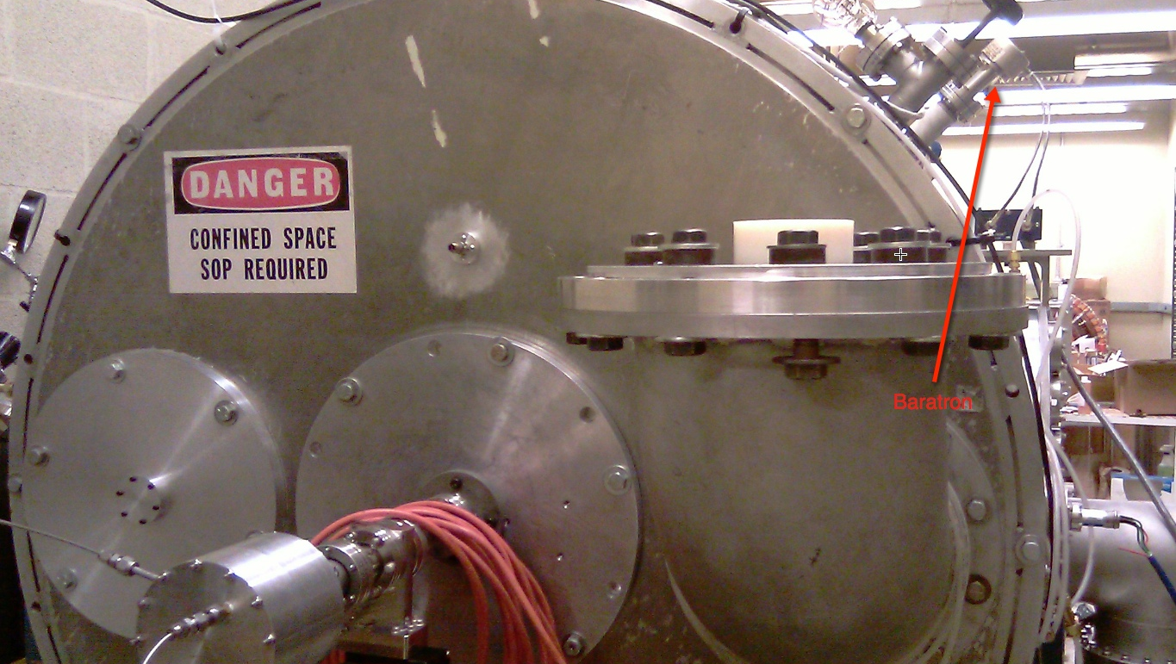
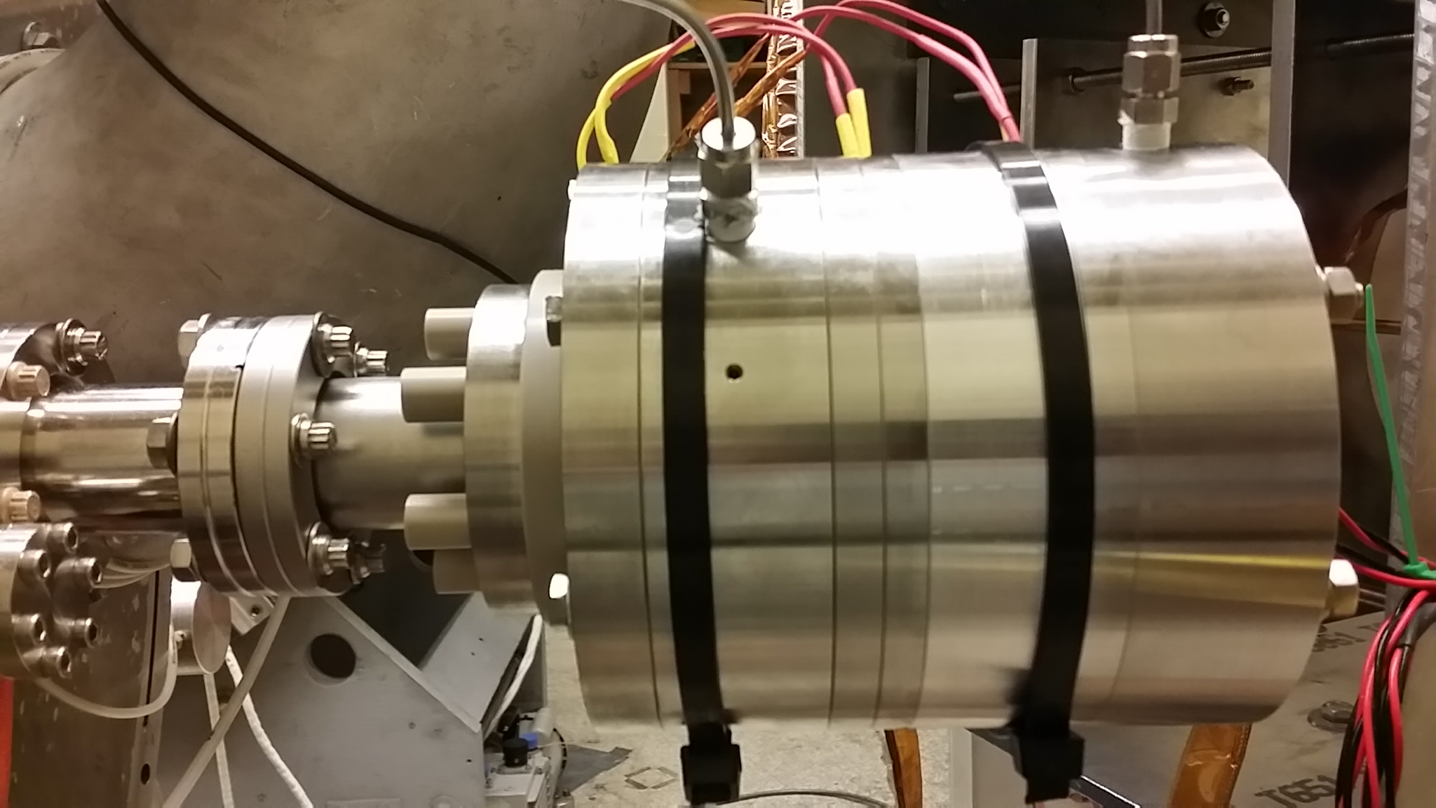
New double solenoid valve design (zero net JxB torque) pass tests for reliability and magnetic field limits
Baratron traces with and without magnetic field
Magnets
Magnets
MGI
Valve
Test stand
MGI
Valve
Fast Baratron
MGI
Valve
University of Washington Test Stand
R. Raman, et al., RSI 85 (2014) 11E801

Slide 27
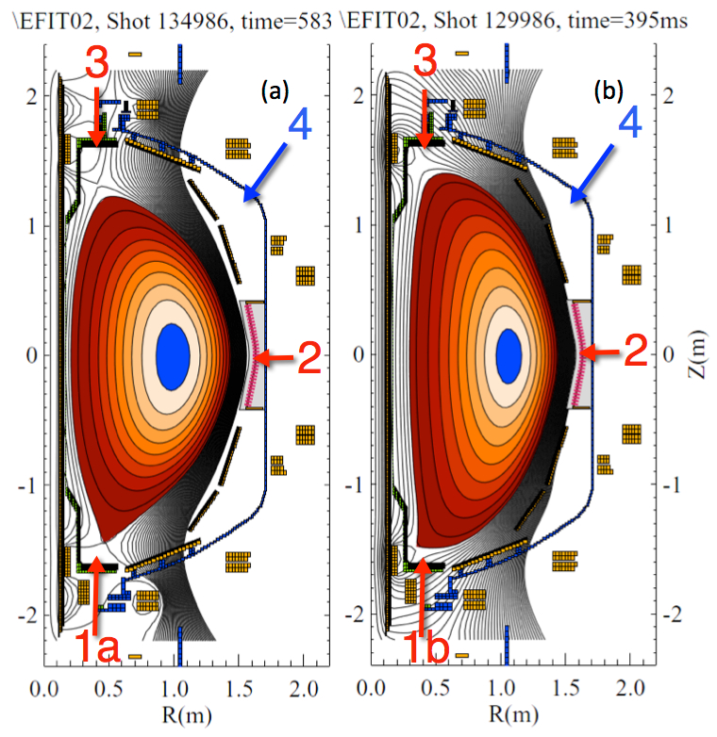
NSTX-U MGI will study poloidal injection location variation using identical MGI valves and gas transit piping
3: Upper divertor
Assess benefits of injection into the private flux region & the high-field side vs. LFS midplane
Quantify MGI gas assimilation fractions and extend model to larger machines
Model gas penetration and assimilation results using 3D MHD codes (incl. M3D-C¹)
First plasma tests April, experiment May 2016
4: future position
2: mid-
plane
1a: Private flux region
1b: Lower SOL, Lower divertor

Slide 28
DPAM Working Group is fulfilling DOE Joint Research Target JRT-16 milestones to start NSTX-U 5 YP research goals
FY16 DOE Joint Research Target summary (1 page)
  http://nstx.pppl.gov/DragNDrop/Working_Groups/DPAM/Repository/JRT16QuarterlyMilestones-V9.pdf
Prediction / Avoidance
  Use disruption prediction algorithm to characterize the reliability of predicting a few types of common disruptions from at least two devices
  Report on capability to reduce disruption rate through active improvement of plasma stability
  Test on at least one facility to detect in real time an impending disruption and take corrective measures to safely terminate the plasma discharge
Mitigation
  Test newly-designed ITER-type massive gas injection valve to study benefits of private flux region massive gas injection vs. mid-plane inj.
Culminating Milestones for 2016

Slide 29
NSTX-U Research is building upon physics understanding and synergizing control for disruption PAM in tokamaks
Disruption PAM Working Group Mission
  Satisfy gaps in understanding disruption prediction, avoidance, mitigation
  Apply knowledge to demonstrate acceptable levels of disruption frequency/severity using quantified metrics
PAC charges are directly addressed
  FESAC/FES Initiatives: NSTX-U DPAM Working group effort was born from 2015 FES effort - is identically aligned with it. Urgent ITER need.
  Research: Disruption Event Characterization And Forecasting effort started to unify physics understanding for disruption avoidance (5 YP Committee member recommendation); MGI to start in 2016.
  Facility enhancements: Quantified disruptivity metrics will assess new capabilities (e.g. plasma rotation, q, active mode control ) and guide future improvements (e.g. planned NCC 3D coil upgrade, et al.)
  PPPL Theory partnership: Is highly leveraged in this effort (10 members)
(see talk by A. Bhattacharjee)

Slide 31
Supporting Slides Follow

Slide 32
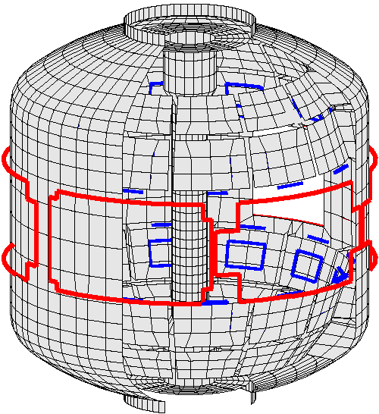
NSTX is a spherical torus equipped to study passive and active global MHD control
High beta, low aspect ratio
  R = 0.86 m, A > 1.27
  I_{p} < 1.5 MA, B_{t} = 5.5 kG
  β_{t} < 40%, β_{N} > 7
Copper stabilizer plates for kink mode stabilization
Midplane control coils
  n = 1 – 3 field correction, magnetic braking of ω_{φ} by NTV
  n = 1 RWM control
Combined sensor sets now used for RWM feedback
  48 upper/lower B_{p}, B_{r}
3D Conducting Structure Model
RWM poloidal
sensors (B_{p})
Stabilizer
plates
RWM radial sensors (B_{r})
RWM active stabilization coils

Slide 33
Modification of Ideal Stability by Kinetic theory (MISK code) is used to determine proximity of plasmas to stability boundary
Initially used for NSTX since simple critical scalar ω_{φ} threshold stability models did not describe RWM stability
Kinetic modification to ideal MHD growth rate
  Trapped / circulating ions, trapped electrons, etc.
  Energetic particle (EP) stabilization
Stability depends on
  Integrated ω_{φ} profile: resonances in δW_{K} (e.g. ion precession drift)
  Particle collisionality, EP fraction
Sontag, et al., Nucl. Fusion 47 (2007) 1005
Hu and Betti, Phys. Rev. Lett 93 (2004) 105002
ω_{φ} profile (enters through ExB frequency)
Trapped ion component of δW_{K} (plasma integral over energy)
Some NSTX / MISK analysis references
J. Berkery et al., PRL 104, 035003 (2010)
S. Sabbagh, et al., NF 50, 025020 (2010)
J. Berkery et al., PRL 106, 075004 (2011)
S. Sabbagh et al., NF 53, 104007 (2013)
J. Berkery et al., PoP 21, 056112 (2014)
J. Berkery et al., PoP 21, 052505 (2014)
J. Berkery et al., NF 55, 123007 (2015)
precession drift
bounce
collisionality

Slide 34
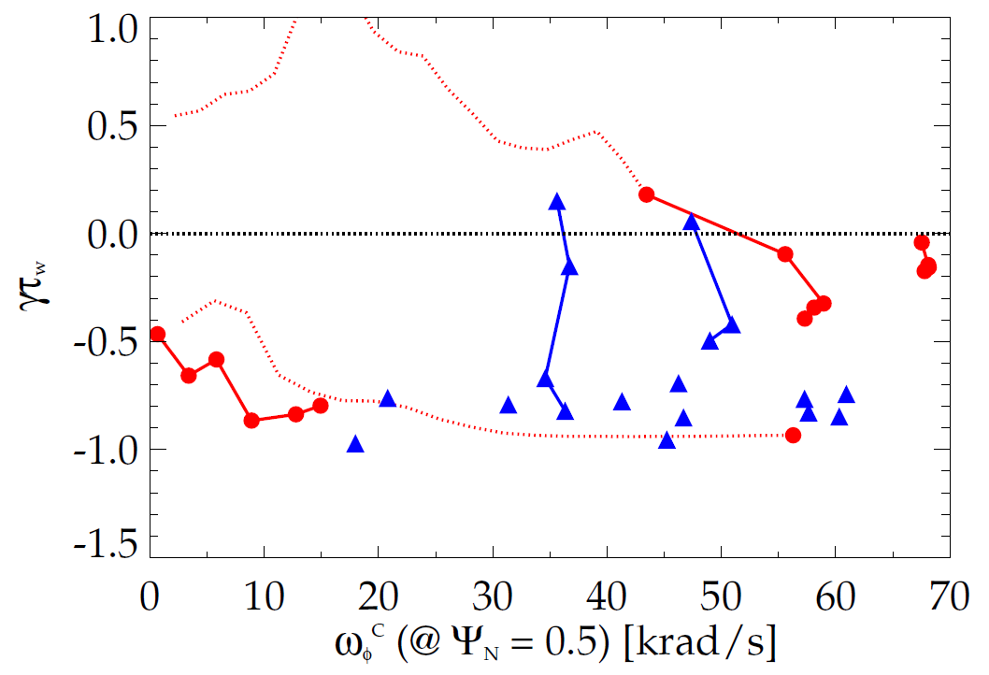
Kinetic RWM stability evaluated for DIII-D and NSTX plasmas, reproduces experiments over wide rotation range
Summary of results
  Plasmas free of other MHD modes can reach or exceed linear kinetic RWM marginal stability
  Bursting MHD modes can lead to non-linear destabilization before linear stability limits are reached
  Extrapolations of DIII-D plasmas to different V_{φ} show marginal stability is bounded by 1.6 < q_{min} < 2.8
Kinetic RWM stability analysis for experiments (MISK)
DIII-D
NSTX
q_{min} = 2.8
unstable
Normalized growth rate (γτ_{w})
“weak stability” region
q_{min} = 1.6
major disruption
minor disruption
extrapolation
stable
Plasma rotation [krad/s] (ψ_{N} = 0.5)
Extensive NSTX / MISK analysis references spanning ~ 7 years
(8 references given in supporting slides)
S. Sabbagh et al., APS Invited talk 2014
J.W. Berkery, J.M. Hanson, S.A. Sabbagh (Columbia U.)

Slide 35
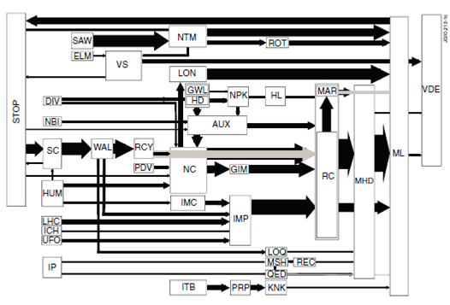
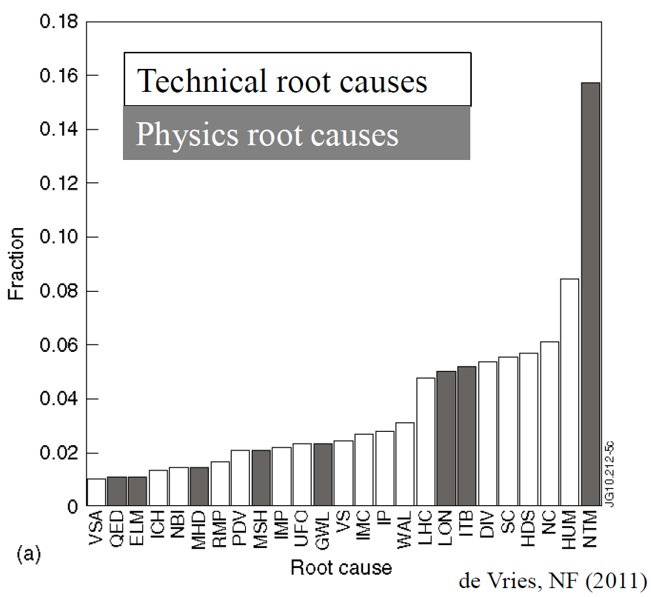
JET disruption event characterization provides framework to follow for understanding / quantifying DPAM progress
JET disruption event chains
Related disruption event statistics
P.C. de Vries et al., Nucl. Fusion 51 (2011) 053018
JET disruption event chain analysis performed by hand, desire to automate
General code written (DECAF) to address the first step – initial analysis started using NSTX data

Slide 36
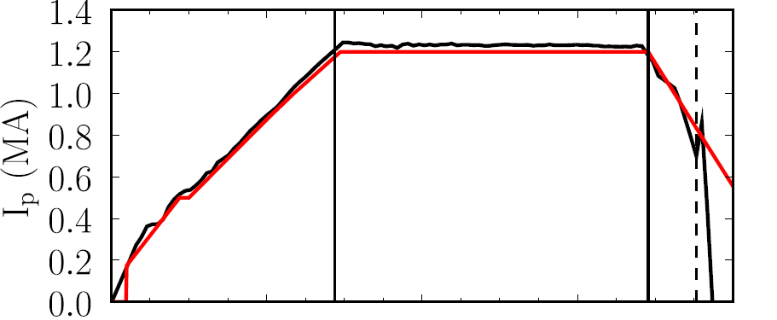
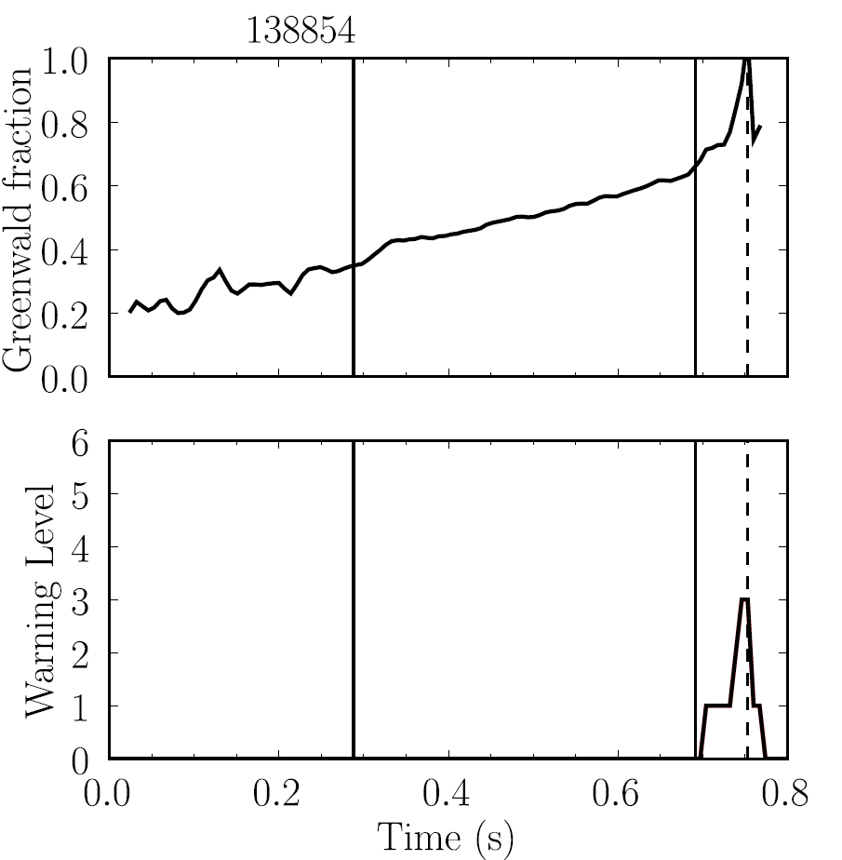
Disruption Characterization Code now yielding initial results: disruption event chains, with related quantitative warnings (2)
NSTX
138854
This example: Greenwald limit warning during I_{p} rampdown
  (GWL) Greenwald limit warning issued
  (VDE) VDE condition then found 0.6 ms after GWL warning
  (IPR) Plasma current request not met
Disruption during
I_{p} ramp-down
GWL warnings
Event chain
GWL
VDE
IPR
Detected at: 0.7442s
0.7448s
0.7502s
J.W. Berkery, S.A. Sabbagh, Y.S. Park

Slide 37
NTV physics studies for rotation control: measured NTV torque density profiles quantitatively compare well to theory
n = 3 coil configuration
n = 2 coil configuration
NSTX
NSTX
x1.7
x0.6
Experimental
-dL/dt
Experimental
-dL/dt
NTVTOK
NTVTOK
ψ_{N}
ψ_{N}
T_{NTV} (theory) scaled to match peak value of measured -dL/dt
  Scale factor ((dL/dt)/T_{NTV}) = 1.7 and 0.6 for cases shown above – O(1) agreement
KSTAR n = 2 NTV experiments do not exhibit hysteresis
See recent NTV review paper: K.C. Shaing, K. Ida, S.A. Sabbagh, et al., Nucl. Fusion 55 (2015) 125001

Slide 38
Active RWM control: dual B_{r} + B_{p} sensor feedback gain and phase scans produce significantly reduced n = 1 field
6
β_{N}
140124
140122
139516
β_{N}
Favorable B_{p} + B_{r} feedback (FB) settings found (low l_{i} plasmas)
Time-evolved theory simulation of B_{r}+B_{p} feedback follows experiment
4
2
0
B_{r} gain scan
0.8
0.6
0.4
l_{i}
l_{i}
No B_{r} feedback
B_{r} Gain = 1.0
0.2
0.0
B_{r}^{n = 1} (G)
S. Sabbagh et al., Nucl. Fusion 53 (2013) 104007
6
6
4
4
2
2
B_{r} Gain = 1.50
0
Simulation of B_{r} + B_{p} control (VALEN)
0.0
0.2
0.4
0.6
0.8
1.0
1.2
1.4
t (s)
Feedback on
0 deg FB phase
B_{r} FB phase scan
Radial field n = 1 (G)
90 deg FB phase
Vacuum error field
+ RFA
180 deg FB phase
Vacuum error field
Δt (s) (model)

Slide 39
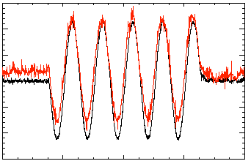
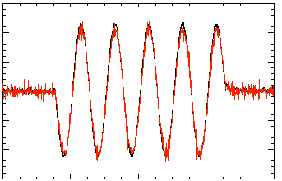
Model-based RWM state space controller including 3D model of plasma and wall currents used at high β_{N}
Full 3-D model
~3000+ states
State reduction (< 20 states)
RWM
eigenfunction(2 phases, 2 states)
Balancing
transformation
…
Controller reproduction of n = 1 field in NSTX
Controller model can compensate for wall currents
  Includes linear plasma mode-induced current model (DCON)
Potential to allow control coils to be moved further from plasma, and be shielded (e.g. for ITER)
  Straightforward inclusion of multiple modes (n = 1, or n > 1)
150
100
5 states
used
50
Sensor Difference (G)
0
Controller
(observer)
-50
-100
118298
-150
Measurement
150
Katsuro-Hopkins, et al., NF 47 (2007) 1157
100
50
10 states
used
0
Sensor Difference (G)
-50
-100
118298
(only wall states used)
-150
0.2
0.4
0.6
0.8
1.0
t (s)

Slide 40
State Derivative Feedback Algorithm needed for Current Control
State equations to advance
Control vector, u; controller gain, K_{c}
Observer est., y; observer gain, K_{o}
K_{c} , K_{o} computed by standard methods
(e.g. Kalman filter used for observer)
Previously published approach found to be formally “uncontrollable” when applied to current control
State derivative feedback control approach
  new Ricatti equations to solve to derive control matrices – still “standard” solutions for this in control theory literature
e.g. T.H.S. Abdelaziz, M. Valasek., Proc. of 16th IFAC World Congress, 2005
Advance discrete state vector
Written into the PCS
General (portable) matrix output file for operator
(time update)
(measurement
update)

Slide 41
NSTX RWM state space controller sustains high β_{N}, low l_{i} plasma – available for NSTX-U with independent coil control
RWM state space feedback (12 states)
NSTX Experiments
(from 2010)
I_{p} (MA)
n = 1 applied field suppression
  Suppressed disruption due to n = 1 field
Feedback phase scan
  Best feedback phase produced long pulse, β_{N} = 6.4, β_{N}/l_{i} = 13
(A)
Run time has been allocated for continued experiments on NSTX-U in 2016
S. Sabbagh et al., Nucl. Fusion 53 (2013) 104007

Slide 42
RWM state space controller sustains otherwise disrupted plasma caused by DC n = 1 applied field
RWM state space feedback (12 states)
n = 1 DC applied field test
  Generate resonant field amplication, disruption
  Use of RWM state space controller sustains discharge
RWM state space controller sustains discharge at high β_{N}
  Best feedback phase produced long pulse, β_{N} = 6.4, β_{N}/l_{i} = 13
1.2
I_{p} (MA)
0.6
Control
applied
0.0
Control not applied
6
β_{N}
3
0
10
5
B_{p}^{n=1} (G)
0
0.5
I_{RWM-4} (kA)
n = 3 correction
0.0
n = 1 field on
12
ω_{φ}/2π_{~q=2}
(kHz)
8
140025
140026
4
0
0.0
0.2
0.4
t(s)
0.6
0.8
1.0
S. Sabbagh et al., Nucl. Fusion 53 (2013) 104007

Slide 43
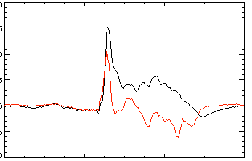
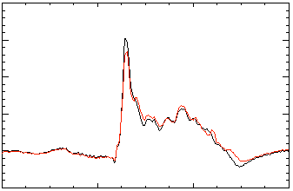
Open-loop comparisons between measurements and RWM state space controller show importance of states and model
A) Effect of Number of States Used
B) Effect of 3D Model Used
2 States
Sensor data
No NBI Port
200
δB_{p}¹⁸⁰
RWM
Controller (observer)
80
δB_{p}⁹⁰
Sensor
data
100
40
RWM
0
0
Controller
(observer)
-40
137722
-100
0.56
0.58
0.60
0.62
0.56
0.58
0.60
0.62
t (s)
t (s)
RWM Sensor Differences (G)
7 States
With NBI Port
200
δB_{p}¹⁸⁰
80
δB_{p}⁹⁰
100
40
0
0
RWM sensors
137722
-100
-40
0.56
0.58
0.60
0.62
0.56
0.58
0.60
0.62
t (s)
t (s)
Improved agreement with sufficient number of states (wall detail)
3D detail of model important to improve agreement

Slide 44
In addition to active mode control, the NSTX-U RWM state space controller can be used for r/t disruption warning
Effect of 3D Model Used
The controller “observer” produces a physics model-based calculation of the expected sensor data – a synthetic diagnostic
If the real-time synthetic diagnostic doesn’t match the measured sensor data, a r/t disruption warning signal can be triggered
  Technique will be assessed using the DECAF code
No NBI Port
80
δB_{p}⁹⁰
Sensor
data
RWM Sensor Differences (G)
40
RWM
0
Controller
(observer)
-40
137722
0.56
0.58
0.60
0.62
t (s)
With NBI Port
80
δB_{p}⁹⁰
40
RWM Sensor Differences (G)
0
-40
137722
0.56
0.58
0.60
0.62
t (s)

Slide 45
In addition to active mode control, the NSTX-U RWM state space controller can be used for real-time disruption warning
Effect of 3D Model Used
The controller “observer” produces a physics model-based calculation of the expected sensor data – a synthetic diagnostic
If the real-time synthetic diagnostic doesn’t match the measured sensor data, a r/t disruption warning signal can be triggered
  Technique will be assessed using the DECAF code
No NBI Port
80
δB_{p}⁹⁰
Sensor
data
RWM Sensor Differences (G)
40
RWM
0
Controller
(observer)
-40
137722
0.56
0.58
0.60
0.62
t (s)
With NBI Port
80
δB_{p}⁹⁰
40
RWM Sensor Differences (G)
0
-40
137722
0.56
0.58
0.60
0.62
t (s)

Slide 46
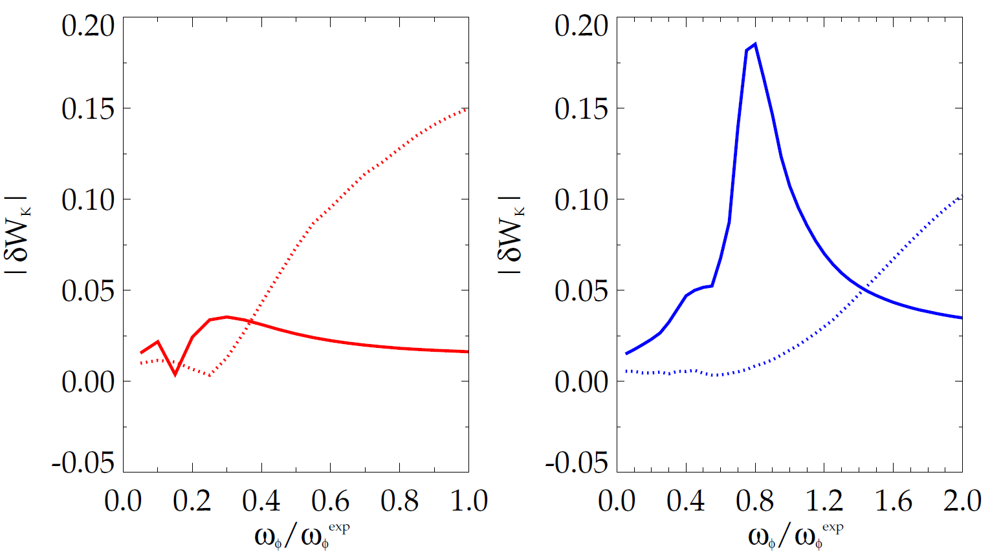
Bounce resonance stabilization dominates for DIII-D vs. precession drift resonance for NSTX at similar, high rotation
|δW_{K}| for trapped resonant ions vs. scaled experimental rotation (MISK)
DIII-D
precession
resonance
NSTX
bounce / circulating
resonance
bounce / circulating
resonance
precession
resonance
133103 @ 3.330 s
stable plasma
133776 @ 0.861 s
stable plasma
DIII-D experimental rotation profile
NSTX experimental rotation profile

Slide 47
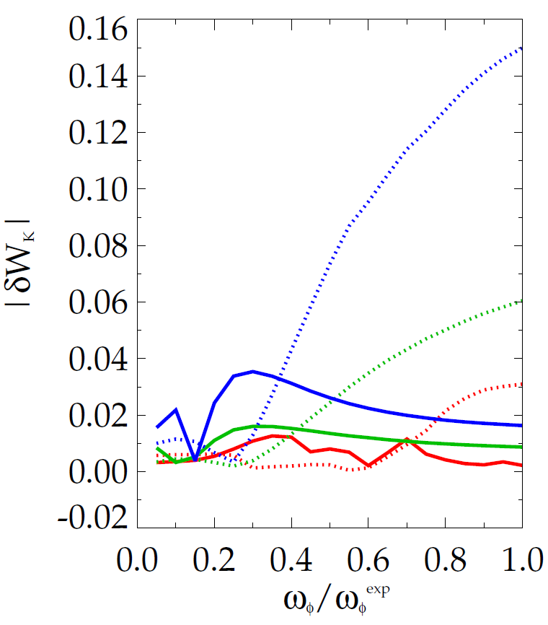
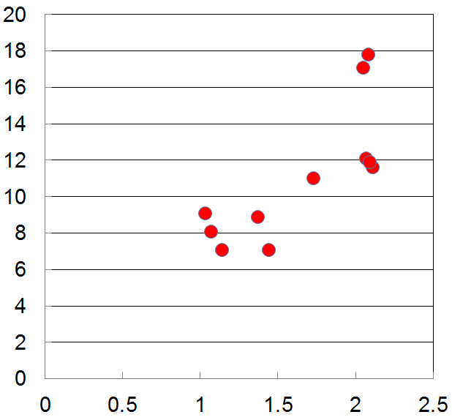

Increased RWM stability measured in DIII-D plasmas as q_{min} is reduced is consistent with kinetic RWM theory
|δW_{K}| for trapped resonant ions vs. scaled experimental rotation (MISK)
Measured plasma response to 20 Hz, n = 1 field vs q_{min}
DIII-D (q_{min} = 1.2)
DIII-D (q_{min} = 1.6)
DIII-D (q_{min} = 2.8)
less stable
bounce /
circulating
resonance
precession drift
resonance
n = 1 |δB_{p} | (G/kA)
q_{min}
Bounce resonance dominates precession drift resonance for all q_{min} examined at the experimental rotation
DIII-D experimental rotation profile

Slide 48
When T_{i} is included in NTV rotation controller model, 3D field current and NBI power can compensate for T_{i} variations
Rotation evolution and NBI and NTV torque profiles
3D coil current and NBI power (actuators)
10
2.0
7
2.5
10⁴
desired ω_{φ}
t₁ = 0.59s
t₂ = 0.69s
t₃ = 0.79s
1.8
6
8
2.0
5
t₃
1.6
6
1.5
4
t₂
NTV
torque
1.4
NBI power (MW)
3D Coil Current (kA)
NBI, NTV torque density (N/m²)
3
Plasma rotation (rad/s)
t₁
t₂
4
t₃
1.0
1.2
t₂
2
2
t₁
t₁
0.5
1.0
1
NBI
torque
t₃
0.8
0
0
0.0
0.5
0.7
0.9
0.5
0.7
0.9
0.0
0.2
0.4
0.6
0.8
1.0
t (s)
t (s)
ψ_{N}
1.8
1.2
T_{i} (keV)
K1 = 0, K2 = 2.5
0.6
NTV torque profile model for feedback dependent on ion temperature
t₁
t₂
t₃
t (s)
0.0
0.4
0.5
0.6
0.7
0.8
0.9

Slide 49
NSTX-U: RWM active control capability increases as proposed 3D coils upgrade (NCC coils) are added
Using present midplane RWM coils
Partial NCC 1x12 (upper), favorable sensors
NCC upper (1x12) (plasma facing side)
Partial 1x12 NCC coil set significantly enhances control
  Present RWM coils: active control to β_{N}/β_{N}^{no-wall} = 1.25
  NCC 1x12 coils: active control to β_{N}/β_{N}^{no-wall} = 1.52
Existing
RWM
coils

Slide 50
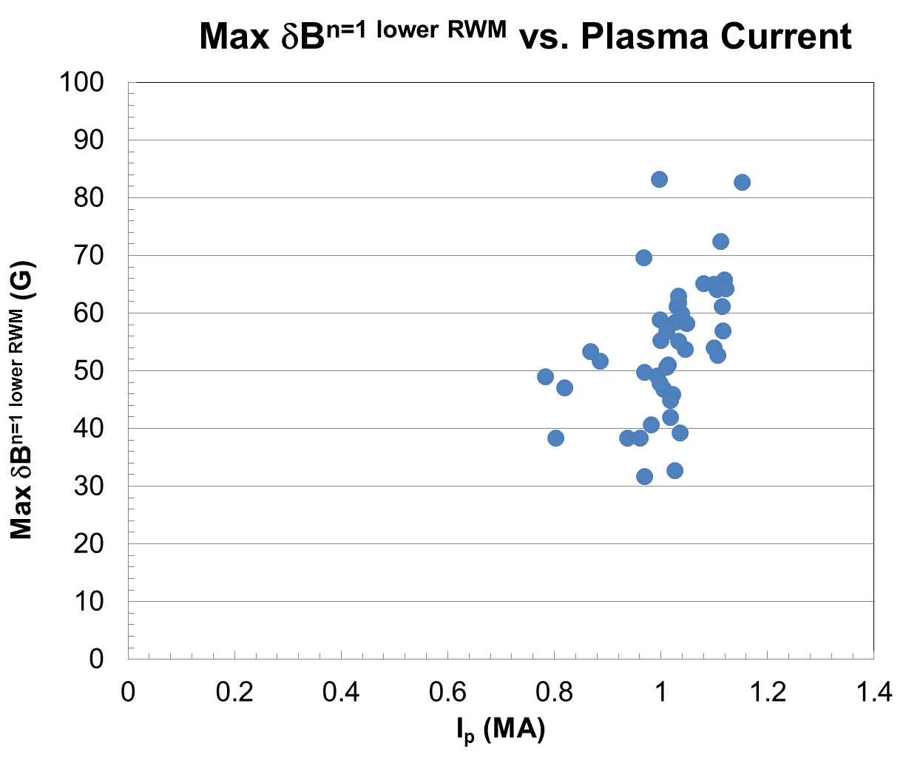
      ITER High Priority need: What levels of plasma disturbances (δB_{p}; δB_{p}/B_{p}(a)) are permissible to avoid disruption?
NSTX RWM-induced disruptions analyzed
  Same database analyzed by DECAF in prior slides
Compare maximum δB_{p} (n = 1 amplitude) causing disruption vs I_{p}
NSTX
RWM-induced
Disruptions
(n = 1 global
MHD mode)
Maximum δB_{p} increases with I_{p}
Next step: add results from other devices

Slide 51
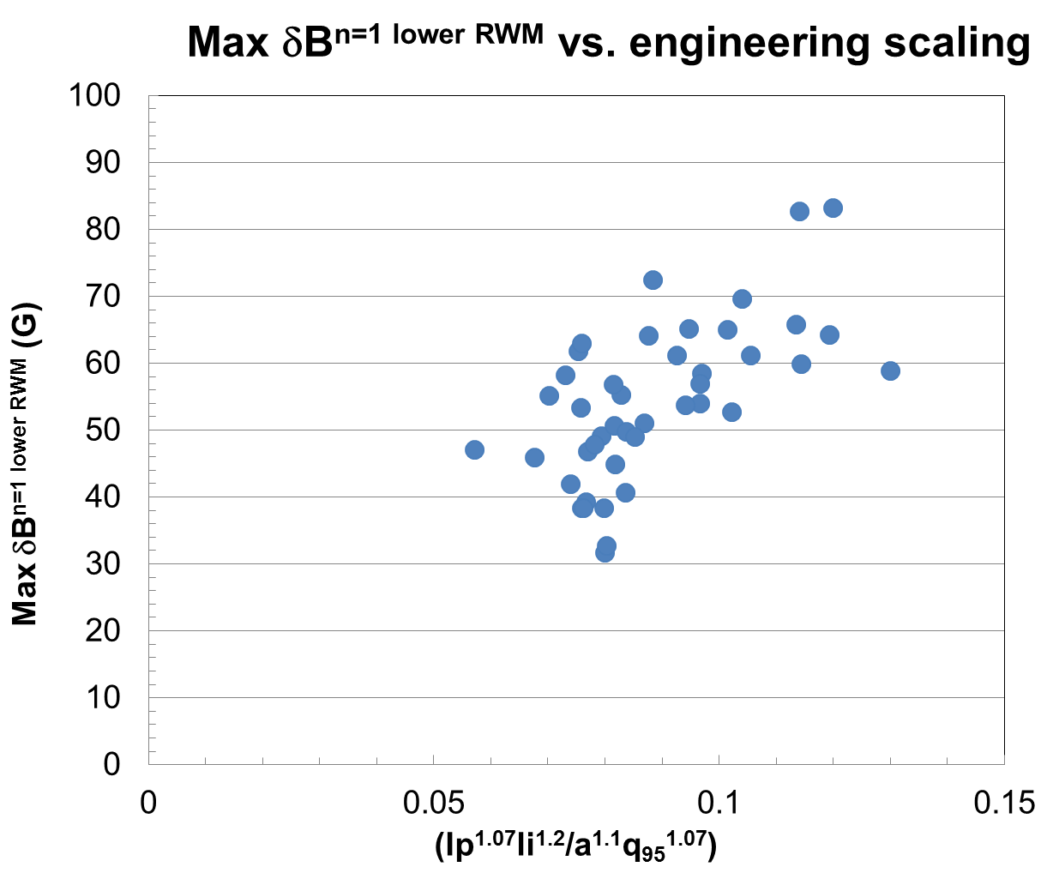
      Maximum δB_{p} might follow a de Vries-style engineering scaling I_{p}^{p1}l_{i}^{p2}/a^{p3}q₉₅^{p4}
NSTX RWM-induced disruptions
Compare maximum δB_{p} causing disruption to de Vries locked NTM scaling
  engineering parameters
  Data shows significant scatter (as does de Vries’ analysis for NTM)
NSTX
RWM-induced
Disruptions
(n = 1 global
MHD mode)

Slide 52
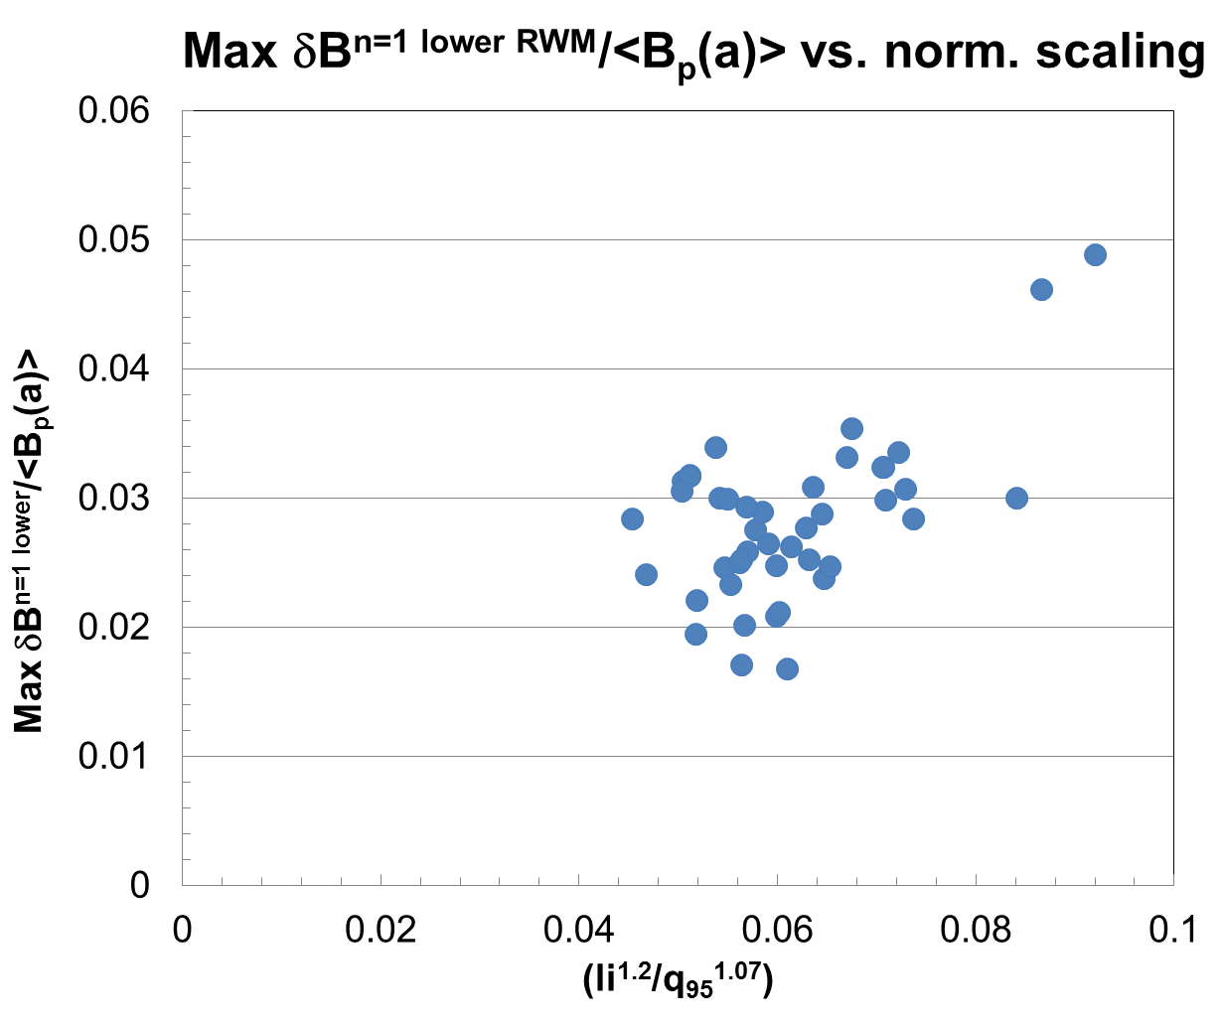
      Maximum δB_{p}/<B_{p}(a)> might follow a de Vries-style scaling l_{i}^{p1}/q₉₅^{p2}
NSTX RWM-induced disruptions
Compare maximum δB_{p} causing disruption vs. de Vries locked NTM scaling
  Normalized parameters
NSTX analysis uses kinetic EFIT reconstructions
  l_{i} instead of l_{i}(3)
  <B_{p}(a)>_{fsa} used
NSTX
RWM-induced
Disruptions
(n = 1 global
MHD mode)

Slide 53
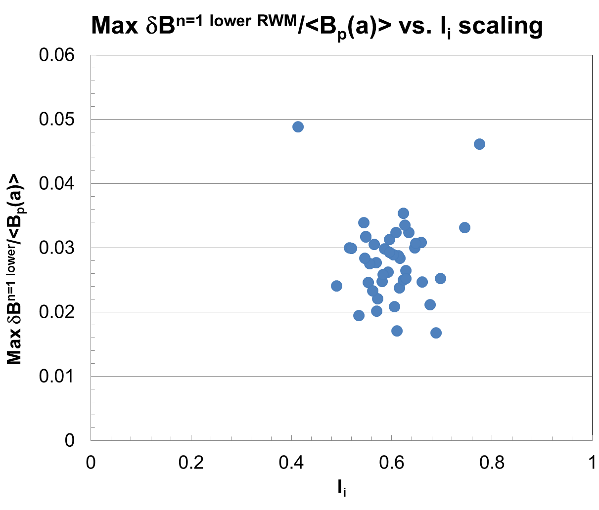
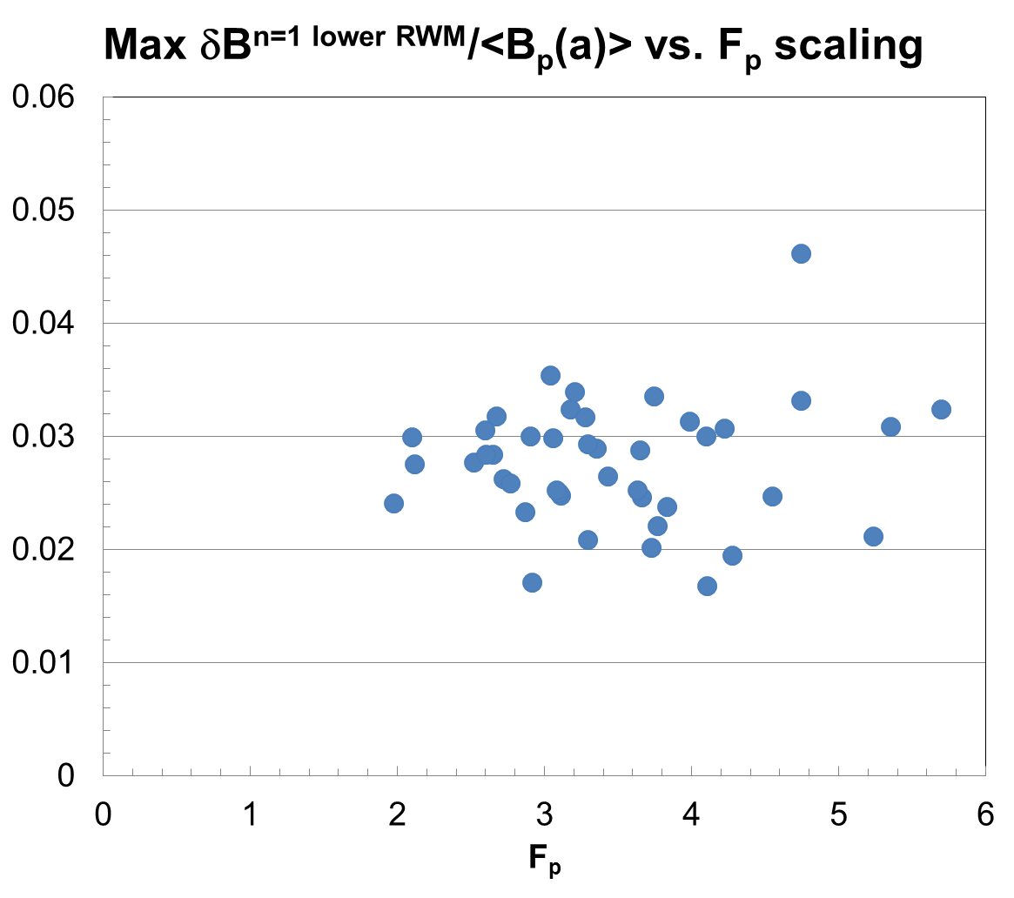
      In contrast, maximum δB_{p}/<B_{p}(a)> seems independent of scaling on (l_{i}) or (F_{p}) (or (F_{p}/l_{i}))
NSTX
RWM-induced
Disruptions
(n = 1 global
MHD mode)
internal inductance
total pressure peaking factor
F_{p} = p_{tot}(0)/<p_{tot}>_{vol} (from kinetic equilibrium reconstructions)
Dependence on l_{i}, F_{p} expected for RWM marginal stability points

