Slide 1

Overview of the Integrated Scenarios Science Group Status and Plans
Stefan Gerhardt, PPPL, SG Leader
R. Raman, U. of Washington, SG Deputy Leader
NSTX-U PAC 37
PPPL B-318
1/27/2015

Slide 2
Outline
Goals & Organization
Milestones and the Research Forum
Research Results, Status, and Plans
  Advanced Scenarios and Control
  RF Heating and Current Drive
  Solenoid Free Start-Up
  Two Multi-TSG Experiments + CC&E (cross cutting and enabling)
Key Research Enabled by the Proposed Facility Enhancements
Connection to FES Priorities and Summary

Slide 3
Outline
Goals & Organization
Milestones and the Research Forum
Research Results, Status, and Plans
  Advanced Scenarios and Control
  RF Heating and Current Drive
  Solenoid Free Start-Up
  Two Multi-TSG Experiments + CC&E
Key Research Enabled by the Proposed Facility Enhancements
Connection to FES Priorities and Summary

Slide 4
Recall: NSTX-U Mission Elements
And How the Integrated Scenarios SG Fits In
Explore unique ST parameter regimes to advance predictive capability – for ITER and Beyond
  WH&CD: Advanced ICRH modeling and code validation
  SFSU: Modeling of reconnection during CHI
Develop Solutions for PMI Challenge
  ASC: Closed loop control of advanced divertor geometry, divertor radiation
Advance ST as a possible FNSF/ Pilot Plant
  HW&CD, SFSU: Non-inductive startup and rampup
  ASC: Fully non-inductive scenarios, profile control

Slide 5
Integrated Scenarios Leadership Team
Deputy SG Leader: Roger Raman (U. of Washington)
Advanced Scenarios and Control
  TSG Leader: Devon Battaglia (PPPL)
  Deputy TSG Leader: Stefan Gerhardt (PPPL)
  Theory/Modeling Rep.: Francesca Poli (PPPL)
  University Rep.: Egemen Kolemen (Princeton University)
RF Heating and Current Drive
  TSG Leader: Rory Perkins (PPPL)
  Deputy TSG Leader: Joel Hosea (PPPL)
  Theory/Modeling Rep.: Nicola Bertelli (PPPL)
  University Rep.: Paul Bonoli (MIT)
Solenoid Free Start-up and Ramp-up
  TSG Leader: Dennis Mueller (PPPL)
  Deputy TSG Leader: Roger Raman (U. of Washington)
  University Rep. + Theory/Modeling Rep.: Fatima Ebrahimi (Princeton University)

Slide 6
Integrated Scenarios Members are Highly Supportive of Physics Operations
Deputy SG Leader: Roger Raman (U. of Washington)
Advanced Scenarios and Control
  TSG Leader: Devon Battaglia (PPPL)
  Deputy TSG Leader: Stefan Gerhardt (PPPL)
  Theory/Modeling Rep.: Francesca Poli (PPPL)
  University Rep.: Egemen Kolemen (Princeton University)
RF Heating and Current Drive
  TSG Leader: Rory Perkins (PPPL)
  Deputy TSG Leader: Joel Hosea (PPPL)
  Theory/Modeling Rep.: Nicola Bertelli (PPPL)
  University Rep.: Paul Bonoli (MIT)
Solenoid Free Start-up and Ramp-up
  TSG Leader: Dennis Mueller (PPPL)
  Deputy TSG Leader: Roger Raman (U. of Washington)
  University Rep. + Theory/Modeling Rep.: Fatima Ebrahimi (Princeton University)
Past, Present, and Future NSTX(-U) Physics Operators

Slide 7
Outline
Goals & Organization
Milestones and the Research Forum
Research Results, Status, and Plans
  Advanced Scenarios and Control
  RF Heating and Current Drive
  Solenoid Free Start-Up
  Two Multi-TSG Experiments + CC&E
Key Research Enabled by the Proposed Facility Enhancements
Connection to FES Priorities and Summary

Slide 8
IS SG Supports Many NSTX-U Research Milestones
FY2016
FY2017
FY2018
Run Weeks:
Incremental
18
16
18
12
16
R16-1
R17-1
R18-1
Boundary Science
+ Particle Control
Assess H-mode confinement, pedestal, SOL characteristics at higher B_{T}, I_{P}, P_{NBI}
Assess scaling, mitigation of steady-state, transient heat-fluxes w/ advanced divertor operation at high power density
Assess impurity sources and edge and core impurity transport
R17-2
IR18-1
Assess high-Z divertor PFC performance and impact on operating scenarios
Investigation of power and momentum balance for high density and impurity fraction divertor operation
R16-2
R17-3
IR18-2
Assess effects of NBI injection on fast-ion f(v) and NBI-CD profile
Assess τ_{E} and local transport and turbulence at low ν* with full confinement and diagnostic capabilities
Assess role of fast-ion driven instabilities versus micro-turbulence in plasma thermal energy transport
Core Science
Begin ~1 year outage for
major facility enhancement(s) sometime during FY2018
IR17-1
R18-2
R16-3
Assess fast-wave SOL losses, core thermal and fast ion interactions at increased field and current
Control of current and rotation profiles to improve global stability limits and extend high performance operation
Integrated Scenarios
Develop physics + operational tools for high-performance: κ, δ, β, EF/RWM
R17-4
R18-3
Develop high-non-inductive fraction NBI H-modes for sustainment and ramp-up
Assess transient CHI current start-up potential in NSTX-U
FES 3 Facility Joint Research Target (JRT)
C-Mod leads JRT
DIII-D leads JRT
NSTX-U leads JRT
Assess disruption mitigation, initial
tests of real-time warning, prediction
Examine effect of configuration on operating space for dissipative divertors
TBD

Slide 9
IS SG Supports Many NSTX-U Research Milestones
FY2016
FY2017
FY2018
Run Weeks:
Incremental
18
16
18
12
16
R16-1
R17-1
R18-1
Boundary Science
+ Particle Control
Assess H-mode confinement, pedestal, SOL characteristics at higher B_{T}, I_{P}, P_{NBI}
Assess scaling, mitigation of steady-state, transient heat-fluxes w/ advanced divertor operation at high power density
Assess impurity sources and edge and core impurity transport
R17-2
IR18-1
Assess high-Z divertor PFC performance and impact on operating scenarios
Investigation of power and momentum balance for high density and impurity fraction divertor operation
R16-2
R17-3
IR18-2
Assess effects of NBI injection on fast-ion f(v) and NBI-CD profile
Assess τ_{E} and local transport and turbulence at low ν* with full confinement and diagnostic capabilities
Assess role of fast-ion driven instabilities versus micro-turbulence in plasma thermal energy transport
Core Science
Begin ~1 year outage for
major facility enhancement(s) sometime during FY2018
IR17-1
R18-2
R16-3
Assess fast-wave SOL losses, core thermal and fast ion interactions at increased field and current
Control of current and rotation profiles to improve global stability limits and extend high performance operation
Integrated Scenarios
Develop physics + operational tools for high-performance: κ, δ, β, EF/RWM
R17-4
R18-3
Develop high-non-inductive fraction NBI H-modes for sustainment and ramp-up
Assess transient CHI current start-up potential in NSTX-U
FES 3 Facility Joint Research Target (JRT)
C-Mod leads JRT
DIII-D leads JRT
NSTX-U leads JRT
Assess disruption mitigation, initial
tests of real-time warning, prediction
Examine effect of configuration on operating space for dissipative divertors
TBD

Slide 10
IS SG Supports Many NSTX-U Research Milestones
FY2016
FY2017
FY2018
Run Weeks:
Incremental
18
16
18
12
16
R16-1
R17-1
R18-1
Boundary Science
+ Particle Control
Assess H-mode confinement, pedestal, SOL characteristics at higher B_{T}, I_{P}, P_{NBI}
Assess scaling, mitigation of steady-state, transient heat-fluxes w/ advanced divertor operation at high power density
Assess impurity sources and edge and core impurity transport
R17-2
IR18-1
Assess high-Z divertor PFC performance and impact on operating scenarios
Investigation of power and momentum balance for high density and impurity fraction divertor operation
R16-2
R17-3
IR18-2
Assess effects of NBI injection on fast-ion f(v) and NBI-CD profile
Assess τ_{E} and local transport and turbulence at low ν* with full confinement and diagnostic capabilities
Assess role of fast-ion driven instabilities versus micro-turbulence in plasma thermal energy transport
Core Science
Begin ~1 year outage for
major facility enhancement(s) sometime during FY2018
IR17-1
R18-2
R16-3
Assess fast-wave SOL losses, core thermal and fast ion interactions at increased field and current
Control of current and rotation profiles to improve global stability limits and extend high performance operation
Integrated Scenarios
Develop physics + operational tools for high-performance: κ, δ, β, EF/RWM
R17-4
R18-3
Develop high-non-inductive fraction NBI H-modes for sustainment and ramp-up
Assess transient CHI current start-up potential in NSTX-U
FES 3 Facility Joint Research Target (JRT)
C-Mod leads JRT
DIII-D leads JRT
NSTX-U leads JRT
Assess disruption mitigation, initial
tests of real-time warning, prediction
Examine effect of configuration on operating space for dissipative divertors
TBD

Slide 11
The Research Forum Determined the Run Plan
Run time allocation set to large extent by the milestones
Significantly more days requested than allocated.
Much discussion produced a tight research plan.
SG structure was very valuable in setting these priorities.
TSG | Requested Days | Allocated Days
ASC | 33 | 8
SFSU | 14.5 | 3.5
WH&CD | 9 | 3.5
Topic | Total Allocation
High-Beta Scenario Development | 3.5
Low Current Ramp-Up | 2 (1 WH&CD + 0.5 SFSU + 0.5 ASC)
Control | 4
CHI | 2.5
HHFW in the Flat-Top | 3
Total | 15
ASC+RF+SFSU | 8+3.5+3.5 = 15

Slide 12
Outline
Goals & Organization
Milestones and the Research Forum
Research Results, Status, and Plans
  Advanced Scenarios and Control
  RF Heating and Current Drive
  Solenoid Free Start-Up
  Two Multi-TSG Experiments + CC&E
Key Research Enabled by the Proposed Facility Enhancements
Connection to FES Priorities and Summary

Slide 13
ASC Research Thrusts Focus on Plasma Control and Scenario Development
#1– Scenario Develop for NSTX-U and Next-Steps
#2 - Axisymmetric Control Development
#3 - Disruption Avoidance By Controlled Discharge Shutdown
#4 - Understand Scenario Physics for Next Step Devices
Defined in the 5 Year Research Plan
For thrust sub-elements, see:
http://nstx-u.pppl.gov/program/science-groups/integrated-scenarios/advanced-scenarios-and-control

Slide 14
Significant Modeling Supports the ASC Research Program
Fully relaxed non-inductive operating points have been explored with free-boundary TRANSP calculations
B_{T}=1.0 T, I_{P}=1 MA, P_{inj}=12.6 MW
Contours of Non-Inductive Fraction
R16-3
Research Timeline for 100% Non-Inductive Scenarios
Operation Year | B_{T} [T] | Current Goal [kA] | Duration Goal
2016 | <=0.75 | ~600-800 | A few τ_{E}
2017 | 0.75-1.0 | ~600-1000 | 1-2 τ_{R}
Out-Years | 1 | 800-1300 | Up to 4.5 s at lower I_{P}
f_{NI}=1
Contours of q_{min}
These scenarios, obtained at first with an inductive ramp-up, will provide a target for non-inductive ramp-up studies
See talk by F. Poli and M. Boyer for more recent modeling results.
q_{min}=1
S.P. Gerhardt, et al, Nuclear Fusion 52 083020 (2012)

Slide 15
Scenario Studies Will Focus on 100% NI and High-Current Long-Pulse
Non-Inductive Scenario Development (XP-1507, Gerhardt, et al.)
  Goal: Develop 100% non-inductive scenarios with I_{P}~ 600 kA.
  Key Issues: Thermal transport, vertical stability at high-κ, n=1 stability
  Modeling/Analysis: TRANSP
S.P. Gerhardt, et al, Nuclear Fusion 52 083020 (2012)
Long Pulse Development (XP-1554, Battaglia et al.)
  Goal: Utilize 80 kV beams, optimized OH waveform, to achieve longest possible pulse
  Key Issues: fuelling optimization, preventing q₀ evolving too far, impurity control.
  Modeling/Analysis: TRANSP
Sustained Reverser Shear (XP-1575 H. Yuh, et al.)
  Goal: Utilize off-axis NBI to sustain reversed shear
  Key Issues: MHD leading to current redistribution, too-high pressure peaking.
  Modeling/Analysis: TRANSP, GS2, other microstability codes pending results
These support milestones R16-2, R17-4, R18-2, & ASC thrusts #1 and #4

Slide 16
NSTX-U Experiments Are Already Using a Significantly Expanded Plasma Shutdown Scheme
NSTX PCS: No means of detecting a disruption, or ramping down the plasma current based on events.
NSTX-U PCS: State machine orchestrates the shutdown.
Disruptions detected by:
  Too large I_{P} error
  Too large Z_{P}(dZ_{P}/dt)
  Large locked n=1 modes
Presently using “Fast I_{P} Rampdown” on every shot
  waiting to use “Slow-I_{P} Rampdown”.
  Have not yet turned on n=1 disruption triggering.
SS=0:
Ramp-Up & Flat-Top
“SS” = “Shutdown State”
SS=1:
Slow I_{P} Rampdown
Disruption Imminent
Disruption Imminent
SS=2:
Fast I_{P} Rampdown
SS=3:
I_{OH} Loss of Control
SS=4: Insufficient I_{P}
Diagram of the State Machine Presently Implemented in PCS
Supports ASC thrust #3

Slide 17
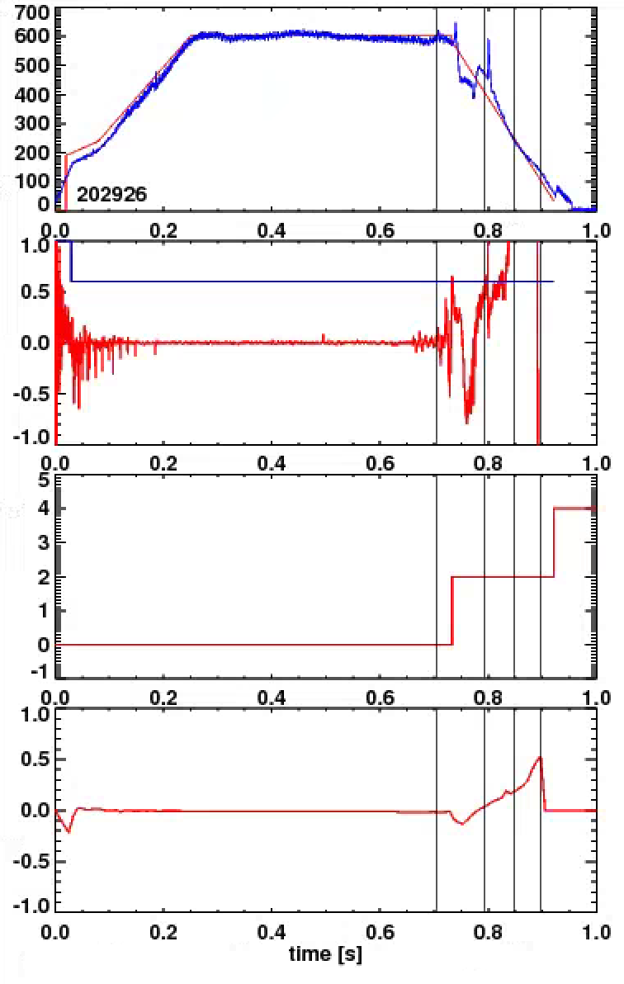
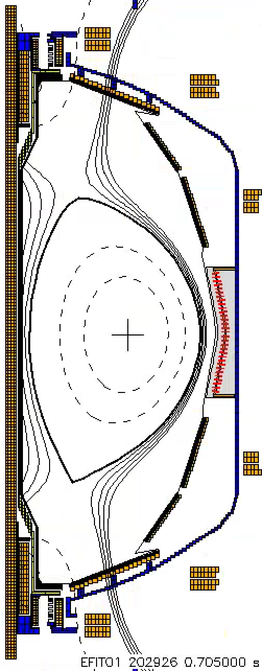
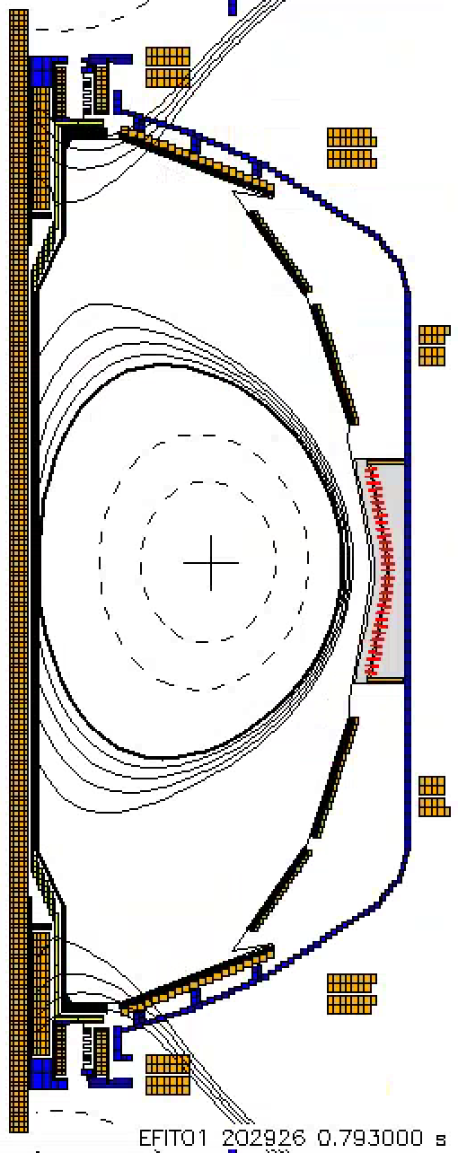
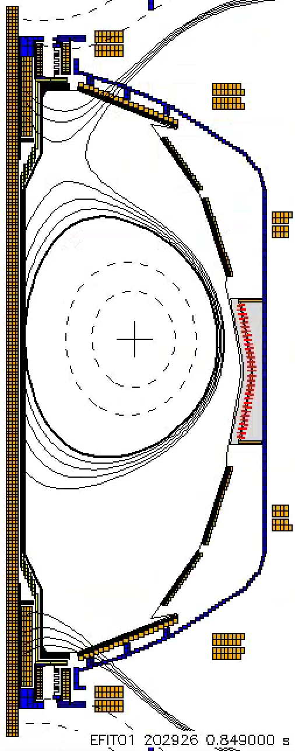
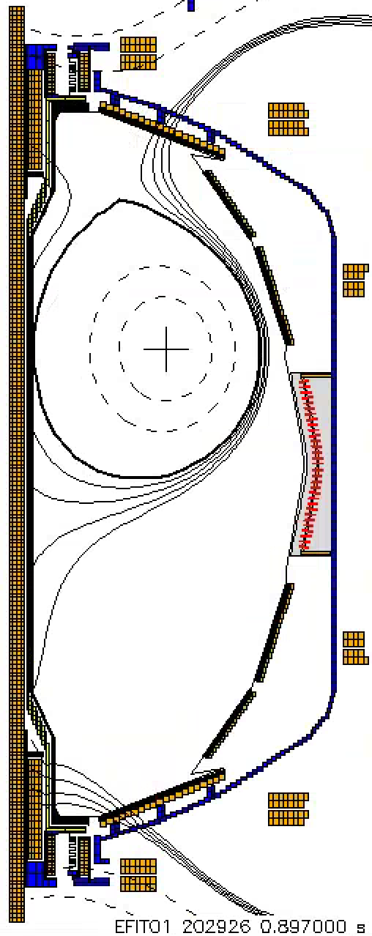
NSTX-U Experiments Are Already Using a Significantly Expanded Plasma Shutdown Scheme
NSTX PCS: No means of detecting a disruption, or ramping down the plasma current based on events.
NSTX-U PCS: State machine orchestrates the shutdown.
Disruptions detected by:
  Too large I_{P} error
  Too large Z_{P}(dZ_{P}/dt)
  Large locked n=1 modes
Presently using “Fast I_{P} Rampdown” on every shot
  waiting to use “Slow-I_{P} Rampdown”.
  Have not yet turned on n=1 disruption triggering.
I_{P}
t=0.705
t=0.793
I_{P} Request
(including asynchronous transition to rampdown)
  Z_{P}(dZ_{P}/dt) threshold
  Z_{P}(dZ_{P}/dt)
“State”
Insufficient I_{P}
t=0.849
t=0.897
Fast I_{P} Rampdown
Normal
  Z_{P} from EFIT
Example: This shot would have been a strong VDE in NSTX
Supports ASC thrust #3
Slow Drift Up, But No VDE or Disruption

Slide 18
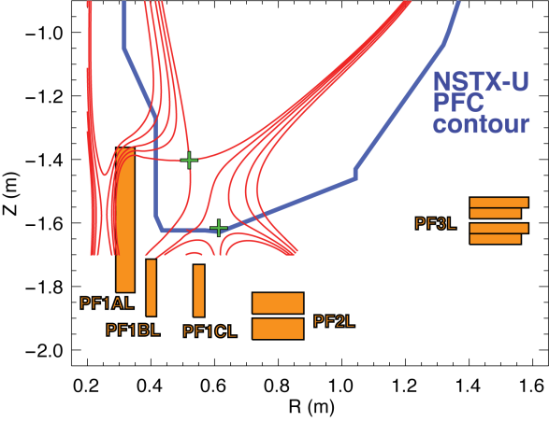
Control Experiments Support NSTX-U Program and Next Step Devices
β_{N} and l_{i} Control Study (XP-1509, Boyer et al)
  Goal: Demonstrate closed loop combined control of β_{N} and l_{i}.
  Method: Realtime measurements with rtEFIT, control via beam, shape, maybe n=3 actuation.
  Key Issues: rtEFIT quality, beam modulation effects on plasma, limited range of l_{i} actuation
Current Profile Controllability Study (XP-1532, Boyer et al, 0.75 days)
  Goal: Demonstrate closed loop control of the current profile
  Method: Dedicated modulation shots for system identification type purposes, attempts at closed loop control if technically possible.
  Key Issues: rtMSE availability, beam modulation effects on plasma
Rotation Control [XP-1564, I. Goumiri, et al]
  Goal: Demonstrate closed loop control of the rotation profile and β_{N}.
  Method: Beam for torque and heating, NTV for breaking. State-Space control algorithm
  Key Issues: rtV_{φ} availability, beam modulation effects on plasma
Snowflake Divertor Control [XP-1508, Kolemen and Vail]
  Goal: Demonstrate control of the unique dual X-point geometry.
  Method: New PCS algorithm with dual X-point tracking based on rtEFIT flux map, PID mechanism for adjusting divertor coil currents.
  Key Issues: rtEFIT quality, coil forces during control oscillations, interaction with other shape controllers
These support milestone R18-2, & ASC thrusts 1, 2, and 4

Slide 19
Outline
Goals & Organization
Milestones and the Research Forum
Research Results, Status, and Plans
  Advanced Scenarios and Control
  RF Heating and Current Drive
  Solenoid Free Start-Up
  Two Multi-TSG Experiments + CC&E
Key Research Enabled by the Proposed Facility Enhancements
Connection to FES Priorities and Summary

Slide 20
Wave H&CD TSG Thrusts Dedicated to HHFW & EC Applications and Code Validation
#1 Develop FW/EC heating for fully NI plasma current start-up and ramp-up
  Joint XP with Solenoid-Free Start-Up TSG…will describe dedicated experiment later in the talk.
#2 Validate state-of-the-art RF codes for NSTX-U and predict RF performance in future burning plasma devices.
For thrust sub-elements, see:
http://nstx-u.pppl.gov/program/science-groups/integrated-scenarios/wave-heating-and-current-drive

Slide 21
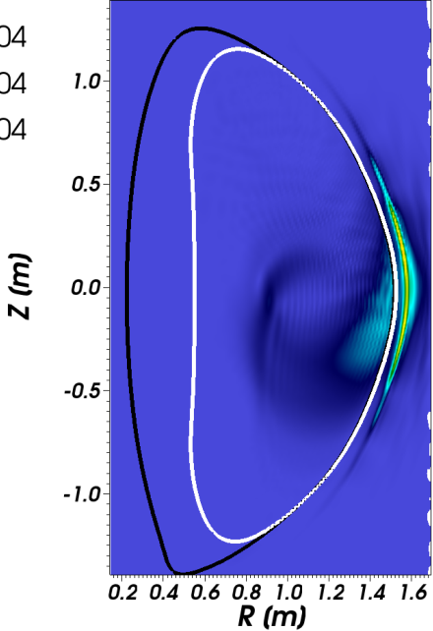
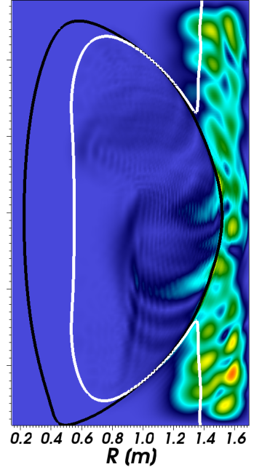
Modeling Is Confirming The Importance of RH Cutoff in Determining SOL Losses
NSTX showed a large loss of RF power in the SOL
Modeling shows large RF field amplitude in SOL under certain conditions
  Seen in full-wave code AORSA
    N. Bertelli et al., Nucl. Fusion 54 (2014) 083004.
    N. Bertelli et al., Nucl. Fusion 56 (2016) 016019.
  Also seen in cylindrical cold-plasma model
    Wave power (axial Poynting flux) confined to periphery, only gradually penetrating the core
    R. J. Perkins et al., 41th EPS Conference on Plasma Physics P-1.011.
RF fields in divertor cause RF sheath; potentially large enough to account for SOL losses
  Increased sheath voltage and electron current predicted to substantially increase heat flux to tiles
    R. J. Perkins et al., Phys. Plasma 22 (2015) 042506.
k_{φ} = 13 m⁻¹
Heating phasing
Lower SOL density (n_{ant} = 1x10¹² cm⁻³)
Higher SOL density (n_{ant} = 2x10¹² cm⁻³)
Cutoff layer

Slide 22
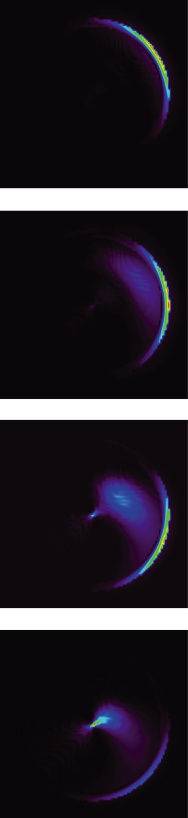
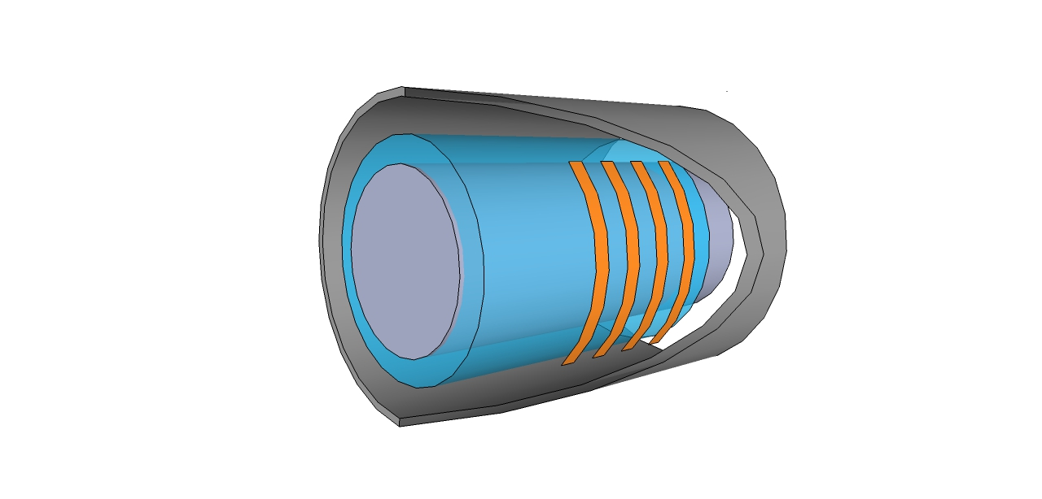
Modeling Is Confirming The Importance of RH Cutoff in Determining SOL Losses
NSTX showed a large loss of RF power in the SOL
Modeling shows large RF field amplitude in SOL under certain conditions
  Seen in full-wave code AORSA
    N. Bertelli et al., Nucl. Fusion 54 (2014) 083004.
    N. Bertelli et al., Nucl. Fusion 56 (2016) 016019.
  Also seen in cylindrical cold-plasma model
    R. J. Perkins et al., 41th EPS Conference on Plasma Physics (2015) P-1.011.
Axial poynting flux
only gradually penetrates core
y
0.25 m
0.75 m
Distance along field lines
Diffuse
Annulus (‘SOL’)
n_{a} ~ 1-3e18 m⁻³
Dense core
n_{c} ~ 5e19 m⁻³
1.25 m
Conducting vessel
wall
Model antenna
adjustable phase
1.75 m
x

Slide 23
Modeling Is Confirming The Importance of RH Cutoff in Determining SOL Losses
NSTX showed a large loss of RF power in the SOL
Modeling shows large RF field amplitude in SOL under certain conditions
  Seen in full-wave code AORSA
    N. Bertelli et al., Nucl. Fusion 54 (2014) 083004.
    N. Bertelli et al., Nucl. Fusion 56 (2016) 016019.
  Also seen in cylindrical cold-plasma model
    R. J. Perkins et al., 41th EPS Conference on Plasma Physics (2015) P-1.011.
RF fields in divertor cause RF sheath; potentially large enough to account for SOL losses
  Rectified sheath voltage and e⁻ current predicted to substantially increase heat flux to tiles
    R. J. Perkins et al., Phys. Plasma 22 (2015) 042506.
Axial poynting flux
only gradually penetrates core
y
0.25 m
0.75 m
Distance along field lines
1.25 m
1.75 m
x

Slide 24
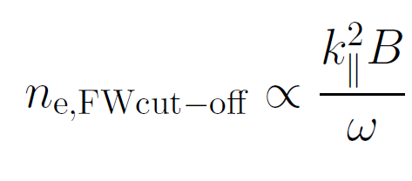
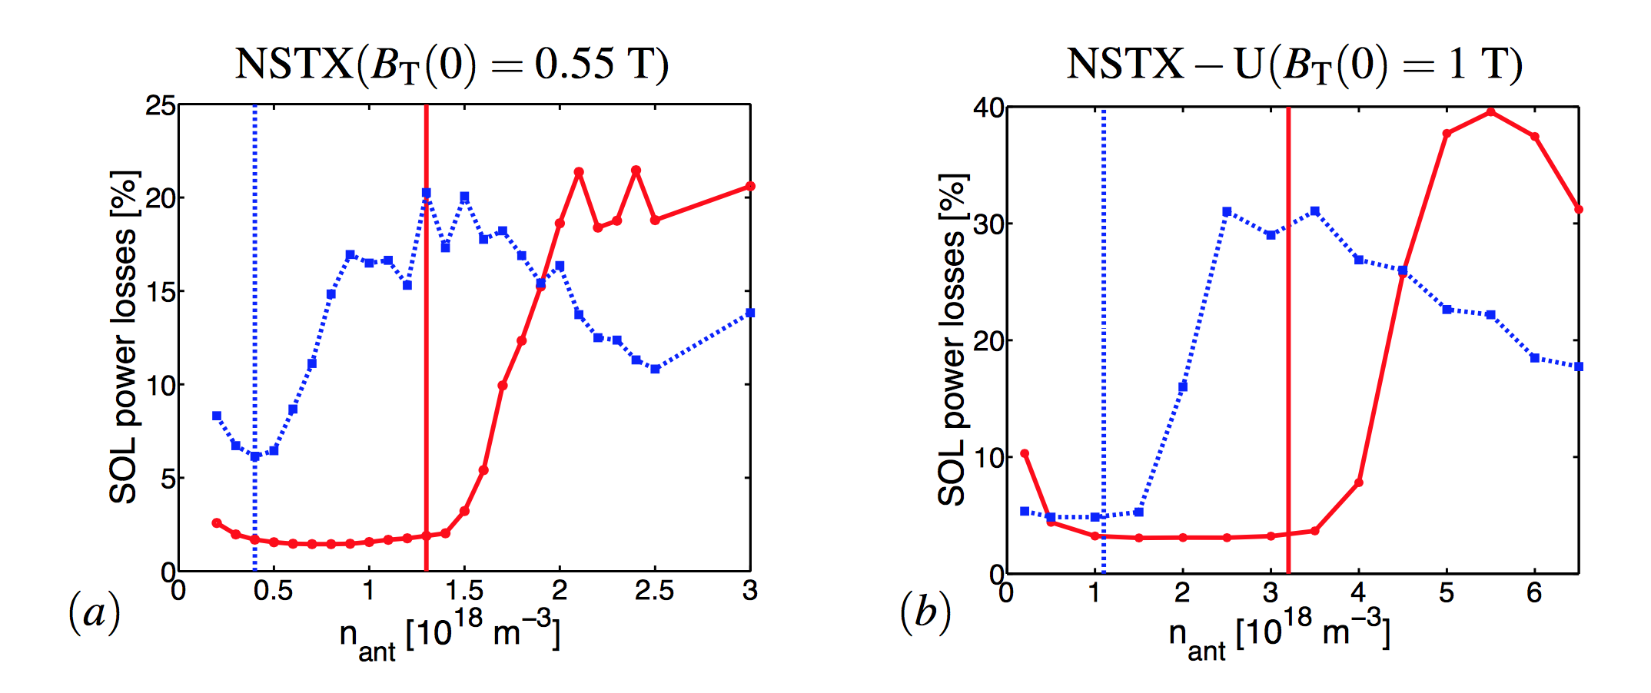
NSTX-U Prospect: Higher Toroidal Field May Reduce These SoL Losses
Right-hand cutoff density proportional to B:
  Larger cutoff density may reduce losses.
AORSA modeling confirms this expectation.
  Using NSTX discharge data and NSTX-U TRANSP scenarios.
n_{φ}=-21
n_{φ}=-12
n_{φ}=-21
n_{φ}=-12

Slide 25
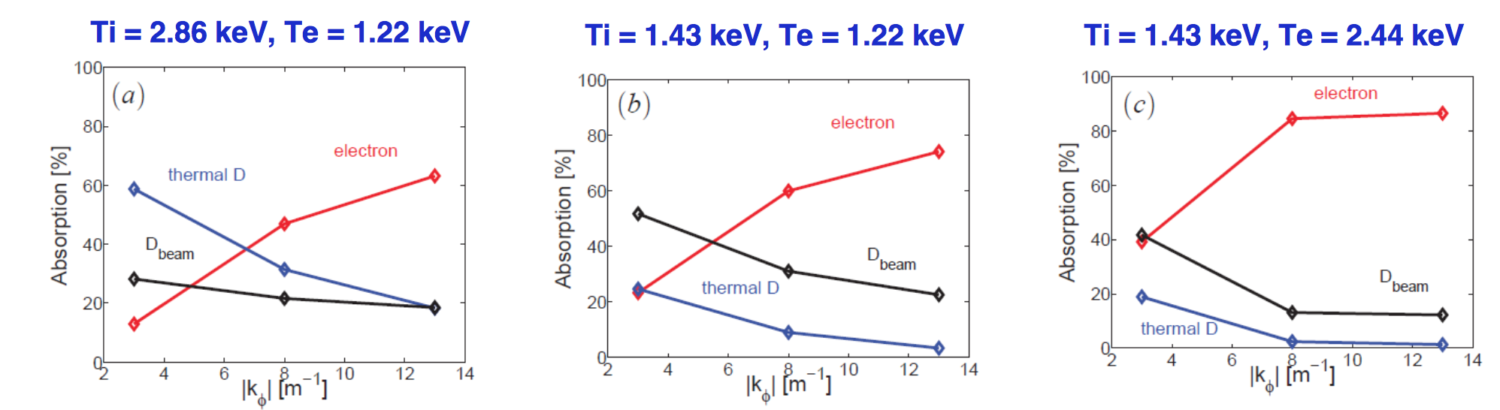
NSTX-U Prospect: Wide Range of Possible Partitions for HHFW Power Absorption
Increased B_{T} may increase the thermal and fast ion absorption
  Decreased ion cyclotron harmonic number, increased cyclotron absorption
AORSA predictions for NSTX-U :
  greater deuterium heating when T_{i} > T_{e}
  Ion heating increases and electron heating decreases as k_{φ} decreases
T_{i}/T_{e}~2.3
T_{i}/T_{e}~1.2
T_{i}/T_{e}~0.6
N. Bertelli, et al AIP Conference Proceedings 2014
This work will benefit from including non-Maxwellian effects in TORIC v.5
  Bertelli et al. APS 2015

Slide 26
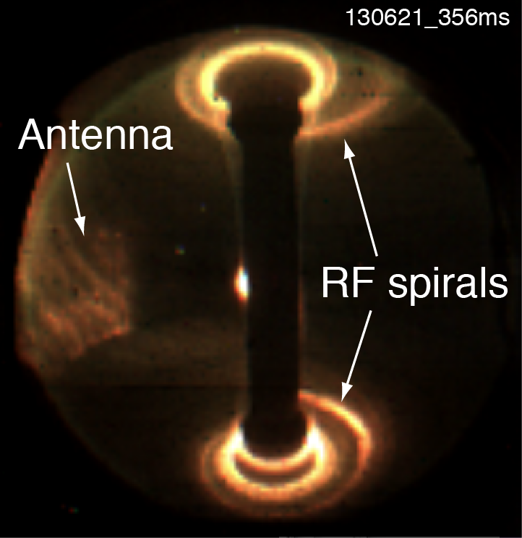
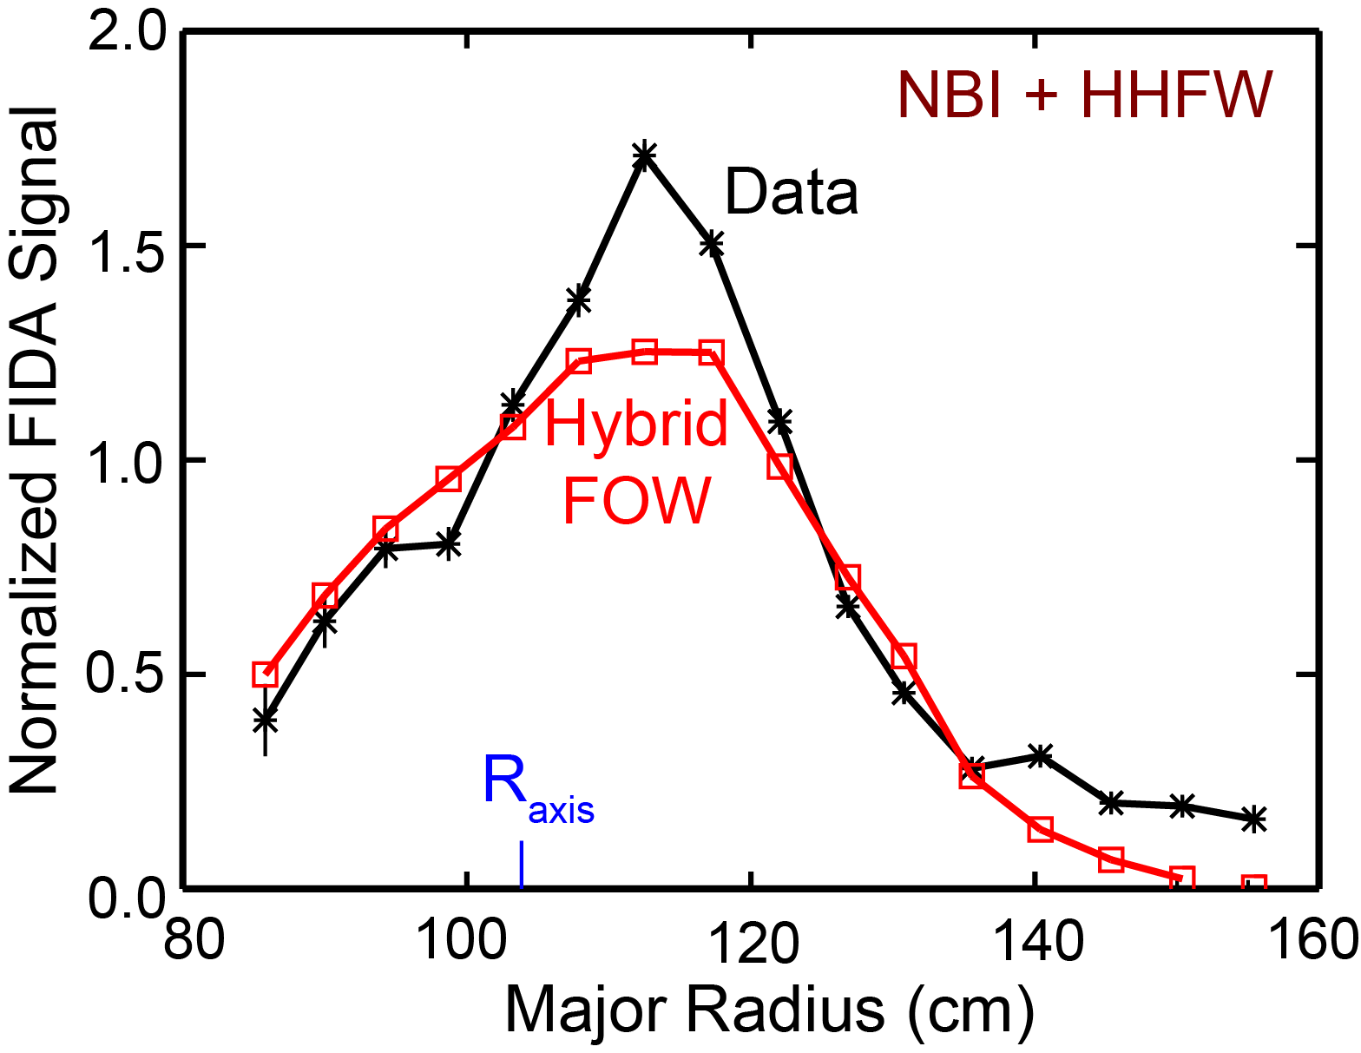
SoL Propagation and Core Absorption Physics Will be Addressed in Two XPs
Characterize SoL Losses of HHFW Power in H-Mode (XP-1510, Perkins, et al.)
  Goal: Assess scaling of SoL losses as a function of edge parameters, B_{T}
  Diagnostics:
    fraction of HHFW power lost & spiral intensity along length of spiral
    RF voltage at the most intense portion of the spiral,
    SOL density profiles in front of antenna.
  Modeling/Analysis: TRANSP, AORSA
HHFW Absorption in NB Heated Plasmas (XP-1533, Bertelli, et al)
  Goal: Characterize RF absorption as a function of RF phase, toroidal field
  Analysis/Modeling
    GENRAY/CQL3D, TORIC, AORSA, AORSA+CQL3D, ORBIT-RF
    Continue validation of CQL3D with fast ion diagnostic (FIDA) data.
R. Harvey et al., 56th APS-DPP 2014
These support milestone IR17-2 , WH&CD Thrusts #2

Slide 27
Outline
Goals & Organization
Milestones and the Research Forum
Research Results, Status, and Plans
  Advanced Scenarios and Control
  RF Heating and Current Drive
  Solenoid Free Start-Up
  Two multi-TSG experiments + CC&E
Key Research Enabled by the Proposed Facility Enhancements
Connection to FES Priorities and Summary

Slide 28
SFSU Research Thrusts Are Synergistic with Other IS TSGs, Address Key Issues for a low-A FNSF
#1 – Establish and Extend Solenoid-Free Plasma Start-up
#2 - Test NBI Current Ramp-Up
#3 - Ramp-up CHI plasma discharges using ECH, HHFW and NBI and test plasma gun start-up
For thrust sub-elements, see:
http://nstx-u.pppl.gov/program/science-groups/integrated-scenarios/solenoid-free-start-up-and-ramp-up

Slide 29
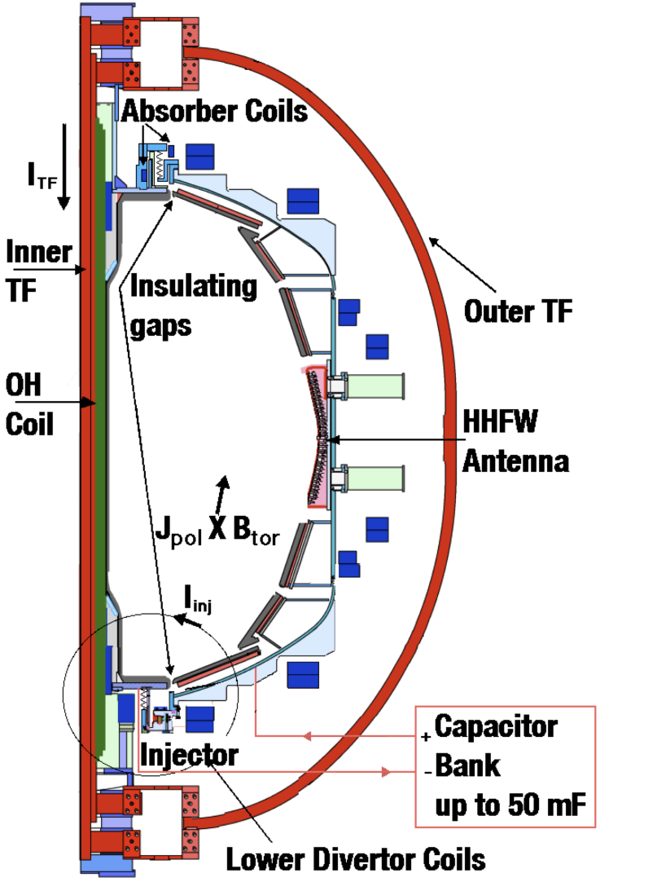

NSTX & NSTX-U Design Incorporates Features for Coaxial Helicity Injection
CHI in NSTX/NSTX-U
Inner and outer vacuum vessels
Injector and absorber regions
Injector coils & TF
Capacitor bank
  2kV, 50 mF
JxB force drives the plasma into the main chamber.
Closed surfaces form when the injector (bank) current dies away or is crowbarred.

Slide 30
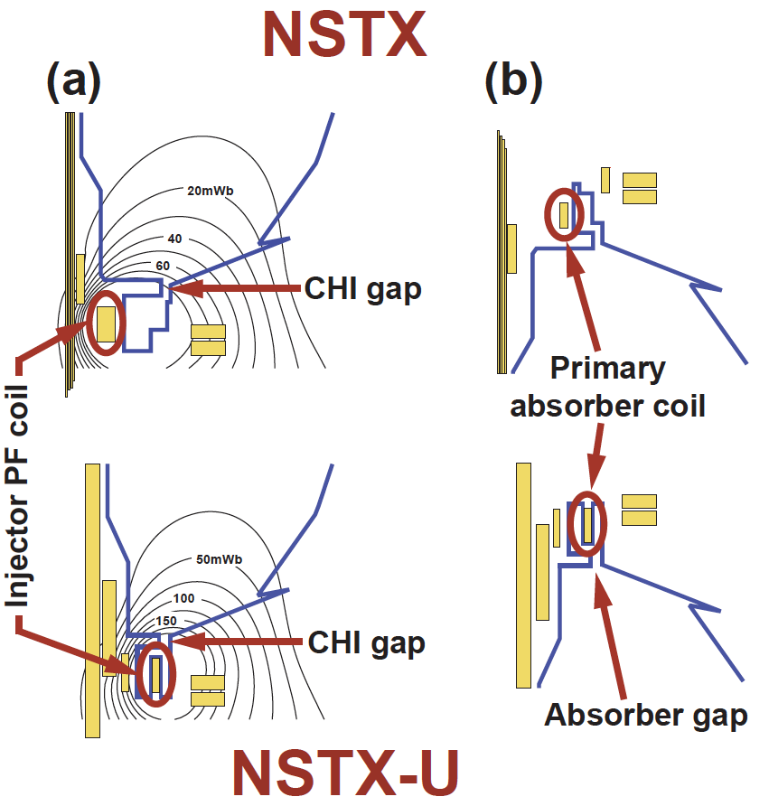
NSTX-U Upgrades that Facilitate CHI Start-up
CHI in NSTX/NSTX-U
NSTX-U Machine Enhancements for CHI
  > 2.5 x Injector Flux (proportional to I_{p} )
  About 2 x higher toroidal field (reduces injector current requirements)

Slide 31
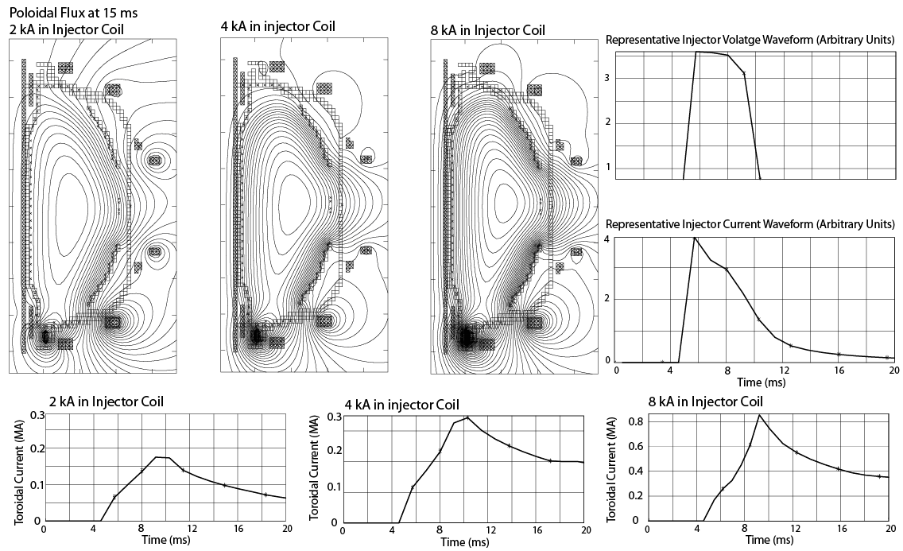
TSC Simulations in the NSTX-U Geometry support up to 400kA Current Start-up Capability in NSTX-U
Raman, et al., IEEE Trans. Plasma Sci. (2014)

Slide 32
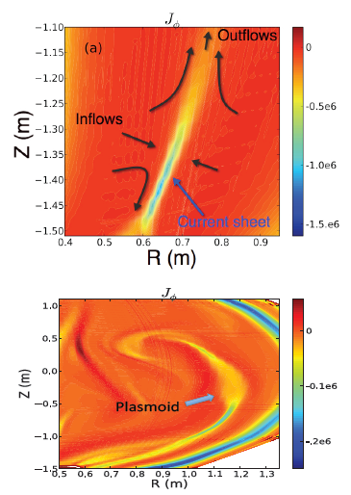
At High Lundquist Number, Plasmoid Mediated Reconnection Identified as Assisting in Flux Closure
Sweet Parker (S-P) reconnection in the injector region at low Lundquist number
At high Lundquist number the S-P current sheet is plasmoid unstable
Plasmoids seen in NSTX CHI
NIMROD Simulations
F. Ebrahimi, et al., PRL (2015)

Slide 33
Two FY-16 Experiments Will Exploit the New Upgrade Capabilities, Target Coupling to Induction
Transient CHI Startup in NSTX-U (XP-1432. R. Raman).
  Motivation: New geometry of CHI gap, PF coils, PFCs mandate experiments to establish transient CHI.
  Goal: Establish reliable flux closure in the NSTX-U geometry.
  Method: Start at NSTX-level fields and currents, then increase B_{T} and injector flux once reliable discharges have been formed.
  Key Issues: Breakdown with new narrow gap, tailoring the flux-footprint with new coils, electrode conditioning.
  Modeling/Analysis: NIMROD + Utilize the extensive suite of cameras to assess plasmoid formation and effects.
Inductive Flux Savings of Inductively-driven Transient CHI Plasmas (XP-1535, B. Nelson)
  Motivation: Coupling transient CHI to induction is a step towards demonstrating compatibility of CHI with subsequent ramp-up schemes.
  Goal: Establish transient CHI discharge and ramp it up with induction
  Key Issues: Persistent enough CHI plasma for good coupling, hand-off to position and I_{P} control.
These support milestone R18-3 , SFSU goal #1

Slide 34
Outline
Goals & Organization
Milestones and the Research Forum
Research Results, Status, and Plans
  Advanced Scenarios and Control
  RF Heating and Current Drive
  Solenoid Free Start-Up
  Two Multi-TSG Experiments + CC&E
Key Research Enabled by the Proposed Facility Enhancements
Connection to FES priorities and Summary
See talk by F. Poli for modeling/theory motivation for these two joint XPs

Slide 35
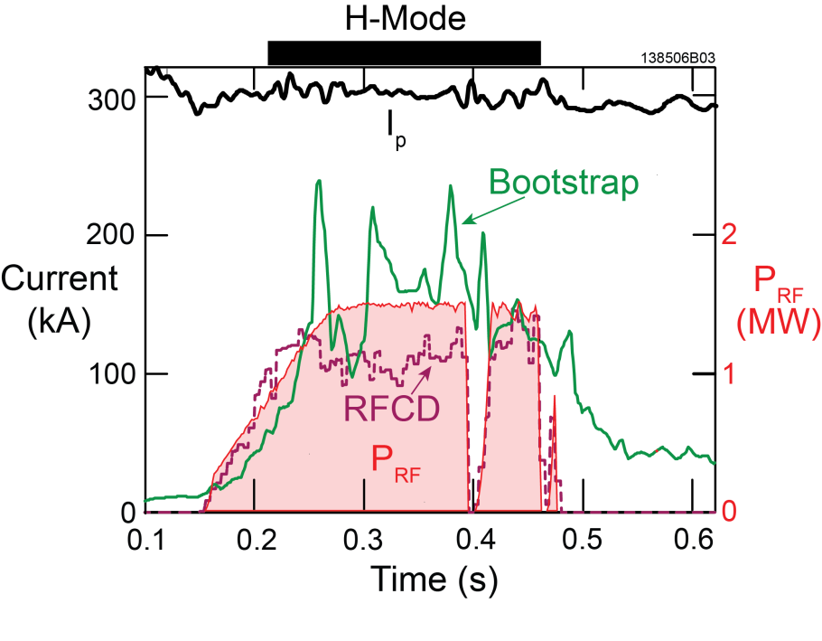
Effective Heating of Low-I_{P} Plasmas Will Be Further Developed
Low Plasma Current, Fully Non-Inductive, HHFW H-Mode Plasmas
(XP-1534, Taylor)
Motivation:
Critical to heat low-I_{P} plasmas to the levels needed for NBI CD.
Very efficient heating of a low current plasma was demonstrated on NSTX
  Bootstrap current dominant when ITB forms
Goal
Re-establish ~300 kA, high-f_{NI}, HHFW heated scenarios in NSTX-U
Attempt overdrive.
Key Issues:
  Shape control and ELMs impact on the RF coupling.
  ITB formation
Analysis/Modeling
TRANSP, TRANSP+TORIC
AORSA
300 kA inductive NSTX target heated to 3keV using ~1 MW HHFW
G. Taylor et al., Phys. Plasmas 19 (2012) 042501
See talk by Poli for how this type of heating fits into the full ramp-up scheme
These support SFSU thrust #3, WH&CD thrusts #1 & 2

Slide 36
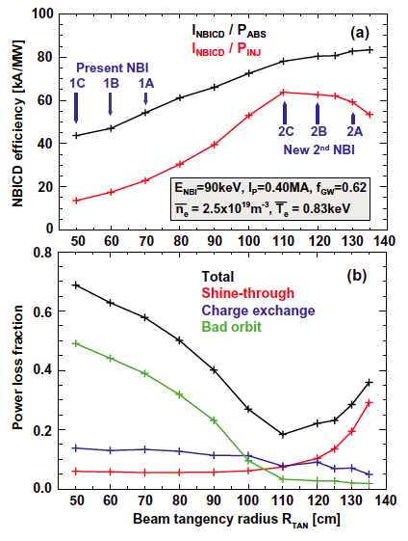
Ability of Large Tangency Radius Beam to Couple Power/Current at Low Current Will Be Assessed
NB Ramp-Up Studies (XP-1567, F. Poli)
Motivation
  Calculations predict high current drive efficiency at low I_{P} for large tangency radius sources
Goal:
  Assess lowest I_{P} (& therefor n_{e}, T_{e}) for NB coupling as a function of tangency radius
Key Issues:
  Shine through losses vs. bad orbit losses
  FI pressure peaking
  Confinement & plasma control at low I_{P}
Method
  High B_{T}, 300<I_{P}<500 kA, 80-90 kV beams.
  FI diagnostics and comparison to TRANSP predictions
  HHFW may be used to increase T_{e}
Analysis/Modeling
  TRANSP/NUBEAM
These support milestone SFSU thrust #2, ASC thrust #1
J. Menard, et al., Nuclear Fusion 42, 083015 (2012)

Slide 37
IS SG Also Supports Cross-Cutting and Enabling XPs & XMPs
Optimization of the Vertical Control Algorithm (XP-1501, Boyer)
  Goal: Optimize control observer parameters, feedback gains, and then push to higher elongation.
  Analysis: TOKSYS, TRANSP-ISOLVER
Tuning of Automated Rampdown Software (XP-1502, Gerhardt)
  Goal: Tune shutdown algorithm for the more challenging H-mode rampdown.
  Key Issues: Shape handoff using ISOFLUX, position transients during H->L.
HHFW Antenna Conditioning (XMP-026, Hosea)
  Goal: Antenna conditioning under plasma conditions, after successful antenna conditioning
Commissioning CHI System (XMP-126, Raman)
  Goal: Commission CHI capacitor bank and dedicated instrumentation, make first CHI discharges.
  Key Issues: Noise reduction on new instrumentation, DCPS configuration during CHI, noise on magnetic diagnostics.
LGI Control (XMP-130, Lunsford)
  Goal: Commission Lithium Granule Injector, including PCS algorithms

Slide 38
Outline
Goals & Organization
Milestones and the Research Forum
Research Results, Status, and Plans
  Advanced Scenarios and Control
  RF Heating and Current Drive
  Solenoid Free Start-Up
  Two Multi-TSG Experiments + CC&E
Key Research Enabled by the Proposed Facility Enhancements
Connection to FES priorities and Summary

Slide 39
Proposed Facility Enhancements Will Be a Dramatic Step Forwards for SFSU and WH&CD Research
28 GHz gyrotron system is largely motivated by the need to connect CHI to HHFW and NB heating.
  See talk by F. Poli for details on how SFSU research will be fundamentally enhanced.
28 GHz gyrotron will also allow EBW heating studies to move forward, following a launcher upgrade.
High-Z PFC upgrade will provide metal electrode surfaces, which will likely prove advantageous for CHI once properly conditioned (reduced low-Z impurities, radiation).

Slide 40
Exciting Opportunities for ASC Research Will Come out of the Facility Enhancements
Cryo-pump should resolve a long-standing, legitimate criticism of NSTX scenario research…lack of density control.
  Will likely be a key capability in exploiting the full NSTX-U magnet and heating systems.
  Will facilitate targeted scenario and physics studies.
  Refer to talks by R. Maingi, M. Ono for more details.
High-Z PFC enhancement will introduce critical, exciting challenges to scenario and control development.
  May make active heat flux management as critical as other control loops, as will be the case in ITER and other next steps.
  See talk by M. Jaworski for details.
NCC will provide an additional key actuator for profile control.
  Closed loop pedestal height control will be assessed as an ELM mitigation strategy.
  More flexible rotation control strategies will be developed, which may be important for scenario optimization

Slide 41
Outline
Goals & Organization
Milestones and the Research Forum
Research Results, Status, and Plans
  Advanced Scenarios and Control
  RF Heating and Current Drive
  Solenoid Free Start-Up
  Two Multi-TSG Experiments + CC&E
Key Research Enabled by the Proposed Facility Enhancements
Connection to FES priorities and Summary

Slide 42
IS SG Research Supports FES Priorities
Advancing predictive capability, model validation
  Control oriented modeling, start-up modeling, RF code validation
    See also talks by Boyer, Poli, in addition to these slides.
Mitigating / avoiding transients
  Disruption avoidance via i) advanced profile control and ii) discharge shutdown studies
Taming the PMI
  Closed-loop control of advanced divertors (magnetic geometry and radiation)
Establishing physics basis for FNSF
  Non-inductive start-up, ramp-up, and sustainment
  RF Physics
Supporting discovery science, basic plasma physics
  Reconnection physics during CHI

Slide 43
This SG Works to Solve Scenario Physics Problems for the NSTX-U Program, ITER, and Next-Step Devices
Strong support for the non-inductive startup, ramp-up, and sustainment across the three TSGs.
Active modeling efforts in all areas support the NSTX-U programmatic goals and FES priorities
Developing the H&CD actuator physics and closed loop control techniques for next step devices.
We have an exciting research program planned for the FY16 run and are ready to go!

Slide 44
Backup

Slide 45
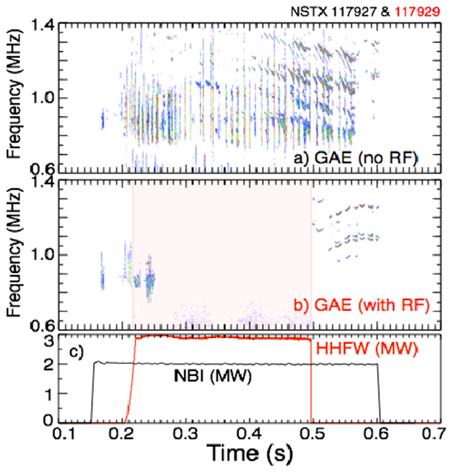
Ion Absorption of HHFW Power Has Potential Benefits and Disadvantages
In NSTX, a significant fraction of (core) HHFW power absorbed by fast ions.
  Seen in neutrons, NPA spectrum, FIDA.
Ion acceleration to loss orbits can be a strong loss mechanism
  detrimental heat loads to the PFCs.
FW interactions with beam ions could be useful for influencing energetic particle modes [EP TSG]
  Modification of fast-ion distribution
    D. Liu et al., Plasma Phys. Control. Fusion 52 (2010) 025006.
  Suppression of energetic-particle driven modes
    E. D. Frederickson et al., Nucl. Fusion 55 (2015) 013012.

Slide 46
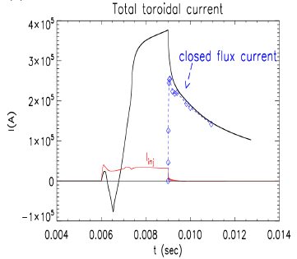
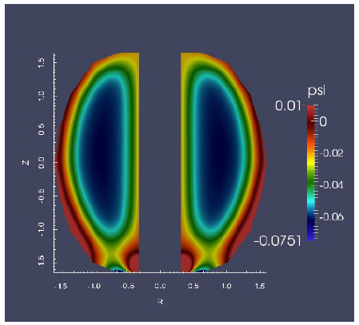
High fraction of open flux conversion to closed flux seen in simulations with narrow injector flux footprint
CHI in NSTX-U configuration naturally has a narrower injector flux foot-print due to improved Injector coil positioning
Due to higher Lundquist number in NSTX-U CHI simulations, closed flux surfaces form even during the actively injected phase
NIMROD Simulations
F. Ebrahimi, et al., submitted to NF-Lett.

Slide 47
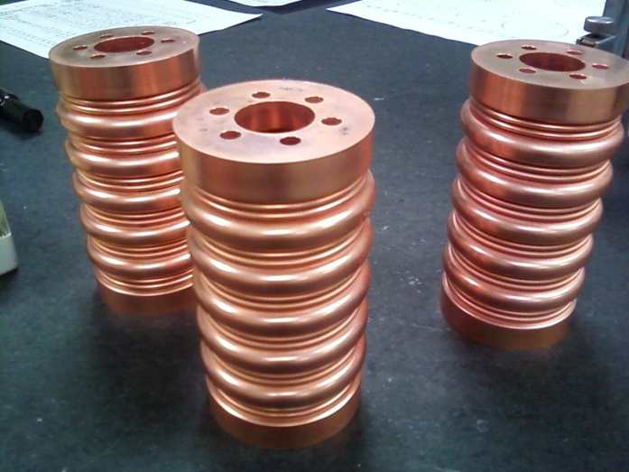
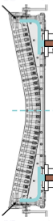
Hardware Upgrades Support HHFW Operations and Physics Studies
Twelve-strap antenna re-installed
  New compliant, bellowed feedthrough used to withstand disruptions at I_{P}=2 MA
  Additional grounding points added to raise voltage standoff
Six RF sources recommissioned; conditioning started
  Recent breaker failure being investigated; replacement parts are ready to go
New color fast camera and infrared camera will monitor antenna
New sets of divertor Langmuir probes
  RF-suitable electronics have been designed, reviewed, and tested
Compliant Feedthroughs
Poloidal Cut of
Antenna Strap
Additional grounding to between antenna box and vessel

Slide 48
Distribution of First Authors (not including CC&E, XMPs)
~12 First Authors
Author | XP | Run Days | Area
Gerhardt | 100% non-inductive | 2 (ASC) | Scenario Development (3.5 Days)
Battaglia | Longest Possible Pulse | 1 (ASC)
Yuh | Reversed Shear | 0.5 (ASC+0.5 T&T)
Kolemen | SFD Control | 1.5 (ASC) | Control Development (4 Days)
TBD | Rotation Control | 0.5 (ASC)
Boyer | Current profile control, β_{N} + l_{i} control | 2.0 (ASC)
Bertelli | Absorption in NB plasmas | 1.0 (RF) | HHFW at Higher Current (3 Days)
Perkins | SOL Losses in H-mode | 1.75 (RF)
D. Smith | Measure Density Perturbation with BES | 0.25 (RF)
Poli | NBI Coupling to Low-Current Plasmas | 1 (0.5 ASC+ 0.5 SFSU) | Ramp-Up (2.0 Days)
Taylor/Poli | Low Current, high f_{NI}, HHFW | 1 (0.5 RF+ 0.5 SFSU)
Raman | Transient CHI startup | 2.0 (SFSU) | CHI (2.5 Days)
Nelson | Inductive Rampup | 0.5 (SFSU)

Slide 49
AORSA show different behavior of SOL power losses between HHFW and IC minority heating regimes
HHFW
IC minority
NO cut-off
NO cut-off
NO cut-off
NSTX-U
scenario
B_{T} = 1 T
f = 30 MHz
ν/ω = 0.01
C-mod
n_{φ} = 10
f = 80 MHz
ν/ω = 0.01
VS.
SOL power losses [%]
SOL power losses [%]
n_{φ} = -12
n_{φ} = -21
n_{ant} [10¹⁸ m⁻³]
n_{ant} [10¹⁸ m⁻³]
SOL RF field amplitude increases when FW
can propagate in the SOL
Direct correlation between SOL RF field amplitude , FW cut-off location , and SOL power losses behavior
Agreement with DIII-D sim./exp.
Larger evanescent region predicted at higher fields achievable in NSTX-U, favorable for future experiments
Possible aspects: cavity modes & magnetic pitch angle
Alcator C-Mod & EAST results show a decreasing of E field amplitude outside LCFS with increasing n_{ant}
No transition to higher SOL power losses
Results perhaps more intuitive
w.r.t. the NSTX/NSTX-U/DIII-D
increase SOL density enhances antenna-plasma coupling lower fraction of power lost
to the SOL region
Consistent with the C-Mod/ASDEX-U exp.
N. Bertelli et al., Nucl. Fusion 56 (2016) 1

Slide 50
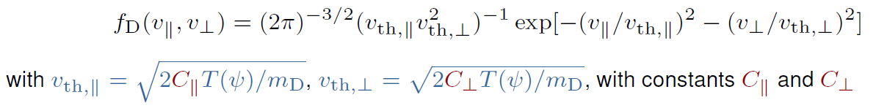
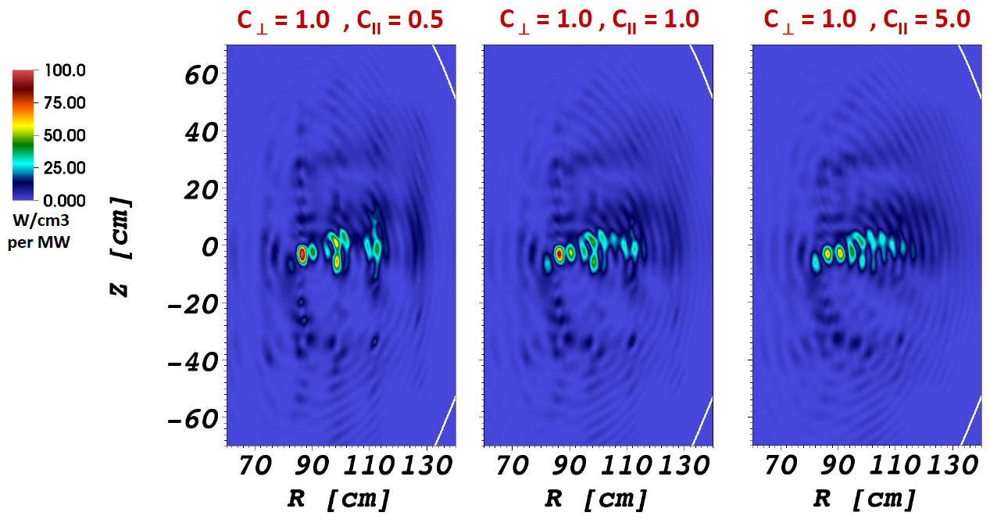
Extended TORIC v.5 to include non-Maxwellian effects both in HHFW and IC minority heating regimes
implementation of the bi-Maxw. and slowing down analytical distributions
Capability to read a numerical fast ion distr. func. from NUBEAM is underway
Non-Maxwellian effects, generally, result in finite changes in the amount and
spatial location of absorption.
Fast ion absorption
assuming a bi-Maxw
distr. func. in NSTX
Bertelli et al. APS 2015

Slide 51
Modeling Is Confirming The Importance of RH Cutoff in Determining SOL Losses
NSTX showed a large loss of RF power in the SOL
Modeling shows large RF field amplitude in SOL under certain conditions
  Seen in full-wave code AORSA
    N. Bertelli et al., Nucl. Fusion 54 (2014) 083004.
    N. Bertelli et al., Nucl. Fusion 56 (2016) 016019.
  Also seen in cylindrical cold-plasma model
    Wave power (axial Poynting flux) confined to periphery, only gradually penetrating the core
    R. J. Perkins et al., 41th EPS Conference on Plasma Physics P-1.011.
RF fields in divertor cause RF sheath; potentially large enough to account for SOL losses
  Rectified sheath voltage and e⁻ current predicted to substantially increase heat flux to tiles
    R. J. Perkins et al., Phys. Plasma 22 (2015) 042506.

Slide 52
ASC (and Broader NSTX-U) Research Facilitated by Numerous Upgrades to the Plasma Control System
Hardware:
  New control computers, reduced latency links to the power supplies
  realtime V_{phi} in final testing, realtime MSE measurement in development.
Methods:
  Complete prose documentation of all physics algorithms within PCS.
  Control design with full-physics models in TRANSP
    See talk by Dan Boyer
Algorithms:
  Reviewed every line of code in every control algorithm
  New shape control capabilities during the ramp-up and ramp-down
  New automatic discharge shutdown system
  More modular beam control, vertical control, ISOFLUX shape control algorithms.
  In final development:
    Snowflake divertor control
    Rotation/Current profile control

