Slide 1
Preparing JET for T and DT operation
26th January 2016
George Sips
Presented at: PPPL, Princeton, USA

Slide 2
Outline
Introduction: JET ITER-like Wall, Goals & Objectives for DT
Operations: NBI & RF power, divertor, real time T_{surface}
protection, disruptions and tritium processing
Diagnostics: Higher resolution measurements since 1998,
CX measurements, 14 MeV calibration.
Scenarios for DT: Status (2014), Gasps for baseline scenario,
Gaps for hybrid scenario and projections to DT
Physics studies: Isotope effects (H,D,T), alpha particles & TAE’s
Timeline and Conclusions
(the material for this talk was presented at EUROfusion science meetings
held 30 September 2015 and 7 October 2015)

Slide 3
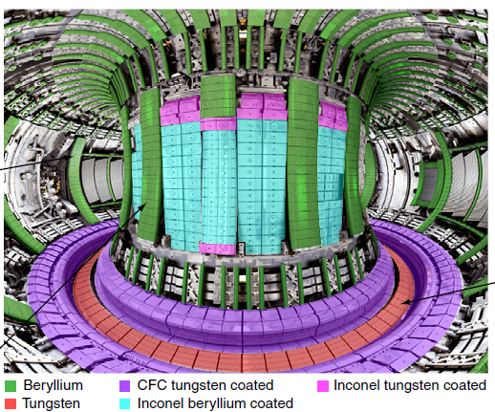
JET: ITER-like Wall using Be/W (ILW)
Since 2011 operation with Be wall and W divertor
Operation with tritium planned:
100% T
DT
(and H operation)
W-divertor

Slide 4
JET Goals Aligned with ITER Projections
Important test of the impact of the ITER-like wall.
High fusion power and Q_{DT} enables alpha-particle physics studies
[R. J. Hawryluk, Ad-Hoc report on Readiness for DT]

Slide 5
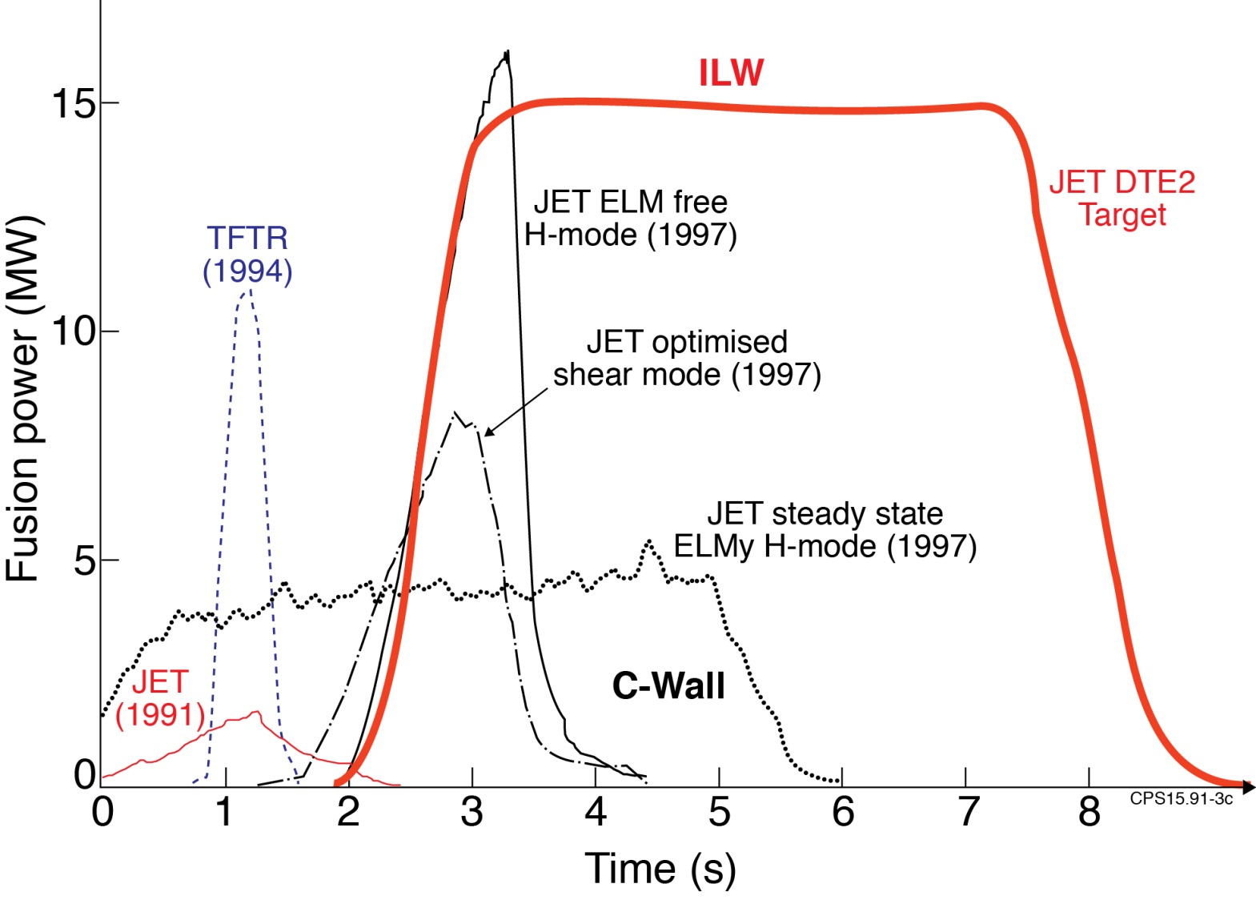
Objective: DT operation with Be/W wall
Towards stationary fusion plasma with ITER Like Wall
W_{fusion} ~ 50-75MJ, P_{fusion} ~ 10-15MW for 5s ?

Slide 6
Summary of operation readiness
Additional heating:
  NBI power 27→ 34 MW, essential for any campaign.
  ICRH power 5→8 MW (from 5 antennas)
Beryllium wall and Tungsten divertor:
  Extensive Real-Time protection systems
  Hot spots, surface temperature limits: 40MW for 6s ?
  Disruptions at high plasma current
Closed-fuel cycle operation in TT or DT:
  60g of T₂ on-site, maximum feed to torus 11g/day

Slide 7
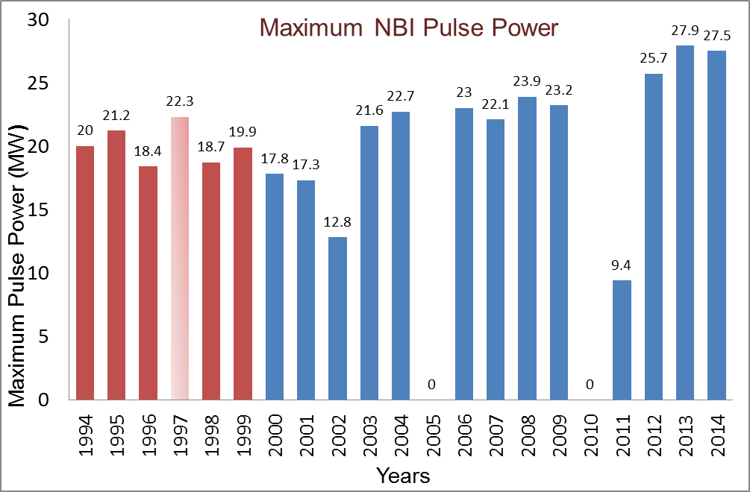
Neutral beam performance
CFC Wall
ITER-like Wall
DTE1
Statistics on NBI performance
for the period 2012-2014
(2600 good plasma pulses):
P_{NBI} > 25 MW: 61 pulses
P_{max} = 27.5-28MW
Average duration: 5-6 s
For 2015/16:
Extensive conditioning of sources in the testbed and during Restart
→ ~30 MW available,
→ Improve power handling in 2016/17 shutdown (ion dumps “J-plates”)
Target for T and DT operation: 34 MW for 5-6s (~250MJ injected)

Slide 8
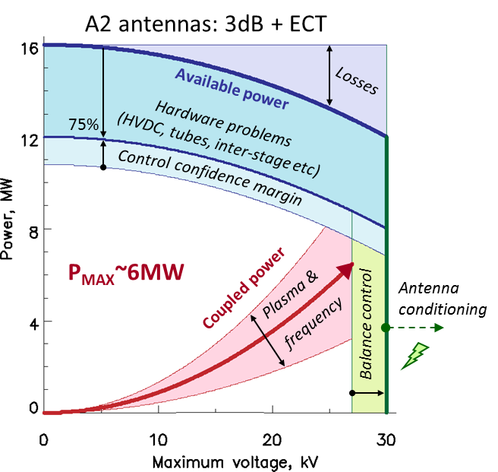
ICRH performance
With the ITER-like Wall ~5MW ICRH in H-modes.
Optimised coupling using gas.
More power at higher frequencies: 42MHz & 51MHz.
Operation typically at 30kV, but ~35kV is possible.
ITER-like antenna (ILA):
Re-instated for 2015/16,
2-4 MW? (2016)
Frequency range 32-48 MHz
Target for T and DT: 6-8MW (including ILA)

Slide 9
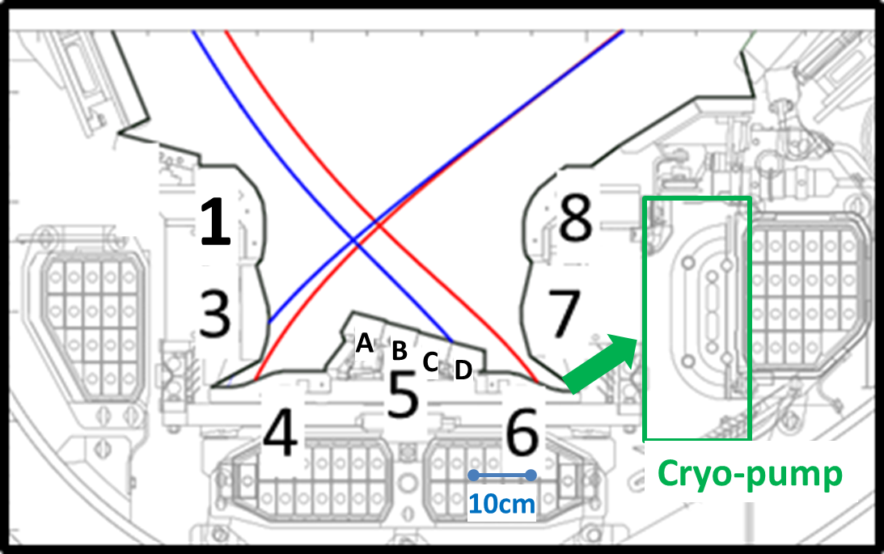
Divertor: Limits
Tile 5: Solid-W, stacks A, B,C and D
        T_{surface} limit 1000ºC-2200ºC
        Input energy limit ~60 MJ/stack
Other tiles: W-coated CFC T_{surface} limit 1200ºC
        Input energy limit ~250 MJ/tile
Be, main chamber
T_{surface} limit 950ºC

Slide 10
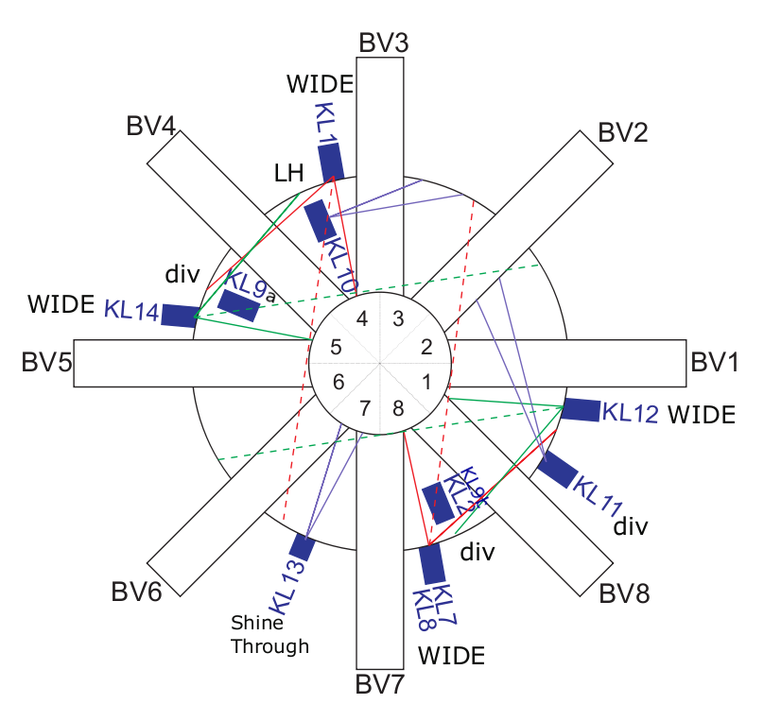
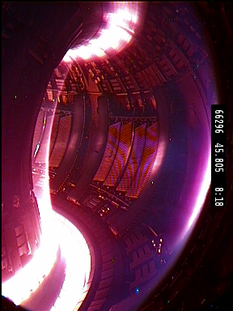
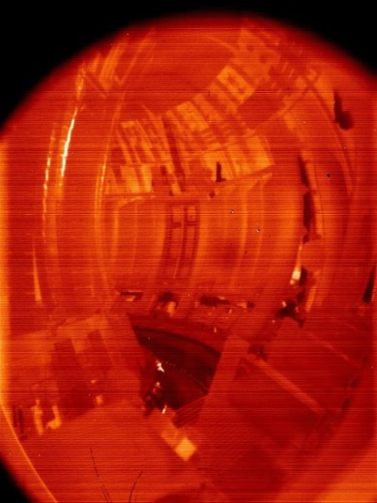
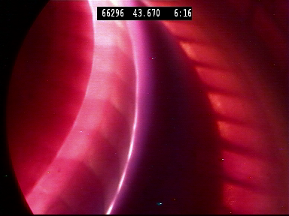
Protection of the ITER-like Wall (PIW)
IR and Protection cameras cover 30% of the vessel
* Views highlighted in yellow are going to be made radiation hard

Slide 11
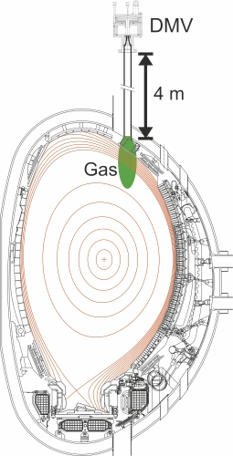
Disruption Mitigation Systems
In 2015 3 disruptions mitigation valves (active mitigation for I_{p}>2MA)
DMV1 installed in 2008 upper vertical port of Octant 1 (not for T&DT)
DMV2 installed in 2013 horizontal port of octant 3
DMV3 installed in 2015 upper vertical port of octant 5
“Low force 4MA” extrapolates to 5.0-7.0 MN force
on vessel (max. allowed 8.5MN).
No experience in mitigation disruptions above 4.0MN
--> essential before T operation
Disruption avoidance is part of scenario optimisation
DMV 1,3
DMV 2

Slide 12
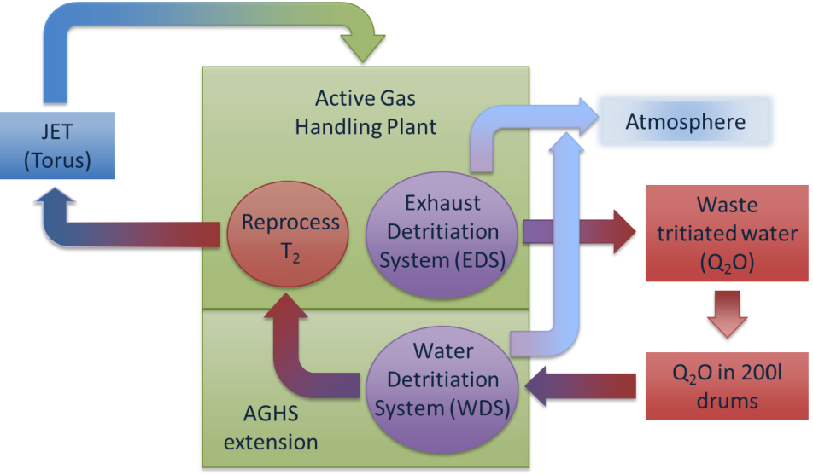
Closed loop tritium fuel cycle
Active gas handling system (AGHS), manned 24hrs, 7days:
60g of T₂ on-site by end of 2016
Tritium: both NBI boxes and 5 new Gas Introduction Modules
However: Nitrogen injection is NOT allowed → Ne/Ar seeding
Tritium inventory limits (Safety Case):
Allows maximum 11g (total) T₂ on cryo-panels outside AGHS
Reprocessing/accounting of tritium → 4 days operation/week
Operation with tritium
Tritium retention with the Be/W ?
Document tritium removal techniques

Slide 13
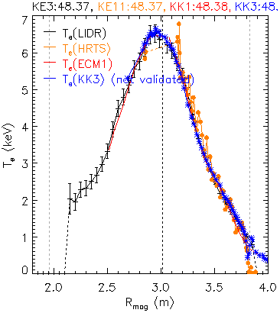
Diagnostic improvements since DTE1 (1998)
Electron fluid: A factor of 10 better spatial and temporal resolution (from about 10 cm to about 1 cm and from a few to 20 Hz)
Total amount of data from 0.5 Gbytes (1998) per shot to 55 Gbytes per shot
New techniques and capabilities
IR and visible Cameras
Neutron diagnostics
Sweeping Doppler and Correlation reflectometry,
Alpha particles (active TAE antenna)
#86599

Slide 14
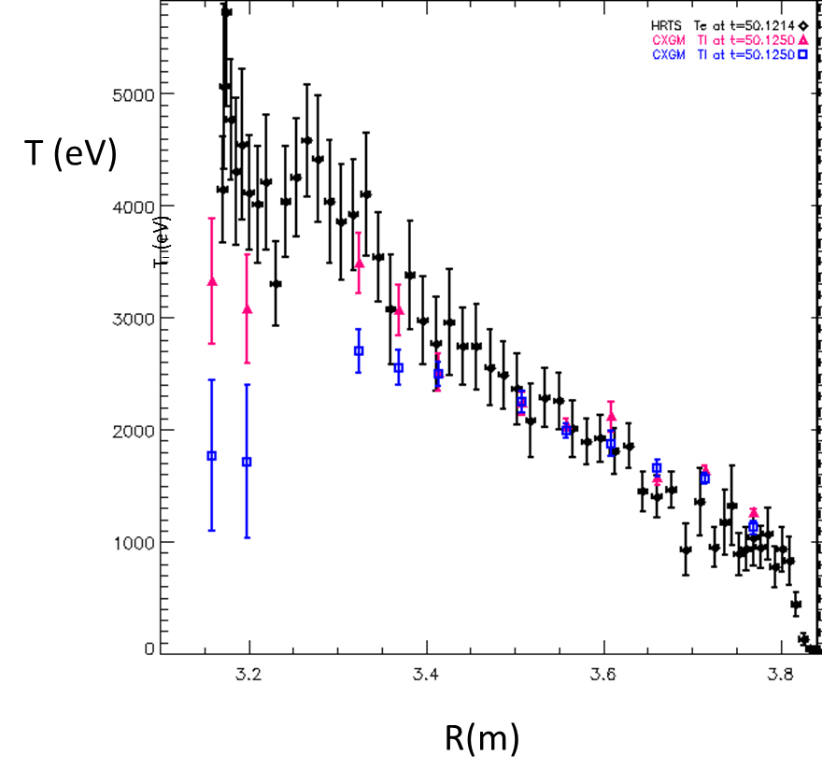
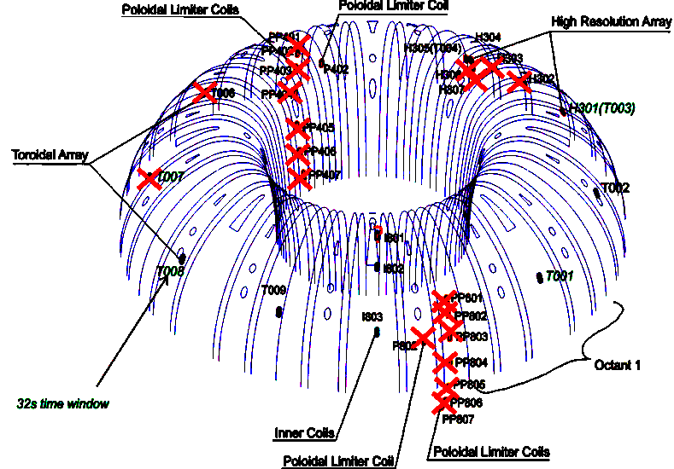
Diagnostics: However….
CX measurements are difficult due to:
Very low residual C content
Weaker NB penetration to the core
Nuisance lines (W…)
NEED to improve this (show stopper)
Beam modulation, CX on neon, analyses red and blue shifted D_{α} ….all this in 2016
High resolution magnetic coil have failed since the installation of ILW.
Worked fine from 1994-2011
NEW design on 2 test coils in 2015/16
In vessel repair in 2016/17
Te,
Ti

Slide 15
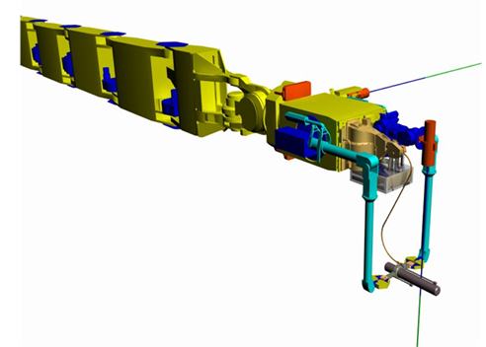
14 MeV neutron diagnostics: Calibration
Objectives:
  Calibrate JET neutron detectors (KN1 & KN2) at 14 MeV
  Benchmark the calibration procedure envisaged in ITER
  Aim to obtain ≤10% accuracy
  Assess the sources of uncertainties (point source, RH tools,….,)
  Requires a well characterized 14 MeV neutron generator of suitable intensity (~10⁸ n/s)
Remote handling boom with source → in-vessel calibration in 2016.

Slide 16
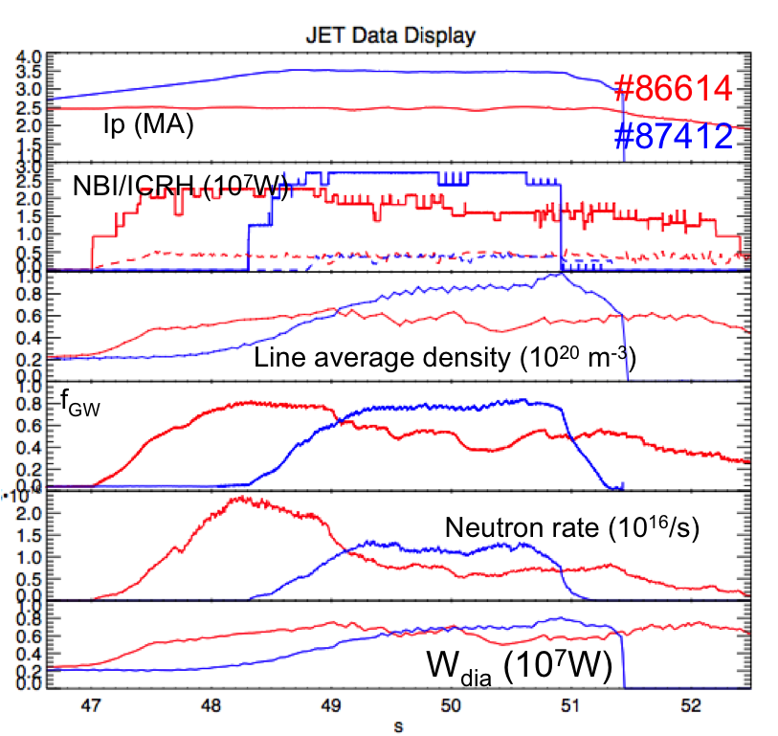
Best discharges in 2014 (~25MW NBI)
  Hybrid: 2.5MA/2.9T (q₉₅=3.7) Transient good confinement phase hampered by impurity accumulation, MHD and divertor temperature limit P_{fus}~6.5MW
  Baseline: 3.5MA/3.3T (q₉₅=3) Stationary plasmas hampered by temperature limit on divertor P_{fus}~4MW
  Need to increase:
    Performance
    Duration to 5s

Slide 17
Scenarios: Performance gaps at q₉₅~3
(ITER baseline scenario)
Not achieved H₉₈=1 above I_{p}=2.5 MA (pedestal + core)
Missing proven strategies to recover H=1 above 2.5 MA (pedestal + core).
There is little first principles understanding in the area of pedestal physics to guide the scenario development
Reliable high beam power in excess of 30 MW needed for systematic scenario development has so far not been achieved
Power exhaust techniques for mitigation (strike point sweeping, impurity seeding) may deteriorate performance
Reliable ICRF heating ~5MW is needed to control the tungsten accumulation
→ optimise central heating at B_{T}=3.4-3.8T (H-minority, ³He minority)

Slide 18
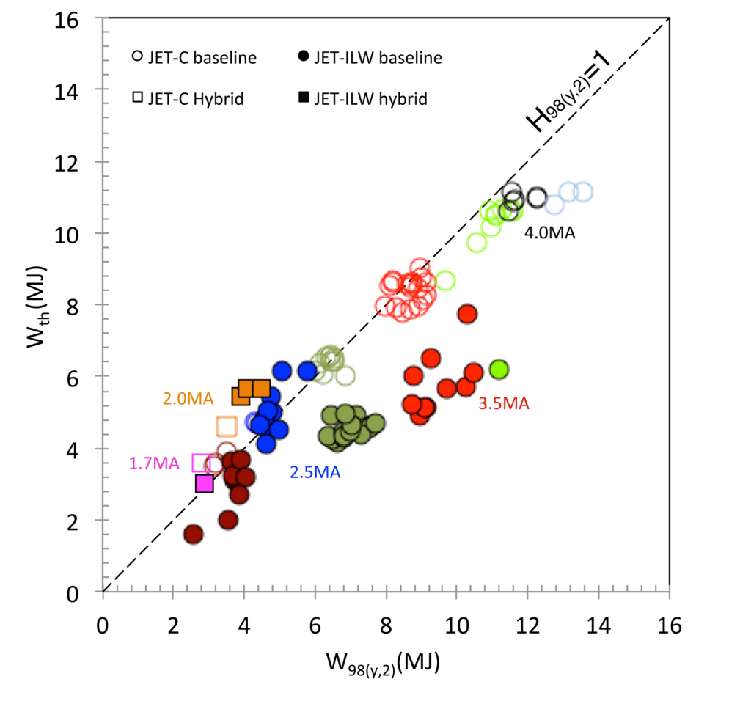
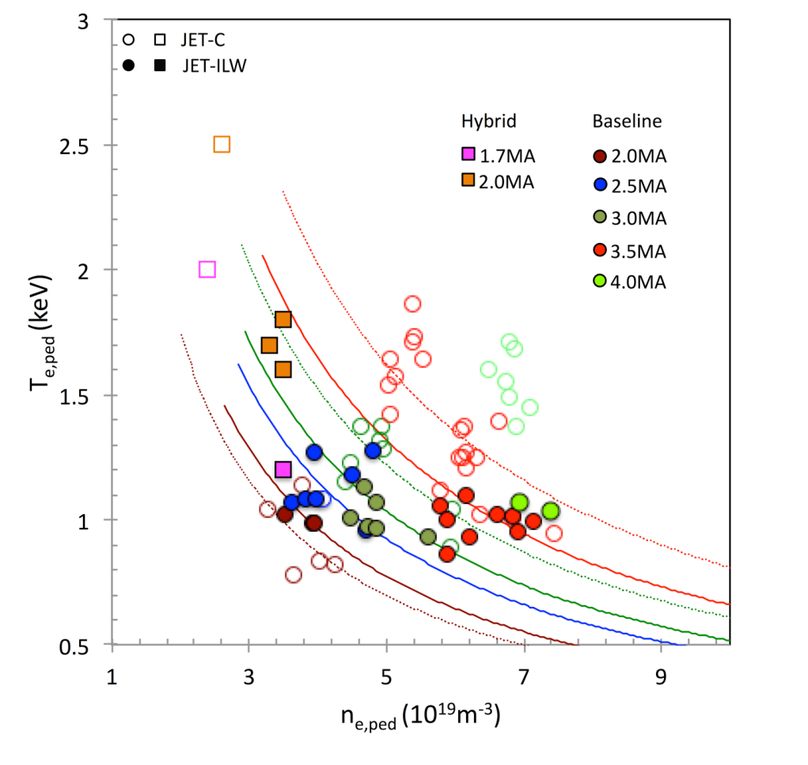
Carbon wall v. ITER-like wall
Global confinement
Pedestal temperature !
With ITER-like wall gas fuelling necessary to control W accumulation
Decrease of pedestal temperature and global confinement
At higher beta (hybrid scenario, see later) pedestal pressure similar to JET-C

Slide 19
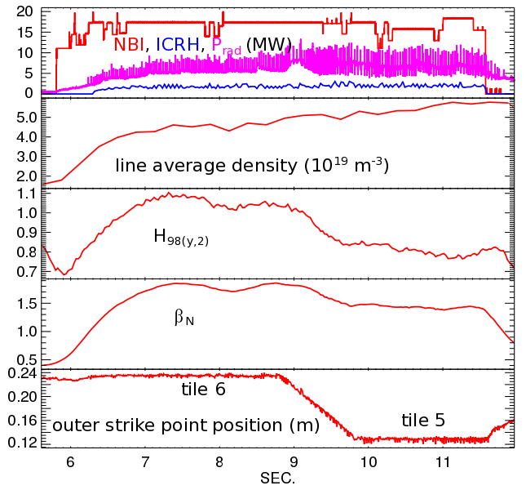
Confinement improves with pumping
Strike points close to pump throat
operate at lower pedestal density ➔ higher pedestal temperature
Not enough to recover confinement at high I_{p} (>2.5MA)
End of 2015/16 campaigns:
Demonstrate exhaust by impurity seeding operating on tile 6 only with small sweeping
Better understanding of edge conditions leading to high temperature pedestals
Outer strike close to cryo-pump

Slide 20
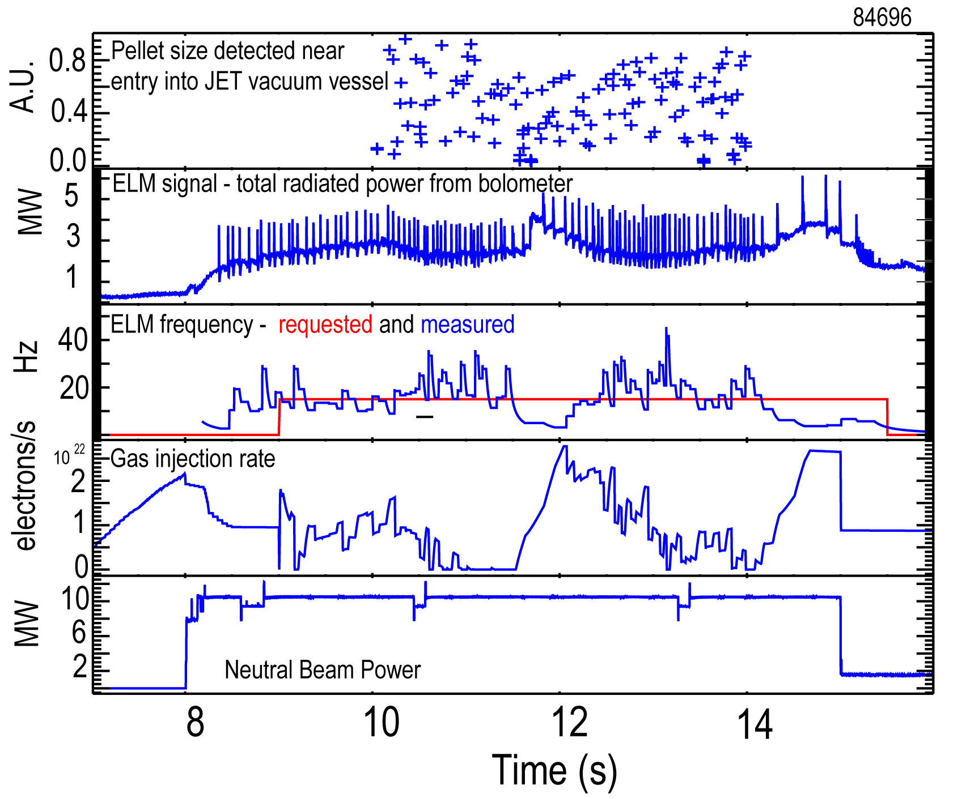
Pellet fuelling and pacing now available
Small fuelling pellets reliably trigger ELMs w/o strong impact on density
RT ELM frequency control by exchange of gas puffing with pellets
End of 2015/16 campaigns:
New pellet track installed → improved reliability
Optimise pellet ELM pacing

Slide 21
Control of T_{surface} in the divertor
Sweeping and/or Seeding:
Might be necessary large sweep (onto tile 5) → reduced pumping
Compare with neon/argon seeding → only stable operation at high density?
End of 2015/16 campaigns:
Demonstration of combined sweeping and impurity injection while maximizing performance
2.5MA/2.35T
#87404 #87215 #87218

Slide 22
Scenarios: Performance gaps at q₉₅~4,
(Hybrid scenario at lower I_{p})
Not achieved high enough performance (neutron rate)
Reliable high beam power only up to 25MW (need max = 34 MW).
Increase B_{T} and/or I_{p} and to find optimum
q profile modifications for better MHD stability/confinement
Not achieved sufficient duration (1.2s → 5s)
ICRH heating scheme optimisation for W control at B_{T}=3.4-3.8T (H-minority, ³He minority). Maximize core heating
Power exhaust techniques for mitigation (strike point sweeping, impurity seeding) may deteriorate performance

Slide 23
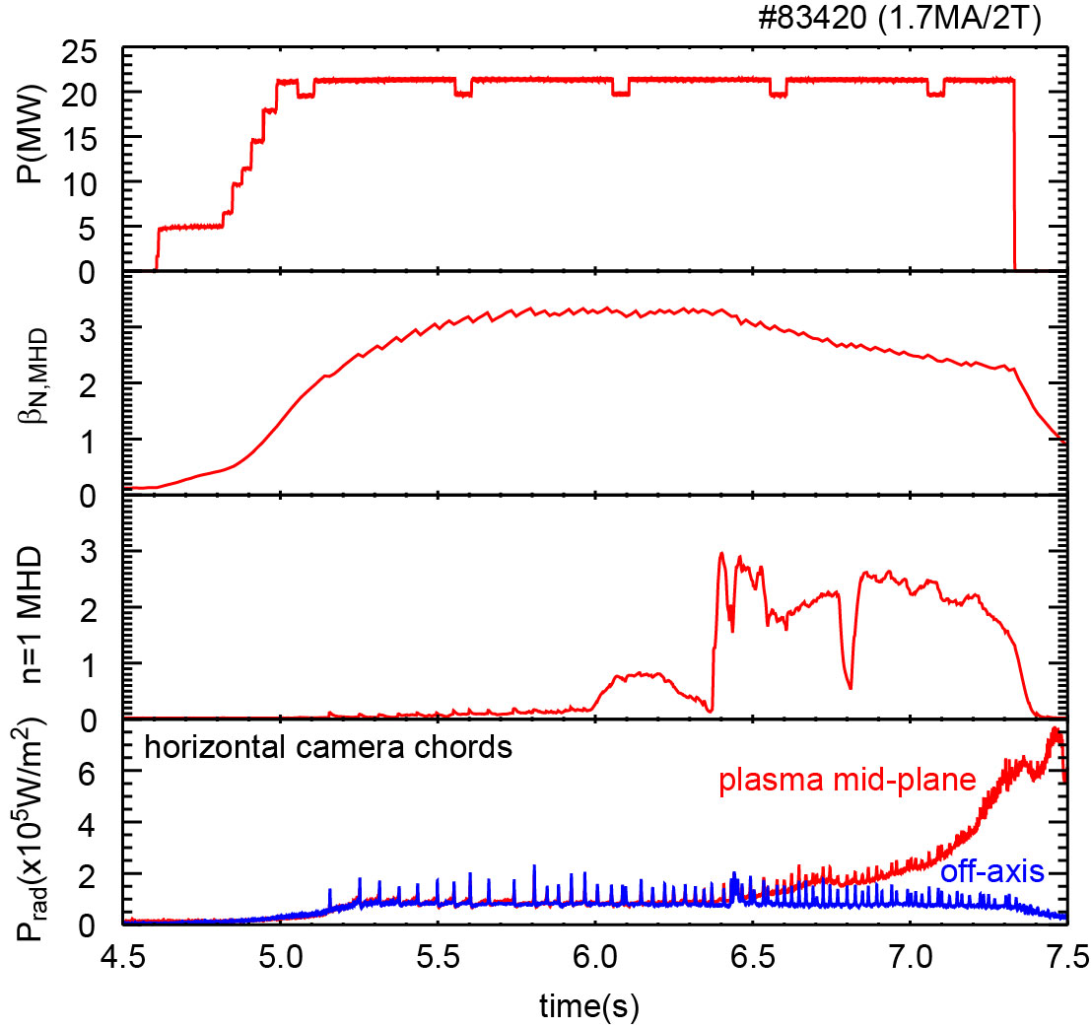
MHD and radiation limit duration
Duration of high performance phase typically limited by MHD
Core radiation peaking correlated with tearing modes and 1/1 islands
Radiation ‘amplifies’ impact of mode on plasma performance
also n=3&4 modes

Slide 24
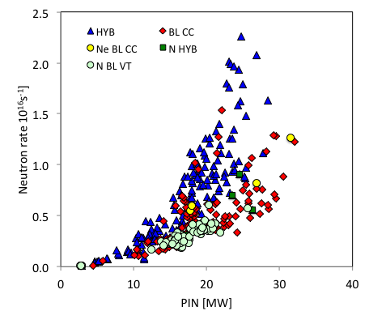
Fusion performance → 34 MW NBI
Target for 2015/16
Neutron scaling good for best hybrids but fails for seeded plasmas or high density H-modes at q₉₅~3
Need maximum beam power (34 MW)
Low plasma density as density ∝ Ip, optimum I_{p} for fusion performance ??

Slide 25
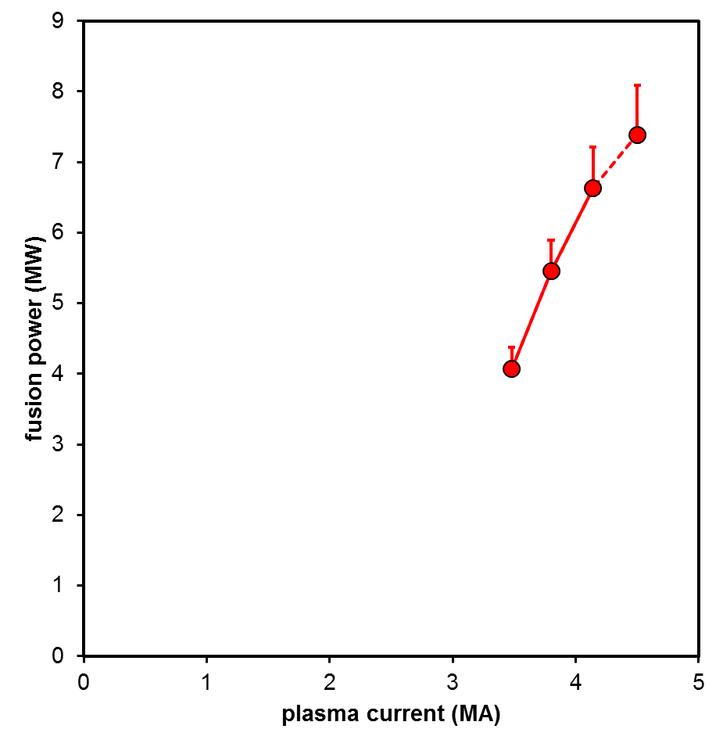
Baseline (q₉₅~3) projection to DT (H₉₈~0.8)
Assumed parameter limits:
I_{P,max}=4.5MA
B_{max}=3.83T
P_{NBI,max}=34MW
Assumptions for projection:
Temperature & density profile shapes constant
n/n_{Greenwald}=constant
H₉₈=constant=0.8
q₉₅ constant unless B limit reached
β_{N} constant unless power
limit reached
P_{RF}/P_{NBI}=constant
No credit for α-heating
P_{DT} scaled to take DD
over-prediction into account
Higher H₉₈ would give higher P_{DT}
Baseline projection (assuming T_{i}=T_{e})
TRANSP
max B
achieved
plasma
parameters
(#87412)
symbol: no isotope scaling
error-bar: IPB98(y,2) isotope scaling

Slide 26
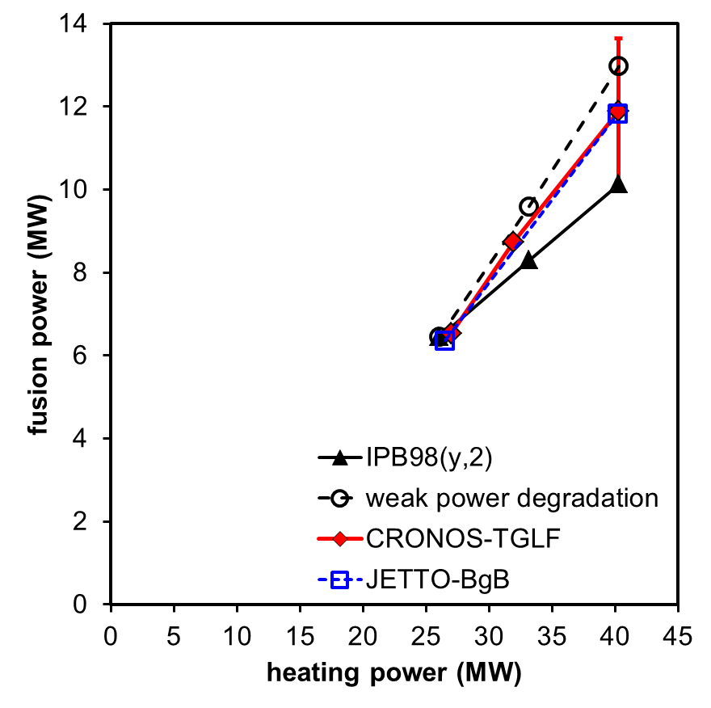
Hybrid (q₉₅~3.5-4) projections to DT
Reference plasma extrapolates to fusion power of ~6MW with DT and full NBI voltage
Simple power extrapolation scales temperature to match scaling assumptions:
  IPB98(y,2) ➔ ~10MW
  Weak power degradation of confinement ➔ ~13MW
Predictive simulations give similar results for CRONOS-TGLF and JETTO-BgB
  P_{fusion}~12MW
Errorbar → uncertainty in density
No credit taken for isotope effects or α-heating
projected from #86614 (2.5MA/2.9T)
H₉₈~1.1-1.2

Slide 27
Alpha and Isotope Physics - overview
1) Isotope campaigns
H,D & T experiments, main aims:
  Characterise core & pedestal transport of energy, particles & momentum
  Provide unique data for testing & developing pedestal and core transport physics & codes to provide improved predictions for ITER (active and non-active phases)
2) Alpha heating and effect of alphas on transport
Experiments in stationary conditions, to demonstrate
  Alpha heating of electrons, screening of impurities and alpha contribution to ITG stabilisation by fast particle beta effect
High temperature, stationary hybrids in DT are best for such experiments
3) TAE physics
Unlike ITER, JET NBI damps TAE’s and alpha driven TAE’s not unstable in JET baselines and hybrids
  Develop a specific TAE-prone discharge for observing unstable TAE’s in JET
  Probe the net stable TAE spectrum using the active TAE antennae in all conditions, inferring damping and drive from measurements

Slide 28
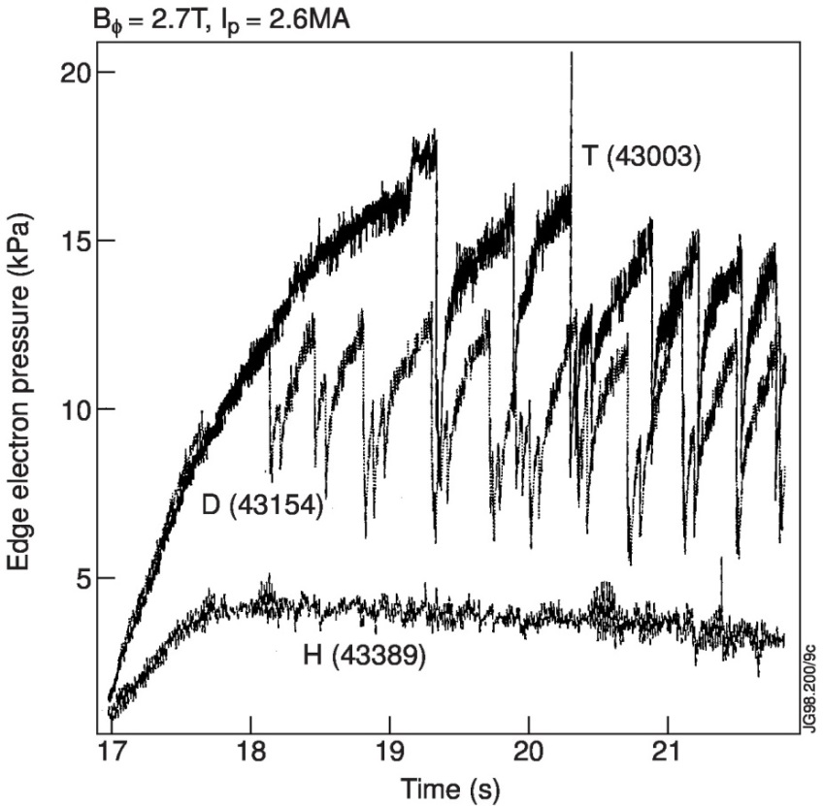
Isotope effects
Motivation:
DTE1: Only a small dataset in full T
DTE1: Poor resolution profile diagnostics
DTE1 results suggest large difference between core scaling (none) and pedestal scaling (strong) with ion mass
Largest pedestal and ELMs in full T
T
D
n_{e}T_{e} pedestal (kPa)
H
Hydrogen campaign: in 2016 (12-14 MW NBI, 5MW ICRH)
Final Deuterium campaign: in 2017/18
→ 100% Tritium campaign: in 2018 (34 MW NBI, 8 MW ICRH)
→ DT campaign: in 2019

Slide 29
Alpha and TAE physics
Study the effects of alpha particles on the plasma with significant alpha heating and alpha pressure (T_{i} ≥ 10keV, β_{N}≥2, P_{α}~1-3MW)
DTE1 alpha heating experiment (D/T ratio scan) was transient
Electron heating by α’s as expected but ion ’’heating’’ was 3x larger and unexpected!
Provide systematic data on Alfvén mode α drive and damping
Study Alfvén modes driven unstable by α’s and their effect on a transport
One of the two toroidally opposite 4-element TAE antennae in JET vessel

Slide 30
Timeline & Conclusions
Operation with tritium
JET operation in both 100% tritium and DT mixtures
P_{fusion}~10-15MW can be envisaged with JET ILW if best confinement regimes can be extrapolated to DT at high power.
Strong scientific programme: ITER scenario optimisation, study of isotope effects and effect of α-particles with the Be/W wall.
Technology programme for tritium and material activation.

