Slide 1

NSTX-U PAC-38 Videocon
J. Menard, S. Gerhardt, R. Hawryluk
January 6, 2017

Slide 2
Agenda (approximate)
11AM - 1PM Eastern – NSTX-U presentations
  NSTX-U mission
  Selected highlights from 1st NSTX-U run
  Progress toward DOE/FES Notable Outcomes
  Collaborations
  NSTX-U technical challenges
  Recovery effort
  5 year plan discussion
1-2PM (≤ 2:30PM) – PAC executive session
2ish PM – verbal debrief from PAC to NSTX-U

Slide 3
Charge
This videoconference is meant to provide the PAC with an informational update on the recent history, status, and plans for the NSTX-U program and facility
The NSTX-U program welcomes PAC comments / recommendations on any aspect of this presentation
As NSTX-U embarks on preparing for the next 5 year plan (FY2019-FY2023), the program would benefit from including US University PIs/leaders in the scientific goal and strategic planning of the research program, and we request PAC ideas/suggestions on how best to solicit and include this additional input
A brief written PAC report is requested by Jan 20, 2017

Slide 4
Outline
NSTX-U mission
Selected highlights from 1st NSTX-U run
Progress toward DOE/FES Notable Outcomes
Collaborations
NSTX-U technical challenges
Recovery effort
5 year plan discussion

Slide 5
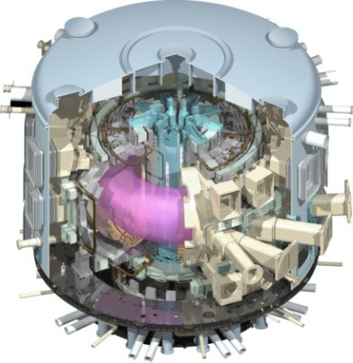
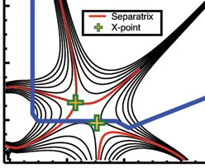
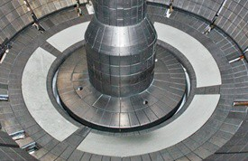
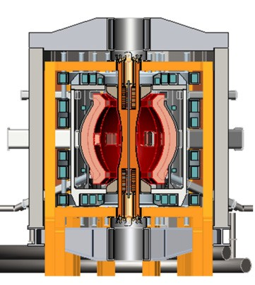
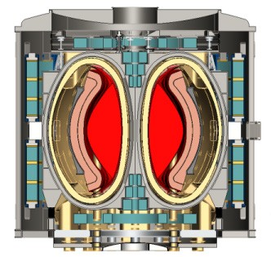
NSTX-U Mission Elements:
Explore unique ST parameter regimes to advance predictive capability - for ITER and beyond
ITER
Develop solutions for plasma- material interface (PMI)
Snowflake/X
Liquid metals / Li
ST-FNSF /
Pilot-Plant
Advance ST as Fusion Nuclear Science Facility and Pilot Plant

Slide 6
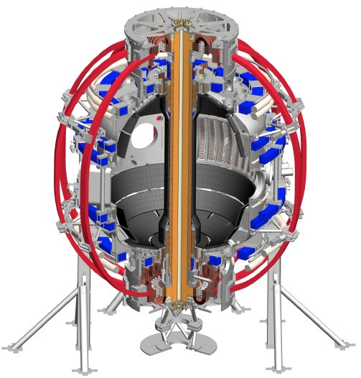
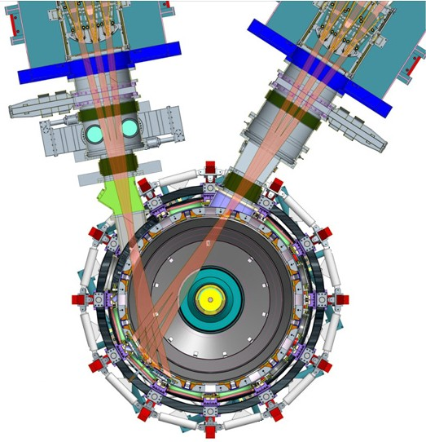
NSTX-U will access new physics with 2 major new tools:
1. New Central Magnet
2. Tangential 2nd Neutral Beam
Higher T, low ν* from low to high β
→ Unique regime, study new transport and stability physics
Full non-inductive current drive
→ Not demonstrated in ST at high-β_{T}
Essential for any future steady-state ST

Slide 7
NSTX-U will have major boost in performance
1. New Central Magnet
2. Tangential 2nd Neutral Beam
Performance goals:
➢2× heating power (5 → 10MW)
Tangential NBI → 2× current drive efficiency
➢4× divertor heat flux (→ ITER levels)
➢Up to 10× higher nTτ_{E} (~MJ plasmas)
➢2× toroidal field (0.5 → 1T)
➢2× plasma current (1 → 2MA)
➢5× longer pulse (1 → 5s)

Slide 8
NSTX-U had scientifically productive 1st year
Achieved H-mode on 8th day of 10 weeks of operation
Surpassed magnetic field and pulse-duration of NSTX
Matched best NSTX H-mode performance at ~1MA
Identified and corrected dominant error fields
Commissioned all magnetic and kinetic profile diagnostics
New 2nd NBI suppresses Global Alfven Eigenmodes (GAE)
Implemented techniques for controlled plasma shut down, disruption detection, commissioned new tools for mitigation
Run ended prematurely (10/18wks) due to divertor PF coil fault
  Coil + other issues → major reviews of design, fab, procedures
  Coil forensics complete, preparation for new coil fabrication underway
  Aim to resume plasma operation during CY2018, but still TBD

Slide 9
NSTX-U Mission Elements:
Explore unique ST parameter regimes to advance predictive capability - for ITER and beyond
ITER
Topical science areas:
  Scenario Development
  Macroscopic Stability
  Transport and Turbulence
  Energetic Particles

Slide 10
NSTX-U Mission Elements:
Explore unique ST parameter regimes to advance predictive capability - for ITER and beyond
ITER
Topical science areas:
  Scenario Development
  Macroscopic Stability
  Transport and Turbulence
  Energetic Particles

Slide 11
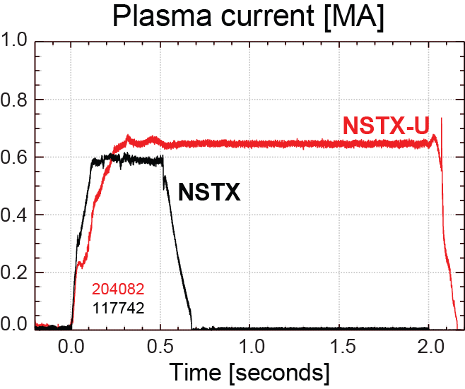
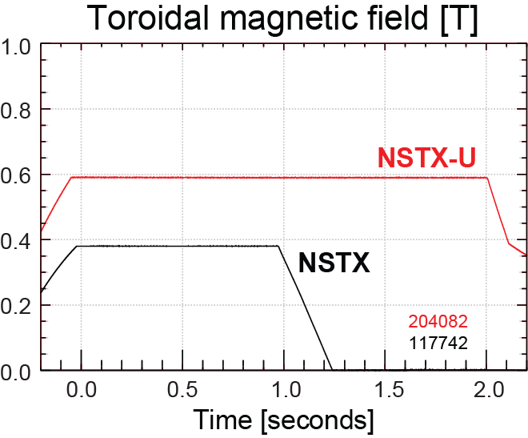
NSTX-U has surpassed maximum pulse duration and magnetic field of NSTX
Compare similar NSTX / NSTX-U Boronized L-modes, P_{NBI}=1MW
4x longer
NSTX-U L-mode duration
exceeds longest NSTX H-mode
NSTX-U B_{T} > highest NSTX B_{T}

Slide 12
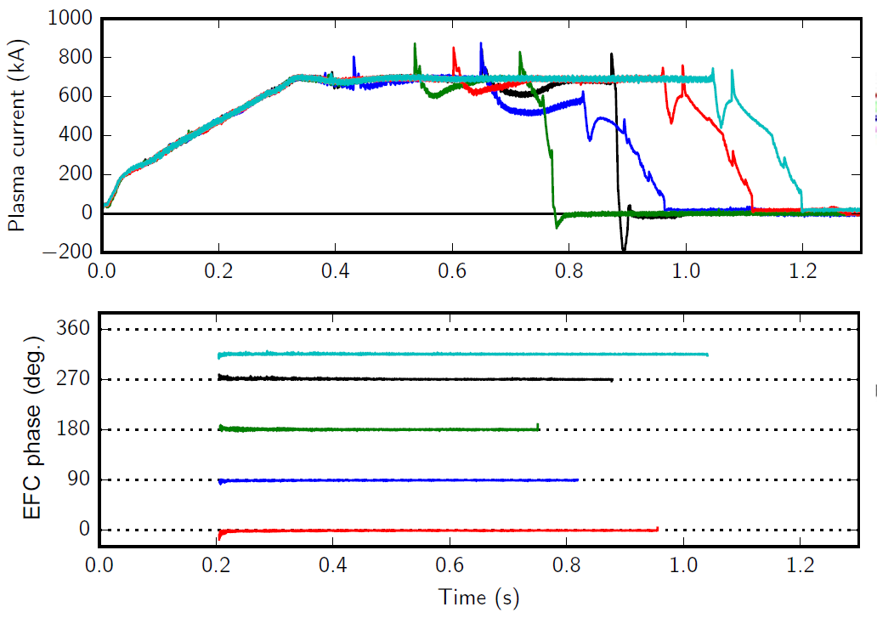
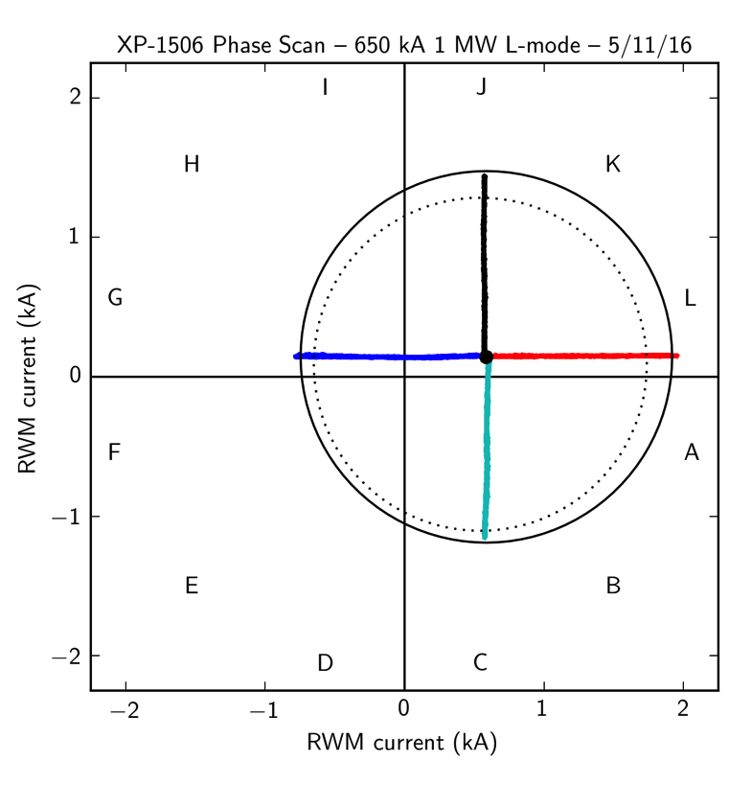
n=1 error field correction (EFC) optimized to maximize pulse length, discharge performance
L-modes used to identify optimal correction amplitude, phase
Multiple compass scans confirm optimal L-mode EFC in flattop
EFC current [kA]
n_{e} = 2.9 ×10¹³ (solid)
n_{e} = 1.4 ×10¹³ (dashed)
EFC current [kA]

Slide 13
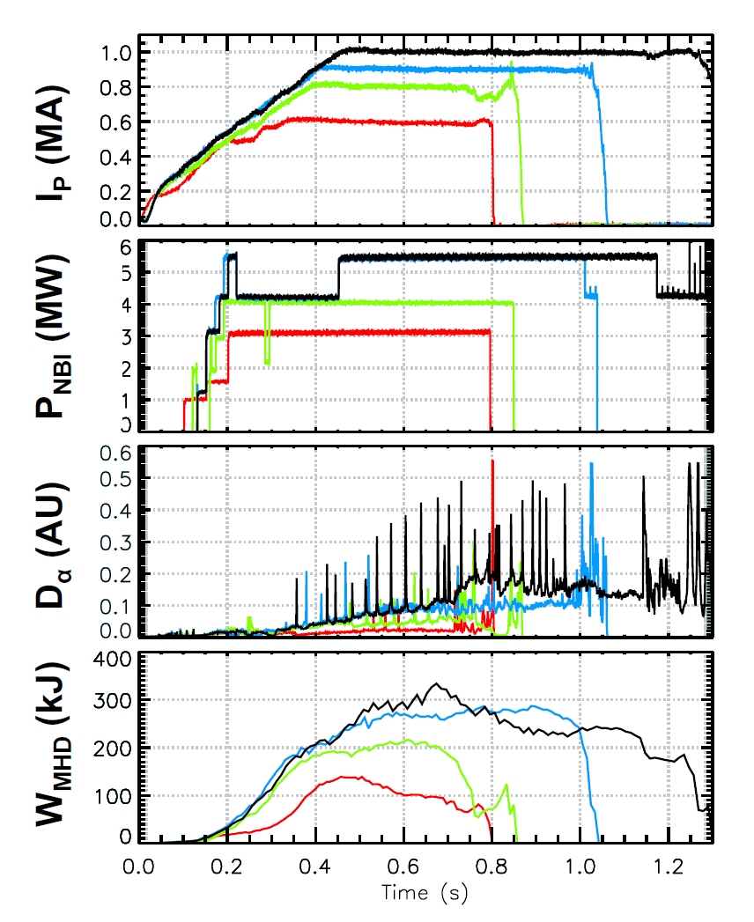
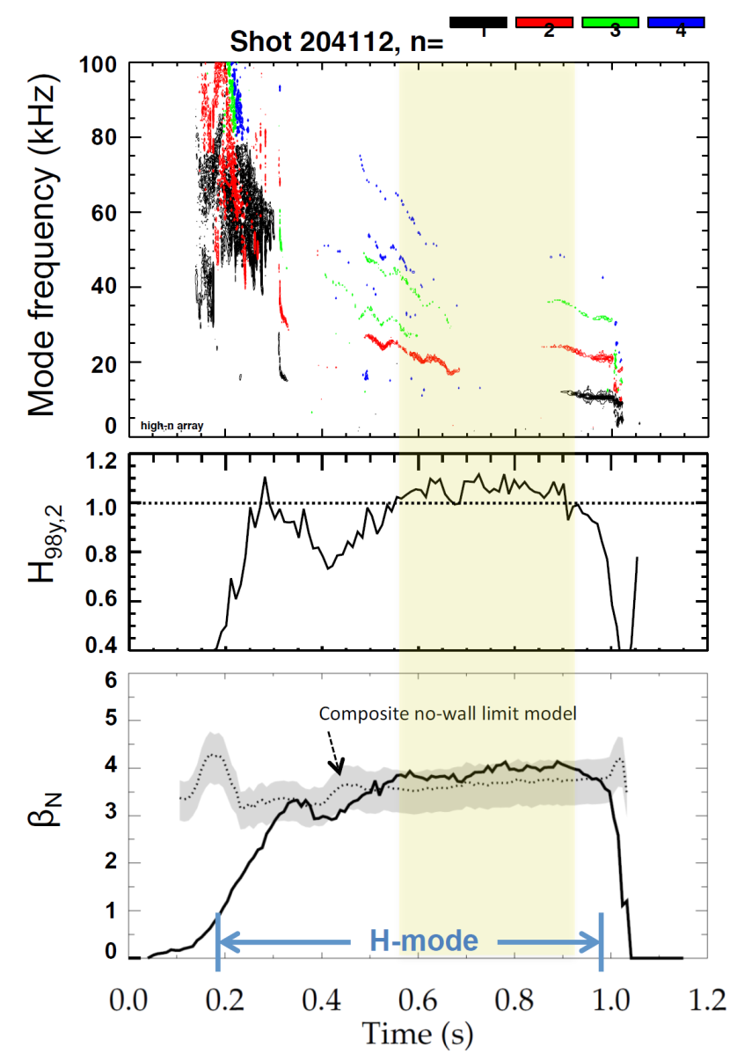
Recovered ~1MA H-modes with weak/no core MHD
202946 – no EFC 204112 – EFC v2
203679 – EFC v1 204118 – EFC v2
H₉₈ ≥ 1, β_{N} ≥ n=1 no-wall limit

Slide 14
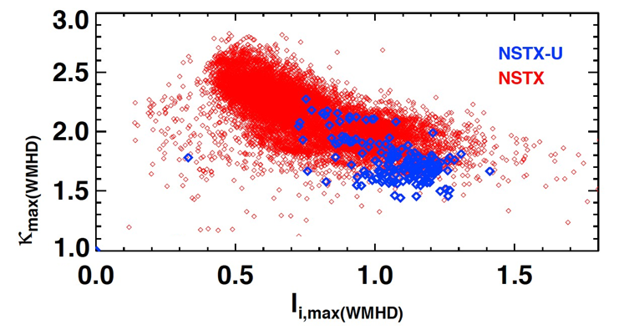
Accessed low l_{i} and high κ using progressively earlier H-mode and heating + optimized EFC
Future goal
NSTX-U (5 run weeks)
NSTX (10 years)
H-mode flattop
L-mode flattop
NSTX-U: Additional sensors improve estimation of Z, dZ/dt
Goals for next run:
  Access l_{i} = 0.5-0.7, κ=2.4-2.7, B_{T} = 0.75-1T, I_{P} = 1.5-2MA

Slide 15
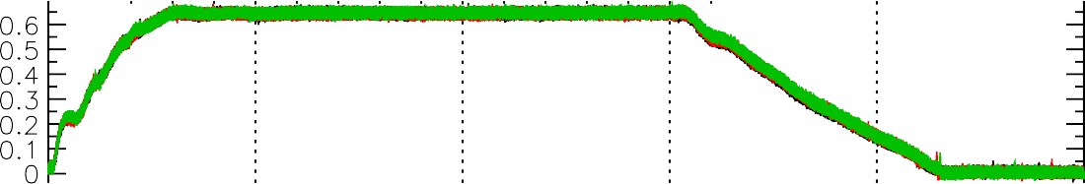
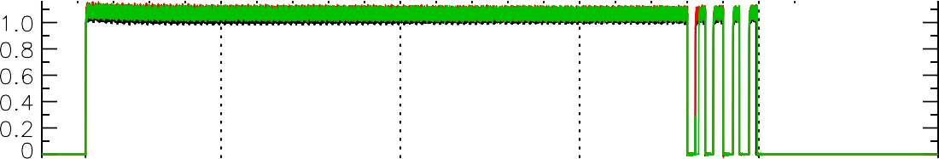
Shutdown handler used for well-controlled disruption-free L-mode ramp-down
Three morning fiducials
One operator waveform used to start ramp-down at t=1.5s
Ramp-down is inner-wall limited, power and current slowly ramped off
L-mode Rampdowns Triggered By a Single Switch
I [MA]
P
P_{inj} [MW]
Beam power ramped down
W_{MHD} [kJ]
204179
204163
204155
κ
n_{e} [10¹³ cm⁻³]

Slide 16
NSTX-U Mission Elements:
Explore unique ST parameter regimes to advance predictive capability - for ITER and beyond
ITER
Topical science areas:
  Scenario Development
  Macroscopic Stability
  Transport and Turbulence
  Energetic Particles

Slide 17
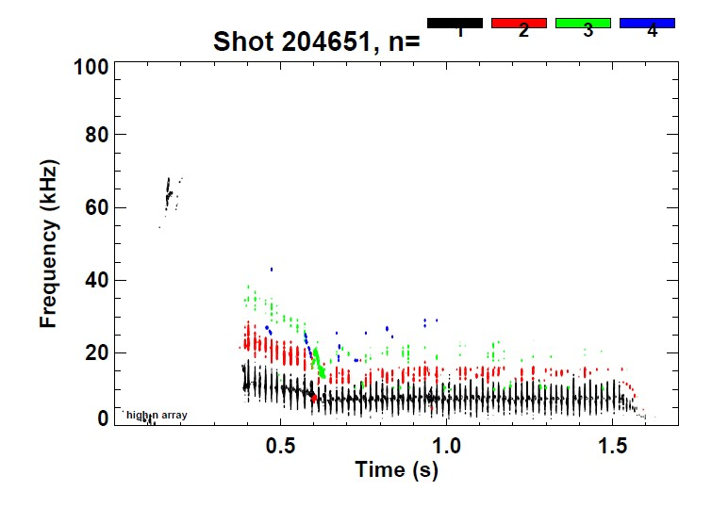
NSTX-U: Long-lived stationary sawtoothing discharges generated with core rotation f~15kHz
W. Guttenfelder
Previously very difficult to achieve in NSTX due to limited flat-top

Slide 18
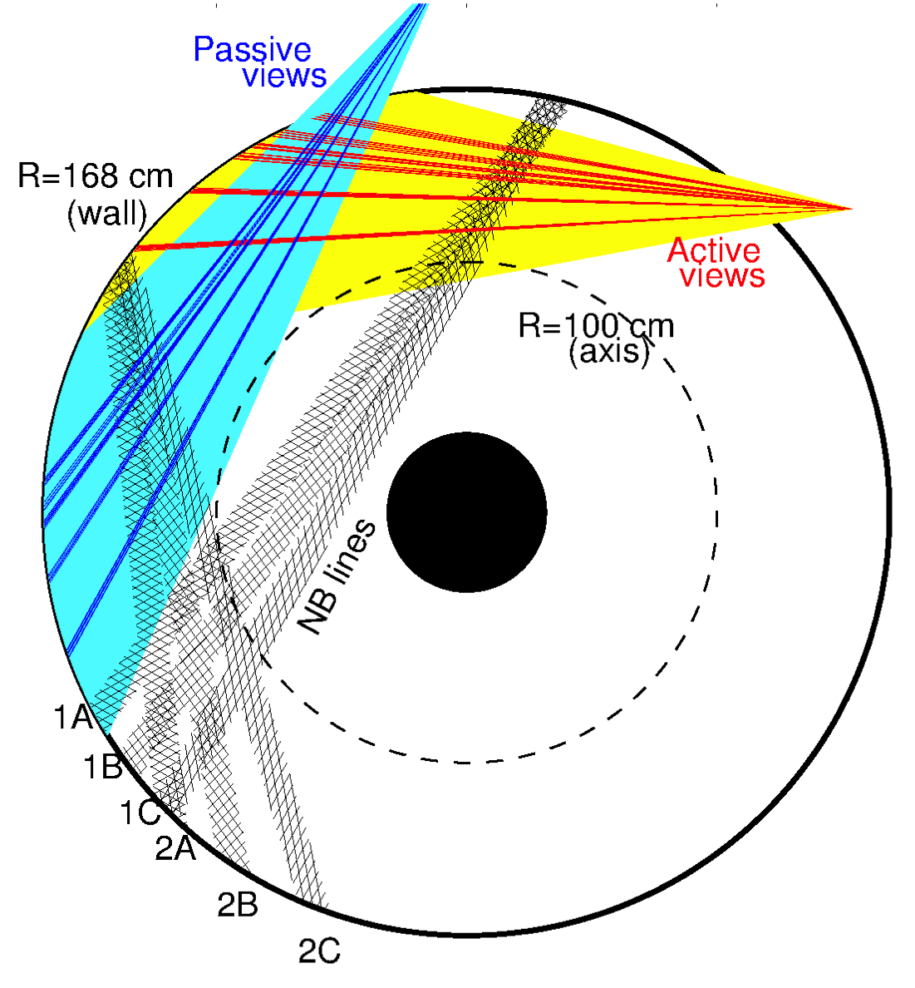
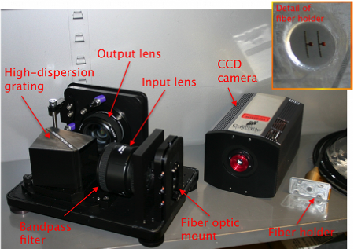
Real-Time Velocity (RTV) is a fast (up to 5kHz) system based on active spectroscopy
System based on active charge-exchange spectroscopy (NB1 line)
Monitor C VI, n=8-7 line @ 5291nm
RTV views interleaved with CHERS views at midplane
  4 views available
    R=112, 125, 132, 140cm
M. Podestá

Slide 19
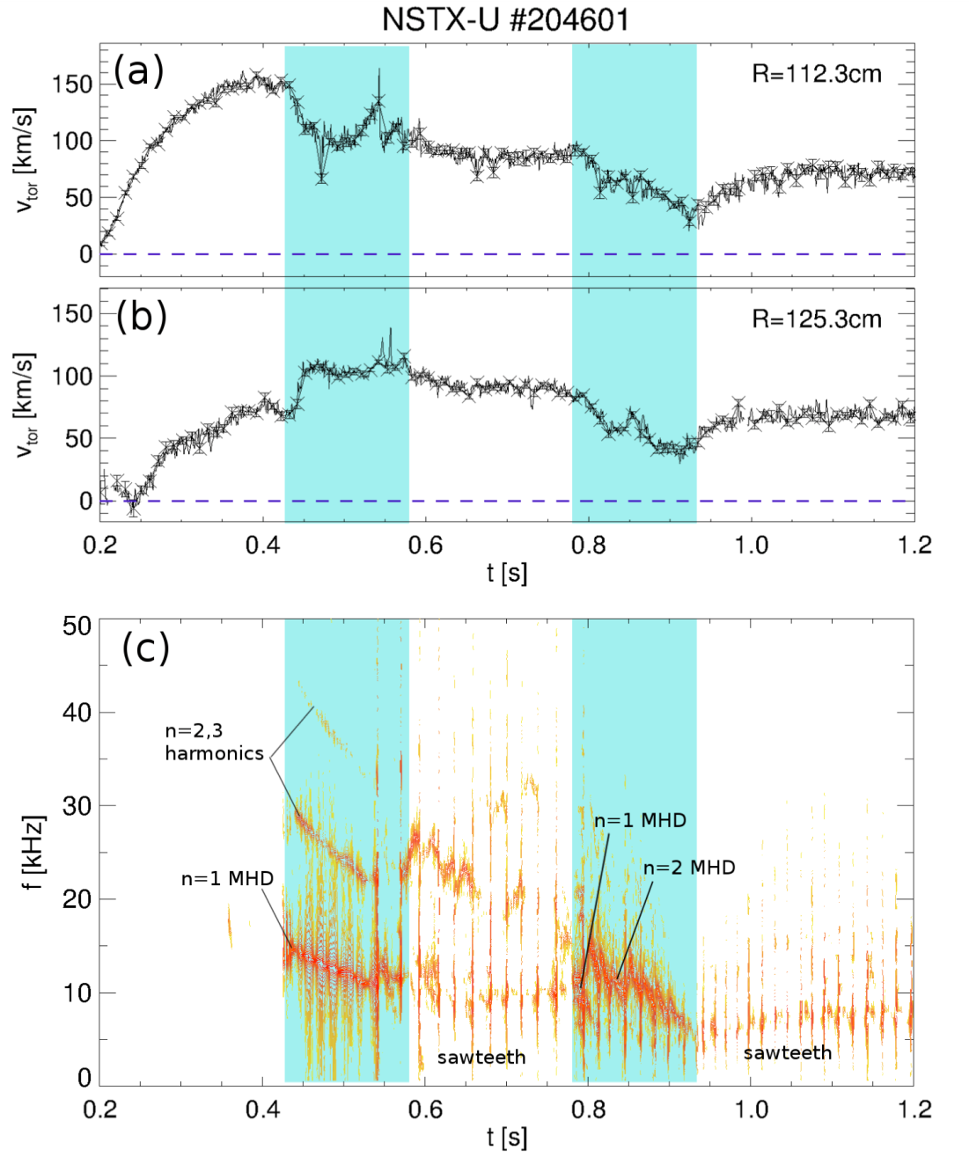
MHD, sawteeth compete in v_{φ} redistribution; different time scales, high f_{samp} or RTV enables separation
Complex scenario
  MHD n=1,2 modes act on ~10ms time scale
  Sawteeth act on ~1ms time scale
High f_{samp} of RTV allows to differentiate time scales
Complements high spatial resolution CHERS profiles
M. Podestá

Slide 20
NSTX-U Mission Elements:
Explore unique ST parameter regimes to advance predictive capability - for ITER and beyond
ITER
Topical science areas:
  Scenario Development
  Macroscopic Stability
  Transport and Turbulence
  Energetic Particles

Slide 21
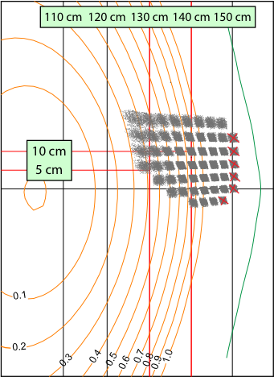
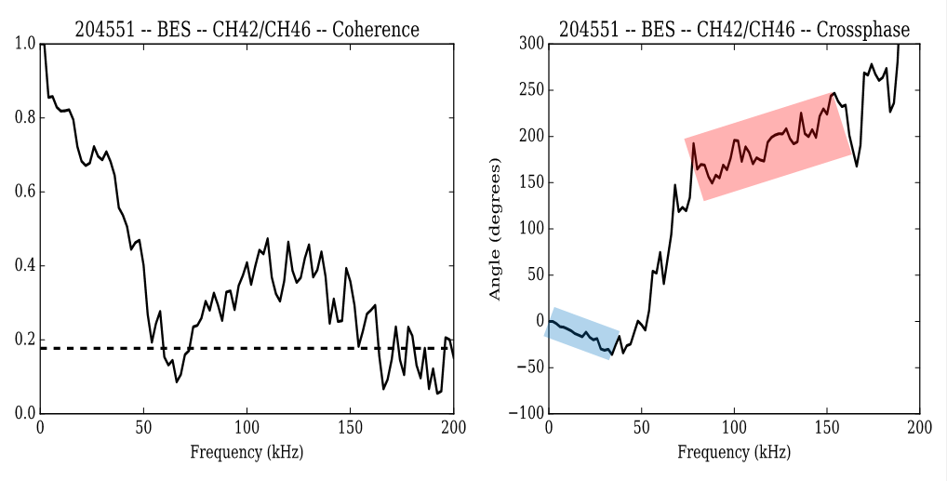

NSTX-U: Bimodal turbulence seen in some L-modes using upgraded 48 channel Beam Emission Spectroscopy (BES) system
ΔZ = 3 cm
R = 142 cm
Δt = 24 ms
11 km/s in ion
diamagnetic direction
13 km/s in electron
diamagnetic direction
Modes propagate in opposite directions
  Similar spectra seen with DIII-D and TFTR BES
  Potential link to grad B direction?
  Gyro-kinetic modelling underway

Slide 22
Same NSTX-U L-modes: Nonlinear ETG simulations give significant transport (R=129-140 cm, r/a=0.47-0.67)
Q_{e,etg} large enough to account for Q_{e,exp} if Z_{eff}=Z_{eff,c}≈1.2
  Larger Z_{eff} (VB Z_{eff}≤2) → lower Q_{e,etg}
New high-k microwave scattering diagnostic (for 2018 run) will be ideal for probing region of ETG turbulence
May require multiscale simulations for validation
ρ ≈ 0.45 0.55 0.65 0.75
Notes:
Future new high-k scattering diagnostic will probe this
SOMETHING ABOUT MULTISCALE, HOWARD NF 2016, HOLLAND IAEA TH/6-1

Slide 23
NSTX-U Mission Elements:
Explore unique ST parameter regimes to advance predictive capability - for ITER and beyond
ITER
Topical science areas:
  Scenario Development
  Macroscopic Stability
  Transport and Turbulence
  Energetic Particles

Slide 24
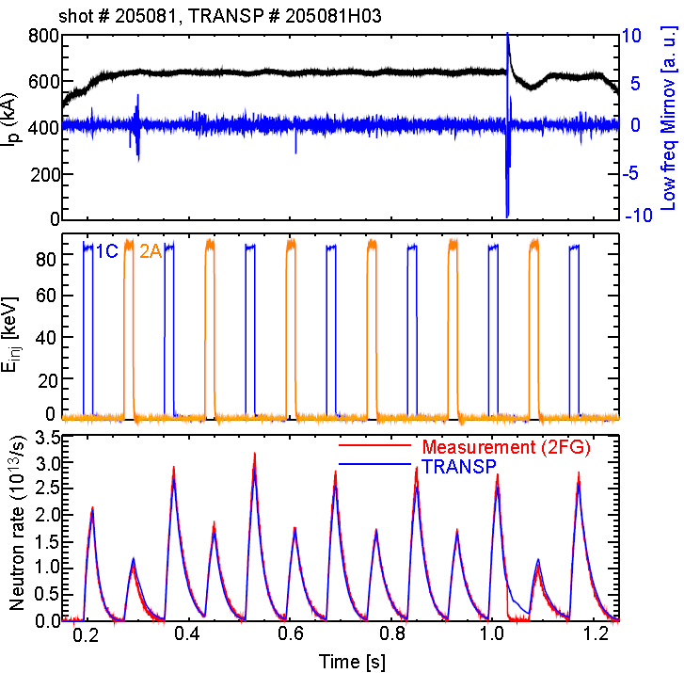
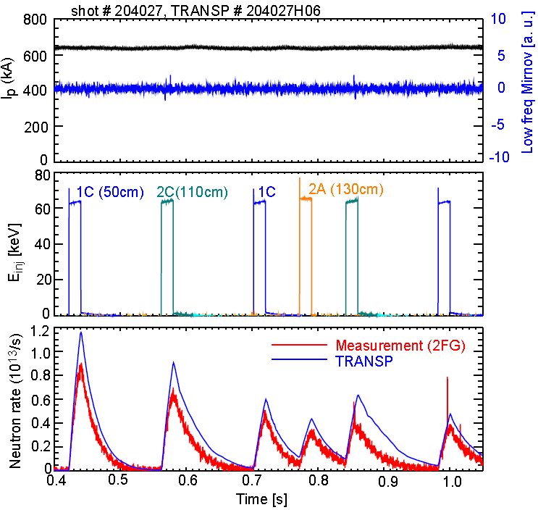
Explored fast-ion behavior with original and new NBI via beam blips with different NBI energies
E_{NBI} = 85keV
E_{NBI} = 65keV
Neutron rate
Good agreement between neutron measurement and TRANSP prediction
~20% discrepancy between data and TRANSP predictions
Exploring possible causes, including NBI source energy split

Slide 25
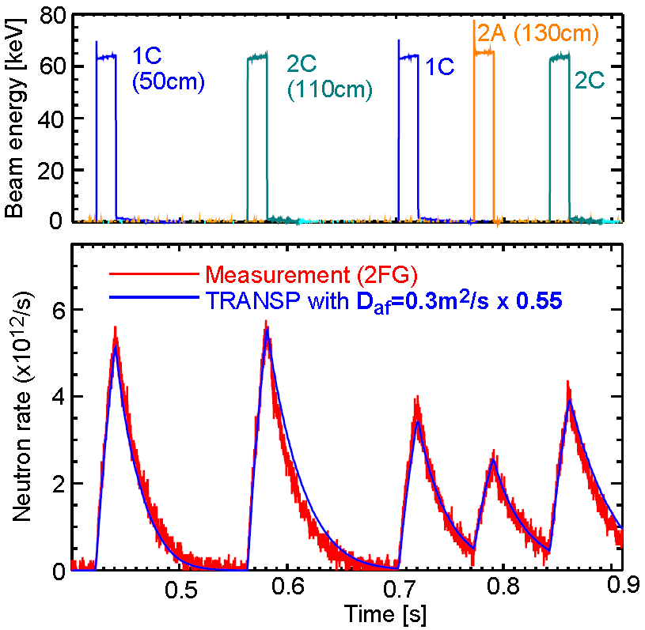
Agreement improved for E_{inj} = 65keV using small anomalous fast-ion diffusion
TRANSP decay time gets reasonable agreement with data when a small anomalous fast ion diffusivity (D_{af}=0.3m²/s) is used
→ Beam ion behavior is still close to classical theory

Slide 26
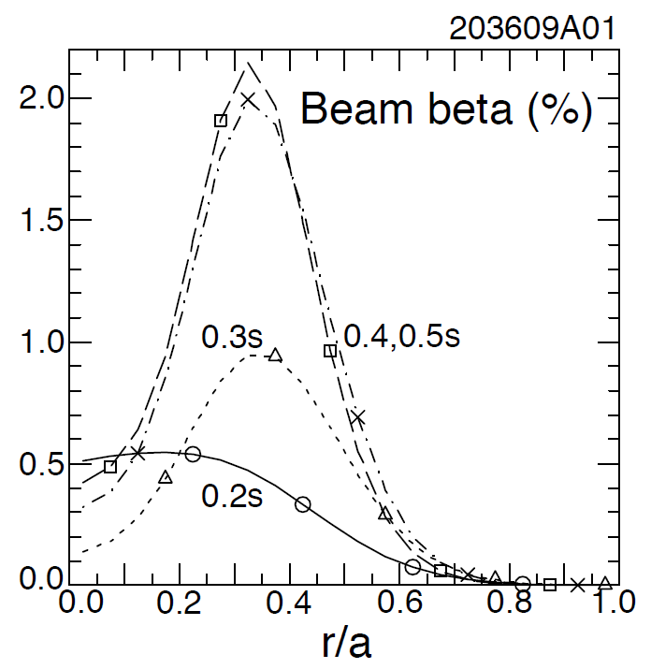
NSTX-U: Most tangential NBI generates counter-propagating Toroidal Alfvén Eigenmodes (TAEs)
Counter-propagating TAE predicted for hollow fast-ion profiles
H.V. Wong, H. Berk, Phys. Lett. A 251 (1999) 126.
TRANSP: As current builds up beam fast-ion beta profile predicted to become hollow
1st evidence of off-axis NBI in NSTX-U

Slide 27
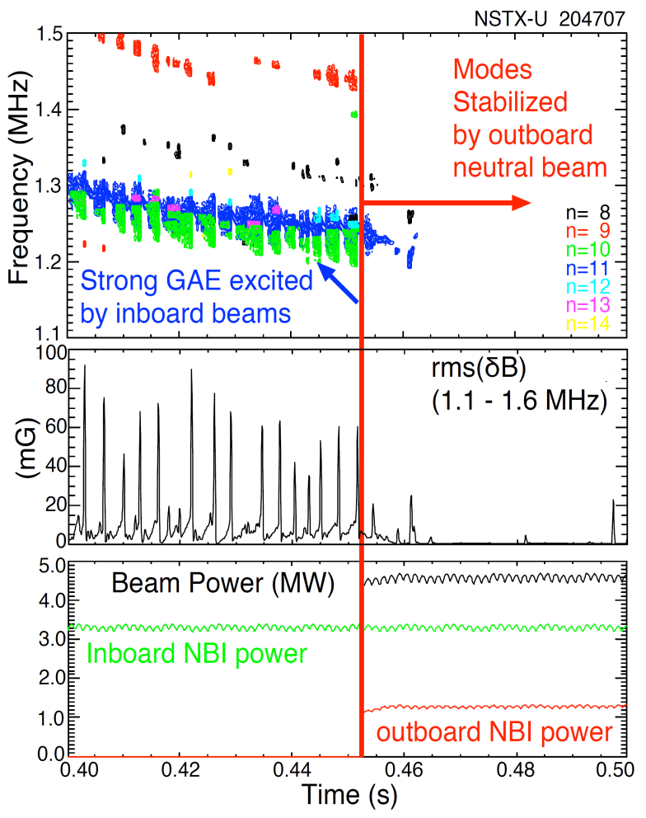
NSTX-U tangential 2nd neutral beam suppresses Global Alfven Eigenmode (GAE) – consistent with simulation
HYM code simulation of #204707, n=10
|δB_{n} |²
t=0.44s
t=0.47s
t ω_{ci}
HYM code: growth of n=10 counter-GAE from 1st NBI
HYM: suppression of n=10 counter-GAE by 2nd NBI
Most unstable n-number, mode ω consistent with HYM
New 2nd NBI already powerful tool for fast ion, AE physics

Slide 28
NSTX-U Mission Elements:
Explore unique ST parameter regimes to advance predictive capability - for ITER and beyond
ITER
Develop solutions for plasma- material interface (PMI)
Snowflake/X
Liquid metals / Li
ST-FNSF /
Pilot-Plant
Advance ST as Fusion Nuclear Science Facility and Pilot Plant

Slide 29
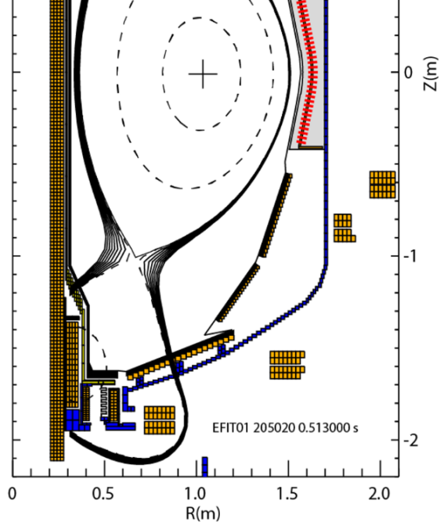
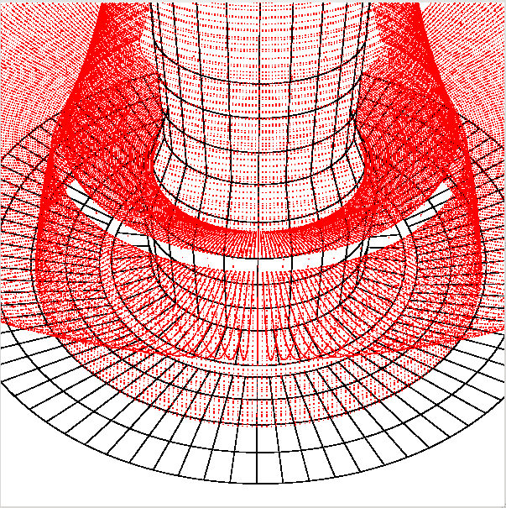
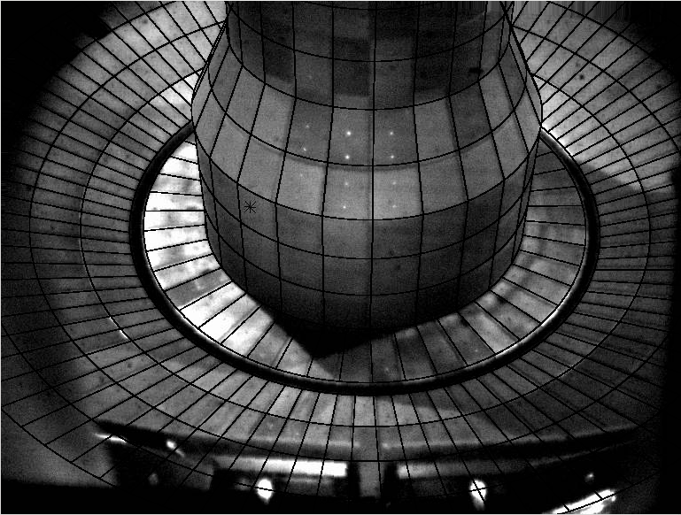
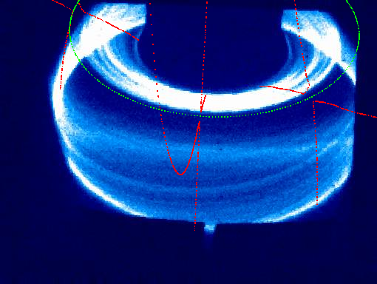
Throughput-optimized camera and high-X-point L-modes enabled near-separatrix turbulence imaging in NSTX-U
Divertor turbulence imaging through different species/charge states provides information at different spatial locations
Throughput-optimized setup enabled turbulence imaging via C III (up to 140kHz)
  Filaments along divertor legs (vs. filament footprint on floor via Li I or Dα)
Reconstructed view + separatrix

Slide 30
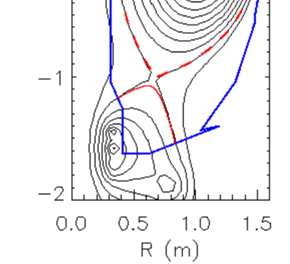

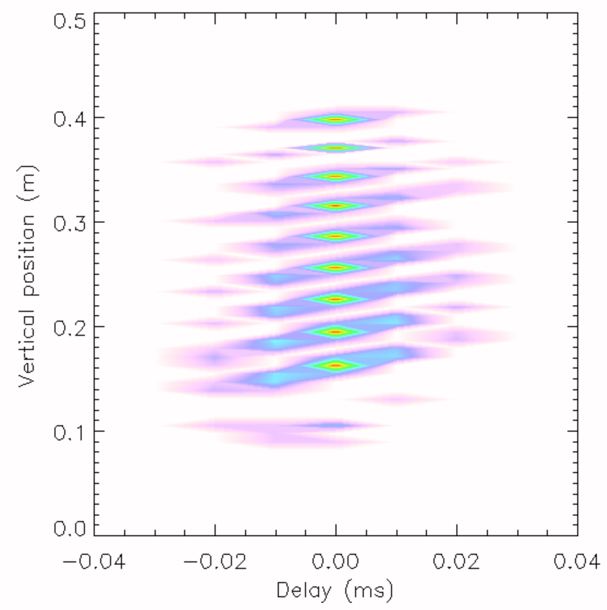

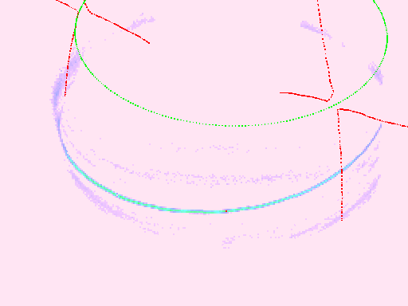
Time delayed cross correlation shows opposite toroidal rotation for inner/outer leg filaments
Time-delayed cross correlation of single pixel with rest of image to show average filament propagation
Apparent poloidal motion for both inner and outer leg filaments towards X-point (also in C-Mod, J. Terry, JNME 2016)
  Or equivalently opposite toroidal directions
  Inconsistent with flux tube rigid rotation (as in J. Terry JNME 2016)
Poloidal velocity ~1km/s
Zero-delay cross correlation
Time-delayed cc
at different elevation
Inner-leg filament
Outer-leg filament

Slide 31
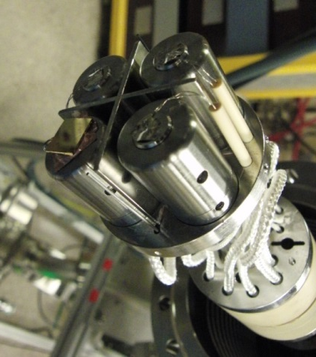
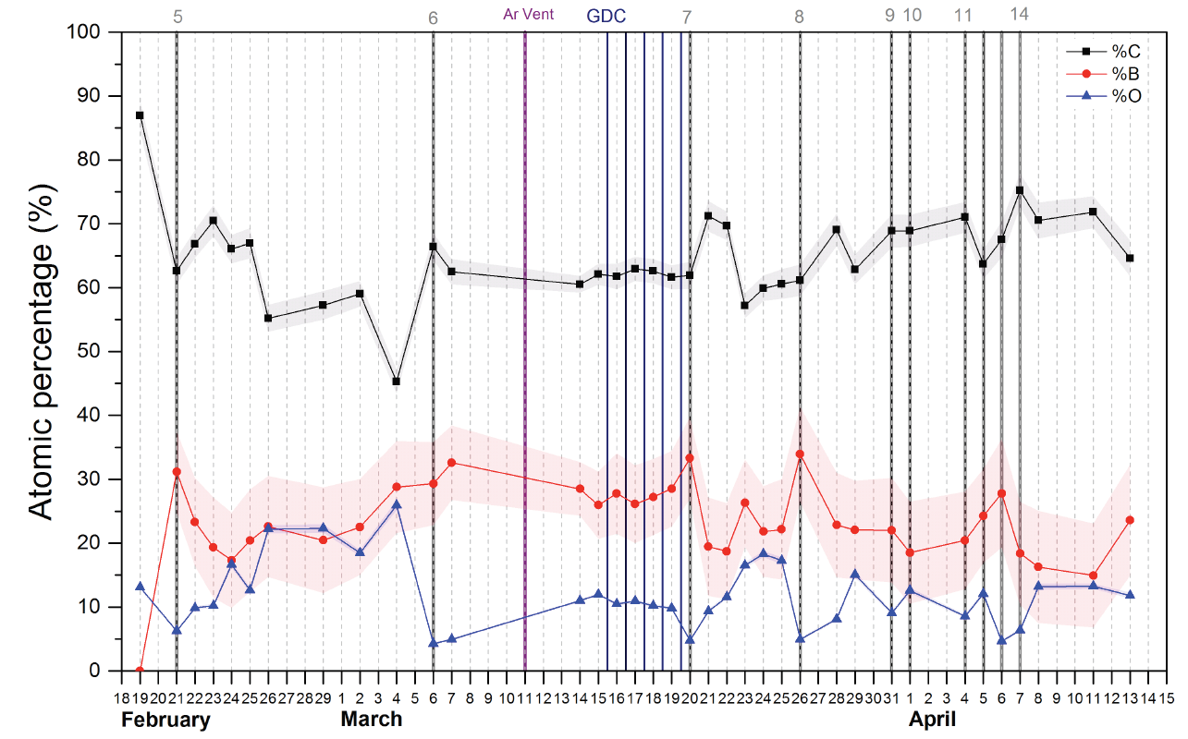
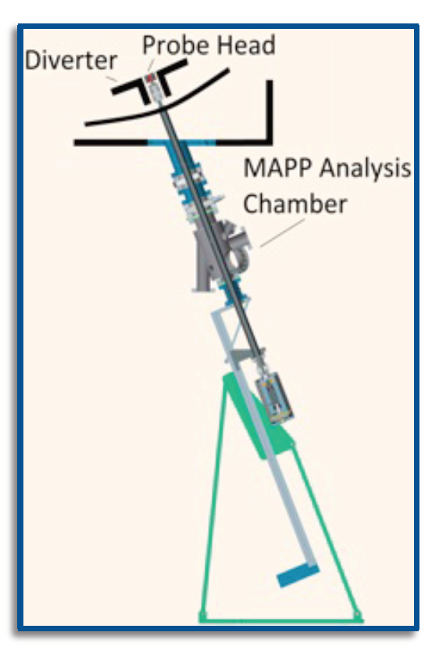

Material Analysis & Particle Probe (MAPP) providing new measurements of surface evolution in NSTX-U
Tracked C/B/O evolution, correlated with plasma performance
Implemented remote-control + between-shot MAPP analysis
Future: Use with Li, understand complex Li chemistry/evolution

Slide 32
NSTX-U Mission Elements:
Explore unique ST parameter regimes to advance predictive capability - for ITER and beyond
ITER
Develop solutions for plasma- material interface (PMI)
Liquid metals / Lithium
Snowflake/X
Advance ST as Fusion Nuclear Science Facility and Pilot Plant
  Results of 5yr study published in Nuclear Fusion
  Invited talk: TOFE 2016 - FNSF/Pilot Plant study
  Invited talk: APS 2016 - Compact Pilot Innovations
ST-FNSF /
Pilot-Plant

Slide 33
NSTX-U strongly supporting advancing predictive capability, ITER, PMI solutions, and next-step STs
For more results info, see 2016 APS-DPP presentations here
Productive first year of operations on NSTX-U
  Rapid H-mode access, scenario development, error field correction
  Surpassed NSTX maximum magnetic field and pulse-duration
  New fast-ion physics with 2nd NBI – GAE stabilization, counter TAE
  Commissioned new advanced PMI diagnostics – MAPP
Developing advanced predictive capability
  New models for tearing stability, reduced models for RWM
  Global ion-scale turbulence (GTS), ∇n ETG stabilization
  GAE stabilization from 2nd NBI consistent with simulation
  Exploring SOL widths, advanced divertor interactions with 3D fields
Developed attractive Cu, HTS ST-FNSF, Pilot concepts
In 2017 will emphasize collaborations, 5YP prep
Aim to resume NSTX-U physics operation in CY2018 - TBD

Slide 34
Progress toward FES Notable Outcomes
Notable Outcome 1: Perform experimental research …at magnetic field, I_{P}, pulse length beyond that achieved in NSTX…
  NSTX-U pulse lengths (>2s) exceeded NSTX (< 1.8s) at field (0.6-0.65T) exceeding maximum NSTX field (0.55T)
  Achieved I_{P} ~ 1MA – but did not exceed max NSTX I_{P} = 1.3MA, will require more run time for early EFC + improved early H-mode scenarios
  Notable Outcome 2: …support the FES joint research target to “Conduct research to detect and minimize the consequences of disruptions in present and future tokamaks”
  Automatic shutdown algorithms developed, detecting disruptions in real-time via I_{P} error, vertical motion, n=1 locked mode signature (future)
  DECAF code progressing toward real-time application
  MGI using an electromagnetic valve similar to ITER design
    2 MGI valves installed, commissioned, not tested in plasma (PF1AU failure)

Slide 35
Likely goals for next NSTX-U run campaign
Only a subset, and will decide as a team via next Research Forum
Increase field to 0.8-1T, current to 1.6-2MA
Develop early H-mode / low-l_{i} / high-κ scenarios
Assess H-mode energy confinement, pedestal, and SOL characteristics with higher B_{T}, I_{P}, P_{NBI}
Complete assessment of effects of NBI parameters on fast ion distribution, neutral beam driven current profile
  Expand upon new physics already observed w/ tangential NBI
  Increase NBI current drive, non-inductive fraction
Key physics, operational tools for high-performance
  Developed shape & vertical control, new inboard gap control, EFC, HFS & LFS fueling under PCS, automated shutdown
  Need to commission: n=1 dynamic EFC, RWM control
  Test Impurity Granule Injector (IGI), MGI, Li evaporation

Slide 36
Outline
NSTX-U mission
Selected highlights from 1st NSTX-U run
Progress toward DOE/FES Notable Outcomes
Collaborations
NSTX-U technical challenges
Recovery effort
5 year plan discussion

Slide 37
Example enhanced collaborations for outage period
Building upon and informing NSTX-U research
EAST: Edge physics, plasma material interactions (high-Z, Li)
  Maingi + collaborators leading experiments this month / early next year
JET: Energetic particle studies and plasma ramp-down scenario development and modelling
  Podesta, Darrow, Poli
KSTAR: Core MHD and rotation physics, plasma control
  Sabbagh (Columbia) + group, J-K Park, J-W Ahn (ORNL)
MAST-U: Control, scenario modelling supporting 1st plasma
  Battaglia (+Boyer) tentatively planning visits/stays summer/fall 2017
W7-X: 3D confinement and stability
  Lunsford - alternate wall conditioning using boron powder dropper
WEST: start-up, RF physics, high-Z PMI, real-time wall protection
  Mueller going in spring, Reinke (ORNL) in fall, possibly PPPL RF physicists
LAPD at UCLA - RF coupling and heating physics, cavity modes
  R. Perkins leading RF development efforts
HL2A in China offering significant run-time
  Y. Ren presented capabilities/opportunities in December, gathering ideas now

Slide 38
DIII-D National Campaign proposals assessed by NSTX-U
Initial guidance: 3+1 week for campaign (4-day weeks)
Solicited & received proposal synopses from team
Run-time over-subscribed by factor of two to three
  Boundary: 17 proposals, 17 days req.
  Core: 12 proposals, 12 days req.
  Integrated Scenario: 8 proposals, 7.5 days req.
Prioritization process
  NSTX-U recommendations: Based on near-term NSTX-U goals, well-defined ideas that require minimal operational development, Early Career considerations
  NSTX-U selections discussed with GA, FFCC in December
    12 days total: Priority 1 (8 days), Priority 2 (4 days)
  Final selections will be made in coming days

Slide 39
Outline
NSTX-U mission
Selected highlights from 1st NSTX-U run
Progress toward DOE/FES Notable Outcomes
Collaborations
NSTX-U technical challenges
Recovery effort
5 year plan discussion

Slide 40
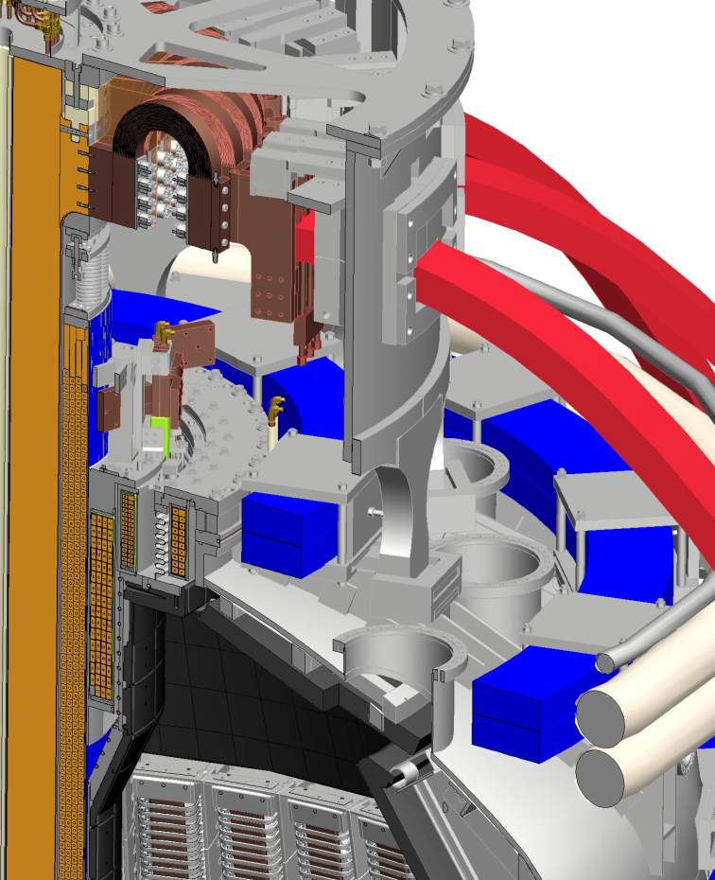
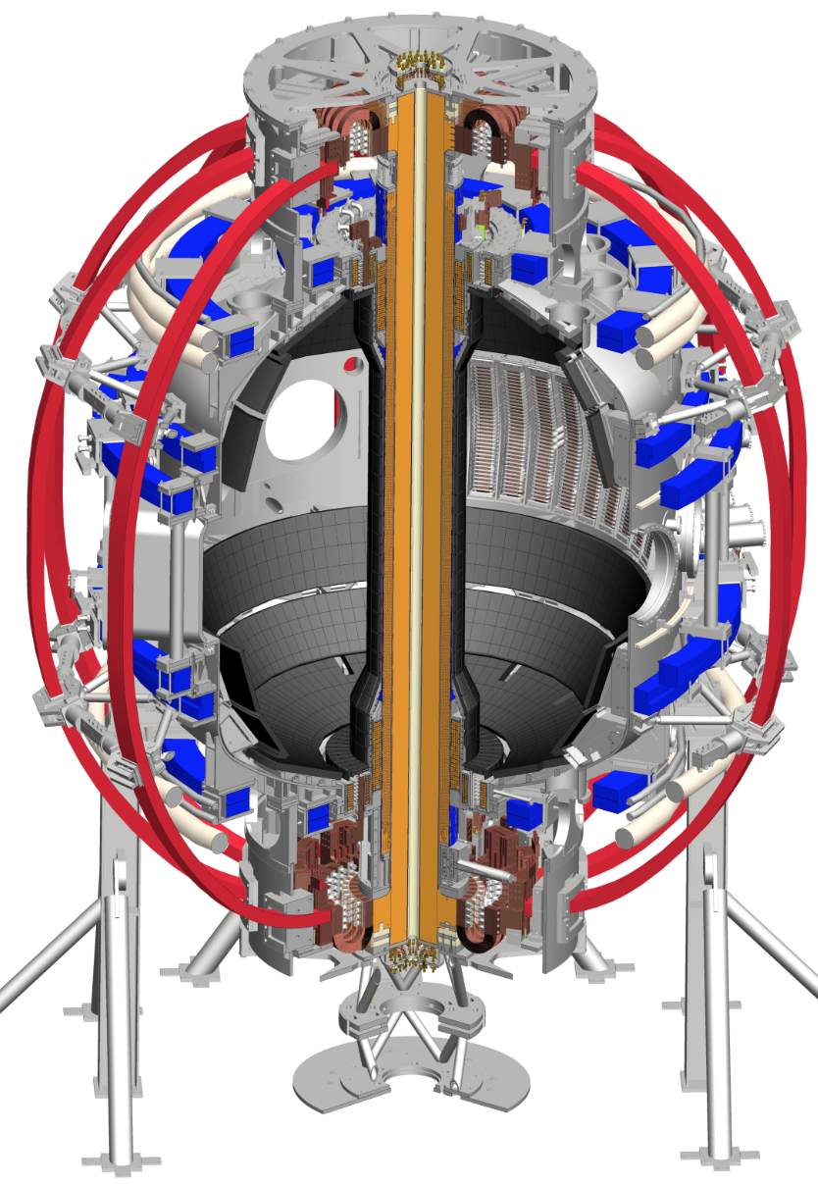
PF1AU coil developed turn-to-turn short(s)
TF
OH
PF1CU
PF1BU
PF2U
PF1AU
PF3U

Slide 41
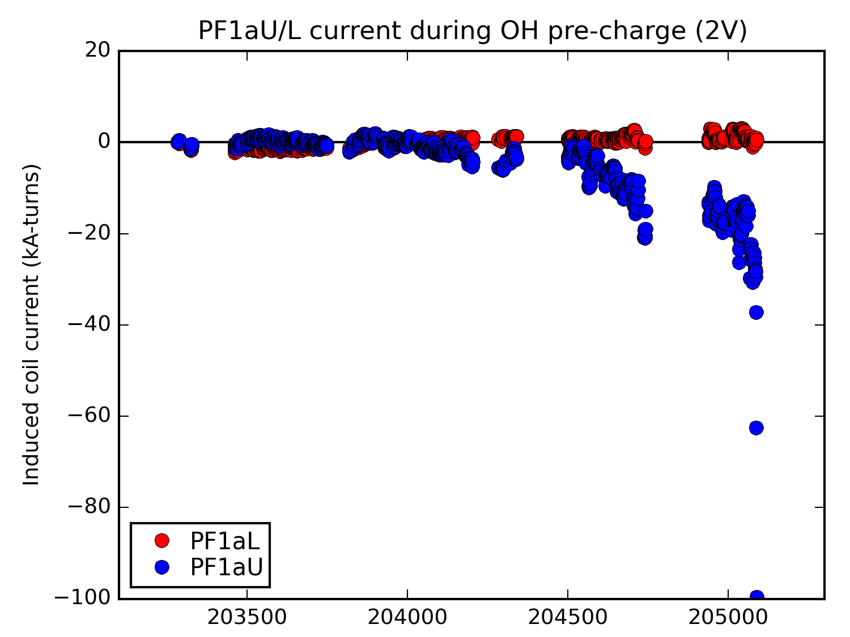
PF1AU coil failed gradually - coil inductance decreased 2-5% over three month period
PF1AU carried current while open circuited during OH pre-charge phase
Starts to conduct current at the end of ~March / April
Very fast degradation on the final run day in June – 100kAt induced current
PF1AL shows no anomalies
May
June
NOTE: Inductance change and induced current inferred from magnetics

Slide 42
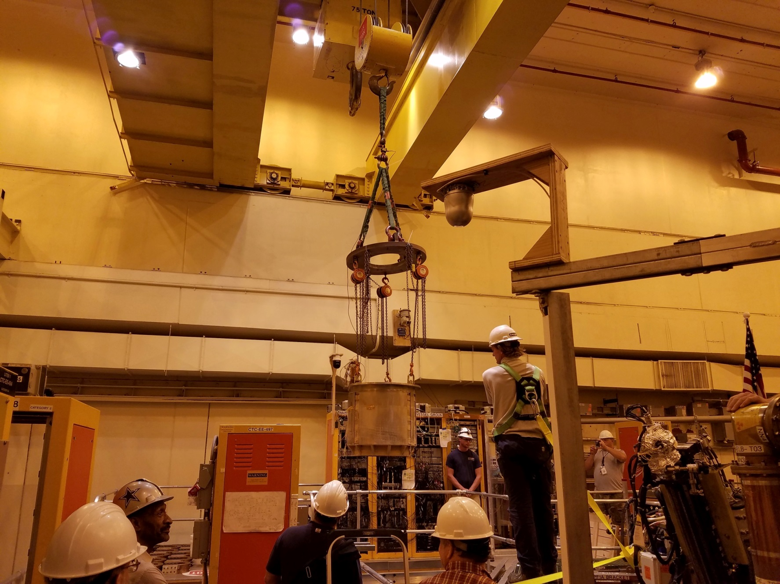
PF1AU removed 8/24/16
Forensic Analysis of this Coil Discussed Later in the Talk

Slide 43
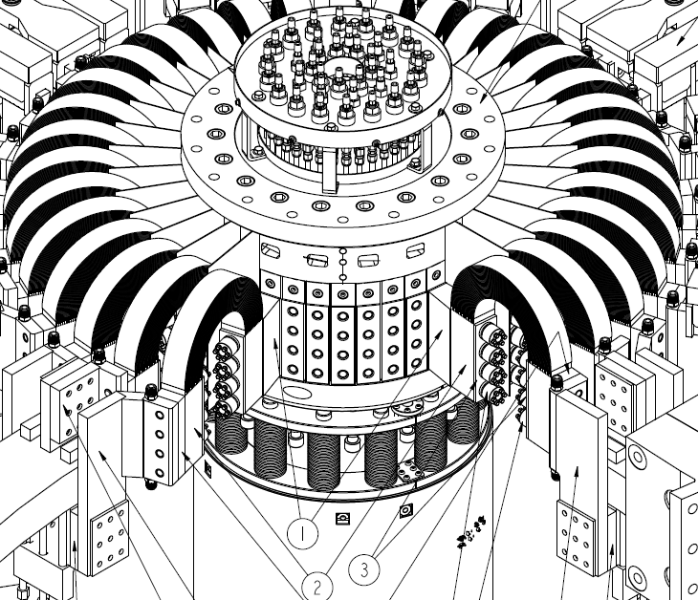
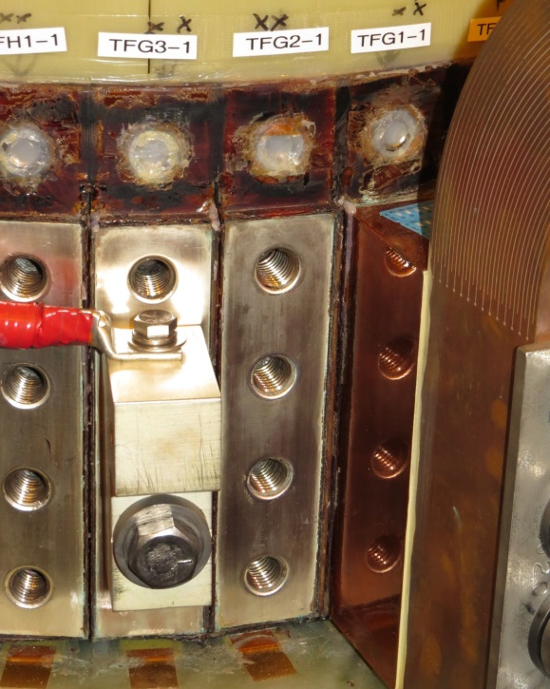
TF joints on CS bundle: All joint resistances and surface conditions were nominal after run
In FY 2016, NSTX-U operated mostly at B_{T} ~ 6.5 kG up to ~ 2.2 s flat top for over 1000 shots
TF joint measurements performed as TF joints were disassembled - joint surfaces in very good condition
But, full performance will increase joint heating 5-6x

Slide 44
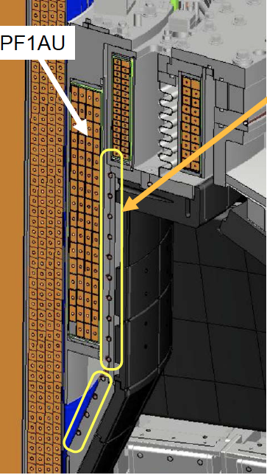
NSTX-U CS Divertor Cooling Tube Issues
• NSTX-U has spiral cooling tubes on airside ID of center-stack casing ends to cool divertor region.
• Another set of vacuum side cooling tubes on the horizonal CS flanges (horizontal inboard divertor).
• Installed to cool PFCs between pulses to avoid thermal ratcheting over multiple high-power shots.
    - This cooling capability has not been needed or used yet, but will be needed in future.
• Similar tubing on bottom of CS casing near PF1AL coil.

Slide 45
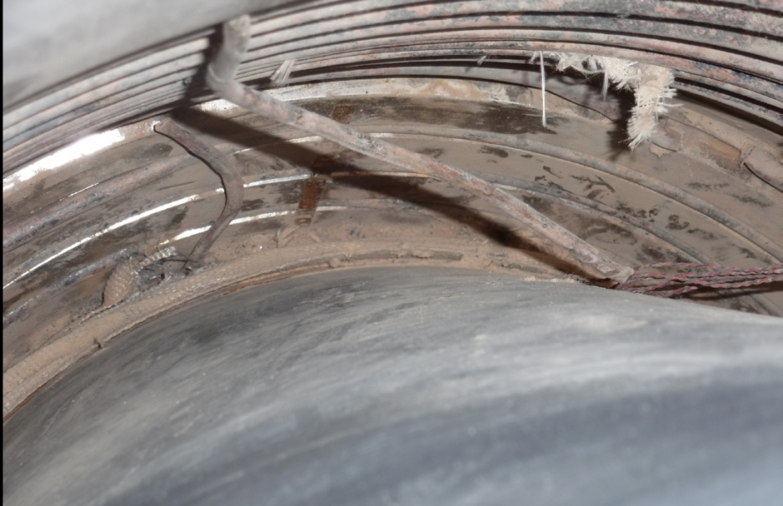
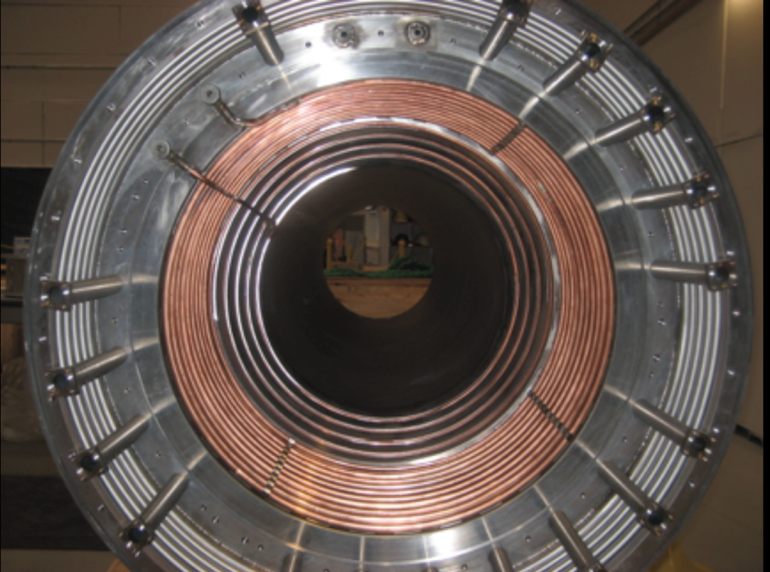
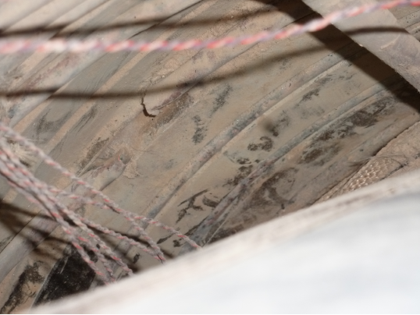
Divertor CS Cooling Tubes Severely Damaged
Induced currents in copper tube likely cause
NSTX-U divertor CS cooling tube before installation
Severe damage in divertor CS cooling tubes
Missing part of tube at multiple locations

Slide 46
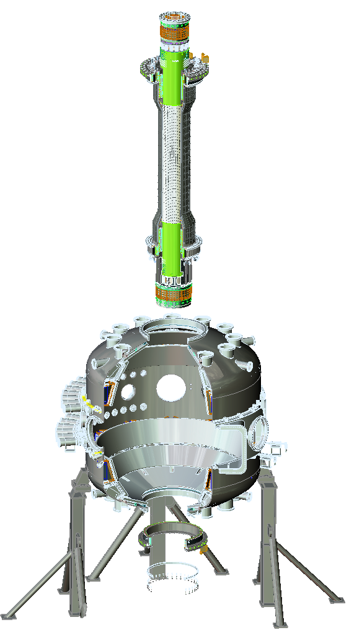
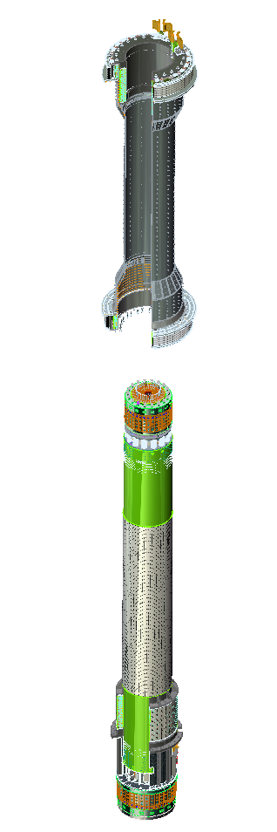
Lower cooling tube also breached → damaged → need to remove both CS and casing to access tube, PF1AL
(1)
(2)

Slide 47
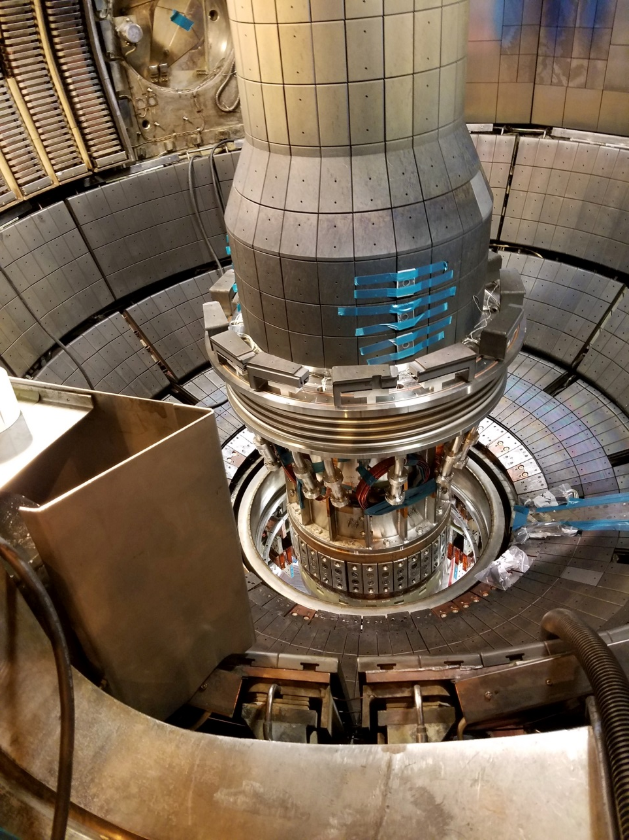

Centerstack removed 11/17

Slide 48


CS on mounting stand after being pulled

Slide 49


CS casing lifted off

Slide 50


Casing fully separated from bundle

Slide 51


Lower cooling tubes also damaged
Failed Upper Cooling Tube
(Previously Reported)
Discovered a Failed Lower Cooling Tube
(“powder” is microtherm insulation dust)
Note: This Result Anticipated Based on
Pressure Testing of the Tube

Slide 52

PF1A lower successfully removed

Slide 53
PF1AU Forensic Analysis Overview
Goal of Phase 1:
  Identify locations with potential issue
  Section the coil in ways that do not destroy regions of interest
  Do visual, electrical, pressure, and vacuum testing on the section.
Desired to not destroy any faulted regions in the coil.
Have documented the results of these tests, discussed with various parties, developing next step plans.
Effort led by Joe Petrella and Irv Zatz
+ great help from tech shop, FCPC techs

Slide 54



X-Rays Identified a Number of Anomalies
(9/1/16, 9/8/16)
Image shows:
Joggles (semi-abrupt transitions in conductor height)
Region of apparent lower density
Other X-rays located all braze joints.

Slide 55


Coil Was Sectioned Using a Milling Machine
Section Planes Chosen to Avoid Any Regions of Interest
Detail of an Initial Cut

Slide 56


A Battery of Tests Was Performed on the Three Sections
Electrical Tests
Videoscope Tests
Also vacuum & pressure testing on individual channels

Slide 57

Videoscope shows breach in cooling channel
Shorted Turns
Region of Shorted Turns
Section A-B, Layer 3, Row 9 Void Anomaly
Large Void on This Turn

Slide 58

View of fault region - concave side

Slide 59

View of fault region - convex side

Slide 60

Hole in conductor from turn exterior

Slide 61
Outline
NSTX-U mission
Selected highlights from 1st NSTX-U run
Progress toward DOE/FES Notable Outcomes
Collaborations
NSTX-U technical challenges
Recovery effort
5 year plan discussion

Slide 62
NSTX-U / PPPL scored poorly in FY16 performance evaluation from DOE/FES
“…serious flaws in the design revealed that PPPL had failed to apply its own basic engineering practices, ultimately causing the failure of several critical components...”
  This resulted in subsequent construction (operation) problems....
Failed to meet a Notable Outcome,… “prevented the performance of experimental research to address spherical torus issues at parameters beyond those achieved on NSTX”
Positive aspects of FY16 run were also noted in performance evaluation, but these are outweighed by the systematic engineering / operational failures

Slide 63
Comprehensive “extent of condition” and engineering policy & procedure reviews will be conducted in FY17
EXTENT OF CONDITION
  FES: Complete an extensive extent-of-condition review of NSTX-U to identify all design, construction, and operational issues. Prepare correction action plan (CAP) to include cost, schedule, scope, and technical specifications of actions. Provide an interim progress report by March 31, 2017 and complete the CAP review and final report to DOE by September 30, 2017.
EXTENT OF CAUSE
  SC/PSO: Conduct a review of policies and procedures for design, construction, installation, commissioning and operations of NSTX-U and other construction activities and projects. Develop corrective actions to ensure the highest quality project management across the lab.

Slide 64

NSTX-U re-organized
Rich Hawryluk leading NSTX-U Recovery Project

Slide 65
Extent of Condition → implement via
Design Verification & Validation Reviews (DVVR)
System Design Description (SDD) is key element

Slide 66

Research Staff supporting SDD development

Slide 67
FY17: Develop Corrective Action Plan based on gaps, review the CAP, then begin implementing CAP actions
  There will be external (+internal / PPPL) reviewer participation in all SDD / DVVR reviews
  Full external review(s) of the CAP and the SDD + DVVR process used to generate the CAP

Slide 68
Extent of Cause Review (Les Hill)
Program review is project management-centric but will necessarily extend to supporting policies, programs, procedures and work practices in areas such as engineering design, configuration management, conduct of operations, etc.
Phase approach adopted to support NSTX-U recovery, restart
  Phase I: Critical review of NSTX-U issues and identification/implementation of near-term actions to preclude recurrence of equipment deficiencies on time line needed to support NSTX-U recovery schedule
  Phase II: Balance of program reviews and development of corrective action plan by end of FY17

Slide 69
NSTX-U will not operate for at least 1 year, possibly significantly longer – depending on:
Number of PF1 coils that will be replaced, schedule for replacement, and resource needs and availability
  Key example: Existing PF1B coils incompatible with 350C bake of inboard horizontal divertor → need to eliminate or build smaller coils – analysis ongoing
Any other major findings from ongoing SDD / DVVRs, and the Extent of Condition reviews
Operational readiness - NSTX-U will (newly) be under DOE accelerator safety order (ASO)

Slide 70
Outline
NSTX-U mission
Selected highlights from 1st NSTX-U run
Progress toward DOE/FES Notable Outcomes
Collaborations
NSTX-U technical challenges
Recovery effort
5 year plan discussion

Slide 71
PF coil recovery schedule → 10 run weeks (mostly commissioning) during present FY14-18 five year plan
FY19-23 plan due spring 2018, peer-reviewed summer 2018
Begin brainstorming early 2017, then writing in summer / fall
Generate research goals, prioritize facility enhancements
Mission Elements and Present 5 Year Plan 5 Highest Priorities
Explore unique ST parameter regimes to advance predictive capability - for ITER and beyond
  Study energetic particle physics prototypical of ITER/FNSF burning plasmas
  Understand energy confinement and MHD stability at high normalized pressure
Develop solutions for PMI challenge
  Dissipate high edge heat loads using expanded magnetic fields + radiation
  Compare performance of solid vs. liquid metal plasma facing components
Advance ST as possible FNSF / DEMO
  Form and sustain plasma current without transformer for steady-state ST
Missions, priorities for next 5 year plan will be a major FY17 deliverable

Slide 72
Near-term schedule for 5 year plan preparation
By end of January – receive PAC report, discuss with science groups
By end of February:
  Outreach to University PIs / UFA to discuss / plan external University participation in defining 5YP science goals
By mid-March 2017:
  Assess implications of EoC and CAP on NSTX-U 5 year plan, share report results and implications with team and PAC
By end of April 2017:
  Hold team-wide 5 year plan science mission, goal, and strategy brainstorming and prioritization meeting including experiment, theory, and University community representation.
  Complete preliminary assessment of existing/planned facility, diagnostic, and simulation capabilities to achieve 5YP science goals.
By end of May 2017:
  Hold team-wide 5 year plan additional facility and diagnostic enhancement brainstorming meeting plus preliminary prioritization

Slide 73
Proposed / possible approaches for enhanced University PI (not already in team) engagement
Ask UFA / university reps to generate ideas for how NSTX-U could be used explore new physics areas not already / typically part of the mainline program
Present these ideas at a dedicated session(s) at mission / goal / strategy brainstorming meeting
Debate ideas amongst full team, select (at least) a few
Assess whether ideas can be supported with existing and/or planned facility and diagnostics
Participate in facility enhancement brainstorming
Contribute 5 year plan proposal text and plans
If appropriate, lead dedicated NSTX-U task force(s) and/or generate milestones to carry out research

Slide 74
Any (more) questions?
Thank you!

