Slide 1
Status and Plans for NSTX-U Recovery
S. Gerhardt, J. Menard, C. Neumeyer, R. Feder, and the NSTX-U Research and Engineering Teams
NSTX-U PAC-39
January 9, 2018
B-318, PPPL
This research was sponsored by the U.S. Dept. of Energy under contract DE-AC02-09CH11466

Slide 2
Outline
Overview of Recovery & Extent of Condition
Technical Content and Impact of Recovery
Extent of Cause Review & ASO

Slide 3
Outline
Overview of Recovery & Extent of Condition
Technical Content and Impact of Recovery
Extent of Cause Review & ASO

Slide 4
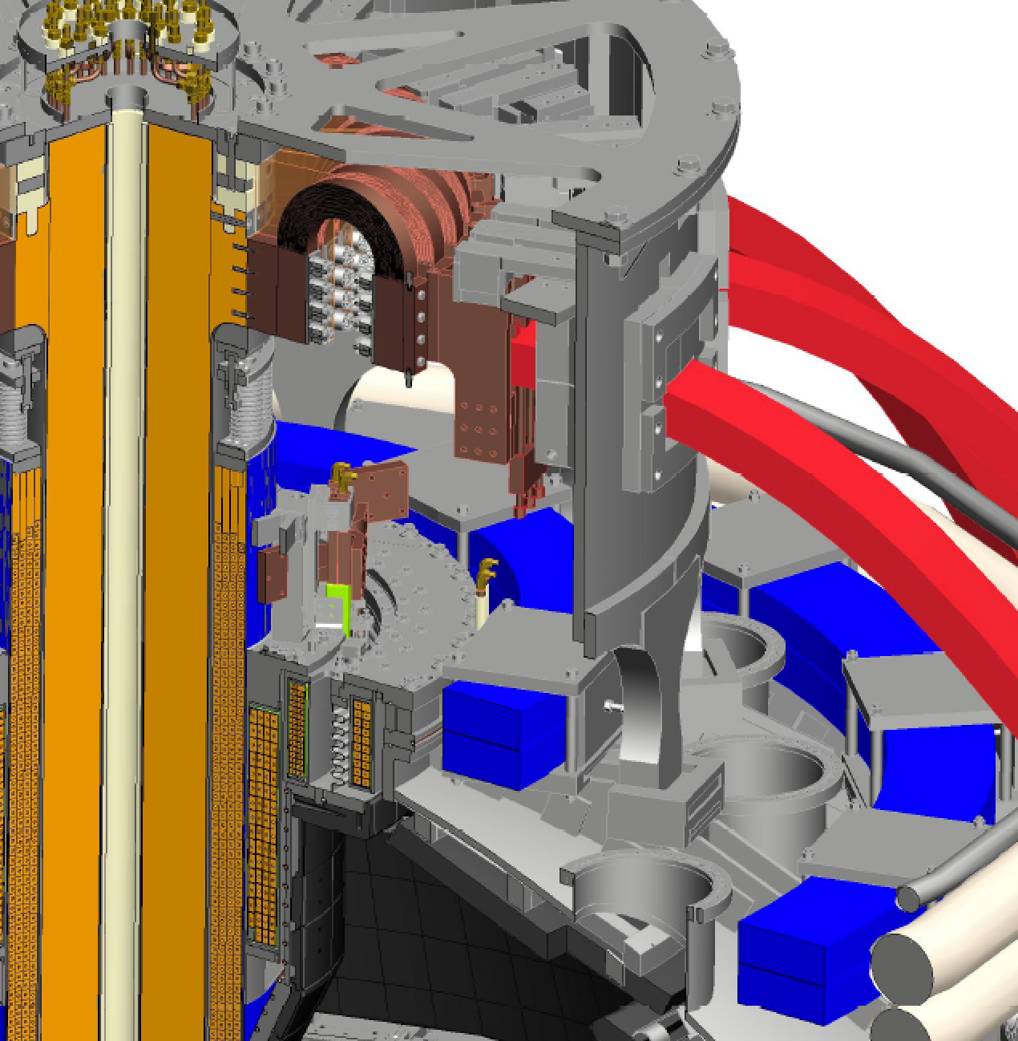
What is NSTX-U “Recovery”?
FY2017: DOE requested PPPL to review “Extent of Condition” and submit Corrective Action Plan (CAP) as a laboratory Notable Outcome
Extent of Condition motivated by:
4/15: OH “Arc Flash” incident
9/15: Inadequate inboard divertor bake
5/16: CS cooling tubes wrong material, induced current/motion, breaches
5/16: Bent PF1AU bus bar
6/16: Internal short in PF1AU coil
Recovery = Implementation of Extent of Condition CAP
OH Ground Braid
PF1B
PF1C
Inboard Divertor
OH Coil
PF1A
Cooling tubes

Slide 5
17 Reviews in FY2017 Enabled Us to Determine the Path Forward
12 Design Verification and Validation Reviews (DVVRs)
1170 “chits” covering entire NSTX-U technical scope → 443 “DVVR Issues”
Then evaluated issue/event probability, duration, and severity → categorize / prioritize
2 Extent of Condition Reviews, chaired by Tom Todd
Assessed issues and conclusions of the DVVRs and the PPPL planned response
Issued 2 reports → recommendations to ensure safety and reliability of the ST core
Design Integration Review
Conceptual Design Review
Cost and Schedule Review
→ 346 page report submitted: Recovery scope + CAP
Total of 47 external reviewers between Extent of Condition Reviews and DVVRs
Recommendations adopted after careful & in-depth deliberations between NSTX-U, EoC Committee, PU, & DoE

Slide 6
6 Major Scope Areas Define Recovery
Improved Reliability Safety and Compliance
Rebuild all six inner-PF coils with a mandrel-free design
Replace plasma facing components that cannot be qualified for the full range of mechanical and projected thermal loads
Improve the “polar regions” (machine top and bottom)
Implement mechanical instrumentation to assess quality of mechanical models, trend machine behavior
Eliminate the safety issues identified with the medium temperature water system used during bakeout, improve He distribution system
Improve the neutron shielding of the test cell

Slide 7
Outline
Overview of Recovery & Extent of Condition
Technical Content and Impact of Recovery
Extent of Cause Review & ASO

Slide 8
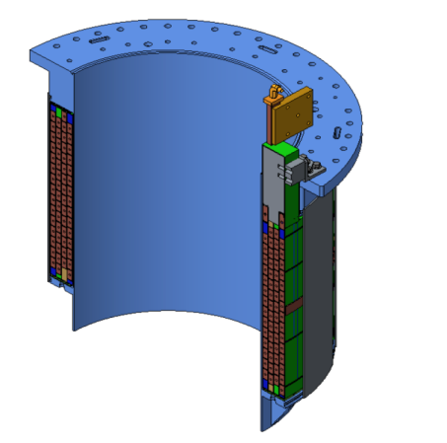
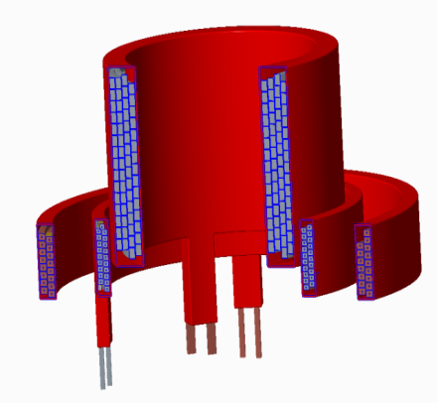
New Inner PF Coils Designed to Improve Testability and Manufacturability
EoCondition Recommendations
Retail all PF-1a/1b/1c coils
Use designs that facilitate turn-to-turn testing
Previous coils fabricated on permanent mandrels
Advantages: Precision winding surface, VPI mold, intrinsic structural support
Disadvantages: mandrel is passive conductor
Impacts turn-to-turn acceptance tests
Deemed unacceptable during extent of condition review
New coils: removable mandrels
Required new winding methods, tooling
Major schedule impact: had been intending to use permanent mandrels until mid-May 2017
New coil design simplifies fabrication
Original PF1A Coil with Mandrel
Three Mandrel-Free Coils
PF1A
PF1B
PF1C

Slide 9
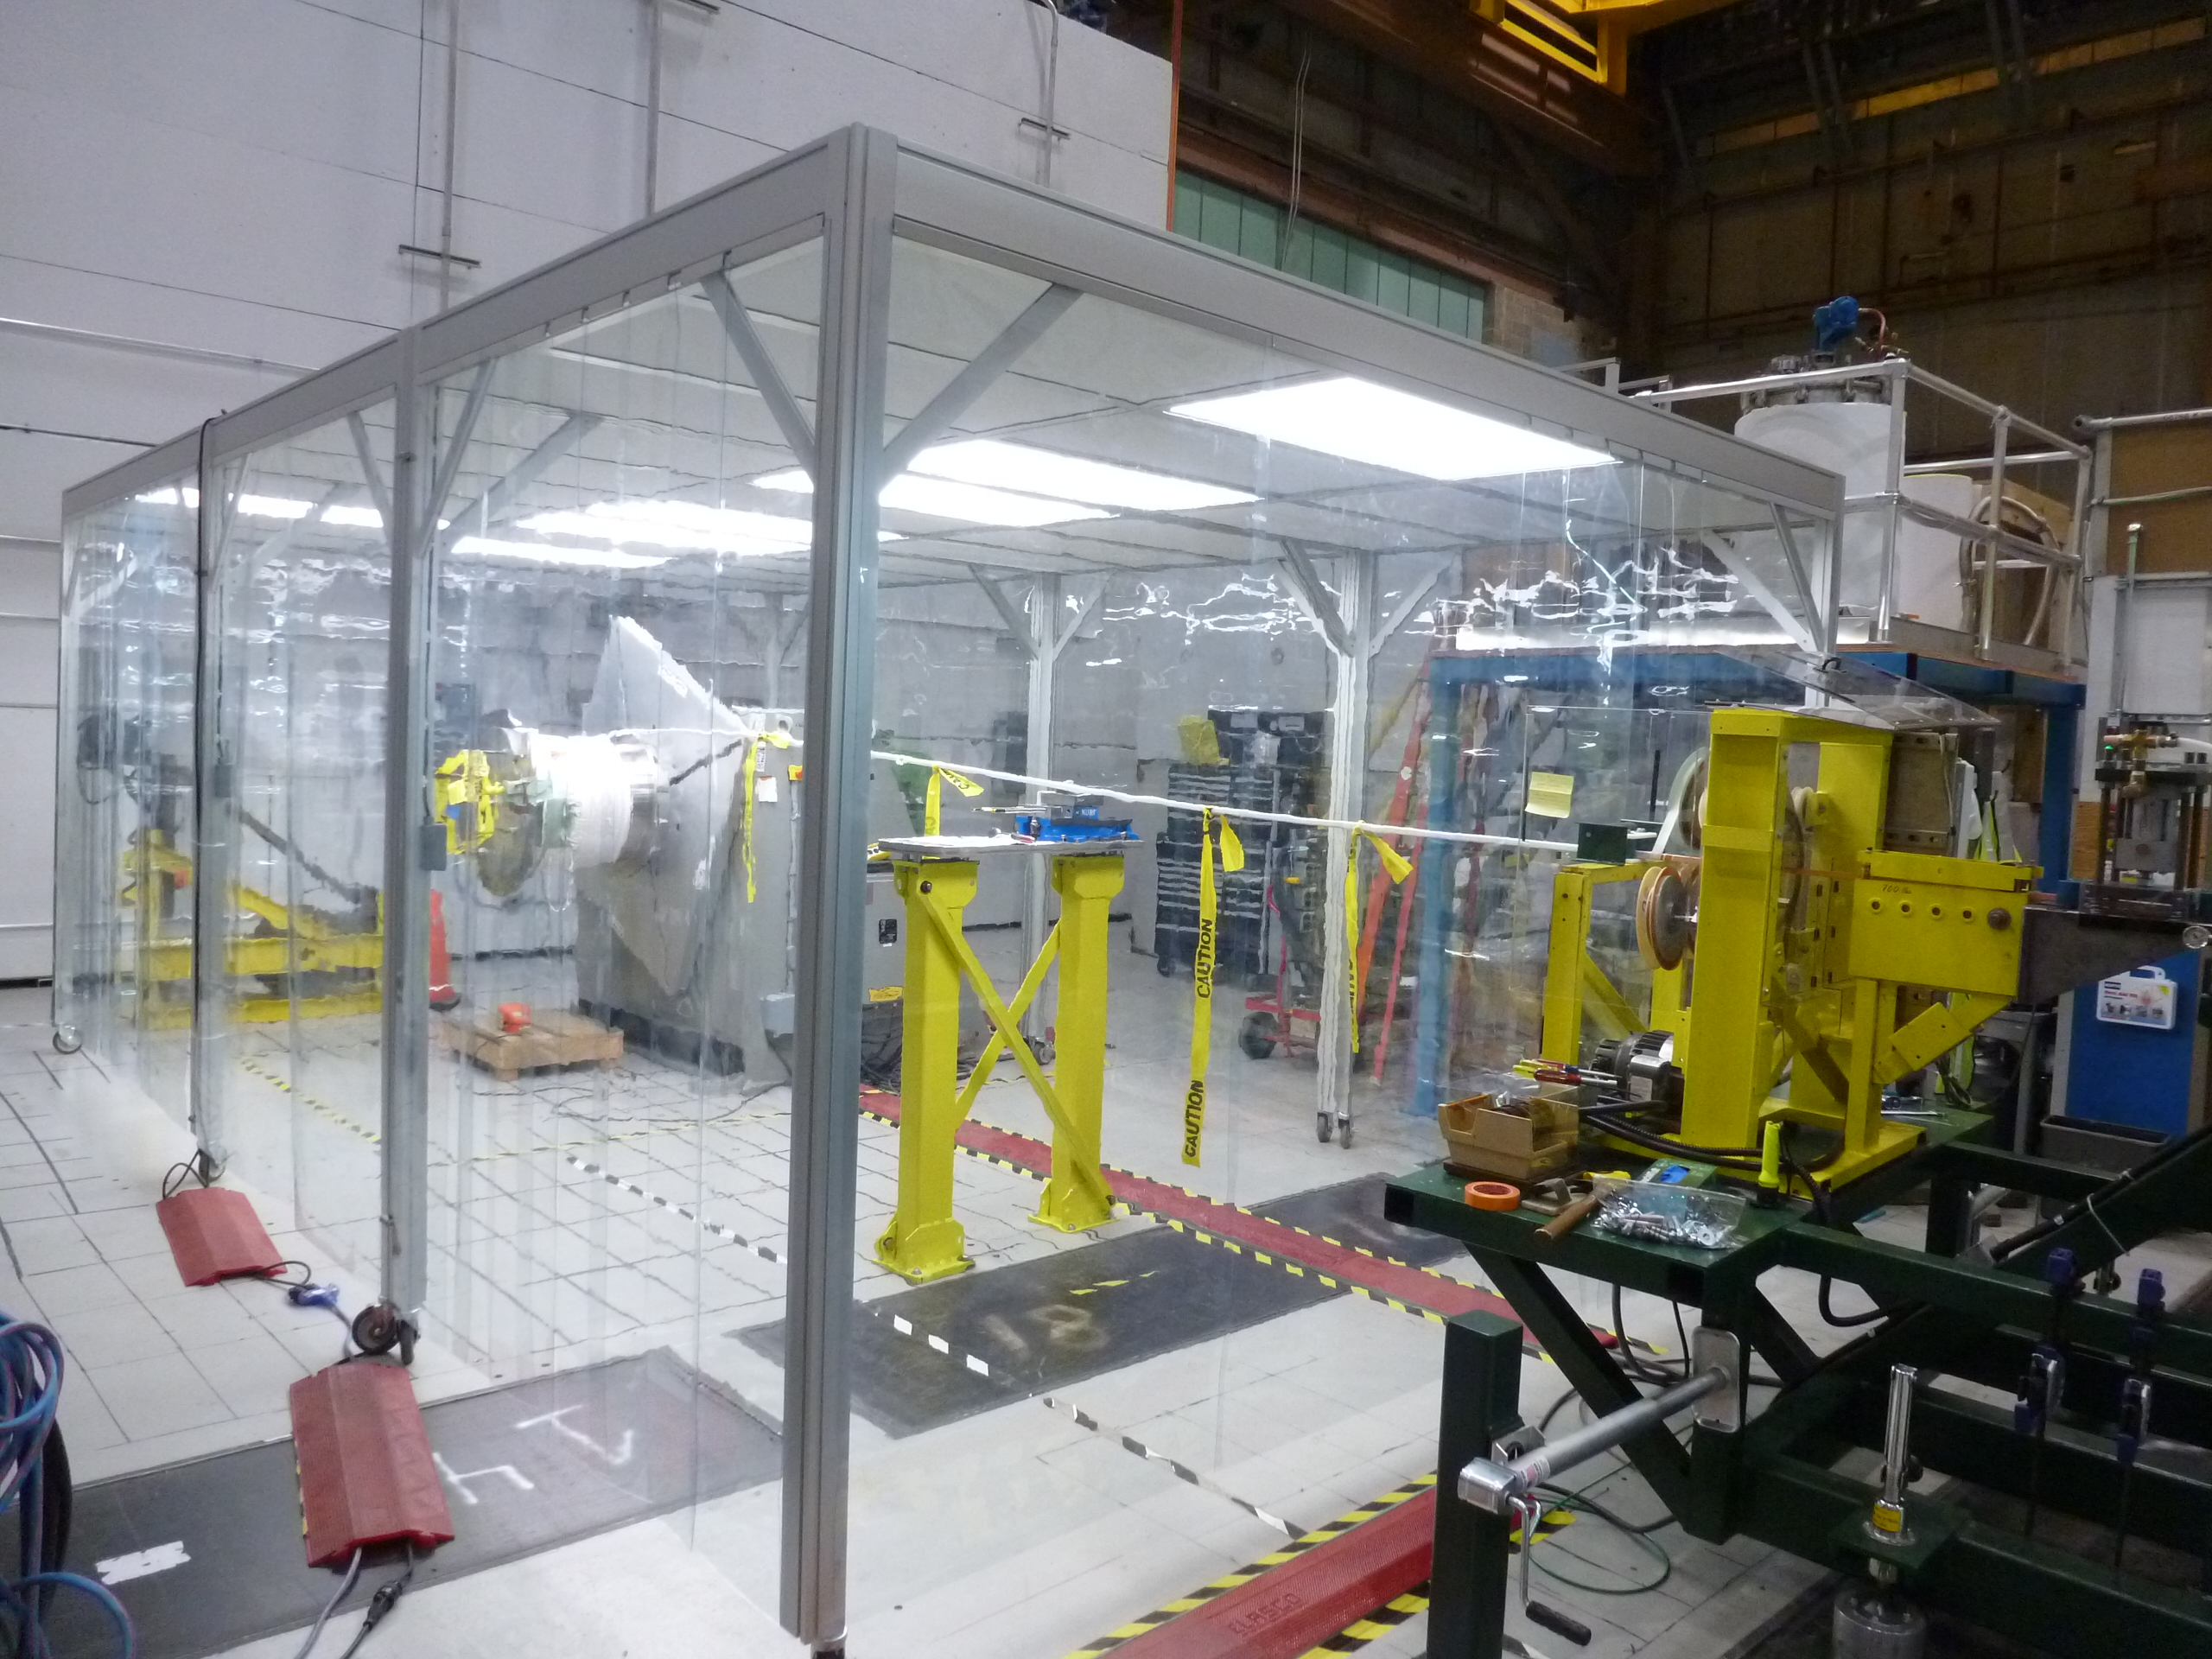
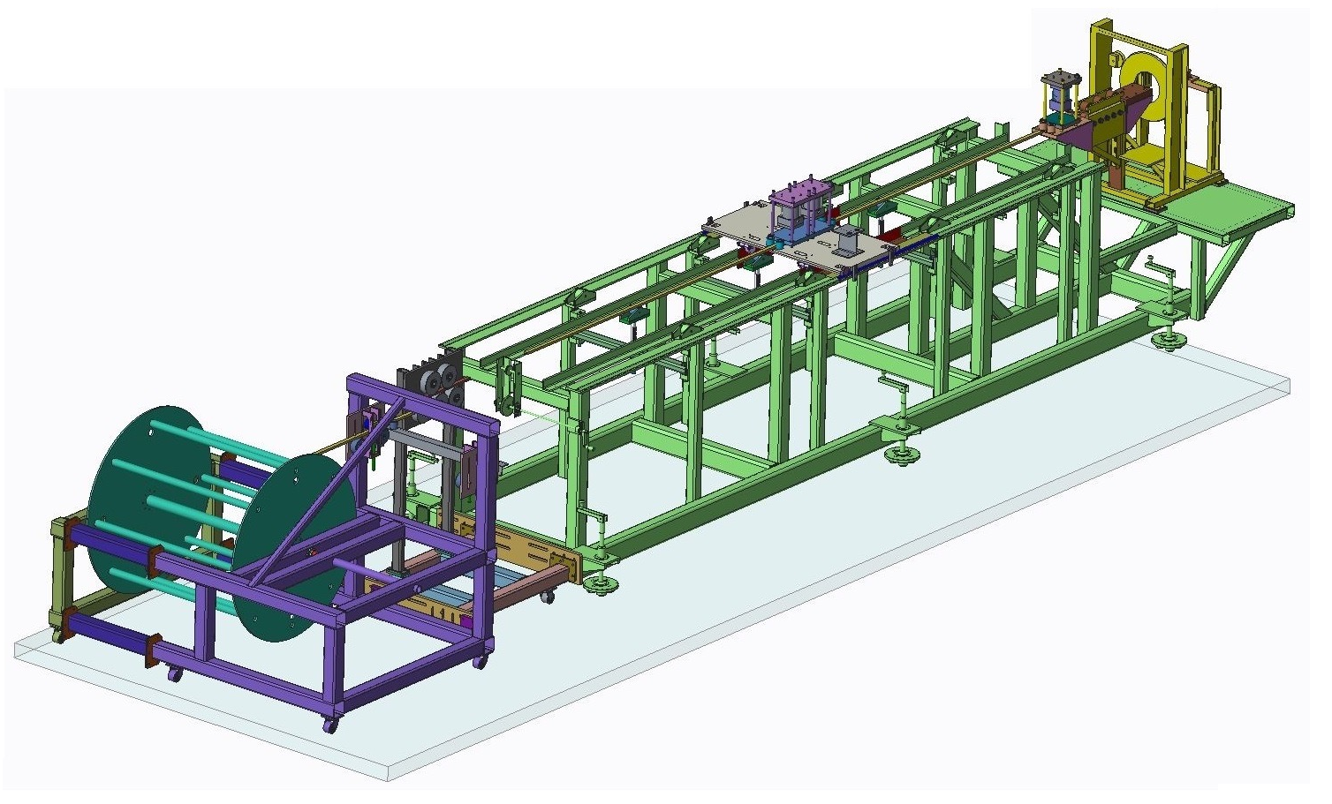
New Inner PF Coils Fabrication Strategy Devised to Ensure Quality
Address quality concerns: All coil manufacturers must first successfully produce a prototype PF1A coil
Prototype quality will be assessed by:
On-site surveillance
High-pot and turn-to-turn testing
Destructive testing (sectioning)
Will use up to 4 manufacturers
Three companies + PPPL all manufacturing prototypes
on-site surveillance for industrial suppliers maintained through production phase
All production coils will be tested to full current and full I²t on a custom test-stand before installation on NSTX-U
Portable Clean Room at PPPL
Winding line at PPPL

Slide 10
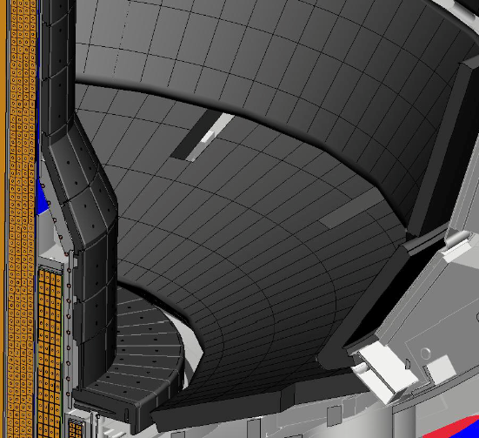
Improved PFC Designs
Two significant issues found with as-installed PFC designs
Halo loads not fully accounted for in initial tile fixturing design
Narrower SOL width now projected
Path Forward
Halo loads revisited based on NSTX, NSTX-U, MAST, other tokamak data
5 year plan research objectives + most recent SOL width models → updated heat flux specs
PFC working group instrumental in forming these requirements
Divide tile scope into 2 regions:
“Targeted Improvement” to chamfers, fixture scheme, material
“Full Redesign” to enhance thermal performance → castellated tiles
All tiles will be designed to withstand B_{T}= 1.0 T, I_{P}=2.0 MA disruptions
Targeted Improvements
Full Redesign

Slide 11
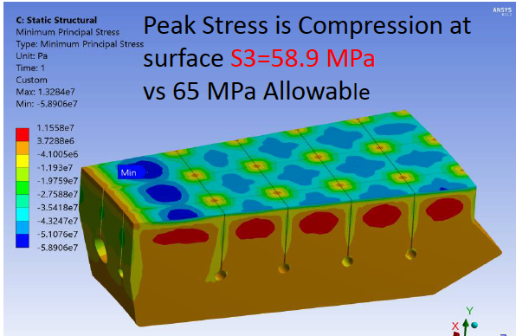
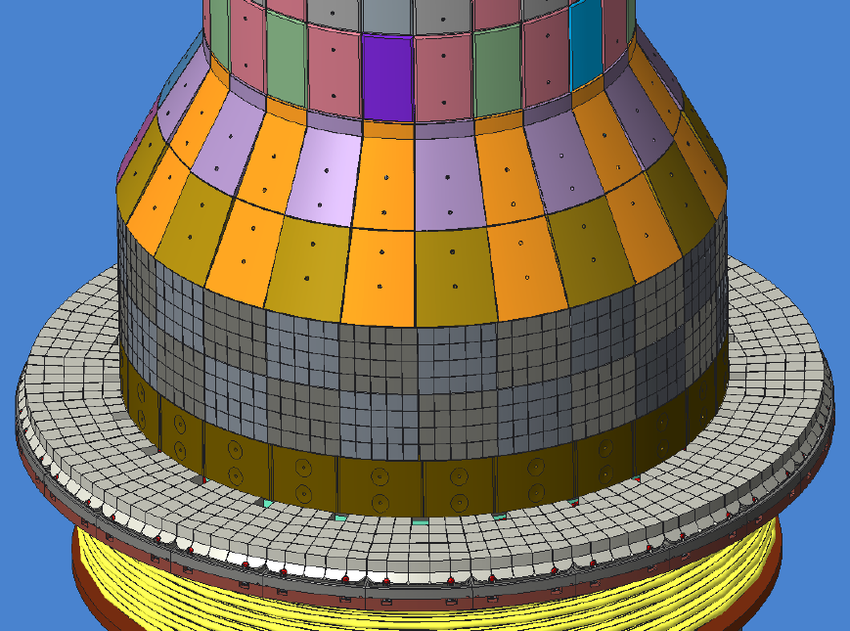
Castellated Tiles Maximize the Allowable Heat Flux
Castellations minimize the surface compressive stresses for a given surface temperature
End of pulse thermal stresses for a castellated tile
Deployment of castellated tiles on the inner targets
Testing material and component samples at Penn State high heat flux test facility (ORNL, PPPL)

Slide 12
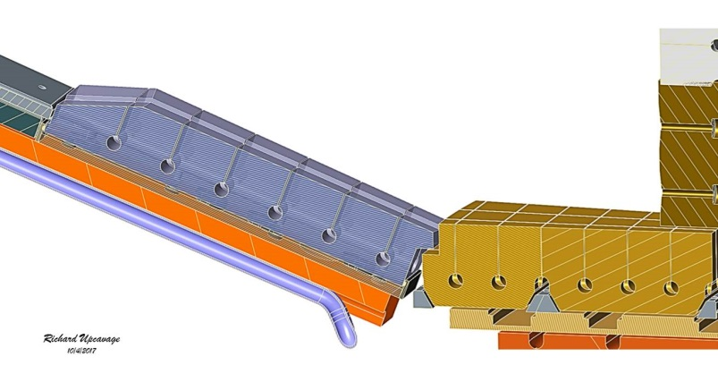
Improving Design of Polar Regions to Ensure High Performance and Reliability
Issues identified
PF1B coil limited divertor bakeout temperature
2 large ceramic insulators potential vacuum risk
Use of single O-rings → potential for leaks
Plasma can sometimes impinge on PF1C enclosure
Solutions
PF1B supported by slings → thermally isolated
Lower ceramic insulator eliminated
Double O-rings with pumped interspaces
Tiles will bridge the CHI gap
Tile gap between inner and outer vessels only large enough to accommodate thermal and mechanical motion, fit-up tolerances
Castellated Outboard Tile
Castellated Inboard Tile
Research / Programmatic Impact:
Coaxial Helicity Injection (CHI) as previously implemented is now excluded
Closed CHI Gap

Slide 13
Key Research Impacts of Recovery Redesign
CHI program eliminated in its previous form.
Elimination of lower ceramic insulator improves system reliability, at the expense of this research capability
CHI design with purely internal electrodes may be realized
Retained 2 kV power supply capability and commensurate coil design for all inner-PF coils with the express goal of allowing rapid field changes for CHI.
Ramped tiles will provide a favored helicity.
However, a modest “reversed helicity” requirement is retained for regions where the intermediate legs of snowflake divertors may land
All inner-PF coils retained.
Bakeout system will be significantly improved, in both safety and functionality.
Leak probability and O-ring permeation significantly reduced.
Elimination of lower ceramic insulator benefits future liquid lithium research.
Tile designs are highly optimized for heat flux handling.
RF and NB systems maintained as before.
Core machine reliability should be significantly improved via numerous targeted improvements.

Slide 14
Outline
Overview of Recovery & Extent of Condition
Technical Content and Impact of Recovery
Extent of Cause Review & ASO

Slide 15
Extend of Cause Review Thoroughly Examined the Processes Used for Work at PPPL
Team of independent experts
DoE Chicago ISC, ORNL, FNL, BNL, PNNL, MIT, expert consultants
Reviewed previous incident reports and CAPs dating back to NCSX, reviewed PPPL procedures, interviewed >20% of staff
And issued reports, with Judgments of Need
In response, PPPL developed the Integrated Corrective Action Plan (ICAP), providing corrective actions across all of the laboratories management systems.
QA/QC, Training & Qualifications, Engineering Design, Project Management, Configuration Management, Work Planning and Control, Contractor Assurance, Performance Management

Slide 16
ICAP will Bring PPPL Management Systems Inline with Complex-Wide Standards
Lack of project-independent oversight of all laboratory activities
ICAP
Create a project-independent Chief Engineer and set of Technical Authorities (subject matter experts reporting to CE)
Lack of risk-based decision making when determining appropriate level of rigor
Formalize a more rigorous graded approach (rigor commensurate with risk)
Insufficient rigor in design assurance
Enhance PPPL’s policies on engineering design assurance
Lack of clear ownership of structures, systems, and components
More clearly defined and delineated roles and responsibilities
Inadequacies in work planning and control
Strengthen the Project Management Office, Project Status Review Board, Work Planning Review Board

Slide 17
Summary
Reviews have determined what needs to be repaired / replaced
We have developed new designs to repair and improve components
Upgrades to laboratory processes will improve rigor of work at PPPL
Recovery will significantly enhance NSTX-U reliability & safety, provide highest-performance ST device as a robust user facility

Slide 18
Backup

Slide 19
NSTX-U is Now Required to Operate Under the Accelerator Safety Order
Accelerator = Device that can accelerate charge particles and create a radiation area
DOE Order 420.2 mandates a greater level of rigor in processes related to safety of employees, the public, and the environment
Initiating upgrades to our safety documentation, project training and qualification, project configuration management,…
One or more Accelerator Readiness Reviews will be required, leading to DoE site office permission to operate

Slide 20
The NSTX-U Recovery Project Taking Specific ICAP Actions to Improve Performance
Hire a project manager
Done: R. Feder has extensive experience fusion facilities
Complete a Preliminary Project Execution Plan
Iterating with DoE
Set up an Interim Project Document Management System
Done: Chit resolution system and interim DMS functioning
Stand up an Independent Advisor Board for Recovery
In progress: Board formed and charter written
Update the project QA plan
Rev. 0 of the QA plan is being revised given new lab-wide procedures
Enhance QA/QC and testing for critical component
Continuous effort, e.g. enhanced magnet testing

Slide 21
New Organization Created to Support Recovery
Shown is the present organization
Has been considerable evolution in details over the year.
Responsible Engineer roles cover the technical scope of the project.
Project manager added in November.
Chief Engineer
V. Riccardo
NSTX-U Recovery
Director: J. Menard
Deputy: S. Gerhardt
Project Administration
K. Lukazik
ES&H
J. Levine
Quality Assurance
F. Malinowski
Project Manager
R. Feder
Planning & Control
S. Langish
Procurement Liaison
A. White
Red = OBS
Project Engineer
C. Neumeyer
Systems Engineering
and Integration
S. Gerhardt
Operations, ASO
T. Stevenson
Construction
L. Dudek
Integrated
Analysis
P. Titus
CAD
Integration
TBD
Tokamak
Core
D. Loesser
COEs
Work Control
Center
F. Jones
Power Systems
J. Dellas
Real Time Control
& Protection
F. Hoffmann
VV & Internal Hdwe
M. Smith
Cooling & Bakeout
Systems
J. Petrella
Heating Systems
T. Stevenson
Plasma Facing
Components
M. Jaworski
Responsible Engineers
Diagnostics
R. Ellis III
Central I&C
G. Tchilinguirian
Magnets
S. Raftopoulos
Test Cell
N. Atnafu
Vacuum & Fueling
Systems
D. Cai

Slide 22
DVVR Process Identified the Issues with NSTX-U
Conducted 12 DVVRs between Jan. 18th and April 20th
Collected 1170 “chits”
Collapsed these into 443 “DVVR Issues” for the Extent of Condition Review
“Scored” the “Issues” with a system that involved event probability, duration, and severity
Topic | #chits | Topic | #chits
Integrated design | 94 | Power Systems | 84
VV & Internal Hardware | 216 | Heating Systems (NBI+RF) | 96
Magnets | 147 | Real-Time Control & Protection | 93
Vacuum & Fueling | 64 | Central I&C | 101
Cooling Systems | 71 | Bakeout System | 76
Diagnostics | 104 | Test Cell | 24

Slide 23
The Two Extent of Condition Reviews Assessed PPPL Response to DVVRs
4 days reviews in each of March and May, 2017
Issued 2 reports with many recommendations focused on ensuring the reliability of operations.
Individual | Institution | Individual | Institution
Tom Todd, (chair) | UKAEA, retired | Ursel Fantz | IPP-Garching
Rem Haange | ITER, retired | Ron Parker | MIT
Rich Callis | General Atomics, retired | John Smith | General Atomics
Frank Casella | ORNL | Michel Huget | ITER, retired
Martin Cox | CCFE | Dennis Youchison | ORNL
Brian LaBombard | MIT | Graeme Murdoch | ORNL
Arnie Kellman | General Atomics
Total of 47 external reviewers between Extent of Condition Reviews and DVVRs

