Slide 1

NSTX-U Energetic Particle Research
M. Podestà
for the NSTX-U Team
NSTX-U PAC-39
PPPL, Princeton University
Jan. 9-10, 2018

Slide 2
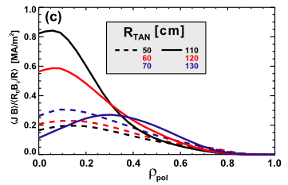
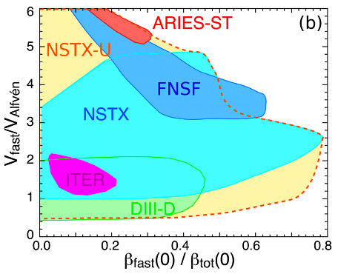
NSTX-U capabilities & operating regimes provide excellent environment to advance Energetic Particle research
  Long pulses >> τ_{r}, flexible NB injection & shaping (& RF), good diagnostic
    Enable detailed EP studies towards high/fully NI scenarios
[Menard, NF 2012]
Battaglia’s talk
Broad range of achievable β_{fast}/β_{tot} and v_{fast}/v_{Alfvén}
  Overlap with conv. R/a regimes, ITER/FNSF
  Unique capability of parameter scans for new physics, model validation
    Already demonstrated from NSTX-U run in FY-16
charges 2/3

Slide 3
Outline
EP-TSG research highlights
Near-term goals & NSTX-U operations
Summary

Slide 4
Outline
EP-TSG research highlights
Near-term goals & NSTX-U operations
Summary

Slide 5
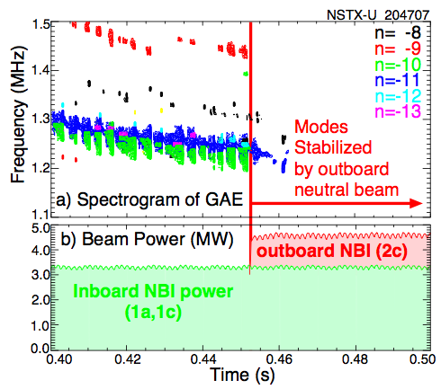
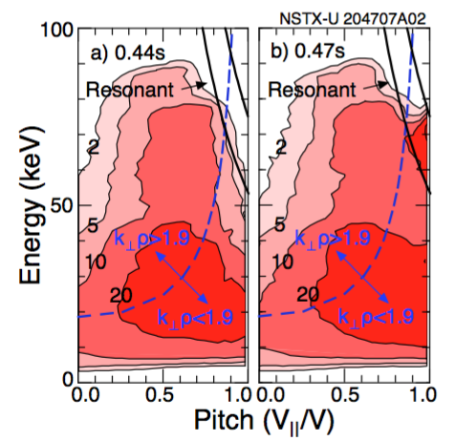
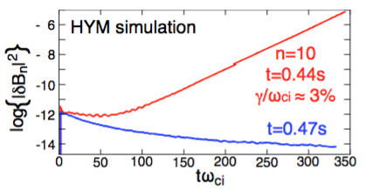
FY-16 results and near term goals (FY18-19) provide improved tools for re-start of NSTX-U operations
[Fredrickson, PRL 2017]
~1MW from 2nd NBI efficiently stabilizes GAEs
NUBEAM + analytic theory
reveal role of stabilizing particles from 2nd NBI
Results confirmed by HYM code, unique tool for ω_{AE}~ω_{ci} instabilities
[Gorelenkov, NF 2003]
destabilize
destabilize
stabilize
stabilize
[Fredrickson, Belova - sub. NF]
Leverage partnership with theory (PPPL, SciDAC-EP)
Indicates path for AE control through tailored NBI + other actuators (RF, 3D fields)
backup: stabilization of cntr-TAEs
see Perkin’s talk
charge 1

Slide 6
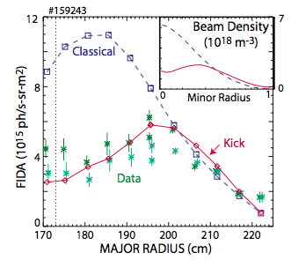
Challenging NSTX-U regimes indicate path for integration between experiments, analysis & modeling
Measured vs predicted FIDA profile on DIII-D
NSTX-U, DIII-D, UCI: Phase space resolved models required for improved understanding of EP transport
  “Kick”, Resonance-broadened Quasi-linear (RBQ1D) reduced models (NSTX-U/PPPL) implemented in TRANSP
  Use of TRANSP puts EP physics in broader context for comprehensive “whole discharge optimization”
    Critical for cross-TSG research (T&T, Macro, Scenarios), projections
[Heidbrink, PoP 2017]
New insight applied to NSTX-U to achieve control of AE instabilities, performance optimization
  Set of tools available to close the loop experiment/modeling/predictions
    Magnetics + AE antenna, flexible NBI, 3D-fields, RF
    Modeling: TRANSP + reduced models, NOVA-K, HYM, FIDASim
  Collaborations strengthen experimental research & modeling efforts
see Kaye’s talk
charge 4

Slide 7
Outline
EP-TSG research highlights
Near-term goals & NSTX-U operations
Summary

Slide 8
FY18-19 research targets urgent issues for EP physics in preparation for NSTX-U ops in FY-20
Notable Outcome FY-17 (with I&T): “Modeling EP losses due to AEs using Resonance-broadened Quasi-Linear (RBQ1D) model”
JRT-18: “Test predictive models of fast ion transport by multiple Alfvén eigenmodes”
  Coordinated by NSTX-U
  Main candidate models (kick, RBQ-1D from PPPL) being validated on NSTX/NSTX-U and DIII-D
  Initial results indicate importance of phase-space resolution for quantitative predictions
Milestone R18-4: “Optimize EP distribution function for improved plasma performance”
  Demonstrated AE suppression, mitigation by tailored NBI on NSTX-U
  Also exploring EP distribution optimization for improved ramp-up scenarios
Milestone R19-4: “Effects of NBI parameters on EP distribution & NB-CD”
  Leverage FY-16 NSTX-U results, extend FY-18 modeling work in TRANSP
  Will combine AE suppression/mitigation with scenario optimization across NSTX-U program
Work being extended through collaborations with DIII-D, MAST-U, AUG, JET et al.
see Kaye’s talk
charge 2

Slide 9
NSTX-U operations will provide critical data, challenge validity of codes/theory towards burning plasmas
Experiments will target AE/EP physics vs properties of fast ion distribution function
  Supported/enabled by new capabilities, e.g. AE antenna
  Required to develop AE control strategies based on available actuators
Extended range of achievable B_{t} & I_{p} enables investigation of expected AE regimes
  E.g. bursting/chirping vs stationary TAEs -> critical for predicting EP transport levels
  Critical to advance predictions for alphas in burning plasmas (including large ρ_{L} and orbit width)
Small R/a, high β_{fast} lead to multi-mode scenarios relevant for burning plasmas
  Coupling among different types of modes -> highly non-linear regimes
Unique NSTX-U regimes lead to identify missing physics for more reliable predictive capabilities & projections
charge 3

Slide 10
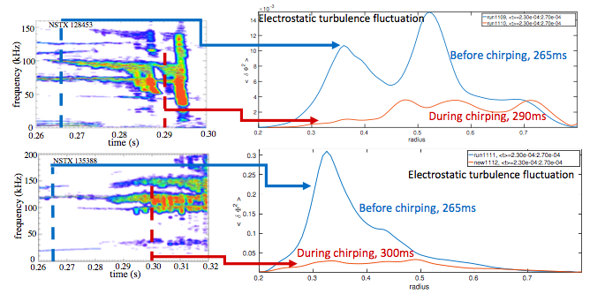
Partnership with theory has led to unravel key physics to predict AE regimes in future devices (ITER, FNSF)
Understand physics of “bursting/chirping” vs quasi-stationary TAEs
  Common on STs, uncommon on conventional R/a devices
  Developed predictive theory; tested/validated on NSTX, TFTR, DIII-D
measured spectra (NSTX)
μ−turbulence from GTS code
  Theory indicates key role of microturbulence
  Competition between:
    Drag: maintain coherence of phase space structures, favors formation of hole/clump pairs
    Microturbulence: destroys coherence, prevent chirping
  Chirping onset observed at decreased μ-turbulence levels
[Duarte, sub. NF 2017]
charge 3

Slide 11
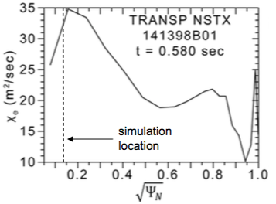
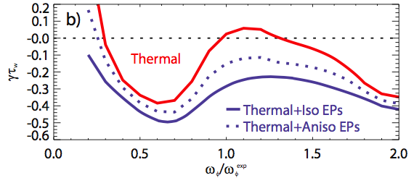
EP research is integral part of Core Science mission for NSTX-U & beyond
Goal: Demonstrate high performance, high/fully non-inductive scenarios at high β
Challenges: address role of EP & thermal transport by AEs and other instabilities to optimize tokamak plasma scenarios
  AEs
    Develop & integrate EP transport module(s) in TRANSP
    Understand thermal electron transport by GAE/CAEs
  Other MHD:
    Assess role of EPs, NB torque in RWM stability (cf .JRT-15)
    Contribute to comprehensive NTM model in TRANSP
    Develop improved Sawtooth models in TRANSP
Predicted χ_{e} from GAEs
based on reflectometer,
NSTX #141398
[Crocker– UCLA]
RWM stability including EP kinetic effects
see Guttenfelder’s talk
[Berkery, PoP 2010]
see Sabbagh’s talk

Slide 12
Summary
EP research on NSTX/NSTX-U is addressing critical issues for burning plasmas
  Understand stability of EP-driven modes & associated EP transport
  Inform on modeling, development of control tools for their suppression/mitigation
  Develop knowledge for integrated tokamak simulations across multiple topics
Near term plans focus on characterizing the effects of complex fast ion distributions
  Develop predictive capabilities across devices/scenarios for reliable projections
Restart of NSTX-U operations will enable access to unique operating space
  Move towards high/fully NI operations
  Supports model development & validation
  Leverage strong partnership with theory/codes developers at PPPL and abroad
NSTX-U offers unique capabilities & complementarity with other devices
  Unique operating regimes at high β_{fast}, super-Alfvénic ions mimicking alphas in burning regimes
  Excellent platform to inform on, develop & validate models/theory for ITER & beyond

Slide 13
Backup

Slide 14
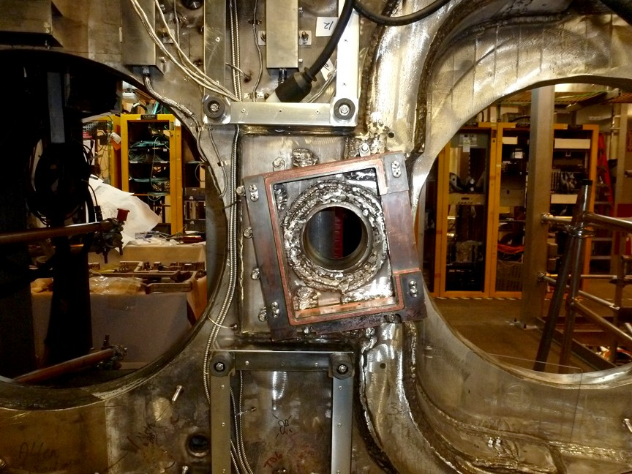
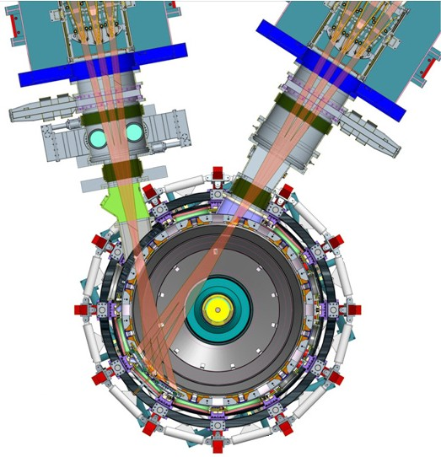
EP research in high-β plasmas with super-Alfvénic ions addresses critical issues for burning plasmas
Investigate drive & damping mechanisms for EP-driven modes
Study EP transport, inform model development for integrated tokamak modeling
  Strong partnership with theory at PPPL and abroad (cf. SciDAC-EP)
  Complement Core Science research (macro-stability, kink/fishbones, thermal transport by AEs)
Assess NB-CD efficiency, degradation by instabilities
  Coordinating ITPA EP-8 Joint Experiment on NB-CD
Mirnovs, AE antenna – mode stability
FIDA, NPAs, sFLIP – fast ions
Mirnov coils
AE antennae
see Guttenfelder & Sabbagh’s talks
sFLIP frame
Provide alternative scenarios wrt conventional R/a devices
  Challenge model validation & projections to future devices (ITER, FNSF, DEMO)
  Integrate EP physics with plasma scenarios
  Develop tools for mitigation/suppression (control) of EP-driven instabilities
charge 2

Slide 15
Unique NSTX-U capabilities complement other devices for rapid progress in EP physics through collaborative work
Understand physics of “bursting/chirping” vs quasi-stationary TAEs
  See next slide
Observed GAE suppression, counter-TAEs w/ OA-NBCD
  Analysis reveals key ingredients for AE destabilization
    Super- vs sub-Alfvenic ions (NSTX-U vs DIII-D), competition in phase space gradients
  Additional tool to investigate thermal transport by AEs
Development/validation of reduced EP transport models
  Being extended to several classes of instabilities (marco-stability, kink/fishbone, sawtooth)
    Connects to Macro, Scenarios TSG work
  Collaboration with several devices (DIII-D, MAST-U, TCV + other ITPA-EP participating facilities)
Characterize NBI+RF synergy (restart of plasma ops)
  Important to understand RF-driven TAEs (JET, AUG, …, ITER and RF-heated ST-FNSF)
  Validate models (under development for TRANSP) -> export to JET DT, ITER
see Guttenfelder’s talk
see Battaglia, Sabbagh’s talks
charge 3

Slide 16
Goals & Plans for year 1-5 (1)
Extend characterization of fast ion distribution with 2nd NB line beyond FY-16
  Use FIDA, ssNPA, sFLIP to measure fast ion profile and losses
  Compare with classical predictions from TRANSP
Assess effects of broadened pressure, NB-CD profile on plasma stability/performance
  Compare with time-dependent simulations
  Investigate effects on *AE stability
    Characterize mode structure with reflectometers, BES
    Characterize damping rate through *AE antenna (TAEs, RSAEs)
    Compare with linear/nonlinear codes
Characterize scenarios with combined NBI+HHFW
  Assess RF power deposition on fast ions as a function of RF injected spectrum, power

Slide 17
Goals & Plans for year 1-5 (2)
Extend *AE studies to nonlinear, multi-mode regimes
Study GAE/CAE effects on electron thermal transport at higher B_{t} and current
  Joint task with T&T-TSG
  Validate codes for GAE/CAE modes
Contribute to non-inductive ramp-up research
  Study *AE stability in low-I_{p} flat-top plasmas prototypical of ramp-up conditions
Extend validation of reduced models for EP transport by MHD (*AEs, low-f kink-like modes)
  Validate Critical Gradient & “kick” models for broad range of *AE activity, NB injection parameters
Assess requirements to affect F_{nb}, NB-driven current through available actuators (NBI, HHFW, external coils)

Slide 18
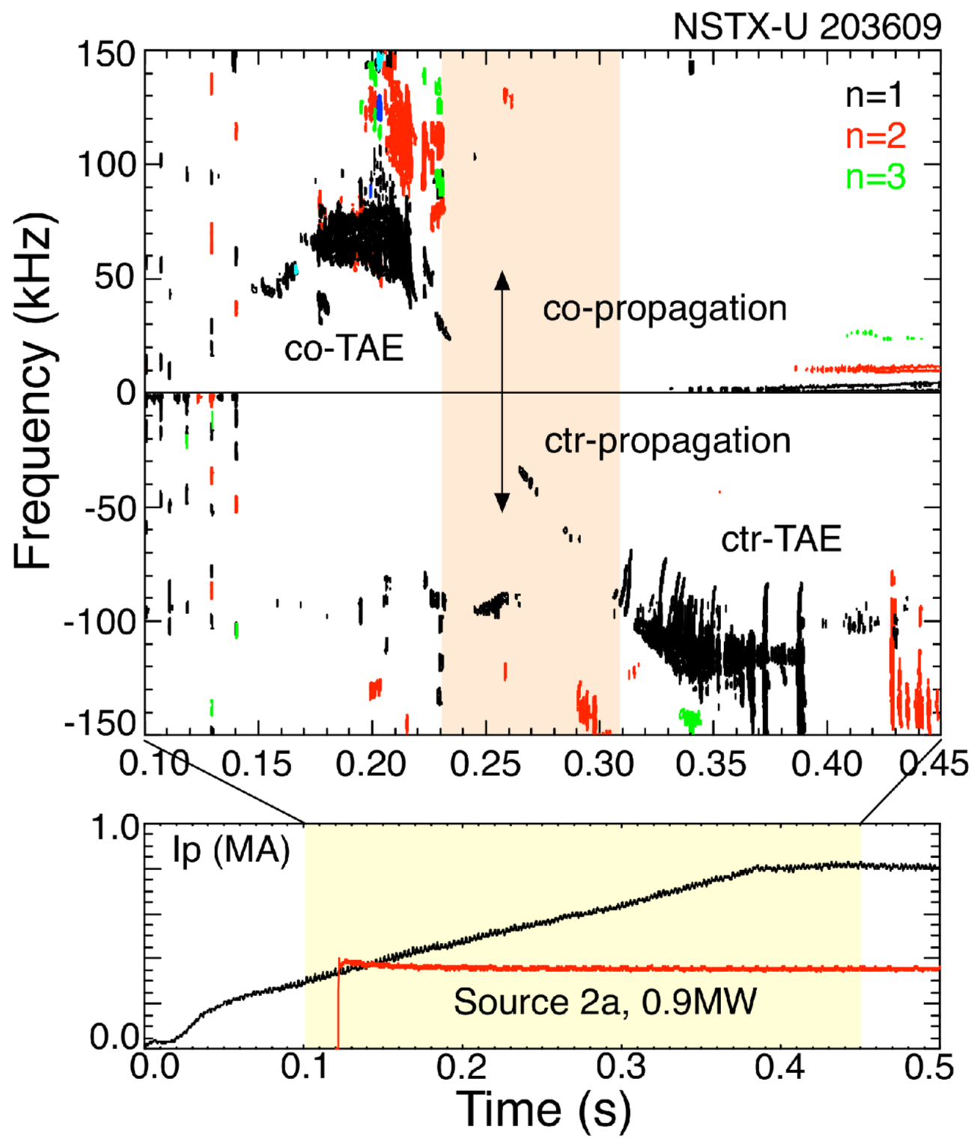
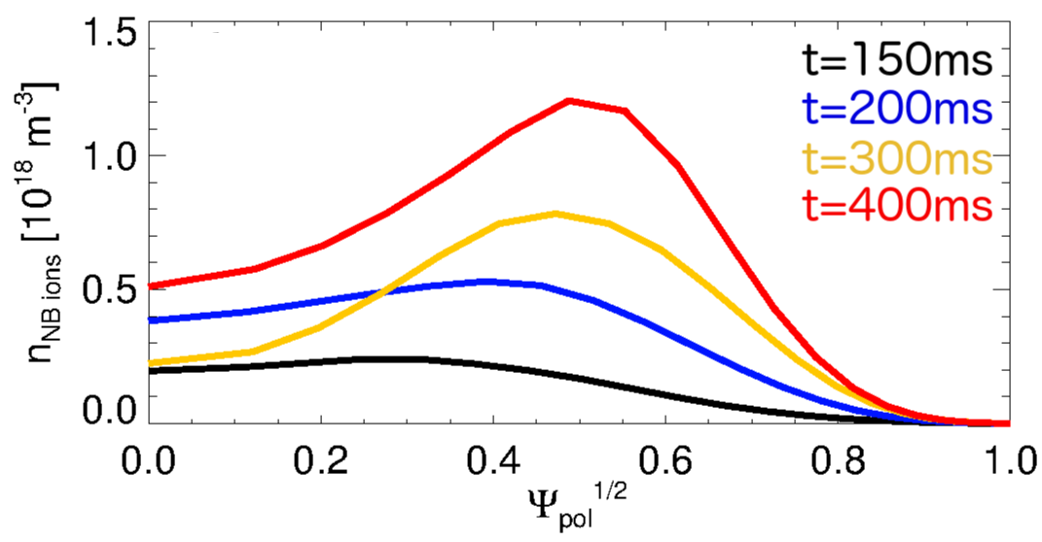
Counter-TAEs can be destabilized by off-axis co-NB injection from 2nd NB line
Single NB source from 2nd NBI
Low power, P_{NB}~1MW
Off-axis NBI results in broad/hollow NB ion density profile
A transition is observed from co-TAEs only to cntr-TAEs

Slide 19
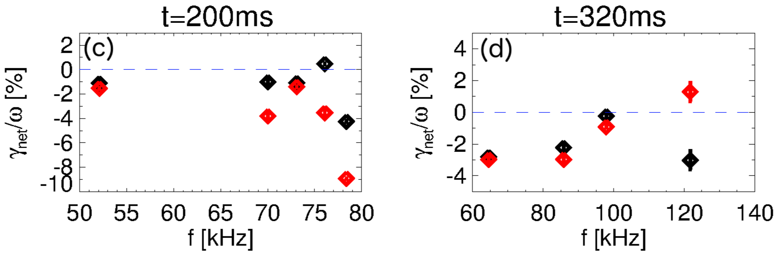
Details of fast ion distribution explain destabilization of counter-TAEs by co-NBI
Single NB source from 2nd NBI
Low power, P_{NB}~1MW
Stability analysis with TRANSP + kick model recovers observations
Drive results from competition between gradients in energy and canonical momentum
[Podestà, sub. NF]
co-TAEs
cntr-TAEs

Slide 20
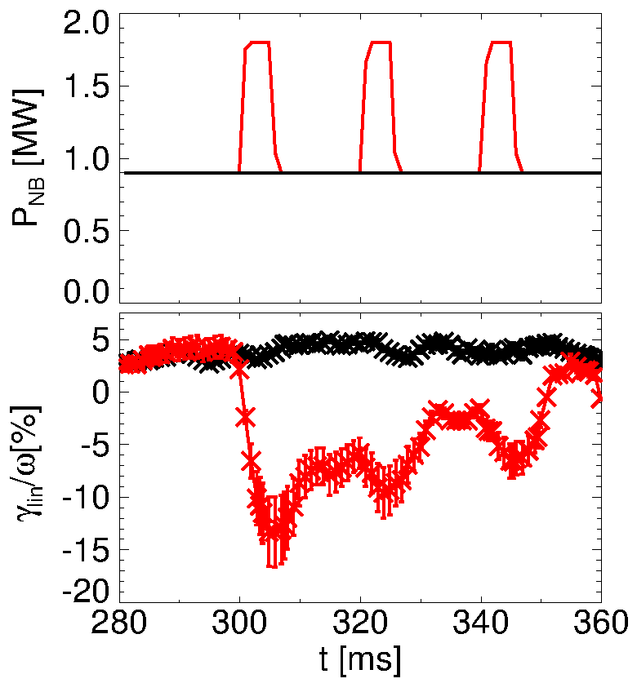
Understanding drive mechanisms leads to develop control strategies via NBI
TRANSP: add 5ms blips from more perpendicular, on-axis NBI
On-axis NBI populates stabilizing phase space region
Enough to suppress cntr-TAEs
  Minimum perturbation to original scenario
  To be tested on NSTX-U
off-axis NBI (experiment)
add on-axis NBI (simulation)
[Podestà, sub. NF]

Slide 21
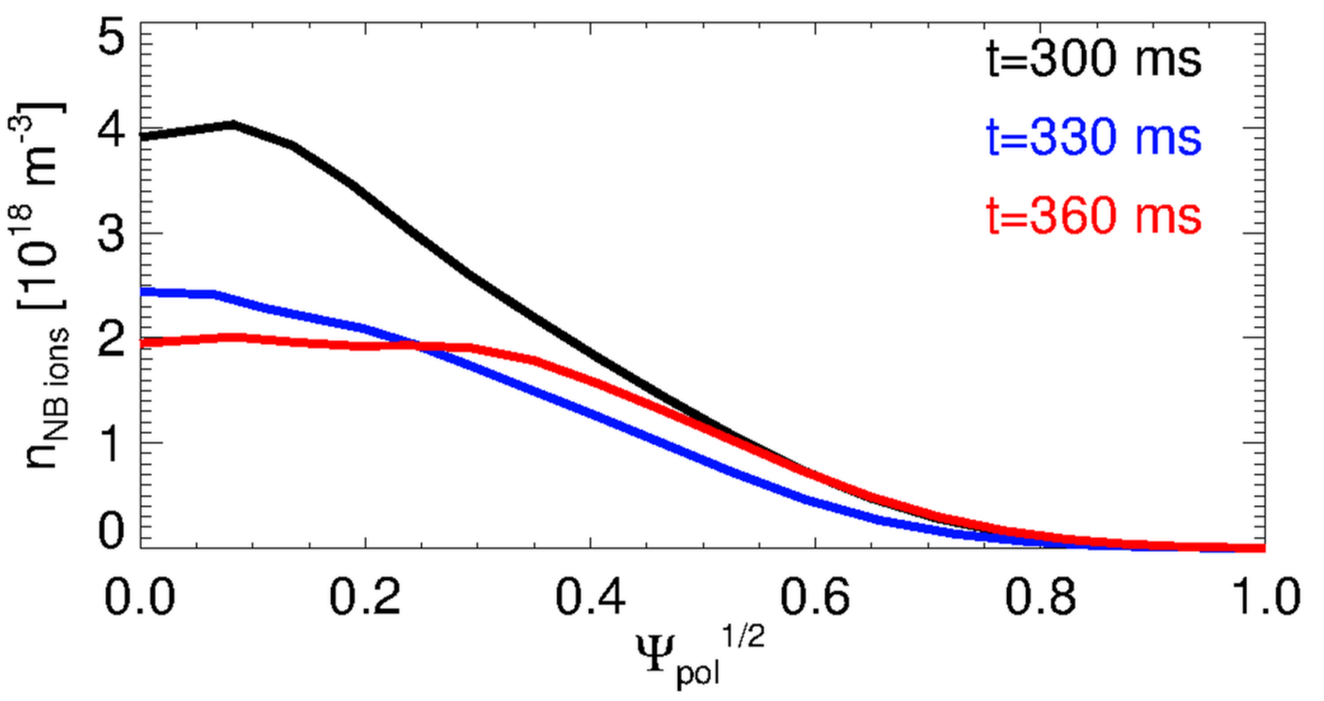
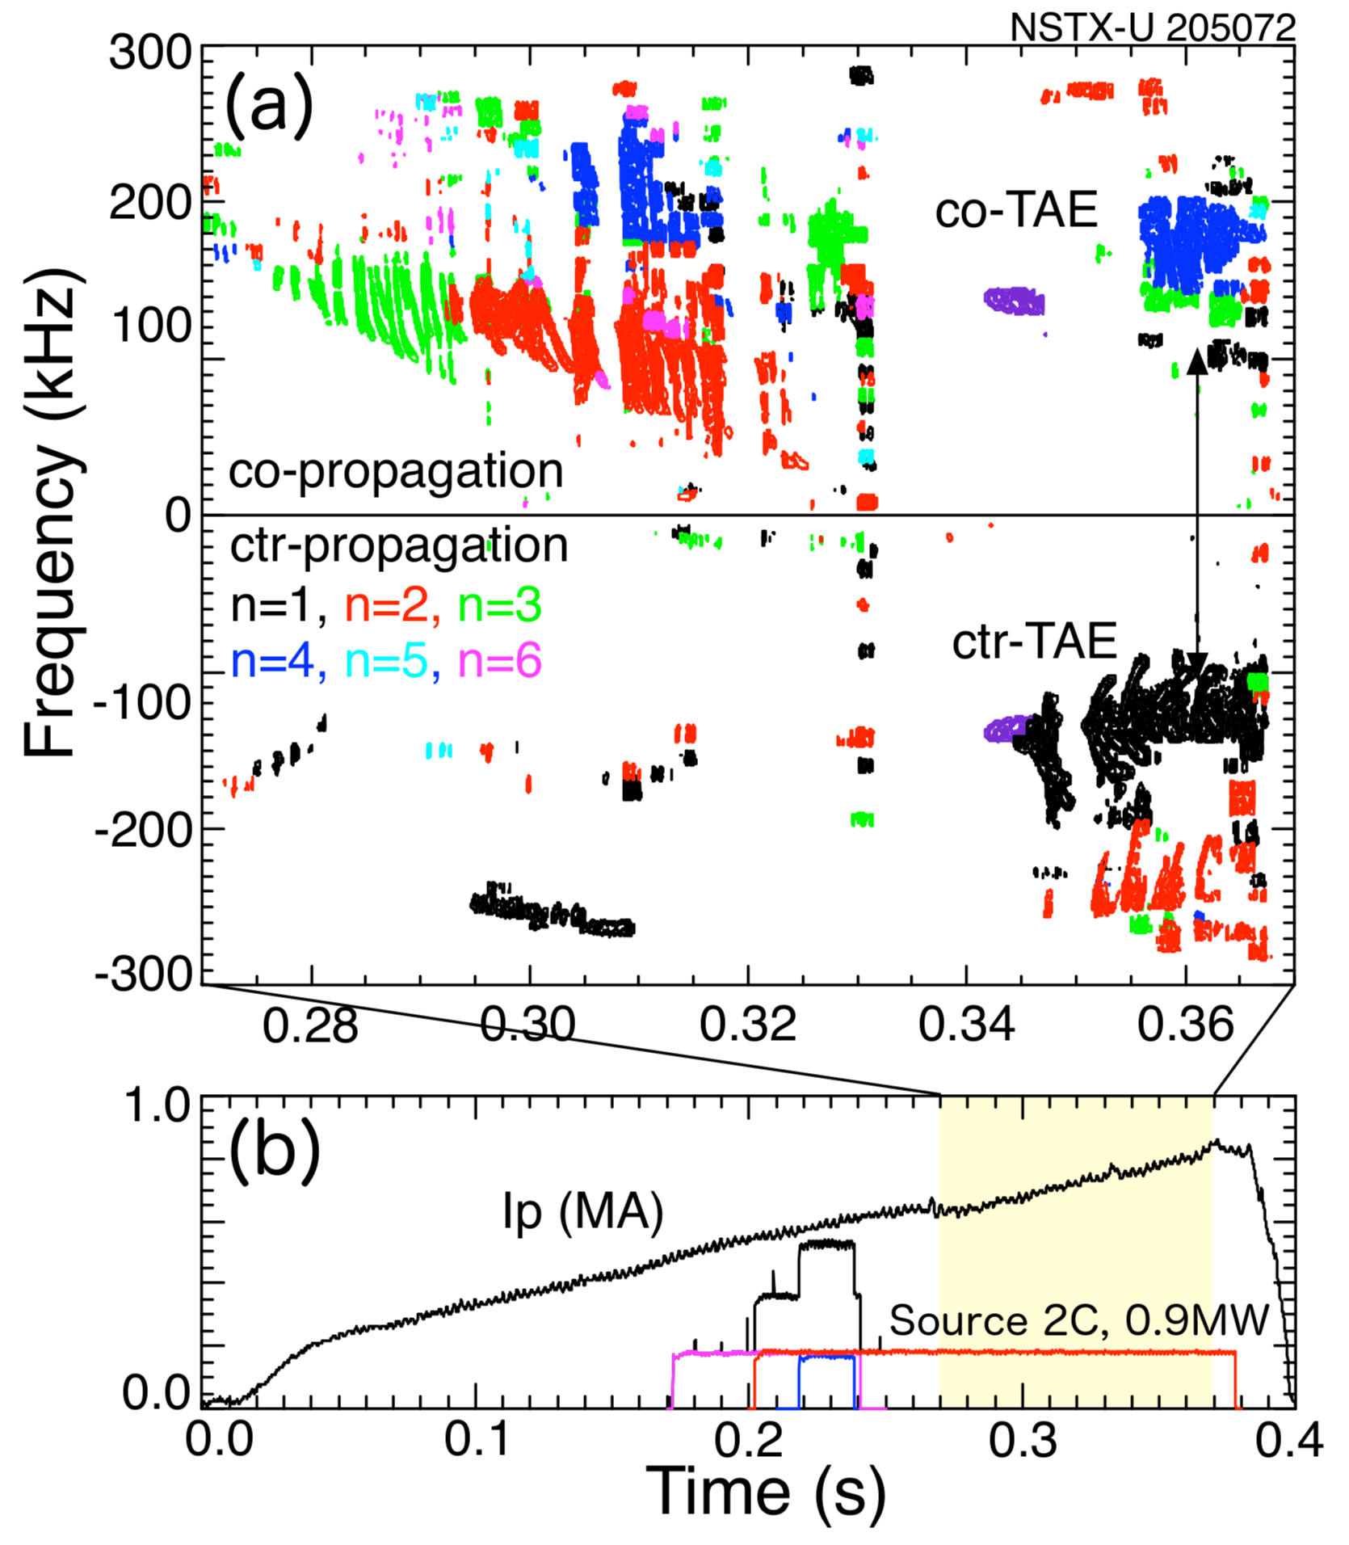
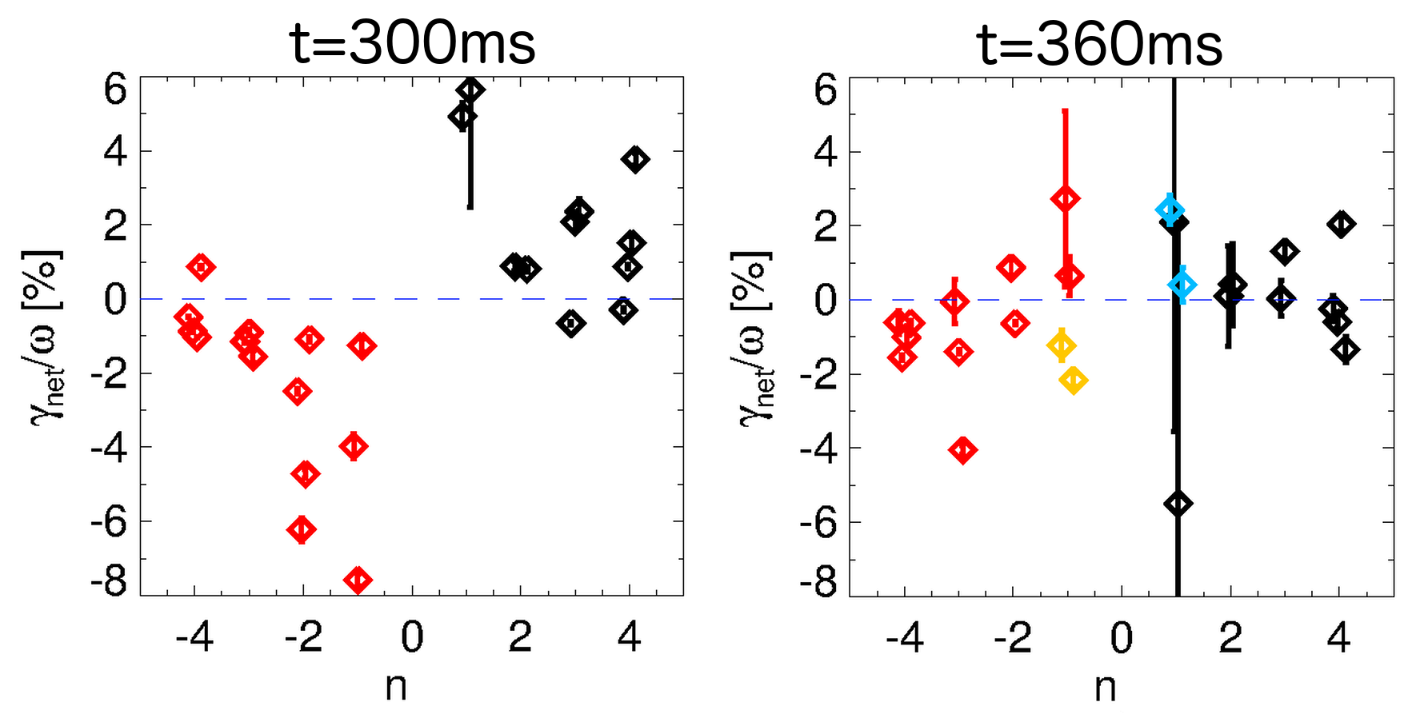
Counter-TAEs are not simply destabilized by inversion in radial EP density gradient
NSTX-U with 2nd NBI only
P_{NB}~1MW, tangential injection
EP density (TRANSP) remains flat/monotonic in this case
Stability analysis (TRANSP + kick model) recovers transition in unstable mode spectrum
[Podestà, sub. NF]

Slide 22
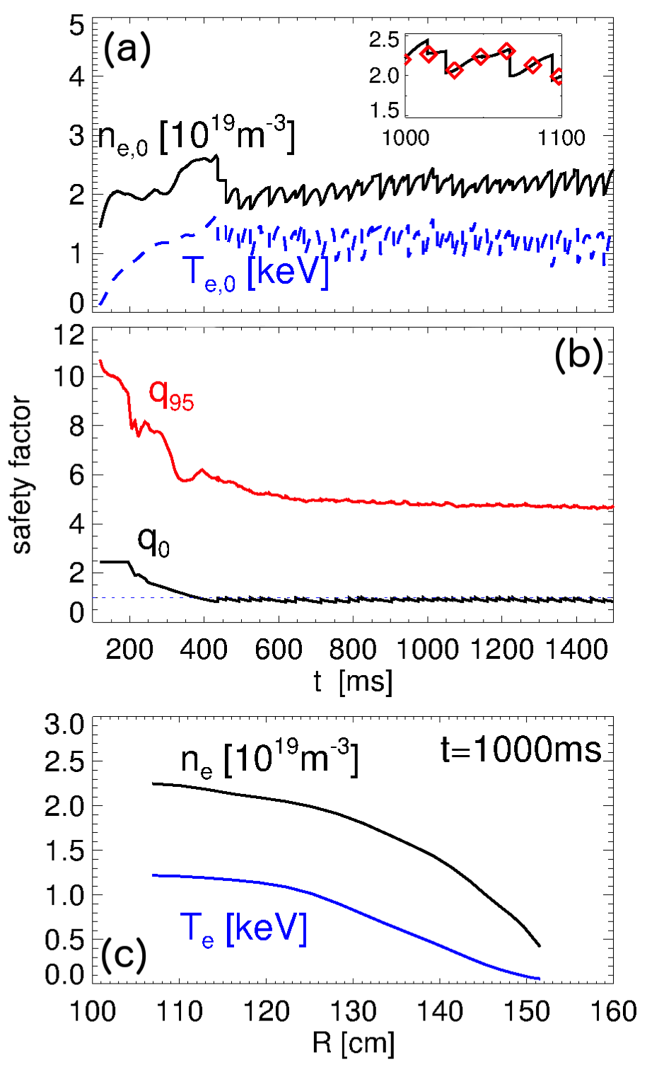
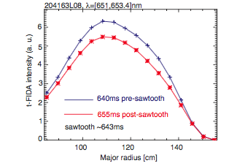
Sawtoothing L-mode scenarios used to test EP transport models in TRANSP
2sec long sawtoothing L-mode scenarios enabled by new centerstack
Fast ion redistribution observed on FIDA
  Not recovered through TRANSP modeling
ORBIT analysis shows redistribution
[Liu, sub. NF]
NB ions [counts]
NB ions [counts]
[Kim, sub. NF]

Slide 23
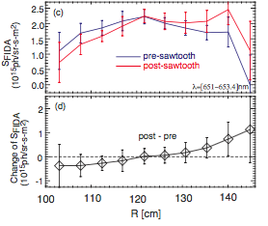
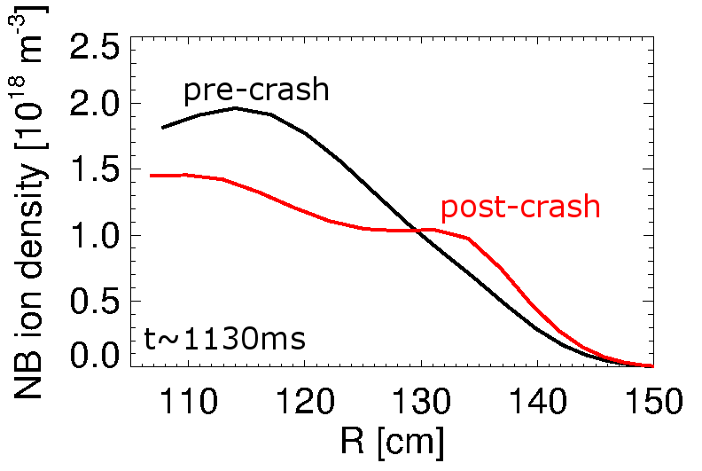
ORBIT modeling provides insight for development of improved models
2sec long sawtoothing L-mode scenarios enabled by new centerstack
Fast ion redistribution observed on FIDA
  Not recovered through TRANSP modeling
ORBIT analysis shows redistribution
  Using kick model to export ORBIT methodology to TRANSP
  Initial tests look promising: consistent with FIDA data
  But: many uncertainties on input thermal plasma evolution
tangential FIDA
TRANSP + kick model
[Liu, sub. NF]
[Kim, sub. NF]

Slide 24
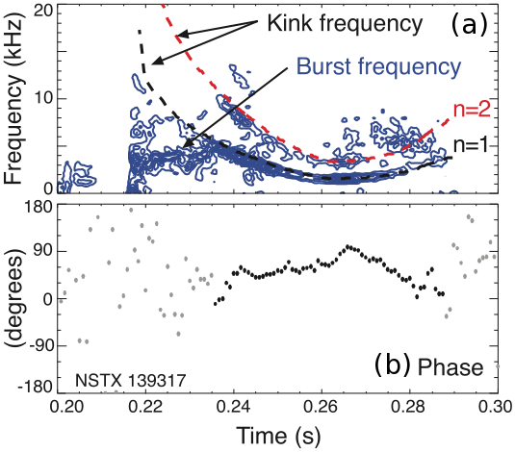
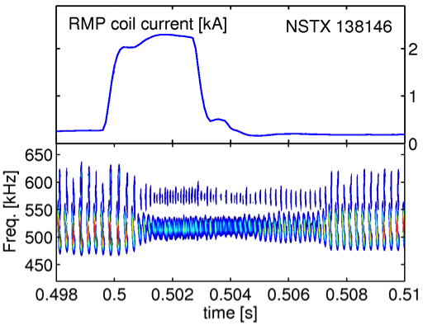
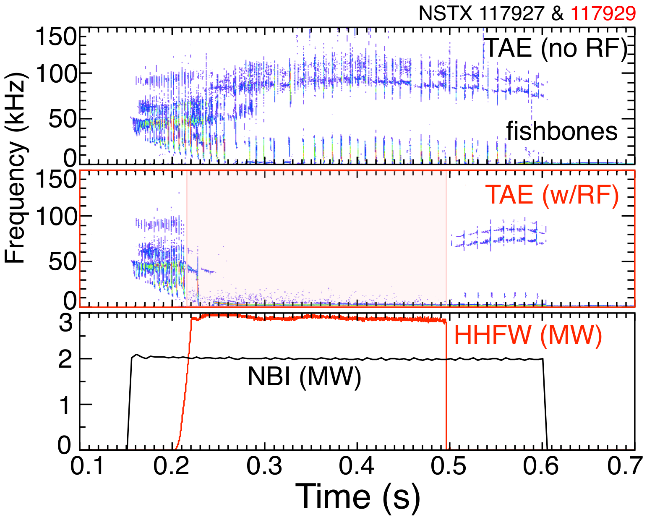
Synergy between different perturbations
Global AE dynamic affected through external fields
Burst amplitude, chirp range are reduced
Effect mediated by F_{nb} modification from 3D fields
Bortolon, PRL 2013; Kramer, PPCF2016
Dynamics of bursting CAE modes modified by coupling to kinks
    Predator-prey dynamics
AE burst frequency locks on kink
Suggests modulation of AE stability by low-f perturbation
AEs suppressed by >2MW of RF power
  Examples of stable AEs destabilized by RF are observed, too
Dependence on RF spectrum, NBI parameters under investigation
E. D. Fredrickson, PoP 2013
E. D. Fredrickson

Slide 25
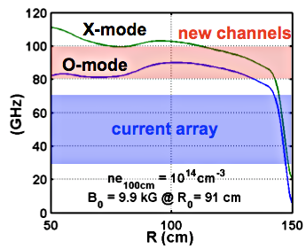
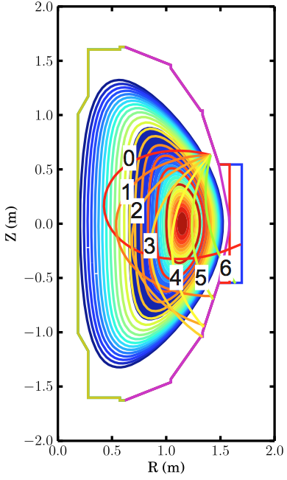
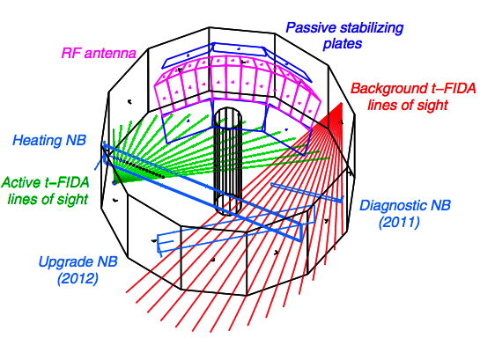
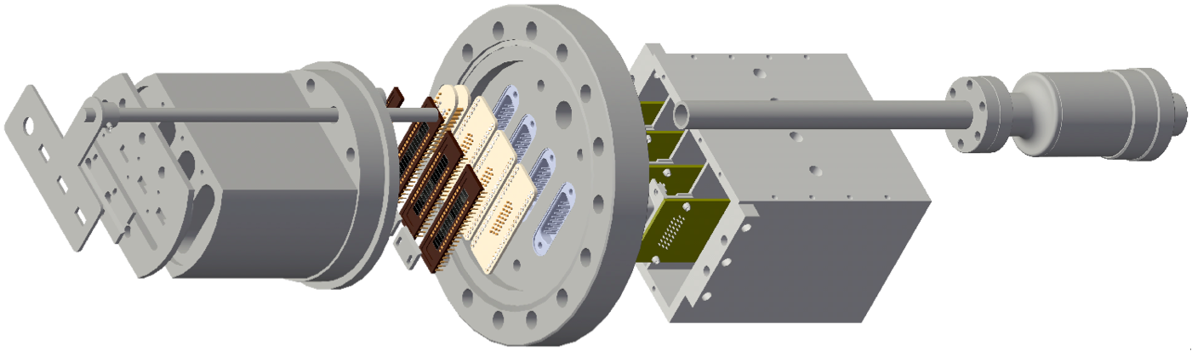
Main EP diagnostics
Reflectometer (UCLA) – mode structure
*AE antenna – mode stability
sFLIP – fast ion losses
Fusion product array (FIU) – fast ion profile, transport
Mirnov coils
*AE antennae
sFLIP frame
FIDA systems (UCI) – fast ion profile, transport
ssNPA arrays (UCI) –
fast ion profile, transport

Slide 26
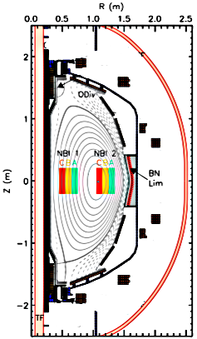
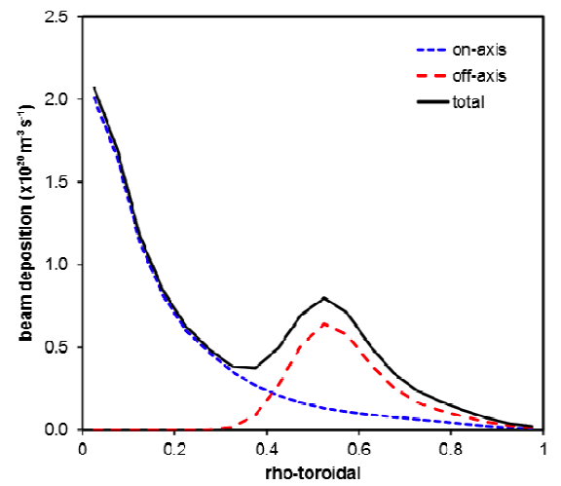
NSTX-U capabilities extend parameter range & flexibility achievable by other devices
  Flexible, independent NBI & shaping
    Enable fine adjustment of deposition & NB-CD profile
  Broad E_{inj} range, 40-95 keV
    Control range of achievable v_{fast}/v_{Alfven} and β_{fast}/β_{tot}
  All 6 NB sources available from Day
    Coditioning achieved at end of FY16
  Main tool for q-profile, rotation control
    Complement NTV from 3D coils
  Envisioned as tool for AE control
    Enhanced by sensors such as Mirnov coils and AE antenna
MAST-U NBIs
(cartoon)
[Menard, NF 2012]
MAST-U
see Battaglia, Sabbagh’s talks
NB deposition [10¹⁹m⁻³/s]

Slide 27
Recent publications
MEDLEY S. et al, Implementation of a 3D halo neutral model in the TRANSP code and application to projected NSTX-U plasmas, PLASMA PHYS. AND CONT FUSION 58 025007 (2016)
PODESTA M. et al, Phase space effects on fast ion distribution function modeling in tokamaks, PHYS. PLASMAS 23 056106 (2016)
HEIDBRINK W. et al, Analysis of fast-ion Dα data from the National Spherical Torus Experiment, NUCL. FUSION 56 056005 (2016)
KRAMER GJ et al, Mitigation of Alfvenic activity by 3D magnetic perturbations on NSTX, PLASMA PHYS. CONT FUSION 58 085003 (2016)
LIU D et al, Compact and multi-view ssNPA arrays on National Spherical Torus Experiment-Upgrade, REV. SCI. INST. 87 11D803 (2016)
WHITE R et al, Saturation of Alfven modes in tokamaks, PLASMA PHYS. AND CONT FUSION 58 115007 (2016)
PODESTA M. et al, Effects of energetic particle phase space modifications by instabilities on integrated modeling, NUCLEAR FUSION 56 112005 (2016)
WANG F. et al, Nonlinear Fishbone Dynamics in Spherical Tokamaks, NUCLEAR FUSION 57 016034 (2017)
SMITH HM and Fredrickson E., CAEs in rotating spherical tokamak plasmas, PLASMA PHYS. CONTROLLED FUSION 59 035007 (2017)
DUARTE V. et al., Prediction of nonlinear evolution character of EP-driven instabilities, NUCLEAR FUSION 57 054001 (2017)
FREDRICKSON E. et al., Suppression of Alfvén modes through additional beam heating, PHYS. REV. LETT. 118 265001 (2017)
PODESTA M. et al, Computation of Alfvén Eigenmode stability and saturation through a reduced fast ion transport model in the TRANSP tokamak transport code, PLASMA PHYS. CONTROLLED FUSION 59 095006 (2017)
DUARTE V. et al., Theory and observation of the onset of nonlinear structures due to eigenmode destabilization by fast ions in tokamaks, PHYS. PLASMAS 24 122508 (2017)
LESTZ JB et al, Energetic-particle-modified global Alfven eigenmodes, Submitted to PHYS. PLASMAS (2017)
HAO G, et al, On the scattering correction of fast-ion D-alpha signal on NSTX-U, Submitted to REV. SCI. INST. (2017)
HAO G. et al, Measurement of the passive fast-ion D-alpha emission on the NSTX-U tokamak,Submitted to PLASMA PHYS. CONTROLLED FUSION (2017)
PODESTA M. et al, Destabilization of counter-propagating Alfvenic instabilities by off-axis, co-current NBI, Submitted to NUCL. FUSION (2017)
CROCKER N. et al, Density perturbation mode structure of high frequency compressional and global Alfven eigenmodes in the National Spherical Torus Experiment using a novel reflectometer analysis technique, Submitted to PLASMA PHYS. CONTROLLED FUSION (2017)

