Slide 1
Pedestal Structure and Control
A. Diallo & R. Maingi
for the NSTX-U Team
NSTX-U PAC-39
Jan. 9-10 , 2018
Supported by U.S. DoE under contract DE-AC02-09CH11466
Notes:
Good morning! today I will be discussing the energy transfer across the L-H transition of NSTX.

Slide 2
NSTX-U will address important questions for H-mode pedestal in fusion science
High Bt and Ip, and access to strong shaping will extend pedestal structure studies to low 𝜈, and high pressures
Develop predictive pedestal model (EPED-like) for ST, and address open EPED questions for all R/a
Charge #3
Charge #2

Slide 3
NSTX-U will address important questions for H-mode pedestal in fusion science
High Bt and Ip, and access to strong shaping will extend pedestal structure studies to low 𝜈, and high pressures
Develop predictive pedestal model (EPED-like) for ST, and address open EPED questions for all R/a
Charge #3
Charge #2

Slide 4
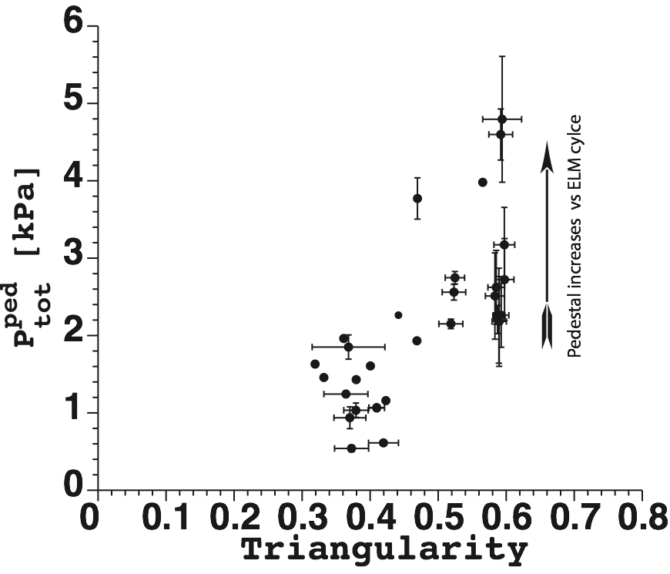
Strong shaping capability in NSTX-U will allow unique tests of ideal MHD stability limits
Charge #3
Ideal MHD has predicted improved edge stability at low R/a
Magnitude of improvement depends on triangularity, elongation, squareness
NSTX showed strong increase in pedestal pressure with triangularity
NSTX-U will have the widest range of δ (0.3-0.8), κ (1.8-2.7), and squareness (0-0.5) to determine the optimum pedestal stability limits
Flexible shaping at high power.
Snyder et al. PPCF (2004)
Maximum stable pedestal pressure as a function
of aspect ratio (fixed a)
Pedestal height during
the last 50 % of ELM cycle

Slide 5
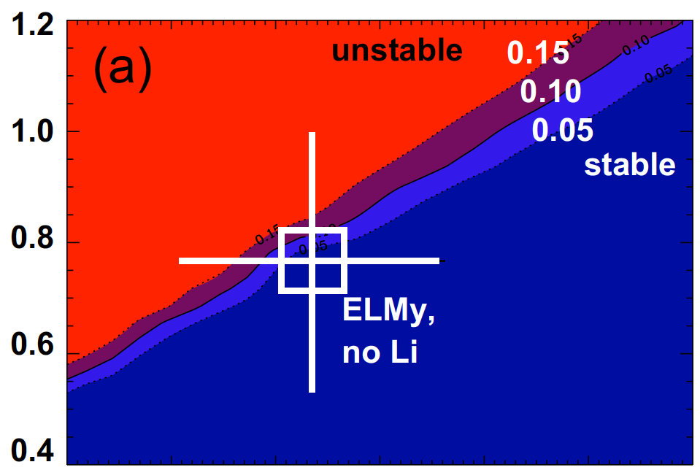
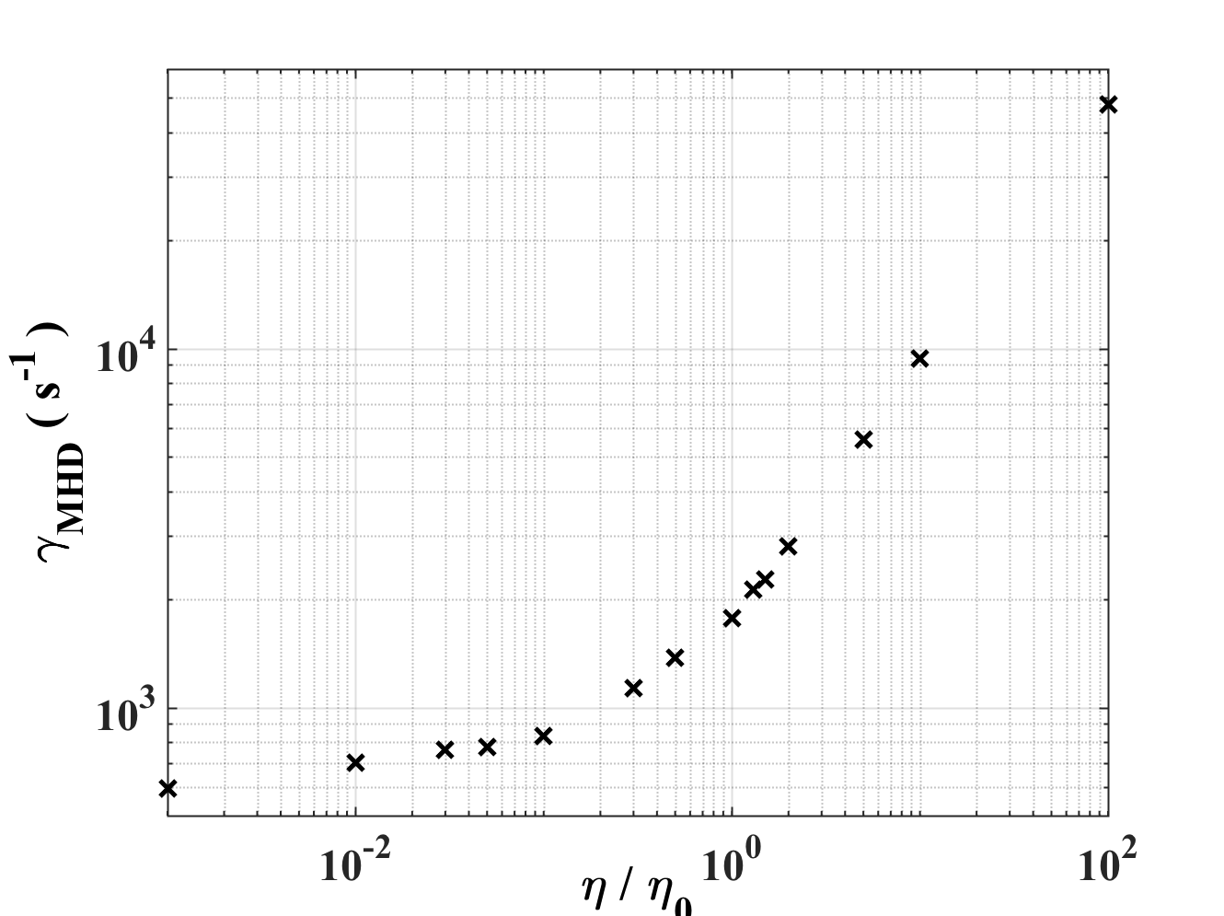
Low collisionality achievable in NSTX-U will access pedestals with ideal and resistive MHD
Charge #3
ELITE calculations
In NSTX, stability analysis of ELMy H-modes identified slowly growing peeling-ballooning modes
0.05 < 𝛾/𝜔*/2 < 0.1 just before ELM onset
Resistive MHD calculations with M3D-C1 suggest resistive modes have larger growth rate ➠ unstable (G. Canal, to be published)
NSTX had pedestal top 𝜈 > 0.5, so resistive MHD cannot be neglected
NSTX-U pedestal top collisionality is projected to go down to 0.1, so ideal and resistive MHD effects can be separated
Better chance of achieving edge ideal MHD stability limits
Edge current
Boyle PPCF 2011
Normalized pressure gradient
M3DC1
NSTX ELMy
Ideal
branch
Resistive
branch
Collisionality

Slide 6
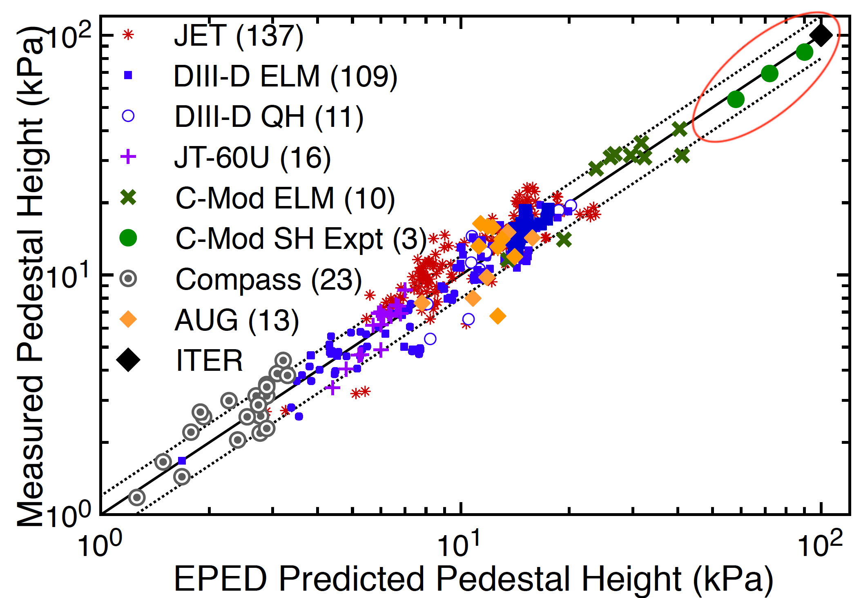
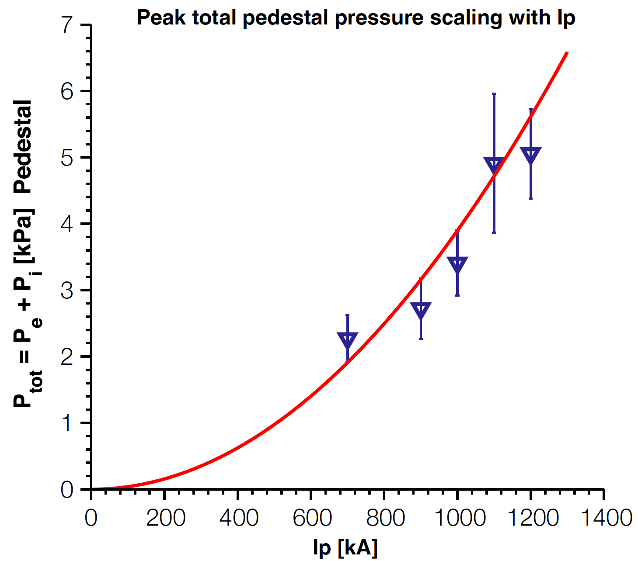
Higher Ip, Bt and heating power in NSTX-U will increase pedestal pressure by 3-5x from NSTX
βn ∝ <P>/(Bt × Ip) ⟹ <P> ∼ βn × Ip × Bt
Assume constant βn then Pped ∼ <P> ⟹ Pped ➠ 3x higher in NSTX-U than NSTX
15 - 20 kPa ELMy H-mode & 20 - 30 kPa for enhanced confinement regimes
In NSTX, some evidence that Pped ~ Ip² ⟹ 27 - 36 kPa ELMy and 36 -54 kPa for enhanced confinement regimes
Highest projected pedestal pressure for an ST
Charge #3
NSTX-U
NSTX
Snyder ITPA 9/2017
Diallo NF 2011

Slide 7
NSTX-U will address important questions for H-mode pedestal in fusion science
High Bt and Ip, and access to strong shaping will extend pedestal structure studies to low 𝜈, and high pressures
Develop predictive pedestal model (EPED-like) for ST, and address open EPED questions for all R/a
Charge #3
Charge #2

Slide 8
There is a need to develop pedestal predictive EPED-like model for ST
Charge #2
EPED is a pedestal model with predicts pedestal pressure height and width
based on two key limiting instabilities
nearly local kinetic ballooning modes (KBMs) ➙ regulate transport between ELMs
non-local peeling–ballooning (P–B)mode ➙ trigger for edge-localized mode (ELM)
EPED 1.6 is in good agreement with large multi-machine datasets
However, EPED fails to predict STs
Snyder ITPA 9/2017
Notes:
Here we focus on the soft limit: KBM

Slide 9
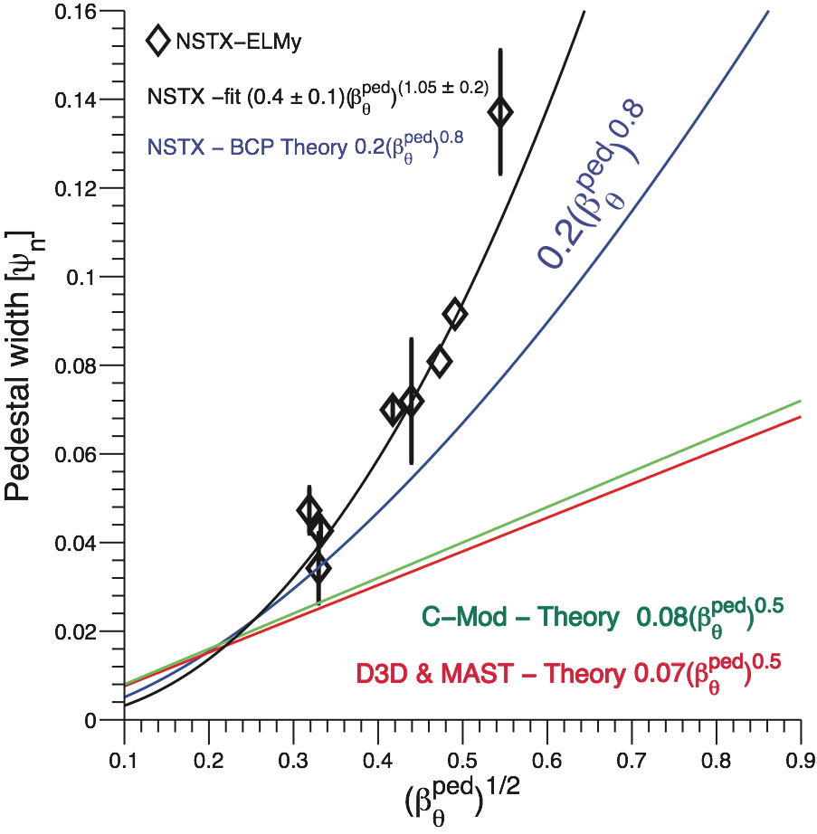
NSTX showed a larger pedestal width with different scaling than EPED predictions for higher R/a
Charge #2
EPED KBM constrain results in width ~ 0.076×√βpol^{ped}
In NSTX, both the leading constant and exponent were larger and qualitatively consistent with preliminary calculations: 0.4×(βpol^{ped})^{1.05}
NSTX and MAST typically operated at different points within the stability boundary
NSTX was typically kink peeling limited (low-n)
MAST was shown to be limited by high-n ballooning modes or at the nose of the peeling-ballooning limit
Large range of pedestal pressure (from 1.7xIp and 1.8xBt), and excellent pedestal diagnostics are necessary ingredients for development of EPED-like model for ST
Groebner NF 2013
Diallo NF 2013

Slide 10
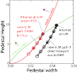
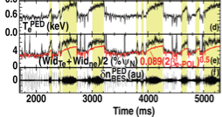
EPED width scaling fails in presence of pedestal localized instabilities that are not KBM
If transport can reduce gradients below KBM onset limit, pedestal can grow wider and higher before ELM onset due to peeling-ballooning mode
Charge #2
Presence of bursty chirping mode BCM (stimulated by Li injection) allowed pedestal width and height to grow well above EPED predictions
Osborne NF 2015

Slide 11
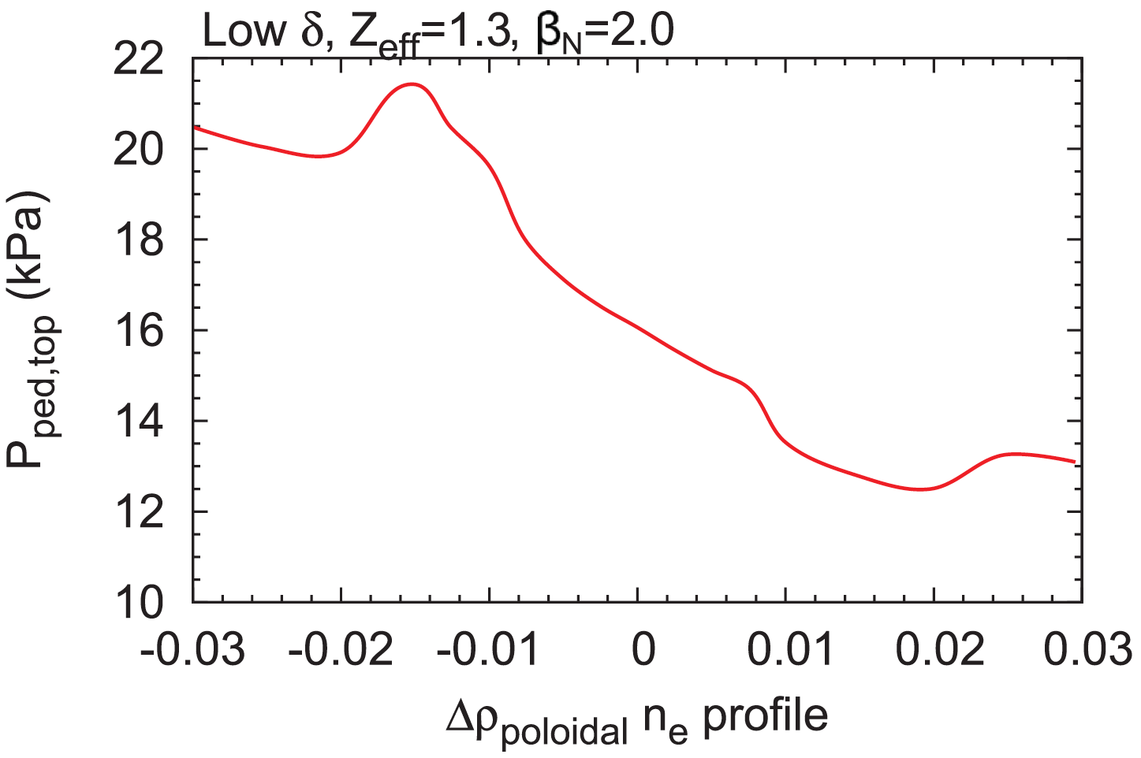
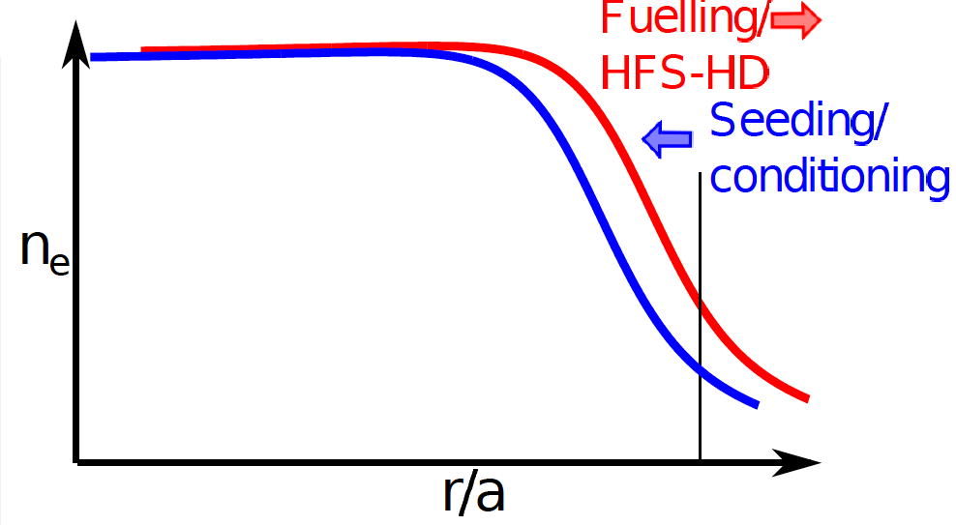
Variations of the density profile relative to the temperature profile can improve understanding of pedestal structure towards optimization
Charge #2 & #3
Shift in ne profile relative to Te profile allows higher Pped with N2 seeding, e.g. from AUG
Allows ~ 2x higher pedestal pressure experimentally and theoretically
Relative shift in density profile relative to temperature profile was up to 10% in 𝜓n in NSTX with Li conditioning, compared with e.g. 5% in DIII-D and 2-3% in AUG
Widest range of profile control demonstrated in NSTX
2x higher total Pped
NSTX & NSTX-U can control the amount of the profile shift by varying the amount of Li conditioning
Help to understand the relative roles of the ne and Te profiles in achievable pedestal stability at all R/a
Inward shift
of profile
Dunne PPCF 2017
AUG
relative shift of ne from Te
without Li
with Li
Inward shift
of profile
JRT 2019: NSTX will be used to test how fueling, reduced recycling, and transport affect the density pedestal structure.
Maingi NF 2012
NSTX

Slide 12
NSTX-U with its comprehensive diagnostic suite coupled with first principle codes will provide world class SOL turbulence research
Charge #2,#3,#4
SOL turbulence plays an important role in confinement, plasma-material interaction, and L-H transition physics
Edge turbulence contributes to transport across the separatrix, and affects the edge temperature profile and density profile
However, for SOL turbulence there is incomplete validation of first-principle modeling
NSTX provided excellent edge turbulence (via 2D GPI & BES) coverage in large range of physics parameters that motivated modeling with SOLT, GBS, and XGC1
See Zweben NF 2015, PPCF 2016 for a summary
High Bt and Ip as well as low collisionality will enable NSTX-U to advance SOL turbulence research
Complete coverage for the divertor imaging as well as mirror Langmuir probes will enable the study of the 3D turbulence structure
Provide direct connection with first principle simulation (e.g., XGC1)
Zweben NF 2015 and PPCF 2016
for summary of NSTX GPI SOL results
Maqueda NF 2010, Scotti RSI 2012

Slide 13
NSTX-U will have excellent pedestal turbulence diagnostics coverage as well as state-of-art simulation codes
Charge #3
Pedestal turbulence has been shown (see backup slide 17) to exhibit robust observation suggesting robust physics at play in standard R/a ➠ that could be extended in ST
University of Wisconsin will have BES channels aimed at the pedestal to resolve low-k density fluctuations
The UCLA Team will be providing intermediate-k density (DBS) and magnetic(CPS) fluctuations, as well as fixed frequency reflectometers
UC-Davis in collaboration PPPL will provide high-k and 2D imaging low-k density fluctuations
Collaboration with PSFC plan to install the Mirror Langmuir probes
Pedestal simulations will support the turbulence measurements by identifying the fluctuations and associated transport
CGYRO; GENE & XGC1

Slide 14
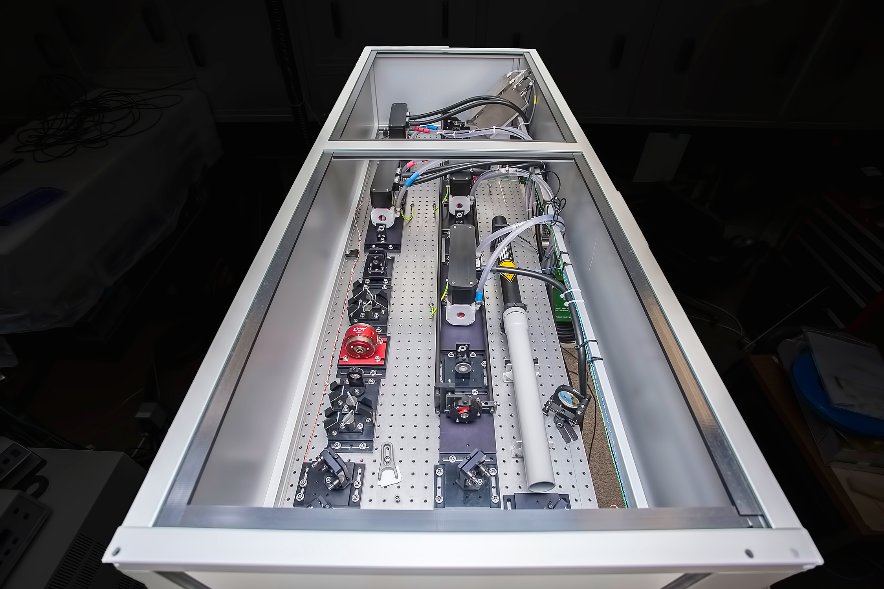
NSTX-U will provide world class pedestal evolution diagnosis and control
Charge #2 & #3
World leading pedestal diagnosis of inter-ELM cycle with the Pulsed Burst Laser System (PBLS) (up 20 kHz rep rate)
ELM mitigation via ELM pace-making with a number of actuators
Impurity granule injector (B, Li, C, …)
Magnetic perturbations
Vertical jogs
ELM elimination via low-Z injection
Prospects for advanced control of pedestal with PBLS and actuators
Rotary
Size selector
Dropper
housing
Pulsed Burst Laser System (PBLS)
Diallo ECA 2013
Impeller
NSTX-U
``
``
Air motor

Slide 15
NSTX-U will address important questions for H-mode pedestal in fusion science
High Bt and Ip, and access to strong shaping will extend pedestal structure studies to low collisionality, and high pressures
Access to low 𝜈 will enable to disentangle the roles of ideal MHD and resistive MHD in ELM stability, an unresolved puzzle from NSTX
Wide range of shaping (δ = 0.3-0.8, 𝜅= 1.8 to 2.7, squareness 0 to 0.5, double-null vs single-null) will enable unique tests of edge stability at low R/a
Higher Ip, Bt in NSTX-U will increase previous pedestal pressure by 3-5x
Develop predictive pedestal model (EPED-like) for ST, and answer open EPED questions independent of R/a
NSTX-U will explore the pedestal width scaling different from conventional aspect ratio
Lithium coating will be used to manipulate recycling and density profile to understand pedestal stability and performance
Charge #3
Charge #2

Slide 16
Backup

Slide 17
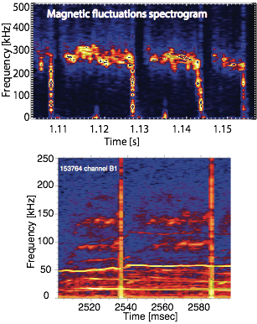
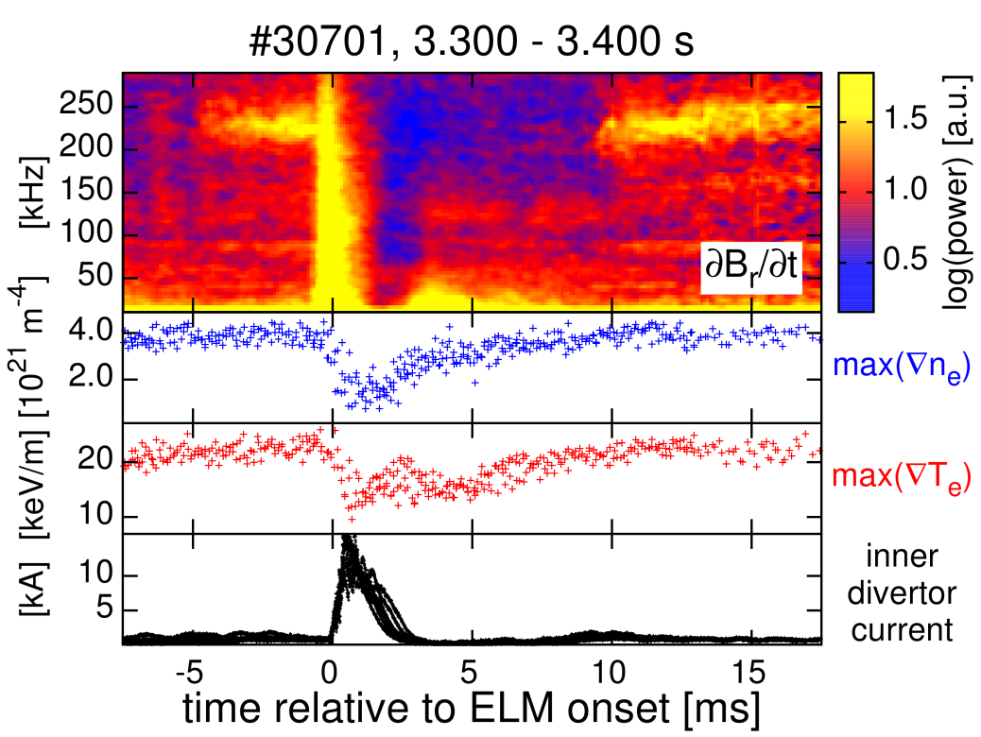
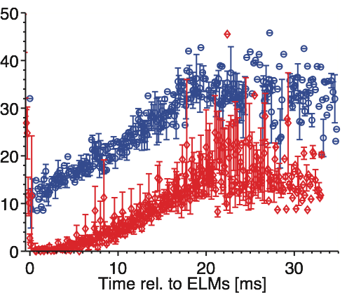
Pedestal fluctuations are observed to clamp the temperature pedestal gradient: robust physics at play that can be extended to strongly shaped ST
Charge #4
C-Mod, DIII-D, AUG, EAST, HL2A clearly showed the existence of quasi-coherent fluctuations correlating with pedestal evolution
Density pedestal recovers faster than temperature that is clamped by edge-localized electromagnetic quasi-coherent fluctuations
Evolution of QCF amplitude and Temperature gradient
∇Te[keV/m]
onset of QCF

Slide 18
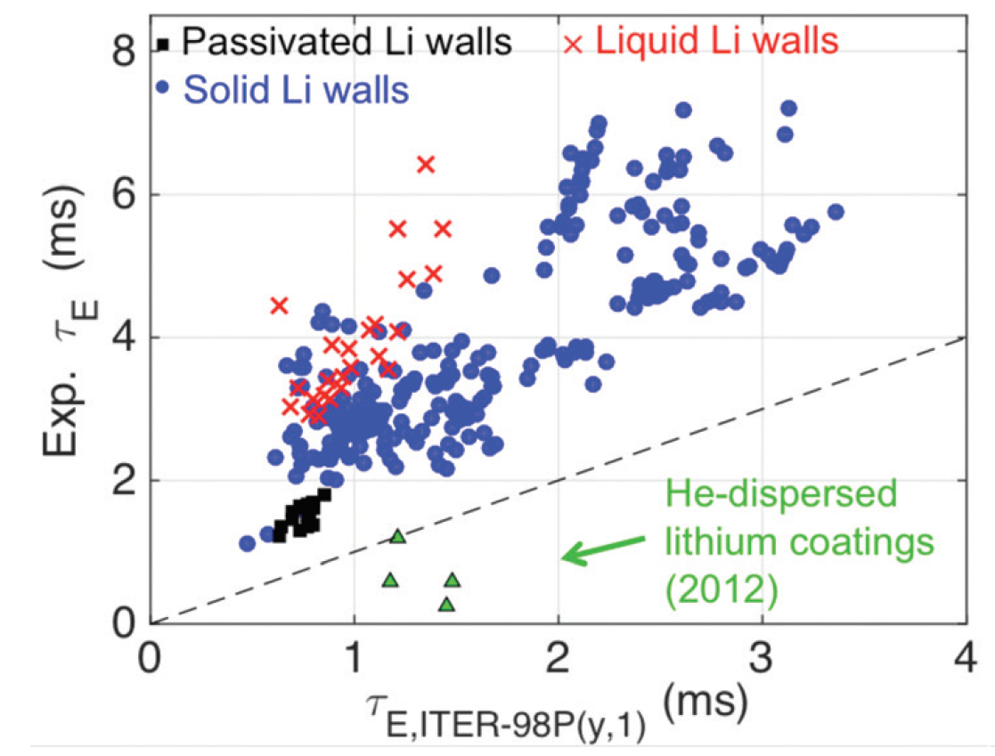
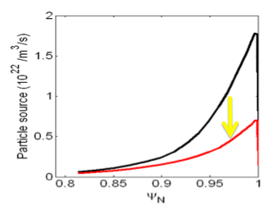
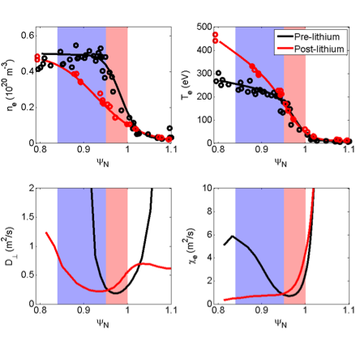
Pedestal structure physics: high confinement with low recycling
High confinement associated with low recycling via e.g. Li walls in LTX
Reduced edge fueling allows temperature to rise
H-factor increased by 50-100% in NSTX with Li coatings on graphite PFCs
Target recycling coefficient reduced from 0.98 to 0.90
Core fueling source dropped 50%
Edge ne profile reduced
Linear GS2 calcs showed:
ETG destabilized in pedestal - Te gradient clamped, so that Pe and Ptot followed ne -> stabilized ELMs
Micro tearing stabilized near pedestal top which allowed T and confinement to increase
Canik NF 2013
Schmitt PoP 2015
Experimental confirmation is
needed to support these calcs

Slide 19
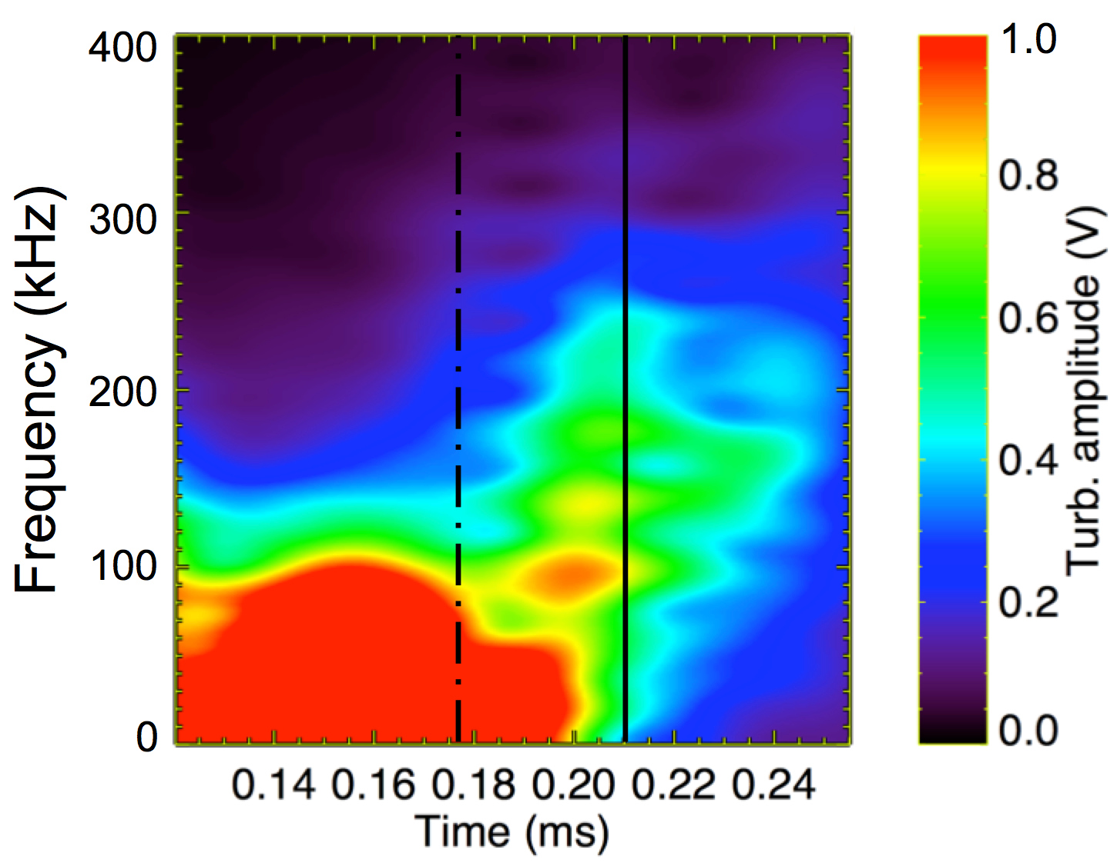
NSTX-U provides a test bed for neoclassical physics: crucial for understanding L-H physics and pedestal formation
[Chang et al., PRL 2017,
using a C-Mod plasma]
XGC finds that L-H bifurcation is from combination of turbulent Reynolds and neoclassical (X-point orbit-loss, here) forces
How will this combination affect ITER when the small ρ* destroys the Grad-p driven ExB?
Survival of the X-point orbit-loss effect by high T_{i} expected
NSTX-U will be highest-T_{i} & most strongly shaped large-ST: excellent machine for neoclassical edge physics study
Manipulate recycling by Li wall coating
Neoclassical effect on pedestal width? EPED does not work.
L-mode
Sharp bifurcation
Reynolds stress eddie shearing
Neoclassical eddie shearing

Slide 20
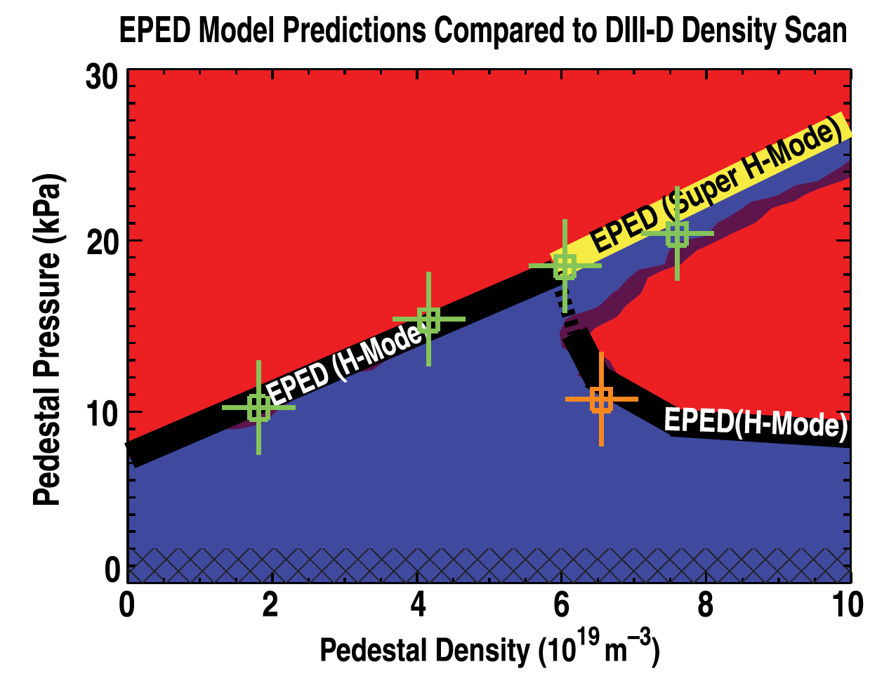
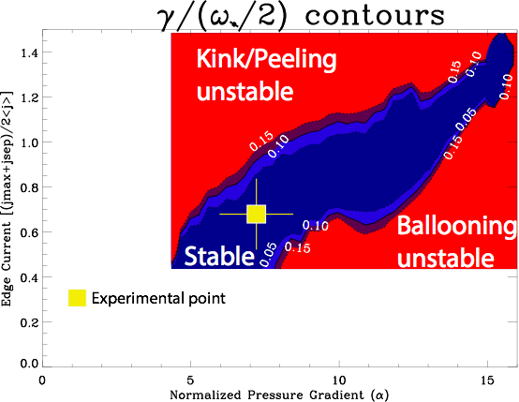
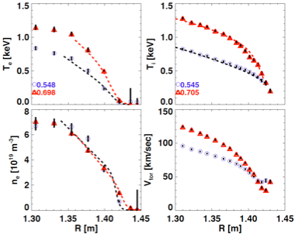
Can enhanced pedestal stability be achieved and understood in NSTX-U?
Charge #3
How robust is the super H-mode channel measured in DIII-D and is there an access path at low R/a, which has stronger shaping naturally?
Previous ELITE calculations have shown a super H-mode like channel in NSTX;
Can Enhanced Pedestal H-mode, which was observed in NSTX, be obtained for long pulse in NSTX-U?
High pedestal Ti, Te, stable beta-N; H98 < 1.8
Solomon PRL 2014
can a such channel be found for low R/a
in general and NSTX-U in particular?
Preliminary
H-mode EP H-mode
Maingi PRL 2010

Slide 21
ELITE and M3D-C1 results agree with respect to ideal modes
M3D-C1 results are in agreement with ELITE results for NSTX, which show ideal modes with ~ 10x lower normalized growth rates
Resistive modes have larger growth rates but are not captured by ELITE
The criterion γ / (ω_{i}* / 2) = 1, which works well for DIII-D plasmas, is derived from ideal MHD
A more general dispersion relation that accounts for resistive modes must be used for NSTX and possibly NSTX-U

Slide 22
Lithium coatings provide an unique control knob to the particle source
Canik PoP 2011
Without lithium
With lithium
Lithium wall conditioning suppresses ELMs and provides better confinement
NSTX demonstrated that lithium widens the pedestal temperature while relaxing the density gradient
Existence of a particle pinch vs. diffusion in setting the pedestal density structure can be directly tackled on NTSX-U
Tools: novel fast measurements (PBLS) density & temperature dynamics, in conjunction with SGI and lithium;
NSTX-U can demonstrate the key role of pinch vs. diffusion
Notes:
tools: wall recycling unknown.
PBLS: unique capability to get at the evolution

Slide 23
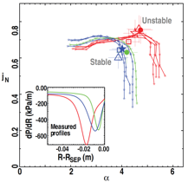
ELITE calculations agree with experimental profiles that are altered by pedestal localized instabilities, fueling…
Charge #2
ELITE analysis of kinetic equilibria are consistent with high achieved pedestal pressure when density and temperature profiles shift relative to each other and/or the separatrix
Relative shift can occur due to enhanced fluctuations or reduced fueling
EPED underestimates the pedestal width and height in these cases, but ELITE calculation can still be used to extend EPED
Dunne PPCF 2017

Slide 24
L-H bifurcation physics: neoclassical physics crucial
It may be conjectured that in a strongly-neoclassical device, such as NSTX, ExB-shearing by orbit-loss force alone could force L-H bifurcation.
Consistent with [Kaye NF11, Battaglia NF13, Diallo NF17]
Can we rely on X-point orbit-loss in the absence of Grad-p driven ExB shearing in ITER?
Turbulent
Neoclassical

Slide 25
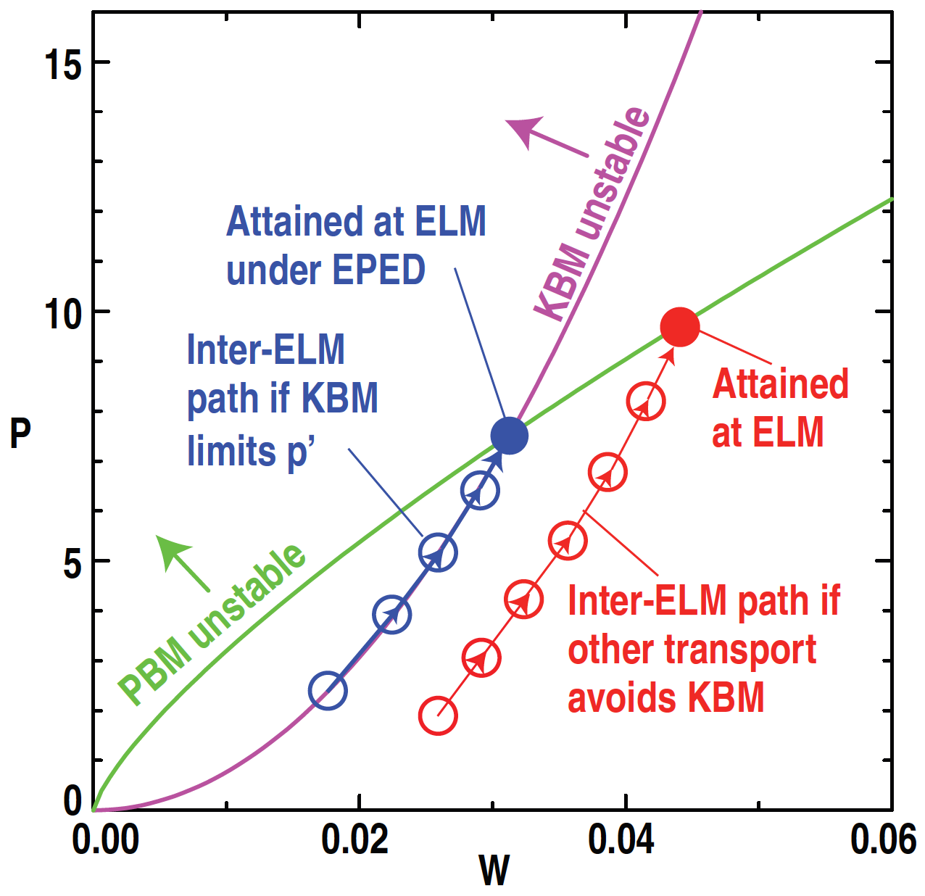
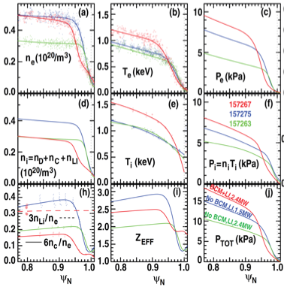
Pedestal structure optimization: Can natural and triggered pedestal-localized instabilities enable wider and higher pedestals?
If transport can reduce gradients below KBM onset limit, pedestal can grow wider and higher before ELM onset due to peeling-ballooning mode
Charge #3
Li injection in DIII-D triggered pedestal localized mode (bursty chirping mode BCM), allowing pedestal width and height to grow
BCM shifted density and pressure profiles away from separatrix, also stabilizing
Osborne NF 2015

Slide 26
Pedestal Stability: can NSTX-U realize predicted edge stability improvement at low R/a?
Access to second stability for high n-modes can significantly increase the pedestal peeling-ballooning stability limits
Optimization of parameters needed,notably strong shaping, intermediate density, and moderate q
EPED extension to be performed
Diamagnetization stabilization at low R/a
Importance of n=1, 2, 3 and resistive MHD
Maximum stable pedestal pressure as a function
of aspect ratio, which is varied by changing the major radius at a fixed minor radius of 60.3 cm
Snyder et al. PPCF (2004)
Notes:
Key scientific question: What is the stability diagram at low aspect ratio when ballooning stability is predicted to be improved?

Slide 27
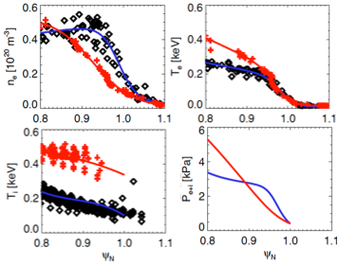
Variations of the density profile relative to the temperature profile can improve understanding of pedestal structure towards optimization
Charge #2 & #3
Shift in ne profile relative to Te profile allows higher Pped with N2 seeding, e.g. from AUG
Allows ~ 2x higher pedestal pressure experimentally and theoretically
Relative shift in density profile relative to temperature profile was up to 10% in 𝜓n in NSTX with Li conditioning, compared with e.g. 5% in DIII-D and 2-3% in AUG
Widest range of profile control demonstrated in NSTX
NSTX & NSTX-U can control the amount of the profile shift by varying the amount of Li conditioning
Help to understand the relative roles of the ne and Te profiles in achievable pedestal stability at all R/a
Inward shift
of profile
Dunne PPCF 2017
AUG
relative shift of ne from Te
Inward shift
of profile
Maingi NF 2012
NSTX

Slide 28
NSTX-U can address critical issues in fusion science of the H-mode pedestal
What are the separate roles of density and temperature profiles in setting the pedestal structure and performance, in addition to the role of the pressure profile?
Is the pedestal density profile and particle transport (mostly main ion) determined by diffusion alone, or is there a pinch? What is the role of neutrals, both fueling and turbulence?
Can natural and triggered pedestal-localized instabilities enable wider and higher pedestals, i.e. off the predicted kinetic ballooning limits?
Can low recycling and high confinement regimes be obtained with wall coatings?Are flowing liquid metal PFCs necessary to obtain these in long pulse?
What are the stability limits at low R/a when ballooning stability is predicted to be improved?
Is there an access path to super H-mode channel at low R/a, which has stronger shaping naturally?
Can Enhanced Pedestal H-mode be understood and reliably obtained in NSTX-U?
What are the physics and limits to ELM triggering/pacing within a stable H-mode pedestal?
To what extent does peak divertor heat flux vary inversely with triggered ELM frequency in ELM pacing scenarios?
Are there physics differences between triggering by pellets/granules, vertical jogs, and magnetic perturbations?

Slide 29
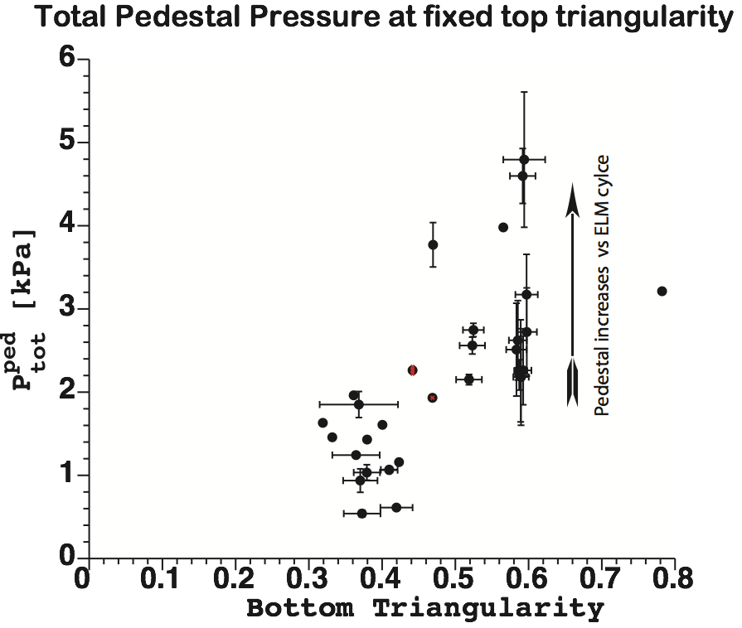
Pedestal pressure height increases with shaping(triangularity δ)
Pedestal height during
the last 50 % of ELM cycle
Notes:
break into two slide/progression

Slide 30
NSTX-U can address critical issues in fusion science of the H-mode pedestal
Exploring why the beta-ped scaling of the NSTX-U pedestal width is different than that in conventional aspect ratio, and relation to EPED/ELITE.
What are the separate roles of density and temperature profiles in setting the pedestal structure and performance, in addition to the role of the pressure profile?
What are the stability limits at low R/a when ballooning stability is predicted to be improved?
What are the physics and limits to ELM triggering/pacing within a stable H-mode pedestal?

Slide 31
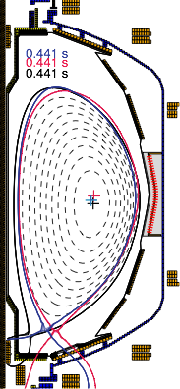
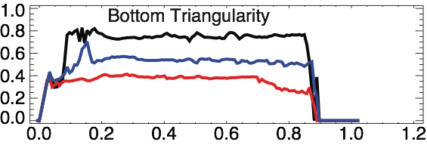
Pedestal pressure height increases with shaping(triangularity δ)
Pedestal height during
the last 50 % of ELM cycle
142433
142427
142426
Upper triangularity = 0.3
and elongation = 2.0
Time [s]
Increasing shaping leads to stability limits at higher P’ped
Notes:
break into two slide/progression

Slide 32
Exploring why the beta-ped scaling of the NSTX-U pedestal width is different than that in conventional aspect ratio, and relation to EPED/ELITE. Is this new physics? Is it related to the Kotschenreuther view of micro instabilities governing the pedestal structure, and why would ST (and specifically NSTX-U be different)? What capabilities do we have to explore this - more flexibility than MAST-U in terms of changing configuration, triangularity, rotation shear with beam geometry?
Similarly, is there new physics in terms of understanding the pedestal height? We have access to more extreme density profiles than does DIII-D and MAST(-U?), with the ability to manipulate it more via lithium, configuration, etc. EPED prediction not good under certain circumstances even for conventional aspect ratio.
Have more flexibility in delta, kappa than MAST-U, and not stuck with DND. Do differences in shaping lead to differences in the ability to suppress ELMs (we can explore this with more flexibility in configuration/shape than can MAST-U)
How will the ability to access higher Bt than MAST-U feed into any of this?
What is role of ExB shear on edge turbulence? Can we control edge torque well (better than MAST-U)?
EPH-mode: dont make a big thing about this since we are still developing an understanding, but you could mention at a high level that we have seen this, it is related to collisionality and ExB shear, and that NSTX-U allows us much flexibility in scanning these parameters to explore how to trigger and maintain this mode. Understanding still being worked on, but can impact our research program in 2020-2025 time scale.
How will flowing liquid walls potentially impact pedestal physics program in 2025-2030?

Slide 33
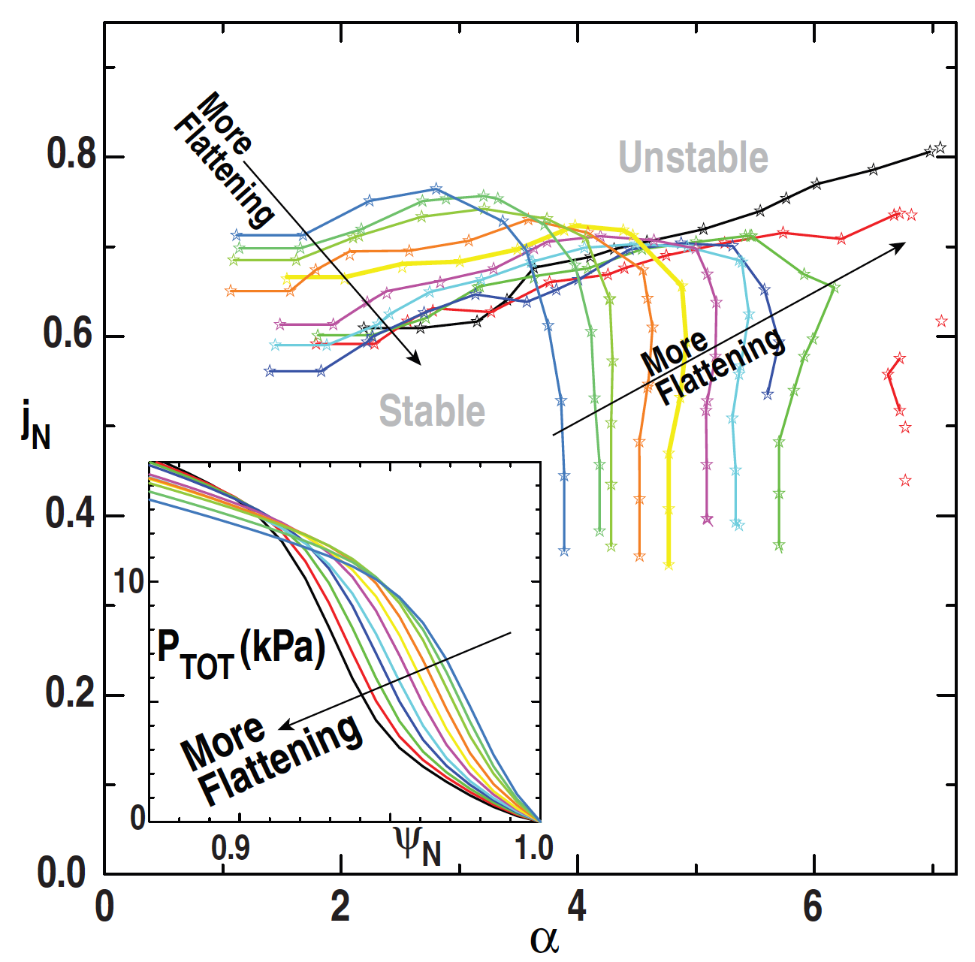
Pedestal structure: How important are the density and temperature profiles in governing the pedestal?
Pped from EPED 1.6 is in good agreement with large multi-machine datasets
Considers only the pressure profile: kinetic ballooning limits local pressure gradient and peeling-ballooning limits height/width at ELM onset
Shape of the pressure profile relative to separatrix affects overall stability
Pressure profile shape is governed by n and T profiles
In DIII-D, pressure profiles shift relative to separatrix affects achievable Pped (2015)
Profile shift due to active impurity injection that triggers pedestal localized mode and shifts ne and P profiles inward from separatrix
In AUG, ne inward profile shift shown to lead In AUG, ne inward profile shift shown to lead to very high pedestal pressure (2017)
ne profile shifts due to reduced fueling from HFSHD region, and leads to P profile shifts.
Osborne NF 2015

Slide 34
Pedestal structure: How important are the density and temperature profiles in governing the pedestal?
Pped from EPED 1.6 is in good agreement with large multi-machine datasets
Considers only the pressure profile: kinetic ballooning limits local pressure gradient and peeling-ballooning limits height/width at ELM onset
Shape of the pressure profile relative to separatrix affects overall stability
Pressure profile shape is governed by n and T profiles
In DIII-D, pressure profiles shift relative to separatrix affects achievable Pped (2015)
Profile shift due to active impurity injection that triggers pedestal localized mode and shifts ne and P profiles inward from separatrix
In AUG, ne inward profile shift shown to lead In AUG, ne inward profile shift shown to lead to very high pedestal pressure (2017)
ne profile shifts due to reduced fueling from HFSHD region, and leads to P profile shifts.
Snyder ITPA 9/2017
Osborne NF 2015
Dunne PPCF 2017

Slide 35
Pedestal structure: How important are the density and temperature profiles in governing the pedestal?
Pped from EPED 1.6 is in good agreement with large multi-machine datasets
Considers only the pressure profile: kinetic ballooning limits local pressure gradient and peeling-ballooning limits height/width at ELM onset
Shape of the pressure profile relative to separatrix affects overall stability
Pressure profile shape is governed by n and T profiles
In DIII-D, pressure profiles shift relative to separatrix affects achievable Pped (2015)
Profile shift due to active impurity injection that triggers pedestal localized mode and shifts ne and P profiles inward from separatrix
In AUG, ne inward profile shift shown to lead In AUG, ne inward profile shift shown to lead to very high pedestal pressure (2017)
ne profile shifts due to reduced fueling from HFSHD region, and leads to P profile shifts.
In NSTX-U, low-Z impurity injection and Li conditioning can be used to manipulate n, T and P profiles to probe edge stability
Snyder ITPA 9/2017
Osborne NF 2015
Dunne PPCF 2017

Slide 36
Pedestal structure physics: What sets the pedestal density structure?
ITER will rely on pellet fuelling since the pedestal is opaque to neutral fuelling
Pedestal structure, including specifically the density profile, determines the stability of the H-mode pedestal and achievable height.
Addressing this question requires varying the ionization source and particle flux produced by fueling and turbulent transport.

Slide 37
Pedestal structure physics: high confinement with low recycling
High confinement associated with low recycling via e.g. Li walls in LTX
Reduced edge fueling allows temperature to rise
H-factor increased by 50-100% in NSTX with Li coatings on graphite PFCs
Target recycling coefficient reduced from 0.98 to 0.90
Core fueling source dropped 50%
Edge ne profile reduced
Linear GS2 calcs showed:
ETG destabilized in pedestal - Te gradient clamped, so that Pe and Ptot followed ne -> stabilized ELMs
Micro tearing stabilized near pedestal top which allowed T and confinement to increase
Canik NF 2013
Schmitt PoP 2015
Experimental confirmation is
needed to support these calcs
NSTX-U will have the ability to coat top and bottom diverters with Li, and eventually flowing liquid Li PFCs to target high confinement

Slide 38
Pedestal structure physics: high confinement with low recycling
High confinement associated with low recycling via e.g. Li walls in LTX
Reduced edge fueling allows temperature to rise
H-factor increased by 50-100% in NSTX with Li coatings on graphite PFCs
Target recycling coefficient reduced from 0.98 to 0.90
Core fueling source dropped 50%
Edge ne profile reduced
ETG destabilized in pedestal - Te gradient clamped, so that Pe and Ptot followed ne -> stabilized ELMs
Micro tearing stabilized near pedestal top which allowed T and confinement to increase
Canik NF 2013
NSTX-U will have the ability to coat top and bottom diverters with Li, and eventually flowing liquid Li PFCs to target high confinement
Schmitt PoP 2015

Slide 39
Pedestal mode characterization: Pedestal fluctuations are observed to clamp the temperature pedestal gradient: robust physics at play to be probed
C-Mod, DIII-D, AUG, EAST, HL2A clearly showed the existence of quasi-coherent fluctuations correlating with pedestal evolution
Density pedestal recovers faster than temperature that is clamped by edge-localized electromagnetic quasi-coherent fluctuations
PBLS can provide the means to address the impact of these fluctuations on the pedestal profiles.
Evolution of QCF amplitude and Temperature gradient
Diallo PRL 2014
∇Te[keV/m]
Diallo PoP 2015
Diallo PoP 2015
onset of QCF
Notes:
Intrinsic of testing physics on multiple machines. similarity on MAST and push this test on high trinagularity and power dependencies.

Slide 40
Pedestal structure optimization: Can natural and triggered pedestal-localized instabilities enable wider and higher pedestals?
NSTX-U will pursue with active low-Z impurity injection to trigger and investigate physics of wide pedestals
using novel tools such as
Pulsed burst laser Thomson for access and exit studies
If transport can reduce gradients below KBM onset limit, pedestal can grow wider and higher before ELM onset due to peeling-ballooning mode
Li injection in DIII-D triggered pedestal localized mode (bursty chirping mode BCM), allowing pedestal width and height to grow
BCM shifted density and pressure profiles away from separatrix, also stabilizing
Wide pedestal QH-mode w/broadband EHO another case
Osborne NF 2015

Slide 41
Pedestal Stability: can NSTX-U realize predicted edge stability improvement at low R/a?
Access to second stability for high n-modes can significantly increase the pedestal peeling-ballooning stability limits
Optimization of parameters needed,notably strong shaping, intermediate density, and moderate q
EPED extension to be performed
Diamagnetization stabilization at low R/a
Importance of n=1, 2, 3 and resistive MHD
Maximum stable pedestal pressure as a function
of aspect ratio, which is varied by changing the major radius at a fixed minor radius of 60.3 cm
NSTX-U capabilities has considerable boundary shaping flexibility, including large range in triangularity, elongation, proximity to double-null, and squareness
NSTX-U is optimized at high triangularity, complimentary to MAST-U which is optimized at low triangularity for super-X diverter studies
NSTX-U and MAST-U can collaborate on extending EPED to low R/a
Snyder et al. PPCF (2004)
Notes:
Key scientific question: What is the stability diagram at low aspect ratio when ballooning stability is predicted to be improved?

Slide 42
Can enhanced pedestal stability be achieved and understood in NSTX-U?
How robust is the super H-mode channel measured in DIII-D and is there an access path at low R/a, which has stronger shaping naturally?
Previous ELITE calculations have shown a super H-mode like channel in NSTX;
Can Enhanced Pedestal H-mode, which was observed in NSTX, be obtained for long pulse in NSTX-U?
High pedestal Ti, Te, stable beta-N; H98 < 1.8
Solomon PRL 2014
H-mode EP H-mode
Maingi PRL 2010

Slide 43
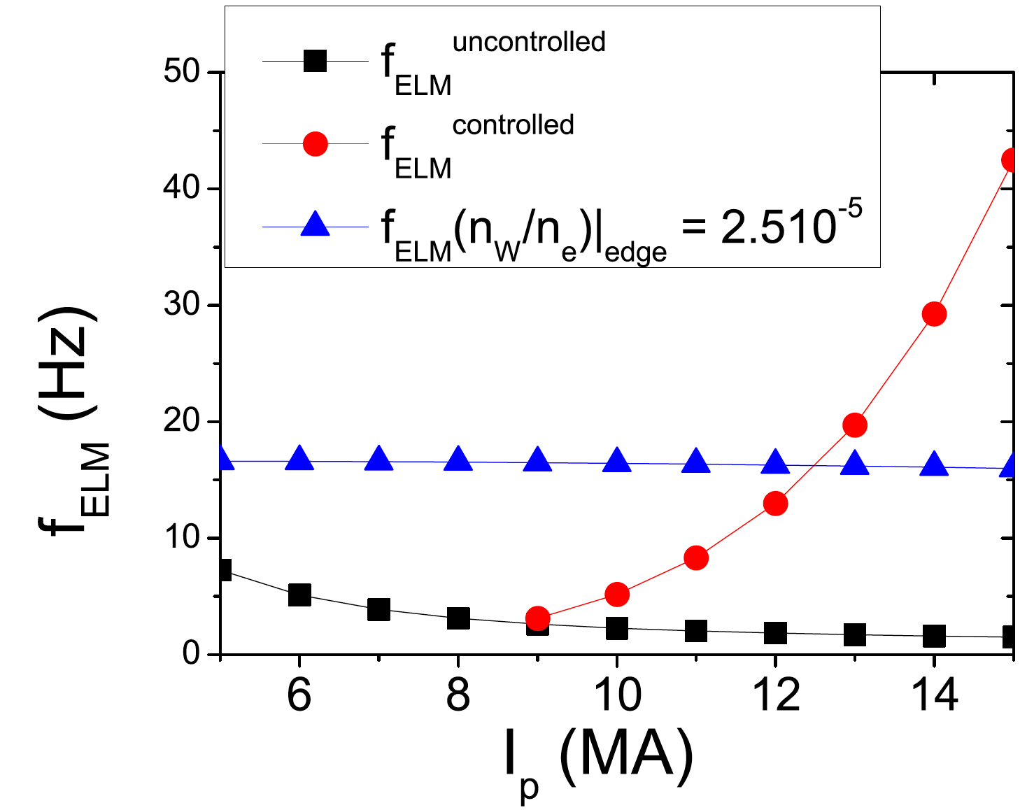
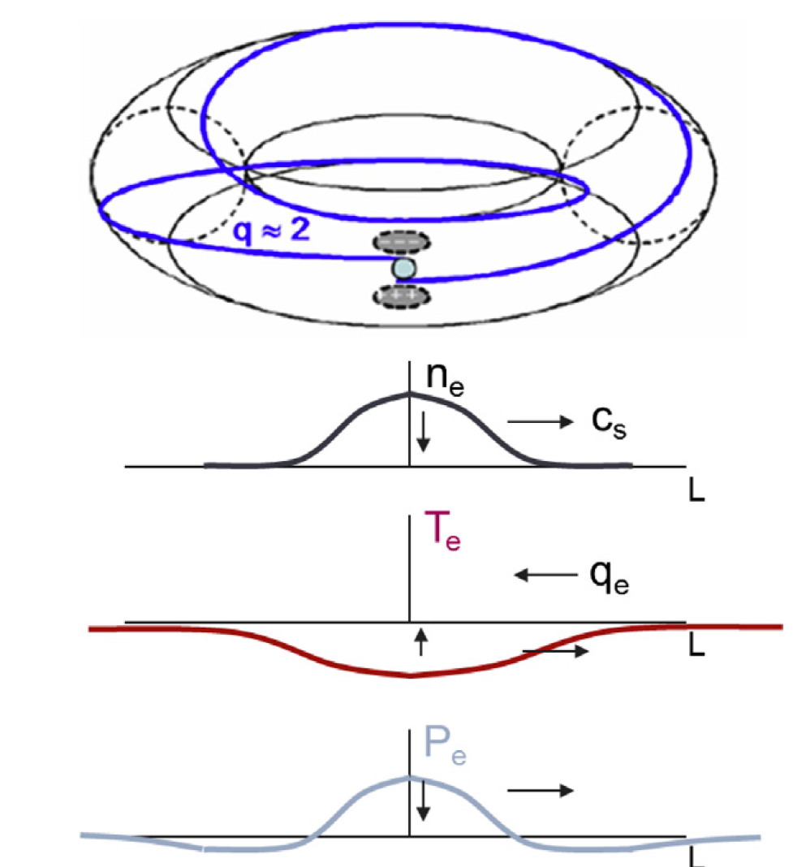
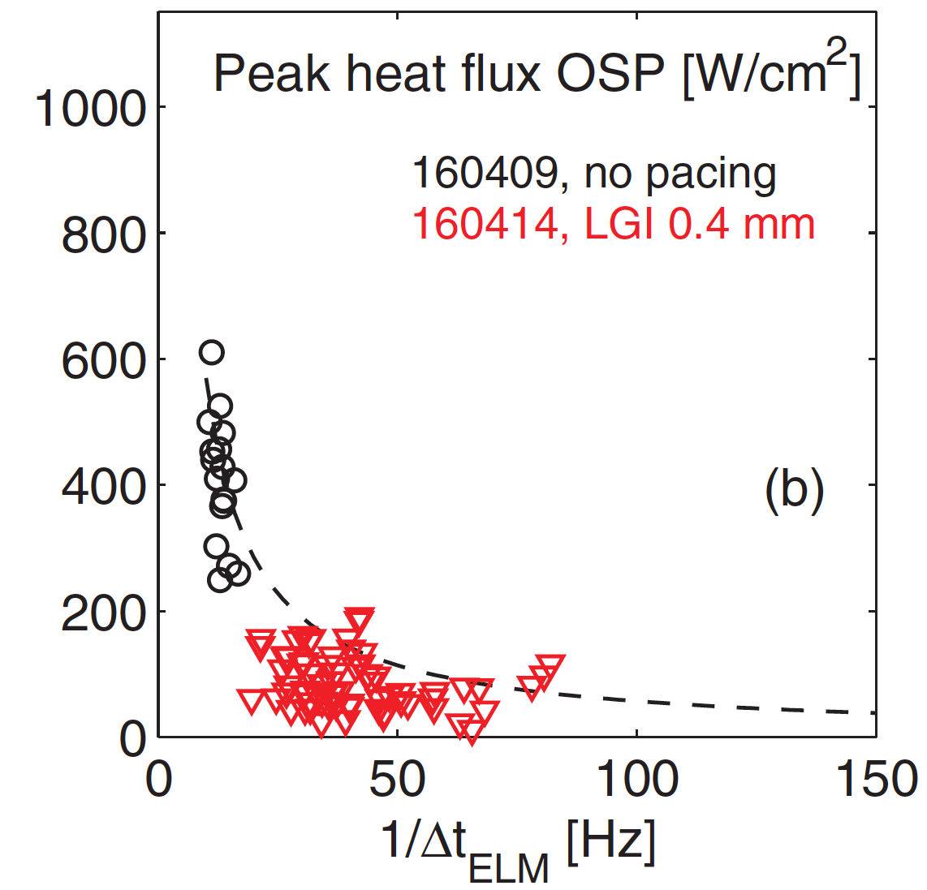
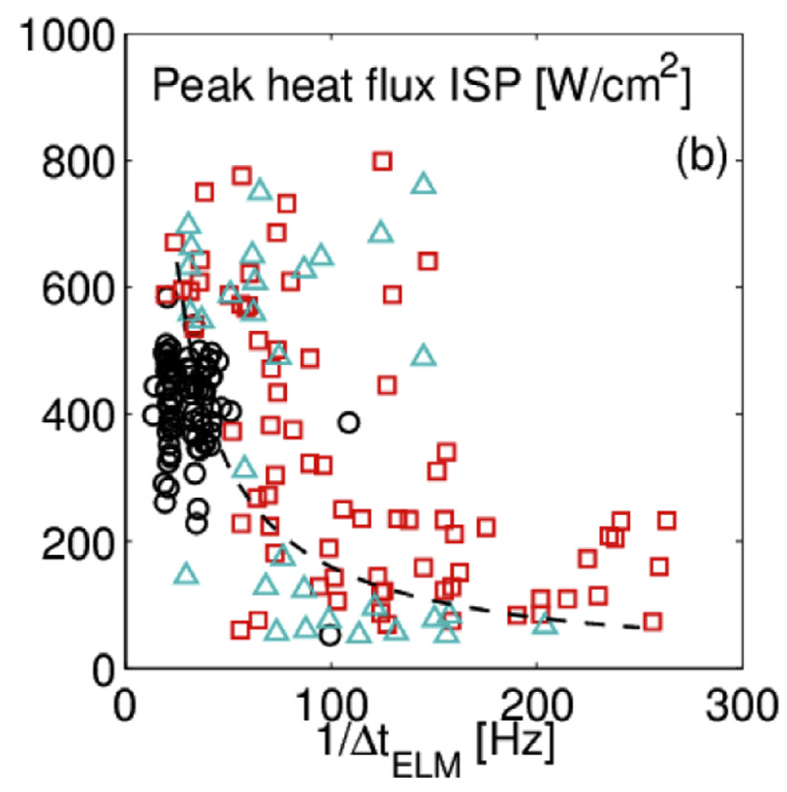
ELM destabilization physics: what are the physics and limits to ELM triggering/pacing within a stable H-mode pedestal?
A baseline ELM mitigation strategy in ITER is ELM pacing at frequency greater than the natural frequency, and hoping that ELM energy ~ 1/ fELM
ITER desires 20-50x ELM size reduction
DIII-D: ELM peak heat flux ~ 1/ fELM sometimes
What physics governs ELM triggering in stable pedestals?
When are there deviations from q ~ 1/fELM?
Are there physics differences between triggering by pellets/granules, vertical jogs, and magnetic perturbations?
Loarte NF 2014
Pellet ELM trigger
Baylor JNM 2015
High torque
Bortolon NF 2016
ITER baseline
Bortolon NME 2017

Slide 44
ELM destabilization physics: what are the physics and limits to ELM triggering/pacing within a stable H-mode pedestal?
A baseline ELM mitigation strategy in ITER is ELM pacing at frequency greater than the natural frequency, and hoping that ELM energy ~ 1/ fELM
ITER desires 20-50x ELM size reduction
DIII-D: ELM peak heat flux ~ 1/ fELM sometimes
What physics governs ELM triggering in stable pedestals?
When are there deviations from q ~ 1/fELM?
Are there physics differences between triggering by pellets/granules, vertical jogs, and magnetic perturbations?
Loarte NF 2014
NSTX-U will have access to ELM pacing via impurity granules and magnetic perturbations to assess the physics of extrapolation, and ready access to low ELM frequency natural ELMy H-mode
Can also do vertical jogs
Pulsed burst laser Thomson for profile changes
Pellet ELM trigger
Baylor JNM 2015
High torque
Bortolon NF 2016
ITER baseline
Bortolon NME 2017

Slide 45
Modeling and Theory

Slide 46
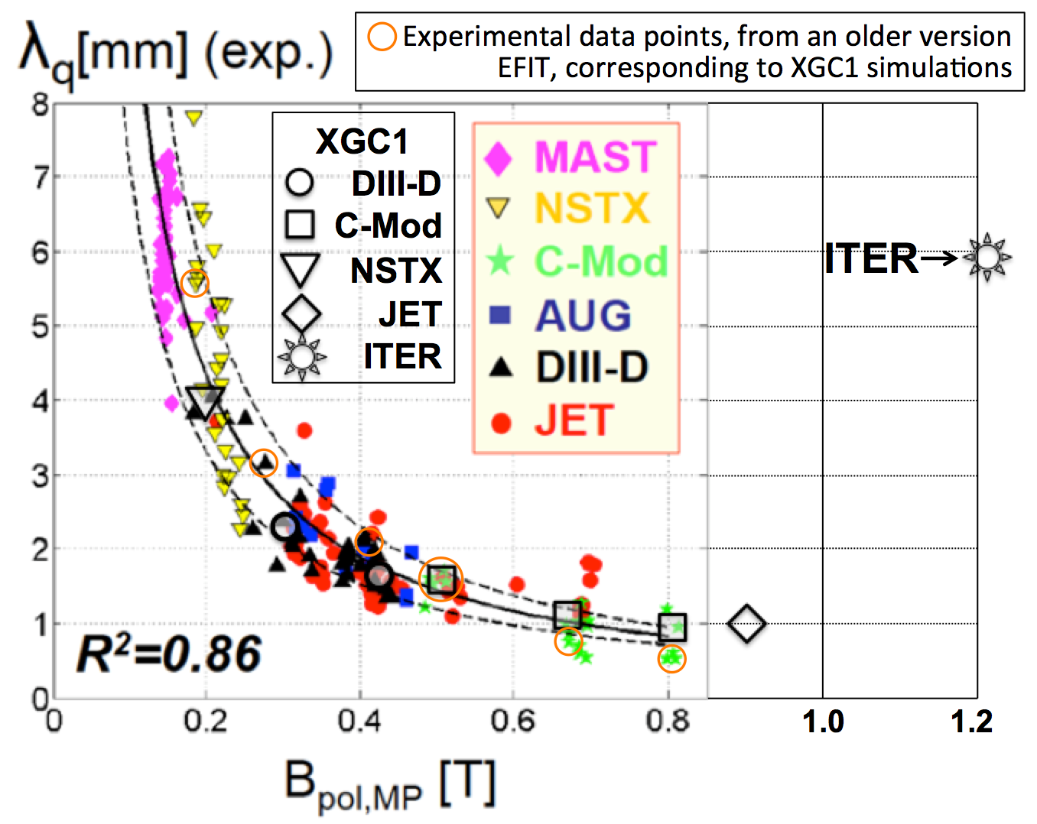
NSTX-U could be a good validation machine for the λq bifurcation physics
A tight-aspect ratio tokamak is an excellent test-bed in studying neoclassical effect.
V_{B}/v_{i} ≈ ρ_{i}/R: For the same ρ_{i}, a compact torus has a greater orbit excursion.
NSTX-U has greater T_{i} than other spherical torus ➙Greater neoclassical effect
Divertor heat-flux width physics
The XGC edge gyrokinetic code recovers heat-flux width λq from all the existing tokamaks
Depends on 1/BP only ➙ neoclassical
Insensitive to other experimental conditions
The same code shows that ITER is well above the 1/BP scaling
Turbulence dominant λq
XGC shows an NSTX-U model plasma at a high-triangularity is also above the 1/BP scaling.
NSTX-U
Chang et al. NF 2017
NSTX-U is an excellent device to study neoclassical effect on some ITER-critical physics

Slide 47
NSTX-U could be a good validation machine for the λq bifurcation physics
A tight-aspect ratio tokamak is an excellent test-bed in studying neoclassical effect.
V_{B}/v_{i} ≈ ρ_{i}/R: For the same ρ_{i}, a compact torus has a greater orbit excursion.
NSTX-U has greater T_{i} than other spherical torus ➙Greater neoclassical effect
Divertor heat-flux width physics
The XGC edge gyrokinetic code recovers heat-flux width λq from all the existing tokamaks
Depends on 1/BP only ➙ neoclassical
Insensitive to other experimental conditions
The same code shows that ITER is well above the 1/BP scaling
Turbulence dominant λq
XGC shows an NSTX-U model plasma at a high-triangularity is also above the 1/BP scaling.
NSTX-U is an excellent device to study neoclassical effect on
some ITER-critical physics
NSTX-U
Chang et al. NF 2017

Slide 48
L-H bifurcation physics: Neoclassical orbit-loss physics plays a crucial role
Chang et al., PRL 2017
L-mode
Sharp bifurcation
Eddie tearing
by ExB shearing
Turbulent
Neoclassical
XGC finds that the L-H bifurcation is from combination of the turbulent Reynolds and neoclassical X-point orbit loss forces
How will this combination affect ITER?
NSTX-U is an excellent tokamak to study the effect of the neoclassical X-point effect.
Isotope effect?
Recycling effect?
High-Z impurity effect?
It may be conjectured that in a strongly-neoclassical device, such as NSTX, the ExB-shearing generation by orbit-loss force alone could force L-H bifurcation.
Consistent with [Kaye NF11, Battaglia NF13, Diallo NF17]

Slide 49
How does this new understanding influence the impact or relevance of the near/medium-term research (2020-2025) and long-term vision (2025-2030)?
Once we develop an understanding in the effects to the pedestal of the lithium and impurity deliveries, we will propose a shift in emphasis of the NSTX-U program to control the pedestal for improved performance.
Strong impact of LM on the pedestal: Better control of the pedestal density formation and instabilities at play.
WORK IN PROGRESS

Slide 50
ELM destabilization physics: what are the physics and limits to ELM triggering/pacing within a stable H-mode pedestal?
A baseline ELM mitigation strategy in ITER is ELM pacing at frequency greater than the natural frequency, and hoping that ELM energy ~ 1/ fELM
ITER desires 20-50x ELM size reduction
DIII-D: ELM peak heat flux ~ 1/ fELM sometimes
What physics governs ELM triggering in stable pedestals?
When are there deviations from q ~ 1/fELM?
Are there physics differences between triggering by pellets/granules, vertical jogs, and magnetic perturbations?
NSTX-U will have access to ELM pacing via impurity granules and magnetic perturbations to assess the physics of extrapolation, and ready access to low ELM frequency natural ELMy H-mode
Can also do vertical jogs
Pulsed burst laser Thomson for profile changes
Pellet ELM trigger
Baylor JNM 2015
Loarte NF 2014
ITER baseline
Bortolon NME 2017

Slide 52
Access to and maintaining a stable H-mode are crucial for performance in future devices: Theory?
It has been suggested that due to the rho* scaling Er-prime will be weak leading to weaker turbulence suppression
Implication: large edge transport which would affect the performance and could ITER might not remain in H-mode
Pedestal transport is clearly important as the Er is determined
ST in general provides a knob, through low R/a, to vary the interchange drive due to short outboard connection length

Slide 53
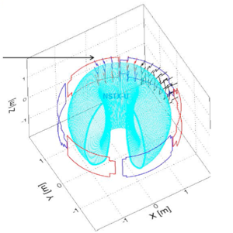
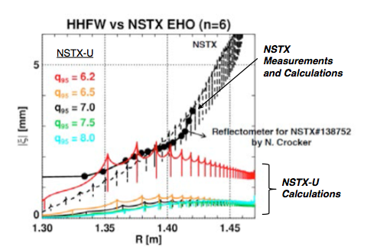
Coupling of the NSTX-U HHFW antenna to the plasma was examined as means to amplify EHO modes
IPEC used to compute plasma displacements using an ideal plasma response model.
Calculations show that displacements with ~1 kA current in the HHFW antenna matches the observed EHO displacements.
NSTX-U calculations indicated that comparable displacements may be achievable at lower-q95
Need to assess the βN dependence
HHFW
HHFW field configuration not fully optimized for the best EHO coupling in NSTX-U
3
Notes:
Radial discplacement at midplane Non axismmetry cos and sine based on model profiles

Slide 54
Pedestal structure optimization: Can natural and triggered pedestal-localized instabilities enable wider and higher pedestals?
If transport can reduce gradients below KBM onset limit, pedestal can grow wider and higher before ELM onset due to peeling-ballooning mode
Li injection in DIII-D triggered pedestal localized mode (bursty chirping mode BCM), allowing pedestal width and height to grow
BCM shifted density and pressure profiles away from separatrix, also stabilizing
Wide pedestal QH-mode w/broadband EHO another case
NSTX-U will pursue with active low-Z impurity injection to trigger and investigate physics of wide pedestals
Pulsed burst laser Thomson for access and exit studies
Osborne NF 2015
NSTX-U will pursue with active low-Z impurity injection to trigger and investigate physics of wide pedestals
using novel tools such as
Pulsed burst laser Thomson for access and exit studies

Slide 55
ELM pacing physics
Key scientific question: what are the physics and limits to ELM triggering/pacing within a stable H-mode pedestal?
to what extent does peak divertor heat flux vary inversely with triggered ELM frequency in ELM pacing scenarios?
are there physics differences between triggering by pellets/granules, vertical jogs, and magnetic perturbations?
NSTX-U will have access to ELM pacing via impurity granules and magnetic perturbations to assess the physics of extrapolation, and ready access to low ELM frequency natural ELMy H-modes

Slide 56
How will NSTX-U be world-leading in your research area when operation resumes around 2020? (Move within science text)
NSTX-U can significantly contribute in leading control solutions for the pedestal using Li (and other impurities)as an actuator and significantly enhance our understanding of basic ELM physics and pedestal transport and formation.
Pedestal turbulence effects on the pedestal evolution
Additional second NBI may affect the edge current necessary to characterize the onset of ELMs
Potential game changer

Slide 57
What are the most important things learned since the original physics design of NSTX-U (2009) and/or since the last 5 year plan was written (2014)? (Move within science text)
Broadening of divertor heat flux profile with increasing number of ELM filaments in NSTX
Might require NSTX to operate more in ballooning side to test its impact on the heat flux scaling
NSTX pedestal width scales strongly with betap
if this result extends to NSTXU, larger pedestal width will enable the sustainment of heigher pedestal height

Slide 58
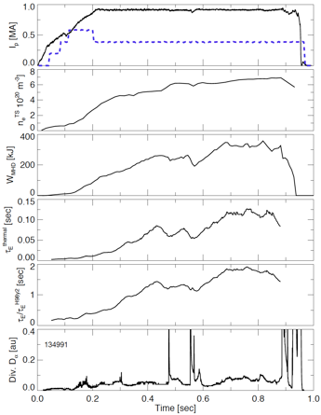
Enhanced Pedestal H-mode (EP- H) observed with H98 < 1.7, higher than H-mode ion temperature pedestal
Profile characterization
PNBI/10 [MW]
Density
Stored energy
Enhanced Pedestal H-mode

Slide 59
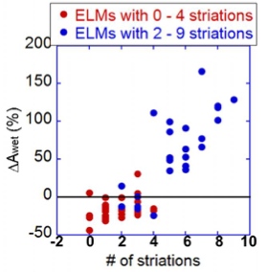
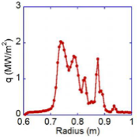
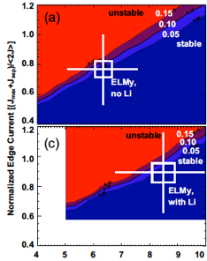
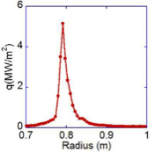
ELM heat flux footprint becomes more peaked with decreasing number of striations; related to NSTX stability on low-n current driven stability boundary
High triangularity
5 striations
High triangularity
Ahn submitted PRL 2014
Low triangularity
0 striation
Low
triangularity
10
For a given low-n (<4), the wetted area increases with number of striations
Shaping appears to play a role in spreading the heat
ITER also predicted to be on low-n current driven boundary – like NSTX?

Slide 60
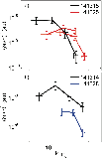
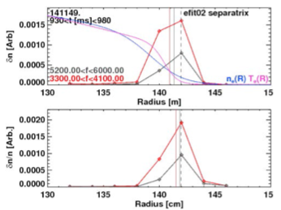
Pedestal structure physics: What sets the pedestal density structure - diffusion, pinch, turbulence, neutrals?
Something about balance between diffusion, pinch turbulence
P1
Lithium (as well as other low Z impurity) can be control knobs to vary recycling
Turbulence are significantly reduced with lithium near the pedestal top(NSTX)
Stabilization of the micro-tearing modes at the top of the pedestal are responsible for the pedestal widening (NSTX)
Canik et al. Physics of Plasmas 18,056118 (2011)

