Slide 1


Divertor, SOL and Plasma Facing Components
M.L. Reinke for the NSTX-U Team
NSTX-U PAC-39
PPPL
January 9th, 2018

Slide 2
Overview
how will NSTX-U address critical issues in fusion science?
  introduce the 2015 PMI Workshop PRDs and show NSTX-U alignment
what is the medium-term research vision (2020-2025)?
  validation of heat exhaust and halo current models used in Recovery
    enable new cryopump PFC design work and future high-Z enhancements
  vigorous study of dissipative divertors (conventional, X-div, snowflake, etc.)
  exploitation of the (planned) cryopump as one of multiple particle control tools
how will NSTX-U be world leading in boundary physics in when operations resume in 2020?
  MAST-U programmatic decisions emphasize boundary physics
  NSTX-U provides a crucial complementary facility to confirm physics, empirical scalings and optimize core-edge integration
briefly discuss high-Z, longer term covered by M. Jaworski

Slide 3
2015 PMI Workshop Priority Research Directions
PRD-A: Identify the present limits on power and particle handling, as well as tritium control and inventory, for solid and liquid plasma facing components, and extend performance to reactor relevant conditions with new transformative solutions
PRD-B: Understand, develop and demonstrate innovative dissipative/detached divertor solutions for power exhaust and particle control, sufficient for extrapolation to steady-state reactor conditions
PRD-C: Understand, develop and demonstrate innovative boundary plasma solutions for main chamber wall components, including tools for controllable sustained operation, sufficient for extrapolation to steady-state reactor application
PRD-D: Understand the science of evolving materials at reactor-relevant plasma conditions and how novel materials and manufacturing methods enable improved plasma performance
PRD-E: Understand the mechanisms by which boundary solutions and plasma facing materials influence pedestal and core performance, and explore routes to maximize fusion performance
How does the NSTX-U facility and program align with these priorities?

Slide 4
2015 PMI Workshop Priority Research Directions
PRD-A: Identify the present limits on power and particle handling, as well as tritium control and inventory, for solid and liquid plasma facing components, and extend performance to reactor relevant conditions with new transformative solutions
PRD-B: Understand, develop and demonstrate innovative dissipative/detached divertor solutions for power exhaust and particle control, sufficient for extrapolation to steady-state reactor conditions
PRD-C: Understand, develop and demonstrate innovative boundary plasma solutions for main chamber wall components, including tools for controllable sustained operation, sufficient for extrapolation to steady-state reactor application
PRD-D: Understand the science of evolving materials at reactor-relevant plasma conditions and how novel materials and manufacturing methods enable improved plasma performance
PRD-E: Understand the mechanisms by which boundary solutions and plasma facing materials influence pedestal and core performance, and explore routes to maximize fusion performance
Most of this work is aspect ratio independent and a fully operational NSTX-U is another platform for testing novel PFC/materials solutions

Slide 5
2015 PMI Workshop Priority Research Directions
PRD-A: Identify the present limits on power and particle handling, as well as tritium control and inventory, for solid and liquid plasma facing components, and extend performance to reactor relevant conditions with new transformative solutions
PRD-B: Understand, develop and demonstrate innovative dissipative/detached divertor solutions for power exhaust and particle control, sufficient for extrapolation to steady-state reactor conditions
PRD-C: Understand, develop and demonstrate innovative boundary plasma solutions for main chamber wall components, including tools for controllable sustained operation, sufficient for extrapolation to steady-state reactor application
PRD-D: Understand the science of evolving materials at reactor-relevant plasma conditions and how novel materials and manufacturing methods enable improved plasma performance
PRD-E: Understand the mechanisms by which boundary solutions and plasma facing materials influence pedestal and core performance, and explore routes to maximize fusion performance
Physics research topics on power exhaust and particle control, including core-edge integration will be emphasized in NSTX-U program

Slide 6
2015 PMI Workshop Priority Research Directions
PRD-A: Identify the present limits on power and particle handling, as well as tritium control and inventory, for solid and liquid plasma facing components, and extend performance to reactor relevant conditions with new transformative solutions
PRD-B: Understand, develop and demonstrate innovative dissipative/detached divertor solutions for power exhaust and particle control, sufficient for extrapolation to steady-state reactor conditions
PRD-C: Understand, develop and demonstrate innovative boundary plasma solutions for main chamber wall components, including tools for controllable sustained operation, sufficient for extrapolation to steady-state reactor application
PRD-D: Understand the science of evolving materials at reactor-relevant plasma conditions and how novel materials and manufacturing methods enable improved plasma performance
PRD-E: Understand the mechanisms by which boundary solutions and plasma facing materials influence pedestal and core performance, and explore routes to maximize fusion performance
‘Demonstrational’ goals must be done on an ST facility to advance the concept, while ‘Understanding’ benefits the entire boundary community

Slide 7
Near-Term NSTX-U Activities Well Aligned with PRDs
novel castellated graphite PFCs designed at heat flux handling limit
  graphite the right choice to validate physics and engineering basis for PFCs in STs
  accelerate PPPL progress on non-carbon replacements
extends the ST to high-q||, up to 0.5 GW/m² at high P_{NET}/P_{TH}
  access to highest B_{p} will test ST SOL physics and empirical scaling for heat flux, λ_{q}
  facility to test strategies for radiative exhaust in conventional and alternative divertors
allows multiple means of particle control in the ST to be explored
  ELM control using 3D-field triggering, particle injection
  direct comparison of evaporated lithium and cryopumping will clarify physics drivers
simultaneous optimization of exhaust and pedestal solutions
  access to high power, high triangularity configurations that maximize pedestal stability
  explore benefits of advanced divertor configurations (snowflake, x-divertor)
  utilization of lithium via evaporated coatings and injection (granules, droppers)

Slide 8
Evolution of NSTX-U PFC Heat Flux Issues
heat exhaust previously identified as a challenge for NSTX-U, but solutions (snowflake, radiation) implied uncertainty for core, pedestal scenarios
  DVVR/EoC process highlighted issues with PFCs meeting requirements and challenged the science basis for existing requirements
NSTX-U established a dedicated Working Group to combine physics and engineering experts to support PFC Recovery
  supported development of PFC Requirements based on TSG input
  charged with to providing guidance on PFC monitoring approaches
  year-to year Recovery-era milestones R18-1 and F18-1 guide Lab work

Slide 9
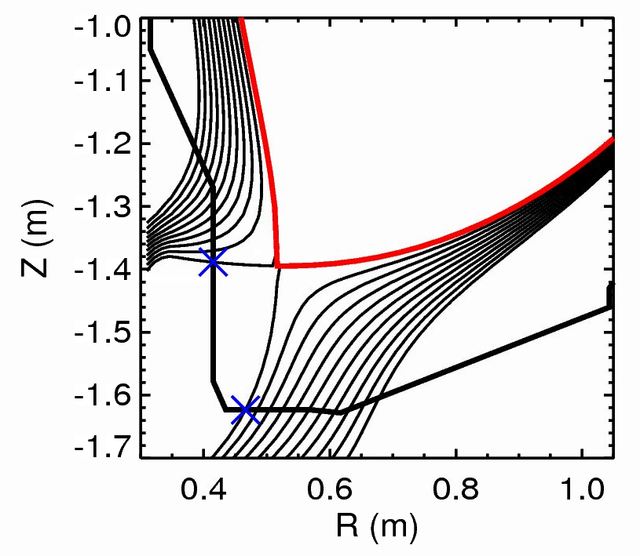
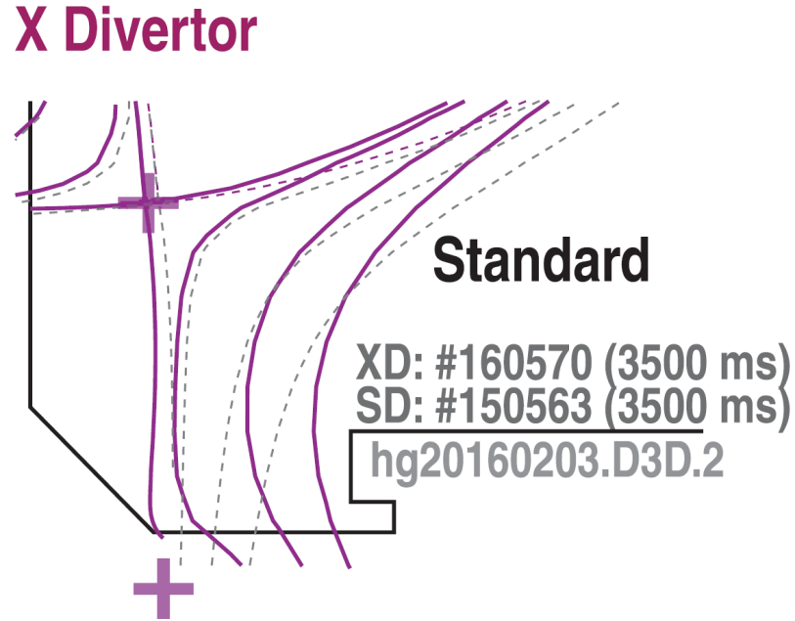
Scope of the NSTX-U Heat Exhaust Challenge
common question: “if Machine X were to use our model, would they predict a PFC problem?”
  ex: DIII-D (LSN): 27 MJ over 10 s to ODIV (floor) 1.15 < R < 1.37 ~ 1.74 m²
  ex: NSTX-U (DN): 14 MJ over 5 s to ODIV (IBDH) 0.45 < R < 0.60 ~ 0.50 m²
‘ideal’ spread evenly
DIII-D: 16 MJ/m²
(floor) 1.6 MW/m²
MAST-U : 10.9 MJ/m²
(T2 tile) 2.2 MW/m²
NSTX-U: 28 MJ/m²
(IBDH) 5.7 MW/m²
NSTX-U
DIII-D

Slide 10
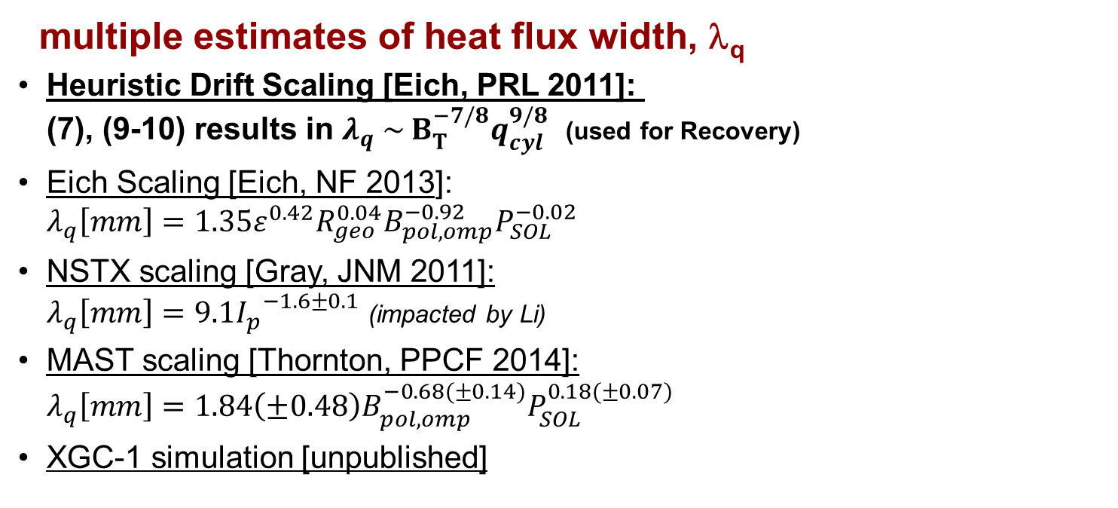
ST’s Have Uncertainty in Empirical λ_{q} Scaling
multiple estimates of heat flux width, λ_{q}
Heuristic Drift Scaling [Eich, PRL 2011]: (7), (9-10) results in $λ_{q} \sim B_{T}^{−7/8}q_{cyl}^{9/8}$ (used for Recovery)
Eich Scaling [Eich, NF 2013]: $λ_{q}\left[mm\right]=1.35{ε^{0.42}R}_{geo}^{0.04}B_{pol,omp}^{−0.92}P_{SOL}^{−0.02}$
NSTX scaling [Gray, JNM 2011]: $λ_{q}\left[mm\right]=9.1{I_{p}^{}}^{−1.6±0.1}$ (impacted by Li)
MAST scaling [Thornton, PPCF 2014]: $λ_{q}\left[mm\right]=1.84\left(±0.48\right)B_{pol,omp}^{−0.68(±0.14)}P_{SOL}^{0.18(±0.07)}$
XGC-1 simulation [unpublished]
2 MA, 1 T, 10 MW
1.9 [mm]
2.0 [mm]
3.0 [mm]
4.1 [mm]
3.0 [mm]

Slide 11
Focus of Near Term Boundary Program
learn to operate NSTX-U within the PFC requirements and develop skills and team to diagnose boundary plasmas
  scenarios likely require sweeping, may need PFC monitoring
  new boundary diagnostics, impact of altered PFC geometry, shaping
validate PFC heat exhaust and halo current models
  power sharing between divertors (in/out, up/down), heat flux width
  halo current model assumptions TPF, I_{halo}/I_{p}, and footprint
explore dissipation physics in conventional and alternative divertors
investigate compatibility of power exhaust solutions w/ pedestal
  this research has been ‘demonstrational’ in standard aspect ratio devices
  results trigger physics studies, code validation and further experiments
comparison of particle control techniques
  revisit the physics and engineering requirements for the cryopump PFCs

Slide 12
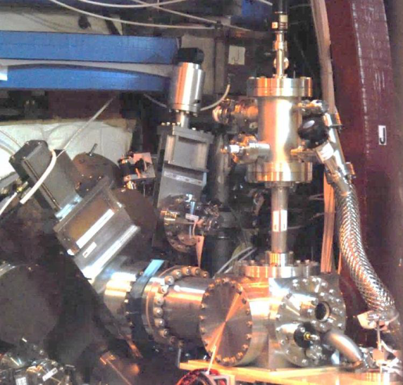
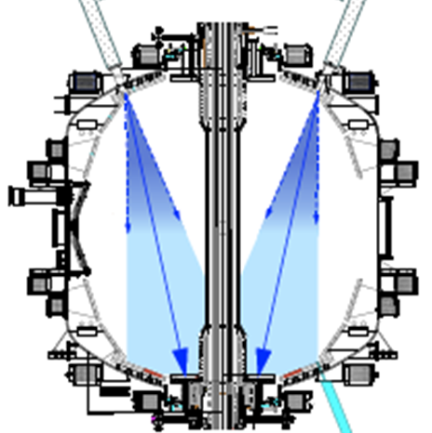
Boundary Supports Key High Impact Program Elements
PFCs and Div/SOL will have an operational role to support pedestal and core science mission
  10+ MW of P_{NBI} is available as a ‘Day 1’ capability while MAST-U plans to upgrade to 10 MW in early 2020’s.
  dealing with power exhaust may be rate limiting to moving to high power longer pulse length
PFCs and Div/SOL will help to demonstrate a diverse, comprehensive set of particle control tools to help optimize advanced scenarios
  stimulated/paced ELMs via 3D fields, granule injection
  fueling from conventional/supersonic gas injection
  pumping via use of evaporated lithium (LITER) and (planned) cryopump [w/ Particle Control Task Force]
FY16 Granule Injector
LITER
(NSTX)

Slide 13
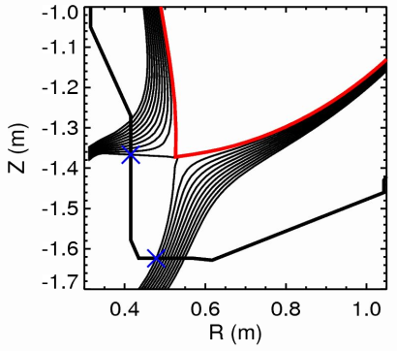
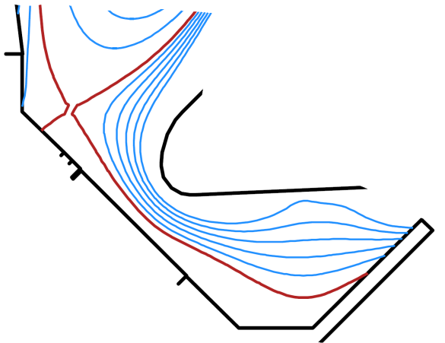
NSTX-U Boundary Physics Complements MAST-U
both NSTX-U and MAST-U needed to explore simultaneous optimization of the boundary and pedestal
  different triangularity optimization for PFCs
  NSTX-U ‘radial’ off-axis beams enable more flexibility in running single null divertor geometries
understanding existing differences in λ_{q} scaling and physics, requires two facilities
MAST-U mission focuses on a wider range of boundary physics areas
  MAST-U has ~50% of run time devoted to exhaust and the first baffled Super-X divertor
  substantially more boundary diagnostics
OSP only
NSTX-U
T1
MAST-U
T2
ISP only,
no probes

Slide 14
Boundary Progress Enables Future High-Z Program
ST’s need to routinely access a high purity, high confinement regime
  transport and current drive physics is impacted by dilution and high Z_{eff}
  examples (ILW, AUG-HFSHD) of pedestal impacted by low-Z concentration
ST’s have not investigated control of high-Z impurities from PFCs
  limited access to wave-heating actuators and reliance on NBI, high torque
  different balance of neoclassical and turbulence ion particle transport
NSTX-U will revisit and roadmap plans for installing high-Z PFCs
  what type of tiles to be used (e.g. solid vs. coated)?
  what fraction of the machine is covered and when?
  what can be learned using near-term NSTX-U ops (high-Z gas, LBO)?
  what can be learned from collaborations (ST-40, Globus-M2)?
high-Z evolution linked to NSTX-U liquid metal strategy (Jaworski)

Slide 15
Summary
NSTX-U will enable the research aligned with multiple Priority Research Directions identified in the 2015 PMI Workshop
  ‘develop and demonstrate’ power exhaust and particle control in the ST configuration, move toward physics ‘understanding’
near term program will enable a robust science mission to
  validate PFC heat exhaust and halo current models
  investigate the compatibility of power exhaust solutions w/ pedestal
  evaluate and understand particle control that enable long pulse
validation of PFC physics and engineering basis enables enhancements (cyropump, high-Z) which unlock a wider range of particle control options
complementary programmatic decisions between MAST-U and NSTX-U highlight a joint role in advancing the ST physics basis for optimized boundary and pedestal exhaust solutions

Slide 16
EXTRA SLIDES

Slide 17
PFC Requirements Derived from TSG Requests
PFCR-MEMO’s developed for each divertor PFC region
  PFCR-MEMO-008: Centerstack Angled Surface and Far OBD
  PFCR-MEMO-009: Inboard Divertor Vertical Surface
  PFCR-MEMO-010: Inboard Divertor Horizontal and Near OBD
MEMOs explore how TSG requests map to PFC areas
  unrealistic, low-priority requests are filtered out
  high-priority scenarios collected to form the requirements
    many medium/lower priority are satisfied by these constraints
    identify non-critical scenarios which will be informed by early operations
Developed PFC Requirements and Diagnostic Req.

Slide 18
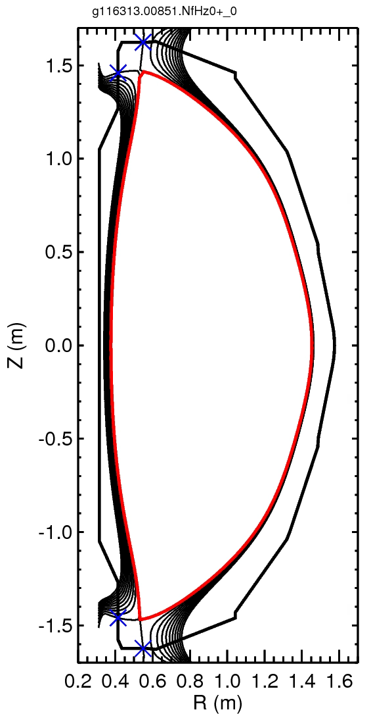
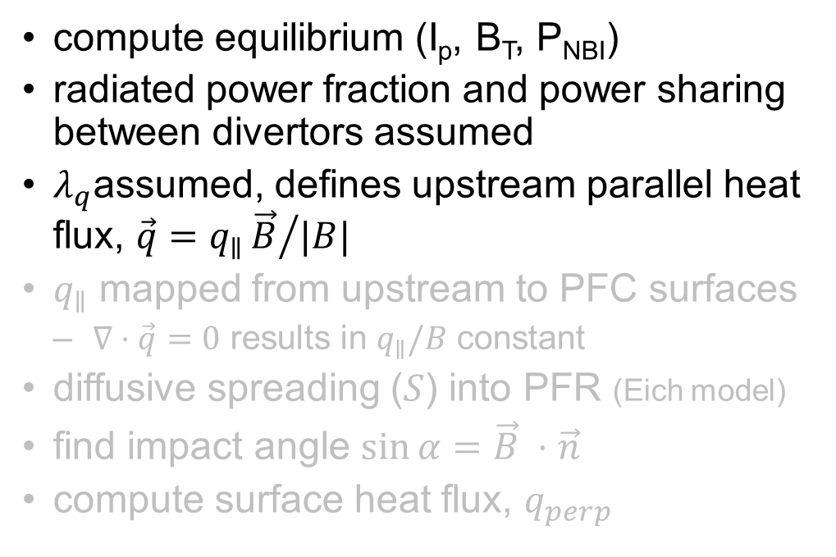
Example of Workflow
compute equilibrium (I_{p}, B_{T}, P_{NBI})
radiated power fraction and power sharing between divertors assumed
$λ_{q}$assumed, defines upstream parallel heat flux, $\vec{q}=q_{∥}{\vec{B}}/{|B|}$
$q_{∥}$ mapped from upstream to PFC surfaces
  $∇⋅\vec{q}=0$ results in $q_{∥}/B$ constant
diffusive spreading ($S$) into PFR (Eich model)
find impact angle $\sin{α=\vec{B} }⋅\vec{n}$
compute surface heat flux, $q_{perp}$

Slide 19
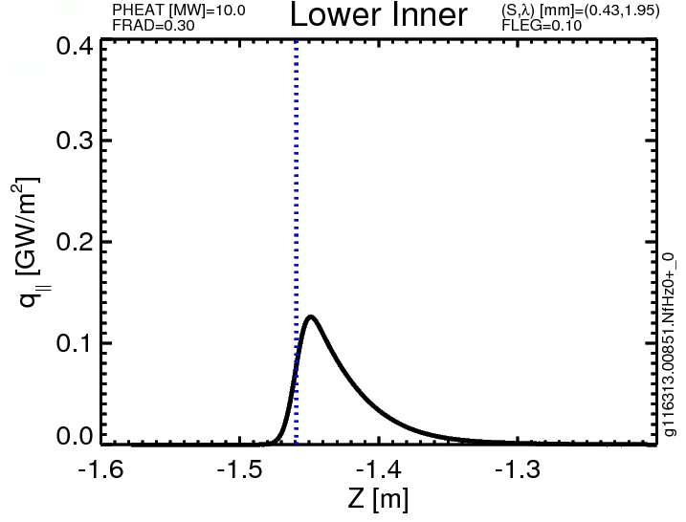
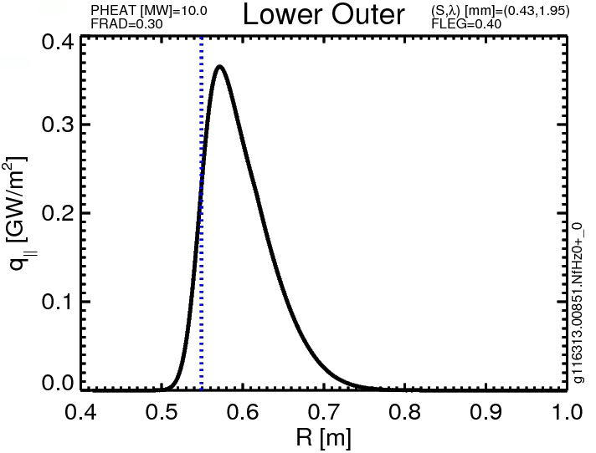
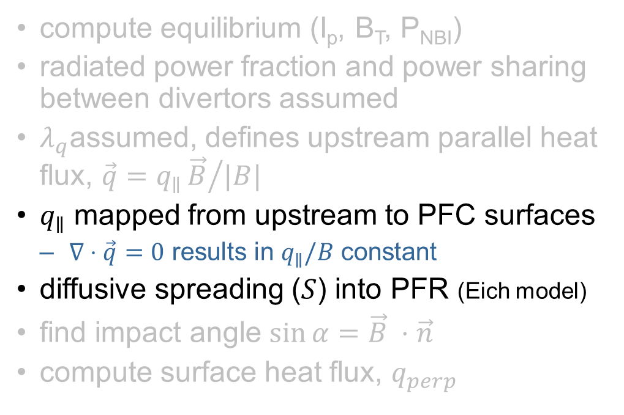
Example of Workflow
compute equilibrium (I_{p}, B_{T}, P_{NBI})
radiated power fraction and power sharing between divertors assumed
$λ_{q}$assumed, defines upstream parallel heat flux, $\vec{q}=q_{∥}{\vec{B}}/{|B|}$
$q_{∥}$ mapped from upstream to PFC surfaces
  $∇⋅\vec{q}=0$ results in $q_{∥}/B$ constant
diffusive spreading ($S$) into PFR (Eich model)
find impact angle $\sin{α=\vec{B} }⋅\vec{n}$
compute surface heat flux, $q_{perp}$

Slide 20
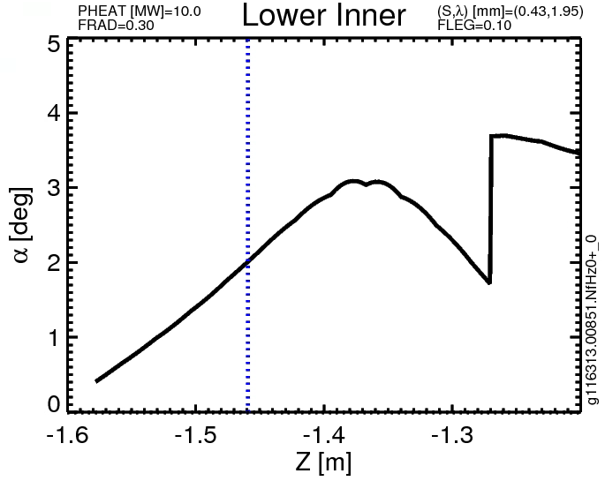
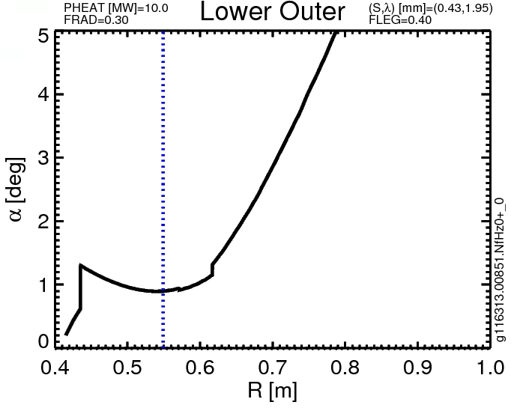
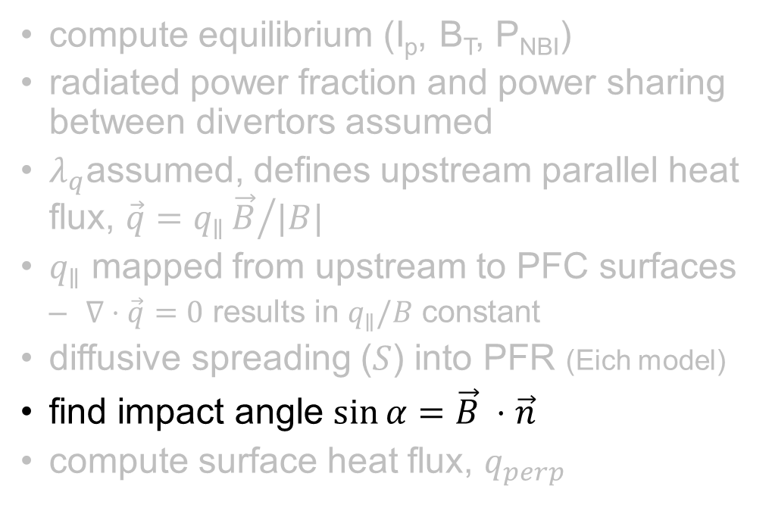
Example of Workflow
compute equilibrium (I_{p}, B_{T}, P_{NBI})
radiated power fraction and power sharing between divertors assumed
$λ_{q}$assumed, defines upstream parallel heat flux, $\vec{q}=q_{∥}{\vec{B}}/{|B|}$
$q_{∥}$ mapped from upstream to PFC surfaces
  $∇⋅\vec{q}=0$ results in $q_{∥}/B$ constant
diffusive spreading ($S$) into PFR (Eich model)
find impact angle $\sin{α=\vec{B} }⋅\vec{n}$
compute surface heat flux, $q_{perp}$

Slide 21
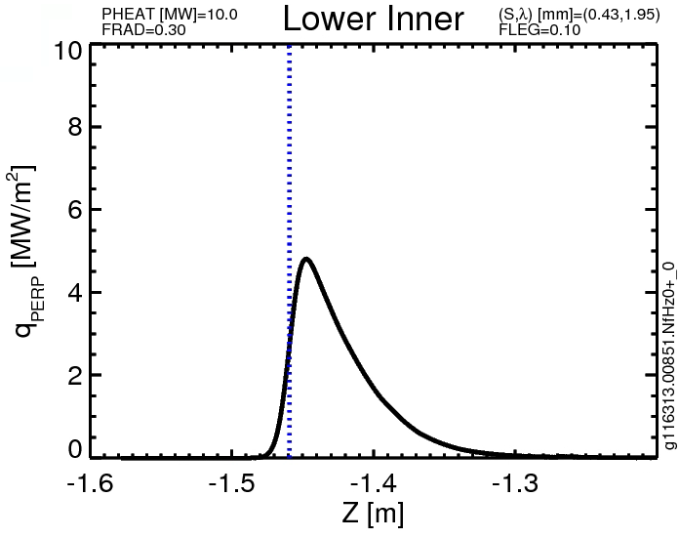
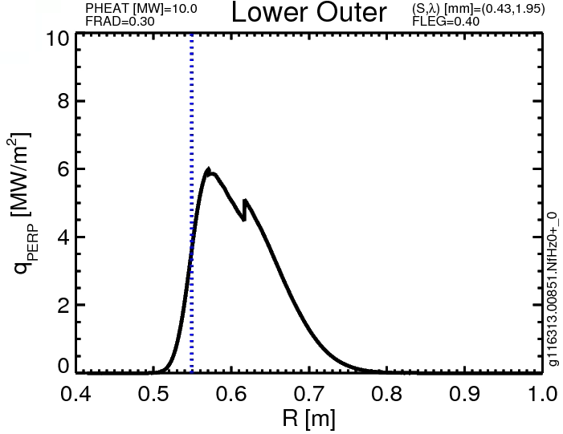
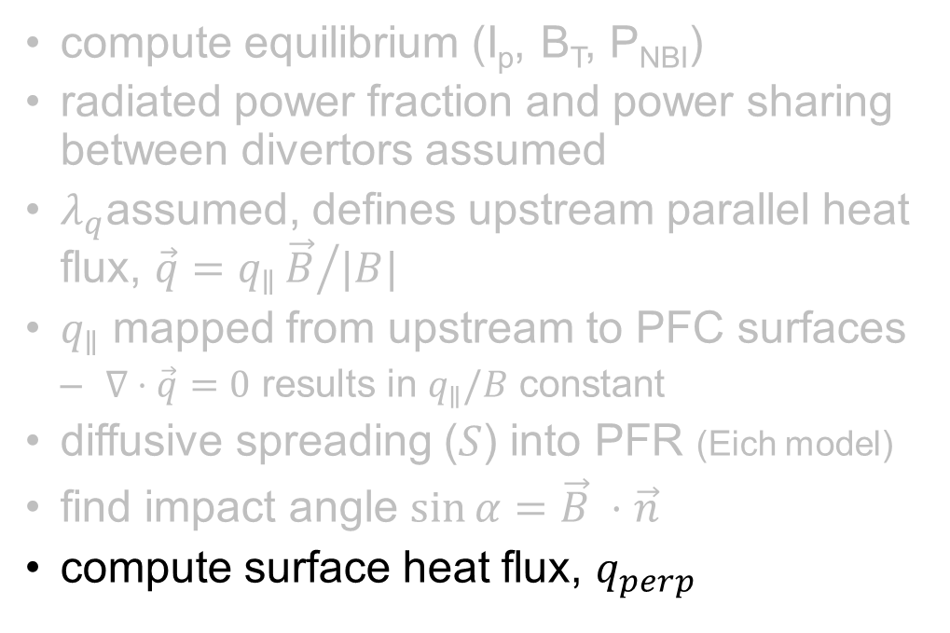
Example of Workflow
compute equilibrium (I_{p}, B_{T}, P_{NBI})
radiated power fraction and power sharing between divertors assumed
$λ_{q}$assumed, defines upstream parallel heat flux, $\vec{q}=q_{∥}{\vec{B}}/{|B|}$
$q_{∥}$ mapped from upstream to PFC surfaces
  $∇⋅\vec{q}=0$ results in $q_{∥}/B$ constant
diffusive spreading ($S$) into PFR (Eich model)
find impact angle $\sin{α=\vec{B} }⋅\vec{n}$
compute surface heat flux, $q_{perp}$
I-DIV Requirement
O-DIV Requirement

Slide 22
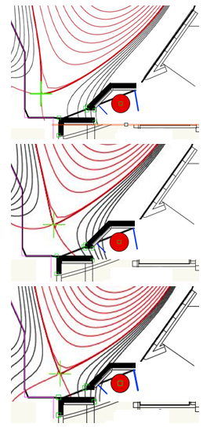
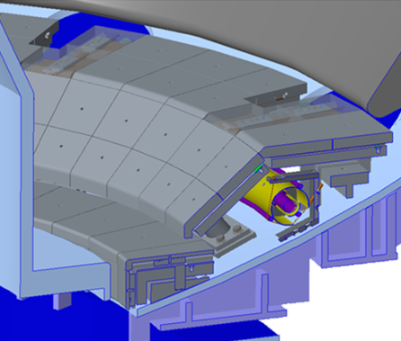
Revisit Cryopump Eng. & Physics Basis
‘cryo’ portion can likely be retained in part or in whole
prior cryopump PFCs not compatible with new requirements
  max temperature, heat flux, tile shaping, halo currents, access holes
  lower CHI gap needs to be closed
improved understanding of metrology use for in-vessel builds & we’ll have a better validated cost and schedule from Recovery
FY16 CDR
Review FY16 plans/mission for Particle Control Tasks:
FY16 CDR
demonstrate the physics basis fluid simulations for pump design
confirm the optimization of pump location with demonstrated range of high-impact mag. geometries
study the correlated impacts on the inner divertor and (unchanged) upper divertor, large R_{MAJ} PFCs

Slide 23
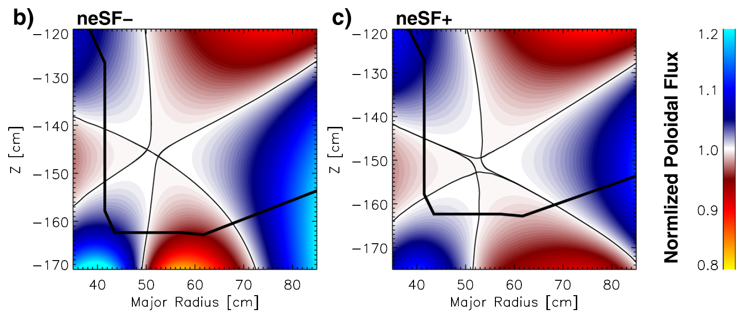
Desire Flexibility to Explore Snowflake Divertor
Frerichs PoP 2016
poloidal field direction switches between legs
SP4 = ‘outer leg’
SP3 = ‘inner leg’
B_{p}
SP4
SP3
prior experiments on NSTX, DIII-D and TCV used flat PFCs
power sharing between strike points import
  TCV sees ~25% of the power on SP3 on SP4 [Remierdes PPCF 2013]
  this power approaches shaped PFCs ~ 90º making q_{surf} ~ q||

Slide 24
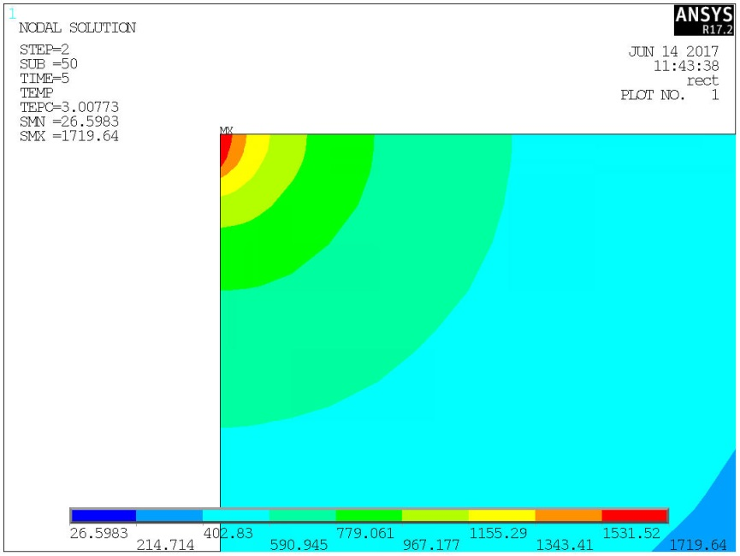
Analysis Shows PFCs May Tolerate ‘Snowflake Like’ Cases
thermal analysis shows heat conducted into PFC bulk allows substantial edge heating over small edges, allowing heat loads in ‘unfavorable’ directions
143 MW/m²
115 MW/m²
q_{edge}=q_{flat}/tan(1º)
d
q_{edge}=57 MW/m²
q_{flat}=1.0 MW/m²
d=.010” (0.25 mm)
q_{edge}=115 MW/m²
Δt = 5 sec
T_{limit}=1600 ºC
q_{edge}=28 MW/m²
q_{flat}=0.5 MW/m²
‘d’ constrained by field line angle and tile size

Slide 25
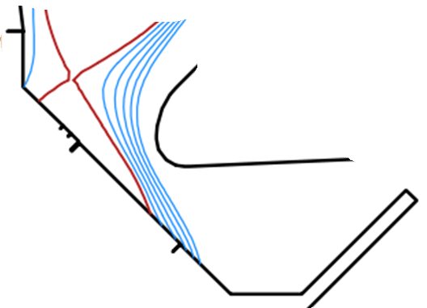
Scope of the NSTX-U Heat Exhaust Challenge
common question: “if Machine X were to use our model, would they predict a PFC problem?”
  ex: MAST-U (DN): 25 MJ over 5 s to ODIV (T2) ~ 2.3 m² [CD/MU/01163]
  ex: NSTX-U (DN): 14 MJ over 5 s to ODIV (IBDH) 0.45 < R < 0.60 ~ 0.50 m²
‘ideal’ spread evenly
MAST-U : 10.9 MJ/m²
2.2 MW/m²
NSTX-U: 28 MJ/m²
5.7 MW/m²
NSTX-U
T1
T2
MAST-U
T2 ~ 2.3 m²
T1 ~ 0.78 m²

Slide 26
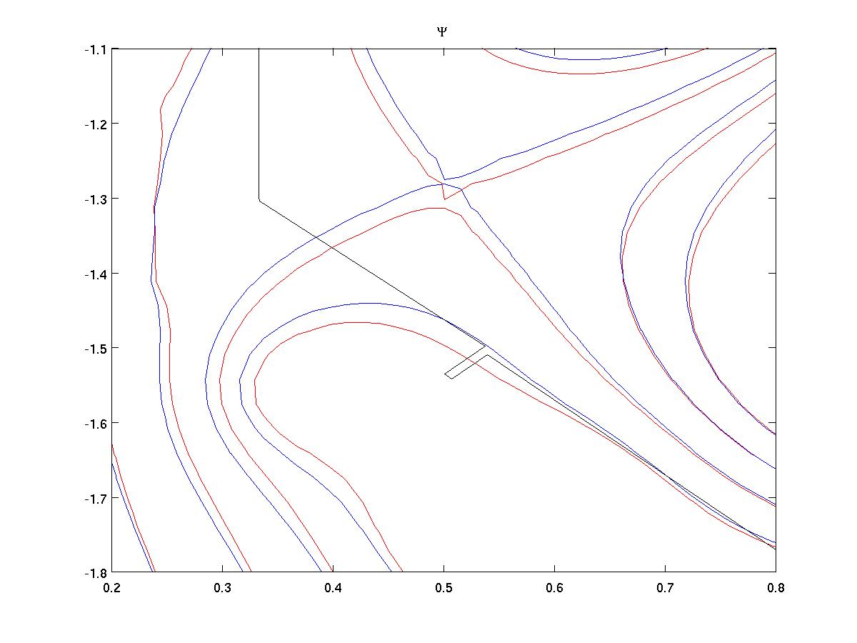
MAST-U Defines a ISP/OSP Transition Region
a=3 mm
b=6 mm
T2
OSP
shadowed
a
End of Langmuir probes
b
c
d
Conical
T1
Transition
ISP
shadowed

Slide 27
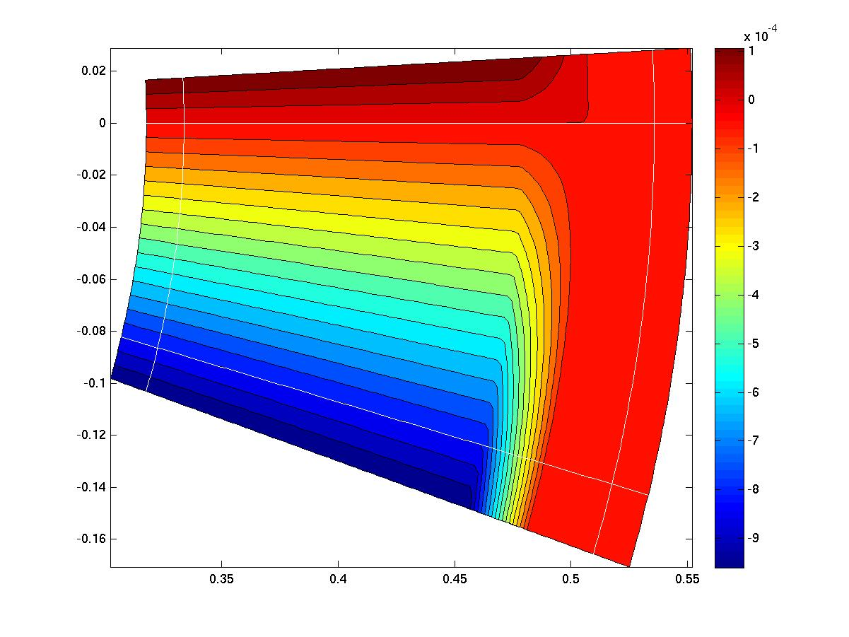
MAST-U Defines a ISP/OSP Transition Region
a=3 mm
b=6 mm
T2
OSP
shadowed
a
End of Langmuir probes
b
c
d
Conical
T1
Transition
ISP
shadowed

Slide 28
