Slide 1

Liquid Metals:
Near and Long-term Plans
M.A. Jaworski for the NSTX-U Team
NSTX-U Program Advisory Committee Meeting
Princeton Plasma Physics Laboratory, Princeton, NJ
January 9th, 2018
Notes:
Good afternoon – I’m hear to speak about the Liquid Metals and PMI program on NSTX-U in broad terms

Slide 2
Outline
Why evaluate liquid metals as a plasma-facing component (PFC)?
  Liquid PFCs resolve several problems plaguing solid PFCs
  Liquid PFCs demonstrated to enhance confinement and can absorb more heat flux than do solid PFCs
Why study liquid metals now and why in NSTX-U?
  PMI Community workshop highlighted liquid PFCs in numerous priority research directions and high-impact cross-cutting activities
  Integrated scenario assessment of ST requires movement away from C
Notes:
The main questions I’d like to cover in this short time are the following two:
Why evaluate liquid metals?
And why study them now and in NSTX-U?

Slide 3
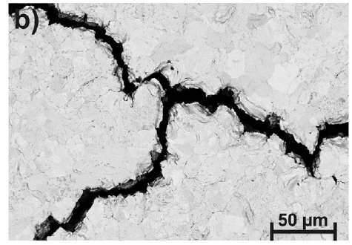
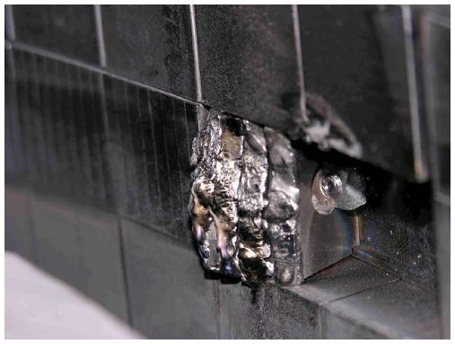
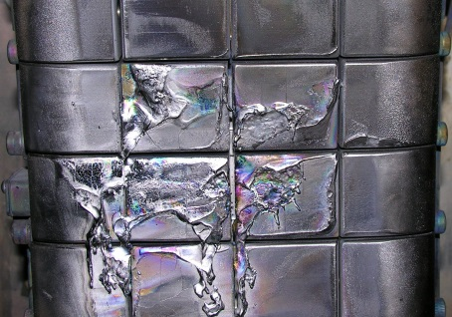
Liquid metals present intrinsic advantages over solid PFCs in several areas
Liquid metals provide a self-healing/renewable plasma-facing material
  Immune to thermo-mechanical stresses
  Returns to equilibrium after perturbations
  Replenishment eliminates net-reshaping by plasma bombardment
Separates neutron damage effects from plasma-material interactions
Eliminates long-time constants associated with solid-wall material transport and evolutionª
Demonstrated confinement effects and power handling capabilities
Cracking after thermal shock loading
Wirtz, et al., JNM 2013
CMOD W-lamellae
Mo first-wall
ªStangeby, JNM 2011
Coenen, et al., JNM 2013
M. Reinke, private comm.
Notes:
On the first point:
LMs present intrinsic advantages in a lot of areas
Self-healing, renewable, immune to thermomechanical damage
Thermally shock a solid, it cracks
Stress a liquid, it flows
And if designed correctly, it will flow back to its original position unlike a solid metal that inadvertantly melts
Eliminates long-time constants associated with solid-wall material transport and evolution
Really, we come to more near term questions: demonstrated confinement effects and power handling capabilities

Slide 4
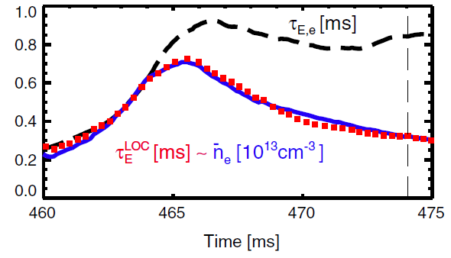
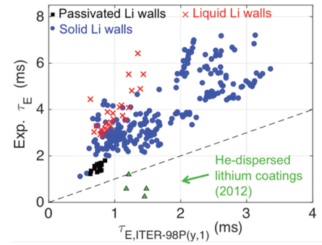
LTX demonstrated (again) confinement gains even with partial oxidation of Li coatings and Li pool
Measured electron energy confinement exceeds neo-Alcator Linear Ohmic Confinement scaling ~3x (Boyle PRL 2017)
Evaporated coatings monitored with MAPP diagnostic correlated with good performance to ~100 hrs (Lucia PhD 2015, Schmitt PoP 2015)
Key question: will flowing liquids perform like coatings (with impurities)?
D. Boyle, et al., Phys. Rev. Lett. 119 (2017) 015001.
J. Schmitt, et al., Phys. Plasmas 22 (2015) 056112.
Notes:
Confinement effects have been demonstrated over a number of years in a number of devices: I highlight the most recent results from our sister machine, the LTX which has been conducting experiments with a mix of coatings and liquid pools
Electron energy confinement exceeds neo-alcator by factor of 3 (see this PRL)
Previous studies have shown that Li coatings seem to behave similarly to walls coated and heated above the liquidus temperature
This is an area of continuing study in both machines: determine the similarities and differences between current experiments on coatings (with impurities) and what would be expected from flowing systems

Slide 5
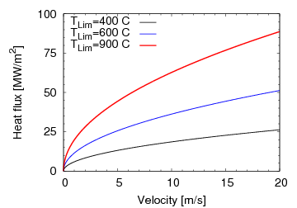
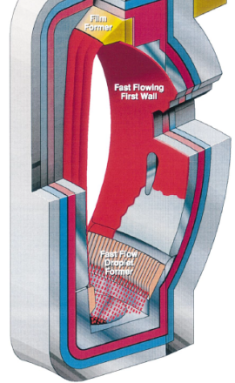
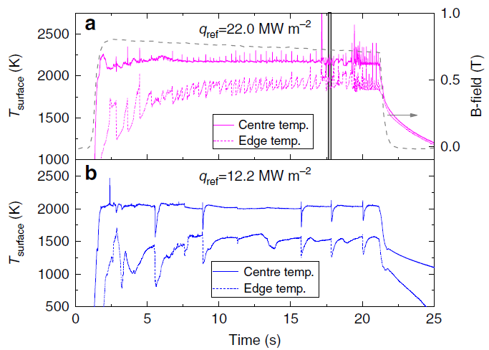
Liquid metal PFCs can absorb more heat flux than do leading tungsten technologies
Actively cooled tungsten expected to
survive 5-15 MW m⁻² steady-state
Fast-flow systems advect power away from heating zones
  Limiting temperature, heating size, and velocity determine limiting heat flux
  Li, Ga, Sn all possible metals for use
Slowly flowing liquid targets recently demonstrated in multiple configurations
  Non-vaporizing, water-cooled tin demonstrated at
  20 MW m⁻² in Magnum-PSIª
  Vapor-shielded tin achieved self-regulated temperature up to 22 MW m⁻² in Magnum-PSI^{b}
Fast Flow Concept
Calculated limiting heat flux
Sn limit?
Absorbing Li limit
Steady vapor-shielding Sn
ªMorgan, 2017 Nucl. Mater. Energy; ^{b}S. Van Eden, et al., Nature Comm. 8 (2017) 192.
Notes:
In the area of power handling, we have several recent demonstrations that indicate liquid metals can exceed conventional tungsten technologies
A reminder first: actively cooled tungsten is expected to survive 5-15 MW/m2 in a reactor, but the achieved number will likely be at 5 due to transients and neutron damage effects
Fast flow systems were designed to advect a lot of power out such as in this first-wall/divertor concept from the ALPS/APEX study. A simple calculation can indicate the level of heat flux exhausted which can easily exceed 5-15MW/m2 at flow rates of 10 m/s, even keeping the surface below 400C. Higher limiting temperatures allow more exhausted power.
Slowly-flowing systems have been demonstrated experimentally in recent years. A slowly-flowing, strongly cooled Sn target absorbed 20 MW/m2. In more extreme studies, Sn and Li targets were allowed to reach a vapor-shielded state and in this figure at the right, 22 MW/m2 were absorbed on a self-regulating Sn surface.
But placing these technologies changes the boundary conditions of the core plasma which brings up the question of how a confinement device really operates with either of these technologies:

Slide 6


Liquid metal PFCs can absorb more heat flux than leading tungsten technologies
Actively cooled tungsten expected to survive
5-15 MW m⁻² steady-state
Fast-flow systems advect power away from heating zones
  Limiting temperature, heating size, and velocity determine limiting heat flux
  Li, Ga, Sn all possible metals for use
Slowly flowing liquid targets recently demonstrated in multiple configurations
  Non-vaporizing, water-cooled tin demonstrated at
  20 MW m⁻² in Magnum-PSIª
  Vapor-shielded tin achieved self-regulated temperature up to 22 MW m⁻² in Magnum-PSI^{b}
  Vapor-shielding Li in plasma achieved with NSTX-U
  inspired pre-filled Li target in Magnum-PSI^{c,d}
Fast Flow Concept
Calculated limiting heat flux
Only in a
confinement device
can one assess the
core-edge integrated scenarios
Sn limit?
Enhanced confinement with vapor-box divertorª?
Absorbing Li limit
Steady vapor-shielding Sn
ªMorgan, 2017 Nucl. Mater. Energy; ^{b}S. Van Eden, et al., Nature Comm. 8 (2017) 192. ^{c}P. Rindt, et al., PMFC 2017;
^{d}P. Rindt, et al., Nucl. Fusion in preparation
ªGoldston, 2016 Phys. Scr.
Notes:
This is an integrated question and only confinement devices can assess the core-edge scenario. What sort of confinement would one get with a lithium vapor-box?
You can do some technology development in linear devices. However, some questions can only be answered in a confinement device.

Slide 7
Outline
Why evaluate liquid metals as a plasma-facing component (PFC)?
  Liquid PFCs resolve several problems plaguing solid PFCs
  Liquid PFCs demonstrated to enhance confinement and can absorb more heat flux than do solid PFCs
Why study liquid metals now and why in NSTX-U?
  PMI Community workshop highlighted liquid PFCs in numerous priority research directions and high-impact cross-cutting activities
  Integrated scenario assessment of ST requires movement away from C
Notes:
The main questions I’d like to cover in this short time are the following two:
Why evaluate liquid metals?
And why study them now and in NSTX-U?

Slide 8
US PMI community workshop highlights the importance of developing tools that can extrapolate to a reactor
Multiple priority research directions (PRDs) highlight need to advance concepts (including liquids):
  PRD-A: limits on power and particle handling, including liquids
  PRD-B: demonstrate dissipative divertor solutions, including liquids
  PRD-C: develop solutions for main chamber components and tools for sustained operation
  PRD-D: science of evolving materials, including liquids
  PRD-E: understand impact of materials on core performance
Multiple high-impact, cross-cutting activities also identified:
  CC-1: enhance exploitation of existing machines for PMI studies
  CC-3: understand the science of liquid surfaces and examine feasibility of liquid PFC solutions
See also Reinke’s talk
Notes:
Why NOW?
The PMI workshop process was designed to identify the key scientific questions that need to be answered TODAY if they are to be cooked into TOMORROW’s reactor.
IN reviewing them, though, I was again amazed at how nearly all of them use the word “reactor”.
These were covered by Matt, but if you look in the text, nearly all of them had some reference also to liquids
[Go through A-E]
In addtion to the PRDs, the workshop also identified several cross-cutting activities that reach across PRDs:
A research thrust on NSTX-U on liquids is highly cross-cutting.
That addresses why NOW? But why NSTX-U?

Slide 9
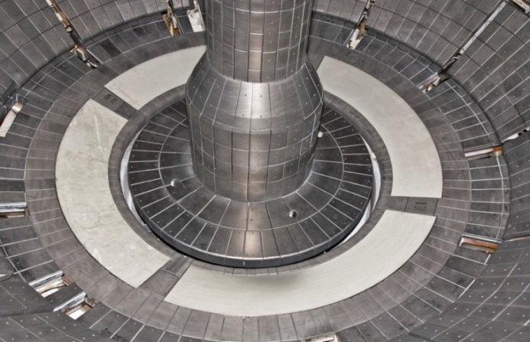
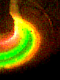
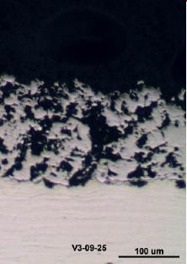
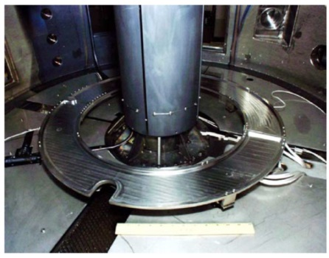
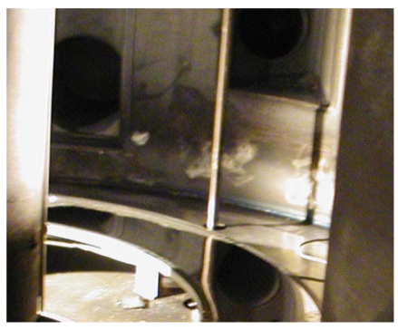
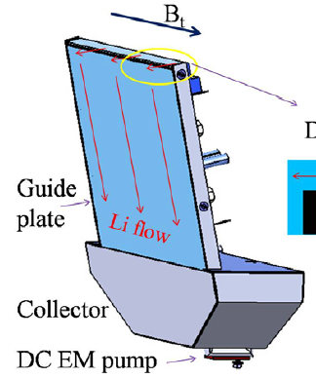
NSTX & PPPL expertise, and need for integrated solutions motivates for liquid metal mission in NSTX-U
Years of developing Li science…
  Diagnostics: dual-band IR (ORNL), divertor imaging/spect. (LLNL), MAPP (U-Illinois)
  Theory: liquid stability, quantum molecular dynamics (SBU) and DFT (PU), whole-device material evolution modeling
  Supporting surface science laboratories
…and technologies
  Lithium experimental methods: LITER, U-LITER, granule & aerosol
  injection, Liquid Lithium
  Divertor
  Large area tray limiters,
  LTX shell system, etc.
NSTX-U can easily
create q┴ > 20 MW m⁻²
  Full heating power: P/R~20
NSTX Liquid Li Divertor
EAST FLiLi
CDX-U large-area tray limiter
Hu 2016 NF
Kaita 2005 JNM
Notes:
NSTX and PPPL expertise, and the potential for high-power operations in NSTX-U make very strong motivations for this research in NSTX-U.
Years have been spent developing both the scientific tools and methods, as well as the technologies for doing lithium studies. This is investment that would have to be rebuilt if not done here.
The science is carried out in state-of-the-art diagnostics, theory, and supporting laboratory experiments
The science is ENABLED by our tools set of methods for conducting lithium experiments, ranging from evaporator systems to full divertors to free-surface trays of liquid metal.
NSTX-U has the heating power and shaping available to greatly exceed the technological limits of solid PFCs – it’s a great place to conduct these studies.
In fact, we have already been developing plans for near-term studies.

Slide 10
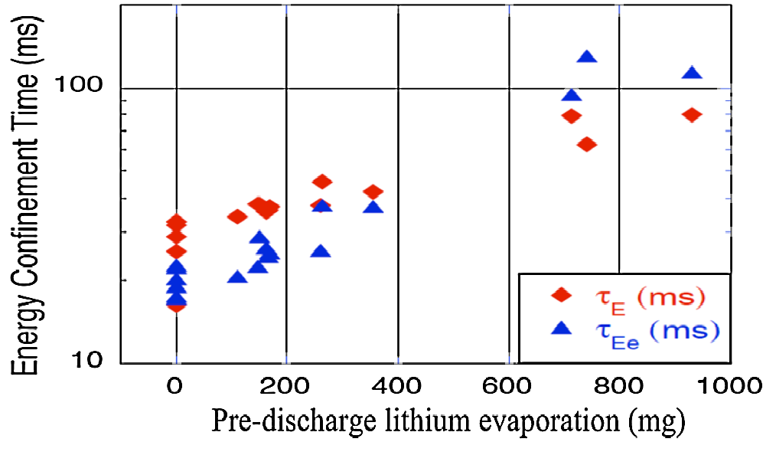
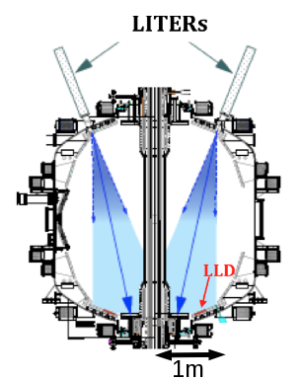
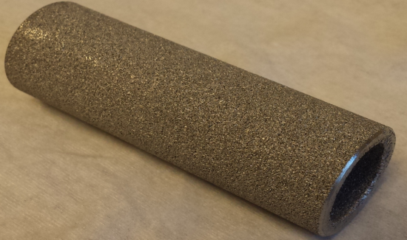
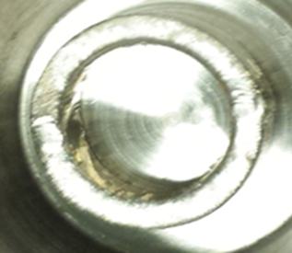
Positive NSTX results motivate near-term plan with Upward LITER in NSTX-U
Confinement improvement attributed to reduced recycling
Machines at PPPL
showing benefits of
lithium conditioning
over increasing areas
  TFTR Li
  “super-shots”
  CDX-U, LTX
  NSTXª
Others examining
Li:
  FTU, T11-M,
  HT-7,EAST, DIII-D
  TJ-II, RFX
NSTX Configuration
NSTX
Upward LITER Development
ªR. Maingi, et al., Phys. Rev.
Lett. 107 (2011) 145004.
Cai, 2017 IEEE TPS
Notes:
In the near-term, Li confinement studies will build on NSTX results by increasing the areal coverage of the Li evaporators.
Confinement improvements attributed to reduced recycling
Multiple PPPL machines have shown this effect – here is a result from NSTX using the LITER system
We have also been developing an upward facing LITER to increase coverage.
This is a capability we could bring up early in this research program.

Slide 11
High-Z + Li NSTX-U would advance multiple Priority Research Directions simultaneously in unique ST facility
NSTX and NSTX-U has emphasized surface science understanding of plasma-material interface (PRD-C,D)
  MAPP deployed in 2016: year 1 capability
  Studying impact of materials on plasma and vice-versa essential to whole-device modeling of material evolution
A liquid metal-capable NSTX-U would enable high-Z vs. lithium comparison studies in a high-power device (PRD-A,B,C,E)
  Extend LTX-beta studies
  Builds on and complements continuing studies in higher A devices like EAST
Heating power available to NSTX-U enables testing of liquid concepts to extreme power levels (PRD-A, B, C, E)
  Potentially critical to ST line
  Potentially critical to economical fusion energy concepts
Notes:
Looking further afield beyond LITER, we see what happens when PFCs are upgraded to metallic as mentioned by M. Reinke.
A high-Z+Li NSTX-U could advance multiple PRDs simultanteously in a unique ST facility
NSTX and NSTX-U have emphasized surface science understandings through unique diagnostics like the MAPP system to explore the impact of materials on the plasma and vice-versa. This addresses PRDs C and D
A liquid metal capable NSTX-U would neable high-Z and Li comparison studies at high-power
This extends LTX-beta results and makes comparison to conventional aspect ratio devices like EAST
This addresses PRD-A,B,C,E
The heating power capabilities in NSTX-U enable testing to extreme powers

Slide 12
One possible progression: staged conversion to mitigate risk while enabling integrated performance assessment of the ST
Full high-Z conversion enables comparison with conventional high-Z
Provides high-power analog to evaluate LTX confinement results
Open divertor and flexible magnetic configuration mitigates risk
C
BN
Li
High-Z
Lower
OBD
high-Z row of tiles
Cryo + All High-Z
+ Prefilled
Cryo + All high-Z + Li loop
Flowing Li
collector
LITER + U-LITER + Granules
High-Z tile row
Pre-filled Target
Flowing Li module

Slide 13
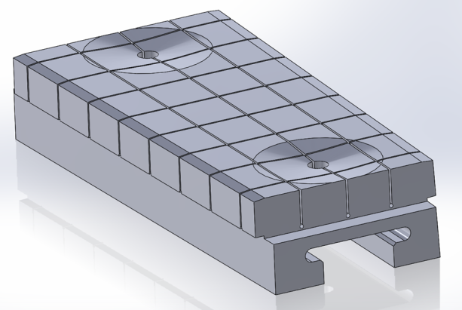
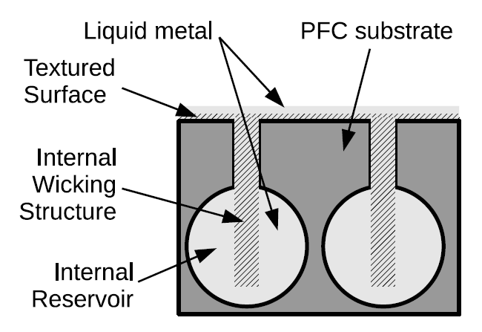
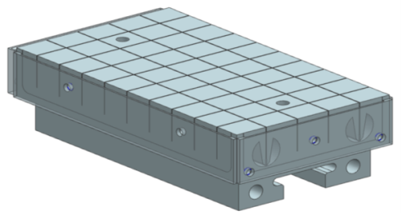
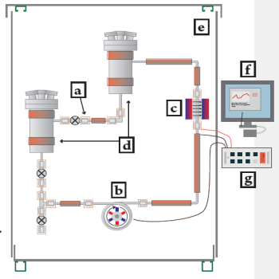
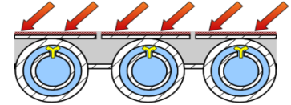
Most mature technologies proposed for current development path (emphasis on qualification testing)
Bulk high-Z for high heat flux regions, Mo/W coatings may be possible in low-heat flux regions
Pre-filled targets build on
high-Z, high-heat flux designs
External Li feed into reservoir region with inertial cooling provides near-term similarity to
DEMO-relevant concepts
2015-16 NSTX-U High-Z Design
~2 yr deploy
~2.5 yr deploy after high-Z
~10 yr deploy

Slide 14
The integrated assessment of the ST can be improved with near- and long-term PMI studies (Li + high-Z)
Liquid metals have potential to solve several long-standing issues associated with solid PFCs
Recent results continue to show confinement gains and potential for steady power exhaust
US PMI Community identified the need to advance liquid metal science and technology, and evaluate feasibility
A staged upgrade for NSTX-U can enable an integrated (plasma-material) assessment of the ST
  New PFCs require sustained R&D starting now for second 5-year plan
Notes:
Repose question soliciting feedback on main logical questions: why liquids, why NSTX-U

Slide 15
Thank you!

Slide 16
Liquid metal PFCs can absorb more heat flux than leading tungsten technologies
Actively cooled tungsten expected to survive 5-15 MW m⁻² steady-state
  Transients and neutrons lead to ~5 MW m⁻²
  Technological limitations lead to
  9m major radius in EU DEMO1
  (P/R=17)ª
Tin CPS water-cooled
target demonstrated
20 MW m⁻² in Magnum-PSI^{b}
Unknown vapor-shielding limit
  Dependent on replenishment
  rate to surface (technology)
  Dependent on core plasma
  compatibility with divertor
Perpendicular Heat Flux Limit
?
Sn limit?
Ablative Li
Sn CPS
Solid W
Absorbing Li limit
ªWenninger 2017 Nucl. Fusion;
^{b}Morgan, 2017 Nucl. Mater. Energy
Fast Flow
Notes:
Combine slow flow and fast flow – draw out better distinction – show plots of slow-flow results
Label fast flow as calculation
Put fast flow on top and use slow flow on bottom to transition to next slide
Higher heat flux potential could lead to more attractive core-pedestal solutions

Slide 17
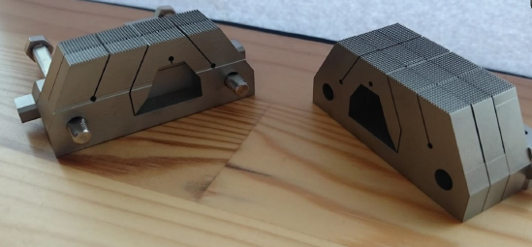
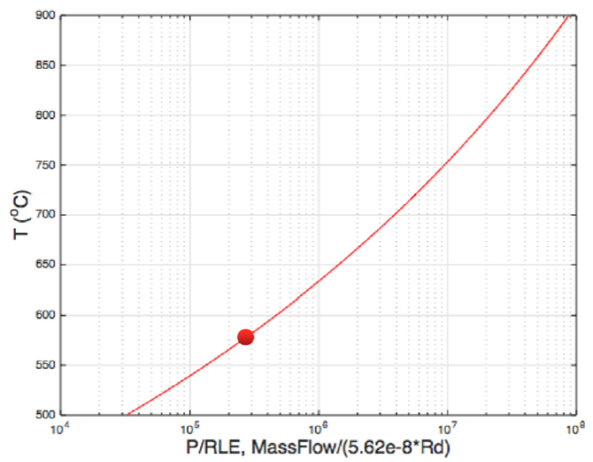

Vapor shielding experiments in linear plasma device; shows path forward for vapor-box concept
Liquid Sn and Li targets tested
  Magnum-PSI linear plasma
  Both exhibit temperature clamping
Li-target tested based on pre-filled concept
Vapor box 0D
calculations
indicate very high
heat flux potential
Sn
900
DEMO reference pt.
2.5GW fusion power
200MW to outer div.
R=6m, l_{p,box}=0.5m
ε_{cool}=250eV
800
Rindt, PFMC 2017
700
600
P/R~33
S. Van Eden, et al., Nature Comm. 8 (2017) 192.
R. Goldston, et al., Nucl. Mater. Energy 12 (2017) 1118.
500

Slide 18
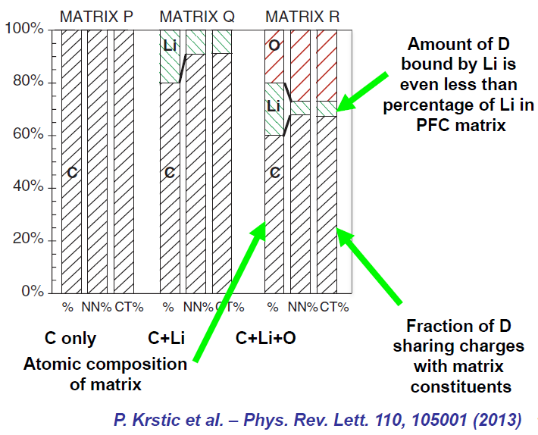
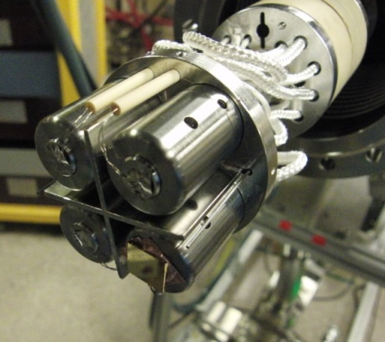
Multiple tools developed to study complex, substrate-dependent lithium chemistry
Quantum modeling by Krstic indicates preferential bonding of deuterium to oxygen in carbon matrix (theory)
Laboratory studies by Capece show increased absorption by oxidized Li, but lower thermal decomposition temperature (laboratory studies)
MAPP diagnostic successfully deployed in NSTX-U 2016 run campaign
MAPP Diagnostic
(U-Illinois)
Krstic, 2013 PRL
Capece, 2015 JNM

Slide 19
Multiple decision points in the research program leading to new science and technology opportunities
NSTX-U PFC Recovery project emphasis on prototypes builds confidence
High-Z introduction enables early evaluation of operational impact of new PFC materials
  LITER and U-LITER allows near-term examination of increased areal coverage with lithium conditioning
Pre-filled target performance presents decision points:
  Is a closed divertor upgrade necessary for high-temperature (i.e. vapor box)?
  Is active cooling or fast-flow required for long-pulse particle flux handling?
Closed loop facility enables broadened facility scope for research on integrated technologies
Vapor-shield
in open div?
Fast flow R&D
High-Z
Start
Pre-fill
Closed divertor
Design iteration?
Active cooling

Slide 20


Most mature technologies emphasized for current development path
Bulk high-Z for high heat flux regions, coatings may be possible in low-heat flux regions
Pre-filled targets build on graphite and high-Z substrate designs
External Li feed into reservoir region with inertial cooling provides nearest target technology for NSTX-U
DEMO-relevant PFC concept
High-Z PFC T-bar design
Pre-filled target concept

Slide 21
Sustained effort needs to start now if this is to be implemented in 2025-2030 timeframe
Reverse schedule developed to identify dependencies in R&D
  Pre-filled high-heat flux tiles build on High-Z HHF
  High-Z high-heat flux and low-heat flux tiles build on PFC Recovery activity
Pre-filled tiles could be used in NSTX-U campaigns ~6 years from start (High-Z HHF in ~2 years)
Li R&D facility recommended to accelerate development
  Serial R&D processes indicate ~10 years of development to integrated PFCs
  Fully flowing modules require Li loop and handling R&D & ops experience
  Fully flowing modules required for Li facility that “runs as long as we want it to run”
  Building/facility recommended in PPPL Li Corrective Action Plan to consolidate Li activities as a best practice

Slide 22

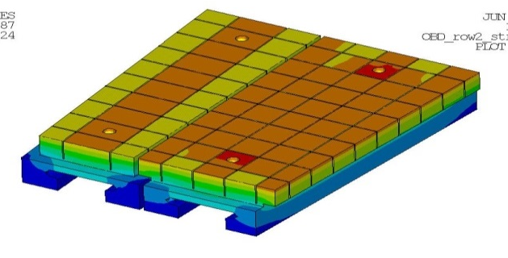

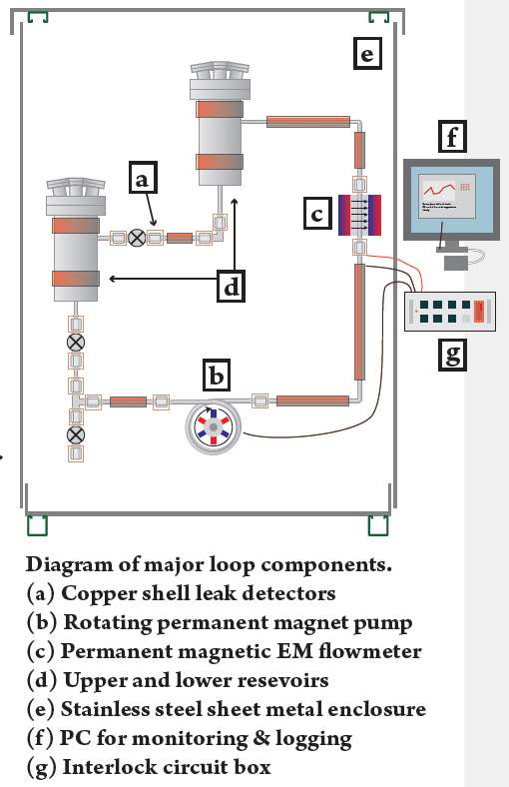
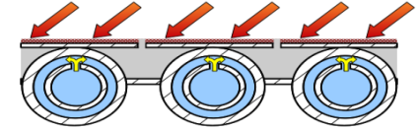
A three-step progression can accelerate tests of flowing, liquid metal PFCs
High-Z divertor tiles + LITER
Pre-filled liquid-metal target
Flowing LM PFC
High Heat Flux, High-Z Divertor Upgrade
Conceptual design for pre-filled LM target
Flowing PFC loop integration

Slide 23
High-Z divertor tiles + Li evaporated coatings provide divertor analogue of Magnum-PSI experiments
High-Z divertor tiles + LITER + U-LITER
  Scientific goals:
    Short-period particle-flux handling through temperature ramp
    Quantify maintenance of Li on high-temperature substrate and protection of substrate
    Re-examine suppression of erosion in high-flux divertor
    Understand impact and core-edge compatibility of high-temp. target with limited inventory of Li
High Heat Flux, High-Z Divertor Upgrade
Conceptual design for pre-filled LM target
Flowing PFC loop integration

Slide 24
Pre-filled targets test LM coverage, resupply and impact of significant Li source
Pre-filled liquid-metal target
  Scientific goals:
    Short-pulse particle-flux handling with localized Li source
    Test models of maintenance of LM wetting and coverage
    Understand limits of LM passive resupply
    Understand impact and core-edge compatibility of high-temp. target with larger inventory of Li
High Heat Flux, High-Z Divertor Upgrade
Conceptual design for pre-filled LM target
Flowing PFC loop integration

Slide 25
Final integration demonstrates LM introduction/extraction and inventory control
Flowing LM PFC
  Scientific goals:
    Short pulse particle flux handling with localized, constant material
    Assess material inventory control to/from LM target
    Understand performance of passive + active replenishment techniques
    Understand impact and core-edge compatibility of high-temp. target
High Heat Flux, High-Z Divertor Upgrade
Conceptual design for pre-filled LM target
Flowing PFC loop integration

Slide 26
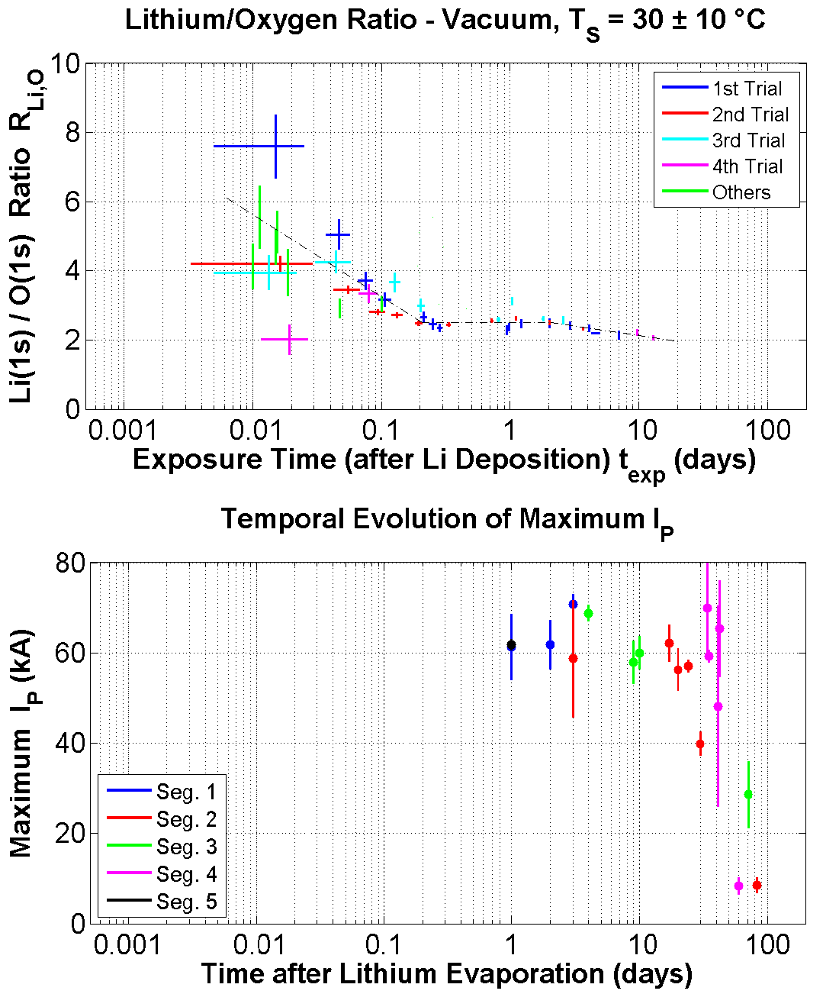
Measurements of surface composition after lithium application indicate formation of stable oxide layer
Results shown from several lithium evaporation experiments
Surface exclusively Li₂O for ~100 hours at H₂O pressure of 2 x 10⁻⁹ T (upper figure)
Persistence of maximum achievable plasma current – good plasma performance – suggests ability of Li₂O to retain hydrogen (lower figure)
Low resolution of MAPP XPS system means more time time needed for scans
  Li₂O formation from lithium unresolved for t < 1 hour

Slide 27
Hydrogen retention in lithium and lithium oxide measured under controlled laboratory conditions
Used stainless steel ultrahigh vacuum chamber with 2×10⁻¹⁰ Torr base pressure
Ni(110) single crystal high-Z substrate
Lithium films created by thermal evaporation onto Ni substrate
  Lithium oxide formed by O₂ exposure
Lithium and lithium oxide films exposed to 500 eV H₂⁺ ion beam for total total fluence of 4×10¹⁵ H⁺cm⁻²
  Beam defocused over surface to provide total fluence of 4×10¹⁵ H⁺cm⁻²
Hydrogen retention determined with temperature programmed desorption
  Measurements made after irradiation with hydrogen at various lithium and lithium oxide film temperatures

Slide 28
Experiments simulated with molecular dynamics calculations
Classical molecular dynamics (MD) used
  Each atom treated as point mass
  Newton’s equations integrated to compute motion
  Individual force equation for each atom derived from potential energy functional for system
Amorphous target surfaces of pure Li and Li₂O prepared for 90, 300, 400, 500, and 600K temperatures
Computational cells of about 2000 atoms initially created at 300K for two cases
  Random distribution of lithium atoms only
  Predefined random distribution of 33% O and 67% of Li atoms

Slide 29
Amorphous distribution of lithium and lithium oxide in unit cells
Li system (2000 lithium atoms)
Li₂O system: 33% of O (660 atoms) and 67% of Li (1340 atoms)
  • Green and red symbols represent Li and O, respectively

Slide 30
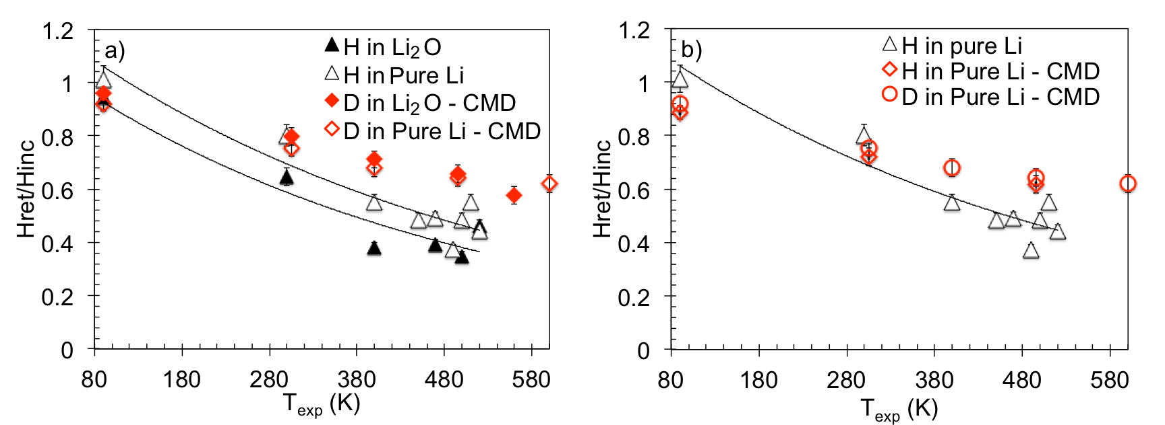
Hydrogen retention in lithium and lithium oxide seen in laboratory experiments and MD simulations
H retention fraction (H retention/H incident) in Li and Li₂O as function of exposure temperature and comparison with D retention from MD calculations
MD and experimental data on H retention fraction only in Li and Li₂O as function of exposure temperature.

Slide 31
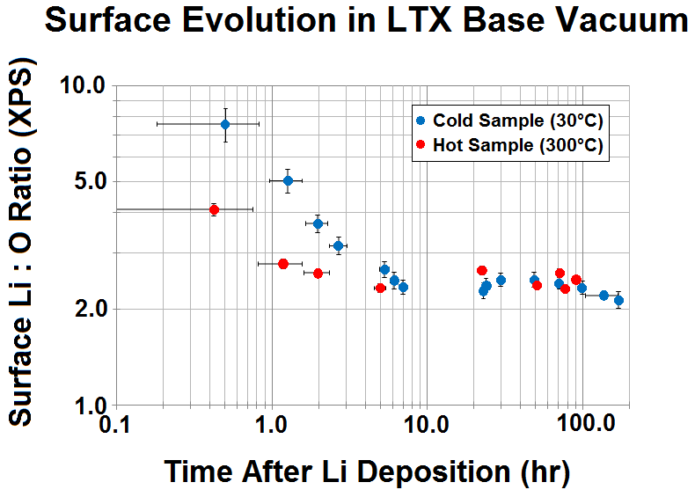
LTX demonstrated (again) confinement gains even with partial oxidation of Li coatings and Li pool
Measured electron energy confinement exceeds neo-Alcator Linear Ohmic Confinement scaling ~3x (Boyle PRL 2017)
Evaporated coatings monitored with MAPP diagnostic correlated with good performance to ~100 hrs (Lucia PhD 2015)
Key question: will flowing liquids perform like coatings (with impurities)?
D. Boyle, et al., Phys. Rev. Lett. 119 (2017) 015001.
M. Lucia, PhD Thesis, Princeton University. 2015.
Notes:
Replace confinement plot with LTX confinement plot showing solid/liquid data sets out of Schmitt PoP 2015??
Instead: replace surface evolution with Schmitt plot?

Slide 32
Liquid metal PFCs provide additional pathways for energy transport
Energy Transport Mode
Conventional, solid PFCs utilize extrinsic impurities to enhance radiation
Heat Conduction
to Substrate
Solid PFCs

Slide 33
Liquid metal PFCs provide additional pathways for energy transport
Energy Transport Mode
Conventional, solid PFCs utilize extrinsic impurities to enhance radiation
Liquid metals access mobility as additional tool for energy transport
Particle retention in Li a strong function of temperature links PMI physics to the technology
Li CPS (first wall, divertor)
Evaporative and Radiative Cooling
Li Vapor Box,
ARLLD (divertor)
Heat Conduction
to Substrate
FLiLi (first wall)
Sn CPS
(first wall,divertor)
LiMiTs
(first wall, divertor)
Heat Convection
by Liquid Metal
Fast Flow, ACLMD
(first wall, divertor)

Slide 34
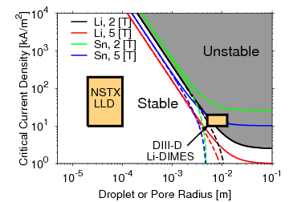
An DEMO-relevant concept provides guidance for relevant technologies in NSTX-U
Stability achieved by porous substrate
Closely connected primary coolant and liquid lithium reservoir/supply structure
  Temperature controls evaporation and condensation
  Temperature controls hydrogen retention
Continuous flow to/from the surface to flush gettered material and maintain wetted surfaces (substrate protection)
Jaworski, et al., Plasma Phys. Control. Fusion 55 (2013) 124040.

Slide 35

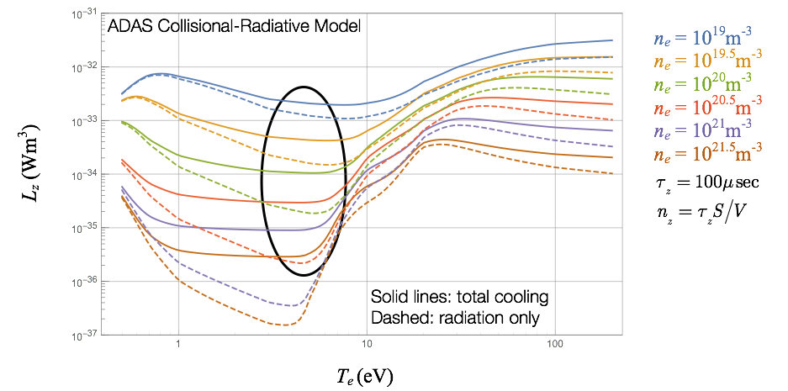
Li Vapor Box (LVB) Divertor
Li vapor divertor target is constrained
in space by differential pumping
  Bottom chamber reaches equilibrium
  density of ~ 10²²/m³ @ 750 C
  Upper chambers pump by condensation,
  at much lower temperature
Plasma energy is dissipated in bottom box
Goldston, ISLA 2015

Slide 36
WallDYN: An integrated global model for mixed material migration
Plasma Model
Surface Model
Experimental Data
Plasma Assumptions
Mixed-Material Surface Binding Energies
Physical Sputtering Calculations (vary energy, projectile, target composition)
SDTRIM.SP
OSM-EIRENE
Plasma Reconstruction
Impurity Transport Probability Calculations
(charge-resolved)
Empirical chemical erosion formulae
DIVIMP
Hydrogenic Fluxes
Wall Initial Conditions
Continuous composition-dependent erosion yields
WallDYN
Coupled system of differential-algebraic equations for erosion fluxes and surface areal densities
D co-deposition
Wall evolution
Virtual diagnostics

Slide 37

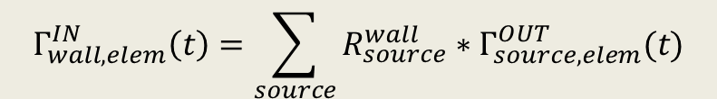
WallDYN parameterizes plasma impurity transport with DIVIMP 2D Monte Carlo code
20k neutrals launched from each wall bin
  Energy and angular distribution typical of sputtered particles
  Deposition location, charge state recorded
R ≡ Fraction of eroded flux from “source” that ends up in a certain charge state at “destination”
1 Algebraic equation for influx of each element & charge state:
Assumptions:
  Impurity concentrations are low enough not to disturb plasma (“trace impurity limit”)
  Plasma transport timescale << wall evolution timescale
  Plasma does not change in time
1
R
D
1→1
2→1
3→1
1→2
2→2
3→2
1→3
2→3
3→3
$$Γ_{wall,elem}^{IN}\left(t\right)=\sum_{source}{R_{source}^{wall}∗Γ_{source,elem}^{OUT}(t)}$$
3
D
D
2
Fig. adapted from Meisl NF 2016

Slide 38
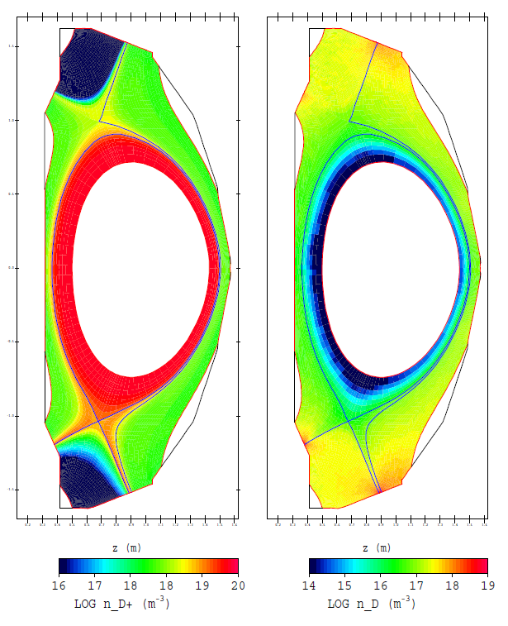
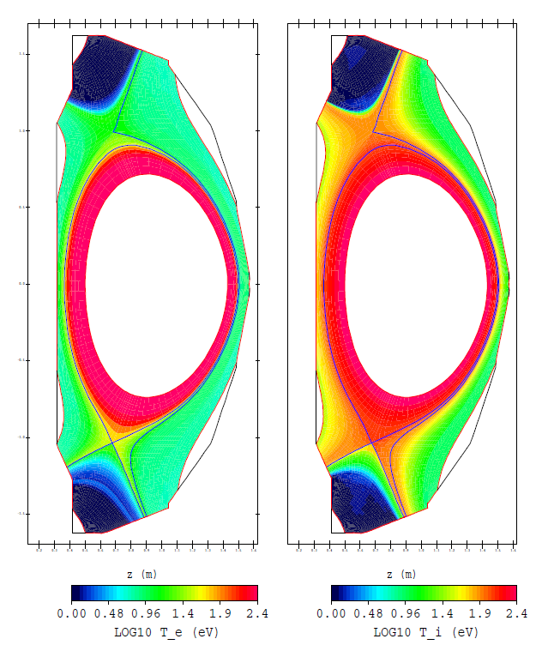
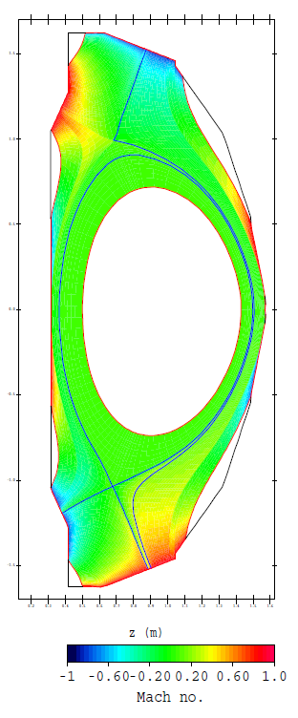
OSM/EIRENE edge plasma background generated for NSTX-U
Ion Density
Neutral Density
Electron Temp.
Ion Temp.
Parallel Flow
High strike point density/temperature, large radial gradients (H-Mode like)
No external flow/pinch applied

Slide 39
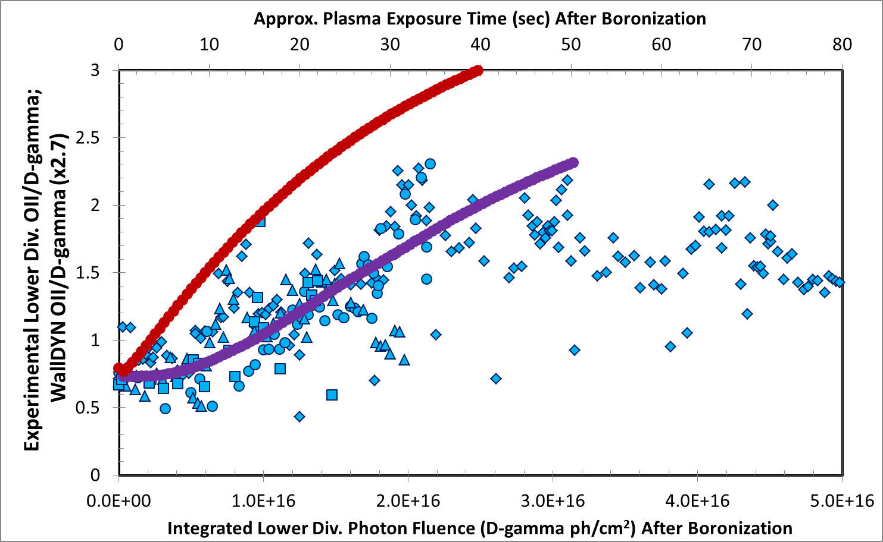
Results: agreement with OII emission trends greatly improved with thin film model
WallDYN (no thin film model)
OII/D-γ
WallDYN
(thin film model, full boronization)
NSTX-U Discharges Following Boronization
B5
B8
B9
B10

Slide 40
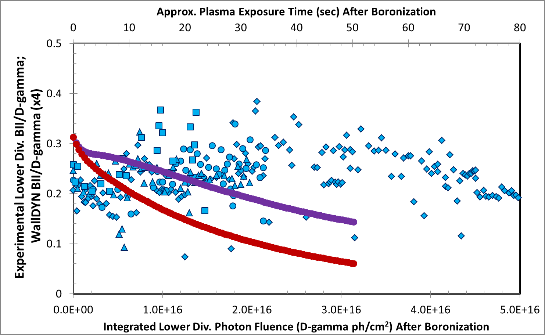
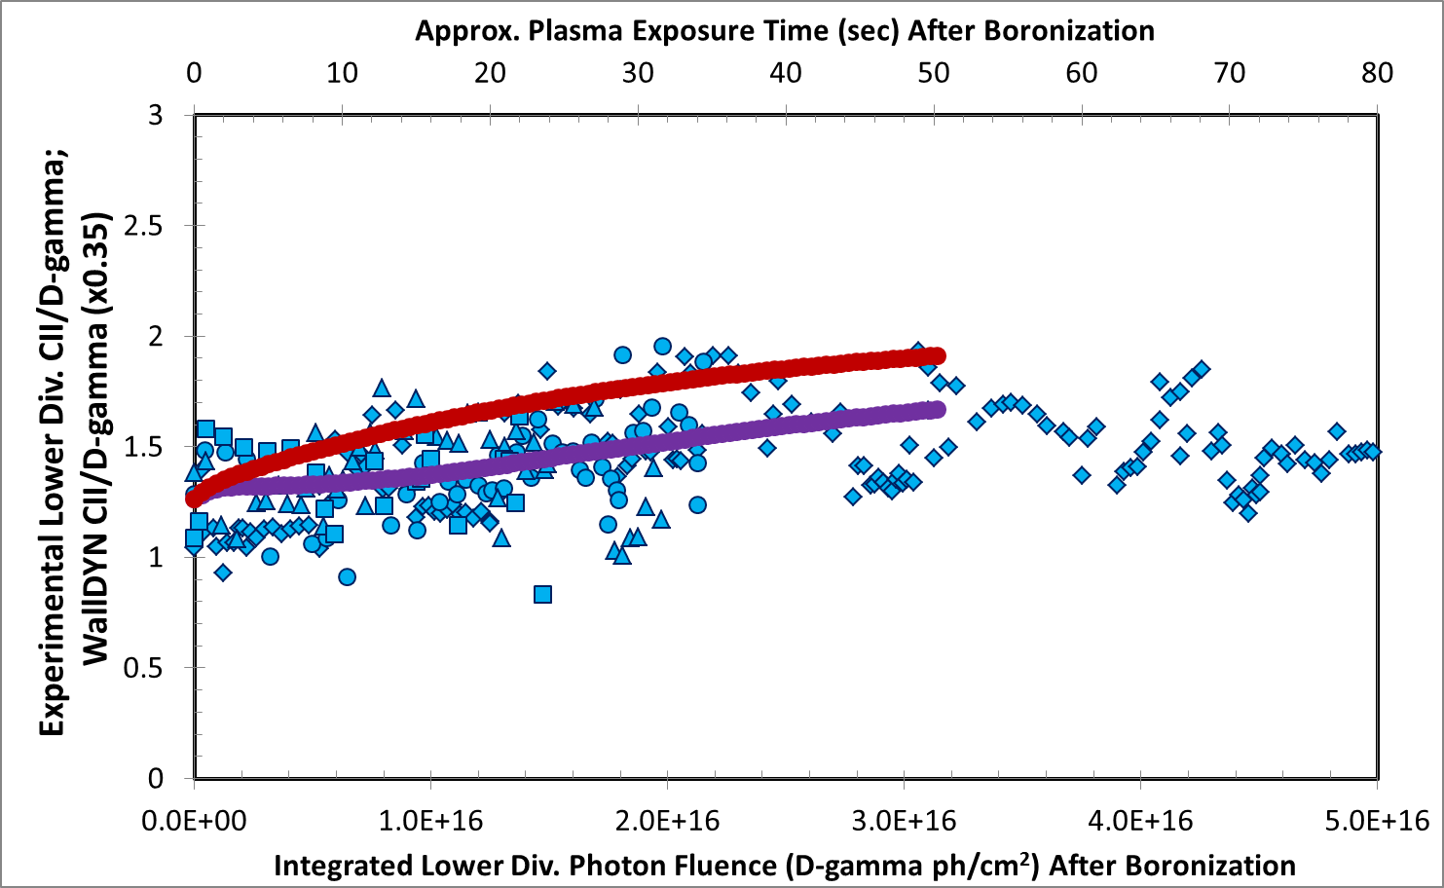
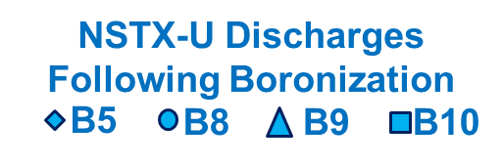

Results: agreement with BII, CII emission trends slightly improved with thin film model
BII/D-γ
WallDYN (no thin film model)
CII/D-γ
WallDYN (no thin film model)
WallDYN (thin film model, full boronization)
WallDYN (thin film model, full boronization)
Thin film model brings WallDYN into good agreement with experimental oxygen emission trends following full boronizations
No experimental trend in carbon emission following boronization
  Good agreement with both WallDYN models
No experimental trend in boron emission following boronization
  Poor agreement with both WallDYN models
  Reason for continued disagreement is under investigation

Slide 41
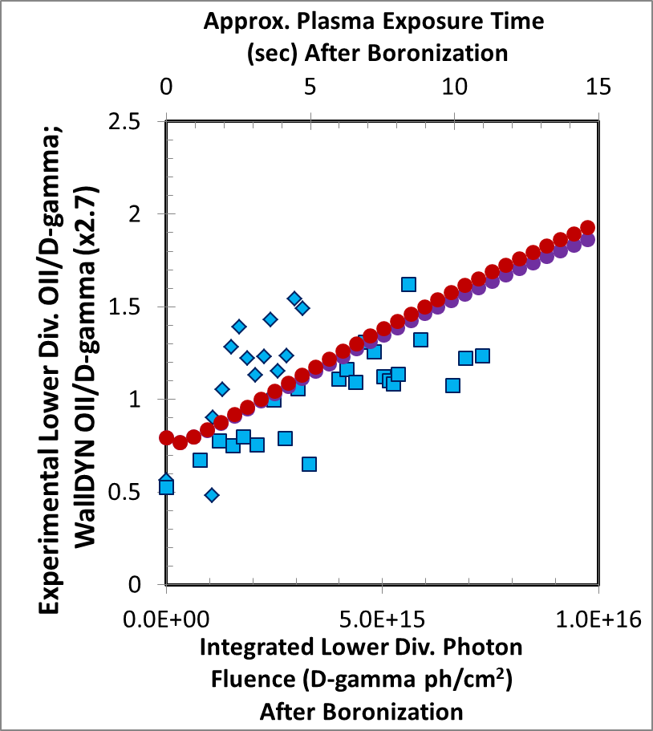
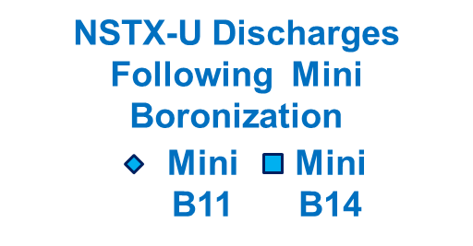
Results: agreement with mini boronization emission trends similar with either model
Thin film WallDYN model capable of differentiating between full and mini boronizations
  Captures faster rise in impurity influx following mini boronization
Both model and experiment show degradation of mini boronization coating on time scale of ~ 1 run day (15 sec plasma exposure)
For mini boronization, thin film WallDYN model is nearly identical to old WallDYN model
  Makes sense, because boron film applied to divertor (~30 A) is thinner than reaction layer (ion penetration depth ≈ 40 A)
OII/D-γ
WallDYN (thin film model, mini boronization)
WallDYN (no thin film model)

Slide 42
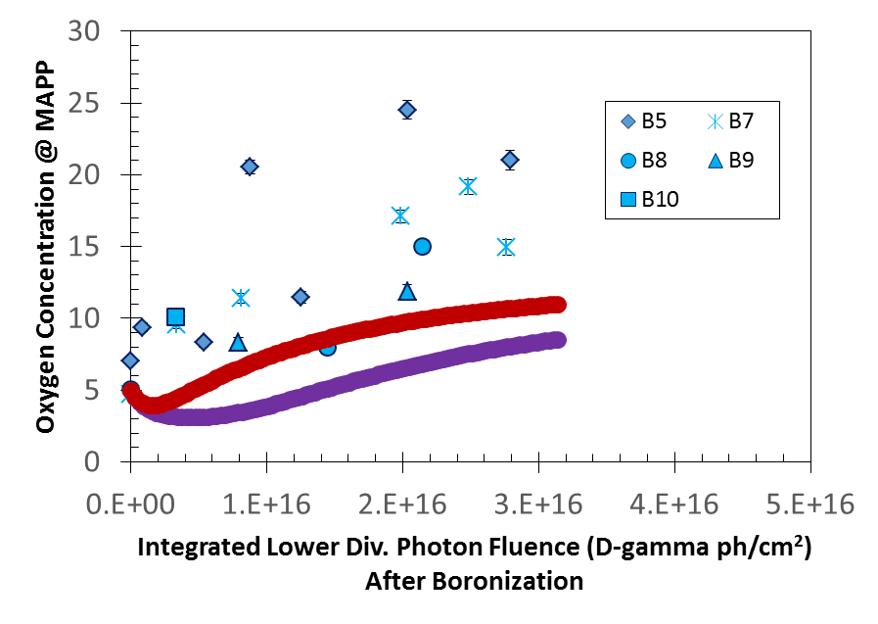
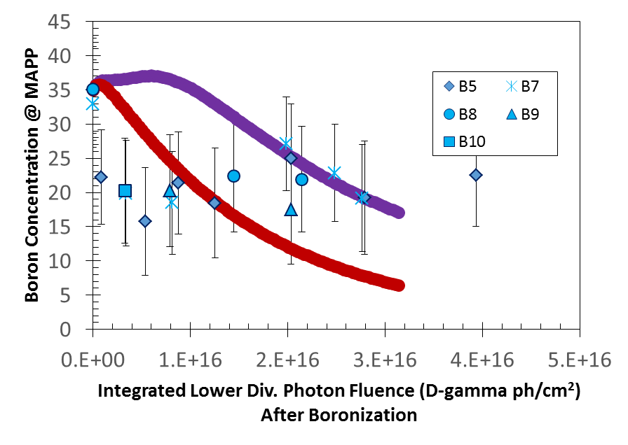
Results: surface concentration evolution during simulations
MAPP measurements following boronization
Both WallDYN models underestimate the rise in oxygen surface composition observed in MAPP
Surface boron agreement inconclusive
Models do not take into account chemical state of surface
  e.g. B-O vs. B-B vs. B-C bonds
  May be important!
  For more B/C/O surface discussion see:
  F. Bedoya JO4.10 Tue PM
  H. Schamis PP11.57 Wed PM
WallDYN (no thin film model)
WallDYN (thin film model, full boronization)
MAPP measurements following boronization
WallDYN (thin film model, full boronization)
WallDYN (no thin film model)

Slide 43
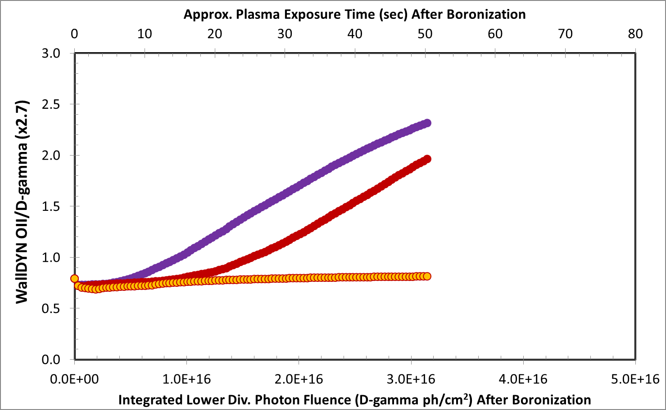
Effect of more uniform boron coverage on oxygen evolution (aka more GDC electrodes)
WallDYN
(“Realistic” coverage: 62-227 A)
WallDYN
(Uniform 104 A, same # B atoms as “Realistic”)
WallDYN
(Uniform 522 A, all B atoms in 9.0 g dTMB utilized)
Uniformity of boron coatings is controlled by properties of He glow discharge and the number of anodes

Slide 44
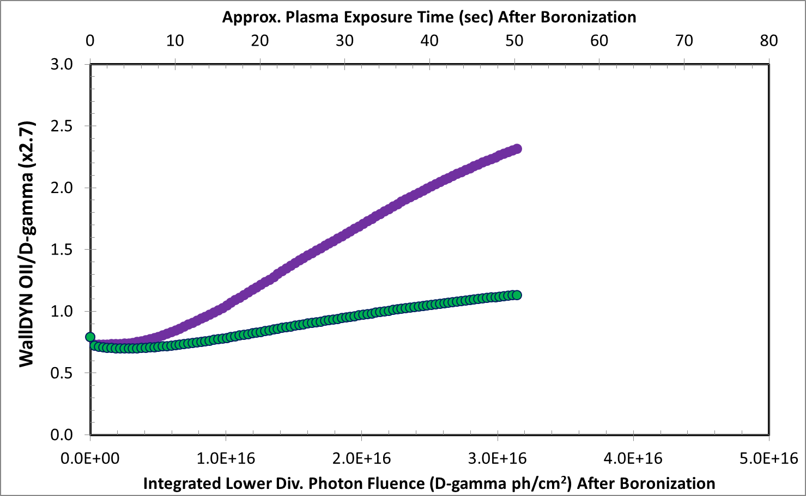
Effect of lower bulk oxygen concentration on oxygen evolution (aka better bakeout)
WallDYN
(Bulk 20% O)
WallDYN
(Bulk 10% O)
Bulk oxygen content is typically controlled by pre-campaign conditioning (bakeout, etc.)

