Slide 1
Wave heating and current drive
R. Perkins & N. Bertelli
NSTX-U PAC-39
PPPL, Princeton, NJ
Tuesday, January 9, 2018

Slide 2
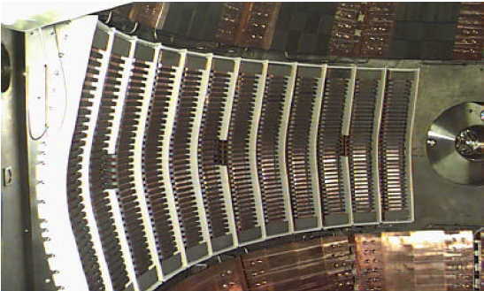
High-harmonic fast-wave (HHFW) heating:
6 MW source power with flexible phasing
30 MHz: well above ion cyclotron frequency
Landau damps on electrons
Can be absorbed by beam-ions
12-strap phased array
Power-deposition control via phasing
Complementary to NBI
Injects heat without particle or momentum input
12-Strap HHFW antenna at NSTX-U midplane
Only ICRF on toroidal experiment in USA
Unique system among STs

Slide 3
HHFW is envisioned as a tool that diversifies and enhances the following NSTX-U research:
Transport studies
Rotation effects on stability
Interactions with fast-ion-driven modes
Low-current non-inductive scenarios
High-Z impurity transport
Solenoid-free start-up
Near- & mid-
term
Long- term

Slide 4
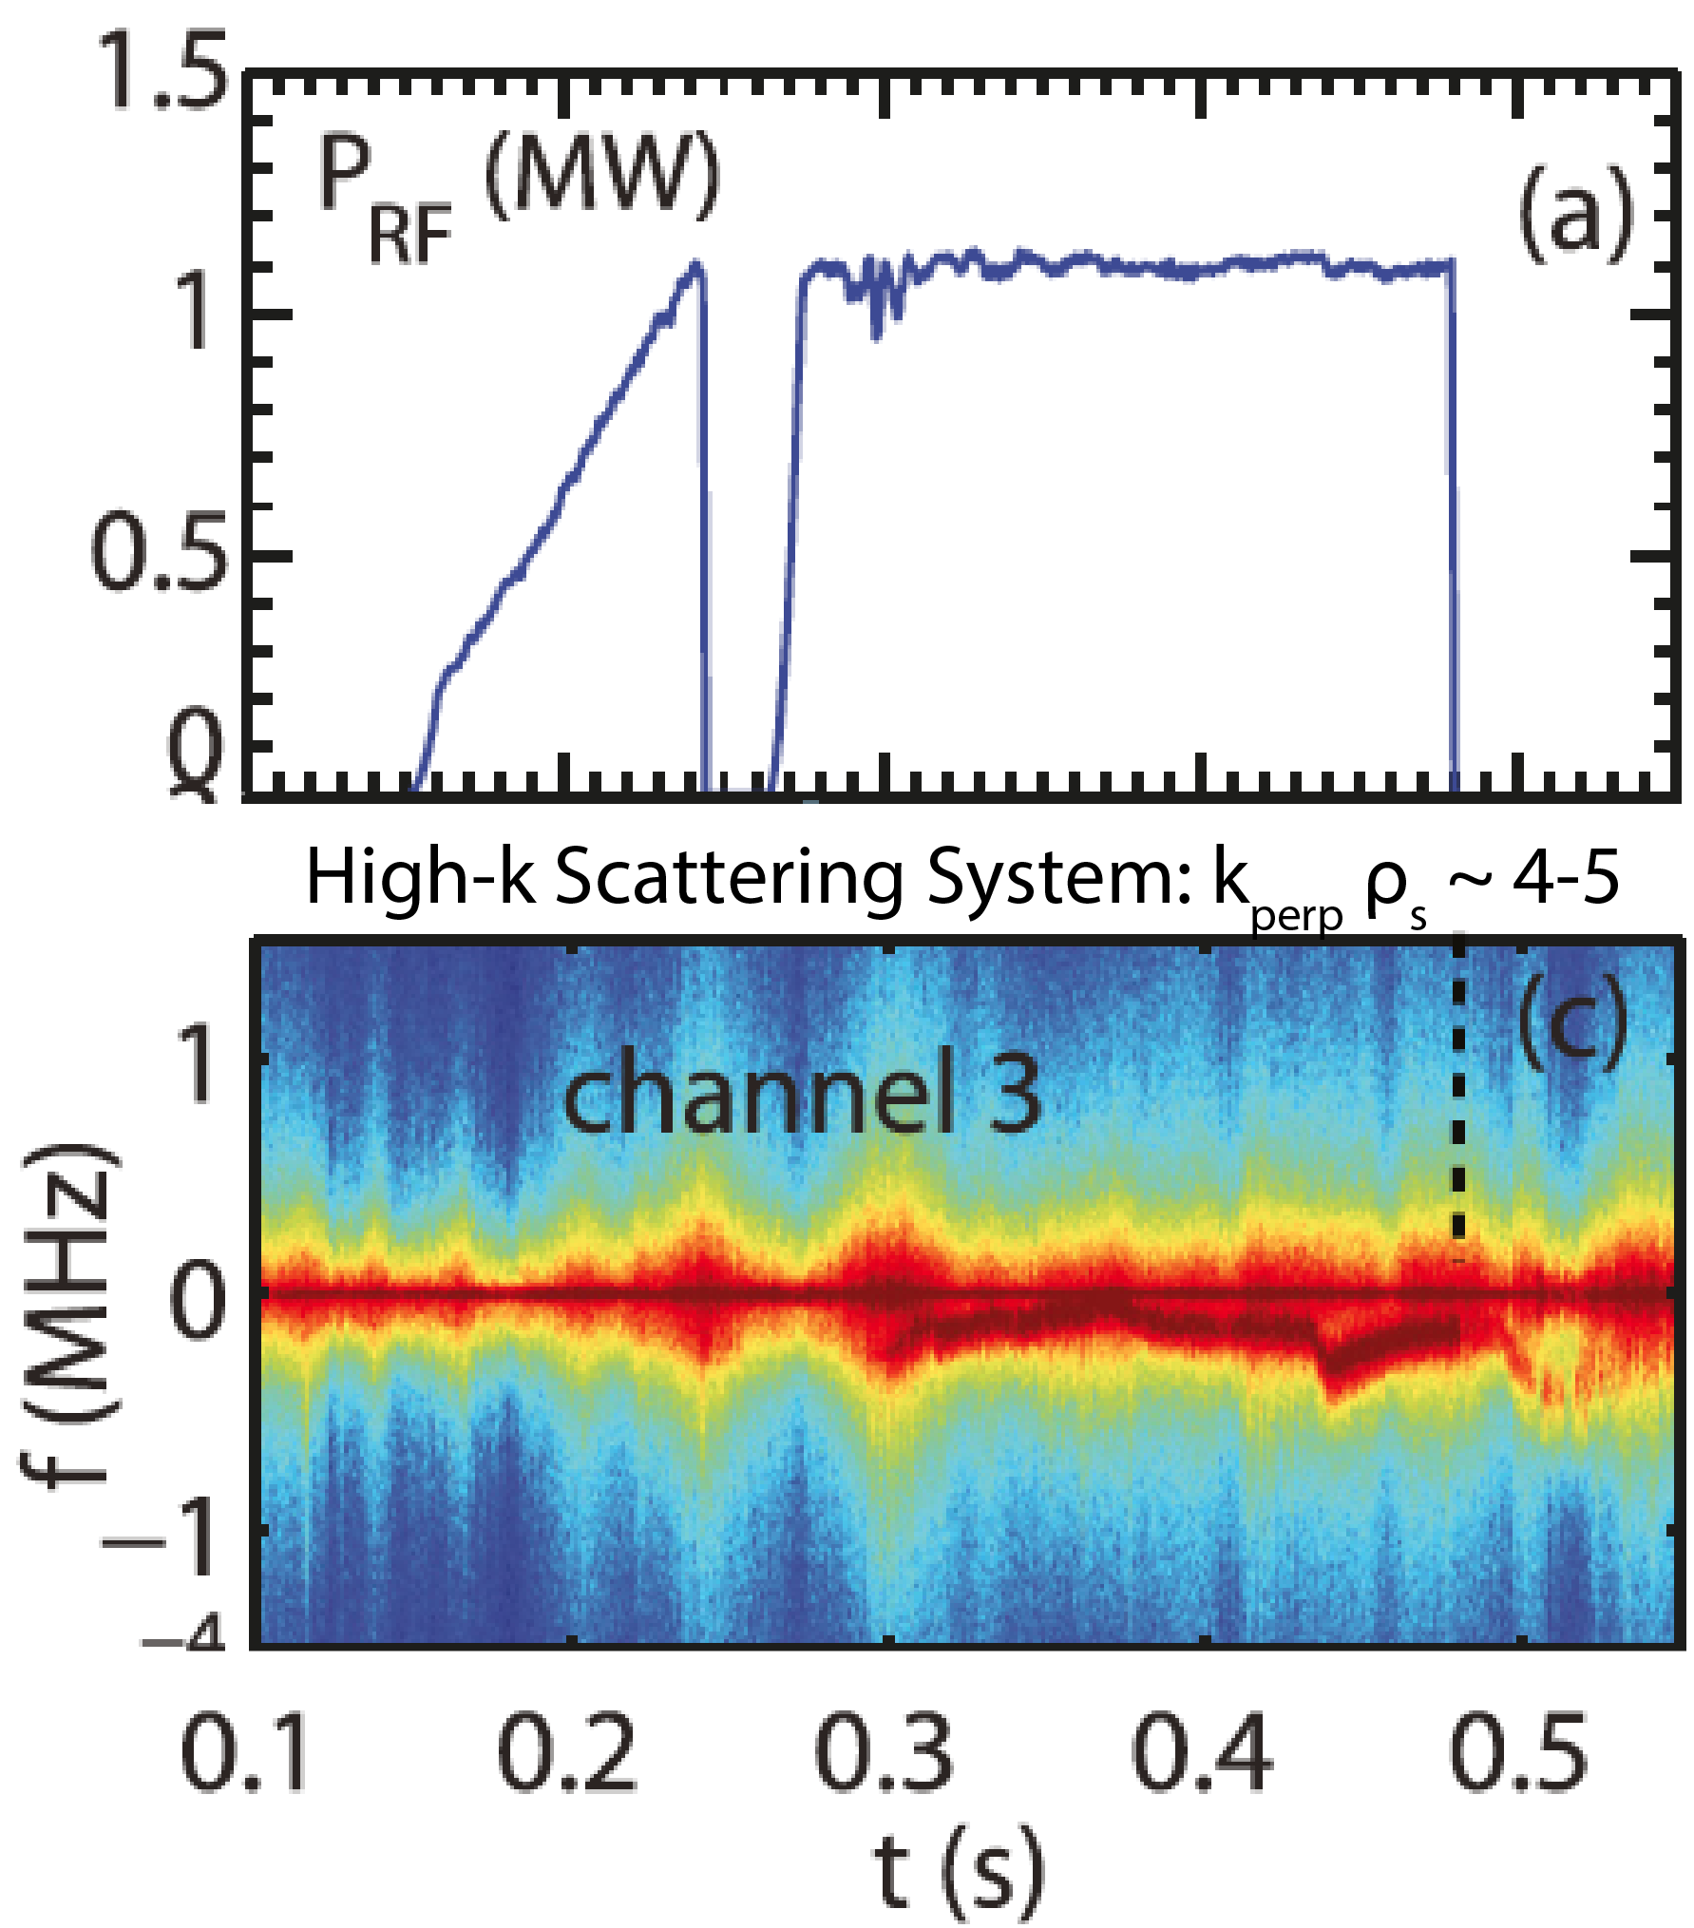
HHFW can support the investigation of ST confinement via significant e⁻ heating [T&T-TSG]
ST record high T_{e} achieved using 3 MW HHFW
(k_{phi} = -8 m⁻¹)
Steep T_{e} gradient
enables transport studies
7
T_{e} > 6 keV
in He
T_{e} [keV]
0
7
T_{e} > 5 keV
in D₂
T_{e} [keV]
0
Perturbative electron transport studies investigating non-local transport (k⊥ ρ_{s} ~ 4-5)
0.2
Radius (m)
1.6
G. Taylor et al., Phys. Plasma 17 (2010) 056114
Y. Ren et al., Phys. Plasma 22 (2015) 110701

Slide 5
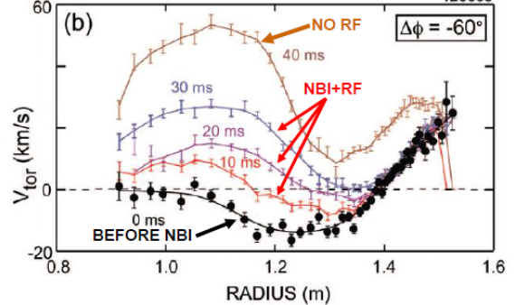
HHFW can strongly change rotation profile; possible tool for transport & stability [T&T- & MS-TSGs]
HHFW influences rotation profile
Clamps edge rotation to no-NBI level
HHFW can produce low-torque H-modes
Study e⁻-heated, low-torque discharges for ITER
Useful for L-H transition studies
Important topic ITER
Compare to JET results
Study NTV offset rotation
Would benefit from x-ray crystal spectrometer (MIT)
Velocity profile evolution during diagnostic beam blip
1.1 MW of HHFW, 2 MW beam blip
G. Taylor et al., Phys. Plasma 17 (2010) 056114

Slide 6
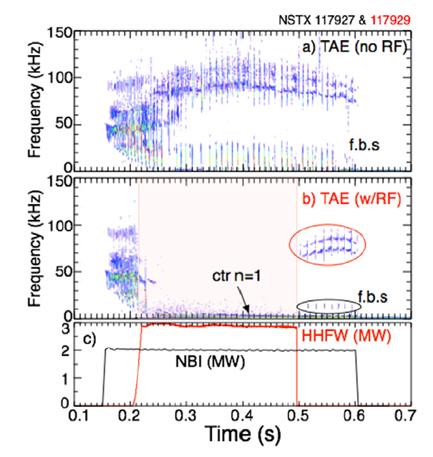
HHFW can suppress EP/AE activity [EP-TSG]
HHFW can significantly modify the fast ion phase space
D. Liu et al., Plasma Phys. Control. Fusion 52 (2010) 025006
Significant interaction between HHFW and fast-ion driven modes
Possible suppression/excitation of EP/AE modes
ITER relevant:
ITER will have (super-Alfvénic) alpha particle & ICRF
NSTX-U beam injection is super-Alfvénic
E. Fredrickson et al., Nucl. Fusion 55 (2014) 013012

Slide 7
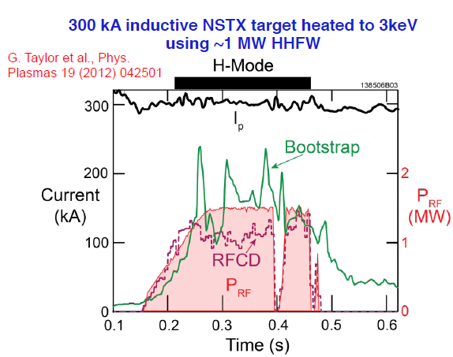
Heating low-I_{P} plasmas: applications to solenoid-free ramp-up & high bootstrap fraction [SSR- & ASC-TSGs]
HHFW can potentially bridge the gap between a solenoid-free start-up plasma and NBI
Bring cold low-current plasma up to suitable target for NBI
NEAR TERM: target low-current (300 KA) Ohmic flattop
MID/LONG TERM: target actual ramp-up phase
See following Non-Inductive Start-up and Ramp-Up talk

Slide 8
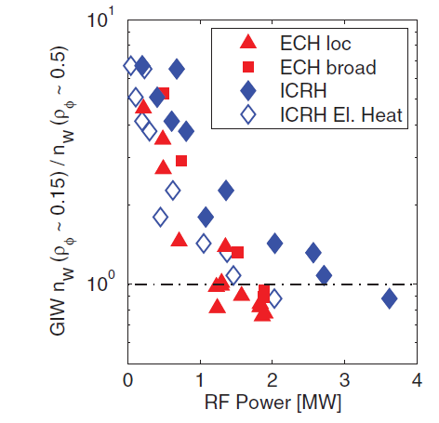
Central RF heating mitigates high Z impurity accumulation in the plasma core [ASC- & M&PFCs-TSGs]
High-Z impurity accumulation is a major issue for high-Z walls
STs can explore neoclassical vs turbulent effects
NEAR TERM: HHFW can contribute in near term (before high-Z tiles)
LONG TERM: HHFW may be an operational need if we transition to a high-Z wall
Significant recommendation from PAC-37
ASDEX-U results showing
reduced W concentration with RF
C. Angioni et al., Nucl. Fusion 56 (2017) 056015

Slide 9
Charge Question 1: Research in 2016-17 in support of improved HHFW operation
Modeling of SOL losses of HHFW power
AORSA simulations including SOL extended to different aspect ratios
N. Bertelli et al., Nucl. Fusion 56 (2016) 083004
FW2D incorporates realistic antenna & limiter geometry
E.-H. Kim et al., EPJ Web of Conferences 157 (2017) 02005
Cylindrical model calculates modes with enhanced fields in edge
R. J. Perkins et al., Nucl. Fusion 57 (2017) 116062
Modeling of HHFW absorption by different ions
Self-consistent TORIC & NUBEAM coupling
N. Bertelli et al., Nucl. Fusion 57 (2017) 056035
Impact of 2nd harmonic H absorption ~1 T
New heating scenario
Collaborations to study far-field rectification
Experiments at LAPD on RF rectification and vessel-wide current paths
Analysis of EAST ICRF experiment: far vs near field rectification

Slide 10
Prospect of HHFW in NSTX-U (2020-25)
Characterize SOL losses at higher toroidal field
Expected to improve based on operation experience & modeling
Quantify losses so users know power input to core
Study HHFW absorption profiles
Assess absorption by 2nd beam ion vs 1st beam
Characterize e⁻ vs beam-ion absorption
Predicted to vary with antenna phases & Te/Ti ratio
Impact of H species on HHFW performance
Continue collaboration with RF SciDAC research
RF core physics: TORIC + non-Maxw. effects + NUBEAM (w/ TRANSP group)
Possible synergy with Helicon research

Slide 11
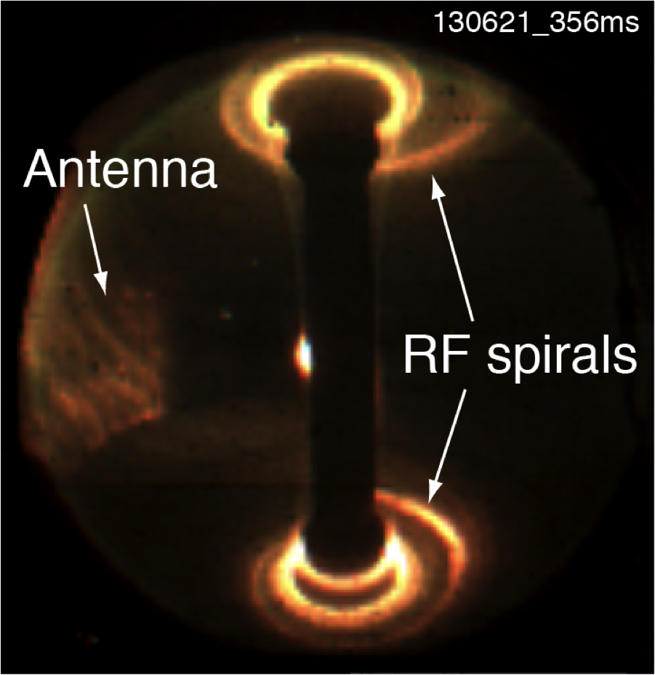
Charge questions 2 & 3: Uniqueness of NSTX HHFW in view of global RF Research
SOL losses: unique physics issues
Modeling of enhanced RF fields in SOL
Far-field rectification: dissipating wave power
Impact of field misalignment of antenna at high pitch
Compare to results obtained from C-Mod field-aligned antenna
HHFW on NSTX-U is a unique feature for spherical tokamaks
Highest power & flexible phasing
TST-II: 21 MHz HHFW system up to 30 kW
Globus-M: ICRH (~7-9 MHz), 2-strap antenna, 0.5 MW
Will be the only ICRF system on a toroidal experiment in US
DIII-D 476 MHz helicon system: lower-hybrid range of frequencies

Slide 12
Summary
HHFW system can provide up to 4 MW couple power
Complementary to NBI
HHFW on NSTX-U would support and enhance a broad spectrum of applications:
High core T_{e} for transport studies
Interaction between HHFW & NBI
Heating of low-I_{p} targets for subsequent NBI ramp-up
Effect on rotation profile
High-Z impurity expulsion
Theory Partnership through RF SciDAC project

Slide 13
THANK YOU

Slide 14
NSTX-U WH&CD research in line with ITPA activities 2017, 2015 PMI & Integrated simulations workshops
ITPA Integrated Operation Scenarios: IOS-5.1 ICRH impurity generation
& 2015 PMI workshop: [PRD-C] Understand, develop and demonstrate innovative boundary plasma solutions for main chamber wall components, including tools for controllable sustained operation, sufficient for extrapolation to steady-state reactor application
Interaction between HHFW and SOL plasma: HHFW SOL losses, antenna impurity sources
2015 Integrated simulations workshop: [PRD-Boundary-4] Integrate RF antenna/plasma-absorption simulations with SOL/pedestal plasma transport simulations, filling a notable gap in present capability
collaboration with the new RF SciDAC project on this task
ITPA ENERGETIC PARTICLES PHYSICS: EP-12 Identification of AE control actuators and preliminary assessment for ITER
Interaction HHFW + NBI: modification of fast ions phase space by RF
suppression of AE activity by HHFW

Slide 15
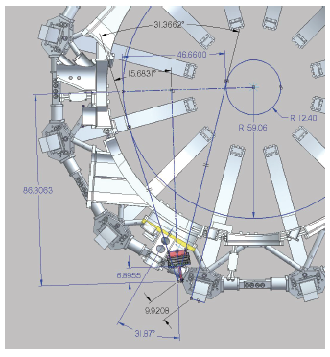
Proposed x-ray crystal spectrometer (MIT)
Obtains rotation & T_{i} profiles without NBI “blips”
Uses argon seeding for Doppler measurements
Useful for HHFW-only discharges for which CHERS is unavailable without beam blips
Conceptual design review completed
Covered redesign of port flange, spectrometer layout, test of analysis
Not included in Recovery scope
Could be near-term capability if supported

Slide 16
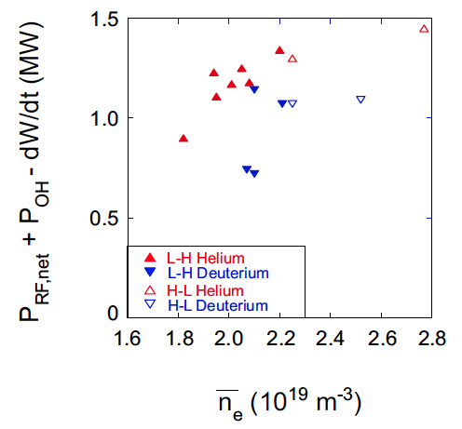
Isotope-dependence in L-H transition studies are enabled by HHFW
HHFW advantages for L-H transition studies
HHFW can heat discharges without momentum input
HHFW heats He discharge w/o injecting D
HHFW power level is arbitrary
NBI “discretized” to 2 MW steps
Important for ITER
Marginal power for L-H transition in hydrogen phase?
Added ST data point to ITPA studies
Will compare future NSTX-U results to recent & upcoming results from JET
S. Kaye et al., Nucl. Fusion 51 (2011) 113019

Slide 17
Developments in RF
SOL losses determine to be field-aligned and occurring across entire width of SOL
MIT field-aligned antenna demonstrates reduced impurity production and variations in reactive loading
RF rectification shown to be a strong candidate mechanism for dissipating HHFW power
Full-wave simulations show strong increase in RF amplitude in SOL when SOL density exceeds cutoff
Cylindrical analytic model shows existence of modes with large edge amplitudes when a half-wavelength structure fits into edge region
Self-consistent full-wave modeling and particle distribution function evolution

Slide 18
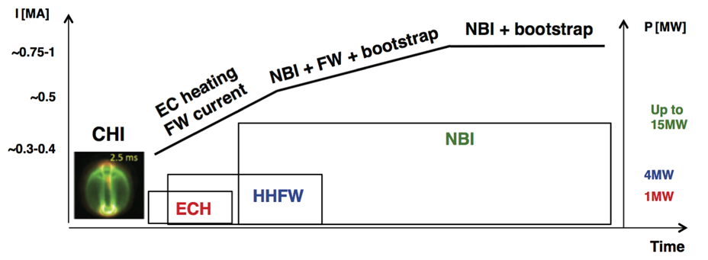
EC/EBW Motivations for NSTX-U
28 GHz gyrotron system can heat CHI plasma to enable HHFW heating and current drive, ramp-up to higher I_{P} with NBI heating
28 GHz gyrotron could also be used for EC/EBW plasma formation, H-mode heating and current drive (with launcher upgrade)
Performed TRANSP simulations combining all heating schemes: EC+HHFW+NBI
F. Poli et al, Nucl. Fusion 55 (2015) 123011
See talk on Non-inductive start-up and ramp-up

