Slide 1

Solenoid-Free Plasma Start-Up & Ramp-Up
¹R. Raman, ²D. Mueller, ²M. Ono, ²F. Poli, ²F. Ebrahimi
1 University of Washington
2 Princeton Plasma Physics Laboratory
NSTX-U PAC-39
Princeton Plasma Physics Laboratory
January 9-10, 2018

Slide 2
Solenoid-free Start-up and Ramp-up are Critical Issues for Compact ST and Tokamak-based Reactors
ST has been addressing critical issue of solenoid-free start-up
  A compact ST has little space for a central solenoid
  Solenoid-free start-up is also attractive for tokamak designs
Maximizing solenoid-free start-up currents reduces reliance on less developed non inductive current ramp-up scenarios
Few MA start-up current is projected for reactors
  Higher currents may be feasible
I_{P} [MA]
Current ramp-up
phase
NSTX-U
Solenoid-free
Start-up phase
NBI
HHFW
ECH/EBW, CHI, LHI
0 MA 0.4 MW 1 MA
Time
ECH / EBW – Utilize 1 – 2 MW 28 GHZ gyrotron
CHI – Coaxial Helicity Injection up to ~ 400 kA
LHI – Local Helicity Injection up to ~ 400 kA
HHFW - ~ 4 MW 30 MHZ high Harmonic Fast Wave
NBI - ~ 10 MW NBI

Slide 3
Solenoid-Free Start-Up / Ramp-Up
Present Plans
NSTX-U can start with Ramp-Up studies using inductively generated targets with HHFW & NBI, as in original plan.
  Eventual goal is to transfer this capability to CHI/LHI/ECH started targets when one or more of these are implemented on NSTX-U
NSTX-U SFPS experiments deferred in the near term; progress will be made through collaborations and theory/modeling:
  Supporting ECH / EBW start-up studies being conducted on QUEST
  Pegasus has been investigating Local Helicity Injection
  Supporting CHI work being conducted on QUEST in Japan

Slide 4
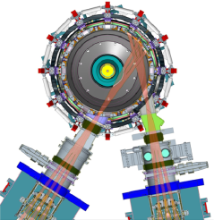
On NSTX-U, Non-inductive Ramp-Up from ~0.4MA to ~1MA Projected to be Possible With New CS + More Tangential 2nd NBI
2nd NBI provides 3-4x higher CD at low I_{P}:
  2x higher absorption (40→80%) at low I_{P} = 0.4MA
    Will test on NSTX-U during YRS 1 & 2
  1.5-2x higher current drive efficiency
NBI
HHFW
TRANSP
Simulations
non-inductive
plasma
FWCD
NBCD
bootstrap
ohmic
More tangential
2nd NBI
First NBI
First NBI
2nd NBI
F. Poli, PPPL

Slide 5

High Current Helicity Injection Start-Up can Reduce Reliance on Less Understood Current Ramp-Scenarios
Method | Device | Current Scaling | Present Demonstrations
ECH / EBW | MAST QUEST | Current scaling not understood | <100 kA on QUEST & MAST (Not coupled to induction)
Local Helicity Injection (LHI) [Small area electrodes / high voltage] | Pegasus | Dynamo Current Drive models need development | 200 kA on Pegasus (Coupled to induction)
Steady State CHI [Large area electrodes / lower voltage] | HIT-II HIST | Dynamo Current Drive models need development | 400 kA on NSTX 200 kA on HIT-II (Not coupled to induction)
Transient CHI [Short 2-3ms pulse discharge] | HIT-II NSTX QUEST | Scaling to large devices well understood | 200kA on NSTX 100 kA on HIT-II Demonstrated flux saving on NSTX by ramping to 1MA with inductive drive

Slide 6
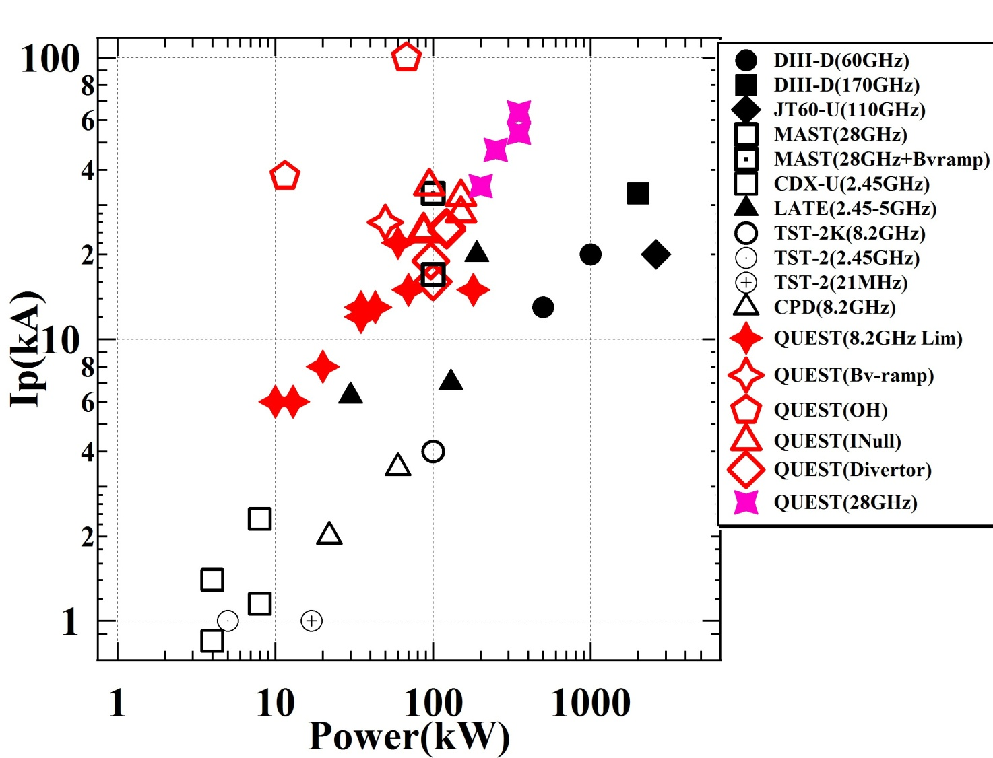
QUEST Has an On-Going Active Program on ECH
NSTX-U is Contributing via. Theory and Diagnostic Support
Current efficiency increased from 66kA/270kW to 85kA/230kW using new wave guides and polarizer
Further polarizer improvements should enable higher power (available up to 400 kW) operations.
Model validation of non-thermal electron tail created by the ECCD being carried out by PPPL researchers (Bertelli, Poli, Taylor)
X-ray camera from PPPL together with modeling to improve understanding of physics of ECCD (Delgado-Aparicio)
Initial 28 GHz plasma current ramp-up experiments on QUEST
Target

Slide 7
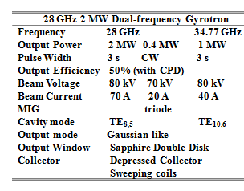
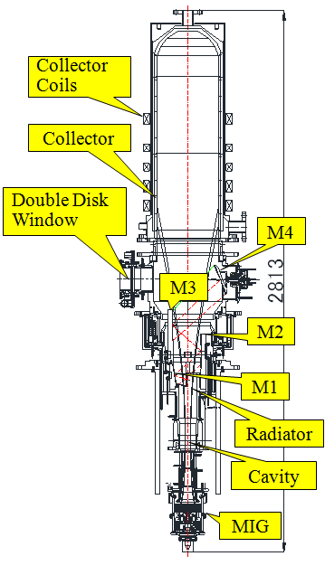
28GHz-34.8GHｚ Two Frequency Gyrotron Development by University of Tsukuba, Japan
T. Kariya, NF 2017
• High power test to be conducted in 2018 for > 1.5 MW at 28 GHz.
• CPD (Cathode Potential Depressor) increased the tube efficiency to ~ 50%
• Double disk window developed for long-pulse/steady-state operations
• High power tube should be technically available for NSTX-U within two years

Slide 8
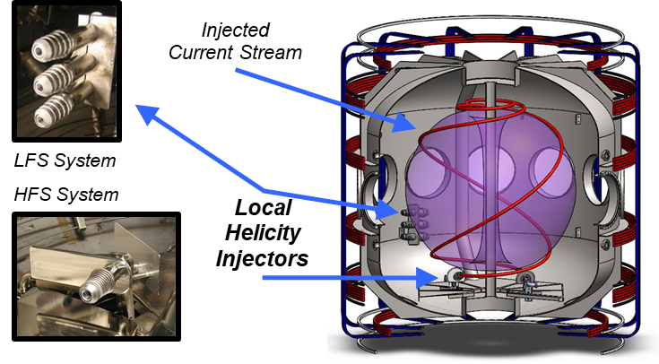
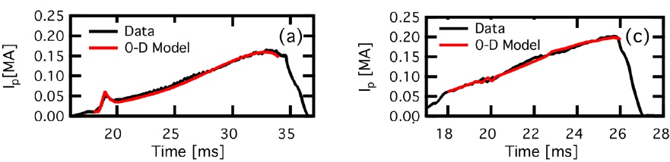
Local Helicity Injection (LHI) Providing High-I_{p} Start-Up being Developed on Pegasus ST (Univ. of Wisconsin)
LHI provides non-solenoidal startup and sustainment:
  I_{p} ≤ 0.2MA to date (with less than 8 kA of injected current)
  Inboard and outboard injection location investigated
LHI also enables access to interesting physics regimes:
  The current drive mechanism does appear to fundamentally be due to edge localized reconnection activity
  Strong edge drive provides access to low ℓ_{i} and very high β_{T} plasmas at relatively high I_{p} discharges at very low 𝐵_{T}
LHI Injector Geometries Vary Dominant Drive on Pegasus
LHI-Driven I_{p} ~ 0.2 MA Scenarios Test Predictive I_{p}(t) Model
Outboard: V_{IND} Dominant
Inboard: V_{LHI} Dominant
J.A. Reusch,et. al, PoP (submitted)

Slide 9

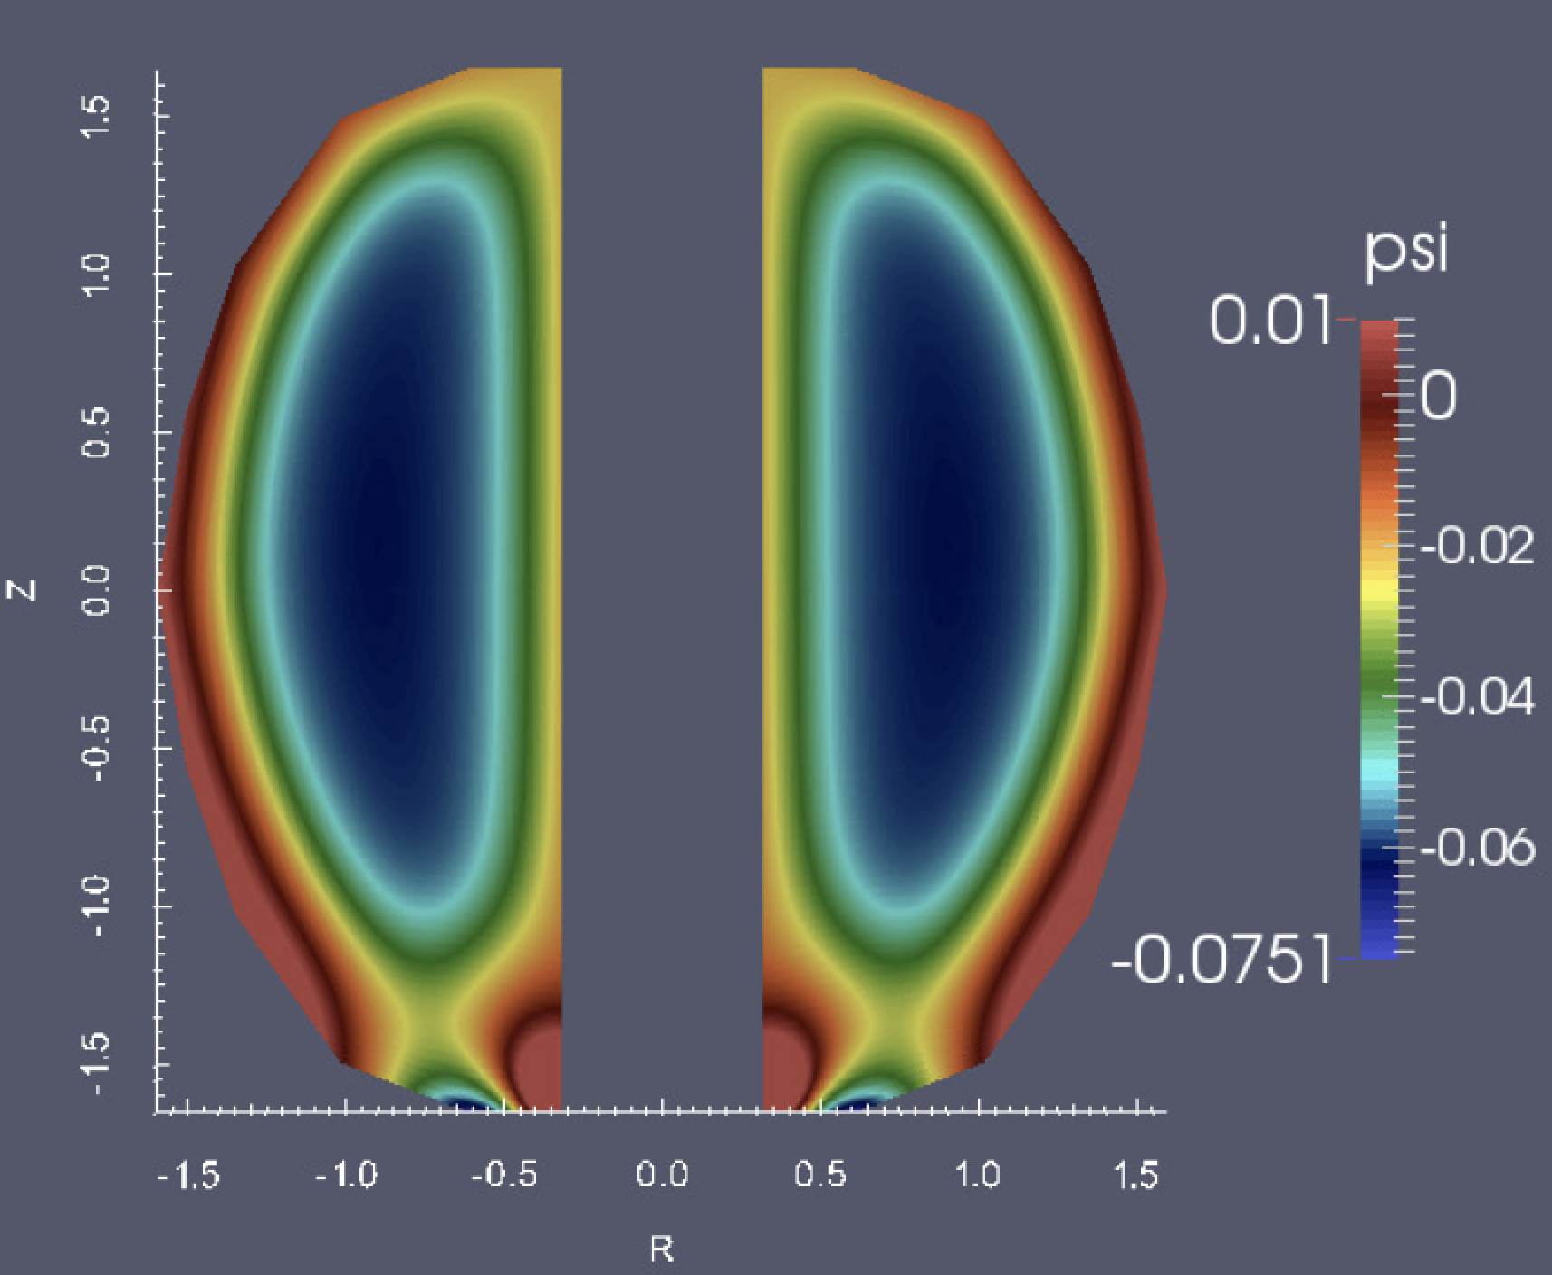
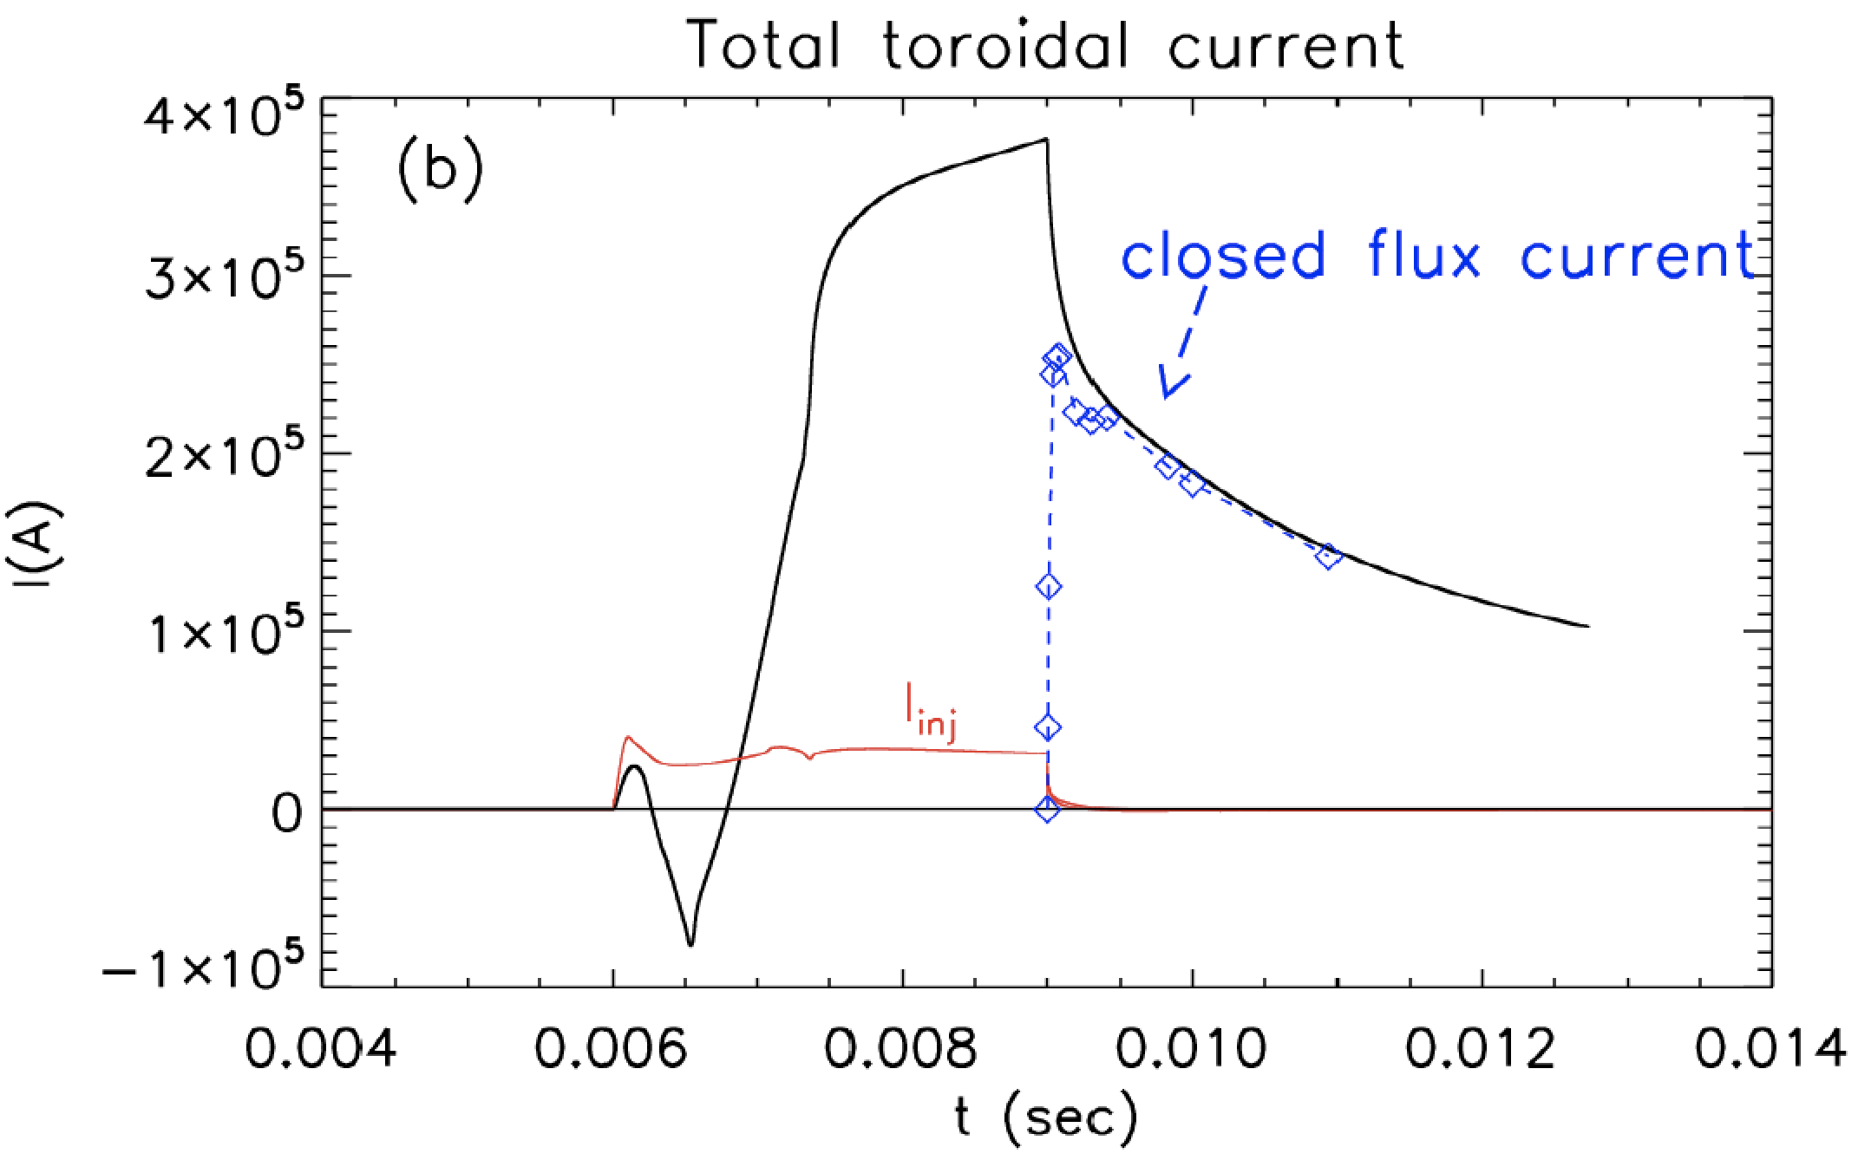
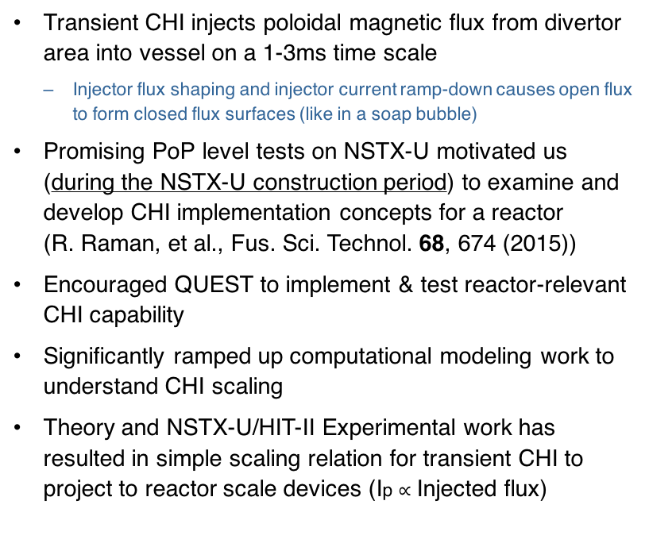
Transient CHI: High Fraction of Open to Closed Flux Conversion in NIMROD Simulations & in Experiments
Transient CHI injects poloidal magnetic flux from divertor area into vessel on a 1-3ms time scale
  Injector flux shaping and injector current ramp-down causes open flux to form closed flux surfaces (like in a soap bubble)
Promising PoP level tests on NSTX-U motivated us (during the NSTX-U construction period) to examine and develop CHI implementation concepts for a reactor (R. Raman, et al., Fus. Sci. Technol. 68, 674 (2015))
Encouraged QUEST to implement & test reactor-relevant CHI capability
Significantly ramped up computational modeling work to understand CHI scaling
Theory and NSTX-U/HIT-II Experimental work has resulted in simple scaling relation for transient CHI to project to reactor scale devices (Ip $∝$ Injected flux)
NSTX
F. Ebrahimi, PPPL

Slide 10
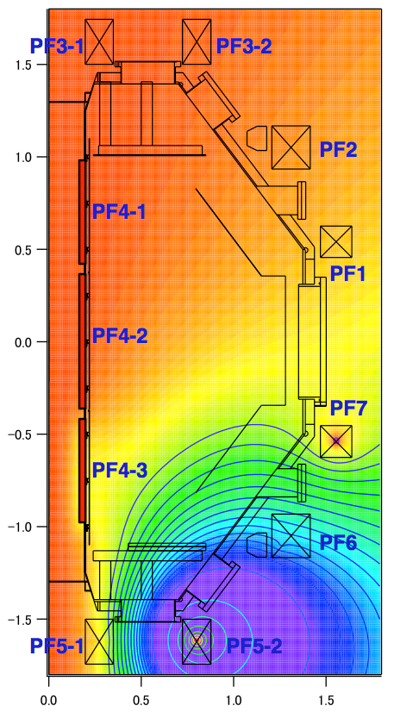
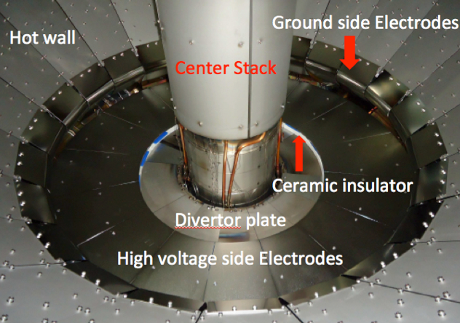
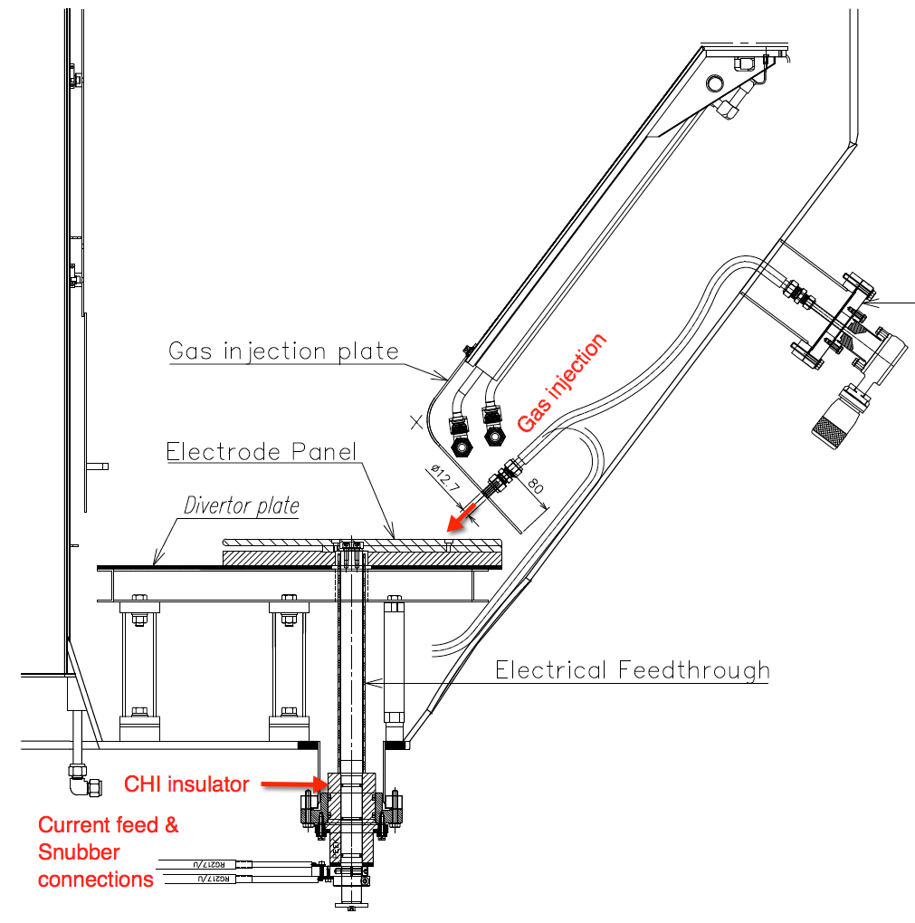
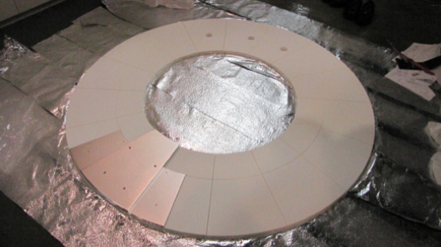
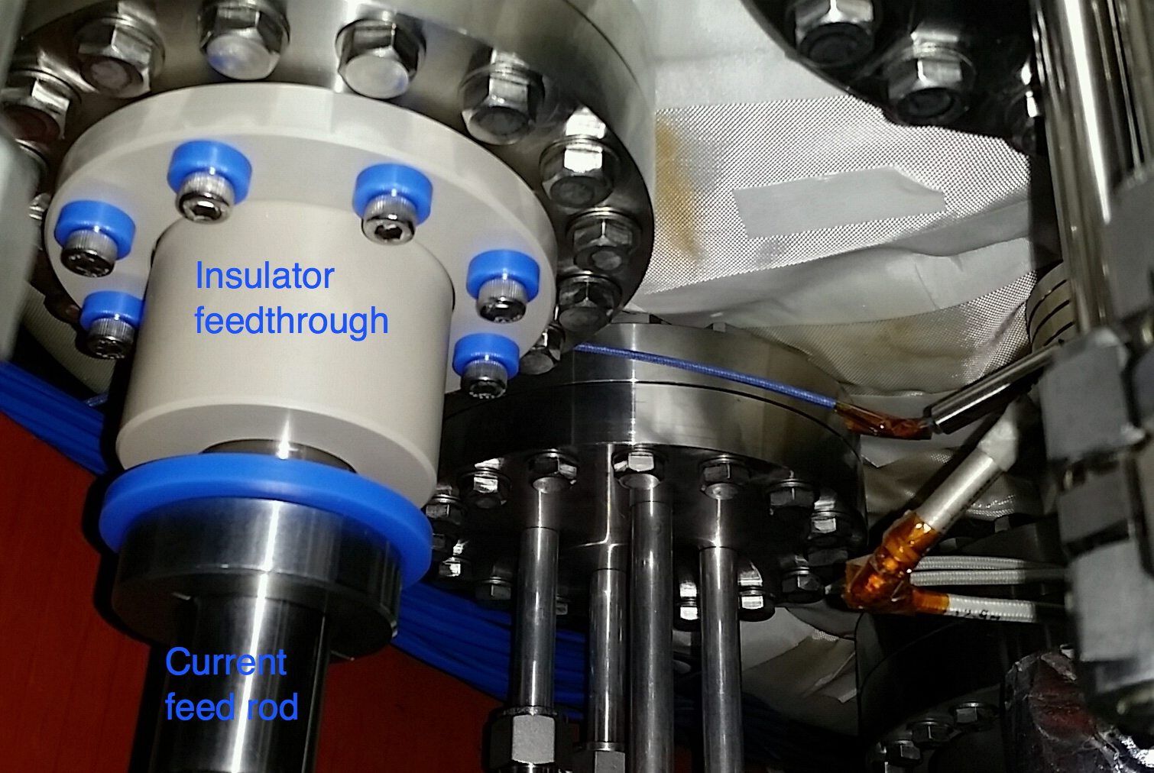
QUEST (in Japan) is Developing Reactor-Relevant CHI Configuration & Will Test ECH Heating of a Transient CHI Plasma
In reactor concept insulator can be shielded from neutrons
Insulator not part of vacuum boundary as on NSTX
  Needs experimental test / verification
CHI system on QUEST is similar in concept to the one planned for NSTX-U
Injector
Flux
Plasma growth
Initial injector current direction
CHI Insulator
Current injection
QUEST CHI is a NSTX-U CHI Team Led Effort

Slide 11
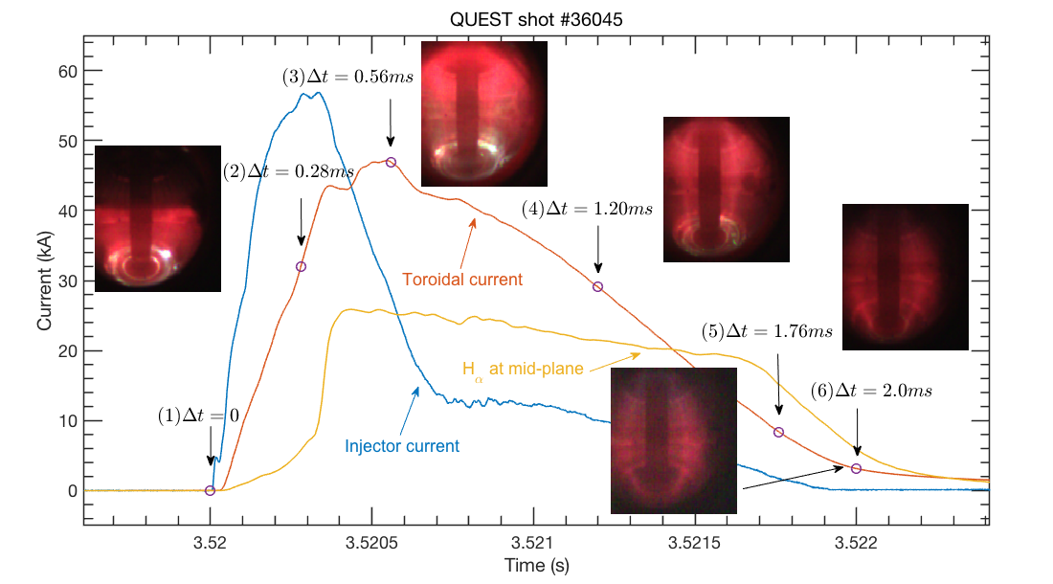
Transient CHI Discharges Successfully Established in QUEST
ECH heating to be tested during 2018

Slide 12
Solenoid-Free Start-Up / Ramp-Up
NSTX-U Plans Utilize Multiple Facilities
NSTX-U Ramp-Up studies will continue using inductively generated targets with HHFW & NBI, as in original plan.
NSTX-U solenoid-free start-up activities will be conducted in other ST facilities in the near term:
    Supporting CHI work being conducted on QUEST in Japan
    Supporting ECH / EBW start-up studies being conducted on QUEST
    Pegasus is studying LHI
Preparation toward NSTX-U CDRs:
    NSTX-U ~ 1.5 MW, 28 GHz gyrotron CDR completed
    NSTX-U reactor-relevant CHI CDR to be ready in ~ 3 years via QUEST and other experiments/modeling

Slide 13
Back-Up Slides

Slide 14
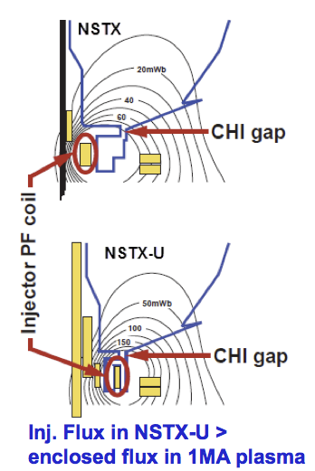
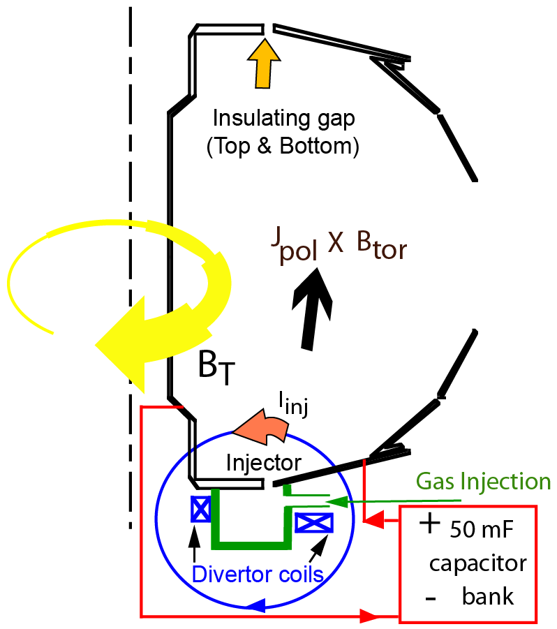
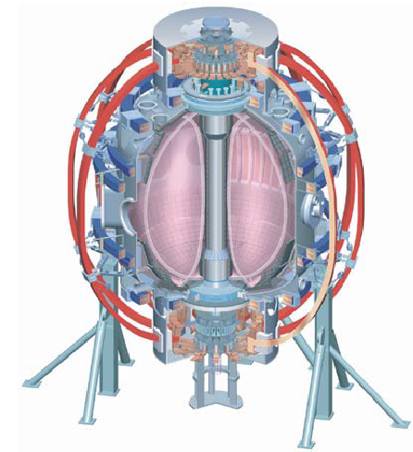
Transient CHI Start-Up

Slide 15
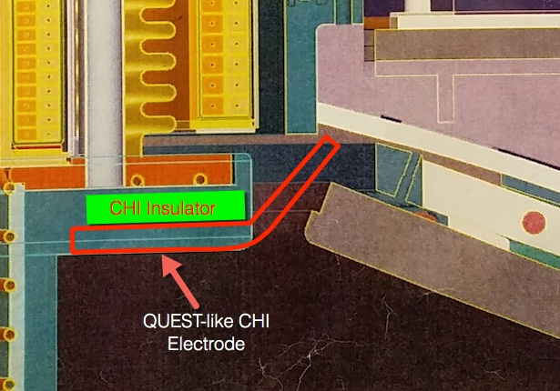
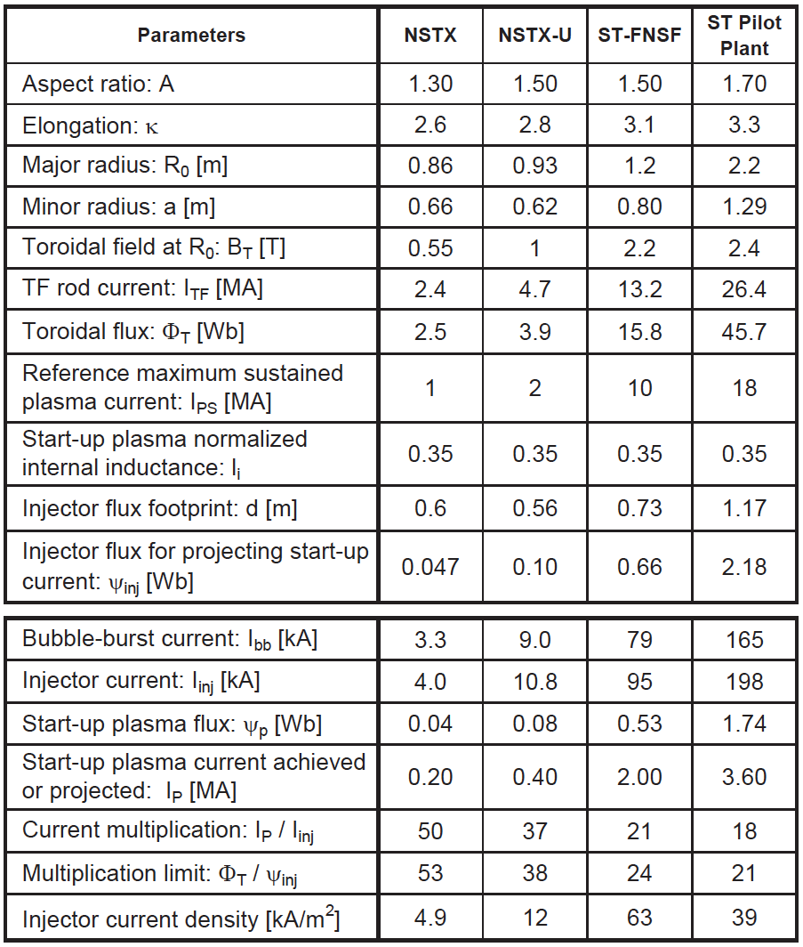
CHI start-up to ~0.4MA is projected for NSTX-U, and is projected to scale favorably to next-step STs
Conceptual concept for “QUEST– like” CHI electrode in NSTX-U upper divertor
Utilizes full injector flux capability in NSTX-U
  I_{p} > 400 kA
  1MA Start-up potential

Slide 16
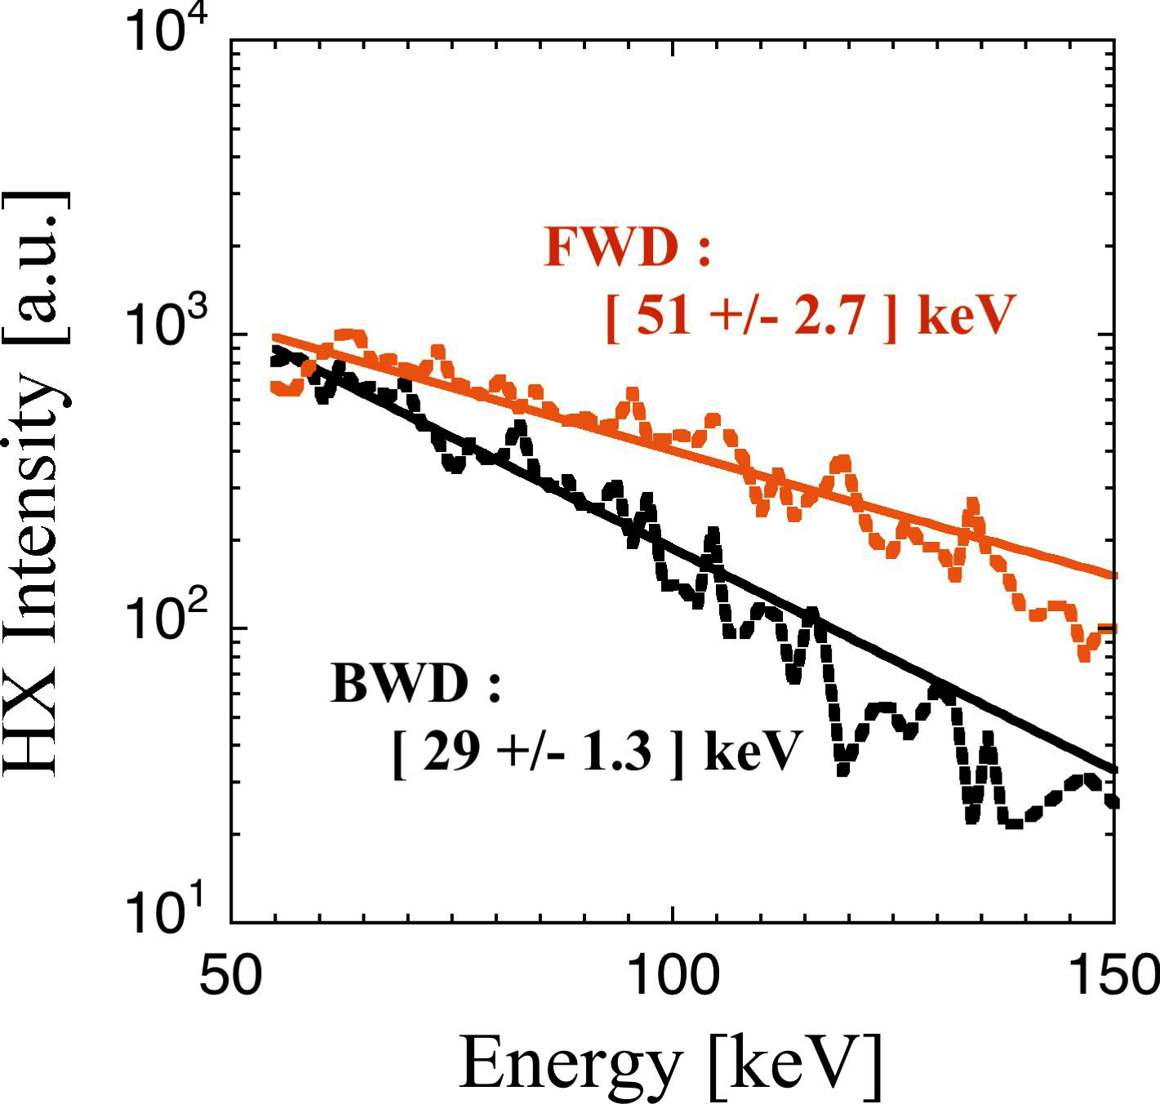
QUEST ECH current start-up generates forward fast electrons
NSTX-U plans to install x-ray camera to elucidate ECCD physics
28GHzRF 2nd
Resonance layer
(R ≈ 320 mm)
I_{p}
e⁻
FWD
QUEST
TOP VIEW
Detector (CdTe)
BWD
• NSTX-U multi-energy soft x-ray camera to be used to measure the QUEST ECH induced high energy electrons with high spatial and time resolutions.
• Developing a new synthetic diagnostic tool for multi-energy soft x-ray camera with UT.
• On-going modeling with GENRAY and CQL3D for ECH fast electron generations.

Slide 17
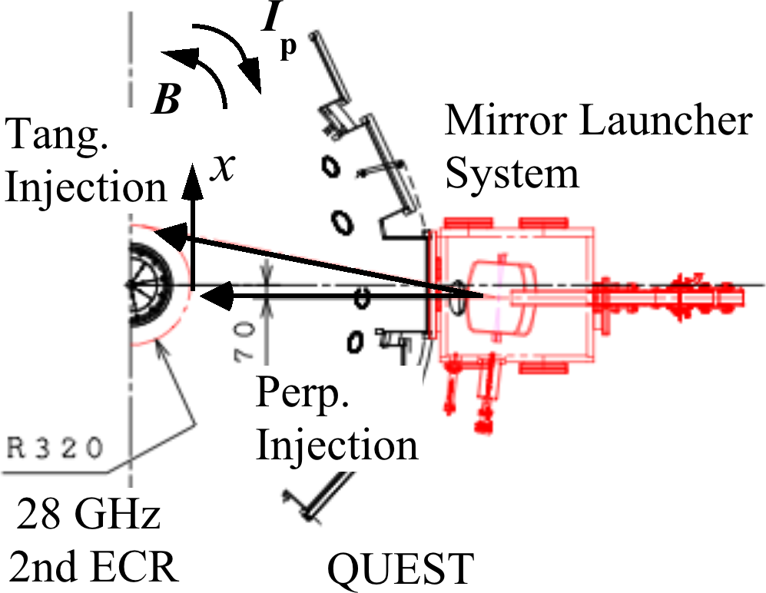
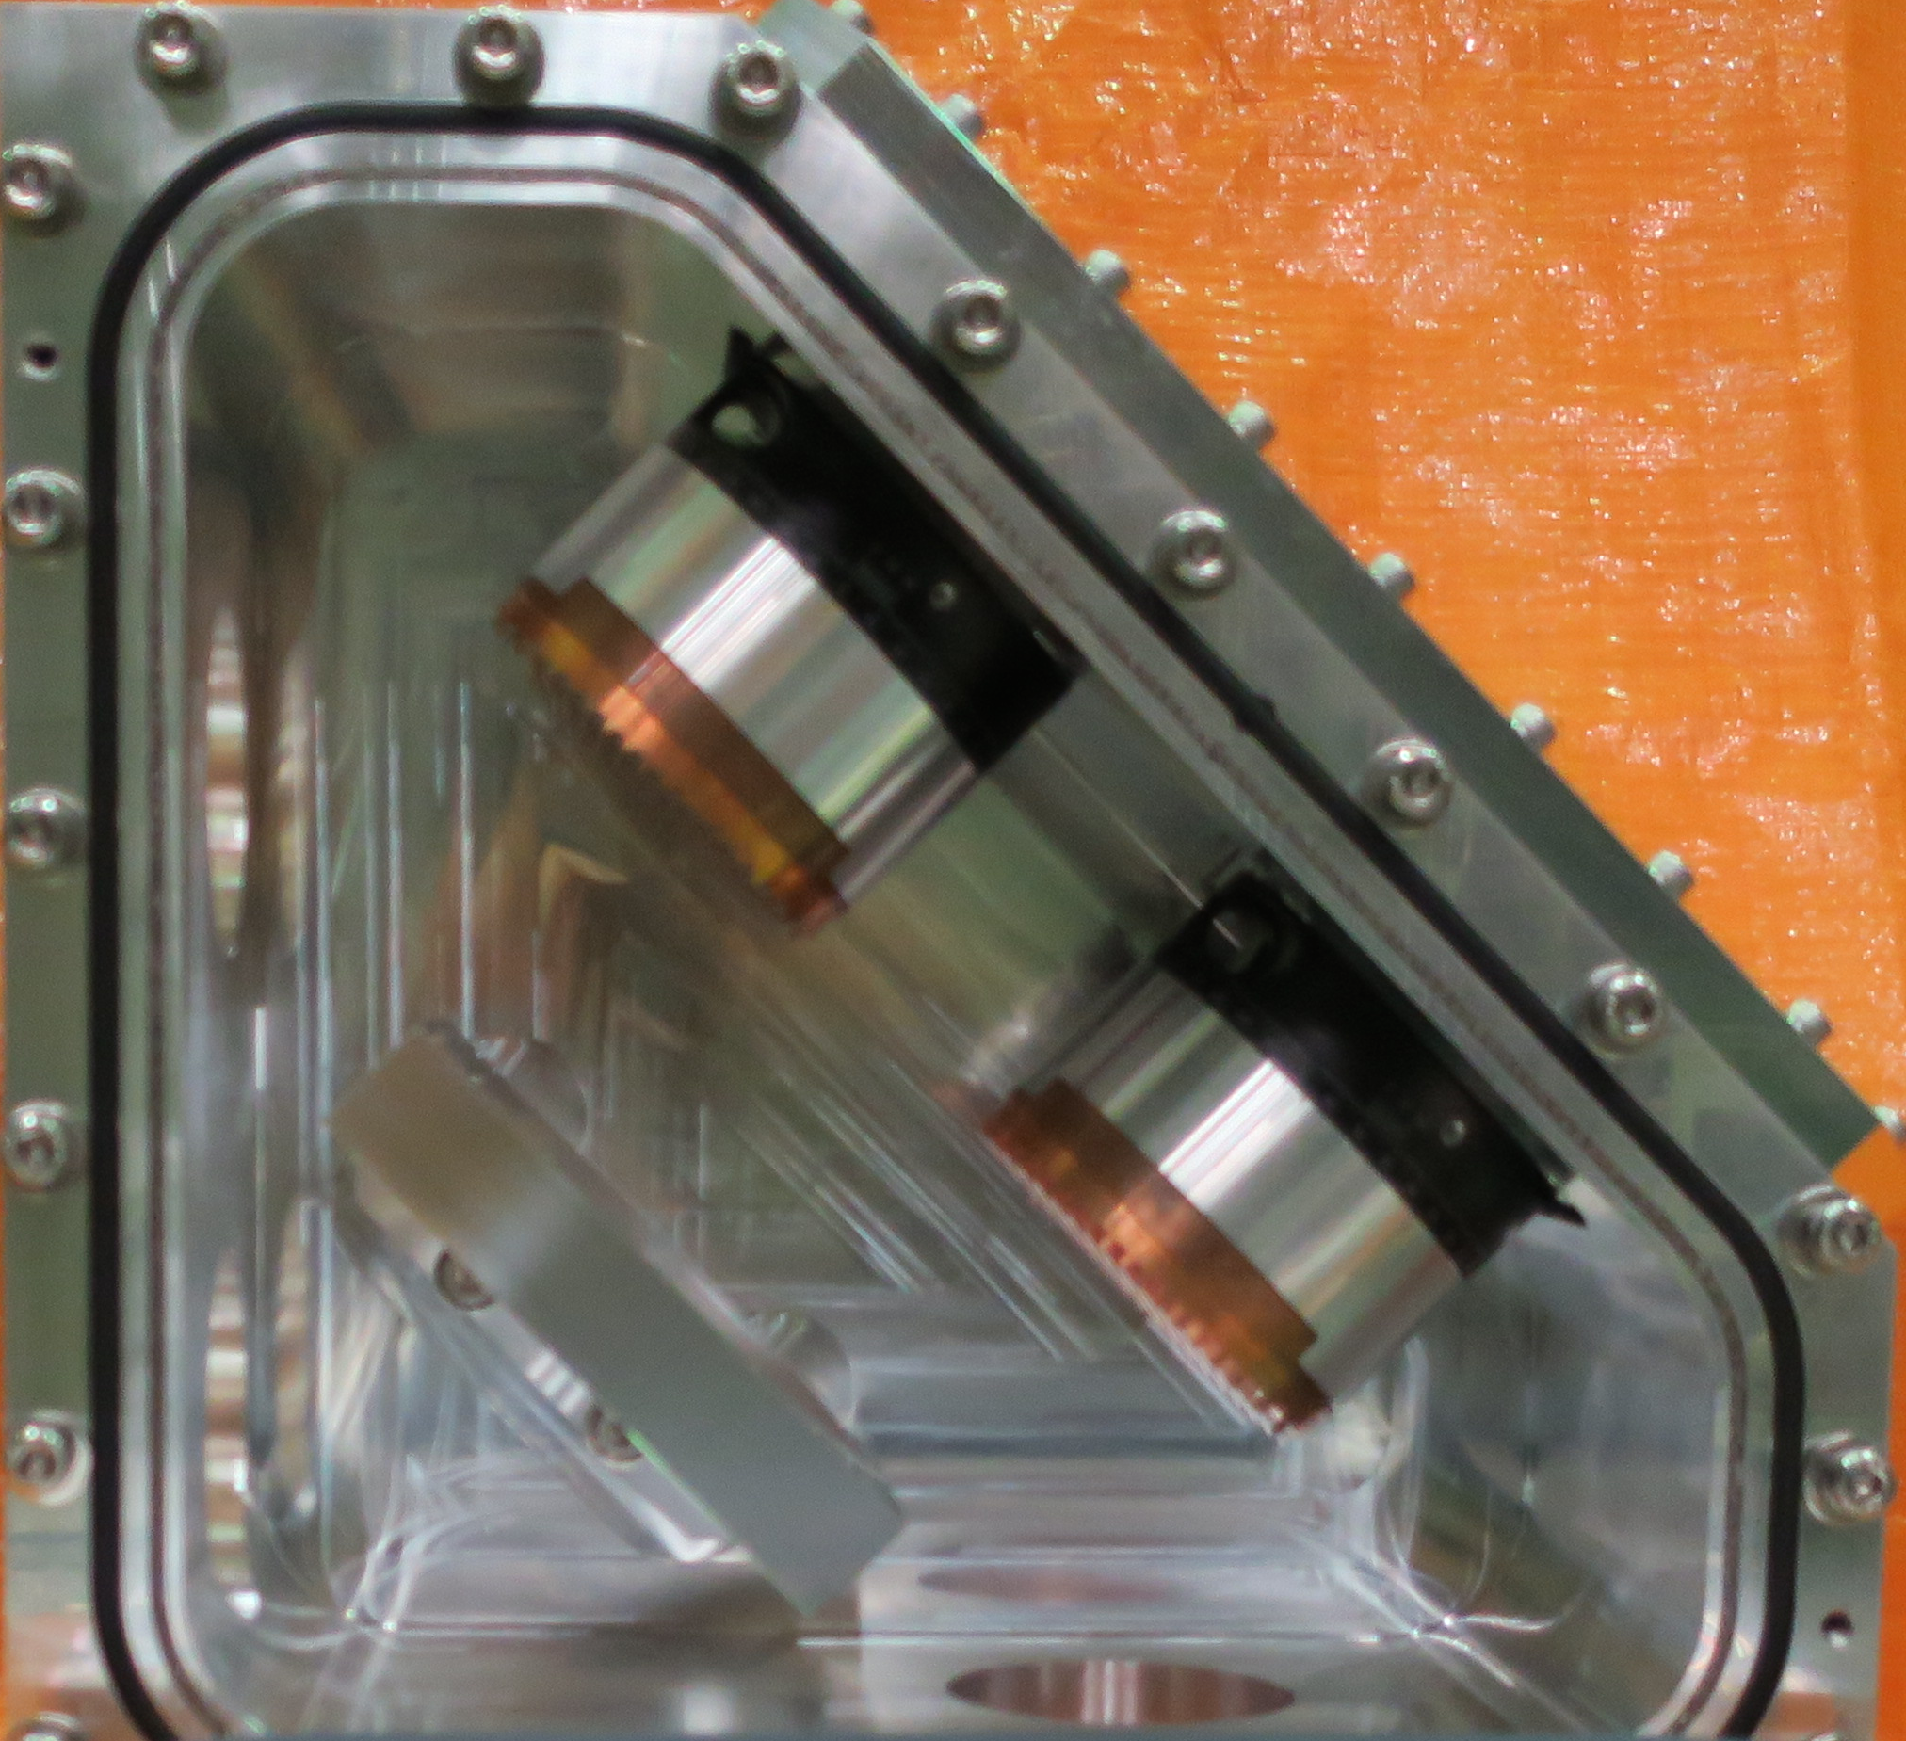
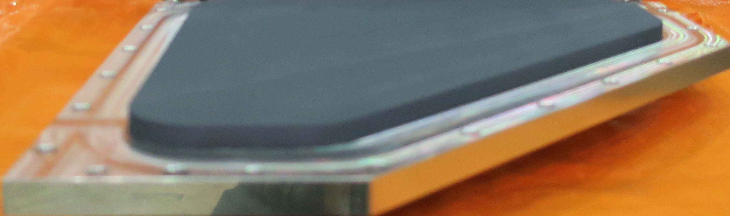
QUEST New ECH Beam Steering, Focusing and Polarization Capability Enabled High Current Access and Physics Study
Quasi-optic Polarizer System
QO Polarizer
System
λ/4
polarizer
To mirror launcher system
out
λ/8
polarizer
Coupling Mirror
HE11⬄HE11
in
Ti02 Coating
Absorber
• Steering and focusing mirror launcher system together with quasi-optic waveguide enables incident polarization, N//, and deposition profile scanning
• ECH power is presently limited by arcing in the quasi-optic waveguide. Improvements are being made for next campaign for higher power (and higher current) operations.
• Current ramp-up and sustainment mechanisms will be also investigated via parameter scanning.

