Slide 1

NSTX-U PAC-39 Questions and Team Responses
NSTX-U Researchers
PPPL
January 10, 2018

Slide 2
Questions
Can the Li wall program be accelerated and if so what would it look like? What is Li program which gets answers in 5 years?
What does NSTX-U add relative to MAST-U?
  Please be specific on parameters of various systems or physics regimes accessed (provide answer for each topical area presented).
Is there any risk mitigation scheme for density control?
  Fully non-inductive demonstration requires density control
Will you work on detachment?
  Clarify scientific goals for high heat flux studies and plasma exhaust

Slide 3
Questions
Can the Li wall program be accelerated and if so what would it look like? What is Li program which gets answers in 5 years?
What does NSTX-U add relative to MAST-U?
  Please be specific on parameters of various systems or physics regimes accessed (provide answer for each topical area presented).
Is there any risk mitigation scheme for density control?
  Fully non-inductive demonstration requires density control
Will you work on detachment?
  Clarify scientific goals for high heat flux studies and plasma exhaust

Slide 4
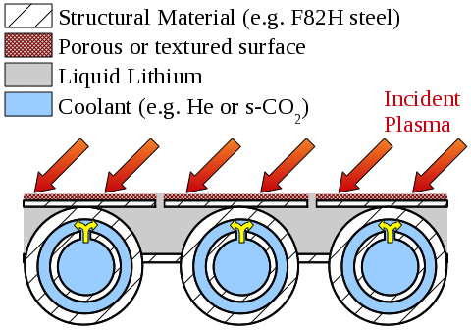
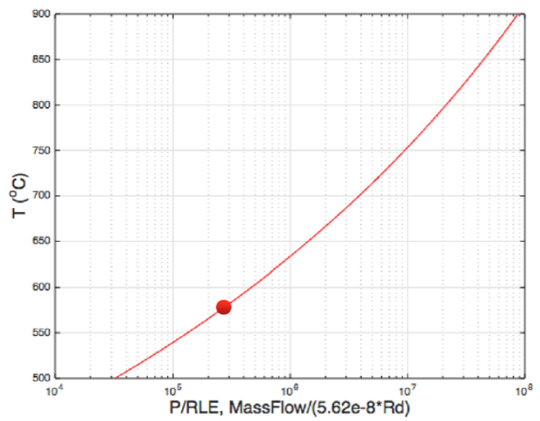
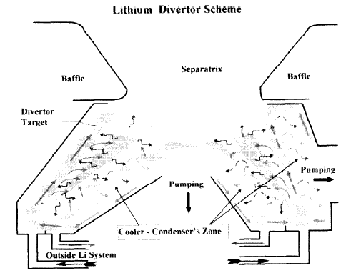
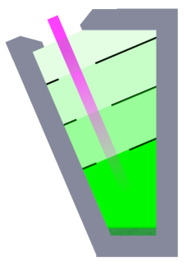
DEMO-relevant tech need: inventory control with evaporating & condensing surfaces inside confinement device
Capillary restrained LM surfaces demonstrated in multiple devices (e.g. NSTX LLD, Jaworski, 2013 NF)
  Slow-flow is faster path – more demonstrations
Close coupling with active cooling allows control of condensation &
evaporation
PFC geometry
can
accommodate
recollection
and pump excess
liquid back out
Accomplishes
inventory control
Jaworski, 2013 PPCF
900
DEMO reference pt.
2.5GW fusion power
200MW to outer div.
R=6m, l_{p,box}=0.5m
ε_{cool}=250eV
800
700
Goldston, 2016 Phys. Scr.
600
500
Golubchikov, et al., JNM 1996

Slide 5
Parallel and aggressive effort to deploy flowing liquid Li modules at start of second 5-year plan of NSTX-U
Continuous engineering science R&D effort and facility required!
Original, serial R&D path

Slide 6
Questions
Can the Li wall program be accelerated and if so what would it look like? What is Li program which gets answers in 5 years?
What does NSTX-U add relative to MAST-U? (in say 2020ish)
  Please be specific on parameters of various systems or physics regimes accessed (provide answer for each topical area presented).
Is there any risk mitigation scheme for density control?
  Fully non-inductive demonstration requires density control
Will you work on detachment?
  Clarify scientific goals for high heat flux studies and plasma exhaust

Slide 7
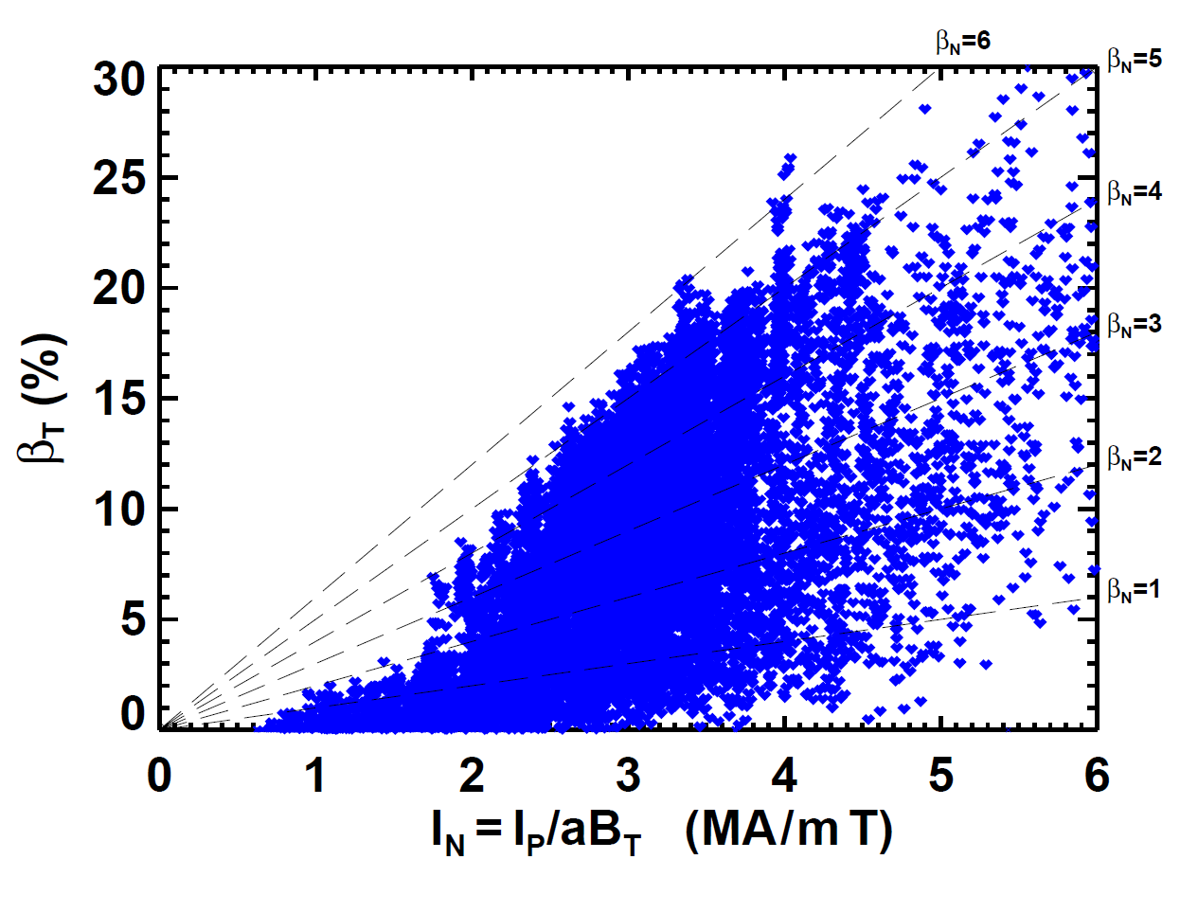
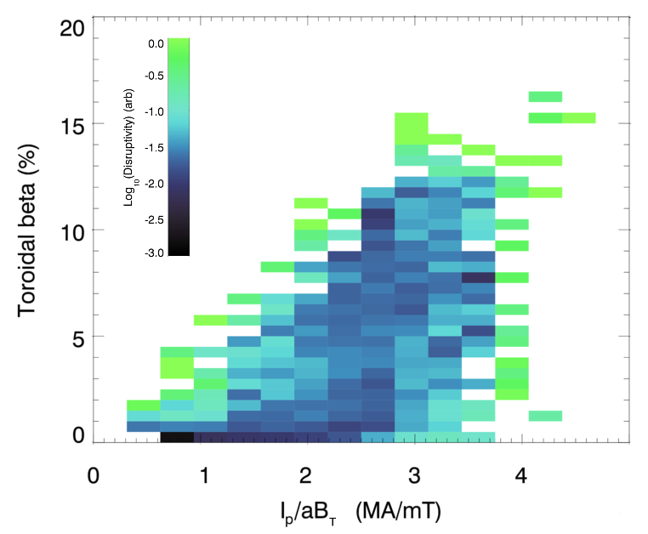
Stability: NSTX accessed β_{T} values ~2× MAST
NSTX
MAST
Expect approx. 1.6-1.8× higher β_{T} in NSTX-U vs. MAST-U
(NSTX-U has higher A than NSTX → β_{N} reduced by 10-20%)

Slide 8
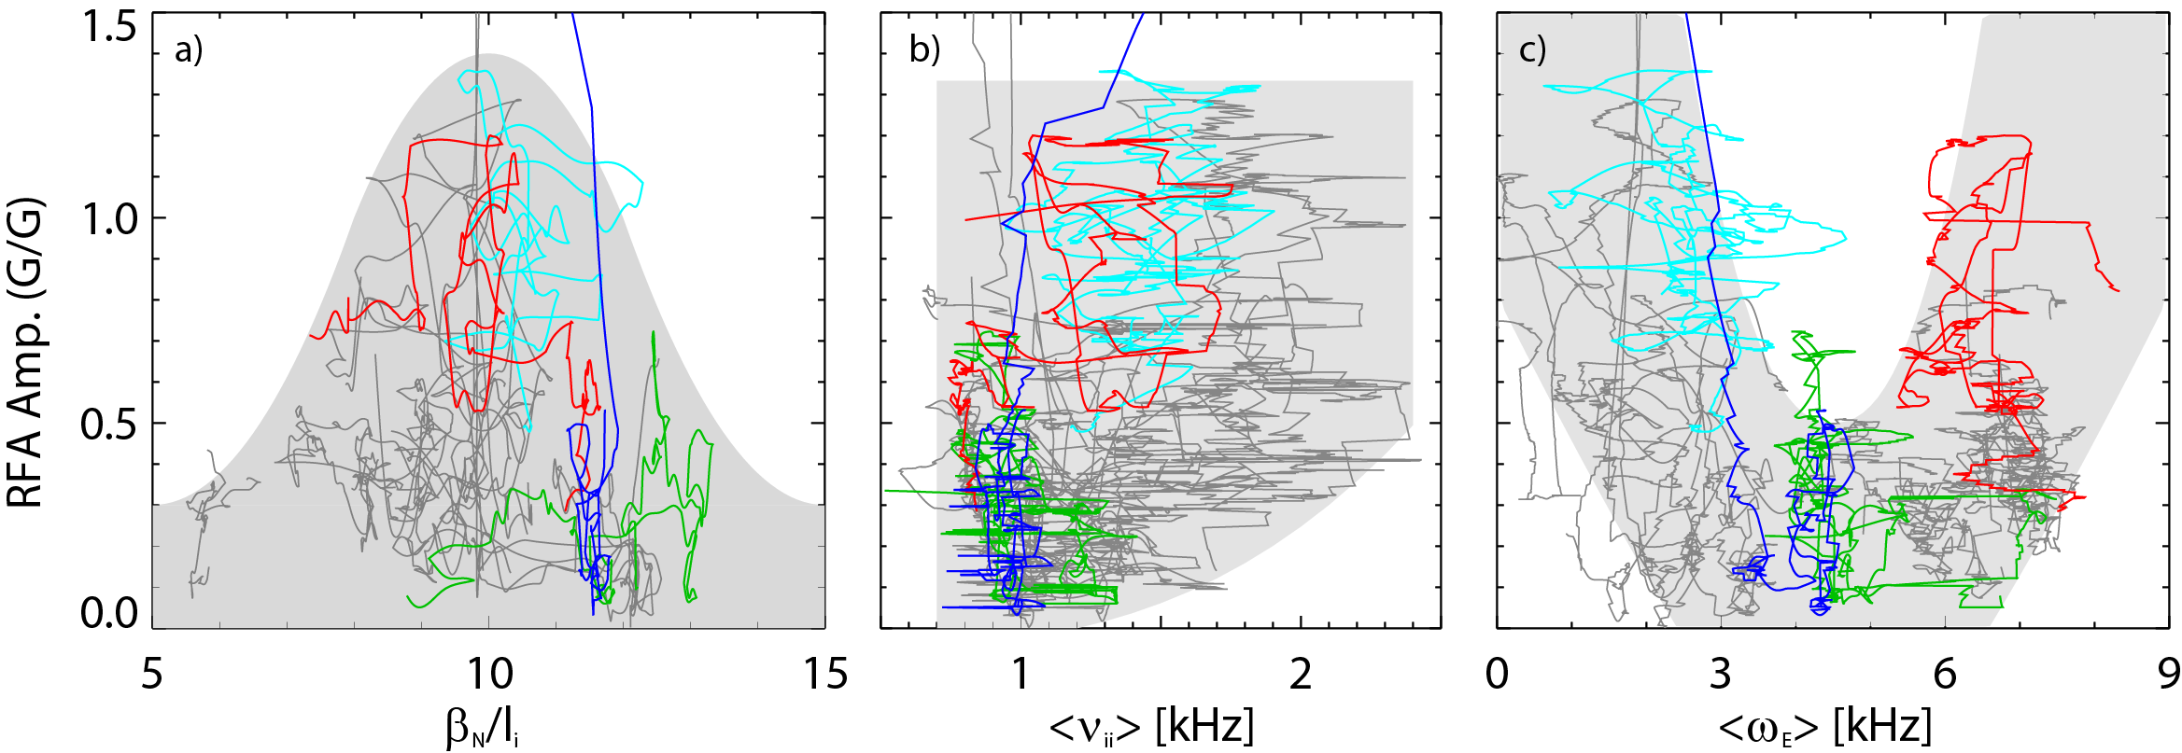
Stability: NSTX-U uniquely able to access strongly wall-stabilized regime where plasma stability increases with increasing β_{N} / l_{i}
Resonant Field Amplification (RFA) vs. β_{N}/l_{i}
RFA vs. rotation (ω_{E})
Most
stable
unstable
RWM
Less stable
RFA Amp. (G/G)
RFA Amp. (G/G)
Less stable
Rotation
See backup for more detailed comparison of capabilities and associated physics

Slide 9
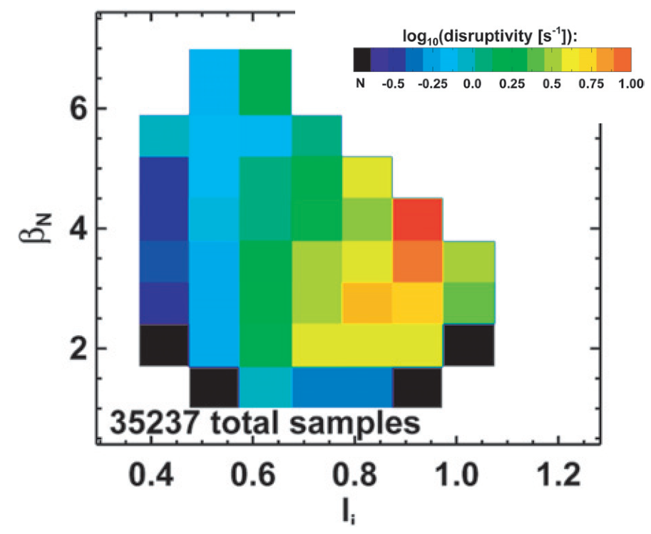
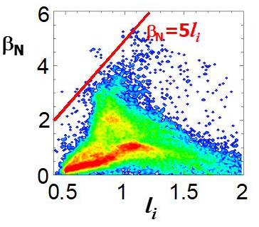
Scenarios: NSTX-U ~2x higher bootstrap fraction → much wider operating space at 100% non-inductive
NSTX-U only ST to access & sustain very high β_{N} at low l_{i}
Important for 100% non-inductive since f_{bootstrap} ∝ β_{N} / l_{i}
Many data points
β_{N} = 12 l_{i}
Not accessible
NSTX
MAST

Slide 10
Scenarios: NSTX-U will have unique capabilities for developing NI scenarios compared to MAST-U in 2020
NSTX-U: higher B_{T,} P_{NBI} in NI scenarios
  <P>, I_{p} in NI scenarios increase B_{T}
  Up to 15 MW improves access to high density, large f_{BS} (> 70%) in stationary conditions for multiple τ_{R} at I_{p} ≥ 1 MA
Real-time NBI deposition control via outer gap and beam selection
  Deposition location control is harder on MAST-U
Parallelized rtEFIT with real-time profile measurements
  rtCHERS, rtMSE, rtMPTS
  Developed profile control algorithms
  MAST-U staging PCS development
MAST-U NSTX-U
B_{T} = 1.0 T
H_{ST} = 1
B_{T} = 0.75 T
H_{ST} = 1
B_{T} = 0.75 T
H_{98y,2} = 1
B_{T} = 1.0 T
H_{98y,2} = 1
Higher B may enable access to higher confinement and non-inductive current

Slide 11
Transport and Turbulence (T&T)
Program
T&T is a dedicated NSTX-U Research Program element (w/ dedicated facility capability, diagnostics, theory/modeling validation) → high priority focus on understanding confinement scaling and implications for the path towards ST Pilot Plant
Facility
~50% higher B_{T} and ~50% higher β → 3x higher p, T, also stronger EM turbulence drive?
Higher P_{NBI} (≥50% higher in 2020) → 1+2 expected to enable lower ν* at comparable or higher β (pending confinement scaling, macro-stability & density control)
  For upcoming review, will make comparison of 0D-projected ν* using (i) different τ_{E} scalings, (ii) expected achievable I_{p}, B_{T}, P_{NBI}, and (iii) different assumptions on n_{e}/f_{GW}, β, etc…
Larger OH flux (~30% higher) → expecting T_{pulse}~5 sec, enables perturbative studies (e.g. fourier analysis)
Different NBI R_{tan} @ 65-100 keV + PCS-controlled beam timing → variation in torque enables flexible momentum transport studies (pinch, residual stress)
RF heating (4 MW) → enhances studying Q_{e} physics, enables controlling n_{imp}
Diagnostics: FIR high-k + DBS → enables multi-scale δn measurement (with BES) + flow (DBS); CPS → enables δB measurement
B vs. Li wall coatings: has uncovered different I_{p} & B_{T} confinement scalings → brings insight on ν* dependence

Slide 12
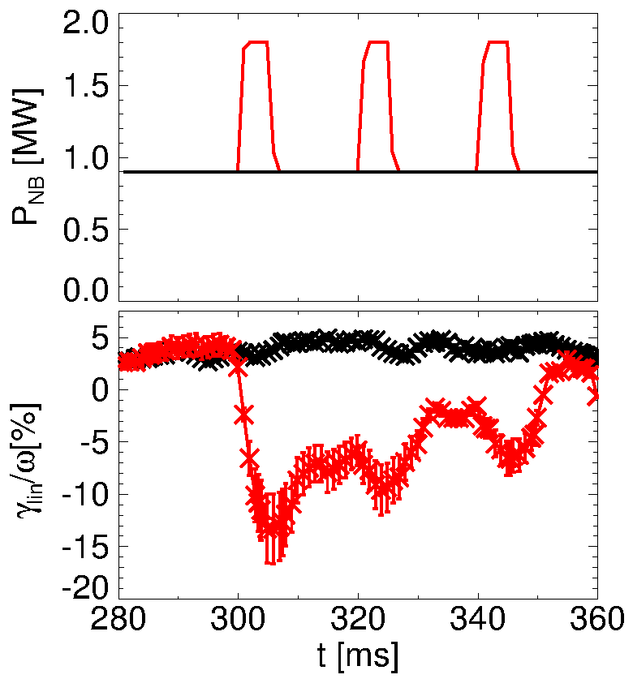
Energetic Particles: NSTX-U has demonstrated flexible NBI capabilities for AE mode mitigation/suppression
NSTX-U NBI sources provide flexible control of deposition location including phase-space resolution
  Adjustable R_{tan}, broader range of injection energy & pitch than MAST-U
  Key for AE control through NBI (cf. FY-16 results)
    See suppression of GAEs – PAC talk
    See predicted stabilization of TAEs by tailored NBI
Flexibility in NBI wrt shape provides additional tools for AE mitigation through plasma shaping
  Cf. [Fasoli, PPCF 52 075015 (2010)]
Availability of HHFW would provide additional tool to affect/control fast ion distribution
Long(er than MAST-U) pulse capability enables studies of NB-CD with relaxed current profiles for high/fully NI studies
off-axis NBI (experiment)
add on-axis NBI (simulation)
unstable TAE (exp’t)
TAE stabilized by on-axis NBI

Slide 13
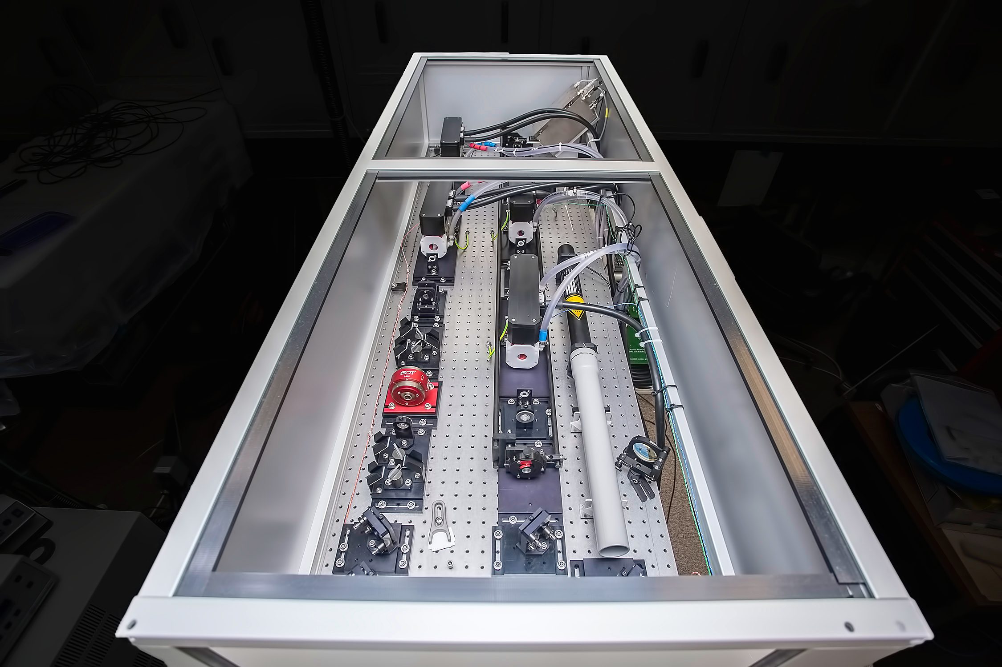
Pedestal structure and control
NSTX-U will have 3x Pedestal pressure ➠ higher than MAST-U
  Need more homework to quantify how much: collaborate to develop EPED-like model for ST
Lithium coating and impurity injection
  Manipulate density profile to understand pedestal stability and performance
    Up to 10% in 𝜓_{n} shift of n_{e} vs. T_{e} profile in NSTX with Li conditioning, study density gradient driven instabilities
  NSTX pedestal width larger than MAST based on the scaling ➠ large range of pedestal gradients
ELM mitigation via ELM pace-making with a number of actuators
  Impurity granule injector (B, Li, C, …)
  Magnetic perturbation for ELM pacing & vertical jogs
ELM elimination via low-Z injection
Diagnostics:
  Pulsed Burst Laser System (PBLS) (up 20 kHz rep rate) to resolve fast pedestal dynamics
  High-k, DBS, CPS (intermediate & high-k δn; δB); 2D imaging low-k density fluctuations
  Pedestal density turbulence over large k-range
  GPI in combination with divertor turbulence to provide data for modeling of heat flux width
Diallo ECA 2013

Slide 14
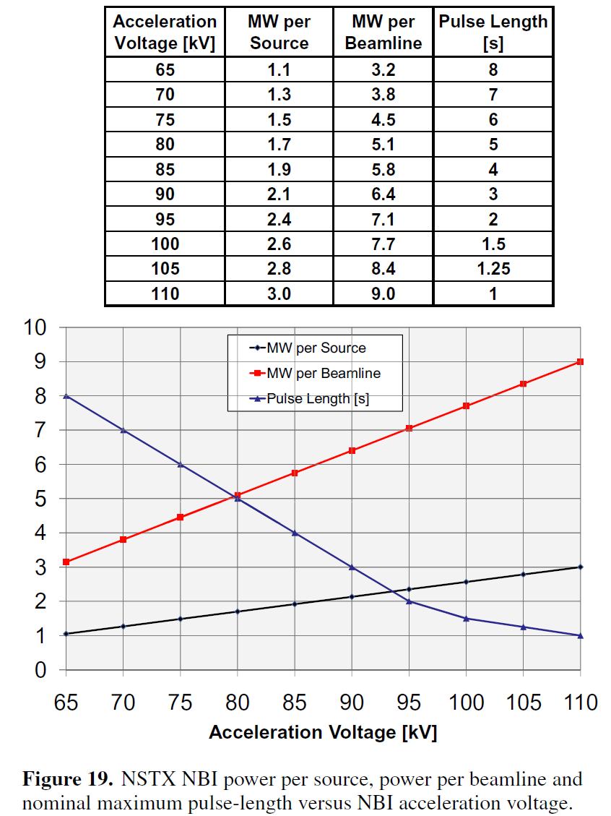
Divertor and SOL, PFCs
NSTX-U will access the highest q|| of any spherical tokamak
  sustain the highest B_{T} and B_{p}, smallest λ_{q}
  NBI sources may reach 15 MW for short pulse (NSTX reliably reached 6.4 MW/beam)
can explore impact of Li on pedestal & SOL
  published, not understood drop in λ_{q} with evap. Li
NSTX-U PFC shaping allow for high triangularity shapes at high power
  use in core-edge integration studies
Mid-plane NBI sources enable access to wider range of single null divertors
  simpler divertor physics studies

Slide 15
High-harmonic fast-waves
NSTX-U High-harmonic fast-wave is unique ST capability
  Can couple up to 4 MW
HHFW supports / enhances broad spectrum of research topics:
  Significant e- heating and/or fast-ion absorption
  Complementary to NBI: heats without direct input of particles or torque
  High core Te for transport studies
  Interaction between HHFW & NBI: suppression of AE/EP modes
  Heating of low-Ip targets for subsequent NBI ramp-up
  Effect on rotation profile
  High-Z impurity expulsion
NSTX-U maintains a strong theory partnership with the RF SciDAC project through continued investment in HHFW hardware

Slide 16
Solenoid-Free Start-Up and Ramp-up
Ramp-up:
  Considerable effort was invested in the configuration used for the second NBI on NSTX-U to support current drive in low current and high current plasmas. The detailed calculation results are published in Nuclear Fusion.
  The second NBI also has more tangency and energy than the NBI system on MAST-U.
Start-up:
  If funded, and subject to the completion of a CDR, NSTX-U is capable of supporting high current start-up using “Quest-like” CHI electrodes
  If funded, will have high-power ECH to support start-up and ramp-up studies
More tangential
2nd NBI
First NBI

Slide 17
Questions
Can the Li wall program be accelerated and if so what would it look like? What is Li program which gets answers in 5 years?
What does NSTX-U add relative to MAST-U?
  Please be specific on parameters of various systems or physics regimes accessed (provide answer for each topical area presented).
Is there any risk mitigation scheme for density control?
  Fully non-inductive demonstration requires density control
Will you work on detachment?
  Clarify scientific goals for high heat flux studies and plasma exhaust

Slide 18
Operation Tools for Density & Impurity Control
Initial operations: Examine Wall Conditioning, Fueling, and ELM Pacing
Boronized PFC Studies
  Utilize regimes with natural ELMs to control impurity accumulation
  Between-shot He glow for wall conditioning
  Deuterium inventory likely to rise throughout the discharge
Lithiated PFC Studies
  High-τ_{E}, ELM-free regimes w/ Li conditioning
  Pulsed 3D fields or lithium granules for ELM pacing to provide impurity control
  Deuterium inventory likely well controlled, but unclear if target Z_{eff}~2 can be achieved
Realtime Density Measurements via FIReTIP
PCS control of Supersonic Gas Inj. for Density Control
Both Scenarios:
Longer-term Facility Enhancements: Cryo-pumping, Possible 3D coil set (NCC)
Cryo-pump in lower-divertor to provide deuterium inventory control
  Natural or paced ELMs to control core impurity accumulation
  Make comparisons to regimes with paced ELMs and lithium pumping
Non-axisymmetric Control Coils (NCC) to aid in ELM pacing and RMP studies
  Attempt direct modification of pedestal particle transport via RMP
  Determine optimal spectrum for magnetic ELM pacing, with minimal core degradation

Slide 19
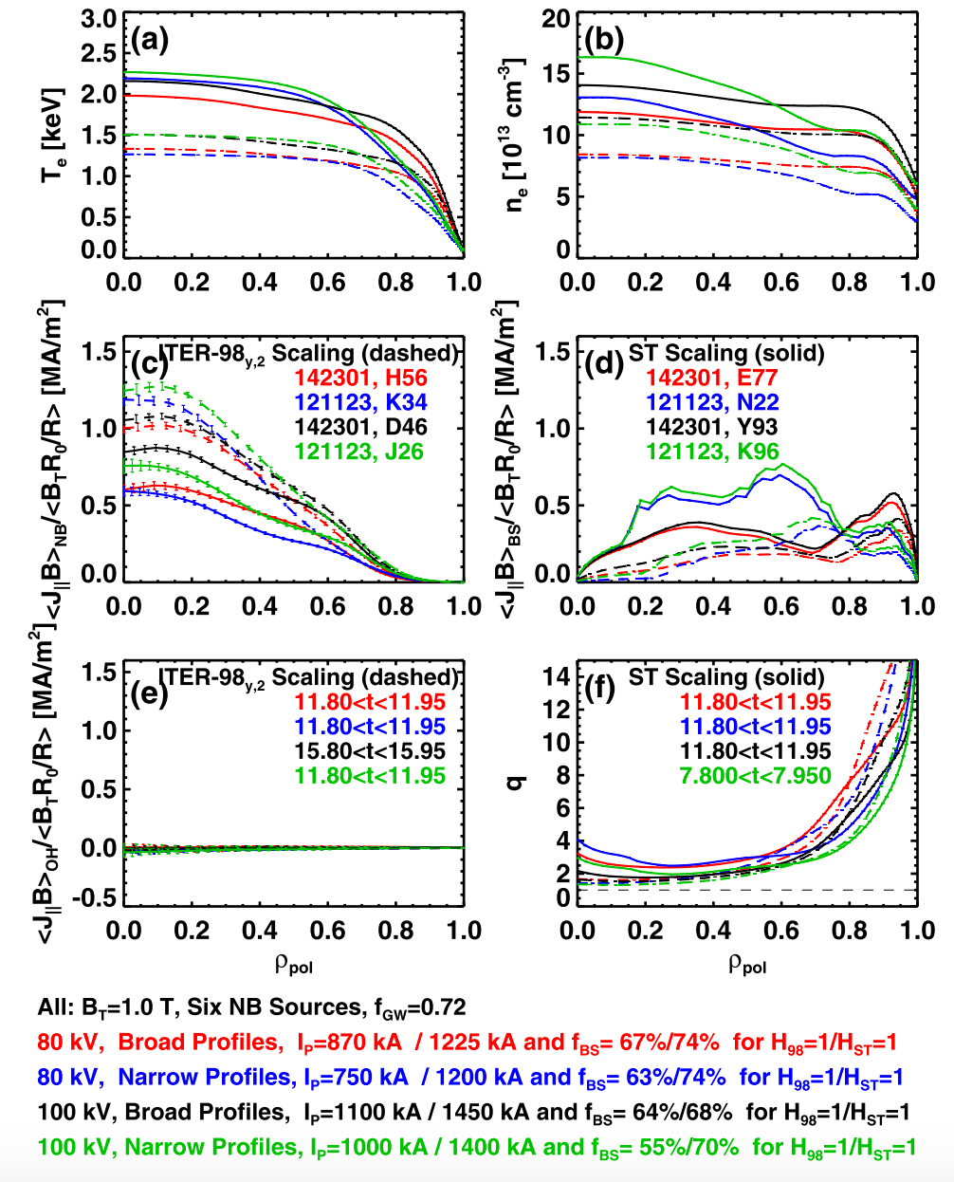
Fully NI discharges projected to be achievable at high n_{e} (above level in nearly stationary n_{e} achieved on NSTX)
TRANSP simulations of 5s 100% NI discharges
f_{GW} = 0.72
Nearly stationary density demonstrated on NSTX
Lithium wall coatings with triggered ELMs via 3D fields
J. Canik et al., NF (2010) 064016

Slide 20
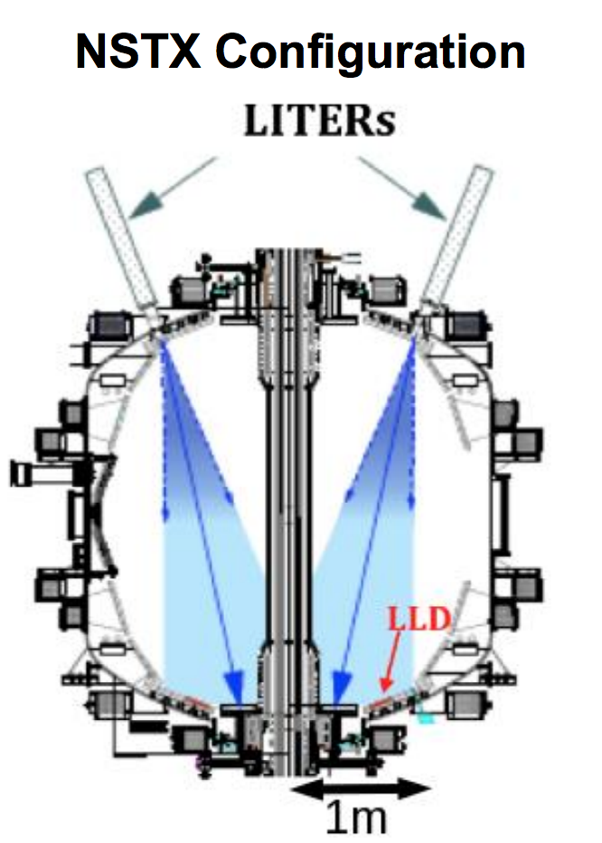
Operational tools for density control –
Fueling and wall conditioning
Between-shot He glow to reduce hydrogenic species in carbon tiles
  Used on NSTX.
Improvements to gas fueling
  Increased number and diameter of CS gas valves
    FY16: started to decrease total gas supplied from outboard injectors by using staged CS injectors
  Super-sonic gas injector (demonstrated on NSTX)
Wall conditioning with lithium evaporators
  Lithium coatings shown to reduce D recycling
  Upward facing LITER would improve coverage
    Initial design phase (CDR pending)

Slide 21
Operational tools for density control -
ELM pacing
ELM-free discharges with lithium coatings required ELMs to mitigate impurity accumulation
ELM pacing
  Granule injector
    New to NSTX-U
  Pulsed 3D fields
  Vertical jogs

Slide 22
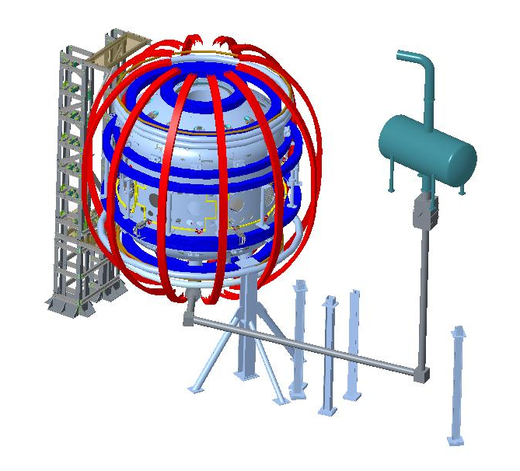
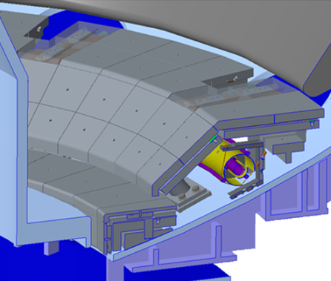
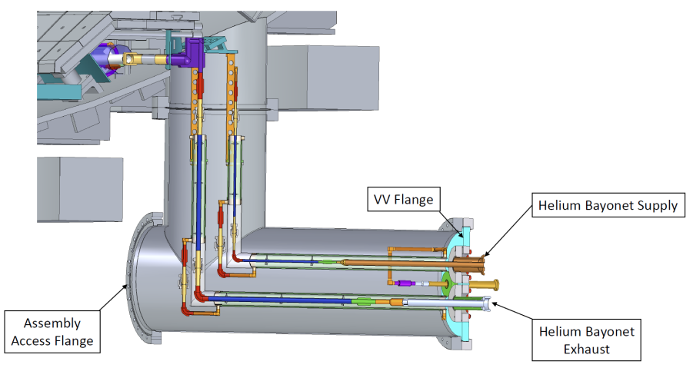
Cryo pump is a high-priority facility enhancement
Successful CDR in FY2015
Need to revisit design post-Recovery

Slide 23
Design met physics goals
Provide pumping for a range of divertor configurations
  Conventional divertor
  Snowflake / X divertor (needed for heat flux mitigation at full current and power = 2MA and 10-15MW)
  Allow some flexibility in strike-point location, flux expansion
Control normalized density n_{e} / n_{Greenwald} over range 0.5 to 1 for full range of plasma current = 0.6 to 2MA
Provide pumping for full NSTX-U NBI power (10MW) for 5s – assume NBI fueling dominant for long pulses

Slide 24
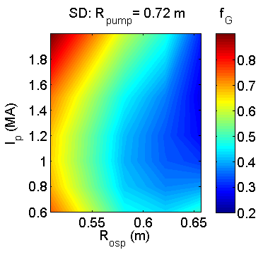
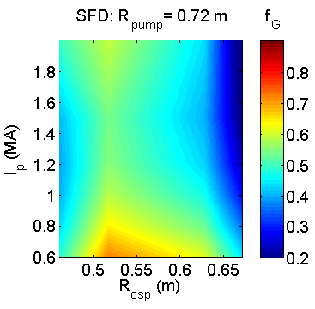
Optimized plenum geometry (R_{pump} = 0.72m) capable of pumping to low density n / n_{G} ~ 0.5 for a range of R_{OSP}, I_{P}
q_{pk} > 10 MW/m²
Equilibrium f_{Greenwald} can be reduced down to < 0.5
– Moving R_{OSP} closer to pump allows lower n_{e}, limited by power handling

Slide 25
Questions
Can the Li wall program be accelerated and if so what would it look like? What is Li program which gets answers in 5 years?
What does NSTX-U add relative to MAST-U?
  Please be specific on parameters of various systems or physics regimes accessed (provide answer for each topical area presented).
Is there any risk mitigation scheme for density control?
  Fully non-inductive demonstration requires density control
Will you work on detachment?
  Clarify scientific goals for high heat flux studies and plasma exhaust

Slide 26
Answer: YES
But the scope of the program is uncertain due to Recovery project changes
(FY14) 5 year plan goal: Develop and utilize high-flux-expansion snowflake divertor and radiative detachment for mitigating high heat fluxes
  THRUST BP-2: Assess and control divertor heat and particle fluxes

Slide 27
FY14: 5 Year Plan for DivSOL
Years 2-3 of 5 Year Plan
  Establish SOL width and divertor database vs. engineering and physics parameters
  Re-establish edge turbulence measurements (GPI, BES, cameras, probes)
  Initial radiative divertor experiments with D2, CD4 and Ar seeding and lithium
  Develop snowflake divertor magnetic control and assess pedestal stability, divertor
  power balance, turbulence, 3D fields as functions of engineering parameters
  Comparison with multi-fluid and gyro-kinetic models
Years 4-5 of 5 Year Plan
  Compare SOL width data with theoretical models and in the presence of 3D perturbations of various types, e.g. RMP coils, HHFW heating, NBI injection
  Combine snowflake configurations with pedestal control scenarios and tools, cryo
  implement radiative divertor control, demonstrate long-pulse H-mode scenario
  Develop experiment-based model projections for ST-FNSF
Diagnostics: MPTS, CHERS, BES, GPI, IR cameras, Langmuir probes, spectroscopy!
  incremental: divertor Thomson Scattering to provide critical data for model validation for snowflake and radiative detachment studies!

Slide 28
Question 4: Div/SOL + PFC Group
FY16 program planning (PAC-37) outlined anticipated program w/ focus on detachment and exhaust studies
  XP1514 (ORNL): SOL widths scaling + transport & turbulence
    connect lower o-div λ_{q} to GPI measurements, study effect of Li
  XP1538 (LLNL): baseline radiative divertor studies + 3D asym.
  XP1539 (LLNL): clarifying Snowflake divertor configuration physics
    emphasis on configuration variations (SF+, SF-), compatibility with 3-D fields and comparison w/ standard detachment work
  XP1557 (ORNL): Interaction of applied 3D fields with detachment
  many other secondary priority topics
none of these experiments were done in FY16, all remain

Slide 29
Question 4: Div/SOL + PFC Group
We have not revisited the priority and necessary resources to support these activities as part of Recovery
Recovery requirements have enhanced gas fueling that can be used for impurity seeding
new PFC designs place limitations on unfavorable heat flux that will arise from snowflake configuration
  new PFC requirements not been turned into OPS guidance
changes in staffing and commissioning schedule impact planning for diagnostics and boundary science program
  what tools will be available? when? much work remains from FY16
  (see extra slides for more information)

Slide 30
Q4 EXTRA SLIDES

Slide 31
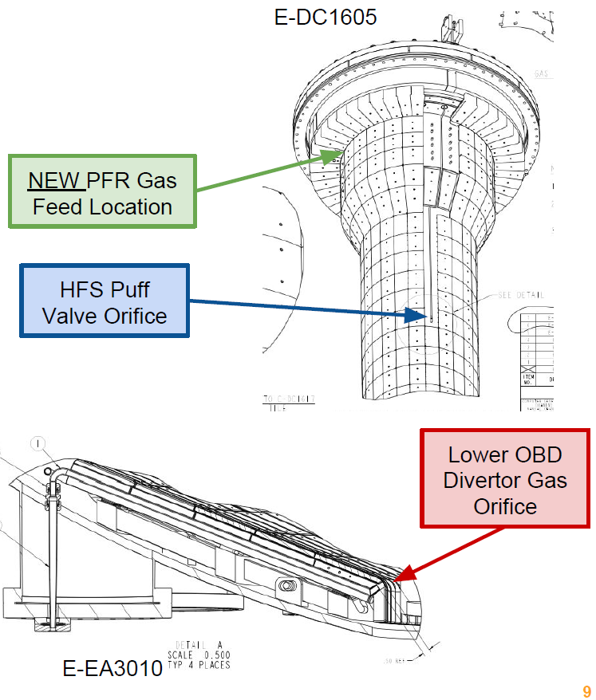
Recovery Requirements- Gas Fueling
Must preserve four high field side puff valves as per NSTX-U.
Must preserve the divertor gas feeds on the lower divertor.
Must add private flux region feeds on each of top and bottom of CS.
plans for how to optimize radiative exhaust will need to be made

Slide 32
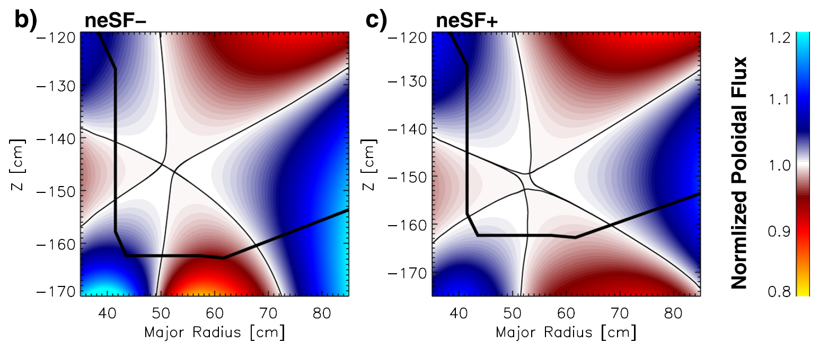
Desire Flexibility to Explore Snowflake Divertor
Frerichs PoP 2016
poloidal field direction switches between legs
SP4 = ‘outer leg’
SP3 = ‘inner leg’
B_{p}
SP4
SP3
prior experiments on NSTX, DIII-D and TCV used flat PFCs
power sharing between strike points important
  TCV sees ~25% of the power on SP3 on SP4 [Remierdes PPCF 2013]
  this power approaches shaped PFCs ~ 90º making q_{surf} ~ q||

Slide 33
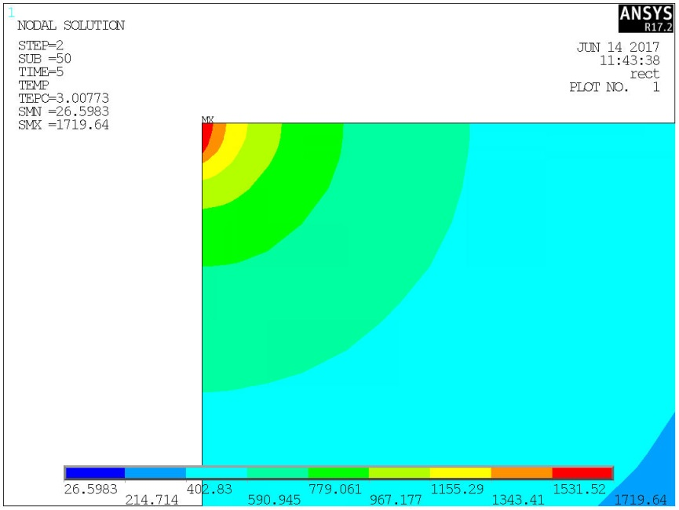
Analysis Shows PFCs May Tolerate ‘Snowflake Like’ Cases
thermal analysis shows heat conducted into PFC bulk allows substantial edge heating over small edges, allowing heat loads in ‘unfavorable’ directions
143 MW/m²
115 MW/m²
q_{edge}=q_{flat}/tan(1º)
d
q_{edge}=57 MW/m²
q_{flat}=1.0 MW/m²
d=.010” (0.25 mm)
q_{edge}=115 MW/m²
Δt = 5 sec
T_{limit}=1600 ºC
q_{edge}=28 MW/m²
q_{flat}=0.5 MW/m²
‘d’ constrained by field line angle and tile size

Slide 34
Div/SOL Diagnostics Collaborator Driven
Divertor AXUV Bolometer [LLNL]
Divertor & Core Resistive Bolometer [ORNL]
Divertor Fast Cameras [LLNL]
Divertor Intensified Cameras [LLNL]
Divertor Langmuir Probes [PPPL]
Divertor UV/Vis/NIR Spectrocospy
(lower div) [LLNL], (upper div) [UT-K]
Filterscopes [PPPL/LLNL]
1D CCDs [LLNL]
Divertor Tangential Imaging [X-Science]
Lower Wide Angle Infrared Camera [ORNL]
Lower Fast IR Cameras [ORNL]
Upper Fast IR Camera [ORNL]
Inner divertor IR cameras [ORNL, UT-K]
Divertor SPRED [LLNL]
SOL reflectometer [ORNL]
Midplane Scanning Probe [MIT]
Multispectral Divertor Imaging [MIT]
Operated in FY16
Tested in FY16
Planned for FY17
Planned/Proposed for Future
He-line ratios [UW, ORNL]
GPI [PPPL, MIT]
Penning Gauges [UW]
ENDD (edge neutral density) [LLNL]
(more PMI diagnostics not discussed)

Slide 35
Backup

Slide 36
NSTX/-U and MAST/-U allow critical opportunities for physics understanding thru complementary macrostability research
NSTX-U attributes | MAST-U attributes | Critical research
Stabilizing conducting wall (high τ_{wall}) enabling highest β_{N}/l_{i} < 14, 2x no-wall limit | Conducting support structures (low τ_{wall}) + P_{NBI} allowing operation over no-wall limit | Role of conducting structure in kinetic MHD stabilization of high β_{N} plasma
Access to lower collisionality, highest β_{N}/l_{i} |  | Verify kinetic MHD stabilization at low ν
Higher shaping of core ST plasma, with varied divertor (e.g. snowflake) | Shaped ST plasma with complex shaping of divertor plasma | Influence of core shaping and divertor geometry on global kink/ballooning
Direct measurement of global MHD stability at highest β_{N}/l_{i} (MHD spectroscpy) | Direct measurement of global MHD stability without conducting structure | Define conditions for access to NSTX improved MHD stability at highest β_{N}/l_{i}
High rotation speed variation (via NTV) w/ wide variation of plasma rotation profile | High rotation speed variation (via NTV) w/ lower variation of plasma rotation profile | Importance of rotation profile variability (e.g. shear) for disruption avoidance
Large variation of EP population via choice of 1st and 2nd NBI power sources | Different EP distribution due to different NBI power, parameters | Influence/strength of EP stabilization on global MHD modes
- Active global MHD mode control - Active rotation control (NBI + NTV) - Active l_{i} and q profile control - Real-time MHD spectroscopy - Real-time kinetic stabilization predictor - Real-time rotating MHD identification | - Open loop control capability - Open loop control capability | Green: NSTX-U available capability Red: NSTX-U planned capability Gray: Capability brought forward after last NSTX-U 5 Year Plan

Slide 37
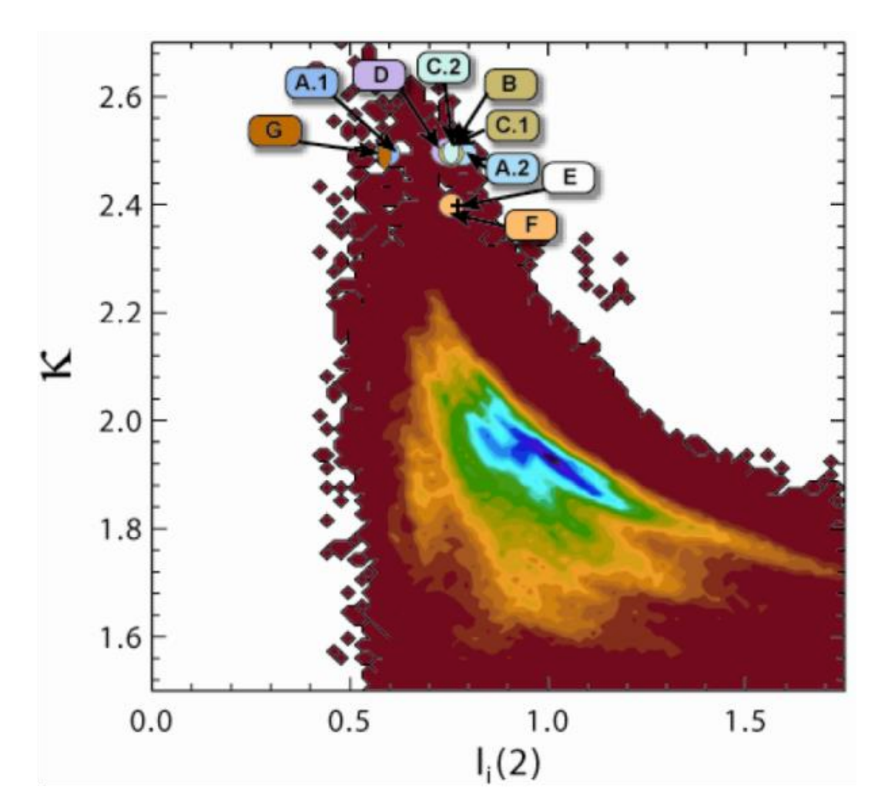
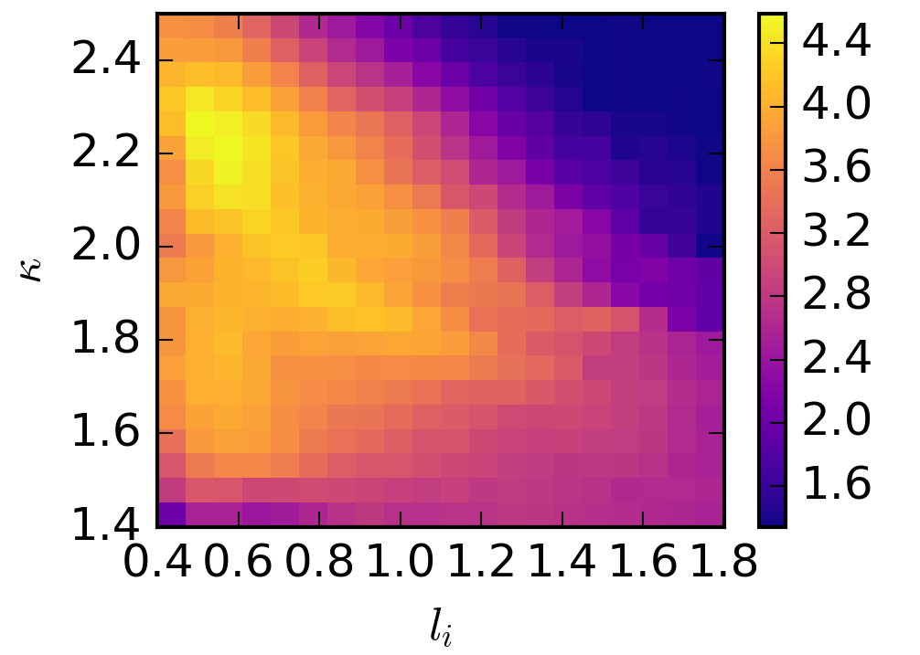
MAST-U and NSTX-U high-performance scenarios target high κ via low l_{i} operation
MAST EFIT database
NSTX EFIT01 database
(log scale)
MAST-U target
NSTX-U target
Most common
NSTX operation
Most common
MAST operation
l_{i} = 0.6
l_{i} = 0.5

