Slide 1


NSTX-U Research Milestone and Research Activities
Update and Plans
NSTX-U PAC-40 – Sept. 11, 2019
D.J. Battaglia
On behalf of the NSTX-U Research Team

Slide 2
NSTX-U PAC-40 Charge
The NSTX-U Research Program requests advice from PAC-40 in three areas:
  Please comment on the quality and importance of recent research results, including collaborative activities, and how they advanced the NSTX-U Mission and Milestones
  How well the FY20 and 21 Research Milestones address issues critical to the ST and fusion as well as the preparation for operations of NSTX-U, and the suitability of expertise and resources needed to achieve these milestones successfully.
  The role, uniqueness and importance of NSTX-U in developing a national fusion strategy and to contribute to the design of a next-step tokamak device. In particular, is the proposed R&D program well-positioned to close gaps needed for a compact pilot plant as outlined in the recent NAS and FESAC TEC studies?

Slide 3
NSTX-U Research Milestones address key scientific missions that will be initiated upon restart
FY19/20 Research Milestones focused on modeling and data analysis
  At this time, Milestones are led by PPPL scientific staff while ”Research Activities” can be led by NSTX-U collaborators
  Talk by Ahmed will highlight recent research supporting NSTX-U science program not captured in FY19 Research Milestones and Activities
FY21/22 Research Milestones target operations on NSTX-U
  Milestones will benefit from reconstitution of NSTX-U research team
  Some elements can be performed through collaborations on other devices
Achievement of Research Milestones will benefit from timely increase in scientific resources
  Necessary to balance support of Recovery Project with progress on scientific mission

Slide 4
Research Milestones address critical issues in fusion research and prepare for NSTX-U operations
Understand mechanisms governing the pedestal structure at low-A
Advance core transport models applicable to high-𝛽 and low-𝜐*
Develop predictive models to understand and optimize fast-ion transport, instabilities and current drive
Enable low-disruptivity scenarios at high 𝛽_{N} and develop tools for disruption avoidance and mitigation
Develop and optimize the real-time control and scenario capabilities needed to sustain high-non-inductive fraction discharges

Slide 5
Research Milestones address critical issues in fusion research and prepare for NSTX-U operations
Understand mechanisms governing the pedestal structure at low-A
Advance core transport models applicable to high-𝛽 and low-𝜐*
Develop predictive models to understand and optimize fast-ion transport, instabilities and current drive
Enable low-disruptivity scenarios at high 𝛽_{N} and develop tools for disruption avoidance and mitigation
Develop and optimize the real-time control and scenario capabilities needed to sustain high-non-inductive fraction discharges

Slide 6
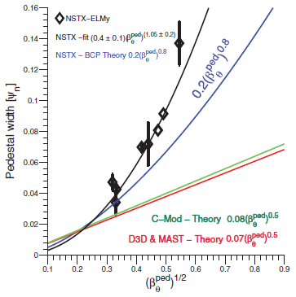
NSTX-U data critical for developing a predictive pedestal model that spans low-A to high-A
Pedestal width at low-A scales more strongly with 𝛽_{𝜃} compared to conventional-A
  Width is enhanced relative to prediction assuming KBM pedestal transport
JRT and milestones advance understanding of pedestal structure at low-A
NSTX data
Diallo NF (2013)
EPED scaling
  JRT-19: Identify role of fueling in pedestal structure
  R20-1: Apply gyrokinetic and neoclassical modeling to advance understanding of pedestal transport at low-A
  R21-1: Characterize pedestal at larger I_{p}, B_{T}, A and lower 𝜐* compared to NSTX
    Elements of milestone may be deferred to FY22

Slide 7
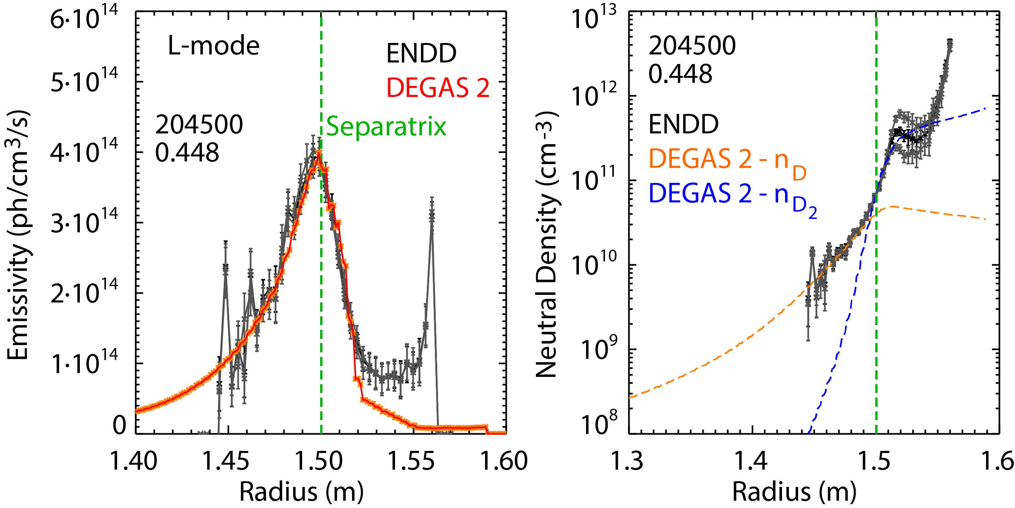
JRT19: Understand role of neutral fueling and transport in determining pedestal structure
Neutral density (n_{D}) measurement developed and validated via neutral transport simulations
  n_{D} profile inferred from from ENDD and GPI diagnostics
  Automated workflow for DEGAS 2 simulations developed to validate inferred n_{D} profile
Measurements (ENDD, GPI) and calculations (DEGAS2) support ongoing detailed analysis of particle fueling and transport mechanisms

Slide 8
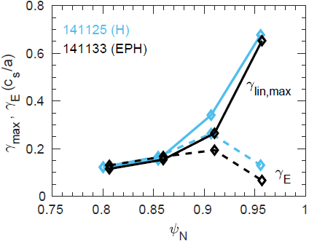
R20-1: Pedestal transport simulation and modeling
R21-1: Characterize pedestal at higher field, lower-𝜈*
Extend previous linear gyrokinetic analysis demonstrating TEM and ETG pedestal transport
  Begin work with non-linear gyrokinetic analysis relevant for the pedestal (CGYRO, XGC1, GS2)
  Revisit neoclassical analysis of ion dynamics in setting pedestal structure (NEO, XGCa)
FY21/22-1 milestone: characterize the pedestal structure and instabilities
  Collaborate with MAST-U in experimental analysis and simulations supporting pedestal structure and transport research
  Commissioning profile and turbulence diagnostics on NSTX-U
CGYRO
TEM predicted in wide-pedestal H & EPH mode
BES
H-mode 141131
H-mode 141125
EP H-mode 141133

Slide 9
Research Milestones address critical issues in fusion research and prepare for NSTX-U operations
Understand mechanisms governing the pedestal structure at low-A
Advance core transport models applicable to high-𝛽 and low-𝜐*
Develop predictive models to understand and optimize fast-ion transport, instabilities and current drive
Enable low-disruptivity scenarios at high 𝛽_{N} and develop tools for disruption avoidance and mitigation
Develop and optimize the real-time control and scenario capabilities needed to sustain high-non-inductive fraction discharges

Slide 10
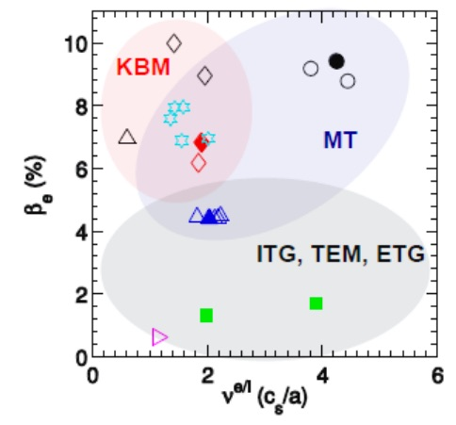
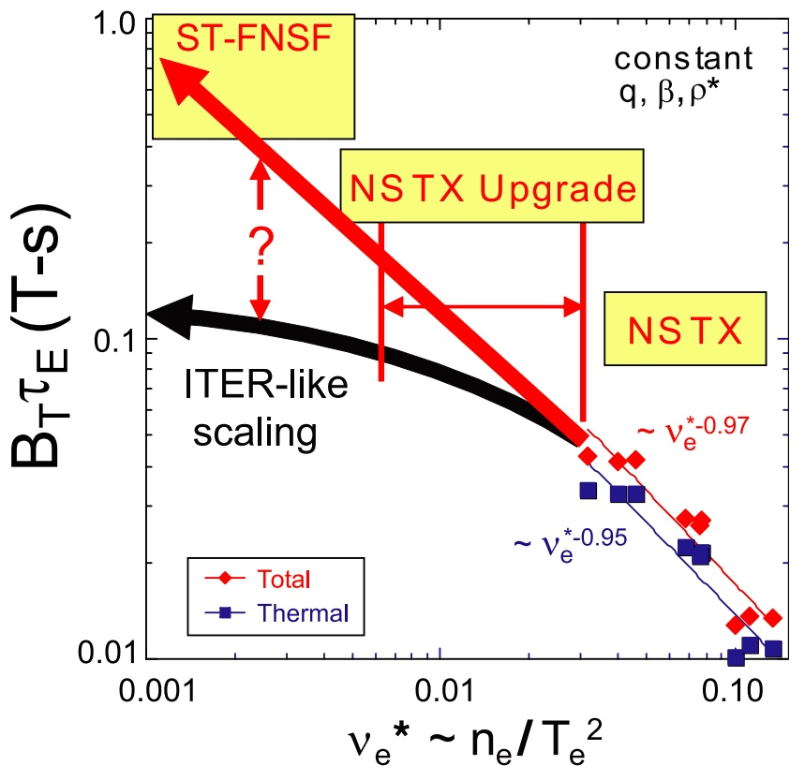
NSTX-U critical for characterizing confinement at low-A and high 𝛽 as 𝜈* is reduced
Next-step devices benefit from a predictive transport model valid across range of 𝛽, 𝜈
  NSTX-U accesses E-M turbulence regimes at high-𝛽
Milestones aim to develop and validate core transport tools for NSTX-U regimes
  R19-1: Validate transport models for high-𝛽 ST H-mode plasmas and assess the importance of multi-scale effects in NSTX-U turbulent transport
  JRT20: Validation of impurity transport models
  RA20-1: Global EM simulations at high-𝛽
  R21-1: Assess H-mode confinement on NSTX-U and/or MAST-U
    Elements of milestone may be deferred to FY22
W. Guttenfelder et al., NF 53 (2013)

Slide 11
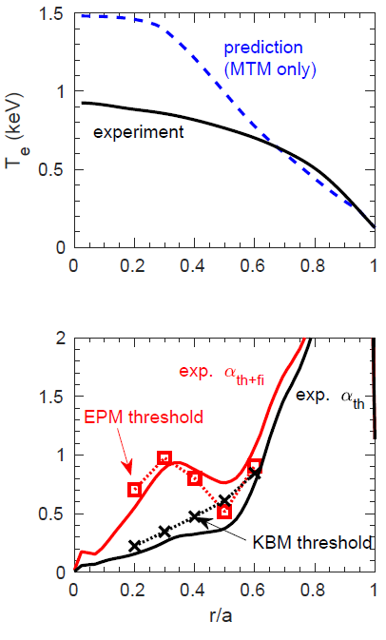
R19-1: Validate transport models for high-β ST H-mode plasmas; assess importance of multi-scale effects
Linear CGYRO analysis identifies unstable MTM & TEM outside r/a≥0.6 (top of pedestal)
  Reduced Rafiq MTM model (part of Multi-mode transport model) predicts outer T_{e} profile
Central profiles predicted to be very near or above threshold for energetic particle mode (EPM)
  EPM threshold depends on total pressure (thermal + fast ion) gradient
  Global, low-n ballooning modes also predicted unstable (M3D-C1)
Developing hypothesis: central T_{e} ultimately clamped by pressure limit
  GAE/CAE modes also postulated to influence core T_{e}
NSTX 133964
Lowest V_{surf} shot
Gerhardt, NF 2011

Slide 12
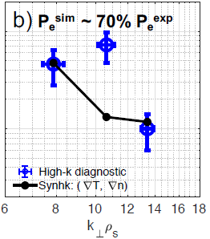
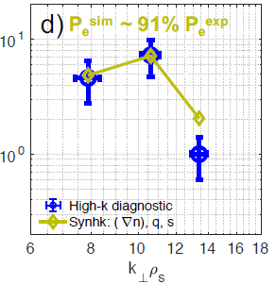
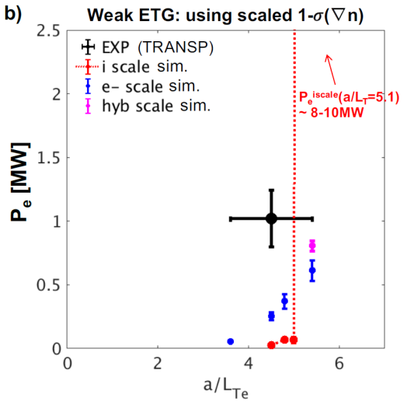
R19-1: Electron-scale (ETG) turbulence can account for anomalous electron loss in lower-β NSTX H-mode
Comprehensive validation effort suggests e-scale (ETG) accounts for anomalous e-transport
  Utilized high-k turbulence measurements + novel synthetic diagnostic to constrain simulation results using numerous sensitivity scans
  Small variation in geometry (s and q) improves match to high-k fluctuation spectra
Single-scale conditions identified in an NSTX H-mode at intermediate β
  Similar to multiscale effect found in C-Mod for conditions with strong ETG drive + near-marginal ion-scale stability (Howard, NF 2016)
s & q varied
within uncertainty
high-k exp.
ETG sim.
+ synth. diag
Strong ETG, near-marginal ion-scale
exp.
ETG sims
ion-scale sims
Ruiz-Ruiz, MIT Ph.D. (2019); PPCF (2019, accepted), APS invited (2019)

Slide 13
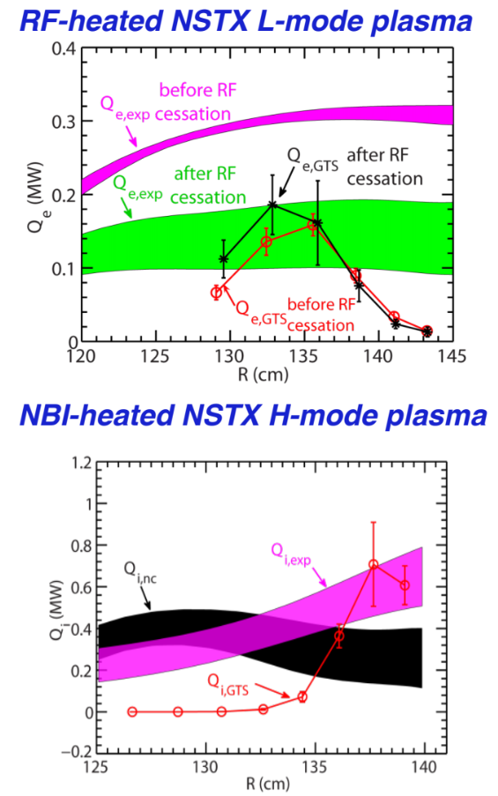
RA20-2: Global E-M simulations in high-𝛽
R21-1: Assess confinement at higher field, lower-𝜈*
Benchmark global electromagnetic simulation capability of GTS using high-𝛽 NSTX discharges
  Assess single-n, linear calculations for large range of modes, from low-n (shear Alfven, tearing modes) to drift-wave instabilities (KBM, MTM)
  Extension to non-linear calculations and/or multiple-n
FY21/22-1 milestone would characterize core confinement at lower 𝜈*
  NSTX-U: B_{T} ~ 0.85 T, I_{p} ~ 1.4 MA at end of first year of ops: ν* ~ factor 1.5-3 lower than NSTX
Y. Ren et al., PoP 2015

Slide 14
Research Milestones address critical issues in fusion research and prepare for NSTX-U operations
Understand mechanisms governing the pedestal structure at low-A
Advance core transport models applicable to high-𝛽 and low-𝜐*
Develop predictive models to understand and optimize fast-ion transport, instabilities and current drive
Enable low-disruptivity scenarios at high 𝛽_{N} and develop tools for disruption avoidance and mitigation
Develop and optimize the real-time control and scenario capabilities needed to sustain high-non-inductive fraction discharges

Slide 15
NSTX-U can access unique fast-ion regimes and instabilities that directly inform burning plasma scenarios and optimization
Explore impact and control of fast-ion heating, current drive and instabilities in burning-plasma regimes
  NSTX-U has very flexible NBI system for modifying the fast-ion phase space
Milestones aim to develop a validated EP transport models for predictive modeling
  R19-4: Assess energetic particle transport by sub-TAE instabilities and develop reduced EP transport modeling tools
  R20-4: Assess the effects of NBI parameters on the fast ion distribution function and NBI driven current profile
  R21-3: Optimization of NBI mix for AE mitigated scenarios
    Elements of milestone may be deferred to FY22

Slide 16
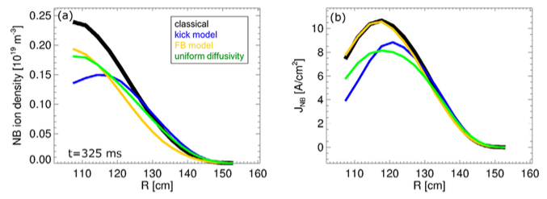
R19-4: Assess energetic particle transport by sub-TAE instabilities and develop reduced EP transport modeling tools
‘Kick model’ in TRANSP extended from high-f (AE) version to include EP transport by low-f modes
  NTMs, kinks, fishbones, and sawteeth coexist with AEs
  Low-f modes: fewer, larger-amplitude resonances with EPs than AEs may lead to non-diffusive transport
  Extended kick model validated with NSTX-U data
    Improves upon ad-hoc models already implemented in TRANSP
  Kick model with NTMs applied to DIII-D and NSTX
    Use Mirnovs and USXR to infer NTM parameters to study impact of NTM on EP transport
    Presently investigating impact of EPs on NTM trigger and saturation toward comprehensive NTM module in TRANSP
D. Kim et al., NF (2019)
Podestà, NF 2019 (in press)
J.-H. Yang, APS-DPP 2019

Slide 17
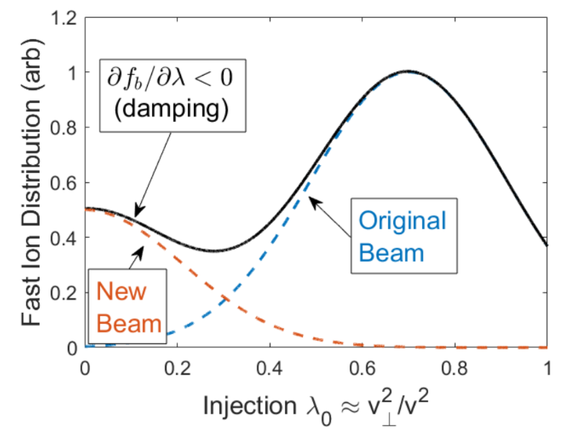
R20-4: Fast ion distribution and NB current profile vs NBI param.
R21-3: Optimization of NBI mix for AE mitigated scenarios
Flexible NBI system on NSTX-U offers opportunity to optimize fast-ion distribution
  Computational (HYM) and analytic models reproduce AE stabilization with tangential beam
  Models identify regions of stability with regards to NBI parameters
Validate models and optimize NBI parameters for stability and current drive
  Utilize dataset and joint experiments with NSTX(-U), MAST(-U) and DIII-D
J. Lestz APS invited 2019
E.V. Belova et al., PoP submitted
FY21/22 milestone would test optimization from simulations
  Complete experiments on MAST-U, DIII-D and NSTX-U (if operating)

Slide 18
Research Milestones address critical issues in fusion research and prepare for NSTX-U operations
Understand mechanisms governing the pedestal structure at low-A
Advance core transport models applicable to high-𝛽 and low-𝜐*
Develop predictive models to understand and optimize fast-ion transport, instabilities and current drive
Enable low-disruptivity scenarios at high 𝛽_{N} and develop tools for disruption avoidance and mitigation
Develop and optimize the real-time control and scenario capabilities needed to sustain high-non-inductive fraction discharges

Slide 19
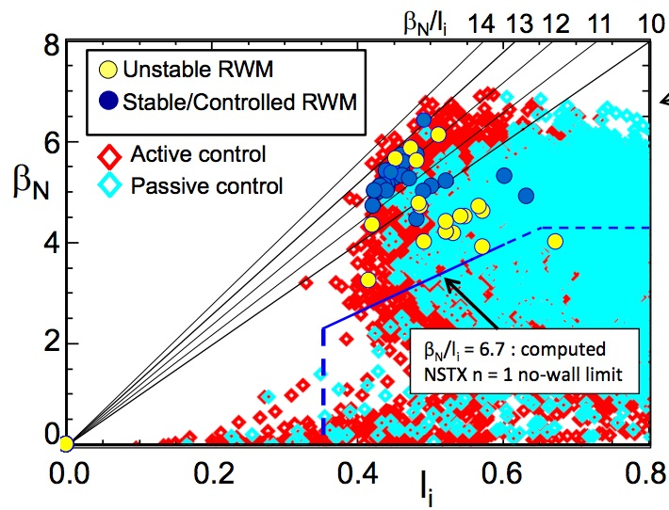
High-performance scenarios on NSTX-U enabled by low-disruptivity at high 𝛽_{N}
Performance and scientific productivity strongly linked to ability to operate near stability boundaries with minimal disruptions
Research Milestones and Activities
  R19-3: Validate tearing mode physics for tearing avoidance in high-performance scenarios
  RA19-1: Expand disruption prediction and avoidance capability for tokamaks
  R20-3: Integrated disruption modeling for NSTX-U
  RA20-1: Application of expanded disruption prediction and avoidance capability for NSTX-U
  R21-4: Multi-mode correction of error fields in NSTX-U and tokamaks
    Elements of milestone may be deferred to FY22
Plasma disruptivity in (l_{i},β_{N}) space
NSTX
S.A. Sabbagh, APS DPP Invited (2018)

Slide 20
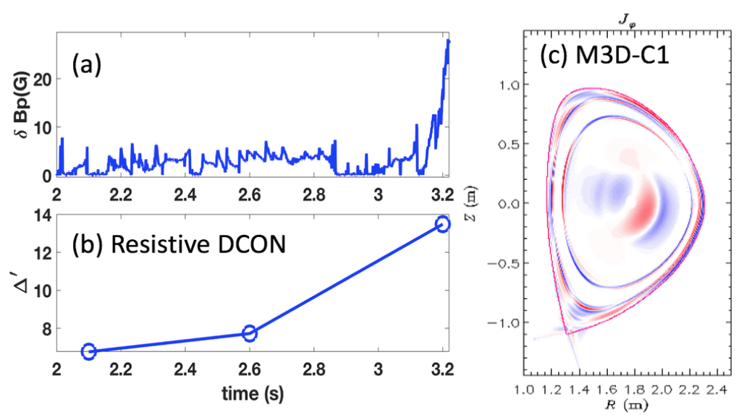
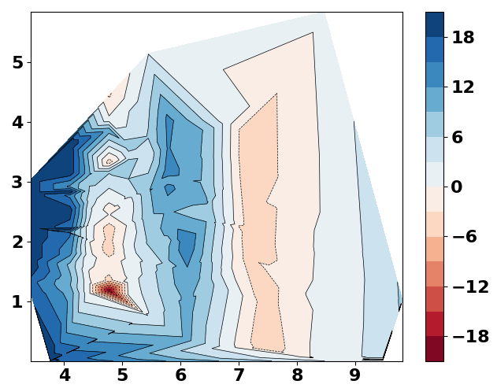


R19-3: Validate tearing mode physics for tearing avoidance in high-performance scenarios
Full toroidal ∆′ required to predict TM stability in high-β, ST geometry with ‘extreme toroidicity’
RDCON and STRIDE are reduced models that can calculate toroidal ∆′
  Verified against full-MHD predictive simulations (M3D-C1) for DIII-D IBS cases
Prediction of tearing modes in DIII-D IBS
Onset of tearing modes
n=1 ∆′ (q=2) in NSTX-U 2MA, 1T, 12MW scenario
$Δ′$(q=2)
RDCON used to map out stability space for NSTX-U
  Being coupled to TRANSP through a reduced NTM model for scenario development
  Also used for MTF stability calcs. (General Fusion)
stable
Unstable
$$q_{95}$$

Slide 21
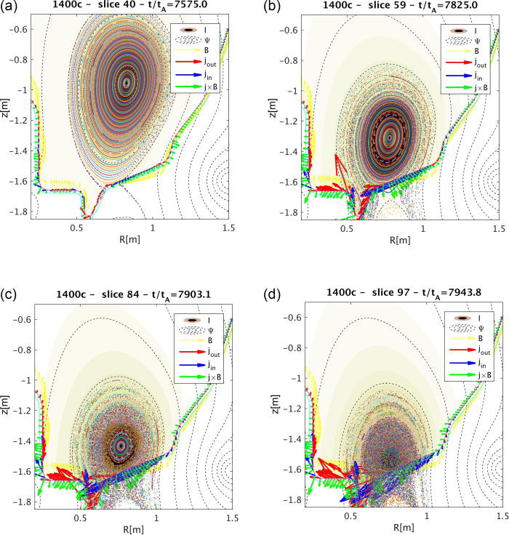
R20-3: Integrated Disruption Modeling for NSTX-U
R21-4: Multi-mode correction of error fields
Avoidance and mitigation of VDE would benefit from validated high-fidelity integrated modeling
  Reduce stress and loads of VDE at high-fields
  Model will integrate realistic resistive walls, impurity ionization, radiation and transport, 3D physics, and runaway electrons
FY21/22: Develop EF mode-locking threshold scalings and correction strategies
  Plasma response is sensitive function of dynamic nature of error fields
  Validate island dynamics from simulations by hybrid and extended MHD codes against experiment
Ferraro, et al. Phys. Plasmas 23, 056114 (2016),
Ferraro et al Nucl. Fusion 59 016001 (2019)
Pfefferle et al Phys. Plasmas 25, 056106 (2018)
Ferraro et al. NF 59 086021 (2019)

Slide 22
Research Milestones address critical issues in fusion research and prepare for NSTX-U operations
Understand mechanisms governing the pedestal structure at low-A
Advance core transport models applicable to high-𝛽 and low-𝜐*
Develop predictive models to understand and optimize fast-ion transport, instabilities and current drive
Enable low-disruptivity scenarios at high 𝛽_{N} and develop tools for disruption avoidance and mitigation
Develop and optimize the real-time control and scenario capabilities needed to sustain high-non-inductive fraction discharges

Slide 23
NSTX-U will demonstrate non-inductive regimes at high 𝛽_{N} and large bootstrap fraction
Compact Tokamak Fusion Power Plant concepts leverage large f_{BS}
  NSTX-U has unique capabilities for demonstrating high f_{BS} at high 𝛽_{N}
Milestones will accelerate progress toward non-inductive operation
  R19-2: Develop optimized ramp-up scenarios in STs
  R20-2: Scenario optimization algorithm development base on reduced models
  R21-2: Commission operational tools that enable high-performance discharges on NSTX-U
    Elements of milestone may be deferred to FY22

Slide 24
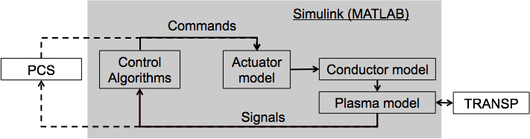
R19-2: Develop optimized ramp-up scenarios in spherical tokamaks
Simulation framework developed over FY18-19
  Reduced models include development of neural net models for fast ions, kinetic profile shapes, and q-profile
Milestone work includes development of metrics for a successful startup
  NSTX-U struggled to achieve passive vertical stability at target I_{p} ramp rate = 10 MA/s
  Applied to MAST-U and NSTX-U to optimize startup
Data
(a)
Vail et al., PPCF 2019
Boyer et al., Nuclear Fusion 2019
Ilhan et al., Fus. Eng. Des. 2019
Less vertical stability
Simulation
(b)
2016 configuration
New machine structure
D. Battaglia et al., NF accepted

Slide 25
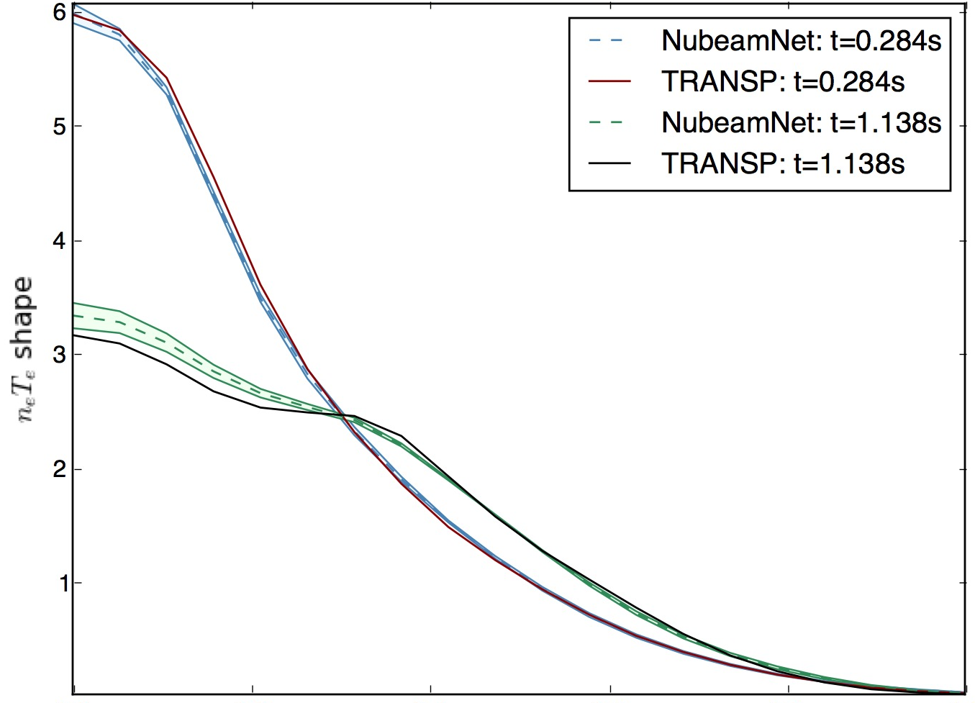
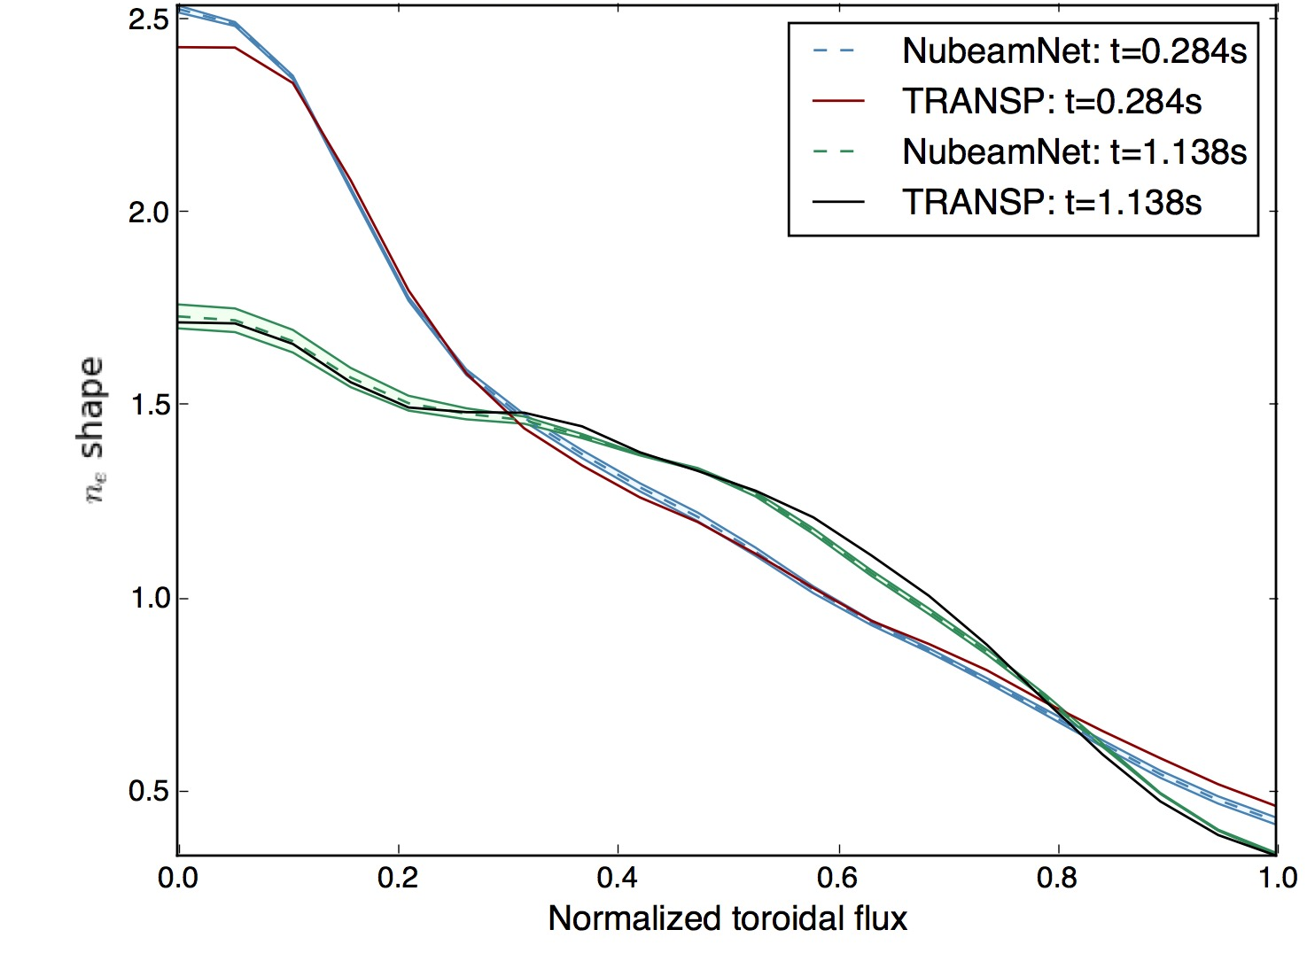
R20-2: Scenario optimization using reduced models
R21-2: Commission operational tools
Reduced models (such as NN models) enable rapid prediction of scenario evolution
  Apply optimization algorithms to identify actuator trajectories to achieve performance goals
  TRANSP simulations will be used to test and refine the optimized trajectories
  Builds off of recent work using optimization algorithms to optimize NSTX-U ramp up
FY21/22 Milestone commissions operational tools on NSTX-U and/or supports MAST-U operations
  Ramp-up optimization, vertical stability at high elongation, RWM feedback, ELM pacing
6
5
4
3
2
1
Shape = profile / vol. average
NubeamNet | 0.284s
Data | 0.284s
NubeamNet | 1.138s
Data | 1.138s
n_{e} x T_{e}
2.5
2.0
1.5
1.0
0.5
NubeamNet | 0.284s
Data | 0.284s
NubeamNet | 1.138s
Data | 1.138s
Wehner et al., Fusion Engineering and Design 2019
Electron density
0.0 0.2 0.4 0.6 0.8 1.0
Normalized toroidal flux

Slide 26
NSTX-U Research Milestones address key scientific missions that will be initiated upon restart
The FY19 Research Milestone and Activities address critical issues in fusion research and advances preparations for NSTX-U operations
The FY20 Research Milestones and Activities build on this progress with efficient use of the resources presently available
Rebuilding the NSTX-U research team well before operations is essential for preparing for operations and to rapidly advance progress with the FY21/22 milestones during the first physics campaign

