Slide 1
Non-Milestone Research Results; Collaborations/Public-Private Partnerships
NSTX-U PAC-40 – Sept. 11, 2019
A. Diallo for NSTX-U Team

Slide 2
Non-Milestone research results that can impact NSTX-U, ITER and tokamak research
NSTX-U scientists are involved in NSTX-U-related research activities as well as collaborations during the Recovery outage
PPPL researchers carrying out research in both areas
Collaborator research funding primarily through collaborations
Collaborations can be on topics that can impact future NSTX-U operations
NSTX-U can capitalize on the DoE investment in research that is independent of NSTX-U

Slide 3
Researchers are actively engaging in other domestic and international collaborations during Recovery
LTX-β (PPPL): Spectroscopy, plasma surface interaction, impurity transport
DIII-D (US): Pedestal physics, 3D physics, plasma materials interactions
EAST (China): edge physics, plasma materials interactions, effect of lithium
ASDEX-U, W7-X (Germany): wall conditioning using boron powder
QUEST (Japan): Full non-inductive startup (CHI, ECCD)
Urunia (UW): CHI
HL-2A (China): LH stabilization of ELMs, effects of NTMs on fast ions
KSTAR (S. Korea): Core MHD, rotation physics, plasma control
MAST-U and ST40 (UK): See next slide
MST (WIPPPL): ME-SXR for profiles and impurity transport
New collaborations (recent International proposal awards - JET, WEST, KSTAR, and COMPASS-U)

Slide 4
Collaboration on MAST Upgrade will afford opportunities with direct connection to the NSTX-U research program
Plasma startup, rampup and control
Confinement and transport, including TRANSP and gyrokinetic analyses, L-H threshold (PPPL), turbulence (UCLA)
Equilibrium and stability including EF and tearing physics (PPPL), RWM, disruptions, equilibrium codes (Columbia U.)
Divertor physics – diagnostics and data analysis (ORNL, LLNL)
Energetic particles, modeling, FIDA support, ssNPA, fusion products (PPPL, UC Irvine, Florida Int. Univ., UCLA)
Pedestal physics (PPPL)
First physics campaign planned for Spring 2020

Slide 5
ST40 collaboration has been approved and will be funded in FY20
Public-private partnership with Tokamak Energy Ltd., UK
Collaboration funded for three years through CRADA (Cooperative Research and Development Agreement)
PPPL, ORNL, UC Irvine, U. Washington, Columbia U.
ST40 is a high-TF (up to 3 T) Spherical Tokamak with Business Milestone by end of third year to “establish fusion conditions” (Ti(0)>10 keV, ne>10²⁰ m⁻³)
2-4 MW NBI
Will not have full diagnostic set; research, and time for it, will have limitations
Areas of collaboration include:
Pedestal physics – PBLS (PPPL), Divertor physics (ORNL)
Confinement scaling, TRANSP, EP physics, EF and tearing physics (PPPL, UC Irvine)
Disruption prediction algorithm development (Columbia U)
RF modeling for startup/rampup (EC/EBW), possible ICRH (PPPL, ORNL)
Scoping for turbulence diag. (PPPL), CHI (U. Washington), Li injection (PPPL)

Slide 6
This talk addresses PAC-40 charge #1
1. Please comment on the quality and importance of recent research results, including collaborative activities, and how they advanced the NSTX-U Mission and Milestones
Edge/pedestal physics
Energetic particle physics
Macrostability
Scenario development
Diagnostics development

Slide 7
Outline
Edge/pedestal physics
Explore dynamic processes in the edge region for understanding pedestal/SOL structure (NSTX/NSTX-U)
Utilize different wall conditioning techniques to optimize plasma performance (EAST, DIII-D, AUG, KSTAR)

Slide 8
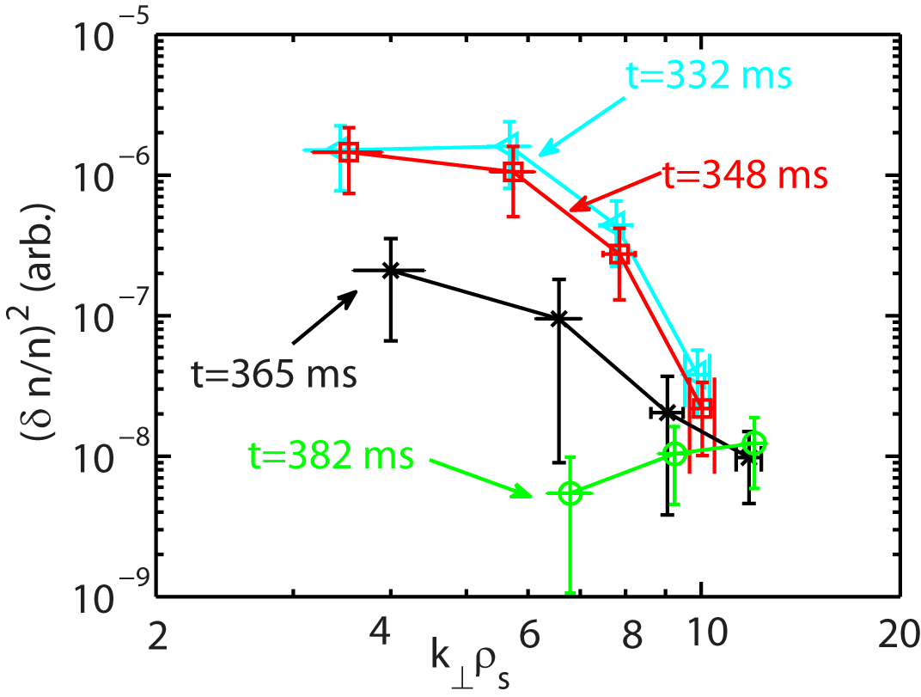
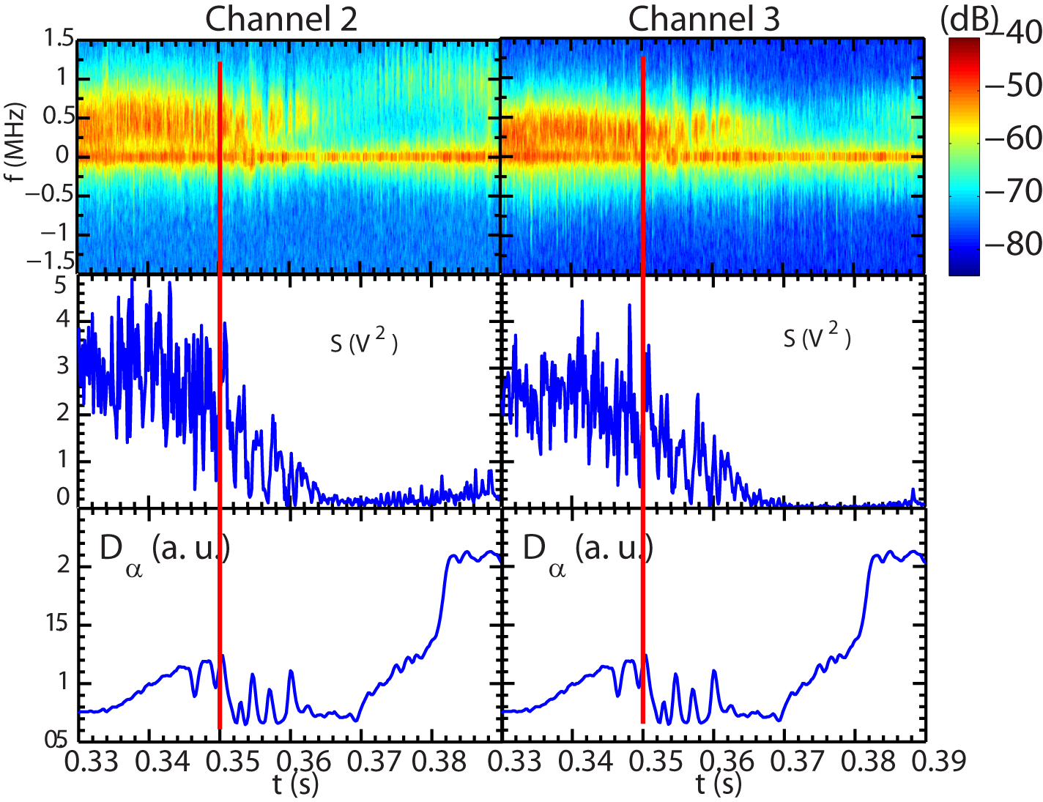
First detailed measurements of high-k (electron-scale) turbulence across L-H transition in NSTX reveal broad spectral changes
Multiple turbulence phases are identified across the L-H transition
Suppression of high-k turbulence at lower wavenumbers, i.e. k┴ρ_{s} ≤ 9-10 (higher wavenumbers unaffected); similar with turbulence changes at ion scale (BES)
Quasi-stationary phase
Intermittent phase
Quiet phase
Recovery phase
Before L-H transition
High-k turbulence frequency spectrum evolution
High-k turbulence wavenumber spectrum evolution
Total scattering power
after intermittent phase
Further into H-mode
L-H transition
Ren et al., Nucl. Fusion (2019)

Slide 9
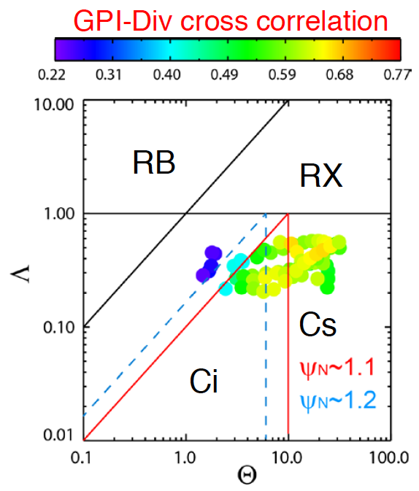
Fast camera imaging of the divertor provides new insights into SOL turbulence
Images in CIII emission
Divertor leg fluctuations observed by fast imaging in NSTX-U
Intermittent; localized to bad curvature side
Simulations with ArbiTER code find unstable resistive ballooning mode [Baver, CCP (2016)]
Disconnection of midplane turbulence from divertor plate due to X-point
Consistent with expectation from two-region blob model [Myra, PoP (2005)]
[Scotti, Nuc. Fusion (2018)]
Resistive
Ballooning
Resistive
X-point
normalized collisionality
Sheath connected
Ideal Interch
normalized blob size

Slide 10
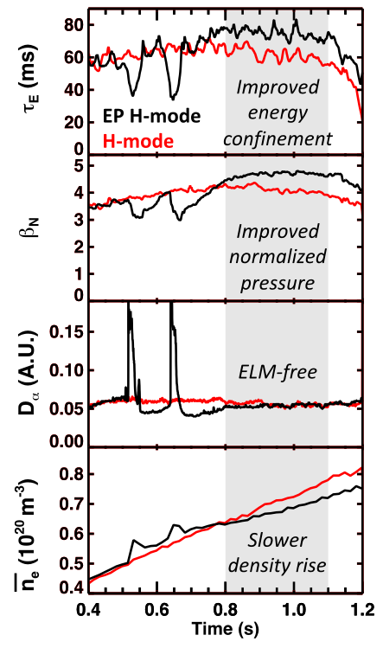
Mechanisms leading to Enhanced Pedestal (EP) H-mode are being better understood
EP H-mode is an attractive ELM-free regime for compact reactors
H_{98y,2} typically 1.5
Slower density and impurity accumulation
Reduced edge ion collisionality drives reduction in neocl. ion energy and momentum transport
Decrease in edge density following an ELM initiates a period of reduced edge ion collisionality
Positive feedback loop: Improved neo. energy confinement compensates for larger anom. particle transport loss
Faster loss of colder ions, slower loss of hotter ions
“Locks in” lower collisionality
Access to lower collisionality may enable routine access to EPH for NSTX-U
Battaglia, 2019 APS invited, PoP to be submitted

Slide 11
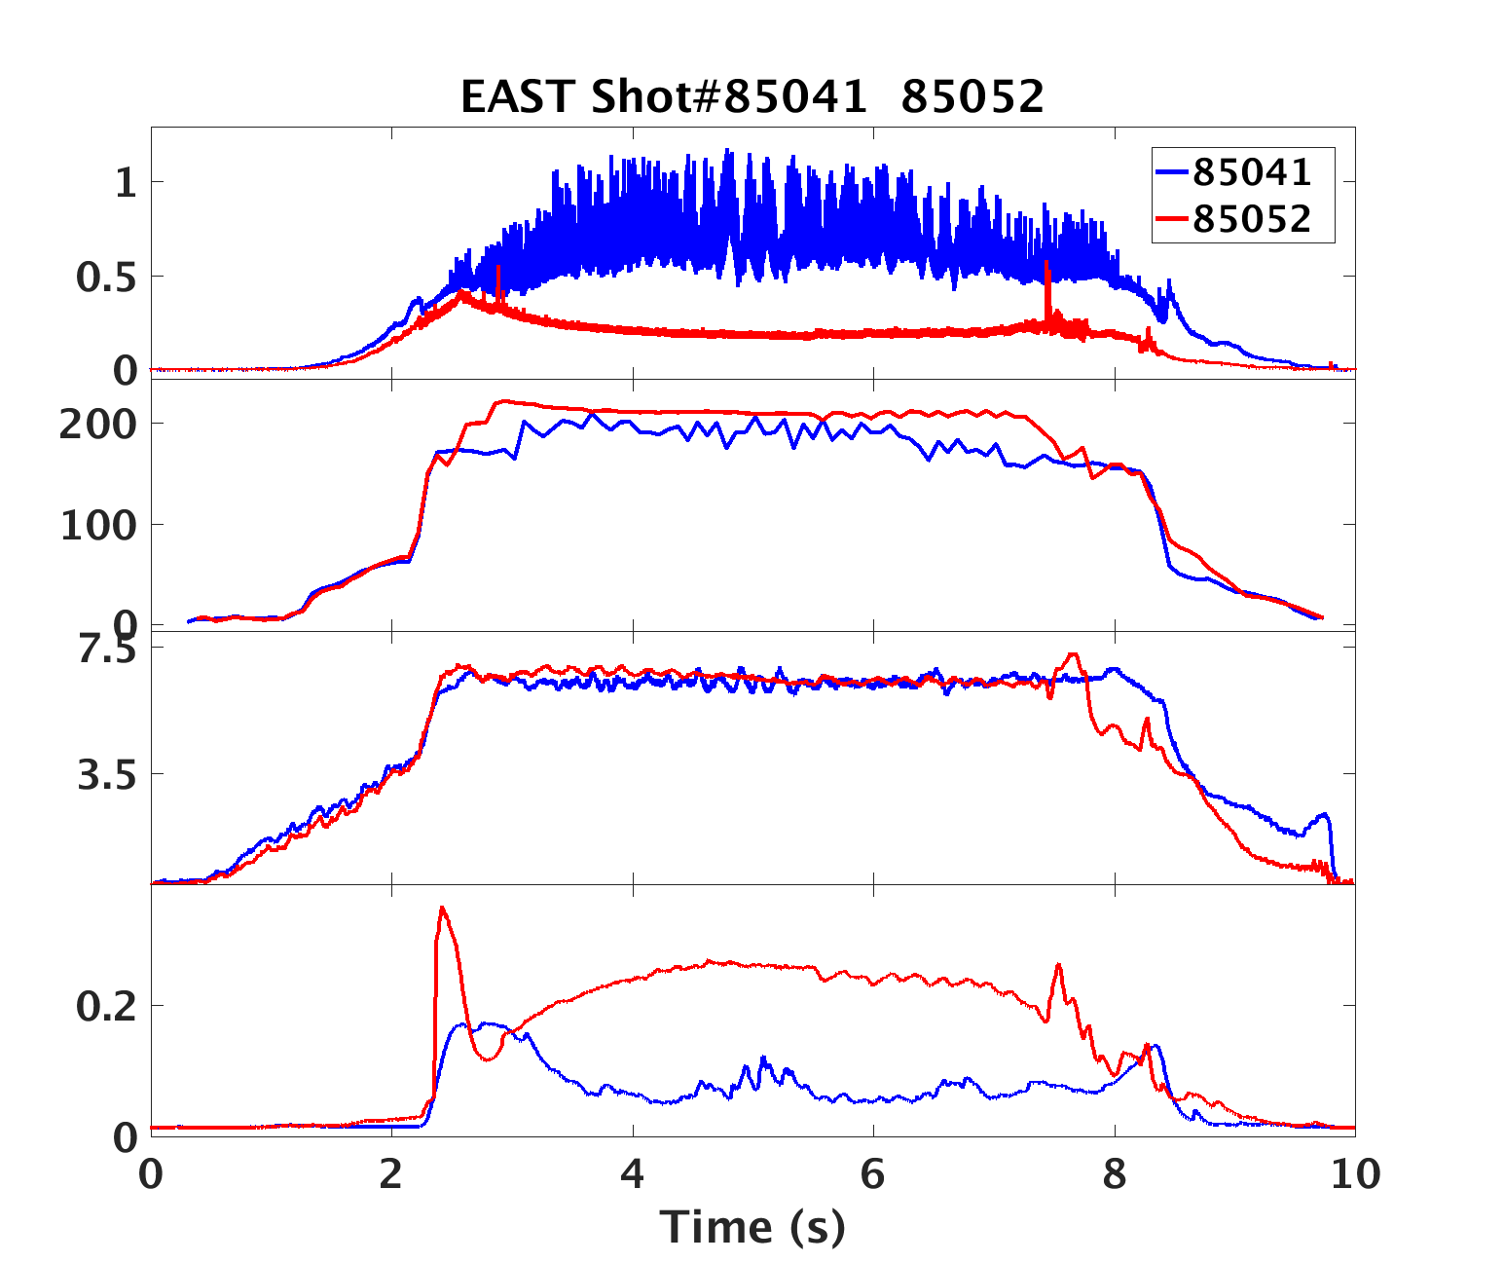
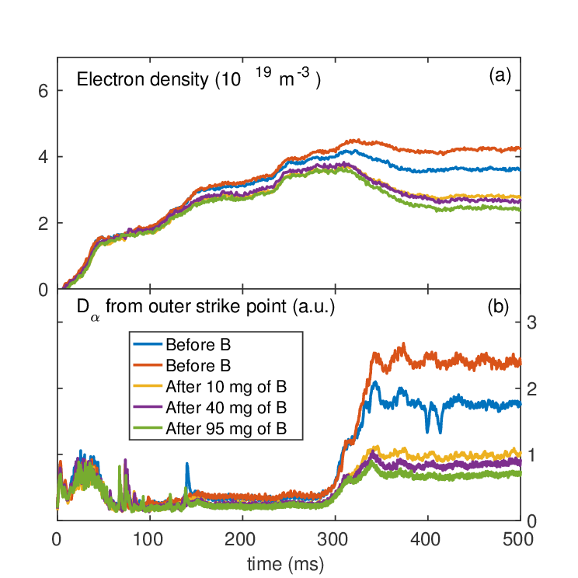
Wall conditioning and ELM control studied with low-Z impurity powder injection on EAST and DIII-D
Impurity powder dropper compatible with many materials deployed on EAST & DIII-D
Original version using Li was first deployed on NSTX
EAST: compare ELM suppression with Li powder injection (reduced recycling) with B powder (low freq. edge mode)
DIII-D: B powder injection successfully used for wall conditioning to reduce recycling and density
EAST
No B powder
B powder
D_{α}
No Li powder
Li powder
W_{MHD} [kJ]
EAST
n_{e} [10¹⁹ m⁻³]
R. Maingi, Nucl. Fusion 58 (2018) 024003
A. Diallo, H-mode workshop 2019
DIII-D
A. Bortolon, APS 2018, NME in prep

Slide 12
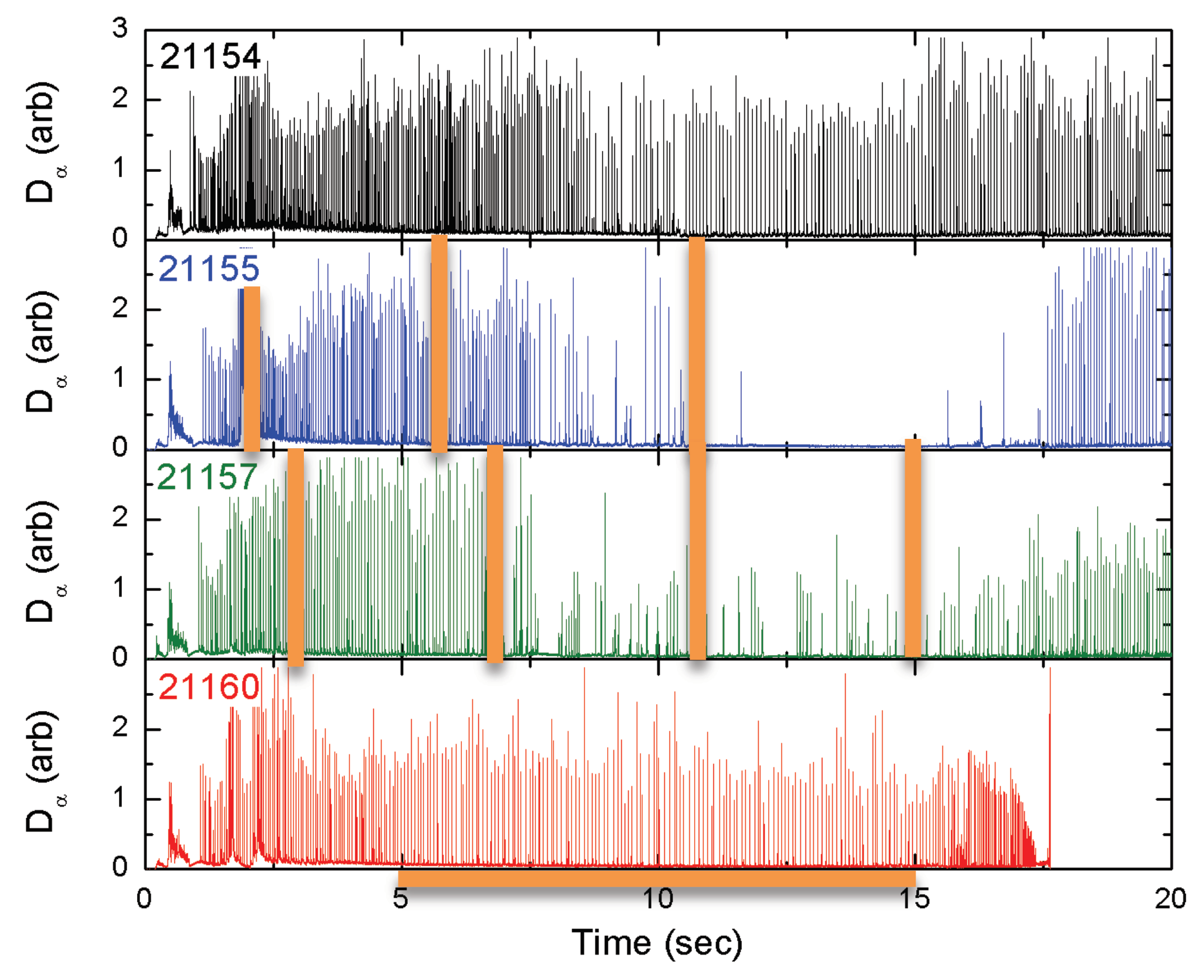
ELM control and enhanced power exhaust studied with low-Z impurity powder injection on KSTAR and AUG
KSTAR: BN powder injection led to periods of ELM quiescence
Dependence on injection rate
AUG: BN powder injection led to enhanced radiated power, reduced heat flux, improved stored energy
Similar to N₂ gas injection
Powder dropper is being considered for early deployment in NSTX-U
KSTAR
No B powder
BN powder
E. Gilson, EPS 2019 P5.126
No B powder
AUG
BN powder - lo
BN powder - hi
A. Bortolon, Nucl. Mater. Energy 19 (2019) 384

Slide 13
Outline
Energetic particle physics
Novel ICE observation on NSTX-U
Effect of EP on NTV on DIII-D
Potential effects on plasma rotation/performance
Effect of RF on EP distribution
Impact on NB heating and current drive

Slide 14
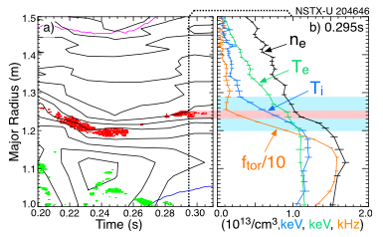
Ion Cyclotron Emission (ICE) from NSTX/NSTX-U scenarios shows features uncommon in larger R/a devices
NSTX(-U): ICE frequency maps to f_{ci} deeper in the core
ICE maps to a region of strong local density gradient
Frequency doesn’t follow Alfvénic scaling (but scales with B)
Contours of electron density (black) with the magnetic spectrogram overlaid (red)
Understanding ICE would provide a reactor-relevant fast ion diagnostic for ITER and beyond
Neutron rate generally proportional to ICE amplitude [JET]
Simple measurements (coils)
ICE typically associated with fast ions
Complement data from larger R/a devices
More theory work needed to explain the observations
[E. Fredrickson, PoP 2019]

Slide 15
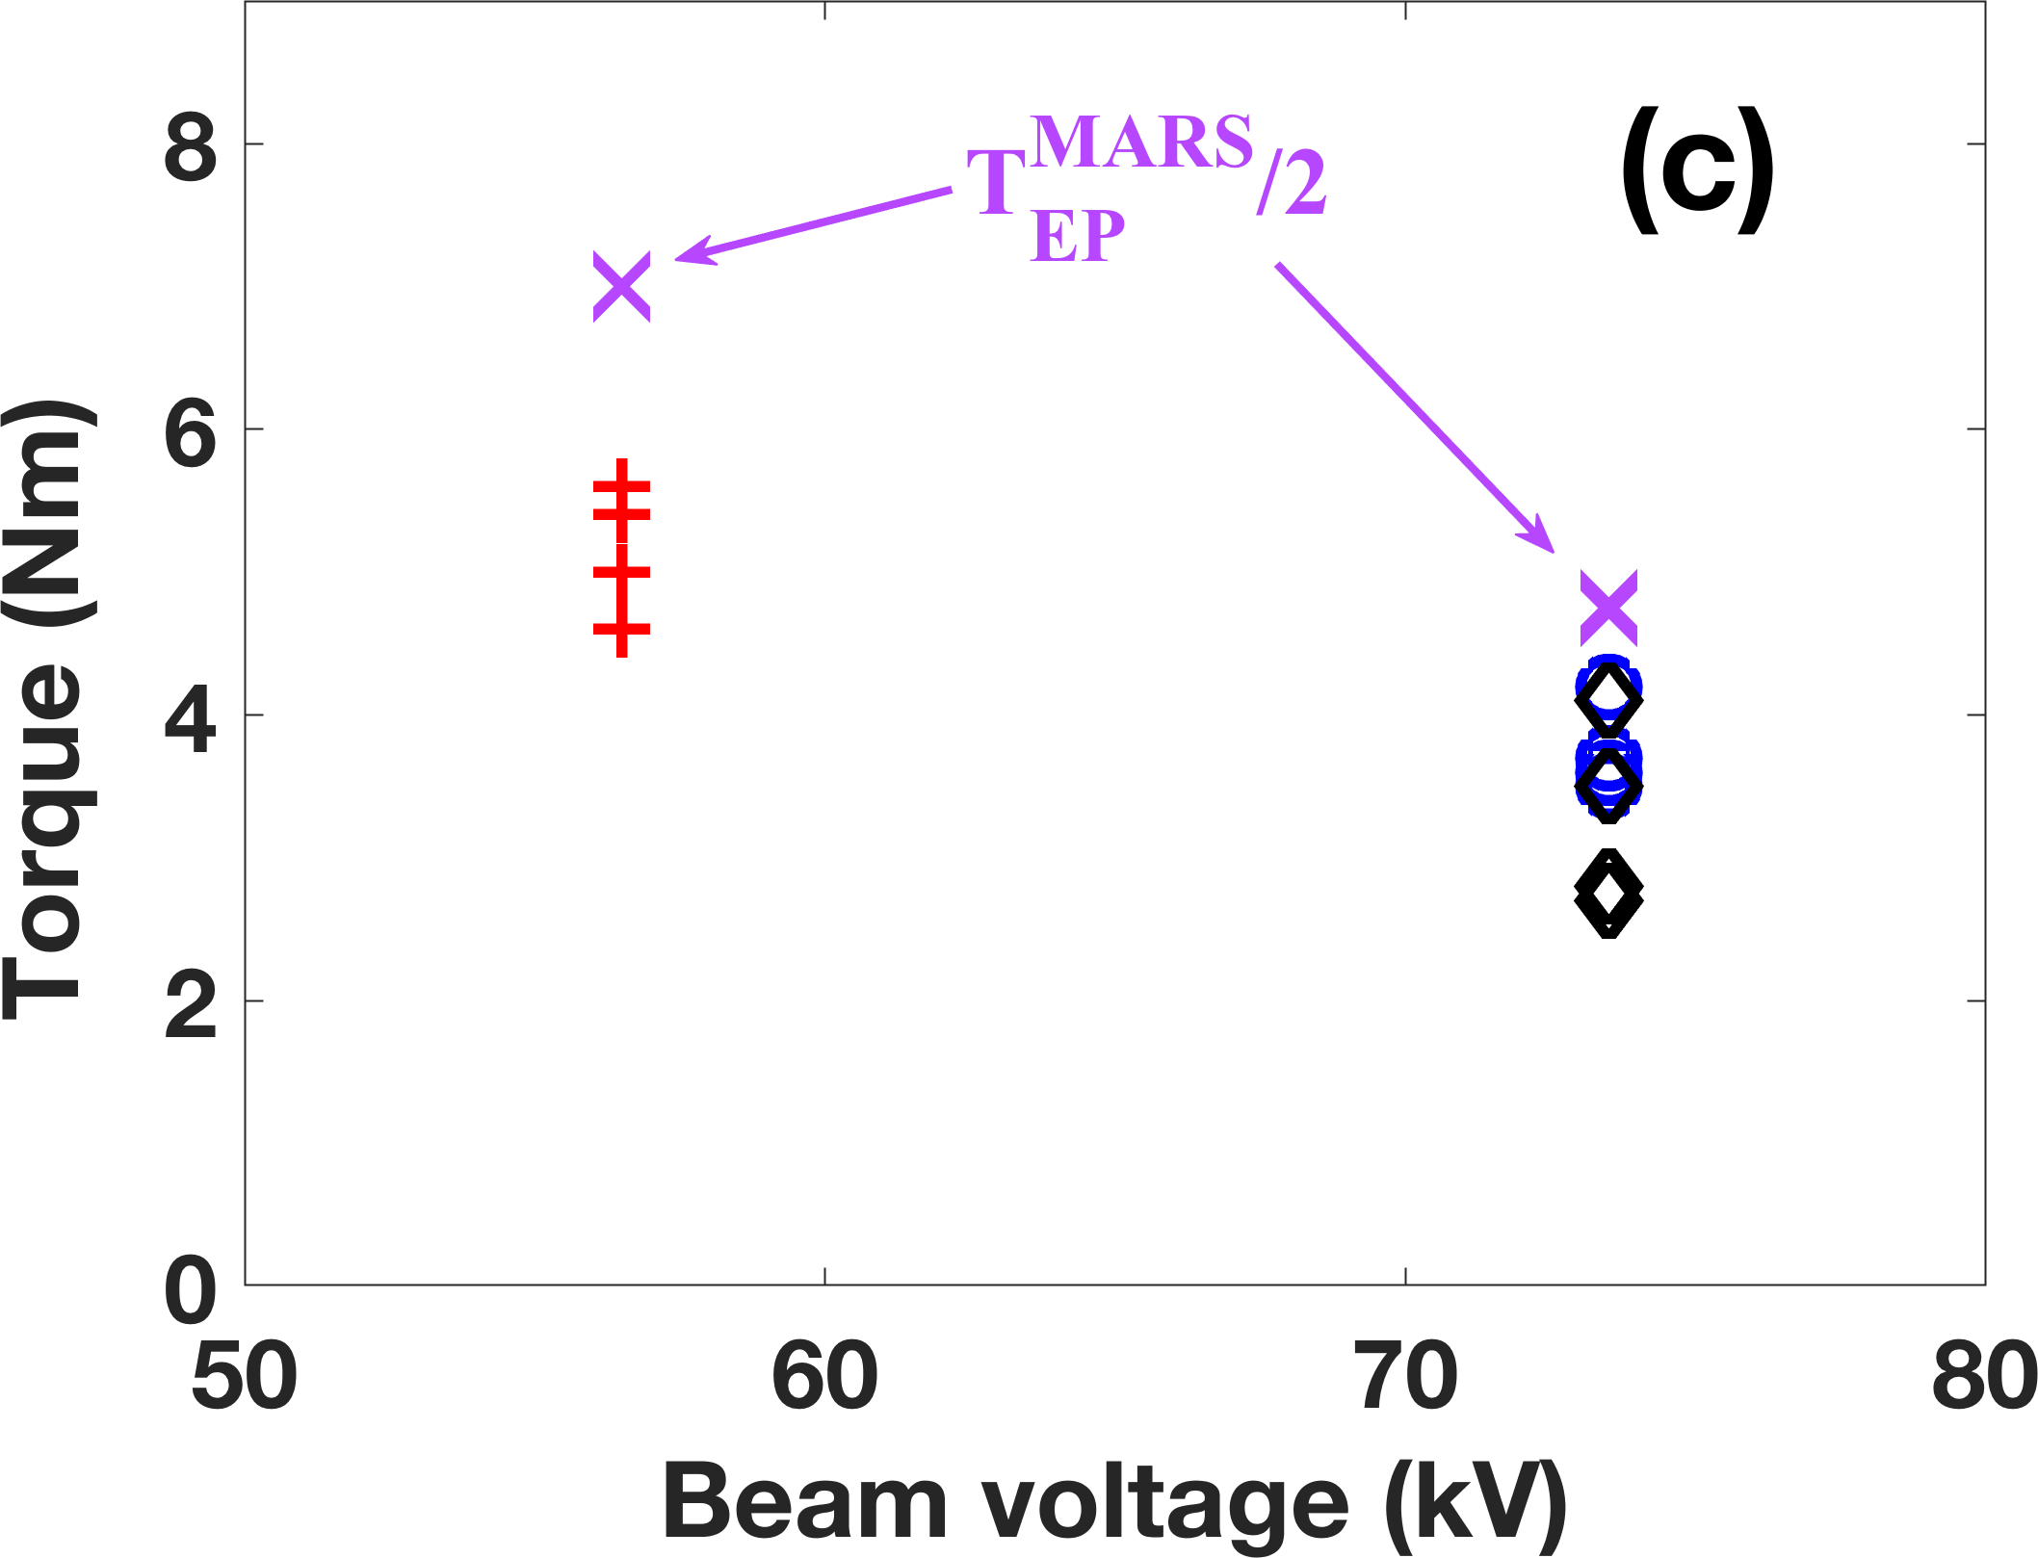
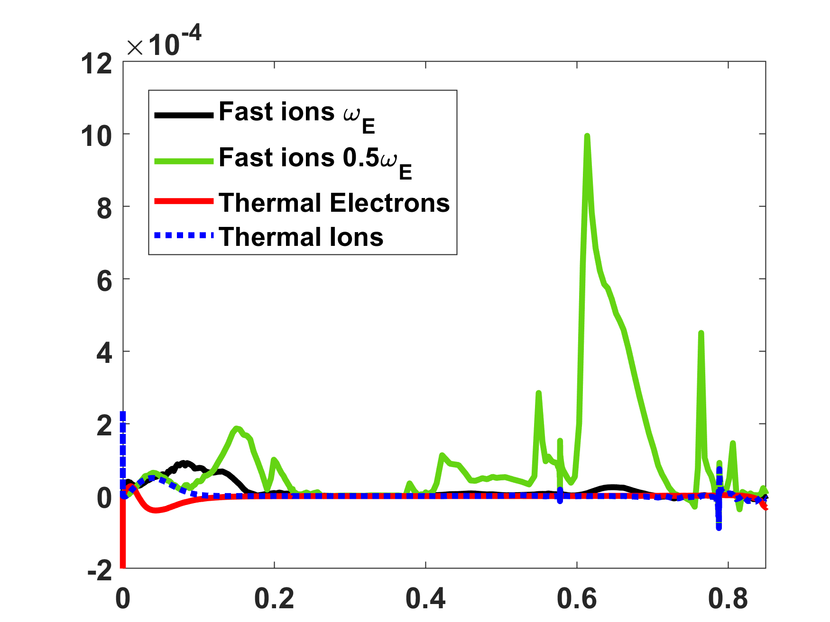
Energetic Particles found to Induce neoclassical toroidal viscosity on DIII-D
EP-induced NTV, predicted by theory was verified in n=1 DIII-D plasma response experiments
Experimental measured NTV torque is varied with beam voltage and injection angle
Simulated EP NTV agrees with experiments
EP NTV, due to precession resonance, can be much stronger than thermal NTV, when ExB rotation is comparable to the precession frequency
Energetic particles, as one of major plasma species, may contribute significant NTV torque in NSTX-U and ITER operation
Can impact plasma rotation and thus confinement and stability
NSTX-U flexible beams can help to further verify EP NTV and improve NTV modelling
MARS-K
Radial
Radial
Tangential
Experiments
MARS-K Simulated NTV
EP-NTV
Torque Density (a.u.)
Thermal Electron-NTV
Thermal ion-NTV
Z.R. Wang, EPS 2019

Slide 16
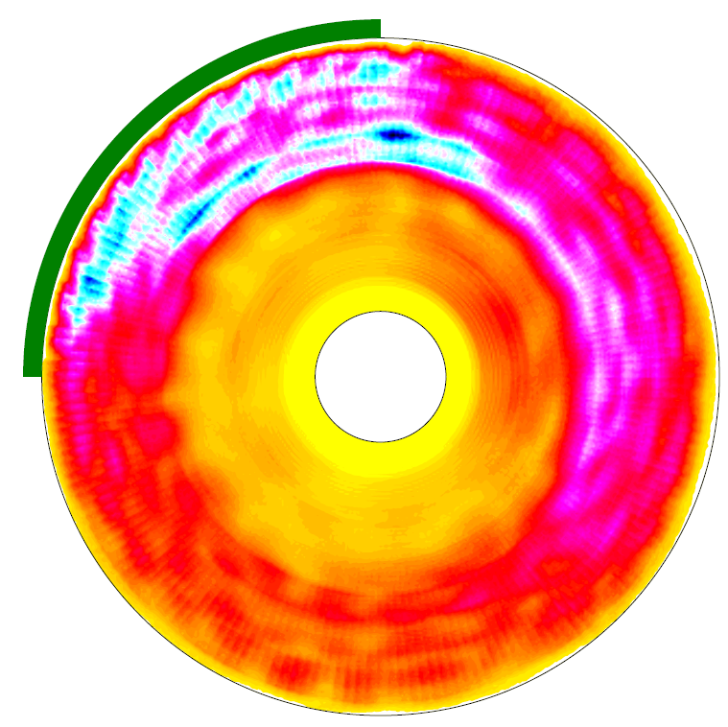
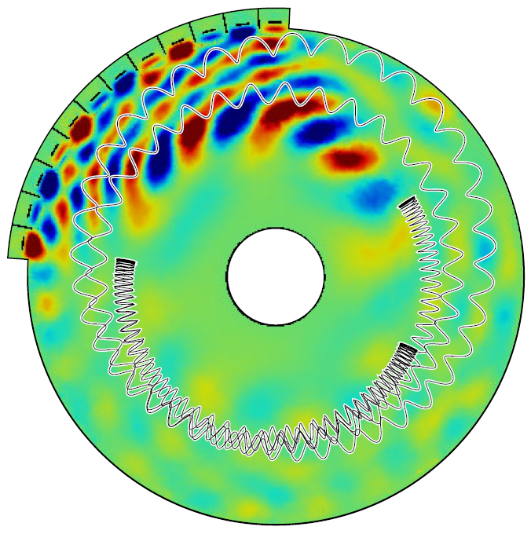
3D RF field (from Petra-M) combined with following particle code SPIRAL to study the interaction of FW with fast ions
Extending to 3D enables accurate core-edge coupling with the antenna
Strong interaction
20k particles
E = 80 keV
v_{II0}=0 m/s
R = 43-155 cm (2 cm step )
= 0-2π
(1 deg step)
Z = 50 cm
Blue
Yellow
Strong
Weak
3D vs. 2D field can affect the interaction between FW and
fast ions
Energy gained
by fast ions from RF

Slide 17
Outline
Macrostability: Study being performed to understand and mitigate processes that impact plasma stability
EF correction (KSTAR and ITER)
Impact on the magnetic footprints on the divertor plates due to the misalignment of NSTX-U equilibrium coils
RWM and effect of wall (MAST - no wall, NSTX - wall)
Disruptions and VDEs

Slide 18
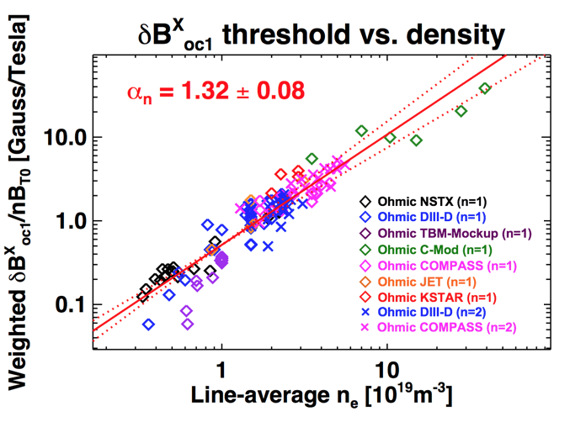
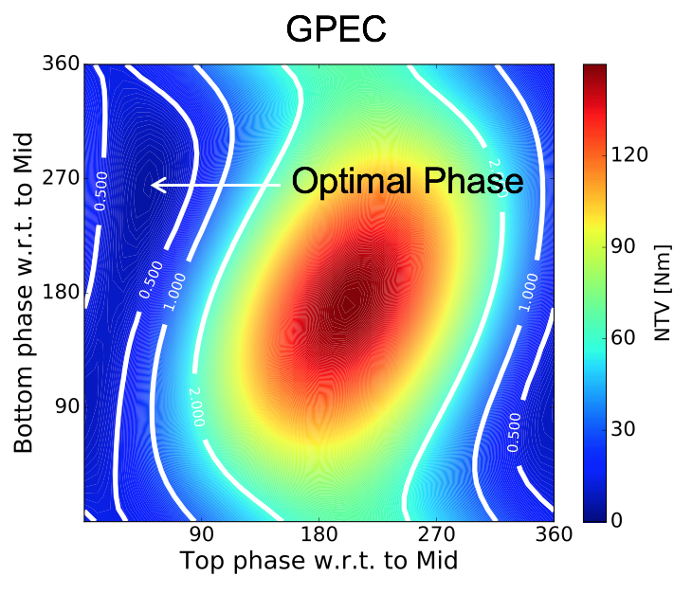
NSTX-U researchers continue to develop and test error field correction (EFC) strategy in tokamaks and for ITER
Developing unified n=1+2 resonant EFC criteria to avoid disruptive MHD modes*
Using IPEC to calculate resonant field threshold for locked modes
Investigating multi-modal aspects of HFS EF effects as seen with NSTX-U TF errors and COMPASS HFS coils
Predicting non-resonant NTV correction capabilities of existing and designed coils
Using self-consistent NTV response matrix in GPEC
Assessing Top/Bottom coil utilities in ITER*, and designing coils to couple NTV dominant response structure in KSTAR
* As a part of ITPA MHD activity (MDC-19)
n=1+2 resonant EF scaling in tokamaks
ITER T/B coil correction against NTV by mid-coils

Slide 19
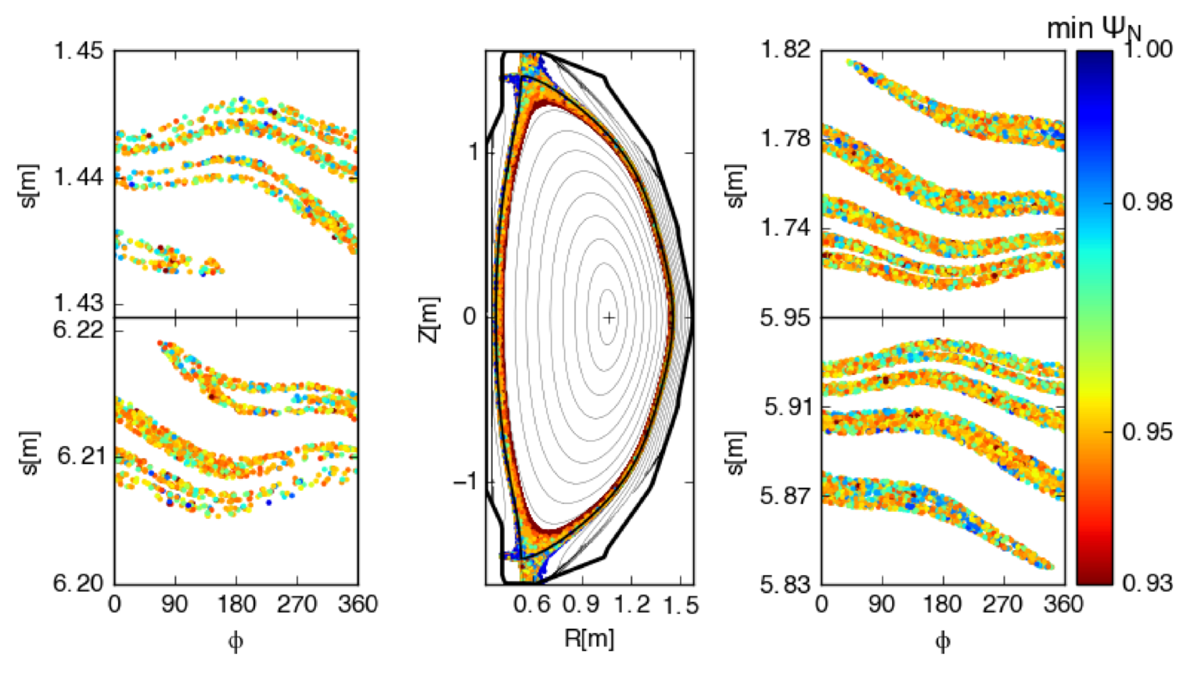
Study the precision needed to install the equilibrium coils of NSTX-U in terms of plasma footprints on the divertor plates
Upper-Outer
A 5 mm shift of the TF coils produces 10 cm wide footprints on the outer divertor plates
The footprint size is linearly proportional to the misalignment magnitude of TF and PF5.
Upper-Inner
“s” is defined as the distance from inner midplane along the wall clockwise
Lower-Inner
Lower-Outer
Study predicted that error fields in NSTX-U will not expand footprints outside of divertor PFCs
Munaretto Nucl. Fusion 59(2019) 076039

Slide 20
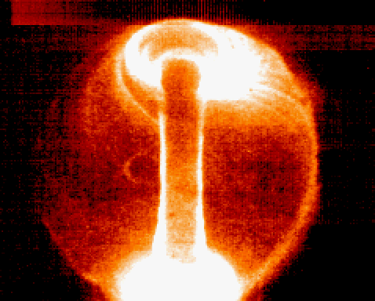
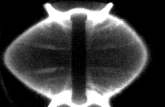
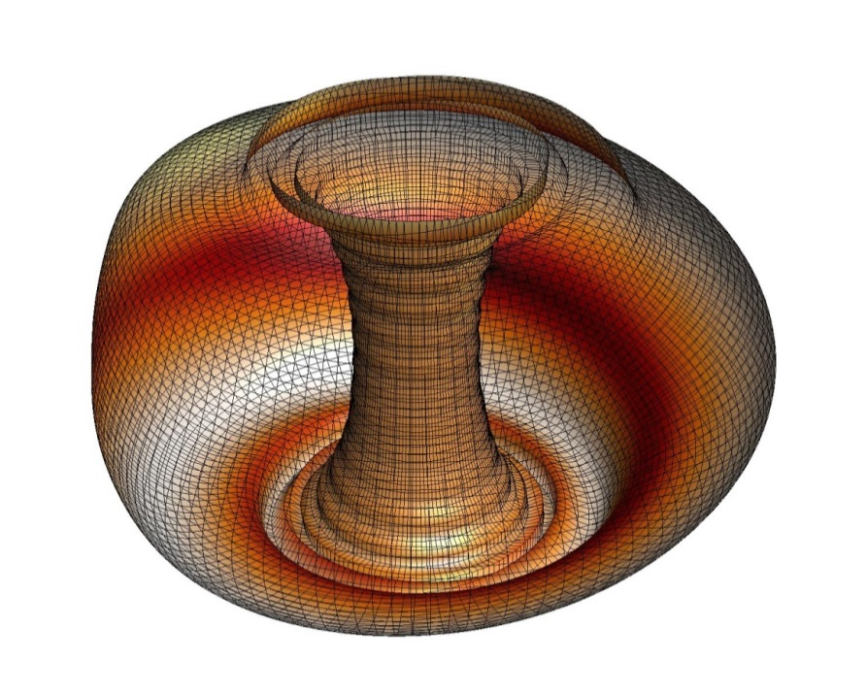
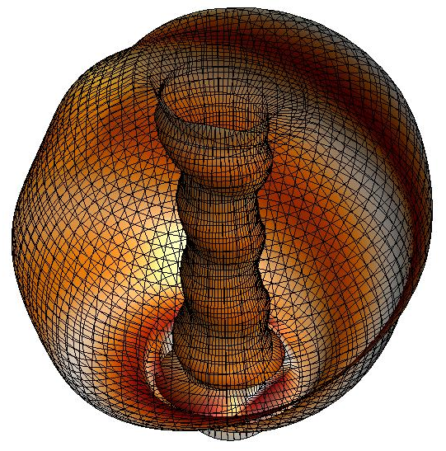
Studies of observed global modes in MAST & NSTX allow for understanding the effect of wall proximity on mode structure
“egg shape event”
Fast camera image
(MAST 21436, t ~ 0.280s)
NSTX 114147, t ~ 0.268s
Images of plasma distortion due to global modes
MAST
NSTX
Sabbagh, et al., Nucl. Fusion 46 (2006) 635
VALEN analysis (n = 1 RWM)
(using MAST 7090)
VALEN analysis (n = 1,2,3 RWM)
(reconstructed 114147)
VALEN code analysis produces similar distortions to MAST and NSTX observations

Slide 21
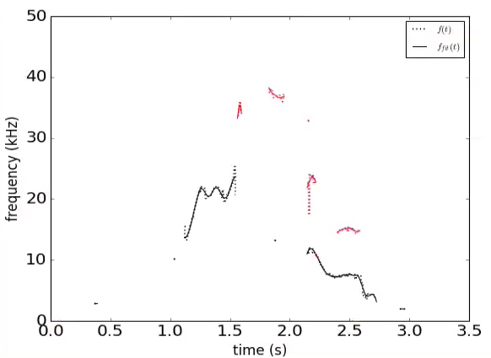
DECAF MHD events are now producing early disruption warnings for KSTAR
DECAF automated MHD objects
n
DECAF* is a physics-based disruption algorithm
Mode locking at reduced plasma rotation
Key notables of MHD warning
“Safe”/“unsafe” MHD periods
Early disruption warning (300 ms) ➔ on transport timescale
3
MHD-n1
2
frequency (kHz)
MHD-n2
1
KSTAR
16299
MHD warning level
warning level
Safe
*D. Humphreys, et al., PoP 22 (2015) 021806
S.A. Sabbagh, APS DPP Invited talk (2018)

Slide 22
Outline
Scenario development
Optimize non-inductive startup and ramp up, including active controls plasma (QUEST, URANIA, MAST (+U), NTSX(+U), KSTAR, DIII-D)
Assess impact of H species in HHFW heated plasma

Slide 23
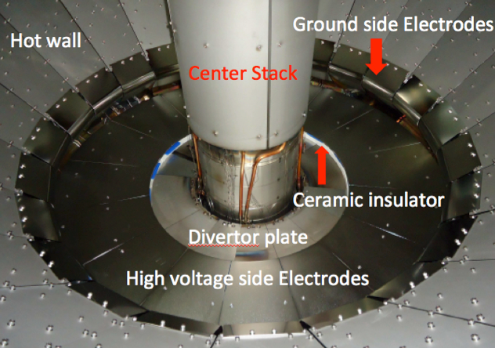
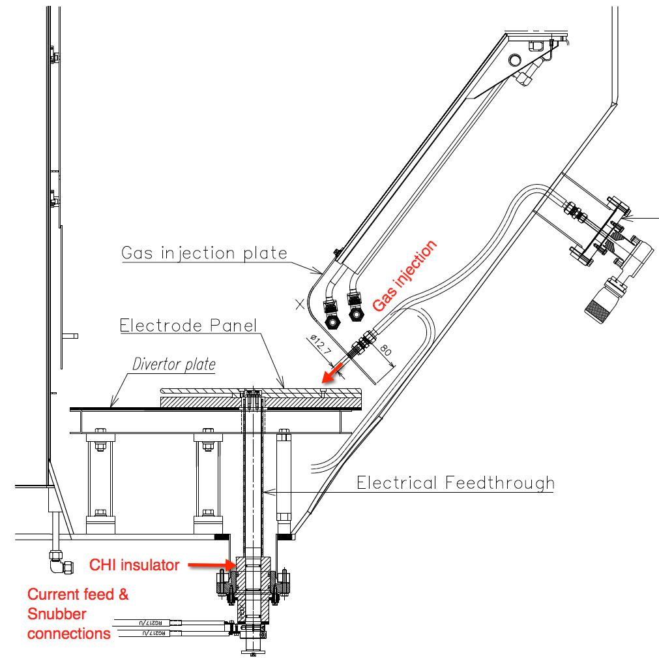
QUEST ECH provides unique opportunity to understand and optimize ECH based tokamak/ST start-up/ramp-up concept
Experiment and modeling of 2nd harmonic electron cyclotron heating and current drive solenoid-free start-up in QUEST
Initial pressure driven current phase
• No X-ray
• No ECCD
gyrotron - 28 GHz
ECCD Phase
• Increasing X-ray – energetic electrons
• I_{p} ∝ I_{X-ray} ∝ n_{eh}
• Minority energetic particle population
Transient CHI on QUEST has shown reliable discharge initiation, and plasma growth in biased electrode configuration
CHI to be tested also on URANIA
N. Bertelli, invited talk at the 23rd Topical RF Conf. (China, 2019)

Slide 24
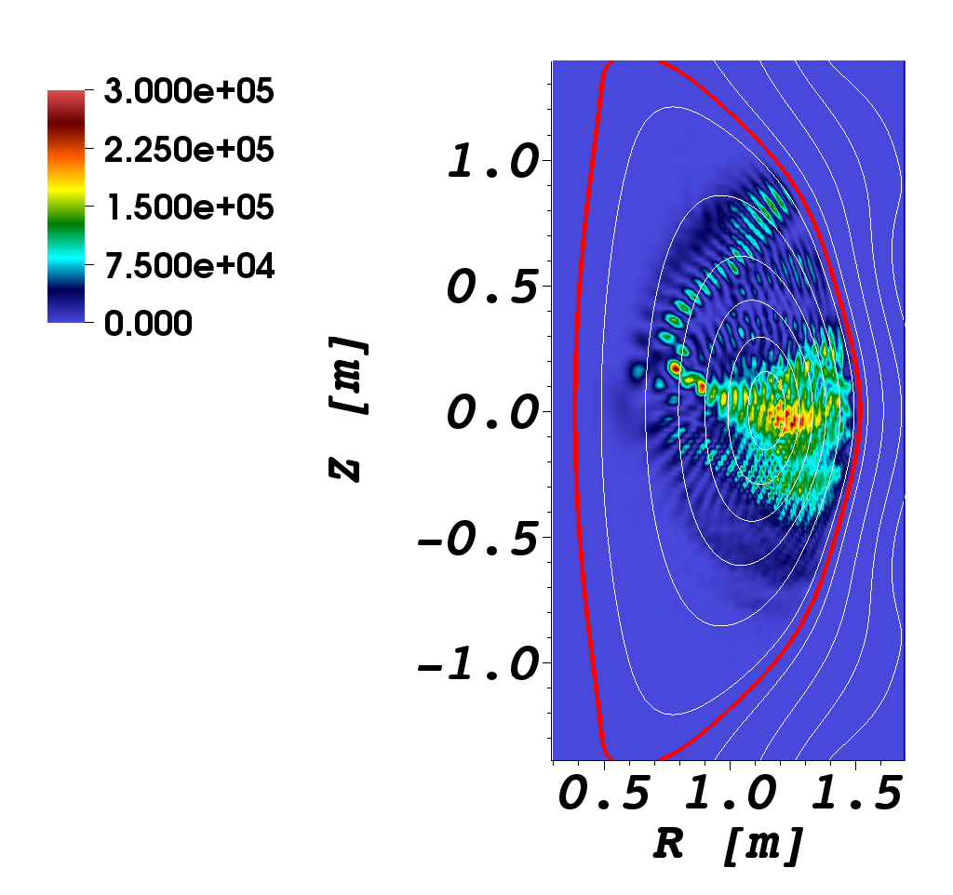
Exploring optimized HHFW with H species
Electron power deposition
H power deposition
Performed through the RF SciDAC collaboration
2nd Harmonic
2D power deposition obtained by AORSA full wave code
10% H concentration case & n_{φ} = -12, f=30MHz, and B_{T} = 1T
W/cm³/MW
Could provide an attractive path for 2nd harmonic H minority heating in NSTX-U (perhaps in the ramp-up phase)
N. Bertelli, invited talk at the 23rd Topical RF Conf. (China, 2019)

Slide 25
Outline
Diagnostics development
Comprehensive measurements for EP distribution and impurity studies
Implementation of real-time capable DECAF

Slide 26
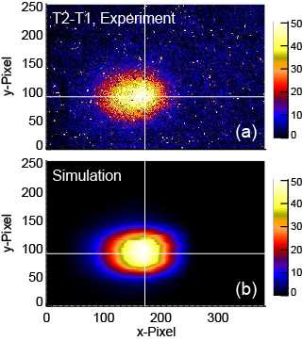
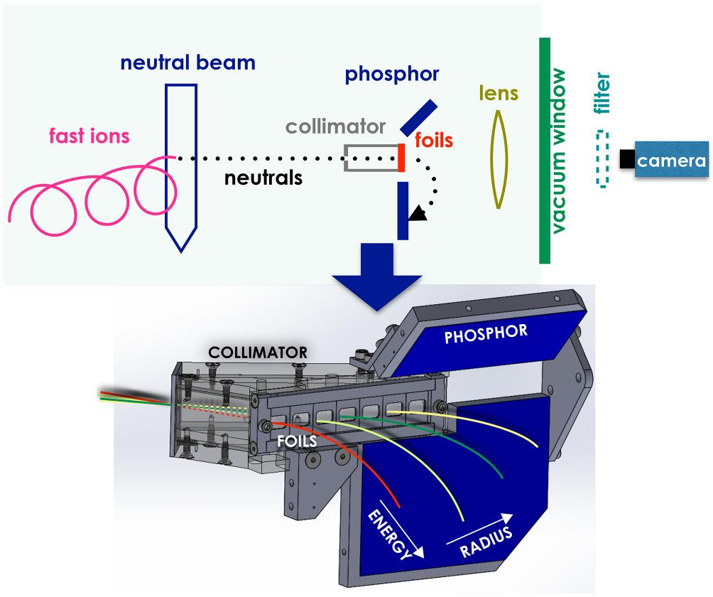
New/Upgraded Fast Ion Diagnostics/Tools to Improve Phase Space Coverage and Accuracy
Fast-Ion D-Alpha Imaging
Much better spatial resolution
Simultaneously get FIDA energy spectra with beam splitter
Imaging Neutral Particle Analyzer (INPA) provides radially resolved image
Gyroradius ➡️ energy
Line-of-sight ➡️ radius
Test NSTX-U neutron electronics at DIII-D
Inference of fast-ion distribution function with all available fast-ion diagnostics (software development)
FIDA Imaging
On DIII-D
M. A. Van Zeeland
PPCF (2009)
UC Irvine
INPA on DIII-D X.D. Du NF(2018)

Slide 27
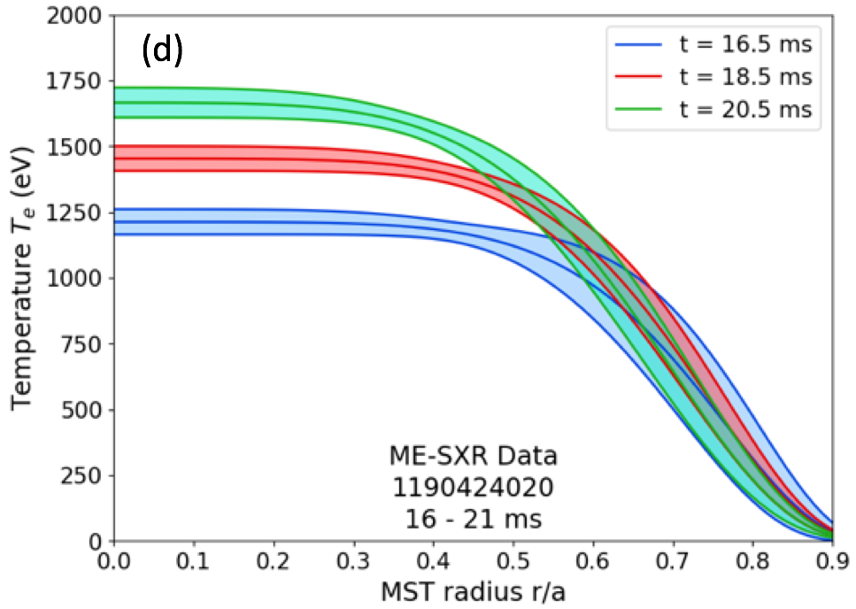
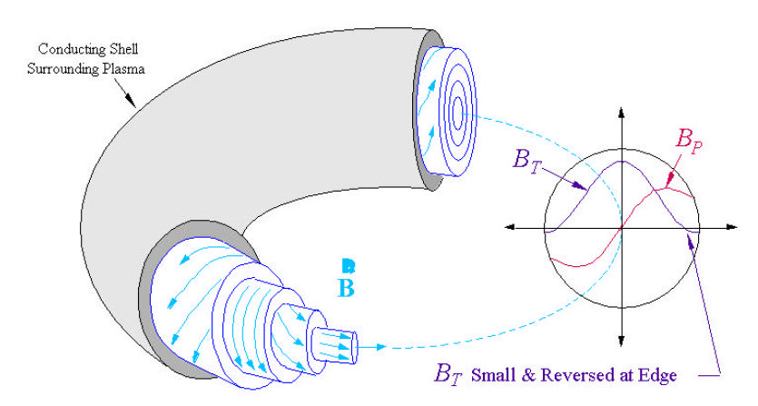
ME-SXR diagnostic tested at MST: originally designed to be installed on NSTX-U for impurity transport experiments
Large # of viewing chords & high energy resolution
SXR-inferred T_{e}(r,t) measurement @ MST
MST
Total count

Slide 28
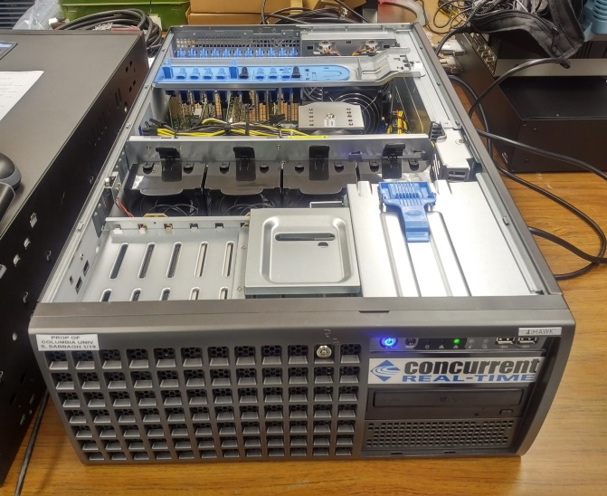
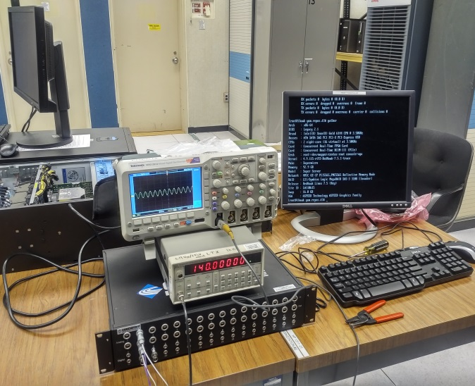
Disruption prediction and avoidance research on KSTAR moving to real-time application in 2019
Disruption Prediction
First real-time computation of DECAF MHD analysis planned for 2019
New KSTAR r/t MHD computer and test stand (Columbia U. / PPPL)
S.A. Sabbagh, et al.
Real-time computer now online at KSTAR; r/t DAQ tests start on 9/10/19
Plasma Stability and Disruption Avoidance
Resistive wall mode active control system with required r/t sensor compensation completed, ready for initial use in 2019
New U.S. DOE funding granted to greatly expand real-time capability

Slide 29
Summary
During the recovery, NSTX-U Team remains actively engaged in research activities on NSTX/U and other devices
Ongoing activities and collaborations address many issues common to NSTX-U and conventional aspect ratio tokamaks
ST collaborations (MAST-U, URANIA, QUEST, ST40) can target ST specific issues necessary to advance tokamaks physics as well as impact and facilitate NSTX-U research

Slide 30
Backup

Slide 31
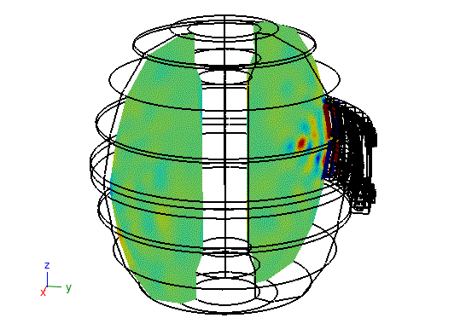
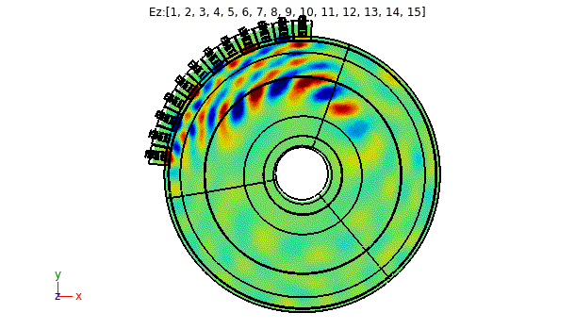
First full 3D torus simulation including realistic antenna geometry
Performed using the Petra-M code developed by RF SciDAC team
Extending to 3D enables accurate core-edge coupling with the antenna
E_{z} component for 90 degree antenna phasing
N. Bertelli, invited talk at the 23rd Topical RF Conf. (China, 2019)

Slide 32
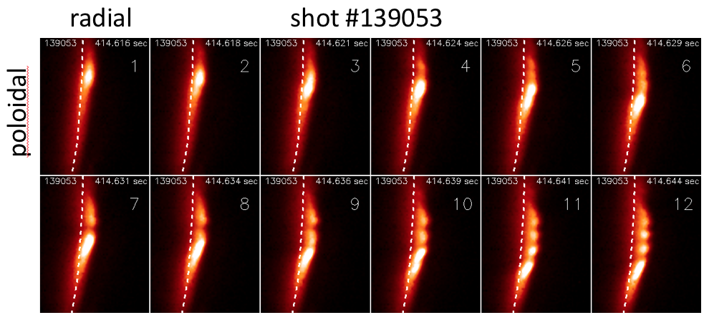
Novel Phenomenon: Blob Wakes in NSTX
2D GPI images vs. time (2.5 µsec/frame)
Blobs sometimes break up into trailing small-scale “wakes”
Direction: poloidally in the opposite direction to the blobs (i.e. wakes move in electron diamagnetic direction)
Theory : blob wakes consistent with to drift or drift-Alfven waves instabilities
Single column of 2D data vs. time showing poloidal propagation
of wakes (upward) vs. blobs (downward)
Zweben, Myra, Diallo et al, Phys. Plasmas 26, 072502 (2019)

Slide 33
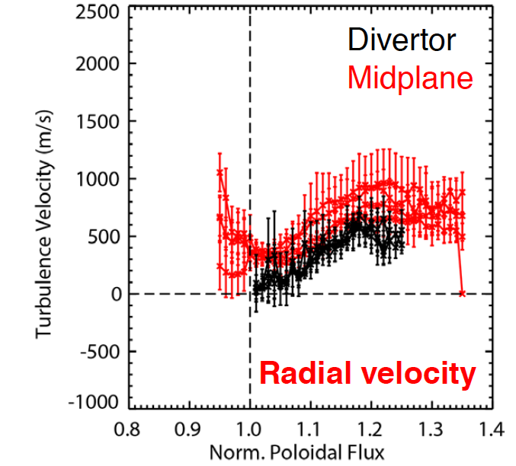
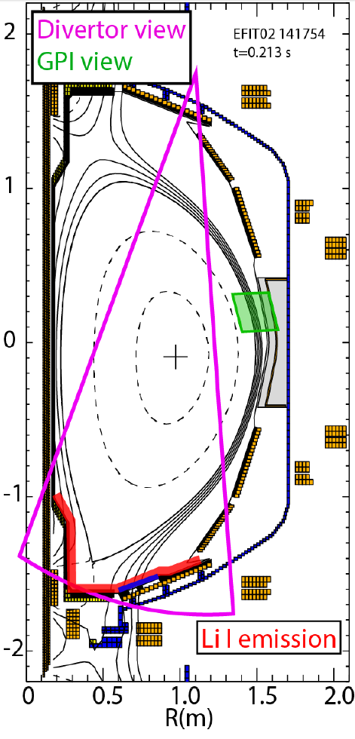
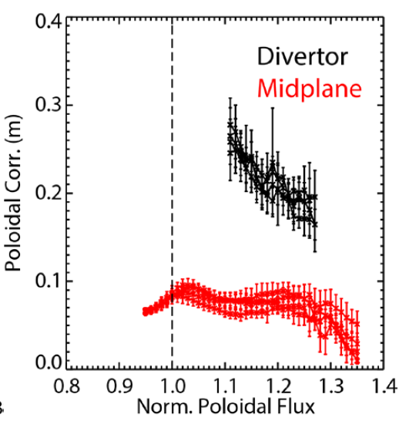
Characterization of SOL and divertor turbulence in NSTX/NSTX-U via imaging of divertor fluctuations
Reduction in V_{rad} with respect to upstream V_{rad} approaching separatrix in disconnected region
Midplane poloidal velocities in agreement with target filament velocity
~2x larger poloidal corr. length on divertor target
Radial velocity reduction consistent with reduction in polarization drive due to X-point
Imaging of diverter localized intermittent field-aligned filamentary structures is support by modeling
Consistent with unstable resistive ballooning modes (ArbiTER code)
Scotti, Nucl. Fusion 58(2018) 126028

Slide 34
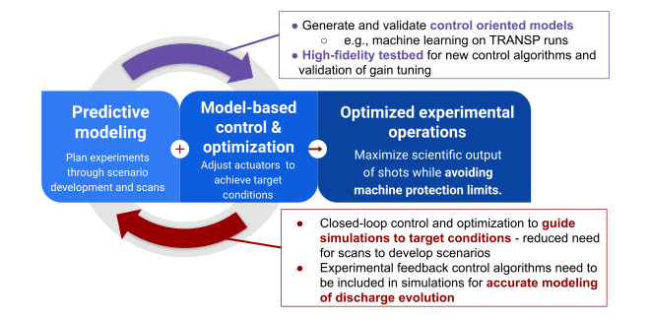
Enable external steering of TRANSP for control and scenario development
Predictive modeling helps control
Socket connection for TRANSP enables passing of information between actuators (NTV, beam, shape, ne, etc…) and controlled parameters (q, li, betaN etc..)
Builds upon previous work on NSTX-U as well as KSTAR collaboration
Control improved the predictive modeling
e.g., Boyer, et al., Nuclear Fusion 2017.

Slide 35
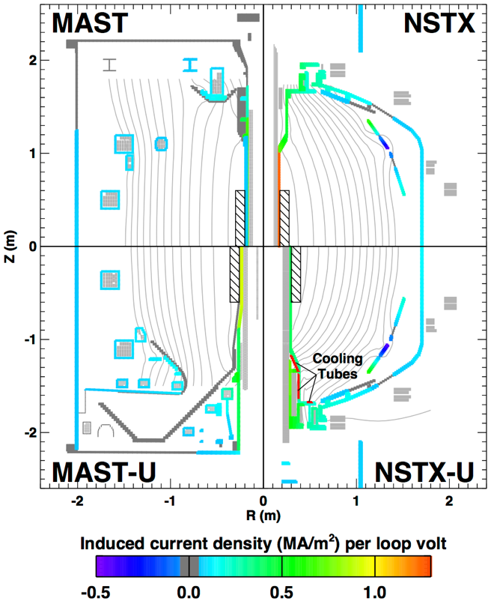
Collaboration with MAST-U led to development of novel, time-dependent model for evaluating startup on Spherical Tokamaks
Vacuum calculation producing 2D, time-dependent E, B able to predict timing of startup in MAST-U and NSTX-U
Includes reduced models describing Townsend Avalanche as well as particle loss on open field lines
Model developed and tested against shared database of MAST and NSTX(-U)
Applied model to scenario development to assist in MAST-U commissioning activities during summer 2018 appointment at CCFE
Supports broader effort to develop startup models for future tokamaks, such as ITER and is supporting experiments on DIII-D (summer, 2019)
Battaglia, D. J. accepted, 2019 Nucl. Fusion

Slide 36
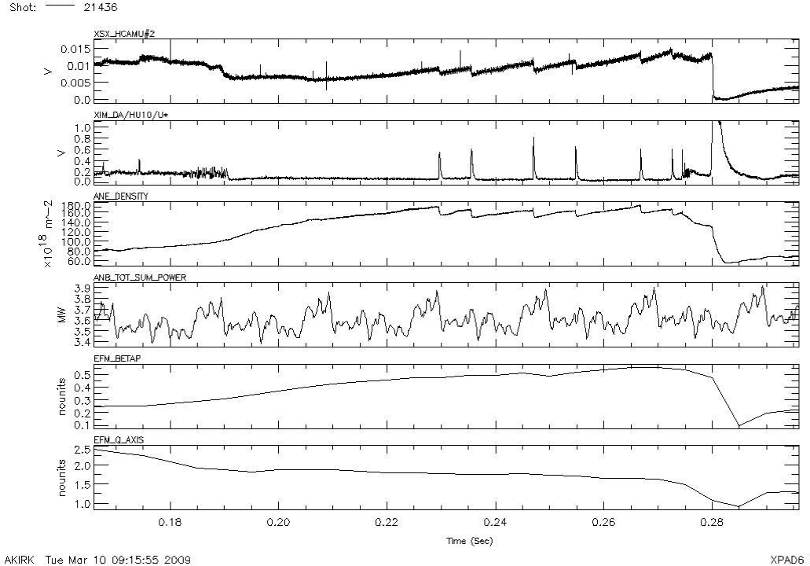
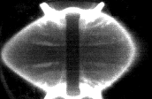
Apparent global mode “egg shape event” has been noted by A. Kirk regarding loss of H-mode ➔ RWM on MAST
disruption
Fast camera images
(21436, t ~ 0.280s)
courtesy A. Kirk
Several shots display asymmetric, global events
Consider that the “egg shape events” are global MHD ➔kink/ballooning/resistive wall modes (RWM) Q: does this follow “standard” theory? A: yes
Mode locked toroidally,
expands radially

Slide 37
DECAF MHD events are now producing early disruption warnings for KSTAR
DECAF automated MHD objects
DECAF “heat map” (for MHD)
n
Plasma rotation profile
and dynamics
}
3
MHD-n1
2
condition
frequency (kHz)
MHD-n2
1
Decreasing β_{N} ➔
High amplitude mode ➔
KSTAR
16299
Very low frequency mode ➔
DECAF* is a physics-based analysis paradigm that meets all disruption predictor requirement metrics
Mode locking at reduced plasma rotation
Key notables of MHD warning
“Safe”/“unsafe” MHD periods
Early disruption warning (300 ms) ➔ on transport timescale
time (s)
MHD warning level
warning level
Safe
*D. Humphreys, et al., PoP 22 (2015) 021806
S.A. Sabbagh, APS DPP Invited talk (2018)

Slide 38
Successful benchmark of nonlinear MHD codes
based on NSTX Vertical Displacement Event
Axisymmetric VDE simulations with M3D-C1, NIMROD & JOREK
Based on NSTX #139536 with simplified resistive wall
Excellent agreement of linear growth rates & nonlinear evolution including halo currents between all three codes
Krebs to be submitted; http://arxiv.org/abs/1908.02387]

Slide 39
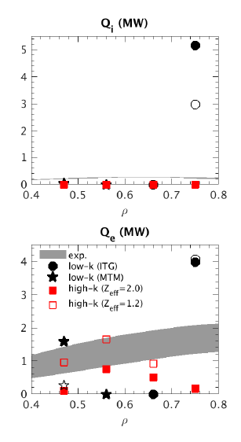
Three distinct turbulence mechanisms predicted by local, single-scale GYRO simulations
Low-k turbulence (ρ_{i} scale)
Different dominant mode active at different radii
(ρ=0.75) ITG dominates
(ρ=0.45) MTM dominates
High-k turbulence (ρ_{e} scale)
(ρ=0.45-0.65) ETG dominates (where E×B shear suppresses low-k)
Also expect non-local & possibly multi-scale effects to matter ➙ need robust global EM gyrokinetic codes + multi-scale simulations
exp.
Provides low-A complement to numerous R/a=3 transport validation studies
W. Guttenfelder et al., Nucl. Fusion 59, 056027 (2019)

Slide 40
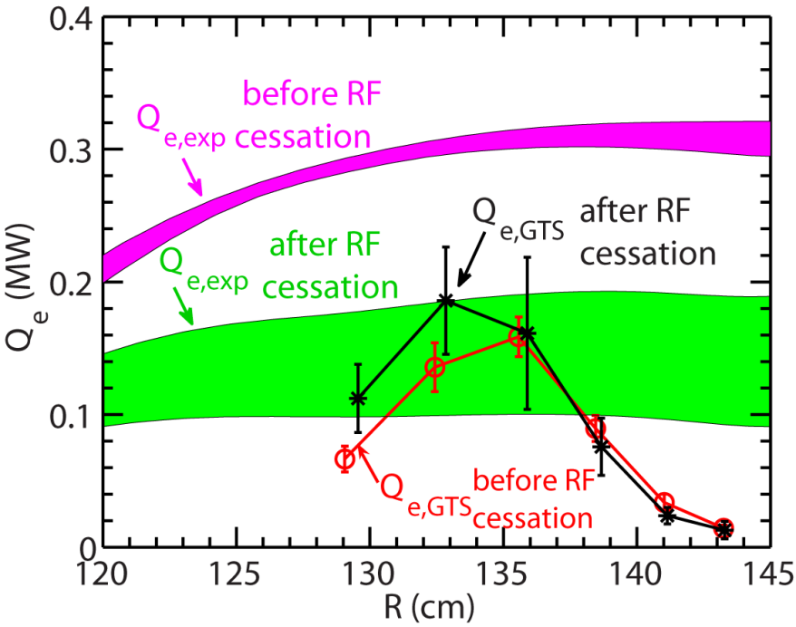
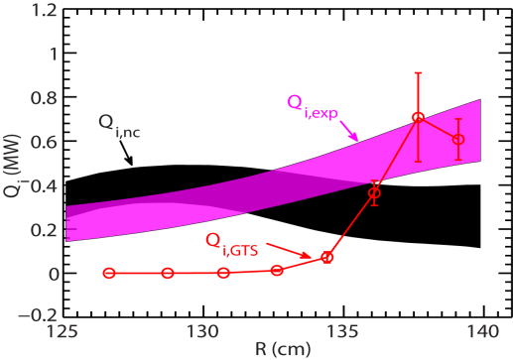
Exploring the Regime of Validity of Delta-f Global Gyrokinetic Simulations with Spherical Tokamak Plasmas
GTS simulations cannot explain the factor of 2 change in heat flux before and after RF cessation (in L-mode)
Due to the gradient driven nature of GTS
However, GTS simulations demonstrate decent agreement in ion thermal transport with a set of NBI-heated NSTX H-mode
More GTS simulations are needed to understand the above discrepancy and to quantify the regime of validity of the GTS code
RF-heated NSTX L-mode plasma
NBI-heated NSTX H-mode plasma

Slide 41
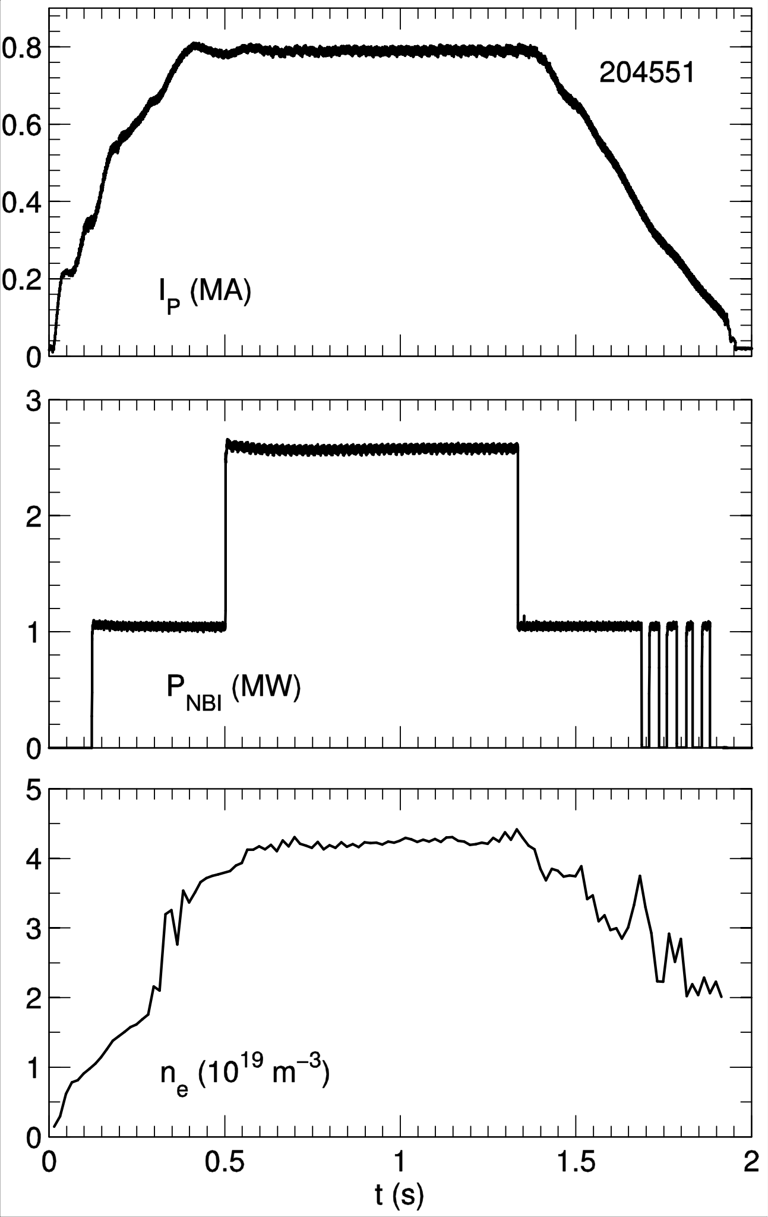
NSTX-U L-mode operation provides valuable flexibility for physics validation studies
NSTX-U L-mode
New centerstack enables stationary L-mode studies over range of Ip, BT, ne, PNBI (was not possible in NSTX)
[D. Battaglia, Nucl. Fusion 58, 046010 (2018)]
Provides low-A complement to numerous R/a=3 transport validation studies
Extending validation of gyrokinetics & transport models to low-A helps unify physics basis for operation & optimization of next-step facilities (ITER and beyond)

Slide 42
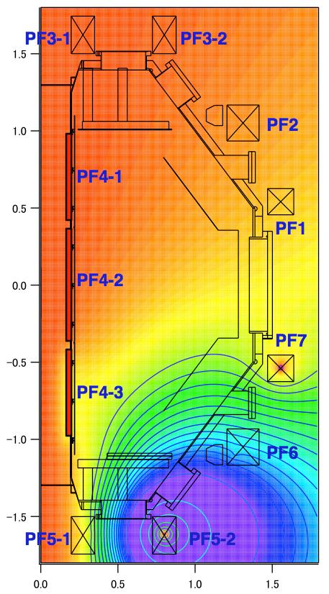
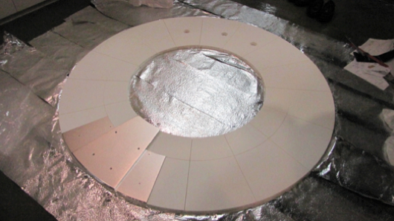
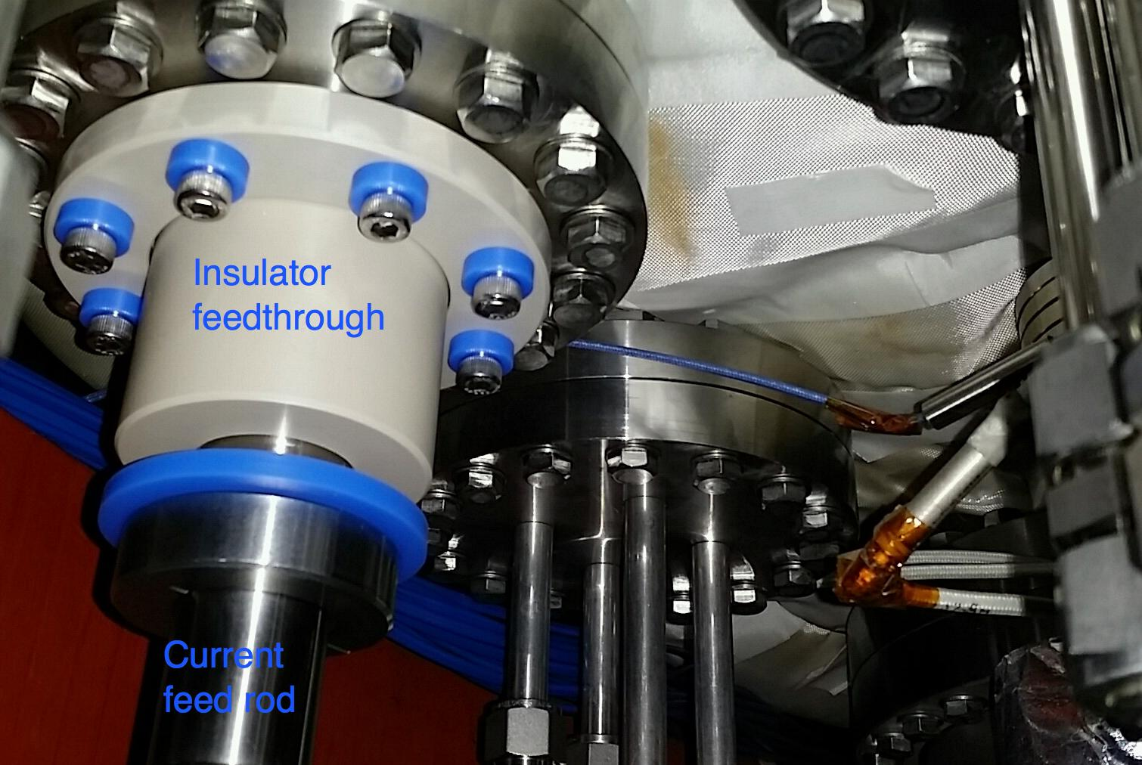
CHI on QUEST Aims to Develop Reactor-relevant CHI Electrodes and Test ECH Heating and Sustainment of CHI Started plasma

Slide 43
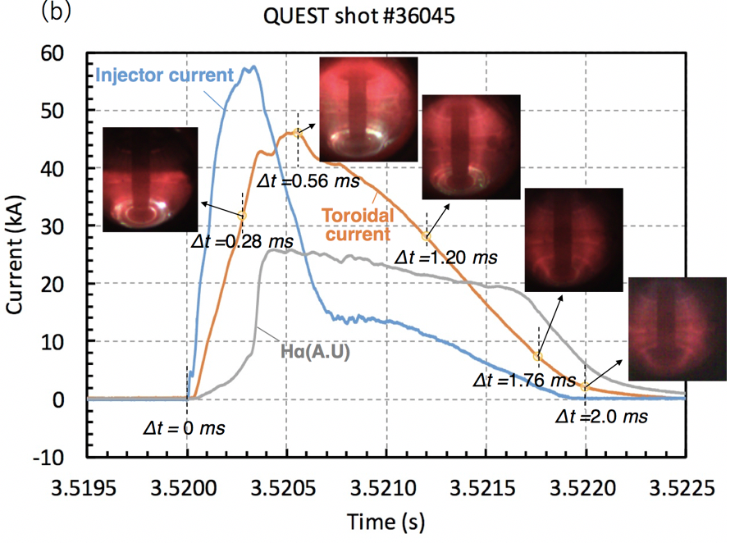
Transient CHI on QUEST has Shown Reliable Discharge Initiation, and Plasma Growth in Biased Electrode Configuration
CHI insulator on QUEST is not part of the vacuum vessel
Objectives
Current persistence
Closed flux current generation
Future objectives
Heat CHI plasma with ECH
Impurity reduction
Increase current magnitude & sustain with ECH

Slide 44
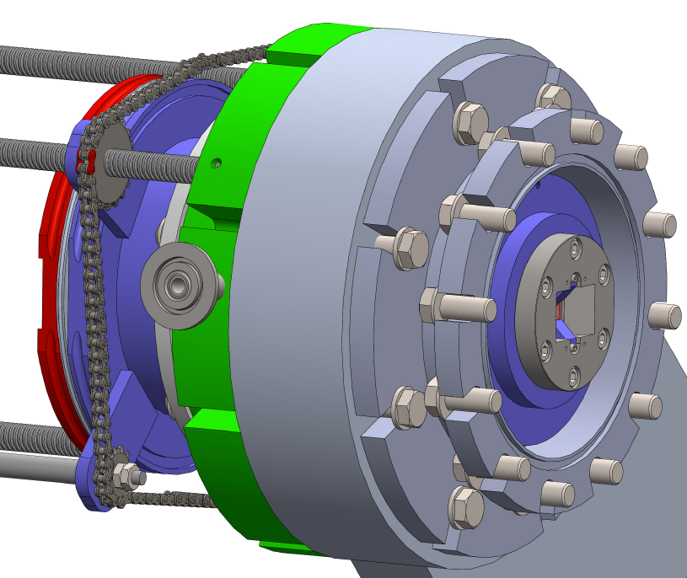
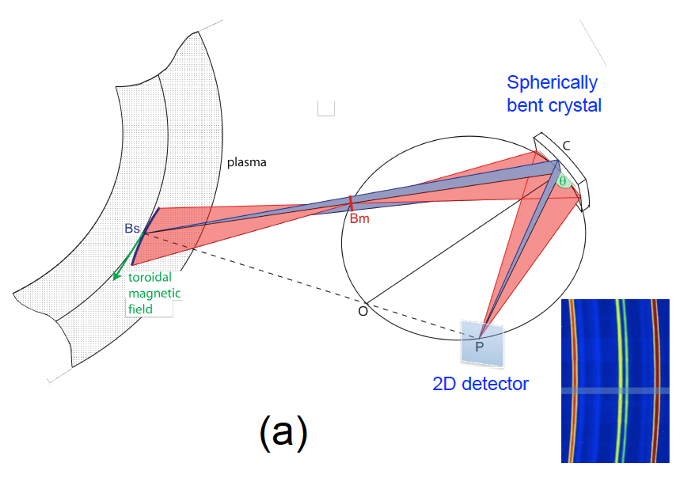
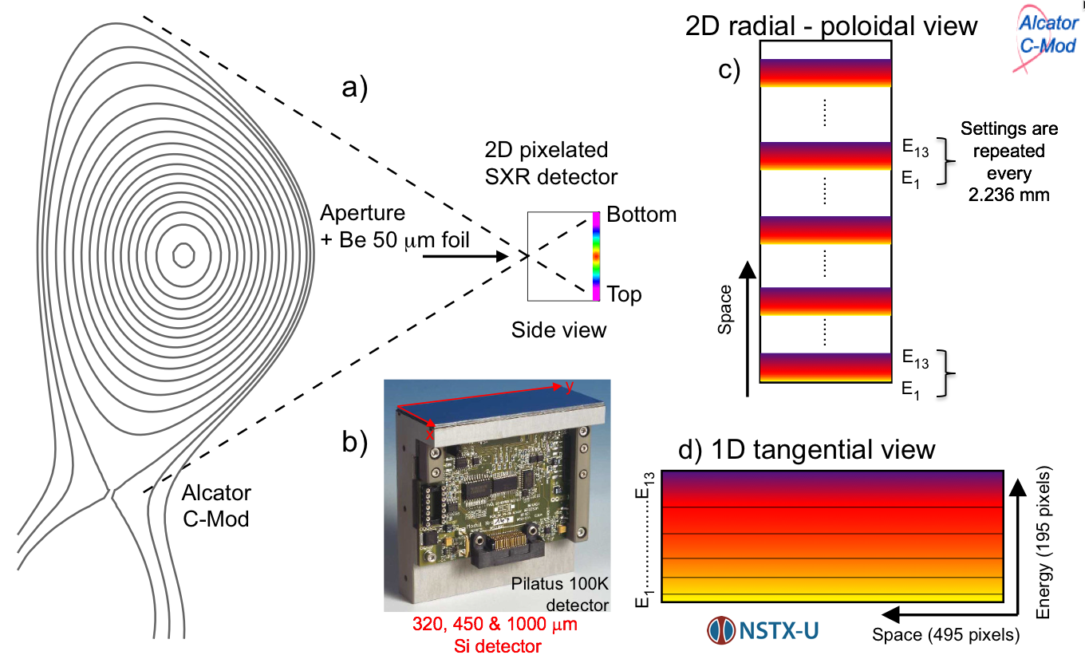
Three new PPPL x-ray diagnostics will be implemented at WEST for T_{e}, n_{Z}, Z_{eff} and n_{e.fast} measurements
Modest-resolution compact x-ray imaging crystal spectrometer (cXICS) for n_{Z} & δZ_{eff} profile measurements
Broadband multi-energy SOFT x-ray (ME-SXR) for n_{Z}, δZ_{eff} and T_{e} profile measurements
Broadband multi-energy HARD x-ray (ME-HXR) for T_{e} & n_{e,fast} measurements
New camera design
New DECTRIS CdTe detector
Sample Ar, Mo, Xe, W emission to constrain n_{Z} & transport
Si
New compact spectrometer is a spin-off PPPL’s collaboration with MIT’s PSFC
New multi energy SXR and HXR systems are upgrades of diagnostic tested at WiPPL

Slide 45
NSTX-U High Harmonic Fast Wave (HHFW) “Scenarios” considered
NSTX-U plasma
B = 1T
Ion species: D, H, C, D_{BEAM}
n_{e}
T_{e}
Z [m]
n_{D}
T_{D}
ρ_{pol}
ρ_{pol}
R [m]

Slide 46
NSTX-U “Scenarios” considered
NSTX-U plasma
B = 1T
H concentration scan:
n_{H}/ n_{e} = 1%, 2%, 5%, 10%
Te & ne scans at βe constant
n_{NBI} scan
B scan:
B = 0.53, 0.63, 0.76, and 1 T
w/ and w/o NBI
Two antenna frequencies:
30 MHz and 60 MHz
Three n_{φ} values: -5, -12, -21
Employed full wave code AORSA (Maxwellian plasma)
N. Bertelli et al 2019 Nucl. Fusion 59 086006

Slide 47
Hydrogen concentration scan: H power absorption increases with larger H concentration and decreases for larger n_{φ}
n_{φ} = -5
n_{φ} = -12
n_{φ} = -21
f = 30MHz
With
NBI
NO
NBI
H concentration
H concentration
H concentration
W/ NBI: dominant electron & fast ions absorption (except for n_{φ} = -5)
W/O NBI: significant H absorption at lower n_{φ}

Slide 48
Lower antenna phasing has stronger interaction with SOL plasma
E_{z} component of the wave field
150 degree
90 degree
30 degree
Strong interaction with the SOL

Slide 49
Anomalous electron losses dominate; strong ion-scale turbulence measured
Observed neoclassical ion losses (in L-mode), anomalous electron losses
However, ion scale turbulence data (BES) shows large amplitude, broadband fluctuations & bi-modal poloidal phase velocity
Bi-modal phase velocities suggestive of two distinct turbulence types (observed in DIII-D & TFTR)
BES fluctuation amplitudes
BES cross-power spectra
BES poloidal cross-phase
i-dia direction
ρ=0.58-0.86
e-dia direction
W. Guttenfelder et al., Nucl. Fusion 59, 056027 (2019)

Slide 50
Control-oriented modeling for NSTX-U with machine learning based on TRANSP and experimental data
Machine learning algorithms are being used to develop fast simulation capabilities for scenario optimization and real-time control
Builds upon neural network development for NSTX-U beam heating
E.g., magnetic diffusion: Neural network models for equilibrium dependent geometric quantities, bootstrap current, and resistivity, kinetic profiles: electron pressure/density profile shapes
Boyer, et al., Nuclear Fusion 2019.
Solid: Expected (TRANSP/NSTX-U)
Dashed: Neural net prediction

Slide 51
“Predict-first” KSTAR TRANSP analysis shows expected high performance plasmas at > 80% NICF
High non-inductive current fraction for 6.5, 7.5, 8.5 MW NBI
β_{N} from 3.0 – 3.5; based on KSTAR plasmas with NICF ~70%
Generate substantial database of long pulse, high β_{N} plasmas in the 2019 KSTAR run for disruption prediction studies
Predicted high non-inductive current fraction (NICF) current profiles
81.5% NICF
93% NICF
101% NICF
J.-H. Ahn, S.A. Sabbagh, et al. (Columbia U.)

