Slide 1


NSTX-U Research Program Update
NSTX-U PAC-40 – Sept. 11, 2019
S.M. Kaye
NSTX-U Interim Director of Research

Slide 2
NSTX-U PAC-40 Charge
The NSTX-U Research Program requests advice from PAC-40 in three areas:
  Please comment on the quality and importance of recent research results, including collaborative activities, and how they advanced the NSTX-U Mission and Milestones
  How well the FY20 and 21 Research Milestones address issues critical to the ST and fusion as well as the preparation for operations of NSTX-U, and the suitability of expertise and resources needed to achieve these milestones successfully.
  The role, uniqueness and importance of NSTX-U in developing a national fusion strategy and to contribute to the design of a next-step tokamak device. In particular, is the proposed R&D program well-positioned to close gaps needed for a compact pilot plant as outlined in the recent NAS and FESAC TEC studies?

Slide 3
Presentations (2:20 + 1:10 hour)
Research Program Update – S. Kaye (30 + 15 min)
  Will address Charge 3, PAC-30 recommendations
Status of NSTX-U Recovery – S. Gerhardt (20 + 10 min)
  Successful Independent Project Review (Aug. 27-29, 2019)
NSTX-U researcher activities
  R19-21/22 Milestone research [Battaglia (30+15)] – Charge 1 & 2
  Non-Milestone research results that can impact NSTX-U, ITER research; collaborations/public-private partnerships [A. Diallo (30 + 15 min)] – Charge 1
Liquid Metal program – R. Maingi (30 + 15 min) – Charge 3
  How to accelerate the LM NSTX-U program

Slide 4
Outline of Research Program Update
Programmatic events since PAC-39
  Summary of FES Office of Project Assessment (OPA) Mission Review (3-18)
Developments in domestic fusion program (NAS Study, FESAC TEC)
  How does NSTX-U fit in? How has the NSTX-U Mission changed?
  10 year mission and research goals (more from Maingi)
Response to PAC-39 recommendations (Kaye, Maingi)
  State of NSTX-U Science Team and plans for its reconstitution

Slide 5
Outline of Research Program Update
Programmatic events since PAC-39
  Summary of FES Office of Project Assessment (OPA) Mission Review (3-18)
Developments in domestic fusion program (NAS Study, FESAC TEC)
  How does NSTX-U fit in? How has the NSTX-U Mission changed?
  10 year mission and research goals (more from Maingi)
Response to PAC-39 recommendations (Kaye, Maingi)
  State of NSTX-U Science Team and plans for its reconstitution

Slide 6
Major OPA Review of NSTX-U Science Mission March 2018
Follows review of NSTX-U Recovery Project conducted in Feb. 2018
Review lasted 2 ½ days
Review Committee: J. van Dam called it the “A Team” of reviewers, OPA the “gold standard” of reviews
  Ray Ohrbach (Chair)
  Dave Campbell (ITER-retired)
  Norbert Holtkamp (SLAC, Stanford U.)
  Thomas Klinger (W7-X, Germany)
  Paul Thomas (Tokamak Energy, Ltd. UK, formerly JET)
  Anne White (MIT)
Talks given by McComas (PU perspective), Hawryluk (PPPL perspective), Menard (Scientific Relevance), Kaye (Transport/Turbulence and EP), Sabbagh (Macrostability and Integrated Scenarios), Maingi (Boundary)
Link to talks: OPA Science Mission Presentations

Slide 7
Major OPA Review of NSTX-U Science Mission in March 2018
(Charge questions and committee responses)
What is the committee’s assessment of continued scientific relevance of spherical torus research and the NSTX-U Facility’s contributions to that area of research? Does the facility address critical issues for fusion science?
  NSTX-U has maintained its relevance; enhanced capabilities important for improving physics basis for ST and ITER; research program wide-ranging and challenging, provides potential for significant advances
Are there advances in plasma physics, or tokamak core technologies, since the NSTX-U project was designed and constructed that may impact the timeliness or relevance of proposed research at the NSTX-U Facility?
  NSTX-U well-positioned to make significant contributions in validating new computing and software methods from well-characterized devices; lithium as an advanced wall material will be world-leading
If the NSTX-U Facility resumes operations in 2020, what is the Committee’s opinion regarding the status and capabilities of other domestic and international spherical torus facilities?
  NSTX-U bigger and more fusion relevant than most; will be world leader in chosen domains of exploration (high-β, low-collisionality core, lithium research)
The NSTX-U Program thanks the PAC for their useful input that led to a successful FES OPA Mission review

Slide 8
Outline of Research Program Update
Programmatic events since PAC-39
  Summary of FES Office of Project Assessment (OPA) Mission Review (3-18)
Developments in domestic fusion program (NAS Study, FESAC TEC)
  How does NSTX-U fit in? How has the NSTX-U Mission changed?
  10 year mission and research goals (more from Maingi)
Response to PAC-39 recommendations (Kaye, Maingi)
  State of NSTX-U Science Team and plans for its reconstitution

Slide 9
NAS Strategic Plan Provides a Vision for the
Fusion Program
Final Report of the Committee on a Strategic Plan for U.S. Burning Plasma Research” (2019)
Two main recommendations:
  (1) The United States should remain an ITER partner as the most cost-effective way to gain experience with a burning plasma at the scale of a power plant.
  (2) The United States should start a national program of accompanying research and technology leading to the construction of a compact pilot plant that produces electricity from fusion at the lowest possible capital cost.

Slide 10
NAS Study Identified Science and Technology Challenges
No surprises in challenges/gaps – identified previously; they include:
  Heating and sustainment
    Transport and confinement
    Energetic particles
    Transients
    Steady-state operation
  Boundary and divertor physics
    Power handling
Challenges formed basis for the agenda of first APS-DPP Community Planning Activity (Madison, WI, July 2019)
  Good representation by NSTX-U researchers and collaborators
    CPP leadership: N. Ferraro, W. Guttenfelder, M. Reinke
    Presentations: Battaglia (Program relevance), Ono (Integrated RF program), Sabbagh (Disruption prediction/avoidance, Raman (CHI), Menard (SHPD Mission), Andruczyk (LM), Gray (LM), Goldston (LM/Vapor Box) + other participants

Slide 11
FESAC TEC Report Identifies Liquid Metal PFCs as a Potential “Game-Changer”
Charge: Identify promising Transformative Enabling Capabilities that could promote efficient advance toward fusion energy, building on burning plasma science and technology
(Fast) flowing liquid metal PFCs may prove to be an attractive alternative to handle both high steady-state and transient plasma heat flux
R. Maingi, co-chair

Slide 12
The NAS and FESAC TEC recommendations elevate the importance of the NSTX-U mission
NSTX-U will provide critical results required to optimize the geometry, including aspect ratio. of next-step compact devices
NSTX-U will provide unique regimes for studying burning plasma-related physics and improve predictive capabilities
NSTX-U will evaluate integrated operations with liquid metal PFCs that would enable compact systems

Slide 13
NSTX-U will provide unique regimes in the initial years of operations required to optimize the geometry (R/a, κ, δ) of next-step devices
Elements of “near-term” program address core/boundary performance
  Demonstrate high-performance steady-state non-inductively sustained regimes at large bootstrap fraction (f_{BS} > 0.7), large Greenwald density fraction (f_{GW} > 0.7) and β_{N} values surpassing typical conventional-A scenarios with sufficient stability margin for low disruptivity
  Investigate if a strong scaling of confinement and stability improvement with reduced collisionality in regimes dominated by electron thermal transport at high-β and low-A persists at lower collisionality
  Burning plasma (i.e., ITER)-related physics issues
  Unify predictive modeling of transport, stability and fast ion physics at low-A, low-ν_{e}* and high-β_{N} with conventional-A tokamaks to improve confidence in projections to next-step fusion devices, including ITER and a CPP

Slide 14
Compact Fusion PP physics basis requires non-inductive regime at high f_{bs}
Tokamak HTS CPP concepts: f_{BS} > 60% and H_{98y,2} = 1.5 – 2
  Fully non-inductive without impurity and He ash accumulation
  Scenario must be compatible with divertor solution for heat flux
NSTX-U will explore the high-β_{n} (>5) and strong shaping (κ>2.5) route to high bootstrap current fractions
  Synergy with broad current profiles and large edge q-shear
  Provides possible transformative route when coupled with enhanced transport and stability properties at low-A
Fully Non-Inductive
Compact PP
Menard
(A=2)
ARC
P_{fus} (MW/m³) = 1.12 B⁴ β²
SHPD
DIII-D (A=3)
(Buttery Initiative)
NSTX-U (A=1.8)
H_{98y,2} ~ 1.4
JT-60U
H_{98y,2} ~ 1.3
JT-60SA (A=2.5)
f_{BS}
DIII-D

Slide 15
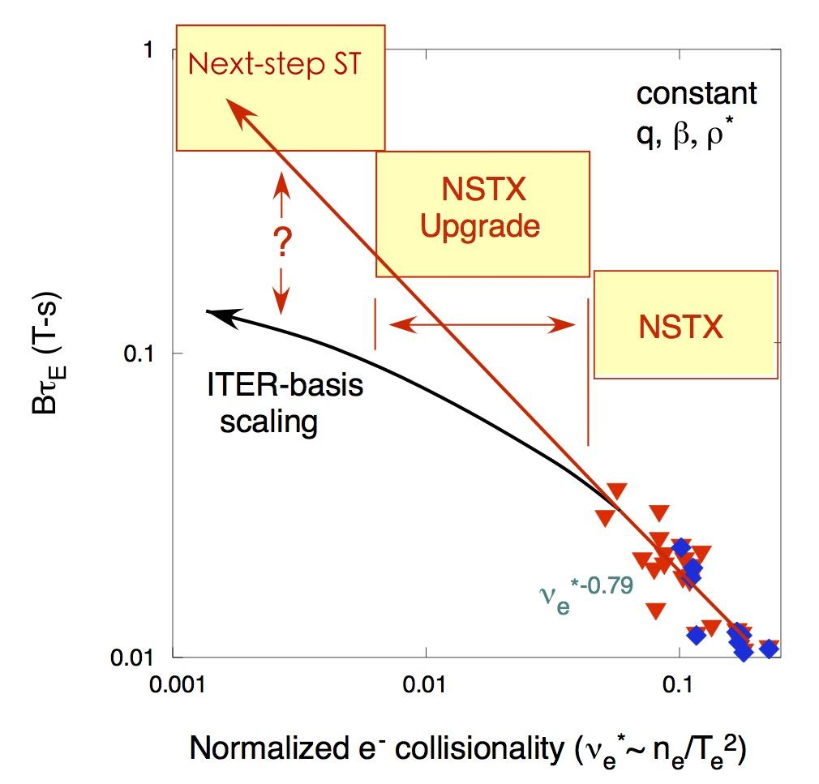
Transport at low-A is fundamentally different than transport at conventional-A
Many features of low-A, high-𝛽 stabilize ES modes (ITG, TEM, ETG) in core
  Neoclassical ion transport, MTM, KBM and EP modes drive electron transport
Dimensionless confinement time scales inversely with collisionality at low-A (Ω_{ci}τ_{E}~ν*^{-0.8})
  Scaling extrapolates to an A=2 CPP with H_{ST} = 0.9 equivalent to H_{98y,2} = 1.75
  NSTX-U will operate at up to a factor of six lower ν* than NSTX
e-m turbulence
NSTX-U
NSTX
Electron beta
Increasing β
e-s turbulence
S. Kaye et al.,
NF (2007, 2013)
M. Valovic et al.,
NF (2011)
High R/a
Normalized collisionality (~n/T²)

Slide 16
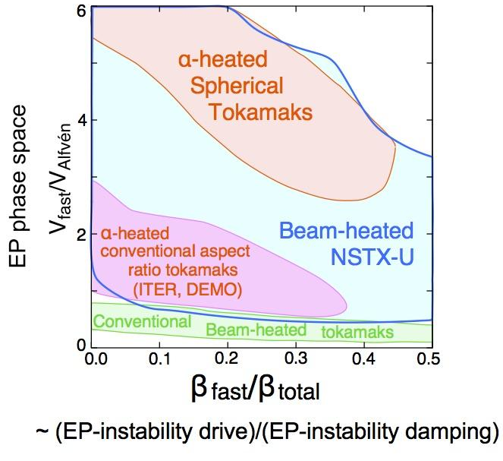
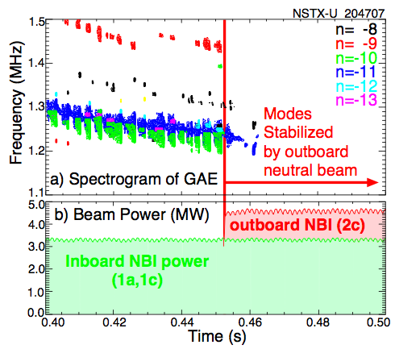
NSTX-U will access unique regimes in fast particle physics critical for prediction and optimization
NSTX-U will produce and study EP modes relevant to alpha driven instabilities expected at both high- and low- aspect ratio
  Characterizing fast ion interaction with RF (see Diallo talk)
  Important for ITER and CPP
Modification of fast-ion distribution using tangential NBI can stabilize EP modes that enhance transport
  Study and develop techniques to suppress alpha-driven modes through phase-space engineering

Slide 17
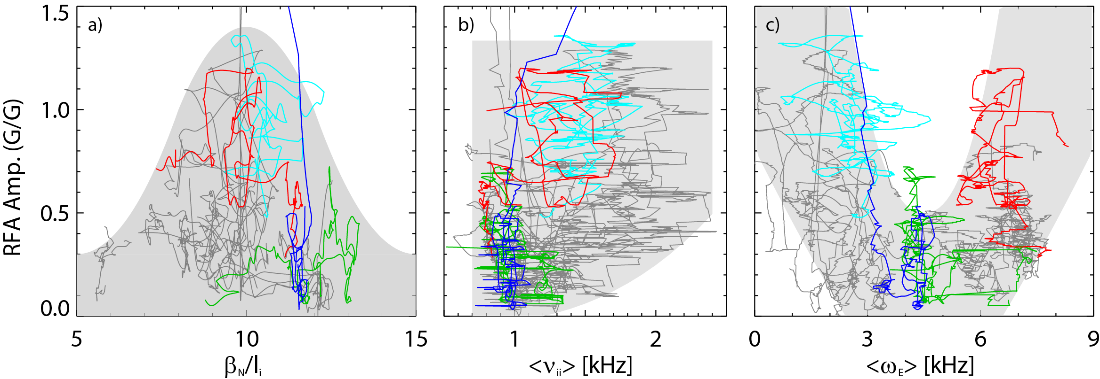
Stability at large 𝛽_{N}/l_{i} is a strong lever for a compact device
f_{BS} ~ 𝛽_{N}/l_{i} → Broad current and pressure profiles
  NSTX achieved large 𝛽_{N}/l_{i} with 𝛽_{N} / 𝛽_{no-wall} > 2
Stability increased as 𝛽_{N}/l_{i} → 10 at critical rotation
  Kinetic stabilization of the RWM
  Prediction that stabilization improves at lower collisionality will be tested on NSTX-U
NSTX-U has expanded suite of real-time control measurements and actuators
  RT profile control using tangential NBI, density and shape actuators
  Increased flexibility in the 3D field spectrum for EFC + rotation control
RFA Amp. (G/G)
Less stable
J.W. Berkery, et al., PoP 21 (2014) 156112,
J.W. Berkery, et al., Phys. Rev. Lett. 106 (2011) 075004

Slide 18
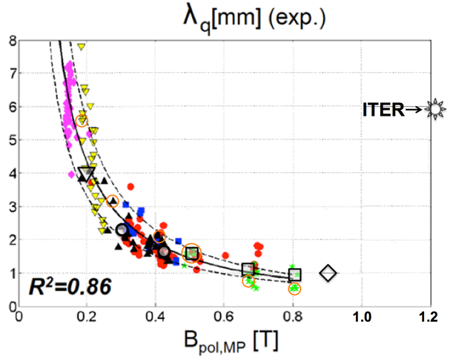
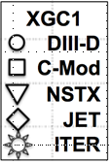
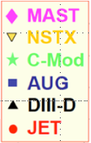
NSTX-U will play important role in understanding how power exhaust width extrapolates to future devices
XGC1 simulations predict turbulence will widen edge heat flux in ITER
2MA NSTX-U
C.S. Chang et al 2017 Nucl. Fusion 57 116023
Range of NSTX-U λ_{q} projections
XGC1 studies of NSTX-U indicate enhanced TEM transport in the low ν*, 2 MA NSTX-U pedestal, similar to mode expected for ITER
C-Mod
∝ Plasma current
Recovery includes divertor tile improvements to access high current, power, shaping

Slide 19
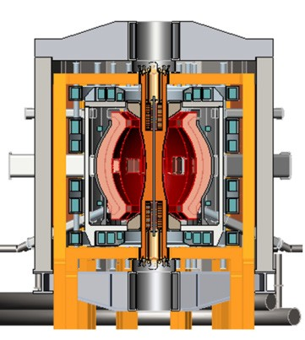
Has the NSTX-U mission changed over the past few years?
Components of the short-term (1-3 yrs) research plan remain the same, and can benefit domestic strategy that is presently being developed by CPP
NSTX-U Science mission can address critical issues for:
  ST-based FNSF
  Optimizing geometry (e.g., κ, δ, aspect ratio) of next step “compact” devices
    CPP Initiative to develop national design team
  ITER
De-emphasize non-solenoidal startup; reassess if Urania successful
LM divertor path instead of cryopump
Menard (2016)
Menard, Brown

Slide 20
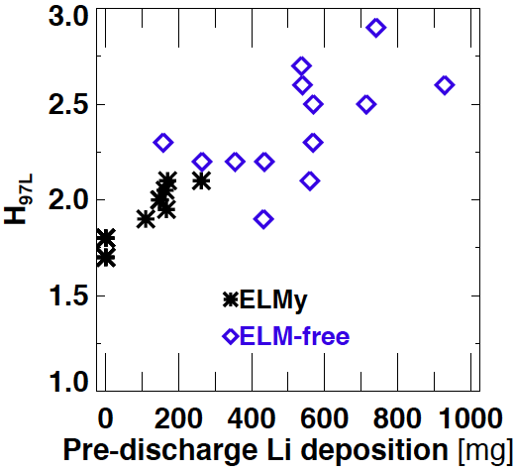
The longer-term (5-10 yrs) mission has directed its focus on testing Liquid Metal PFCs (Maingi presentation)
NSTX: Higher lithium deposition → higher confinement
NSTX-U near-term: Double Li deposition, effect on confinement (carbon tiles)
Long-term: Test liquid metals as transformative wall solution:
  Phase I: prefilled high-Z tiles/LM modules
  Phase II: complete toroidal coverage (LM/Vapor Box)
H₉₈~1
Could begin design and fabrication in 2020 with appropriate support as Engineers roll off Recovery
2019
2020
2021
2022
2023
2024
2025
2026
2027
2028
2029
NSTX-U:
Construction
1st campaign Carbon
Phase I high-Z
Phase II - All metal/Liq. Lithium/VB
Design & Fab. of Phase I, II (?)
Li evap (top
& bottom)
Pre-filled high-Z tiles
/liquid Li modules
Fully toroidal/VB option

Slide 21
Outline of Research Program Update
Programmatic events since PAC-39
  Summary of FES Office of Project Assessment (OPA) Mission Review (3-18)
Developments in domestic fusion program (NAS Study, FESAC TEC)
  How does NSTX-U fit in? How has the NSTX-U Mission changed?
  10 year mission and research goals (more from Maingi)
Response to PAC-39 recommendations (Kaye, Maingi)
  State of NSTX-U Science Team and plans for its reconstitution

Slide 22
Response to PAC-39 concerns and recommendations
Liquid metal research to be covered in Maingi presentation
“It is recommended that the NSTX-U national facility adopt an integrated scientific management of the facility”
  “NSTX-U program appeared to divide the team between PPPL and non-PPPL participants, applying different work structures and metrics to them”
-MISCONCEPTION-
  During ops and planning for ops, there is no distinction between PPPL and non-PPPL participants
    Team fully integrated in both research and management
    Non-PPPL held scientific leadership roles, had input in developing research program
    NSTX-U management sensitive to collaborators’ goals to satisfy their funded objectives, and made accommodation for them

Slide 23
Most NSTX-U Team members (PPPL & non-PPPL) involved in collaborative research during Recovery
Areas that could impact NSTX-U research (Diallo presentation)
  Wall conditioning on domestic and international devices (Maingi presentation)
  ST-related research on MAST Upgrade, ST40 (public-private partnership), QUEST, Pegasus/Urania
Funding for non-PPPL researchers mostly shifted to non-NSTX-U projects
  Targeted Recovery, JRT tasks
  Need to achieve research goals ”outside” NSTX-U purview
    Future NSTX-U could capitalize on this work
Present funding for PPPL researcher activities minimized and capped (to benefit Recovery funding)

Slide 24
NSTX-U has lost a number of Team members critical to even initial operations
Retirement, outside opportunities, other (both PPPL and non-PPPL researchers)
  Machine ops Magnetics Neutronics and fast ion physics
  Boundary physics and engineering (including Li systems)
  RF physics and engineering MSE, SXR
Because of Recovery demands, cannot replace or add PPPL researchers
  Pulled back 5 reqs for post-doc/Jr. staff (transport analysis, scenario development, RF physics, LM PFCs, neutronics/fast ions), 5-8 other reqs for ops prep on hold
  Cut back Theory partnership by >1 FTE (20%)
  Remaining (PPPL) researchers split efforts between NSTX-U and collaborations
    Much work common between NSTX-U and collaborations (e.g., real-time control)
    Employing junior staff would help achieve goals in both
Attempt to maintain cohesiveness through weekly research meetings
  Should expand with start of MAST Upgrade, ST40 physics program (Spring 2020)

Slide 25
We are developing a plan to reconstitute the Research team in advance of NSTX-U restart
Early start: May ‘21 (Late – March ‘22): First Plasma
  Vessel closed ~7 months prior to First Plasma (Nov. ‘20 if Early start)
Recognize need to assemble initial research team, diagnostics and any related in-vessel work, and have experimental plan in place well before to First Plasma
  Plan for success (i.e., Early start)
Developing list of high-level research objectives as well as necessary diagnostics and theory/modeling tools for first 1 to 3 years through “informal” discussions
  Will guide needs for personnel, resources
  Detailed research plan to be developed through Research Forum once Team assembled
Revisit science program governance (mission driven vs science user facility)

Slide 26
Pre- and experimental-operation planning has to be coupled to discussions with Recovery Project and FES
Cannot impact Recovery schedule
  Take advantage of pre-2 shift Recovery work for in-vessel tasks?
Plan to hold discussions with FES to develop timeline for PPPL personnel funding, call for collaboration proposals once Project once CDE2/3 approval given (end Sept. 2019)
  Need to dovetail NSTX-U funding growth with other commitments (ST, International-funding grants)
    NSTX-U will have to compete with these other projects for resources
  Funding can be phased in, but need to ensure ready for operation and experiments leading to substantive scientific results when restart occurs - even if Early!

Slide 27
Notional timeline for funding
It is most likely that Restart will be at least
several months after May ‘21

Slide 28
Diagnostics are one key to being able to do science
Day 1 diagnostic set is minimum set and is sufficient only
for commissioning activities
Magnetics for equilibrium reconstruction PPPL
PFC thermocouples PPPL
PFC Langmuir probes PPPL
Multi-Pulse Thomson Scattering (MPTS) PPPL
Toroidal CHERS PPPL
Fission chamber neutron detectors PPPL
Plasma TV cameras PPPL
Filterscopes LLNL
Extreme Ultraviolet (EUV) spectrometers LLNL
Has to be funded through Maintenance & Run Prep budget
- In process of assessing available resources for this

Slide 29
Many other diagnostics that were available in 2016 are essentially “ready to go”
In most cases, would require incremental funds to make available
  Large return for small investment
  Would allow for comprehensive physics studies shortly after restart
e.g., EP physics studies would require:
fast Mirnovs (high–f magnetic fluctuations), reflectometer (fluctuation amplitudes)
FIDA, ssNPA (fast ion distribution function)
MSE (current profile to assess NBCD)
Aside from funding issue, have to work with Recovery to ensure not draining their technician resources or impacting their schedule

Slide 30
Responses to other PAC comments
S&MHD-1 | List of objectives for a research plan to demonstrate non-inductive ops on NSTX-U – Milestones and steps of how to achieve within in first five years | See following vugraphs
S&MHD-2 | Emphasize in plan to achieve non-inductive ops that it is at higher field and density compared to NSTX, MAST-U | Reported in OPA Mission review
S&MHD-3 | Highlight world-class, real-time measurement and control capabilities upon restart and results from collaborations. | Reported in OPA Mission review, see following vugraphs
S&MHD-4 | Focus on ramp-up and not plasma formation; study role of fast ion transport in achieving sufficient current drive | See slides on R19-2, R19-4
S&NHD-5 | Detail research milestones for macroscopic stability and disruption detection/avoidance for first five years | Not yet done
Core-1 | Investigate low- and high-Z impurity transport properties in prep for high-Z wall operations | Will conduct research on restart
Core-2 | Explore turbulent transport and stability at reactor relevant rotation | Some done in Ruiz et al. (2019), Ren et al. (2019); more to be done with HHFW on restart
Core-3 | Broaden EP to included active control of fast ion distributions combined with predictive model testing for stabilization of AEs | R19-4, R20-4 (also see note in R19-2) slides, in the research plan
Core-4 | Specify EP physics questions that are important for ST, and a clear list of objectives to achieve in first five years | See following vugraphs
Core-5 | Maintain, if not improve, HHFW system | System being maintained, dummy load tested on a regular basis. Some improvements to control electronics made. Fully employing system will require additional staff (physics and technical)

Slide 31
Responses to other PAC comments
Ped-1 | Pedestal research should be organized around potential impact on NSTX-U and PP operational scenarios. | Scenarios with optimum core-edge coupling for high performance will be consider as part of research operation planning in FY20/21
Ped-2 | More tightly couple pedestal to core research. Leverage increasing sophistication of core transport models to the pedestal | See above and R20-1
Ped-3 | Exploit use of lithium to examine role of pedestal fueling from edge on pedestal density transport and edge density profile. Identify any additional diagnostic and modeling needs. | Baseline covered by JRT-19. Objective for initial ops after restart. Starting process to identify additional diagnostic needs and detailed research approach.
Ped-4 | Highlight ELM-control strategies, especially at lower collisionality and higher pedestal pressure, and how ELM control can impact pedestals and scenario performance | Assessment being done through collaborative research (AUG, EAST, DIII-D, KSTAR)
Div-1 | Leverage XGC results to identifying diagnostics and experimental scans necessary to validate heat flux width predictions | Will be done as part of research operation planning in FY20/21
Div-2 | Integrate divertor with pedestal research to understand divertor compatibility with high performance ST core | Will be done as part of research operation planning in FY20/21 and on restart(divertor detachment, impurity transport)
Div-3 | Develop boundary solutions for PFC heat flux and erosion control | Program is putting more emphasis and immediacy on liquid metal wall solutions to the boundary heat flux issue.

Slide 32
Near-term objectives for non-inductive operation research program
Year 1: Demonstrate f_{NI} > 90%, τ_{pulse} ~ 𝜏_{CR} at B_{T} = 0.65 - 0.85T
  Test and refine predictions for fully NI scenarios at I_{p} < 0.9 MA
  Scan NBI mix and parameters at fixed shape, I_{p,} strive for constant f_{GW}
  Test and refine models used for ramp-up optimization
Year 2: Demonstrate f_{NI} ~ 100%, τ_{pulse} > 𝜏_{CR} at B_{T} = 0.85 - 1T
  Ramp-up and RT control optimization to achieve strong shaping
  Demonstrate fully NI scenarios at B_{T} = 1T over range of NBI voltage, f_{GW}
  Begin integrating heat flux mitigation into higher I_{p} (1 MA) scenarios
Year 3: Extend pulse length of f_{NI} ~ 100% scenarios to multiple 𝜏_{CR}
  Integrate heat flux mitigation into high-I_{p} scenarios
  Density and RT profile control to achieve steady-state q-profile
  Integrate HHFW heating into ramp-up to reduce OH flux consumption

Slide 33
Real-time control capabilities on NSTX-U
Control target | Real-time measurement (Ready, near term, long-term) | Actuator | Status
B_{T}, I_{p}, Separatrix position, X-point/strikepoint | rtEFIT with Magnetics + wall model P = P_{e} + P_{i} + P_{fast} (rtMPTS, rtCHERS, reduced model + rt neutrons) q-profile (rtMSE) | Coil voltages | 65x65, multi-threaded rtEFIT (as low 1ms slow-loop) Magnetics only rtEFIT ready
Multiple X-point control (snowflake/X-divertor) | Magnetics | Divertor coil voltages | Ready.
Vertical position | Up-down flux difference | PF3 voltages, offset current in RWM coils | Ready.
Plasma density | rtMPTS, rtFIR interferometer | LFS fueling, supersonic gas injector | Feed-forward control ready.
Divertor radiation, divertor heat flux | AXUV diodes, divertor neutral pressure, EUV spectroscopy, IR thermography, SOL currents | Strikepoint location/sweep, divertor fueling | Feed-forward control ready.
Volumetric radiation | AXUV diodes, bolometry | LFS impurity fueling | Feed-forward control ready.

Slide 34
Real-time control capabilities on NSTX-U
Control target | Measurements | Actuators | Status
q_{min}, q-profile | rtEFIT (rtMSE essential) | NBI, outer gap, density, HHFW | rtMSE needed.
Toroidal rotation | rtCHERS | NBI, 3D field, outer gap, density, HHFW | Planned for restart.
𝛽_{N} | rtEFIT (rtMPTS, rtCHERS, P_{fast} model + neutrons important) | NBI | Ready with magnetics only rtEFIT.
Control capability | Goal | Status
Active feedback on RWM | Detect RWM, apply 3D field to maintain plasma rotation | Ready
Disruption avoidance | Avoid disruption by altering plasma state and/or triggering controlled ramp down | Initial tests completed, research program
Controlled ramp-down | Terminate discharge without a disruption | Initial tests completed, research program

Slide 35
EP Physics Questions/Milestones
Core-4: “…specifying the energetic particle physics questions that are important for STs and a clear list of objectives that NSTX-U plans to achieve in the first five years…”
The two main Thrusts for EP research after NSTX-U operations restart are:
  Develop predictive tools for projections of AE-induced fast ion transport (extended to other types of instabilities)
  Assess requirements for fast-ion phase space engineering techniques, aimed at controlling/mitigating instabilities and improve plasma performance (e.g. through optimization of the NB driven current profile)

Slide 36
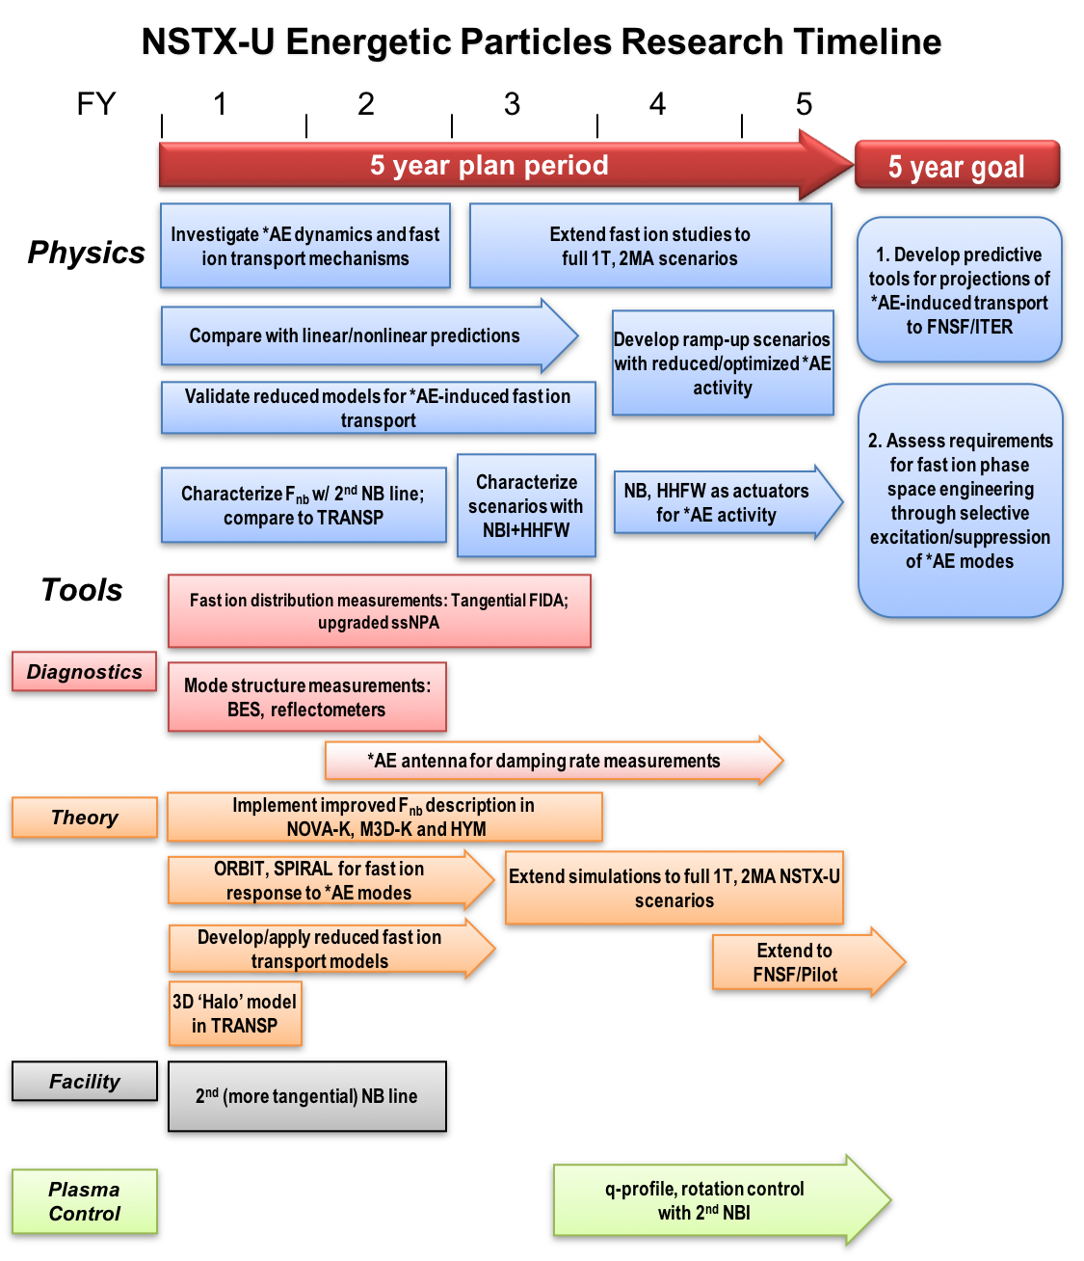
Energetic Particle research timeline

Slide 37
Summary
NSTX-U research is critical to retain a world-leading ST science capability
  High-level research goal emphasis revisited to align well with the NAS and FESAC TEC report recommendations, as well as with PAC-39 recommendations
  Vital for developing predictive capability for fusion science, next-step designs
We need to start the process of reconstituting the Research Team now to be prepared upon restart to perform science critical to the ST concept and fusion energy development

Slide 38
Backup

Slide 39
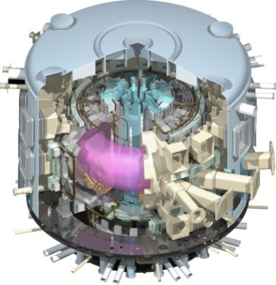
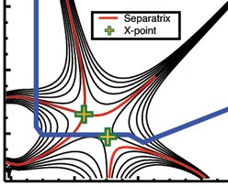
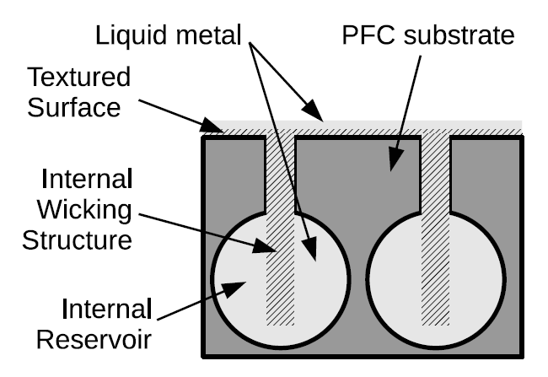
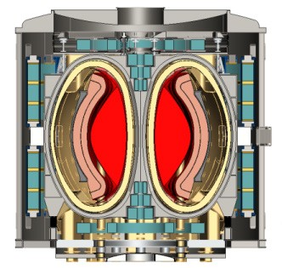
NSTX-U Mission Elements Support the NAS Vision
Exploit unique Spherical Tokamak (ST) parameter regimes to advance predictive capability - for ITER and beyond
Develop solutions for plasma-material interface (PMI) challenge
Explore ST physics towards reactor relevant regimes (Fusion Nuclear Science Facility, low-A Pilot Plant)
ITER
Advanced divertors
Liquid metals
ST-FNSF / Pilot-Plant

Slide 40
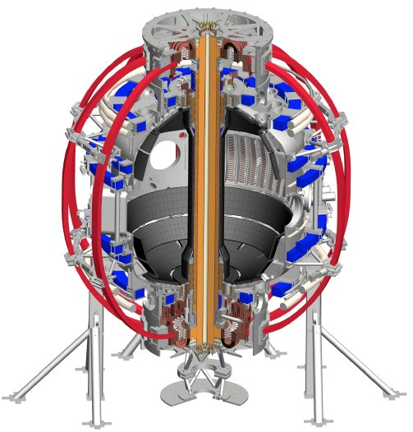
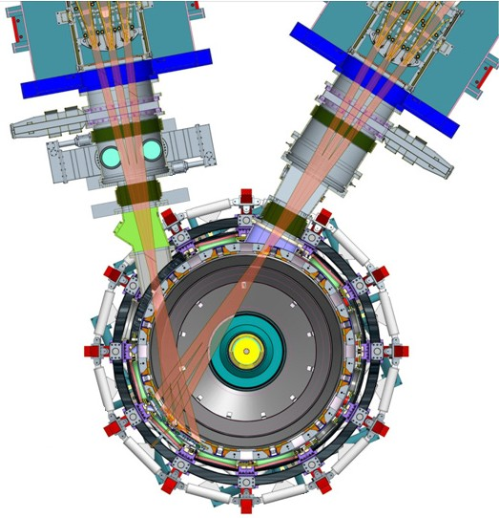
NSTX-U vital for addressing key ST / fusion questions
Highest normalized pressure at high T
Unique regime, study new transport and stability physics
Sustain steady-state plasma
Not yet achieved at high-β_{T,} low ν*
Two new tools:
1. New Central Magnet
2. Tangential 2nd Neutral Beam
Ultimate Performance Levels:
B_{t} =1T
I_{p} = 2 MA
P_{NB} = 10 MW
Flat top duration = 5s
40

Slide 41
NSTX-U has many unique aspects relative to MAST-U
NSTX-U is unique when compared with MAST-U for addressing key goals:
Higher pressure and field (enabling the key goal of assessing ST confinement)
Longer pulse (enabling the key goal of developing sustained high beta scenarios)
Close-fitting wall (enabling the key goal of developing sustained high beta scenarios)
Higher density non-inductive scenario (enabling key goal of sustained high beta scenarios)
HHFW (enabling the key goal of developing sustained high beta scenarios)
Wall conditioning with lithium, wider pedestals and a path to lithium-wall.
Wide shaping flexibility when applying full beam power (whereas MAST-U is limited by vertically-displaced beam geometry)
Larger q|| for short pulse to assess divertor scalings in STs
More flexible beam injection tangency allowing studies of fast ion physics, momentum transport etc in wider range of scenarios as well as for current ramp-up development
NSTX-U will benefit from strong collaboration with MAST-U to exploit complementary capabilities
NSTX-U also has leading capabilities that contribute to mainline program

Slide 42
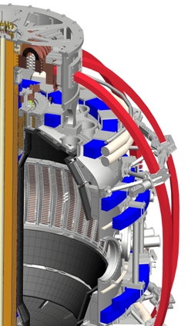
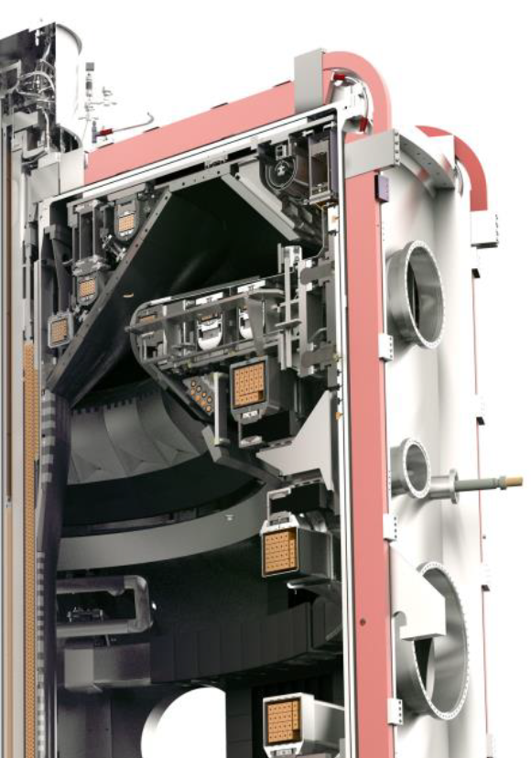
NSTX-U and MAST-U are the most capable devices in a world-wide ST research program
NSTX-U
Similar features:
Major radius R = 0.8-1m
Plasma current up to 2MA
Pulse durations 1s → up to 5s
Strong neutral beam heating
Having both NSTX-U and MAST-U important to confirm unique ST results
MAST-U (UK)
Complementary Research:
Core emphasis
Boundary emphasis
• Highest magnetic field, pressure
Highest plasma beta in large ST
2× higher max power (NBI+RF) and edge heat fluxes
2× higher self-driven current
Only large ST with RF heating
• Highly-flexible “long-leg” divertor for power exhaust research
• Only large ST with off-midplane 3D magnetic field coils for edge instability control

Slide 43
NSTX-U targeting major performance increase to explore new physics regimes
1. New Central Magnet
2. Tangential 2nd Neutral Beam
Ultimate Performance Goals:
➢2× toroidal field (0.5 ➔ 1T)
➢2× plasma current (1 ➔ 2MA)
➢5× longer pulse (1 ➔ 5s)
➢2× heating power (5 ➔ 10MW for 5s)
Tangential NBI ➔ 2× current drive efficiency
Up to 15MW NBI + 4MW RF for 1-2s
➢Up to 10× higher nTτ_{E} (~MJ plasmas)
➢4× divertor heat flux (➔ ITER levels)

Slide 44
NSTX-U vital for addressing key ST / fusion questions
Will access new physics with 2 new tools:
Highest normalized pressure at high T
➔ Unique regime, study new transport and stability physics
Sustain plasma without transformer
➔ Not yet achieved at high-β_{T,} low ν*
Essential for any future steady-state ST
1. New Central Magnet
2. Tangential 2nd Neutral Beam
2× field, current, power
4× heat flux, 5× pulse length
Up to 10× higher nTτ_{E}

Slide 45
NSTX-U design enables access to 2-3× higher plasma pressure, temperature than MAST-U
NSTX-U
NSTX-U central magnet provides 1.5× higher toroidal field current
→ ~1.5 - 2× higher B_{T}²
(depending on plasma shape)
MAST-U
Conducting plates can suppress global kink instabilities,
~1.5× higher β_{T}
p ∝ β_{T} B_{T}²
2-3× higher
Expect ~2× higher edge “pedestal” pressure due to higher B, shaping

Slide 46
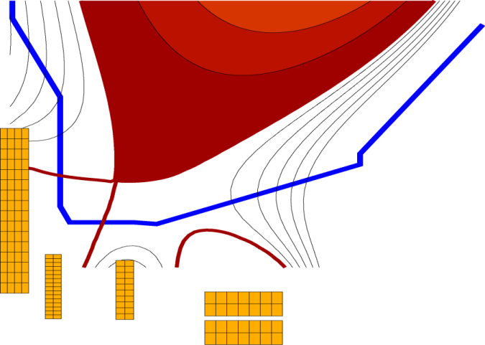
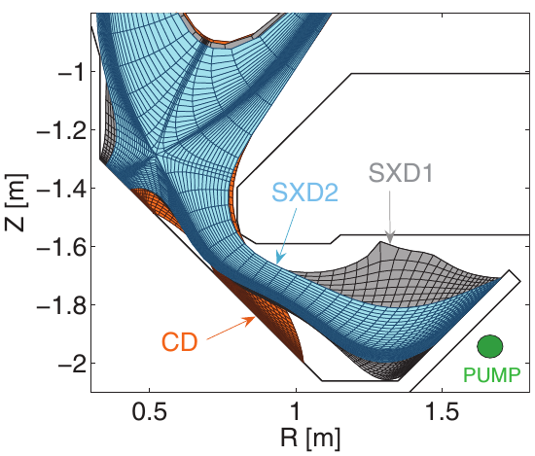
STs will provide leading contributions to development and understanding of advanced divertors
MAST-U: World-leading pumped long-leg + flexible flaring, radiation
NSTX-U: Short-leg flared divertor + radiation to mitigate heat flux
Super-X divertors
Conventional Divertor
New PF1 magnets for flaring control, highest shaping, highest ST edge parallel heat flux
E. Havlickova, et al., Plasma Phys. Control. Fusion 56 (2014) 075008
Together provide science basis to integrate high performance ST core with advanced power exhaust

