Slide 1
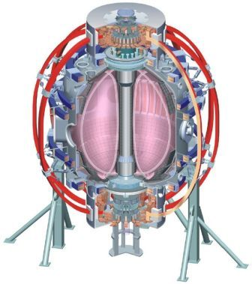
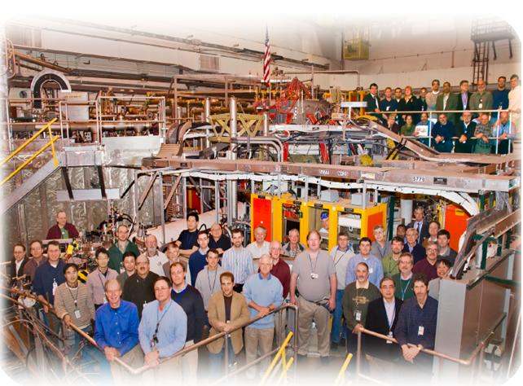
NSTX
Supported by
Divertor options for NSTX and NSTX-Upgrade
College W&M
Colorado Sch Mines
Columbia U
Comp-X
General Atomics
INL
Johns Hopkins U
LANL
LLNL
Lodestar
MIT
Nova Photonics
New York U
Old Dominion U
ORNL
PPPL
PSI
Princeton U
Purdue U
SNL
Think Tank, Inc.
UC Davis
UC Irvine
UCLA
UCSD
U Colorado
U Maryland
U Rochester
U Washington
U Wisconsin
Rajesh Maingi,
On behalf of the NSTX Research Team
Culham Sci Ctr
U St. Andrews
York U
Chubu U
Fukui U
Hiroshima U
Hyogo U
Kyoto U
Kyushu U
Kyushu Tokai U
NIFS
Niigata U
U Tokyo
JAEA
Hebrew U
Ioffe Inst
RRC Kurchatov Inst
TRINITI
KBSI
KAIST
POSTECH
ASIPP
ENEA, Frascati
CEA, Cadarache
IPP, Jülich
IPP, Garching
ASCR, Czech Rep
U Quebec
NSTX Program Advisory Committee Meeting
Princeton, NJ
Feb. 3-5, 2010

Slide 2
This talk responds to a PAC-25 request
The PAC recommends that the NSTX Team consider ways to devote additional resources to the investigation and development of a high heat flux divertor for NSTX. A high heat flux divertor with sufficient particle control is critical to the NSTX Program. Therefore, the PAC recommends even greater emphasis be placed in the research program, run plan, and diagnostic implementation plan for addressing Li divertor issues. For next year’s PAC meeting, we request that the NSTX National Team make an explicit presentation detailing what will be the heat flux targets required in post-upgrade discharges and identification of high-heat flux divertor options compatible with reasonable density control targets.
Lithium coatings provide transient pumping, and the power handling schemes in this talk are all thought to be compatible
LLD experiments this year will determine if pumping can be extended
Other techniques, such as cryopumps, are more sensitive to strike point locations, and are presently being considered as backup options

Slide 3
Divertor options for NSTX-U
Base plan: use high flux expansion divertor for heat flux handling, and liquid lithium for pumping
Up/down power sharing (double-null), plus small inner gap for inner wall power exhaust sharing may be required
Gas puffing for radiative/detached divertor would be used for safety margin, but should not be required a priori
Backup option: use Super-X divertor for heat flux handling, and a cryopump for density control
PFC material choice undecided: carbon (baseline) or high-Z?
High-Z more reactor relevant
Considering changing inner divertor graphite tiles in NSTX with Mo tiles for improved compatibility with lithium in high δ discharges
Research goal: project NSTX-U heat flux from NSTX data
Assess NSTX-U operational window (I_{p}, P_{heat}, n_{e}, pulse length)

Slide 4
Outline
Heat flux projection methods
0-D: Heat flux peak (q_{peak}) and width (λ_{q}) scalings
2-D modeling: extrapolate based on NSTX data
Heat flux mitigation techniques
High flux expansion divertors
Gas puffing for extra radiation and partial detachment
Successful in NSTX, shown at previous PACs
Experiment and analysis plan

Slide 5
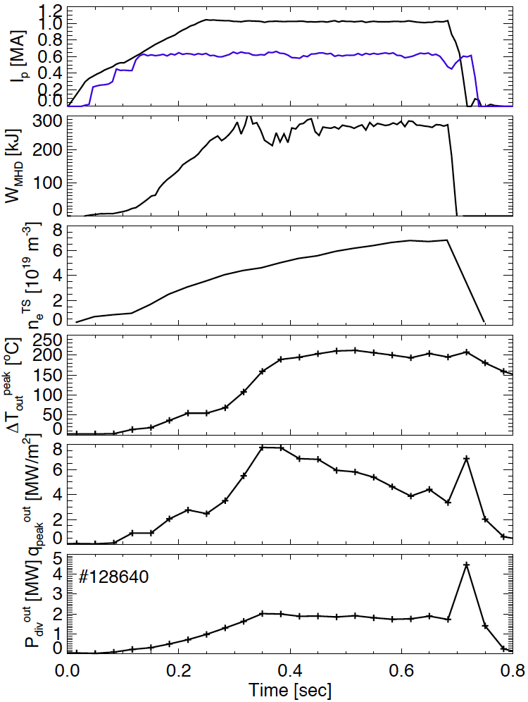
Divertor peak heat flux evolves during discharge
I_{p} flat-top at 0.25 sec (L-H transition at 0.13 sec)
Stored energy usually flat-tops after I_{p} flat-top
Density ramps throughout the discharge (large δ_{r}^{sep}, small ELMs)
Peak divertor temperature rise flattens as density rises
Outer divertor heat flux peaks when W_{MHD} flat-tops; rolls over as density rises
Total outer divertor power relatively constant (i.e. profile broadens)
I_{p}
P_{heat}/10 [MW]
W_{MHD}
n_{e}
ΔT_{peak}^{div}
q_{peak}^{div}
P_{div}
Use highest values for projections

Slide 6
Simplest 0-D heat flux projection based on power balance extrapolates from measured NSTX heat flux profiles
IR thermography measures heat flux profile q_{div}^{out}(r) for calculation of divertor power loading:
Define characteristic divertor heat flux scale length, :
Assume related* to characteristic midplane scale length through flux expansion f_{exp}:
Project NSTX-U q_{peak}^{div}: I_{p}=2 MA, P_{loss}=10 MW, B_{t}=1 T, f_{exp}=30
For P_{loss} extrapolation, use
Determine dependence of λ_{q}^{mid} on external parameters (I_{p}, P_{loss}, B_{t}, flux expansion) from NSTX data (FY10 Joint Research Target)
*Loarte, JNM 1999

Slide 7
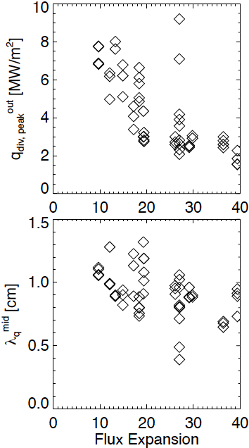
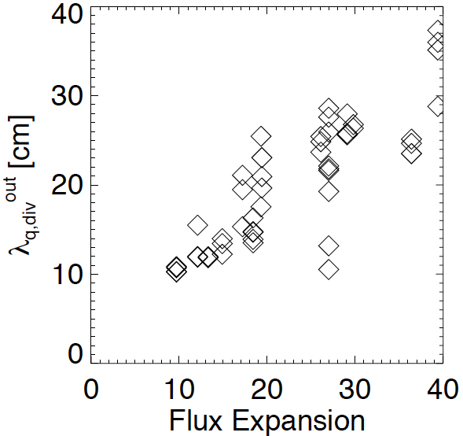
Peak heat flux decreases inversely with flux expansion with roughly constant λ_{q}^{mid}
λ_{q}^{div} increases with flux expansion
λ_{q}^{mid} stays approximately constant during the scan

Slide 8
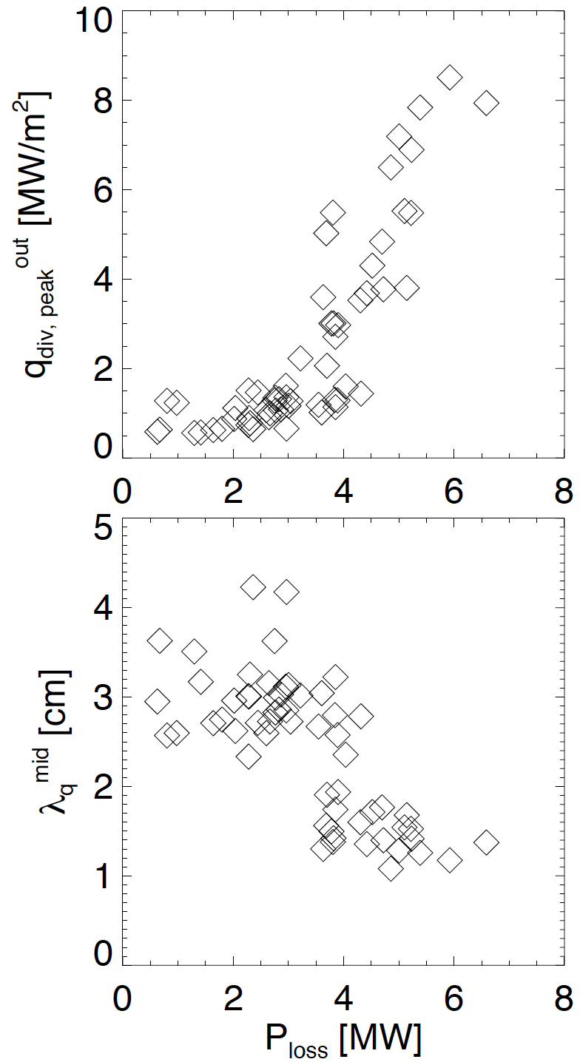
Heat flux width λ_{q}^{mid} largely independent of P_{loss} in attached plasmas
Radiative/
Detached Attached
Radiative/
Detached Attached
~ 0.5, f_{exp} ~ 6, I_{p}= 0.8 MA
Peak divertor heat flux increases with P_{loss}
Apparent change in slope near P_{loss}=4 MW in these conditions, as divertor transitions from a radiative/detached divertor to an attached divertor
λ_{q}^{mid} relatively independent of P_{loss} in high heat flux regime
All data in this talk averaged over ELMs and before lithium coatings

Slide 9
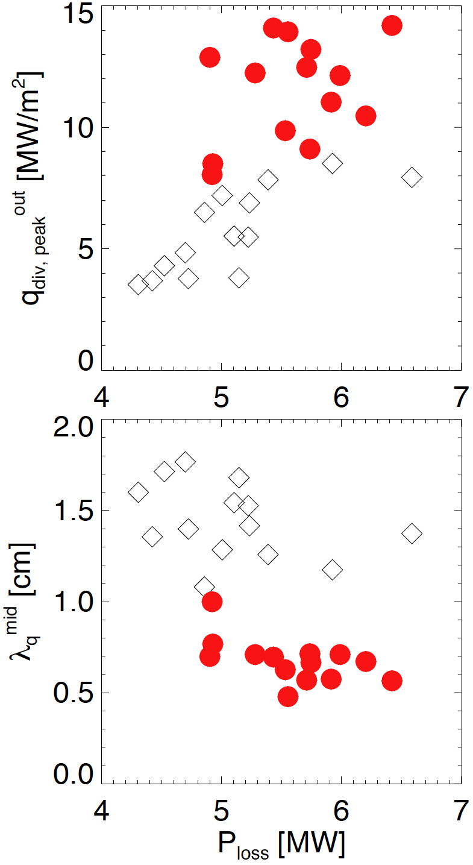
Heat flux width λ_{q}^{mid} largely independent of P_{loss} in attached plasmas
Radiative/
Detached Attached
Radiative/
Detached Attached
~ 0.5, f_{exp} ~ 6, I_{p}= 0.8 MA
+ δ ~ 0.7, f_{exp} ~ 16, I_{p}= 1.2 MA
Narrow P_{loss} plot range
Add in high δ data
Apparent I_{p} or q₉₅ effect

Slide 10
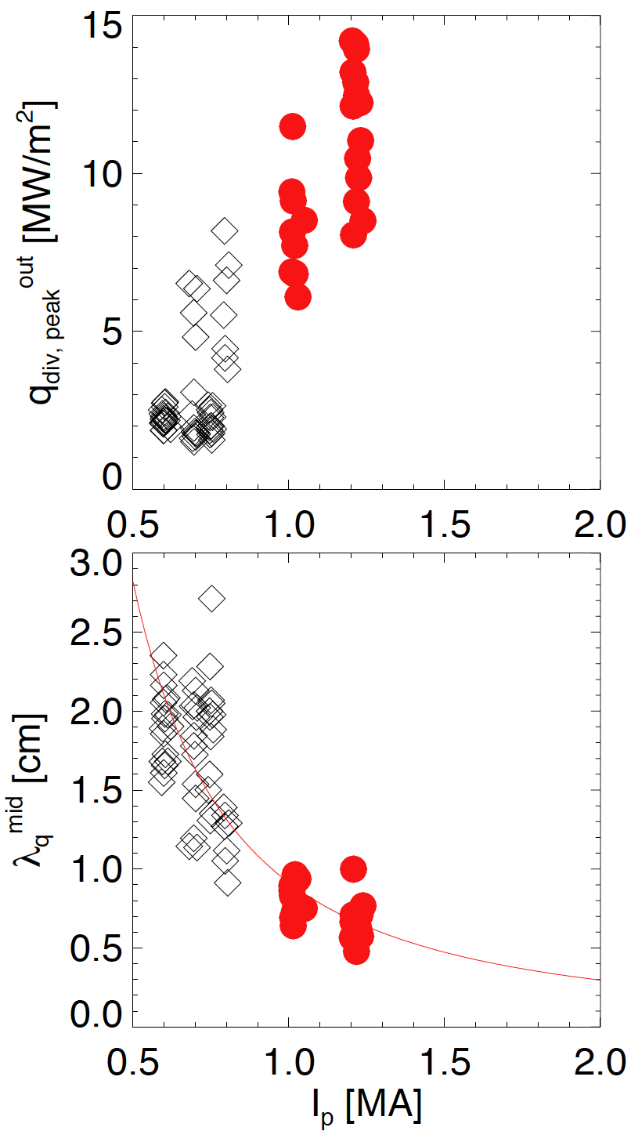
Heat flux width decreases with I_{p}
Combined data from dedicated I_{p} scans in low δ and high δ discharges
I_{p} dependence also in DIII-D, JET
Different P_{NBI} and f_{exp}, but previous slides shows no P_{loss} or f_{exp} effect on λ_{q}^{mid}
q₉₅, l|| different
Power law fit: λ_{q}^{mid} ~ 3 +/- 0.5 mm @ 2 MA
Project q_{peak} = 24 +/- 4 MW/m²
Flux expansion = 30
P_{loss} = 10 MW, f_{div} = 0.5
Note: n/n_{GW} ~ 0.5 in projection
~ 0.5
f_{exp}~6
P_{NBI}=4 MW
~ 0.7
f_{exp}~16
P_{NBI}=6 MW
λ_{q}^{mid} = 0.91I_{p}^{-1.62}
Anticipate NSTX-U operation with n/n_{GW} from 0.5-1

Slide 11
2D modeling used to extrapolate from NSTX discharges to NSTX-U
Generate grid based on discharge equilibrium
Prescribe power and particle fluxes through inner boundary from data
Vary free parameters (χ(ψ), D(ψ), target recycling coefficients) to match measured midplane and divertor profiles
Use above values to extrapolate to higher heating power
Extrapolate based on NSTX data from 1.2 MA, 6 MW discharge, which have highest measured heat flux

Slide 12
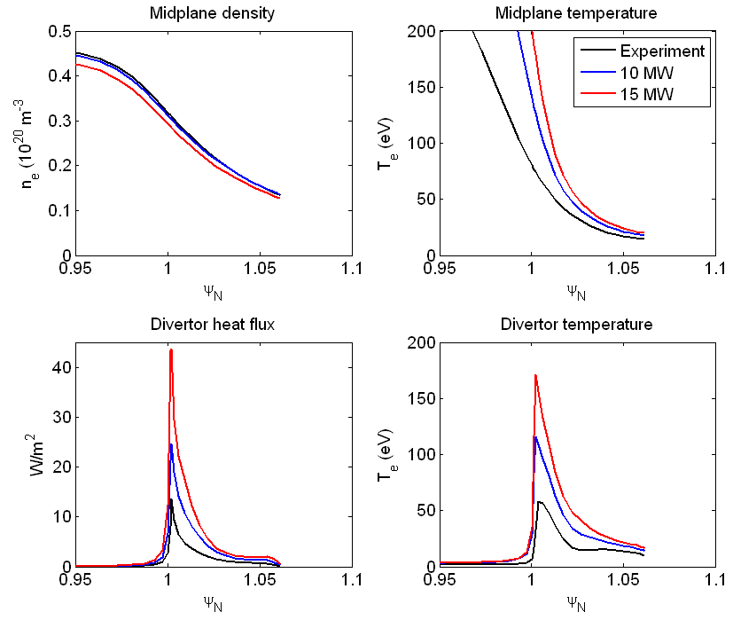
Interpretive 2D modeling also projects to very high peak heat flux with increased heating power
Peak divertor heat flux to 25 MW/m² at 10 MW power
Differences here and through 0-D projection:
Cross-field transport χ, D independent of I_{p}
f_{exp}=16
Near term work will incorporate scalings, detachment, NSTX-U geometry
J. Canik

Slide 13
Outline
Heat flux projection methods
0-D: Heat flux peak (q_{peak}) and width (λ_{q}) scalings
2-D modeling: extrapolate based on NSTX data
Heat flux mitigation techniques
High flux expansion divertors
Gas puffing for extra radiation and partial detachment, i.e. operate with 0.5 < n/n_{GW} < 1
Successful in NSTX, shown at previous PACs
Experiment and analysis plan

Slide 14
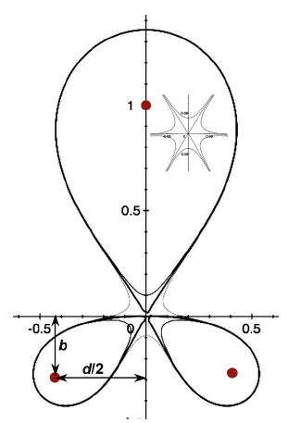
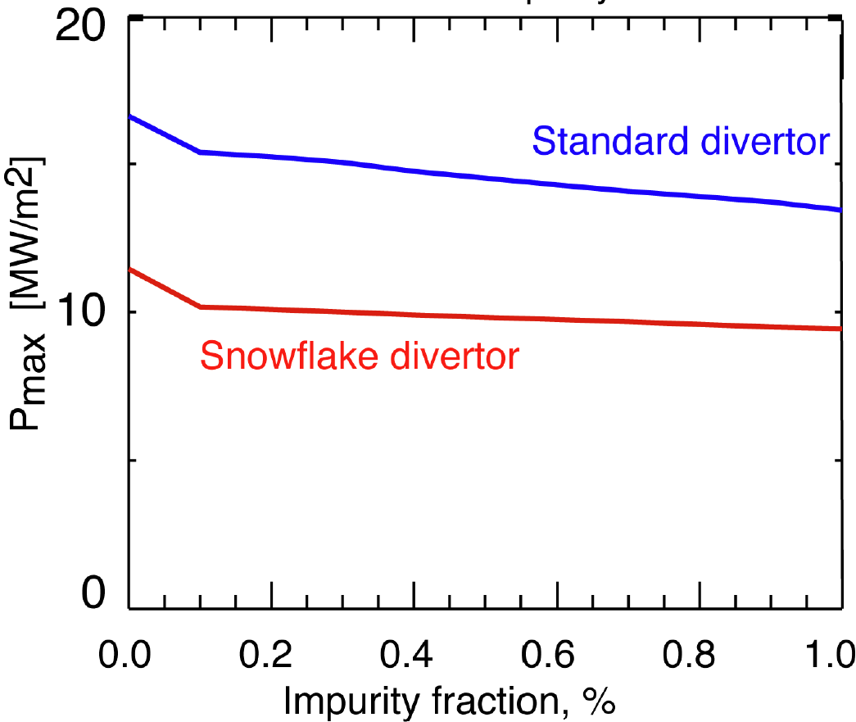
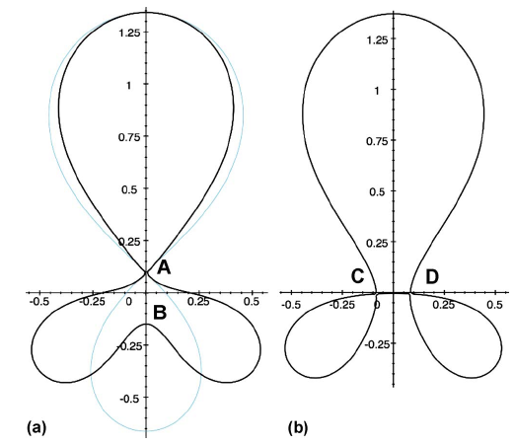
Heat flux solution: Snowflake divertor configurations predicted to facilitate power handling
Snowflake divertors
+ -
Snowflake topological features
Higher magnetic flux expansion
Longer l|| near separatrix
Calculation for Fusion
Development Facility (FDF)
Ryutov, PoP 2007
Umansky, NF 2009

Slide 15
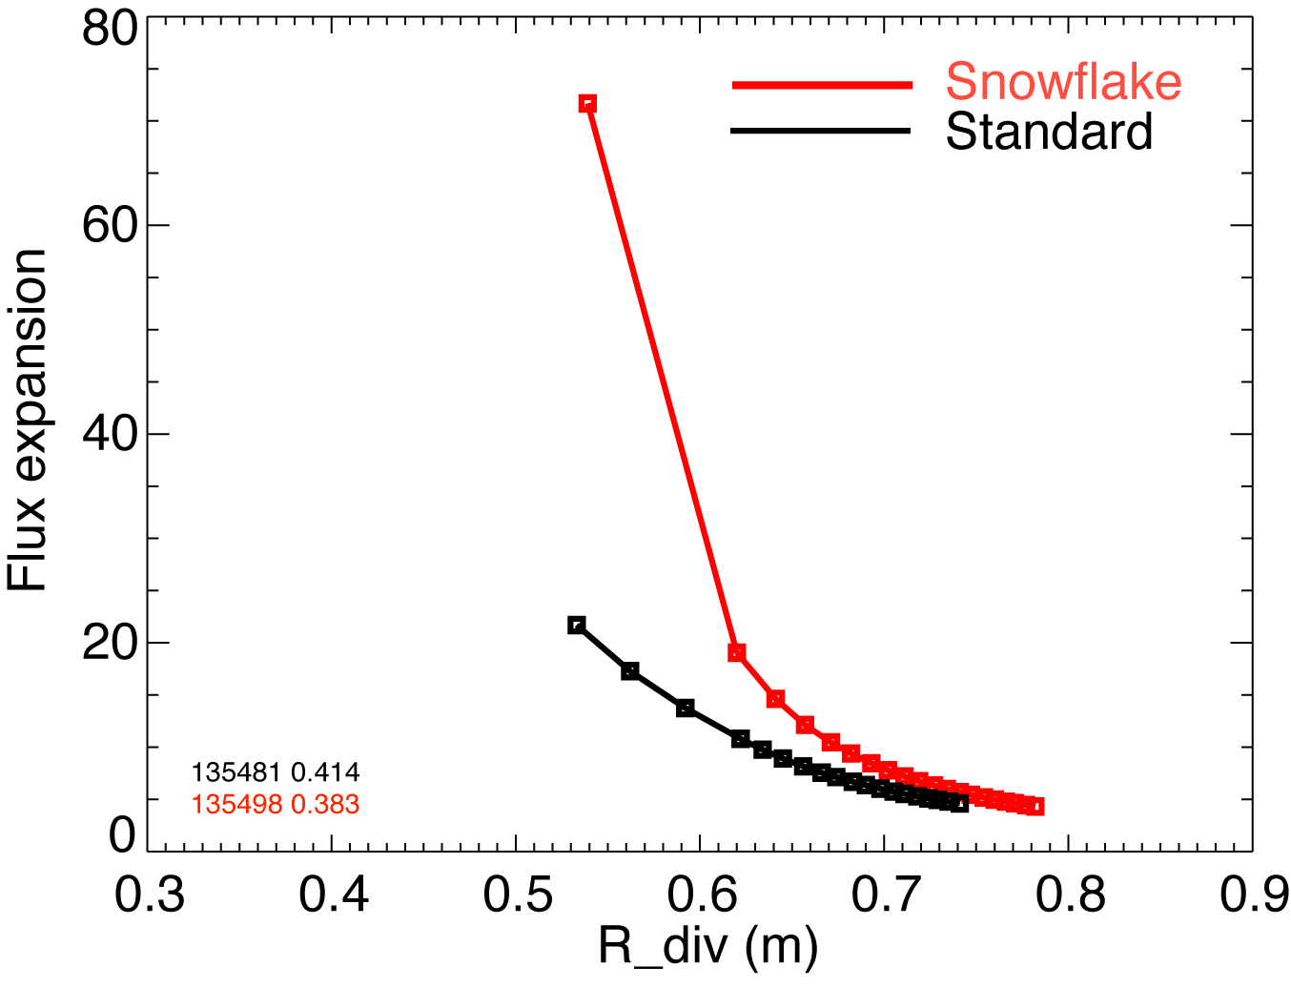
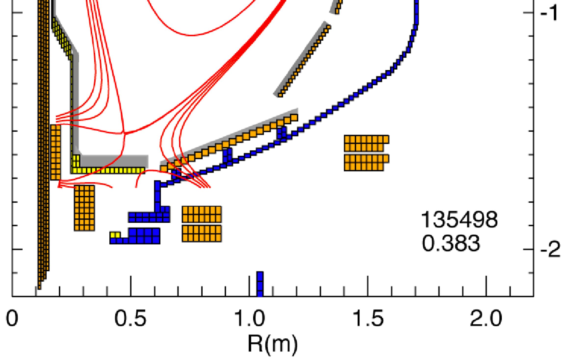
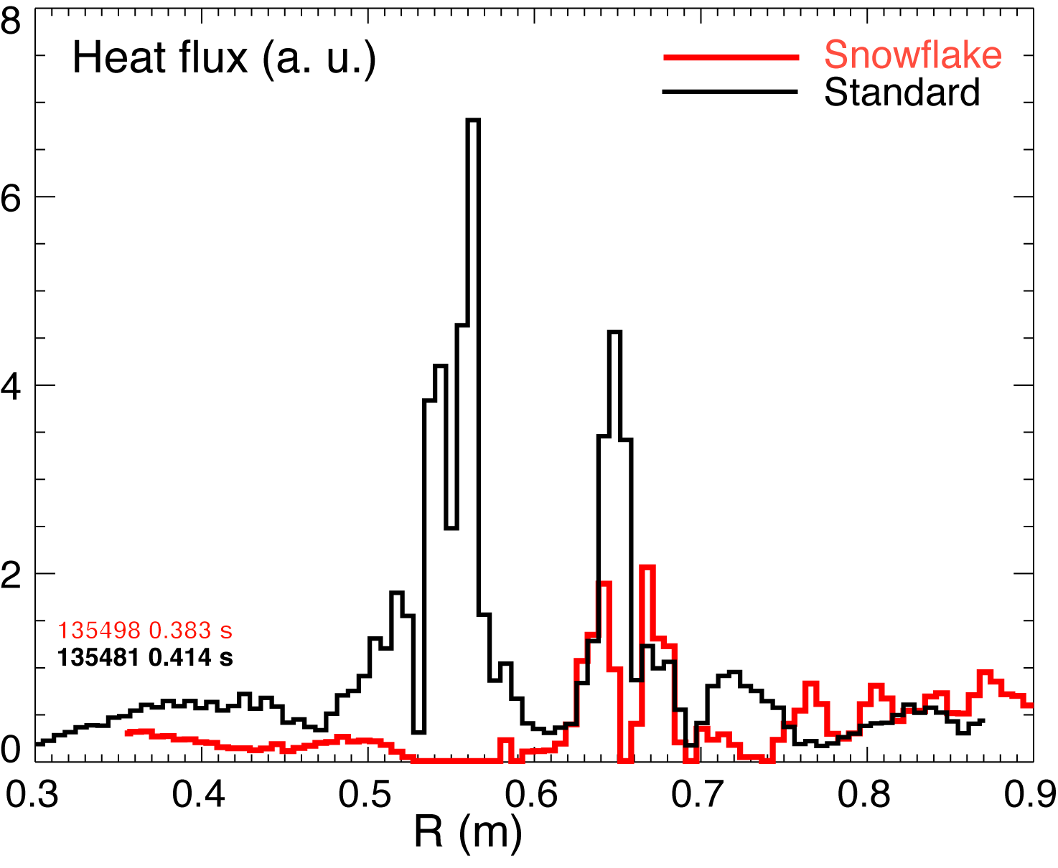
Snowflake-like topology showed broad region of low heat flux
Approximate snowflake divertor configuration achieved, with higher f_{exp} (3 mm flux surfaces shown)
Heat flux profile made broader with reduced peak value
Substantial high-n Balmer emission, indicative of volume recombination
CHI gap
Soukhanovskii, IAEA 2010

Slide 16
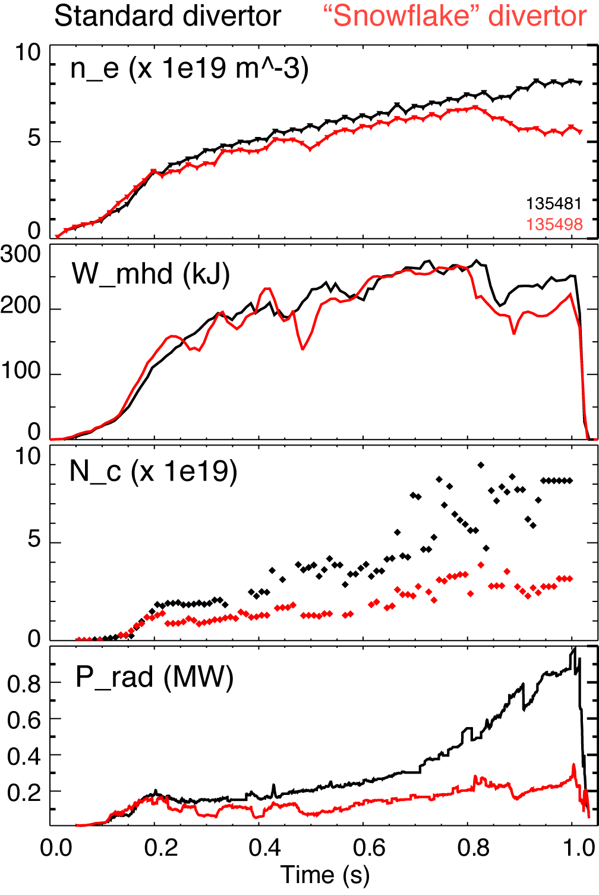
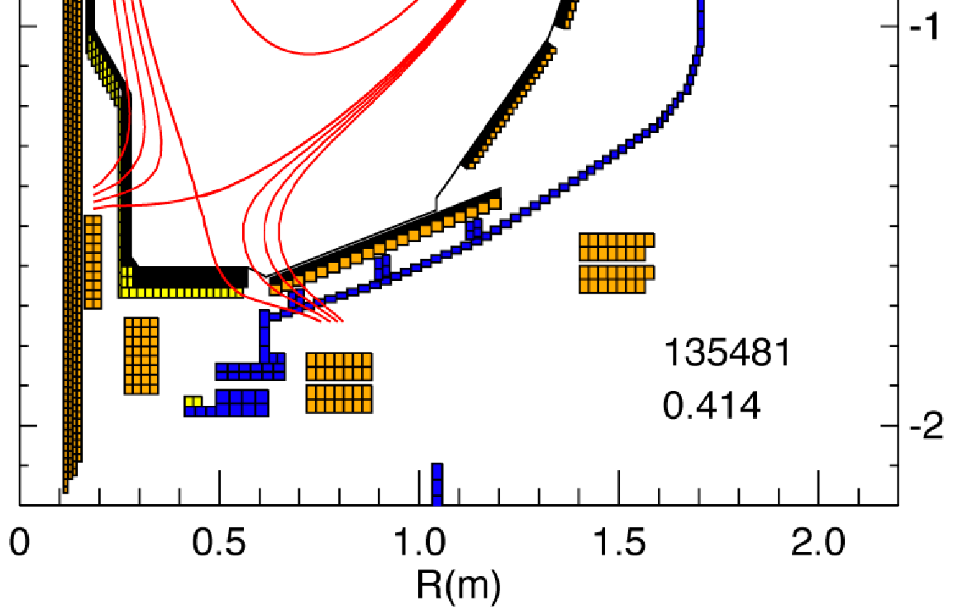
Discharges with snowflake configuration appear promising for impurity control
“Snowflake” divertor
Standard divertor
Soukhanovskii, IAEA 2010

Slide 17
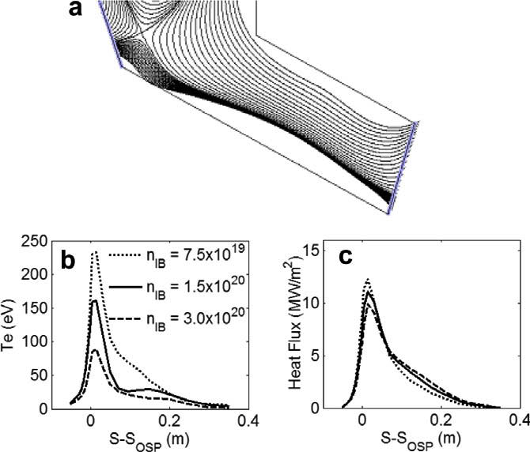
Heat flux solution: Super-X divertor (SXD) predicted to reduce peak heat flux in low R/a NHTX
Baseline Super-X
Canik, JNM 2009

Slide 18
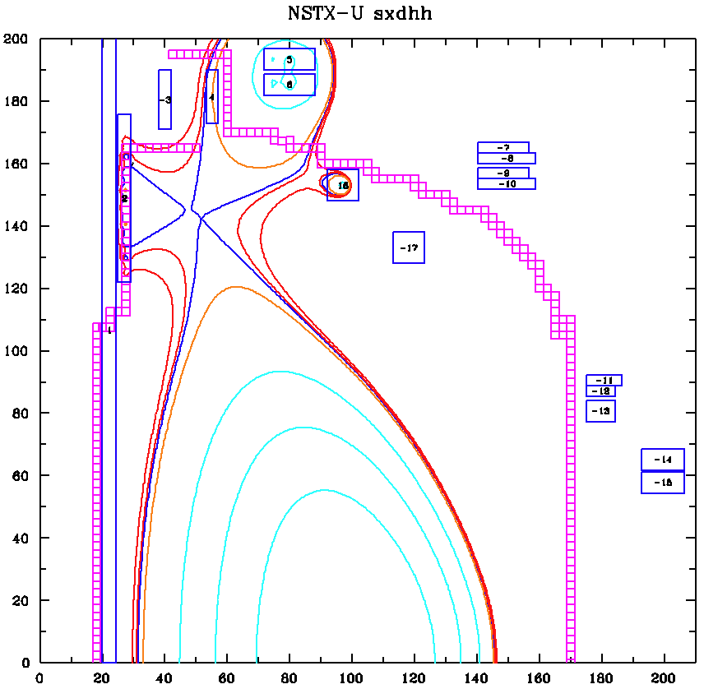
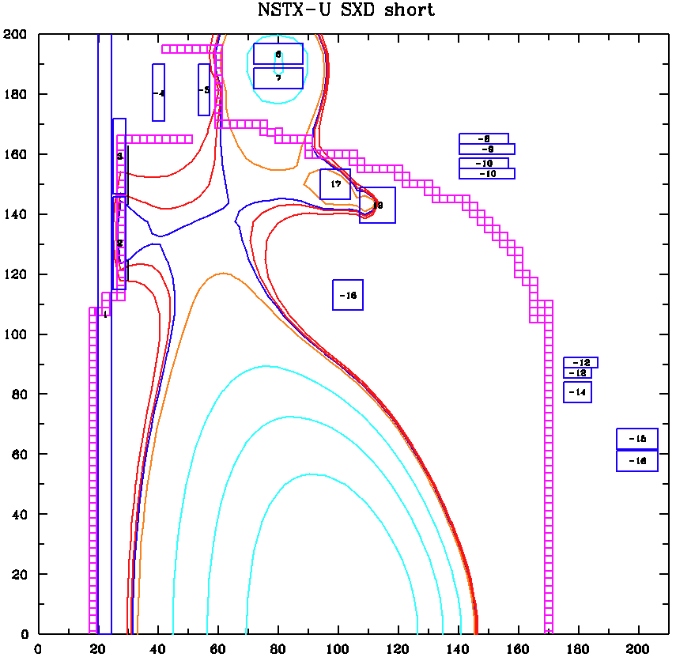
Multiple SXD options available with in-vessel coils
NSTX-U options being explored by Univ. Texas (with NSTX team)
Could be used in conjunction with large-R cryopump, if desirable
Coils shown are consistent with present Center Stack design
Cost of in-vessel coils not included in NSTX-U, i.e. future possibility
Valanju

Slide 19
FY 2010 experiment and analysis plan forNSTX-U divertor design
Measure I_{p}, P_{heat}, n_{e}, B_{t} dependences on heat flux profile with lithium at high I_{p} for improved scaling
Continue snowflake divertor development
Continue 2D modeling of scenarios
Unmitigated heat flux: decrease χ, D with I_{p}, increase flux expansion, and use computed NSTX-U equilibria
Detached case: add impurities, increase P_{heat}, and use χ=f(I_{p})
Begin to model snowflake results, including lithium/LLD effects
Begin to model super-X with LLD and/or cryo
Quantify density dependence of heat flux profiles, and examine high core radiated power scenarios
New data with LLD, including evaporative cooling
Assess replacing lower inboard div. C tiles with Mo

Slide 20
BACKUP
20
Notes:
20

Slide 21
Interpretive 2D modeling sets cross-field transport and recycling coefficients to match plasma profiles
1.2 MA, 6 MW NBI with high peak heat flux data
Code calculations reasonably match measured profiles
Deuterium only in simulations (impurity radiation small in sheath limited regime)
J. Canik

Slide 22
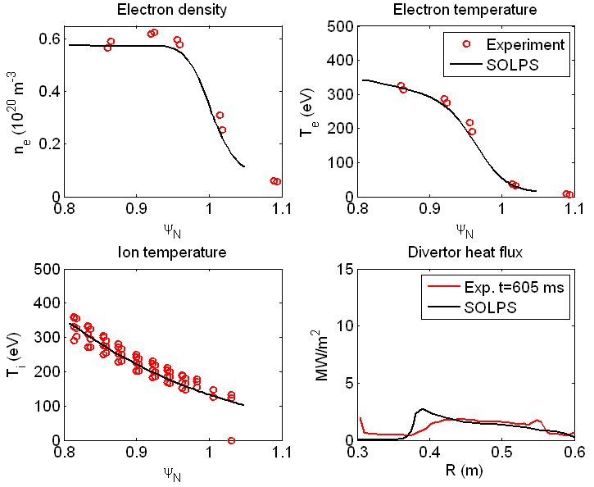
Interpretive 2D modeling of detached discharge shows much lower peak heat flux
Projection of this scenario in progress
Deuterium only in simulations so far– inclusion of impurities needed
Differences between this and baseline case (higher n_{e}, lower T_{e}) folded in through transport coefficients, i.e. no divertor puff here
J. Canik

Slide 23
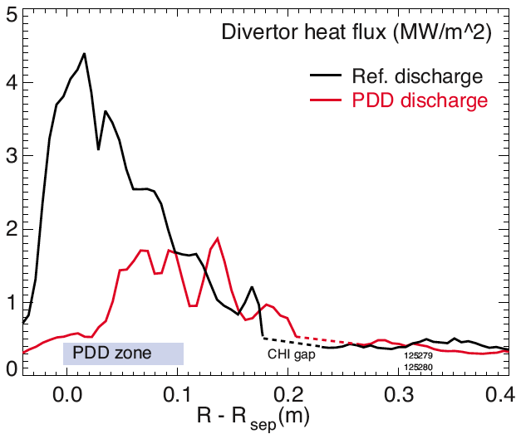
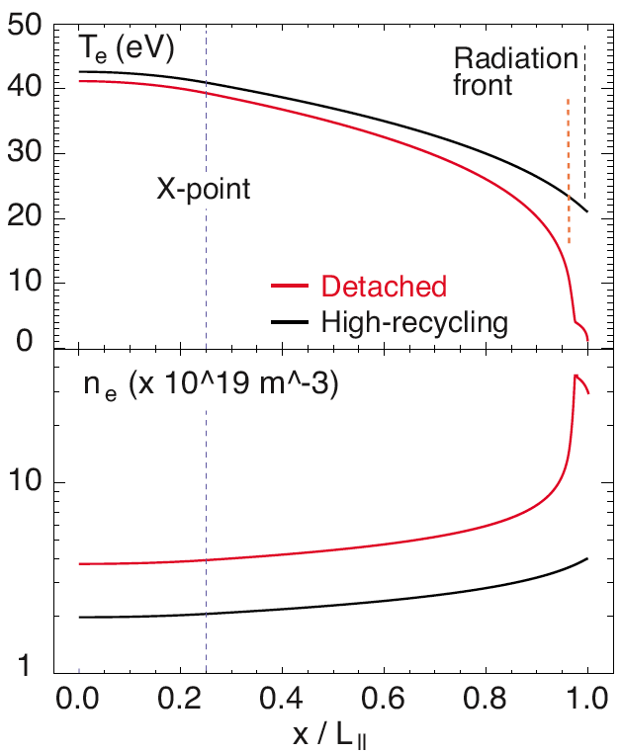
Divertor physics and detachment physics program focuses on needs for NSTX-Upgrade and next step ST design
ST effects: low l||, small R, low in/out power split make outer leg detachment difficult
Power management through flux expansion and partial detachment (PDD) will be required for heat dissipation in high power ST’s
ST effects above allow broader test of detachment physics in 2-D codes
Heat flux management through plasma shaping and detachment with good confinement shows promise in NSTX
Need to to extend to highest I_{p}
Soukhanovskii PoP 2009

Slide 24
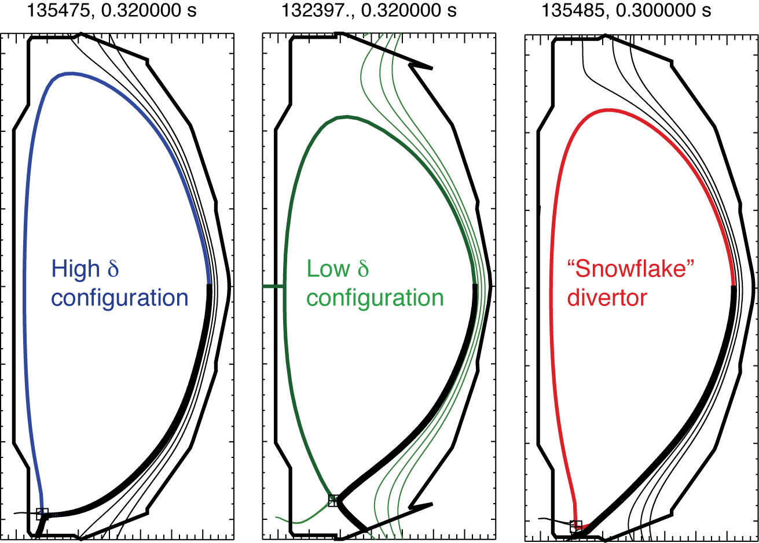
Snowflake-like magnetic topology achieved in NSTX
Configuration | Flux expansion | L_{x} (m) | L_{tot} (m)
SFD | 68.1 | 16.3 | 36.5
Low δ | 4.3 | 8.4 | 19.6
High δ | 10.0 | 4.5 | 15.0
Soukhanovskii, IAEA 2010

Slide 25
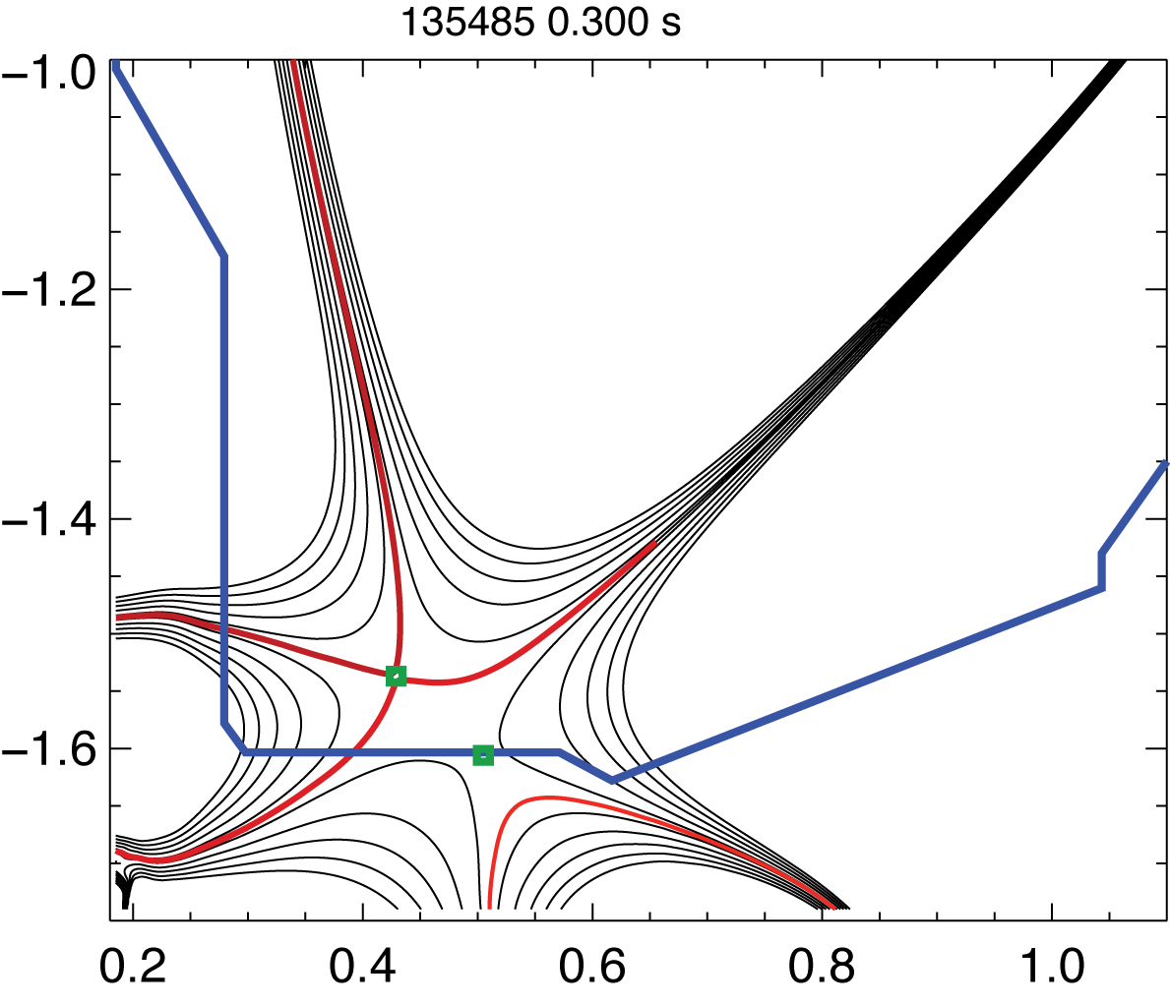
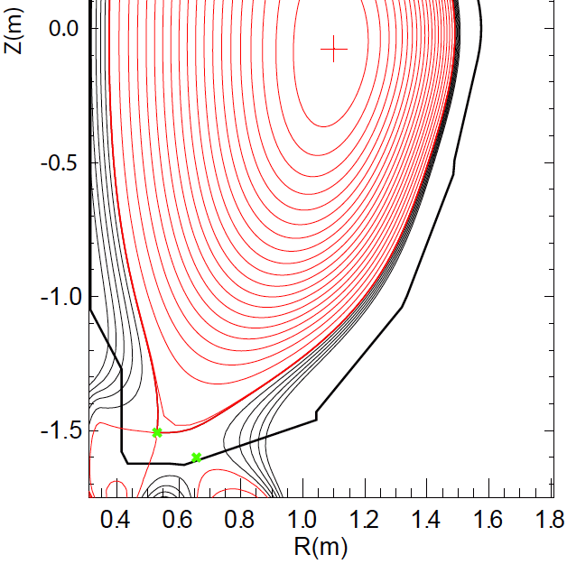
Snowflake equilibria generated for NSTX-Upgrade
NSTX – actual NSTX-U – model

