Slide 1


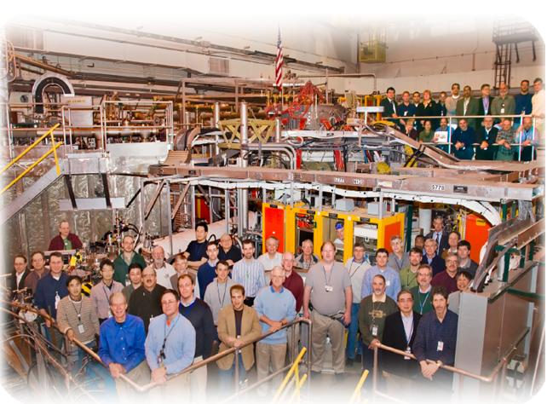
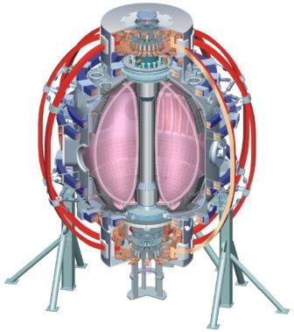
NSTX
Supported by
Transport and Turbulence Physics Progress and Plans
College W&M
Colorado Sch Mines
Columbia U
CompX
General Atomics
INL
Johns Hopkins U
LANL
LLNL
Lodestar
MIT
Nova Photonics
New York U
Old Dominion U
ORNL
PPPL
PSI
Princeton U
Purdue U
SNL
Think Tank, Inc.
UC Davis
UC Irvine
UCLA
UCSD
U Colorado
U Illinois
U Maryland
U Rochester
U Washington
U Wisconsin
Yang Ren, PPPL
Howard Yuh, Nova photonics
Gregory W. Hammett, PPPL
for the NSTX Research Team
Culham Sci Ctr
U St. Andrews
York U
Chubu U
Fukui U
Hiroshima U
Hyogo U
Kyoto U
Kyushu U
Kyushu Tokai U
NIFS
Niigata U
U Tokyo
JAEA
Hebrew U
Ioffe Inst
RRC Kurchatov Inst
TRINITI
KBSI
KAIST
POSTECH
ASIPP
ENEA, Frascati
CEA, Cadarache
IPP, Jülich
IPP, Garching
ASCR, Czech Rep
U Quebec
NSTX PAC-29
PPPL B318
January 26-28, 2011

Slide 2
Outline
Motivations of NSTX Turbulence and Transport (T&T) research.
Recent results and plans for FY11 and FY12
Activities during NSTX upgrade period (FY13 and FY14)
Summary

Slide 3
NSTX Accesses a Unique Parameter Regime to Address T&T Issues Crucial for Future ST and non-ST Devices
Strong ExB flow shear: decoupling of the electron and ion channels (ions close to neoclassical in H-mode) to study electron thermal transport
Achievable range of β_{T} can lead to significant EM contribution: Assessing magnetic flutter effect, e.g. micro-tearing turbulence
Large ρ_{e} makes localized electron-scale measurement possible
Validating physics models over a wide range of operating space (B_{T}, Ip, ν_{e}*, etc.) for NSTX-U and future devices
  Validating gyro-kinetic models for electron transport by varying β_{e} and ν_{e}*: μ-tearing (high β_{e}, ν_{e}*) and ETG (low β_{e}, ν_{e}*) with both high and low k measurements
  Validating GAE electron transport model by varying B_{T} and P_{NBI}

Slide 4
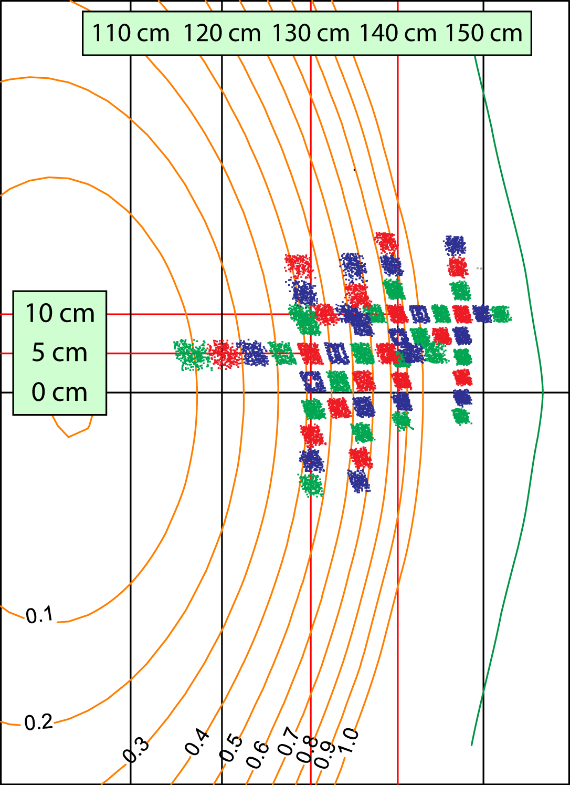
BES Diagnostic System Commissioned in 2010 with up to 24 Detection Channels
Measures Doppler-shifted D_{α} emission from neutral beams
Radial coverage from r/a~0.1 to beyond LCFS with 2-3 cm spot size
56 fiber views
Fiber layout includes radial and poloidal arrays and 2D grids
Digital anti-alias FIR filter eliminates photodetector e-noise > 1 MHz
32 detection channels planned for 2011
Image locations
R. Fonck, G. McKee, D. Smith, and I. Uzun-Kaymak (UW-Madison) and B. Stratton (PPPL)

Slide 5
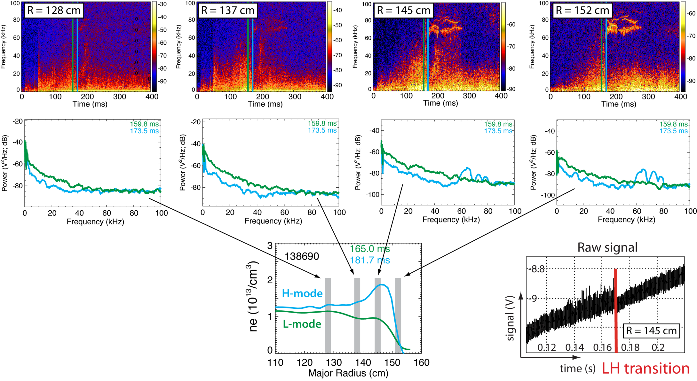
BES Observed Decrease in Fluctuations at L-H transition from Edge to Core Regions
PAC27-24
R. Fonck, G. McKee, D. Smith, and I. Uzun-Kaymak (UW-Madison) and B. Stratton (PPPL)
Notes:
Initial measurements have shown that fluctuations decrease at LH transitions. In the top row you see spectrograms from 4 BES channels located from 128 cm to 152 cm. You can see the radial locations and a density profile in the bottom graph. The blue and green time slices show measured spectra before and after the h-mode transition. In the bottom right you can see the RMS value of the time-series signal decreases at the h-mode transition. Initial measurements have also shown fluctuations increase at the HL back-transition.

Slide 6
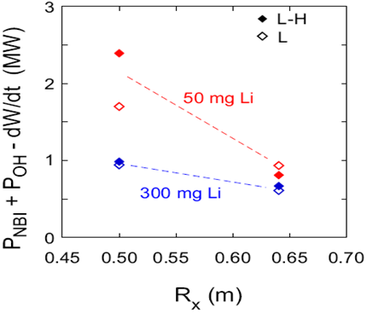
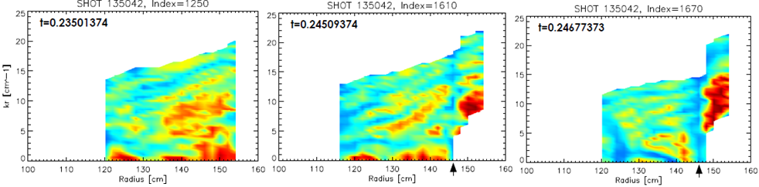
L-H Transition Study on NSTX Characterizes both Power Threshold and Turbulence
P_{LH} decreases with R_{X} and Li deposition
  Consistent with XGC-0 predicted E_{r} well depth
  B_{T} at X-point location is important in determining P_{LH}
    Plan to study the effect of X-point height and to investigate P_{LH} dependence on B_{TX} with XGC-0
k_{r} backscattering measurements from improved reflectometer show turbulence suppression at the Electron Transport Barrier (ETB) location (R≈146 cm) after L-H transition
PAC27-24
L-mode
H-mode
H-mode
ETB location
ETB location

Slide 7
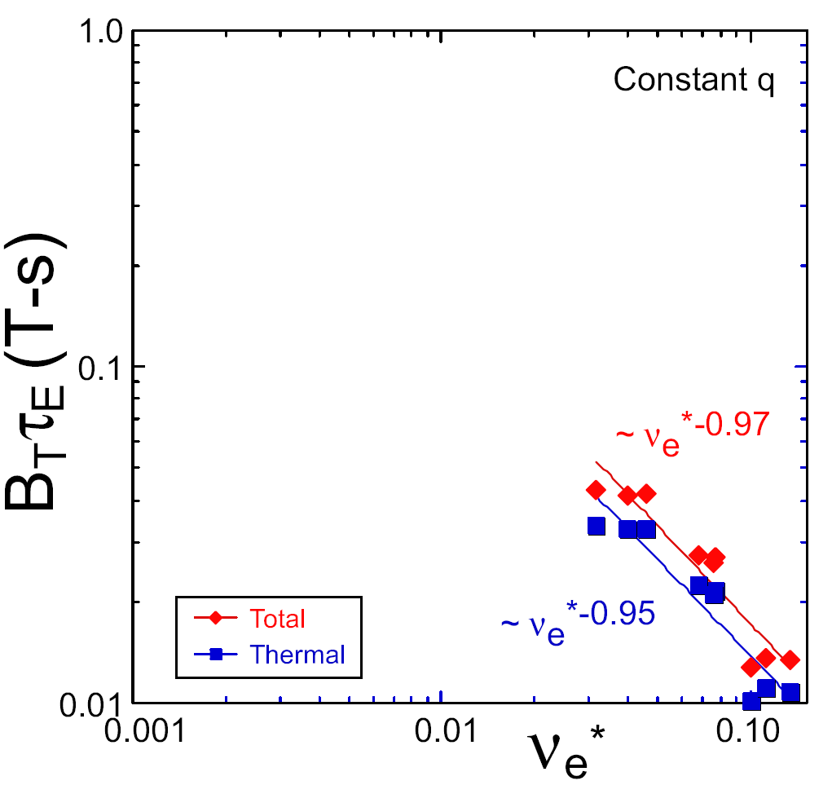
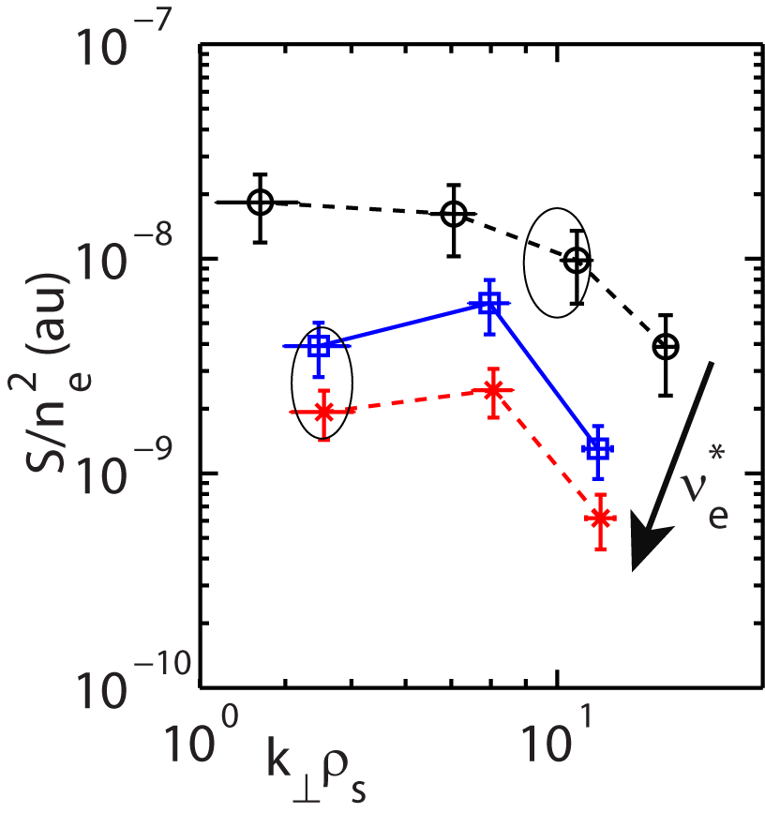
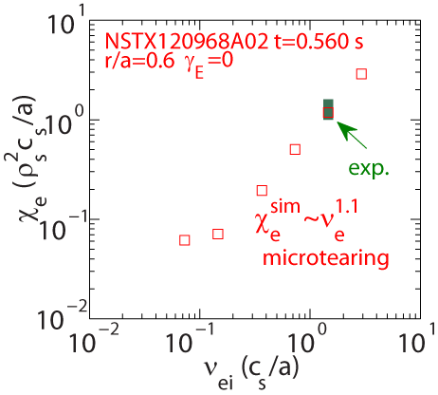
Coupling of Measurement and Simulations is Improving Understanding of NSTX ν_{e}* Confinement Scaling
observed in NSTX H-mode
Non-linear μ-tearing simulations indicate
High-k measured fluctuation power decreases with ν_{e}* (R11-1, TC-10)
  ETG linearly unstable, high-k scaling consistent with ETG predictions
  Unclear how sensitive high-k
  scattering is to μ-tearing
μ-tearing (high β_{e}, ν_{e}*) and
ETG (low β_{e}, ν_{e}*)
  BES, high-k and/or k_{r} back-
  scattering
  R11-1, TC-10, 2012 JRT
ST-FNSF
constant q, β, ρ∗
NSTX Upgrade
?
NSTX
ITER-like scaling
ν_{e}* ∝ n_{e} / T_{e}²
High-k measurement
Non-linear μ-tearing simulation with GYRO
β_{e} ≈2.6%
β_{e} ≈8.6%
constant q, β, ρ_{e}*
PAC27-23

Slide 8
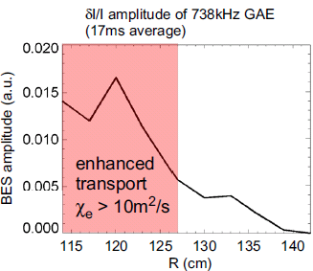
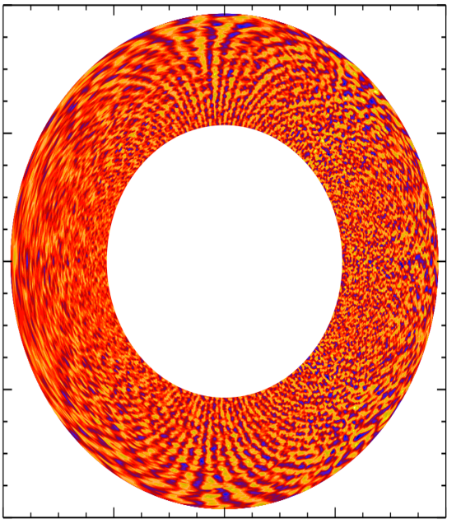


NSTX is also Exploring Other Mechanisms of Electron Thermal Transport (R11-1, TC-10, 2012 JRT)
BES measured Global Alfvén Eigenmode (GAE) peak amplitudes consistent with numerically simulated electron thermal transport
  BES calibrated mode structures and amplitudes
  for future ORBIT simulations
Relative mode profile
δI/I amplitude 738 kHz GAE (17 ms average)
No Frequency compensation
  To investigate robustness of physics with constant-q B field scan and P_{NBI} scan
PAC27-23
ETG is identified in NSTX reversed shear plasmas
  Off-mid-plane ETG streamers nonlinearly driven by mid-plane unstable ETG with steep T_{e} profile (nonlinear GYRO)
  High-k measurement at off-mid-plane will be conducted
    High-k scattering at Z/a≈-0.3 possible
    Shifting magnetic axis will be tried.
0.4
Peak Saturated Amplitude
0.2
Z/a 0
Peak Growth Rate
-0.2
-0.4
-0.4 -0.2 0 0.2 0.4
r/a

Slide 9
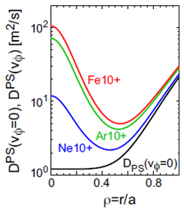
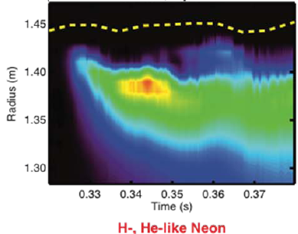
Impurity Transport Studies will Exploit New Diagnostics and Modeling Capabilities (R11-1, 2012 JRT)
Neon diffusivity neoclassical in the core accompanied by some anomalous convection
  Under-resolved at the edge and suffered from low signal
Plasma rotation enhancing core impurity transport without invoking low-k turbulence
New Multi-Energy Soft X-Ray diagnostic in 2010
  ~1 cm resolution; <100 μs response; high SNR; r/a>0.65
STRAHL transport code being used
  Neoclassical calculation embedded; Up-to-date
  atomic data
Impurity transport study at plasma edge
  Carbon build up in ELM-free discharges
  Z dependence of impurity transport
  Measure edge turbulence and its relation to impurity transport (BES, High-k, reflectometer etc.)
Neon puff
separatrix
PAC27-25

Slide 10
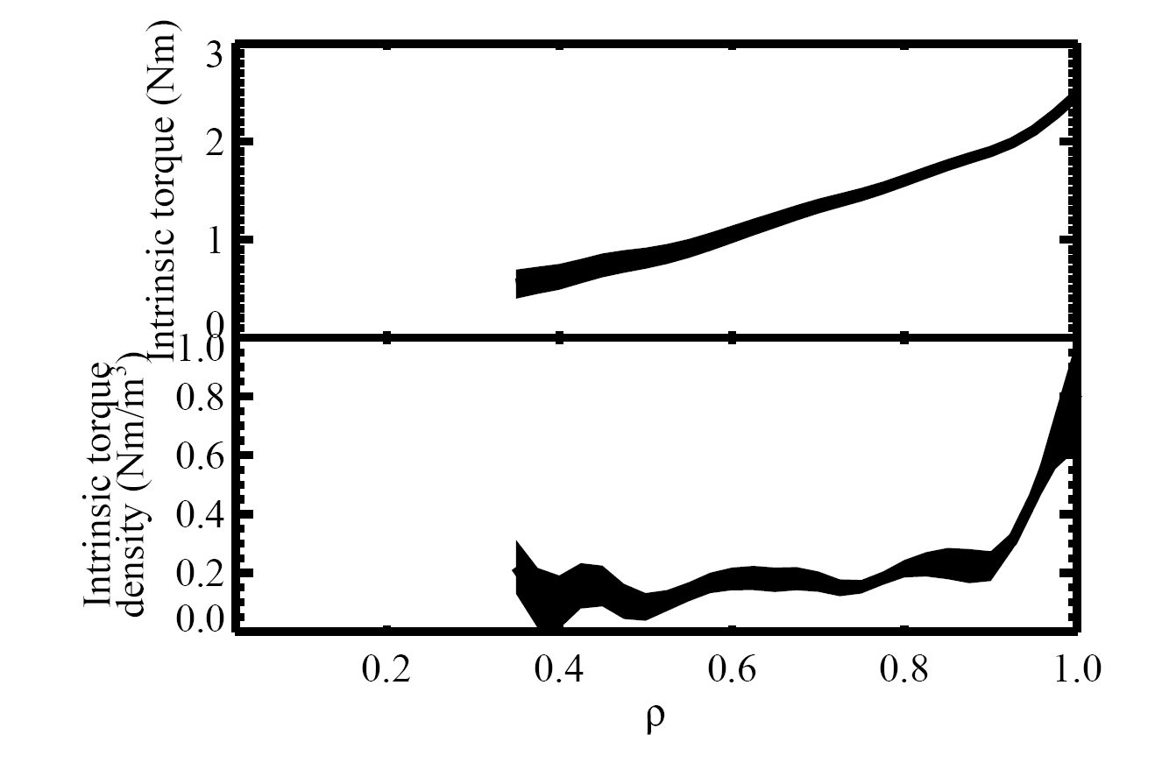
NSTX is Participating in ITPA JEX Studying Intrinsic Torque
Preliminary results indicating higher and more edge-localized intrinsic torque in NSTX than in DIII-D (TC-9)
  Qualitatively similar torque profile as observed on DIII-D
Understanding the mechanism of
intrinsic torque is important for ITER
  Projection and optimization of rotation profile
Plans for FY11 and FY 12:
  Characterize role of turbulence in driving
  intrinsic rotation (R11-1)
  Modification to intrinsic drive by RF/HHFW (TC-14)
  Interaction of intrinsic drive with other torques (e.g. NTV)
  Contribute data to ρ* scaling experiment (TC-17)
  Look for signature of thermal ion orbit loss
141139A02

Slide 11
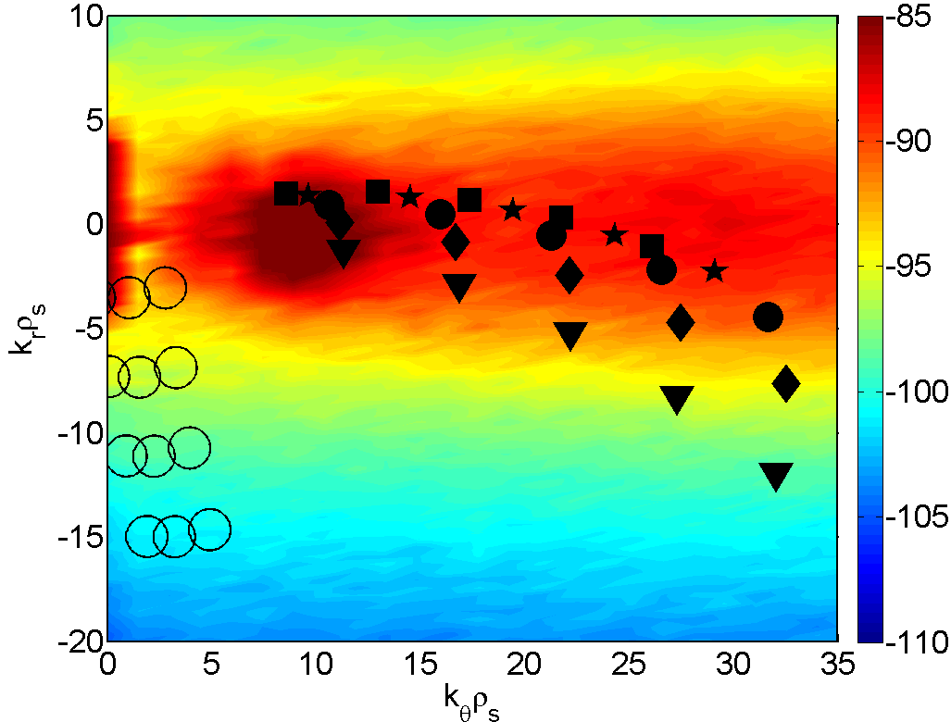
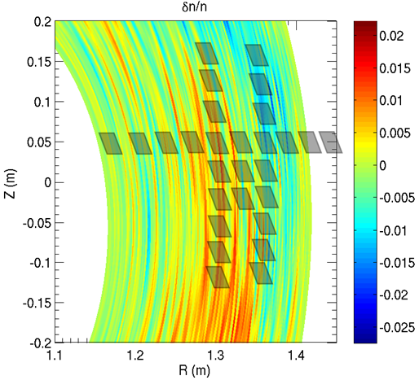
T&T TSG Activities for FY13 and FY14
Current high-k_{r} scattering system will be removed to install the 2nd NB during upgrade
  Design of a new high-k scattering system is in progress and will be completed during FY13 and FY14
Extensive comparison between measurements and micro-instability calculations including GYRO, GTS, GS2, GTC-NEO
  Use synthetic diagnostics to compare simulated and measured fluctuating quantities and their spectral characteristics
k space coverage for the present and future high-k scattering systems with ETG k spectrum (non-linear GYRO, NSTX L-mode)
k_{r} ρ_{s}
Present high-k
k_{θ} ρ_{s}
Future high-k
BES views with micro-tearing density fluctuations (nonlinear GYRO NSTX H-mode)

Slide 12
NSTX will Provide Physics Basis Leading to Predictive Capability for Transport in Future ST/AT Devices
Newly commissioned BES and ME-SXR diagnostics complement an extensive set of fluctuation instruments
  High-k_{r} microwave scattering, GPI (gas-puff imaging), radial and poloidal correlation reflectometers, high bandwidth infrared interferometer (FIReTIP)
Fluctuation measurements covering both high and low k coupled with nonlinear simulations will improve our understanding of:
  Physics mechanisms influencing H-mode confinement at low aspect ratio
  Processes that drive electron transport
  L-H transition and changes in turbulence over the entire plasma profile
  The role of turbulence on Intrinsic torque and momentum transport
  Impurity transport studies
FY11 T&T milestone well suited to the goal of providing an extensive set of fluctuation measurements to further understanding of thermal, momentum, particle, and impurity transport processes

Slide 13
Backup Slides

Slide 14
NSTX Efforts Towards PAC27 T&T Recommendations
PAC27-22 | It has been shown that the improvement of confinement with Lithium operation is due to a local decrease of the electron heat diffusivity. This clearly answers a PAC recommendation, though it would be interesting to know more about the reasons why this local improvement occurs. | Recent experiments has found a decrease in on the top of the pedestal as more Lithium is introduced. Reflectometer measurements have shown a ten-fold decrease in density fluctuation with Lithium. High-k measurement showed some decrease in fluctuation power at k┴ρ_{s}<10.
PAC27-23 | The near-term program will continue to investigate the respective role of different candidates (ETG, micro-tearing modes, and GAEs) to explain electron turbulent transport. With respect to the planned upgrade, it would be interesting to see the parametric dependence of the observed ETGs and GAEs on Bt and Ip to see if the different confinement scaling can be related to the proposed transport mechanisms. | An investigation of high-k turbulence dependence on electron collisionality shows that the measured high-k turbulence power actually decreases with increasing collisonality, which seems to scale differently than NSTX H-mode scaling. However, recent nonlinear micro-tearing simulations using GYRO are able to reproduce the experimental scaling. Measurement of micro-tearing turbulence using BES, high-k scattering system and backscattering system will be conducted to identify micro-tearing instability. Study of the dependence of GAE on Bt and Ip will be conducted in FY11 and FY12.
PAC27-24 | The work that has been done on the L-H transition is interesting, in particular regarding hysteresis and the parametric dependences of the power threshold. The experiments that are planned should bring more information, and the PAC looks forward seeing these results. It is of particular importance to go beyond threshold scaling experiments and characterize also the fluctuations in order to understand the triggering mechanism for the transport barrier. | Recent L-H threshold experiment has shown that the L-H power threshold decreases with increased R_{x}, which is consistent with XGC-0 predictions for the E_{r} well depth. Measurements by a backscattering diagnostic using FWCW reflectometer shows that high-k_{r} fluctuation power is suppressed at ETB location after L-H transition.
PAC27-25 | Overall, it is certainly important to clarify the issues related to edge turbulence and its interplay with core turbulence, in view of the operation of NSTX with Li-coated PFCs. Regarding this point and the possible implementation of Molybdenum tiles, the PAC recommends intensifying the study of impurity transport and investigating possible solutions (e.g., external coils, RF heating) to prevent impurity accumulation. | The impurity transport study using Neon gas puff in 2009 found that the Neon diffusivity in the plasma core is neo-classical accompanied by some anomalous convection. However, it was unclear for the plasma edge due to poor radial resolution and low signal level of the SXR diagnostic used. A new ME-SXR diagnostics, commissioned in 2010, is capable to study impurity study at the plasma edge with ~ 1cm spatial resolution, >10 kHz frequency response and high SNR.

Slide 15
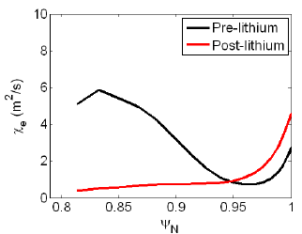
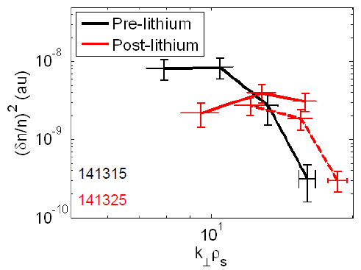
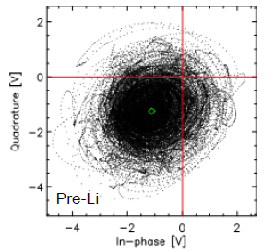
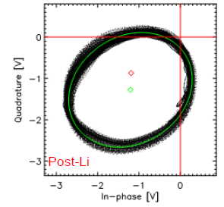
Electron Transport Reduced by Lithiated PFC
Lithiated PFC leads to broadened T_{e} profile, corresponding to reduced pedestal-top
  Reduction of turbulence at k┴ρ_{s} <10 measured by high-k scattering
  Turbulence level reduced from ~10% to ~1% with lithium measured by reflectometer
Plan to investigate how fluctuation changes in the core
PAC27-22

Slide 16
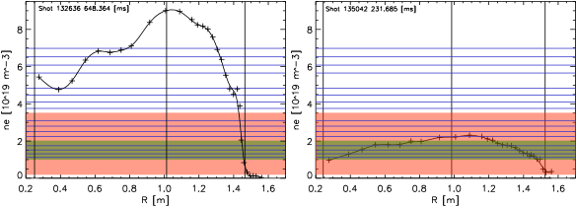
UCLA Reflectometers on NSTX
Millimeter-wave reflectometers available for 2010 (Bay J mid-plane)
  Ultra-fast swept FMCW reflectometers coupled with new analysis techniques
    Electron density profiles with ≥4 μs time resolution, 13-53 GHz
    Sub-millisecond turbulence radial correlations
    k_{r} back-scattering with radial resolution
  Poloidal correlation reflectometer (2 channel, 28.5-40 GHz)
    Turbulence flow
    Poloidal correlations
    k_{r} back-scattering with radial resolution
  16 channel fixed-frequency reflectometers (30 to 75 GHz)
    Detailed profile of coherent and turbulent fluctuation levels (2.5 MHz bandwidth)
Fixed
Frequency
Swept FMCW
Poloidal
Correlation

Slide 17
Ohmic L- to H-Mode Transition
Turbulence radial correlation length decreases prior (<1 ms) to L- to H-mode transition
  Change only seen localized at ETB location R~144.5 cm
  Utilizes FMCW correlation reflectometer with <1 ms resolution
  Consistent with previous k_{r} backscattering measurements which show “all k_{r}” turbulence suppressed around ETB location

Slide 18
ETG believed to be important for driving anomalous electron transport
ETG mode has been identified by comparing linear growth rate and rest frequency of measured fluctuations to linear GS2/GYRO calculations
ETG in e-ITB found to be suppressed by reversed magnetic shear, allows access to supercritical electron temperature gradients
Expt.
(shear = -0.5)
RS
accessible
Rest frequency of peak amplitude mode measured by subtraction of Doppler shift due to plasma rotation
Linear GS2 / GYRO simulations of ETG mode growth rates are consistent with high-k measurements
PAC25-22

Slide 19
Reversed shear suppresses mode growth even at supercritical ETG gradients during e-ITBs
1
Intermittent, short duration bursts of ETG observed during RS phase
Average ETG mode amplitude low, T_{e} gradient well above ETG critical
A series of large amplitude, closely spaced in time bursts of ETG collapses Te profile
Magnetic shear becomes zero/positive due to anomalous current redistribution
T_{e} profile can only be reheated to ETG critical gradient at zero shear
ETG mode amplitude grows to a moderate continuous level
2
3
1
2
3
ETG mode amplitude
1
1
3
3
2
2

Slide 20
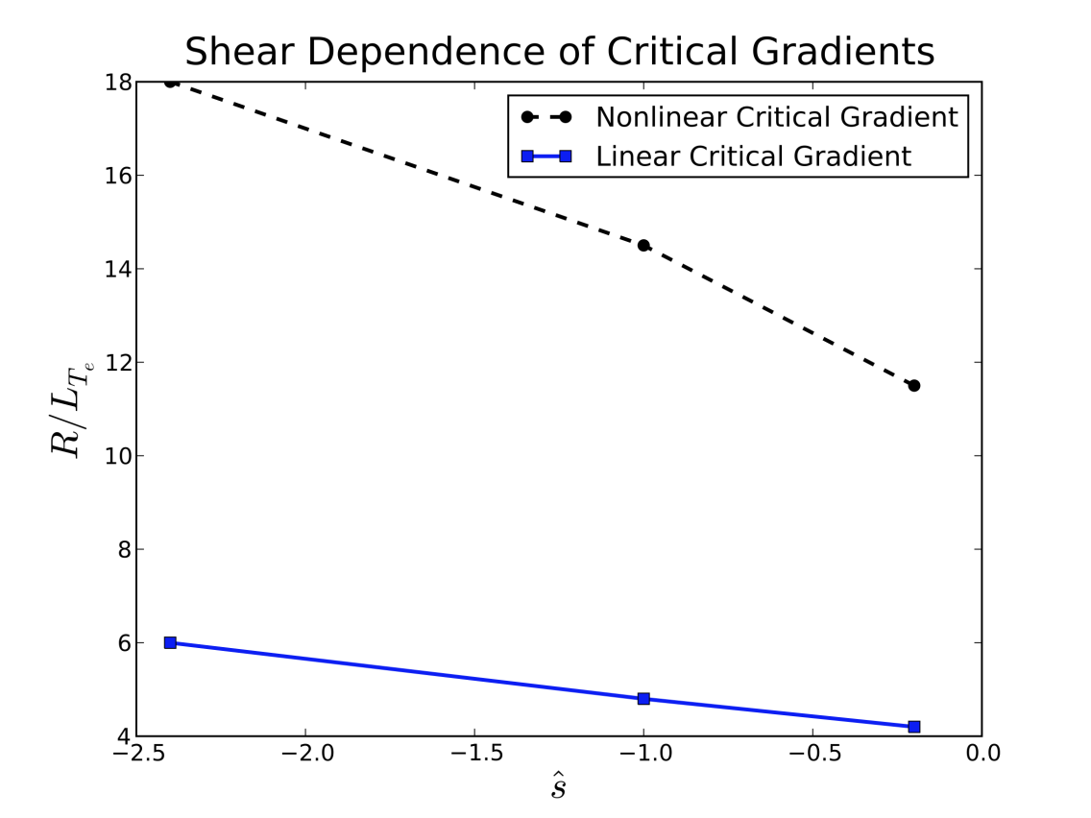
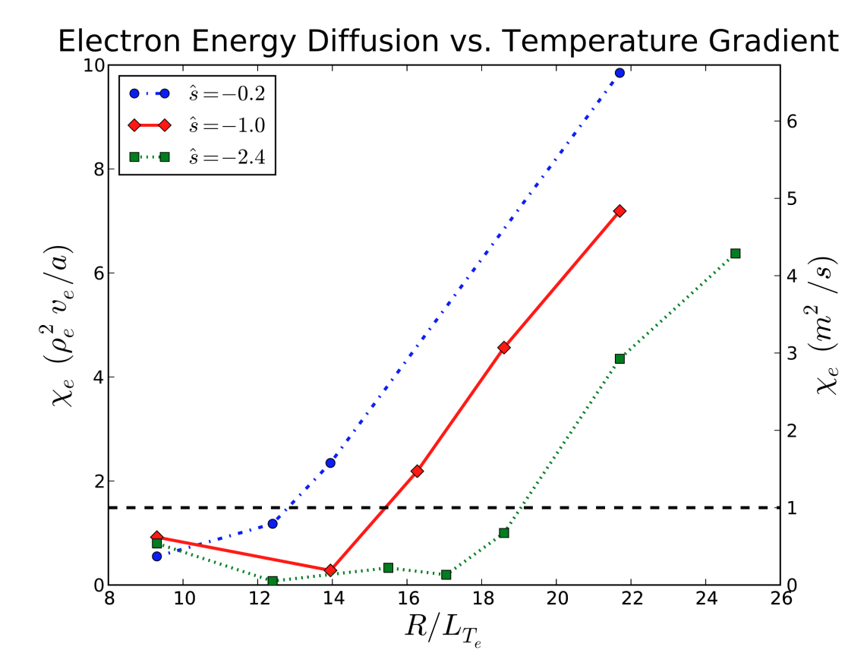
Nonlinear GYRO Simulations of NSTX Reversed Shear Show Strong Up-Shift of Critical Gradient for ETG Turbulence
Non-linear up-shift of critical ETG gradient
Scan in shear and electron temperature gradient for NSTX e-ITB baseline parameters
Nonlinear critical gradient for transport has large up-shift during reversed shear

Slide 21
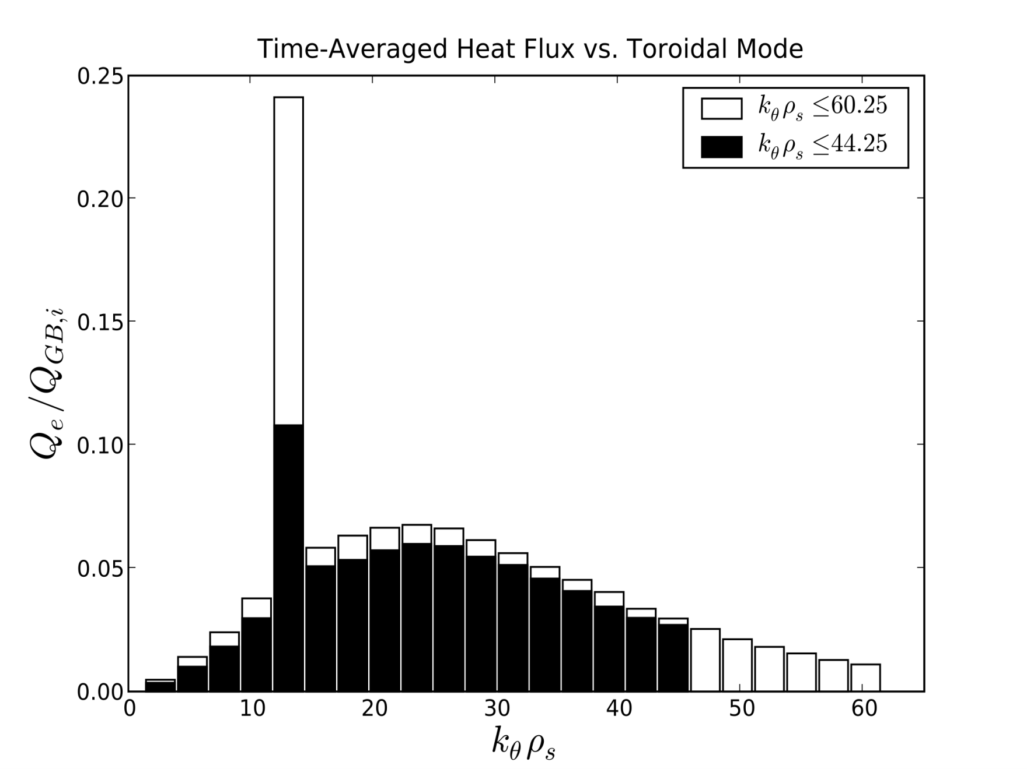
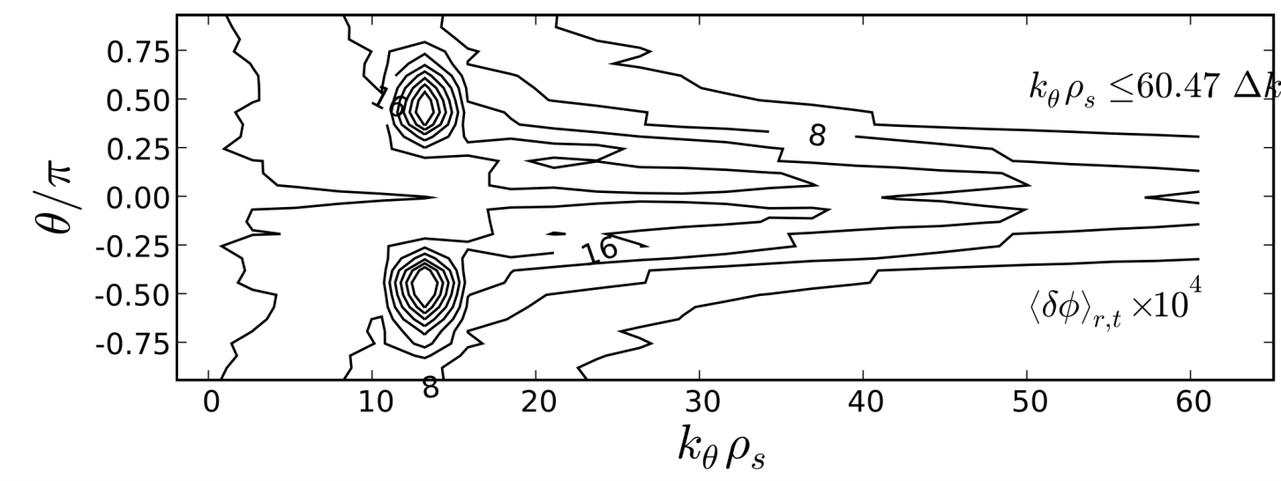
Evidence of Energy Transfer to Off-Midplane Streamers
Off-midplane streamers
Modal and Poloidal Dependence of Fluctuation Amplitude
NL Energy Transfer
Peak ETG Drive
If don’t include peak ETG drive, amplitude of off-midplane streamers drops.

Slide 22
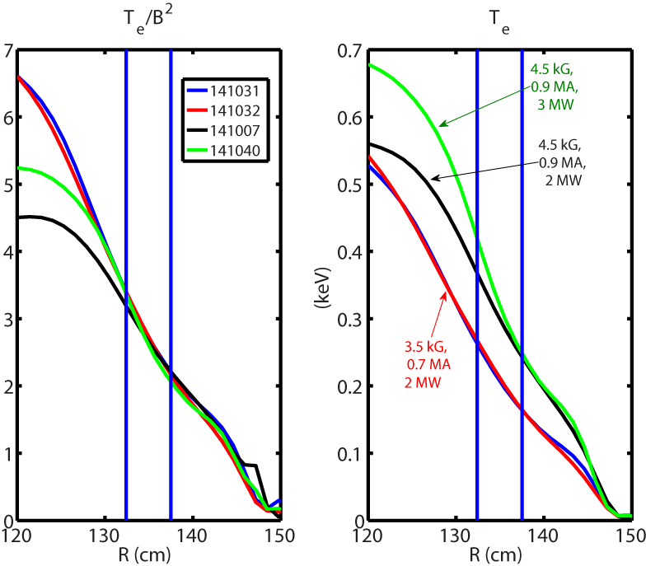
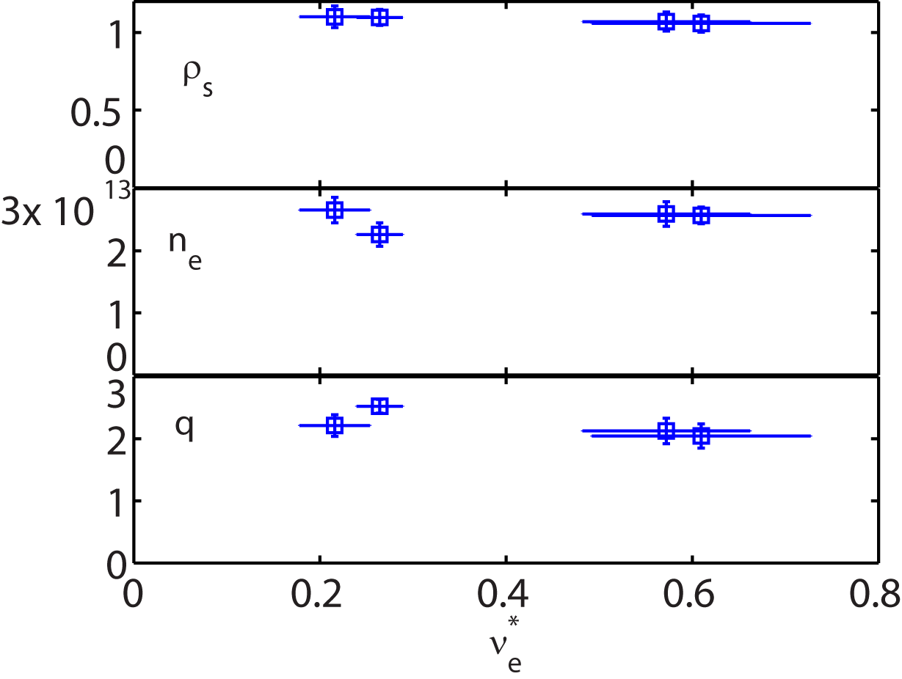
A Factor-of-Three Local Collisionality Scan Achieved
Normalized T_{e}
Time points chosen so that T_{e} / B² was well maintained from R=130-145 cm: local ν_{e*} was varied with constant ½_{e} and ¯_{e}
I_{p} and B_{T} were varied with a constant ratio to keep constant q
Neutral beam power was adjusted to have a better match in T_{e} profile.
The scan was carried out with (I_{p}(MA), B_{T} (kG))=(0.7,3.5), (0.9, 4.5) and (1.1, 5.5)
(1.1 MA, 5.5 kG) shots have much high density and Z_{eff} and are not used.
Factor of three change in ν_{e*} is achieved
ρ_{s} , n_{e} and q have only small variations against ν_{e*}
High-k measurement location

Slide 23
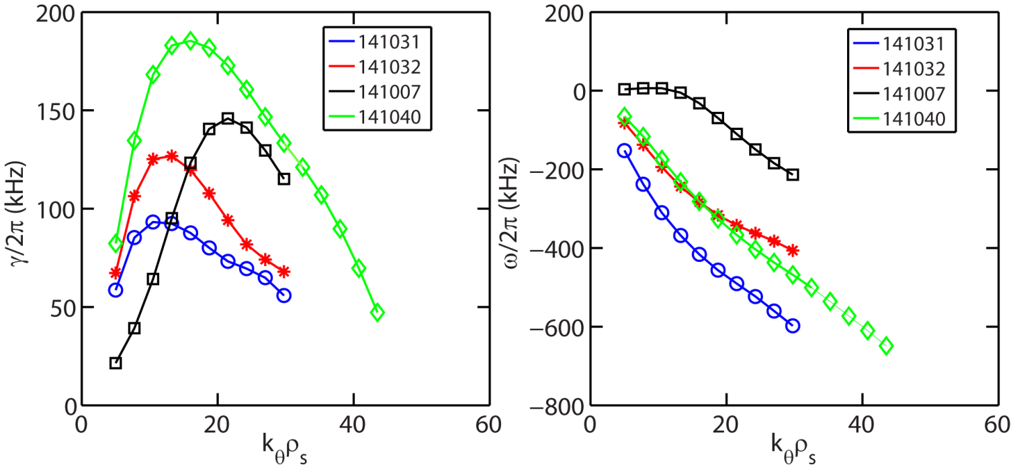
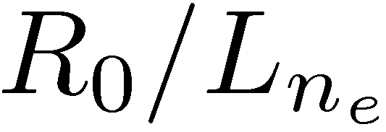
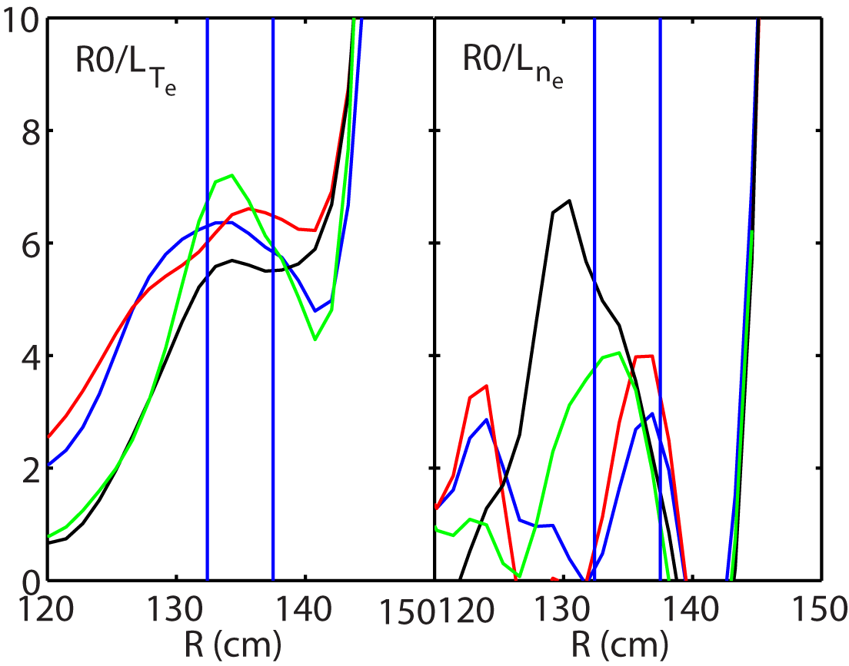
ETG Turbulence Linearly Unstable in all These Discharges
Lower collisionality
Higher collisionality
Comparable between these shots
Maximum ETG growth rates are higher for the lower collisionality cases, the same trend as wavenumber spectral power
Nonlinear simulations will be conducted

Slide 24
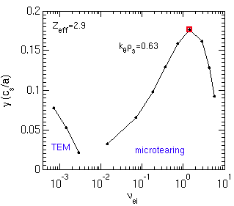
Microtearing instability exhibits thresholds in electron temperature gradient, collisionality and beta
(1) Apparent threshold in ∇T_{e}, (a/L_{Te})_{crit} ≈1.3-1.5 (a/L_{Te,exp}=2.7)
(2) Growth rates decrease with ν_{e} < ν_{e,exp} (consistent with experimental ν* scan)
(3) Lowering beta stabilizes microtearing
Linear growth rates (γ⋅a/c_{s}) for NSTX 120968 t=0.56 s r/a=0.6
(1)
(2)
(3)
Exp. value
Exp. value

Slide 25
Nonlinear microtearing transport comparable to experimental transport*
With no E×B shear predicted transport (1.2 ρ_{s}²c_{s}/a) comparable to experimental transport (1.0-1.6 ρ_{s}²c_{s}/a)
Transport reduced when increasing γ_{E} to local experimental value
What are the other important dependencies?
χ_{e} vs. E×B shear
χ_{e} exp
ρ_{s}²c_{s}/a=5 m²/s
*Guttenfelder et al., submitted to PRL (2010)

Slide 26
Predicted non-linear collisionality dependence consistent with experimental scaling
χ_{e} vs. ν_{e}
χ_{e} vs. a/L_{Te}
χ_{e} exp
χ_{e,sim} ~ ν_{e}^{1.1}
χ_{e} exp
Transport very sensitive to ∇T_{e} - may be more important to characterize scaling of effective threshold gradient, (a/L_{Te})_{crit,microtearing}
Might help distinguish from expected ETG scaling, (a/L_{Te})_{crit,ETG} – work in progress

Slide 27
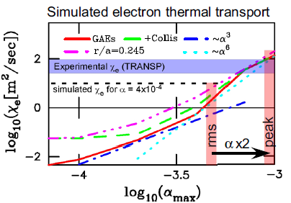
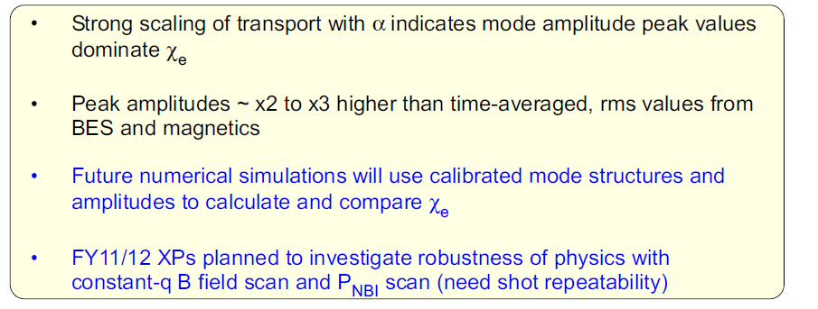
BES Measured GAE Peak Amplitudes Consistent with Numerically Simulated Electron Thermal Transport

Slide 28
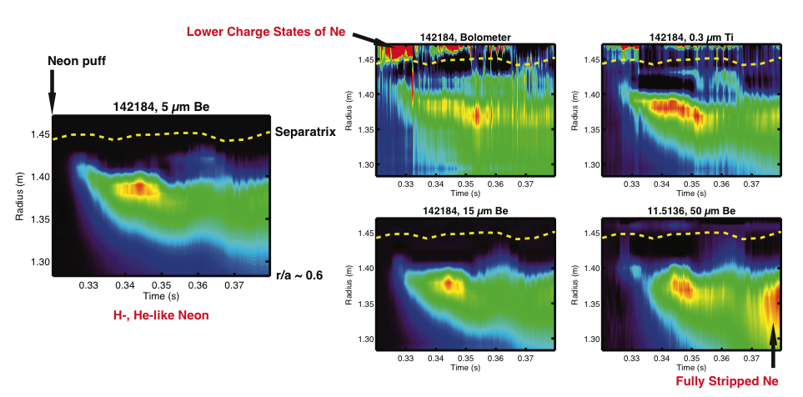
Inverted Data from Five Arrays Provide X-Ray Emissivity Profiles Used for Transport Modeling
Five arrays are used to distinguish different charge states
STRAHL impurity transport code is now being implemented to calculate radial transport coefficients D_{r}(r), v_{r}(r)
Example: 1.1 MA, 0.55 T

Slide 29
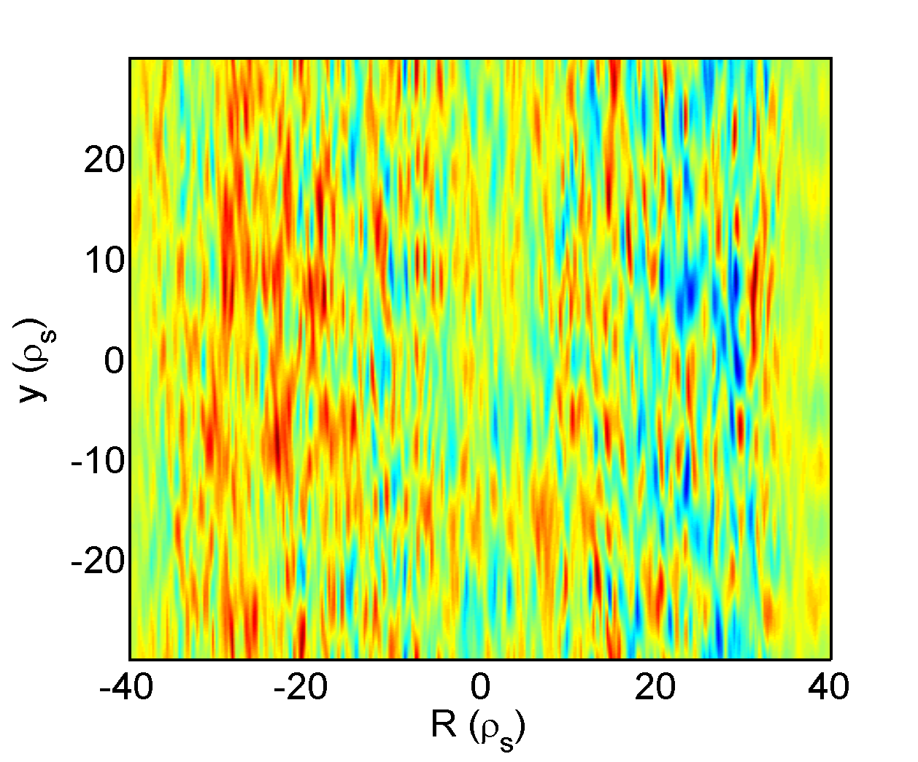
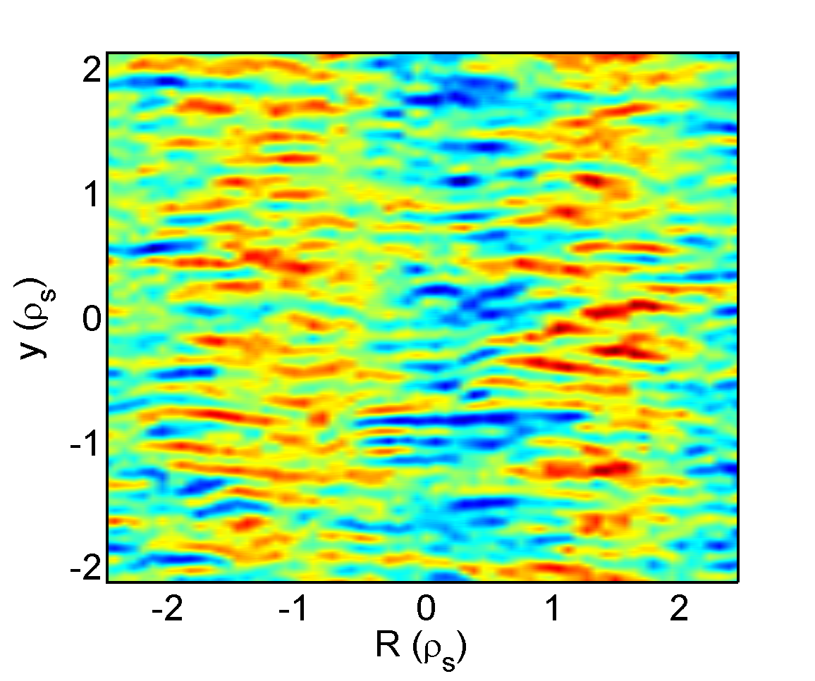
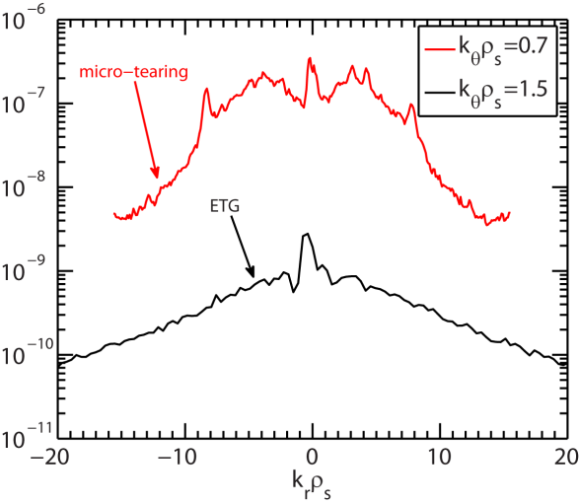
Measuring Micro-tearing Turbulence with High-k Scattering System
Micro-tearing turbulence has significant density fluctuations
  Very Different 2D k spectrum anisotropy than ETG
  Significant spectral power in large k_{r} (electron-scale) is expected for micro-tearing turbulence
The present high-k system measures mostly k_{r} spectrum and is able to distinguish the different anisotropies
Micor-tearing density fluctuation, NSTX H-mode
ETG density fluctuations, NSTX L-mode

Slide 30
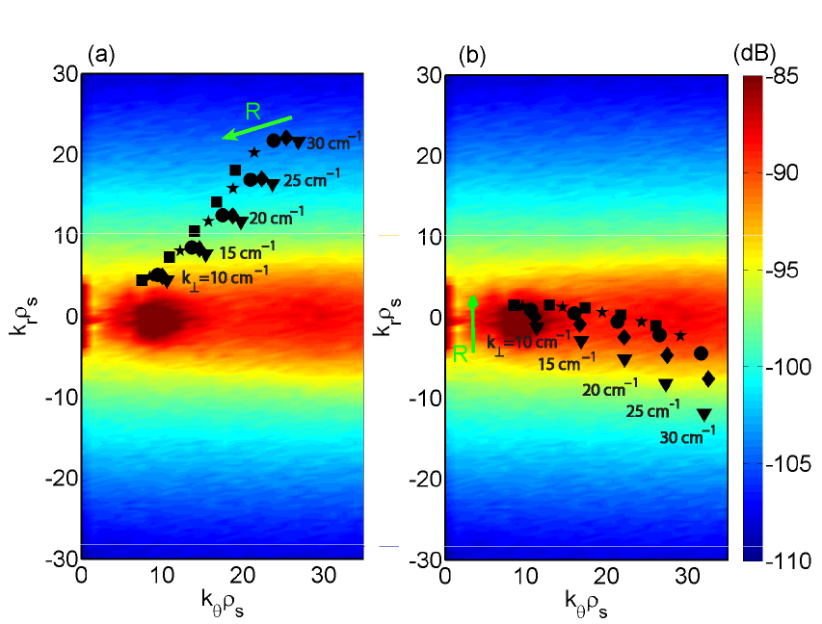
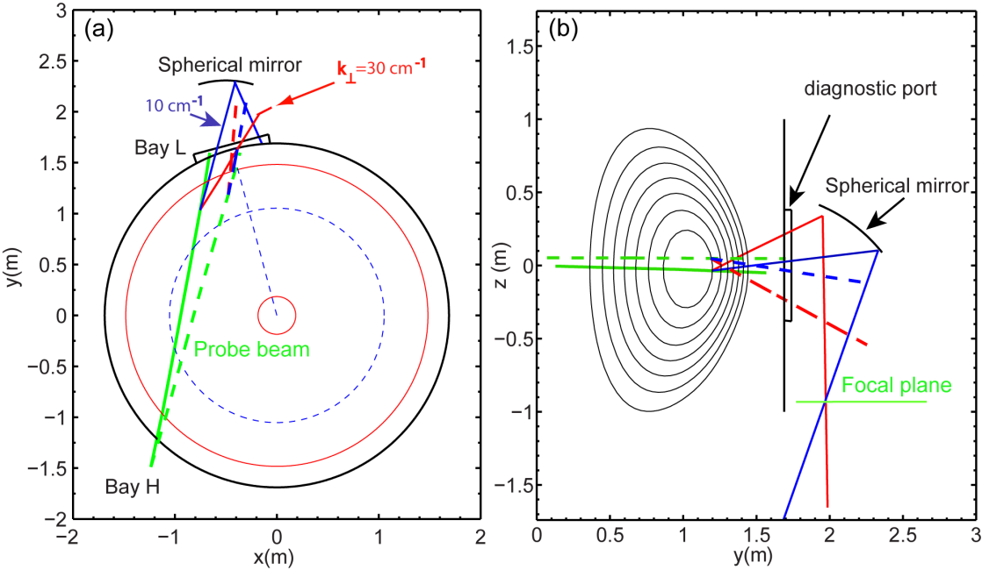
Preliminary Design of the New High-k Scattering System for NSTX-Upgrade
The design utilizes the launching port of the present high-k_{r} system and its microwave hardware
Two scattering configurations of the system allow it to measure 2D k spectrum

