Slide 1
Summary of Answers
Q: Maximum pulse length at 1MA, 0.75T, 1st year parameters?
A1: Full 5 seconds at 1025-1300 kA, four 80 kV sources, q_{min}>1, w/o challenging I²t on any coil.
A2: Can achieve 8-10 seconds at ~1 MA using six 65 kV or interleaved modulated 80 kV beams, q_{min}>1, approaching OH and TF I²t limits.
Q: Maximum pulse length at 2 MA, 1T?
2 MA operation requires 1T, is likely limited by q-evolution rather than solenoid flux or heating.
Current redistribution time with six 80 kV beams is 0.6-0.8 at f_{GW}=0.7.
A: For year 2 operation with 1-2 sec TF flat-top, can use the full TF w/o encountering OH I²t limit or q_{min} problems.
Allow physics studies of PMI, BP, MS, EPs, transport and turbulence.
Will fit in PFC temperature limit w/ SFD and some divertor radiation.
Q: Maximum current that can be sustained non-inductively for 5 seconds (80 kV Beams)?
A1: 635-800 kA with four beams, 0.75 T
A2: 750-1225 kA with six beams, 1.00 T

Slide 2
Background Information On Simulations (Much Covered in ASC Talk)
Typically assess a scenario using two profile and two confinement assumptions.
Good for bracketing the expected operating points.
Central NBCD tends to drive down q_{min} for f_{GW}<~0.7.
The exact low-density boundary for q_{min}=1 depends on the configuration.
NSTX discharges become strongly susceptible to core m/n = 1/1+2/1 modes as q_{min} approaches 1.
Define “maximum sustainable current” as that which leads to q_{min}~1.1-1.2.
Typically more limiting than the solenoid flux or I²t limits.
Heating duration is a strong function of the beam voltage.
Limits are due to heating on the primary energy ion dump.
Upgraded ion dumps could result in extension of pulse lengths.
5 seconds generally required 80 kV sources, with 1.7 MW/source

Slide 3
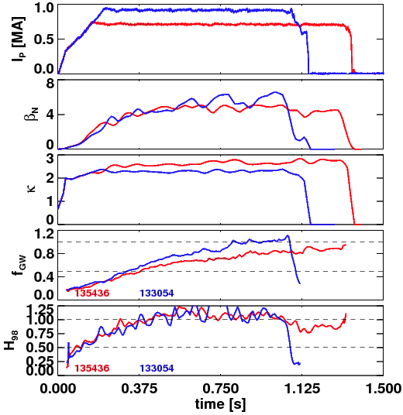
Discharges Have Shown Good Confinement and High Density and Elongation.
Upgrade simulations generally call for H₉₈=1 at 0.65<f_{GW}<1.0.
Database analysis shows this regime is accessible with Upgrade-relevant shaping.
Time Traces of Discharges with Good Confinement at High Density

Slide 4
Flux Consumption Assumptions for the Upgrade Based on Extrapolation of NSTX Results
Upgrade OH capacity is substantially improved
Factor 3.5 increase in I²t limit.
Vs capability increased from 0.75 Wb to 2.1 Wb.
Very few high-performance scenarios limited by flux consumption.
Extrapolate ramp-up flux for 2MA as ~0.8 Wb.
Must keep surface voltage under (2.1-0.8)/5 = 0.25 V
2MA scenarios project to 0.2-0.3 V.
Similar increase in TF capability.
Factor of 20 increase in I²t.
Maximum field increase by factor of ~2.
Results in quite long TF Flat-top durations compared to NSTX.
~6.5 s at 1 T, ~11.5 s at 0.75 T

Slide 5
Question: Non-Inductive Sustainment Level for 5 seconds? Answer: 750-1225 kA for 1T, 635-800 kA for 0.75 T
Summary of Fully Non-Inductive Scenarios at 0.75 & 1 T
Voltage [kV] | # of Sources | Heating Duration | B_{T} [T] | Non-Inductive Current Range | Current Time [s]
80 | 4 | 5 | 0.75 | 635-800 | 0.25-0.4
90 | 4 | 3 | 0.75 | 675-865 | 0.3-0.43
80 | 6 | 5 | 1.0 | 750-1225 | 0.35-0.7
90 | 6 | 3 | 1.0 | 875-1325 | 0.4-0.8
All the details for the 100% non-inductive scenarios
β_{N} values are similar to commonly achieved values in NSTX

Slide 6
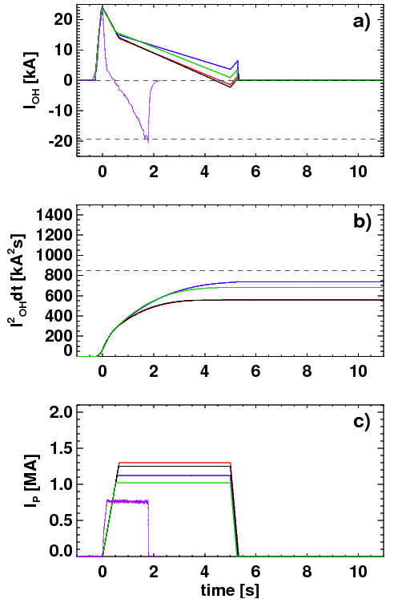
Question: Pulse Duration at 1 MA? Answer #1: At 0.75 T, the Maximum Sustainable Current is in the Vicinity of 1000-1300 kA for 5 Seconds.
1100-1300 kA Scenarios Don’t Challenge OH Coil Limits
Summary of 0.75 T scenarios with q_{min}~1.15
Sustainable current exceeds 1 MA at 0.75 T, even for most pessimistic confinement assumptions
Voltage | # of Sources | Heating Duration | B_{T} [T] | Range of Sustainable Currents | Current Time [s]
80 | 4 | 5 | 0.75 | 1025-1300 | 0.35-0.45
90 | 4 | 3 | 0.75 | 1125-1350 | 0.4-0.5
Table With Complete Details on 0.75 T Scenarios with q_{min}~1.15

Slide 7
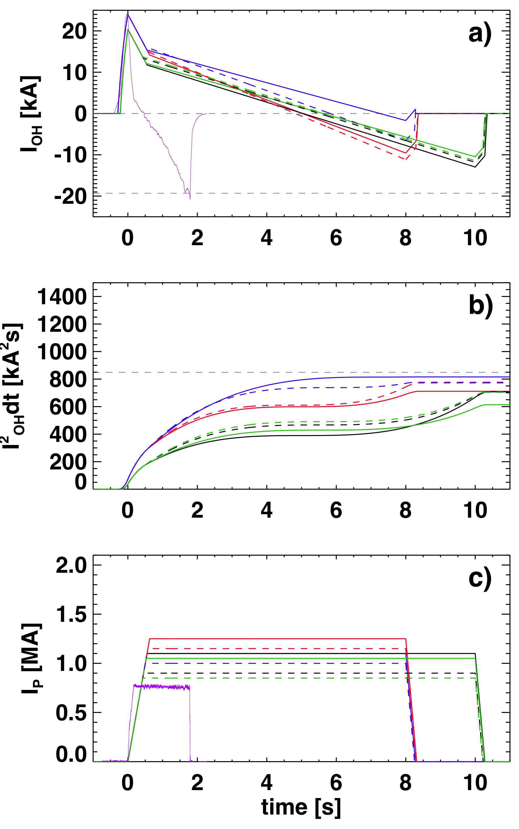
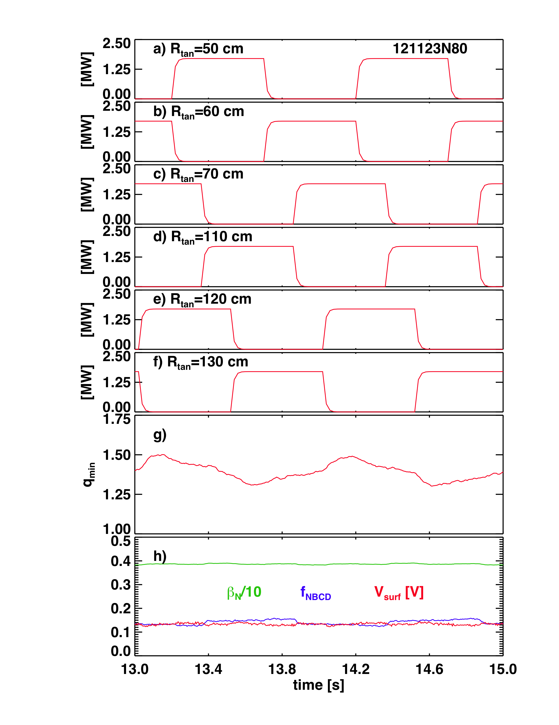
Question: Pulse Duration at 1 MA? Answer #2: Heating and magnetic system capable of 8-10 s ~1 MA pulses!
B_{T}=0.75 T scenarios with 5.1 or 6.6 MW input power
Interleaved 80 kV case can sustain q_{min}> 1with 850-1050 kA for 10 sec.
65 kV case can sustain q_{min}>1 with I_{P}=1000-1250 kA for 8 sec.
NSTX Record!
Example Beam Modulation Pattern Designed to Minimize q_{min} Variation
Results in 5.1 MW for 10 s!
Solenoid Current & Heating, and Plasma Current Waveforms
NSTX Record!

Slide 8
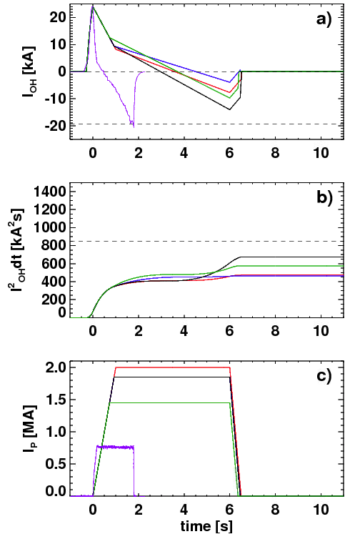
Question: Pulse Duration at 2 MA? Answer 1: The “maximum sustainable current” is typically a somewhat less than 2 MA.
10.2 MW, 1500-2000 kA Scenarios at f_{GW}=1 Don’t Challenge OH Coil Limits
Summary of 1.0 T scenarios with q_{min}~1.15
Only most optimistic projections at high f_{gw} result in relaxed q_{min}>1 at 2 MA
Voltage [kV] | # of Sources | Heating Duration [s] | B_{T} [T] | f_{GW} | Range of Sustainable Currents [kA] | Current Time [s]
80 | 6 | 5 | 1.0 | 0.7 | 1250-1800 | 0.44-0.8
80 | 6 | 5 | 1.0 | 1.0 | 1500-2000 | 0.4-0.6
90 | 6 | 3 | 1.0 | 0.7 | 1350-1900 | 0.5-0.85

Slide 9
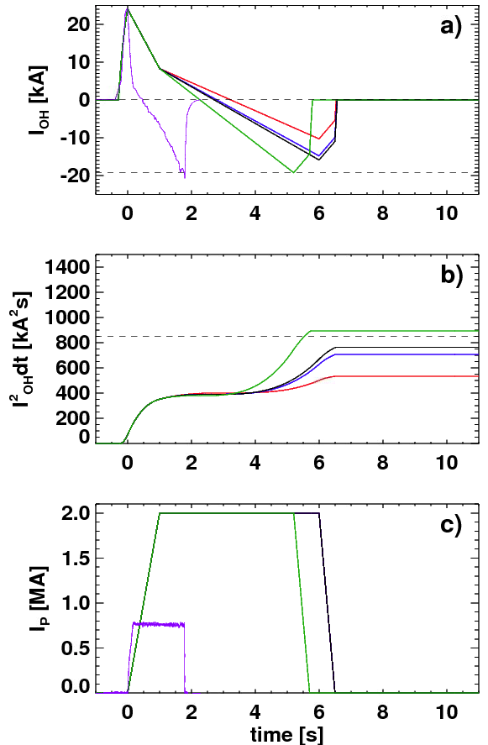
Question: Pulse Duration at 2 MA? Answer 2: Long Current Redistribution Times Will Allow Long Pulse
Summary of 10.2 MW, 1.0 T , 2 MA, 5 sec. scenarios
2000 kA Scenarios at f_{GW}=0.7 Only Challenge OH Coil For Unfavorable Confinement and Profiles
Scaling | Relaxed q_{min} | Current Time [s]
ITER | 0.46-0.54 | 0.65
ST | 0.78-0.85 | 0.75-0.8
NSTX discharges evolving to q_{min}<1 typically last ~4 τ_{CR}.
By similar logic, expect 2-3 seconds at 2 MA.
Sufficient for all confinement, stability, and boundary physics studies.

Slide 10
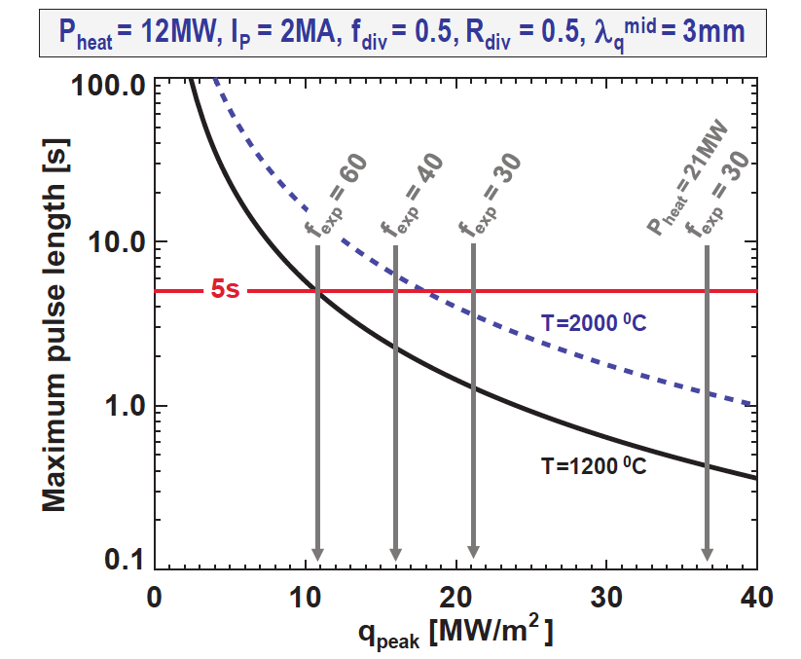
Divertor Temperature Can Be A Pulse Length Limiting Factor
For f_{exp}=30 and f_{div}=0.5, and no radiation:
Limited to ~1.5 second for a 1200 C divertor.
Approximately matches the expected pulse length for year 2, 1 T, 2MA operation.
Relief could come from impurity radiation.
Snowflake divertor utilized to achieve large f_{exp} promotes detachment.
Research plan will develop radiative divertor control if SFD does not naturally develop them.
Higher density for q_{min}>1 purposes helps promote divertor radiation solutions.
Pulse Length as a Function of Peak Heat Flux.
Menard, et al., submitted to Nuclear Fusion

Slide 11
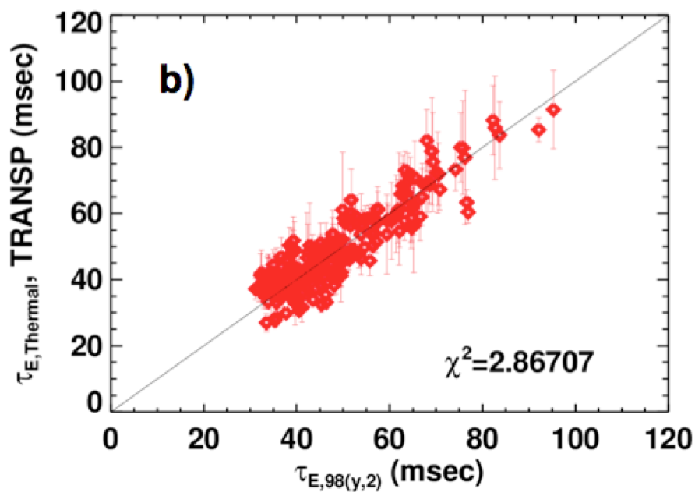
NSTX Context For Confinement and Flux Consumption Assumptions in Upgrade
Relationship Between Confinement, Density, and Elongation
Confinement Quality in Recent Lithiated Discharges Agrees Strikingly Well with ITER-98y,2
Gerhardt, et al., NF 2011
See comparison to “ST-Scaling” in talk by Y. Ren.
Menard, et al., Submitted to Nuclear Fusion

Slide 12
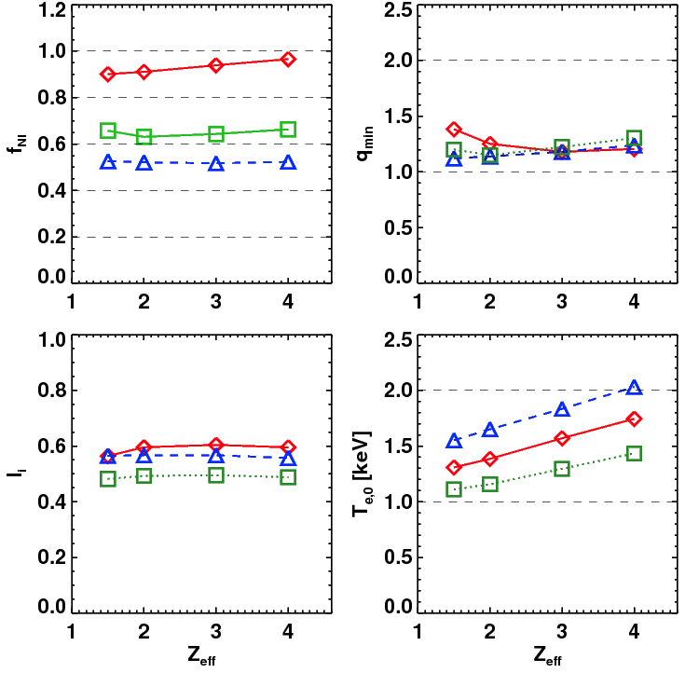
Scenario Goals Can be Met over a Range of Z_{eff}, Provided Confinement is Maintained
Li H-modes, even w/ small ELMs and controlled density, tend to have Z_{eff}~2-4.
Best confinement at the higher Li evaporation rates.
Increasing Z_{eff} with fixed T_{e} reduces non-inductive fraction.
Increased Z_{eff}, with fixed H₉₈, results in very little change.
H₉₈~1 confinement (or better) observed in lithiated H-modes over a range of Z_{eff}.
The electron confinement is a critical variable in determining the scenario performance.
1.0 MA, 1.0 T, P_{inj}=12.6,
near non-inductive
1.6 MA, 1.0 T, P_{inj}=10.2 MW, partial inductive
1.2 MA, 0.55 T, P_{inj}=8.4 MW, high β_{T}
All: f_{GW}=0.7, H₉₈=1

