Slide 1




NSTX-U
Supported by
NSTX Physics Results and Analysis Highlights
S. A. Sabbagh (FY11-12 Run Coordinator)
Columbia University
M.G. Bell (Deputy) – (now happily retired)
PPPL
for the NSTX Research Team
Coll of Wm & Mary
Columbia U
CompX
General Atomics
FIU
INL
Johns Hopkins U
LANL
LLNL
Lodestar
MIT
Lehigh U
Nova Photonics
ORNL
PPPL
Princeton U
Purdue U
SNL
Think Tank, Inc.
UC Davis
UC Irvine
UCLA
UCSD
U Colorado
U Illinois
U Maryland
U Rochester
U Tennessee
U Tulsa
U Washington
U Wisconsin
X Science LLC
Culham Sci Ctr
York U
Chubu U
Fukui U
Hiroshima U
Hyogo U
Kyoto U
Kyushu U
Kyushu Tokai U
NIFS
Niigata U
U Tokyo
JAEA
Inst for Nucl Res, Kiev
Ioffe Inst
TRINITI
Chonbuk Natl U
NFRI
KAIST
POSTECH
Seoul Natl U
ASIPP
CIEMAT
FOM Inst DIFFER
ENEA, Frascati
CEA, Cadarache
IPP, Jülich
IPP, Garching
ASCR, Czech Rep
NSTX PAC-31 meeting
PPPL B318
April 17th, 2012
V1.8

Slide 2
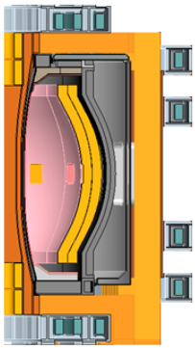
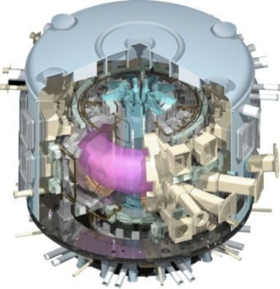
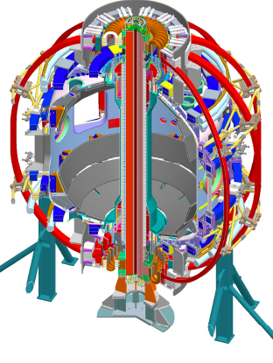
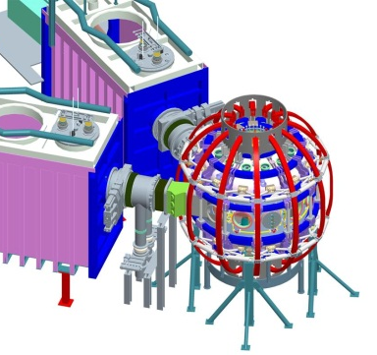
NSTX research targets predictive physics understanding needed for fusion energy development facilities
Enable key ST applications
  Move toward steady-state ST FNSF, pilot plant
  Close key gaps to DEMO
Extend understanding to tokamak / ITER
  Leverage ST to develop predictive capability
Fusion Nuclear Science Facility (FNSF)
ST Pilot Plant
Present Research
Develop key physics understanding to be tested in unexplored, hotter ST plasmas
  Study high beta plasma transport and stability at reduced collisionality, extended pulse
  Prototype methods to mitigate very high heat/particle flux
  Move toward fully non-inductive operation
ITER
NSTX-U
New center-stack
2nd Neutral Beam

Slide 3
Following last PAC, the largest NSTX experimental program to date was planned for FY11-12
Research Forum (March 2011): Record number of proposals
  193 XPs/XMPs were considered, totaling 226 days requested
    Run time was ~3 times oversubscribed (see backup slide for detail)
  TSG leaders + run coordination defined a full prioritized and scheduled plan for CY11-FY12 period (20 weeks)
FY2011 run was abbreviated by TF coil fault
  Only 4 weeks of run in FY2011 - important BES and transport data
  NSTX-U was accelerated 6 months (upgrade began 1-Oct-2011)
Research Milestones FY11-12 drove the run plan
  FY11 milestones were largely addressed
  Experiments aimed to exploit new capabilities are deferred to NSTX-U
    e.g. Broader 3D fields studies, n > 1 control (2nd SPA); MSE-LIF; moly tiles; tangential fast ion D_{α}; more Thomson channels, real-time V_{φ},…
Continued research based on NSTX data prepares needed physics hypotheses to be tested in the new, lower collisionality ST operational regime to be provided by NSTX-U

Slide 4
Brief summary of NSTX Milestones – key guidance for TSG XP prioritizations – FY2011
JRT-11
2011 OFES Joint Research Milestone (Boundary Physics, Transport & Turbulence)
  Improve understanding of physics mechanisms responsible for pedestal structure, compare with predictive models
  Perform detailed measurements of the height and width of the pedestal, E_{r}, initial measurements of pedestal region turbulence
  Perform focused analytic theory/computational effort, including large-scale simulations, on physics controlling pedestal structure, height
R(11-1) : Measure fluctuations causing turbulent electron, ion, impurity transport
  TSGs: Transport & Turbulence
R(11-2) : Assess ST stability dependence on plasma aspect ratio and boundary shaping
  TSGs: Macrostability, Advanced Scenarios and Control
R(11-3) : Assess very high flux expansion divertor operation
  TSGs: Boundary Physics, Advanced Scenarios and Control
R(11-4) : H-mode pedestal transport, turbulence, and stability response to 3D fields
  TSGs: ITER/CC, Transport & Turbulence, Boundary Physics, Macrostability
See backup slides for original FY2012 milestones

Slide 5
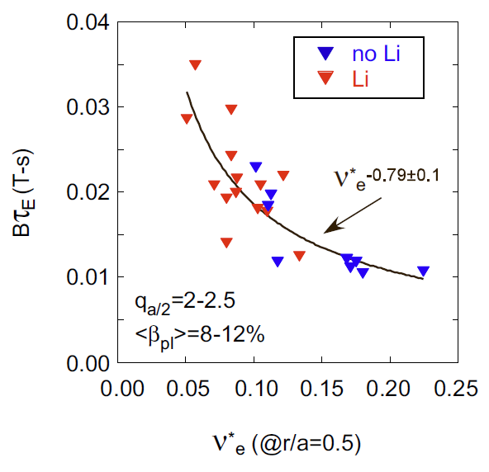
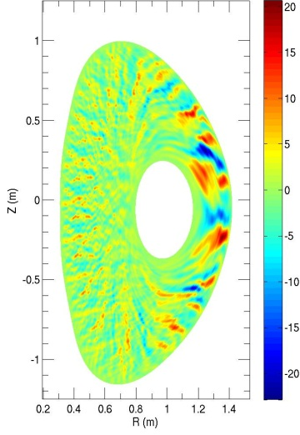
First successful nonlinear microtearing simulations for NSTX predict reduced electron heat transport at lower collisionality
Experiment
Theory
R(11-1)
δB_{r} (Gauss)
experiment
B_{t}τ_{E} (T-s)
χ_{e}^{sim} ~ ν_{e}^{1.1}
120968
W. Guttenfelder, et al., PRL 106, 155004 (2011)
ν∗_{e} (at r/a = 0.5)
Predicted χ_{e} and scaling ~ ν_{e}^{1.1} consistent with experiment (Ωτ_{E} ~ B_{t}τ_{E} ~ ν*_{e}^{-0.8})
Transport dominated by magnetic “flutter”
  δB_{r}/B ~ 0.1% - possibly detectable by planned UCLA polarimetry system
Increase in τ_{E} as ν∗_{e} decreases
Trend continues when lithium is used
NSTX-U computed to extend studies down to ~ 1/4 of present ν∗
see Y. Ren T&T talk

Slide 6
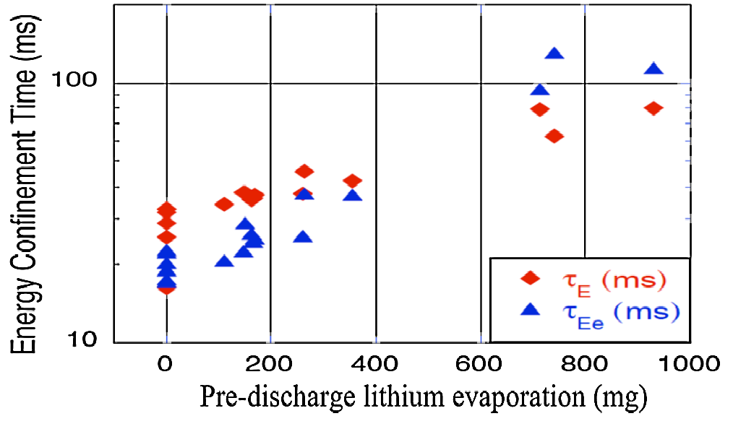
Plasma characteristics change nearly continuously with increasing lithium evaporation inside vessel
JRT-11
Measured density fluctuation vs. k⊥ρ_{s}
Outer plasma
R = 1.4 - 1.46 m
(r/a = 0.74 – 0.95)
Without Li
Energy Confinement Time (ms)
(δn/n)² (arb)
With Li
Pre-discharge lithium evaporation (mg)
141314
141328
R(11-4)
R. Maingi, et al., PRL 107, 145004 (2011)
k⊥ρ_{s}
R(11-1)
Global parameters generally improve
ELM frequency declines - to zero
  ELMs stabilize
Edge transport declines
  As lithium evaporation increases, transport barrier widens, pedestal-top χ_{e} reduced
Measured reduction in high-k turbulence consistent with reduced χ_{e}
Impact of collisionality and ∇n on turbulence is under investigation
  B_{t}τ_{E} ~ ν_{e}*^{-0.8} observed
D. Boyle, et al., PPCF (2011)
J. Canik, et al., PoP (2011)
see C. Skinner Li talk
see Y. Ren transport & turbulence talk

Slide 7
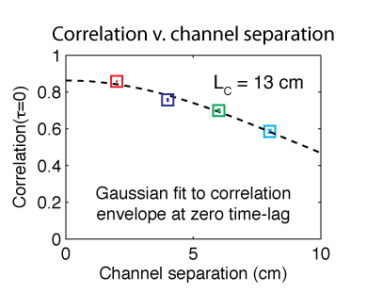
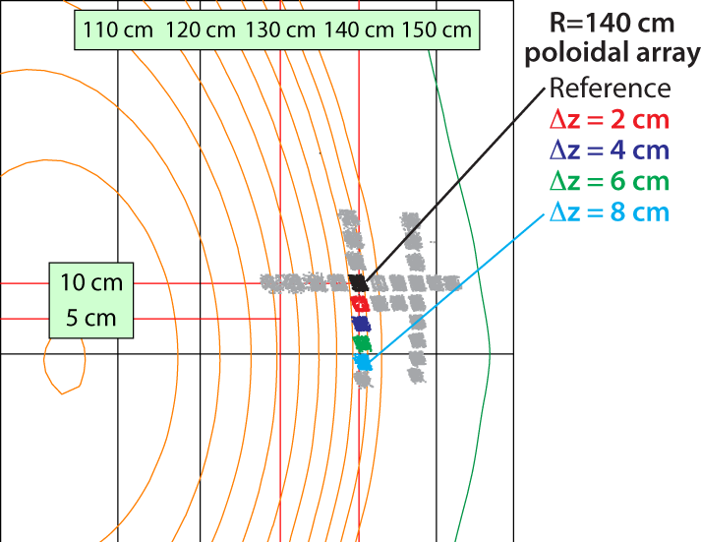
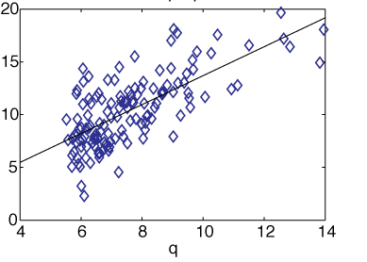
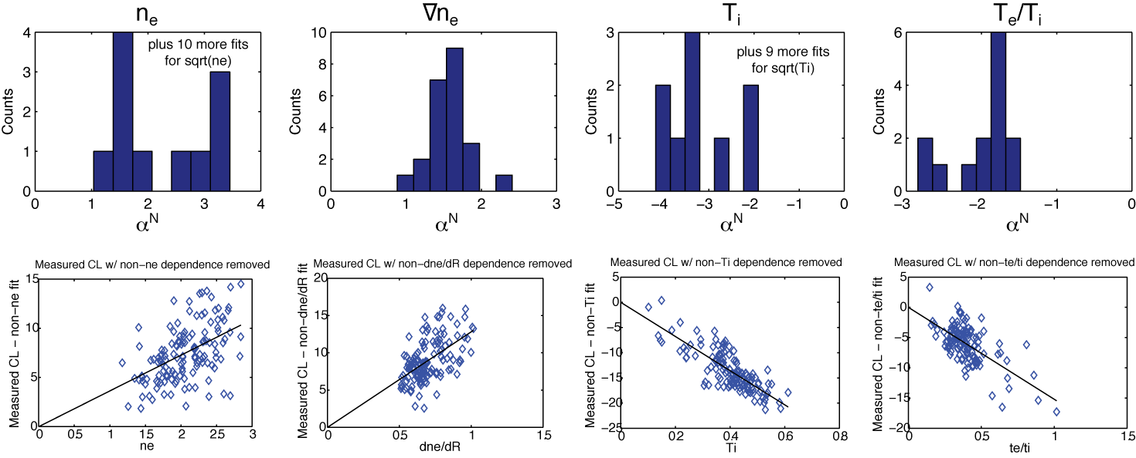
BES provides poloidal correlation lengths of turbulence in ELM-free H-mode pedestal and parametric dependencies
Beam emission spectroscopy (BES) array
R(11-1)
Z
Poloidal Correlation Length vs. Parameters
Correlation Length
R
q
∇n_{e}
Large poloidal correlation lengths
  k_{θ} ≈ 0.2-0.4 cm⁻¹ and k_{θ}ρ_{i} ≈ 0.1-0.25
Cross-phase, time-lags show eddy advection in ion diamagnetic direction
T_{i}
T_{e}/T_{i}
Correlation Length
D. Smith (UW-Madison)

Slide 8
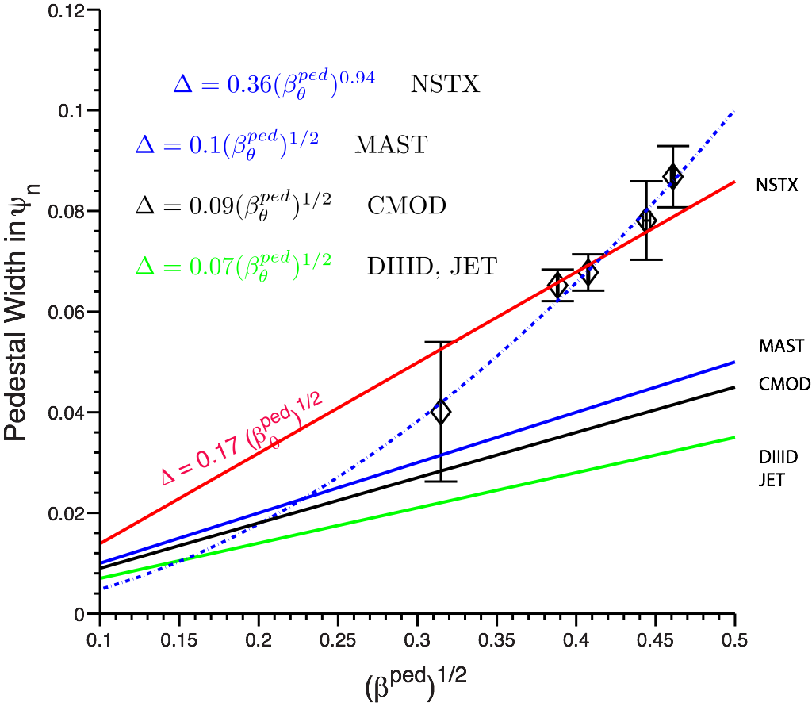
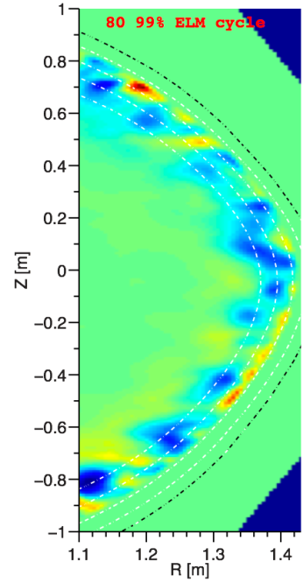
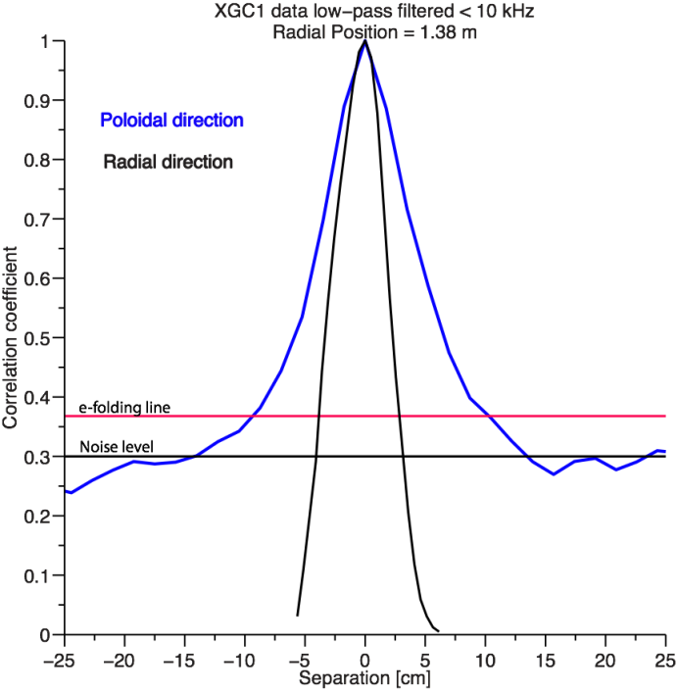

Pedestal scaling, structure, and dynamics studied theoretically and experimentally
JRT-11
R(11-1)
Pedestal width scaling
Turbulence correlation lengths
Theory (non-linear XGC1)
Radial
~ 3 cm
Poloidal
~ 11 cm
R = 1.38m
Pedestal width scaling β_{θ}^{α} applies to multiple machines
In NSTX, observed ped. width is larger
  1.7 x MAST, 2.4 x DIII-D
  Data indicates stronger for NSTX: β_{θ}^{0.94} vs. β_{θ}^{0.5}
Measured correlation lengths are consistent with theory
  Radial (reflectometry) ~ 2 – 4 cm
  Poloidal (BES) ~ 10 – 14 cm
    spatial structure exhibits ion-scale microturbulence (k_{θ}ρ_{i}^{ped} ~ 0.1 - 0.2)
A. Diallo, et al., NF 51, 103031 (2011)
A. Diallo, C.S. Chang, S. Ku (PPPL), D. Smith (UW), S. Kubota (UCLA)
8
8
Notes:
8
8

Slide 9
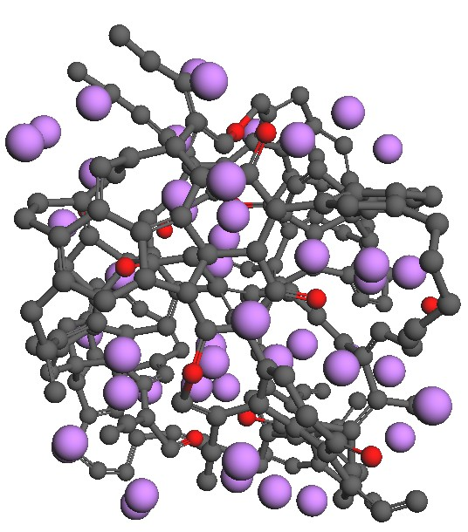
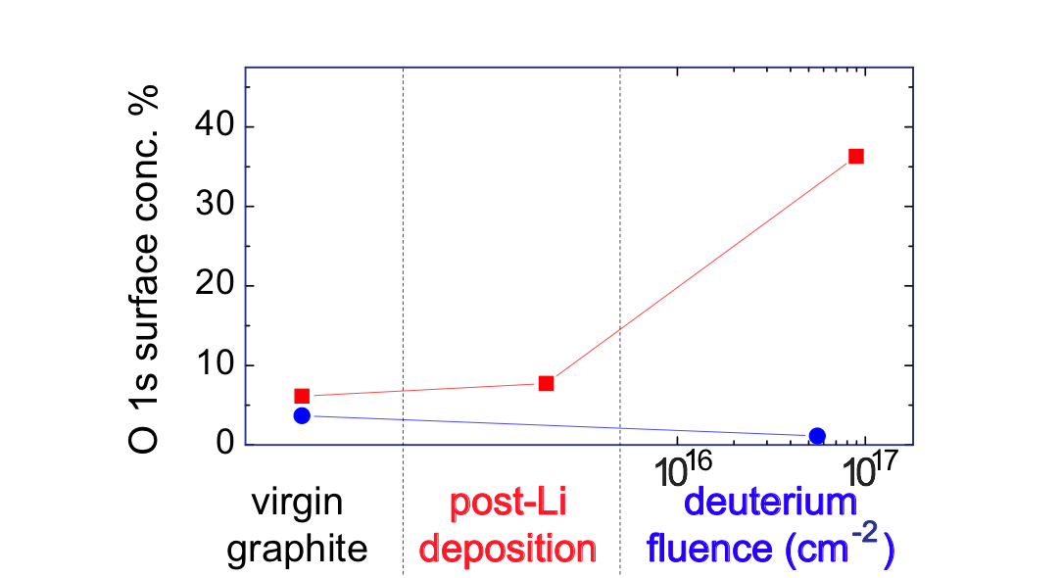
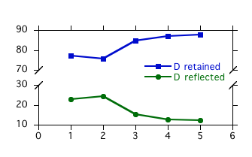
Simulations and lab results show importance of oxygen in lithium-graphite PMI for pumping deuterium
PAC29-18
Quantum-classical atomistic simulations show surface oxygen plays key role in the retention of deuterium in graphite
D
%
O
Li
C
P. Krstic, sub. to Nature Comm.
Accordingly, lab results support that Li on graphite can pump D effectively due to O
  XPS measurements (Purdue) show 2 µm of Li increases surface oxygen content of lithiated graphite to ~10%
  deuterium ion irradiation of lithiated graphite greatly enhances oxygen content to 20%-40%
    In stark contrast, D irradiation of graphite without Li decreases amount of surface O
  Li acts as an O getter, and the O retains D
1 2 3 4 5
atomic composition
D⁺ bombarded Li-graphite
D⁺ bombarded graphite
J.P. Allain, Taylor (Purdue U.)
see C. Skinner Li talk

Slide 10
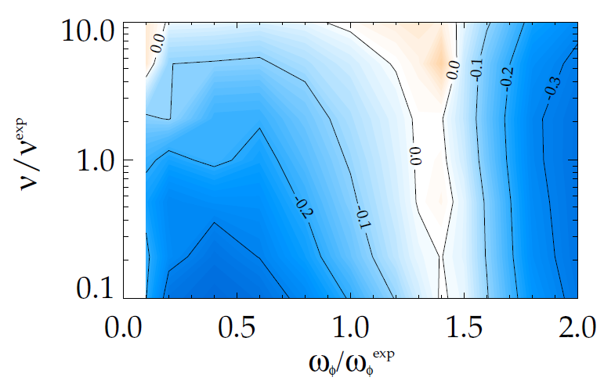
Kinetic RWM stability theory further tested against NSTX experiments, provides guidance for NSTX-U
R(11-2)
RWM stability vs. ω_{φ}
MISK code
RWM growth rate contours (γτ_{w})
Marginal
Stability
unstable
NSTX
NSTX-U
Collisionality
Plasma Rotation
Two competing effects at lower ν
  Collisional dissipation reduced
  Stabilizing resonant kinetic effects enhanced (contrasts early theory)
Expectations at lower ν
  More stabilization near ω_{φ} resonances; almost no effect off-resonance
    Active RWM control important
Improvements to physics model
  Anisotropy effects
  Testing terms thought small
    Already good agreement between theory and experiment of marginal stability point improved
Part of ITPA MDC-2 benchmarking task
(S. Sabbagh, leader)
J. Berkery et al., PRL 106, 075004 (2011)
see J.-K. Park talk

Slide 11
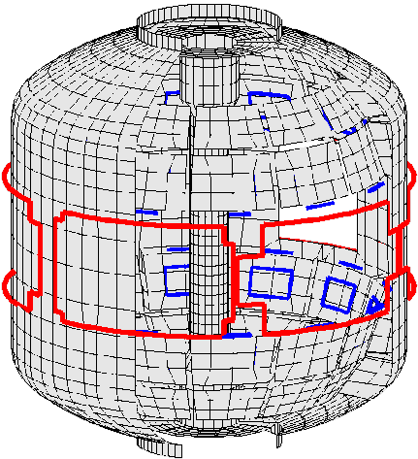
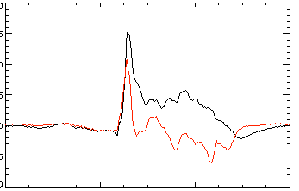
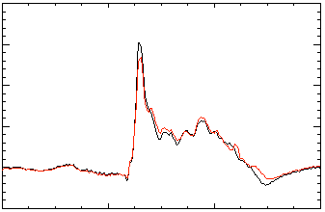
Improved RWM control includes radial and poloidal field, and state space feedback with a 3D conducting structure model
Active n = 1 B_{p} + B_{R} feedback (FB) control
Calculation of B_{r} + B_{p} control (VALEN)
6
Feedback on
140124
140125
140126
140127
2.8
β_{N}
0 deg FB phase
4
2.7
2
B_{r} FB phase = 225º
0
2.6
B_{r}^{n = 1} (G)
Radial field n = 1 (G)
90 deg FB phase
6
B_{r} FB phase = 180º
2.5
4
Vacuum error field
2
2.4
180 deg FB phase
+ RFA
0
Vacuum error field
0.0
0.2
0.4
0.6
0.8
1.0
1.2
1.4
2.3
B_{r} FB phase = 0º
B_{r} FB phase = 90º
t (s)
0.0
0.04
0.08
0.12
R(11-2)
Δt (s) (model)
RWM State Space Controller
2 states
7 states
200
δB_{p}¹⁸⁰
Measurement
δB_{p}¹⁸⁰
Measurement
3D wall,
ports,
mode currents
100
Sensor Differences (G)
0
-100
Controller (observer)
Controller (observer)
0.56
0.58
0.60
0.62
0.58
0.60
0.62
Significantly reduced disruptions at high β_{N} in controlled experiments
t (s)
t (s)
S.A. Sabbagh, O. Katsuro-Hopkins,
J.M. Bialek
see J.-K. Park talk

Slide 12
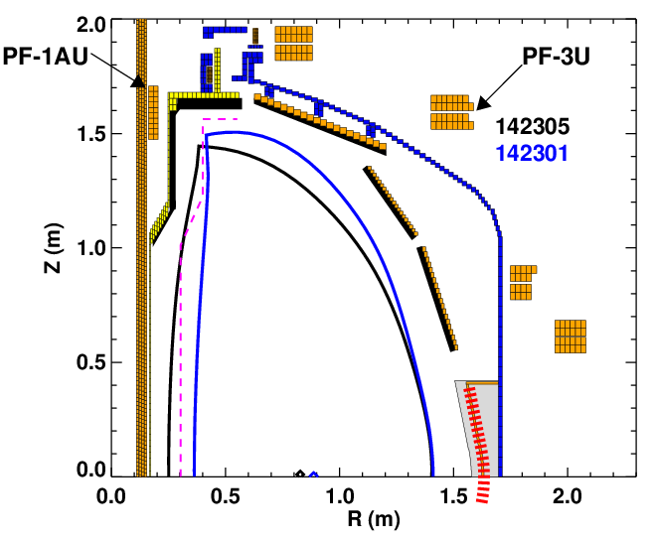
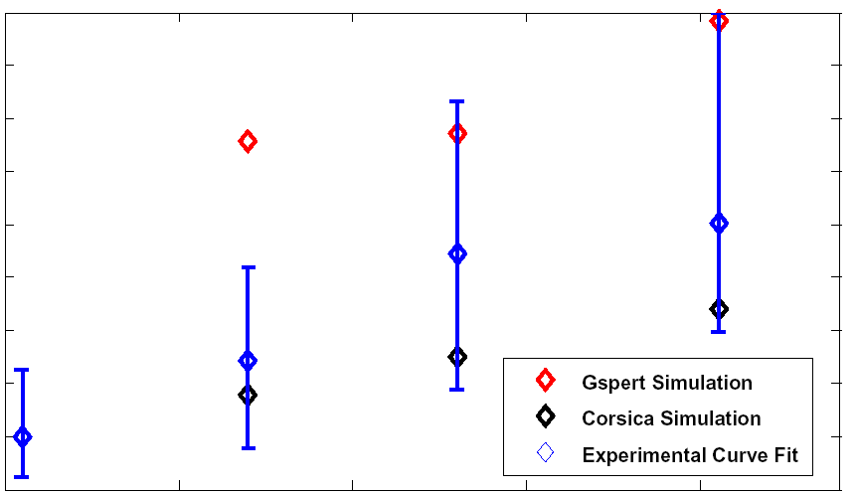
Higher aspect ratio of NSTX-U tested in NSTX, vertical stability growth rate data obtained, compared to simulation
R(11-2)
Vertical Stability Growth Rates vs. A
5
4
3
2
1
GSPERT
Corsica
Experiment
γ/γ₀
1.5 1.55 1.6 1.65
Aspect Ratio
NSTX-U
PFC Boundary
Improvements to vertical control capability and understanding
  Begun to compare measured growth rates to theoretical predictions (Corsica, GSPERT)
  Improved plasma position observer
  Modeled use of RWM coils for n=0 control
NSTX Discharges have matched aspect ratio and elongation of NSTX-U without performance degradation
see S.P. Gerhardt ASC talk

Slide 13
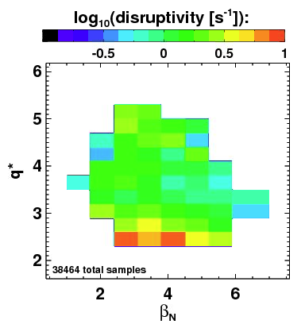
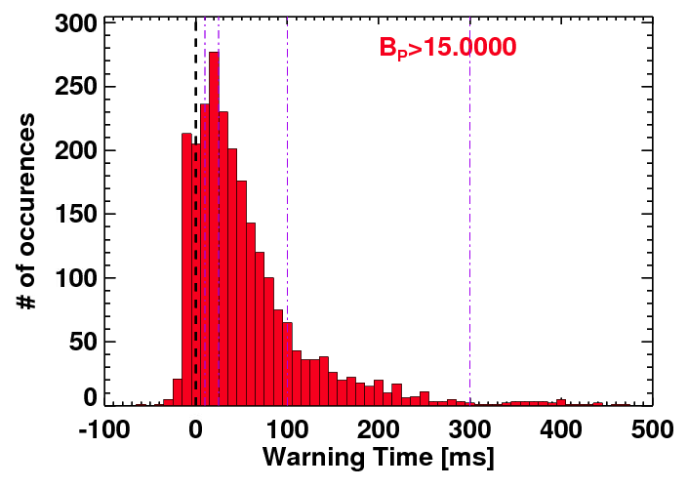
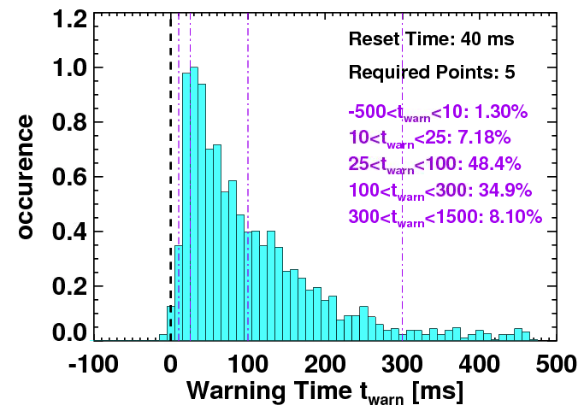
Disruption Detection and Warning Analysis is Being Developed for Disruption Avoidance
Disruptivity
Warning Algorithms
All discharges since 2005 with 1/3 ms sampling time
  Recorded equilibrium and kinetic parameters, disruption statistics
Disruption warning algorithm shows high probability of success
  Based on combinations of threshold based tests; no machine learning
Statistics for a single threshold test
Statistics of full warning algorithm
ΔB_{p}^{n=1} >~15 G used to detect disruption
Physics results
  Minimal disruptivity at relatively high β_{N} ~ 6; β_{N} / β_{N}^{no-wall(n=1)} ~ 1.3-1.5
    Consistent with past specific disruption control experiments
  Strong disruptivity increase for q* < 2.5
  Strong disruptivity increase for lowest rotation
Results & Physics implications
  ~99% disruptions flagged with at least 10ms warning, ~8% false positives
  Most false positives are due to “near disruptive” events
    Early MHD slows ω_{φ}
    recoverable Z motion
see S.P. Gerhardt ASC talk

Slide 14
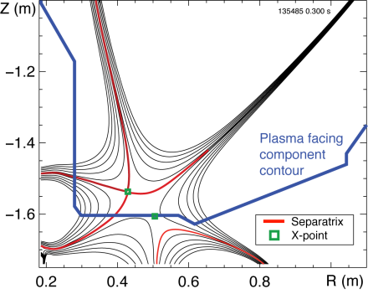
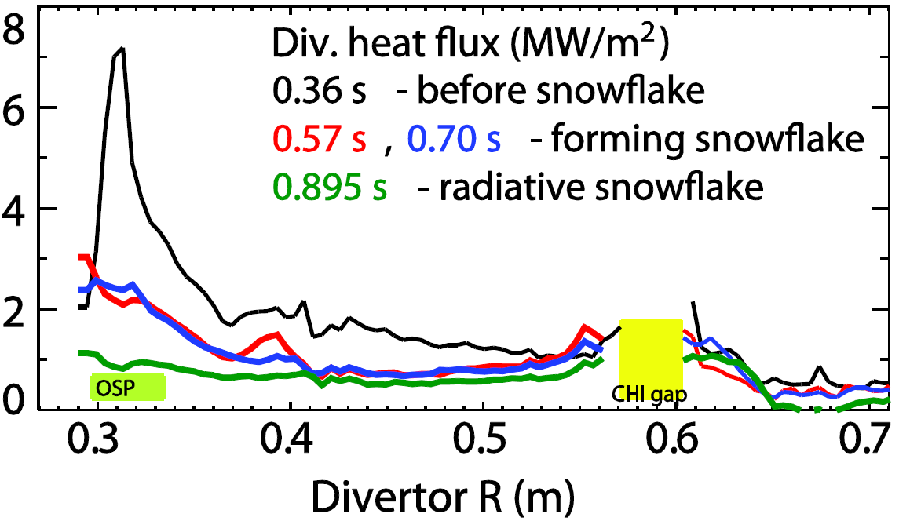
Snowflake divertor experiments provide basis for required divertor heat flux mitigation in NSTX-U
R(11-3)
Snowflake divertor in NSTX
Divertor heat flux width strongly decreases as I_{p} increases in NSTX, DIII-D, C-Mod
Snowflake divertor experiments in NSTX (P_{NBI}=4 MW, P_{SOL}=3 MW)
  Good H-mode confinement (τ_{E}, T_{e,i}(0), β_{N}, H98(y,2) )
  Significant reduction in steady-state divertor heat flux (from 3-7 to 0.5-1 MW/m²)
  Synergistic combination of detachment + radiative snowflake divertor
OSP
Divertor heat flux (MW/m²)
See V. Soukhanovskii, boundary physics talk

Slide 15
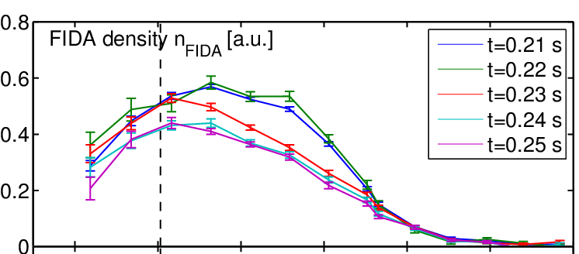
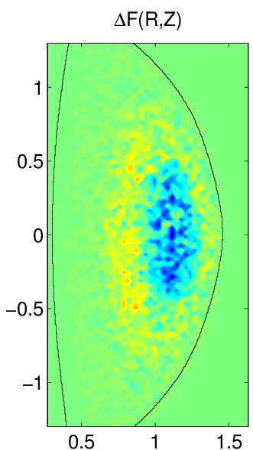
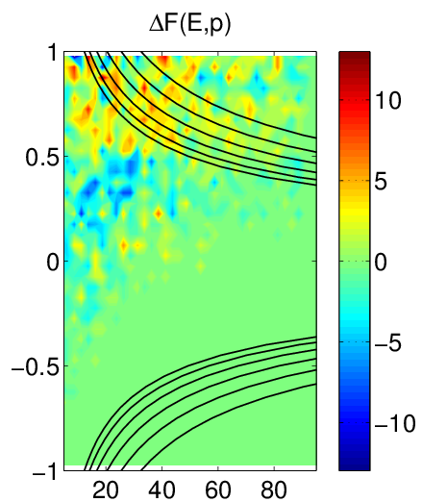
Fast ion redistribution associated with low frequency MHD measured by fast ion D_{α} (FIDA) diagnostic
Caused by kink-like, global instabilities
  Primarily n = 1, weaker n = 2 present
Redistribution can affect stability of *AE, RWMs, other MHD
  CAE activity observed after onset of low frequency MHD
Full-orbit code (SPIRAL) shows redistribution in real and velocity space
  Radial redistribution from core plasma
  Particles shift towards V||/V = 1
Fast ion density reduction
0.9
1.0
1.1
1.2
1.3
1.4
1.5
R(m)
Change in distribution due to kink mode
SPIRAL code
Z [m]
V||\V
CAE resonances
Measured CAEs (reflectometer) examined as possible cause of enhanced core χ_{e}
  mode #, frequency measured: modes peak in core, resonant with electron orbit frequencies
R [m]
Energy [keV]
N. Crocker et al. PPCF 53, 105001 (2011)
FEATURED article
A. Bortolon

Slide 16
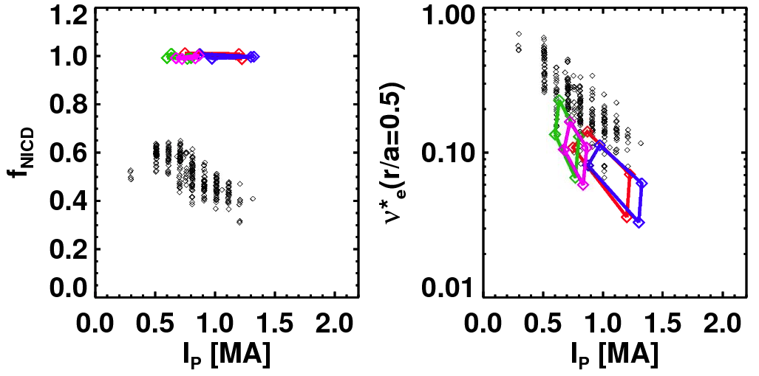
Non-inductive current fractions of up to 65% sustained in NSTX, >70% transiently; Upgrade projected to achieve 100%
NSTX-U projections
NSTX Results
NSTX Results
Total Non-inductive Fraction
B_{T}=0.75 T
B_{T}=1 T
via high harmonic FW
B_{T}=0.75 T
NSTX-U
(100% NI)
B_{T}=1 T
(ranges created by profile peakedness, τ_{E} scalings, etc.)
I_{p} (MA)
Maximum sustained non-inductive fractions of 65% w/NBI at I_{P} = 0.7 MA
100% non-inductive scenarios found over wide operation range
  Scenarios at 74% Greenwald density
70- 100% non-inductive reached transiently using HHFW CD
see G. Taylor W&EP talk
(S. Gerhardt, submitted to NF)
see S. Gerhardt ASC talk

Slide 17
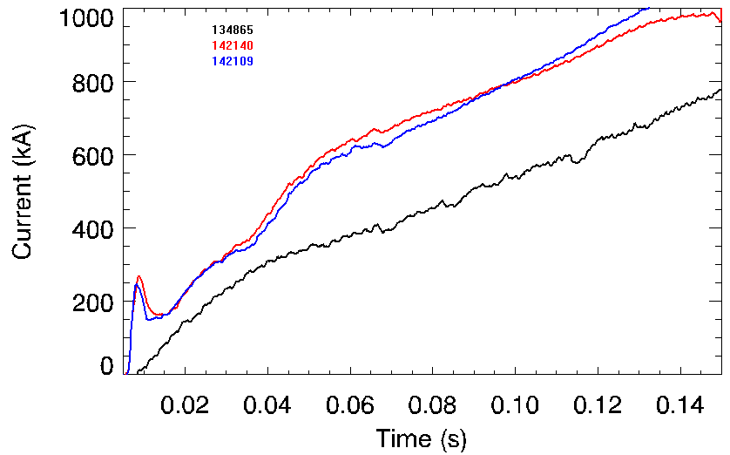
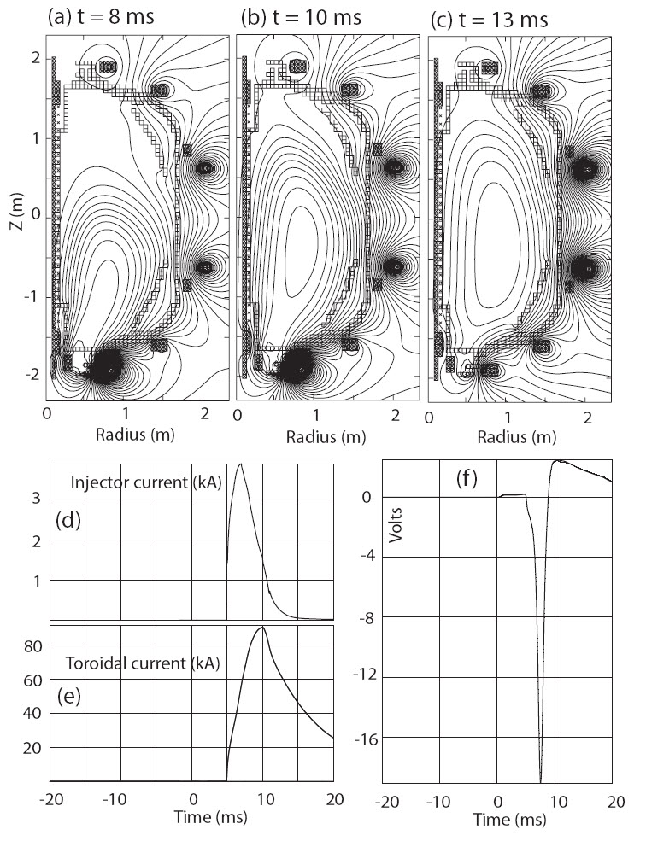
L-mode discharge ramping to 1MA requires 35% less inductive flux when coaxial helicity injection (CHI) is used
1.0
TSC simulation of NSTX CHI startup
CHI-initiated
0.8
0.6
Plasma current (MA)
0.4
Reference inductive
start-up
134865
142140
142109
0.2
0.0
0.0
0.04
0.08
t (s)
0.12
Reference inductive discharge
  Uses 396 mWb to get to 1MA
CHI initiated discharge
  Uses 258 mWb to get to 1MA (35% less inductive flux)
Estimated startup current of 0.4 MA - 0.6 MA for NSTX-U
Decaying poloidal flux induces positive loop voltage, causes flux closure
R. Raman, et al. Nucl. Fusion 51, 113018 (2011)

Slide 18
Continuing analysis of NSTX data targets a predictive physics understanding required for future fusion devices
Operating at reduced collisionality
  Nonlinear microtearing simulations predict reduced χ_{e} of experiment
  Measured high-k turbulence reduction consistent with lower edge χ_{e}
  Reduced ν can be stabilizing for resistive wall modes, but only near kinetic resonances (requires control)
  Nearly continuous increase of favorable effects with increased lithium
  ELM stabilization through density profile modification by lithium
Handling increased heat flux
  Large heat flux reduction from synergistic combination of detachment + radiative snowflake divertor
Detecting & avoiding disruptions
  Initial success in disruption detection and avoidance algorithms
  Expansion of physics model for RWM state space active control; determine favorable stability at ω_{φ} targets accessible by rotation control
Developing non-inductive start-up and sustainment
  Non-inductive current up to 65%, CHI yields 35% flux savings (I_{p}=1MA), NSTX-U scenarios computed to access 100% NICD in broad operational range

Slide 19
Supporting slides follow

Slide 20
CY2011-FY2012 prioritized run plan met run-time guidance
Run time guidance for experiments and proposal stats (CY2011 & FY2012)
Record number of proposals (193 XPs/XMPs were considered)
Requested run days outpaced available days by factor of 2.8
TSGs were either very close to meeting, or met run time guidance
  Slight (up to 0.5 day) mis-alignment of FY12 1st and 2nd priority not an issue – some shuffling may be required at mid-run assessment
  WEP TSG is +0.5 days on their FY11 1st priority XPs (but total # days ok)

Slide 21
Brief summary of NSTX Milestones – key guidance for TSG XP prioritizations – FY2011
JRT-11
2011 OFES Joint Research Milestone (Boundary Physics, Transport & Turbulence)
  Improve understanding of physics mechanisms responsible for pedestal structure, compare with the predictive models.
  Perform detailed measurements of the height and width of the pedestal, E_{r}, initial measurements of pedestal region turbulence.
  Perform focused analytic theory/computational effort, including large-scale simulations, on physics controlling pedestal structure, height.
R(11-1) : Measure fluctuations causing turbulent electron, ion and impurity transport
R(11-2) : Assess ST stability dependence on plasma aspect ratio and boundary shaping
R(11-3) : Assess very high flux expansion divertor operation
R(11-4) : H-mode pedestal transport, turbulence, and stability response to 3D fields
Original FY12 Milestones
2012 OFES Joint Research Milestone (Transport & Turbulence)
  Improve understanding of core transport and enhanced capability to predict core temperature and density profiles.
  Assess the level of agreement between theoretical / computational transport models and available experimental measurements of core profiles, fluxes and fluctuations.
  Emphasize simultaneous comparison of model predictions with experimental energy, particle and impurity transport levels/fluctuations in various regimes, including with electron modes.
R(12-1): Investigate relationship between Li-conditioned surface comp. and plasma behavior
R(12-2): Assess confinement, heating, and ramp-up of CHI start-up plasmas
R(12-3): Assess access to reduced density and collisionality in high-performance scenarios

