Slide 1




NSTX-U
Supported by
NSTX-U Research Program Overview
FY2012-14 research, collaboration, and 5 year planning
Jonathan Menard, PPPL
For the NSTX Research Team
Coll of Wm & Mary
Columbia U
CompX
General Atomics
FIU
INL
Johns Hopkins U
LANL
LLNL
Lodestar
MIT
Lehigh U
Nova Photonics
ORNL
PPPL
Princeton U
Purdue U
SNL
Think Tank, Inc.
UC Davis
UC Irvine
UCLA
UCSD
U Colorado
U Illinois
U Maryland
U Rochester
U Tennessee
U Tulsa
U Washington
U Wisconsin
X Science LLC
Culham Sci Ctr
York U
Chubu U
Fukui U
Hiroshima U
Hyogo U
Kyoto U
Kyushu U
Kyushu Tokai U
NIFS
Niigata U
U Tokyo
JAEA
Inst for Nucl Res, Kiev
Ioffe Inst
TRINITI
Chonbuk Natl U
NFRI
KAIST
POSTECH
Seoul Natl U
ASIPP
CIEMAT
FOM Inst DIFFER
ENEA, Frascati
CEA, Cadarache
IPP, Jülich
IPP, Garching
ASCR, Czech Rep
NSTX PAC-31 Meeting
PPPL – B318
April 17-19, 2012

Slide 2
Outline
NSTX program/project events since PAC-29
Schedule for 5 year plan preparation
PAC-31 charge questions
FY2012-14 plans and milestones
Overview of 5 year plan elements
ST-FNSF development study
Summary

Slide 3
NSTX Program/Project events since PAC-29 (I)
Research Forum for FY11-12 run – March 15-18
  See previous description by S. Sabbagh
Five year plan (2009-13) mid-term review – June 6-7
NSTX Upgrade Final Design Review (FDR) – June 22-24
  NSTX systems tested, ready for plasma ops – July 19, 2011
NSTX central TF bundle electrical short/failure – July 20, 2011
PAC-30 review of program letter for diag. collab. – Aug 2011
Successful independent forensic review of TF fault – Sept 2011
Extensive FES + team discussions → decided to begin Upgrade
DOE-OFES approval to commence outage – Sept 2011
DOE CD-3 approval to begin construction – Dec 2011
FY2012-14 milestones revised to reflect non-operation – Dec 2011-Jan 2012
  Increased emphasis on data analysis, simulations & projections to NSTX-U, collaboration

Slide 4
NSTX Program/Project events since PAC-29 (II)
Preparation for 5 year plan (to cover 2014-18):
  Outline for 8 year plan (2011-18) circulated to NSTX team – April 2011
  Brainstorming sessions:
    3 meetings: Diagnostics, facility enhancement, theory/simulation needs
    Very positive team/lab-wide response ~ 150 ideas total
  For more info: http://nstx-u.pppl.gov/five-year-plan/five-year-plan-2014-18
Impact of presidential fusion budget guidance for FY2013-14:
  NSTX Upgrade delayed ~1 year → 1st plasma mid-late 2015
  Lab-wide/NSTX-U reductions in direct staff: 50-100/15-17 FTEs
  Collaboration on C-Mod eliminated, substantially reduced on DIII-D
  No funding for engineering design of longer-term (5 yr plan) upgrades
  Masa’s presentation (next talk) will cover facility and budget issues
5 retirements from NSTX-U experimental staff in early FY2012
  Impacts capabilities in lithium/PFCs, operations, turbulence
  Need experience/continuity from NSTX for successful NSTX-U ops
    Several early career/post-doctoral researchers relocated to DIII-D to maintain skills, enhance PPPL off-site collaboration, prepare for NSTX-U operation

Slide 5
Schedule for 5 year planning preparation
Now: Presenting initial ideas to PAC-31, get feedback
May-June 2012 – formulate/finalize plan elements and outline, identify/finalize authors, begin writing chapters
October 2012 – First drafts of plan chapters due
Nov-Dec 2012 – internal review/revision/editing of plan
Jan/Feb 2013 – 5 yr plan presentation ‘dry-run’ to PAC-33
Plan presented to review committee and FES Mar/Apr 2013

Slide 6
Response to NSTX PAC-29 recommendations
Excel table of responses to PAC-29 recommendations in backup of this presentation, and on PAC-31 website
Detailed responses to PAC-29 provided (and enumerated) in presentations over next 2 days
Presentation by J. Canik responsive to recommendations to:
  Perform more device-realistic design study for divertor cryo-pumping
  More quantitatively project D particle control w/ Li-coatings for NSTX-U

Slide 7
NSTX-U PAC-31 charge questions:
Are the planned NSTX-U team science activities appropriate during the Upgrade outage?
  Comment on progress toward research milestones
  Comment on the NSTX-U team plans and preparations for collaboration with other facilities to prepare for NSTX-U operation and contribute to fusion science generally.
Are the plans, preparation, and progress for the next 5 yr plan strongly supportive of NSTX-U and FES missions? Consider two time periods:
  Initial operation of NSTX-U, i.e. the first 1-2 run years
  Longer term, i.e. years 3-5 of NSTX-U operation
Research milestones addressed in highlights and topical presentations
Collaboration plans in topical presentations, and summarized in backup
5 year plan ideas contained in this and subsequent presentations

Slide 8
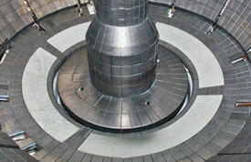
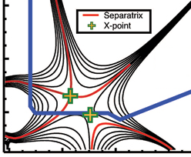
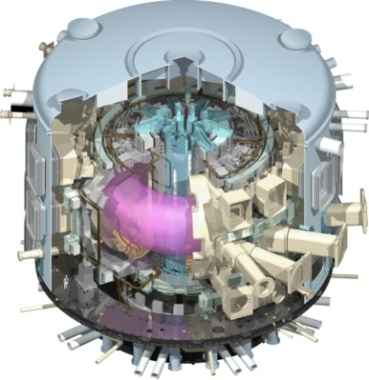
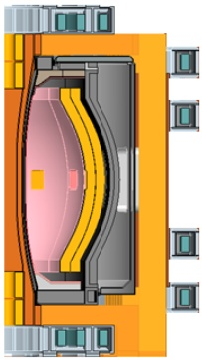
NSTX Upgrade Mission Elements
Advance ST as candidate for Fusion Nuclear Science Facility (FNSF)
Develop solutions for plasma-material interface
Advance toroidal confinement physics predictive capability for ITER and beyond
Develop ST as fusion energy system
ST-FNSF
Lithium
“Snowflake”
ITER
ST Pilot Plant

Slide 9
NSTX-U contributes strongly to FES vision for where U.S. fusion program should be in 2021
(From E.J. Synakowski - Associate Director, Office of Science for FES – APS-DPP November 14-18, 2011)
ITER Research
  The U.S. has strong research team hitting the ground on completed ITER project
  This team is capable of asserting world leadership in burning plasma science.
Fusion materials science
  The U.S. has made strides in fusion materials science and passed critical metrics in tokamak and ST operations with national research teams. It has assessed technical risks associated with moderate vs small aspect ratio and scope of mission, and is prepared to move beyond conceptual design of a fusion nuclear science facility
Extend the reach of plasma control science and plasma-wall interactions
  U.S. fusion research has successfully levered new international research opportunities, including program leadership, in long pulse plasma control science and 3-D physics.
  Opportunities also include the plasma-wall interaction science made possible with long pulses.
Validated predictive capability
  The U.S. is a world leader in integrated computation, validated by experiments at universities & labs. Such computation should be transformational, as it must reduce risks associated with fusion development steps.
Plasma science for discovery
  The U.S. is the world leader in plasma science for discovery. Leverage has been successfully applied across agencies in Discovery Science with NNSA and NSF, and overseas

Slide 10
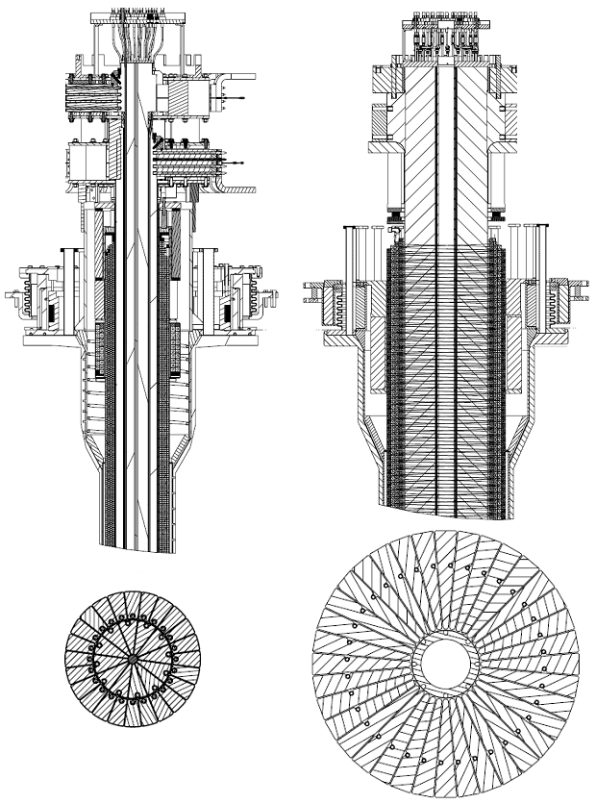
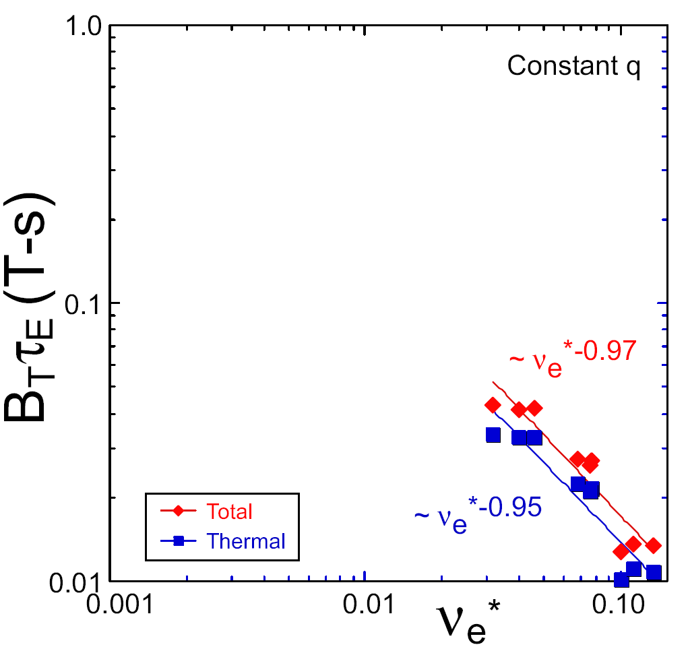
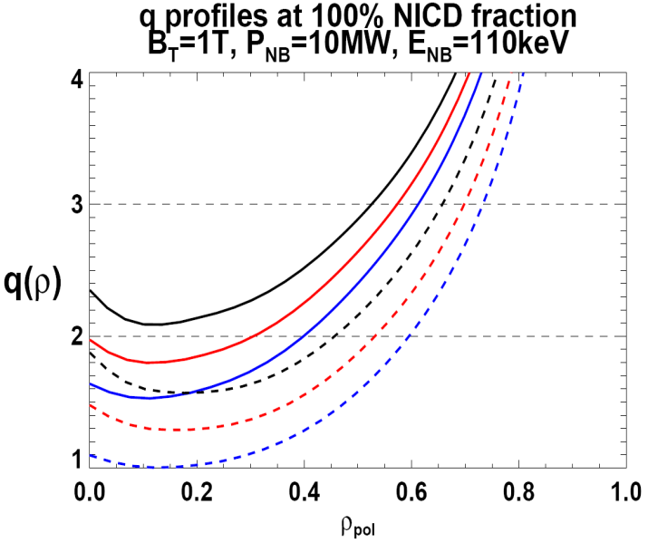
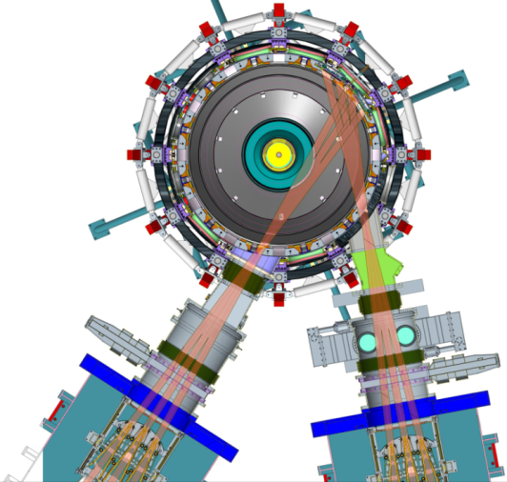
NSTX Upgrade will address critical plasma confinement and sustainment questions by exploiting 2 new capabilities
Previous
center-stack
New
center-stack
ST-FNSF
Reduces ν* → ST-FNSF values to understand ST confinement
  Expect 2x higher T by doubling B_{T}, I_{P}, and NBI heating power
  Provides 5x longer pulse-length
  q(r,t) profile equilibration
  Tests of NBI + BS non-inductive ramp-up and sustainment
constant q, β, ρ∗
NSTX Upgrade
?
ITER-like scaling
TF OD = 20cm
TF OD = 40cm
Normalized e-collisionality ν_{e}* ∝ n_{e} / T_{e}²
I_{P}=0.95MA, H_{98y2}=1.2, β_{N}=5, β_{T} = 10%
B_{T} = 1T, P_{NBI} = 10MW, P_{RF} = 4MW
  2x higher CD efficiency from larger tangency radius R_{TAN}
100% non-inductive CD with q(r) profile controllable by:
  NBI tangency radius
  Plasma density
  Plasma position (not shown)
n
e
/
n
Greenwald
0.95
0.72
R_{TAN} [cm]
__________________
50, 60, 70, 130
60, 70,120,130
70,110,120,130
Present NBI
New 2nd NBI

Slide 11
Topical Science Groups organize research,
5 year planning, and preparation for NSTX-U operation
NSTX-U Topical Science Groups
Summary of research activities during Upgrade outage
Advanced Scenarios and Control
S. Gerhardt, E. Kolemen
Advanced scenario modeling for NSTX-U, q(r) + rotation profile control development with Lehigh on DIII-D
* ORNL
** Columbia Univ.
# Univ. of Wash.
## LLNL
Boundary Physics
V. Soukhanovskii##, A. Diallo
Theory: D. Stotler
Understand snowflake + detachment + control, assess and project pedestal structure, turbulence, transport
Lithium Research
C. Skinner, M. Jaworski
Theory: D. Stotler
Perform lab-based R&D to understand Li surface chemistry, develop flowing liquid Li prototypes/modules
Macroscopic Stability
J.-K. Park, J. Berkery**
Theory: A. Boozer**
Assess kinetic effects for RWM, NTM, NTV, analysis of proposed 3D coils (NCC), characterize disruptions
Solenoid-free start-up & ramp-up
R. Raman#, D. Mueller
Theory: S. Jardin
Simulate CHI start-up + ramp-up with TSC + NIMROD, extend to include ECH for current ramp-up w/ NBI-CD
Transport and Turbulence
Y. Ren, W. Guttenfelder
Theory: G. Hammett
Simulate low-k to high-k micro-instabilities, compare to measured χ, prepare for high-k_{θ} scattering, polarimetry
Waves and Energetic Particles
G. Taylor, M. Podestá
Theory: N. Gorelenkov
Optimize HHFW and design ECH system for start-up, develop predictive capability for fast-ion transport, design active system to excite/study AE modes
Cross-Cutting / ITER needs
J. Menard, R. Maingi*
Theory/Modeling: J. Canik*
Physics design of cryo-pump, assess Li D pumping and extrapolation to NSTX-U, next: lead off-midplane 3D coil physics design (w/ MS TSG)

Slide 12
Baseline: FY12-14 research milestones emphasize analysis, simulation, projection to/preparation for NSTX-U, FNSF, ITER
FY2012
FY2013
FY2014
Expt. Run Weeks:
NSTX-U ops in mid FY2015
Transport and Turbulence
R(13-1)
Perform integrated physics+optical design of new high-k_{θ} FIR system
R(12-1)
R(14-1)
Macroscopic Stability
Investigate magnetic braking physics and toroidal rotation control at low ν* (with ASC TSG)
Assess access to reduced density
and ν* in high-performance scenarios (with ASC, BP TSGs)
R(13-2)
Boundary
and Lithium
Project deuterium pumping using lithium coatings and cryo-pumping
Assess relationship between lithium-conditioned surface composition and plasma behavior
R(12-2)
R(13-3)
R(14-2)
Waves+Energetic Particles
Perform physics design of ECH & EBW system for plasma start-up & current drive in advanced scenarios
Assess reduced models for *AE mode-induced fast-ion transport
R(12-3)
Solenoid-free Start-up/ramp-up
Simulate confinement, heating, and ramp-up of CHI start-up plasmas
(with HHFW TSG)
R(14-3)
Adv. Scenarios and Control
Assess advanced control techniques for sustained high performance (with MS, BP TSGs)
R(13-4)
ITER Needs + Cross-cutting
Identify disruption precursors and disruption mitigation & avoidance techniques for NSTX-U and ITER
Joint Research Target (3 facility)
Understand core transport and enhance predictive capability
Stationary regimes w/o large ELMs, improve understanding of increased edge particle transport
TBD

Slide 13
Incremental funding would accelerate first-plasma to FY2014, enabling access to new physics + assessment of ST for FNSF
Incremental funding
FY2012
FY2013
FY2014
Expt. Run Weeks:
~10
Transport and Turbulence
R(13-1)
Assess τ_{E} vs. higher I_{P}, B_{T}
Perform integrated physics+optical design of new high-k_{θ} FIR system
R(12-1)
R(14-1)
Macroscopic Stability
Investigate magnetic braking physics and toroidal rotation control at low ν* (with ASC TSG)
Assess access to reduced density
and ν* in high-performance scenarios (with ASC, BP TSGs)
R(13-2)
Boundary
and Lithium
Project deuterium pumping using lithium coatings and cryo-pumping
Assess relationship between lithium-conditioned surface composition and plasma behavior
R(12-2)
R(13-3)
R(14-2)
Waves+Energetic Particles
Perform physics design of ECH & EBW system for plasma start-up & current drive in advanced scenarios
Assess reduced models for *AE mode-induced fast-ion transport
R(12-3)
Solenoid-free Start-up/ramp-up
Simulate confinement, heating, and ramp-up of CHI start-up plasmas
(with HHFW TSG)
Assess NBICD w/ larger R_{TAN}
Adv. Scenarios and Control
R(14-3)
Assess advanced control techniques for sustained high performance (with MS, BP TSGs)
R(13-4)
ITER Needs + Cross-cutting
Identify disruption precursors and disruption mitigation & avoidance techniques for NSTX-U and ITER
Joint Research Target (3 facility)
Understand core transport and enhance predictive capability
Stationary regimes w/o large ELMs, improve understanding of increased edge particle transport
TBD

Slide 14
Outline
FY12-14 research plans
  Transport and Turbulence
  Macroscopic Stability
  Energetic Particles
  Solenoid-Free Plasma Start-up (Coaxial Helicity Injection)
  Wave Heating and Current Drive
  Advanced Scenarios and Control
  Boundary Physics and Lithium Research

Slide 15
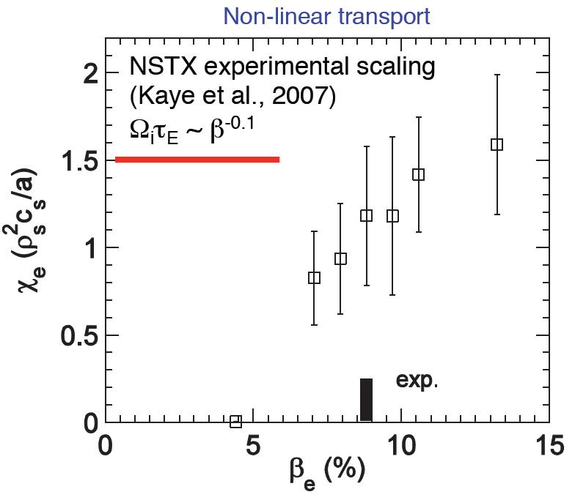
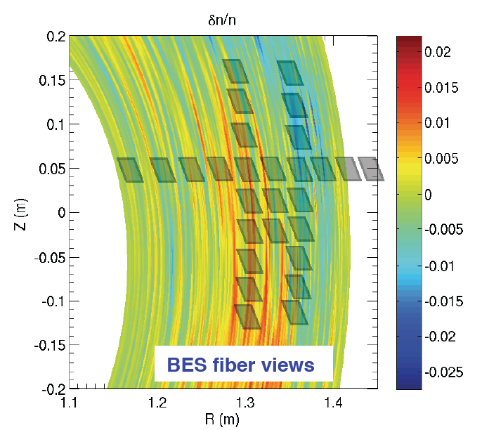
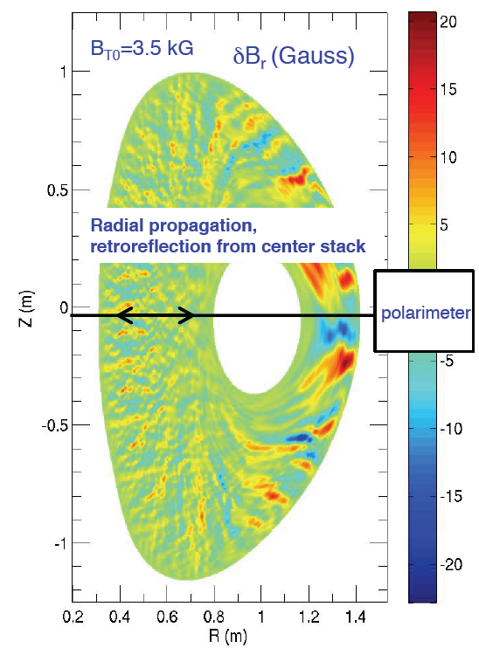
NSTX-Upgrade will extend diagnosis and understanding of micro-instabilities potentially responsible for anomalous transport in STs
GYRO simulations
of micro-tearing
(W. Guttenfelder)
Electrons dominant loss channel for ST thermal confinement
  Micro-tearing strong candidate for anomalous thermal e-transport at higher β
  ETG can also contribute to e-transport at lower β
  Alfvénic instabilities (GAE/CAE) can also cause core electron transport
NSTX-U goal is to study full turbulence wave-number spectrum:
  low-k – ITG/TEM/AE/μ-tearing (BES, polarimetry) + high-k – ETG (μ-wave scattering)
NSTX-U enables access to unique turbulence regime with high β + lower ν*

Slide 16
Transport and Turbulence Research Plans for FY2012-14:
Develop advanced turbulence diagnostics, reduced transport models
FY12/JRT: Simultaneous comparison of electron thermal and particle/impurities transport channels in NSTX, coupled with turbulence measurements and gyro-kinetic simulations
  Test TGLF profile predictions for NSTX discharges (with GA)
FY12-13: Identify diagnostics for micro-tearing, intermediate k_{θ} ρ_{s} ~ 1-4 turbulence as possible drive for e-transport
  Work/collaborate with DIII-D (polarimetry), C-Mod (PCI, polarimetry)
FY13: Develop integrated physics and optical design of the new high-k_{θ} FIR scattering system
  Investigate micro-tearing mode by varying relevant parameters (β, ν, Z_{eff}) and using BES diagnostics on MAST
FY14: Work toward development of reduced transport models and validation of existing models using ST data and linear and non-linear gyro-kinetic simulations

Slide 17
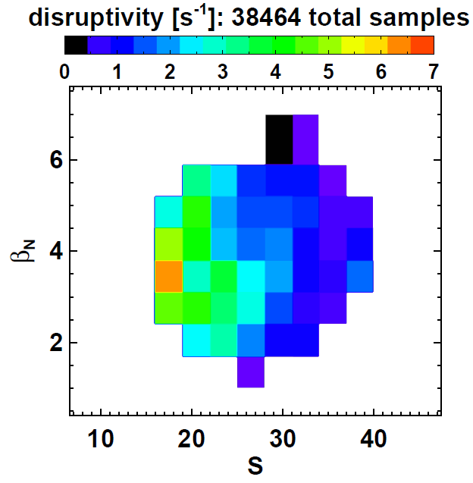
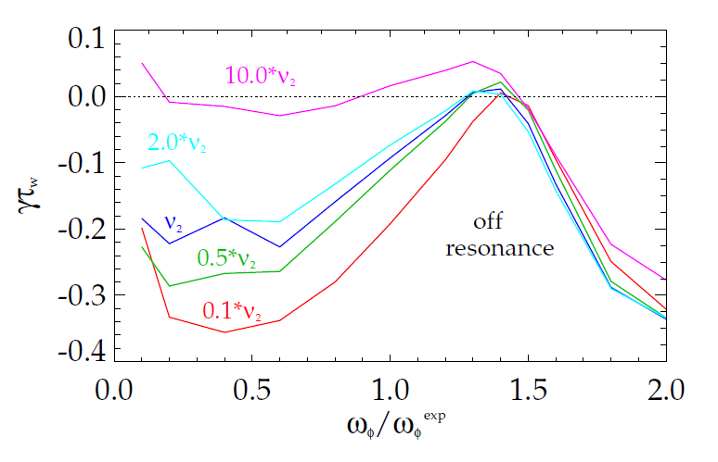
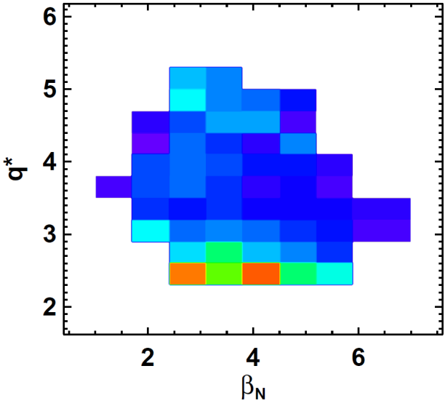

Resistive wall mode studies and systematic disruption analysis inform control requirements for FNSF, ITER
NSTX disruptivity is minimized for S > 30, q* > 2.5
  Weaker dependence on β_{N} (confinement limited)
NSTX-tested kinetic RWM stability theory shows dependence on rotation and collisionality
  Reduced ν strongly stabilizing “on-resonance”
  Expect NSTX-U, tokamaks at lower ν (e.g. ITER) could have stronger RWM stability dependence on rotation
β_{N}
J.W. Berkery et al., PRL 106, 075004 (2011)
S ≡ q₉₅ I_{P} / aB_{T} [MA/m·T]
unstable
Marginal
Stability
RWM growth rate (γτ_{w})
off
resonance
q*
140132 @ 0.704
on resonance
Plasma rotation
β_{N}
Results motivate high κ, δ + control of ω_{φ}, q profiles (2nd NBI, NTV) for ST-FNSF

Slide 18
Macroscopic Stability Research Plans for FY2012-14:
Investigate kinetic RWM and disruption physics, assess new 3D coils
FY12-13: Investigate RWM kinetic stability w/ MISK for NSTX & NSTX-U + experimental (DIII-D and KSTAR) and computational (MARS-K, HAGIS) RWM collaborations
FY12-13: Compile NSTX disruption database, study NSTX disruptions, combine various precursors/signals for disruption characterization and prediction
  Develop disruption mitigation + avoidance strategies for NSTX-U, ITER
FY13-14: Assess access to reduced density and collisionality by investigating RWM, tearing mode physics, and 3D physics including error field + magnetic braking in NSTX-U scenarios
  Collaborate with DIII-D, KSTAR, and MAST
FY13-14: Assess utility of new Non-axisymmetric Control Coils (NCC) for RWM, TM, RMP, EFC, NTV/v_{φ} control for NSTX-U
  Collaborate with DIII-D, KSTAR, MAST to identify optimal coil set

Slide 19
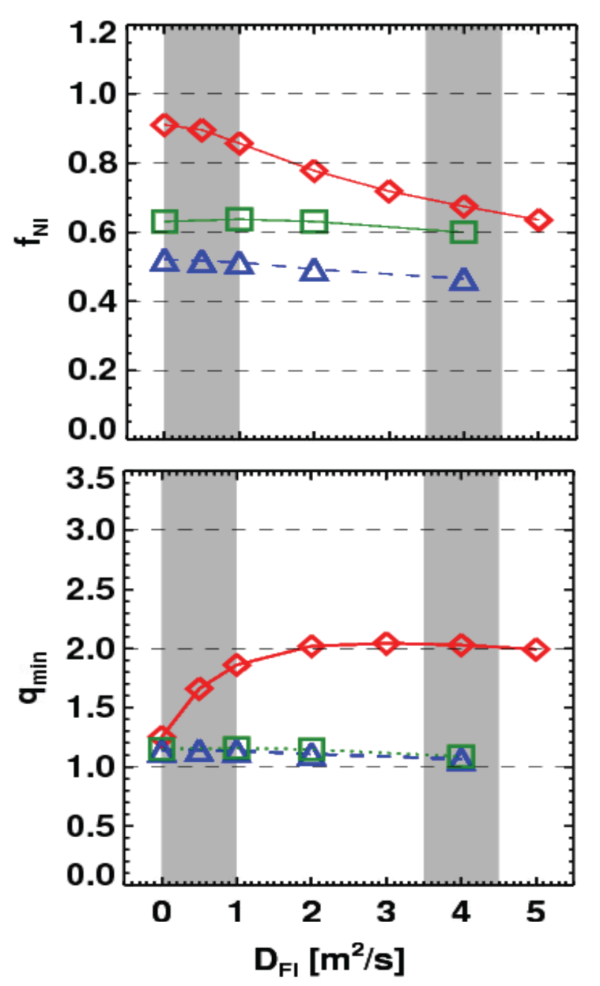
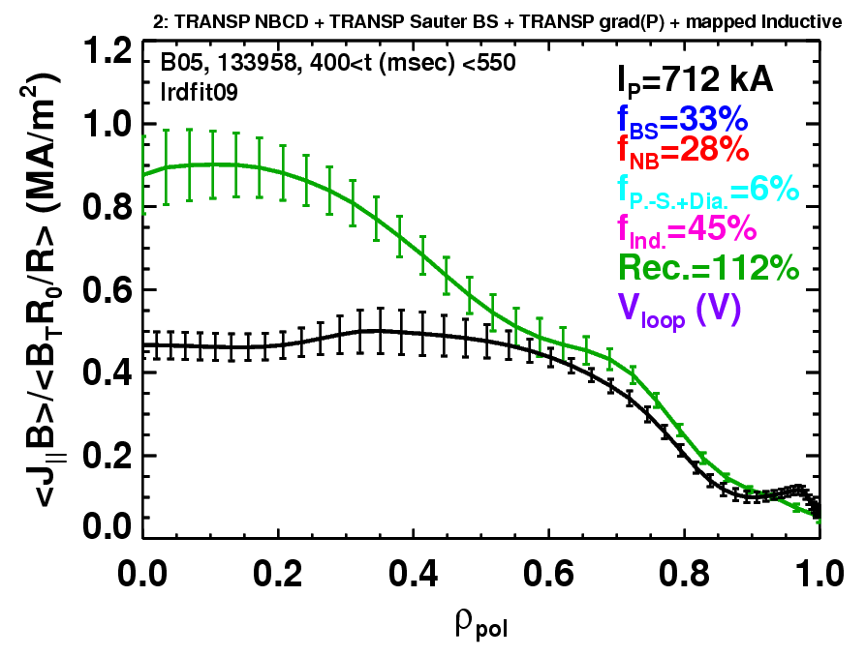
Rapid TAE avalanches could impact NBI current-drive in advanced scenarios for NSTX-U, FNSF, ITER AT
NSTX-U TRANSP simulations
NSTX: rapid avalanches can lead to
redistribution/loss of NBI current drive
Discrepancy between reconstruction and total assuming
classical J_{NBCD}
1 MA, 1T, H₉₈=1, near non-inductive
1.6 MA, 1T, partial inductive
1.2 MA, 0.55T, high β_{T}
All: f_{GW}=0.7, H₉₈=1
Minor radius
700kA high-β_{P} plasma with rapid
TAE avalanches has time-average D_{FI} = 2-4m²/s

Slide 20
Energetic Particle Physics Research Plans for FY2012-14:
Develop full and reduced models of fast-ion transport, f(v) diagnostics
FY12: Model TAE stability for NSTX, project to NSTX-U H-mode plasmas w/ NOVA & M3D-K codes
FY12-13: Improve model of fast ion response to high-frequency GAE/CAE (Develop interface between SPIRAL and HYM codes)
FY12-13: Collaborate with MAST and DIII-D on AE experiments, ID optimal FI diagnostics for NSTX-U
FY13-14: Develop reduced model for AE-induced fast ion losses – needed for NBICD in STs/ATs/ITER
  Collaboration with MAST, DIII-D, Irvine
FY13-14: Finalize design of prototype AE antenna and of upgraded solid-state NPA diagnostic

Slide 21
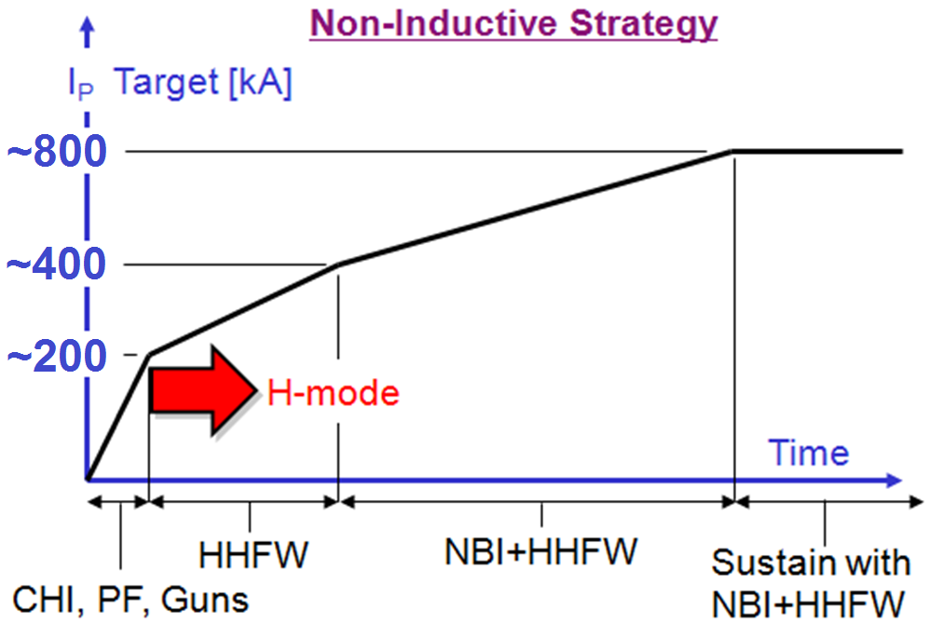
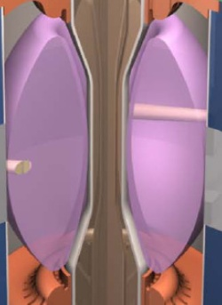
Plasma initiation with small or no transformer is unique challenge for ST-based Fusion Nuclear Science Facility
ST-FNSF has no/small central solenoid
CHI / guns, ECH
NSTX-U goals:
  Generate ~0.3-0.4MA full non-inductive start-up with helicity injection + ECH and/or fast wave heating, then ramp to ~0.8-1MA with NBI
  Develop predictive capability for non-inductive ramp-up to high performance 100% non-inductive ST plasma → prototype FNSF

Slide 22
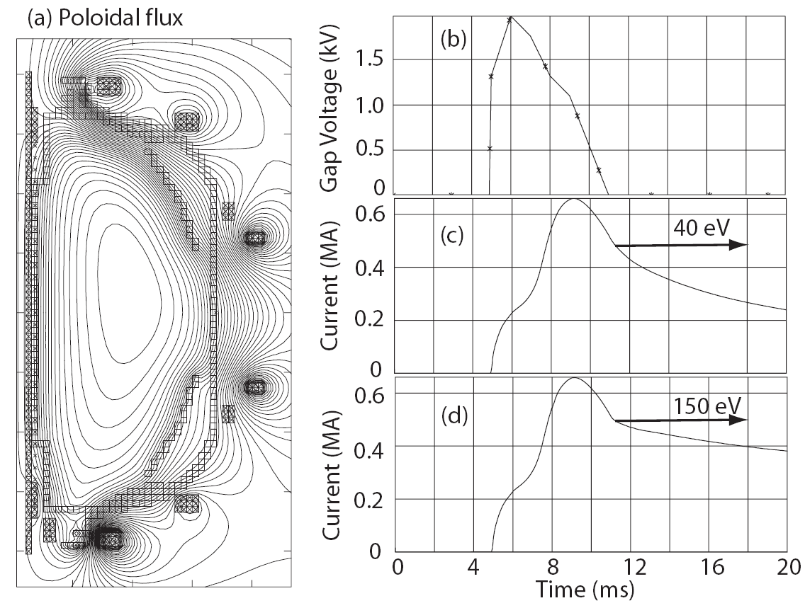
Simulations of CHI project to increased start-up current in NSTX Upgrade, highlight need for additional electron heating
TSC simulations of transient CHI consistent with NSTX trends
Favorable projections for NSTX-U:
  TF increased to 1T and injector flux increased to about 80% of max allowed → can generate up to ~400kA closed-flux current
  Figs (a-c): T_{e} = 40 eV, Z_{eff} = 2.5
  Fig (d): T_{e} = 150 eV for t > 12 ms
T_{e} ~150-200eV needed to extend current decay time to several 10’s of ms
Low density and β of CHI plasma + transient position (i.e. outer gap) evolution → HHFW coupling and heating very challenging
NSTX CHI plasmas not over-dense → 28GHz ECH heating of 1T CHI plasma likely best option for generating non-inductive ramp-up target
See presentations by R. Raman and G. Taylor for more details

Slide 23
Solenoid-Free Start-up and Ramp-up Research Plans for FY2012-14:
Simulate CHI start-up/ramp-up, prepare CHI/guns for NSTX-U
FY12-13: Model CHI start-up → HHFW+NBI ramp-up scenarios using the NSTX-U vessel + coil geometry
  Use TSC simulations w/ free-boundary capabilities, identify and develop CHI experiments using FY14 reduced coil set
  Use TRANSP to vary I_{P}, T_{e}, n_{e} and study how NBI couples to these plasmas with low and zero loop voltage
Design (FY12) and implement (FY13) upgrades to CHI capacitor bank and diagnostics for NSTX-U
FY12-13: Participate in PEGASUS plasma gun start-up experiments to identify hardware requirements for implementation on NSTX-U
FY13-14: Finish CHI design study for QUEST, work with QUEST group for possible CHI usage on QUEST

Slide 24
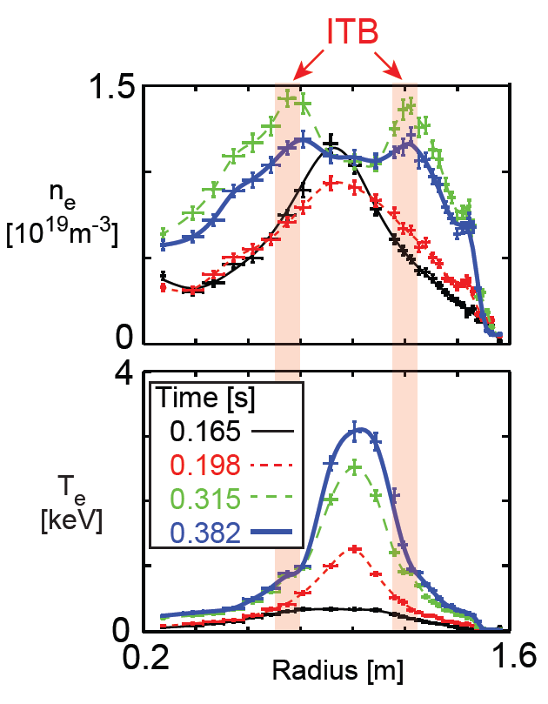
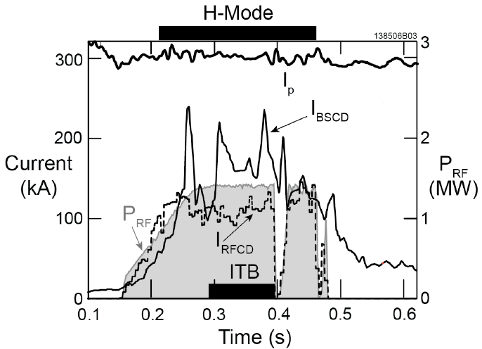
HHFW promising for heating low current target plasma for NBI non-inductive ramp-up
Can heat I_{P} ~ 300kA, 200eV plasma to T_{e} = 3keV w/ low P_{RF} ~1.4MW
Form core + edge transport barriers
Non-inductive fraction of 65-85%
  40-50% bootstrap, 25-35% RF-CD
Projects to 100% non-inductive at P_{RF} = 3-4MW in NSTX-U
  → Target for NBI I_{P} ramp-up

Slide 25
Wave Physics Research Plans for FY2012-14:
Simulate & develop reliable ICRF H-mode, prepare ECH/EBW/EHO design
FY12-13: Extend HHFW coupling/heating calculations to higher I_{P}, B_{T} NSTX-U equilibria, including fast-ion interactions
FY12: Collaborate w/ MAST on EBW start-up
FY12-13: Collaborate on development of reliable ICRF-heated H-mode scenarios for NSTX-U and ITER
  ICRF H-mode on EAST - extend work on NSTX RF-only H-modes
  ICRF + NBI H-mode experiments on DIII-D to further study NSTX SOL power loss mechanisms with application to ITER
FY13-14: Physics design for ECH/EBW system (28GHz, 1→2MW) for start-up heating and sustainment CD
FY13-14: Physics design of EHO excitation system, assist in antenna design for AE spectroscopy

Slide 26
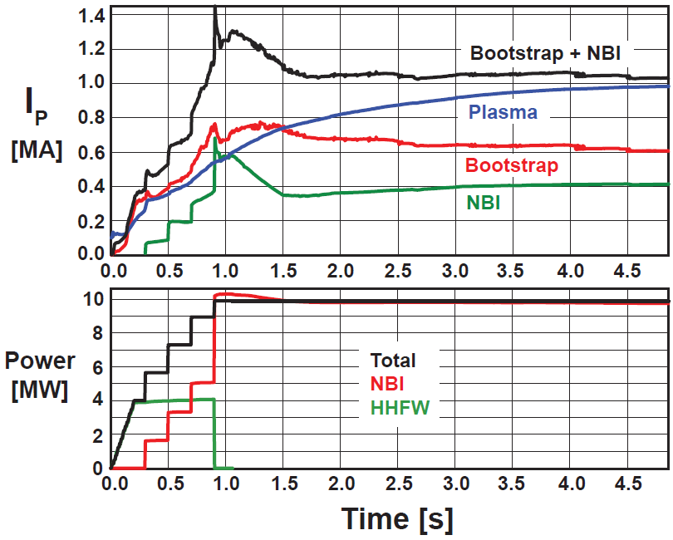
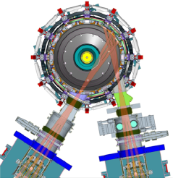
Non-inductive ramp-up from ~0.4MA to ~1MA projected to be possible with new CS + more tangential 2nd NBI
New CS provides higher TF (improves stability), 3-5s needed for J(r) equilibration
More tangential injection provides 3-4x higher CD at low I_{P}:
  2x higher absorption (40→80%) at low I_{P} = 0.4MA
  1.5-2x higher current drive efficiency
TSC simulation of non-inductive ramp-up from initial I_{P} = 0.1MA, T_{e}=0.5keV target
Present NBI
More tangential 2nd NBI

Slide 27
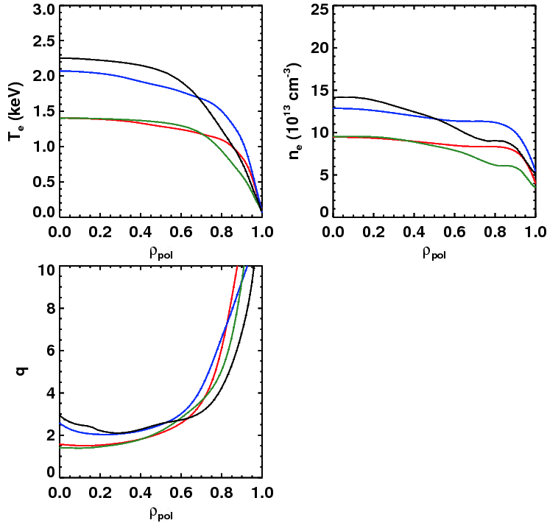
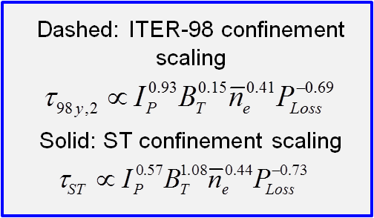
Scenario modeling using TRANSP projects to 100% non-inductive current at I_{P} = 0.9-1.3MA at B_{T}=1.0 T
Dashed: ITER-98 confinement scaling
Solid: ST confinement scaling
Narrow, H_{ST}=1
Broad, H_{ST}=1
Narrow, H_{ST}=1
Broad, H_{ST}=1
Broad, H₉₈=1
Broad, H₉₈=1
Narrow, H₉₈=1
Narrow, H₉₈=1
Fix: 1.0T, P_{inj}=12.6 MW, f_{GW}=0.72
Fix: A=1.75, κ=2.8
Find the non-inductive current level for 2 confinement and 2 profile assumptions…yields 4 different projections.
Broad, H_{ST}=1
Confinement | Profiles | I_{P} [kA] | β_{N}
H₉₈=1 | Broad | 975 | 4.34
H_{ST}=1 | Broad | 1325 | 5.32
H₉₈=1 | Narrow | 875 | 4.87
H_{ST}=1 | Narrow | 1300 | 5.97
Narrow, H_{ST}=1
Broad, H₉₈=1
Narrow, H₉₈=1

Slide 28
Advanced Scenarios and Control Research Plans for FY2012-14:
Simulate scenarios for NSTX-U, develop advanced control algorithms
FY12-13: TRANSP scenario/equilibrium simulations
  RF-assisted start-up/ramp-up/sustainment simulations – w/ SFSU+WEP
  Scenario guidance for cryo-pump design (shapes, particle inventories)
  Provide relevant scenario targets for physics studies + diagnostic design
JRT-2013: “Evaluate stationary enhanced confinement regimes without large Edge Localized Modes (ELMs), and to improve understanding of the underlying physical mechanisms that allow increased edge particle transport while maintaining a strong thermal transport barrier”
FY13-14: Assess and/or implement advanced control algorithms in preparation for NSTX-U operation
  Proposing to develop NSTX-U snowflake control on DIII-D (PPPL+LLNL)
  J profile control using off-axis NBI on DIII-D for NSTX-U 2nd NBI
    Implement rt-MSE (if funded) in rt-EFIT for q-profile reconstruction
  Assess simultaneous J profile, rotation, and beta control
  Project improvement in NSTX-U rotation control using 2nd NBI deposition flexibility + improved NTV control w/ proposed NCC coils

Slide 29
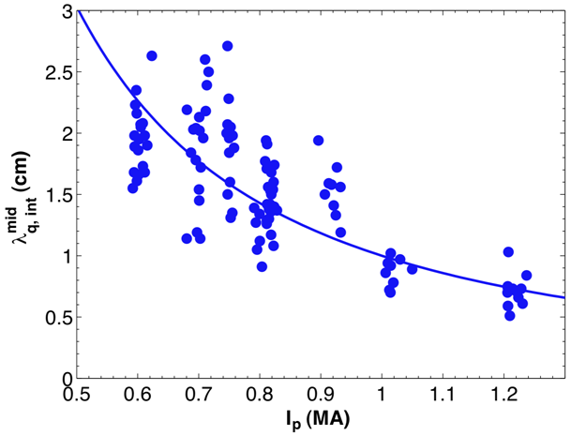
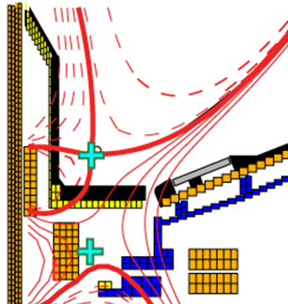
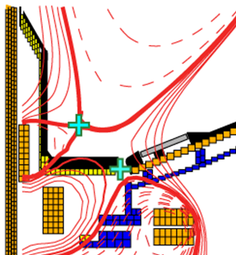
NSTX-U will investigate high flux expansion snowflake divertor + detachment for large heat-flux reduction
λ_{q}^{mid} ~ I_{p}^{-1 to -1.6}
Divertor heat flux width decreases with increased plasma current I_{P}
  Major implications for ITER, FNSF
NSTX Upgrade with conventional divertor projects to very high peak heat flux up to 30-45MW/m²
Standard Divertor
Snowflake Divertor
Divertor heat flux inversely proportional to flux expansion over a factor of five
Snowflake→ high flux expansion 40-60, larger divertor volume and radiation
U/D balanced snowflake divertor projects to acceptable heat flux < 10MW/m² in Upgrade at highest expected I_{P} = 2MA, P_{AUX}=10-15MW
Partial detachment → ~2x reduction in NSTX (modeling underway)

Slide 30
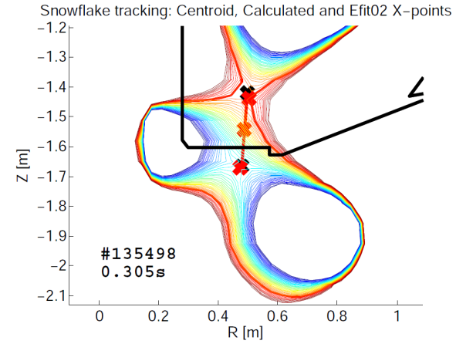
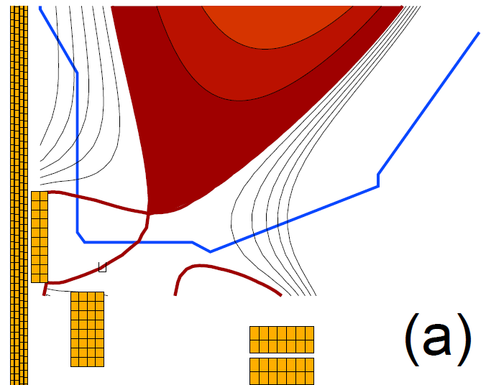
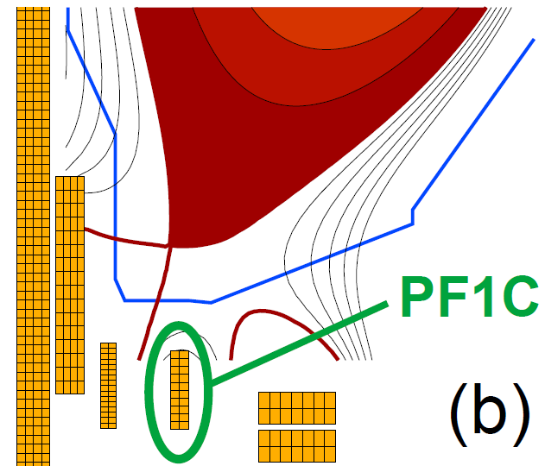
Upgrade CS design provides additional coils for flexible and controllable divertor including snowflake
NSTX Snowflake
x: Post-shot EFIT x-points
x: fast-tracking algorithm
NSTX-U Snowflake
Substantial progress made in developing fast algorithms for ID of multiple X-points suitable for real-time snowflake control
Next-step is to implement into PCS through PPPL/LLNL collaboration with GA

Slide 31
Boundary Physics Research Plans for FY2012-14:
Advance snowflake & edge turbulence understanding, plan cryo & PFCs
FY12-13: Perform modeling of synergy of snowflake with radiative divertor in NSTX, project to NSTX-U and beyond
FY12-13: Perform cryo-pumping physics design for NSTX-U compatible with vessel geometry and snowflake shapes
  Use SOLPS to interpret/reproduce heat and particle flux profiles from high I_{P} and P_{NBI} discharges from NSTX, project to NSTX Upgrade
  (Initial results indicate snowflake compatible with cryo-pumping)
FY12-14: Study divertor power exhaust with high-Z Mo PFCs on C-Mod & EAST, assess for NSTX-U
  Assess Mo with low-Z (B & Li) coatings, study cryo-pumping for density control with moly PFC (particle balance, supersonic gas jet fueling), possibly radiative divertor control development (C-Mod)
FY12-14: Investigate pedestal transport & turbulence:
  Utilize correlation reflectometer on C-Mod, EPH/VH expts + XGC0 simulations on DIII-D, SOL turbulence with GPI on EAST and C-Mod

Slide 32
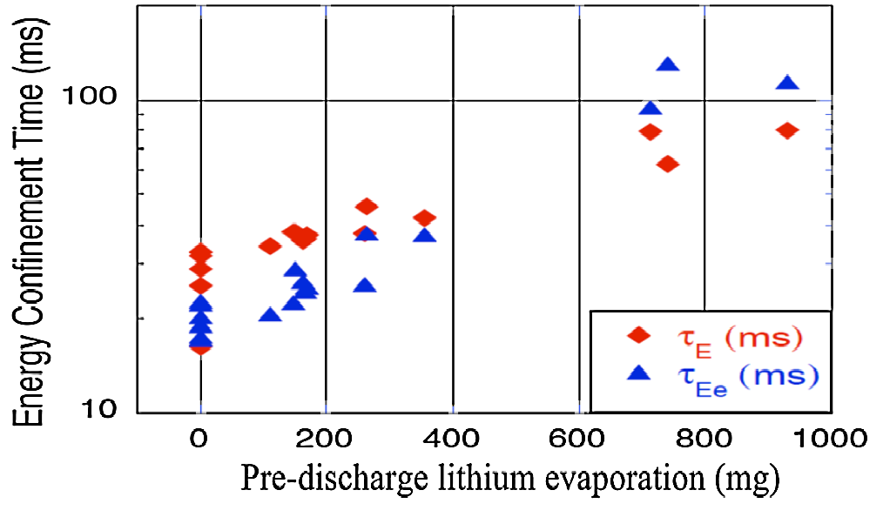
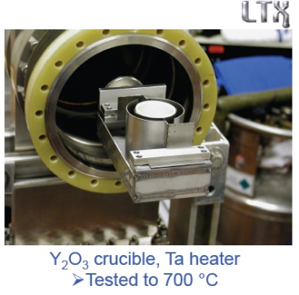
Lithium coatings will continue to be an important research tool for NSTX-U
R. Maingi, et al., PRL 107, 145004 (2011)
Work with LTX to understand Li chemistry, impact of wall temperature, Li coating thickness
Assess D pumping vs. surface conditions (MAPP), lab-based surface studies, PFC spectroscopy
Design/develop methods to increase Li coating coverage:
  upward evaporation
  evap into neutral gas
  Li paint sprayer
Assess impact of full wall coverage on pumping, confinement
Test Li coatings for pumping longer τ_{pulse} NSTX-U plasmas
Energy confinement increases continuously with increased Li evaporation in NSTX
High confinement very important for FNSF and other next-steps
what is τ_{E} upper bound?

Slide 33
Lithium Research Plans for FY2012-14:
Advance-Li PFC understanding and technology, R&D for flowing Li
FY12: Model D pumping from Li coatings in NSTX, project to NSTX-U conditions, compare to cryo-pumping projections
FY12-13: Collaborate with EAST/HT-7 on lithium research
  Assess interplay between cryo-pumping and lithiumization, and high-Z PFC interactions/synergies with lithium
  Study effects of Li on thermal and particle transport, further develop sustained/long-pulse lithium delivery systems (Li slapper, dropper)
FY12-14: Measure Li coating lifetime on ATJ, TZM, W for NSTX-U like divertor conditions: Magnum-PSI collaboration
FY13: Study lithium-conditioned surface composition using MAPP (Purdue) between-shot surface analysis on LTX
FY13-14: Develop Li-coating tool for upper PFCs of NSTX-U, +
  Perform lab-based R&D to develop circulation of Li in/out of divertor
  Physics/pre-conceptual design of next-generation LLD with flowing Li and/or capillary porous system (CPS)

Slide 34
NSTX-U team continuing to strongly support ITER through participation in ITPA joint experiments and activities
NSTX typically actively participates in ~25 Joint Experiments/Activities
Advanced Scenarios and Control (4)
  IOS-1.2 Study seeding effects on ITER baseline discharges
  IOS-4.1 Access conditions for advanced inductive scenario with ITER-relevant conditions
  IOS-4.3 Collisionality scaling of confinement in advanced inductive plasmas
  IOS-5.2 Maintaining ICRH coupling in expected ITER regime
Boundary Physics (10)
  PEP-6 Pedestal structure and ELM stability in DN
  PEP-19 Edge transport under the influence of resonant magnetic perturbations
  PEP-23 Quantification of the requirements of ELM suppression by magnetic perturbations from internal off mid-plane coils
  PEP-25 Inter-machine comparison of ELM control by magnetic field perturbations from mid-plane RMP coils
  PEP-26 Critical edge parameters for achieving L-H transitions
  PEP-27 Pedestal profile evolution following L-H/H-L transition
  PEP-28 Physics of H-mode access with different X-point height
  PEP-31 Pedestal structure and edge relaxation mechanisms in I-mode
  PEP-32 Access to and exit from H-mode with ELM mitigation at low input power above P_{LH}
  DSOL-24 Disruption heat loads
Macroscopic Stability (5)
  MDC-2 Joint experiments on resistive wall mode physics
  MDC-4 Neoclassical tearing mode physics – aspect ratio comparison
  MDC-14 Rotation effects on neoclassical tearing modes
  MDC-15 Disruption database development
  MDC-17 Physics-based disruption avoidance
Transport and Turbulence (7)
  TC-9 Scaling of intrinsic plasma rotation with no external momentum input
  TC-10 Experimental identification of ITG, TEM and ETG turbulence and comparison with codes
  TC-12 H-mode transport at low aspect ratio
  TC-14 RF rotation drive
  TC-15 Dependence of momentum and particle pinch on collisionality
  TC-17 ρ* scaling of the intrinsic torque
  TC-19 Characteristics of I-mode plasmas
Wave-Particle Interactions (4)
  EP-2 Fast ion losses and redistribution from localized AEs
  EP-3 Fast ion transport by small scale turbulence
  EP-4 Effect of dynamical friction (drag) at resonance on non-linear AE evolution
  EP-6 Fast ion losses and associated heat loads from edge perturbations (ELMS and RMPs)

Slide 35
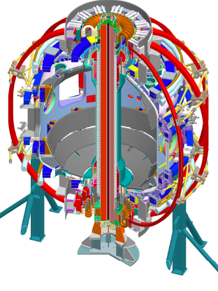
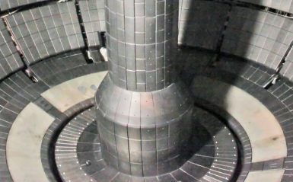
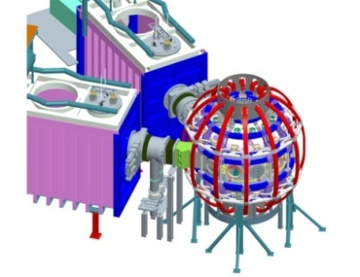
Formulating FY2014-18 5 year plan to access new ST regimes with Upgrade + additional staged & prioritized upgrades
2009 | 2010 | 2011 | 2012 | 2013 | 2014 | 2015 | 2016 | 2017 | 2018
1 MA Plasma
Upgrade Outage
1.5 → 2 MA Plasma
NSTX Upgrade research goals in support of FNSF and ITER
• Low collisionality plasma regimes
• 100% non-inductive operation
• Long-pulse, high power divertor
• Advanced high-β scenarios
CHI Control Coils
New Center-Stack
0.5 MA CHI
1 MA CHI / Plasma Gun
LLD
Moly-tile
2nd NBI
ECH/EBW
1MW
2 MW
HHFW Upgrade
New Center-stack
0.5 MA Plasma Gun
Long–pulse
Divertor
“Snowflake”
NCC Upgrade
Secondary
PP option
2nd NBI
Primary
PP option
NOTE: Upgrade operation would be delayed ~1 year to mid-2015 w/o incremental, other follow-on upgrades are further delayed
Existing
coils
Lithium
Non-axisymmetric Control Coils (NCC)

Slide 36
NSTX-U 5 year plan goal: transition to (nearly) complete wall coverage w/ metallic PFCs to support FNSF PMI studies
Assess compatibility of high τ_{E} and β + 100% NICD with metallic PFCs
Baseline
W is leading candidate material for FNSF/Demo divertor
C
BN
Mo PFCs
plus W divertor
Upper
Mo divertor
All
Mo divertor
All Mo tiles
All Mo PFCs
Mo
W
Li
Possible implementation paths for high-Z PFCs
Beginning of 5 yr plan
End of 5 yr plan

Slide 37
Direct comparison of cryo-pumping and flowing LLD by end of next 5 yr plan would inform FNSF divertor decisions
Partially-detached snowflake + cryo-pump may provide sufficient heat-flux mitigation and particle control for NSTX-U, FNSF
  Presentation by J. Canik will discuss cryo-design
However, erosion of solid PFCs could pollute plasma, damage FNSF divertor/FW
  FNSF at 30% duty factor → ~10² - 10³ kg net erosion / year for typical FNSF size & power
  Further motivates research in flowing liquid metals
5 year plan for divertors (present thinking):
  Dedicate upper divertor to cryo-pump
  Dedicate lower divertor to flowing liquid Li tests, materials analysis particle probe (MAPP)
Cryo-pump
C
BN
Mo
(or W)
Li
Flowing LLD, MAPP probe, possible replaceable divertor module (RDM)

Slide 38
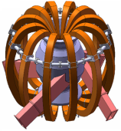
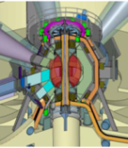
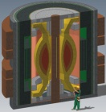
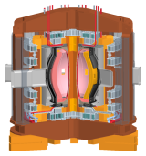
NSTX/ST researchers contributing to study of Mission and Configuration of an ST-FNSF
Overarching goal of study:
  Determine optimal mission, performance, size
Goals of study:
  Review existing designs, identify advantageous features, utilize these features in an updated and potentially improved configuration
  Assess potential of designs to achieve T self-sufficiency
  Assess maintainability and upgradeability of internal components
    Consider divertors, shields, blankets, and identify maintenance strategies
  Perform at least one self-consistent and detailed physics and engineering assessment for use by community
Strong ST community participation in the study so far
  Input from 13+ NSTX physicists + other US & UK researchers, LDRD supporting modest engineering and neutronics analysis
Russia
Culham
UT Austin
ORNL
PPPL

Slide 39
Summary: NSTX-U plan strongly supports OFES vision for fusion for next decade emphasizing ITER, PMI, FNSF
Plasma dynamics and control
  NSTX performed detailed measurements of turbulence, transport, core/edge stability, and integrating this knowledge to develop advanced high-β ST scenarios
  NSTX Upgrade will extend these scenarios to full non-inductive operation with current profile control + advanced stability control w/ application to FNSF, ITER-AT
Plasma material science and technology, support FNSF
  NSTX has provided critical data on SOL-width scaling and SOL turbulence, novel high-flux-expansion divertors for heat-flux mitigation, and lithium-based PFCs
  NSTX Upgrade will extend these studies to substantially higher heat flux, τ_{pulse}
  NSTX + Upgrade providing critical data for assessing the ST as potential FNSF
Validated predictive capability, discovery science
  Performing leading validation efforts for turbulent transport, RWM stability and 3D MHD effects, edge turbulence, fast-ion transport from AE - important to ITER, ST
  Upgrade will substantially extend range of collisionality, rotation, fast-ion drive, enabling access to a unique parameter regime of order-unity β and low ν*

Slide 40
Backup material – PAC-29 recommendations

Slide 41
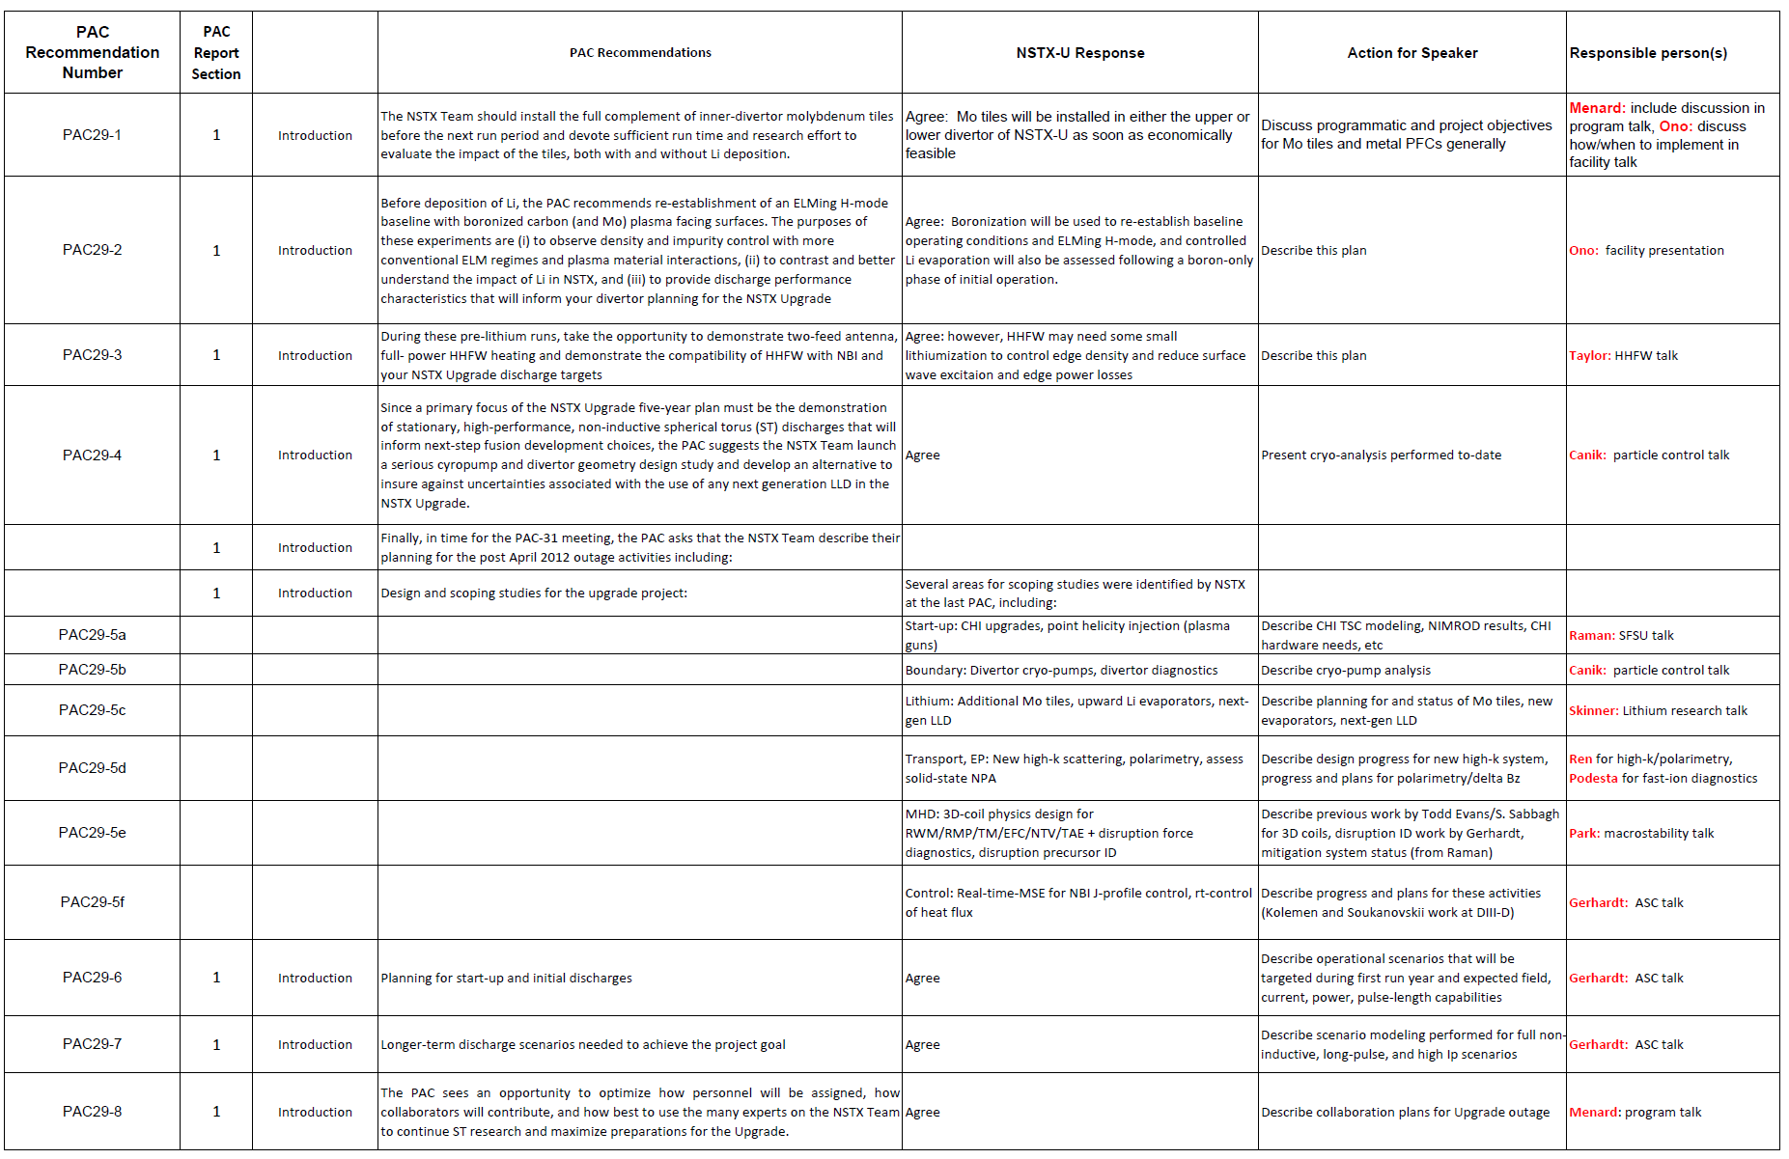
Table of responses to PAC-29 recommendations (1)

Slide 42
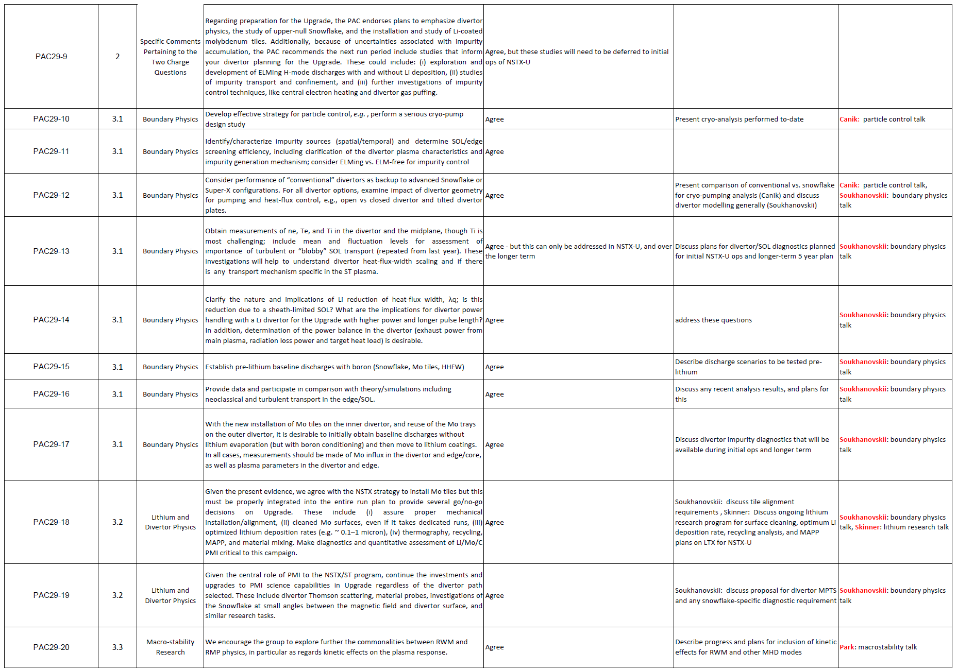
Table of responses to PAC-29 recommendations (2)

Slide 43
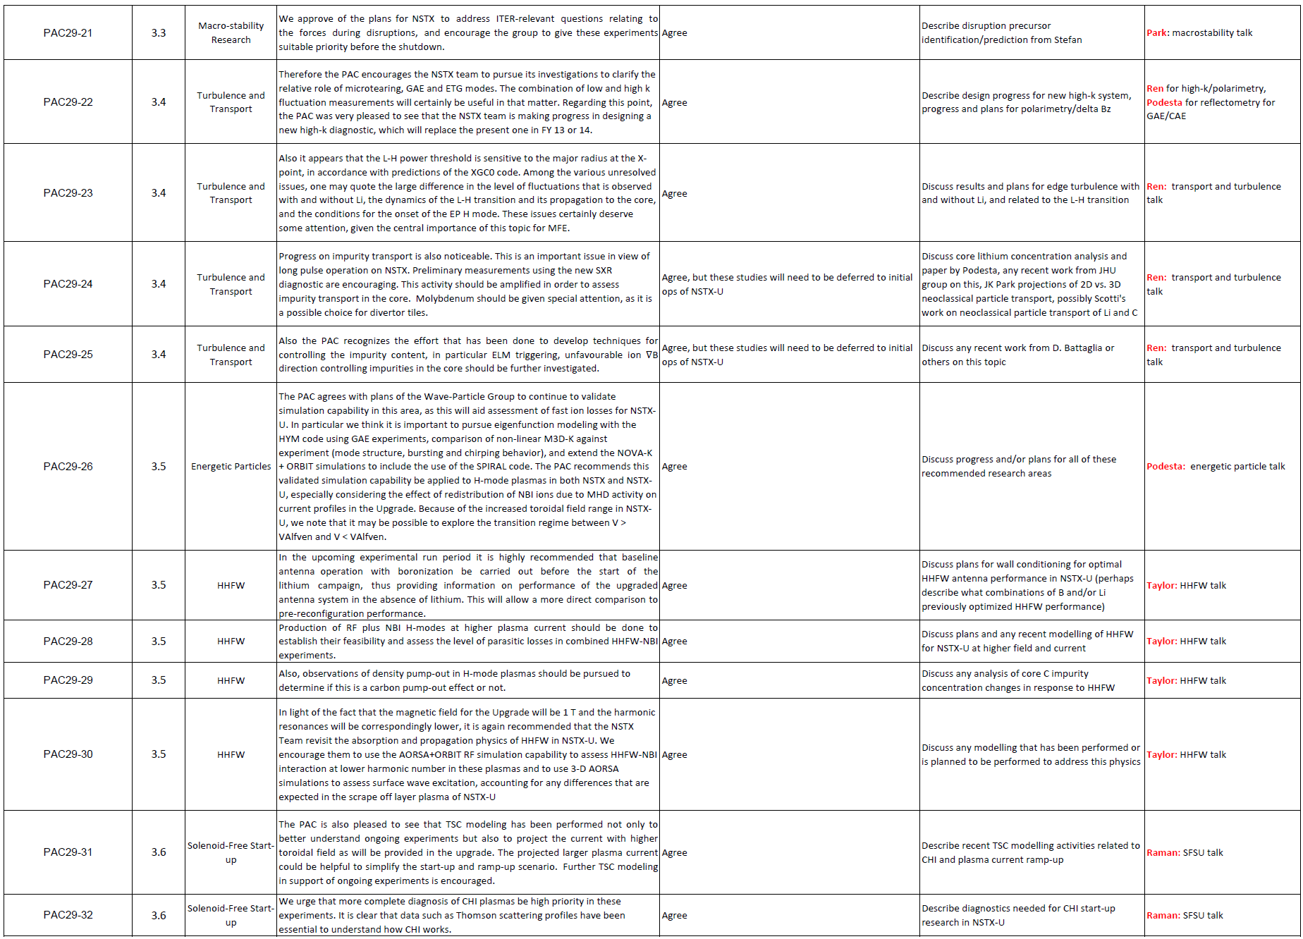
Table of responses to PAC-29 recommendations (3)

Slide 44
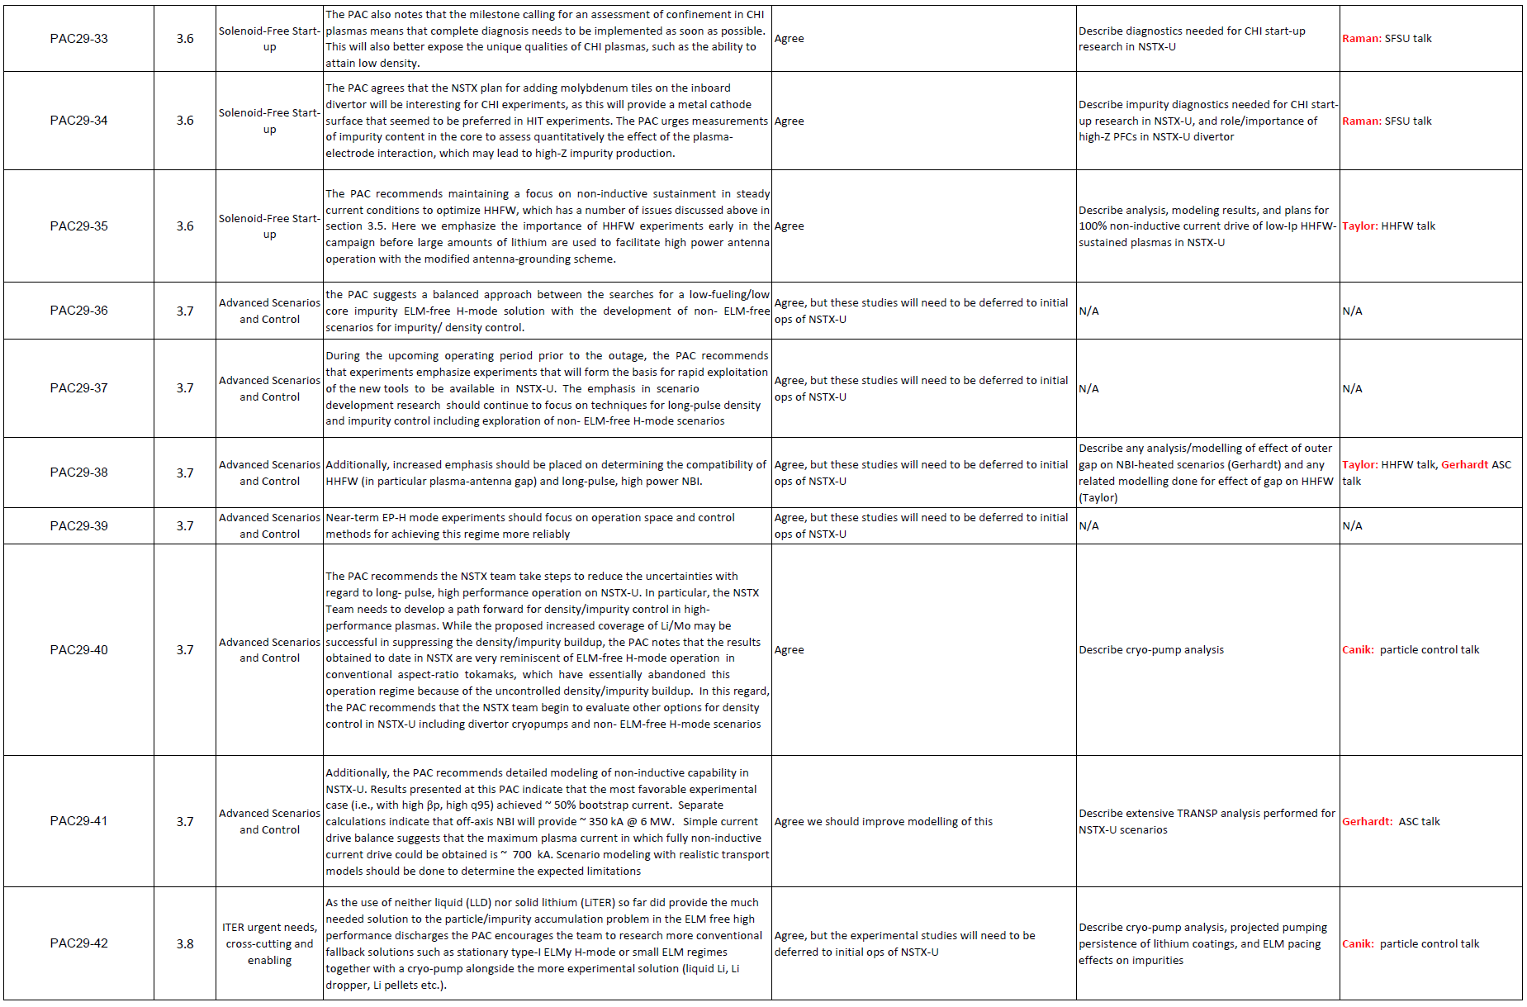
Table of responses to PAC-29 recommendations (4)

Slide 45
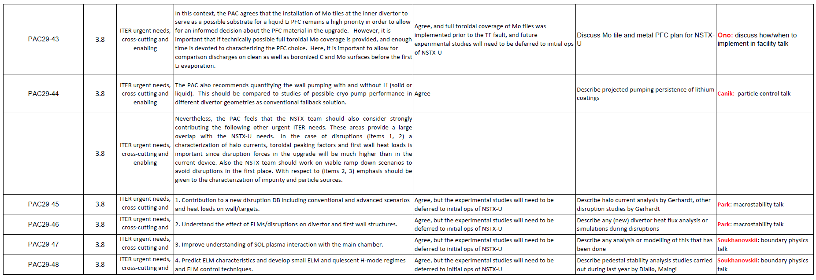
Table of responses to PAC-29 recommendations (5)

Slide 46
Backup: LLD results and needs for flowing LLD

Slide 47
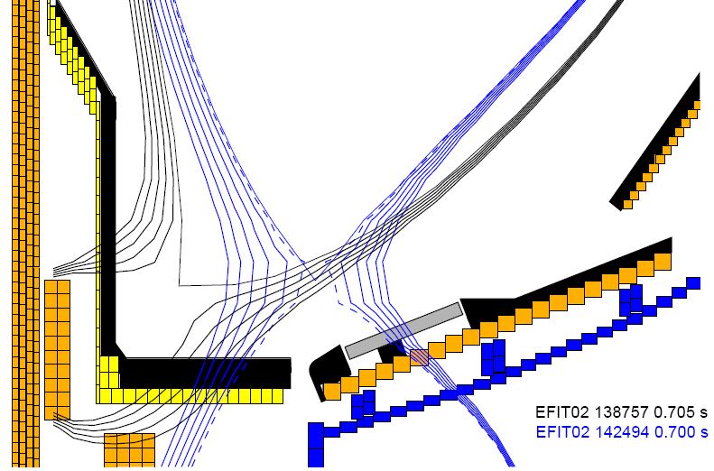
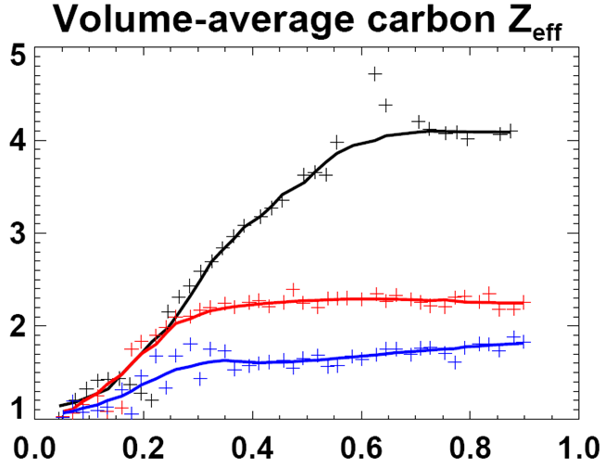

Operation with outer strike-point on liquid lithium divertor (LLD)
(porous Mo coated w/ Li) compatible w/ high plasma performance
LLD FY2010 results:
LLD
LLD did not increase D pumping beyond that achieved with LiTER
No evidence of Mo from LLD in plasma during normal operation
Operation with strike-point on LLD can yield reduced core impurities
Row of inboard Mo tiles installed for FY11-12 run, can re-use in NSTX-U
Strike-point on inner C divertor (no ELMs)
Strike-point on LLD, T_{LLD} < T_{Li-melt}
Strike-point on LLD, T_{LLD} > T_{Li-melt} (+ fueling differences)
  No ELMs, no → small, small → larger
  Li + plasma-facing component research will be continued, extended in NSTX-U

Slide 48
Flowing LLD will be studied as alternative means of particle and power exhaust, access to low recycling
LLD, LTX → liquid Li required to achieve pumping persistence
  Flowing Li required to remove by-products of reactions with background gases
Substantial R&D needed for flowing Li
Need to identify optimal choice of concept for pumping, power handling:
  Slow-flowing thin film (FLiLi)
  Capillary porous system (CPS)
  Lithium infused trenches (LiMIT)
  All systems above require active cooling to mitigate highest heat fluxes of NSTX-U
Elimination of C from divertor needed for “clean” test of LLD D pumping
  May need to remove all C PFCs?
Possible approach:
Dedicate 1-2 toroidal sectors (30-60˚ each) to LLD testing
(and/or integrate with RDM?)
Test several concepts simultaneously
Full toroidal coverage after best concept is identified
C
Mo
Flowing LLD

Slide 49
Backup: summary of collaboration activities

Slide 50
Collaborations: Held team-wide discussion on FY12-13 opportunities and expectations in Sep-Dec 2011
Collaboration should aim to support NSTX-Upgrade mission
  Also support toroidal physics generally, ICCs, and non-fusion applications
For all researchers, use Upgrade outage as opportunity to:
  Extend and improve your ongoing and future research on NSTX
  Learn about other facilities – bring back knowledge, best practices
  Try or learn something new – new physics, diagnostics, analysis, …
Aim to form small teams from NSTX (PPPL + non-PPPL)
  Coordinate research plans, analysis, travel, and participation
Expectations for researchers:
  Select 1 primary and 1 secondary/backup collaboration project
  Aim for 1st author papers, invited talks – PRL/NF/PoP, APS/IAEA
  Present your results periodically to NSTX, PPPL research seminars
Facilities: MAST, DIII-D, C-Mod, LHD, EAST, KSTAR, JET, more to come
Funding: PPPL covers salaries of PPPL NSTX researchers by default
Challenge: no additional NSTX funding dedicated to collaboration
Working closely with PPPL off-site research department

Slide 51
Collaborations in materials/PMI, boundary physics
EAST is only other divertor H-mode facility using lithium
  Li/transport expts on EAST – D. Mansfield, J. Menard, M. Jaworski, K. Tritz
Li surface chemistry issues on LTX, working with PU, Purdue
  Use Purdue MAPP on LTX + surface/PMI studies – C. Skinner, M. Jaworski
  Improve equilibrium reconstruction/control on LTX – Gerhardt, Menard
Assess high-Z PFCs for NSTX-U through collaboration on C-Mod
  LLNL group to assess: Mo with low-Z coatings, study cryo-pump for density control with moly PFC (particle balance, supersonic gas jet fueling), possibly radiative divertor control development
Develop NSTX-U snowflake control on DIII-D
  V. Soukhanovskii + E. Kolemen
Test LLNL SPRED, NIR for NSTX-U divertor diagnosis
  LLNL to work with Y. Raitses’ LTP source
Pedestal/SOL transport, turbulence, stability research for ITER and NSTX-U
  Pedestal turbulence using correlation reflectometer on C-Mod - A. Diallo
    A. Diallo also planning XPs on DIII-D (R. Groebner), possibly MAST
  XGC0 simulations of DIII-D edge transport w/ 2D & 3D fields - D. Battaglia
  SOL turbulence measurements with GPI on EAST, C-Mod - S. Zweben

Slide 52
Collaborations on core transport and turbulence
Pursue TGLF/TGRYO studies for scenario prediction for NSTX-U and DIII-D, also DIII-D transport studies
  W. Guttenfelder, Y. Ren, and S. Kaye
Comparison of NSTX and MAST transport physics, BES data
  S. Kaye, W. Guttenfelder, D. Smith/Univ. Wisconsin
Exploration of new/needed turbulence diagnostics for NSTX-U
  PCI for intermediate k_{θ} ρ_{s} (C-Mod) – Y. Ren
  Polarimetry for δB from μ-tearing (DIII-D & C-Mod) – Ren, Guttenfelder
Impurity transport studies, perturbative transport
  Exploring use of ME-SXR on EAST for profile meas. – K. Tritz (JHU)
3D field effects on transport and turbulence
  Transport simulations on LHD - D. Mikkelsen & (maybe) W. Guttenfelder

Slide 53
Collaborations in start-up, scenarios/control, MHD
Plasma start-up
  Work with Pegasus on plasma guns, possibly DIII-D to improve PF-only + EC start-up and inform proposed NSTX-U ECH/EBW – D. Mueller
  Investigate application of CHI on QUEST – R. Raman (U. Wash)
  EBW startup experiments on MAST - G. Taylor
Advanced Scenarios and Control - E. Kolemen (relocated to GA)
  Prepare for current and rotation profile control in NSTX-U through collaboration on DIII-D using off-axis NBI (and counter-NBI), NTV
  Contribute to development of ITER plasma control specification
  MAST vertical control analysis/experiments – prep for NSTX-U/MAST-U
  Long-pulse tokamak ops/control experience (EAST/KSTAR) – D. Mueller
MHD Physics
  Assist DIII-D in new 3D δB sensors - N. Logan, J-K Park, J. Menard
  3D field physics in long-pulse H-mode in KSTAR – J.-K. Park, S. Sabbagh
  RWM physics at reduced ν* on DIII-D, NTV on MAST – S. Sabbagh/CU

Slide 54
Collaborations in waves and energetic particles, and diagnostic development
RF coupling and edge-loss studies in DIII-D for NSTX-U, ITER
  J. Hosea, R. Perkins, G. Taylor
RF-only H-mode in EAST – R. Wilson, G. Taylor
  Supports RF-only plasma heating/start-up studies for NSTX-U
Energetic particles and Alfvén eigenmode physics
  Study fast-ion physics on JET (2 year relocation), prep for possible DT campaign, beam ion loss measurements on LHD - D. Darrow
  Several fast-ion/AE physics opportunities on MAST
    Assess operation of MAST *AE antenna, participate in expts – E. Fredrickson
    Assess performance of neutron collimator, NBI fast-ion redistribution models – M. Podesta
    Fusion product loss detector – D. Darrow, W. Boeglin
Diagnostic development
  Assist with ITER diagnostics – B. Stratton
  Assist with MPTS on JET, LTX, maybe KSTAR & Pegasus – B. LeBlanc
  Develop/prepare new Accurate Wavelength Lens Spectrometer (AWLS) on LTX for installation/usage on NSTX-U – R. Bell

Slide 55
Some statistics, and issues going forward
Tracking 30-35 researchers, including on-site collaborators
  ~90% of researchers have definitive plans well-aligned with NSTX-U and/or PPPL research goals
Approximate order of collaboration emphasis by facility:
  DIII-D, C-Mod, EAST, MAST, KSTAR, LHD, LTX, …
  U.S. facilities most mature in diagnostics, tools, analysis, and are therefore often most attractive to researchers
EAST and KSTAR have expressed strong interest in collaboration from PPPL/NSTX researchers
  EAST, KSTAR still developing diagnostics, heating systems, organization for integrating collaborators – improving
Prep for NSTX-U operation highest priority by late 2013
  Also tracking who/what is needed for operations and diagnostics

Slide 56
Additional backup

Slide 57
Mission of ST-FNSF
Provide a continuous fusion nuclear environment of copious neutrons to develop an experimental database on:
  Nuclear-nonnuclear coupling phenomena in materials in components for plasma-material interactions
  Tritium fuel cycle
  Power extraction
ST-FNSF
(M. Peng, ORNL)
Complement ITER, prepare for component test facility (CTF):
  Low Q (≤ 3): 0.3 x ITER
  Neutron flux ≤ 2 MW/m²: 3 x
  Fluence = 1 MW-yr/m²: 5 x
  t_{pulse} ≤ 2 wks: 1000 x
  Duty factor = 10%: 3 x
Low-aspect-ratio “spherical” tokamak (ST) is most compact embodiment of FNSF

Slide 58
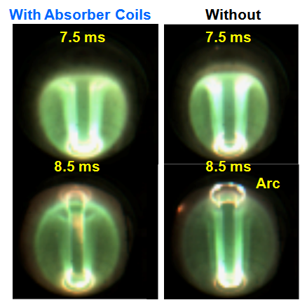
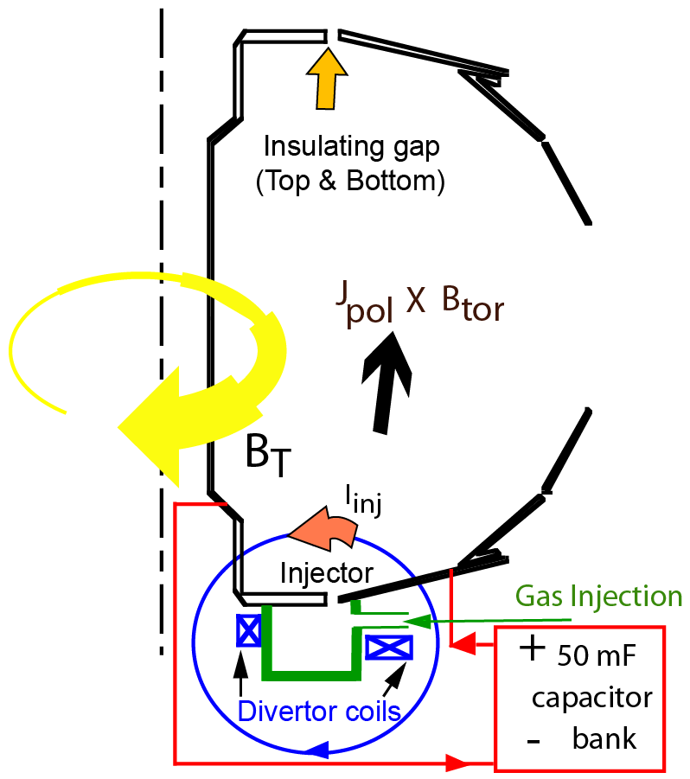
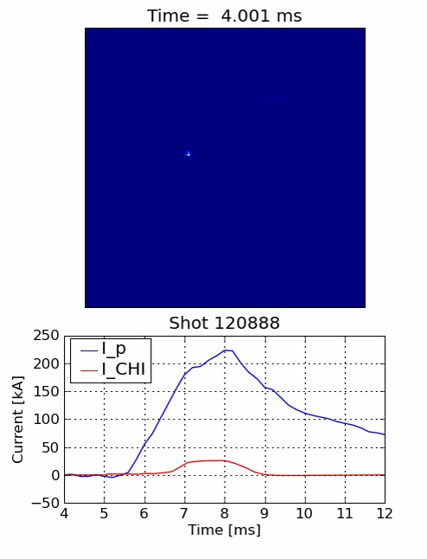

Transient CHI: Axisymmetric Reconnection Leads to Formation of Closed Flux Surfaces
Absorber region
Current multiplication increases with toroidal field
    - Favorable scaling with machine size
    - High efficiency (10 Amps/Joule in NSTX)

