Slide 1




NSTX-U
Supported by
Boundary Physics Progress and Plans
Vlad Soukhanovskii, LLNL
Ahmed Diallo, PPPL
Daren Stotler, PPPL
for the NSTX Research Team
Coll of Wm & Mary
Columbia U
CompX
General Atomics
FIU
INL
Johns Hopkins U
LANL
LLNL
Lodestar
MIT
Lehigh U
Nova Photonics
ORNL
PPPL
Princeton U
Purdue U
SNL
Think Tank, Inc.
UC Davis
UC Irvine
UCLA
UCSD
U Colorado
U Illinois
U Maryland
U Rochester
U Tennessee
U Tulsa
U Washington
U Wisconsin
X Science LLC
Culham Sci Ctr
York U
Chubu U
Fukui U
Hiroshima U
Hyogo U
Kyoto U
Kyushu U
Kyushu Tokai U
NIFS
Niigata U
U Tokyo
JAEA
Inst for Nucl Res, Kiev
Ioffe Inst
TRINITI
Chonbuk Natl U
NFRI
KAIST
POSTECH
Seoul Natl U
ASIPP
CIEMAT
FOM Inst DIFFER
ENEA, Frascati
CEA, Cadarache
IPP, Jülich
IPP, Garching
ASCR, Czech Rep
NSTX PAC-31
PPPL B318
17 – 19 April 2012

Slide 2
NSTX Boundary Physics program contributes to a critical research area for ITER/tokamaks and STs
DOE Joint Research Targets
  FY 2013: Enhanced confinement regimes without ELMs
NSTX research milestones
  R(12-2): Project deuterium pumping capabilities for NSTX-U using lithium coatings and cryo-pumping (with LR and ASC TSGs)
  R(13-2): Investigate the relationship between lithium-conditioned surface composition and plasma behavior (with LR TSGs)
  R(14-2): Develop advanced axisymmetric control in sustained high performance plasmas (with ASC and MS TSGs)
Divertor solution for NSTX-U
  Integrated power, impurity and density control aimed at future STs
ITPA participation and high-priority ITER research tasks
2
Notes:
2

Slide 3
Outline
Boundary physics progress and near-term plans
  Edge transport and plasma-surface interactions
    Thermal heat transport in the SOL and divertor, heat flux mitigation
    SOL transport and turbulence studies
    Impurity source control
  H-mode physics
    Pedestal physics studies
    ELM characterization and control
Planning Boundary research for NSTX-U
  Initial years (1-2) of NSTX-U operation
  Later years (3-5) of NSTX-U operation
  Facility and diagnostic improvements, divertor power control plans
Summary
3
Notes:
3

Slide 4
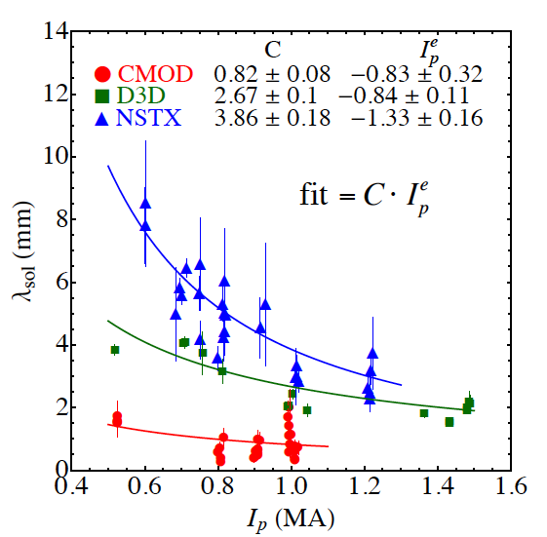
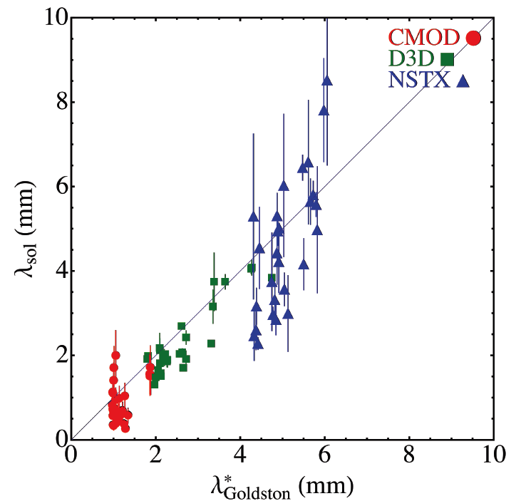
SOL width studies in NSTX elucidate on divertor projections for NSTX-U, ST-FNSF and ITER
JRT 2010 on heat transport
  λ_{q}^{mid} contracts with increasing I_{p}: λ_{q}^{mid} ~ I_{p}^{-1.6}
Comparison with SOL models
  Parallel transport: conductive/convective, cross-field : collisional / turbulent / drift
  XGC0 reproduced I_{p} dependence λ_{q}^{mid} ~ I_{p}^{-1.0}
  SOLT: I_{p} scaling is weaker than observed
    P_{SOL}, collisionality, L_{II} /R set cross-field transport and turbulence structure that affect λ_{q}
  Goldston drift-based model of SOL flows
    Attached H-mode regimes
    ∇B and curvature drift motion sets SOL width λ_{SOL} ~ (2a/R) ρ_{i}, Spitzer thermal conduction sets T_{sep}
  Exploring mechanisms setting steep pressure gradient region and connection to SOL width
Projections to NSTX-U
  λ_{q}^{mid} = 3±0.5 mm
  As q_{peak} ~ I_{p} and q_{peak}~P_{SOL}, q_{peak} ~ 20-30 MW/m²
M. Makowski, APS 2011
PAC29-12
PAC29-14

Slide 5
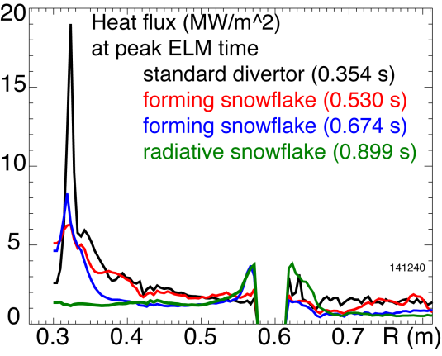
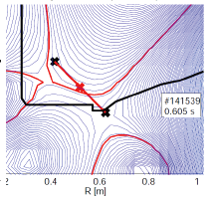
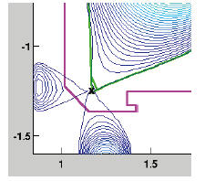
Further studies of snowflake divertor configuration contribute to NSTX-U divertor heat flux control options
NSTX snowflake divertor
  Second divertor null maintained with existing coils for ≤10 τ_{E}
  H-mode confinement, reduced core carbon
  Effective in heat flux dissipation
    Reduction from 3-7 MW/m² to 0.5-1 MW/m² between ELMs
    Reduction from ~ 20 MW/m² to 2-8 MW/m² at ELM peak
New collaboration with DIII-D
  Configuration control algorithm implemented in PCS
  Experiment proposed at ROF 2012
    If control demonstrated, positive outlook for run time in FY2012
    Excellent pedestal and divertor diagnostic capabilities to clarify outstanding questions (e.g. power balance, pedestal stability, particle control with cryo-pumping and argon seeding )
Modeling of NSTX snowflake experiment data
  Analysis of pedestal stability with BOUT++
  UEDGE modeling of heat transport and radiation
NSTX
experiment
DIII-D
simulation
R(14-2)

Slide 6
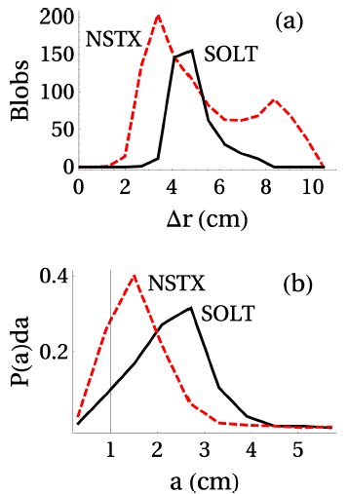
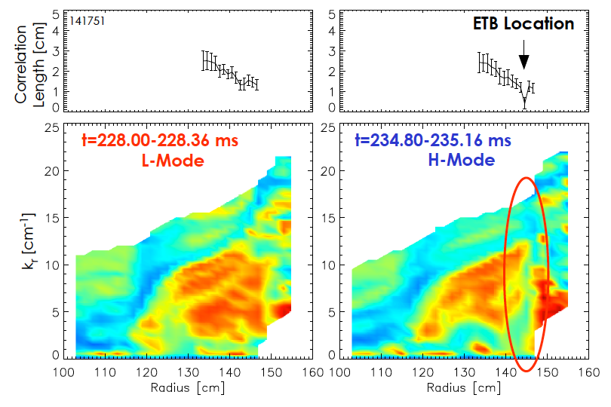
Pedestal / SOL turbulence measurements with reflectometry, BES and GPI contribute to model validation and L-H transition studies
Comparison of NSTX L-mode GPI turbulence data with SOLT simulation in agreement
  Number of blobs vs radius and probability distribution of blob poloidal half-width
Collaborating with EAST in GPI turbulence measurements
Reflectometry data at ohmic L-H transition shows:
  Edge k_{r} spectra: turbulence suppression
  Correlation lengths decreases
Further studies – comparison with GPI and BES
PAC29-13
PAC29-16

Slide 7
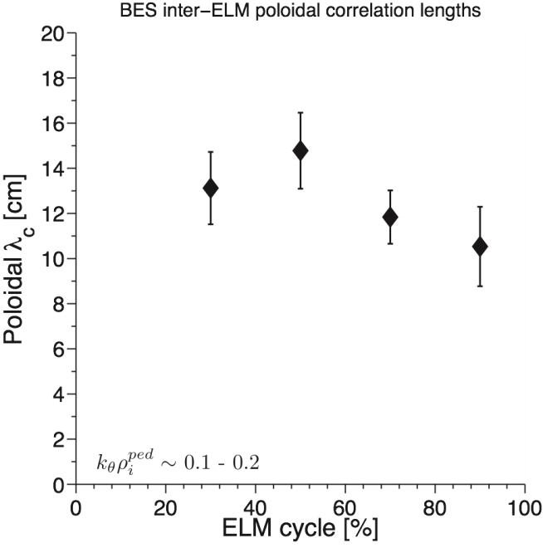
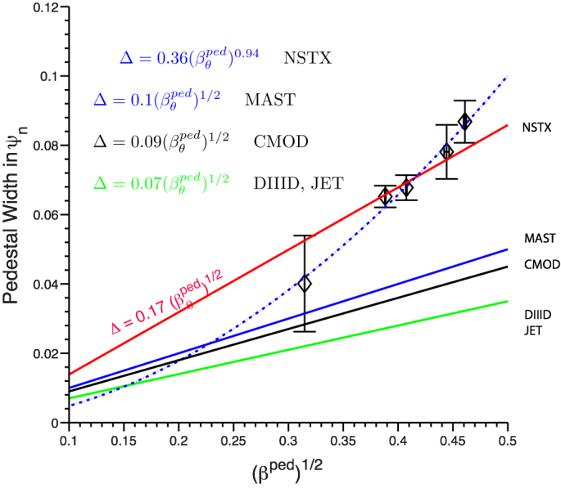
NSTX data from JRT 2011 on pedestal structure, stability and fluctuations to aid model development and projections to NSTX-U
Pedestal structure and stability with Type I ELMs
  P_{tot ped} ~ I_{p}², increases with δ_{bot}, independent of B_{t}
    Saturates only in the last 30% of the ELM cycle at low and intermediate I_{p}, and not at the high I_{p} > 1 MA
  ΔP_{tot} increases during the ELM cycle, independent of I_{p}
  Pressure gradient is clamped during most of the ELM cycle
  Characterization of fluctuations during the inter-ELM phase
    Reflectometry: a coherent density fluctuation, λ_{r}
    BES: modest change in pol. correlation length, propagation in ion diamagnetic direction
    Ion scale turbulence 0.2 ≤ k⊥ρi ≤ 0.7 with λ_{θ}>λ_{r}
    ITG, ITG/TEM, KBM stability modeling underway
Transition from ELMy to ELM-suppressed H-modes with lithium coatings
Comparison with models: ELITE, Paleoclassical, XGC1
Further work
  Collaboration with Alcator C-Mod on O-mode correlation reflectometry and M3D modeling
  Microturbulence (GS2) and microturbulence-neoclassical (XGC1) modeling

Slide 8
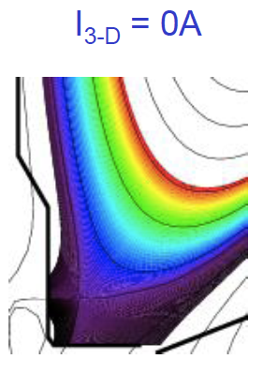
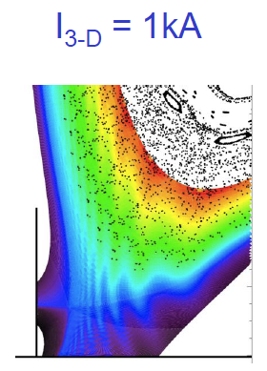
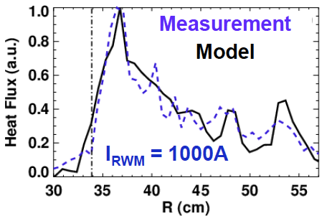
NSTX studies of ELM regimes and ELM control contribute to mitigation strategies for ITER and future STs
ELM triggering with n=3 RMP
  Weak RMP impact on pedestal transport
  Strong impact on stability
    T_{e}, pressure gradient increase
    PEST shows edge unstable with n=3
  Triggered ELMs are phase locked to the imposed 3D fields for n=1 and n=3
Divertor heat and particle structures during ELMs, intrinsic and 3D fields
  Applied 3D fields reattach detached divertor plasma
  Developing model of toroidally non-uniform heat and particle flux structures using EMC3-EIRENE
Small transport ELM-like events from 3D field application below ELM triggering threshold (w.r.t. duration or amplitude)
Collaboration with MAST in perturbed equilibria modeling
Discussing collaboration with ASDEX in small ELM analysis, effects of 3D fields on detachment
PAC29-48
JRT 2013

Slide 9
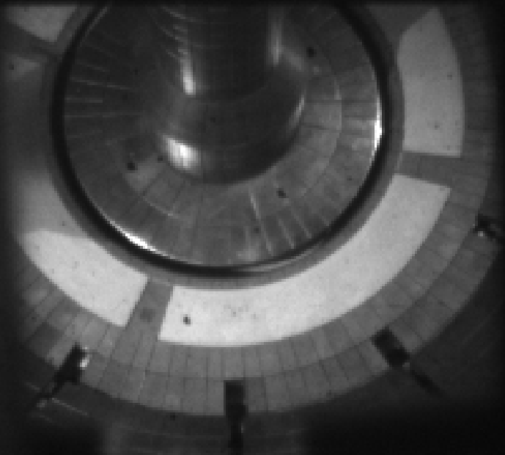
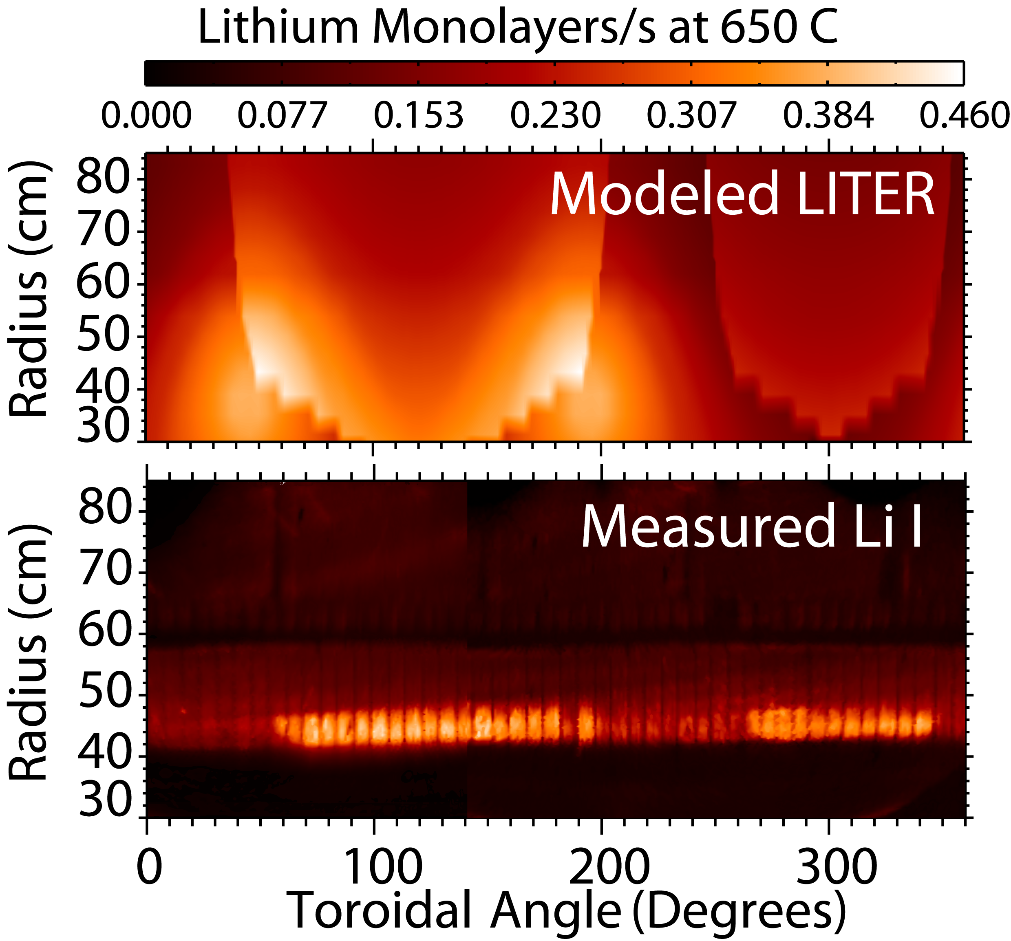
Diagnosis and analysis of impurity sources and transport aimed at understanding means to reduce impurity accumulation in NSTX-U
Carbon accumulation in ELM-free H-mode discharges w/ lithium
  Increased inward core carbon transport from NCLASS multi-species analysis
  Divertor carbon influx slightly decreased (from SXB analysis)
  SOL parallel transport being analyzed with UEDGE
Toroidally non-uniform erosion fluxes due to LITER deposition patterns
  Result in mixed impurity fluxes (Li, C)
Assessment of high Z PFC materials for NSTX-U
  Collaboration with Alcator C-Mod on molybdenum gross and net erosion diagnosis using intensified filtered camera
    Collaboration with ADAS consortium on Mo I and Mo II SXB and PEC
PAC29-17
R(12-2)
PAC29-18
R(13-2)
PAC29-47

Slide 10
Outline
Boundary physics progress and near-term plans
  Edge transport and plasma-surface interactions
    Thermal heat transport in the SOL and divertor, heat flux mitigation
    SOL transport and turbulence studies
    Impurity source control
  H-mode physics
    Pedestal physics studies
    ELM characterization and control
Planning Boundary research for NSTX-U
  Initial years (1-2) of NSTX-U operation
  Later years (3-5) of NSTX-U operation
  Facility and diagnostic improvements, divertor particle and power control plans
Summary
10
Notes:
10

Slide 11
Boundary Research in years 1-2 of NSTX-U operation aims at comparing results to NSTX trends, extending to longer pulse
Re-establish reliable H-mode operation
Complete assessment of trends w.r.t. NSTX
  Pedestal structure
    Dependence on B_{t}, I_{p}, shaping
  Response to 3D magnetic field perturbations
    ELM studies, ELM control development, pedestal transport
  H-mode research
    EPH-mode, I-mode development
  Edge and SOL physics
    Midplane and divertor turbulence, zonal flows, L-H transition
  Divertor research
    Heat flux width scaling, connection to SOL models
    Snowflake divertor studies and control development
    Radiative divertor with D₂, Ne, Ar seeding
    Impurity erosion and SOL transport studies
    Experiments to support validation of cryo-pump designs

Slide 12
Advanced diagnostic and facility capabilities of NSTX-U aim to establish Boundary Physics basis for ST-FNSF in Years 3-5
Assess Mo divertor PFCs and their impact on H-mode confinement
  Core moly density and transport in baseline scenarios
  Effect of lithium coatings on molybdenum PFCs (synergistic study with EAST)
  Divertor Mo influx in baseline and impurity-seeded radiative divertor scenarios
Develop and validate divertor heat and particle control
  Support projections of heat flux width and divertor scenarios to ST-FNSF
  Utilize magnetic control for long-pulse snowflakes with reduced heat flux
  Implement radiative divertor control
Assess and optimize pedestal structure and SOL parameters for advanced ST operation
  Utilize 3D fields to optimize pedestal transport and stability
  Perform experiments and develop models enabling projections to FNSF

Slide 13
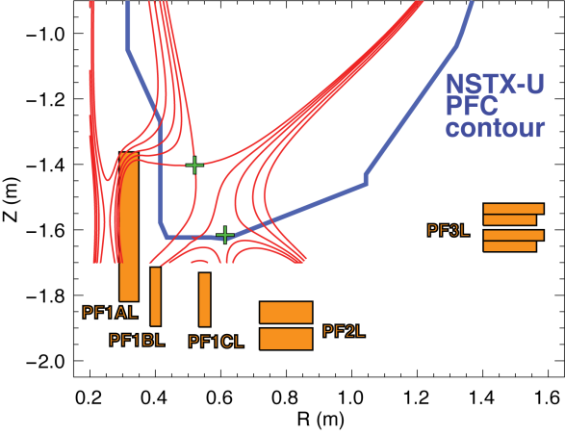
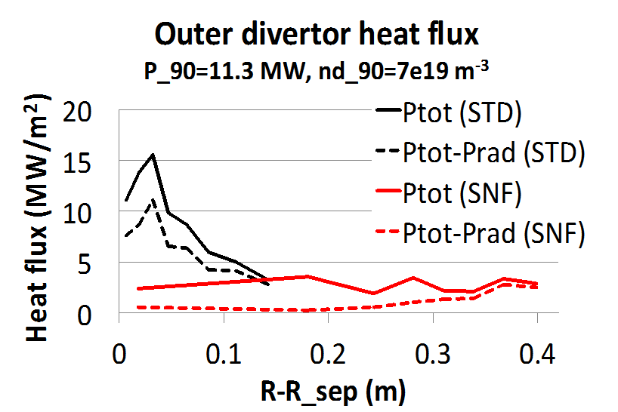
Snowflake geometry and impurity-seeded radiative divertor with feedback control are the leading heat flux control candidates
NSTX-U scenarios with high I_{p} and P_{in} projected to challenge thermal limits of graphite divertor PFCs
Single and double-null radiative divertors and upper-lower snowflake configurations considered
  Supported by NSTX-U divertor coils and compatible with coil current limits
Snowflake divertor projections to NSTX-U optimistic
  UEDGE modeling shows radiative detachment of all snowflake cases with 3% carbon and up to P_{SOL}~11 MW
    q_{peak} reduced from ~15 MW/m² (standard) to 0.5-3 MW/m² (snowflake)
Radiative divertor feedback control development
  Divertor monitor development and prototyping
    Heat flux, surface temperature, radiation, neutral pressure, recombination
  Considering improvements to divertor gas system & controls, PCS capability w/ ASC TSG
  Discussing collaboration with DIII-D
NSTX-U
snowflake
simulation

Slide 14
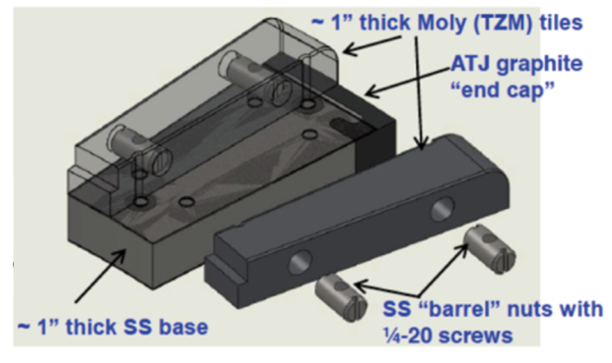
NSTX-U facility improvements and capabilities should provide excellent support of Boundary Research
Developing PFC plan to transition to full metal coverage for FNSF-relevant PMI development
Wall conditioning: GDC, Li and / or boron coatings
PFC bake-out at 300-350ºC
PCS control of divertor coils
Non-axisymmetric control coils
Possible progressions
C
BN
C
BN
C
BN
BN
Mo
Mo
Mo
Mo
Mo
W
Baseline
Upper
Mo divertor
All
Mo divertor
All Mo tiles
All Mo PFCs
Mo wall
+ W divertor
5 yr plan
Fueling tools:
  Near-term: NBI, edge gas injection (including HFS and SGI) with PCS feedback control
  Divertor impurity gas seeding
  Longer term: pellet, molecular cluster, compact toroid injectors
Mo tiles
Secondary
PP option
Primary
PP option
Existing
coils
Non-axisymmetric Control Coils (NCC)

Slide 15
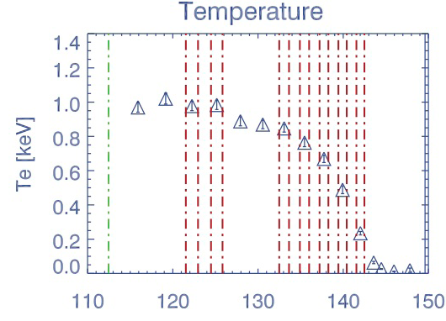
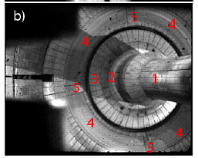
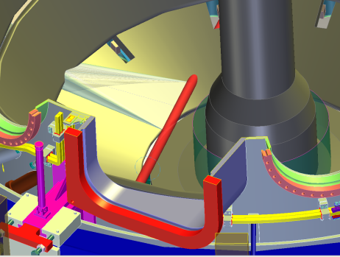
Diagnostic improvement strategy focuses on baseline support in Years 1-2, advanced capabilities in Years 3-5
NSTX existing pedestal and SOL/divertor diagnostics would provide sufficient capabilities for initial experiments
High priority improvements for initial NSTX-U operation:
  Pedestal and SOL fluctuation diagnostics (2D BES, 3D GPI)
  Divertor Langmuir probes
  Divertor bolometry
  Upper divertor IR and visible cameras and spectroscopy
  Inner divertor (lower and upper) IR and visible cameras and spectroscopy
Longer term NSTX-U Boundary diagnostic goals:
  Molybdenum core, edge, divertor spectroscopy (VUV, visible)
  Edge profile reflectometry
  Full plasma radiation tomography
  Edge neutral density measurements (LIF or LII)
  Divertor Thomson Scattering system
  SOL flow measurements
  SOL and divertor ion energy or temperature
  SOL current sensors
  NSTX MPTS 2011
R(cm)

Slide 16
NSTX Boundary Physics Program Summary
Improving understanding of SOL heat and particle transport to enable their control in NSTX-U and projections to ITER and ST-FNSF
Improving understanding of H-mode pedestal structure, ELM stability and 3D physics
Preparing for NSTX-U research
  Collaborating on experiments and modeling
  Developing prioritized research plans
  Improving diagnostic and facility capabilities in support of research plans
16
Notes:
16

Slide 17
Backup

Slide 18
  Overview of NSTX Contributions to JRT 2013 on
  Enhanced Confinement Regimes without ELMs
Original intention was that NSTX would collect targeted data during the operation period July 2011-February 2012.
  TF magnet failure during machine commissioning →NSTX last collected data in Oct. 2010 → will contribute analysis of existing data
NSTX contributions under consideration:
  Heat flux measurements during type-V ELMs.
  Further study of type-V ELM regime access conditions.
  Occurrence of EHOs and the potential to actively drive them.
  Modifications to particle and heat transport with 3D fields.
    Not RMP ELM suppression.
  Search for I-mode in the database.
  Other…EPH, Lithium application, IPEC+NTV
Courtesy of
S. Gerhardt,
R. Maingi

Slide 19
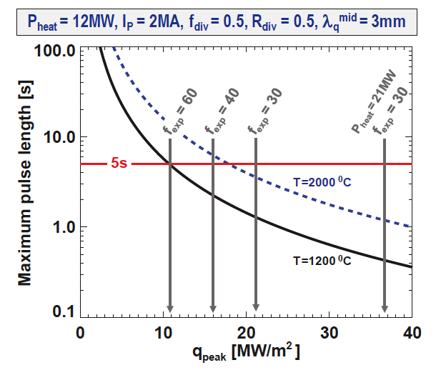
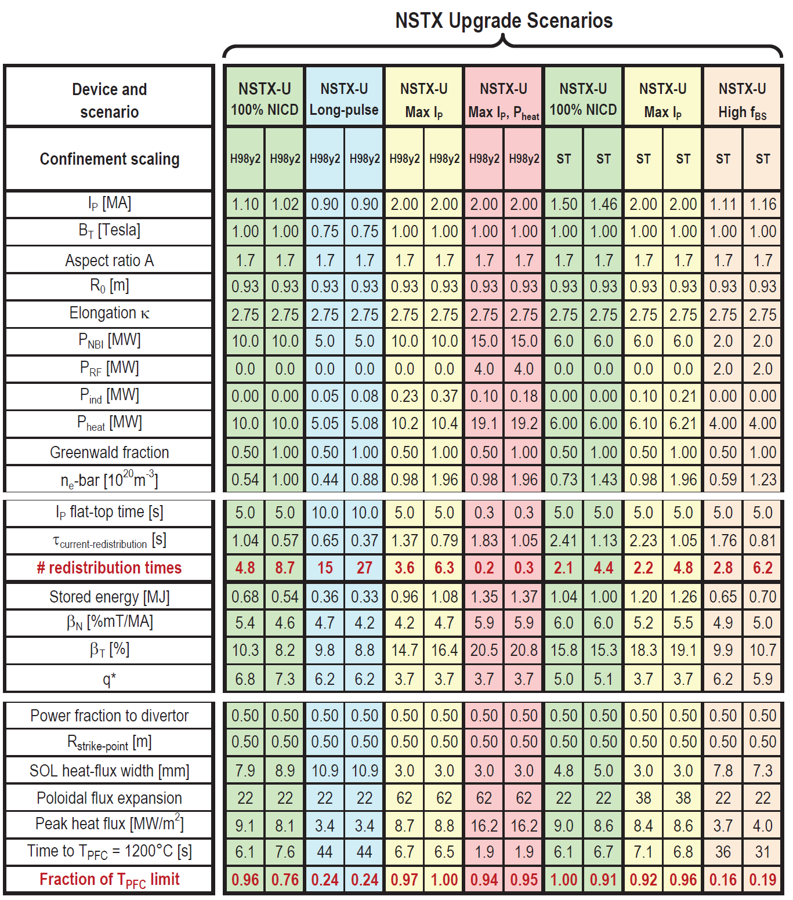
NSTX-U scenarios with high current and power are projected to challenge passive cooling limits of graphite divertor PFCs
High I_{P} scenarios projected to have narrow λ_{q}^{mid} → ~3mm
  At high power, peak heat flux ≥ 9MW/m² even with high flux expansion ~60 with U/L snowflake
  Numbers shown ignore radiation, plate tilt, strike-point sweeping
Passive cooling ok for low-I_{P} scenarios
Long-pulse + high I_{P} and power may ultimately require active divertor cooling

Slide 20
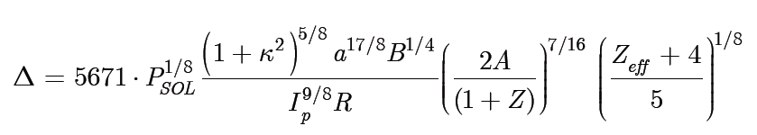
Heuristic Drift Scaling Fits Recent Data from JET, AUG,
C-MOD, DIII-D and NSTX in Attached H-Mode Regimes
Courtesy of
R. J. Goldston
GradB and curvB drift motion sets SOL width, Spitzer thermal conduction sets edge T
NSTX data constrain aspect ratio scaling roughly in agreement with theory

Slide 21
Various techniques developed for reduction of heat fluxes q|| (divertor SOL) and q_{peak} (divertor target)
Promising divertor peak heat flux mitigation solutions:
  Divertor geometry
    poloidal flux expansion
    divertor plate tilt
    magnetic balance
  Radiative divertor
Recent ideas to improve standard divertor geometry
  X-divertor (M. Kotschenreuther et. al, IC/P6-43, IAEA FEC 2004)
  Snowflake divertor (D. D. Ryutov, PoP 14, 064502 2007)
  Super-X divertor (M. Kotschenreuther et. al, IC/P4-7, IAEA FEC 2008)

Slide 22
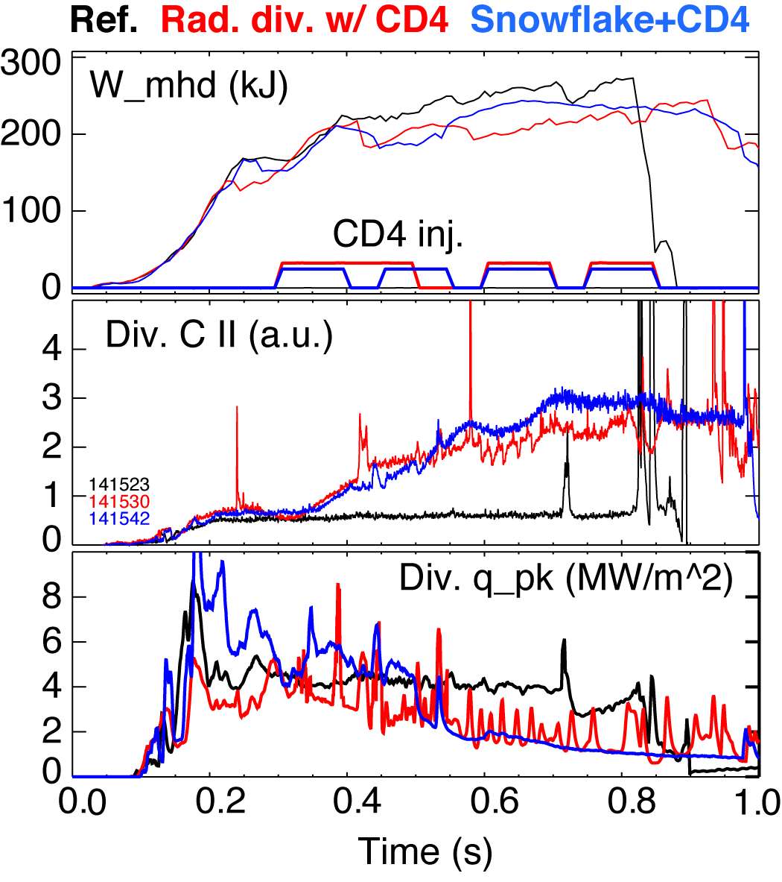
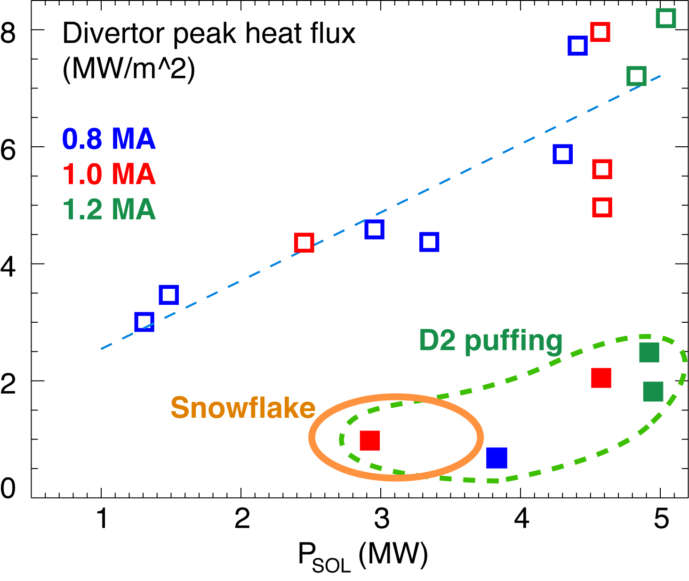
Snowflake geometry and impurity-seeded radiative divertor are the leading heat flux mitigation candidates for NSTX-U
Conventional and snowflake radiative divertors demonstrated divertor heat flux reduction simultaneously with H-mode confinement in NSTX
  Standard radiative divertor with D₂ or CD₄ seeding
  Snowflake divertor with D₂ or CD₄ seeding
    Increased divertor radiation beyond standard radiative divertor
NSTX data

Slide 23
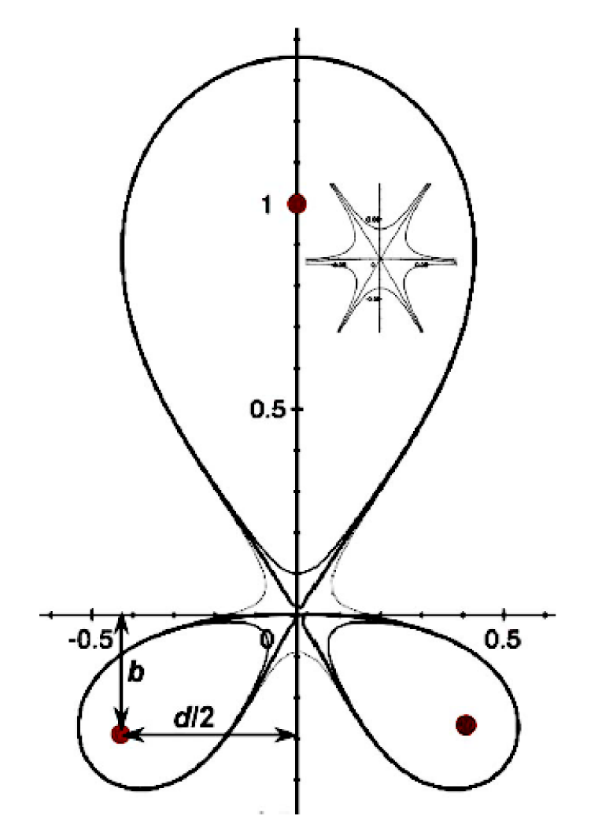
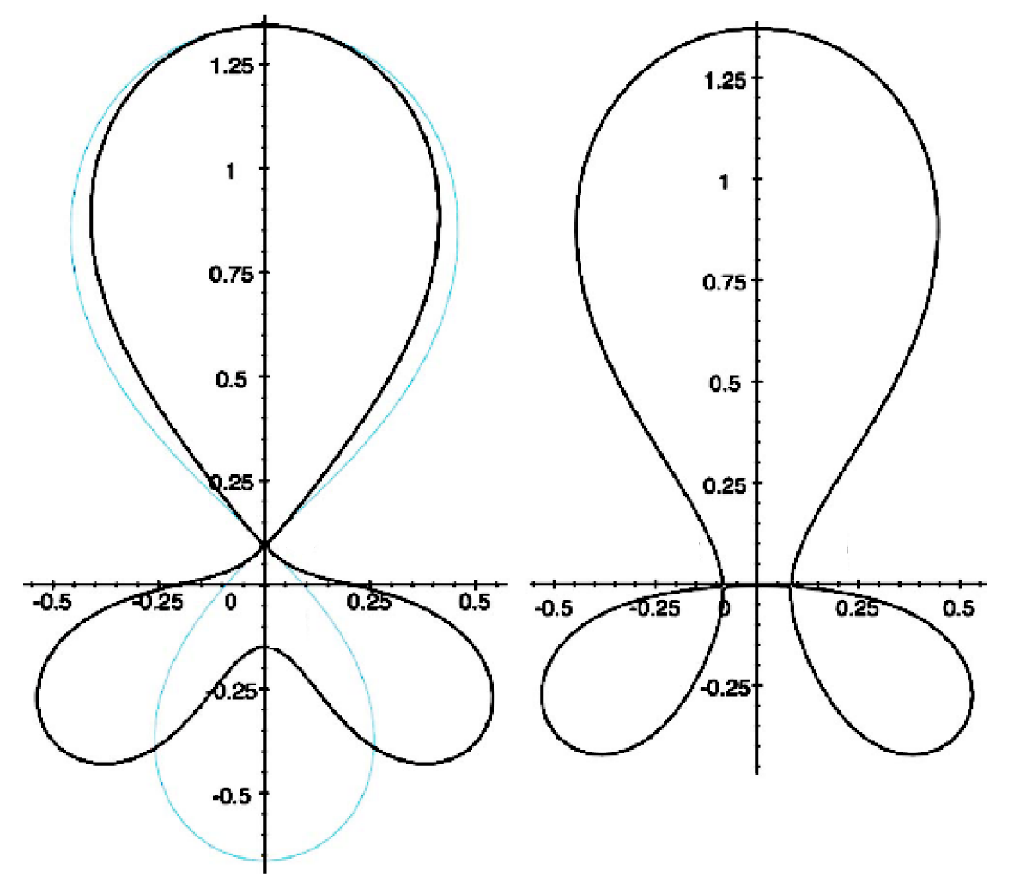
Snowflake divertor geometry attractive for heat flux mitigation
Snowflake divertor
  Second-order null
      B_{p} ~ 0 and grad B_{p} ~ 0 (Cf. first-order null: B_{p} ~ 0)
  Obtained with existing divertor coils (min. 2)
  Exact snowflake topologically unstable
Predicted geometry properties (cf. standard divertor)
  Larger region with low B_{p} around X-point: ped. stability
  Larger plasma wetted-area A_{wet} : reduce q_{div}
  Larger X-point connection length L_{x} : reduce q_{II}
  Larger effective divertor volume V_{div} : incr. P_{rad} , P_{CX}
Experiments
  TCV (F. Piras et. al, PRL 105, 155003 (2010))
  NSTX
Exact
snowflake
divertor
snowflake-minus
snowflake-plus
D. D. Ryutov, PoP 14, 064502 2007

Slide 24
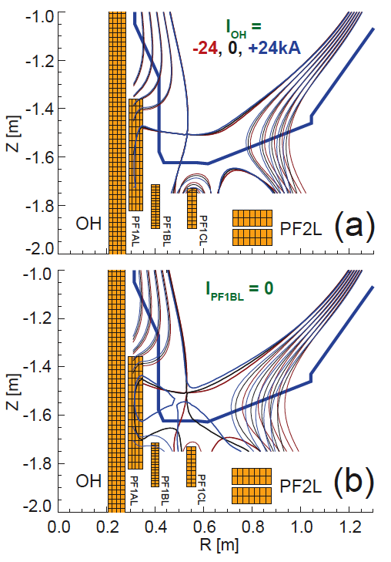
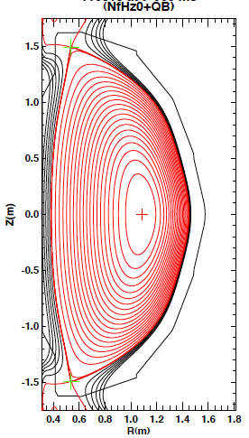
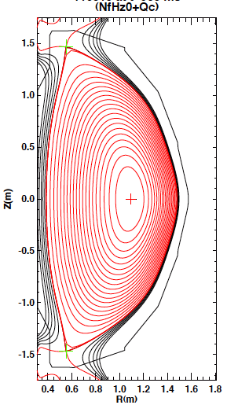
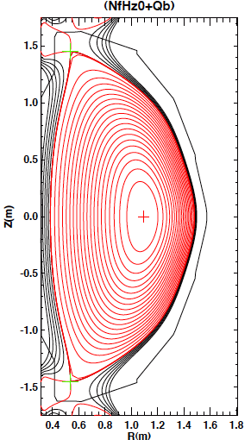
Boundary magnetic configuration modeling for NSTX-U
Single and double-null radiative divertors and upper-lower snowflake configurations considered
  Supported by NSTX-U divertor coils and compatible with coil current limits
  ISOLVER modeling shows many possible equilibria
    Impact of changing I_{OH} on snowflake minimal
    Reduced divertor coil set can be used for snowflakes
NSTX-U simulation
NSTX-U double-null
NSTX-U double-snowflake-plus
NSTX-U double-snowflake-minus

Slide 25
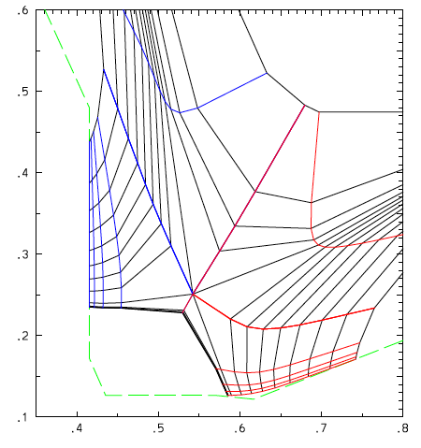
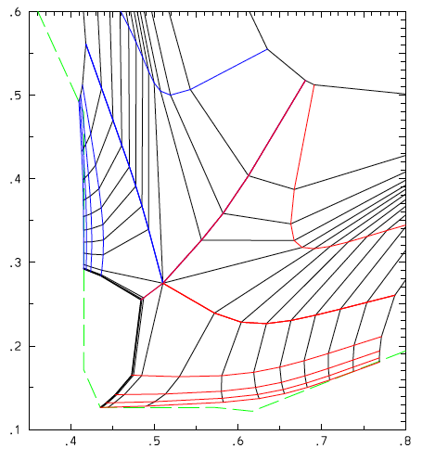
Snowflake divertor transport modeling with UEDGE for NSTX-U
2D multi-fluid code UEDGE
  Mesh setup based on modeled equilibria:
    psi=0.9 to psi=1.055
    STD grid covers 9.1 mm at midplane
    SNF grid covers 10.5 mm at midplane
  Fluid (Braginskii) model for ions and electrons
  Fluid for neutrals (diffusive model used)
  Classical parallel transport, anomalous radial transport
    D = 0.25 m²/s; χ_{e,i} = 0.5 m²/s
  recycp=.98; recycw=1; fixed fraction C – 3%
  Core boundary conditions based on TRANSP
    Year 3-5: B_{t}=1.0 T, I_{p}=1700 kA, P_{inj}=12.6 MW
    Scan in UEDGE power and density around TRANSP values +/- 20%:
      P_90 = 7.6, 9.5, and 11.3 MW
      nd_90 = 7e19, 8.5e19, and 1e20 m⁻³
Standard divertor
Snowflake divertor
D* | D* | A
D | A | A
A | A | A
D | D | D
D | D | D
D | D | D
nd_90 (m⁻³)
nd_90 (m⁻³)
P_90 (MW)
P_90 (MW)
A → attached
D → detached (at outer target, T_e < 5 eV within 8 cm of SP)
* → not converged (solution is oscillating in detached state)
Courtesy of E. Meier

Slide 26
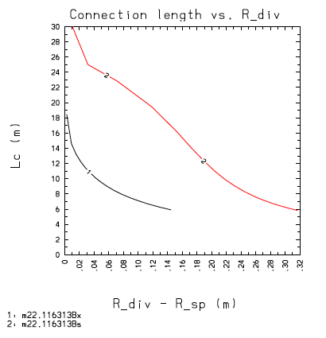
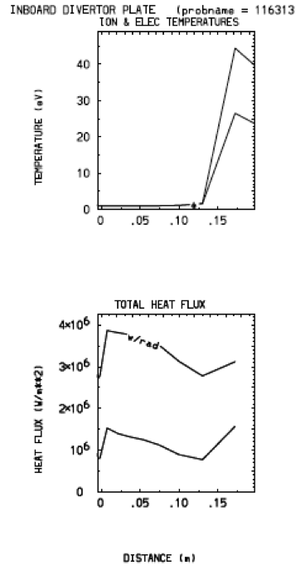
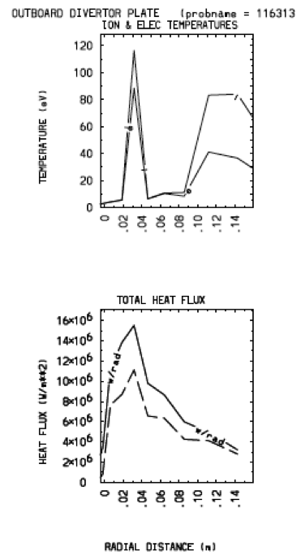
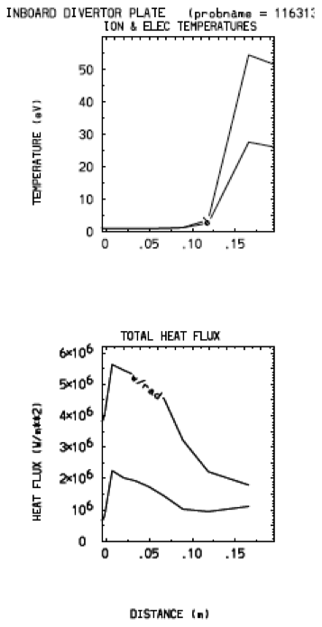
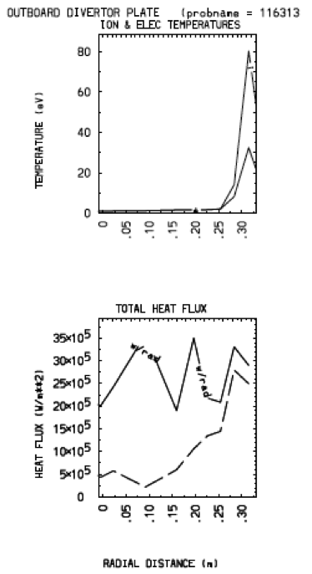
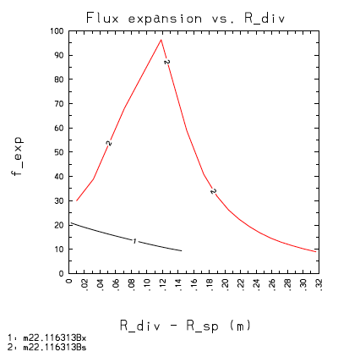
UEDGE modeling shows radiative snowflake divertor detachment for all NSTX-U cases up to P₉₀=11.3 MW, n_{d,90}=7e19 m⁻³
Standard divertor Snowflake divertor
λ_{q}^{mid} = 3-5 mm
 | P_90 | Pdiv,out | Pdiv,in | Pwall | Prad
A: STD | 9.5 | 3.95 (2.54) | 1.73 (0.62) | 0.83 | 5.48
A: SNF | 9.5 | 3.07 (0.61) | 1.66 (0.71) | 0.69 | 6.95
B: STD | 11.3 | 5.08 (3.66) | 1.75 (0.64) | 0.78 | 6.49
B: SNF | 11.3 | 3.56 (1.50) | 1.65 (0.70) | 0.65 | 8.28
Courtesy of E. Meier

Slide 27
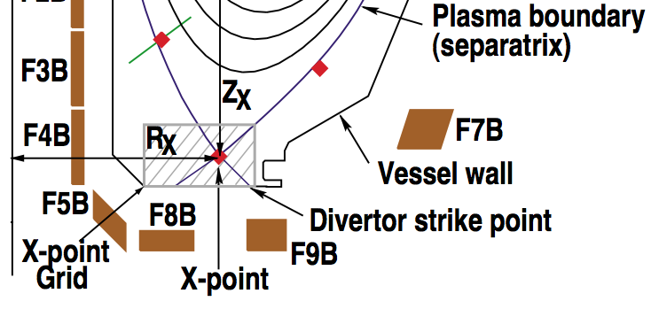
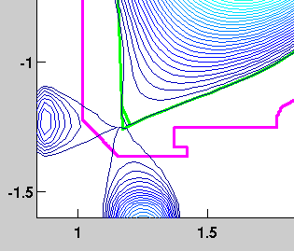
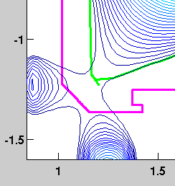
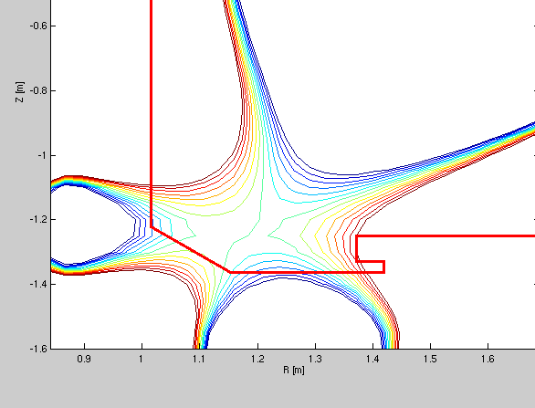
Modeled DIII-D Snowflake configurations are compatible with coil limits and operation requirements
Perfect snowflake and snowflake -/+ are possible at DIII-D with F4B, F5B, F8B.
x
DIII-D Coil Configuration
DIII-D Perfect Snowflake
x
x
x
x
Courtesy of
E. Kolemen
DIII-D Snowflake +
DIII-D Snowflake -

Slide 28
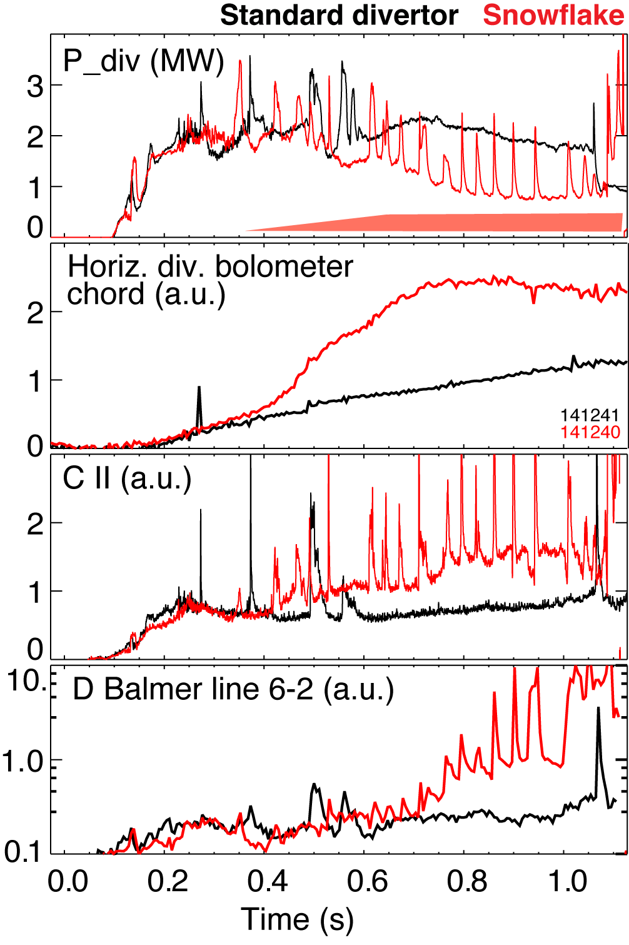
Snowflake configuration formation was followed by radiative detachment in NSTX
standard divertor snowflake divertor
P_{SOL} ~ 3 MW (P_{NBI} = 4 MW)
Attached divertor -> snowflake transition (still attached) -> snowflake + detachment
Q_{div} ~ 2 MW -> Q_{div} ~ 1-1.2 MW -> Q_{div} ~ 0.5-0.7 MW

Slide 29
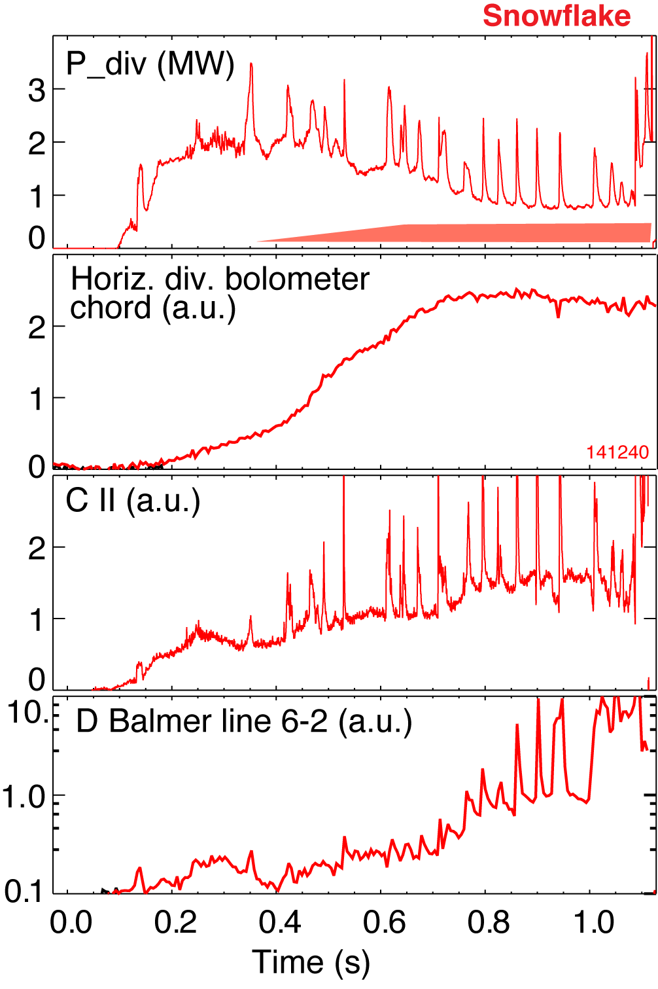
Significant reduction of steady-state divertor heat flux observed in NSTX snowflake divertor
C III, CIV profiles
courtesy of F. Scotti
Attached standard divertor -> snowflake transition -> snowflake + detachment
More experiments and modeling needed to understand geometry vs radiative effects

Slide 30
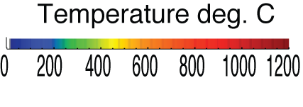
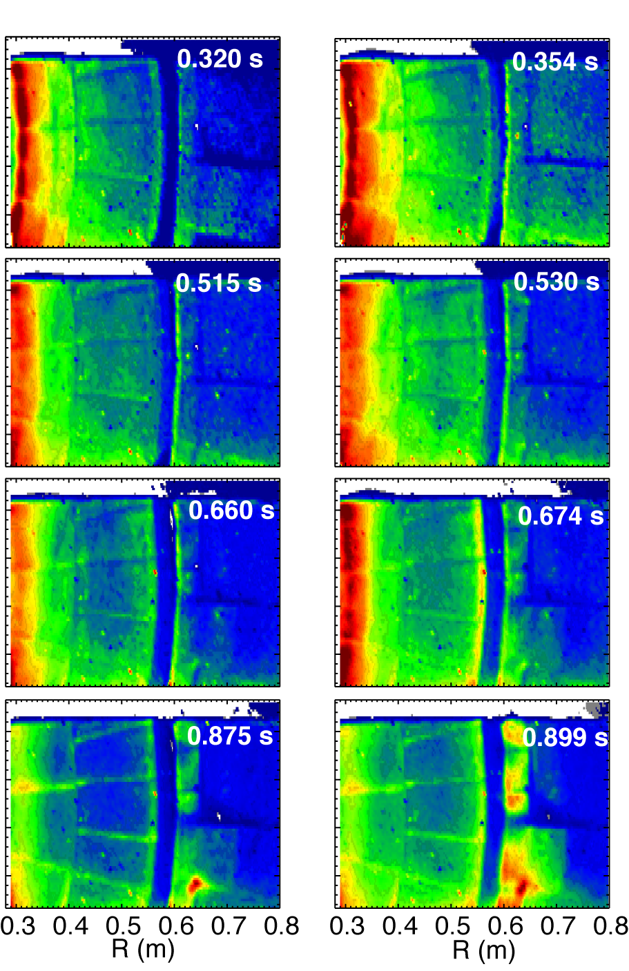
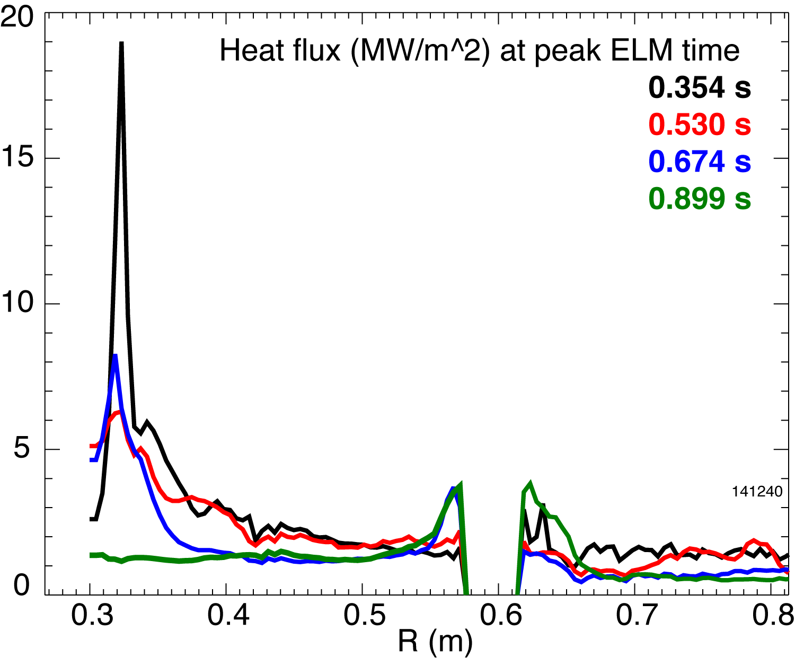
Impulsive heat loads due to Type I ELMs are partially mitigated in NSTX snowflake divertor
Steady-state At ELM peak
H-mode discharge, W_{MHD} ~ 220-250 kJ
  Type I ELM (ΔW_{tot}/W_{tot} ~ 5-10 %)
Theory and modeling developments
  D.D. Ryutov, JP9.00104 : A snowflake divertor: reduction of the ELM heat load due to plasma convection
  T.D. Rognlien, JP9.00105 : Reduced ELM heat loads from increased magnetic field-line length in snowflake configurations

Slide 31
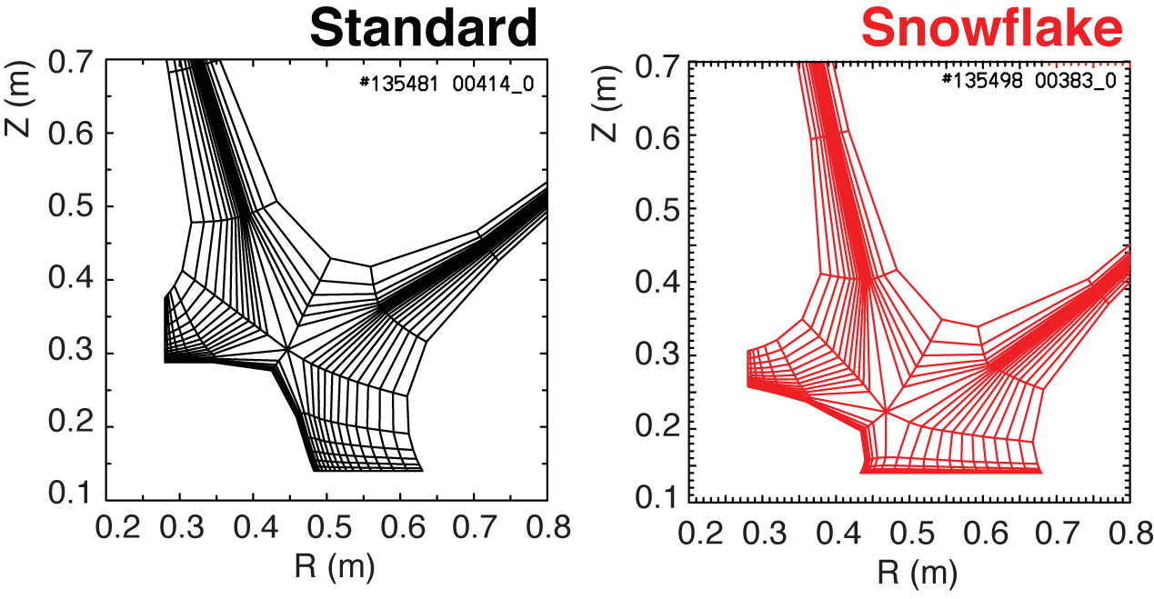
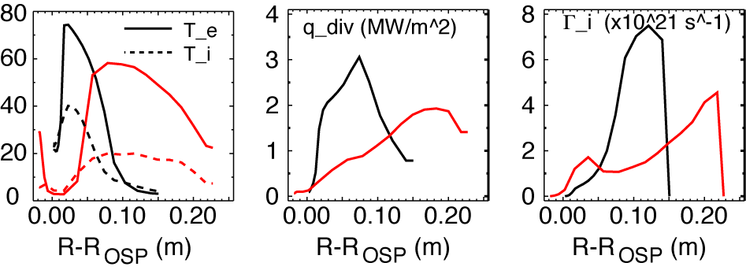
2D modeling shows a trend toward reduced temperature, heat and particle fluxes in NSTX snowflake divertor
2D multi-fluid code UEDGE
  Fluid (Braginskii) model for ions and electrons
  Fluid for neutrals
  Classical parallel transport, anomalous radial transport
    D = 0.25 m²/s
    χ_{e,i} = 0.5 m²/s
  Core interface:
    T_{e,i} = 120 eV
    n_{e} = 4.5 x 10¹⁹
  R_{recy} = 0.95
  Carbon 3 %

Slide 32

Temperature pedestal height increases during the ELM cycle while the density pedestal show no convincing trend
More than a factor of two increase in pedestal temperature
Density pedestal is much less sensitive to the ELM cycle
Heat and particle evolutions appear to be decoupled
Data measured using Thomson scattering at the same spatial locations

Slide 33



Pedestal width and height progressively increase during ELM cycle but the peak pressure gradient remains clamped
Pedestal Height
Pedestal width
Pedestal height
saturation/may be rollover
Diallo Nucl. Fusion (2011)
Pedestal height increases by a factor ≤ 3
  Height scales with Ip
Pedestal width increases independently of Ip
Gradient is clamped early in ELM cycle
Maximum pressure
gradient

Slide 34



Saturation of the gradient is ubiquitous across devices, but different trends in pedestal height evolution are observed
MAST
DIIID
of fits
Groebner Nucl. Fusion 49 (2009)
D Dickinson et al. PPCF 53 (2011) 115010

Slide 35



Radial correlation length evolution depends on location inside pedestal region
Radial correlation length increases at the pedestal top
  A factor of 2 increase during the last 50% of ELM cycle
  Increase size of eddies
    suggesting enhanced radial transport during the ELM cycle
Steep gradient correlation length is unchanged
Quantify the geometric effects on the measured correlation?
Region where the
pedestal pressure
saturates
Pedestal top
Steep gradient
Pedestal width
Instrument resolution
Notes:
Turbulence spreading refers to the spatial propagation ofturbulence from a region of the plasma where it is generatedto another region where the turbulence drive is smaller ornonexistent

Slide 36

In the EPED model, peeling ballooning provides a sufficient constraint for the pedestal height and KBM limits the width
Kinetic ballooning mode (KBM) has been proposed to limit the pedestal gradient in standard aspect ratio tokamaks
KBM-like modes are observed in DIIID
MAST and NSTX have shown using GS2 and GYRO the existence of both microtearing and KBM near the pedestal top
Snyder et al. PoP 9 (2002)
Yan, PRL, (2011)
Osborne, H-Mode Workshop (2011)
Dickinson, PPCF, (2011)
Guttenfelder, submitted PoP, (2011)
Notes:
Looking for signature of instabilities capable of constraining the pedestal width is primarily motivated
by recently proposed KBM which could be limiting the pedestal gradient in combination the peeling-ballooning modes.
In addition, recent work on DIIID shows that the pedestal structure appears to follow the KBM constrain in green earlier on in the ELM cycle.
The question we would like to address/investigate would be the turbulence structure during the inter_ELM evolution for additional clues in potential culprit in setting the pedestal width.

Slide 37


Stability diagram with and without lithium:
Lithium cases are farther away from the kink/peeling boundary
129020
129031
NSTX
129032
Boyle PPCF (2011)
129038
Consistent with NSTX close to the kink/peeling stability boundary
Lithium coatings are a useful tool for shifting peak pressure gradient inward and stabilizing kink/peeling modes.
Notes:
make sure to point out that increasing lithium leads to a not quite monotonic trend ELM stabilization, but that the profile fitting and stability analysis can capture this: the ELMy profiles have narrower pedestals and are close to the kink/peeling limit, whereas the ELM-free ones are farther from the stability boundary.
Clues for limiting the pedestal height? search for microturbulence as key/ leading mechanism?

Slide 38


ELMy regimes transition to ELM-free regimes with the application of lithium on the divertor to access larger pedestal pressure and width
Pedestal height vs width
symmetry pt
ELM-free regimes exhibit a pedestal height and width larger than in ELMy cases
  Application of lithium clearly modifies the edge pressure
Inward shift of the peak pressure gradient
Notes:
Stress plot number 2

Slide 39
NSTX Participation in ITPA Joint Experiments and Activities
Boundary Physics
  PEP-6 Pedestal structure and ELM stability in DN
  PEP-19 Edge transport under the influence of resonant magnetic perturbations
  PEP-23 Quantification of the requirements of ELM suppression by magnetic perturbations from internal off mid-plane coils
  PEP-25 Inter-machine comparison of ELM control by magnetic field perturbations from midplane RMP coils
  PEP-26 Critical edge parameters for achieving L-H transitions
  PEP-27 Critical edge parameters for achieving L-H transitions
  PEP-28 Physics of H-mode access with different X-point height
  PEP-31 Pedestal structure and edge relaxation mechanisms in I-mode
  PEP-32 Access to and exit from H-mode with ELM mitigation at low input power above PLH
  DSOL-24 Disruption heat loads

