Slide 1




NSTX-U
Supported by
Macroscopic Stability (MS) Research Progress and Plans
Coll of Wm & Mary
Columbia U
CompX
General Atomics
FIU
INL
Johns Hopkins U
LANL
LLNL
Lodestar
MIT
Lehigh U
Nova Photonics
ORNL
PPPL
Princeton U
Purdue U
SNL
Think Tank, Inc.
UC Davis
UC Irvine
UCLA
UCSD
U Colorado
U Illinois
U Maryland
U Rochester
U Tennessee
U Tulsa
U Washington
U Wisconsin
X Science LLC
Jong-Kyu Park (PPPL)
J. W. Berkery (Columbia University)
A. H. Boozer (Columbia University)
and the NSTX Research Team
Culham Sci Ctr
York U
Chubu U
Fukui U
Hiroshima U
Hyogo U
Kyoto U
Kyushu U
Kyushu Tokai U
NIFS
Niigata U
U Tokyo
JAEA
Inst for Nucl Res, Kiev
Ioffe Inst
TRINITI
Chonbuk Natl U
NFRI
KAIST
POSTECH
Seoul Natl U
ASIPP
CIEMAT
FOM Inst DIFFER
ENEA, Frascati
CEA, Cadarache
IPP, Jülich
IPP, Garching
ASCR, Czech Rep
NSTX-U PAC-31
B318, PPPL
April 18, 2012

Slide 2
Goal of MS research is to establish predictive capability for stability, 3D field, and disruption, in future STs and ITER
Directly aligned with OFES research themes for “Validated predictive capability” and “3D magnetic fields” for FNSF, ITER, and next-step devices
MS TSG milestones:
  R(12-1): Investigate magnetic braking physics to develop toroidal rotation control at low collisionality for NSTX-U and ITER
  R(13-4): Identify disruption precursors and disruption mitigation & avoidance techniques for NSTX-U and ITER
  R(14-1): Assess access to reduced density and collisionality in high-performance scenarios – with new NBIs and 3D coils (NCCs)
NSTX-U MS researchers are active in collaborations world-wide, in both theory and experiment
  RWM, TM, NTV, 3D field, disruption: ITPA MDC-1,2,4,7,15,17,WG7,9
  RWM, TM, NTV, 3D field : DIII-D, KSTAR, ITER

Slide 3
Outline
Research highlights and progress towards FY12 milestones
  Importance of rotation and its control for RWM and EF correction
  Improvement of understanding NTV braking and plan for study
  Study on fast particle effects on RWM in NSTX and NSTX-U
Research plans and progress for FY13-14 milestones
  Study on disruptivity and halo current dynamics
  Full 3D modeling of eddy currents for active RWM control
Highlights and plans for collaborations with other devices
Plans during years 1-2 for NSTX-U operation
Long term research plans in years 3-5 for NSTX-U operation
  Importance of Nonaxisymmetric Control Coil (NCC) for future research
Summary
*FY12-14 milestones:
R(12-1)
R(13-4)
R(14-1)
*Response to PAC29 questions:
PAC29-##
*ITPA activity:
ITPA ##

Slide 4
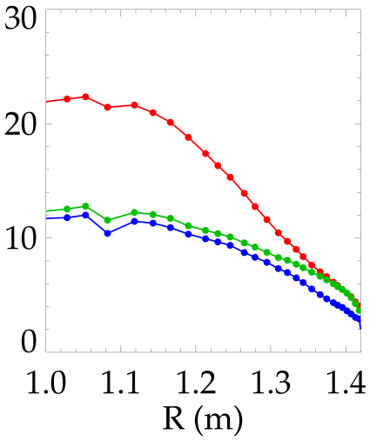
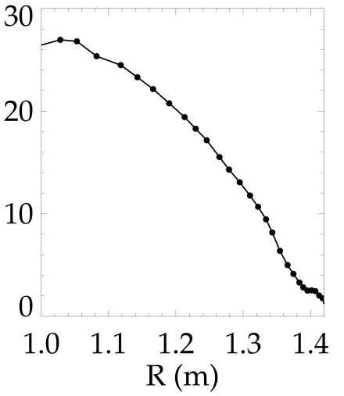
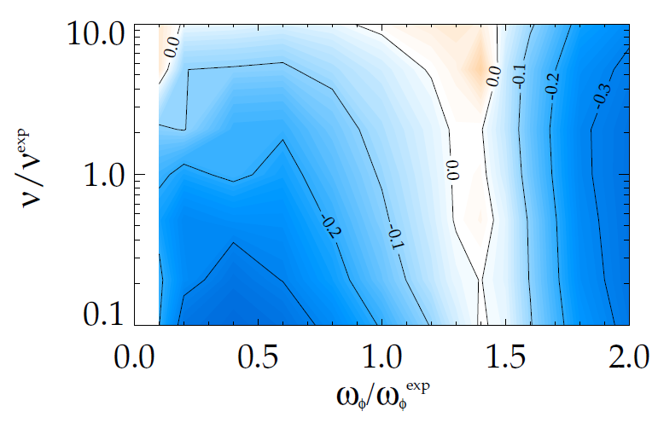
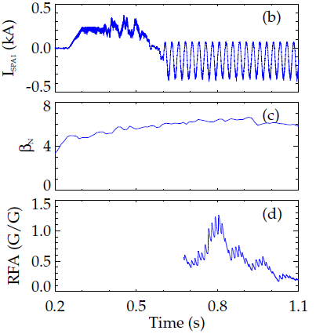
Study of RWM kinetic stabilization is unveiling complex rotation and collisionality dependence
R(12-1)
RWM can be stabilized by kinetic effects through rotational resonance
  Implying importance of rotation control, NTV, NCC coils
NSTX-tested kinetic RWM stability theory showed that reduced ν* can be stabilizing through kinetic resonances
J. W. Berkery et al, PRL 104 035003 (2010)
J. W. Berkery et al., POP 17 082504 (2010)
S. A. Sabbagh et al., NF 50 025020 (2010)
RWM, RFA vs. rotation
J. W. Berkery et al., PRL 106 075004 (2011)
NSTX RWM stability (γ_{W}) vs. (ν, ω_{ϕ}) by MISK
(140102)
(137722)
ω_{φ} [kHz]
marginal ω_{φ} profile: ω_{φ} ^{exp}
Marginal
Stability
unstable
stable
unstable
Collisionality
140102
J. W. Berkery (Columbia. U)
S. A. Sabbagh (Columbia. U)
Plasma Rotation
Time (s)
PAC29-20

Slide 5
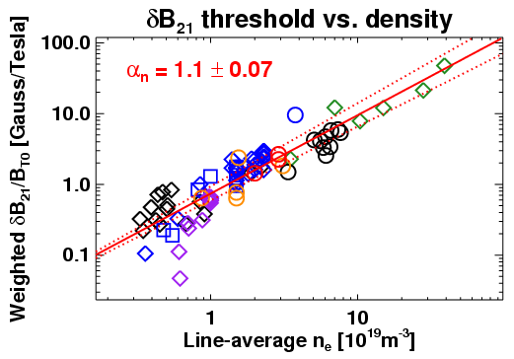
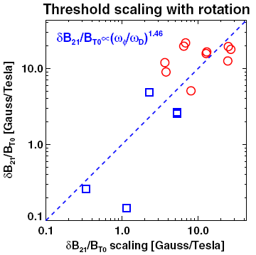






Error field correction requirements more demanding due to non-resonant braking of rotation
R(12-1)
IPEC applications are successfully combining error field threshold data across various tokamaks and are being used for ITER
However, error field threshold can be substantially changed when strong braking is introduced
  Implying importance of non-resonant field correction by NCC coils
J. E. Menard, J.-K. Park et al., ITER IPEC TA (2011)
J. -K. Park et al, NF 52 023004 (2012)
Resonant error field threshold scaling
J.-K. Park,
R. J. Buttery (GA),
T. Hender (CCFE),
M. J. Schaffer (GA),
S. M. Wolfe (PSFC),
Y. M. Jeon (NFRI)
Scaling correction for rotation
DIII-D TBM: Locking by dB₂₁/B_{T0} ~10⁻⁵
NSTX: Locking by dB₂₁/B_{T0} ~10⁻⁵
ITPA WG9

Slide 6
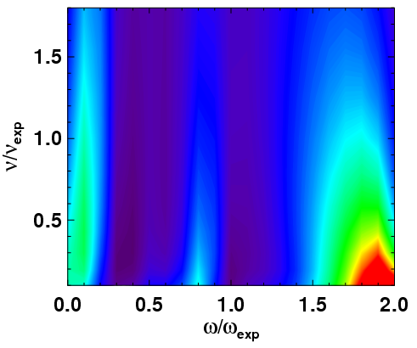
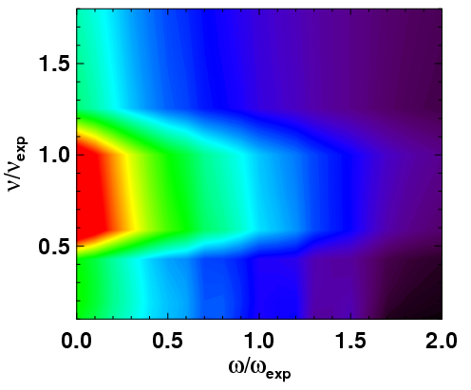

Studying effects of 3D fields on plasma rotation to develop and understand NTV braking for rotation control
R(12-1)
NTV analysis on NSTX data shows:
  n=1 braking has a complex but similar dependency on rotation and collisionality to the RWM kinetic stabilization (as the dissipation plays a same role to both physics)
  n=3 braking is strongly dominated by SuperBanana-Plateau (SBP) and traditional 1/ν and ν dependency on collisionality (providing qualitative explanation of NSTX data)
Present tools will be put to the rigorous verification and validation
S. A. Sabbagh, IAEA 2010
NSTX NTV n=1 braking vs. (ν, ω_{ϕ}) by IPEC+NTV
NSTX NTV n=3 braking vs. (ν, ω_{ϕ}) by IPEC+NTV
SBP
+
+
l=1 bounce resonance
l>1 bounce resonance
#132725
#132725
Torque [Nm] per RWM/EF 1kA
SBP
XP1062
J.-K. Park,
S. A. Sabbagh
PAC29-20

Slide 7
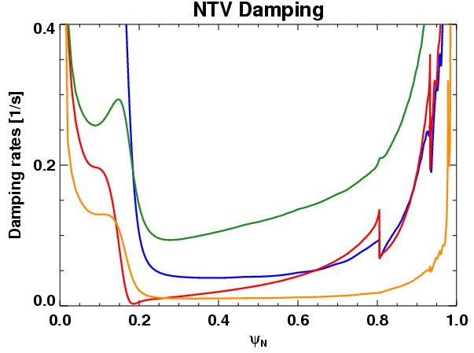
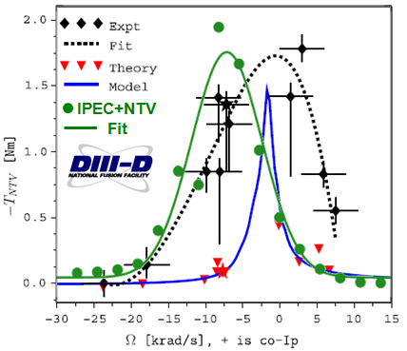
Collaboration with other facilities important and useful for NTV model validation
R(12-1)
IPEC and NTV codes have been successfully used to
  Explain locking by DIII-D proxy error field experiment
  Verify NTV peaks observed in DIII-D low rotation
  Predict required NTV braking for DIII-D QH mode experiments
  Explain observed damping in KSTAR RMP experiments
J.-K. Park, R. J. Buttery, J. M. Hanson
J.-K. Park, for A. J. Cole, PRL 106 225002 (2011)
J.-K. Park, K. H. Burrell
J.-K. Park, Y. M. Jeon
NTV increase in DIII-D proxy error correction
NTV Experiments vs. Theories
Providing explanation for increased locking sensitivity
Reproducing SBP peaks
-T_{NTV} [Nm]
Proxy error case
ω_{φ}[krad/s] + is co-I_{p}
J.-K. Park, R. J. Buttery (GA), J. M. Hanson (CU), W. M. Solomon
PAC29-20
ITPA WG9

Slide 8

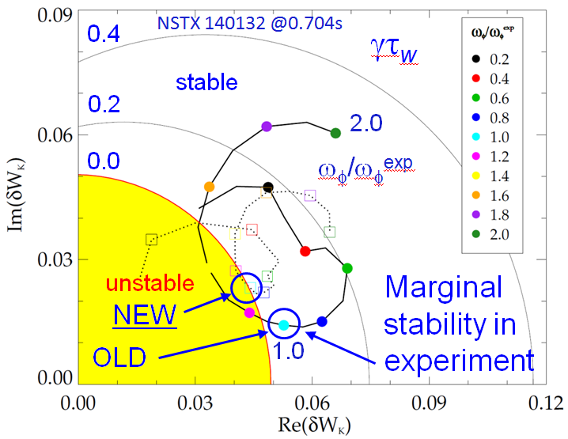
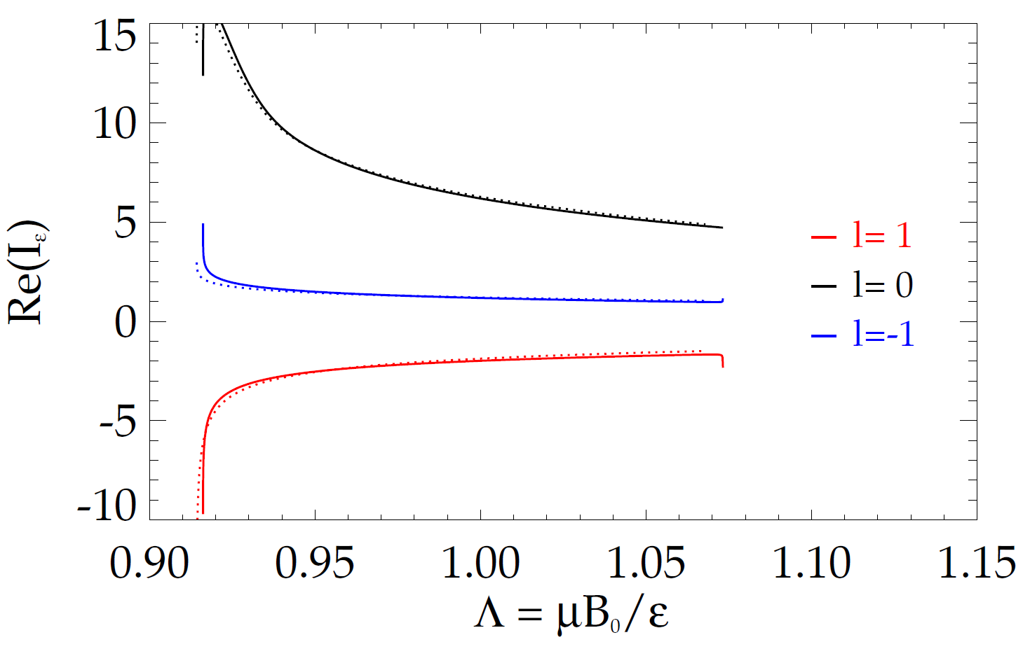
Present NTV and kinetic RWM physics analysis tools are under active benchmarking and upgrading
R(12-1)
Fundamental relation between perturbed energy (RWM) and toroidal torque (NTV) has been theoretically proved
  Implying both physics studies can be unified and validated all together
RWM analysis tools, MISK/MARS-K/HAGIS, are under benchmark in details (ITPA MDC-2, Group leader: S. A. Sabbagh)
J.-K. Park, POP 18, 110702 (2011)
MISK and MARS-K benchmark for energy integral
Marginal stability prediction by improved MISK
Solov’ev test case
Trapped thermal ions
MARS-K
MISK
pitch angle variable
J. W. Berkery
*For improved MISK analysis through benchmark, see backup page 23
PAC29-20
ITPA MDC-2

Slide 9
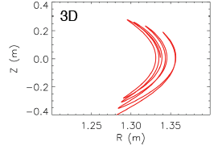
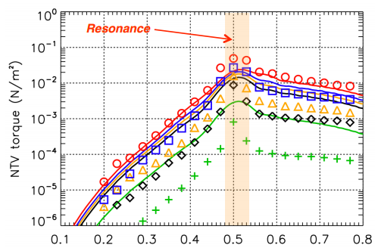
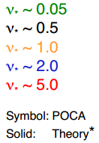
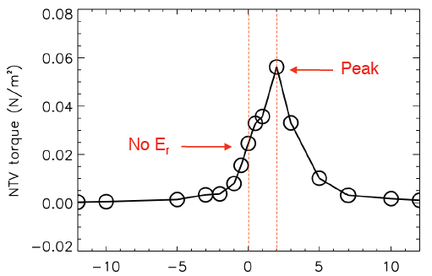
Advanced NTV and kinetic RWM computations are also being developed and benchmarked
NTV and kinetic RWM calculations can be improved by computing precise 3D orbits and perturbed distribution function
  Particle Orbit Code for Anisotropic pressures (POCA) is under development and benchmark
  MARS-K and M3DC-1 computations are also planned
R(12-1)
3D orbits without collision
Analytic NTV and POCA benchmark
POCA demonstration of superbanana-plateau
K. Kim, Submitted to POP
dФ/dT
K. Kim, Sherwood 2012
Benchmark for the same case on
S. Satake(NIFS), J.-K. Park, PRL 107 055011,(2011)
*For MARS-K with self-consistent eigenfunctions, see backup page 24
PAC29-20

Slide 10
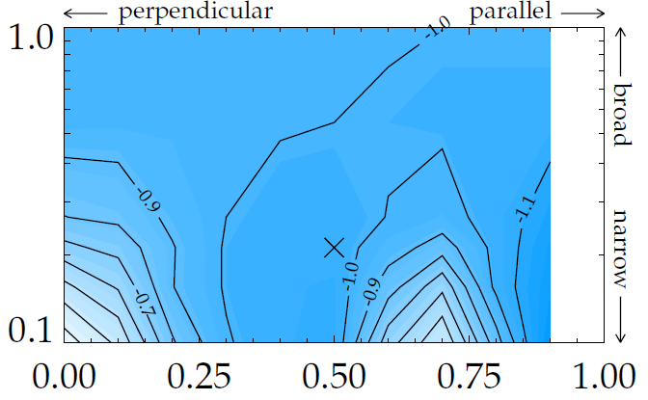
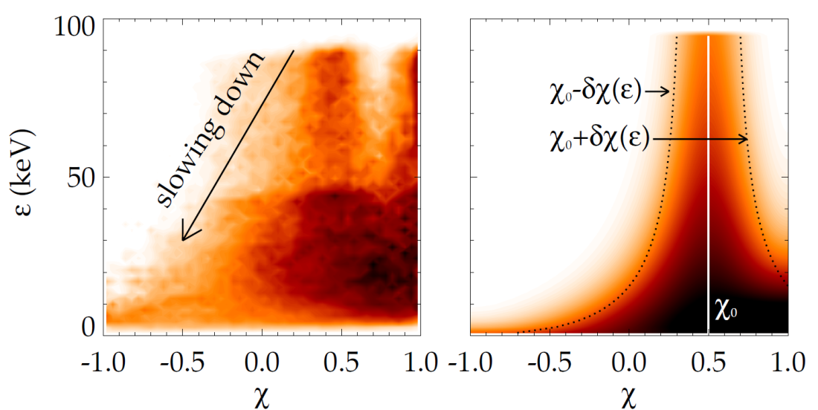
Extended RWM study indicates stabilizing effects of energetic particles will be modified in NSTX-U
R(12-1)
Reminder: NSTX-U will have three additional tangential beam sources
Anisotropic slowing-down distribution function for energetic particles:
  RWM kinetic stabilization effects were tested with perpendicular vs. parallel and broad vs. narrow NB injection
Simulated distribution function by TRANSP
MISK anisotropy + fluid + kinetics for (γ_{W})
present NSTX
future NSTX-U
TRANSP
Model
spread δχ₀
~NSTX
NSTX-U
= (v∥/v)
= (v∥/v)
J. W. Berkery
injection pitch χ₀
*For further highlights, see backup page 25 (RWM active control) and page 26 (Tearing mode)
PAC29-20

Slide 11
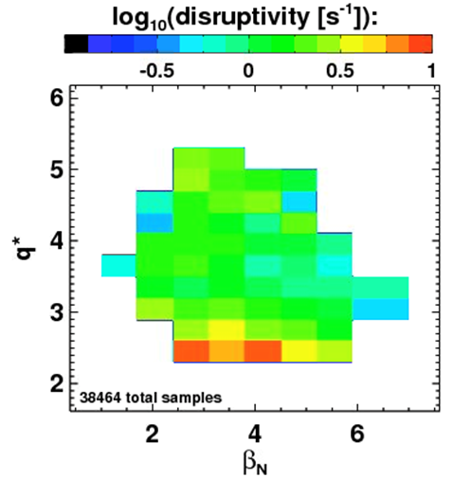
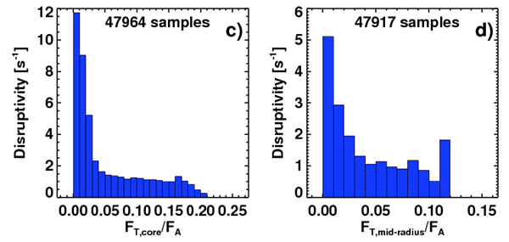
NSTX database shows important correlations between disruptivity and stability variables
R(13-4)
NSTX disruptivity has been studied based on ~40000 sampled time slices, and revealed correlations with stability indices such as q, β_{N}, ω
  Disruptivity increases in lower q*, as expected, but decreases in highest β_{N} (Consistent with “weaker” RWM stability at “intermediate” rotation)
  Rotation decreases disruptivity, but not strongly when ω>2-3%ω_{A}
Disruptivity vs. q* and β_{N}
S. P. Gerhardt
Disruptivity vs. rotation (ω)
*For more statistics for disruptivity, see backup page 27
PAC29-21
PAC29-45
ITPA MDC-15

Slide 12
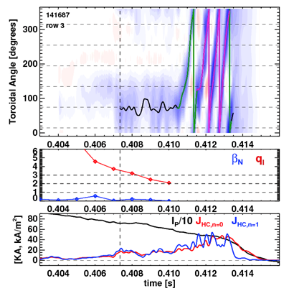
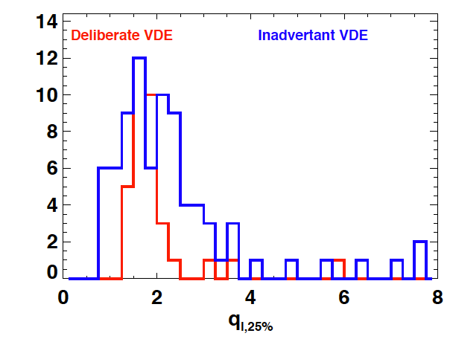
Halo currents propagate toroidally and depend on evolution of q at limiter flux-surface during disruption
Dynamics of NSTX n=1 halo currents (Important for ITER, ITPA MDC-15)
  Rotates 2 kHz in average during ~4ms
  Typically rotates 1-3 times
  Halo current tend start at about time of edge-q dropping beneath 2
  Appears that n=1 vanishes when LCFS vanishes, n=0 a few ms later as the open field line current dies away
R(13-4)
Halo current rotation vs. q and LCFS
Statistics for q when n=1 rotates
S. P. Gerhardt
Submitted to NF
*For more about disruption studies, see back up 28-30 (including head loading)
PAC29-45
ITPA MDC-15

Slide 13
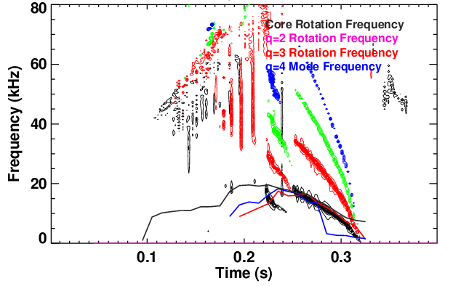
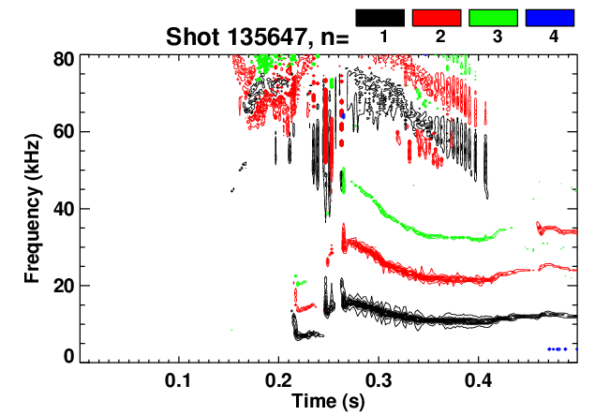
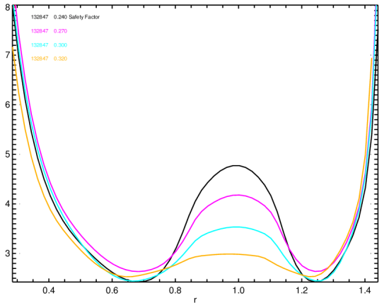
Access to reduced density in NSTX-U can be improved by early MHD mode control in startup
R(14-1)
Reduced-density operation in NSTX was occasionally unsuccessful by early MHD modes, which could be induced by unfavorable q-profiles or error fields
  Implying importance of current, heating, 3D field control
MHD stability and control in reduced density and collisionality will be actively studied on developed NSTX-U scenarios, with new NBIs and potential NCC coils
Disruptive low density startup with early MHDs
Non-disruptive low density startup by beam control
Locking
7
0.24s
0.27s
0.3s
0.32s
6
q
5
S. P. Gerhardt
4
3
Steady rotation
0.4 0.6 0.8 1.0 1.2 1.4
R (m)

Slide 14
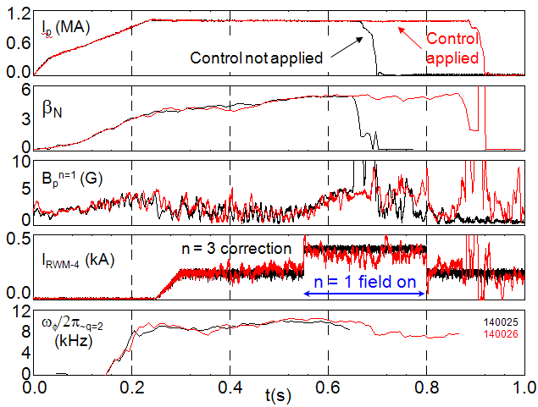
Full 3D modeling for RWM control pioneered on NSTX will be important for NSTX-U, ITER, FNSF
R(14-1)
RWM State Space (RWMSC) controller created using full 3D eddy current model (VALEN-3D code) has been implemented and successfully tested in NSTX, and will be used with independent coil control in NSTX-U
State space controller modeling
Use of RWM state space controller for NSTX
~3000 states for 3D eddy currents in total
Controller with 12 states (including 10 wall + 2 plasma states) sustains discharge at high β_{N}=6.4 and β_{N}/l_{i}=13, otherwise disrupted by n=1 field
Controller reproducing rotating n=1
S. A. Sabbagh, O. Katsuro-Hopkins, J. Bialek (CU)
*For more about RWMSC, see backup page 31, for RWM control summary in NSTX , see backup page 32

Slide 15
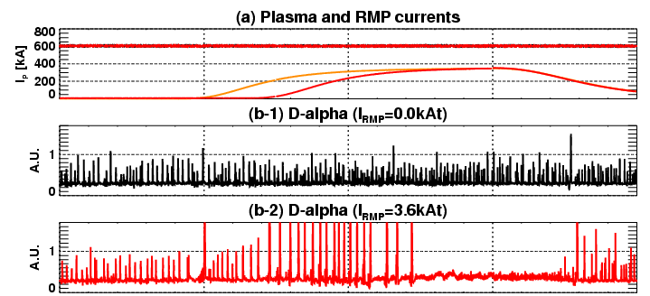
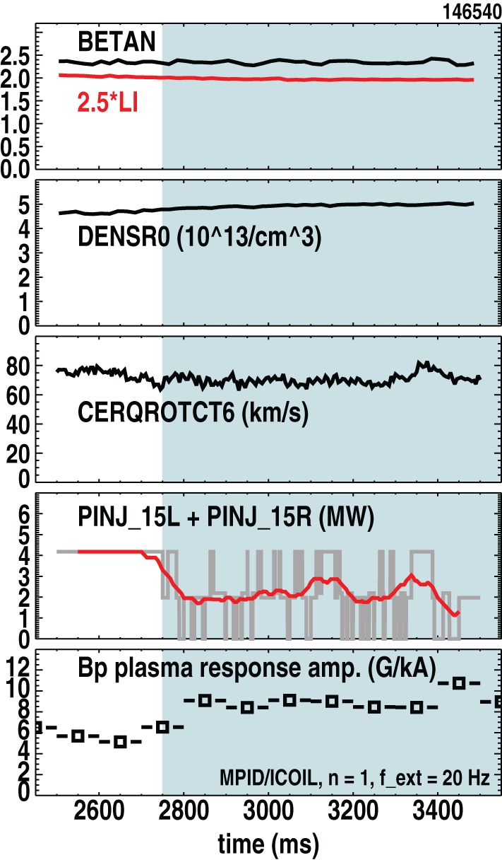
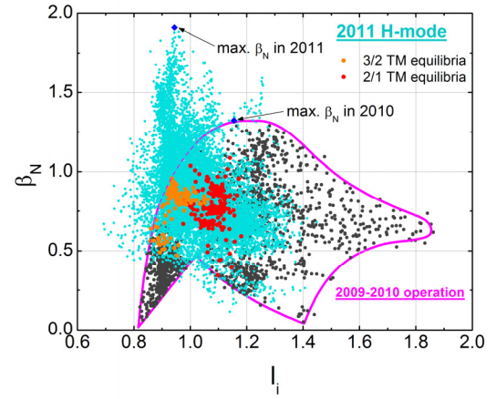
MS group will continue strong collaborations with other devices such as KSTAR, DIII-D, and ITER team
KSTAR: Collaborations on 3D fields achieved n=1 ELM suppression, error field, tearing mode, NTV analysis, and supported equilibrium reconstruction
DIII-D: Strong collaborations and joint experiments will be continued on RWM, NTV, error fields, and RMP suppressions
ITER: Leading RWM and error field physics analysis efforts for recently requested ITER control group needs
ELM suppression by 3D fields in KSTAR
RMPs
Y. M. Jeon, J.-K. Park, Submitted to PRL
Joint RWM experiments in DIII-D
KSTAR operation window
Stability decreases by off-axis beams
J. M. Hanson (CU),
S. A. Sabbagh,
J. W. Berkery
*For MISK calculations for ITER, see backup page 33
S. A. Sabbagh, Y.-S. Park (CU), IAEA2012

Slide 16
MS research will exploit new 2nd NBI and upgraded SPA capabilities during years 1-2 of NSTX-U operation
Focus in Year 1 of NSTX-U operation:
  Recover and explore NSTX MS control capabilities
  Identify n=1,2,3 error fields and optimize corrections with new SPAs
  Assess the β_{N} or q limit with new shaping control and off-axis NBCD
  Recover and upgrade RWM B_{P}+B_{r} and state space control with SPAs, including n>1 and multi-mode control
  Revisit disruptivity and study halo current dynamics and heat loads on divertor
  Apply MGI mitigation and explore dependency on injection locations*
Focus in Year 2 of NSTX-U operation:
  Explore NTV physics with new NBIs and SPAs
  Begin implementation of rotation control with new NBIs and SPAs
  Validate RWM physics in reduced ν* and varied fast ion populations
  Utilize off-axis NBCD to vary q-profile and applies to RWMs and tearing modes
  Identify disruption characteristics in various scenarios obtained by off-axis NBCD
  Test and optimize MGI techniques by varying positions and actuators
*For MGI plans and present modeling efforts, see backup page 34

Slide 17
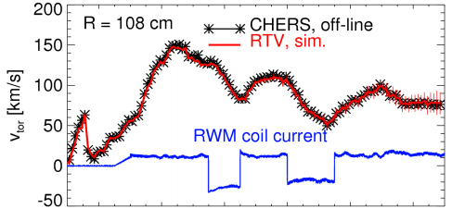

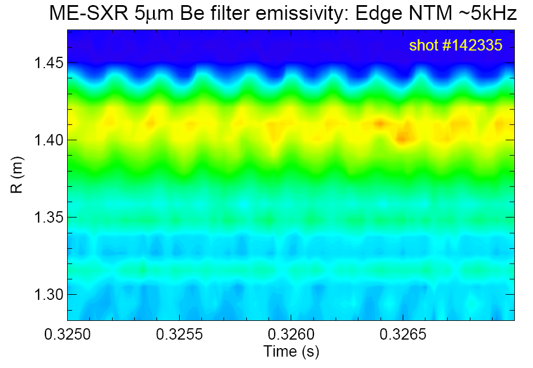
Key diagnostics have been identified and are being developed or proposed to support MS research
Key diagnostics identified for MS study:
  Real-Time Velocity measurement for successful implementation of rotation control, and disruption detection
  Toroidally displaced multi-energy SXR to study 3D physics including island dynamics, and RWM eigenfunctions
  Core X-ray imaging spectrometer to study rotation effects on error field and early MHD without NBIs
  Internal magnetic fluctuation measurement for island structures in details
  Real time MSE and MPTS for fast and precise kinetic equilibrium reconstruction
  Magnetic sensors including B_{P} and B_{R} sensors will be refurbished and upgraded
R(14-1)
Algorithm test for RTV with off-line CHERS
M. Podesta
Edge islands by single ME-SXR
*For present identification for key diagnostics, see backup page 35
K. Tritz (JHU)

Slide 18
Long term research plans for next 3-5 years will be focused on integrated MS study in NSTX-U
Year 3 NSTX-U operation:
  Optimize rotation feedback control for improving RWM and TM stability
  Assess and optimize tradeoffs between q, rotation, β to improve stability
  Explore the lowest ν* regimes and optimize RWM and TM stability
  Explore disruption precursors and avoidance scenarios with various MHD origins
  Explore MGI triggering for real-time actuation for disruption mitigation
Year 4 NSTX-U operation:
  Combine rotation and β feedback control to maximize performance
  Provide FNSF/Pilot projection on RWM and TM stability and disruption
  Couple MGI triggering techniques to mitigate disruptions
Year 5 NSTX-U operation:
  First use of NCC (if resources permitting)
  Integrate MS control to avoid RWM, TM, ELM instability, disruption, with disruption mitigation protection
  Integrate validation of models for FSNF/Pilot

Slide 19
Non-axisymmetric Control Coil (NCC) would greatly improve control capabilities on stability and 3D fields
Non-axisymmetric Control Coil (NCC) will play an important role in each
  Rotation control, and thereby RWM kinetic stabilization, error field correction, tearing mode stabilization
  RWM active control for significant multi-mode spectrum
  ELM control and stabilization
  Prediction for ITER 3D coil capabilities
NCCs may prove essential to achieve integrated MS control
  Simultaneous control for rotation, RWM, error field, TM, ELM
IPEC, NTV, VALEN-3D, RWMSC codes will be actively used for 3D physics studies with NCCs
Secondary PP option
Primary
PP option
Existing
coils
VALEN3D prediction
Showing substantial improvement
on RWM stability by NCCs
NCC in front of:
Secondary Plates
Primary Plates
growth rate γ [1/s]
passive
Ideal wall limit
external coils
J. Bialek
β_{N}
PAC29-5e

Slide 20
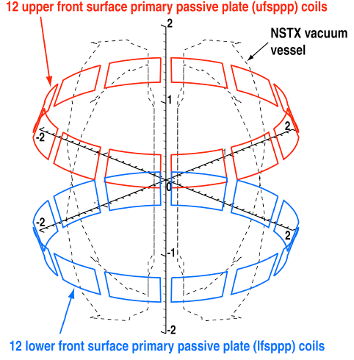
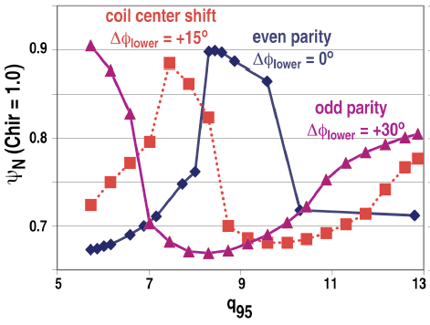
NCCs can maintain edge stochastic layer over a wide range of q₉₅ by varying n=6 toroidal phase
TRIP3D code analysis on NCCs for various target plasmas showed:
  In high shaping NSTX plasmas, n=6 fields produce a wider edge stochastic layer than n=3 I-coil fields in DIII-D, over a wide range of q₉₅ (5.3<q₉₅<12.8)
  Combined n=6 and existing n=3 field line loss fractions exceed those combined n=3 I-coil and n=1 C-coil fields in DIII-D
Next step: Plasma response and NTV calculations with NSTX-U scenarios
NCC model in TRIP3D
Stochastic layer by n=6 NCC fields
T. E. Evans (GA)

Slide 21
Summary of MS research progress and plans
MS research is addressing important issues to establish predictive capability for stability, 3D field effects, and disruptions, for NSTX-U, ITER, and FNSF
NSTX is making vital contributions in the areas of:
  Physics understanding for complex rotation dependencies in RWM stabilization, error field correction, tearing modes, and NTV braking, in present NSTX and future devices
  Understanding disruptivity and halo current dynamics
  Full 3D modeling of eddy currents in RWM control
MS research and integrated stability control of NSTX-U plasmas would be greatly enhanced with NCC coils
Integrated MS research and control in NSTX-U will be compared and validated with upgraded analysis tools, utilizing more principle-based computations*
Collaborations with other devices will play important role in developing MS predictive capability
*For key modeling efforts, see backup page 36

Slide 22
Back up

Slide 23
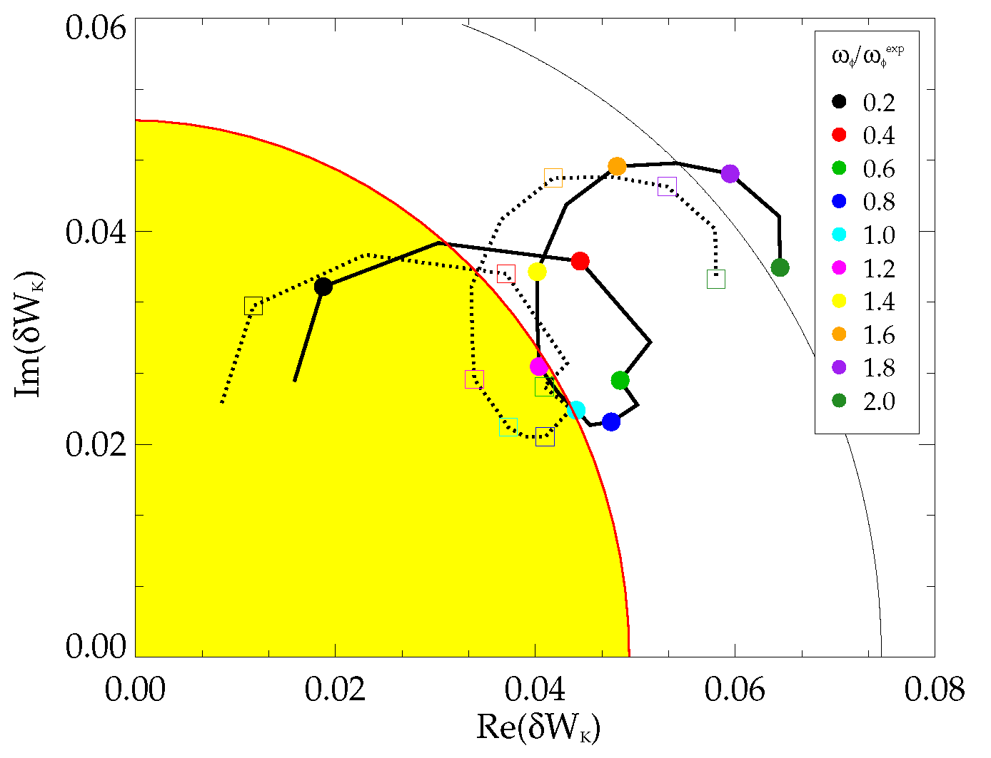
Kinetic stability calculations show reduced stability in low l_{i} target plasma as ω_{φ} is reduced, RWM becomes unstable
Stability evolves
  Computation shows stability at time of minimum l_{i}
  Region of reduced stability vs. ω_{φ} found when RWM becomes unstable (l_{i} = 0.49)
Quantitative agreement between theory/experiment
  MISK, MARS-K, HAGIS code benchmarking (ITPA MDC-2)
  MISK calculations improved
    (already good) agreement between theory/experiment improved (no free params.)
    Conclusion: Best agreement with fast particle effects included
R(12-1)
RWM stability vs. ω_{φ} (contours of γτ_{w})
140132, t = 0.704s
w/fast particles
thermal
2.0
ω_{φ}/ω_{φ}^{exp}
marginal
stability
(experiment)
1.0
unstable
More quantitative comparison to theory
- S.A. Sabbagh, et al., IAEA FEC 2008, Paper EX/5-1
- J.W. Berkery, et al., PRL 104 (2010) 035003
- S.A. Sabbagh, et al., NF 50 (2010) 025020
- J.W. Berkery, et al., Phys. Plasmas 17, 082504 (2010)
- S.A. Sabbagh, et al., IAEA FEC 2010, Paper EXS/5-5
PAC29-20
ITPA MDC-2

Slide 24
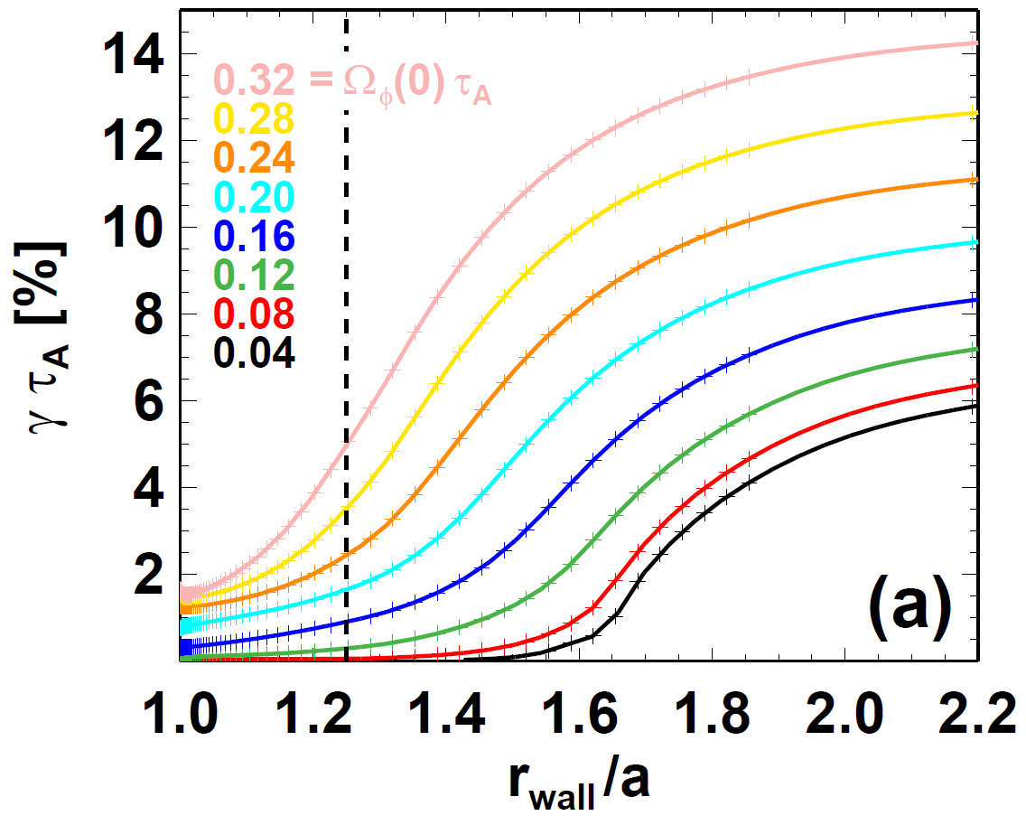
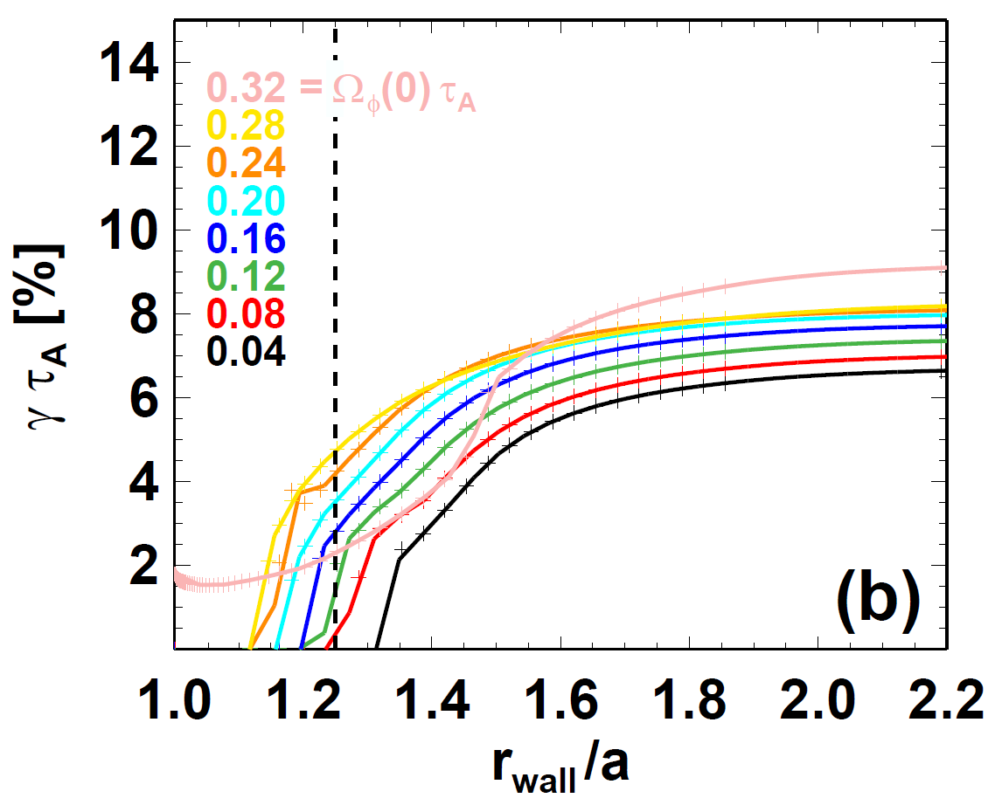
RWM stability changes not only by particle kinetic energy, but also by modified eigenfunctions
R(12-1)
Kinetic δW can be comparable to or larger in magnitude than the fluid δW component, implying eigenfunctions can change
MARS-K calculations showed self-consistent eigenfunctions can substantially differ by rotations and can even change ideal-wall limit
Ideal wall stability in fluid plasma
Ideal wall stability in kinetic plasma
Plasma becomes unstable along with rotation, by Kevin-Helmholtz instability
Without bounce motions, kinetic effects stabilize plasma, as expected, but can be destabilizing by rotation
Shot 119621
t = 0.47s with
β_{N} scaled to 5.1
(Expt Ω_{φ}(0) τ_{A} ~ 0.22)
Destabilizing
Unstable even with ideal wall
J. E. Menard, Y. Liu (CCFE), EPS2012
PAC29-20
ITPA MDC-7

Slide 25
Combined RWM B_{r} + B_{p} sensor feedback gain and phase scans produce significantly reduced n = 1 field
6
140124
140122
139516
R(12-1)
β_{N}
Favorable B_{p} + B_{r} feedback (FB) settings found (low l_{i} plasmas)
  Fast RWM growth ~ 2 - 3 ms control by B_{p}
  B_{r} feedback controls slower (~10 ms) n=1 field amplification, modes
Time-evolved theory simulation of B_{r}+B_{p} feedback follows experiment
β_{N}
4
2
0
B_{r} gain scan
0.8
0.6
0.4
l_{i}
l_{i}
No B_{r} feedback
B_{r} Gain = 1.0
0.2
0.0
B_{r}^{n = 1} (G)
6
6
4
4
2
2
B_{r} Gain = 1.50
0
Simulation of B_{r} + B_{p} control (VALEN)
0.0
0.2
0.4
0.6
0.8
1.0
1.2
t (s)
1.4
Feedback on
0 deg FB phase
B_{r} phase scan
Radial field n = 1 (G)
90 deg FB phase
Vacuum error field
+ RFA
180 deg FB phase
Vacuum error field
S. A. Sabbagh
Δt (s) (model)
ITPA MDC-7

Slide 26
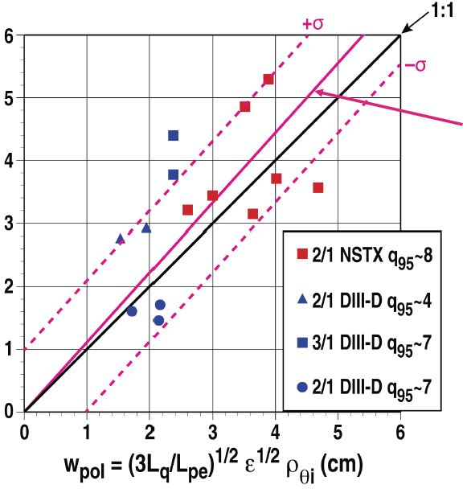
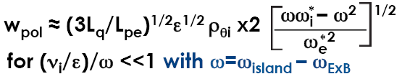
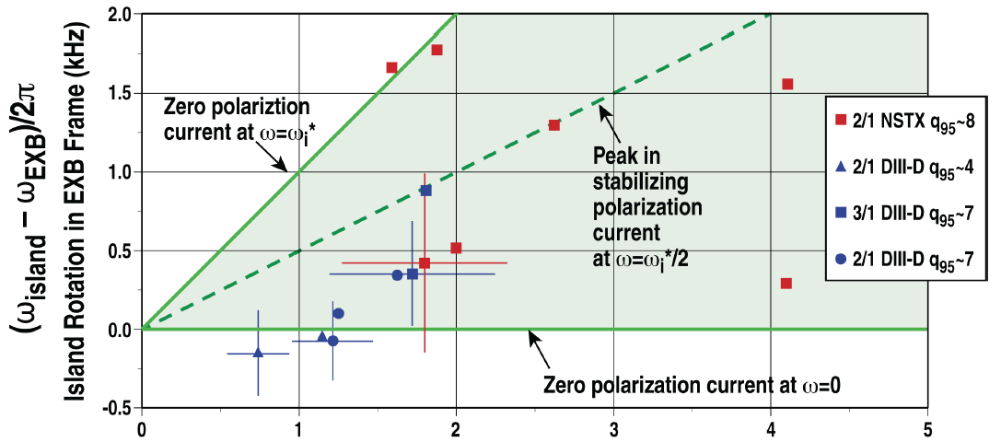


Tearing stability threshold in NSTX can be explained with existing models with rotations
R(12-1)
NSTX island rotations, which are faster than ExB rotations, should provide stabilizing helical polarization currents
The polarization model gives a fair fit to the marginal island data for both NSTX and DIII-D
  Advantageous for STs
Theory vs. experiments for marginal islands
TM stability vs. ExB and diamagnetic rotation
R. La Haye (GA), S. P. Gerhardt
ITPA MDC-4

Slide 27
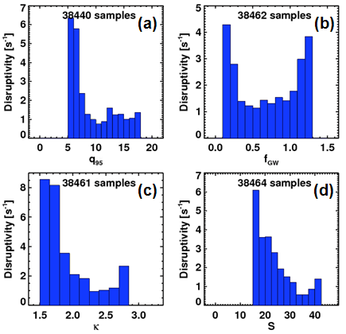
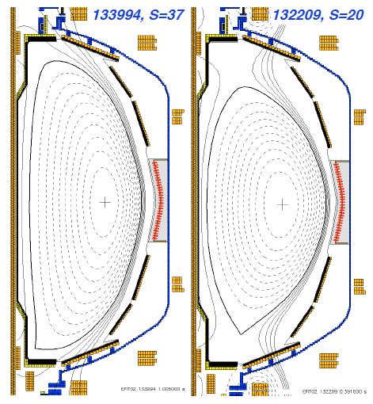
Further disruptivity study shows importance of q₉₅, density, shaping control to disruption avoidance
Disruption analysis on NSTX database additionally shows disruptivity
  (a) dramatically increases for q₉₅<7.5 (as shown by q*)
  (b) increases in low density with f_{GW}<0.3 by typically early disruption in the flat-top, and in high density with f_{GW}>1.1
  (c) Increases in low elongation and
  (d) increases in low shaping factor
R(13-4)
Disruptivity as a function of macro-variables
High shaping
S=37
Low shaping
S=20
S. P. Gerhardt
Submitted to NF
PAC29-21
PAC29-45
ITPA MDC-15

Slide 28
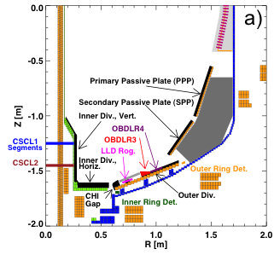
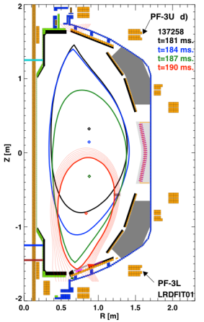
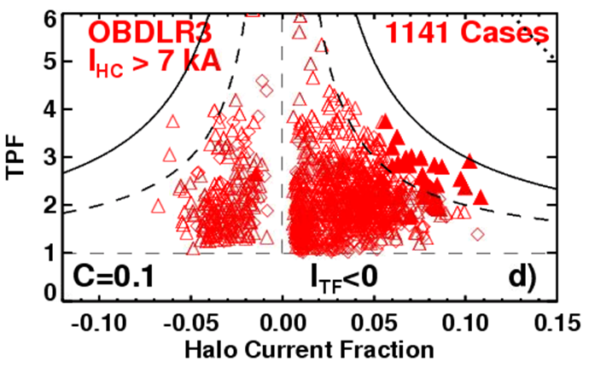
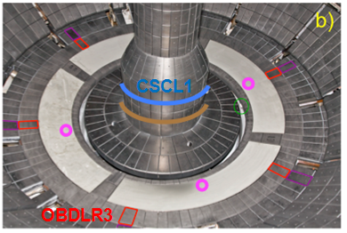
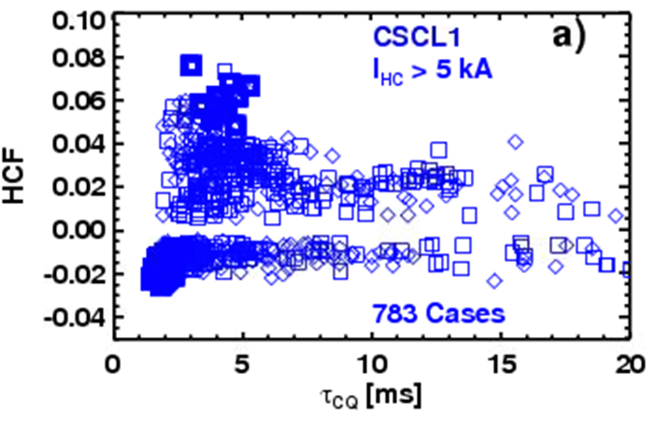
Halo currents in NSTX disruptions have low toroidal peaking, but get stronger in fast quench
R(13-4)
Detailed study for halo currents showed Toroidal Peaking Factor (TPF) is anti-correlated with Halo Current Fraction, but peaking is low
Halo Current Fraction becomes stronger in fast quench
Halo current detection system
S. P. Gerhardt
Submitted to NF
TPF = 1+C/HCF, C~0.1
HCF vs. current quench
PAC29-45
ITPA MDC-15

Slide 29
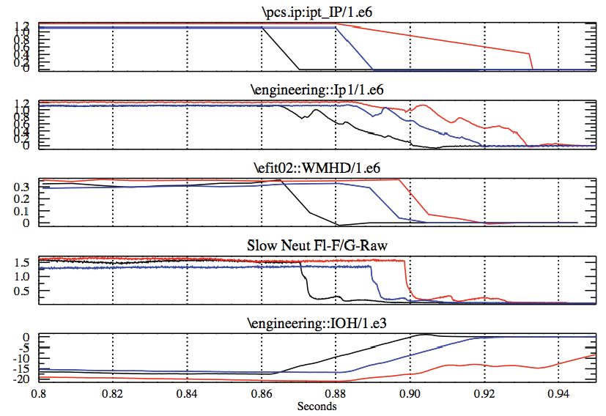
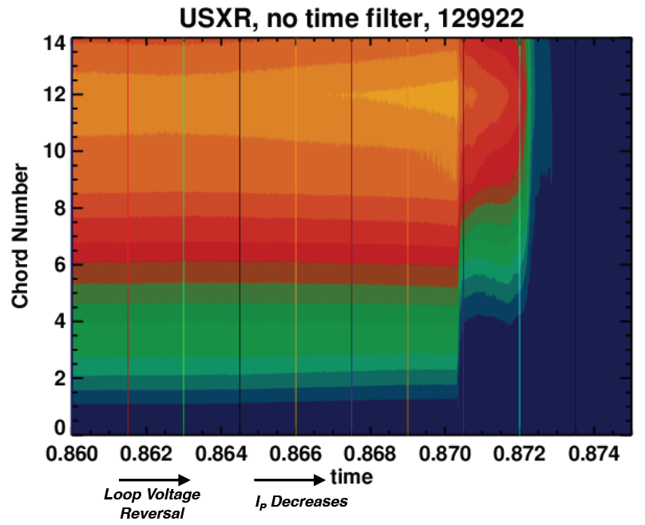
NSTX high energy disruptions were investigated to study heat loading on divertor
R(13-4)
High energy disruptions in NSTX occurred soon after loop voltage was reversed without leading RWM, TM locking, or vertical motion before TQ
USXR analysis shows that heat is lost in two steps very rapidly
  May provide an ideal scenario for studying disruptive heat transport through scrape off layer region
3 of the 4 largest NSTX disruptions since 2007
USXR before and during disruption
129922 134269 129953
Loop voltage reversal
S. P. Gerhardt, A. Mclean (ORNL)
PAC29-46
ITPA MDC-15

Slide 30
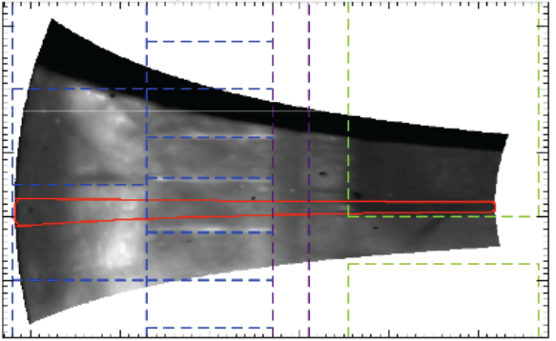
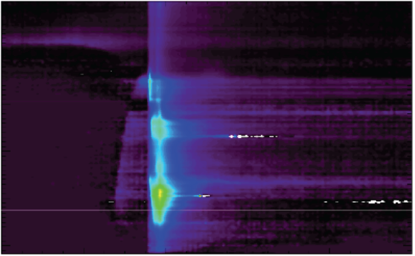

Fast IR camera demonstrated ability to resolve disruption heat loading
T [Cº]
R(13-4)
NSTX fast dual-band IR temperature
2-D surface temperature shows significant turbulence
T, q in time shows interesting pre-collapse signature
  Peak q using THEODOR shows much lower value (~10) than 1-D C&J
Fast cooling of the surface shows that incorporation of surface layer physics is essential
250
1000
#140440
240
750
230
Toroidal angle
500
220
250
210
0.3
0.4
0.5
0.6
0.7
0.8
0
R [m]
Divertor temperature vs. time
T [Cº]
Divertor heat flux (THEODOR) vs. time
q [MW/m²]
0.8
1000
15
0.7
800
10
0.6
600
Major Radius [m]
5
0.5
400
0.4
200
0
0.3
0
-5
300
320
340
360
380
400
300
320
340
360
380
400
Time [ms]
A. Mclean (ORNL)
Time [ms]
PAC29-46
ITPA MDC-15

Slide 31






Open-loop comparisons between measurements and state space controller show importance of states and 3D model
R(14-1)
Agreement can be greatly improved with sufficient number of states and with 3D detail of model (such as NBI port)
Extra NBI port is also included in NSTX-U prediction
Effect of Number of States Used
Effect of 3D Model Used
NSTX-U passive stability vs. β_{N}
2 States ~ Proportional Gain
No NBI Port
200
δB_{p}¹⁸⁰
RWM
80
δB_{p}⁹⁰
100
Measurement
40
0
0
-100
-40
137722
0.56
0.58
0.60
0.62
0.56
0.58
0.60
0.62
t (s)
Controller (observer)
t (s)
RWM Sensor Differences (G)
7 States
With NBI Port
200
δB_{p}¹⁸⁰
80
δB_{p}⁹⁰
100
40
0
0
-100
-40
137722
0.56
0.58
0.60
0.62
0.56
0.58
0.60
0.62
t (s)
S. A. Sabbagh, J. Bialek
t (s)

Slide 32

(R10-1) Improvements in stability control techniques significantly reduce unstable RWMs at low l_{i} and high β_{N}
Computed n = 1 no-wall limit β_{N}/l_{i},~ 6.7 (low l_{i} range 0.4 – 0.6)
Synthetic equilibria variation: n = 1 no-wall unstable at all β_{N} at l_{i} < 0.38 (current-driven kink limit)
  significant for NSTX-U, next-step ST operation
Subset of discharges
  High I_{p} ≥ 1.0MA, I_{NICD}/I_{p} ~ 50%
2009 experiments
  48% disruption probability (RWM)
2010 experiments
  n = 1 control enhancements
  Significantly reduced disruption probability due to unstable RWM
    s14% of cases with β_{N}/l_{i} > 11
    Much higher probability of unstable RWMs at lower β_{N}, β_{N}/l_{i}
S. A. Sabbagh

Slide 33



ITER advanced scenario requires alpha particles for RWM stability across all rotation values
R(14-1)
Improved MISK calculations again shows the importance of alpha particles in ITER for RWM stability
RWM, error field, and NTV prediction for ITER and next-step devices will be continued
ITER equilibrium WG7
MISK prediction for ITER RWM
I_{p} = 9 MA, β_{N} = 2.9 (7% above no-wall limit)
Revisited from MARS-K benchmark and still showing importance of alpha particles
stable
expected
β_{α}
expected ω_{φ}
unstable
J. W. Berkery, POP 17 082504 (2010)
PAC29-20
ITPA WG7

Slide 34


MS research will be combined to improve disruption detection, as well as mitigations
Disruption mitigation techniques will be tested in NSTX-U, using our unique access in inboard and private flux region
Modeling for gas dynamics has been started
MGI location variation in NSTX configuration
UEDGE+DEGAS2 gas penetration modeling
R. Raman (UW), D. P. Stotler
PAC29-45
ITPA MDC-1

Slide 35
Important diagnostics for MS topics were identified and will be under proposal and/or development
Diagnostics | Resolution | Related topics
Magnetic refurbishment | kHz-MHz | Whole MS area
Radial and poloidal magnetic sensors |  | 3D, global
rtMSE | 1-3cm, 5ms | Global, tearing
Internal magnetic fluctuation measurement | 18CH, 100kHz, 5-10ms | 3D, Tearing
rtMPTS | 10-20CH, 11-16.7ms | Global, tearing
Toroidally displaced ME-SXR | 1-3cm, 10-100kHz | 3D, global, tearing, disruption
Core X-ray Imaging Spectrometer | <1cm, >5ms | 3D, global, tearing
Disruption force diagnostics |  | Disruption
RTV (Real Time Velocity) measurements | 4-6CH, <5kHz | 3D, global, tearing
Neutron collimator | 3-4CH, 5-20ms | Global, tearing
Tangential FIDA, High density FIDA | 1cm, 5ms | Global, tearing
NPA, ssNPA | 5-10cm, 1MHz, 10keV | Global, tearing
SOLC with magnetic probes, electrodes, sensors |  | 3D, global, tearing, disruption
Additional RWM sensors near upper and lower divertors |  | 3D, global
EBW measurements for magnetic field | 1-3mm (rho=0.7-0.9) | 3D, global, tearing, disruption
MSE-LIF | 1-3cm, 5ms | 3D, global, tearing
Radiation tomography |  | Disruption
Improved reflectometer system | 1-10kHz | Global, ASC
Fast thermography, thermocouples | 5-10cm, 1ms | Disruption
Visible bremsstrahlung imaging | 1cm, 20us | Global
Error field measurements with external coils |  | 3D

Slide 36
Summarized theory topics in MS
Category | Existing efforts | Associated physics issues
More robust equilibrium reconstruction and modeling including toroidal rotation and SOL, and stability analysis | EFITs including rotation LRDFITs including rotation (E,LRD)FITs + FLOW (E,LRD)FITs + FLOW + M3D-C1 | Stability boundary with toroidal rotation? Stability boundary including separatrix? Can be routinely available as GEQDSK in NSTX-U?
Quasi-linear 3D equilibrium modeling including islands, neoclassical, and kinetic MHD effects | IPEC with tensor pressures and islands + POCA + Inner-layer FLOW, MARS-F, MARS-K M3D-C1 | 3D equilibrium with opened islands? 3D equilibrium with rotation? 3D equilibrium with anisotropic pressures? Self-consistent modeling for NTV in NSTX-U?
Quasi-linear stability modeling including neoclassical and kinetic MHD effects | MISK with anisotropic pressures and fast ions MARS-K, NOVA-K M3D-C1 | RWM passive stability with 2nd NBIs in NSTX-U? Effects by Self-consistent eigenfunction? Second RWM code with full kinetic treatment?
Non-linear (as well as linear) 3D modeling for time-evolving dynamics of islands, neoclassical, full kinetic MHD effects | M3D-C1 with distribution function solver (Ramos theory or NTV theory) XGC0 | - Non-linear effects in 3D equilibrium and stability, including SW (q=1) and NTM? Two fluid effects in 3D equilibrium and stability? Full kinetic effects in 3D equilibrium and stability?
Gas penetration physics modeling including MGI and runaway electrons and disruption simulation | DEGAS2 for gas penetration TSC for runaway electrons M3D for disruption simulation Use of 3D equilibrium sequence | Gas penetration with atomic physics? Runaway electrons in NSTX-U? Coupling gas and plasma modeling? Why mode locking cause a disruption? What is the origin of a density limit disruption?
Full 3D modeling for external structure for RWM dynamics | Multi-mode VALEN3D Plasma permeability with neoclassical and kinetic MHD effects VALEN3D + Plasma permeability | Full 3D current effects on RWM? Effects of full 3D + kinetic plasma permeability on RMW stability and control?

