Slide 1
NSTX-U PAC-31 questions – day 1
1a. What are the research priorities for the 5 year renewal period
That leverage new NSTX-U capabilities in advancing the 4 stated mission elements?
That address critical path issues to a FNSF?
1b. Use slide 50 in your talk to briefly describe the process for collaborations during the upgrade. Describe the status of the conversations with the collaborating facilities.
2. Based on density and power control consistent w/ existing database, what is projected pulse length for 1 MA? 2 MA?
3. Based on density and power control consistent with the existing database, what is the maximum current for fully non-inductive, 5 sec operation in NSTX-U?

Slide 2
Summary of response to question 1a: 5 research thrusts / high-level goals for 5 year plan
Note: as requested, these thrusts are ordered/prioritized assuming general FNSF needs - (not necessarily) ST-specific
Demonstrate 100% non-inductive current at performance that extrapolates to ≥ 1MW/m² neutron wall loading in FNSF
Access reduced ν* combined with ability to vary q & rotation profile to dramatically extend ST plasma understanding
Develop and utilize high flux expansion divertor magnetic configuration for heat flux mitigation
Develop and understand non-inductive start-up/ramp-up to project to ST-FNSF operation w/ small/no solenoid
Assess high-Z PFCs + flowing liquid lithium to develop high-duty-factor integrated PFC/PMI solution for FNSF, beyond

Slide 3
Demonstrate 100% non-inductive current at performance that extrapolates to ≥ 1MW/m² neutron wall loading in FNSF
Importance: Critical issue for using tokamak as steady-state neutron source (for both low and conventional A), Demo
Especially important for ST w/o solenoid, also informs ITER-AT
Leverages:
New more tangential NBI for increased non-inductive current drive
Utilizes new higher B_{T} from new CS to increase plasma T, pulse-length
Lithium coatings, then cryo-pump for long-pulse density control
rt-MSE (funded thru collaboration), control collaboration w/ Lehigh, GA
Existing/new fast-ion diag. (FIDAs/ssNPA) for NBI redistribution
Projected performance levels
A ~ 1.7-1.8 , κ ~ 2.75-3, I_{P} ~ 1MA, B_{T} ≥ 0.75T, I_{P}/aB_{T} ≥ 2.5-3.5
β_{N} ≥ 4.5, β_{T} ≥ 10-15%, n_{e} / n_{G} = 0.7-1, H₉₈ ≥ 1
Demonstrate this for few τ_{E}→ 1-2 τ_{CR} initially
Extend to longer pulse with long-pulse divertor (including cryo), β and RWM control, J(r) control, disruption avoidance techniques

Slide 4
Access reduced ν* combined with ability to vary q & rotation profile to dramatically extend ST plasma understanding
Importance: Understanding and optimizing confinement (core and edge) and stability (RWM/NTV) through ν* and q + rotation will be important for FNSF (low or conventional A)
Scaling of B_{T}τ_{E} with ν* important for compact low-A FNSF
Leverage:
Projected 3-5x lower collisionality from higher temperature from:
2x higher TF and I_{P} from new center-stack, structural enhancements
2x higher heating power from 2nd NBI
Upgraded high-k_{θ} diagnostic, increased BES resolution, polarimetry
Existing 2nd SPA for EFC/RWM coil spectral flexibility
Off-axis NBI current-drive and momentum deposition to modify q, Ω
NCC coils for improved rotation control (up to n=6), ELM control, and increased stable operating β
Unique high β + low ν* plasmas to validate range of models, provide knowledge-base for FNSF, ITER, Pilot/Demo

Slide 5
Develop and utilize high flux expansion divertor magnetic configuration for heat flux mitigation
Importance: heat-flux mitigation in divertor critical issue for using tokamak as steady-state neutron source, Demo
Projected peak heat fluxes at low-A and high-A above long-pulse material limits for conventional divertor
Leverages:
High (unmitigated) peak heat flux accessible in NSTX-U (30-45MW/m²) from increased NBI (+ HHFW) power, narrower SOL at 2MA
New up/down symmetric divertor PF coils implemented in new CS
Snowflake x-point control being developed in PCS (w/ LLNL and GA)
Cryo-pumping for ability to systematically vary core and SOL density
Scientific approach:
Measure and model peak heat flux reduction vs. flux expansion, core density, impurity content/radiation, and access to partial detachment
Contribute to improving predictive capability for detachment, and detachment control - remain critical issues for ITER, next-steps

Slide 6
Develop and understand non-inductive start-up/ramp-up to project to ST-FNSF operation w/ small/no solenoid
Importance: Low-A FNSF requires substantial/full non-inductive start-up/ramp-up current
Leverages:
More tangential 2nd NBI couple to/ramp-up low-I_{P} target plasma
Higher field and pulse-length of new CS for stability, profile equilibration
Upgraded CHI + higher TF (1T) to increase start-up current to ~0.4MA
Existing HHFW heating and current drive for NBI ramp-up target
ECH: 1MW 28GHz for heating start-up plasma for HHFW/NBI ramp-up
Metallic divertor (to reduce impurity radiation during CHI)
Plasma guns to provide/test retractable helicity injection start-up
Develop predictive capability
2D and 3D models of plasma start-up and ramp-up – TSC, TRANSP, NIMROD, possibly M3D-C1

Slide 7
Assess high-Z PFCs + flowing liquid lithium to develop high-duty-factor integrated PFC/PMI solution for FNSF, beyond
Importance: high-Z (namely W) is leading candidate for PFC in FNSF, and there are major concerns about sputtering/erosion that motivate replenished/flowing liquid lithium/metals
Leverages:
NSTX Li coating experience that shows little lithium going into core plasma, reduced recycling, improved confinement & ELM stability
CDX-U tray results on heat-flux handling ability of liquid metals
LTX high-Z wall experiments with and without lithium (solid & liquid)
NSTX LLD experience of Li on porous Mo to protecting underlying PFC
MAPP tests on LTX for NSTX-U + lab-based R&D on surface chemistry
Lab-based R&D on flowing liquid metal concepts, emphasizing reliability
High heat flux (energy to divertor) accessible in NSTX-U with 2nd NBI
Approach: progressively test Mo (or W) tiles in divertor → FW
Implement flowing Li when technically ready
Proceed in way compatible with other goals described previously

Slide 8
Q1b “Collaborations: Held team-wide discussion on FY12-13 opportunities and expectations in Sep-Dec 2011” (started Mar/Apr 2011)
Collaboration should aim to support NSTX-Upgrade mission
Also support toroidal physics generally, ICCs, and non-fusion applications
For all researchers, use Upgrade outage as opportunity to:
Extend and improve your ongoing and future research on NSTX
Learn about other facilities – bring back knowledge, best practices
Try or learn something new – new physics, diagnostics, analysis, …
Aim to form small teams from NSTX (PPPL + non-PPPL)
Coordinate research plans, analysis, travel, and participation
Expectations for researchers:
Select 1 primary and 1 secondary/backup collaboration project
Aim for 1st author papers, invited talks – PRL/NF/PoP, APS/IAEA
Present your results periodically to NSTX, PPPL research seminars
Facilities: MAST, DIII-D, C-Mod, LHD, EAST, KSTAR, JET, more to come
Funding: PPPL covers salaries of PPPL NSTX researchers by default
Challenge: no additional NSTX funding dedicated to collaboration
Working closely with PPPL off-site research department

Slide 9
Summary of Answers to questions #2 and #3
Q: Maximum pulse length at 1MA, 0.75T, 1st year parameters?
A1: Full 5 seconds at 1025-1300 kA, four 80 kV sources, q_{min}>1, w/o challenging I²t on any coil.
A2: Can achieve 8-10 seconds at ~1 MA using six 65 kV or interleaved modulated 80 kV beams, q_{min}>1, approaching OH and TF I²t limits.
Q: Maximum pulse length at 2 MA, 1T?
2 MA operation requires 1T, is likely limited by q-evolution rather than solenoid flux or heating.
Current redistribution time with six 80 kV beams is 0.6-0.8 at f_{GW}=0.7.
A: For year 2 operation with 1-2 sec TF flat-top, can use the full TF w/o encountering OH I²t limit or q_{min} problems.
Allow physics studies of PMI, BP, MS, EPs, transport and turbulence.
Will fit in PFC temperature limit w/ SFD and some divertor radiation.
Q: Maximum current that can be sustained non-inductively for 5 seconds (80 kV Beams)?
A1: 635-800 kA with four beams, 0.75 T
A2: 750-1225 kA with six beams, 1.00 T

Slide 10
Background Information On Simulations (Much Covered in ASC Talk)
Typically assess a scenario using two profile and two confinement assumptions.
Good for bracketing the expected operating points.
Central NBCD tends to drive down q_{min} for f_{GW}<~0.7.
The exact low-density boundary for q_{min}=1 depends on the configuration.
NSTX discharges become strongly susceptible to core m/n = 1/1+2/1 modes as q_{min} approaches 1.
Define “maximum sustainable current” as that which leads to q_{min}~1.1-1.2.
Typically more limiting than the solenoid flux or I²t limits.
Heating duration is a strong function of the beam voltage.
Limits are due to heating on the primary energy ion dump.
Upgraded ion dumps could result in extension of pulse lengths.
5 seconds generally required 80 kV sources, with 1.7 MW/source

Slide 11
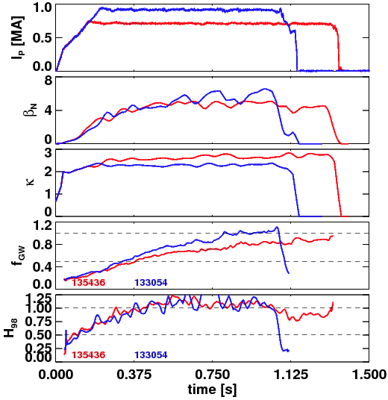
Discharges Have Shown Good Confinement and High Density and Elongation.
Upgrade simulations generally call for H₉₈=1 at 0.65<f_{GW}<1.0.
Database analysis shows this regime is accessible with Upgrade-relevant shaping.
Time Traces of Discharges with Good Confinement at High Density

Slide 12
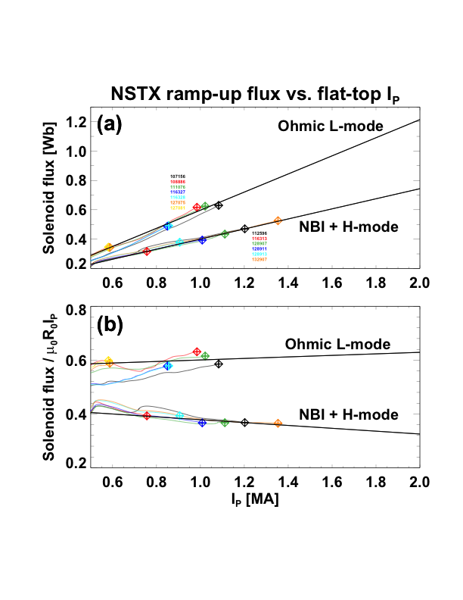
Flux Consumption Assumptions for the Upgrade Based on Extrapolation of NSTX Results
Upgrade OH capacity is substantially improved
Factor 3.5 increase in I²t limit.
Vs capability increased from 0.75 Wb to 2.1 Wb.
Very few high-performance scenarios limited by flux consumption.
Extrapolate ramp-up flux for 2MA as ~0.8 Wb.
Must keep surface voltage under (2.1-0.8)/5 = 0.25 V
2MA scenarios project to 0.2-0.3 V.
Similar increase in TF capability.
Factor of 20 increase in I²t.
Maximum field increase by factor of ~2.
Results in quite long TF Flat-top durations compared to NSTX.
~6.5 s at 1 T, ~11.5 s at 0.75 T

Slide 13
Question: Non-Inductive Sustainment Level for 5 seconds? Answer: 750-1225 kA for 1T, 635-800 kA for 0.75 T
Summary of Fully Non-Inductive Scenarios at 0.75 & 1 T
Voltage [kV] | # of Sources | Heating Duration | B_{T} [T] | Non-Inductive Current Range | Current Time [s]
80 | 4 | 5 | 0.75 | 635-800 | 0.25-0.4
90 | 4 | 3 | 0.75 | 675-865 | 0.3-0.43
80 | 6 | 5 | 1.0 | 750-1225 | 0.35-0.7
90 | 6 | 3 | 1.0 | 875-1325 | 0.4-0.8
All the details for the 100% non-inductive scenarios
β_{N} values are similar to commonly achieved values in NSTX

Slide 14
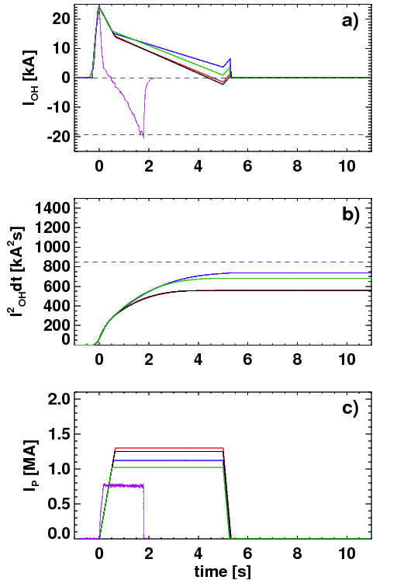
Question: Pulse Duration at 1 MA? Answer #1: At 0.75 T, the Maximum Sustainable Current is in the Vicinity of 1000-1300 kA for 5 Seconds.
1100-1300 kA Scenarios Don’t Challenge OH Coil Limits
Summary of 0.75 T scenarios with q_{min}~1.15
Sustainable current exceeds 1 MA at 0.75 T, even for most pessimistic confinement assumptions
Voltage | # of Sources | Heating Duration | B_{T} [T] | Range of Sustainable Currents | Current Time [s]
80 | 4 | 5 | 0.75 | 1025-1300 | 0.35-0.45
90 | 4 | 3 | 0.75 | 1125-1350 | 0.4-0.5
Table With Complete Details on 0.75 T Scenarios with q_{min}~1.15

Slide 15
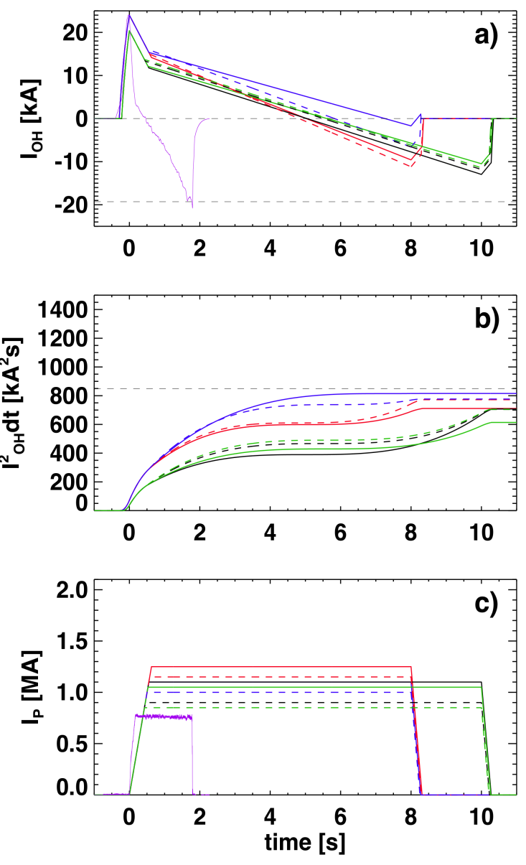
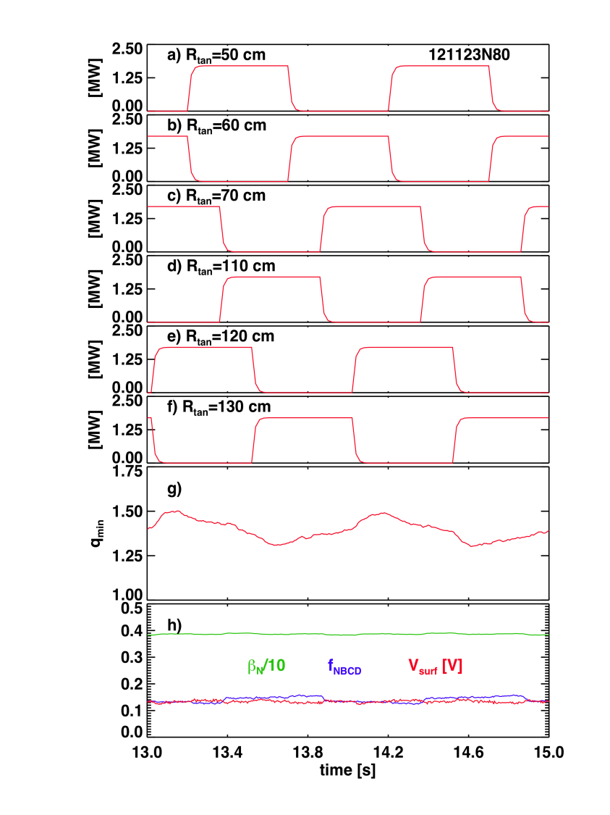
Question: Pulse Duration at 1 MA? Answer #2: Heating and magnetic system capable of 8-10 s ~1 MA pulses!
B_{T}=0.75 T scenarios with 5.1 or 6.6 MW input power
Interleaved 80 kV case can sustain q_{min}> 1with 850-1050 kA for 10 sec.
65 kV case can sustain q_{min}>1 with I_{P}=1000-1250 kA for 8 sec.
NSTX Record!
Example Beam Modulation Pattern Designed to Minimize q_{min} Variation
Results in 5.1 MW for 10 s!
Solenoid Current & Heating, and Plasma Current Waveforms
NSTX Record!

Slide 16
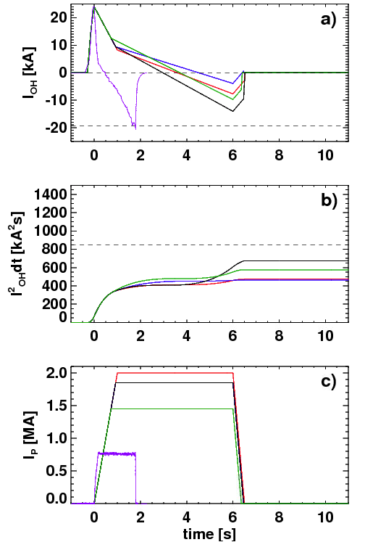
Question: Pulse Duration at 2 MA? Answer 1: The “maximum sustainable current” is typically a somewhat less than 2 MA.
10.2 MW, 1500-2000 kA Scenarios at f_{GW}=1 Don’t Challenge OH Coil Limits
Summary of 1.0 T scenarios with q_{min}~1.15
Only most optimistic projections at high f_{gw} result in relaxed q_{min}>1 at 2 MA
Voltage [kV] | # of Sources | Heating Duration [s] | B_{T} [T] | f_{GW} | Range of Sustainable Currents [kA] | Current Time [s]
80 | 6 | 5 | 1.0 | 0.7 | 1250-1800 | 0.44-0.8
80 | 6 | 5 | 1.0 | 1.0 | 1500-2000 | 0.4-0.6
90 | 6 | 3 | 1.0 | 0.7 | 1350-1900 | 0.5-0.85

Slide 17
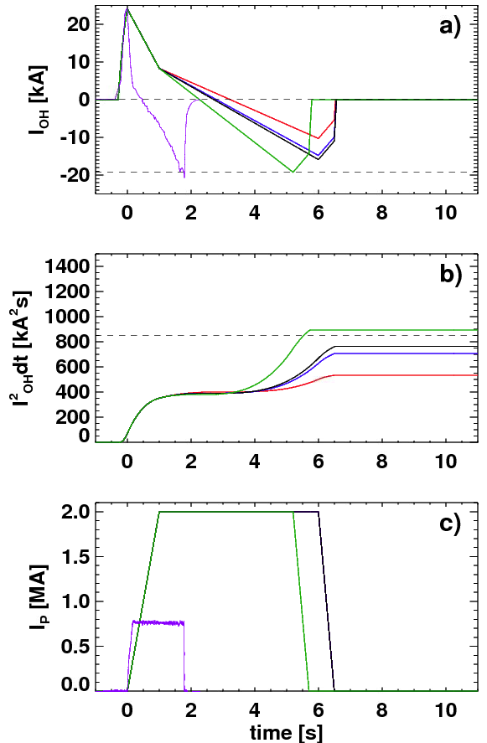
Question: Pulse Duration at 2 MA? Answer 2: Long Current Redistribution Times Will Allow Long Pulse
Summary of 10.2 MW, 1.0 T , 2 MA, 5 sec. scenarios
2000 kA Scenarios at f_{GW}=0.7 Only Challenge OH Coil For Unfavorable Confinement and Profiles
Scaling | Relaxed q_{min} | Current Time [s]
ITER | 0.46-0.54 | 0.65
ST | 0.78-0.85 | 0.75-0.8
NSTX discharges evolving to q_{min}<1 typically last ~4 τ_{CR}.
By similar logic, expect 2-3 seconds at 2 MA.
Sufficient for all confinement, stability, and boundary physics studies.

Slide 18
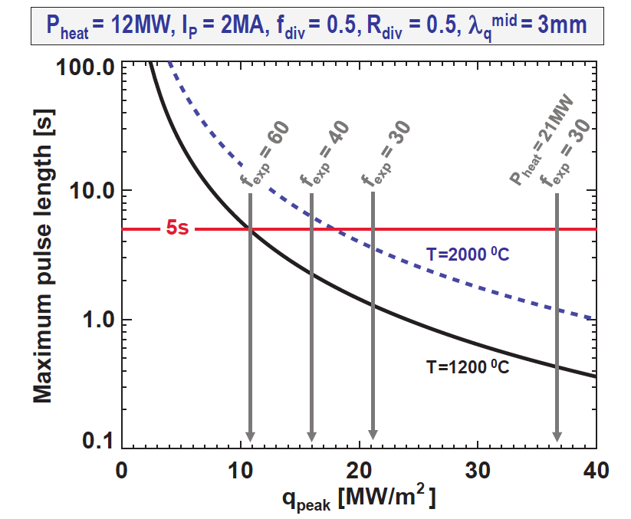
Divertor Temperature Can Be A Pulse Length Limiting Factor
For f_{exp}=30 and f_{div}=0.5, and no radiation:
Limited to ~1.5 second for a 1200 C divertor.
Approximately matches the expected pulse length for year 2, 1 T, 2MA operation.
Relief could come from impurity radiation.
Snowflake divertor utilized to achieve large f_{exp} promotes detachment.
Research plan will develop radiative divertor control if SFD does not naturally develop them.
Higher density for q_{min}>1 purposes helps promote divertor radiation solutions.
Pulse Length as a Function of Peak Heat Flux.
Menard, et al., submitted to Nuclear Fusion

Slide 19
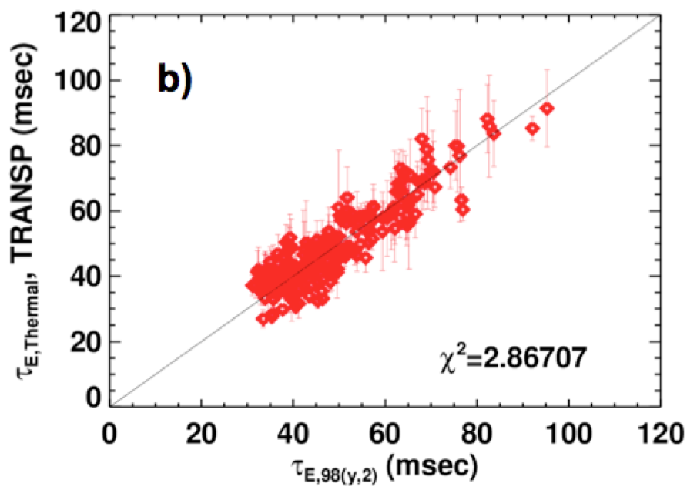
NSTX Context For Confinement and Flux Consumption Assumptions in Upgrade
Relationship Between Confinement, Density, and Elongation
Confinement Quality in Recent Lithiated Discharges Agrees Strikingly Well with ITER-98y,2
Gerhardt, et al., NF 2011
See comparison to “ST-Scaling” in talk by Y. Ren.
Menard, et al., Submitted to Nuclear Fusion

Slide 20
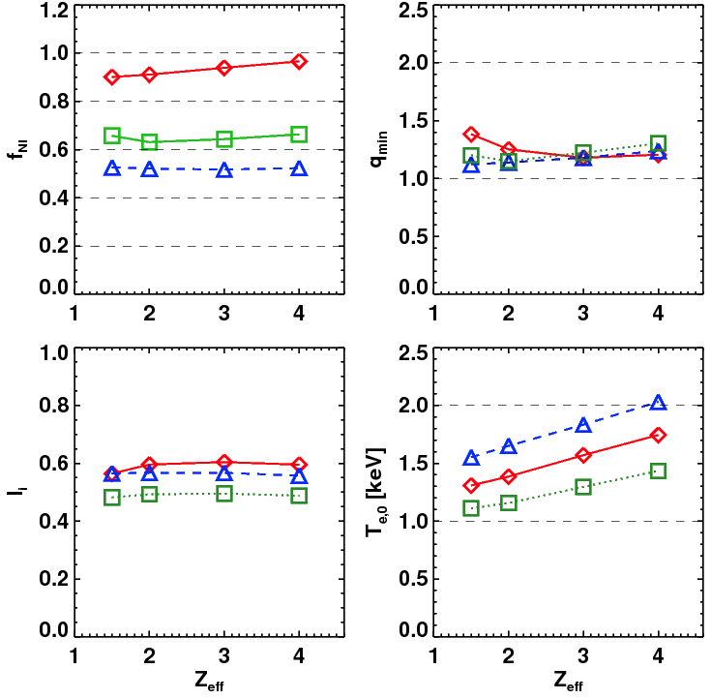
Scenario Goals Can be Met over a Range of Z_{eff}, Provided Confinement is Maintained
Li H-modes, even w/ small ELMs and controlled density, tend to have Z_{eff}~2-4.
Best confinement at the higher Li evaporation rates.
Increasing Z_{eff} with fixed T_{e} reduces non-inductive fraction.
Increased Z_{eff}, with fixed H₉₈, results in very little change.
H₉₈~1 confinement (or better) observed in lithiated H-modes over a range of Z_{eff}.
The electron confinement is a critical variable in determining the scenario performance.
1.0 MA, 1.0 T, P_{inj}=12.6,
near non-inductive
1.6 MA, 1.0 T, P_{inj}=10.2 MW, partial inductive
1.2 MA, 0.55 T, P_{inj}=8.4 MW, high β_{T}
All: f_{GW}=0.7, H₉₈=1

