Slide 1


MS TSG Effect of Polar Changes
Jack Berkery
Columbia University
PPPL
May 24, 2017
*This work supported by the US DOE contracts DE-AC02-09CH11466 and DE-FG02-99ER54524

Slide 2
MS TSG concerns
Many experiments in MS TSG purposefully make disruptions
  This ability needs to be maintained, mitigated and unmitigated, up to 1T 2MA
  Direct impact forces and halo current forces exerted on the tiles
  Strikepoints move during disruptions – should be studied
  Conversely, disruption avoidance XPs need long pulse to demonstrate stability
3D fields utilized by the MS TSG will impact the polar region
  By changing the heat flux pattern and field line angles
  Rotating 3D fields for diagnostic purposes requires long pulse
Plasma shapes for continuity with tearing studies requested
  NSTX and DIII-D similar shapes, κ up to 2.2, upper δ up to 0.45, lower δ up to 0.7
L-modes (~1s) and controlled shutdown (0.5s) limited on CS
Co- vs counter-I_{p} XPs require B_{T} reversal; new EP loss pattern

Slide 3
MS TSG concerns
Access to high beta is critical for MS TSG
  Ability to operate all 6 NBI should be retained
  Pulse lengths long enough for magnetic braking and to trigger NTMs
Access to low collisionality is required for stability studies
  Glow discharge cleaning, bakeout, tile material (outgassing) important
Massive gas injection experiments are planned
  NSTX-U only machine for private flux vs. midplane injection study – retain holes
  Injection from private flux region may help radiate/protect divertor tiles in VDE

Slide 4
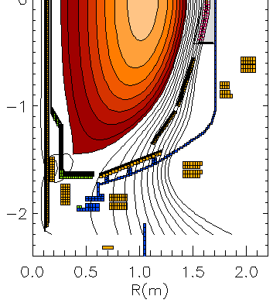
MS TSG concerns
Necessary magnetics should not be affected
  Coverage for equilibrium reconstruction, including polar region for snowflake
  Capacity for upgraded halo current sensors should be retained… (next slides)
  Extended magnetic sensors in the divertor region have long been planned
    If ceramic break for CHI is removed, could in principle consider another channel at even lower major radius
Present sensor locations
B_{R} sensors (nominally normal, B_{norm})
B_{p} sensors (nominally tangential, B_{tan})
New sensor locations

Slide 5
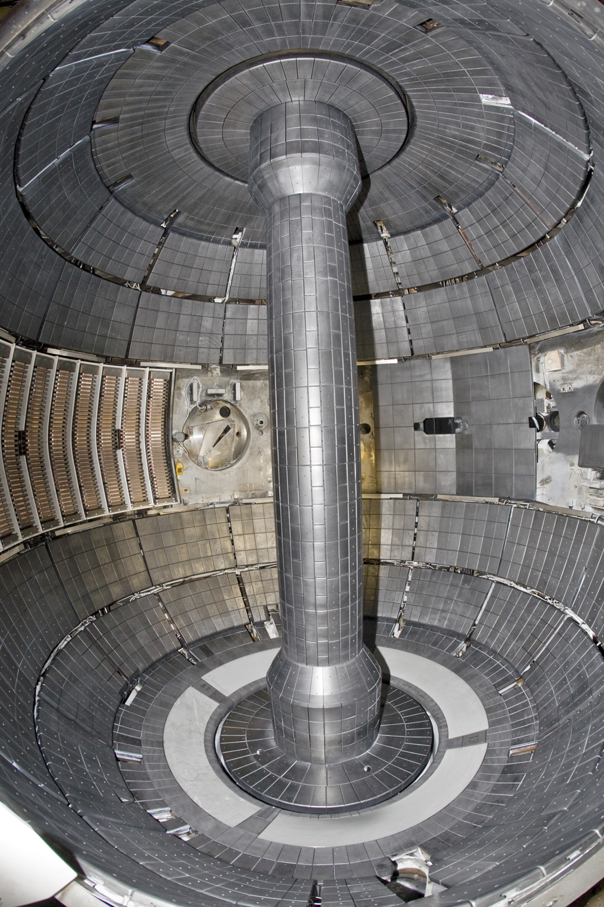
Sketch of present NSTX-U configuration (FY16)
Normal-current shunt tiles
Single axis B sensors
Multi-axis B sensors
Dense Langmuir probes

Slide 6
Sketch of planned enhancements
Normal-current shunt tiles
Single axis B sensors
Multi-axis B sensors
Dense Langmuir probes

Slide 7
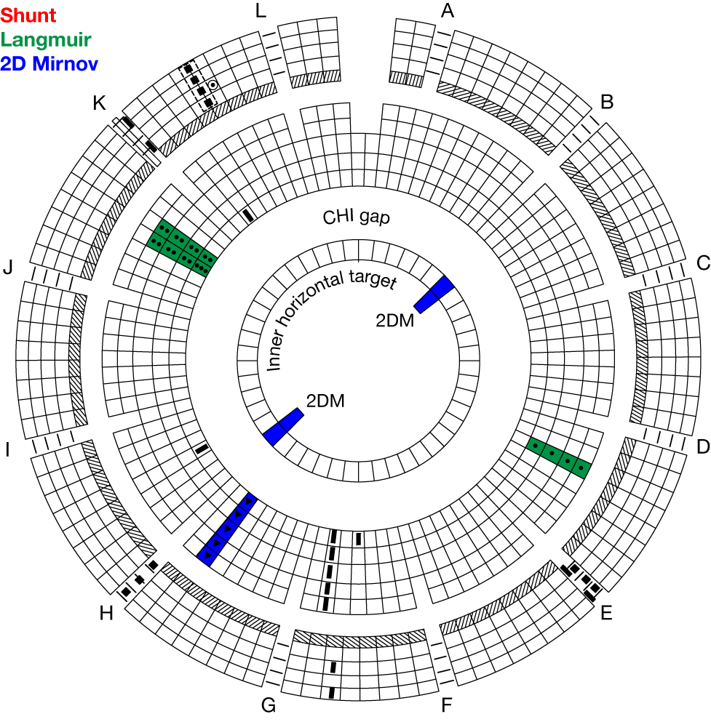
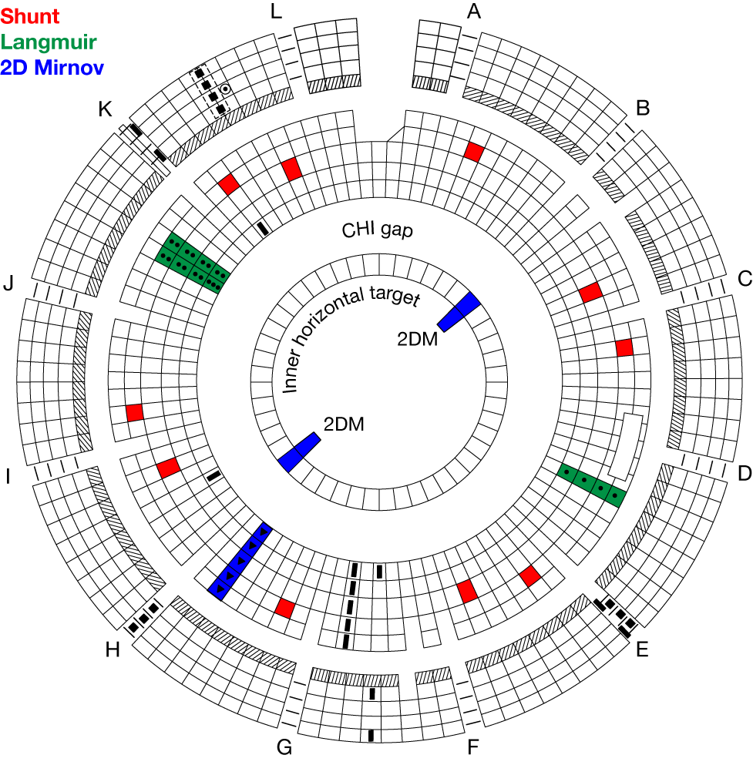
Existing configuration (FY16)
Upper
Lower

Slide 8
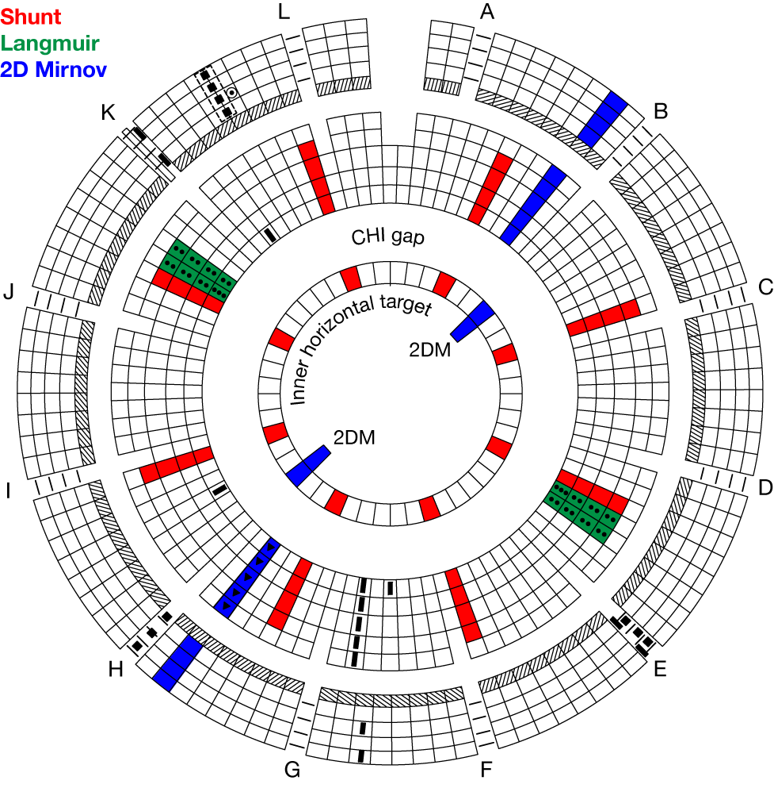
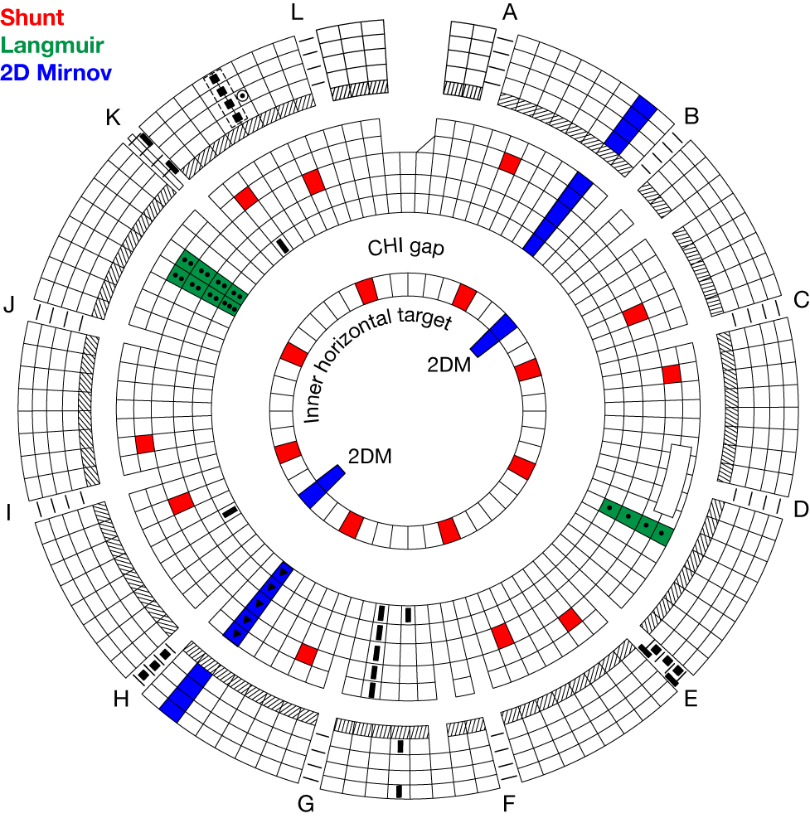
Enhanced configuration
Upper
Lower

