Slide 1
MS TSG Effect of Polar Changes
Jack Berkery
Columbia University
PPPL
May 24, 2017
*This work supported by the US DOE contracts DE-AC02-09CH11466 and DE-FG02-99ER54524

Slide 2
MS TSG five year plans
Thrust MS-1: Understand and advance passive and active feedback control to sustain macroscopic stability
RWM kinetic stability, state space control, rotation control
Thrust MS-2: Understand 3D field effects and provide the physics basis for optimizing stability through equilibrium profile control by 3D fields
Error fields, NTM, NTV
Thrust MS-3: Study and develop techniques for disruption prediction, avoidance, and mitigation, and understand disruption dynamics and in high-performance ST plasmas
DECAF disruption avoidance, Halo currents, MGI

Slide 3
MS TSG concerns
Many experiments in MS TSG purposefully make disruptions
This ability needs to be maintained, mitigated and unmitigated, up to 1T 2MA
Direct impact forces and halo current forces exerted on the tiles
Strikepoints move during disruptions – should be studied
Conversely, disruption avoidance XPs need long pulse to demonstrate stability
3D fields utilized by the MS TSG will impact the polar region
By changing the heat flux pattern and field line angles
Rotating 3D fields for diagnostic purposes requires long pulse
Plasma shapes for continuity with tearing studies requested
NSTX and DIII-D similar shapes, κ up to 2.2, upper δ up to 0.45, lower δ up to 0.7
L-modes (~1s) and controlled shutdown (0.5s) limited on CS
Co- vs counter-I_{p} XPs require B_{T} reversal; new EP loss pattern

Slide 4
MS TSG concerns
Access to high beta is critical for MS TSG
Ability to operate all 6 NBI should be retained
Pulse lengths long enough for magnetic braking and to trigger NTMs
Access to low collisionality is required for stability studies
Glow discharge cleaning, bakeout, tile material (outgassing) important
Massive gas injection experiments are planned
NSTX-U only machine for private flux vs. midplane injection study – retain holes
Injection from private flux region may help radiate/protect divertor tiles in VDE

Slide 5
MS TSG concerns
Necessary magnetics should not be affected
Coverage for equilibrium reconstruction, including polar region for snowflake
Capacity for upgraded halo current sensors should be retained… (next slides)
Extended magnetic sensors in the divertor region have long been planned
If ceramic break for CHI is removed, could in principle consider another channel at even lower major radius
Present sensor locations
B_{R} sensors (nominally normal, B_{norm})
B_{p} sensors (nominally tangential, B_{tan})
New sensor locations

Slide 6
Sketch of present NSTX-U configuration (FY16)
Normal-current shunt tiles
Single axis B sensors
Multi-axis B sensors
Dense Langmuir probes

Slide 7
Sketch of planned enhancements
Normal-current shunt tiles
Single axis B sensors
Multi-axis B sensors
Dense Langmuir probes

Slide 8
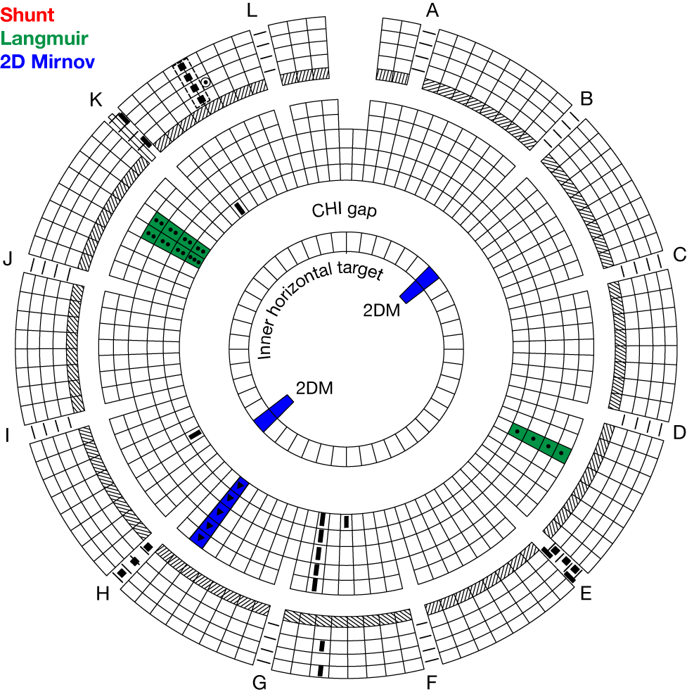
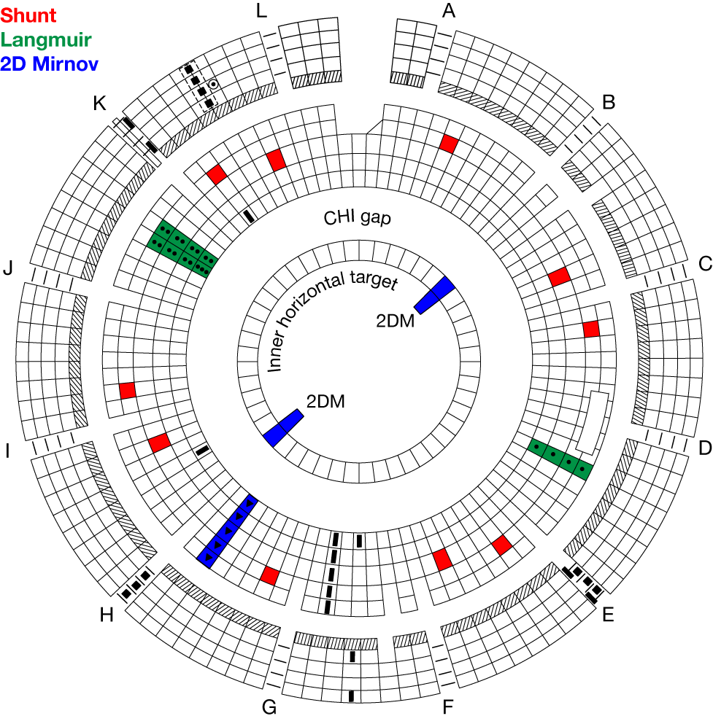
Existing configuration (FY16)
Upper
Lower

Slide 9
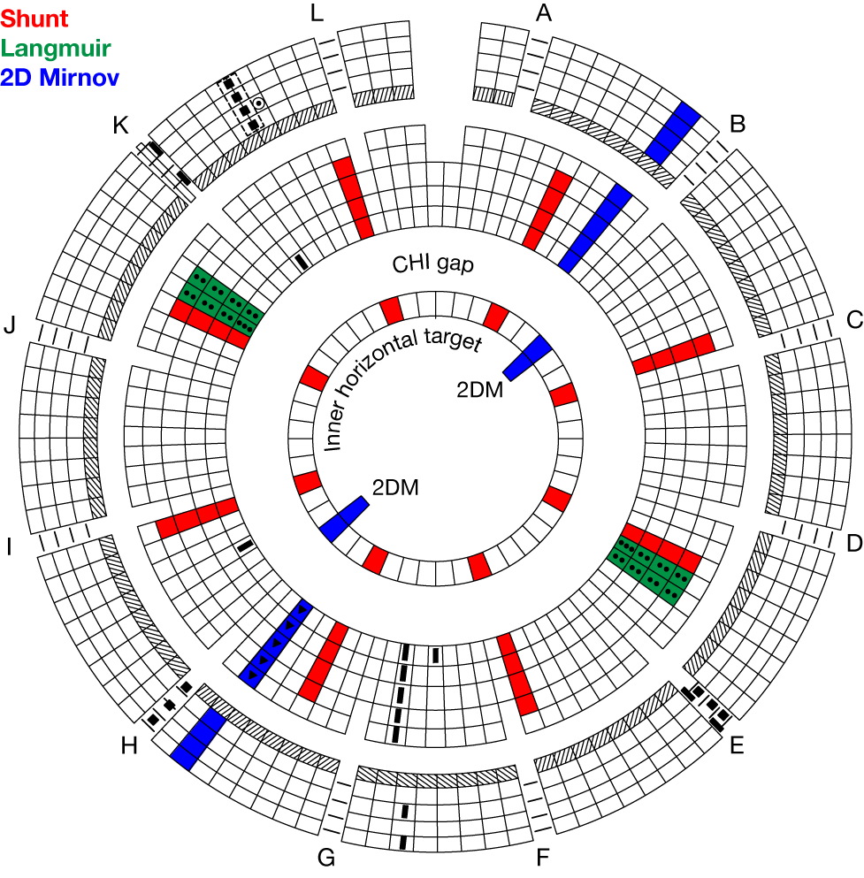
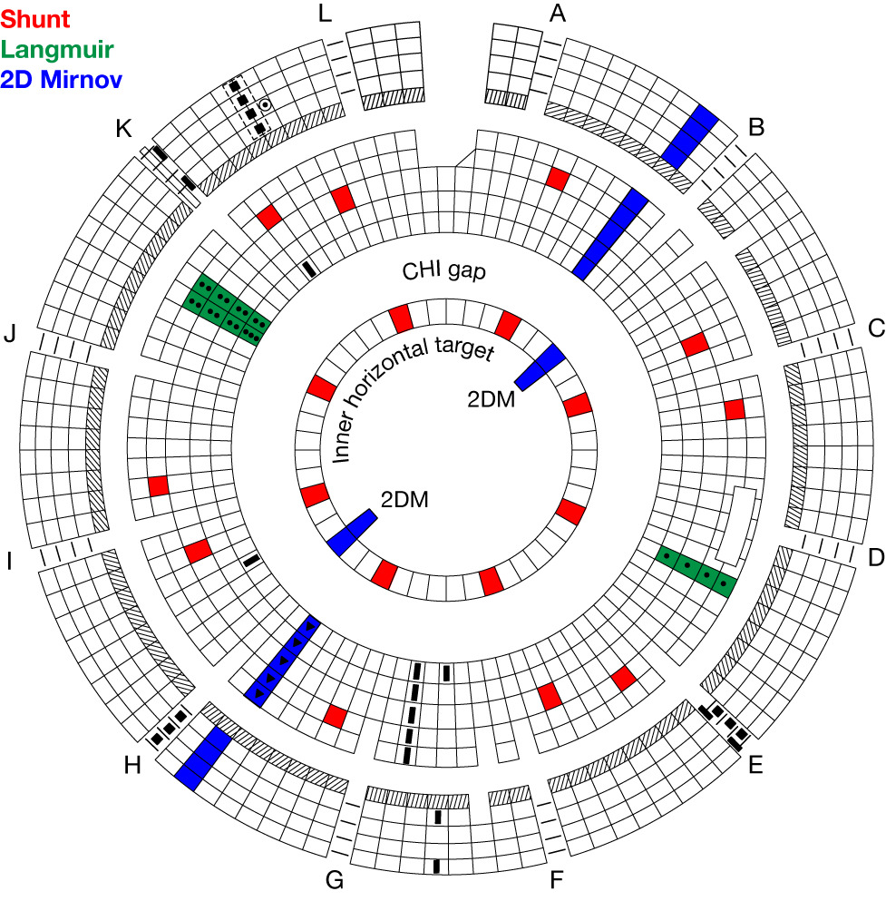
Enhanced configuration
Upper
Lower

