Slide 1

Impact of polar region design changes on Divertor and SOL TSG research
V. A. Soukhanovskii and J.-W. Ahn
NSTX-U Meeting
Princeton, NJ
23 May 2017

Slide 2


NSTX-U Five Year Plan defined three Boundary research thrusts
  BP-1: Assess and control pedestal structure, edge transport and stability
    Pedestal structure, transport and turbulence studies
    ELM characterization and control
  BP-2: Assess and control divertor heat and particle fluxes
    SOL transport and turbulence, impurity transport
    Divertor heat flux mitigation with impurity seeding and divertor geometry
  BP-3: Establish and compare long-pulse particle control methods
    Validate cryo-pump physics design, assess density control and recycling
    Compare cryo to lithium coatings for particle (collisionality) control

Slide 3
Plan for SOL and divertor research from Five Year Plan
Year 1 of 5 Year Plan
  Continue analysis of SOL width database and comparison with models
  Collaboration with DIII-D on snowflake and radiative divertor experiments
Years 2-3 of 5 Year Plan
  Establish SOL width and divertor database vs. engineering and physics parameters
  Re-establish edge turbulence measurements (GPI, BES, cameras, probes)
  Initial radiative divertor experiments with D₂, CD₄ and Ar seeding and lithium
  Develop snowflake divertor magnetic control and assess pedestal stability, divertor power balance, turbulence, 3D fields as functions of engineering parameters
  Comparison with multi-fluid and gyro-kinetic models
Years 4-5 of 5 Year Plan
  Compare SOL width data with theoretical models and in the presence of 3D perturbations of various types, e.g. RMP coils, HHFW heating, NBI injection
  Combine snowflake configurations with pedestal control scenarios and tools, cryo
  Implement radiative divertor control, demonstrate long-pulse H-mode scenario
  Develop experiment-based model projections for ST-FNSF
Let’s focus
on this

Slide 4
NSTX-U engineering and plasma parameters for main DivSOL research areas
  SOL transport and turbulence (SOL width, Edge/SOL turbulence, divertor database vs. engineering and physics parameters, etc)
    ≤2 MA, P_{NBI}≤6 MW, flattop 1-2 s, highly shaped, B_{t} can be lower than 1 T
    Main priority λ_{q}, B2Li, DN vs LSN shape, pitch angle considerations, drsep control
  Impact of 3D fields on divertor
    ≤2 MA, P_{NBI}≤6 MW, flattop 1-2 s, highly shaped, n=3 RMP, B_{t} can be lower than 1 T
    Issues: dependence on collisionality, residual n=1 field, snowflake divertor compatibility
  Boron to Lithium transition
    ~1 MA, P_{NBI}≤4-6 MW, flattop 1-2 s, highly shaped, B_{t} can be lower than 1 T
  Radiative divertor experiments with D₂, CD₄, N₂, Ar seeding and/or lithium
    1-2 MA,P_{NBI}≤4-10 MW, flattop 1-2 s, highly shaped, B_{t} can be lower than 1 T
    Issues: DN/LSN shape control, divertor gas system
  Advanced divertor configurations (cusp/X, high flux expansion, long leg, etc)
    1-2 MA, P_{NBI}≤4-10 MW, flattop 1-2 s, highly shaped, B_{t} can be lower than 1 T
    Issues: equilibria and control with new divertor coils, tile fish-scaling impact on field angles and R_{sp}
  Snowflake divertor
    1-2 MA, P_{NBI}≤4-10 MW, flattop 1-2 s, highly shaped, B_{t} can be lower than 1 T
    Issues: equilibria and control with new divertor coils, tile fish-scaling impact on field angles and R_{sp}

Slide 5
Impact on critical SOL and divertor diagnostics
Measurements | Nature of impact
Magnetics (equilibria reconstructions, sensor locations and proximity to plasma) | New sensor design and new locations
Midplane kinetic profiles | No impact
GPI | No impact
Heat flux measurements (IR cameras, thermocouples, Langmuir probes) | Surface macro-non-uniformity and shadowing due to fish-scaling. Spatial resolution for IR cameras.
Radiated power (bolometers, radiometers) | Potential impact on sightlines?
Particle flux and recycling (probes, spectroscopy) | Surface macro-non-uniformity and shadowing due to fish-scaling. Spatial resolution for spectrometers and cameras. Langmuir probe locations and measurements due to shadowing.
Impurity flux measurements (spectroscopy) | Surface macro-non-uniformity and shadowing due to tile fish-scaling. Spatial resolution for spectrometers and cameras.
Neutral pressure measurements | CHI gap closure may affect conductance

Slide 6
DivSOL TSG research program is impacted
SOL/divertor diagnostics are significantly affected by proposed polar region design changes
Some unique research directions (e.g., advanced divertors) may be significantly affected and/or not even possible
Some “mainstream” research directions not significantly affected

Slide 7
Backup

Slide 8
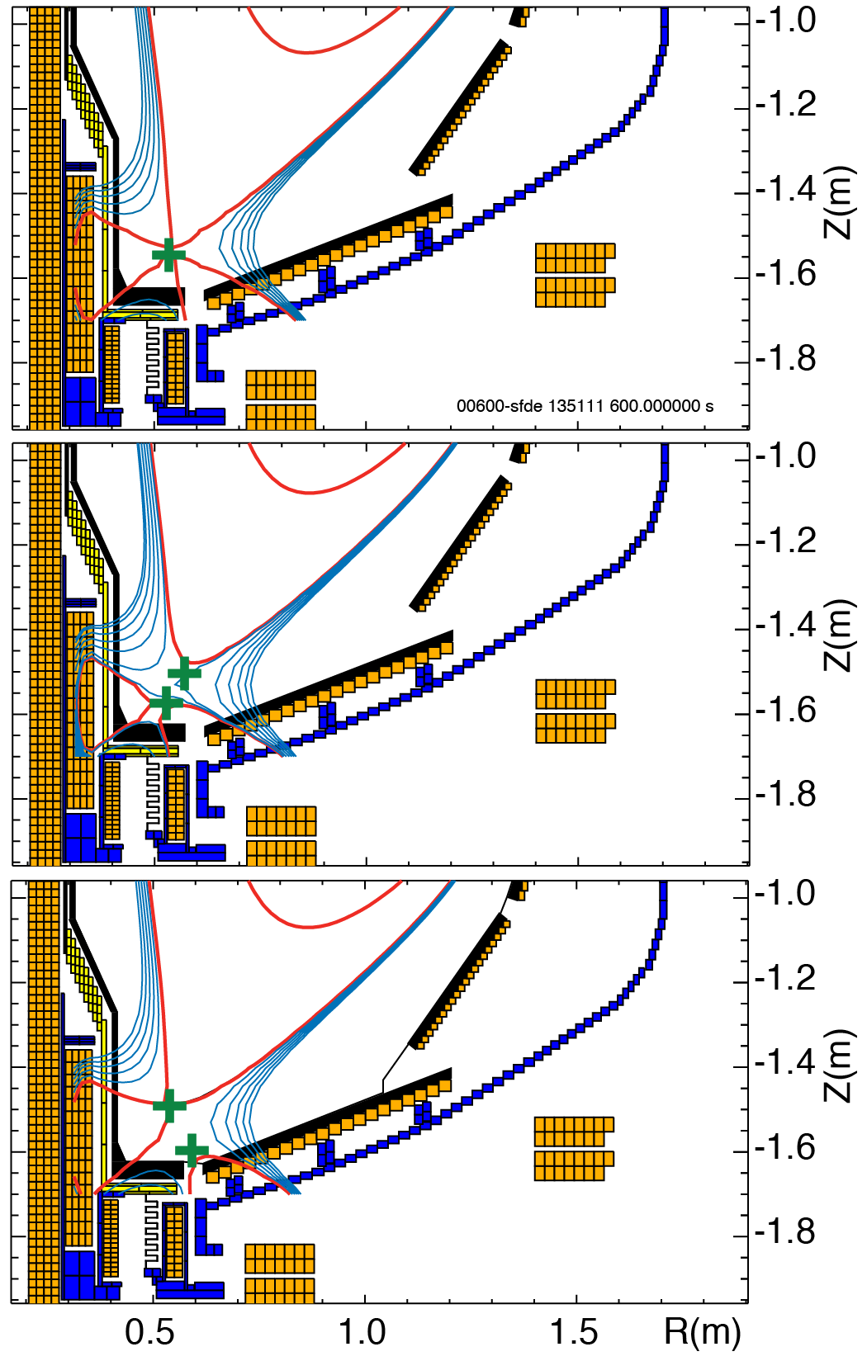
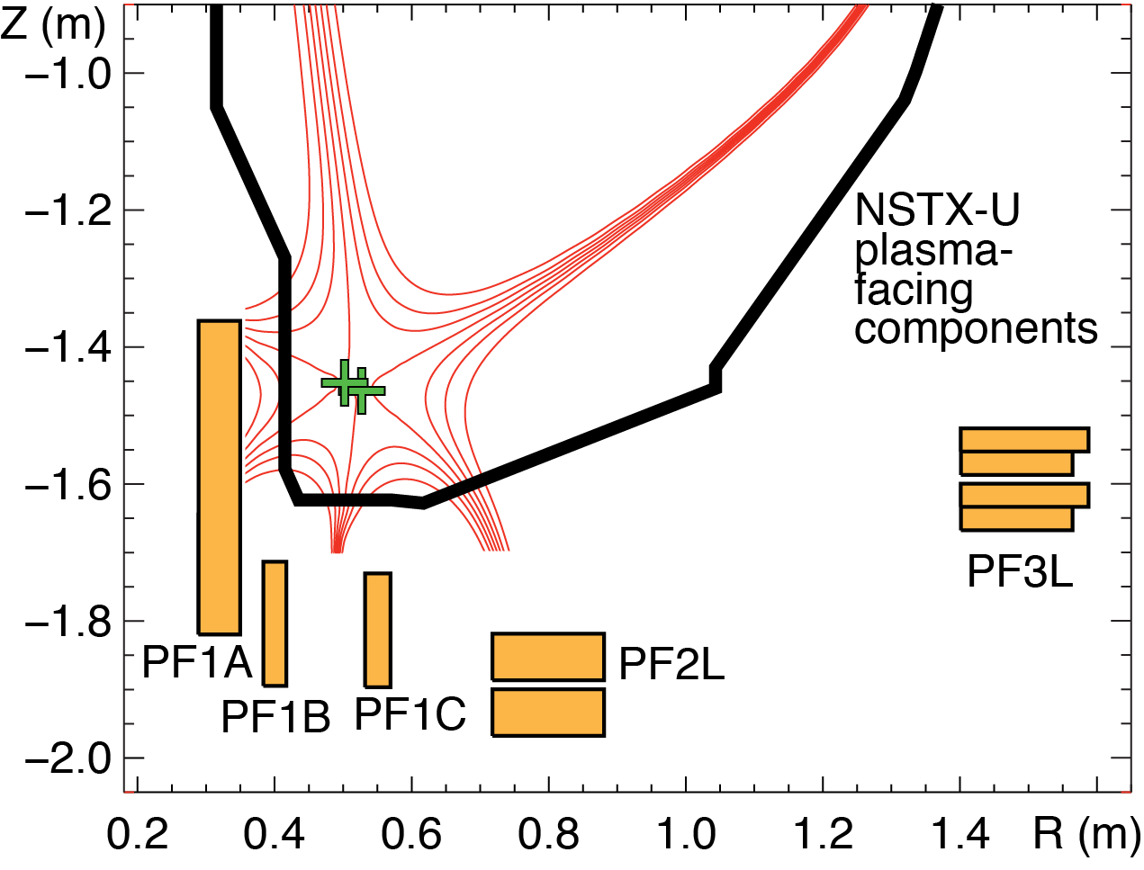
Snowflake divertor configuration
Impact of divertor coil set
Impact of PFC fish-scaling
With PF1B
Without PF1B

Slide 9
Experiments proposed in 2015
1557 | Interaction of applied 3D fields with detachment | Ahn
1514 | Relationship Between Plasma Turbulence and SOL Width Scaling in NSTX-U | Gray
1538 | Radiative divertor experiments | Soukhanovskii
 | Relationship between lambda_q, S and Connection Length | Gray
1539 | Clarifying Snowflake divertor configuration physics | Soukhanovskii
1558 | Toroidal divertor flux deposition asymmetries due to localized gas injection | Lore
 | Obtain 2D divertor density image using lithium emission | Schmitz
1559 | Assessment of 3D field effects on the properties of the snowflake divertor | Canal
1569 | Testing divertor performance metrics for X-divertors on NSTX-U | TBD
1580 | Effect of Lithium on SOL Power Balance | Gray
 | Detachment comparison study for Snowflake, X-divertor, Standard Divertor and long/short divertor leg | Eldon
 | Compare alternative advanced divertor configurations: X-divertor, Snowflake | Kolemen
 | S parameter under 3D perturbations | Kolemen
 | Transport and radiation in the high flux expansion divertor configuration with cusp-like fields. | Soukhanovskii
1560 | Parallel Correlation of SOL Turbulence | Zweben
 | Role of plasma response in the formation of lobe structures by 3D fields | Ahn
 | Performance optimization of divertor detachment | Ahn
 | Distinguishing between 3d magnetic field structures and transport | Canik
 | Investigation of ELM heat flux footprints with the variation of ELM regime | gan
 | Relaxation of the interchange instability and effect on SOL width with Li wall conditioning | Gray
 | Relation between the midplane SOL pressure width and the divertor heat flux width | Hager
 | SOL Width Scaling: Goldston's Heuristic Drift Model vs Critical Pressure Gradient Model | Kolemen
 | Divertor conditions and detachment characteristics in plasmas with 3-D fields | Loarte
 | Studies of low- and high-Z dust transport in NSTX-U | Smirnov
 | Boundary diagnostic-optimized configuration (BDOC) for model comparisons. | Soukhanovskii
 | Initial NSTX-U edge characterization. | Soukhanovskii
 | ENDD Midplane Neutral Density Profiles in NSTX-U | Stotler

