Slide 1
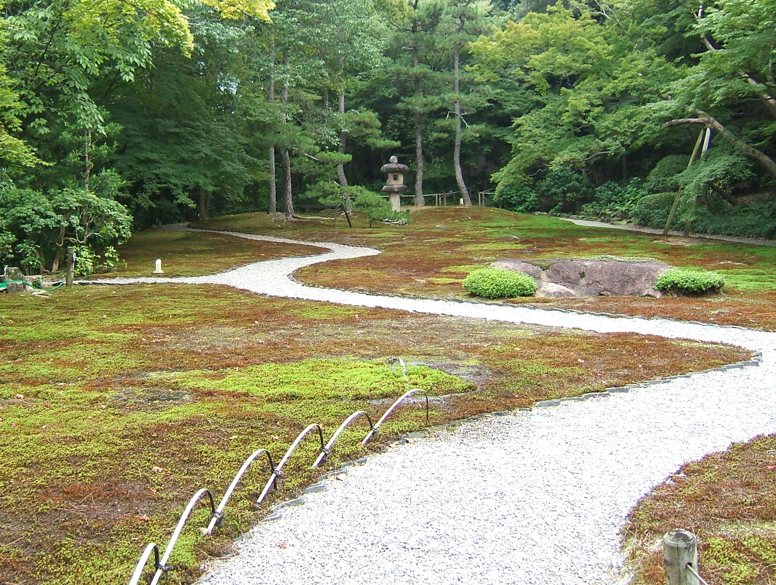
Magnetic Confinement Fusion Research:
History and Fundamentals
Michael Bell
former Head of NSTX Experimental Research Operations
Princeton Plasma Physics Laboratory
Princeton University
presented to the
Joint ICTP-IAEA College on Plasma Physics
International Center for Theoretical Physics, Trieste
October 2012

Slide 2
Topics
Nuclear fusion as a fundamental source of energy
Fusion reactions for energy production
Conditions for fusion and the Lawson criterion
Inertial and magnetic confinement approaches
Magnetic confinement systems
Emergence of the tokamak
Plasma heating
The large tokamaks and the start of ITER
Current research directions

Slide 3
Fusion Energy Has Powered Our Planet and Economy and Continues to Do So
Since the formation of the solar system, the sun has showered us with energy from fusion reactions in its core
  Energy comes predominantly from proton-proton fusion occurring in the hot (~15 million K), dense ( ~150 g.cm⁻³) core (<1/4 solar radius)
  Energy slowly (~10⁷ years) radiates, diffuses and convects to the solar surface where it radiates into space approximating a “black body at ~6000K
Photosynthesis produces biofuels (wood, peat) and laid down the deposits of carbon-based fossil fuels (coal, oil, gas)
Solar energy drives the wind and waterfalls which historically provided mechanical power
Developments in solar photovoltaic cells (and other technologies) are beginning to provide a significant source of electricity, but
  Energy storage and transmission are needed for solar electricity to work

Slide 4
About 70 Years Ago, the Possibility of Tapping Nuclear Energy on Earth Was Discovered
By a combination of good luck and great skill an entirely new source of energy, fission of heavy nuclei, was developed
Fission uses the “fossil fuel” of rare unstable (radioactive) nuclei
  Created by different fusion processes under extreme conditions in prehistoric supernovae as stars depleted their proton fuel
Fission power plants now provide a significant fraction of the electrical power in many countries
  70% in France
  Reliable “base-load” power without green-house gas emissions
However, nuclear fission energy does have problems
  Long-lived, biologically hazardous radioactive waste
  Creates possibilities for nuclear weapons proliferation
  After-heat from decay of unstable fission products
  Engineering management: Three-Mile Island, Chernobyl, Fukushima
  Public mistrust

Slide 5
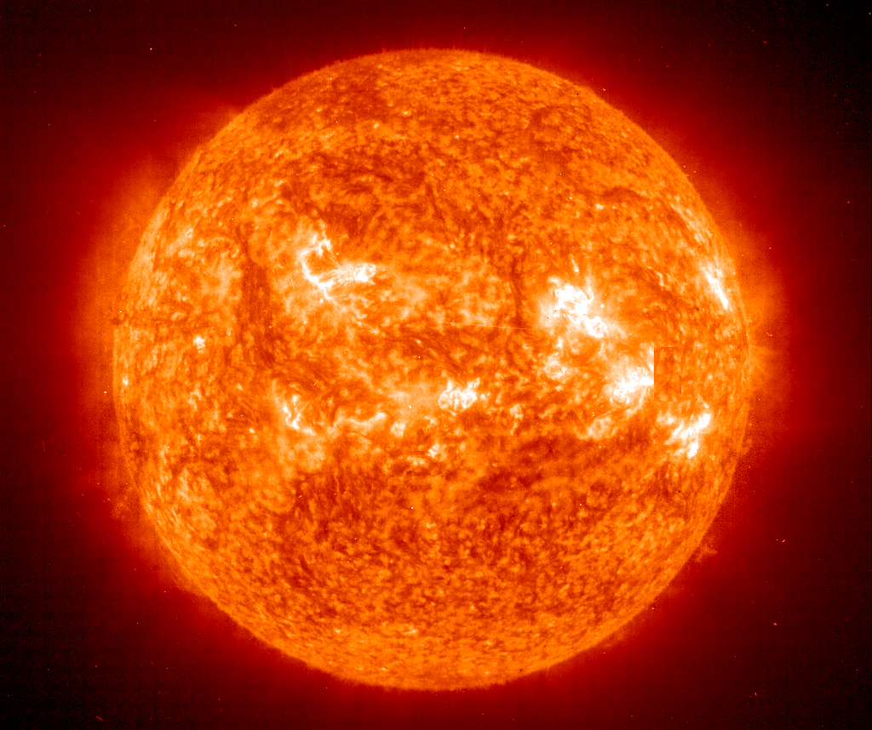
If Fusion Energy Powers the Sun,
can we make it work on earth?

Slide 6
The Beginnings of Fusion Energy Research
1928 Concept of fusion reactions providing energy radiated by stars proposed [R. Atkinson & F.G. Houtermans, Physik, 54 (1929)]
  Physicist James Jeans is skeptical that fusion can occur in stars;
  Arthur Eddington retorts: “I suggest he find a hotter place”
1932 Fusion reactions discovered in laboratory by Mark Oliphant
  Using deuteron beam from an electrostatic accelerator
1935 Basic understanding of fusion reactions - tunneling through Coulomb barrier (electrostatic repulsion) - G. Gamov et al.
  Nuclei must collide with kinetic energy 10 – 100 keV
1939 H. Bethe develops fusion power cycle for the stars
  Nobel prize 1967 "for his contributions to the theory of nuclear reactions, especially his discoveries concerning the energy production in stars"

Slide 7
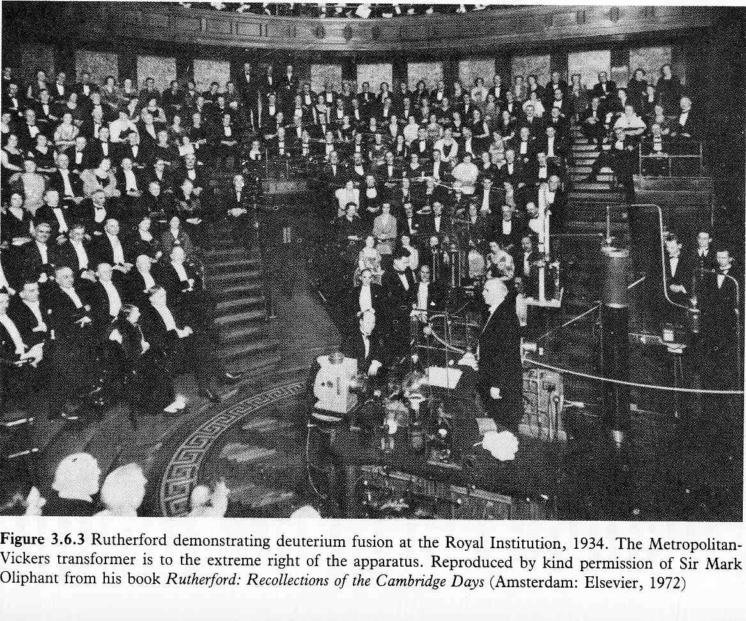
Ernest Rutherford Demonstrates Fusion in a Public Lecture in 1934
Rutherford felt possibility of generating power using beam - solid target fusion was “moonshine.”

Slide 8
Fusion Reactions of Interest for
Terrestrial Fusion Power
Proton-proton fusion is much too improbable for energy production
Use reactions involving the strong nuclear force
T⁺ (1MeV) + p⁺ (3MeV)
50%
²D⁺ + ²D⁺
50%
³He⁺⁺ (0.8MeV) + n⁰ (2.5MeV)
²D⁺ + ³T⁺
⁴He⁺⁺ (3.5MeV) + n⁰ (14MeV)
²D⁺ + ³He⁺⁺
⁴He⁺⁺ (3.6MeV) + p⁺ (15MeV)
“Fuel” nuclei (²D⁺, ³T⁺, ³He⁺⁺) must collide with energy >10keV

Slide 9
Fusion Reactions of Interest for
Terrestrial Fusion Power
Proton-proton fusion is much too improbable for energy production
Use reactions involving the strong nuclear force
T⁺ (1MeV) + p⁺ (3MeV)
50%
²D⁺ + ²D⁺
50%
³He⁺⁺ (0.8MeV) + n⁰ (2.5MeV)
²D⁺ + ³T⁺
⁴He⁺⁺ (3.5MeV) + n⁰ (14MeV)
²D⁺ + ³He⁺⁺
⁴He⁺⁺ (3.6MeV) + p⁺ (15MeV)
“Fuel” nuclei (²D⁺, ³T⁺, ³He⁺⁺) must collide with energy >10keV
D-T reaction has the highest cross-section
“Fusion products” (He, n) are very energetic
  Energy “payoff” is large

Slide 10
Need to Obtain Fusion Fuels not
Naturally Occurring on Earth
Deuterium occurs naturally and can be extracted from water
Tritium is unstable (radioactive half-life 12.7yr) - no natural source
  Obtained from n+D reactions in heavy-water fission reactors
³He is produced by radioactive (β) decay of tritium
  It has also been suggested that it could be mined from lunar rocks
For DT fusion reactors, need to “breed” tritium by another fusion reaction
n⁰ + ⁶Li³⁺
⁴He⁺⁺ (2.1MeV) + ³T⁺ (2.7MeV)
This uses the energetic neutron from DT fusion to recreate the T consumed
⁶Li³⁺ occurs as 6% of natural lithium which is fairly abundant
The overall fusion reaction cycle is therefore
²D⁺ + ⁶Li³⁺
2 ⁴He⁺⁺ + 22.4MeV
The n⁰+⁶Li reaction would occur in a solid or liquid “blanket” containing lithium surrounding the hot DT fusion reaction region
Most of the energy from DT fusion will be captured as heat in the blanket

Slide 11
DT Fusion Could Be An
Abundant, Safe and Reliable Energy Source
Worldwide, long term availability of low cost fuel (D, Li)
  Reduces geopolitical instability due to competition for energy resources
No CO₂ production
  Reduced pollution and global climate change
No possibility of runaway reaction or meltdown
  No after-heat from fission product decay
Relatively short-lived radioactive waste
  Reduced need for long-term storage but tritium management an issue
Lower risk of nuclear proliferation
  All nations can have the full fusion fuel cycle with minimal oversight
Steady power source that can be located near markets
  No need for energy storage or large land use
Can we make it cost-competitive with future coal, fission?

Slide 12
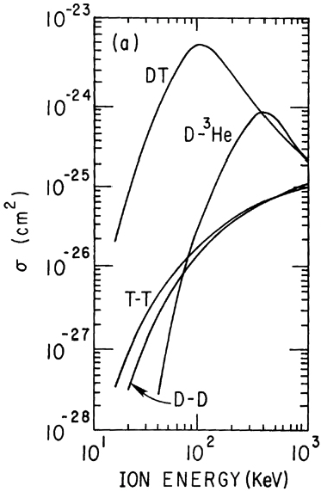
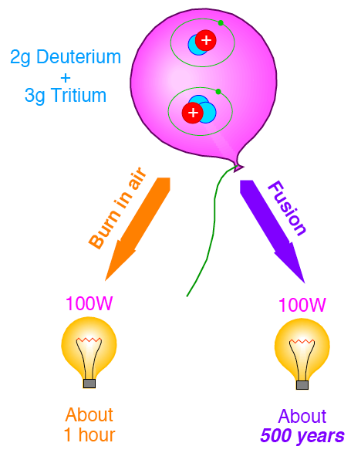
DT Fusion is Energy Intensive but
Fusion Reaction Cross-Sections are Small
Coulomb (electrostatic elastic) collisions
between nuclei are much more probable
than fusion

Slide 13
Energy Production by DT Fusion
Although fusion reactions can be produced by accelerating D or T ions into a solid target, it is not possible to achieve energy gain this way
  Coulomb collisions slow most of the ions before they can fuse with a nucleus
At energies required for DT fusion (>10keV), collisions strip nuclei of bound electrons and they become ions: fuel becomes a plasma
  Electrons must remain for charge neutrality but play no role in fusion reactions
  The light electrons (m_{e}:m_{p} = 1:1836) profoundly affect plasma properties
Consider a thermalized plasma with local D, T particle densities n_{D}, n_{T}. The fusion power production from a volume V is
P_{DT} = E_{DT} ∫n_{D} n_{T} σ_{DT}v dV
where E_{DT} = 17.6MeV = 2.8 × 10⁻¹²J and σ_{DT}v is the reaction rate coefficient calculated by integrating the fusion cross-section over the Maxwellian distribution of particle velocities ƒ_{M}(v)
σ_{DT}v = ∫ σ_{DT}(E) v ƒ_{M}(v) dv
For T_{DT} = 10keV ≈ 10⁸K, n_{D} = n_{T} = 5 × 10¹⁹m⁻³, P/V ≈ 0.8MWm⁻³

Slide 14
Lawson Criterion* for DT Fusion Energy Gain
A hot plasma needs energy input to balance losses by radiation, thermal diffusion
We define an energy confinement time τ_{E} as the plasma thermal energy divided by its rate of heat loss, so for a volume V of locally equilibrated (T_{e} = T_{i}) plasma
P_{loss} ∝ ∫_{V}nTdV / τ_{E}
For plasma around the optimum DT fusion temperature (~15keV) with n_{D} = n_{T}
σ_{DT}v ~ T² ⇒ P_{DT} ∝ ∫ n²T²dV
Ratio of fusion power to heating power to maintain steady state (P_{heat} = P_{loss})
Q ≡ P_{DT}/P_{heat} ∝ (∫_{V}n²T²dV/V) / [(∫_{V}nTdV/V) / τ_{E}] = (<n²T²>/<nT>)τ_{E}
In terms of measurable quantities and for P_{DT} << P_{loss}, this is often approximated as
Q ∝ n_{e,max}·T_{i,max}·τ_{E}
Energetic (14.1MeV) neutron from DT fusion escapes from plasma but charged 3.5MeV alpha particle can be trapped and heat plasma by Coulomb collisions
Fusion ignition occurs when alpha heating balances plasma losses. This requires
n_{e}·T_{i}· τ_{E} = 6 × 10²¹ m⁻³ ·keV·s (with the same approximation)
* J.D. Lawson, Proc. Phys. Soc. B, 70 (1957) 6

Slide 15
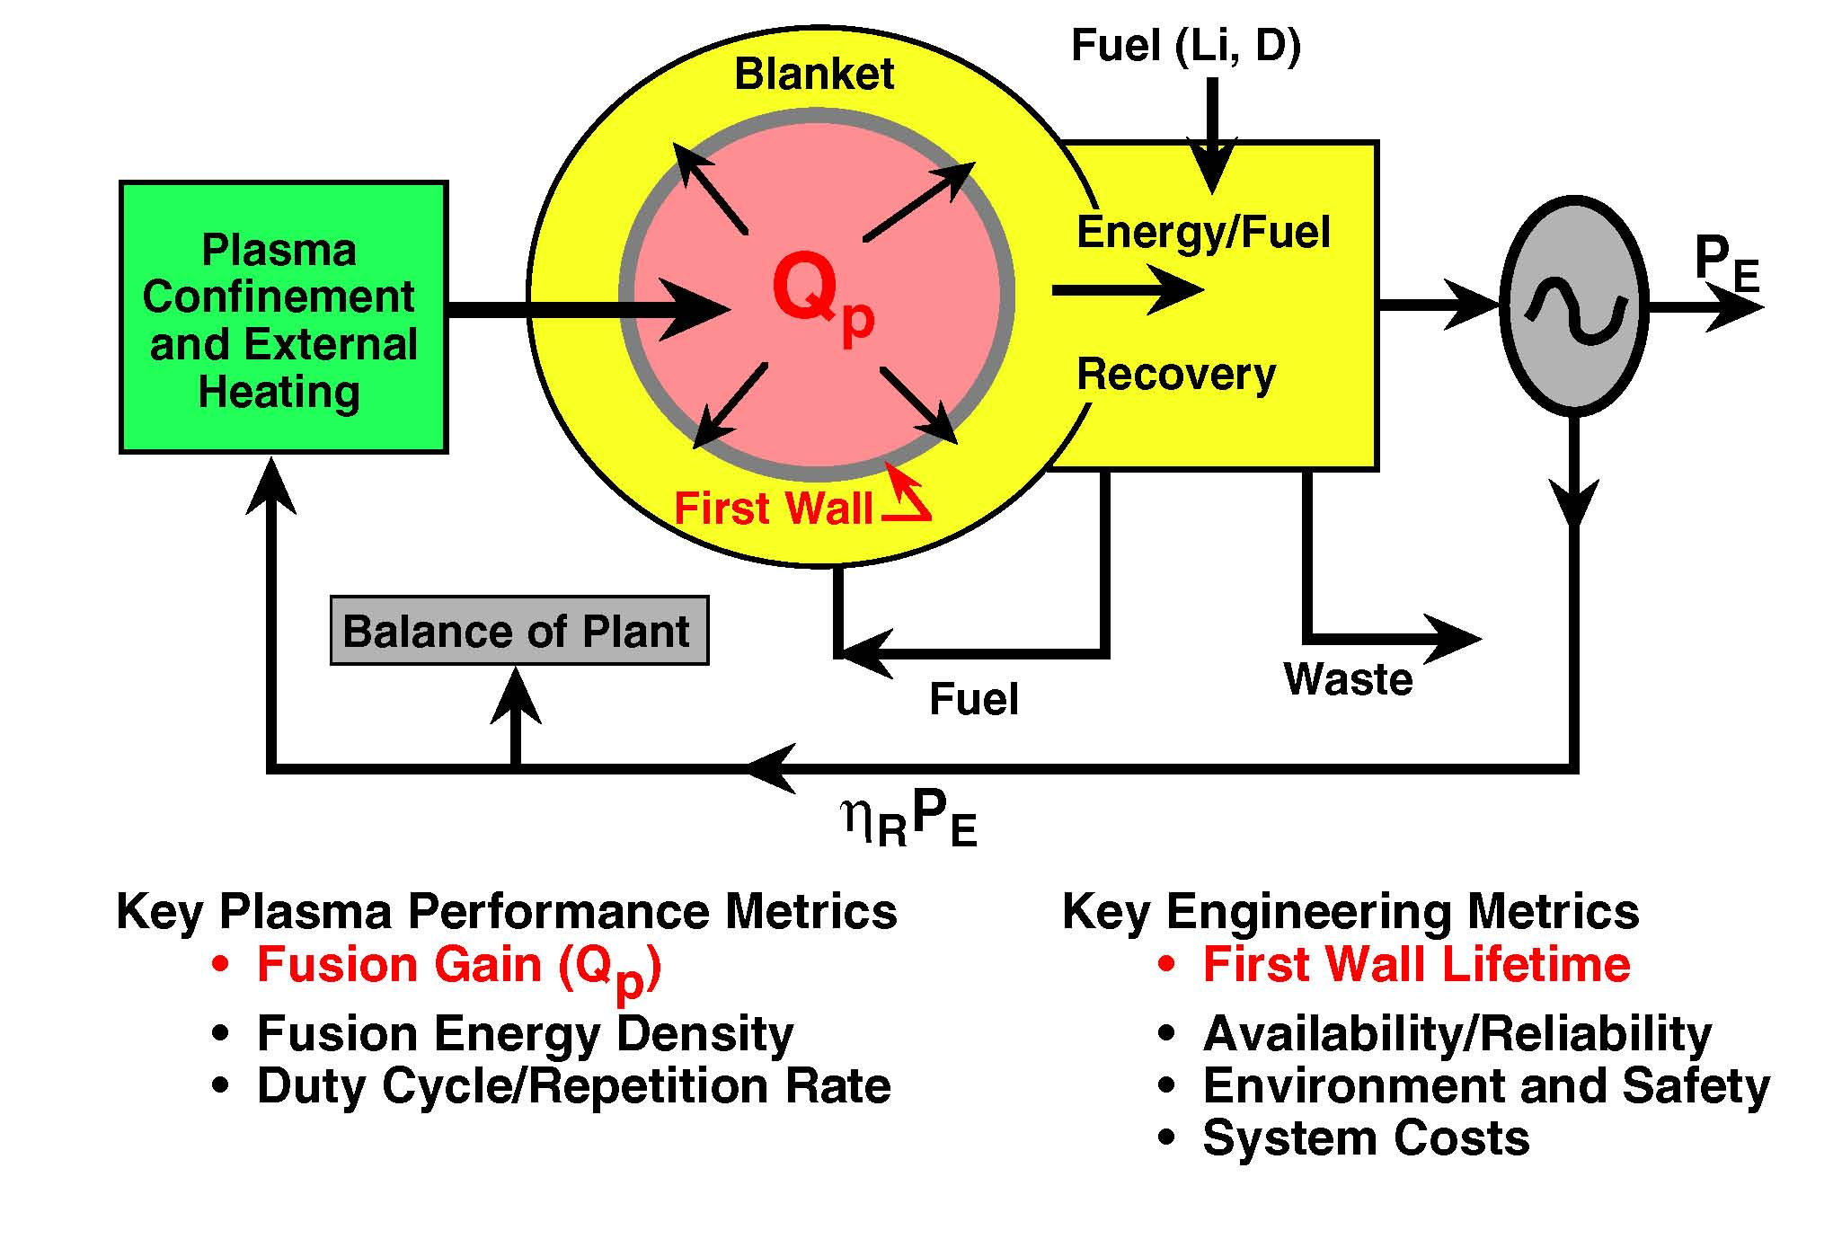
Elements of a Fusion Power Plant

Slide 16
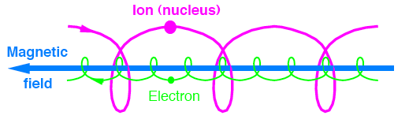
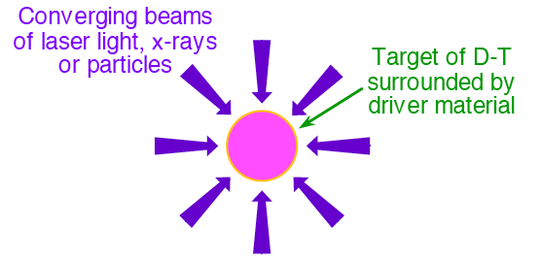
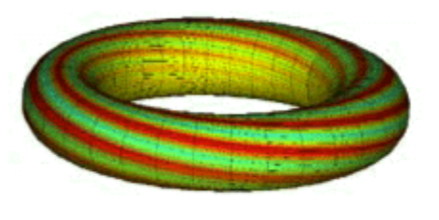
Many Fusion Concepts Have Been Tried, but Essentially Only Two Now Remain
Spherical Implosion
Toroidal Magnetic Confinement
Drive transient implosion of tiny fuel pellet (<mm) with
  Lasers
  Particle beams
  Collapsing bubbles?
Very high density: 100 x solid
“Inertial” confinement: “τ_{E}” < 1ns
Stability of implosion critical
Charged particles spiral around magnetic field (F = qv × B)
Make field lines close on them-selves to eliminate end losses
  Ions travel many km before undergoing a fusion reaction
Low density: 10⁻⁹ x solid
Good confinement: τ_{E} > 1s
Also hybrid approach: magnetically insulated implosion

Slide 17
Inertial Confinement Fusion (1940s-early 50s)
1940s First ideas on using fusion reactions to boost fission bombs
1950 Edward Teller given approval to develop fusion bomb “Super”
  – Two stage concept (Ulam-Teller), second driven by radiation
A Soviet Army sergeant Oleg Lavrentiev (d. Feb 2011), proposed fusion-bomb concept to Beria (Deputy Premier), and gridded electrostatic confinement for fusion energy production
  Idea sent to Andrei Sakharov and Igor Tamm, who conceive tokamak concept for purely magnetic confinement
1951 Greenhouse-Cylinder - radiation compression of 1cm D-T pellet
1952 First US H-bomb, Ivy-Mike (liquid D₂), exploded
1954 Castle-Bravo (solid-LiD) exploded at Bikini Atoll: 15MT yield
References -
“Dark Sun” by Richard Rhodes, 1995
“History of Soviet Fusion”, V.D. Shafranov, Physics-Uspekhi 44(8) 835-865 (2001)

Slide 18
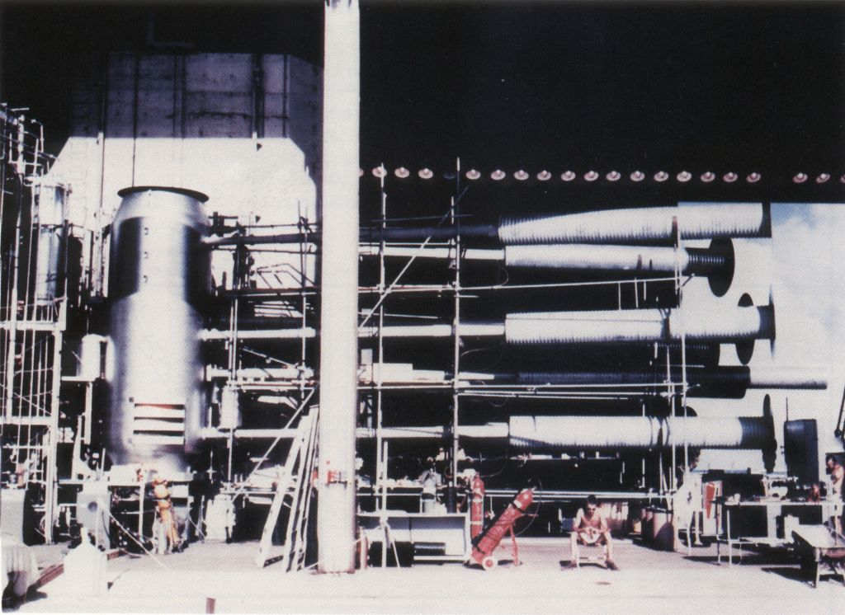
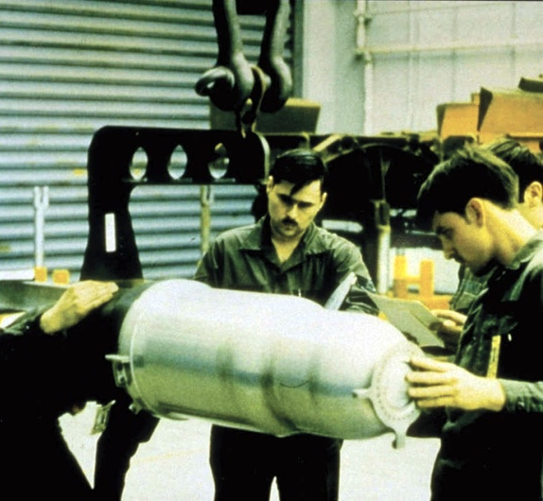



Inertial Confinement Works but Has Not Yet Been Achieved on a Manageable Scale for a Power Source
1952 Ivy-Mike “sausage” (~80 tons)
⇒ 10.7MT = 1.42GW.yr energy
W-80 nuclear warhead
NIF “hohlraum” capsule
Compression of small D-T pellets to fusion ignition now being studied at the National Ignition Facility (Lawrence Livermore Natl. Lab.)
  Using “indirect drive” by x-rays generated in a tiny (mm) cavity by intense frequency-tripled Nd-glass laser radiation (192 beams)
  Laser inefficiency makes it difficult to achieve Q = 1 by this route
“Direct drive” implosions also being investigated using lasers, particle beams or x-rays produced by exploding wires

Slide 19
Early Years of Magnetic Confinement
Fusion Research
1940s Concept of using a magnetic field to confine a hot plasma for fusion
1947 G.P. Thomson and P.C. Thonemann began classified investigations of toroidal “pinch” RF discharge, eventually leading to ZETA, a large pinch at UKAEA Harwell, England in 1956
1949 R. Richter in Argentina, backed by President Peron, claimed to have achieved controlled fusion
  turned out to be bogus, but news piques interest of astrophysics professor Lyman Spitzer at Princeton
1950 Spitzer conceived “stellarator” (while on a ski lift) and proposes experiments to US Atomic Energy Commission ($50K!)
  “Project Matterhorn” initiated at Princeton
1950s Classified US Project Sherwood on controlled thermonuclear fusion
1958 Magnetic fusion research declassified. US and others unveil results at 2nd UN Atoms for Peace Conference in Geneva

Slide 20
Requirements for Magnetic Confinement DT Fusion Energy Development Were Understood Very Early
Plasma conditions for self-sustaining fusion defined by Lawson criterion
T_{i} ~ 10 – 20 keV, nτ_{E} ≈ (6 – 3) × 10²⁰m⁻³·s
Fusion power density ~ 5 MWm⁻³ ⇒ plasma pressure ~ 10 atm
  Need to maximize β = 2μ₀⟨p⟩/ B_{max}²
Control interaction of plasma with surrounding material wall
  ~ 2 MWm⁻² thermal load on wall
  Prevent impurities from diluting fuel and radiating energy
Neutron wall loading ~ 4 MWm⁻² for economic feasibility
Self-sufficient tritium breeding to complete the fuel cycle
High-duty cycle, essentially steady-state

Slide 21
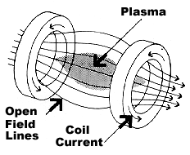
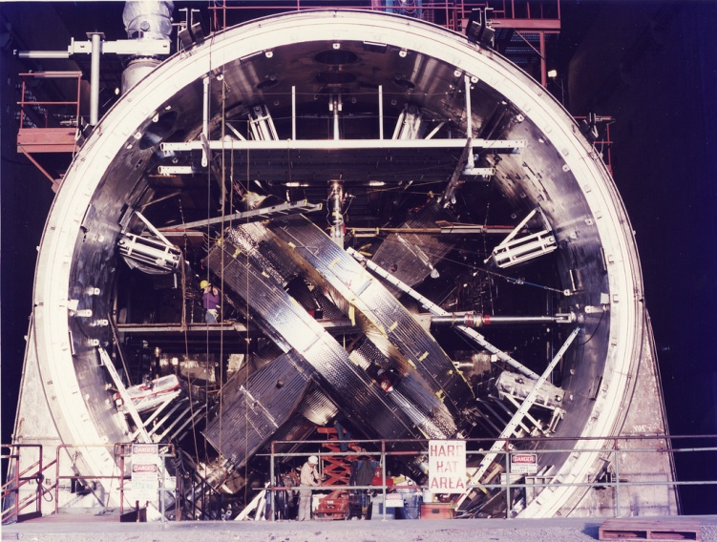
Digression: Magnetic Mirror Confinement
Create regions of higher magnetic field surrounding a central region with lower field
Conservation of magnetic moment μ = mv⊥²/2B of gyrating charged particles causes them to be reflected from higher field “mirrors” at ends
However, there is a region in the distribution function of particles, the “loss cone”, that can escape through the mirrors and be lost
  Many schemes to minimize these losses were devised and tried but
  Plasma instabilities tend to scatter particles into the “loss cone”
Mirror confinement fusion reached its zenith in 1986 with construction of MFTF-B at Lawrence Livermore National Laboratory
  Device was mothballed after completion
v⊥
Trajectory of
trapped particle
Reflection
point
Loss cone
Loss cone
v||
http://www.flickr.com/photos/llnl/5794563833/sizes/l/in/set-72157626754270259/

Slide 22
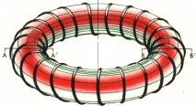

Toroidal Magnetic Confinement Schemes -
“Closed” Traps
Particles spiral around straight field lines but in a torus
B
  – Curvature and gradient in B cause single particles to drift vertically
  Charge separation at the edges produces a downward E field that drives outward drift of plasma
B
+ +
+ +
B
.
x
v_{D}
E
E
v_{D}
∇B
∇B
- -
- -
v_{D} = E x B/B²
Introduce rotational transform (helical twist) to field lines so drifts are compensated over several transits
  external windings, geometrical modification ⇒ stellarators
  toroidal current in the plasma itself ⇒ tokamaks
Toroidal symmetry improves particle orbits

Slide 23
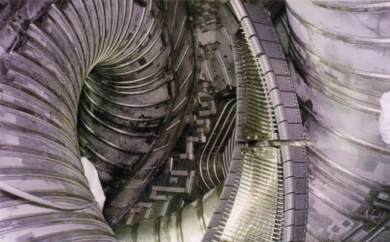

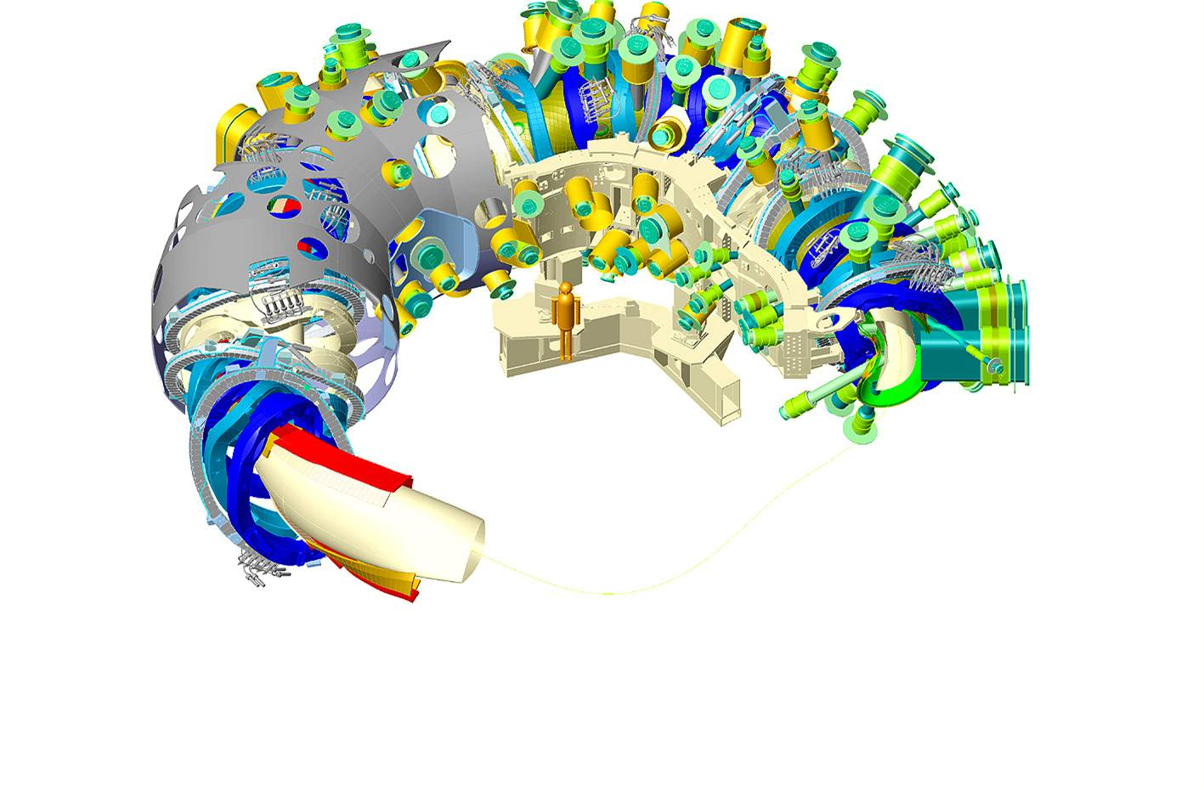
In Stellarators Rotational Transform Is Created by Twisting the Axis or External Coils (or Both)
Twisted axis stellarator
Twisted coil stellarators
LHD
Early stellarators had small plasma relative to magnetic field volume
Modern designs avoid this through extensive numerical modelling and optimization of coil configuration
  Large superconducting stellarators in Japan (LHD - operating) and Germany (W-7X - under construction)
Wendelstein 7X

Slide 24
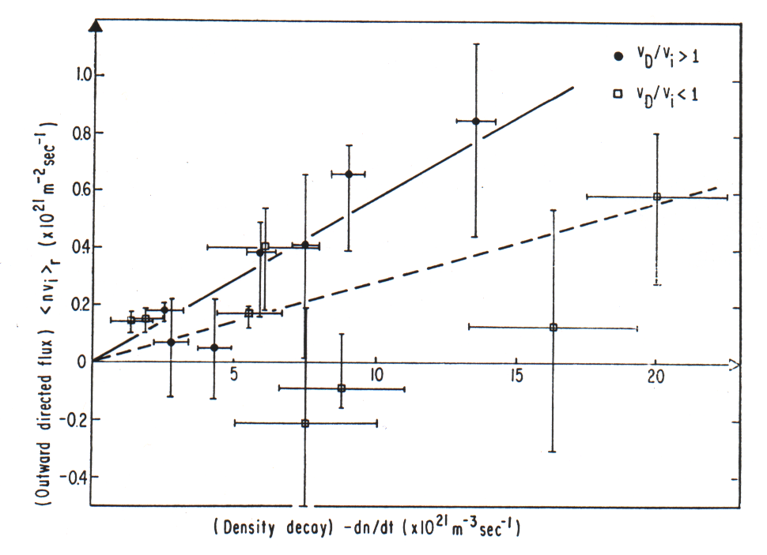
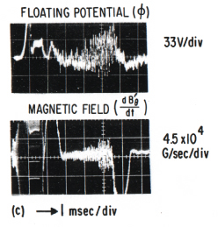
Stellarators in Early 1960s - The Depths of Despair
Stellarator experiments in the late ’50s were plagued with instabilities
  Confinement limited by fluctuations leading to “Bohm diffusion”
Model C Stellarator at Princeton was large to reduce deleterious effects of impurities and wall neutrals, but
  Results 1961-66 again showed Bohm diffusion ⇒ poor confinement
Bohm flux
K.M. Young, Phys Fluids 10, 213 1967

Slide 25
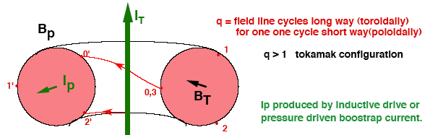
Toroidal Confinement - The Tokamak Approach
Toroidal plasma current adds a poloidal magnetic field to the externally applied toroidal field causing field lines to spiral
Field lines form nested flux surfaces surrounding a magnetic axis
Collisions cause plasma to diffuse outward from one surface to the next
Variation of the toroidal field from outside to inside (B_{T} ∝ 1/R) traps some particles in local magnetic mirrors
  Trapped particles have larger orbit excursions, adding to diffusion
A challenge is to drive toroidal plasma current continuously and efficiently
  Trapped particles plus a pressure gradient drive “bootstrap” current

Slide 26
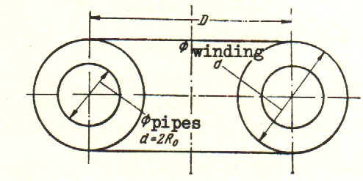
The First Tokamak Reactor Design ~ 1955
I. Tamm (1951) and A. Sakharov (1952)
  Objective: D-D reactor producing T or ²³³U for weapons
  R₀ = 12m, a_{p} = 2 m
  water-cooled copper coils B = 5 T
  P_{fusion} = 880 MW
  (assuming “classical” heat losses)
First openly discussed at Geneva 1958 after declassification
There was skepticism and resistance in the west
  Concern that the plasma current was a source of instability
  Maintaining the toroidal current - stellarators were steady-state
Group at Australian National University investigated a tokamak-like device - “slow toroidal θ-Z pinch” or “Liley torus” in the mid-late 60s
Ref: V.D. Shafranov, “History of Soviet Fusion” Physics-Uspekhi 4 835-865 (2001)

Slide 27
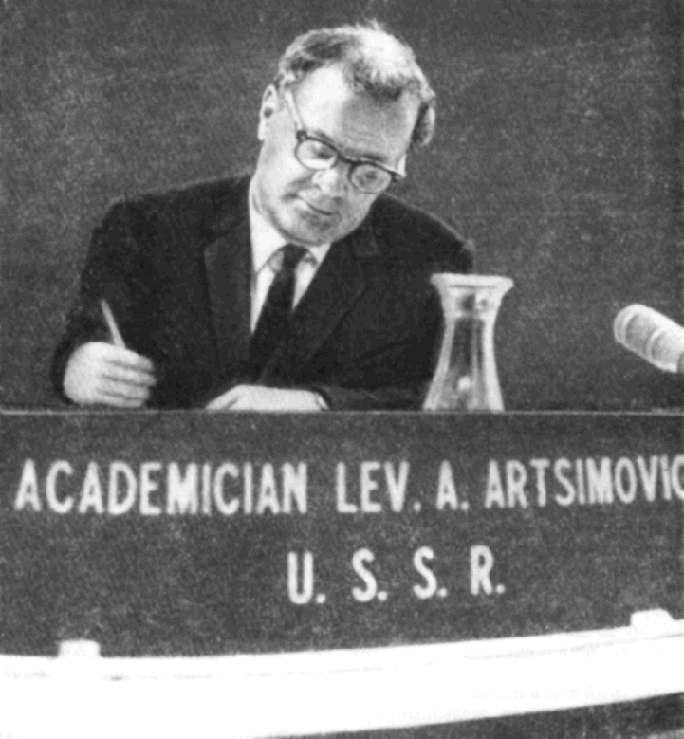
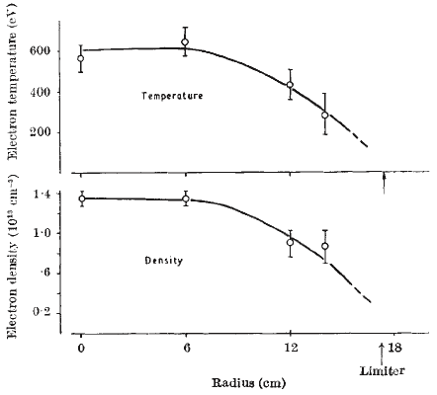
The Late 1960s - The Tokamak Emerges
Led by L.A. Artsimovich, tokamaks at Kurchatov Institute, Moscow, progressed through a sequence to T-3
  R = 1.0 m, a = 0.20m, B = 4T, I_{p} < 200 kA
Results at 1968 IAEA Conference in Novosibirsk:
T_{e} ≈ 1 keV and τ_{E}/τ_{Bohm} ≈ 50 – met with skepticism
Team from UK (D. Robinson, N. Peacock)
took a Thomson Scattering system to T-3
Confirmatory results were obtained and presented at Dubna meeting in 1969
Within 6 months, Model C stellarator at
PPPL was converted to the
Symmetric Tokamak (ST)
Led to an explosion in tokamak research worldwide, culminating in TFTR (US), JET (EU), JT-60 (Japan), now ITER (international)
N.J. Peacock, D.C. Robinson et al. Nature 224 (1969) 488

Slide 28
1973 Oil Embargo - Energy R&D Explodes in US
500
40
450
35
400
30
350
Fusion Budget
300
25
$ in Millions (Actual)
Dollars per Barrel
250
20
Crude Oil*
200
15
150
10
100
5
50
0
0
68
70
72
74
76
78
80
82
84
86
88
90
92
94
96
98
00
02
04
Years
*In Actual $’s from Energy Information Administration/Annual Energy Review 2004 Table 9.1, Crude Oil Price Summary, Refiners Acquisition Costs, Imported, Nominal. Web Site: eia.doe.gov. Year 2004 is estimated based on 9 months record.

Slide 29
In 1970s, a Succession of Tokamaks
Investigated Plasma Heating Schemes
First tokamaks were “Ohmically” heated by toroidal current induced in plasma to produce confinement: local heating ηJ²
Plasma resistivity η ∝ T_{e}^{-3/2} decreases with electron temperature
  Maximum T_{e} ~ few keV and T_{i} < 1keV since ions heated by electrons
New methods of “auxiliary heating” to supplement Ohmic heating were needed to produce fusion temperatures
  Compressional heating by varying B: successful but transient
  Increasing plasma resistivity by exciting plasma turbulence
  Injecting beams of energetic neutral atoms (NBI) which ionize, become trapped and transfer their energy to the plasma
  Injecting powerful RF electromagnetic waves to excite plasma waves which can deposit their energy in electrons or ions
    Ion cyclotron resonance (ICRH): 10 – 100 MHz
    Electron cyclotron resonance (ECRH): 20 – 150 GHz
    Lower hybrid resonance (LHH): 2 – 5 GHz

Slide 30
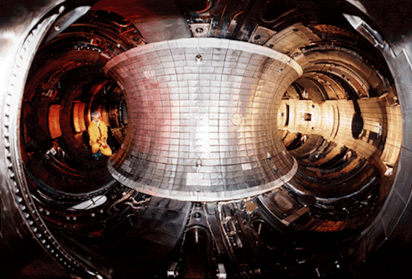
The Success of Neutral Beam Injection (NBI) Heating Led to the TFTR Era at PPPL
July 1973 US DOE proposes a superconducting D-T ignition device
– Not yet well defined but it would have represented a huge step
Dec 1973 PPPL suggests smaller “Two-Component Torus” with intense NBI then being developed for the Princeton Large Torus (PLT)
– Harold Furth:“If what you want is fusion neutrons ...”
July 1974 DOE selects PPPL approach – goal: significant D-T fusion power
Dec 1975 PLT starts operation – similar design with NBI, but smaller
Mar 1976 TFTR construction starts
Aug 1978 PLT T_{i} = 5.5 keV
– Success of NBI heating
– Allays fears of instabilities at high T_{i}
Dec 1982 First TFTR plasma – ~50 kA
ASDEX-U (Germany) discovers H-mode
in NBI-heated tokamak with a magnetic divertor

Slide 31
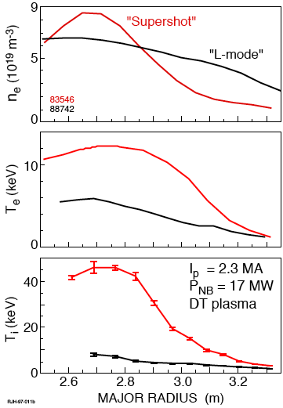
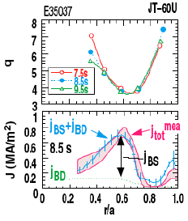
Competition Between TFTR, JET (EU) & JT-60U (Japan), Propelled Fusion Research Forward for Over a Decade
1986 TFTR “Supershots” – Confinement × 2–3, record T_{i}, P_{DD}
1988 TFTR confirms the “bootstrap” current in supershots
1990 TFTR evidence that Ion Temperature Gradient (ITG) modes determine transport: T_{i}(0) ∝ T_{i}(a) – marginal stability
TFTR & DIII-D discover benefits of negative magnetic shear
→ internal transport barriers; role of sheared plasma flow in suppressing ITG mode
JET achieves high fusion performance hot-ion H-mode in
shaped divertor plasmas
1990s JET utilizes beryllium plasma facing components,
investigates several divertor configurations and RF heating
1996 JT-60U installs high-energy (0.4MeV) negative-ion neutral beam system
JT-60U sustains negative shear for 2.6 s in a quasi-steady state by fully non-inductive current drive (bootstrap current ~75% plus NINBI-CD)

Slide 32
First DT Experiments in JET and TFTR Yielded a Wealth of Physics
1991 JET “Preliminary Tritium Experiment” producing P_{DT} > 1MW
1993 TFTR D-T experiments begin – leading to P_{DT} = 10.7MW, favorable isotope scaling, alpha-particle heating, alpha-driven instabilities, RF heating; tritium and helium “ash” transport, tritium retention in walls
TFTR shut down after >60000 plasma shots, >1000 with D-T fuel
JET resumes DT experiments – leading to P_{DT} = 16MW, alpha-particle heating; H-mode and “hybrid” mode in DT; different isotope scaling
15
JET (1997)
TFTR (1994)
10
Fusion power (MW)
JET (1997)
5
JET
(1991)
0
0
1
2
3
4
5
6
Time (s)
2015 JET plans to resume DT operation with its “ITER-like Wall”

Slide 33
From 1970 through 1997, Progress in Fusion Energy Output Even Outpaced Computer Speed
TFTR
JET(EU)
10⁸
10⁶
DT
10⁴
10²
Fusion Energy (per pulse) (J)
10⁰
10¹⁰
10⁻²
10⁸
10⁻⁴
10⁶
10⁻⁶
10⁴
1970
1980
1990
2000
Progress in performance followed major investments in 1980s
In mid-90s, budgets for fusion research decreased and have remained almost static so progress has slowed

Slide 34
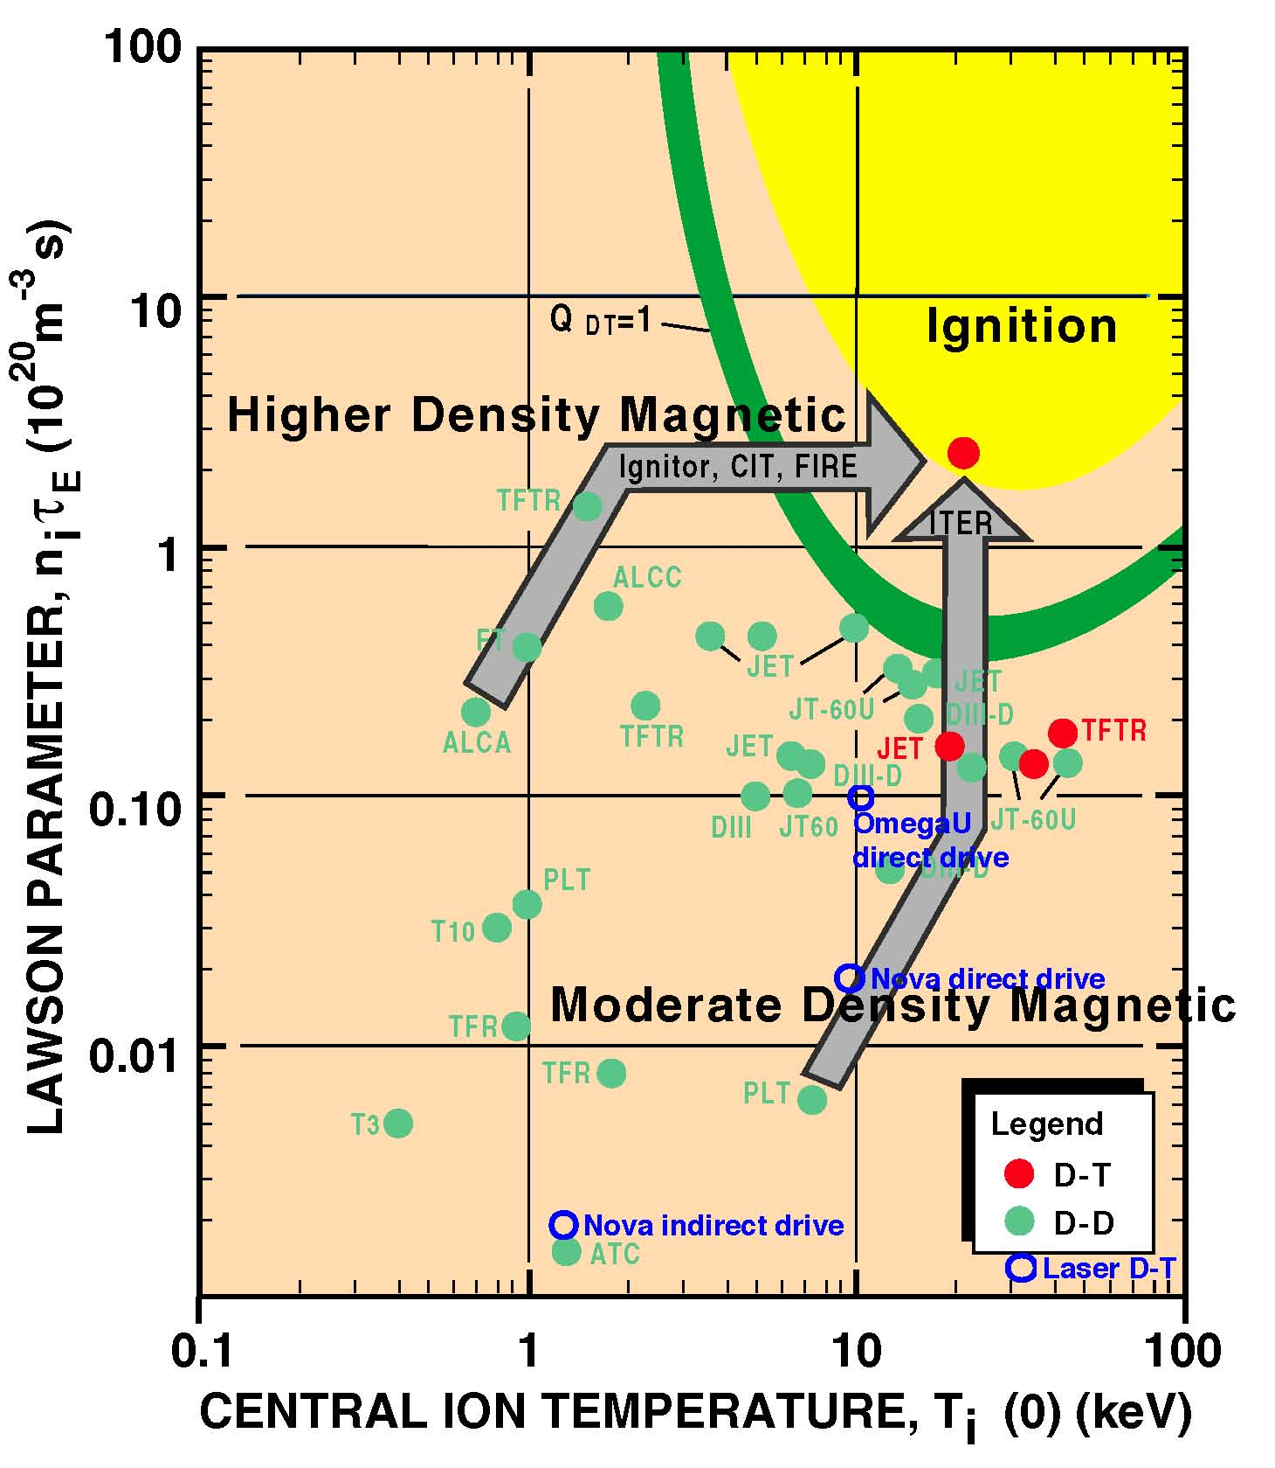
After ~60 years, MFE Has Progressed
~10% of Way to DT Fusion Ignition
“Lawson diagram” shows steady progress in tokamaks on two “fronts”
  Achieved T_{i} required,
  but need 10 × nτ_{E}
  Achieved nτ_{E} ≈ 1/2 required, but need 10 × T_{i}
Requirements depend on plasma profiles, impurities, synchrotron radiation, etc.
Curves similar for ICF but modified by bremsstrahlung absorption
NSTX
Data compiled by D. Meade

Slide 35
Since 2000, Magnetic Confinement Research
Has Pursued Two Tracks
ITER: tokamak to produce and study ignited (Q ≥ 10) DT plasmas
  Originated in 1985 (Gorbachev-Reagan summit)
  Large superconducting tokamak: R = 6.2m, I_{p} = 15MA
  Implementing agreement signed November 2006 between
  EU, Japan, Russia, USA, Korea, China, India
    US had pulled out in 1999 but rejoined in 2003
    Ageement delayed by competition between EU and Japan for host site
  Being built in Cadarache, France: cost estimated at ~20B Euro
  First plasma operation in 2020, D-T operation in 2027
Innovation: use existing devices or new confinement concepts to
improve the prospects for magnetic fusion
  New devices include advanced stellarator at IPP Greifswald, Germany
  Research may also benefit ITER by improving its design margins, relaxing its requirements and broadening its operating regime

Slide 36
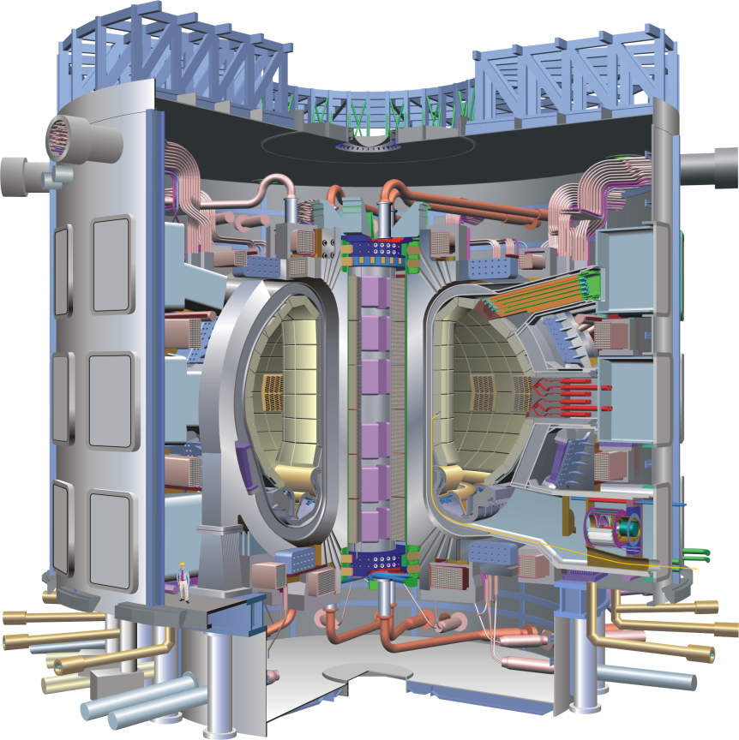
ITER will Demonstrate the Scientific and
Technological Feasibility of Fusion Power
ITER is a dramatic step towards self- sustained fusion reactions
  500 MW(th) for >400 s with gain Q >10
but ...
ITER is not a self-sufficient power-producing plant
New science and technology are needed for a demonstration power plant
  2500 MW(th) with gain >25, in a
  device with similar size and field
  Higher power density
  Efficient continuous operation
  Tritium self-sufficiency
30m
Extensive research programs will be needed to address these issues

Slide 37
TFTR, JET and JT-60U Achieved Many of the Plasma Parameters Expected to be Produced in ITER
TFTR ITER
Central pressure β(0) % 6 6
Collision frequency ν_{e}* (10⁻²) 1 0.8
Electron density (10²⁰ m⁻³) 1.0 1.1
T_{i} (keV)/T_{e} (keV) 36/13 18/20
Fuel mixture D/T 1 1
Toroidal field B_{T} (T) 5.6 5.3
Fusion Power Density (MWm⁻³) 2.8 1
Confinement was the outstanding issue and remains so
Confinement time (s) 0.2 2.5
Most reliable solution: bigger device with higher current
Normalized gyro-radius ρ_{i}/a (10⁻³) 6.5 2
Ref: http://www.iter.org/a/index_use_5.htm

Slide 38
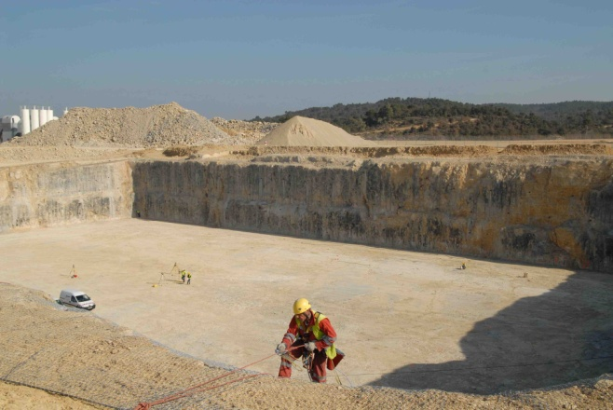
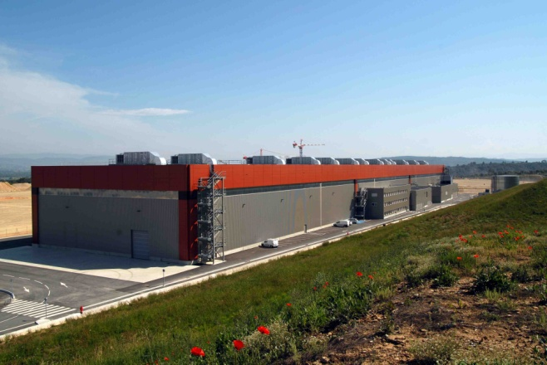
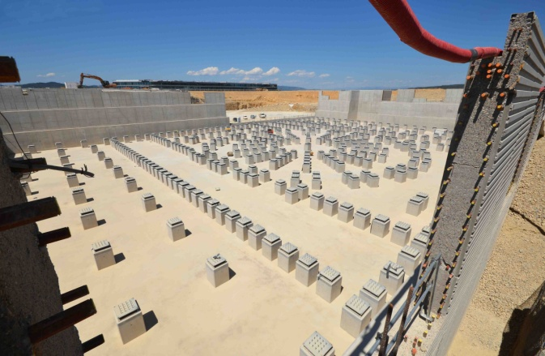
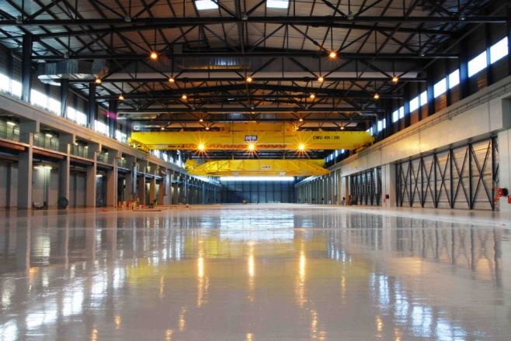
ITER is a Huge Construction Project Involving Many Technical and Management Challenges
The ITER parties contribute specified equipment and systems which must fit and function together
Most visible progress is at the ITER site but many construction tasks are now underway
Tokamak seismic pit and foundation
Poloidal field coil winding building
90m × 130m × 17m deep
250m long
http://www.iter.org/construction

Slide 39
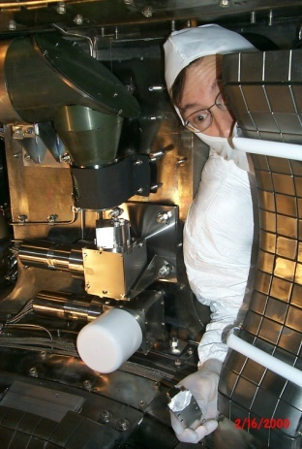
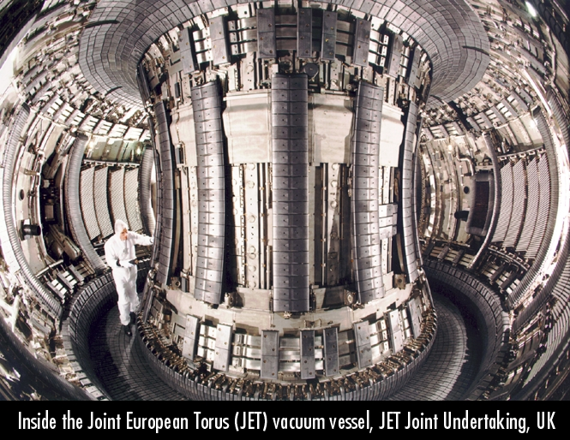
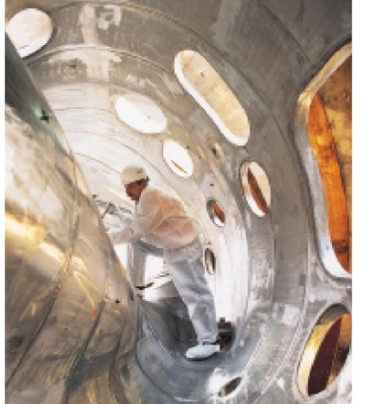
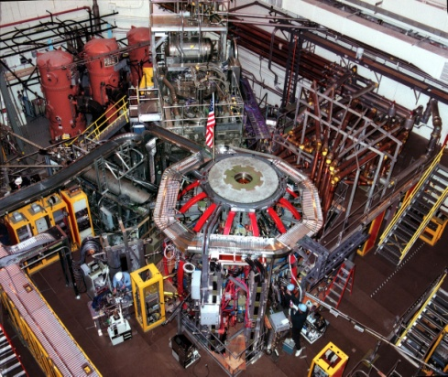
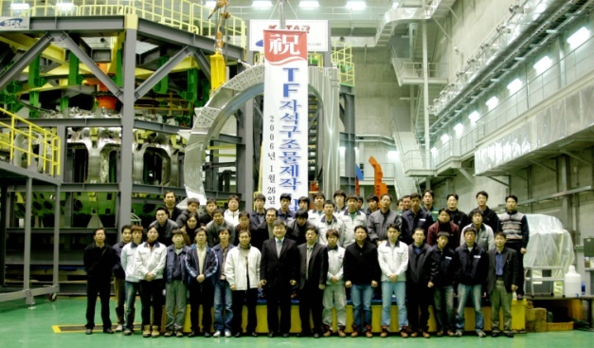
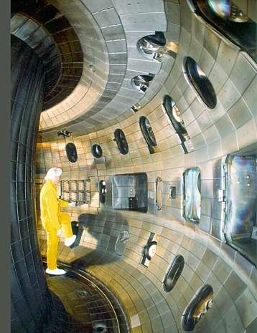
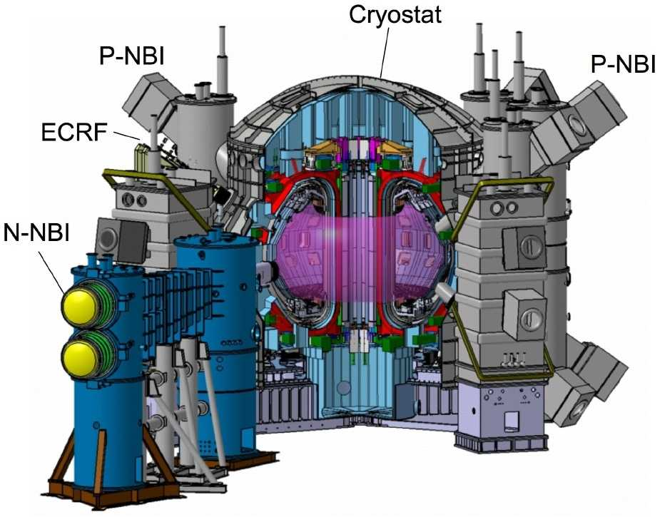
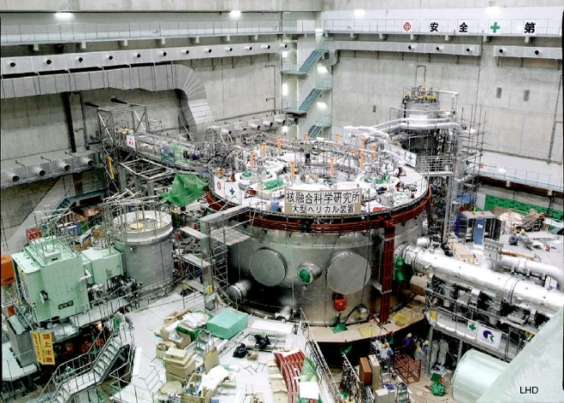
Experiments Around the World Are Investigating and Attempting to Optimize the Magnetic Configuration
C-Mod,
Tokamak
MIT
JET, Large
Tokamak – EU
W7-X, Large
Superconducting
Stellarator – EU
National Spherical
Torus Experiment
PPPL (also MAST – EU)
EAST, SST-1, KSTAR
Superconducting Tokamaks,
– China, India, Korea
JT-60SA, Large
Superconducting
Tokamak – JA (2019)
DIII-D, Tokamak
General Atomics
LHD, Large
Superconducting
Stellarator – JA

Slide 40
Magnetic Confinement Fusion Research is Now at a Crossroads
We must demonstrate that ignited DT plasmas can be produced and controlled in ITER
  After 60 years of research, this is the crucial step
  ITER requires an unprecedented level international cooperation
  Information from the existing tokamak program is needed to make critical choices remaining on aspects of its design and operation
At the same time, we should look beyond ITER to a fusion power plant
  Electricity from a tokamak based on the ITER design would not currently be competitive with other sources
  Are there configurations that can achieve the needed confinement in steady-state?
  Smaller unit size is a great advantage for introducing new technology
Finding the optimum balance between these efforts will determine whether magnetic fusion energy can succeed in meeting its potential

