Slide 1
Parametric dependencies of low-k pedestal turbulence in NSTX H-mode plasmas
David R. Smith¹
with R. Fonck¹, G. McKee¹, D. Thompson¹, I. Uzun-Kaymak¹,
A. Diallo², and B. Stratton²
¹University of Wisconsin-Madison
²Princeton Plasma Physics Lab
Plasma Physics Seminar
UW-Madison
April 23, 2012

Slide 2
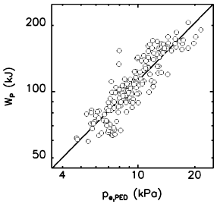
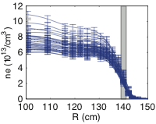
What are the characteristics and parametric dependencies of pedestal turbulence in NSTX?
ITER and next-step devices need accurate models of pedestal dynamics
  Global confinement predictions
  Diverter heat flux and first-wall lifetime predictions
  ST edge parameters are among the most challenging regimes for turbulence simulations (steep gradients, high β, large ρ_{ι}/a, strong shaping)
Here, we measure pedestal turbulence parameters in NSTX H-mode plasmas during ELM-free, MHD quiescent periods
  Poloidal correlation length, wavenumber, and decorrelation time
  Identify parametric dependencies (∇n_{e}, ∇T_{i}, etc)
C-Mod:
stored energy increases with pedestal height
NSTX: BES
measurements
from multiple
discharges in steep gradient region
Hughes, PoP, 2002

Slide 3
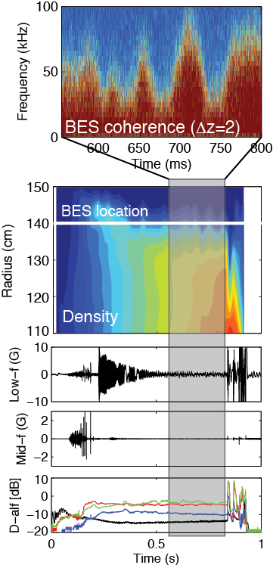
Outline
Beam emission spectroscopy (BES)
diagnostic overview
Pedestal turbulence measurements
  LH transition
  ELM-free, MHD quiescent periods
  Parametric scalings
Correlation length during the ELM cycle
  Initial theory/experiment comparison
Other BES observations
  Post-ELM harmonic features
  TAE and GAE mode structures
Future work and summary

Slide 4
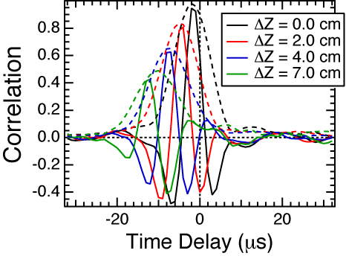
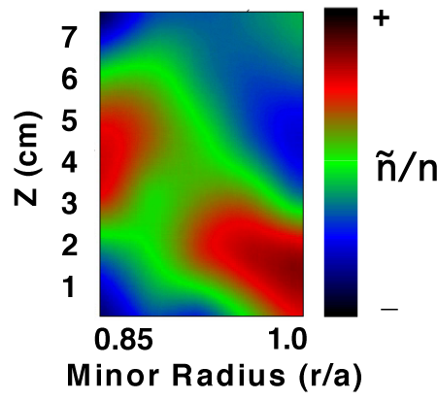
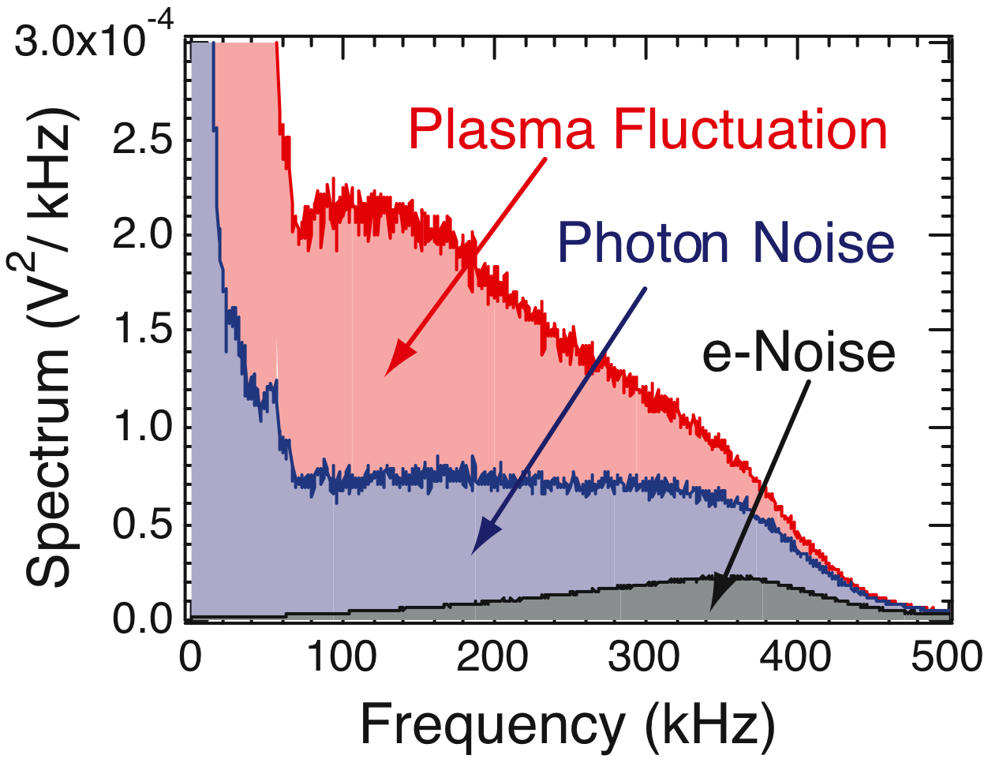
Beam emission spectroscopy (BES) is a diagnostic technique for measuring ion gyroscale (kρ_{i} < 1) density fluctuations
Measured & derived quantities
  Fluctuation amplitudes
  Frequency spectra
  Radial and poloidal correlation lengths
  Decorrelation times
  Poloidal flow, flow fluctuations,
  flow shear, and 2D flow fields
  2D fluctuation imaging
  3-wave bispectral analysis
  Particle flux
Figures courtesy of
DIII-D BES group

Slide 5
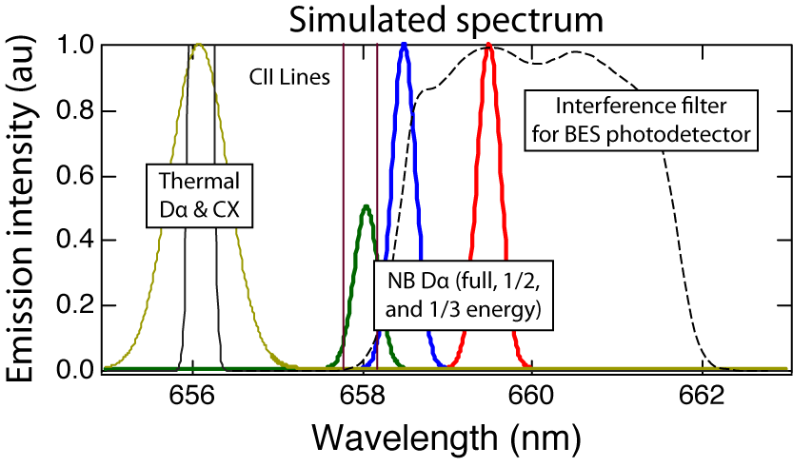
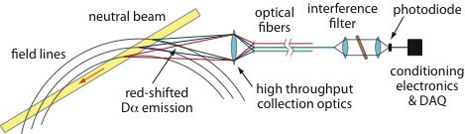
BES measures Doppler-shifted D_{α} emission (λ₀=656 nm) from neutral beam particles
C ≈ 1/2
neutral beam
D_{α} emission
density
fluctuation

Slide 6
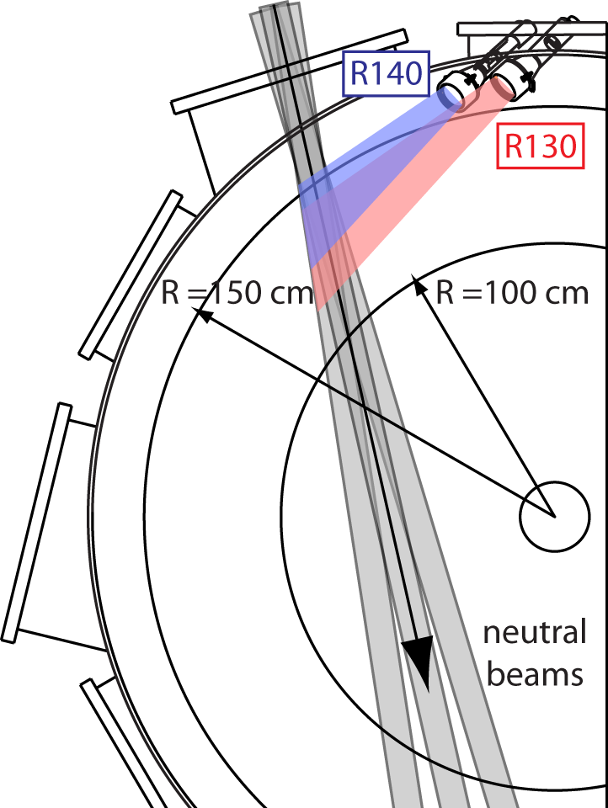
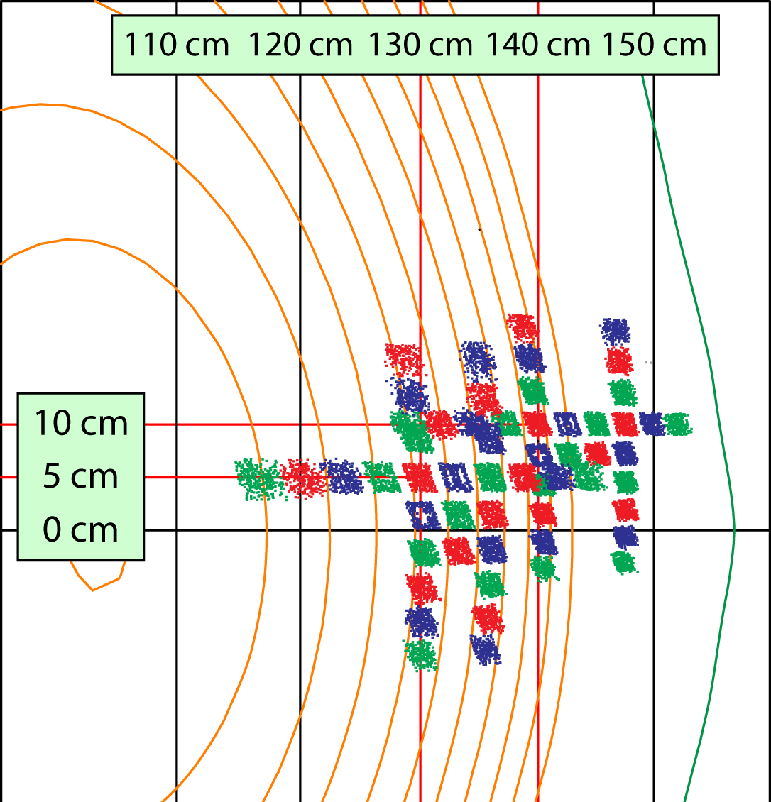
NSTX BES system includes 56 sightlines in radial and poloidal arrays spanning core to SOL
32 detection channels; expansion planned for NSTX-U
2 MHz sampling with digital anti-alias filter
2-3 cm image size and sensitive to ñ with k┴ρ_{i} ≤ 1.5
Field-aligned optics with high throughput (etendue = 2.3 mm²-ster)

Slide 7
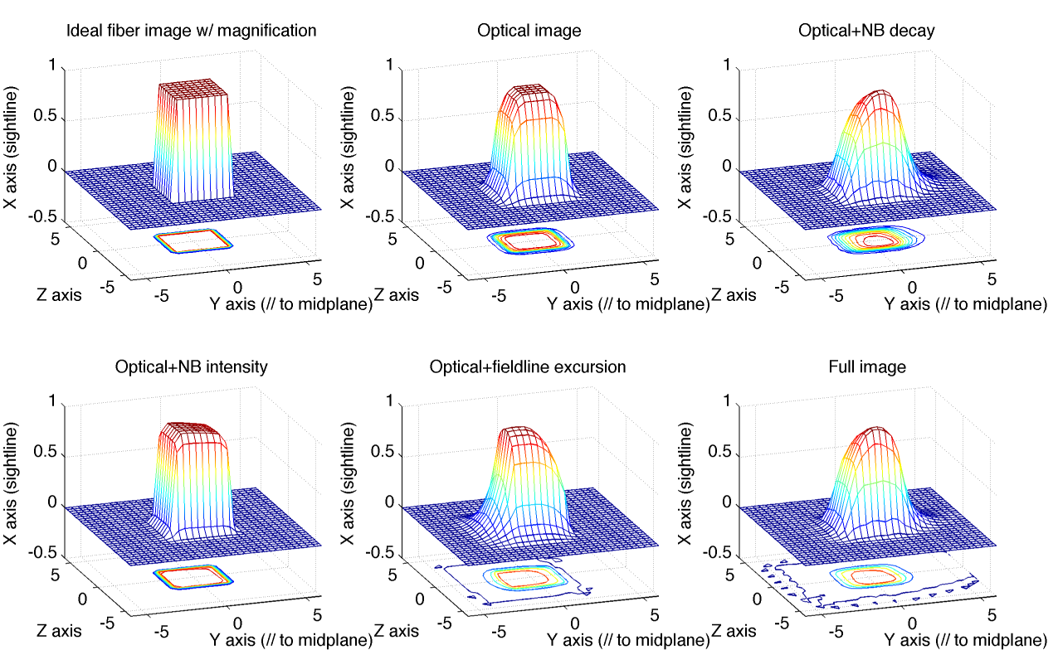
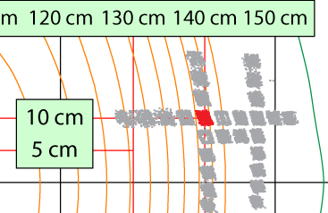
Point spread functions
Model | Ideal fiber | Focusing optics | Optical+NB decay | Optical+NB intensity | Optical+fieldline excursion | All effects
Y 1/e² width (cm) | 3.2 | 4.0 | 4.4 | 3.2 | 4.4 | 4.4
Y displacement (cm) | 0.0 | 0.0 | 0.5 | 0.0 | -0.5 | 0.3
X (au) image int.
Y (cm) ~ radial
Z (cm) ~ binormal

Slide 8
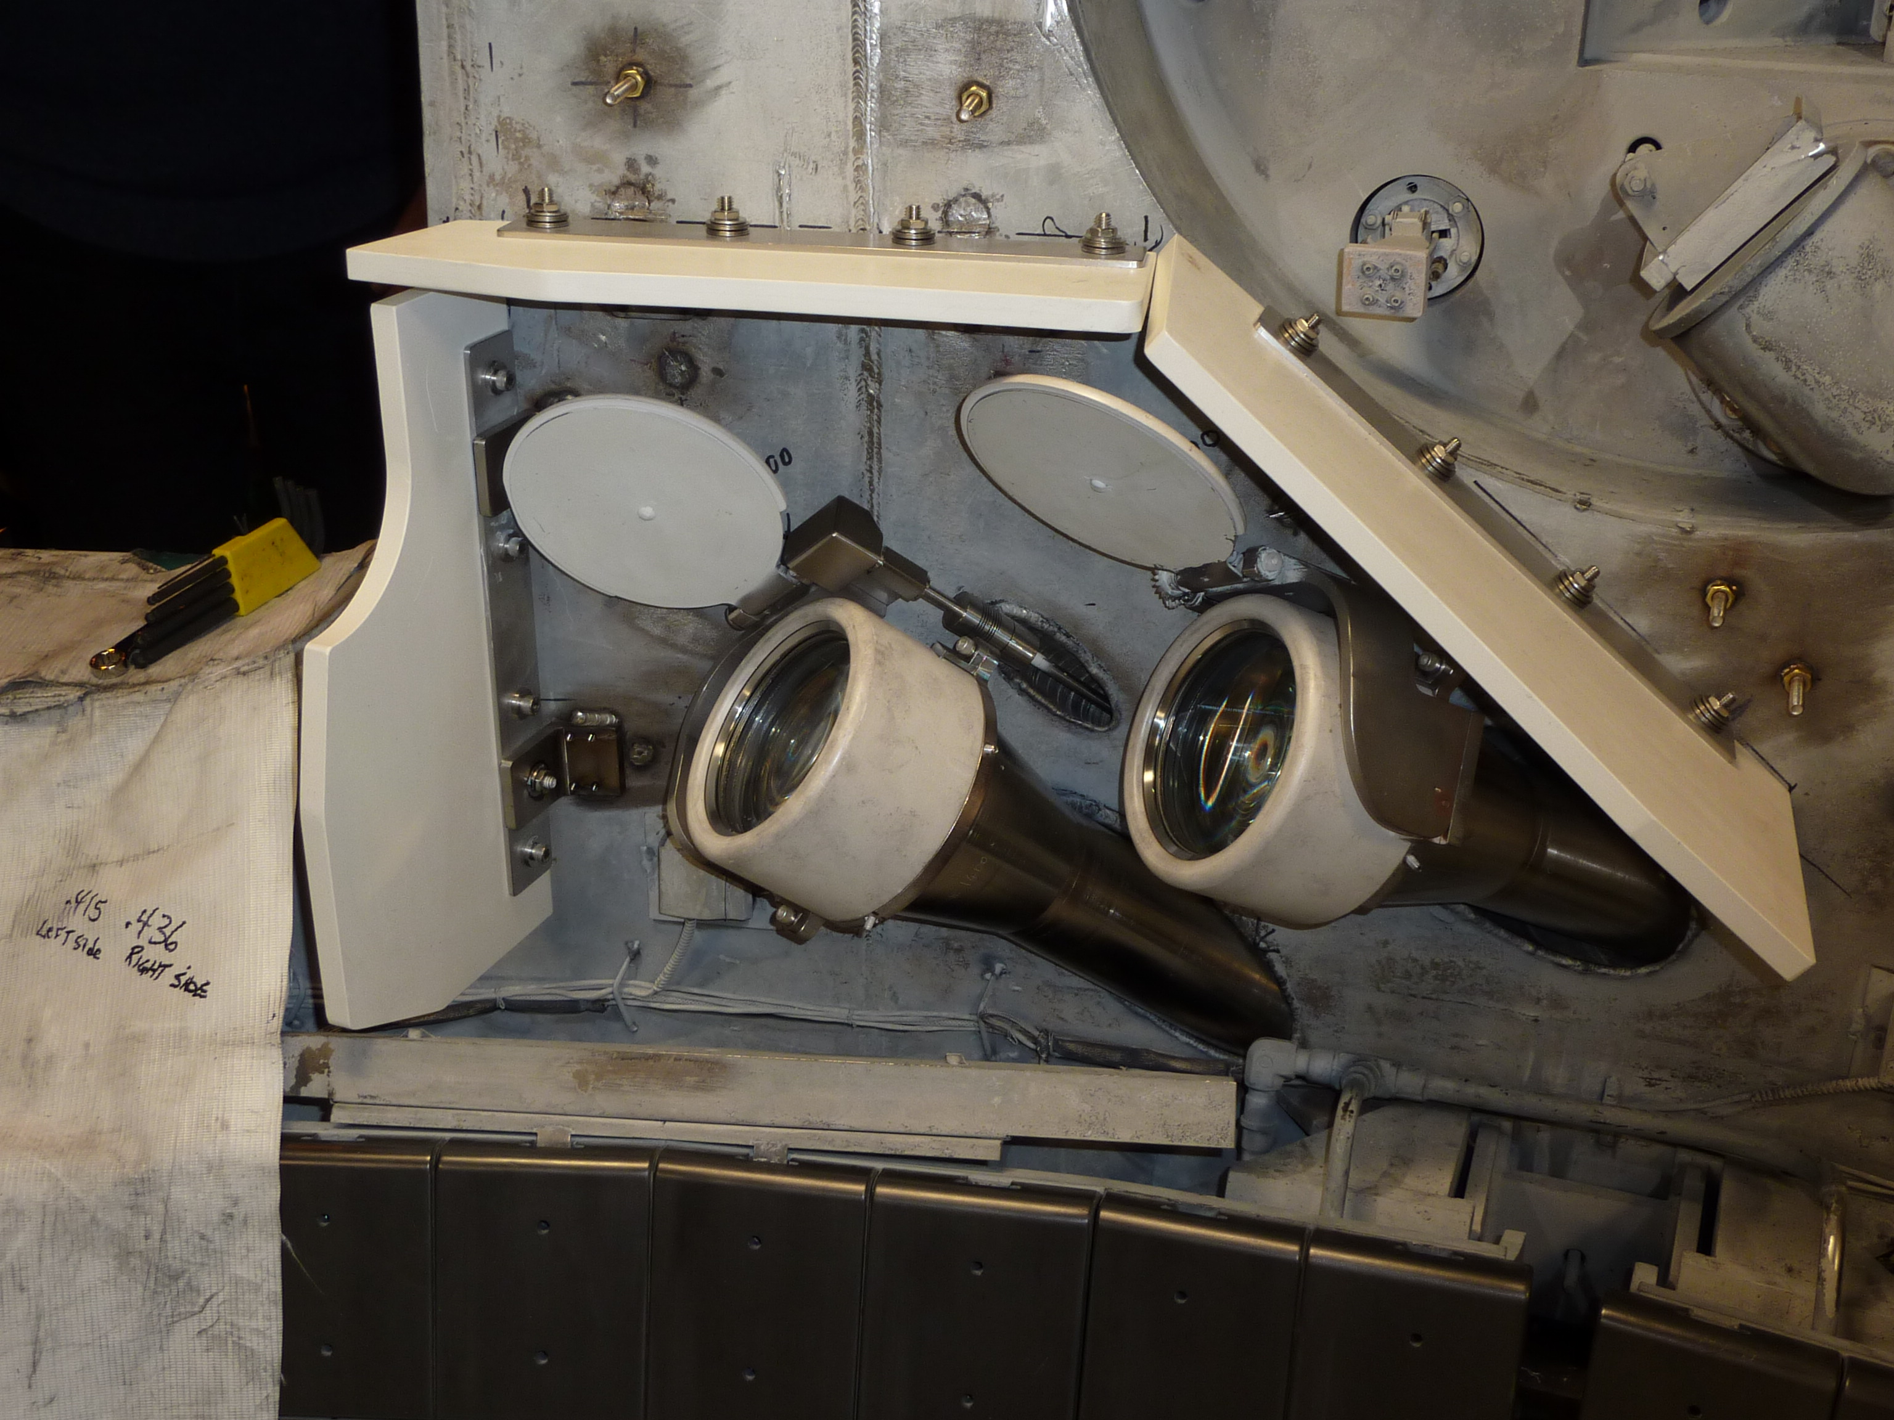
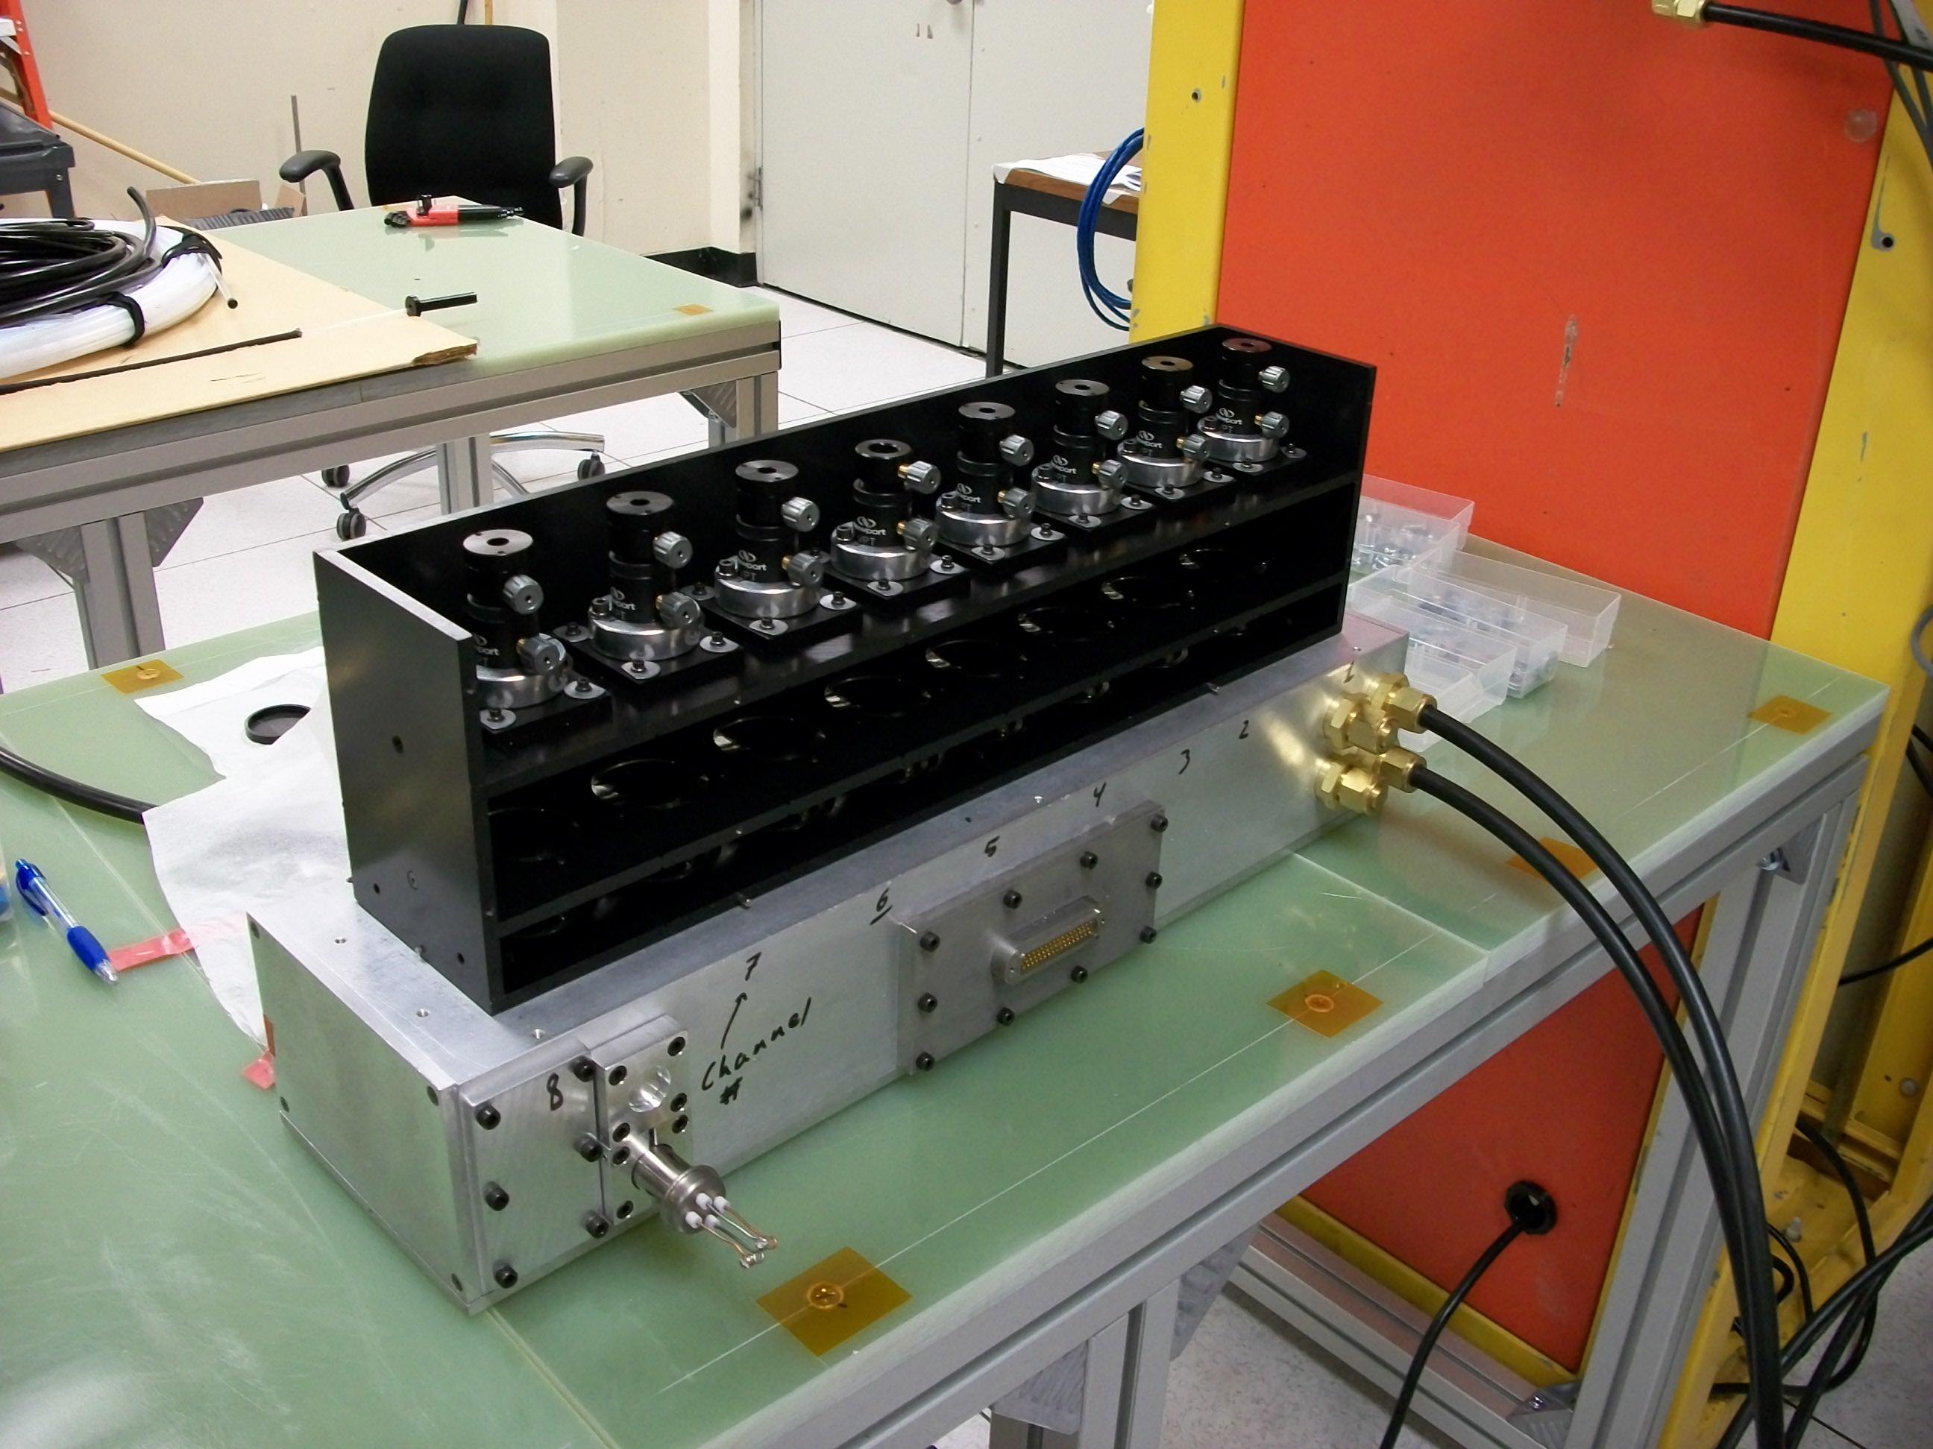
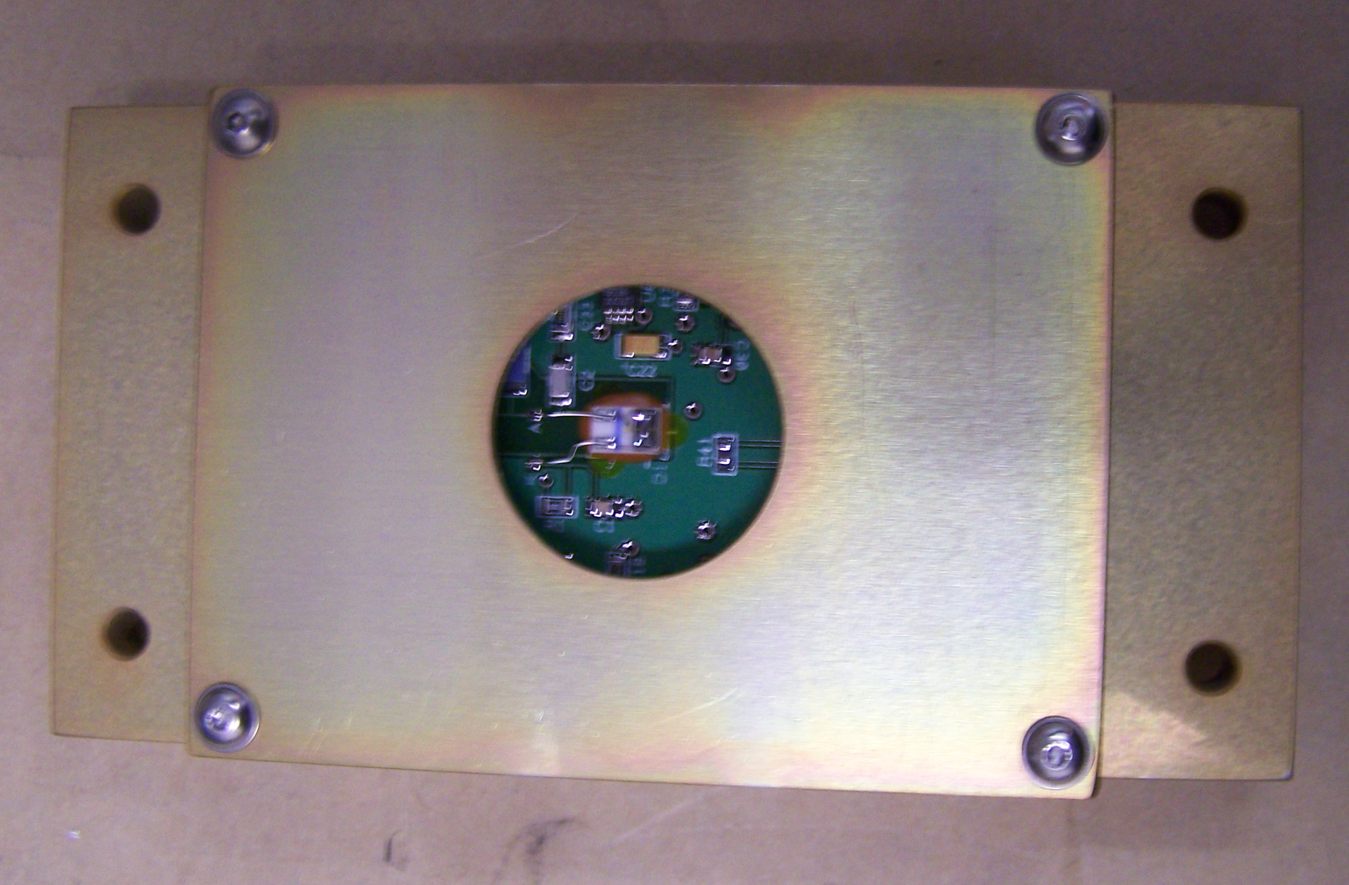
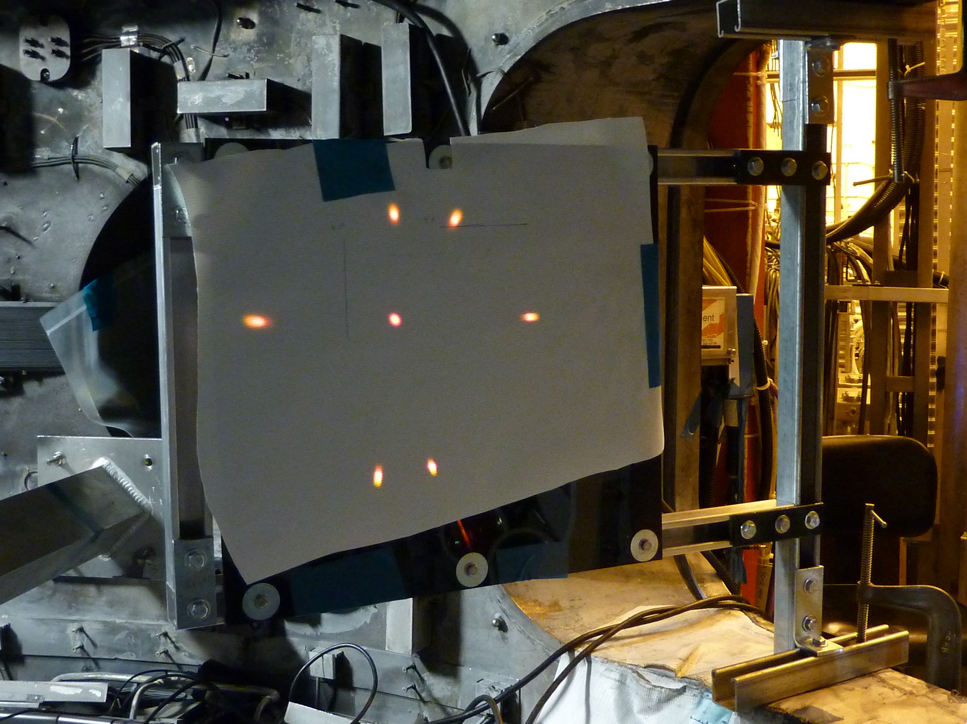
NSTX BES system commissioned in 2010

Slide 9
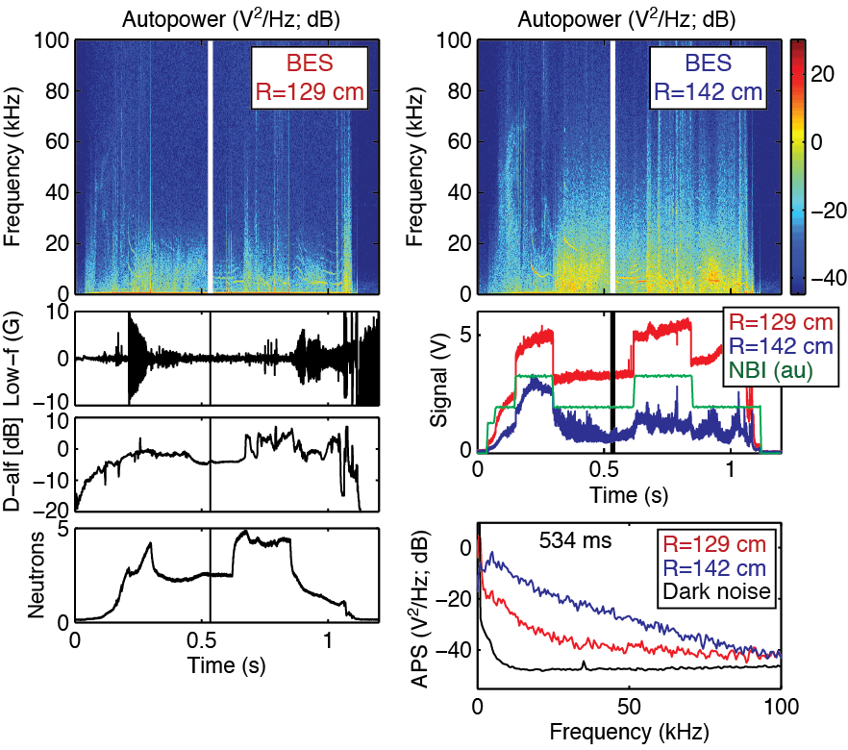
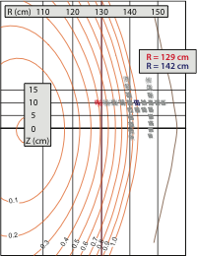
BES measurements show radially-localized response to NB emission and high signal-to-noise ratio

Slide 10
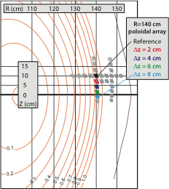
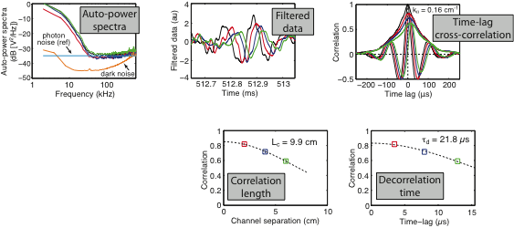
BES measurements provide poloidal correlation lengths (L_{c}), poloidal wavenumbers (k_{θ}), and decorrelation times (τ_{d}) in the pedestal
Filtered data shows eddy propagation
Turbulence quantities calculated from time-lag cross-correlations

Slide 11
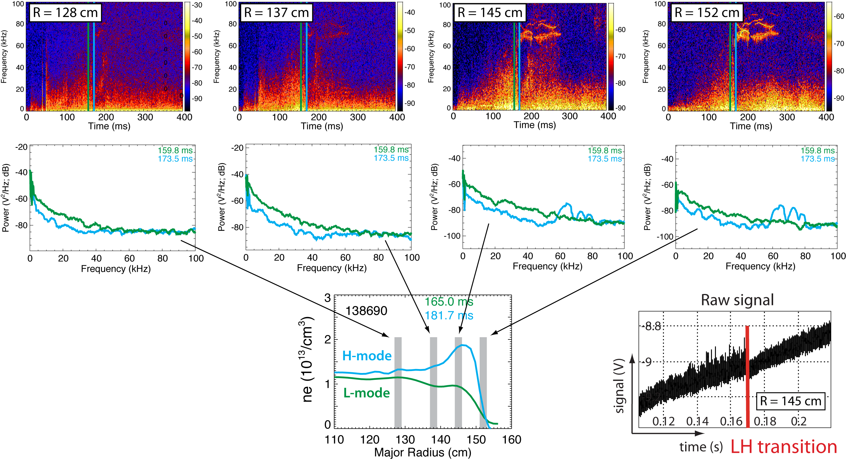
Decrease in fluctuations at LH transition observed from edge to core regions
Similar increase in fluctuations observed at HL back-transitions

Slide 12
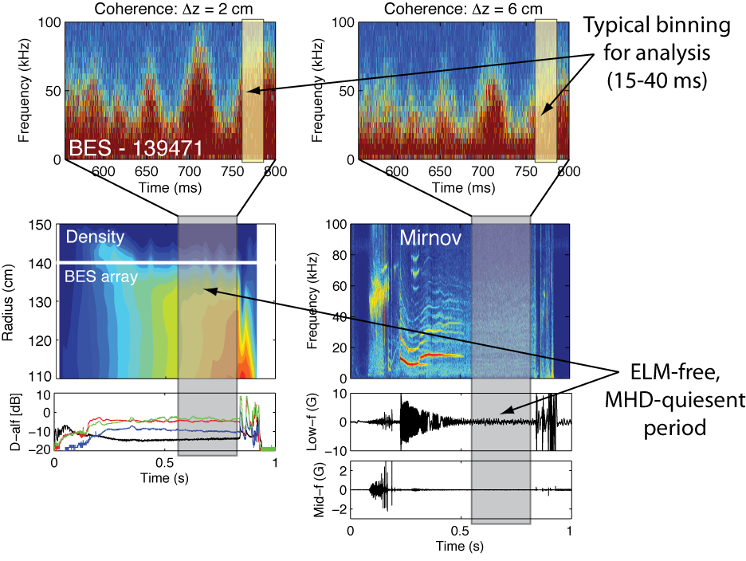
BES shows complex turbulence activity in pedestal during quiescent H-mode periods

Slide 13
Questions about pedestal turbulence to ask and answer with BES measurements
What are typical L_{c}, k_{θ}, and τ_{d} values in the H-mode pedestal during ELM-free, MHD quiescent periods?
How do L_{c}, k_{θ}, and τ_{d} change with plasma parameters?
  ∇n_{e}, ∇T_{i}, q/ŝ, ν_{e}, β_{e}, n_{ped}, etc.
Can we connect observations to edge turbulence simulations?
  XGC1 or BOUT++?

Slide 14
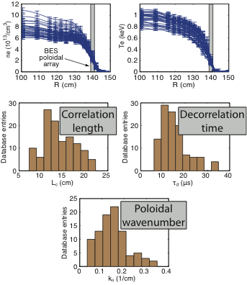
Pedestal turbulence measurements and plasma parameters from ELM-free, MHD quiescent H-modes were gathered in a database
Database details
129 entries from 29 discharges
  B_{T0} = 4.5 kG
  I_{p} = 700-900 kA
  15-45 ms averaging
Turbulence parameters
  L_{c}/ρ_{i} ~ 12
  k_{θ}ρ_{i} ~ 0.2
  τ_{d}/(a/c_{s}) ~ 5
  τ_{d}ω*_{pi} ~ 0.15
Plasma parameters
  generally 50%-300% variation
  n_{e}, ∇n_{e}, T_{e}, ∇T_{e}, Ti, ∇T_{i}, v_{t}, ∇v_{t}, q, ŝ, ν_{e}, ν_{i}, β, β_{e}, n_{ped}, ΔR_{ped}, δ_{r}^{sep}

Slide 15
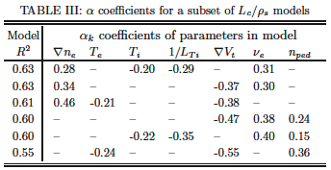
A search algorithm identified linear regression models that show similar scalings despite different parameter compositions
plasma
parameters
turbulence
parameters
scaling
coefficient
Search algorithm minimizes regression model’s squared sum of errors (SSE) by adding or removing x_{k} in model
Many SSE local minima exist in high dimensional x_{k} space
Objective: find many models and screen for statistical quality
  Statistical significance (α_{k} t-statistics)
  Multicollinearity (variance inflation factor)
  Error normality (Studentized residuals)
Linear regression models exhibit similar scalings despite different parameter compositions

Slide 16
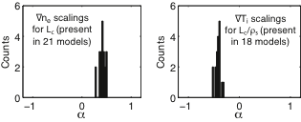
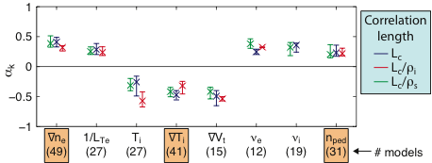
L_{c} increases at higher ∇n_{e}, 1/L_{Te}, ν, and n_{ped}; decreases at higher T_{i}, ∇T_{i}, and ∇v_{t}
Consistent scalings
emerge from
different regression
models

Slide 17
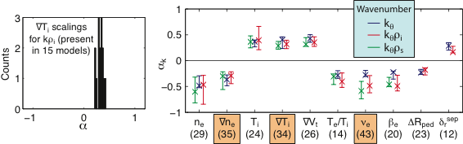
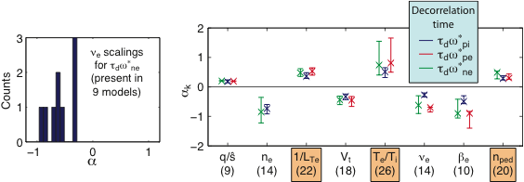
k_{θ} scalings consistent with L_{c} scalings; τ_{d} scalings provide additional insight

Slide 18
Scalings point to a variety of turbulence mechanisms
Parametric scalings point to enhanced turbulence structures (larger L_{c} and τ_{d}) at higher ∇n_{e} and 1/L_{Te}
  Possibly TEM turbulence
∇v_{t} scalings for L_{c} and k_{θ} point to turbulence suppression
  Equilibrium E×B flow shear
ν_{e} and ν_{i} scalings for L_{c} and k_{θ} are consistent with zonal flows
  τ_{d} decreases with ν_{e}
Pedestal height (n_{ped}) increases at larger L_{c} and τ_{d}
  Consistent with larger structures and wider pedestals

Slide 19
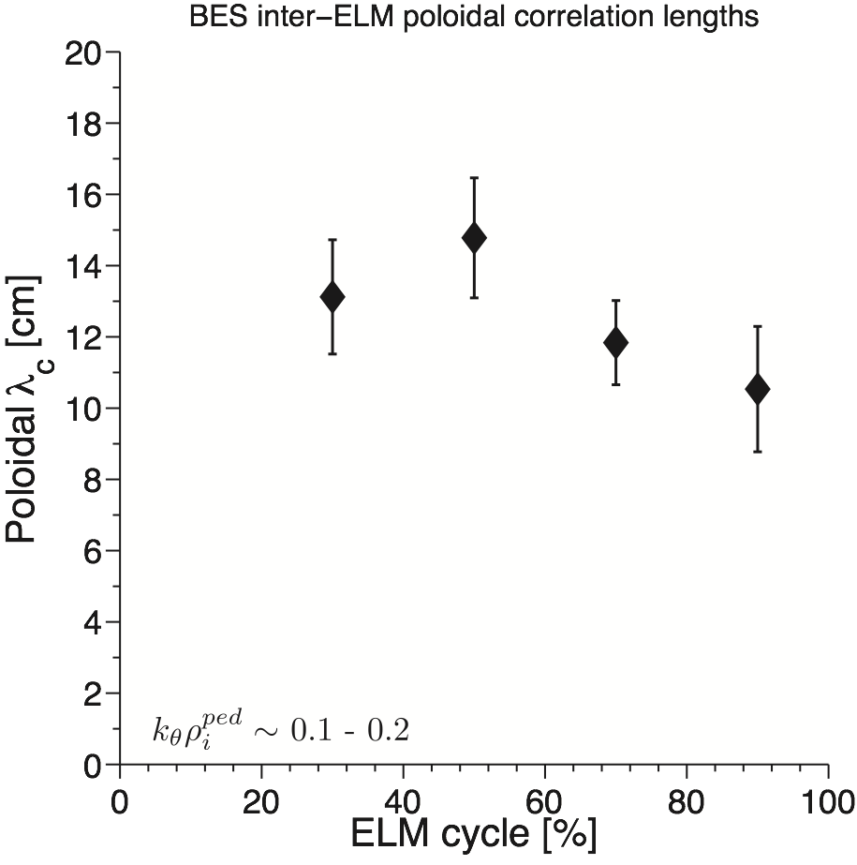
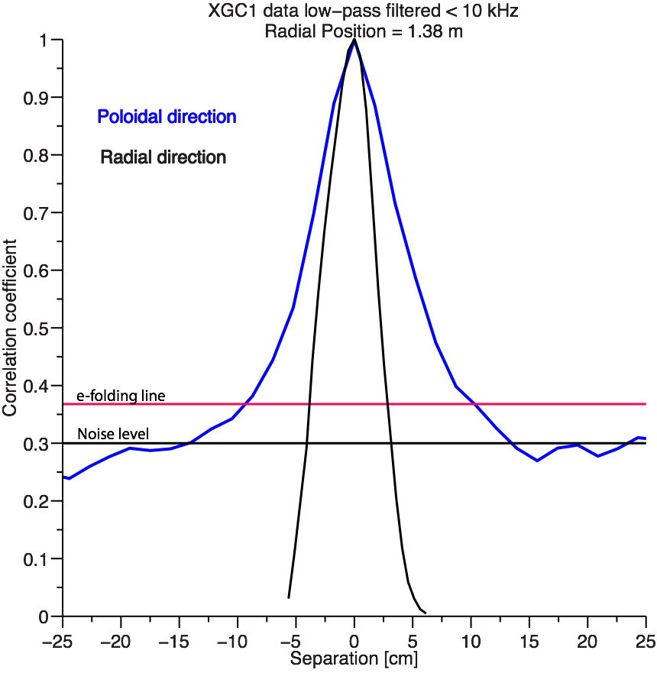
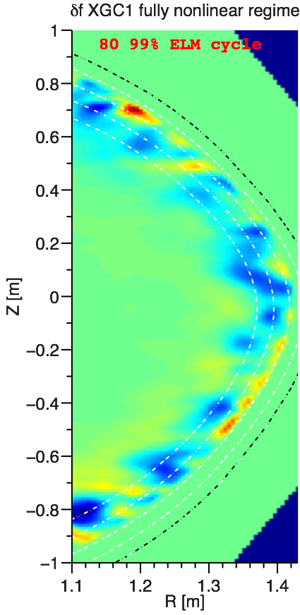
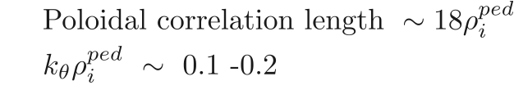
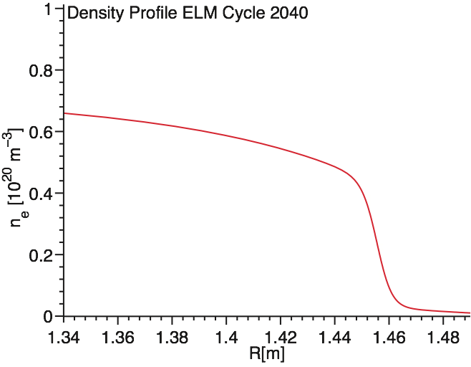
Poloidal correlation lengths during inter-ELM cycle are consistent with XGC1 simulation
~ 10 cm
~ 4 cm
Sampled BES region
Radial L_{c} analysis is in progress
(BES & refl.)

Slide 20
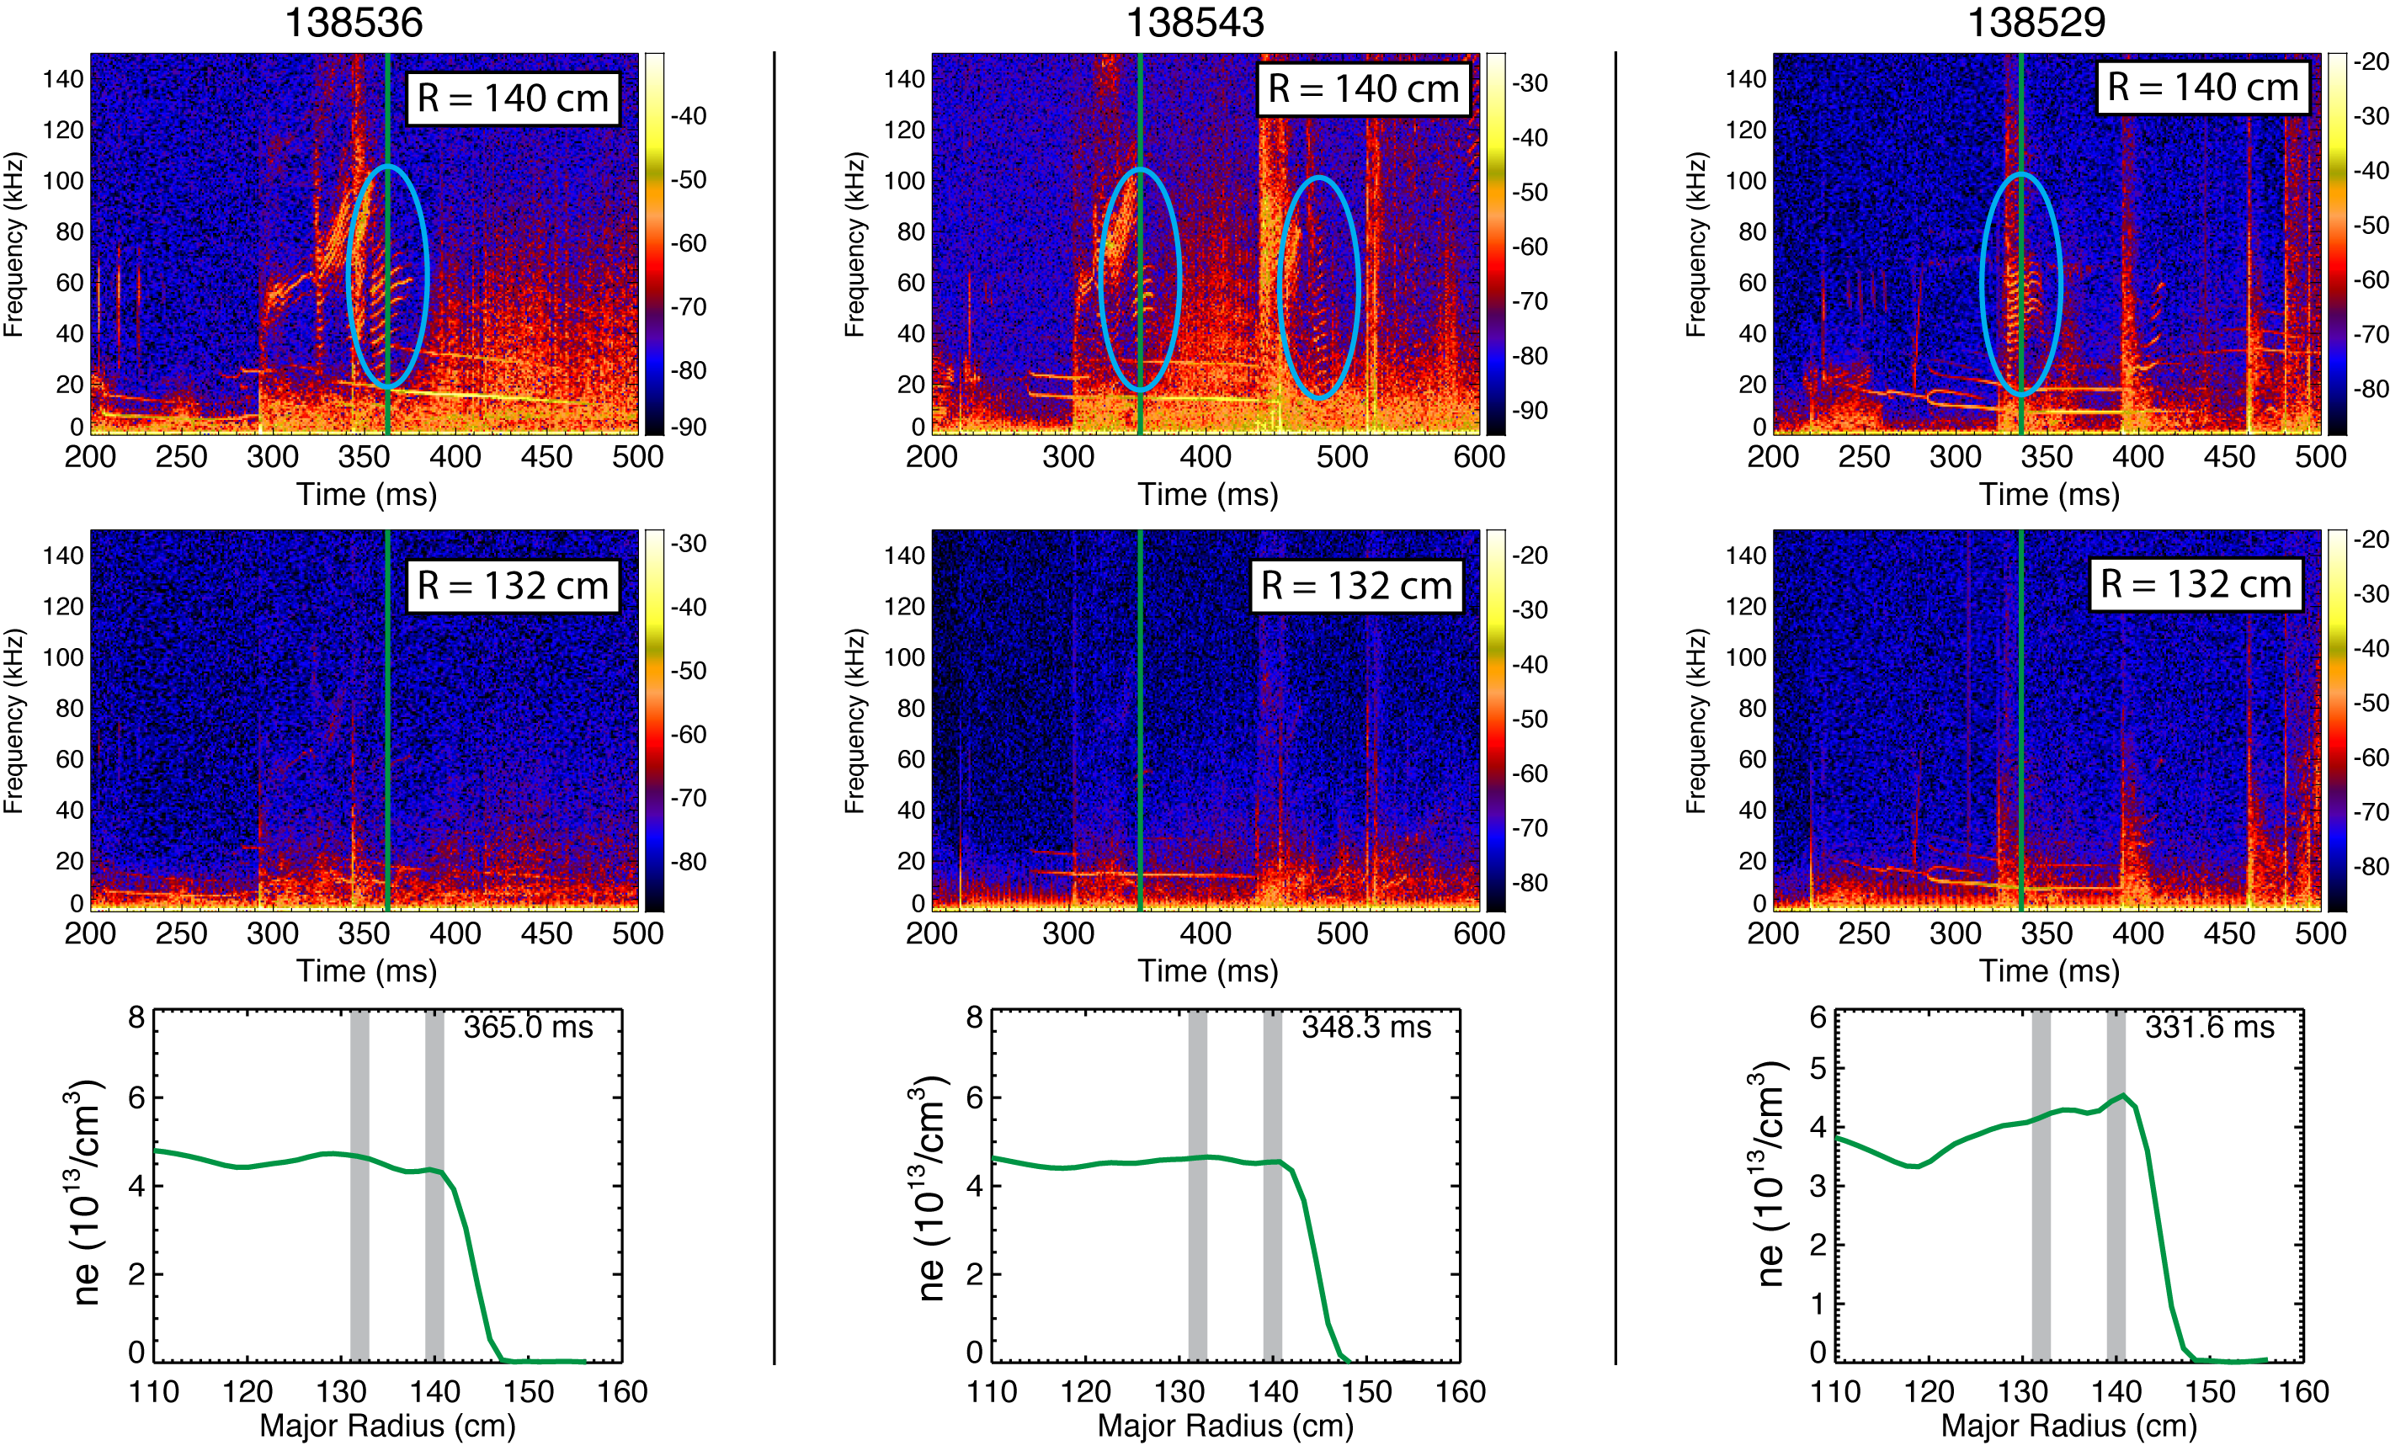
Post-ELM harmonic features at 50-100 kHz are localized at the top of the pedestal
Harmonic features are either absent from or weakly present in magnetic spectra

Slide 21
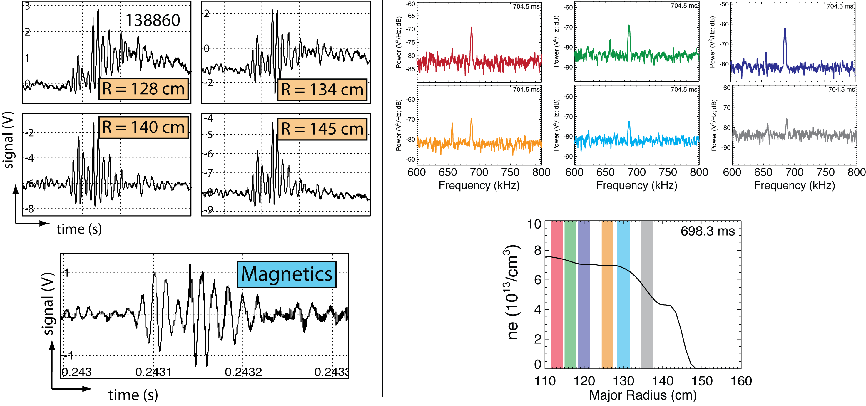
TAE and GAE mode structures have been observed in extended radial regions
TAE burst
GAE mode

Slide 22
Directions for future work
Quantify fluctuation amplitudes
Quantify radial correlation length
Study pre- and post-LH transition
Measure flow fluctuations and flow shear
  Study flow fluctuations and shear across LH transition
Identify post-ELM harmonic oscillations
  Captured by peeling-ballooning model?
  Connect to DIII-D observations

Slide 23
Summary: We measured pedestal turbulence quantities and identified parametric dependencies in ELM-free, MHD quiescent H-mode plasmas
ST edge parameters are among the most challenging regimes for simulations
The BES system on NSTX can measure poloidal correlation length, wavenumber, and decorrelation time of pedestal turbulence
Regression models identify parametric scalings that point to a variety of turbulence mechanisms
  Enhanced turbulence structures at higher ∇n_{e} and 1/L_{Te}
  ∇v_{t} scalings point to E×B turbulence suppression
  Collisionality scalings for L_{c} and k_{θ} are consistent with zonal flows
  Pedestal height increases at longer L_{c} and τ_{d}
Other observations
  Initial experiment/theory comparison for inter-ELM measurements
  Reduced turbulence at LH transition
  Post-ELM harmonic oscillations
  TAE and GAE mode structure

