Slide 1


Progress and Plans for NSTX Upgrade and
Kinetic Resistive Wall Mode Stability
Jack Berkery, Columbia University
and the NSTX-U team
University of Washington,
Seattle, WA
October 26, 2015

Slide 2
Outline
ST Overview and Motivation
NSTX-U Mission and Status
NSTX/NSTX-U Research Highlights
  Transport and Turbulence
  Power Exhaust
  Plasma Start-up
  Scenarios, Control, and Stability
Modifications to Ideal Stability by Kinetic Effects
Summary

Slide 3
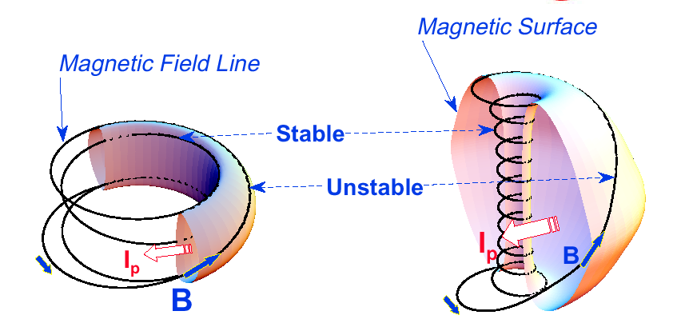
“Spherical” tokamak (ST) has aspect ratio A < 2
Aspect Ratio A = R /a
Elongation κ = b/a
Toroidal beta β_{T} = ⟨p⟩ / (B_{T0}²/2μ₀)
Tokamak
ST
A ~ 3-4,
κ = 1.5-2,
q₉₅ = 3-4,
β_{T} = 3-10%
A ~ 1.2-2,
κ = 2-3,
q₉₅ = 6-20,
β_{T} = 10-40%
• ST has high I_{P}, economically, due to high κ and low A
I_{P} ~ I_{TF} (1 + κ²) / (2 A² q*)
Energy confinement time τ_{E} ∝ I_{P}
• Favorable average curvature improves stability at high beta
Access high pressure, rapid rotation, low collisionality

Slide 4
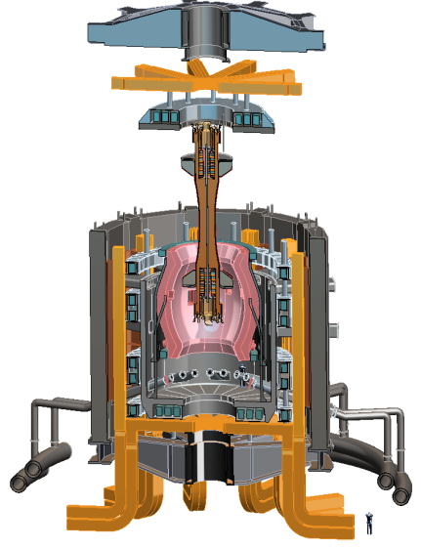
Design studies show ST potentially attractive as FNSF
PPPL ST-FNSF concept
Projected to access high neutron wall loading at moderate R, P_{fusion}
  W_{n} ~ 1-2 MW/m² , P_{fus} ~ 50-200MW, R ~ 0.8-1.8m
Modular, simplified maintenance
Tritium breeding ratio (TBR) near 1
  Requires sufficiently large R, careful design

Slide 5
Outline
ST Overview and Motivation
NSTX-U Mission and Status
NSTX/NSTX-U Research Highlights
  Transport and Turbulence
  Power Exhaust
  Plasma Start-up
  Scenarios, Control, and Stability
Modifications to Ideal Stability by Kinetic Effects
Summary

Slide 6
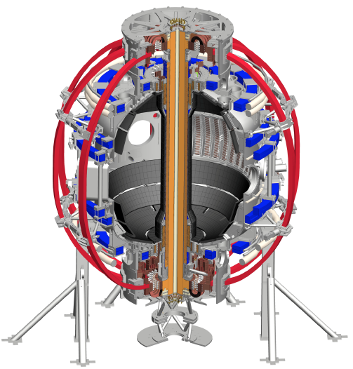
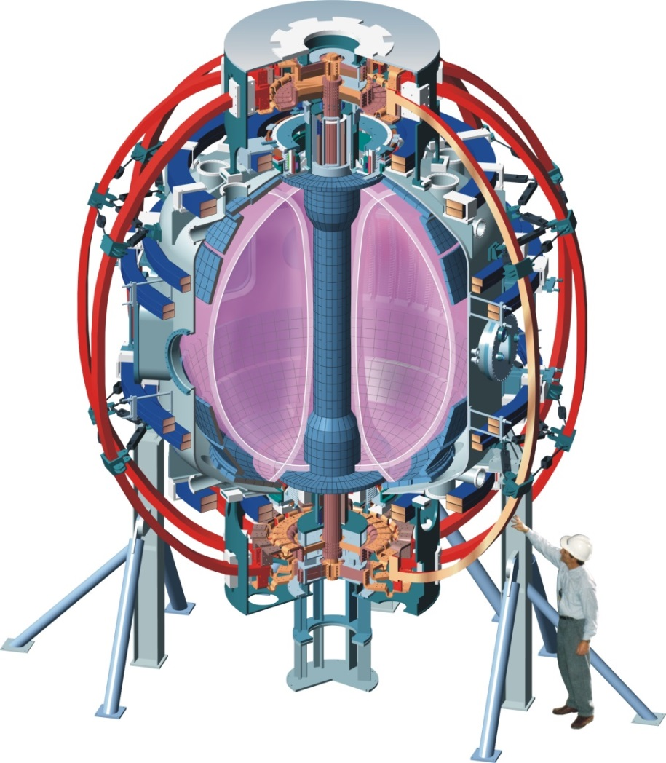
The National Spherical Torus Experiment Upgrade (NSTX-U) at the Princeton Plasma Physics Lab
NSTX (1999-2011)
NSTX-U
~2x higher B_{T}, I_{p}, P_{NBI} and ~5x pulse length vs. NSTX

Slide 7
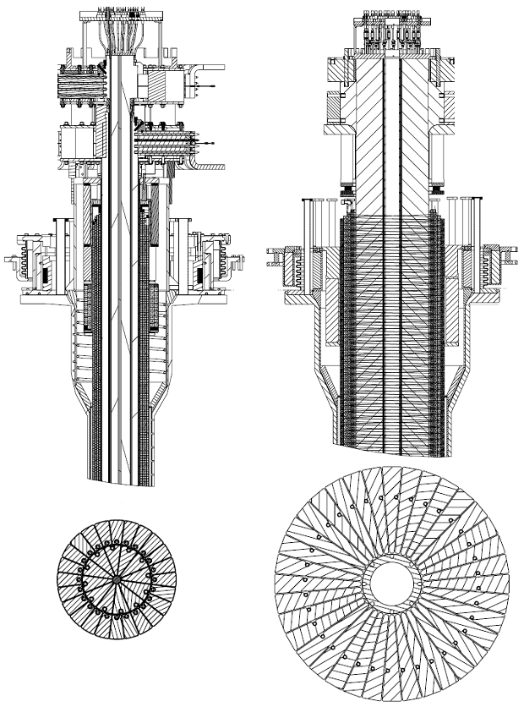
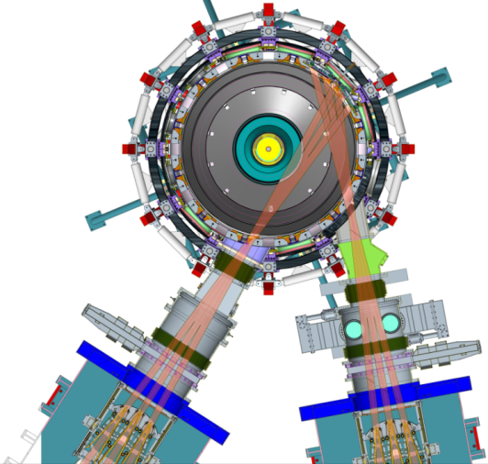
The National Spherical Torus Experiment Upgrade (NSTX-U) at the Princeton Plasma Physics Lab
Previous
center-stack
New
center-stack
New center column doubles toroidal magnetic field, plasma current
  Access conditions closer to FNSF
  Pulse lengths increase from 1 to 5 seconds
Second neutral beam injection system
  Doubles heating power, increases flexibility available for experiments
  More tangential injection improves current drive, especially at small plasma current
Increased flexibility in divertor configuration
TF OD = 20cm
TF OD = 40cm
Present NBI
New 2nd NBI

Slide 8
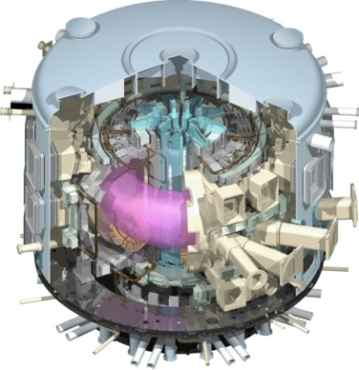
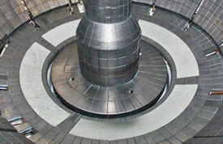
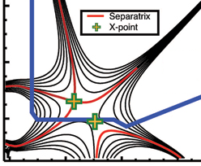
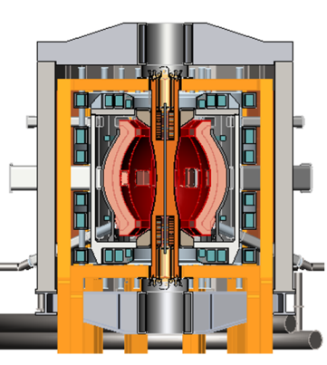
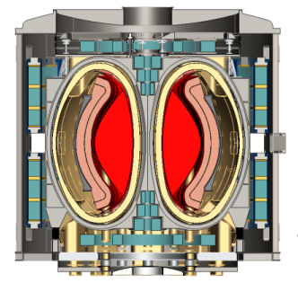
NSTX Upgrade mission elements
Explore unique ST parameter regimes to advance predictive capability - for ITER and beyond
Develop solutions for the plasma-material interface (PMI) challenge
Advance ST as candidate for Fusion Nuclear Science Facility (FNSF)
Develop ST as fusion energy system
ITER
Lithium
“Snowflake”
ST-FNSF / Pilot-Plant

Slide 9
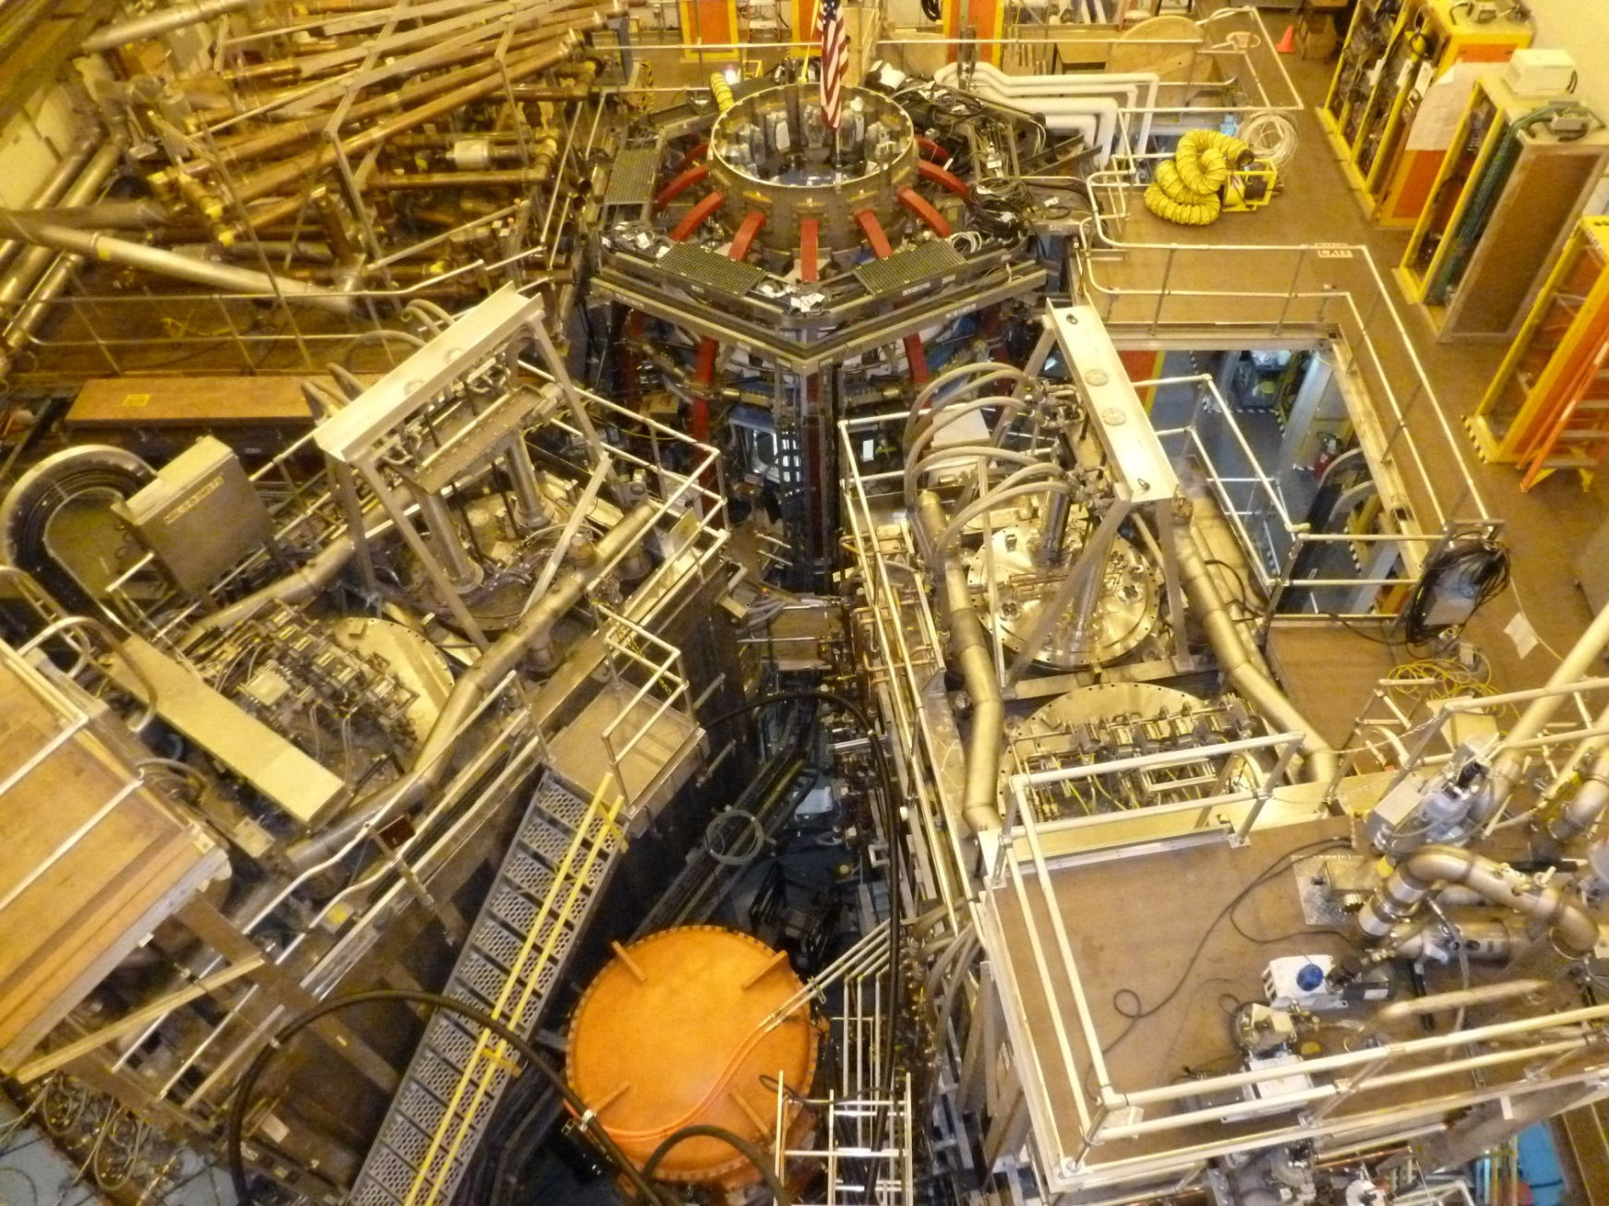
NSTX Upgrade project recently completed
On cost and schedule, first test plasma ~100kA (Aug. 10, 2015)
1st NBI
New 2nd NBI

Slide 10
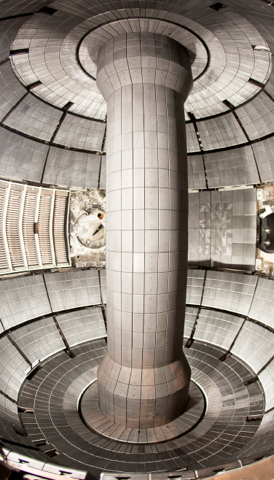
NSTX Upgrade project recently completed
On cost and schedule, first test plasma ~100kA (Aug. 10, 2015)
Center stack installed

Slide 11
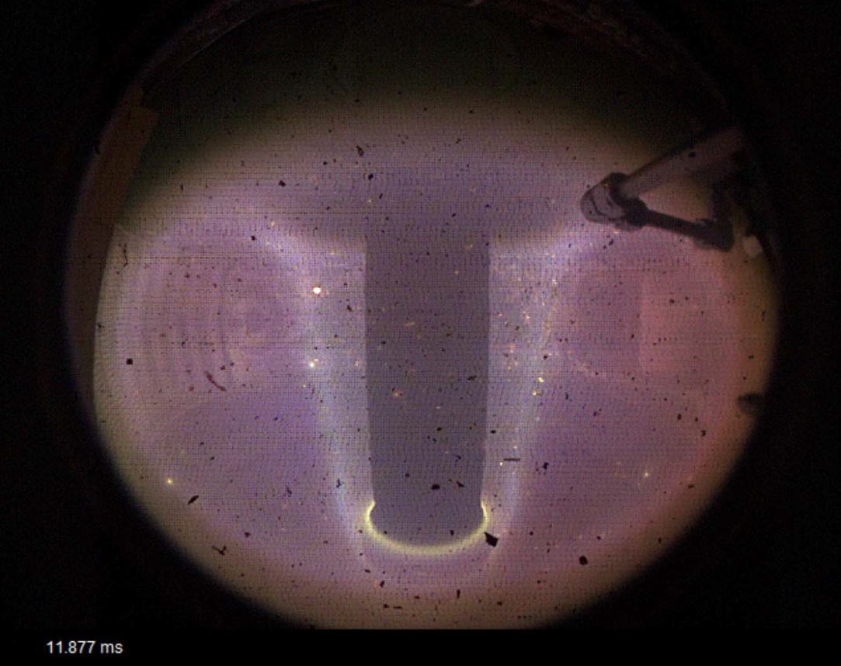
NSTX Upgrade project recently completed
On cost and schedule, first test plasma ~100kA (Aug. 10, 2015)
First test plasma
(Ohmic heating only)

Slide 12
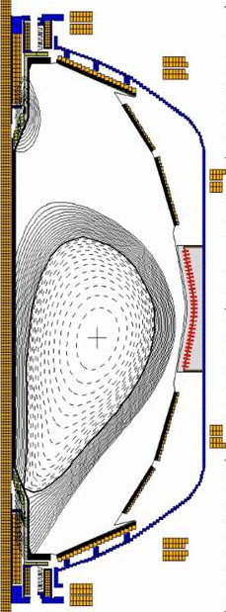
NSTX Upgrade project recently completed
On cost and schedule, first test plasma ~100kA (Aug. 10, 2015)
First test plasma
(Ohmic heating only)
EFIT I_{p}
NSTX-U EFIT Model created and used for first test shots
  Challenging at I_{p}/I_{wall} ~ ¼, but successful (good magnetics)
Physics research operations to begin in December 2015

Slide 13
Outline
ST Overview and Motivation
NSTX-U Mission and Status
NSTX/NSTX-U Research Highlights
  Transport and Turbulence
  Power Exhaust
  Plasma Start-up
  Scenarios, Control, and Stability
Modifications to Ideal Stability by Kinetic Effects
Summary

Slide 14
Low collisionality operation achieved on NSTX using lithium wall coatings
Lithium coatings on carbon tiles reduced gas source from wall
  Lead to a larger H-mode pedestal, larger core temperature
  Confinement continued to improve with reduced collisionality
Longer discharges will address first wall solutions
  New diagnostics and campaigns with different wall materials will advance studies of plasma-wall interaction
R. Maingi, PRL 2011

Slide 15
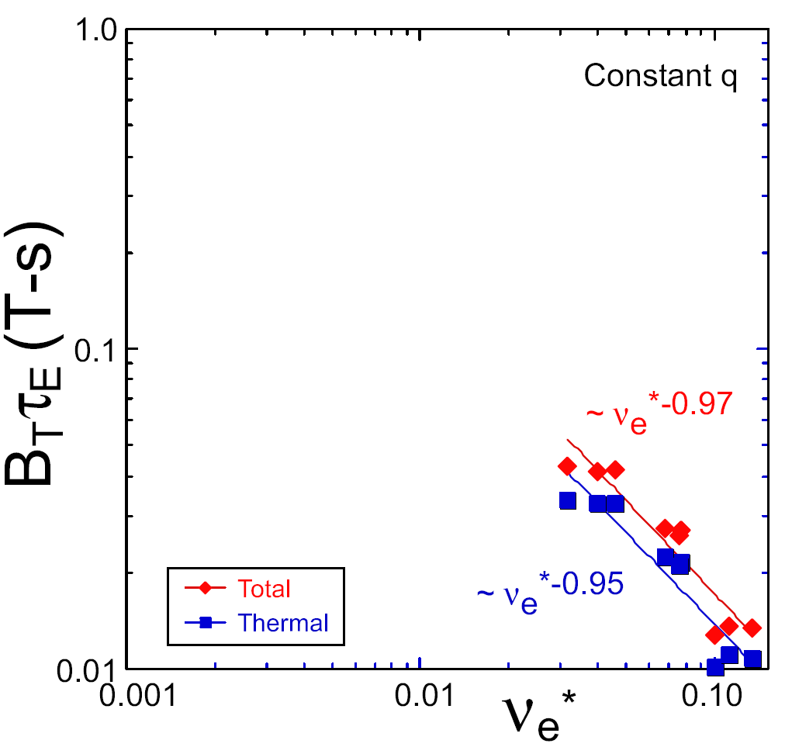
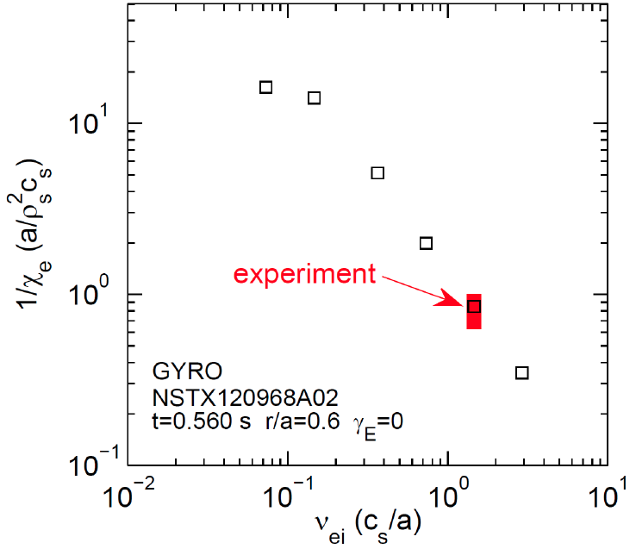


Major motivation for NSTX Upgrade: Determine if confinement trend continues, or is like conventional A
Micro-tearing-driven transport may explain ST τ_{E} collisionality scaling
ST-FNSF
constant q, β, ρ∗
NSTX Upgrade
Confinement
NSTX-U
?
NSTX
ITER-like scaling
NSTX
Normalized electron collisionality
ν_{e}* ∝ n_{e} / T_{e}²
W. Guttenfelder, PoP 2013, PoP 2012, PRL 2011
S. Kaye, NF 2013
Favorable confinement results could lead to more compact ST reactors

Slide 16
Outline
ST Overview and Motivation
NSTX-U Mission and Status
NSTX/NSTX-U Research Highlights
  Transport and Turbulence
  Power Exhaust
  Plasma Start-up
  Scenarios, Control, and Stability
Modifications to Ideal Stability by Kinetic Effects
Summary

Slide 17
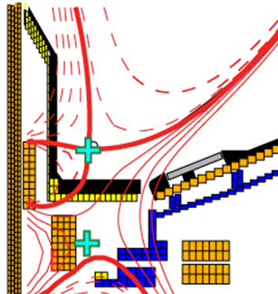
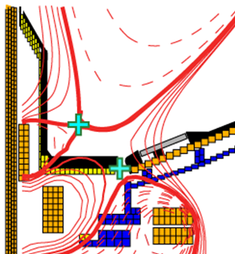
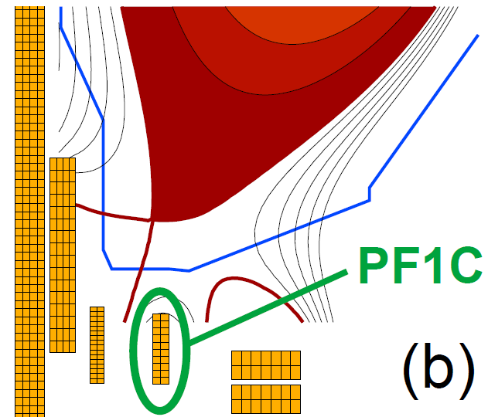
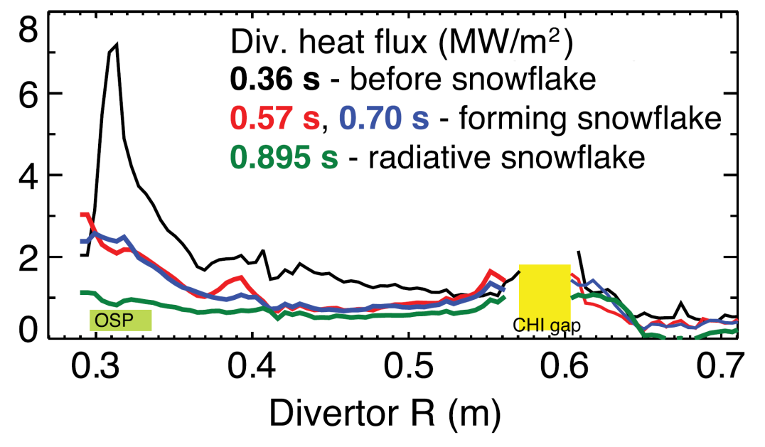
NSTX-U will test ability of radiation and advanced divertors to mitigate very high heat-fluxes
NSTX: reduced heat flux 2-4×via radiation (partial detachment)
Additional null-point in divertor expands field, reduces heat flux
Standard Divertor
Snowflake/X Divertor
NSTX-U peak heat fluxes will be up to 4-8× higher than in NSTX
NSTX-U has additional coils for up-down symmetric snowflake, improved control
V. Soukhanovskii, JNM, 2013

Slide 18
Outline
ST Overview and Motivation
NSTX-U Mission and Status
NSTX/NSTX-U Research Highlights
  Transport and Turbulence
  Power Exhaust
  Plasma Start-up
  Scenarios, Control, and Stability
Modifications to Ideal Stability by Kinetic Effects
Summary

Slide 19
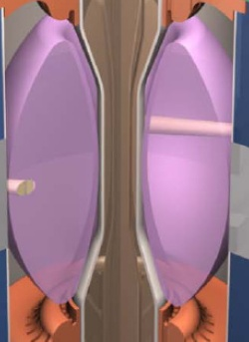
I_{P} Start-up/Ramp-up Critical Issue for ST-FNSF/Demo
Compact ST-FNSF has no/small central solenoid
ST-FNSF Scenarios
high β_{T}, β_{N}, κ, disruption avoidance, high H, heat flux mitigation
I_{P} [MA]
Current ramp-up and profile control
NBI
Solenoid-free
Start-up
HHFW
EC/EBW, HI, PF
Time
• Two novel techniques for solenoid-free start-up and ramp-up will be investigated
  RF: ECH/EBW and HHFW
  Helicity Injection
~ 1-2 MA of solenoid-free start-up current needed for FNSF

Slide 20
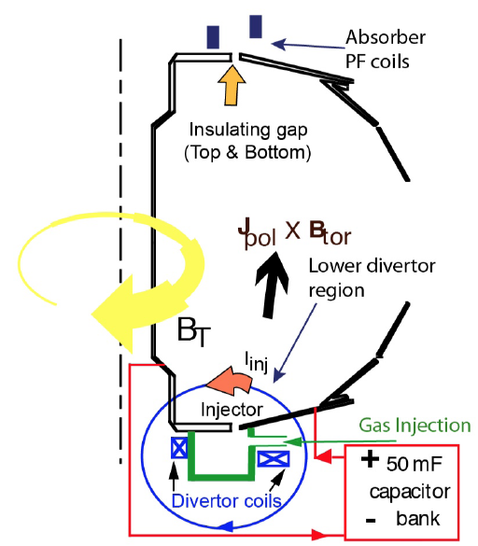
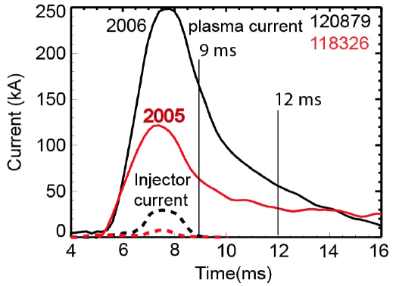
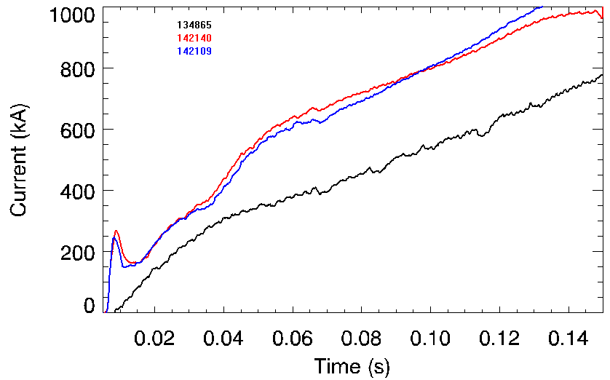
Helicity Injection is efficient method for current initiation
Coaxial Helicity Injection (CHI) concepts being developed
CHI developed on HIT, HIT-II
Transferred to NSTX / NSTX-U
Discharge evolution of 160 kA closed flux current produced by CHI alone in NSTX
Standard NSTX inductive start-up, requires 50% more inductive flux than CHI started discharge
R. Raman et al., PRL 2006
R. Raman et al., POP 2011

Slide 21
Outline
ST Overview and Motivation
NSTX-U Mission and Status
NSTX/NSTX-U Research Highlights
  Transport and Turbulence
  Power Exhaust
  Plasma Start-up
  Scenarios, Control, and Stability
Modifications to Ideal Stability by Kinetic Effects
Summary

Slide 22
NSTX achieved 70% “transformer-less” current drive
Will NSTX-U achieve 100% as predicted by simulations?
TRANSP Contours of Non-Inductive Fraction
H_{98y2}
ITER H-mode confinement scaling multiplier
I_{P}=1 MA, B_{T}=1.0 T, P_{NBI}=12.6 MW
S. Gerhardt, NF 2012
Steady-state operation required for ST, tokamak, or stellarator FNSF

Slide 23
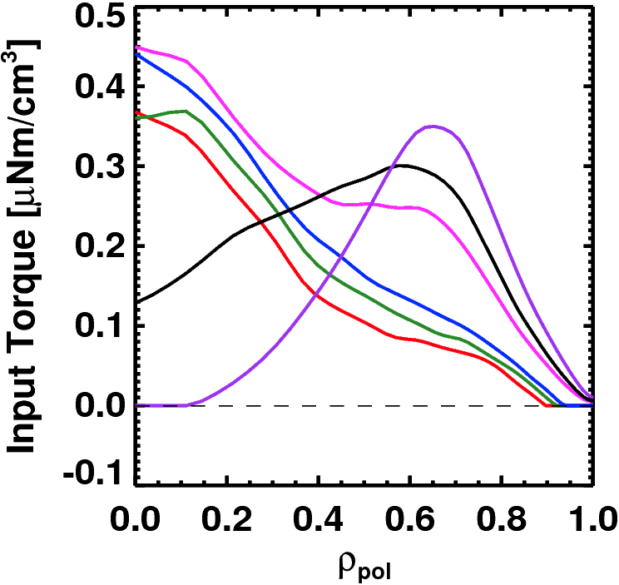
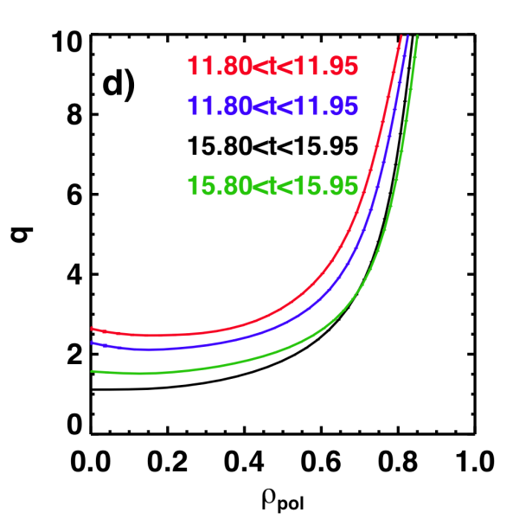
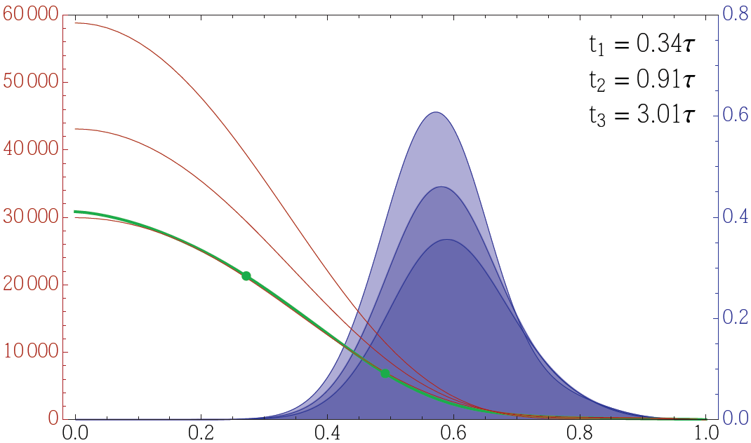
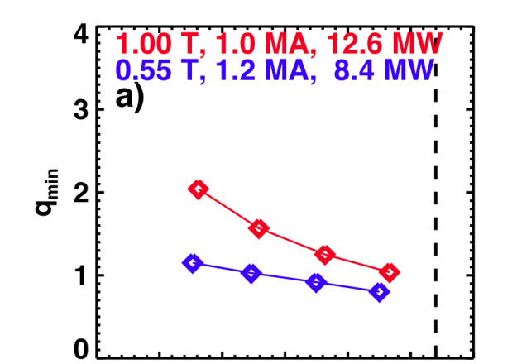
NSTX-U developing a range of profile control actuators for physics studies, scenario optimization
q-Profile Actuators
Rotation Profile Actuators
Variations in Beam Sources
800 kA Partial Inductive, 87% < f_{NI} < 100%
Largest R_{tan}
Torque Profiles From 6 Different NB Sources
800 kA and 1 T
[50,60,70,130] cm
[50,60,120,130] cm
[60,70,110,120] cm
[70,110,120,130] cm
Neutral
Beams
(TRANSP)
Smallest R_{tan}
NSTX-U state-space ω_{φ} controller w/NTV as actuator
6
10⁴
t₁
Variations in Outer Gap
t₂
4
t₃
NTV
region
Plasma rotation (rad/s)
NTV torque density (N/m²)
2
desired ω_{φ}
0
S. Gerhardt,
NF 2012
27 22 17 12 7 2
Radial coordinate
Outer Gap
S. Sabbagh, IAEA 2014

Slide 24
Record β_{N} and β_{N} / l_{i} accessed in NSTX using passive + active resistive wall mode stabilization
  High β_{N} for fusion performance, high non-inductive fraction for continuous operation
    High bootstrap current fraction -> Broad current profile -> Low l_{i} = <B_{p}²>/<B_{p}>_{ψ}²
  Unfavorable for ideal stability since low l_{i} reduces the ideal n = 1 no-wall beta limit
The highest β_{N}/l_{i} is not the least stable in NSTX
  Passive stability of the resistive wall mode (RWM) must be explained
ST-FNSF
Unstable RWM
Stable / controlled RWM
S. Sabbagh, NF 2013; J. Berkery, POP 2014
Major NSTX-U mission is to achieve fully non-inductive operation at high β

Slide 25
Outline
ST Overview and Motivation
NSTX-U Mission and Status
NSTX/NSTX-U Research Highlights
  Transport and Turbulence
  Power Exhaust
  Plasma Start-up
  Scenarios, Control, and Stability
Modifications to Ideal Stability by Kinetic Effects
Summary

Slide 26
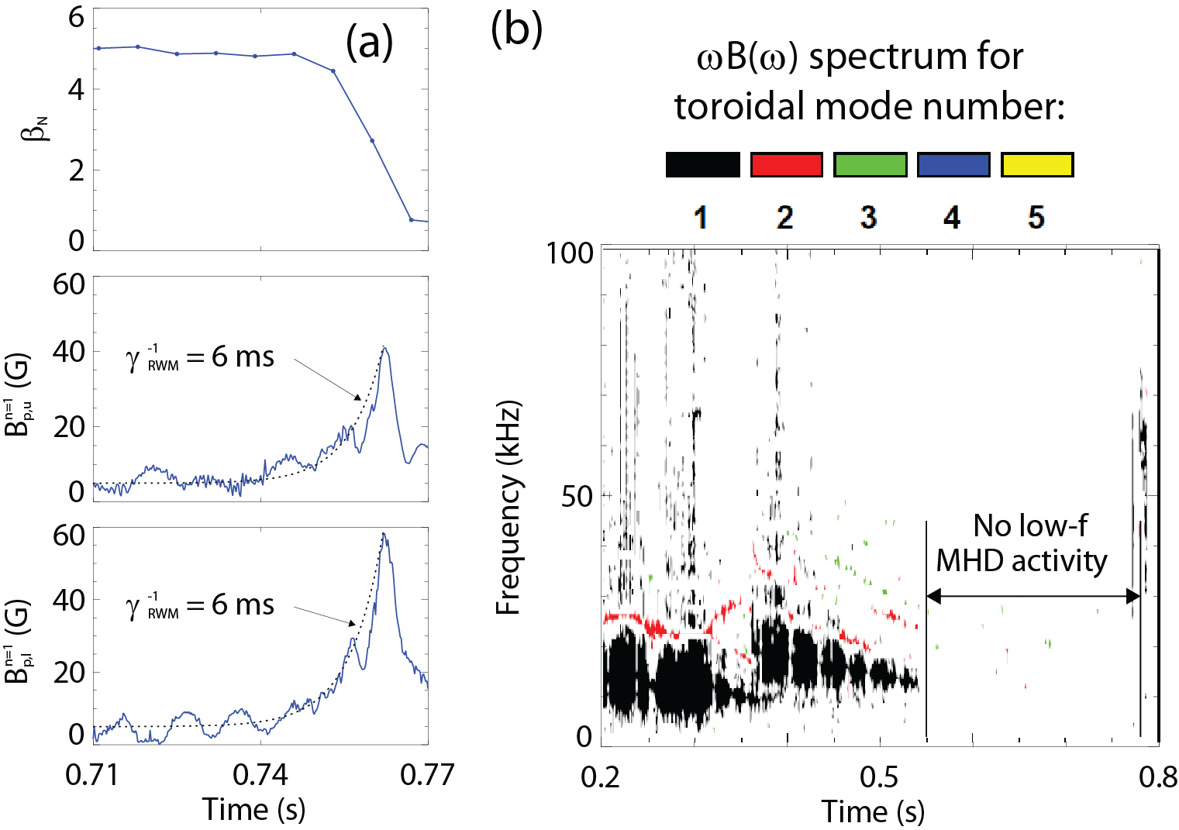
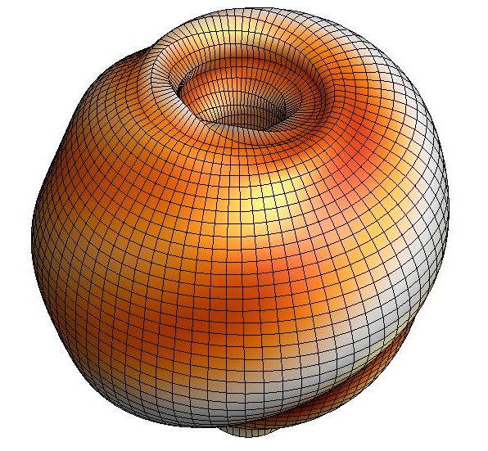



An unstable RWM is an exponential growth of magnetic field line kinking that can cause disruptions
The resistive wall mode (RWM) is a kinking of magnetic field lines slowed by penetration through vessel structures
130235
B_{p}
where
[S. Sabbagh et al., Nucl. Fusion 46, 635 (2006)]
RWMs in NSTX cause a collapse in β, disruption, and termination of the plasma

Slide 27
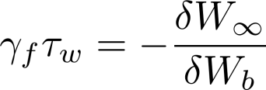
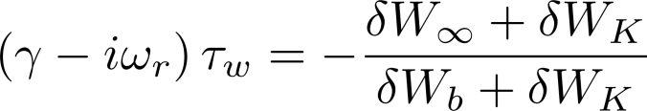
RWM dispersion relation evaluated with ideal and kinetic components allows for passive stabilization of the RWM
Resistive Wall Mode (RWM) fluid dispersion relation:
Ideal Kink Mode
Resistive Wall Mode
γ
~τ_{w}⁻¹
unstable
0
τ_{w}⁻¹ is slow enough for active stabilization (feedback)
stable
However, experiments operate above the no-wall limit without active control!
β_{N}^{no-wall}
β_{N}^{with-wall}
Ideal Stability
Kinetic Effects
Passive stabilization
  Collisional dissipation
  Rotational stabilization
    Models with scalar “critical rotation” for stability could not explain experiments
[B. Hu et al., Phys. Rev. Lett. 93, 105002 (2004)]
[S. Sabbagh et al., Nucl. Fusion 50, 025020 (2010)]

Slide 28
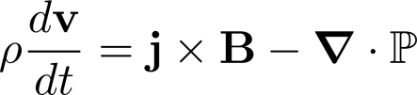
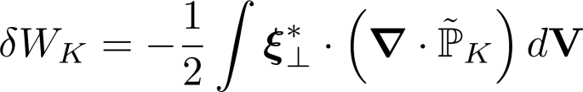


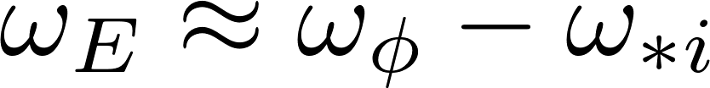
Kinetic effects arise from the perturbed pressure, are calculated in MISK from the perturbed distribution function
Force balance:
leads to an energy balance:
Kinetic Energy
Fluid terms
Change in potential energy due to perturbed kinetic pressure is:
is solved in MISK by using from the drift kinetic equation for
~ Plasma Rotation
Precession Drift
Collisionality

Slide 29
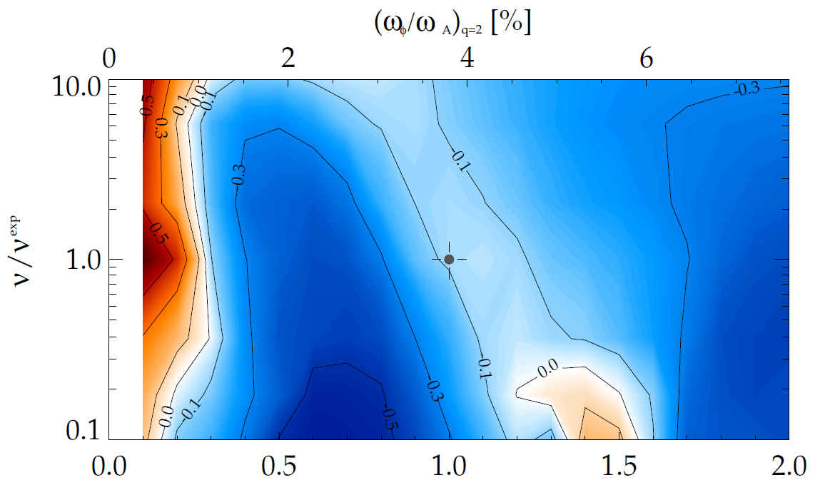
Kinetic RWM theory consistent with RWM destabilization at intermediate plasma rotation; stability altered by collisionality
γτ_{w} contours vs. ν and ω_{φ}
MISK code
(marginal stability)
Plasma evolution
Precession drift resonance stabilization
Marginal stability
Bounce/transit resonance stabilization
ν_{eff}/ν^{exp (marginal stability)}
instability
(experiment)
unstable
NSTX 121083
unstable
ω_{φ}/ω_{φ}^{exp (marginal stability)}
Destabilization appears between precession drift resonance at low ω_{φ}, bounce/transit resonance at high ω_{φ}
Stability gradient with ω_{φ} stronger at low collisionality
[J. Berkery et al., Phys. Rev. Lett. 104, 035003 (2010)]

Slide 30
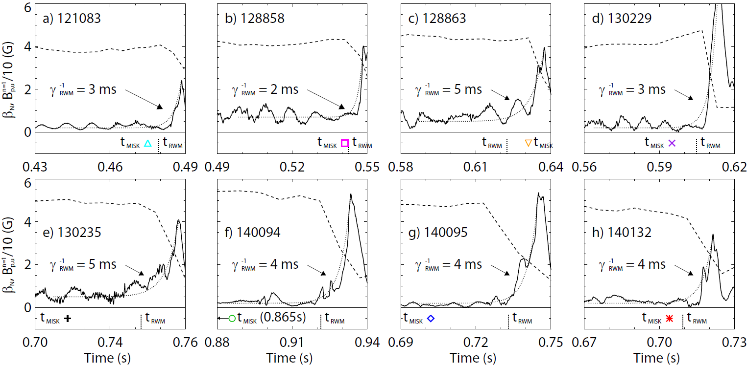
MISK calculations are grounded in validation against unstable experimental plasmas
NSTX
MISK calculations (at t_{MISK}) include kinetic effects, have been tested against many marginally stable NSTX experimental cases
[J. Berkery et al., accepted by Nuclear Fusion (2015)]

Slide 31
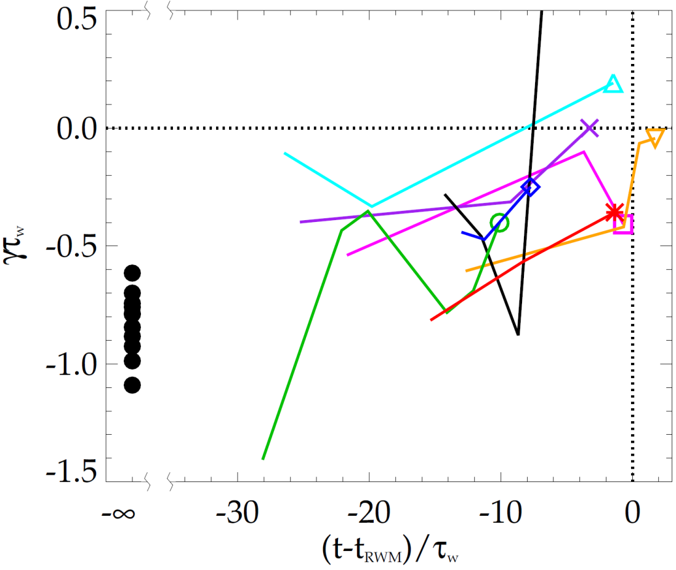
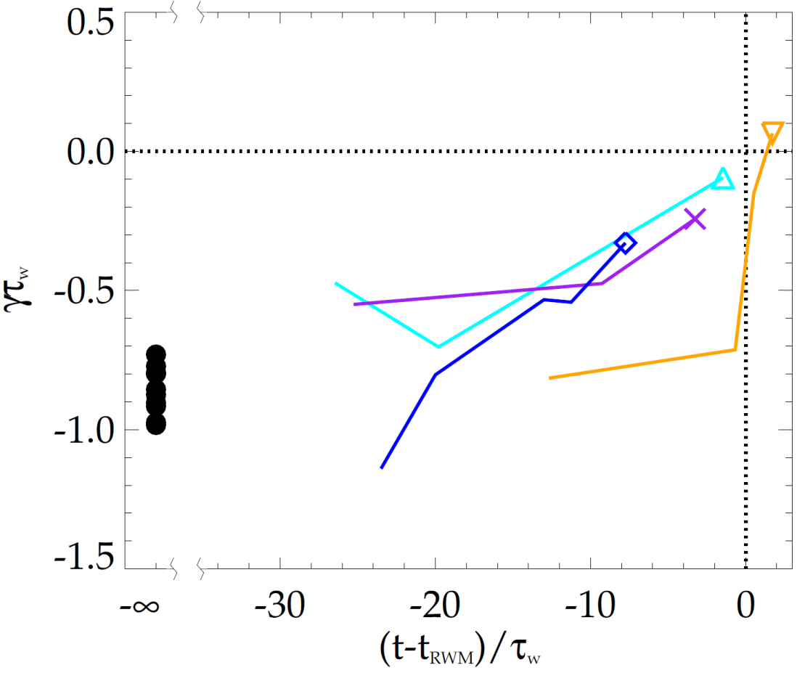
MISK calculations generally reproduce the approach towards marginal stability seen in experiments
NSTX
NSTX
unstable
unstable
stable
stable
Thermal particles
with energetic particles
In each case, the calculations trend towards instability (γτ_{w} = 0) as the time approaches the time of experimental RWM instability growth
  Twelve equilibria from discharges with no RWM show no trend and are more stable in the calculations
[J. Berkery et al., accepted by Nuclear Fusion (2015)]

Slide 32
Summary
NSTX-U project recently completed on cost and schedule with ~100kA test plasma in August
  Physics research to begin in December 2015
NSTX began, and NSTX-U will extend, opportunities to study toroidal confinement physics in novel regimes:
  Low aspect ratio, strong shaping, high β, low collisionality
  Advanced divertors, lithium walls, unique start-up solutions
  Will inform optimal configuration for next-step FNSF device
Modification of ideal stability by kinetic effects can explain resistive wall mode stability at high beta
More: Berkery APS poster Tues. morning, Sabbagh talk Weds. afternoon

Slide 33
Backup

Slide 34
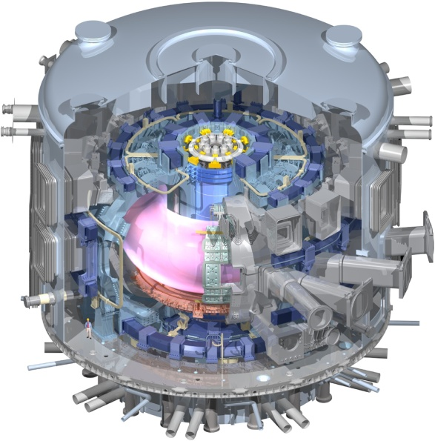
Unique ST properties also support ITER
ST Extends Predictive Capability for ITER and Toroidal Science
  High β physics, rotation, shaping extend stability, transport knowledge
  NBI fast-ions in present STs mimic DT fusion product parameters in ITER → study burning plasma science
  STs can more easily study electron scale turbulence at low collisionality → important for all magnetic fusion
Burning Plasma Physics - ITER

Slide 35
Brief Overview of FY2016-18 NSTX-U Goals
FY2016
  Obtain first data at 60% higher field/current, 2-3× longer pulse:
    Re-establish sustained low l_{i} / high-κ operation above no-wall limit
    Study thermal confinement, pedestal structure, SOL widths
    Assess current-drive, fast-ion instabilities from new 2nd NBI
FY2017
  Extend NSTX-U performance to full field, current (1T, 2MA)
    Assess divertor heat flux mitigation, confinement at full parameters
  Access full non-inductive, test small current over-drive
  First data with 2D high-k scattering, prototype high-Z tiles
FY2018
  Assess causes of core electron thermal transport
  Test advanced q profile and rotation profile control
  Assess CHI plasma current start-up performance
  Study low-Z and high-Z impurity transport
    Possibly test/compare pre-filled liquid-Li tiles/PFCs vs. high-Z solid

Slide 36
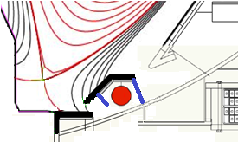
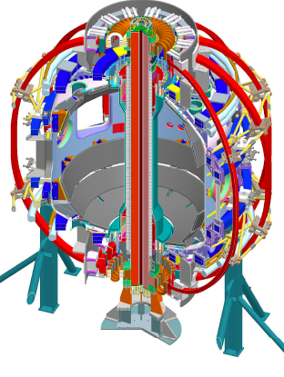
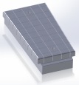
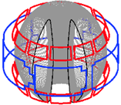
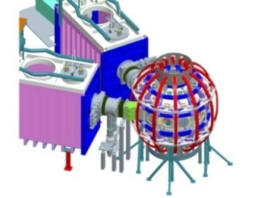
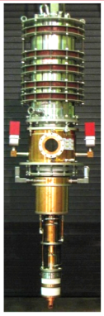
Five Year Facility Enhancement Plan (green = ongoing)
2015: Engineering design for high-Z tiles, Cryo-Pump, NCC, ECH
Fiscal Year:
2015 | 2016 | 2017 | 2018 | 2019
Major enhancements:
Base funding
+15% incremental
Upgrade Outage
1.5 → 2 MA, 1s → 5s
Run Weeks:
14-16
16-18
12-16
10-12
New
center-stack
Pulse-burst MPTS
Lower divertor cryo-pump
Boundary Science
+ Particle Control
Boronization
High-Z tile row on lower OBD
High-Z PFC diagnostics
Li granule injector
Upward
LiTER
LLD using bakeable cryo-baffle
MAPP
MGI disruption mitigation
Upgraded halo sensors
Off-midplane 3D coils (NCC)
Core Science
δB diag. - incremental
Enhanced MHD sensors
Laser blow-off
42 ch MPTS
DBS, PCI, or other intermediate-k
48 ch BES
High k_{θ}
MSE/LIF
Charged fusion product
Neutron collimator
4 coil AE antenna
Establish control of:
Rotation
q_{min}
HHFW limiter upgrade
Snowflake
Integrated Scenarios
FIReTIP
n_{e}
Divertor P_{rad}
2nd NBI
1 MW ECH/EBW
Upgraded CHI for ~0.5MA
0.5-1 MA CHI
up to 1 MA plasma gun

