Slide 1



Confinement and stability discoveries from high-beta spherical tori
Jonathan Menard (PPPL)
Program Director for NSTX Upgrade
With contributions from the NSTX, MAST
Pegasus, and other ST research teams
Norman Rostoker Memorial Symposium
The Fairmont Newport Beach Hotel
August 24-25, 2015

Slide 2
Outline
ST overview
Global MHD Stability
Energy Confinement
Energetic Particles
ST Upgrade Status
Summary

Slide 3
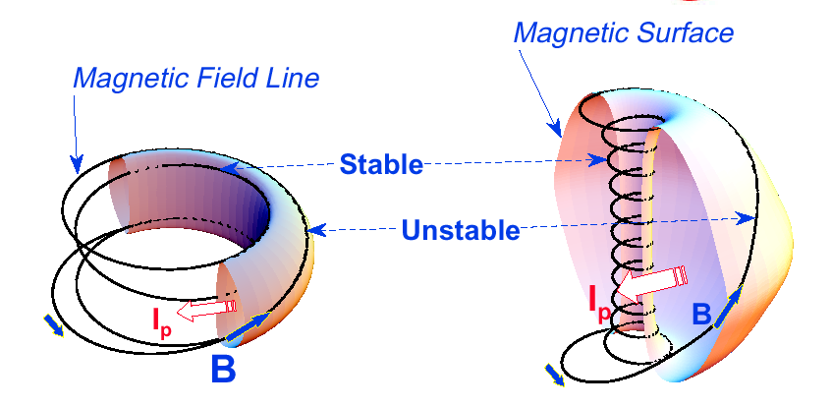
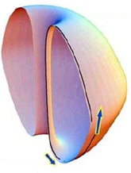
“Spherical” tokamak (ST) has aspect ratio A < 2
Aspect Ratio A = R /a
Elongation κ = b/a
Toroidal Beta β_{T} = ⟨p⟩ / (B_{T0}²/ 2μ₀)
Natural elongation makes its spherical appearance
Favorable average curvature improves stability at high beta
Tokamak
A ~ 3-4,
κ = 1.5-2,
q₉₅ = 3-4,
β_{T} = 3-10%
ST
A ~ 1.2-2,
κ = 2-3,
q₉₅ = 6-20,
β_{T} = 10-40%
FRC
A ~ 1,
κ = 0.5-10,
q ~ 0,
β ~ 100%
Notes:
A spherical tokamak is a low aspect ratio tokamak. Tokamak is a donut like aspect ratio of about 3 where as ST is aspect ratio of about 1.5. As the aspect ratio is reduced, the hole of the donut is reduced and it disappears entirely at A = 1. As the aspect ratio is reduced, the plasma elongate naturally takes on the spherical shape due to self fields. Another important property is the magnetic field line. The tokamak magnetic field line goes around torus at relatively constant pitch where as the ST geometry, the field line transit the outboard unstable region quickly but spend many toroidal transits in the inboard stable region. This makes ST plasma stable for high beta and also makes the edge safety factor high ~ 10 compared to ~ 3 for tokamak.
As a result, there are a number of new unique physics regimes which can be accessed at low aspect ratio, which can be utilized to enhance the understanding of toroidal confinement physics and improve predictive capabilities for ITER and future fusion facilities.

Slide 4
High β_{T} enables compact Fusion Nuclear Science Facility (FNSF) with high neutron wall loading
P_{fusion} ∝ ⟨p⟩ ² x Vol
Database from START, MAST, PEGASUS, NSTX
β_{N} = 6
40
5
P_{fusion} ∝ β_{T}² B_{T0}⁴ x Vol
ST-FNSF
4
Toroidal β (%)
3
20
Tokamak
$
2
Physics limited
ITER
Investment & engineering limited
0
0
4
8
W_{n} ∝ P_{fusion} / Area
I_{p}/aB_{T0} (MA/mT)
W_{n} ∝ β_{T}² B_{T0}⁴ a (not strongly size dependent)
W_{n} ~ 1-2 MW/m² with R ~ 1-2m FNSF feasible!

Slide 5
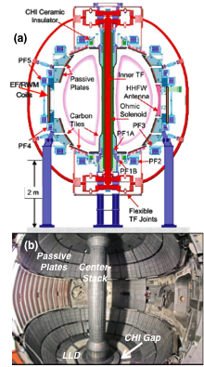
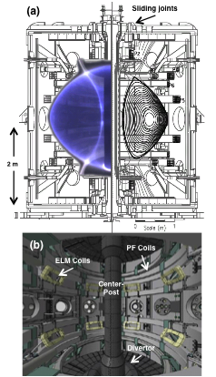
MA-Class ST Research Started ~2000
Complementary Physics Capabilities of NSTX and MAST
NSTX
Complementary Capabilities
MAST
Passive Plates
Helicity Injection
Fast wave heating
1 x 6 RWM Coils
Large divertor volume
Merging/Compression
Electron Cyclotron
2 x 12 ELM coils
Similar Capabilities
NSTX
R = 85 cm
A ≥ 1.3
= 1.7 - 3.0
B_{T} = 5.5 kG
I_{p} ≤ 1.5 MA
V_{p} ≤ 14 m³
P_{NBI} = 7.4 MW
MAST
R = 80 cm
A ≥ 1.3
= 1.7 – 2.5
B_{T} ~ 5.0 kG
I_{p} ≤ 1.5 MA
V_{p} ≤ 10 m³
P_{NBI} = 4.0 MW
Comprehensive diagnostics
Physics integration
Scenario development
M. Ono, IAEA 2000, NF 2001
A. Sykes, IAEA 2000, NF 2001

Slide 6
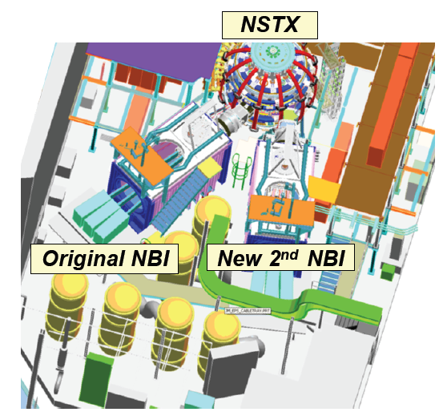
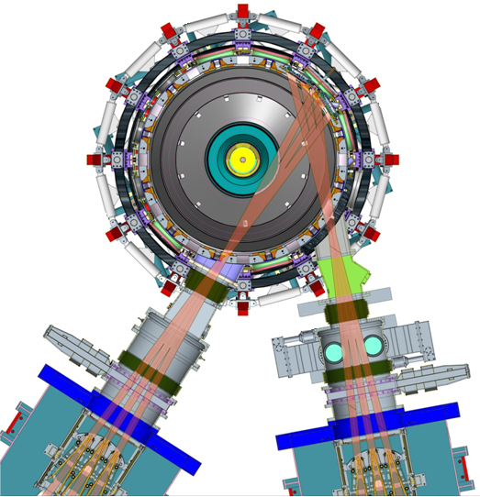
Mega-ampere-class STs rely heavily on co-injected neutral beams for heating, current drive
NSTX-U
Original NBI
(R_{TAN} = 50, 60, 70cm)
5MW, 5s, 80keV
New 2nd NBI
(R_{TAN}=110, 120, 130cm)
5MW, 5s, 80keV

Slide 7
New physics accessed in ST → enhanced understanding of toroidal confinement physics
Lower A → higher β, strong shaping
Higher β →
  Electromagnetic effects in turbulence
  More potential drive for fast-ion-driven instabilities
    Simulate fast-ion transport of ITER / burning plasmas
  Over-dense plasmas: RF heating, current drive
Low-A / high-β broadly impact transport, stability:
  Higher fraction of trapped particles (low A)
  Increased normalized orbit size (high β)
  Increase flow shear (due to low B, low A)
  Compact geometry (small R) → higher power and particle fluxes relevant to ITER, reactors

Slide 8
Outline
ST overview
Global MHD Stability
Energy Confinement
Energetic Particles
ST Upgrade Status
Summary

Slide 9
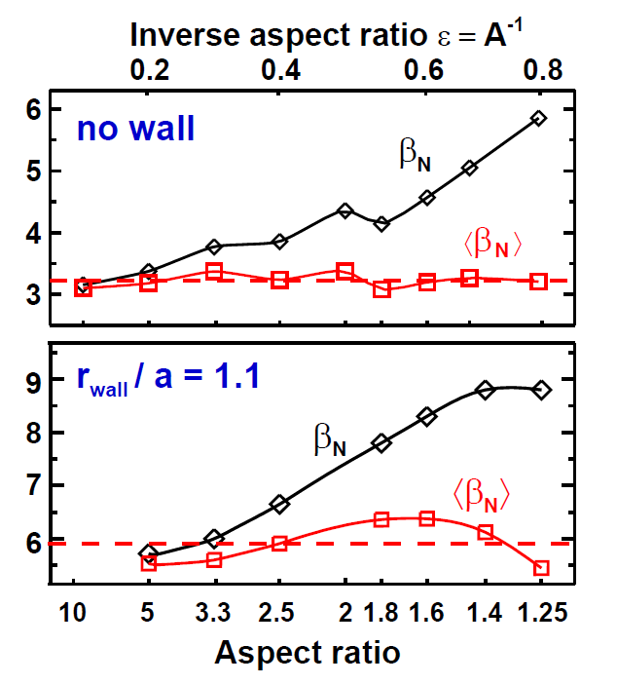
Simulations find ⟨β_{N}⟩ is more aspect ratio invariant than β_{N} – both with & without wall stabilization
Para / diamagnetic effects and B_{P} / B ratio important at low-A
f_{Bootstrap} ~ 50%
β_{T} ≡ 2μ₀⟨p⟩ / B_{T0}²
⟨β⟩ ≡ 2μ₀⟨p⟩ / ⟨B²⟩
I_{N} ≡ I_{P} / aB_{T0} [MA/mT]
β_{N} ≡ β_{T} (%) / I_{N}
⟨β_{N}⟩ ≡ ⟨β⟩ (%) / I_{N}
f_{BS} ~ 100%
J. Menard, PoP 2004, PPPL-3779

Slide 10
Record β_{N} and β_{N} / l_{i} accessed in NSTX using passive + active resistive wall mode stabilization
High β_{N} regime is important for bootstrap current generation.
High β_{N} / l_{i} regime important since high f_{BS} regime has low l_{i}.
ST-FNSF
Unstable RWM
Stable / controlled RWM
S. Sabbagh, PRL 2006
J. Berkery, PRL 2011
W. Zhu, PRL 2006
Major NSTX-U mission is to achieve fully non-inductive operation at high β

Slide 11
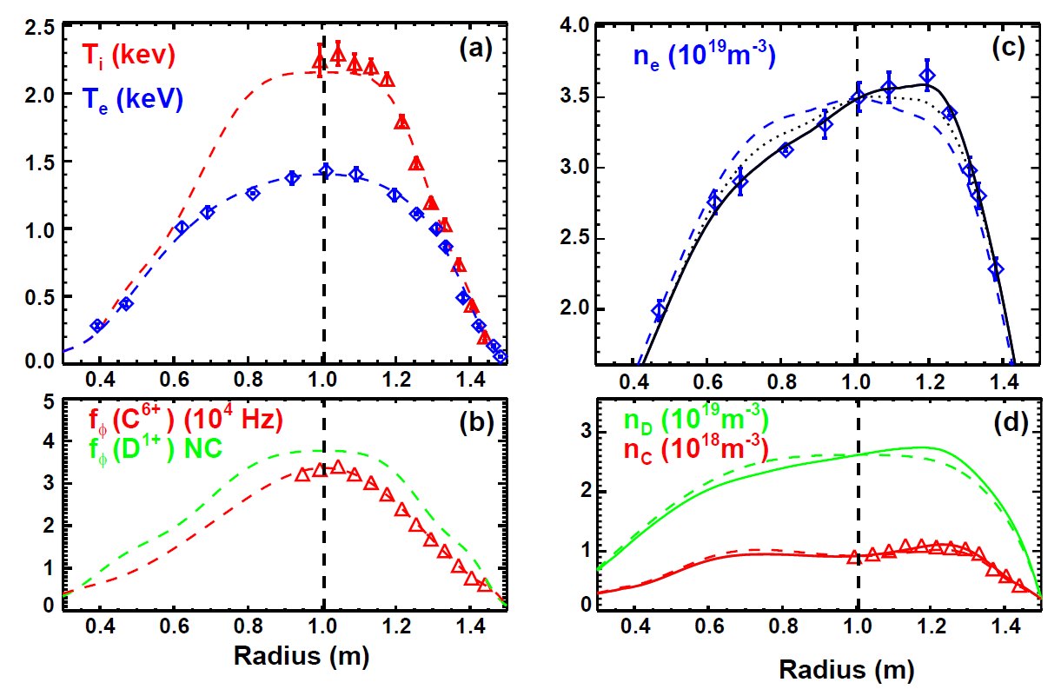
Rotation / centrifugal effects important and measureable in equilibrium
J. Menard, NF 2005

Slide 12
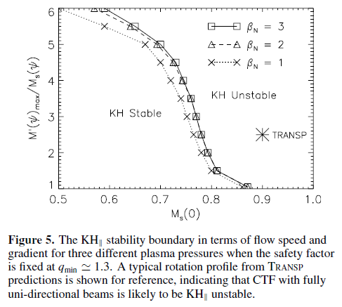
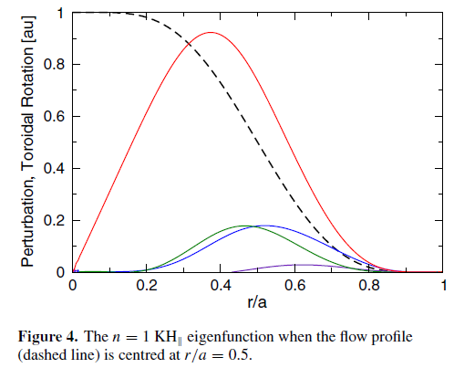
Kelvin-Helmholtz (KH) instabilities predicted when central sound-speed Mach number M_{s} ≈ 0.7-0.8
Rotation profile
n=1 K-H
Eigenfunction
I. Chapman, NF 2012

Slide 13
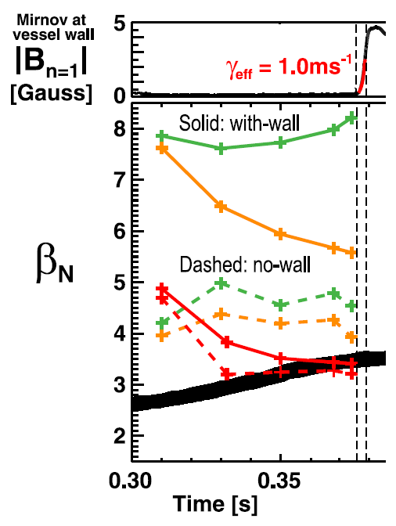
Hybrid MHD-drift-kinetic stability calculations find rotation + fast-ions can weaken wall-stabilization of ∇p-driven kink
MARS-K code needed / used to explain NSTX instability onset at highest rotation, β_{fast} fractions
Low-rotation fluid with-wall limit is very high → marginal β_{N} ~ 7-8
Increasing rotation lowers max β_{N} to ~5.5 at mode onset time
Full kinetic treatment including fast-ions → marginal β_{N} ~3.5 → most consistent with experiment
Experimental β_{N}
J. Menard, PRL 2014

Slide 14
Outline
ST overview
Global MHD Stability
Energy Confinement
Energetic Particles
ST Upgrade Status
Summary

Slide 15
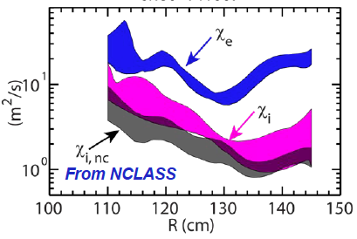
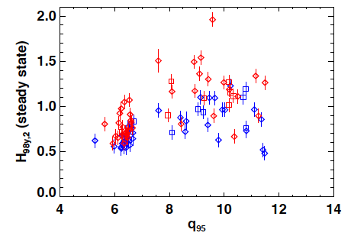
High confinement multiplier H needed for compact ST
Fusion gain Q depends strongly on “H”, Q ∝ H ⁵⁻⁷
H = 1.2 – 1.3 enables compact FNSF, design flexibility/margin
• Ion energy transport in H-mode ST plasmas near neoclassical level due to high shear flow and favorable curvature
• Electron energy transport anomalous (as for all tokamaks)
Enhanced pedestal H-mode (EPH) has H up to 1.5-2 → attractive for ST-FNSF
NSTX
NSTX
EPH
ST-FNSF
H-mode
Y. Ren (PPPL)
R. Maingi, PRL 2010
S. Gerhardt NF 2014

Slide 16
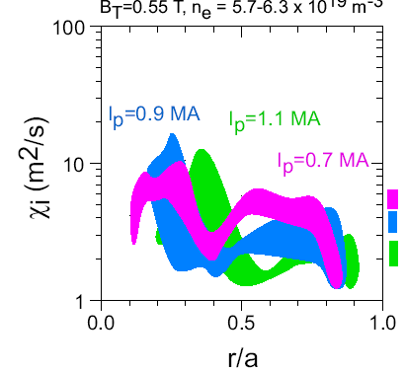
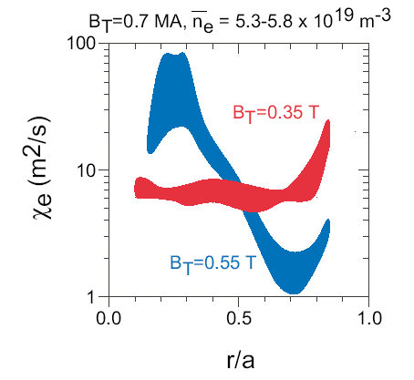
Electron and ion τ_{E} scale differently in ST, and different than at higher aspect ratio
Ions: τ_{E} ∼ I_{p}
Ion τ_{E} ∼ I_{P}, consistent with neoclassical ion transport
  Implies ion turb. suppressed by high E×B shear → possibility of isolating causes of e-transport
Electron τ_{E} ∼ B_{T}
  Could imply Electron Temperature Gradient (ETG) modes, and/or electromagnetic turbulence
Neoclassical
(r/a=0.5-0.8)
Electrons: τ_{E} ∼ B_{T}
3.5 kG
5.5 kG
S.M. Kaye, PRL 2007

Slide 17
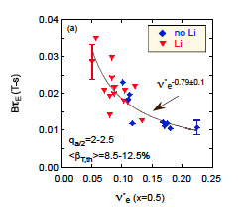
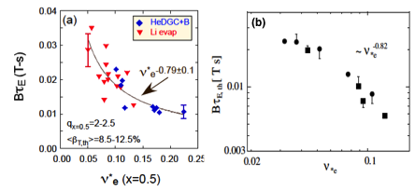

Favorable confinement trend with collisionality, β found
Important implications for future ST FNSF, Demo with lower ν*
τ_{E, th} ∝ ν_{*e}^{-0.1} β^{-0.9} tokamak empirical scaling (ITER 98_{y,2})
τ_{E, th} ∝ ν_{*e}^{-0.8} β^{-0.0} ST scaling
NSTX
Fig. 70. (a) Normalized confinement time as a function of collisionality at mid-radius in NSTX. Blue points are from discharges that used HeGDC+B wall conditioning, while red points are from discharges that used Li. Reprinted with permission from S.M. Kaye et al., Nucl. Fusion 53 063005 (2013). Copyright (2013). Institute of Physics.
(b) Collisionality scan of thermal energy confinement time in MAST. Reprinted with permission from M. Valovic et al., Nucl. Fusion 51 073045 (2011). Copyright (2011) Institute of Physics.
NSTX
MAST
~ ν_{*e} ^{-0.82}
B τ_{E,th} [ T s]
ν_{*e}
S.M. Kaye, NF 2007, 2013
M. Valovic, NF (2011)
Very promising ST scaling to reactor condition, if continues on NSTX-U/MAST-U

Slide 18
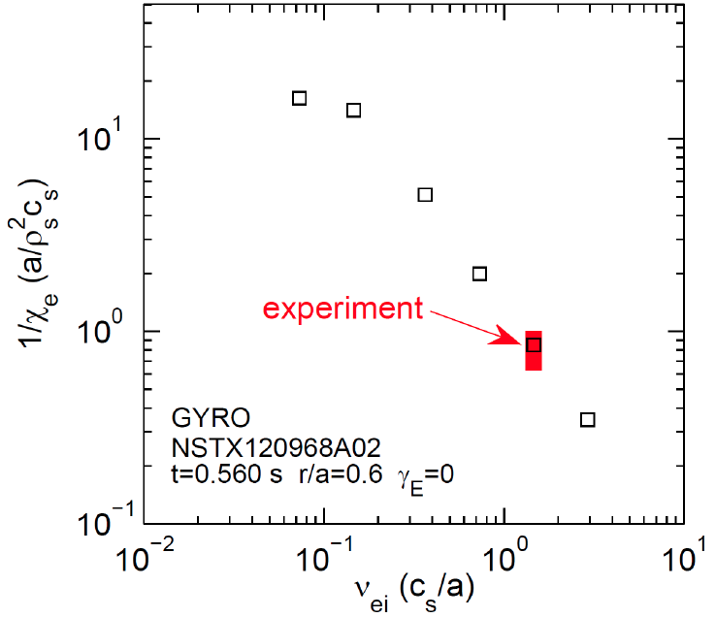


Micro-tearing-driven (MT) transport
may explain ST τ_{E} collisionality scaling
MT-driven χ_{e} vs. ν_{ei} using the GYRO code
MT growth rate decreases with reduced collisionality in qualitative agreement with the NSTX experiment.
Further electron confinement improvement expected due to reduced collisionality.
NSTX-U
NSTX
W. Guttenfelder, PoP 2013, PoP 2012, PRL 2011

Slide 19
Outline
ST overview
Global MHD Stability
Energy Confinement
Energetic Particles
ST Upgrade Status
Summary

Slide 20
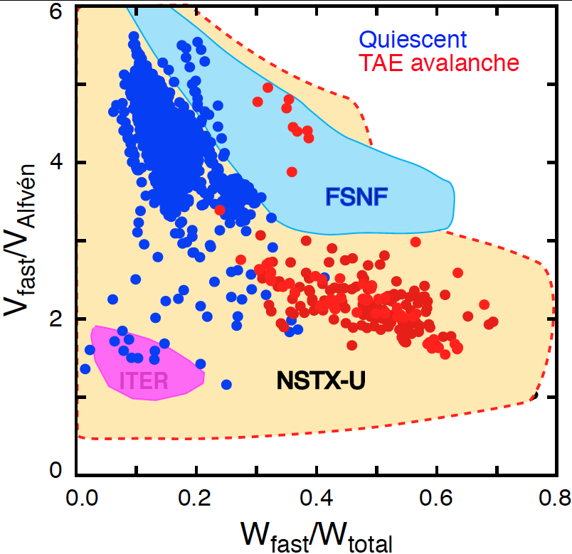
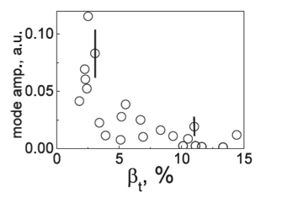
NBI-heated STs excellent testbed for α-particle physics
Alfvenic modes readily accessible due to high V_{fast} > V_{Alfvén}
α-particles couple to Alfvénic modes strongly when V_{α} > V_{A} ~ β^{−0.5} C_{s}
V_{α} > V_{A} in ITER and reactors: condition easily satisfied in ST due to high β
Fast-particle-driven Alfvén Eigenmodes: Toroidal, Global, Compressional
NSTX-U will also explore V_{fast} < V_{A} regime giving more flexibility
EP parameter space
TAEs significantly modified at high β as V_{A} → C_{s}
NSTX data:
Stabilization of TAEs at high β in MAST
  E. Fredrickson, NF 2013
  M.P. Gryaznevich, PPCF 2004

Slide 21
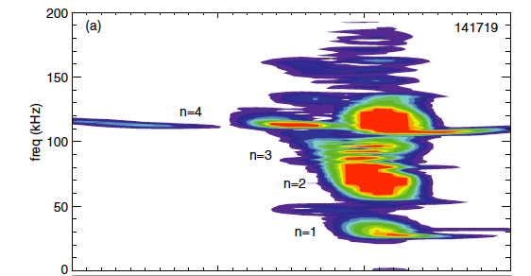
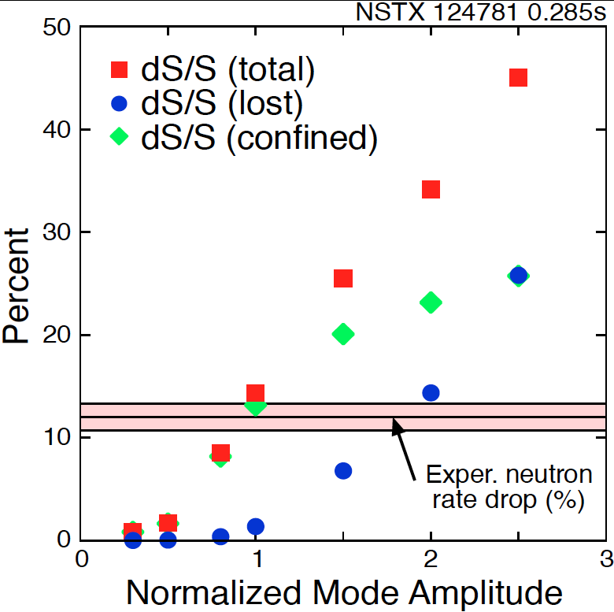
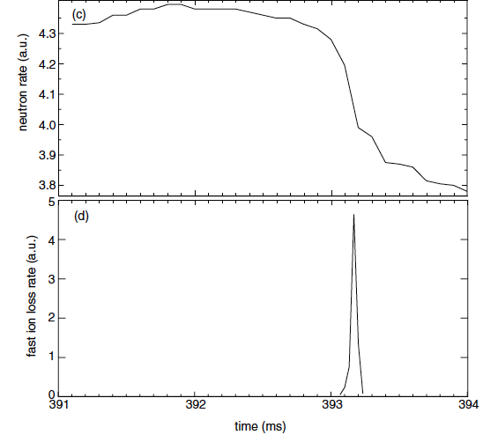
“TAE avalanche” shown to cause energetic particle loss
Uncontrolled α-particle loss could cause reactor first wall damage
Multi-mode TAE avalanche can cause significant EP losses as in “sea”of TAEs expected in ITER
Progress in simulation of neutron rate drop
due to TAE avalanche
(a)
Frequency (kHz)
Neutron rate (a.u.)
Fast ion loss rate (a.u.)
Time (ms)
Time (ms)
D.S. Darrow, NF (2013)
  E. Fredrickson, NF 2013

Slide 22
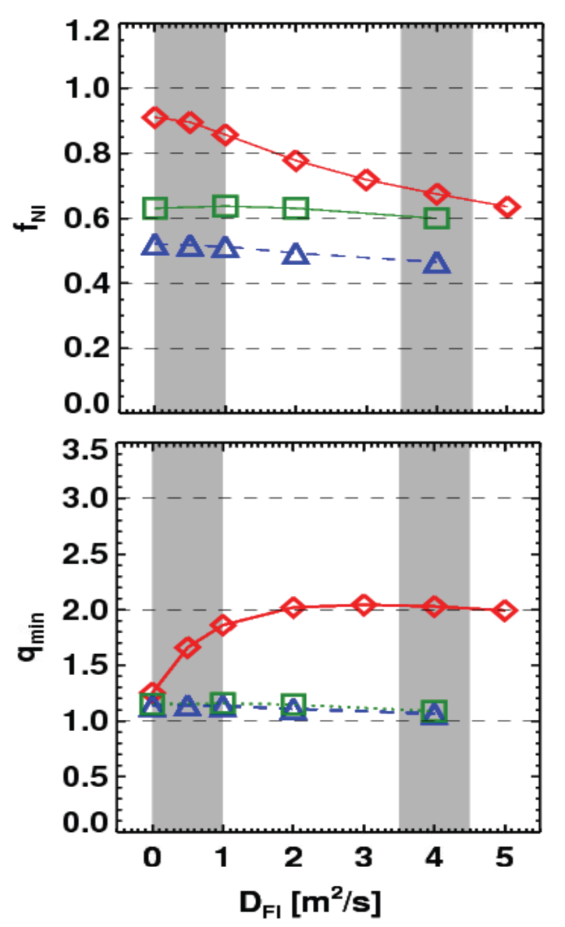
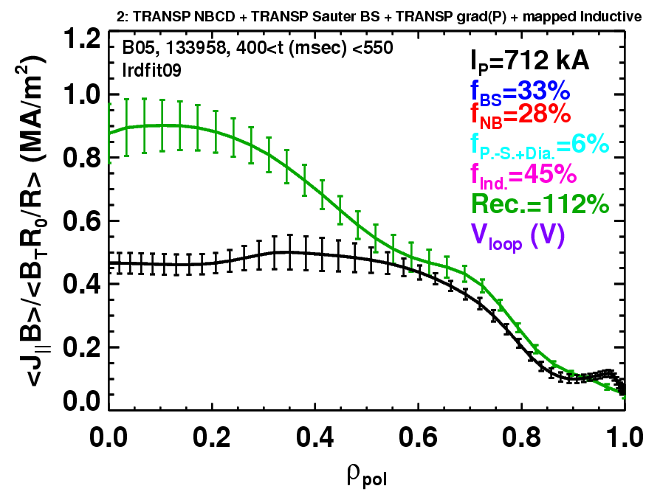
Rapid TAE avalanches could impact NBI current-drive in advanced scenarios for NSTX-U, FNSF, ITER AT
NSTX-U TRANSP simulations
NSTX: rapid avalanches can lead to
redistribution/loss of NBI current drive
Discrepancy between reconstruction and total assuming
classical J_{NBCD}
1 MA, 1T, H₉₈=1, near non-inductive
1.6 MA, 1T, partial inductive
1.2 MA, 0.55T, high β_{T}
All: f_{GW}=0.7, H₉₈=1
Minor radius
700kA high-β_{P} plasma with rapid
TAE avalanches has time-average D_{FI} = 2-4m²/s
S. Gerhardt NF 2011, NF 2012

Slide 23
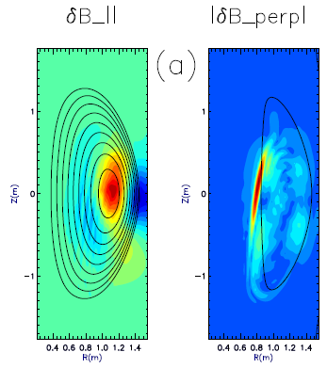
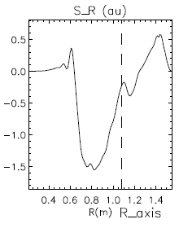
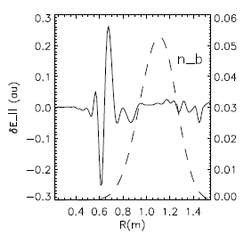
CAE mode-conversion to kinetic Alfvén waves (KAW) predicted to transfer core NBI power to mid-ρ electrons
GAE/CAEs cause large χ_{e} through stochastic orbits (N. Gorelenkov, NF 2010)
CAEs also couple to KAW - Poynting flux redistributes fast ion energy near mid-radius, E|| resistively dissipates energy to thermal electrons
  P_{CAE→KAW} ~ 0.4 MW from QL estimate + experimental mode amplitudes
  P_{e,NBI} ~ 1.7 MW for ρ <0.3, NBI power deposited on core electrons
Radial Poynting flux
⟨E×B⟩_{R}
CAE
(n=8)
KAW
Up to 25% of electron heating power transferred to KAW off-axis
~ρ_{beam}
HYM code
E. Belova, PRL 2015
ω_{A}(R,Z)=ω_{CAE}

Slide 24
Outline
ST overview
Global MHD Stability
Energy Confinement
Energetic Particles
ST Upgrade Status
Summary

Slide 25
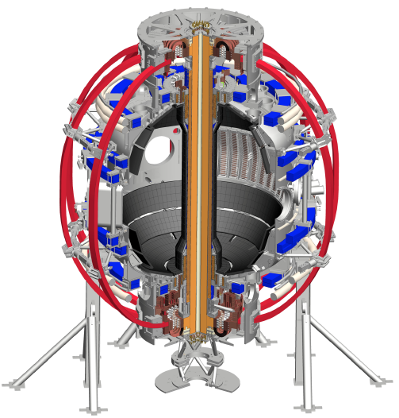
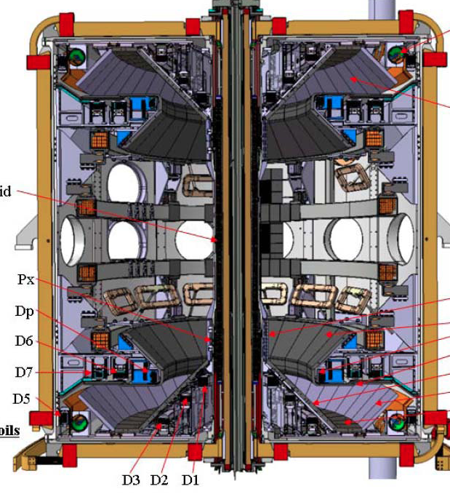
NSTX and MAST are undergoing major upgrades
~2x higher B_{T}, I_{p}, P_{NBI} and ~5x pulse length vs. NSTX/MAST
NSTX-U
MAST-U
Highly tangential 2nd NBI for non-inductive sustainment, profile control
Super-X divertor configuration for FNSF/DEMO divertor solution
First test plasma few weeks ago
First test plasma 2017

Slide 26
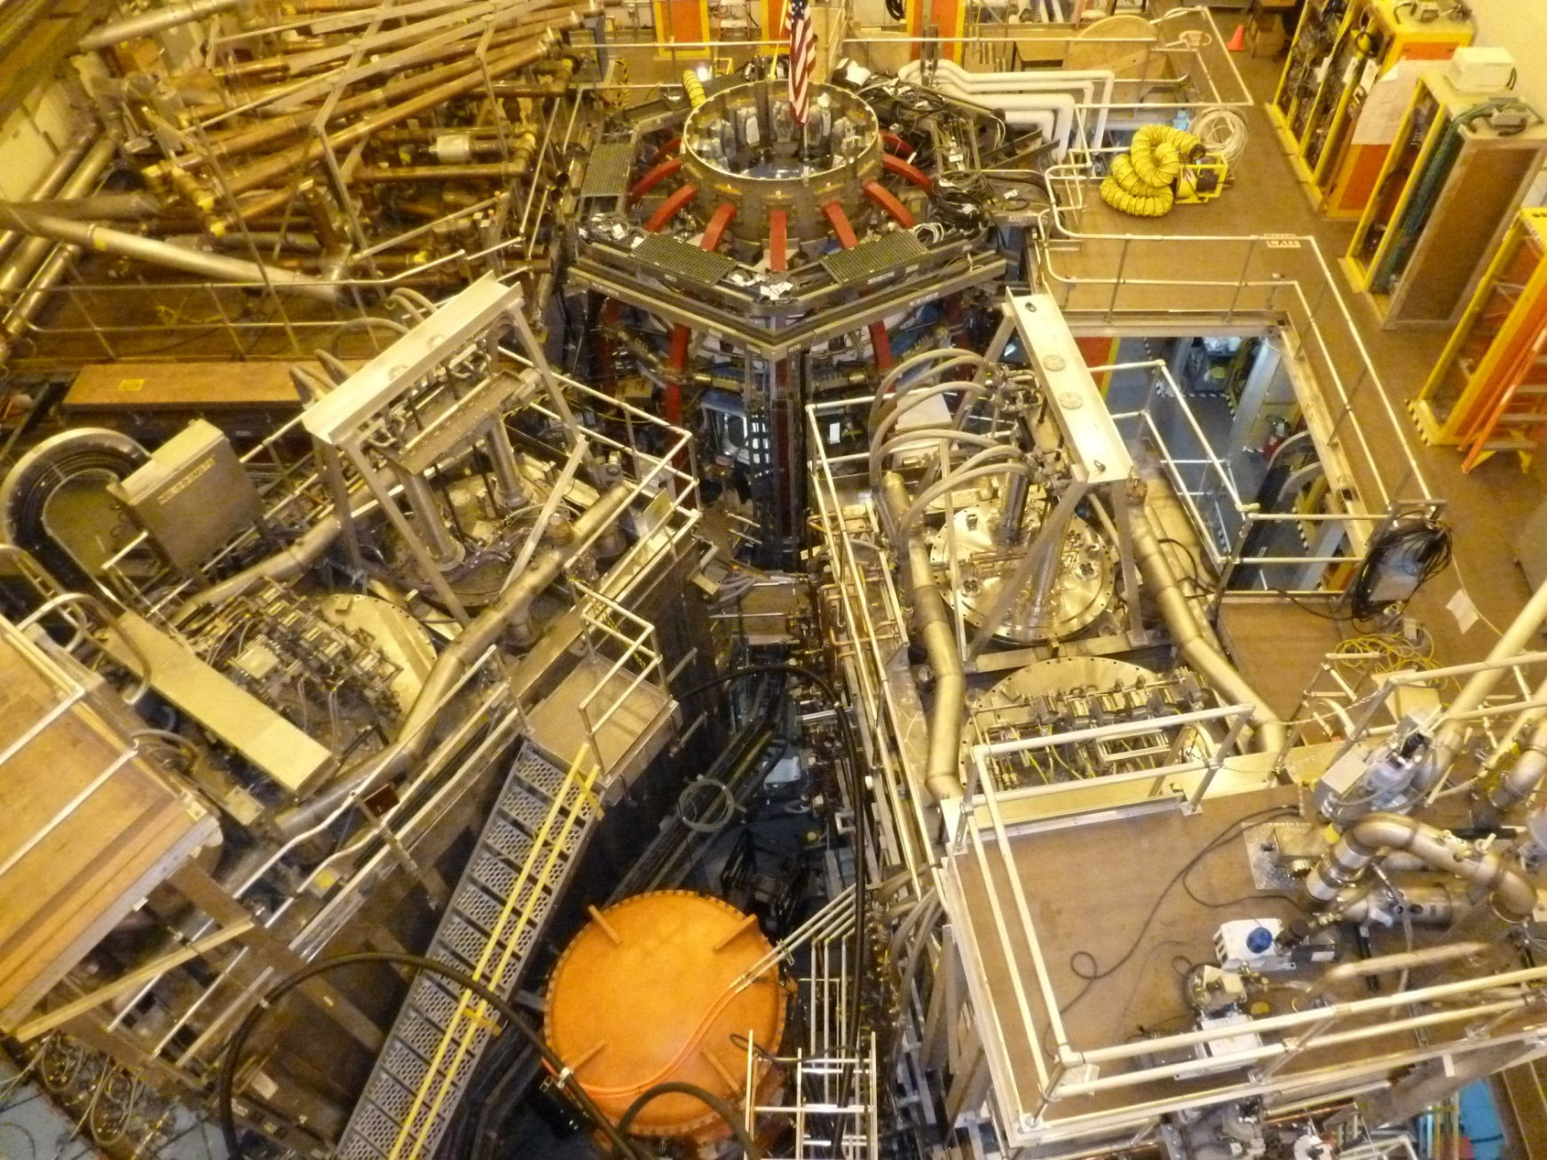
NSTX Upgrade project recently completed
On cost and schedule, first test plasma ~100kA (Aug. 10, 2015)
1st NBI
New 2nd NBI

Slide 27
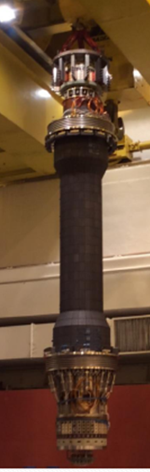
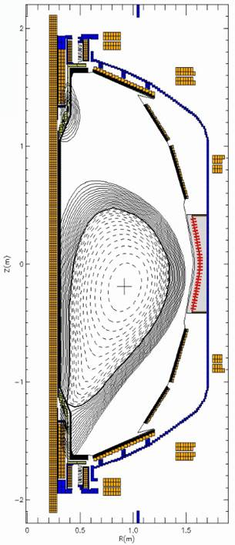
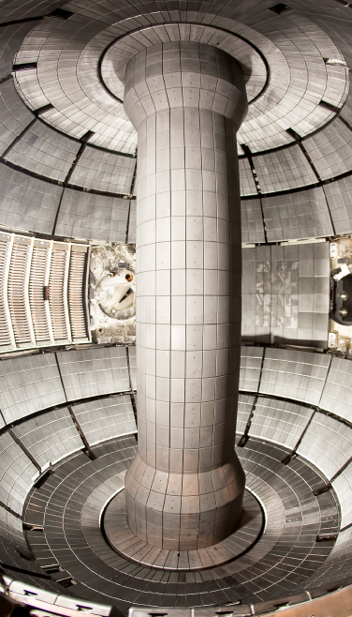
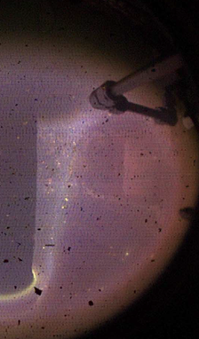
New centerstack (CS) highlights: Jan – Aug 2015
Magnetics functional → EFIT reconstructions
CS crane lift
CS installed
First test plasma
(Ohmic heating only)

Slide 28
Summary
Upgraded STs will provide many opportunities to study toroidal confinement physics in new regimes:
  Low aspect ratio, strong shaping, high β, low collisionality
  Access to strong fast-ion instability drive, high rotation
  Advanced divertors, lithium walls, high-Z PFCs
There are potentially interesting linkages between ST and CT / FRC physics that could be explored further:
  Role of rapid rotation, strong beams, kinetic effects, …
Thank you!
Notes:
Here is the outline of this review to give you an overview of the world ST research.

