Slide 1


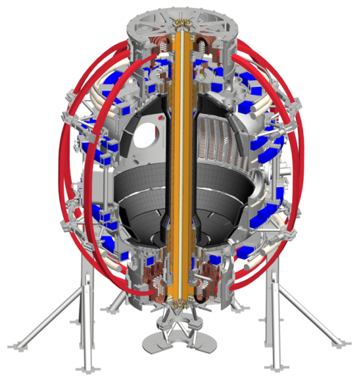

NSTX-U
Supported by
The National Spherical Torus Experiment Upgrade (NSTX-U)
Coll of Wm & Mary
Columbia U
CompX
General Atomics
FIU
INL
Johns Hopkins U
LANL
LLNL
Lodestar
MIT
Lehigh U
Nova Photonics
Old Dominion
ORNL
PPPL
Princeton U
Purdue U
SNL
Think Tank, Inc.
UC Davis
UC Irvine
UCLA
UCSD
U Colorado
U Illinois
U Maryland
U Rochester
U Tennessee
U Tulsa
U Washington
U Wisconsin
X Science LLC
xxx, PPPL
For the NSTX-U Team
Culham Sci Ctr
York U
Chubu U
Fukui U
Hiroshima U
Hyogo U
Kyoto U
Kyushu U
Kyushu Tokai U
NIFS
Niigata U
U Tokyo
JAEA
Inst for Nucl Res, Kiev
Ioffe Inst
TRINITI
Chonbuk Natl U
NFRI
KAIST
POSTECH
Seoul Natl U
ASIPP
CIEMAT
FOM Inst DIFFER
ENEA, Frascati
CEA, Cadarache
IPP, Jülich
IPP, Garching
ASCR, Czech Rep
xxx
March 14, 2015
*This work supported by the US DOE Contract No. DE-AC02-09CH11466

Slide 2
Remember to change the title in the slide master

Slide 3
Outline
Overview of fusion and plasmas
Fusion plasma confinement in a tokamak
Motivation for studying spherical tokamaks
NSTX Upgrade scientific goals and questions

Slide 4
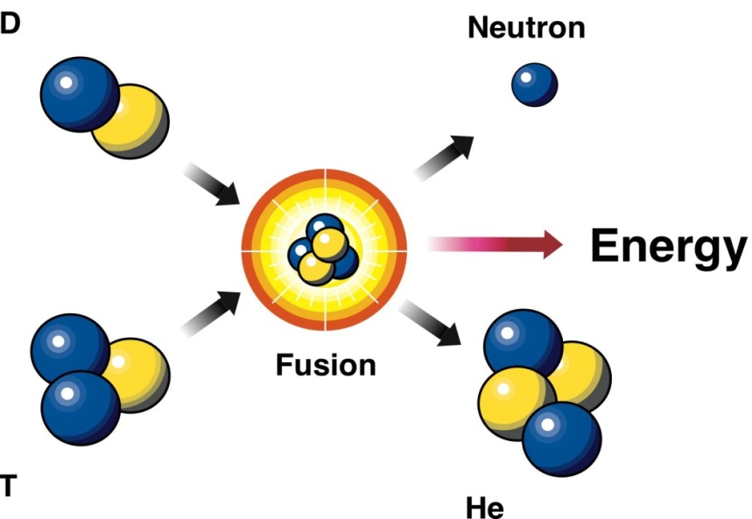
Advantages of fusion: safe, sustainable, high energy density, environmentally attractive
“D-T” fusion reaction:
Cannot have runaway reaction
  Only small amount of fuel present
  If particles cool, fusion stops
Abundant fuel supply
  D from seawater: HDO, D/H = 1/6400
  T bred from lithium in earth’s crust
High energy density
  1 liter water = 500 liters gasoline
Waste short-lived, low-level
No CO₂ production
D: deuterium
n: neutron
T: tritium
α: helium
High energy gain
≈ 1000 ×

Slide 5
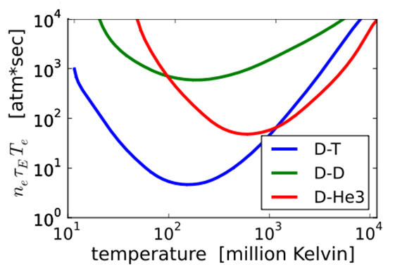
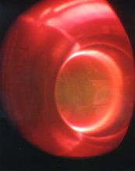
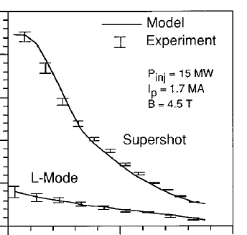
Fusion requires very high temperatures, but these have already been achieved
TFTR at PPPL (1990’s)
~250 million C
core
boundary
Fusion is easiest here at 200 million ^{ᵒ}C (!!) (350 million ^{ᵒ}F)
  Minimum fusion “triple-product” (pressure nT and energy confinement time τ_{E}) value: 8 atmosphere-seconds

Slide 6
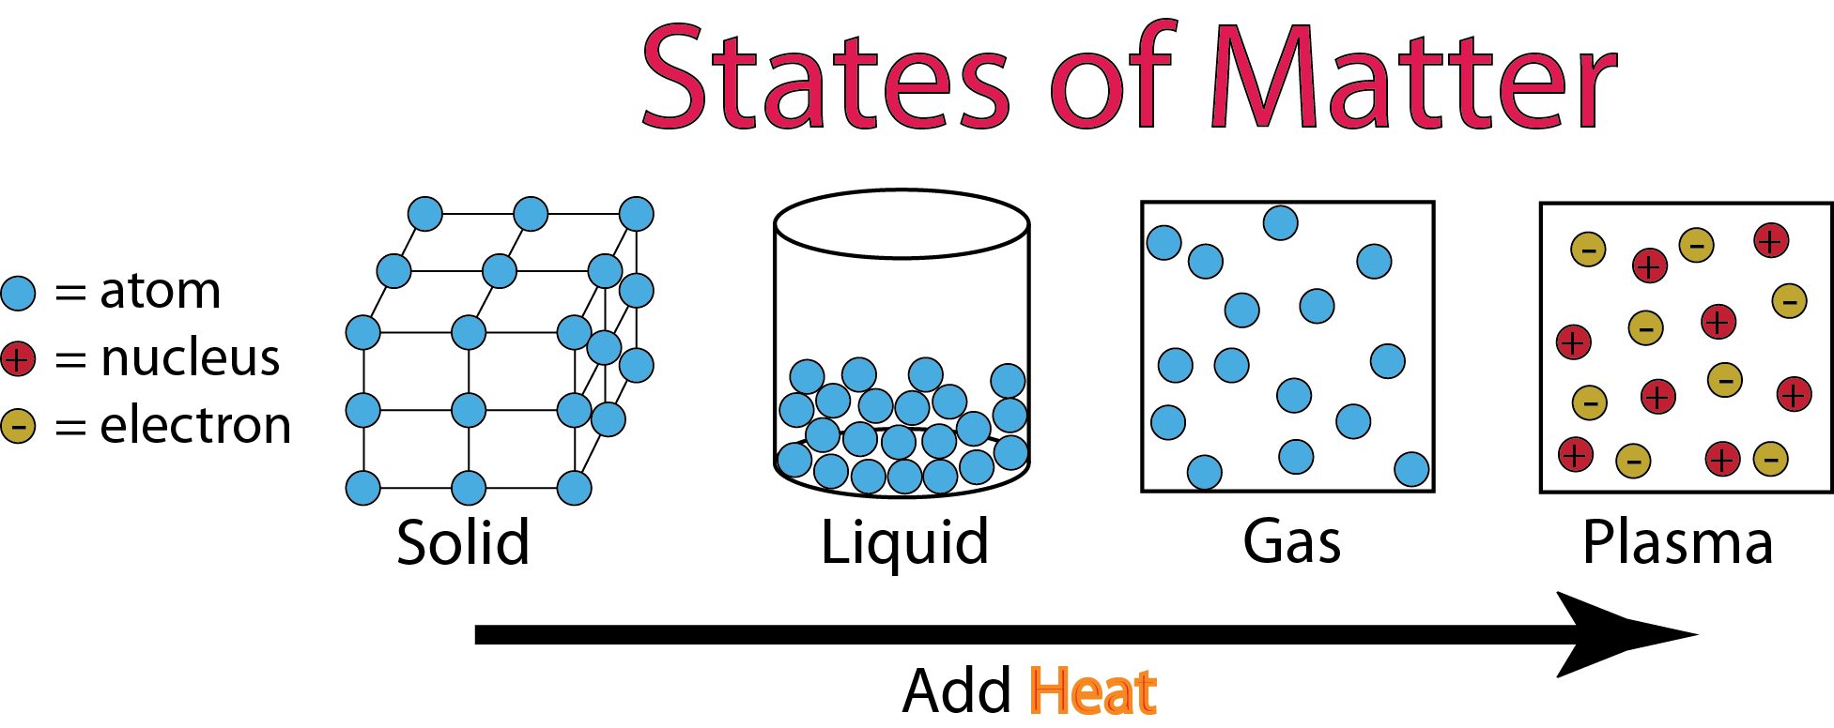
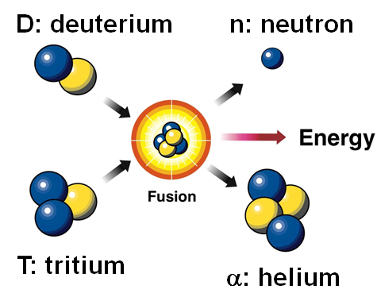
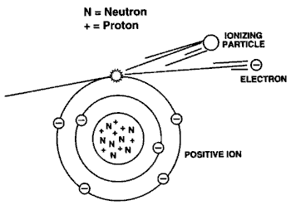
At fusion temperatures gas becomes plasma, a “soup” of electrons and positive ions
DT fusion:
200,000,000 ^{ᵒ}C
Water:
0 ^{ᵒ}C
100 ^{ᵒ}C
160,000 ^{ᵒ}C
At fusion temperatures, particles are so energetic that electrons are stripped from neutral atoms leaving positively charged (+) ions

Slide 7
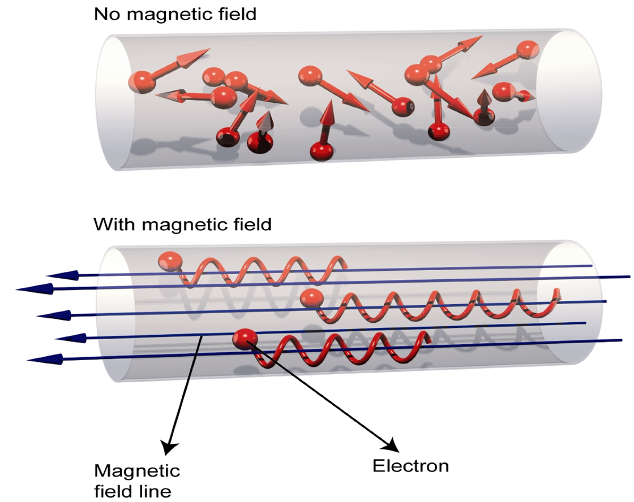
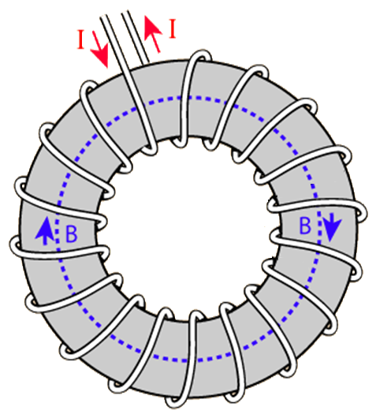
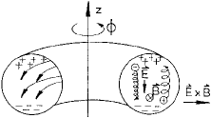
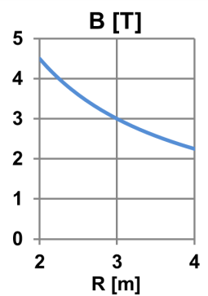
Charged particles confined by magnetic fields, but a simple toroidal field gives poor confinement
R
Charged particles spiral around field lines, move freely along field
Bending field into torus creates non-uniform B~1/R
Electrons and ions drift apart vertically → charge separation
Electric field created → particles expelled outward

Slide 8
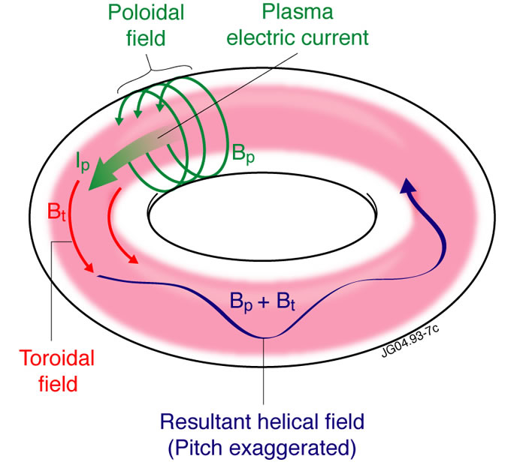
Tokamak: Poloidal field from plasma current + toroidal field from magnets create helical field
Helical field = B-field covers toroidal surfaces
Allows currents to flow along magnetic field
Short-circuits electric fields that would otherwise expel plasma
Particles tied to surface
Improved confinement
“Tokamak”: Russian acronym for “toroidal chamber with magnetic coils”

Slide 9
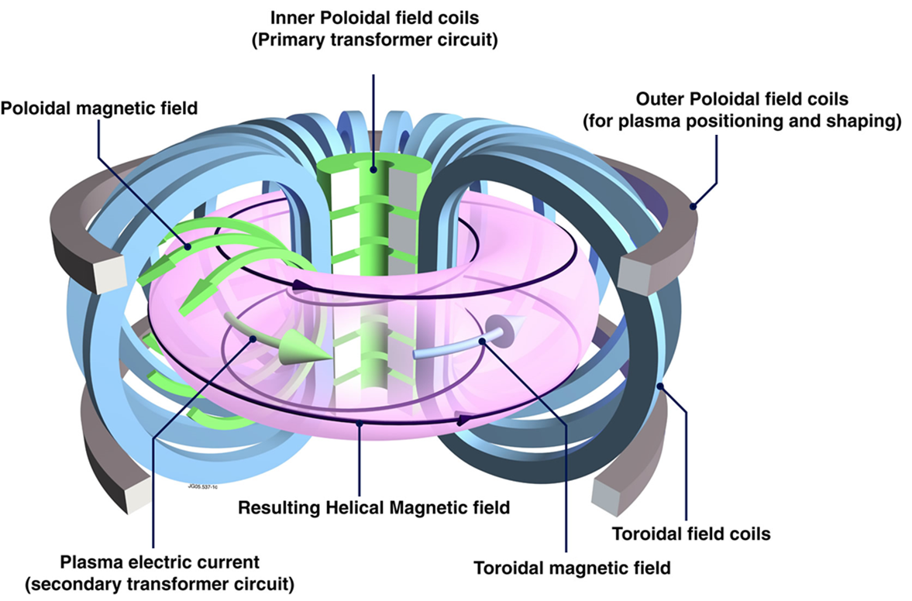
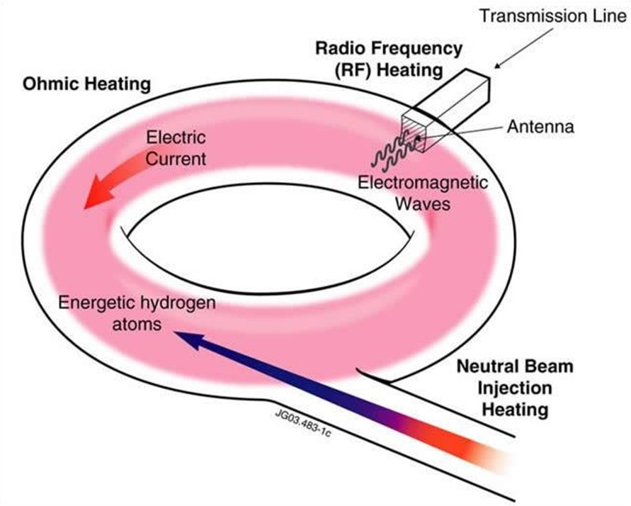
Tokamaks are not presently steady-state, but in the future will operate without transformer
Conventional Tokamak
Primary transformer coils drive toroidal current in plasma
Must stop when transformer coils reach current/force limits
Advanced Tokamak
External: wave and beam current drive
Self-generated: high pressure plasmas make “bootstrap” current
Efficient tokamak power plant will need 70-90% self-generated current
Inner Poloidal Field Coils
(Primary transformer circuit)
Plasma electric current
(Secondary transformer circuit)

Slide 10
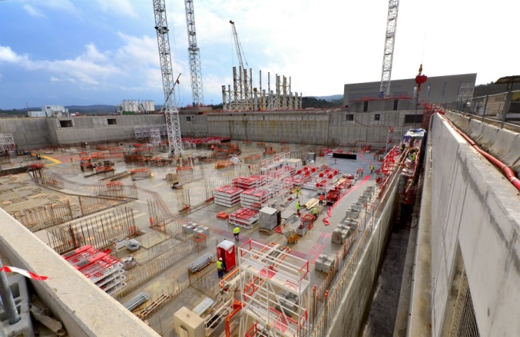
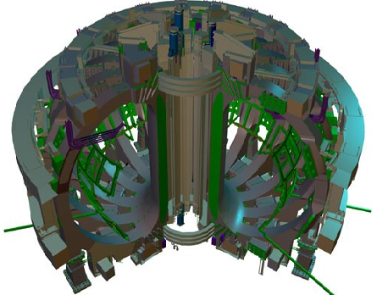
ITER will be first device to access “burning plasma”, is very large and expensive
ITER under construction in Cadarache, France
Burning plasma: majority of plasma heating power comes from fusion alpha particles from DT reactions
  DT reaction energy split: 1/5 in alphas, 4/5 in neutrons
ITER goal Q = P_{fusion} / P_{ext} = 10 → P_{α} / P_{ext}= 2
P_{α} / P_{α + ext} = 2/3
Size of ITER driven largely by energy confinement which scales with plasma current, and therefore with size
Can we make smaller devices with better confinement and smaller or cheaper magnets?
A = 3.1
R = 6.2m
B_{T} = 5.3T
I_{P} = 15MA
6500 tons
80,000 km of Nb3Sn super-conducting strand
Plasma current: 15 MA
Toroidal field current: 165 MA

Slide 11
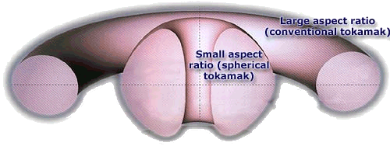
Aspect ratio and elongation are important free parameters
Aspect ratio A = R / a, Elongation κ = b / a
R = major radius, a = minor radius, b = vertical ½ height
b
a
R
a
Spherical torus/tokamak (ST) has A = 1.1-2
Conventional tokamak typically A = 3-4
Higher elongation improves stability, confinement

Slide 12
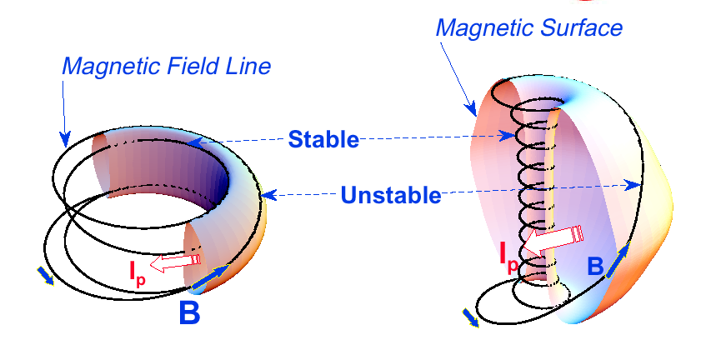
ST can be compact, high beta, and high confinement and favorable average curvature improves stability
Tokamak
ST
• ST has high I_{P} , achieves it cost effectively
$
I_{P} ~ I_{TF} (1 + κ²) / (2 A² q*)
Plasma spends less time in unstable curvature region
• I_{P} increases performance
A ~ 3
κ = 1.5-2
β_{T} = 3-10%
A ~ 1.5
κ = 2-3
β_{T} = 10-40%
Energy confinement time τ_{E} ∝ I_{P}
Toroidal beta β_{T} = ⟨p⟩ / (B_{T0}²/2μ₀)
β_{T} [%] ≡ β_{N} I_{P} / (aB_{T0})
Higher elongation κ and low A
lead to higher I_{P} , β_{T} and τ_{E}
Notes:
A spherical tokamak is a low aspect ratio tokamak. Tokamak is a donut like aspect ratio of about 3 where as ST is aspect ratio of about 1.5. As the aspect ratio is reduced, the hole of the donut is reduced and it disappears entirely at A = 1. As the aspect ratio is reduced, the plasma elongate naturally takes on the spherical shape due to self fields. Another important property is the magnetic field line. The tokamak magnetic field line goes around torus at relatively constant pitch where as the ST geometry, the field line transit the outboard unstable region quickly but spend many toroidal transits in the inboard stable region. This makes ST plasma stable for high beta and also makes the edge safety factor high ~ 10 compared to ~ 3 for tokamak.
As a result, there are a number of new unique physics regimes which can be accessed at low aspect ratio, which can be utilized to enhance the understanding of toroidal confinement physics and improve predictive capabilities for ITER and future fusion facilities.

Slide 13
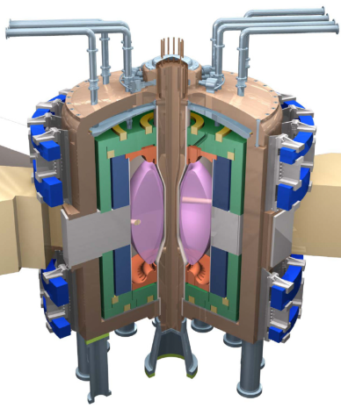
Higher β_{T} enables higher fusion power and compact FNSF for required neutron wall loading
Fusion Nuclear Science Facility (FNSF) could aid technology development
ST-FNSF
Plasma facing components for exhaust, vacuum vessel and shield, tritium fuel cycle…
P_{fusion} ∝ ⟨p⟩ ² V ∝ β_{T}² B_{T0}⁴ V
Database from NSTX,
NSTX-U
β_{N} = 6
40
5
Physics Knob
$
Product
4
High neutron wall loading W_{n} possible in a compact ST
Toroidal β (%)
ST-FNSF
3
20
W_{n} ∝ P_{fusion} / A ∝ β_{T}² B_{T0}⁴ a
(not strongly size dependent)
Tokamak
2
ITER
W_{n} ~ 1 MW/m² with R ~ 1 m FNSF feasible!
0
8
0
4
I_{p}/aB_{T0} (MA/mT)

Slide 14
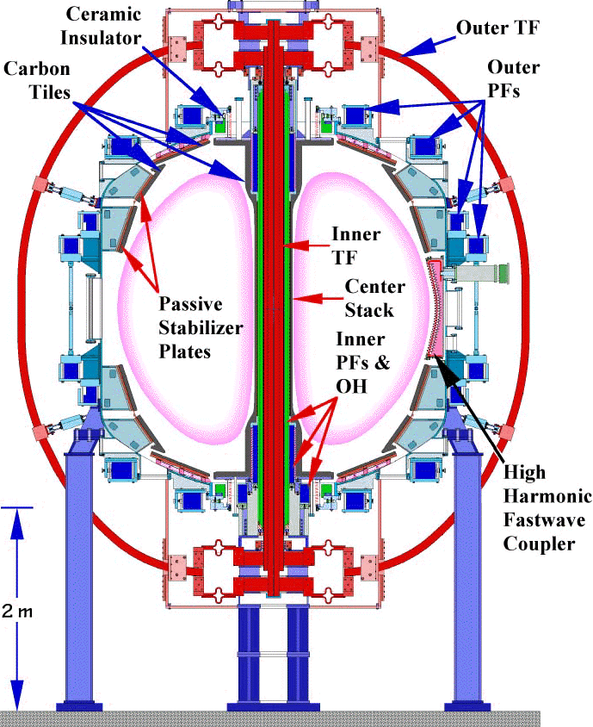
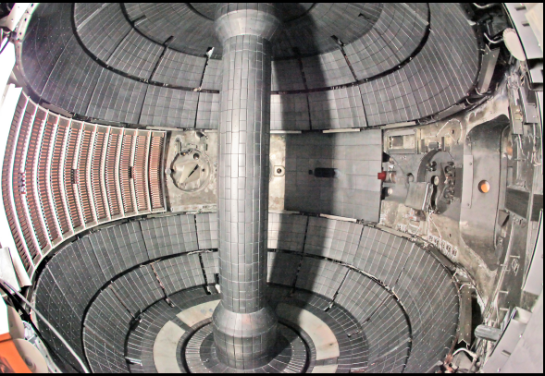
The National Spherical Torus Experiment (NSTX)
Located at the Princeton Plasma Physics Laboratory in Princeton, NJ
Operated from 1999-2010
Major accomplishments:

Slide 15
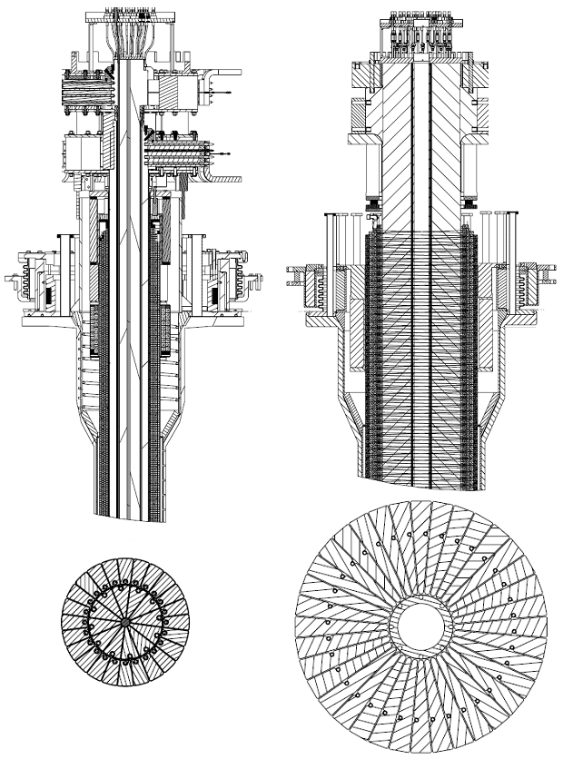
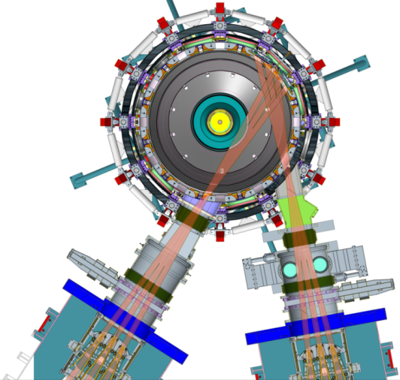
NSTX-U will provide new data to support ST-FNSF design, ITER operations, boundary solutions
Previous
center-stack
New
center-stack
New center-stack doubles toroidal field, plasma current, 5× pulse-length
Tangential injection provides 3-4× higher current drive at low I_{P}:
  2x higher absorption (40→80%) at low I_{P}
  1.5-2x higher current drive efficiency
~ 5-10x increase in nTτ from NSTX
NSTX-U average plasma pressure ~ tokamaks
TF OD = 20cm
TF OD = 40cm
NSTX-U mission elements:
Advance ST as candidate for FNSF
Develop solutions for the plasma-material interface challenge
Explore unique ST parameter regimes to advance predictive capability - for ITER and beyond
Develop ST as fusion energy system
Present NBI
New 2nd NBI

Slide 16
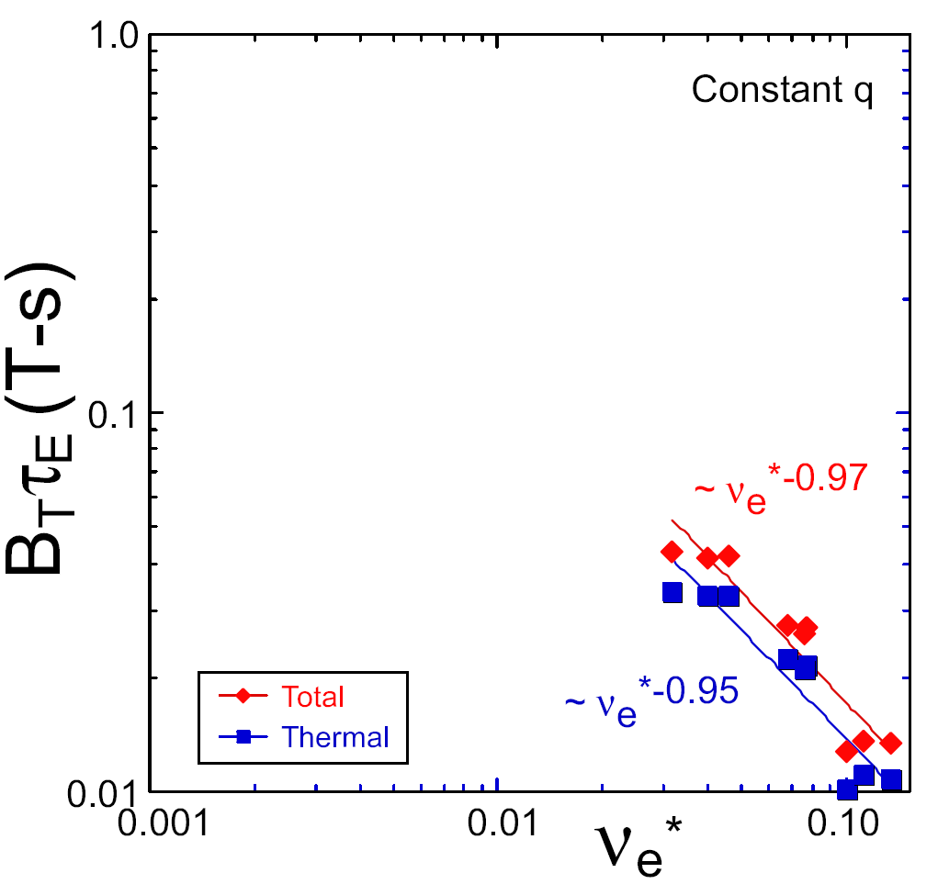
NSTX achieved favorable confinement and current drive results; Will trends continue in NSTX-U?
ST-FNSF
TRANSP Contours of Non-Inductive Fraction
constant q, β, ρ∗
NSTX Upgrade
?
H_{98y2} confinement
parameter
NSTX
ITER-like scaling
I_{P}=1 MA, B_{T}=1.0 T, P_{NBI}=12.6 MW
Normalized electron collisionality ν_{e}* ∝ n_{e} / T_{e}²
NSTX observed confinement increase at higher T_{e}!
Will trend continue, or look like conventional A?
NSTX achieved 70% “transformer-less” current drive Will NSTX-U achieve 100% as predicted?
Favorable confinement results could lead to more compact ST reactors
Steady-state operation required for FNSF

Slide 17
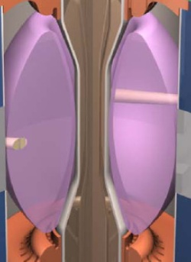

I_{P} Start-up/Ramp-up Critical Issue for ST-FNSF, NSTX achieved 200kA (~20%) “transformer-less” start-up
Compact ST-FNSF has no/small central solenoid
Long-term major goal of NSTX-U: generate and sustain a high-performance plasma without using any transformer
1.0 ms
1.6 ms
2.7 ms
2
1
Z (m)
0
-1
-2
0
1
2
0
1
2
0
1
2
R (m)
R (m)
R (m)
~ 1-2 MA of transformer-free start-up current needed for FNSF → 10-20% of total current
TSC code successfully simulated helicity injection I_{P} ~200kA in NSTX
Will NSTX-U achieve 400kA or more as per simulations?
Notes:
ST has been addressing critical issues for FNSF: A compact FNSF facility does not have solenoid. So, the solenoid-free start-up is a critical issue for ST-FNSF. But solenoid-free start-up is attractive for tokamak reactor design as well. Other issues are ramp-up….

Slide 18
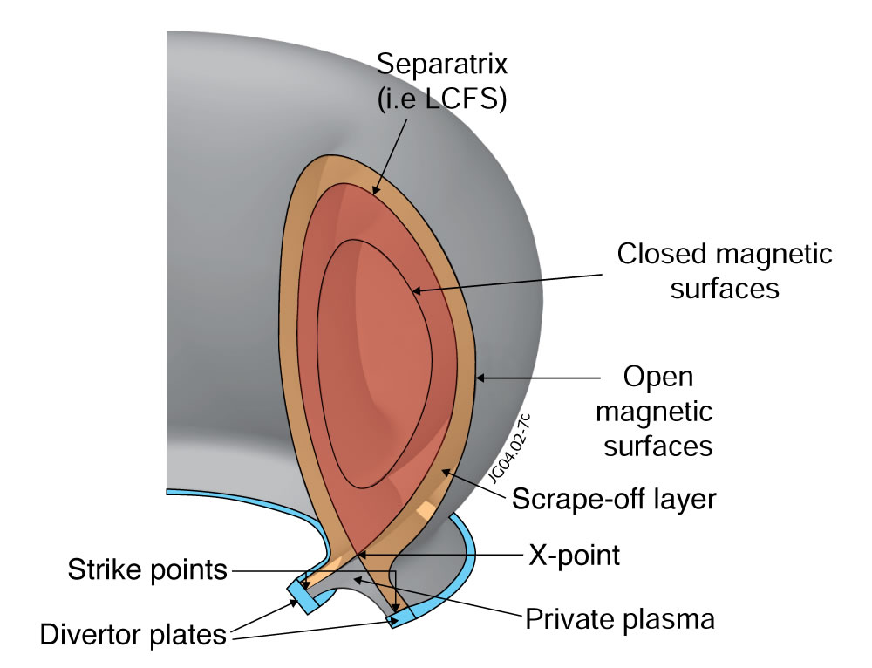
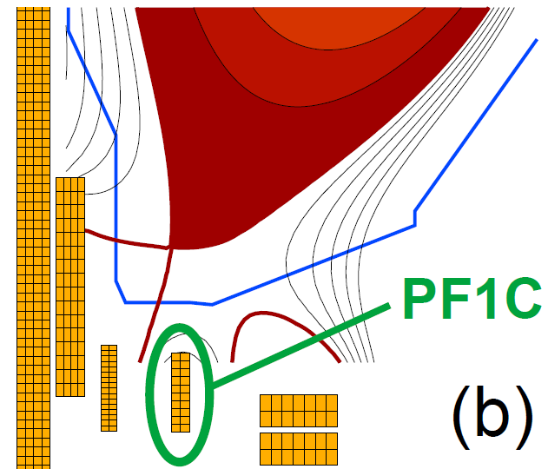
NSTX-U will test ability of advanced divertors to mitigate very high heat-fluxes
Power exhaust width outside main plasma can be very narrow (few mm)
NSTX-U peak heat fluxes will be up to 4-8× higher than in NSTX
Additional null-point in “snowflake” divertor expands field, reduces heat flux
Power / particles contact target plates here
NSTX-U has additional coils improved control of snowflake

Slide 19
Your more specific slides here

Slide 20
Conclusions
NSTX-U is advancing the spherical torus as a candidate for a Fusion Nuclear Science Facility

Slide 21
Opportunities to participate in NSTX-U research

Slide 22
Back-up slides

Slide 23

What is fusion?
“D-T” fusion reaction:
D: deuterium
n: neutron
High energy gain
≈ 1000 ×
E = mc²
T: tritium
α: helium

Slide 24
Advantages of fusion: safe, sustainable, high energy density, environmentally attractive
Cannot have runaway reaction
  Only small amount of fuel present
  If particles cool, fusion stops
Abundant fuel supply
  D from seawater: HDO, D/H = 1/6400
  T bred from lithium in earth’s crust
High energy density
  1 liter water = 500 liters gasoline
Waste short-lived, low-level
No CO₂ production

Slide 25
Fusion requires very high temperatures
Fusion difficulty
(pressure × confinement)
Fusion is easiest here at 200 million ^{ᵒ}C (!!) (350 million ^{ᵒ}F)
  Requires lowest pressure nT and energy confinement time τ_{E}
  Minimum fusion “triple-product” value: 8 atmosphere-seconds

Slide 26
Magnetic fusion has already achieved the necessary very high temperatures!
TFTR at PPPL (1990’s)
~250 million C
core
boundary

Slide 27
Gas becomes plasma at fusion temperatures
DT fusion:
200,000,000 ^{ᵒ}C
Water:
0 ^{ᵒ}C
100 ^{ᵒ}C
160,000 ^{ᵒ}C

Slide 28
Plasma is a gas of charged particles:
“Soup” of negatively charged electrons, positive ions
At fusion temperatures, particles are so energetic that negatively charged (-) electrons are stripped from neutral atom leaving positively charged (+) ions
One benefit of plasma state: charged particle motion can be manipulated by electric and magnetic fields

Slide 29
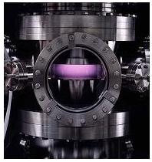
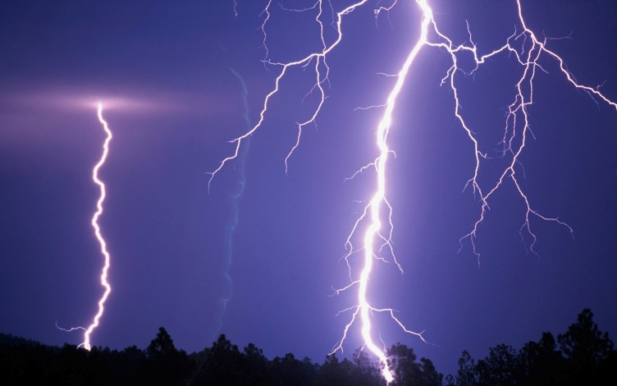
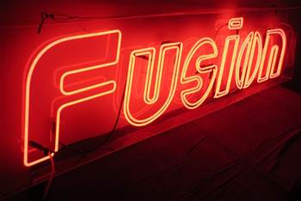
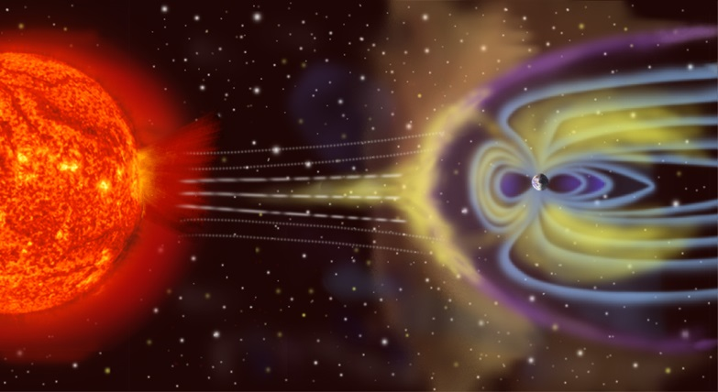
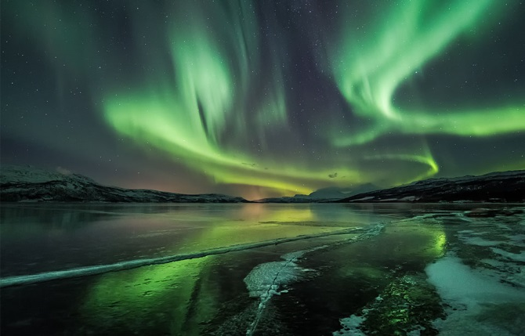
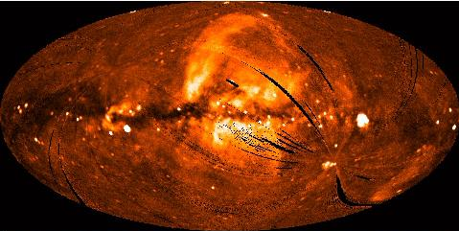
An estimated 99% of matter in the observable universe is in the plasma state
Plasma processing (semiconductors)
Lightening
Neon signs
Interstellar medium
Solar wind
Aurora Borealis
A few examples of plasma

Slide 30
How do we confine plasma?

Slide 31
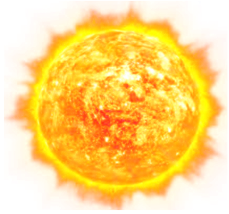
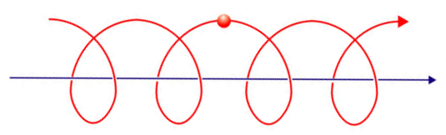
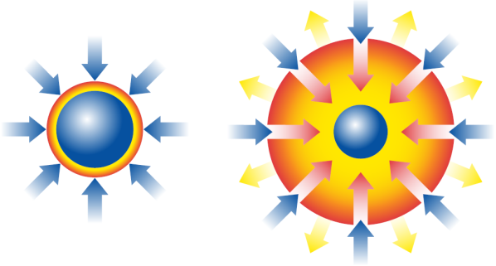
Confinement methods for controlled fusion
Gravitational Confinement
Gravity
Sun
Fusion
Magnetic Confinement
Inertial Confinement
Charged particle
Intense Energy
Beams
Magnetic field
Fuel Pellet

Slide 32
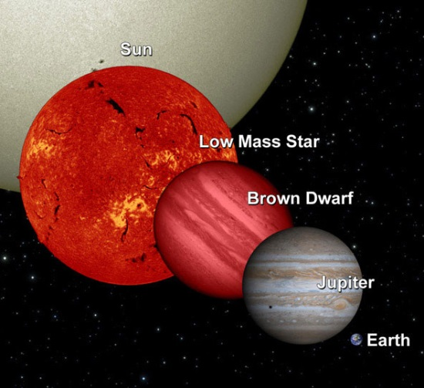
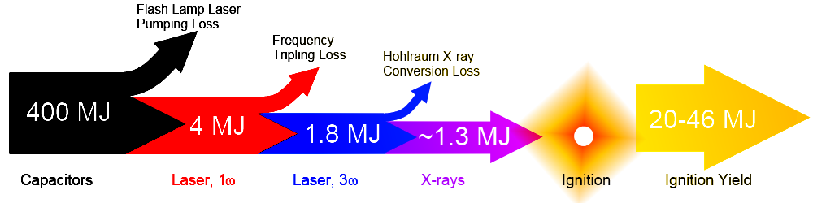
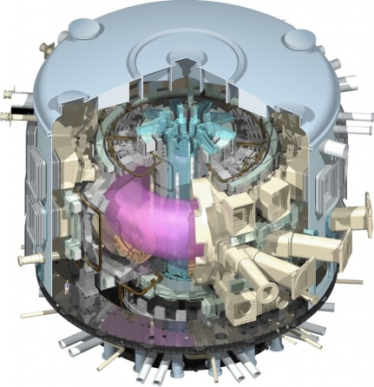
Magnetic fusion is arguably closest to ultimate goal of electricity generation
Gravitational confinement fusion requires large device
  Need 7-8% of mass of our sun
  Approximately 10× diameter of Earth
Laser fusion ala NIF at best has E_{fusion} / E_{electrical} ~ 5%
  So far, 0.004% efficient
Magnetic fusion in ITER:
  Goal: 500MW fusion power for
  ≤ 600MW electrical input for 400s
  Industrial levels of fusion power
Ryan Hamerly (Stanford)
14kJ fusion yield achieved

Slide 33
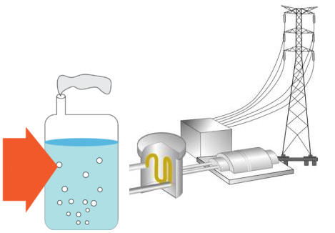

How would magnetic fusion make electricity?
Plasma
(100 million ^{ᵒ}C)
Magnets
(-270 - 100^{ᵒ}C)
Steam or hot helium
External heating
(10’s of MW)
Neutrons
α self heating
Heat
Spin turbines, generate electricity
Blanket
(350 - 1000^{ᵒ}C)
Tritium bred from lithium in blanket
helium and deuterium exhaust

Slide 34
Charged particles confined by magnetic fields
No magnetic field: Charged particles move freely in all directions
Charged particles spiral around magnetic field “arrows”, but move freely along the field
Magnetic fusion goal: make field so particles never touch walls

Slide 35
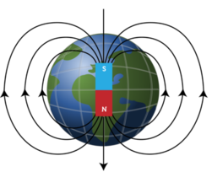
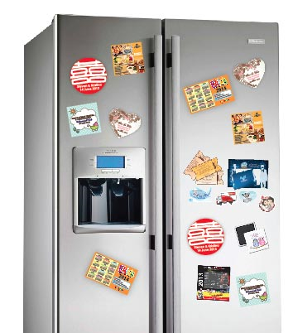
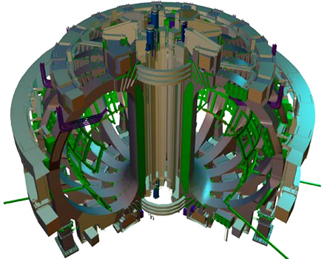
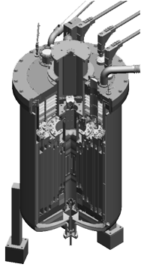
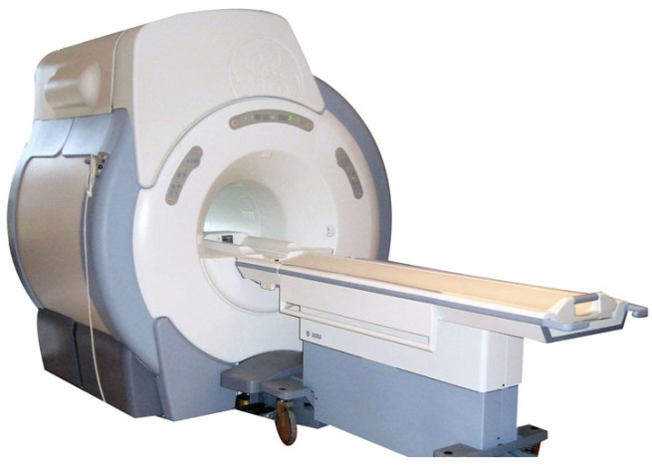
Example magnetic fields in units of Tesla [ T ]
Earth: ~5 × 10⁻⁵ T
Refrigerator magnets
~1-5 × 10⁻³ T
PPPL’s NSTX-U: 1 T
MRI: 0.5-3 T
ITER: 5.3 T
World Record: 100 T
Non-destructive - for few milliseconds
National High Magnetic Field Laboratory

Slide 36
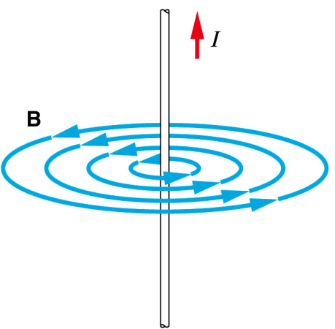
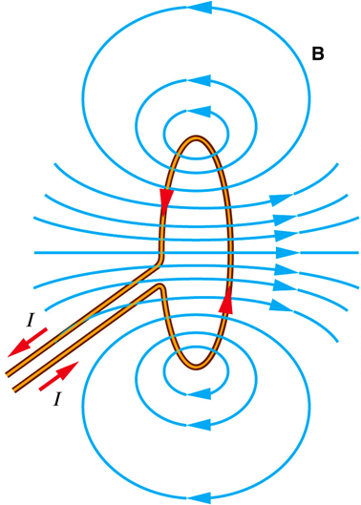
Magnetic fusion uses electromagnets
Electromagnet: use electrical current “I” to create magnetic field “B”
I
B
“B” is perpendicular to “I”
Circular current “coil” makes strong nearly uniform B at center of coil
  Want low/no resistance coil to reduce power: copper and/or superconductors
B
I
I

Slide 37
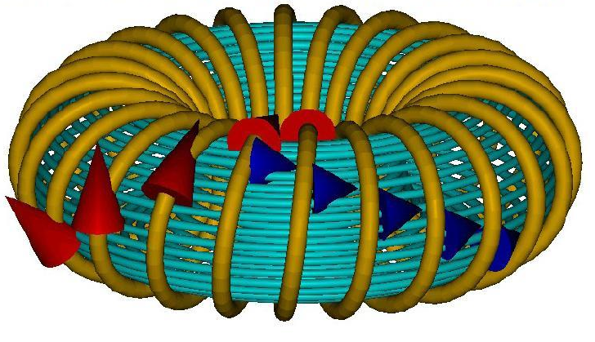
Fusion: Use multiple coils to create “toroidal” field
× 10-20
Position many coils into donut or “torus” shape
Magnetic field never touches wall (!)
Do charged particles ever touch wall?

Slide 38
Simple toroidal field → poor confinement
Bending field into torus creates non-uniform B
  B ~ 1 / R → factor of 2
Electrons and ions drift apart vertically → charge separation
Electric field created → particles expelled outward toward vessel wall
R

Slide 39
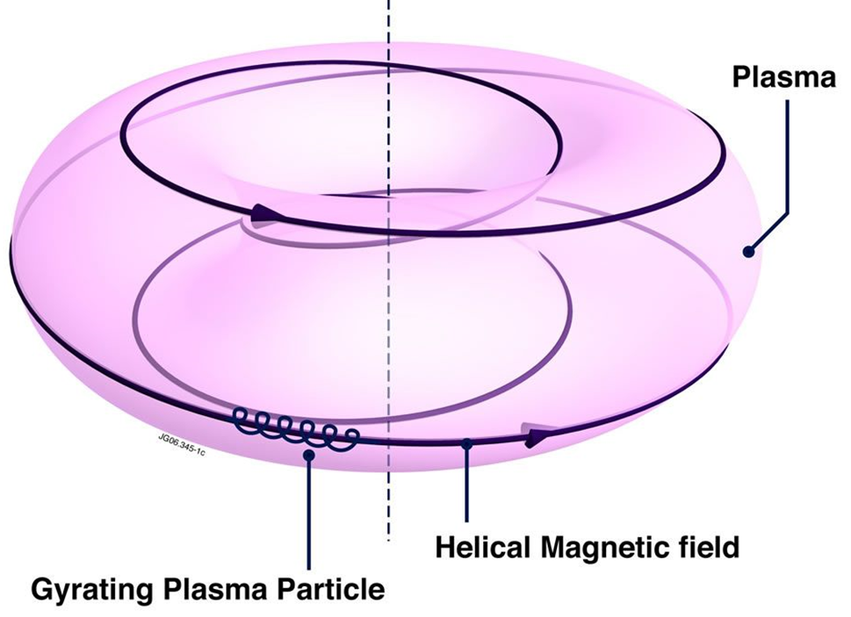


Helical magnetic field improves confinement
“Helical” field = B-field covers toroidal surfaces
  B arrows never puncture donut
Allows currents to flow along magnetic field
Short-circuits electric fields that would otherwise expel plasma
Particles tied to surface
Improved confinement
“Tokamak”
“Stellarator”

Slide 40
Tokamak: Poloidal field from plasma current + toroidal field from magnets create helical field
“Tokamak”: Russian acronym for “toroidal chamber with magnetic coils”

Slide 41
Conventional tokamak is not steady-state
Primary transformer coils drive toroidal electric current in plasma
Must stop when transformer coils reach current and/or force limit
Inner Poloidal Field Coils
(Primary transformer circuit)
Plasma electric current
(Secondary transformer circuit)

Slide 42
“Advanced Tokamak” uses external + self-generated current to operate without transformer
External: wave and beam current drive
Self-generated: high pressure plasmas make “bootstrap” current
Efficient tokamak power plant will need 70-90% self-generated current

Slide 43


Stellarator: Toroidal / helical currents in coils + toroidal field from magnets create helical field
Helical coils
or
Discrete / modular coils

Slide 44


Tokamaks and stellarators are the leading configurations in magnetic fusion
Superconducting tokamak
Superconducting stellarator
KSTAR (South Korea)
W7-X (Germany) – 1st plasma in late 2015
Tokamak advantages:
  Best confinement, closest to “breakeven”
  Simpler planar coils and power/particle exhaust
Disadvantages:
  Must drive multi-mega-ampere plasma current
  More prone to rapid loss of plasma = “disruption”
Stellarator advantages:
  No plasma current drive necessary
  More stable, steady-state
Disadvantages:
  More complex coils and exhaust
  Confinement < tokamaks (so far…)

Slide 45


ITER will be first device to access “burning plasma”
Burning plasma: majority of plasma heating power comes from fusion alpha particles from DT reactions
  DT reaction energy split: 1/5 in alphas, 4/5 in neutrons
ITER goal Q = P_{fusion} / P_{external heating} = 10
Q = 10 → P_{alpha} / P_{external} = 2
P_{alpha} / P_{alpha + external} = 2 / 3 > 50%
A=3.1, R=6.2m, B_{T}=5.3T, I_{P}=15MA
ITER under construction in Cadarache, France

Slide 46

ITER magnets will be largest ever built
18 toroidal field magnets
12 Tesla at coil
Weight: 6500 tons
80,000 km of Nb3Sn superconducting strand in total length
Plasma current:
15 million amps
Toroidal field current
165 million amps
15 amps
(1800W)

Slide 47
Size of ITER driven largely by plasma confinement
Energy confinement scales with plasma current
Large plasma current requires large toroidal field and/or plasma size for plasma to remain stable
Current and confinement both scale with size
Can we make smaller devices with better confinement and smaller or cheaper magnets?
Such questions motivate exploring alternatives…

Slide 48
How might we possibly improve the conventional tokamak?

Slide 49
Aspect ratio is important free parameter
Aspect ratio A = R / a
R = major radius a = minor radius
R
a
Spherical torus/tokamak (ST) has A = 1.1-2
Conventional tokamak typically A = 3-4

Slide 50
STs have higher natural elongation
Elongation κ = b / a
b = vertical ½ height a = minor radius
b
a
Higher elongation improves stability, confinement

Slide 51
Favorable average curvature improves stability
Tokamak
ST
Plasma spends less time in unstable curvature region
A ~ 3
κ = 1.5-2
β_{T} = 3-10%
A ~ 1.5
κ = 2-3
β_{T} = 10-40%
Aspect Ratio A = R /a
Elongation κ = b/a
Toroidal beta β_{T} = ⟨p⟩ / (B_{T0}²/2μ₀)
Notes:
A spherical tokamak is a low aspect ratio tokamak. Tokamak is a donut like aspect ratio of about 3 where as ST is aspect ratio of about 1.5. As the aspect ratio is reduced, the hole of the donut is reduced and it disappears entirely at A = 1. As the aspect ratio is reduced, the plasma elongate naturally takes on the spherical shape due to self fields. Another important property is the magnetic field line. The tokamak magnetic field line goes around torus at relatively constant pitch where as the ST geometry, the field line transit the outboard unstable region quickly but spend many toroidal transits in the inboard stable region. This makes ST plasma stable for high beta and also makes the edge safety factor high ~ 10 compared to ~ 3 for tokamak.
As a result, there are a number of new unique physics regimes which can be accessed at low aspect ratio, which can be utilized to enhance the understanding of toroidal confinement physics and improve predictive capabilities for ITER and future fusion facilities.

Slide 52

ST can be compact, high beta, and high confinement
Higher elongation κ and low A lead to higher I_{P} , β_{T} and τ_{E}
Aspect Ratio A = R /a
Elongation κ = b/a
Toroidal beta β_{T} = ⟨p⟩ / (B_{T0}²/2μ₀)
• ST has high I_{P} due to high κ and low A
High κ ∼ 3.0 equilibrium in NSTX
I_{P} ~ I_{TF} (1 + κ²) / (2 A² q*)
• I_{P} increases tokamak performance
Energy confinement time τ_{E} ∝ I_{P}
Normalized pressure β_{T} [%] ≡ β_{N} I_{P} / (aB_{T0})
• ST achieves high performance cost effectively
I_{P} ~ I_{TF} for ST due to low A and high κ
$
Notes:
A spherical tokamak is a low aspect ratio tokamak. Tokamak is a donut like aspect ratio of about 3 where as ST is aspect ratio of about 1.5. As the aspect ratio is reduced, the hole of the donut is reduced and it disappears entirely at A = 1. As the aspect ratio is reduced, the plasma elongate naturally takes on the spherical shape due to self fields. Another important property is the magnetic field line. The tokamak magnetic field line goes around torus at relatively constant pitch where as the ST geometry, the field line transit the outboard unstable region quickly but spend many toroidal transits in the inboard stable region. This makes ST plasma stable for high beta and also makes the edge safety factor high ~ 10 compared to ~ 3 for tokamak.
As a result, there are a number of new unique physics regimes which can be accessed at low aspect ratio, which can be utilized to enhance the understanding of toroidal confinement physics and improve predictive capabilities for ITER and future fusion facilities.

Slide 53
Fusion technology development is major challenge
Fusion Nuclear Science Facility (FNSF) could aid development
Need to develop reliable and qualified nuclear and other components which are unique to fusion:
Divertor, plasma facing components for exhaust
Blanket and Integral First Wall
Vacuum Vessel and Shield
Tritium Fuel Cycle
Remote Maintenance Components
ST-FNSF
Without R&D, fusion components could fail prematurely, requiring long repair/down time.
This would cripple power plant operation
FNSF can help develop reliable fusion components
Such FNSF facilities must be: modest cost, low T, and reliable

Slide 54
Higher β_{T} enables higher fusion power and compact FNSF for required neutron wall loading
P_{fusion} ∝ ⟨p⟩ ² x Volume
Data base from START, MAST, PEGASUS and NSTX
β_{N} = 6
40
5
P_{fusion} ∝ β_{T}² B_{T0}⁴ x Vol
4
$
Toroidal β (%)
ST-FNSF
Product
Physics Knob
3
Investment
20
Tokamak
2
High neutron wall loading W_{n} possible in a compact ST
ITER
0
8
0
4
W_{n} ∝ P_{fusion} / Area
I_{p}/aB_{T0} (MA/mT)
W_{n} ∝ β_{T}² B_{T0}⁴ a (not strongly size dependent)
W_{n} ~ 1 MW/m² with R ~ 1 m FNSF feasible!

Slide 55

Design studies show ST potentially attractive as FNSF
PPPL ST-FNSF concept
Projected to access high neutron wall loading at moderate R, P_{fusion}
  W_{n} ~ 1-2 MW/m² , P_{fus} ~ 50-200MW, R ~ 0.8-1.8m
Modular, simplified maintenance
Tritium breeding ratio (TBR) near 1
  Requires sufficiently large R, careful design

Slide 56
Unique ST properties also support ITER
ST Extends Predictive Capability for ITER and Toroidal Science
  High β physics, rotation, shaping extend stability, transport knowledge
  NBI fast-ions in present STs mimic DT fusion product parameters in ITER → study burning plasma science
  STs can more easily study electron scale turbulence at low collisionality → important for all magnetic fusion
Burning Plasma Physics - ITER

Slide 57
What are the goals of
NSTX Upgrade (NSTX-U)?
What key science questions
will NSTX-U address?

Slide 58




NSTX Upgrade mission elements
Advance ST as candidate for Fusion Nuclear Science Facility (FNSF)
Develop solutions for the plasma-material interface challenge
Explore unique ST parameter regimes to advance predictive capability - for ITER and beyond
Develop ST as fusion energy system
ST-FNSF
Liquid metals/Li
“Snowflake”
ITER

Slide 59
NSTX-U will provide new data to support ST-FNSF design, ITER operations, boundary solutions
Previous
center-stack
New
center-stack
New center-stack doubles toroidal field, plasma current, 5× pulse-length
Tangential injection provides 3-4× higher current drive at low I_{P}:
  2x higher absorption (40→80%) at low I_{P}
  1.5-2x higher current drive efficiency
~ 5-10x increase in nTτ from NSTX
NSTX-U average plasma pressure ~ tokamaks
TF OD = 20cm
TF OD = 40cm
Key NSTX-U research topics for FNSF and ITER:
Stability and steady-state control at high β
Confinement scaling (esp. electron transport)
Non-inductive start-up, ramp-up, sustainment
Divertor solutions for mitigating high heat flux
Present NBI
New 2nd NBI
J. Menard, et al., NF (2012)

Slide 60
NSTX achieved 70% “transformer-less” current drive
Will NSTX-U achieve 100% as predicted by simulations?
TRANSP Contours of Non-Inductive Fraction
H_{98y2}
ITER H-mode confinement scaling multiplier
I_{P}=1 MA, B_{T}=1.0 T, P_{NBI}=12.6 MW
Steady-state operation required for ST, tokamak, or stellarator FNSF

Slide 61
I_{P} Start-up/Ramp-up Critical Issue for ST-FNSF
Compact ST-FNSF has no/small central solenoid
~ 1-2 MA of transformer-free start-up current needed for FNSF → 10-20% of total current
Long-term major goal of NSTX-U: generate and sustain a high-performance plasma without using any transformer
  (this will not be easy…)
Notes:
ST has been addressing critical issues for FNSF: A compact FNSF facility does not have solenoid. So, the solenoid-free start-up is a critical issue for ST-FNSF. But solenoid-free start-up is attractive for tokamak reactor design as well. Other issues are ramp-up….

Slide 62
NSTX achieved 200kA (~20%) “transformer-less” start-up
Will NSTX-U achieve 400kA or more as per simulations?
TSC code (2D) successfully simulated helicity injection I_{P} ~200kA in NSTX
1.0 ms
1.6 ms
2.7 ms
2
1
Z (m)
0
-1
-2
0
1
2
0
1
2
0
1
2
R (m)
R (m)
R (m)
Additional electron heating likely required
Design of heating system is underway…

Slide 63
NSTX / MAST observed confinement increase at higher T_{e} (!) Will confinement trend continue, or look like conventional A?
ST-FNSF
constant q, β, ρ∗
NSTX Upgrade
?
NSTX
ITER-like scaling
Normalized electron collisionality ν_{e}* ∝ n_{e} / T_{e}²
Favorable confinement results could lead to more compact ST reactors

Slide 64
All modern tokamaks / STs use a “divertor” to control where power and particles are exhausted
Power exhaust width outside main plasma can be very narrow (few mm)
Power / particles contact target plates here

Slide 65

Tokamak + ST data: power exhaust width varies as 1 / B_{poloidal}
Will previous ST trend continue at 2× I_{P} , B_{P} , B_{T}, power?
ST data breaks aspect ratio degeneracy of data set
Issue: If peak heat flux in divertor region exceeds 10 MW/m² → material damage
Wider heat-flux width may offset smaller R → maybe better than tokamak

Slide 66



NSTX-U will test ability of radiation and advanced divertors to mitigate very high heat-fluxes
NSTX: reduced heat flux 2-4×via radiation (partial detachment)
Additional null-point in divertor expands field, reduces heat flux
Standard Divertor
Snowflake/X Divertor
NSTX-U peak heat fluxes will be up to 4-8× higher than in NSTX
NSTX-U has additional coils for up-down symmetric snowflake/X, improved control

Slide 67
How was NSTX-U constructed?

Slide 68



New center-stack designed to handle increased forces
Identical 36 TF conductors and innovative flex-bus design
TF conductor
TF cooling lines
Electric Discharge Machining Cuts
Friction-stir welded TF flag joints
TF flex-bus
CTD-425 cyanate ester epoxy blend insulation
Tested for
300k cycles
CHI bus
PF coil 1C
PF coil 1B
PF coil 1A
CS casing
OH coil

Slide 69





Center-stack fabrication and assembly (1)
Innovative manufacturing techniques developed
Cooling tube soldered with resin-based flux into inner TF conductor
Conductor being wrapped with fiberglass insulation
Insulated conductor being placed into mold
Assembled TF mold ready for Vacuum Pressure Impregnation (VPI) w/ CTD-425
Completion of first TF quadrant

Slide 70





Center-stack fabrication and assembly (2)
4 TF quadrants assembled
Full TF Bundle after VPI
Aquapour + glass layer applied
OH conductor wound over TF

Slide 71


Completion of transformer winding and VPI

Slide 72

Same-day delivery to D-Site costs extra

Slide 73


New Center-Stack installed in NSTX-U (!)
Vacuum pump-down achieved in January, 2015

Slide 74



Relocated 2nd NBI beam line box from
the TFTR test cell into the NSTX-U test cell
TFTR NBI beam box and components successfully tritium decontaminated
Beam Box being lifted over NSTX
Beam Box placed in its final location and aligned
Beam Box being populated with components

Slide 75

NSTX Upgrade Project nearing completion
Test plasmas expected in April, research plasmas in June
1st NBI
New 2nd NBI

Slide 76

Magnetic Confinement Fusion Performance

Slide 77

Particle trajectories in a tokamak

Slide 78
Record β_{N} and β_{N} / l_{i} accessed in NSTX
using resistive wall mode stabilization
High β_{N} regime is important for bootstrap current generation.
High β_{N}/l_{i} regime important since high f_{BS} regime has low l_{i}.
ST-FNSF
Unstable RWM
Stable / controlled RWM
S.A. Sabbagh PRL(2006)
J. W. Berkery, PRL (2011)
W. Zhu, PRL (2006)
S.A. Sabbagh at this APS
Major mission of NSTX-U is to achieve fully non-inductive operations at high β

Slide 79


NSTX Data Demonstrates a Favorable Operations Window For Reduced Disruptivity in an ST-FNSF
ST-FNSF
S=37
S=20
No strong increase in disruptivity as β_{N} increases
Reduction in disruptivity also with:
  Decreasing l_{i} (broader current profile)
  Decreasing pressure peaking
(S=q₉₅I_{P}/aB_{T})
Example: Disruptivity is reduced with strong shaping of the plasma boundary.
Upgrades will test and improve these favorable trends in a systematic way
S.P. Gerhardt et al., NF (2013)

Slide 80


Favorable Confinement Trend with Collisionality and β found
Important implications for future STs and Demo with much lower ν*
τ_{E, th} ∝ ν_{*e}^{-0.1} β^{-0.9} tokamak empirical scaling (ITER98_{y,2})
τ_{E, th} ∝ ν_{*e}^{-0.8} β^{-0.0} ST scaling
NSTX
Fig. 70. (a) Normalized confinement time as a function of collisionality at mid-radius in NSTX. Blue points are from discharges that used HeGDC+B wall conditioning, while red points are from discharges that used Li. Reprinted with permission from S.M. Kaye et al., Nucl. Fusion 53 063005 (2013). Copyright (2013). Institute of Physics.
(b) Collisionality scan of thermal energy confinement time in MAST. Reprinted with permission from M. Valovic et al., Nucl. Fusion 51 073045 (2011). Copyright (2011) Institute of Physics.
NSTX
MAST
~ ν_{*e} ^{-0.82}
B τ_{E,th} [ T s]
ν_{*e}
S.M. Kaye et al., NF (2007) (2013)
M. Valovic et al., NF (2011)
Very promising ST scaling to reactor condition, if continues on NSTX-U/MAST-U

Slide 81



Microtearing-driven (MT) transport may explain ST collisionality scaling
Microtearing-driven χ_{e} vs. ν_{ei} using the GYRO code.
MT growth rate decreases with reduced collisionality in qualitative agreement with the NSTX experiment.
Further electron confinement improvement expected due to reduced collisionality.
NSTX-U
W. Guttenfelder, et al., PoP(2012)

Slide 82




ETGs measured for the first time with high-k scattering
High β_{e} or larger ρ_{e} ∝ β_{e}^{0.5} of ST plasma enabled measurement of ETGs.
Electron Temperature Gradient Mode (ETG) Excitation with Core Electron Heating
ETG Suppression in Reversed Shear
Calculated ETG χ_{e} by GTS code agrees with experiment
χ_{e} (m²/sec)
χ_{e} (m²/sec)
χ_{e} (GTS)
time (V_{th}/L_{Te})
S. Ethier et al., IAEA (2010)
E. Mazzucato et al., NF (2009)
Shear stabilization of ETGs D. R. Smith, et al., PRL (2009)
Density gradient stabilization of ETGs Y. Ren, et al., PRL (2011)
Note: Here we call electron gyro-scale turbulence as ETGs
H.Y. Yuh et al., PoP (2009)
J.L. Peterson, et al., PoP(2011).

Slide 83


High Confinement Needed for Compact FNSF
High confinement H-mode in the range of FNSF obtained
Fusion gain Q depends strongly on “H”, Q ∝ Η ⁵⁻⁷
Higher H enables compact ST-FNSF H = 1.2 – 1.3
Higher H gives more reactor design flexibility and margins.
• Ion energy transport in H-mode ST plasmas near neoclassical level due to high shear flow and favorable curvature.
• Electron energy transport anomalous
H-mode confinement in STs H ~ 1 (ITER98_{y,2}) but enhanced pedestal H-mode (EPH) has 50% higher H up to H ~ 2
NSTX
NSTX
EPH
FNSF
H-mode
Y. Ren.
S. Gerhardt NF (2014)
R. Maingi, PRL (2010)

Slide 84


Divertor flux expansion of ~ 50 achieved with
Snow Flake Divertor with large heat flux reduction in NSTX
Snowflake divertor in NSTX
NSTX-U will investigate novel divertor heat flux mitigation concepts needed for FNSF and Demo.
• Up-and-down symmetric Snow Flake / X-divertors
• Lithium + high-Z metal PFCs
OSP
Divertor heat flux (MW/m²)
V. A. Soukhanovskii et al., PoP (2012)

Slide 85



ST-FNSF has high P/R due to small R
Innovative Heat Flux Mitigation via Divertor Flux Expansion
Lower toroidal field of outboard divertor leg of STs facilitates heat flux mitigation by divertor flux expansion solutions
Snow-flake
X-Divertor: CREST
Super-X: MAST-U
D. Ryutov, et al., PoP (2007)
P.M. Valanju, et al., PoP (2009).
Kotschenreuther, et al., PoP (2007)
Major mission of MAST-U is to investigate up-down symmetric Super-X configuration. NSTX explored Snow-flake / X-divertor.

Slide 86



H-mode / ELM physics: High Priority Research Goal
Unmitigated ELMs could cause PFC damage in reactors
Video images of MAST plasmas showing a filamentary ELM structure.
ST is in strongly shaped ELM regimes
L-H power threshold scaling extended for low A
P.B. Snyder et al., PoP (2002).
MAST
(Type I)
NSTX, PEGASUS
(Type I)
FNSF
  N. Ben Ayed et al., PPCF (2009).
K.E. Thome et al., EPR (2014)
• NSTX/MAST/PEGASUS accessed H-mode at very low heating power < 1 MW and also in ohmic plasmas
• NSTX-U and MAST-U will provide H-mode access scaling for FNSF

Slide 87



ELM Stabilization and Mitigation
Through application of lithium and 3-D fields
ELMs stabilized with edge pressure modification with Li in NSTX
ELM mitigation with n=3
3-D fields (ELM Coils) in MAST
D.K. Mansfield, et al., JNM (2009)
Increasing Type I ELM freq. by x 8 (900 Hz) has reduced heat flux
R. Maingi, et al., PRL (2009).
A. Kirk et al., NF (2013)

Slide 88


NBI heated ST plasmas provide an excellent testbed for α-particle physics
Alfvenic modes readily accessed due to high V_{α} > V_{Alf}
α-particles couples to Alfven-type mode strongly when V_{α} > V_{Alf} ~ β^{−0.5} Cs
V_{α} > V_{Alf} in ITER and reactors
In STs, the condition is easily satisfied due to high beta
A prominent instabilities driven by fast particles are global and called toroidal Alfven eigenmodes (TAE).
NSTX-U will also explore V_{α} < V_{Alf} regime giving more flexibility
EP parameter space
TAEs significantly modified at high β as V_{Alf} C_{s}
Stabilization of TAEs at high β in MAST
  M.P. Gryaznevich et al. PPCF (2004)
  E. D. Fredrickson et al., NF (2013)

Slide 89



“TAE avalanche” shown to cause energetic particle loss
Uncontrolled α-particle loss could cause reactor first wall damage
Multi-mode TAE avalanche can cause significant EP losses as in “sea”of TAEs expected in ITER
Progress in simulation of neutron rate drop
due to TAE avalanche
(a)
Frequency (kHz)
Neutron rate (a.u.)
Fast ion loss rate (a.u.)
Time (ms)
Time (ms)
D.S. Darrow et al., NF (2013).
  E. D. Fredrickson et al., NF (2013)

Slide 90



Helicity Injection Is an Efficient Method for Current Initiation
Coaxial Helicity Injection (CHI) Concepts Being Developed
CHI developed on HIT and HIT-II and transferred to NSTX
Discharge evolution of 160 kA closed flux current produced by CHI alone in NSTX
R. Raman et al., PRL (2006)

Slide 91


Current Ramp-Up and Profile Control Crucial for FNSF
Major Research Topics for NSTX-U
Efficient HHFW electron heating due to high β_{e} achieved in NSTX.
Near sustained discharges obtained with modest HHFW power
NSTX
G. Taylor et al., PoP (2010), (2012)
HHFW current ramp-up will be tested in NSTX-U at higher power ~ 4 MW.

Slide 92
Current Ramp-Up and Profile Control Crucial for FNSF
Major Research Topics for MAST-U and NSTX-U
Off-axis NBI CD Required for Profile Control Demonstrated in MAST
Efficient HHFW electron heating due to high β_{e} achieved in NSTX.
Near sustained discharges obtained with modest HHFW power.
NSTX
  M. Turnyanskiy et al., NF (2009)
Off-axis current drive for profile control will be tested in both MAST-U and NSTX-U with major NBI upgrades.
G. Taylor et al., PoP (2010), (2012)
HHFW current ramp-up will be tested in NSTX-U at higher power ~ 4 MW.

Slide 93


Helicity Injection Is an Efficient Method for Current Initiation
Local Helicity Injection (LHI) Concepts Being Seveloped
  3-6 kA current injector array in plasma SOL
Long-Pulse Startup Demonstrated in PEGASUS with LHI
J. O’Bryan, PhD. Thesis, UW Madison 2014
Improving predictive capability for both CHI and LHI
CHI and LHI startup to be tested at higher current ~ 0.5-1.0 MA in NSTX-U.

Slide 94


Merging Start-Up Yielded High Current STs
Rapid ion heating observed from magnetic reconnection
Merging-compression start-up in MAST
CS Induction
Ultra high β STs produced by mergings in TS-3 Device
A. Sykes et al., NF (2001)
Y. Ono, et al., this APS
Y. Ono, et al., NF (2003)

Slide 95


NSTX has accessed A, β_{N}, κ needed for ST-based FNSF
Requires f_{BS} ≥ 50% for plasma sustainment
f_{BS} ≡ I_{BS} / I_{p} = C_{BS} β_{p} / A^{0.5} = (C_{BS}/20) A^{0.5} q* β_{N} ∝ A^{-0.5} (1+κ²) β_{N}² / β_{T}
SC-ST
S.P. Gerhardt et al., NF (2011)
NSTX achieved f_{BS} ~ 50% and f_{NI} ~ 65-70% with beams
NSTX-U expects to achieve f_{NI} ~100% with the more tangential NBI (~ 1.5- 2x higher current drive efficiency)

Slide 96
















Operating ST Research Facilities Since 2000
NSTX and MAST: MA-class STs, Smaller STs addressing topical issues
NSTX, USA
PEGASUS, USA
LTX/CDX-U, USA
GLOBUS-M, Russia
MAST, UK
HIST, Japan
LATE, Japan
TST-2, Japan
UTST, Japan
R₀ ~ 0.75 m
QUEST/CPD, Japan
R₀ ~ 0.85 m
VEST, Korea
HIT-II, USA
HIT-II
PEGASUS
GLOBUS-M
QUEST
HIST
LATE
TST-2
TS3/4
UTST
MAST
KTM
VEST
NSTX/LTX
ST25(HTS)
SUNIST
SUNIST, China
ETE, Brazil
ST25, UK
TS3/4, Japan
ETE
STs operated since 2000
Notes:
NSTX and MAST are MA class STs so they are the flag ships of ST research. They are at present undergoing upgrades for 1 T operation. Globus-M is a medium size ST and it is undergoing upgrade to 1 T operation. There a large number of STs in Japan. And the QUEST device is the largest and their flagship device. It aim is to operate steady-state. There are also STs in China, Korean, Kazakhstan, and Brazil. One recent addition is ST25 which is the first all high temperature SC magnet tokamak by Tokamak Energy which is private funded enterprise. You can see quite a range of aspect ratio. The lowest one is PEGASUS with A = 1.15 with extremely slender center post. LTX is a lithium dedicated machine with A = 1.5. I do not have the time to cover the lithium research but there are companion papers at this conference for those interested. NSTX and MAST are 1.32. The ST devices spans quite broad range to make sure we capture necessary low A physics.

Slide 97


MA-Class ST Research Started in 2000
Complementary Physics Capabilities of NSTX and MAST
NSTX
Complementary Capabilities
MAST
Passive Plates
Heilicity Injection
HHFW
1 x 6 RWM Coils
Large divertor volume
Merging/Compression
ECH
2 x 12 ELM coils
Similar Capabilities
NSTX
R = 85 cm
A ≥ 1.3
= 1.7 - 3.0
B_{T} = 5.5 kG
I_{p} ≤ 1.5 MA
V_{p} ≤ 14 m³
P_{NBI} = 7.4 MW
MAST
R = 80 cm
A ≥ 1.3
= 1.7 – 2.5
B_{T} ~ 5.0 kG
I_{p} ≤ 1.5 MA
V_{p} ≤ 10 m³
P_{NBI} = 4.0 MW
Comprehensive diagnostics
Physics integration
Scenario development
M. Ono, et al., IAEA 2000, NF 2001
A. Sykes, et al., IAEA 2000, NF 2001

