Slide 1
Identification of ELM evolution patterns with unsupervised clustering of time-series similarity metrics
David R. Smith¹, G. McKee¹, R. Fonck¹,
A. Diallo², S. Kaye², B. LeBlanc²,
S. Sabbagh³, and B. Stratton²
¹U. Wisconsin-Madison, ²PPPL, ³Columbia U.
2nd IAEA Technical Meeting on Fusion Data
Processing, Validation and Analysis
Boston, MA, USA
May 30 - June 2, 2017
Notes:
Thank you for this opportunity to tell you about ELM evolution patterns on NSTX and NSTX-U
I’d like to acknowledge contributions from several colleagues from Wisconsin, PPPL, and Columbia

Slide 2
Opportunities for data-driven analysis at fusion facilities with large data archives
The “4th paradigm” of data-driven science
  Patterns/relationships in large datasets ➞ scientific insights
Opportunities for machine learning in fusion science
  Identify/classify ELM evolution patterns (this talk)
  High-dimensional relationships at the LH transition
  Find and classify disruptions in a data archive
  Analyze data volumes not possible with visual inspection
  NSTX/NSTX-U: About 40 TB of data obtained with R&D investment approaching $1B USD
Many data-rich scientific fields successfully leverage machine learning techniques
  Cancer genomics, exoplanet detection, seismic wave classification, seizure onset prediction, Higgs boson
  High-level initiatives from US funding agencies
  Intersection of experimental science and high performance computing

Slide 3
ELM evolution patterns on NSTX/NSTX-U
Beam emission spectroscopy (BES) system on NSTX/NSTX-U
ELM evolution patterns with unsupervised machine learning analysis
  Time-series similarity metrics
  Hierarchical and k-means cluster analysis
  Parameter regimes for identified evolution patterns
1-slide digression: Fusion Data Platform
  An extensible data framework for magnetic fusion experiments

Slide 4
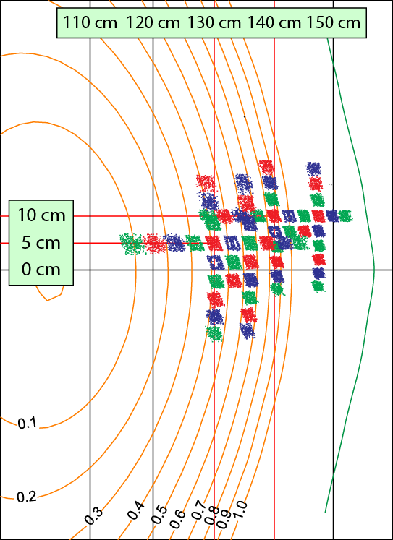
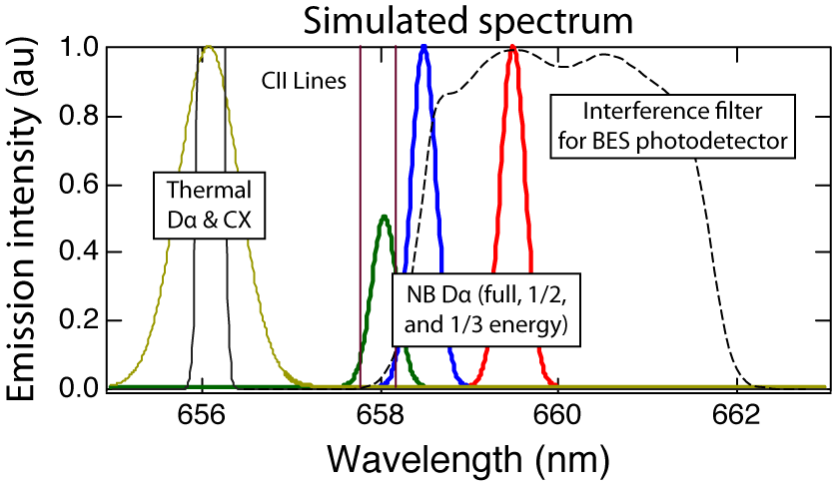
BES measures Doppler-shifted D_{α} emission from a deuterium heating beam to observe ion-scale fluctuations
Measurements are sensitive to density fluctuations on the ion gyroscale with k⊥ρ_{i} ≤ 1.5
(2010 configuration)
C ≈ 1/2
neutral beam
D_{α} emission
density
fluctuation
D. Smith et al, RSI 81, 10D717 (2010)
G. McKee et al, RSI 74, 2014 (2003)
R. Fonck et al, RSI 61, 3487 (1990)
Notes:
The left figure shows the radial and poloidal coverage of the original BES system on NSTX. The spot sizes were 2 cm in the edge region and 3 cm in the core region.
The sightlines were split among two sets of collection optics: the edge “R140” view and the core “R130” view.
The measurements are sensitive to fluctuations down to the ion gyroscale.
And scientific applications include ELMs, EHOs, LH transition, turbulence dynamics, velocimetry, Alfven eigenmodes and more

Slide 5
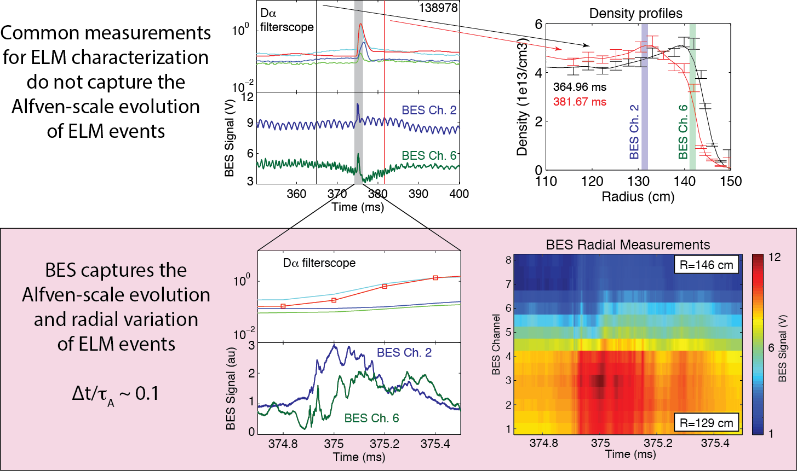
BES measurements capture the Alfven-scale evolution and radial profile of ELM events
Notes:
This slide illustrates how BES measurements can capture ELM events with Alfven-scale time resolution and multi-point radial measurements.
ELMs are often characterized with Thomson scattering and filterscope measurements. MPTS provides profile data at time intervals long compared to the ELM event, and similarly filterscopes do not capture the Alfven-scale evolution of ELM.
In the bottom panels, you can see that BES captures ELM evolution details not available in other measurements.

Slide 6
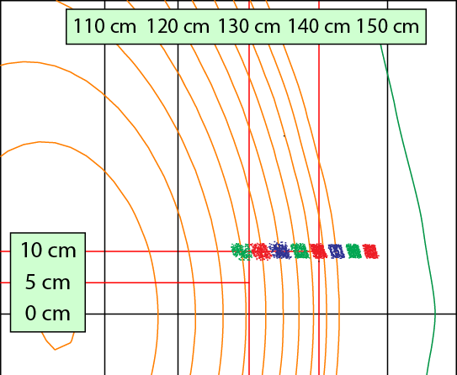
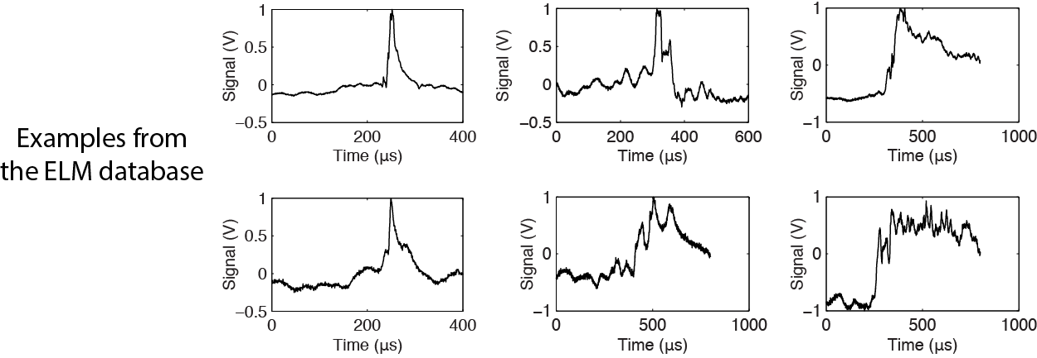
Goal – Identify common evolution patterns (if any) in a database of Type I ELM time-series data
Database of 51 ELM events measured with BES
  8 radial BES channels spanning pedestal region
  34 NSTX discharges from 8 run days spanning 4 months
  1%-16% stored energy loss and observable pedestal collapse
  Most likely type I ELMs
  Time-series from radial array condensed into single time-series with principle component analysis
Notes:
We assembled a database of 51 ELM events with measurements from a radial array of BES sightlines spanning the outer plasma and SOL, shown in the top left.
The ELMs exhibited a stored energy loss of 1-16% and an observable pedestal collapse from MPTS measurements.
The ELMs are most likely type I ELMs, and time-series data from the radial array was condensed into a single characteristic time series using Principle Component Analysis
In the bottom, you see that BES measurements reveal significant variation in ELM evolution. The goal of this research activity is use machine learning tools to identify evolution patterns in ELM time-series data.

Slide 7
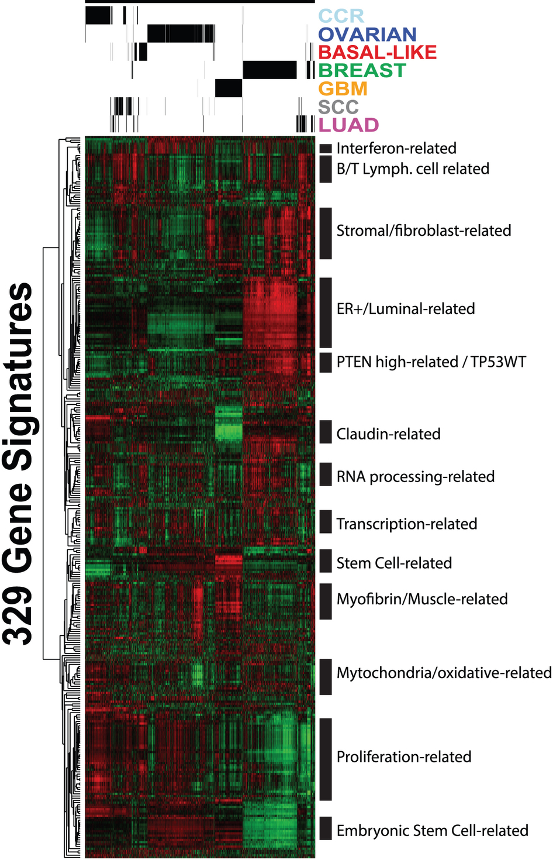
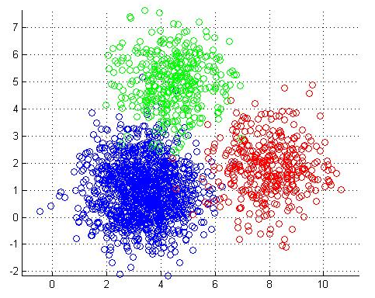
Method – Apply unsupervised machine learning techniques to identify common ELM evolution patterns
Hierarchical clustering
  Produces a multi-level hierarchy of objects
  Popularized in genomics
  Requires an similarity metric to quantify similarity among time-series
Time-series similarity metrics
  Time-lag cross-correlation
  Euclidean distance
  Dynamic time warping (DTW)
  Wavelet decomposition
K-means clustering
  Partition observations
  into k mutually
  exclusive clusters
D. Smith et al,
PPCF 58, 045003 (2016)
Mathworks.com
Prat et al, Scientific Reports 3, 3544 (2013)

Slide 8
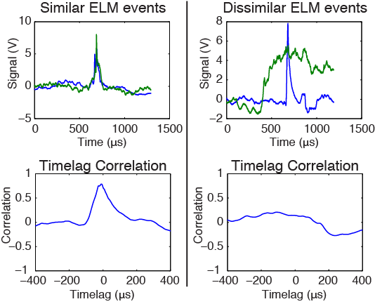
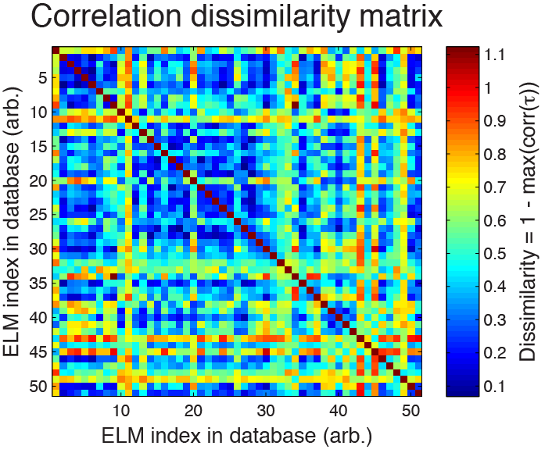
Hierarchical clustering (I) – Assemble time-lag cross-correlation metrics into a dissimilarity matrix
Time-lag cross-correlation can quantify the similarity of ELM time-series data
Assemble pair-wise metrics into a dissimilarity matrix
Red = low
similarity
Blue = high
similarity
Larger max correlation ➞ more similar
Notes:
We start with hierarchical clustering and we consider time-lag cross-correlation as a similarity metric.
On the left you see that ELM events with similar evolution traces exhibit a larger maximum cross-correlation.
We collect maximum cross-correlations for all ELM pairs and we assembly a dissimilarity matrix where dissimilarity is defined to be 1- max(corr). In the matrix, blue represents high similarity pairs and red is low similarity pairs.

Slide 9
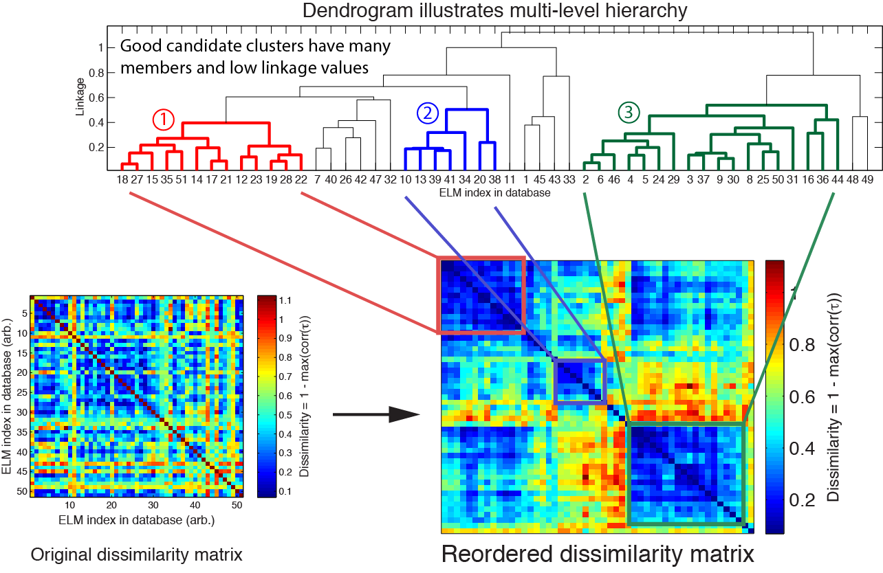
Hierarchical clustering (II) – Apply clustering algorithm to dissimilarity matrix to identify groups of similar ELMs
Low
similarity
High
similarity
Colors preserved in
remainder of presentation
Blue squares on
diagonal are good
candidate clusters
D. Smith et al, PPCF 58, 045003 (2016)
Notes:
The hierarchical clustering algorithm produces the dendrogram in the top that links objects and groups by similarity
Good candidate clusters have several members and low linkage values
The red, blue, and green groups are good candidate groups, and the designation of red, blue, and green groups will be preserved in upcoming slides.
The dissimilarity matrix can be re-ordered based on the dendrogram for another visualization of results. Good candidate clusters are blue squares regions on the diagonal.

Slide 10
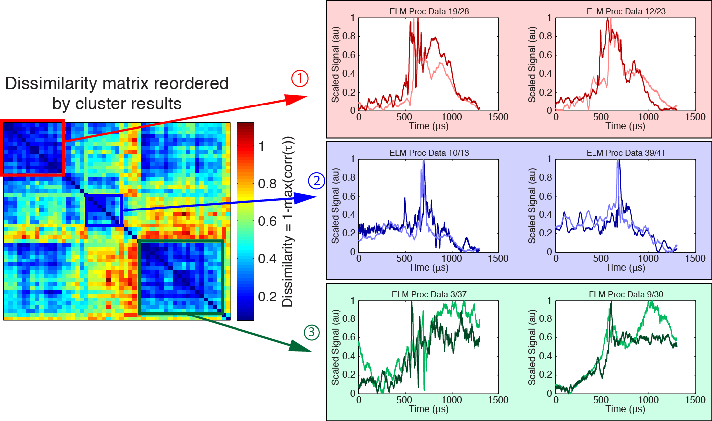
The identified ELM groups show similar evolution characteristics

Slide 11
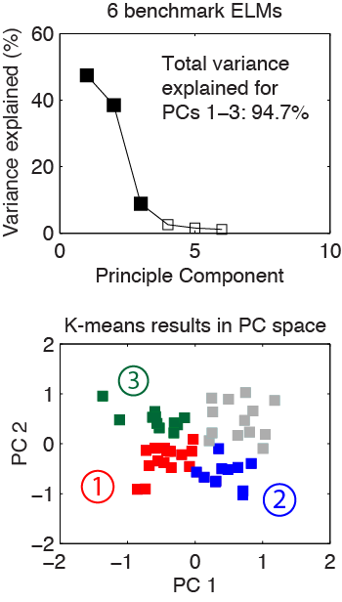
K-means clustering – Group objects into mutually exclusive groups
Requires extrinsic similarity metrics
  Designate benchmark ELMs to serve as basis for extrinsic metrics
Utilize PCA to visualize high-dim. results in low-dim. sub-space
6 benchmark ELMs
# of clusters | Mean ratio*
2 | 0.49
3 | 0.51
4 | 0.52
5 | 0.48
6 | 0.46
7 | 0.45
Optimal
4th group?
*Out-of-cluster/in-cluster distance ratio
D. Smith et al,
PPCF 58, 045003
(2016)
Clusters are highly consistent for calculations with different benchmark ELMs

Slide 12
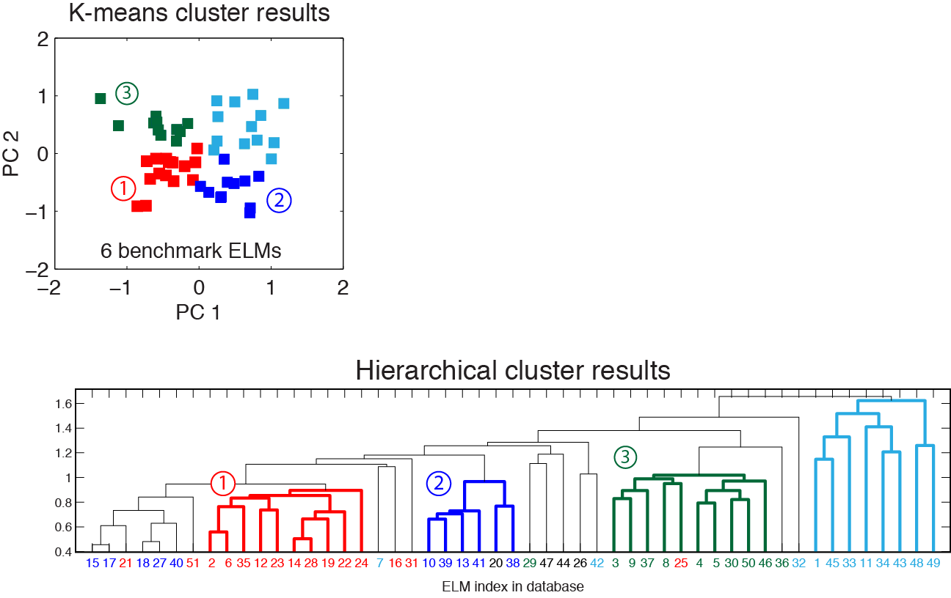
k-means clustering and hierarchical clustering yield consistent results
Red, Blue, and Green groups in k-means results are largely consistent with previous hierarchical cluster results
The Cyan group in k-means corresponds to poorly linked ELMs in the hierarchical cluster
Colors correspond to k-means clusters
D. Smith et al, PPCF 58, 045003 (2016)

Slide 13
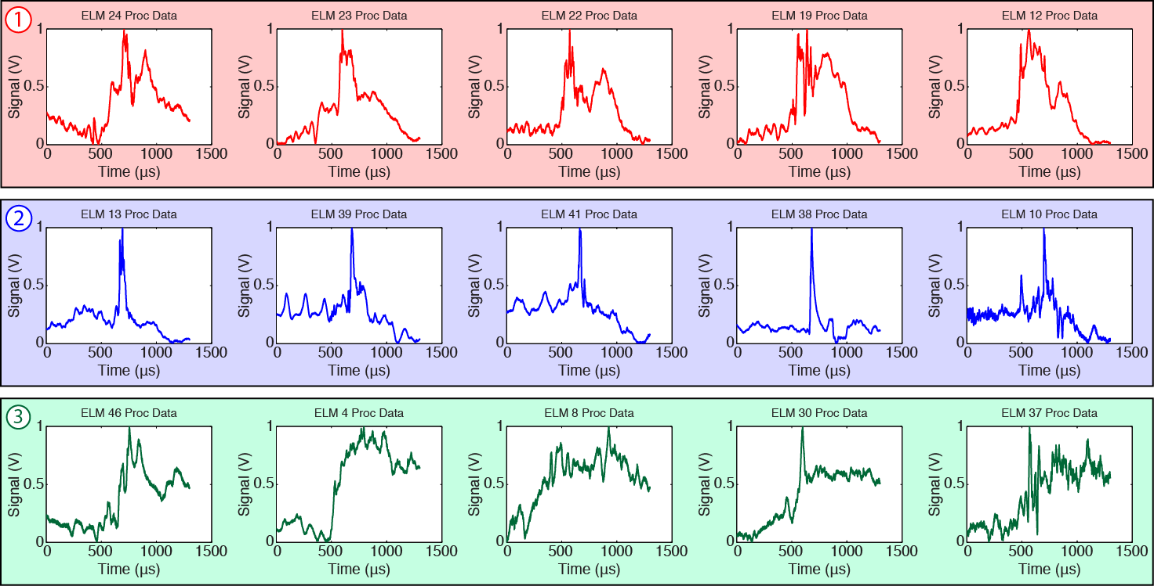
ELM evolution patterns identified with machine learning techniques
Next step: automate discovery and tagging of ELMs in the NSTX/NSTX-U data archive

Slide 14
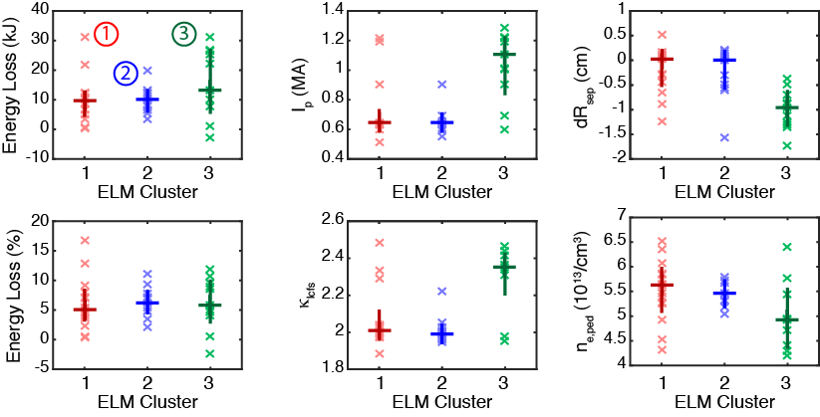
The identified ELM groups correspond to parameter regimes for I_{p}, 𝜅, dR_{sep}, and n_{e,ped}, but not stored energy loss
The identified ELM groups exhibit similar stored energy loss …
… but different regimes for ELM-relevant parameters like plasma current, magnetic balance, elongation, and pedestal density height
Individual ELMs
Work-in-progress: BOUT++ & M3D-C1 simulations to investigate the identified ELM groups and parameter regimes
20th, 50th, & 80th percentile values

Slide 15
Fusion Data Platform (FDP) – a data framework for magnetic fusion experiments
https://github.com/Fusion-Data-Platform/fdp
An extensible software layer that unifies data access, management, analysis, and visualization for multiple machines
A hierarchical machine abstraction with easy-to-discover data and methods
Data access/formatting tasks are handled behind the scenes
A collaborative development platform for data analysis tools
Built with popular, open-source resources like Python, Numpy and Matplotlib
>>> <machine>.<shot>.<diagnostic>.<signal>.<method> # typical
>>> import fdp
>>> nstxu = fdp.nstxu()
>>> nstxu.s204551.chers.ti.plot() # plot Ti from CHERS
>>> nstxu.s204551.logbook() # show logbook entries
>>> nstxu.s204551.mpts.listSignals() # list MPTS signals
>>> nstxu.s204551.bes.ch01.listMethods() # list methods for BES signals
developed with K. Tritz (Johns Hopkins) and H. Yuh (formerly Nova Photonics)

Slide 16
Summary
BES measurements with Alfvenic time resolution capture the nonlinear evolution of ELM events on NSTX
Unsupervised machine learning algorithms identified groups of ELMs with similar evolution characteristics
  The identified ELM groups correspond to specific parameter regimes relevant to ELM physics: I_{p}, κ, dR_{sep}, n_{e,ped}
  Working towards NL simulations to clarify the mechanisms at play in the identified ELM groups and parameter regimes
  D. Smith et al, PPCF 58, 045003 (2016)
Excellent opportunities to exploit machine learning tools for analysis tasks not feasible with manual inspection

Slide 17
Backup

Slide 18
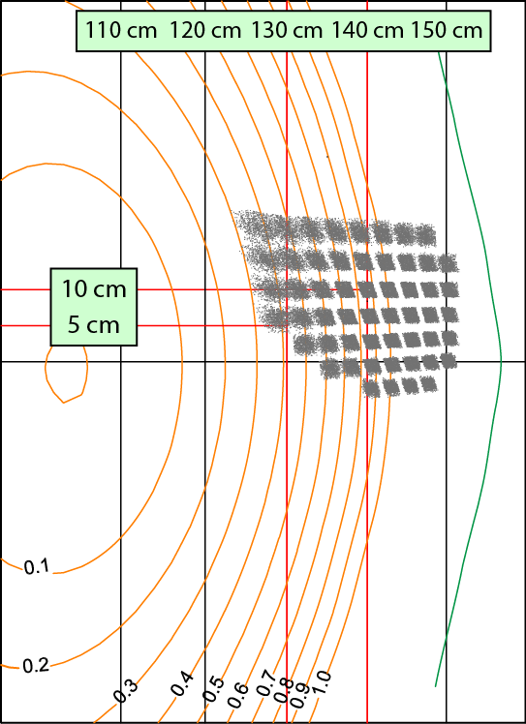
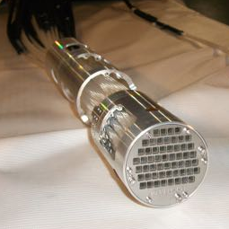
Upgraded 2D coverage on NSTX-U in 2015
2D fiber assembly
w/ 54 bundles of 3x3 fibers
NSTX-U
2D grid contoured
for typ. flux surfaces
Designed & fab’ed
by UW Phys. Sci. Lab
Notes:
For NSTX-U, BES sightlines were reconfigured for 2D measurements.
On the left, you see the 2D fiber assembly that was designed and fabricated by the UW Physical Sciences Lab. Each sightline is a 3x3 fiber bundle.
On the right, you see the 2D layout of sightlines. Also, the 2D grid is contoured to approximate flux surfaces.
At the end of this presentation, I’ll show you a movie of an ELM observed with the 2D BES system

Slide 19

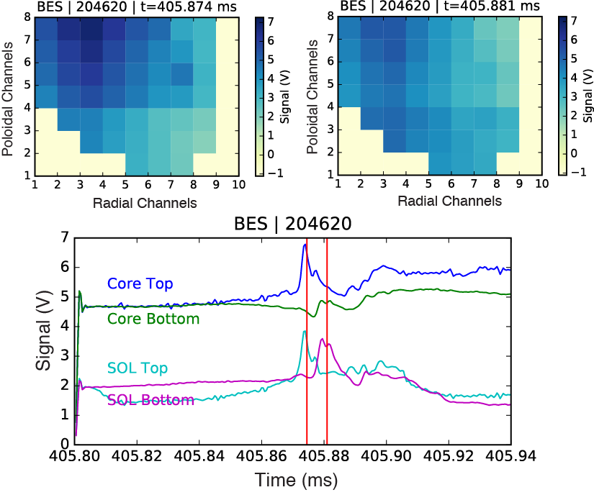
2D BES measurement of ELM event on NSTX-U
2D BES measurement captures downward motion
of ELM structure

Slide 20
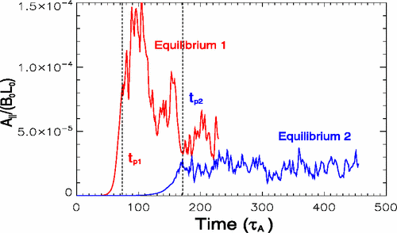
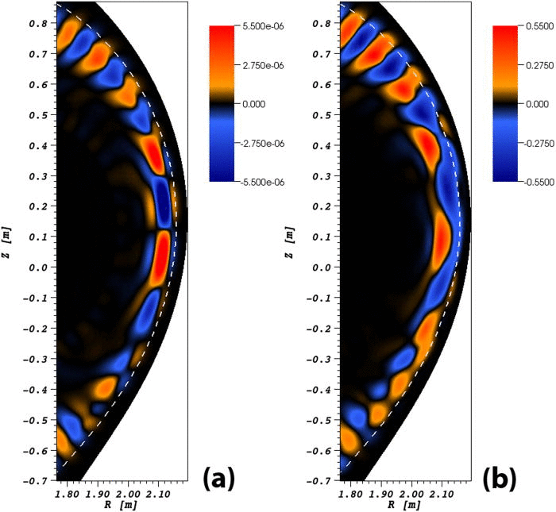
Beam emission spectroscopy captures the nonlinear,
Alfven-scale dynamics of ELM events
Edge localized modes (ELMs) are peeling-ballooning instabilities in the edge/pedestal region driven by pressure and current gradients
  Unmitigated ELMs pose risk for ITER
Nonlinear mechanisms impact ELM dynamics
  Broadly: NL mode coupling, saturation mechanisms, filament dynamics
  Hyper-resistivity is key for realistic ELM radial penetration (X. Xu et al, PRL, 2010)
  Growth of sub-dominant linear modes in the NL phase (M. Holzl et al, PoP, 2012)
  EHOs attributed to saturated PB modes (K. Burrell et al, PRL, 2009)
Common diagnostic tools and analysis methods do not capture the nonlinear, Alfven-scale dynamics of ELMs
  Heuristic classification schemes (Type I, III, etc.)
  Sub-Alfvenic measurements with Thomson scattering and filterscopes
  Linear stability threshold for peeling-ballooning modes
BOUT++
JOREK
Notes:
ELMs are pedestal instabilities driven by pressure and current gradients, and unmitigated ELMs pose a risk for ITER
Nonlinear dynamics influence ELM dynamics through mode coupling and saturation mechanisms. For instance, hyper-resistivity is a necessary mechanisms for realistic simulation of radial penetration. Also, sub-dominant linear modes can grow to driven dominant modes in the nonlinear phase.
However, common tools and methods do not capture the nonlinear, Alfven-scale dynamics of ELMs
BES, however, captures the nonlinear, Alfven-scale dynamics of ELM events

Slide 21
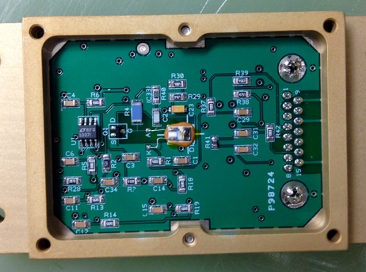
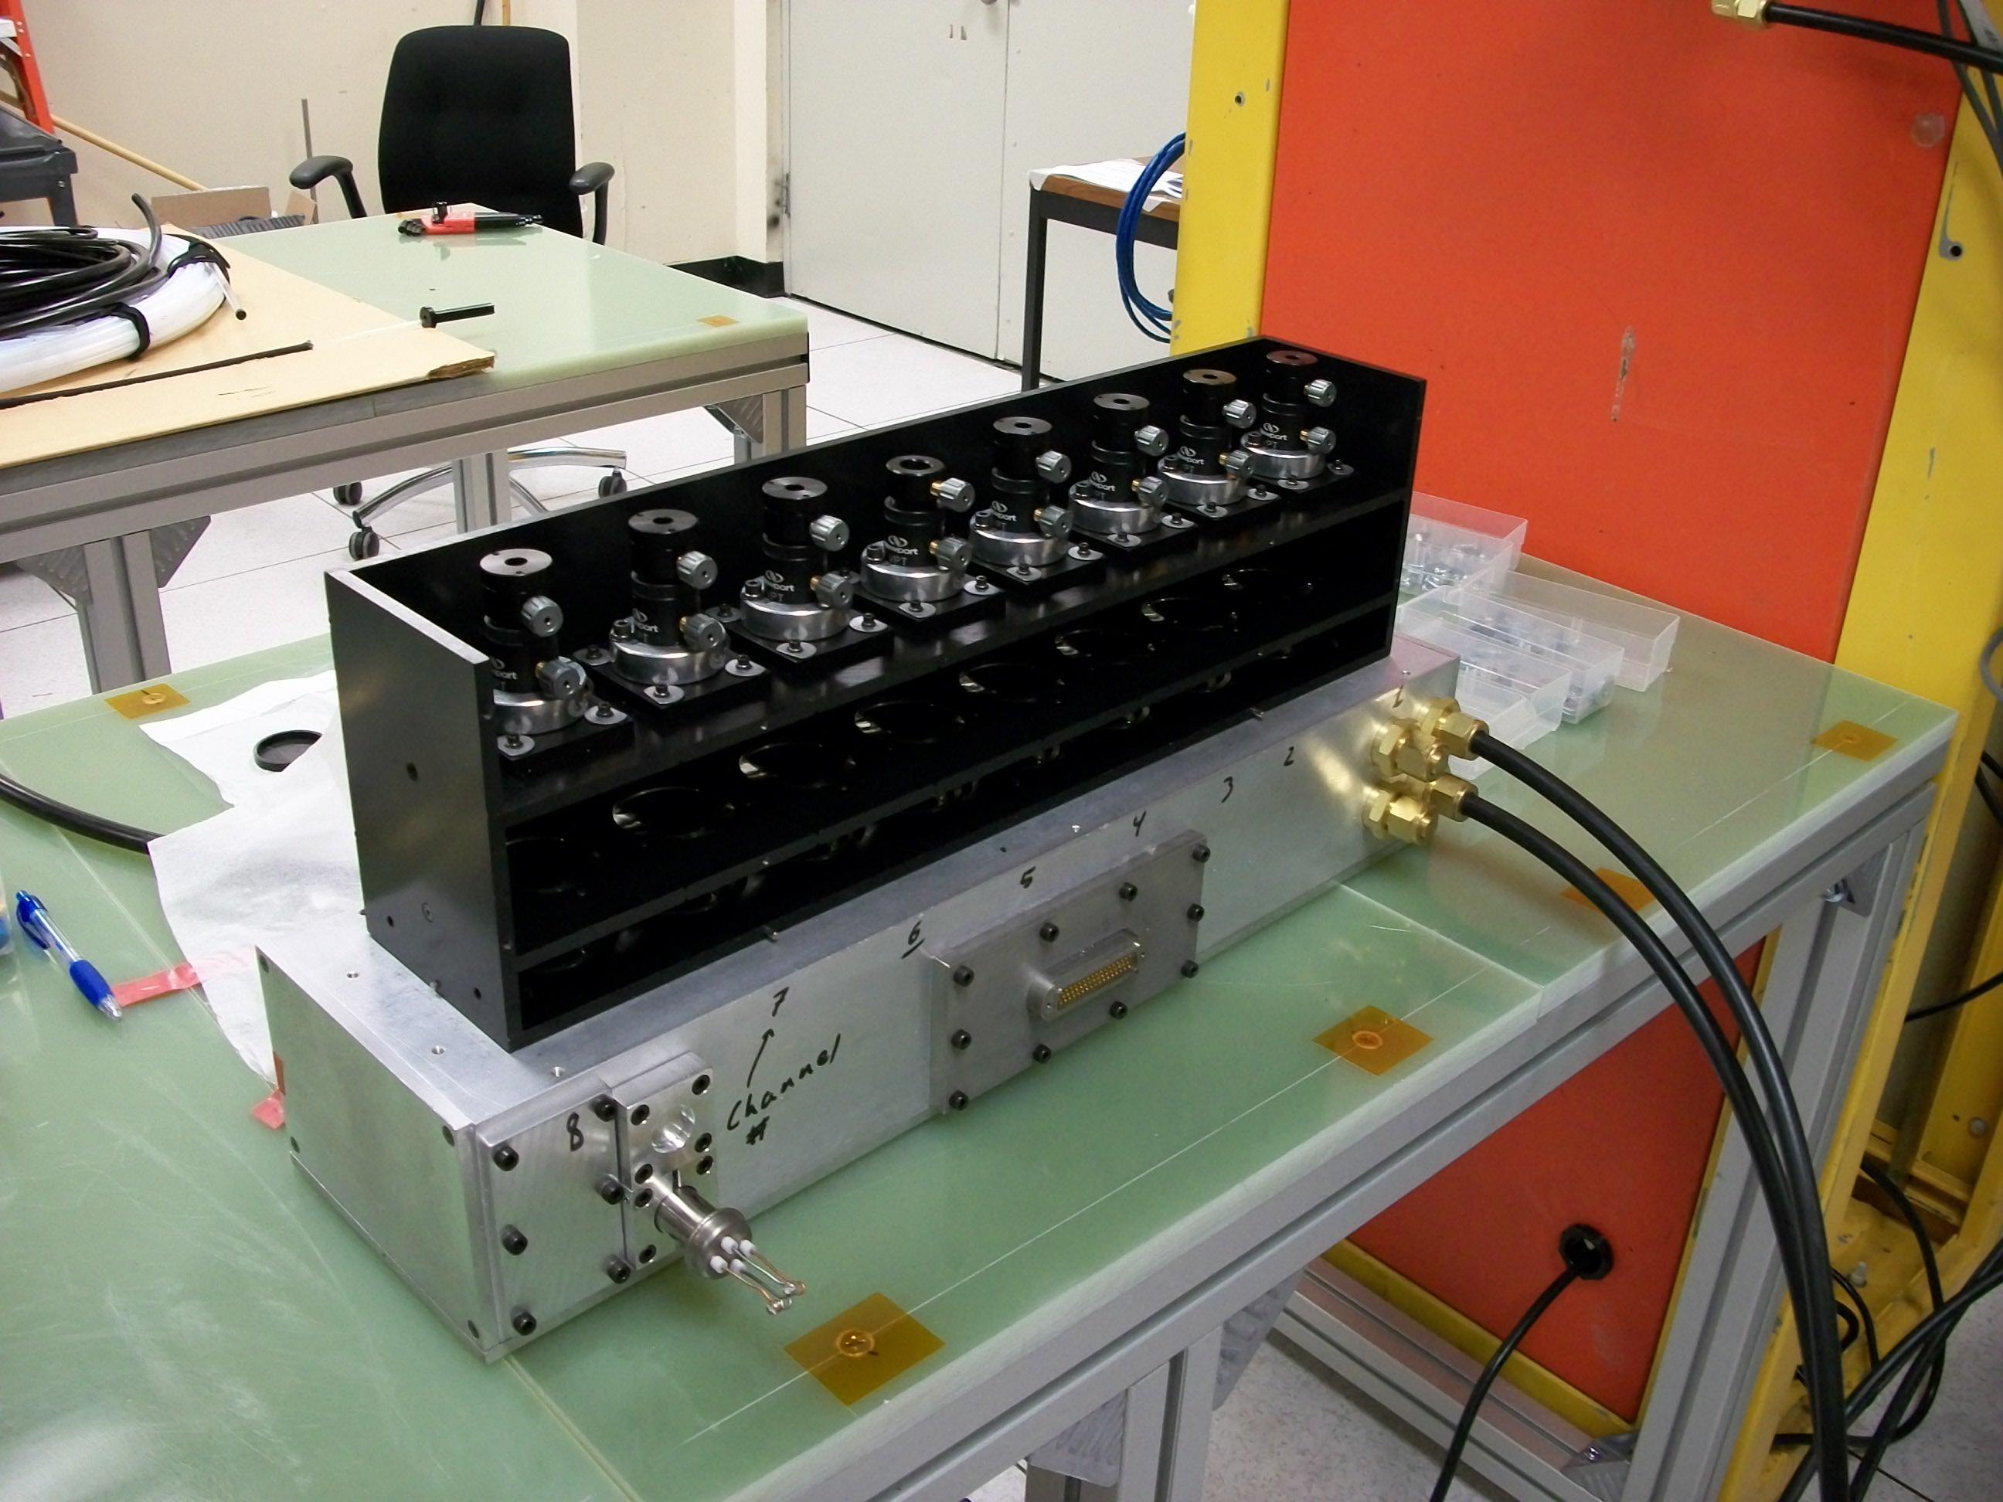
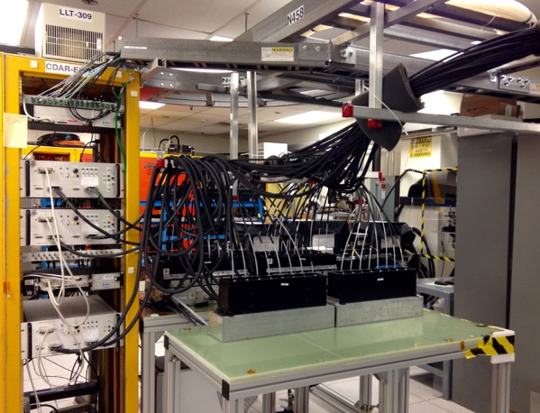
Low noise, high quantum efficiency detectors achieve photon-noise-limited measurements up to about 500 kHz
PIN photodiode (0.45 A/W)
and pre-amp circuit
Fiber mount,
collimating lens,
and filter
8-channel module
Designed & fab’ed by
UW Space Astro. Lab
Vacuum box with
refrigerant lines
48-channel (6 modules)
detection system
Digitizers: 2 MHz sampling with onboard FPGA-based FIR filter
Notes:
The detection system includes low-noise, high quantum efficiency PIN photodiodes. The detectors achieve photon-noise limited measurements up to about 500 kHz.
The top left shows a PIN photodiode and preamp circuit, and the circuit was designed by the UW Space Astronomy Lab.
The top right shows an 8-channel detector module. The top black region contains fiber mounts, collimating lenses, and interference filters. The bottom is the vacuum box that houses the detectors. Here you see vacuum and vacuum-jacketed refrigerant lines connected to the vacuum box.
On the bottom you see 54 fiber bundles winding down from the ceiling into 6 detector boxes; that’s 48 channels. In the rack you see three 16-channel signal conditioning units and two 32-channel digitizers.
The digitizers provide 2 MHz sampling with an onboard FPGA-based FIR filter to eliminate aliased noise.

Slide 22
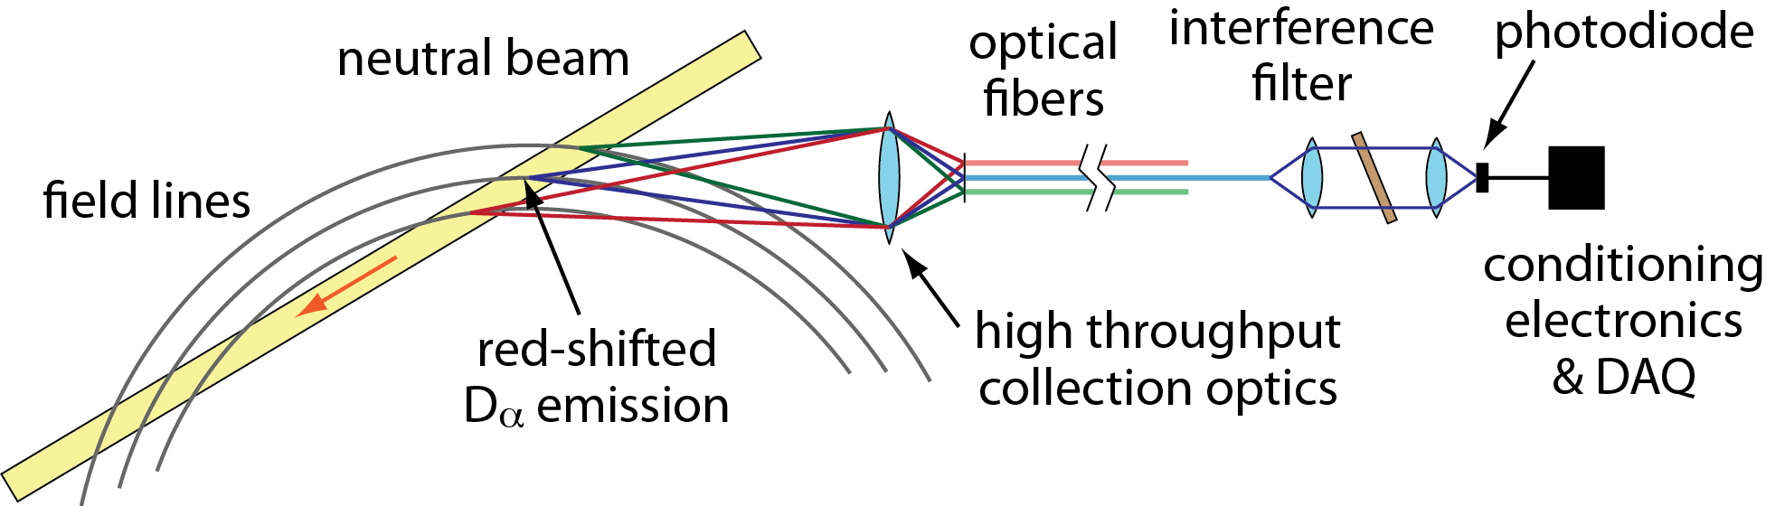
Beam emission spectroscopy (BES) measures Doppler-shifted
D_{α} emission from a deuterium heating beam
C ≈ 1/2
neutral beam
D_{α} emission
density
fluctuation
R. Fonck et al, RSI 61, 3487 (1990)
R. Fonck et al, PRL 70, 3736 (1993)
Notes:
BES measures Doppler-shifted D-alpha emission from a deuterium heating beam.
In the top left, you can see NB D-alpha red-shifted relative to thermal D-alpha emission. An optical filter in the BES detection system passes the NB D-alpha and blocks other emission.
In the top right, you see that the emission intensity is primary sensitive to plasma density and weakly sensitive to beam energy and temperature.
In the bottom, you see a cartoon layout of the NSTX BES system. The beam emission is imaged onto optical fibers. At the fiber termination, the emission is collimated, passed through the interference filter, and reimaged onto a photodiode.

Slide 23
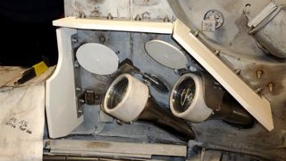
BES radial and poloidal coverage on NSTX in 2010
High-throughput, field-aligned
collection optics
2.5-3 cm spot sizes
Measurements are sensitive to density fluctuations on the ion gyroscale with k⊥ρ_{i} ≤ 1.5
Applications: ELMs, LH transition, EHOs, turbulence, velocimetry, Alfven
eigenmodes, etc.
D. Smith et al, RSI 81, 10D717 (2010)
N. Schoenbeck et al, RSI 81, 10D718 (2010)
D. Smith et al, RSI 83, 10D502 (2012)
Notes:
The left figure shows the radial and poloidal coverage of the original BES system on NSTX. The spot sizes were 2 cm in the edge region and 3 cm in the core region.
The sightlines were split among two sets of collection optics: the edge “R140” view and the core “R130” view.
The measurements are sensitive to fluctuations down to the ion gyroscale.
And scientific applications include ELMs, EHOs, LH transition, turbulence dynamics, velocimetry, Alfven eigenmodes and more

