Slide 1
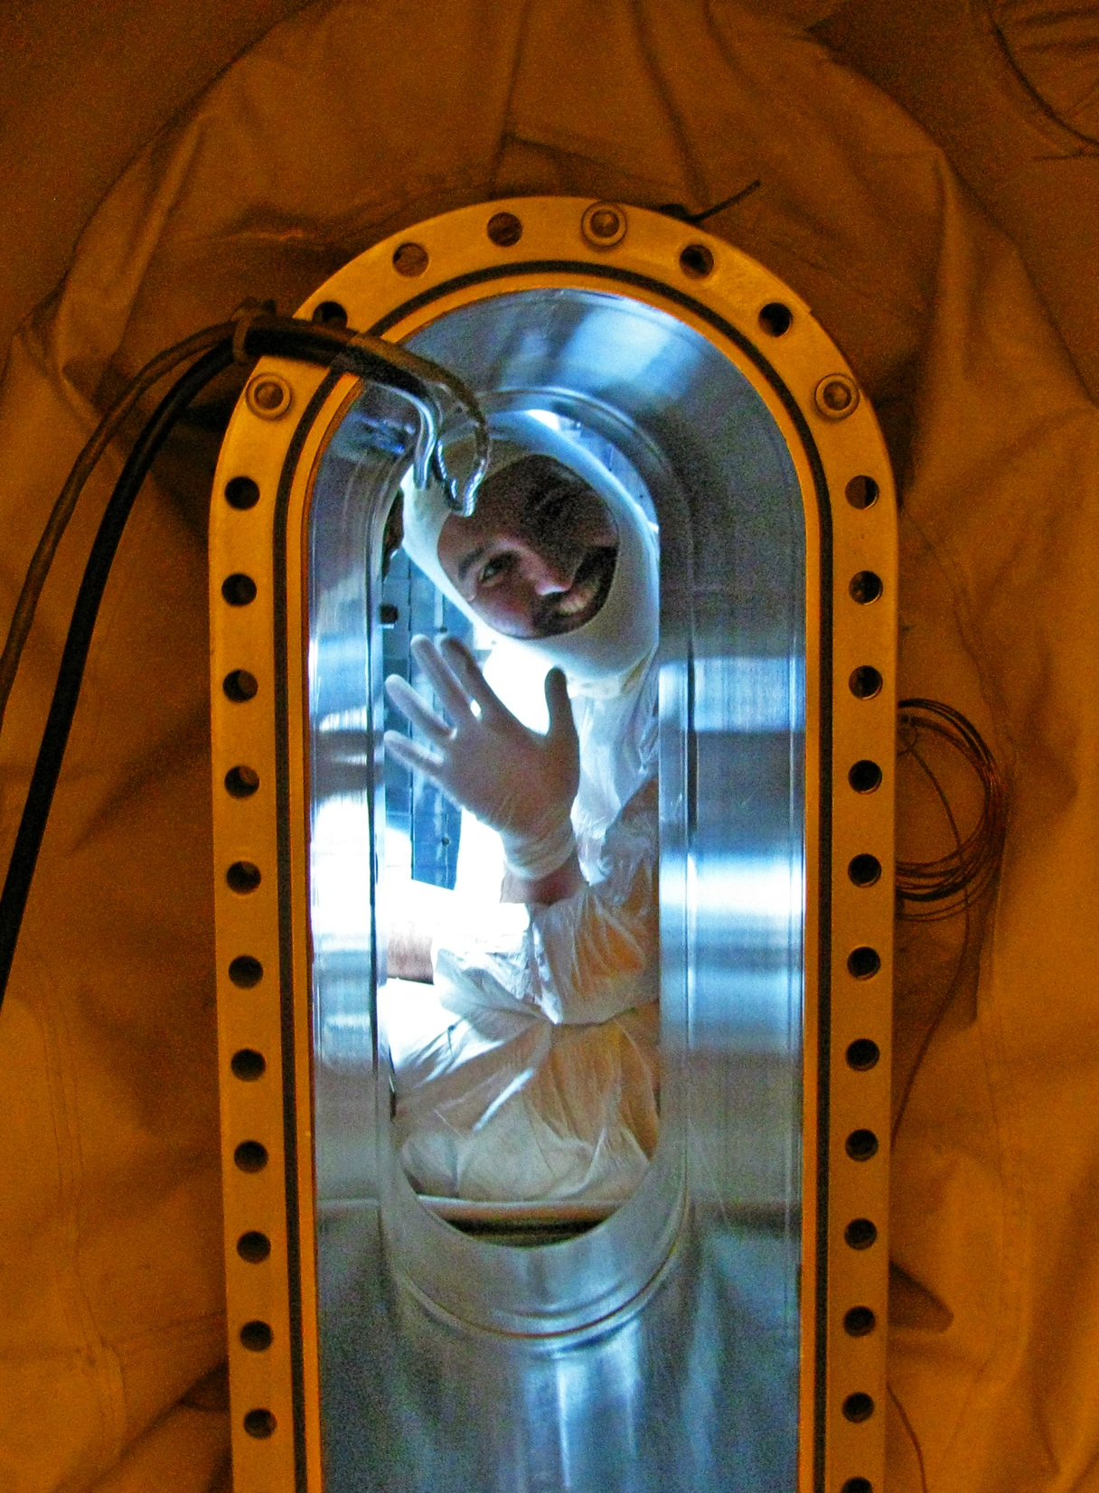
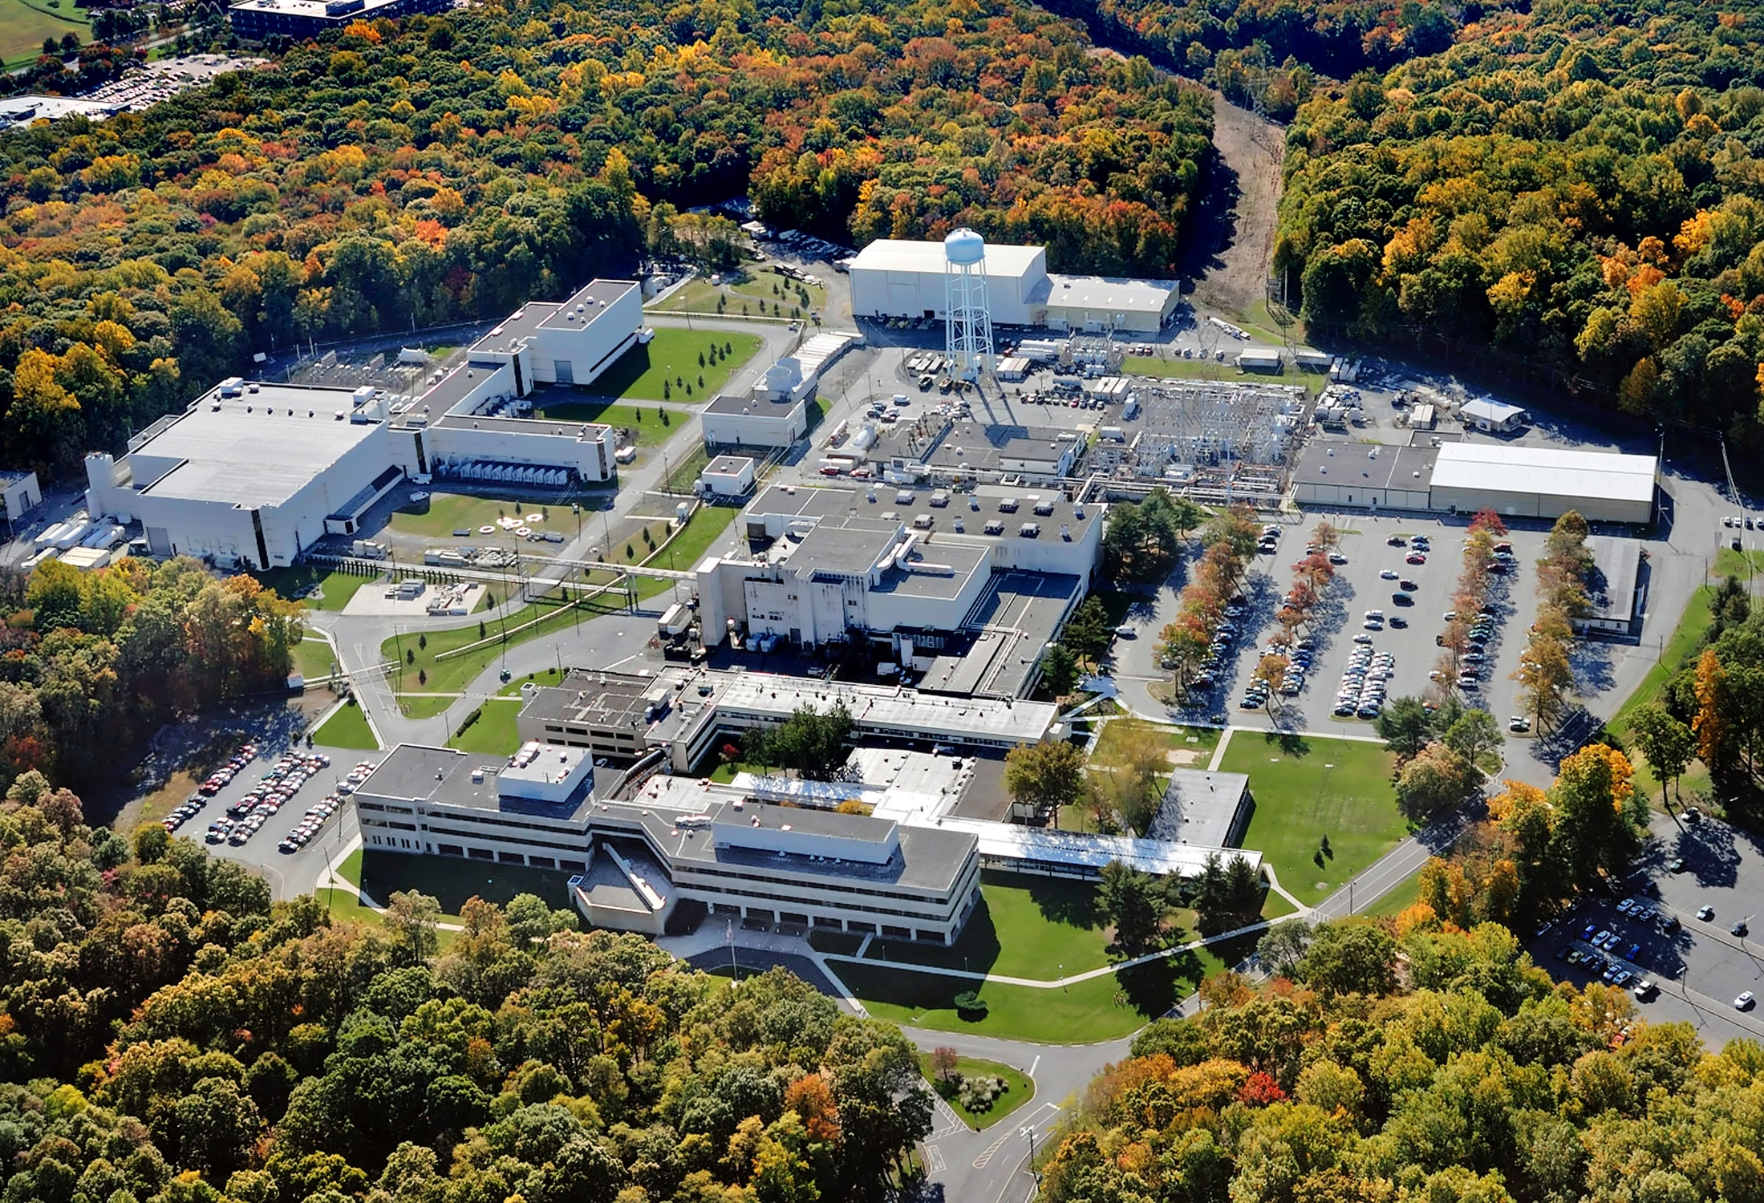

Plasma, Fusion, and PPPL: The quest to making a star on earth
Presented by:
Arturo Dominguez
1

Slide 2




From Bogota to Austin to Cambridge to Princeton
I’m originally from Colombia South America
Started studying physics at the National University of Colombia at Bogota.
Transferred to University of Texas at Austin where I finished undergrad (HOOK’EM HORNS!)
Did my graduate work at MIT, in Boston on fusion plasmas (GO BEAVERS!)
Now I’m at the Princeton Plasma Physics Lab (GO TIGERS!)
2

Slide 3
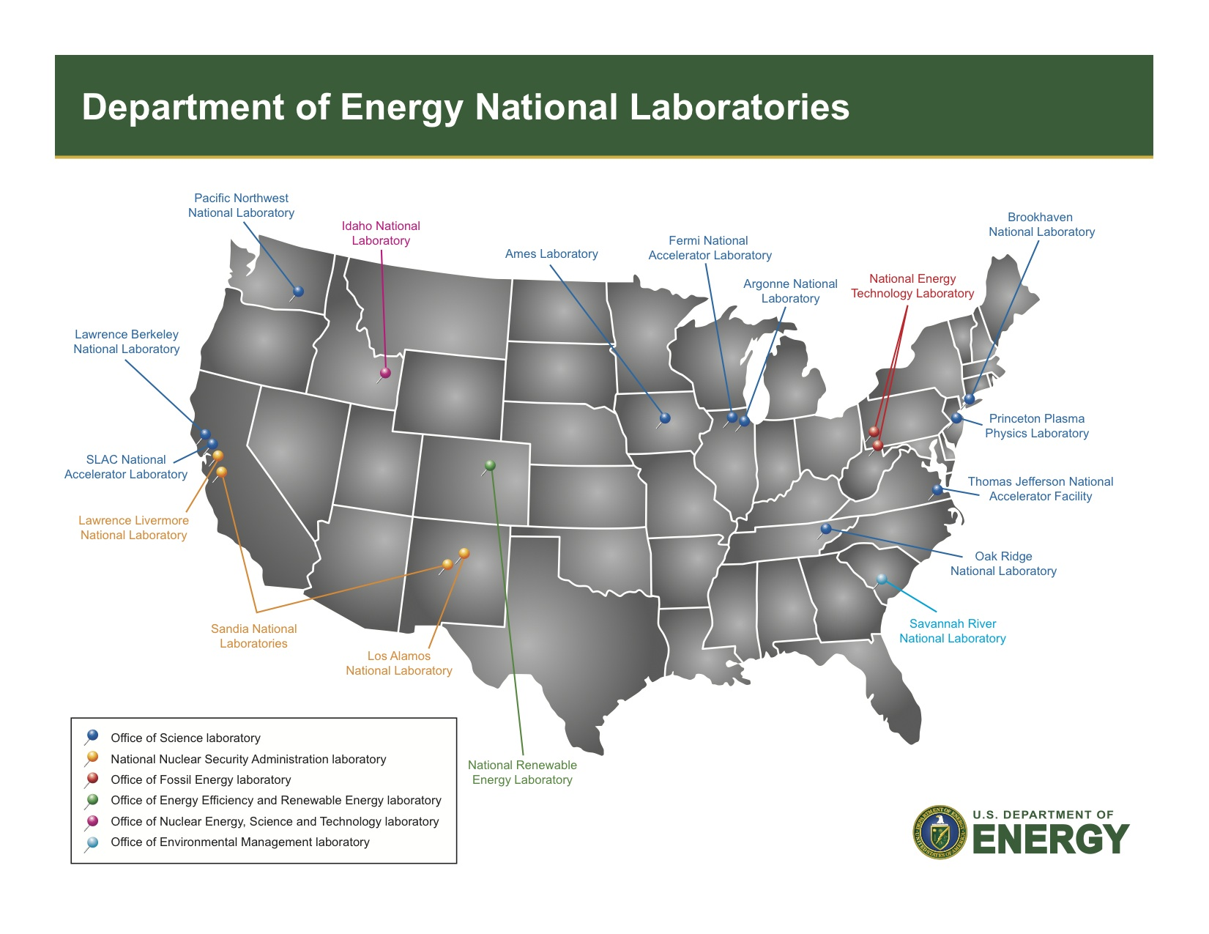
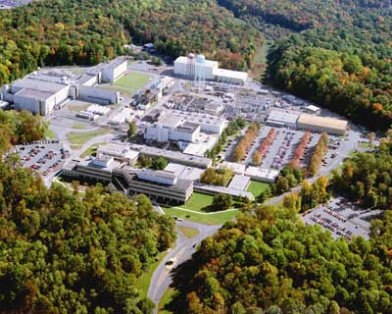
PPPL: Princeton Plasma Physics Lab
PPPL is one of 17 DoE national laboratories.
We are managed by Princeton University but have a government mandate that focuses on fusion energy research and basic plasma science.

Slide 4
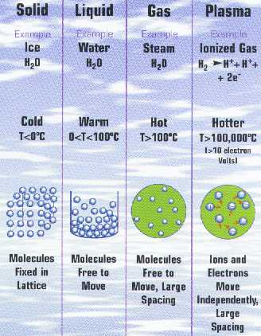
So…what is plasma?
Matter becomes a plasma when the electrons have enough energy to “detach” from their nuclei (ions)…but…how small are atoms?
7

Slide 5
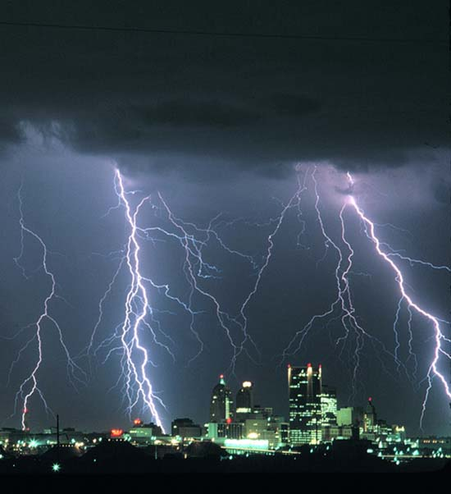
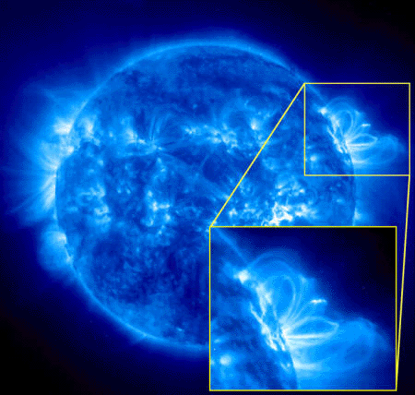
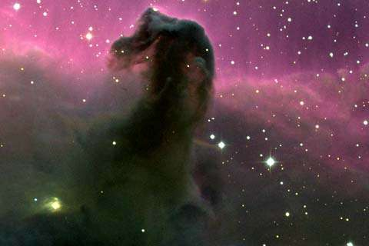
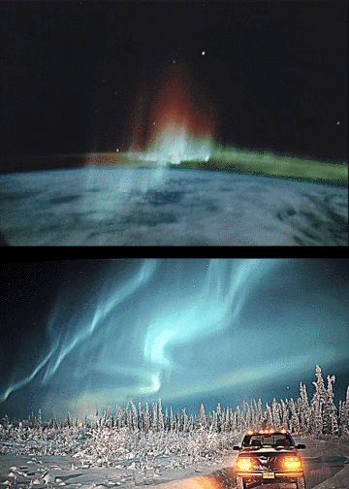

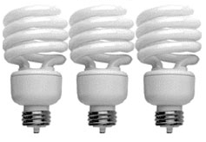
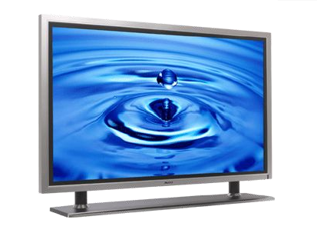
Plasma: The TV kind,
but not the blood kind
1) Lightning
2) Sun / Stars
3) Interstellar “Gas” / Nebulae
4) Northern Lights
5) Neon Lights / Florescent Lights
6) Plasma TV
7) Flames
9

Slide 6
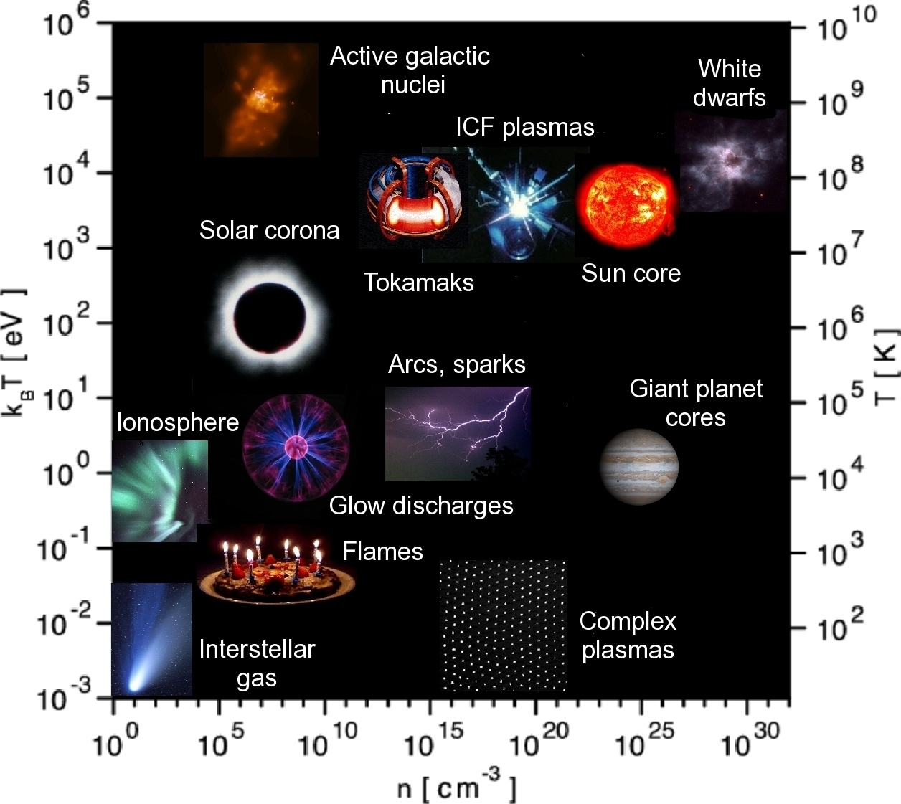
Plasma: It’s hot, but it’s a dry heat
Plasma is the 4th state of matter: It is qualitatively different than gas due to its collective behavior, particularly its interactions with E&M fields.
Plasmas cover a wide range of densities and temperatures This makes the field rich in scope
4

Slide 7
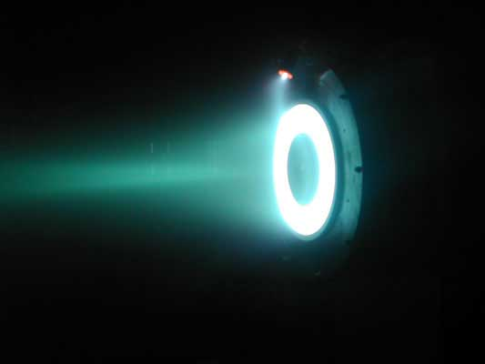
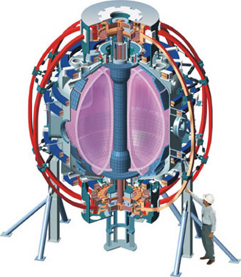
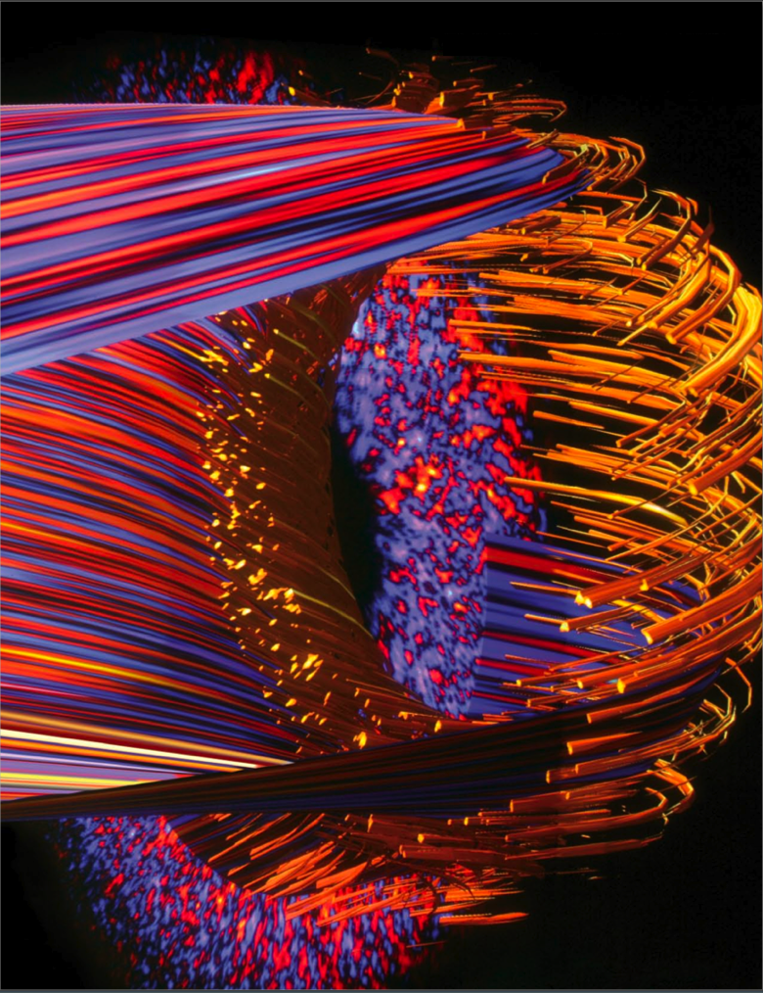
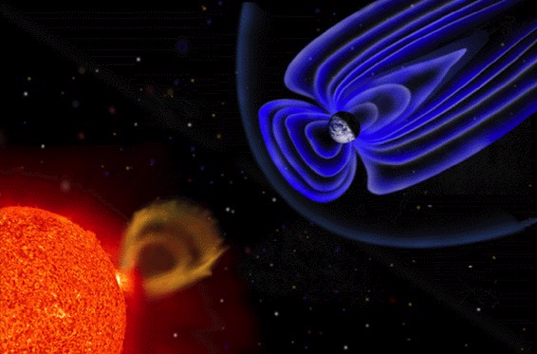
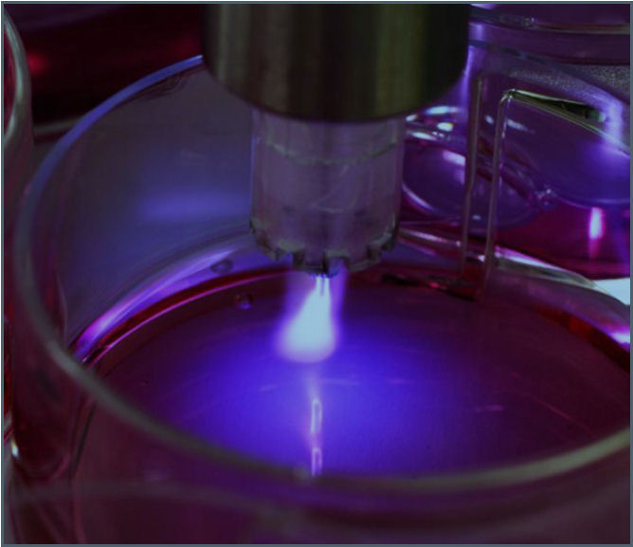

At PPPL, we try to understand many aspects of plasma
Basic plasma physics
Plasma theory and simulation
Fusion Research
Astrophysical plasmas
Plasma in other fields (e.g. medicine)
10

Slide 8
Before we talk about fusion, let’s make a detour into….
Astrophysical plasmas
10

Slide 9


One large research topic is magnetic reconnection
Current sheets in the earth’s magnetosphere are one example of reconnection
Field lines break and reconnect
Before
After
Topological rearrangement of the plasma → breaks the “frozen in” condition on the magnetic field
Converts some magnetic field energy into particle energy → the plasma charges a “toll” to the magnetic field
10

Slide 10
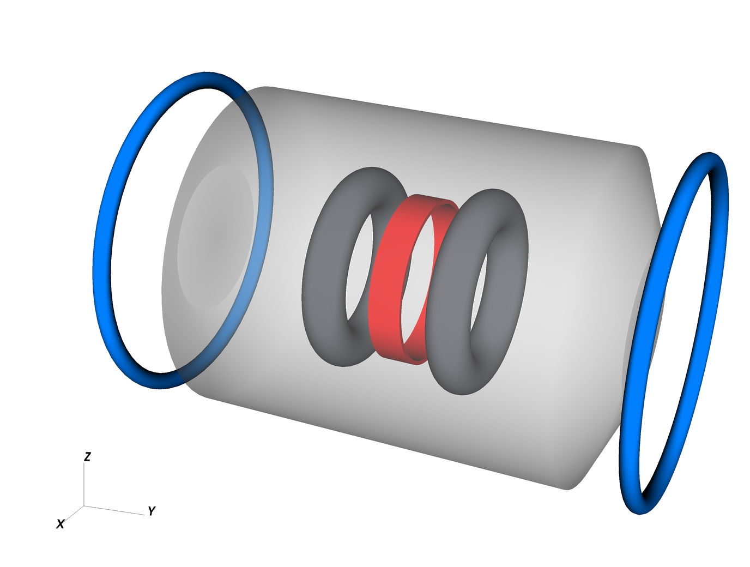
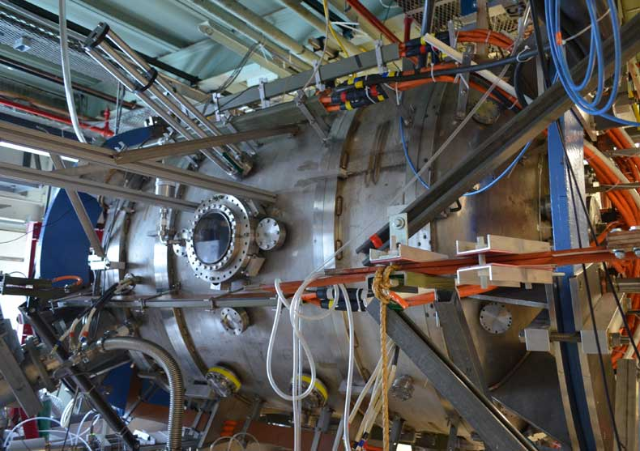
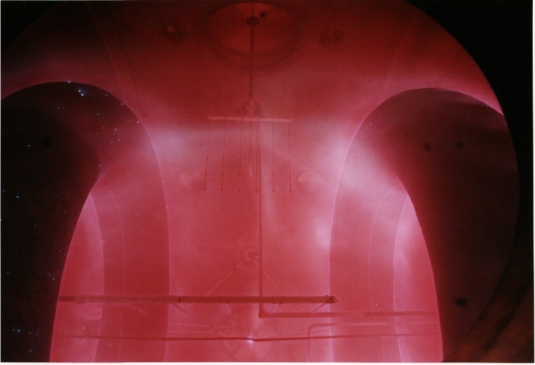
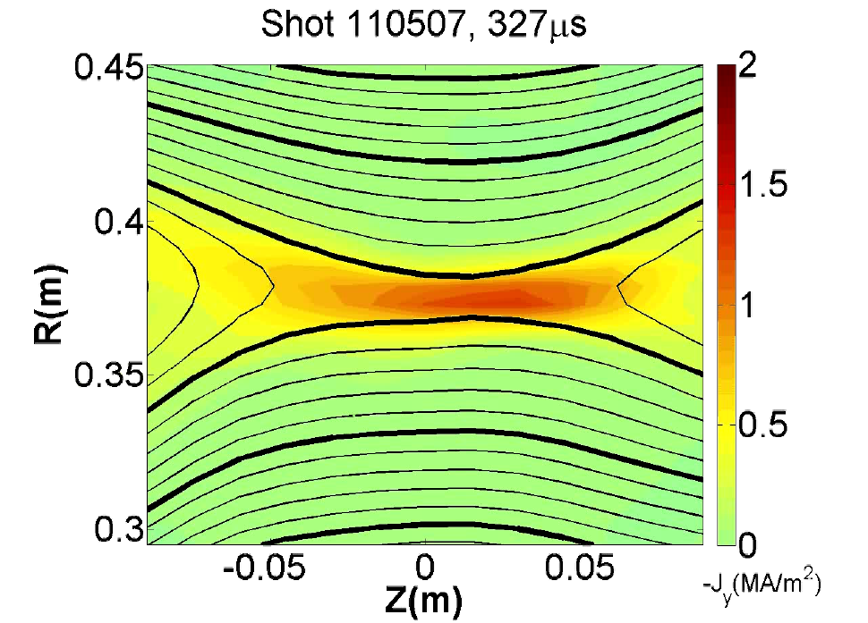
Magnetic Reconnection Experiment (MRX)
MRX Setup
Flux Cores
Reconnection
Current Sheet
The magnetic reconnection experiment (MRX) is designed to study reconnection in the lab. It recreates it and measures plasma parameters.

Slide 11
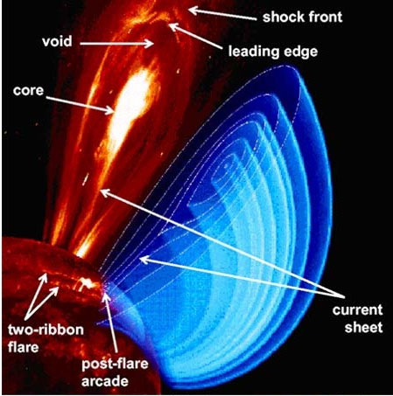
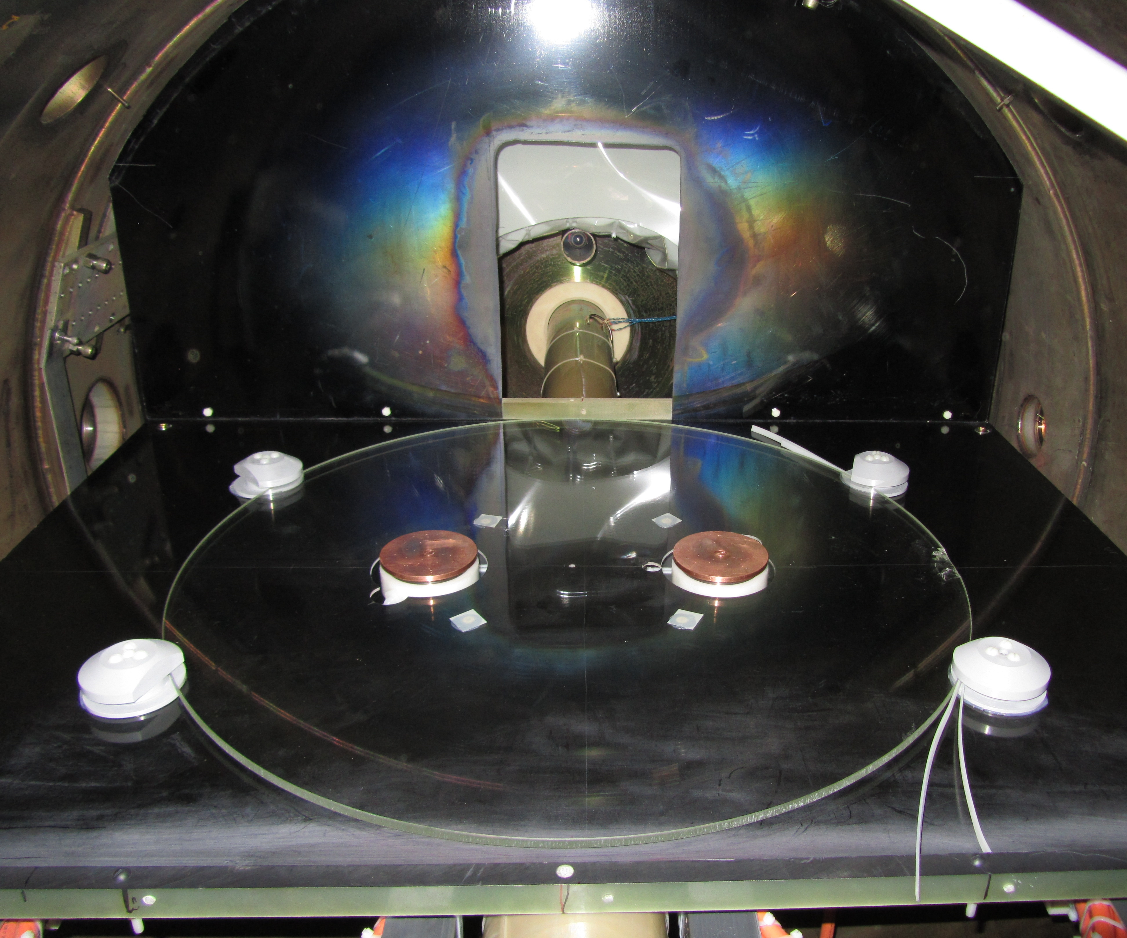
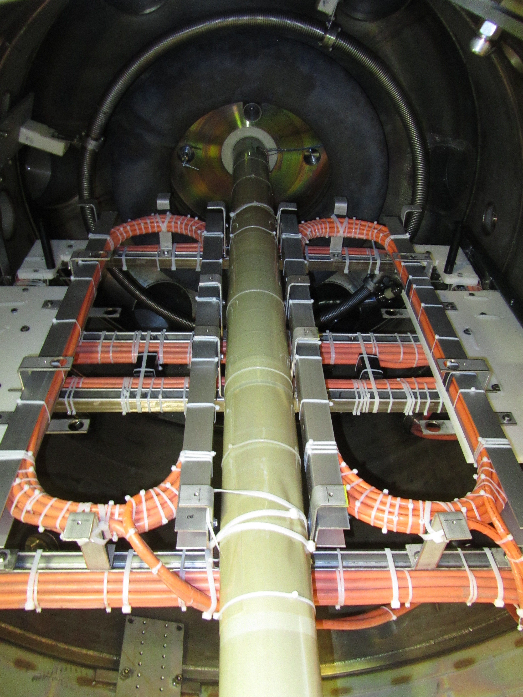
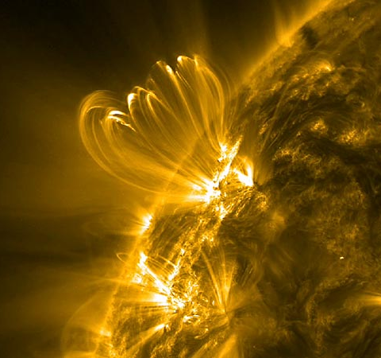
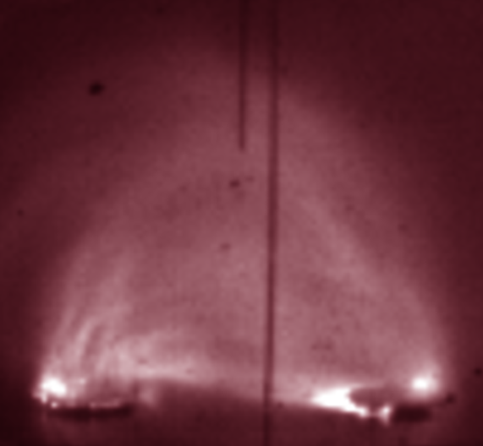
Coronal Mass Ejection on MRX
Magnetic
coils
Electrodes
Coronal mass ejections are also being studied at PPPL by reproducing their magnetic configuration in the MRX machine.

Slide 12
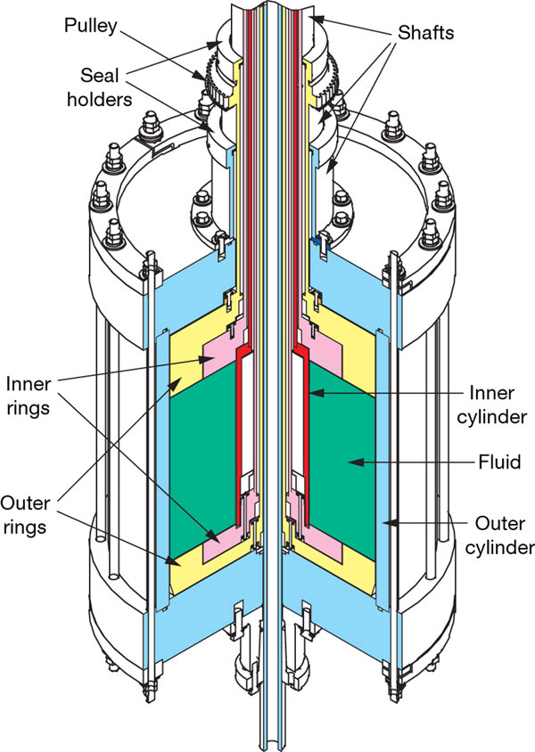
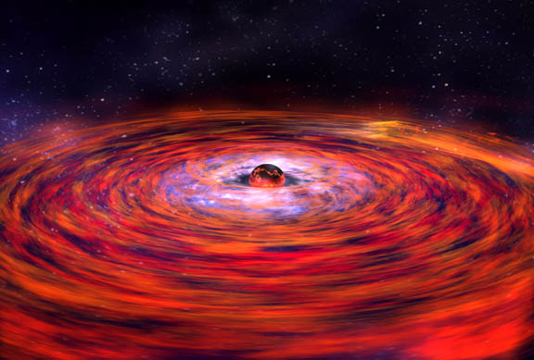
Experimental study of anomalous momentum transport in accretion discs
Angular momentum measurements in accretion discs don’t conform to current astrophysical models.
The Magneto-rotational instability experiment (MRI) is testing the hypothesis of anomalous (turbulent) transfer of angular momentum.

Slide 13
At PPPL, we try to understand many aspects of plasma
Basic plasma physics
Plasma theory and simulation
Fusion Research
Astrophysical plasmas
Plasma in other fields (e.g. medicine)
10

Slide 14
Fusion is our main mission
Fusion Research
12

Slide 15
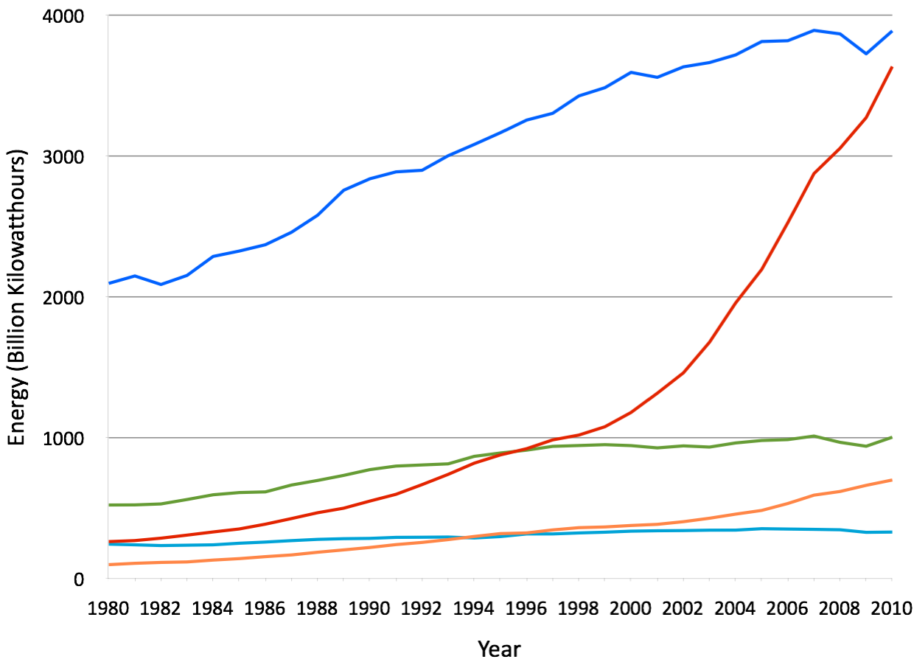
World energy consumption is increasing dramatically
USA
China
Japan
India
U.K.
12

Slide 16
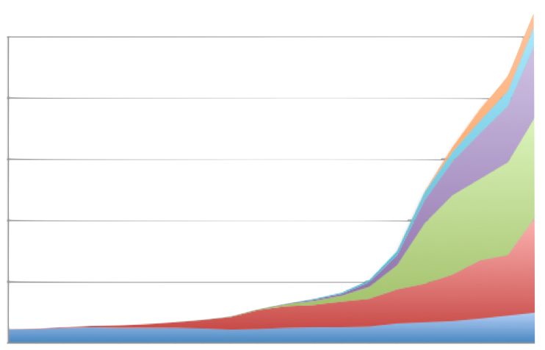
Most of the energy is coming from environmentally unfriendly sources
Nuclear
Hydro
500
Natural Gas
400
300
Oil
Energy (Billion Kilowatthours)
200
Coal
100
Biofuels
0
1830 1850 1870 1890 1910 1930 1950 1970 1990 2010
Year
12

Slide 17
Fusion is an ideal alternative
Fusion energy is:
Clean
Safe
Inexhaustible
Efficient
Independent of geographical location (compared to solar and wind)
Available 24/7
12

Slide 18
Fusion is an ideal alternative
Fusion energy is:
Clean
Safe
Inexhaustible
Efficient
Independent of geographical location (compared to solar and wind)
Available 24/7
Nonexistent (yet!)
12

Slide 19
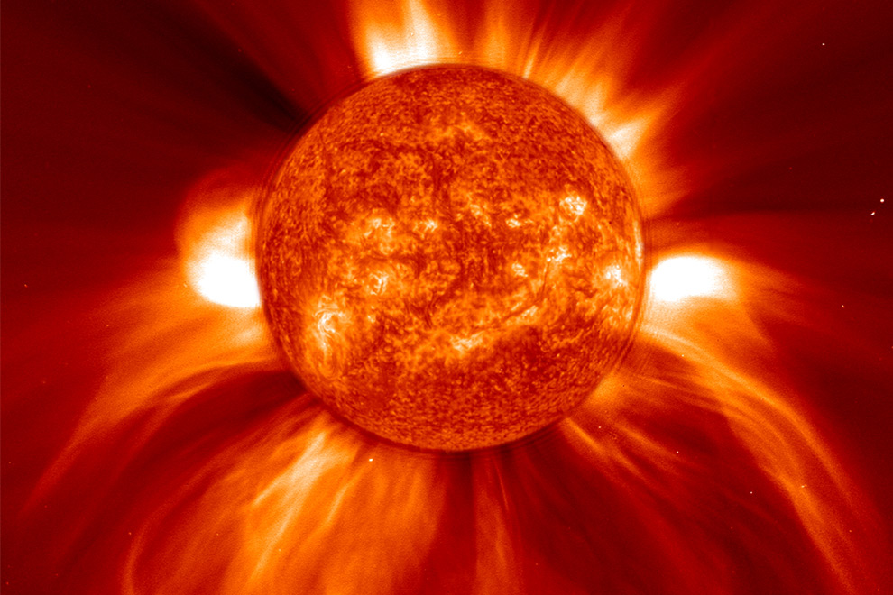
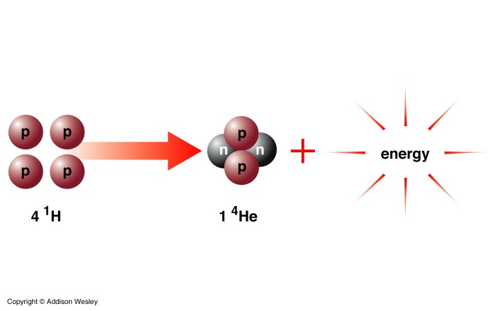
The sun’s energy comes from FUSION
When small hot atoms (usually hydrogen) combine….
There is a lot of ENERGY produced!
This is FUSION

Slide 20
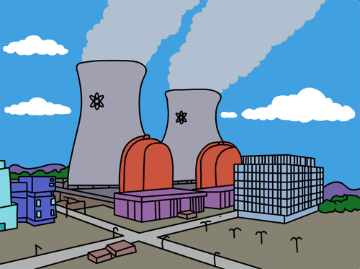
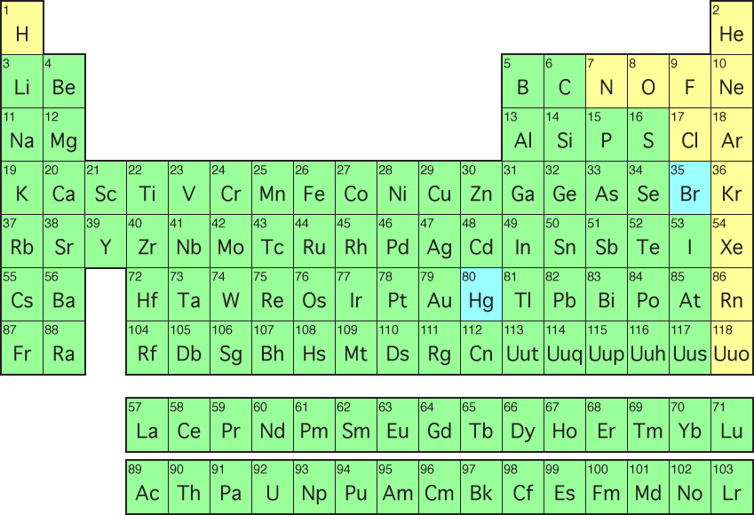
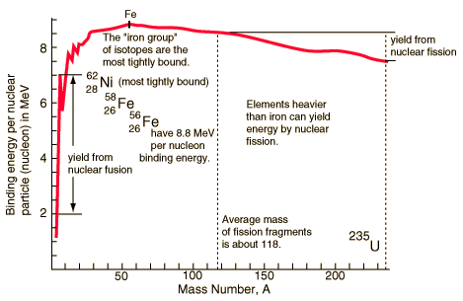
Fusion energy is the other side of the nuclear energy coin
Fusion
Fission
12

Slide 21
We can get a LOT of power from the nuclei
Protons and neutrons (“nucleons”) are bound together in the nucleus of an atom by the strong nuclear force.
The mass can be converted to energy using….
E=mc²
11

Slide 22
We can get a LOT of power from the nuclei
Protons and neutrons (“nucleons”) are bound together in the nucleus of an atom by the strong nuclear force.
The mass can be converted to energy using….
E=mc²
This is a LOT, lets say I, Arturo, turn into energy:
E_{Arturo}=(90kg)(3x10⁸m/sg)²=8.1x10¹⁷J
11

Slide 23
We can get a LOT of power from the nuclei
Protons and neutrons (“nucleons”) are bound together in the nucleus of an atom by the strong nuclear force.
The mass can be converted to energy using….
E=mc²
This is a LOT, lets say I, Arturo, turn into energy:
Energy consumed by the US in 1 day
E_{Arturo}=(90kg)(3x10⁸m/sg)²=8.1x10¹⁷J ~
11

Slide 24
Hydrogen, Deuterium and Tritium
¹H
²H or D
³H or T
-
-
-
+
+
n
+
n
n

Slide 25
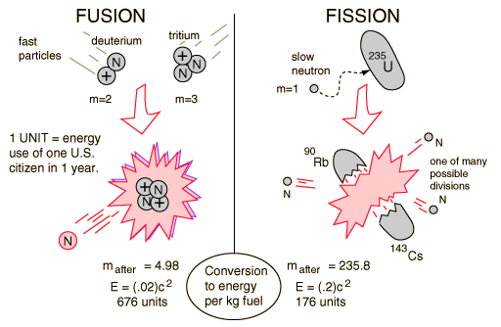
For both fusion and fission, the energy comes from the mass
15

Slide 26
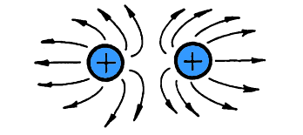
Problem: Same sign charges repel
But…if same charges repel, how do we make them collide?
16

Slide 27
Problem: Same sign charges repel
But…if same charges repel, how do we make them collide?
We make it really hot!!
16

Slide 28
Really Really Really Hot
Peak at 70keV~700Mill Kelvin!
The optimum temperature for
Fusion devices is ~15keV
~150 Million Kelvin!
(proportional to probability of reaction)
The center of the sun is
~15 Million Kelvin!
How can we contain such hot
plasma on earth?

Slide 29
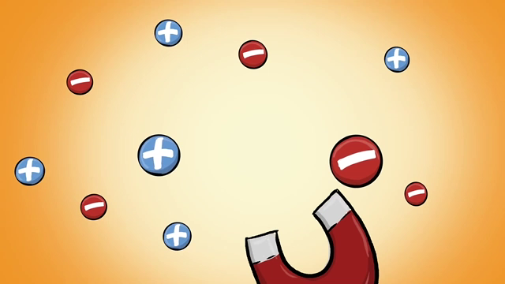
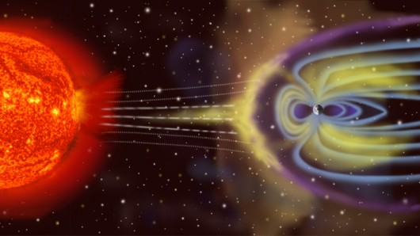
We use magnetic field to contain the plasma
Plasma can be contained at millions of degrees by trapping them with magnetic field.

Slide 30

Circular fields are not enough though

Slide 31
Circular fields are not enough though
Bad curvature
Good curvature

Slide 32
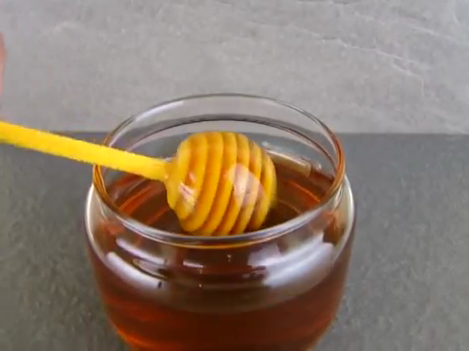
Circular fields are not enough though
Bad curvature
Good curvature

Slide 33
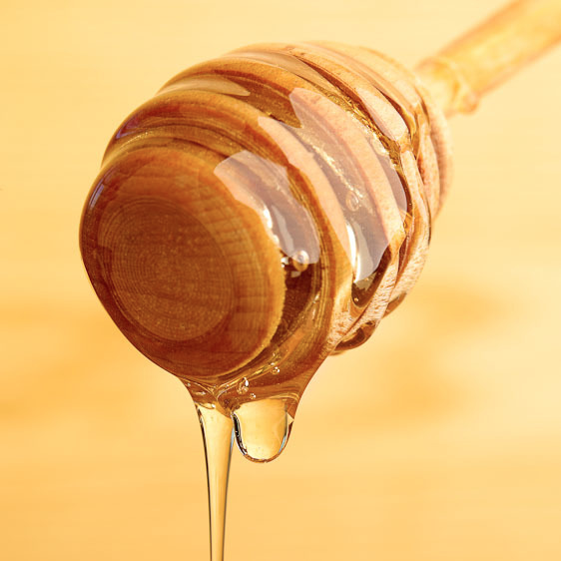
Circular fields are not enough though
Bad curvature
Good curvature
Good curvature
Bad curvature

Slide 34
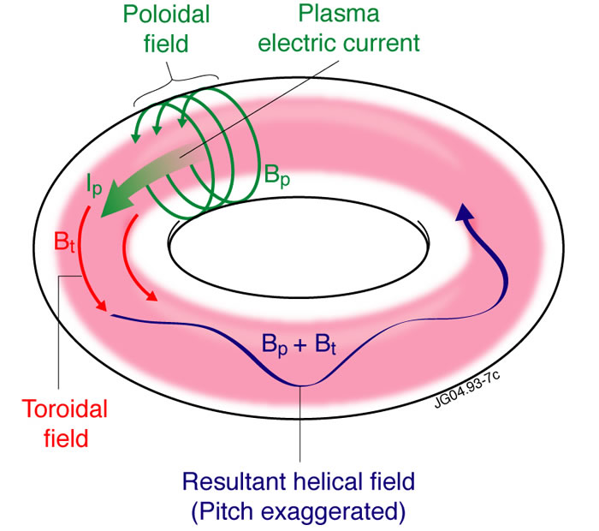
Circular fields are not enough though
Bad curvature
Good curvature
Good curvature
Bad curvature

Slide 35
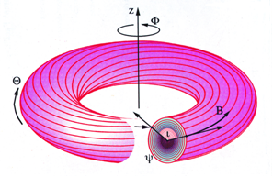
Circular fields are not enough though
Bad curvature
Good curvature
Good curvature
Bad curvature

Slide 36
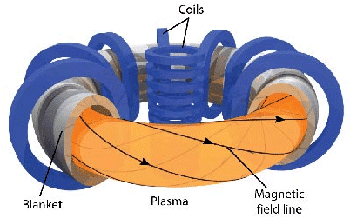
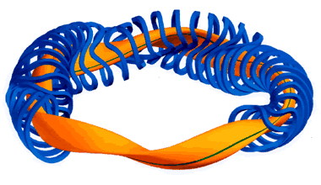
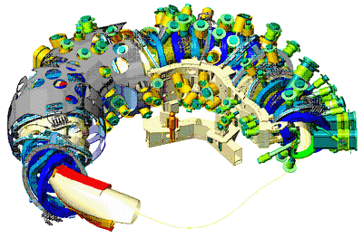
The two main configurations of magnetic confinement devices
Tokamak
Stellarator
W7X @ Max-Planck / Germany
NSTXU @ PPPL

Slide 37
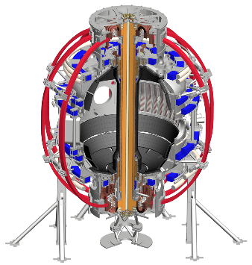
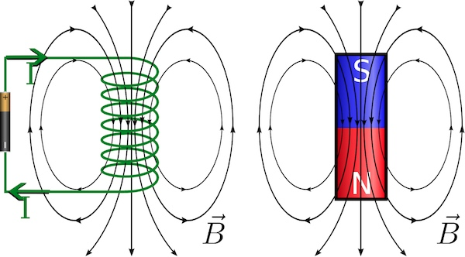
In a Tokamak the Toroidal Field is Easy
Electric currents create magnetic fields (Electromagnets)

Slide 38
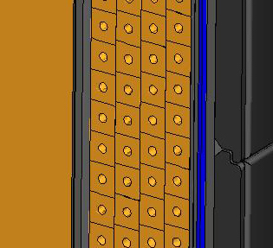
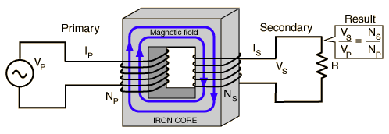
The Poloidal field is a bit harder
The poloidal field is induced using a central solenoid

Slide 39
The Poloidal field is a bit harder
The poloidal field is induced using a central solenoid
The solenoid
Is the primary
The plasma is the
secondary

Slide 40
The Poloidal field is a bit harder
The poloidal field is induced using a central solenoid
The solenoid
Is the primary
Added benefit: you heat the plasma with the current
The plasma is the
secondary

Slide 41


The U in NSTX-U is the Upgrade that just finished
In 2012, NSTX went down for the upgrade
The main change was the improvement of the center stack
With the new changes, NSTXU will have:
  x2 toroidal field
  x2 plasma current
  x5 Pulse length
The upgraded center stack has been tested and installed.
Operation will begin by the end of the month

Slide 42













There are many tokamaks around the world studying different plasma parameters and shapes
MAST
Asdex U
Alcator C-Mod
T10
K-Star
DIII-D
Tora Supra
JET
NSTXU
EAST
JT-60
ETE
SST-1
*Plus many
more
16

Slide 43

There are many tokamaks around the world studying different plasma parameters and shapes
MAST
Asdex U
Alcator C-Mod
T10
K-Star
DIII-D
Tora Supra
JET
NSTXU
ITER
EAST
JT-60
ETE
SST-1
*Plus many
more
16

Slide 44
ITER will be the first time we have more energy OUT than IN
ITER is a collaboration between USA, EU, China, Japan, Korea, India and Russia
It’s expected to produce 500MW of power using 50MW to run…this is the 1st time in history where P_{out}>P_{in}
First plasmas expected by 2020
16

Slide 45


There’s one more step to produce electricity
ITER will still not produce electricity…a working reactor will need a Lithium blanket that heats up, boils water and turn turbines.
After ITER, a demonstration reactor would be built.
Steam or hot helium
Neutrons
Heat
Spin turbines, generate electricity
Blanket
(350 - 1000^{ᵒ}C)
Tritium bred from lithium in blanket
Realistically, fusion could be in the grid around 2050
helium and deuterium exhaust
16

Slide 46
The challenges are many, but the rewards are immense
Fusion energy only requires Deuterium (from sea water) and Lithium to run. There are reserves for hundreds of thousands of years.
There’s no chance of a meltdown because fusion can’t have chain reaction events.
The only byproduct is Helium (no greenhouse gases).
There’s no long term radioactive waste. Tritium is radioactive but it’s half live is ~16 years.
It would run continuously.
16

Slide 47
EXTRA SLIDES

Slide 48

National Spherical Torus eXperiment Upgrade (NSTX-U)
Our flagship experiment is NSTX-U
Research focuses on understanding particular “spherical tokamak” geometry
Studying particle and energy confinement, crucial for reactor regimes
Developing solutions for plasma-material interfaces
Implementing diagnostic techniques to measure temperature, density, magnetic fields, etc.

Slide 49

Diagnostic development
One of the main challenges of fusion reactors is the implementation of tools to measure plasma parameters.
At PPPL, many of the projects are centered around individual diagnostics and their development. This is critical for next generation reactors.
Imaging techniques
Novel X-ray diagnostic

Slide 50



Modeling is essential in all fields of plasma physics
Model of first wall physics
Evolution and destruction of turbulence
Simulation of a disruption event

Slide 51

Lithium walls have shown improved confinement
Liquid lithium walls are actively being studied to try to reduce excess power to the walls and to improve energy confinement.
Results have been very positive
Liquid lithium
walls
7
Liquid lithium
walls
7
6
5
Solid lithium
walls
Energy confinement time (ms)
Solid lithium
walls
4
3
2
empirical scaling
empirical scaling
1
2
0
0
2
1
4
0 1 2 3 4
Empirical scaling expression (ms)
Empirical scaling expression (ms)

Slide 52


Lithium Tokamak Experiment (LTX)
The Lithium Tokamak Experiment (LTX) focuses exclusively on testing the effects of liquid lithium in a high temperature magnetic confinement device

